Slide 1
ISAC Target Infrastructure Refurbishment
TRIUMF User Group Meeting
2017 July 14
Alexander Gottberg
Department Head, Targets and Ion Sources

Slide 2
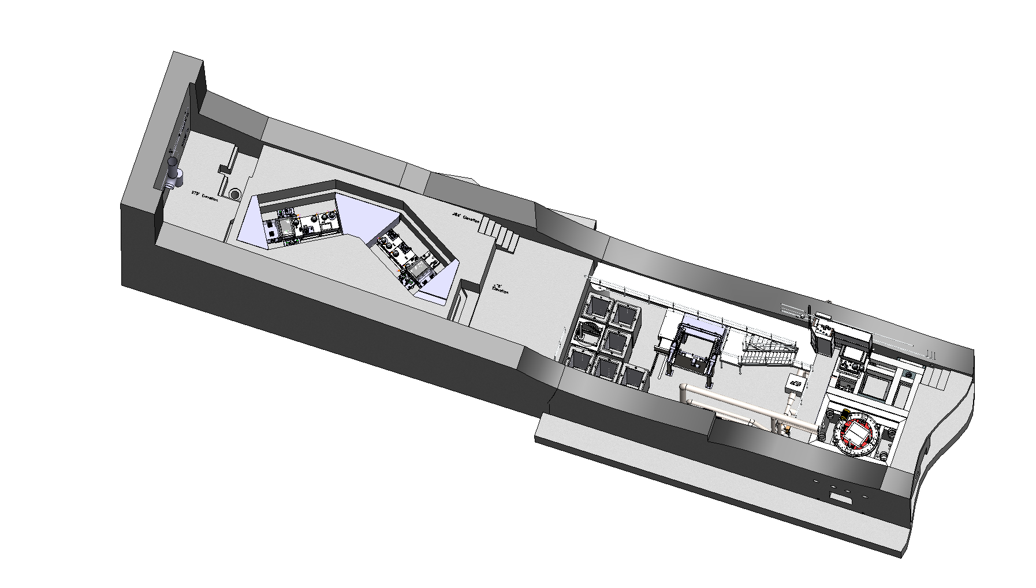
ISAC Target Hall Overview
ISAC Target station West (ITW)
ISAC Target station East (ITE)
Target Decay Vault (TDV)
Conditioning Station (CS)
North Hot Cell (NHC)
Target pit
Module Storage Silos (MSS)
South Hot Cell (SHC)

Slide 3
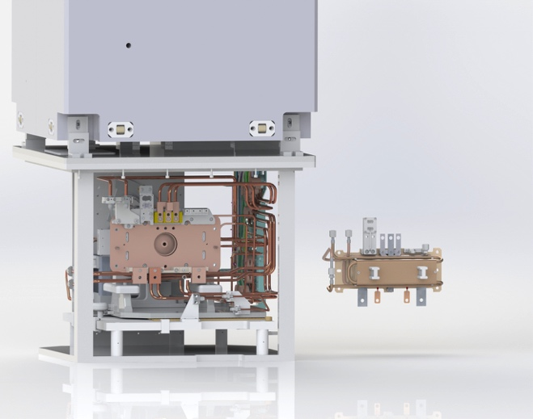
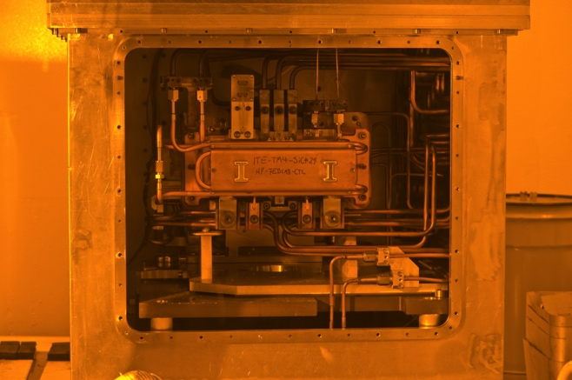
ISAC Routine Operation Overview
Day 1: Installing new target to target module in South Hot Cell (SHC) (6 hours)
Day 2: Transferring target module to Conditioning Station (CS) (4 hours)
Day 2: HV and vacuum conditioning of module-target-ion source assembly in CS (7 days)
Day 9: Transferring target module through air to ISAC Target station East (ITE) or ISAC Target station West (ITW), connect module services (8 hours)
Day 9: Pumping, HV and thermal conditioning, stable beam setup, etc.
(7 days)
Day 16: Cover target station with shield blocks (4 hours)
Day 17: Irradiation and RIB delivery (limited by target performance losses or license limit for actinide targets typically 3-5 weeks) (28 days)
Day 45: Cool down (some hours to days, depending on target, irradiation conditions and available time) (14 days)
Day 59: Uncovering shield blocks, disconnecting services (6 hours)
Day 60: Transferring target module to SHC (4 hours)
Day 61: Detaching target-ion source assembly and PIE (8 hours)
Day 62: Transfer target-ion source assembly to decay vault (decay time 1-3 years, depending on target) (4 hours)
Day 62: Target module back to operation or to module storage silo (MSS)
(4 hours)
Target module, source tray, target
Hot cell view
Target module, source tray, target

Slide 4
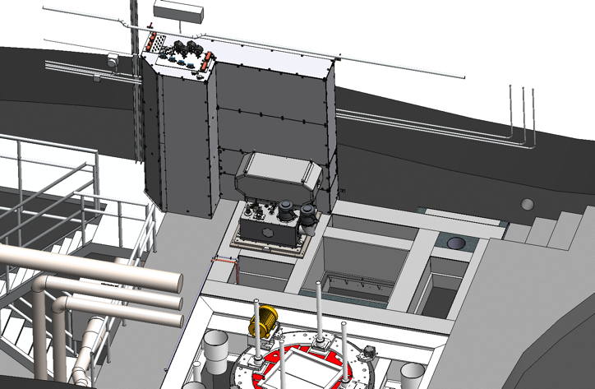
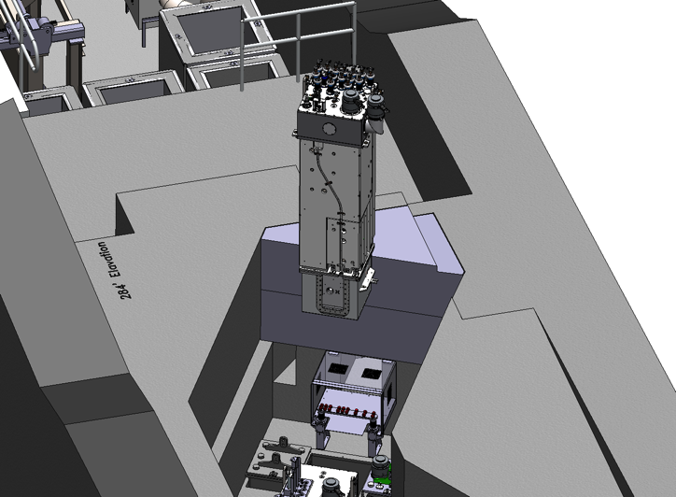
ISAC Routine Operation Overview
Day 1: Installing new target to target module in South Hot Cell (SHC) (6 hours)
Day 2: Transferring target module to Conditioning Station (CS) (4 hours)
Day 2: HV and vacuum conditioning of module-target-ion source assembly in CS (7 days)
Day 9: Transferring target module through air to ISAC Target station East (ITE) or ISAC Target station West (ITW), connect module services (8 hours)
Day 9: Pumping, HV and thermal conditioning, stable beam setup, etc.
(7 days)
Day 16: Cover target station with shield blocks (4 hours)
Day 17: Irradiation and RIB delivery (limited by target performance losses or license limit for actinide targets typically 3-5 weeks) (28 days)
Day 45: Cool down (some hours to days, depending on target, irradiation conditions and available time) (14 days)
Day 59: Uncovering shield blocks, disconnecting services (6 hours)
Day 60: Transferring target module to SHC (4 hours)
Day 61: Detaching target-ion source assembly and PIE (8 hours)
Day 62: Transfer target-ion source assembly to decay vault (decay time 1-3 years, depending on target) (4 hours)
Day 62: Target module back to operation or to module storage silo (MSS)
(4 hours)
CS
SHC
TM
ITE

Slide 5
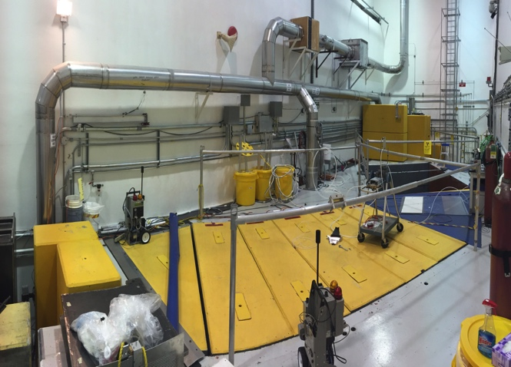
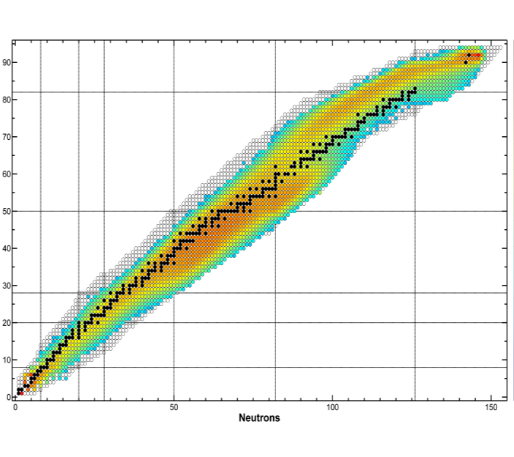
ISAC Routine Operation Overview
Day 1: Installing new target to target module in South Hot Cell (SHC) (6 hours)
Day 2: Transferring target module to Conditioning Station (CS) (4 hours)
Day 2: HV and vacuum conditioning of module-target-ion source assembly in CS (7 days)
Day 9: Transferring target module through air to ISAC Target station East (ITE) or ISAC Target station West (ITW), connect module services (8 hours)
Day 9: Pumping, HV and thermal conditioning, stable beam setup, etc.
(7 days)
Day 16: Cover target station with shield blocks (4 hours)
Day 17: Irradiation and RIB delivery (limited by target performance losses or license limit for actinide targets typically 3-5 weeks) (28 days)
Day 45: Cool down (some hours to days, depending on target, irradiation conditions and available time) (14 days)
Day 59: Uncovering shield blocks, disconnecting services (6 hours)
Day 60: Transferring target module to SHC (4 hours)
Day 61: Detaching target-ion source assembly and PIE (8 hours)
Day 62: Transfer target-ion source assembly to decay vault (decay time 1-3 years, depending on target) (4 hours)
Day 62: Target module back to operation or to module storage silo (MSS)
(4 hours)
covered ITW
Radioisotope production map 500 MeV in UCx

Slide 6
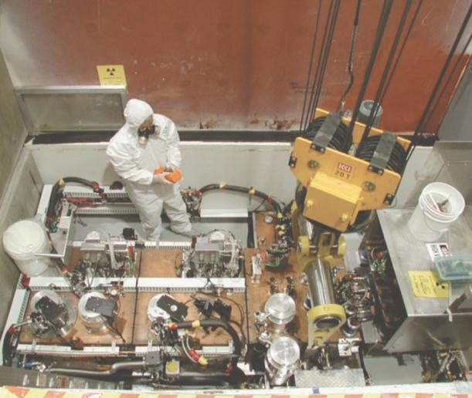
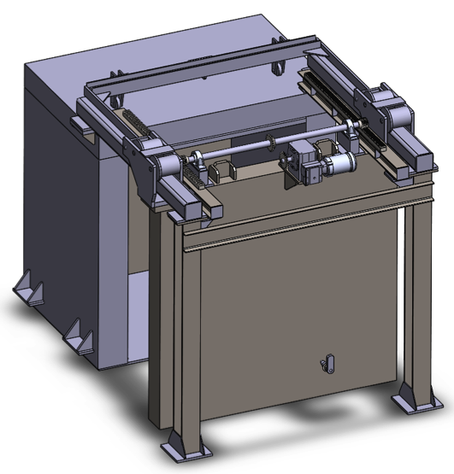
ISAC Routine Operation Overview
Day 1: Installing new target to target module in South Hot Cell (SHC) (6 hours)
Day 2: Transferring target module to Conditioning Station (CS) (4 hours)
Day 2: HV and vacuum conditioning of module-target-ion source assembly in CS (7 days)
Day 9: Transferring target module through air to ISAC Target station East (ITE) or ISAC Target station West (ITW), connect module services (8 hours)
Day 9: Pumping, HV and thermal conditioning, stable beam setup, etc.
(7 days)
Day 16: Cover target station with shield blocks (4 hours)
Day 17: Irradiation and RIB delivery (limited by target performance losses or license limit for actinide targets typically 3-5 weeks) (28 days)
Day 45: Cool down (some hours to days, depending on target, irradiation conditions and available time) (14 days)
Day 59: Uncovering shield blocks, disconnecting services (6 hours)
Day 60: Transferring target module to SHC (4 hours)
Day 61: Detaching target-ion source assembly and PIE (8 hours)
Day 62: Transfer target-ion source assembly to decay vault (decay time 1-3 years, depending on target) (4 hours)
Day 62: Target module back to operation or to module storage silo (MSS)
(4 hours)
Target decay
vault

Slide 7
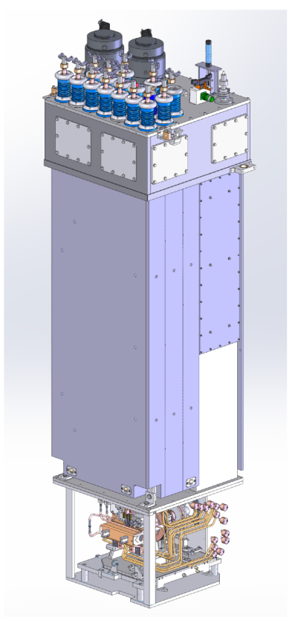
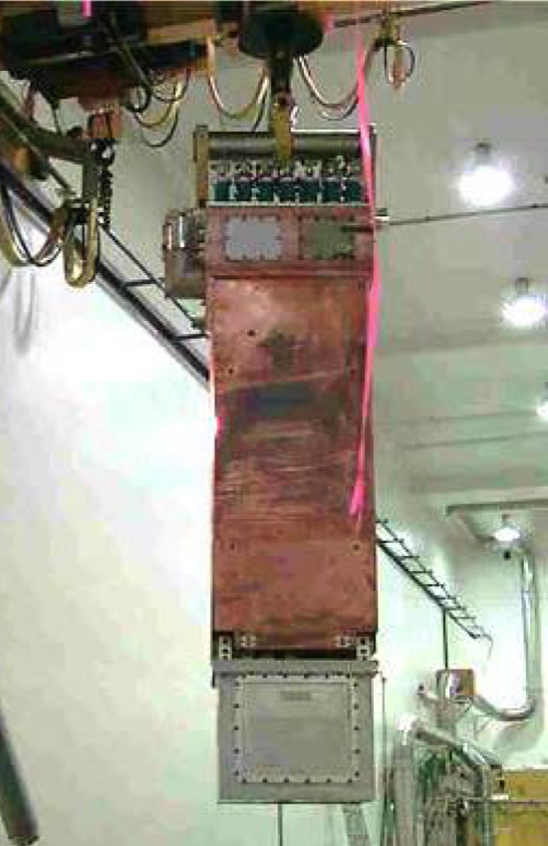
ISAC Routine Operation
ISAC target exchange every 3-5 weeks
Indirect (transferring 10 t target module and exchanging target in hot cell not in target station)
Advantages:
Applicable to high-power irradiation:
  Allows for handling the highly active spent target in hot cell
  Maintenance and repair on activated parts of source tray in hot cell
A part of the target exchange can take place during operation
Disadvantages:
Resource intensive
Slow and evolved target exchange process
Additional aging of components during move
Repairs are complex
Full replacement is nearly impossible (waste)
service cap
shield plug with service and vacuum chase
containment box with source tray

Slide 8
Compatibility with ARIEL 3 Weeks Target Life Cycle
What needs to change for a faster target exchange cycle?
Day 1: Installing new target to target module in South Hot Cell (SHC) (6 hours)
Day 2: Transferring target module to Conditioning Station (CS) (4 hours)
Day 2: HV and vacuum conditioning of module-target-ion source assembly in CS (7 days)
Day 9: Transferring target module through air to ISAC Target station East (ITE) or ISAC Target station West (ITW), connect module services (8 hours)
Day 9: Pumping, HV and thermal conditioning, stable beam setup, etc. (7 days)
Day 16: Cover target station with shield blocks (4 hours)
Day 17: Irradiation and RIB delivery (limited by target performance losses or license limit for actinide targets typically 3-5 weeks) (21 days)
Day 38: Cool down (some hours to days, depending on target, irradiation conditions and available time)
(14 days)
Day 52: Uncovering shield blocks, disconnecting services (6 hours)
Day 53: Transferring target module to SHC (4 hours)
Day 54: Detaching target-ion source assembly and PIE (8 hours)
Day 55: Transfer target-ion source assembly to decay vault
(decay time 1-3 years, depending on target) (4 hours)
Day 55: Target module back to operation or to module storage silo (MSS) (4 hours)
programmed crane operation -2h
stable TM HV -5d
programmed crane operation -4h
more conditioning, stable beam ovens -2d
programmed crane operation -2h
remote service and remote crane connections -13d
programmed crane operation -3h
programmed crane operation -2h
programmed crane operation -2h
programmed crane operation -2h
Overall reduction from 8 weeks to 5 weeks
programmed crane operation total: -2d

Slide 9
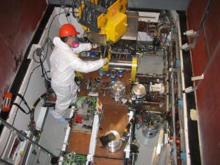
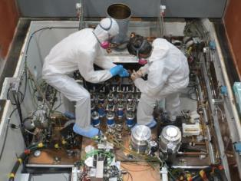
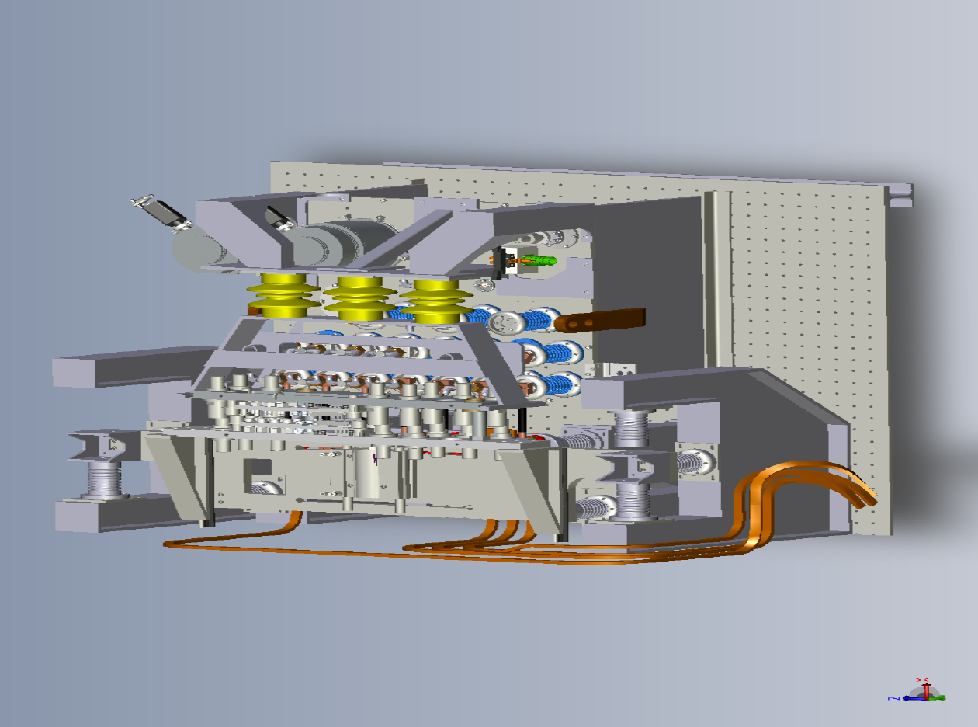
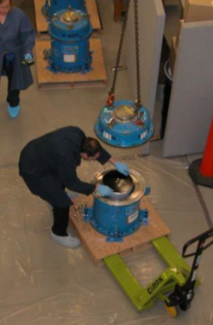
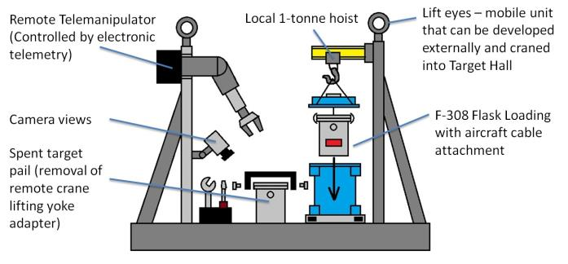
ISAC Target Life Cycle - Required Upgrades
Target Exchange
  Despites cool-down period, manual service disconnections and rigging of target module are most dose-intense routine activities at TRIUMF
  With cool-down period the 3 weeks target exchange cycle cannot be met
  Development and implementation of full remote target module services and crane disconnection required
Target Disposal:
  Dose intense manual loading step of shipment flask
  At increased target disposal rate this dose needs to be lowered
  Development and implementation of a robotic loading system of F-308 flasks

Slide 10
ISAC Target Module Status
TM | HV [kV] | SIS/LIS | FEBIAD | IG-LIS | Einzel lens | p current [µA] | Stations | Notes
1 | 24 | X |  |  |  | 10 (40) | ITW | Refurbished (source tray) 2011 Water leak on p⁺ window cooling 2015 (10 µA limit) Window design limits use to ITW only
2 | ~54 | X | X |  | X | 100 | ITW + ITE | Refurbished (source tray) 2015
3 | 15 | X | X |  | X | 100 | ITW + ITE | Refurbished (source tray) 2013 Steerer failure, HV limited Investigation project started 2015
4 | ~55 | X |  | X | X | 100 | ITW + ITE | FEBIAD coil line removed 2013 (water leak)
TM performance since refurbishment
TM | Targets | p current [mAh]
1 | 21 | 250
2 | 7 | 150
3 | 3 | 65
4 | 44 | 950
Notes:
Replacement of TM2 source tray removes IG-LIS capability until we have a re-wiring concept developed and tested.
TM1 is currently out of commission (but could be called into emergency action for UCx targets). It has a different shield plug architecture. Future use uncertain.
None of the modules is currently fulfilling requirements – as defined by 60 kV, all ion sources, both target stations, HPT and LPT, 100 µA proton beam

Slide 11
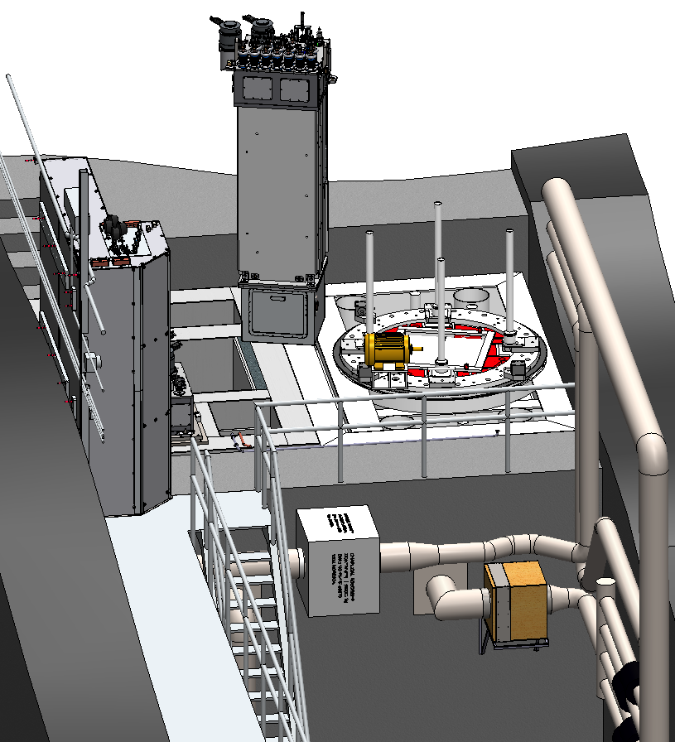
ISAC Reliability Constraints
  All manipulations in target hall (target modules, shield plugs, etc.) are performed by the target hall main crane.
    Crane is equipped with trolley, bridge and lift redundancy but not with rotational redundancy.
    The only location that can accept a target module in any orientation is the SHC → currently: SHC needs to be vacated during every target module move
  Regular target exchange requires SHC
  → long-duration repair or maintenance tasks in hot cell limited
  The main ISAC vulnerability is the ageing and complex target modules
  → failure makes partial refurbishment necessary every 5-10 years
  Two fully functional modules are constantly required in operation (one being irradiated, one being prepared)
  → Required number of target modules is therefore 4:
  (one in being irradiated, one in preparation, one in refurbishment, one spare)
TM
on crane
NHC
SHC
CS

Slide 12
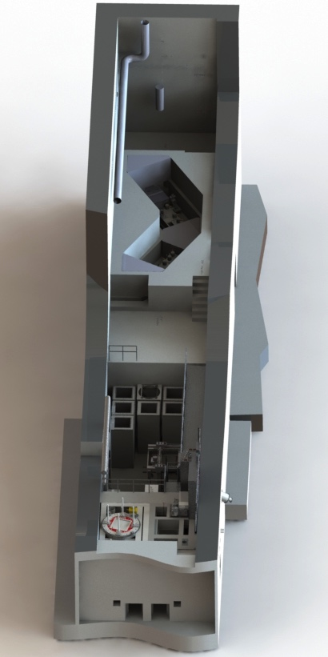
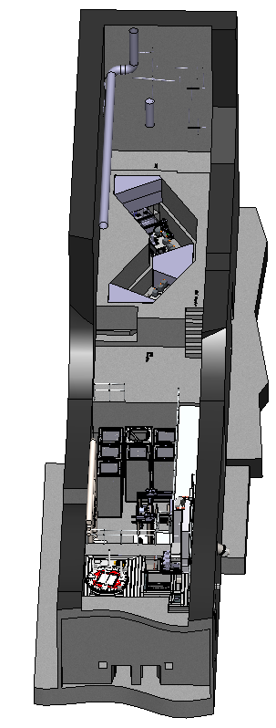
ISAC Reliability Upgrade Overview
Projects currently running for an integrated approach for ISAC reliability upgrade:
NHC (P0426)
A dedicated target exchange hot cell, freeing up the SHC for extended refurbishment and repair activities.
SMP (P0421)
A shielded landing site that supplies rotational redundancy that is missing at the target hall crane. This allows that the hot cell does not have to be empty during every module move.
TM3 Investigation (P0416)
An offline inspection of target module 3 that will provide design guidelines for designing a sustainable TM refurbishment strategy including the capability of meeting the technical TM requirements.
Cold Target Module Fabrication (P0432)
A new (cold) version of the existing TM design that addresses known issues and that can be procured relatively quickly with minimum TRIUMF personnel in order to provide an interim solution until periodic refurbishment program launches.
All projects have been assigned the highest priority designation. Projects 1-3 have assigned budget and personnel, resources need to be allocated for project 4.
ITW
ITE
SMP
TDV
CS
SHC
NHC

Slide 13
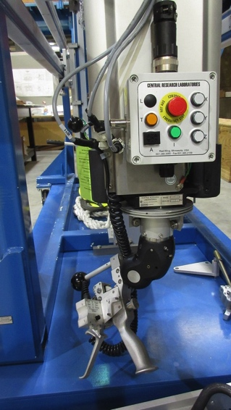
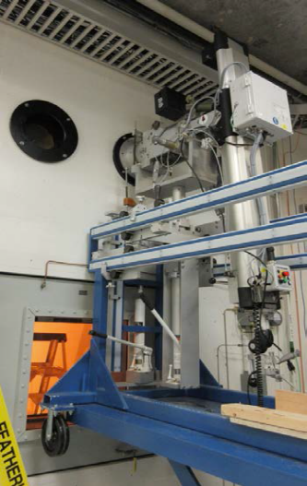
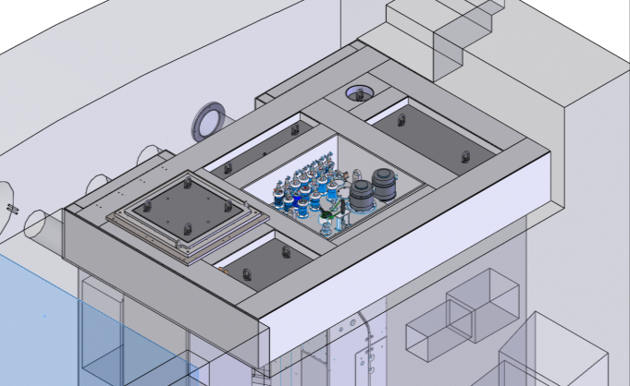
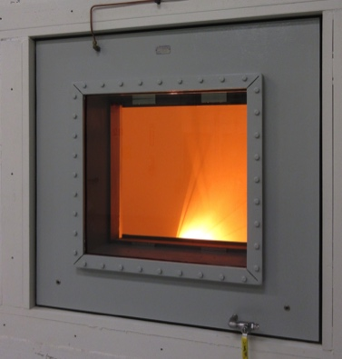
ISAC North Hot Cell
Installation of second ISAC hot cell (NHC)
NHC will be dedicated for target exchange
SHC will be dedicated to extended maintenance or repair tasks
Status
Manipulators and spare manipulators received
Tool ports received and installed
Nuclear ventilation modification done
Shielded window and partitions installed
Walls finished, missing shielding blocks designed
Passed Gates 0-3
On-track for 2018 Q2 completion
Isaac Earle, et al.

Slide 14
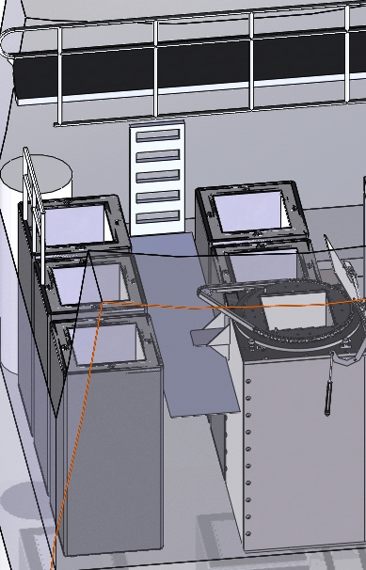
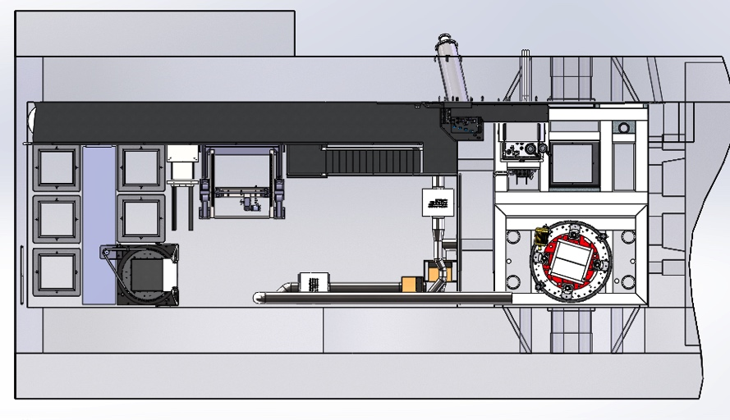
ISAC Safe Module Parking
System supplies safe landing site for any module in any orientation during manipulation with ISAC target hall crane
(currently SHC has to be free during every module move)
Conceptual design nearing completion:
  Location finalized
  General design finalized (vacuum vessel, shielding, turntable, remotely operated lid)
  Preparation for
  installation ongoing
Passed Gates 0-1
On-track for
2018 Q2 completion
new access
platform
SMP
SMP
Yasmine Saboui, et al.
14

Slide 15
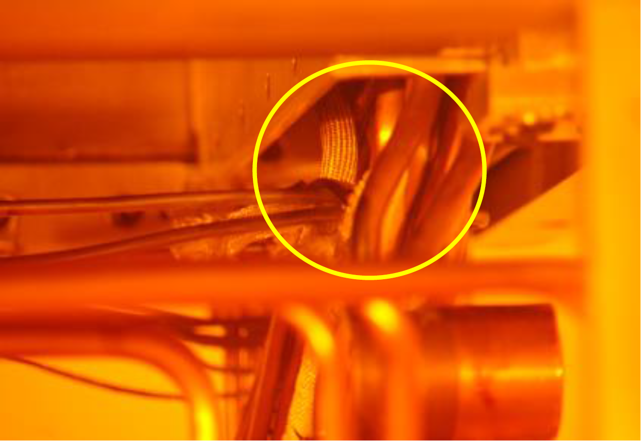
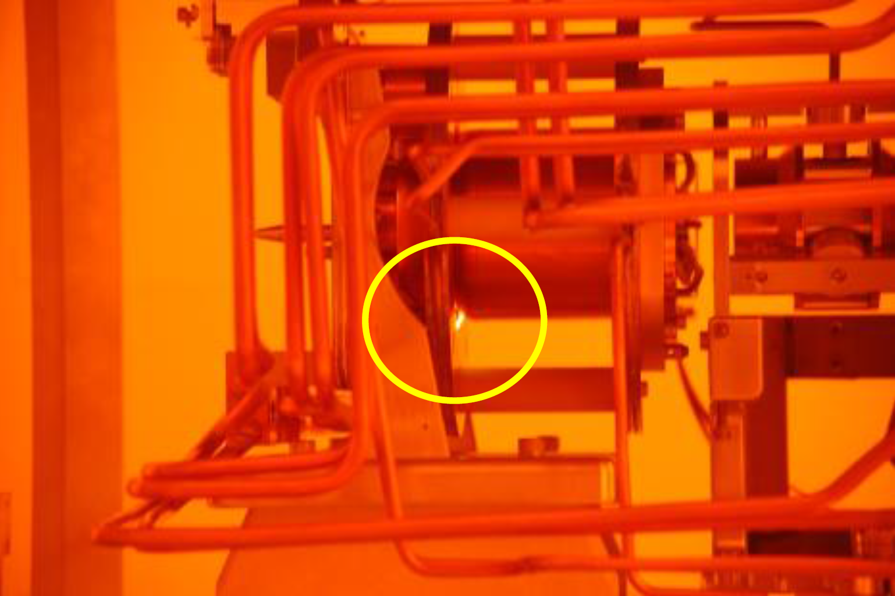
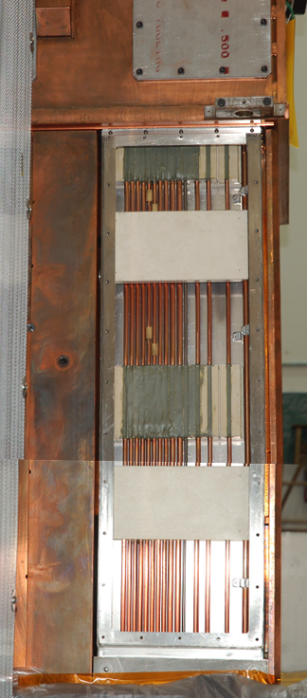
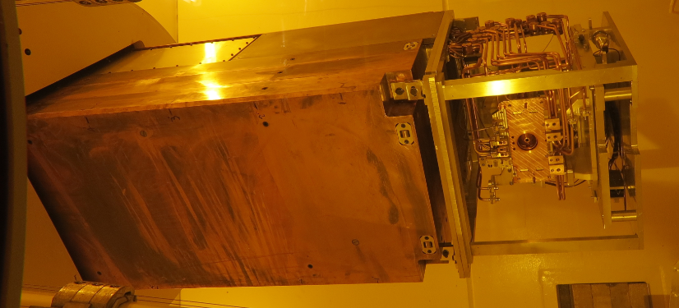
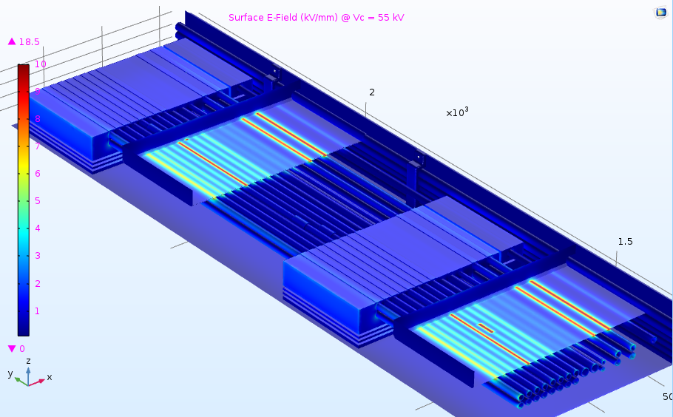
Target Module 3 Investigation
Strategy: Identify and eliminate sources of HV breakdown until 60 kV and inform design of future modules and refurbishment plan
Source of poor HV performance being investigated by
  HV simulations
  locating sparks with UV cameras
  identifying spark marks
Investigations in ISAC SHC and conditioning station ongoing: sources of HV break-down identified and eliminated
Module now holds 60 kV (without target, heating, beam)
Aurelia Laxdal, et al.

Slide 16
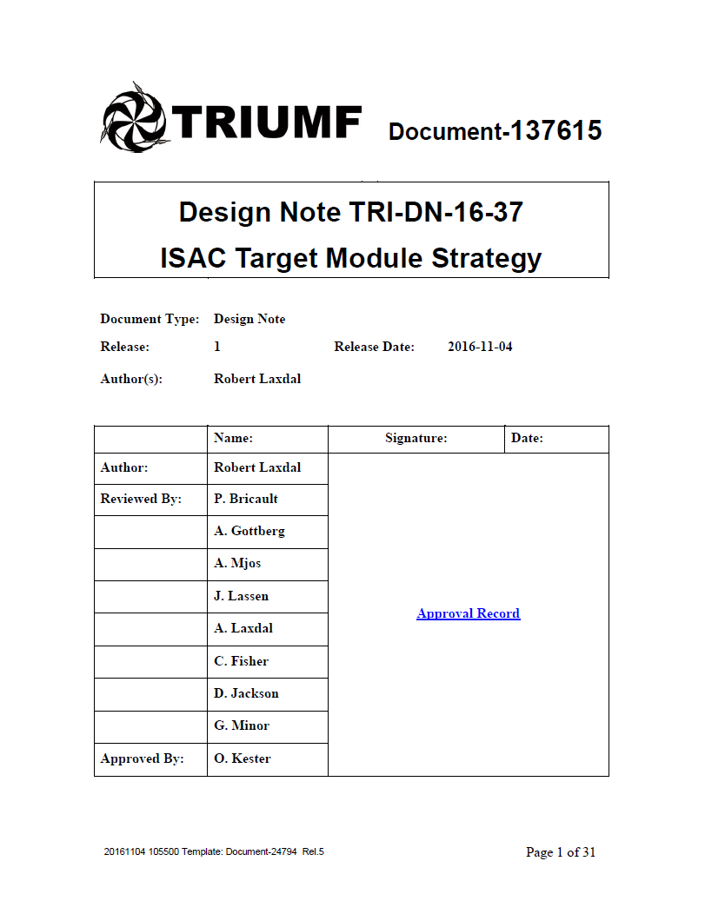
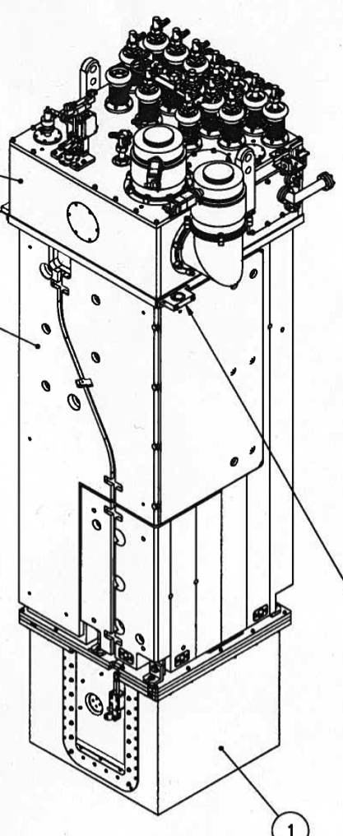
Target Module Refurbishment Strategy
Source tray is the only component that is regularly refurbished (after failure)
Other components (HV service tray, source cap) increasingly causing failure and low performance
Every refurbishment is currently a one-off program
Aiming at sustainable refurbishment strategy using procedures and parts that are applicable to all modules (TM2-4) following a ‘plug-and-play’ component design
Making use of 2nd hot cell (NHC) and SMP
→ one hot cell (SHC) continuously available for long term refurbishment

Slide 17
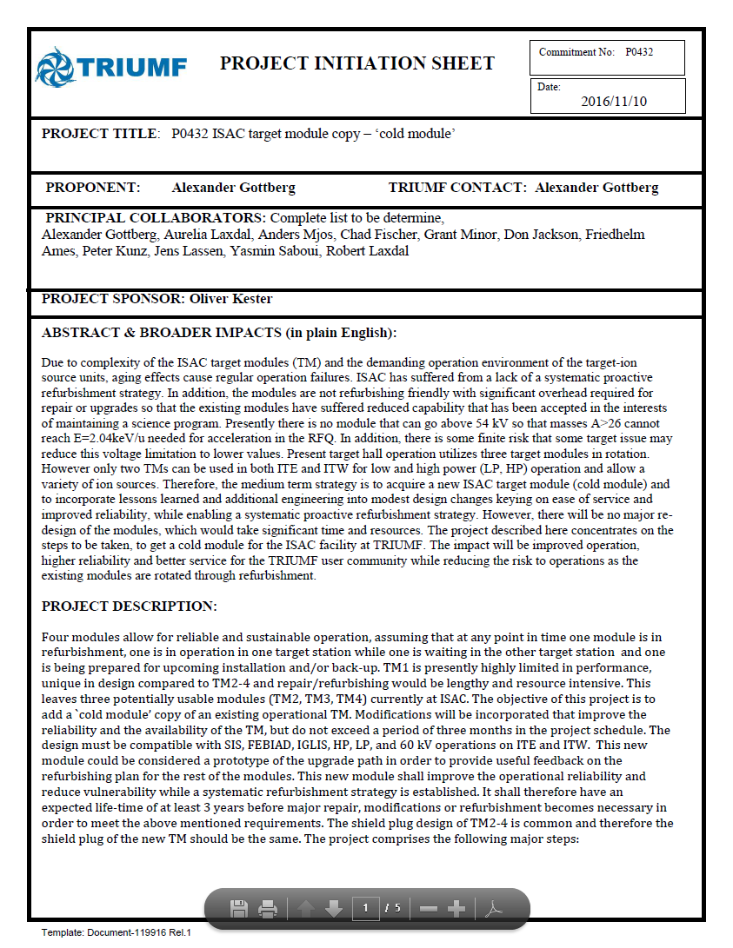

Cold Target Module Copy
Expedite procurement of ‘cold target module copy’ with minimum TRIUMF personnel
Informing design of components for target module refurbishment strategy through systematic investigations of HV and thermal performance of TM3 (P416)
Interim solution and contingency for TM2/4 failure until ARIEL completion (possible schedule):
Year | TM2 | TM3 | TM4 | TM-new
2017 | operation | investigation | operation | proc. shieldplug
2018 | operation | refurb strat. | operation | procur., assembly
2019 | operation | refurbishment | operation | operation
2020 | operation | refurbishment | decay | operation
2021 | decay | operation | refurbishment | operation
2022 | decay | operation | refurbishment | operation
2023 | refurbishment | operation | operation | operation
2024 | refurbishment | operation | operation | operation
2025 | operation | operation | operation | decay, refurb
2026 | operation | operation | operation | refurbishment
2027 | operation | decay, refurb. | operation | operation
2028 | operation | refurbishment | operation | operation
2029 | operation | operation | decay, refurb | operation
2030 | operation | operation | refurbishment | operation
2031 | decay, refurb. | operation | operation | operation
2032 | refurbishment | operation | operation | operation
2033 | operation | operation | operation | decay, refurb
SMP and NHC completion
ARIEL completion
Start regular refurb. cycle

Slide 18
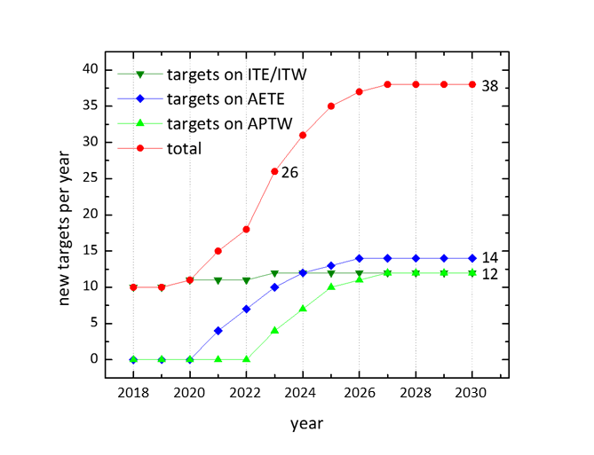
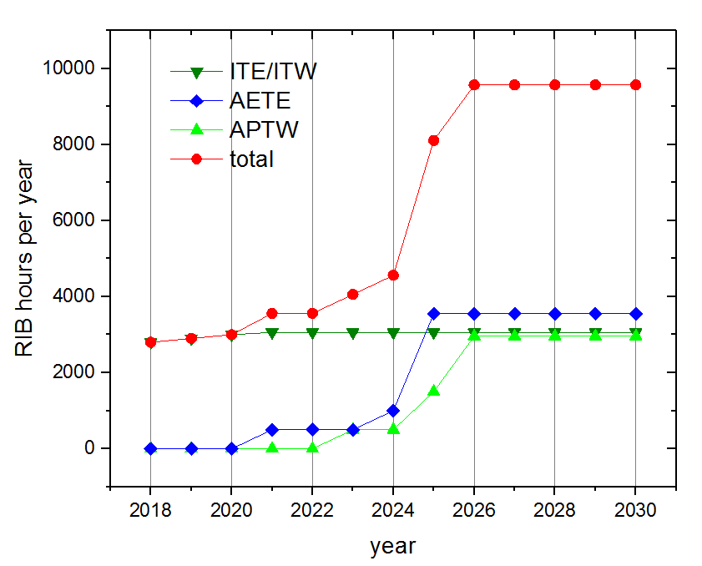
Suggested Operational Ramp Up
Targeted RIB delivery to experiments towards 2025: > 9000 h/a
ISAC now:
  ≈10 targets/a
  ≈ 9 weeks / target exchange
  capability for 3 UC_{x} targets/a,
ISAC ramp-up:
  11 targets/a in 2020, 12 targets/a in 2023
  5 weeks / target exchange in 2020
  5 UC_{x} targets in 2018, capability for 12 UC_{x} targets/a in 2023 (UC_{x} ramp-up development ongoing)
Requirements
4 target modules in circulation
North hot cell and SMP
Target production efficiency increase (especially of UC_{x})
Critical spares
Preventive maintenance
Faster target exchange (Remote TM service disconnections and remote crane rigging)

