Slide 1
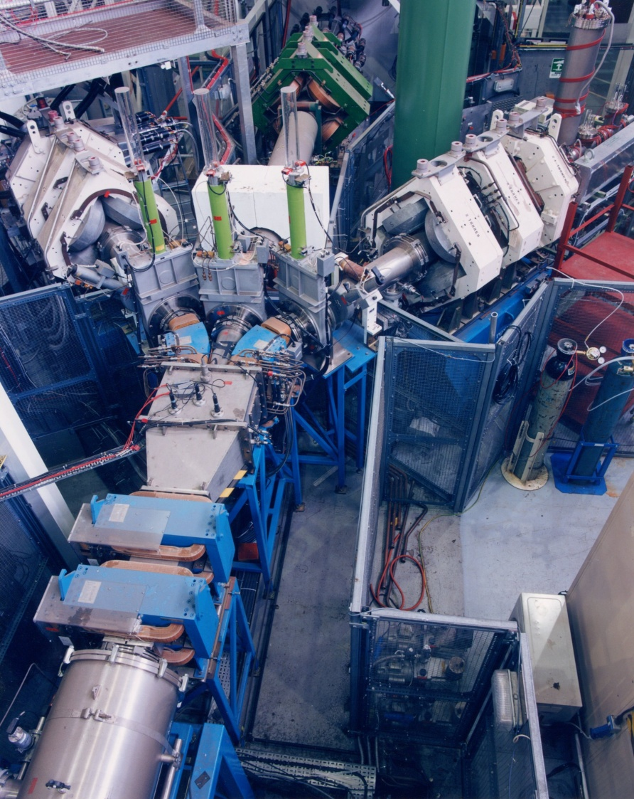

TRIUMF Science Week
The benefits of the off-line characterisation labs
Adrian Hillier
Presented by
Adam Berlie
ISIS Muons
Support

Slide 2
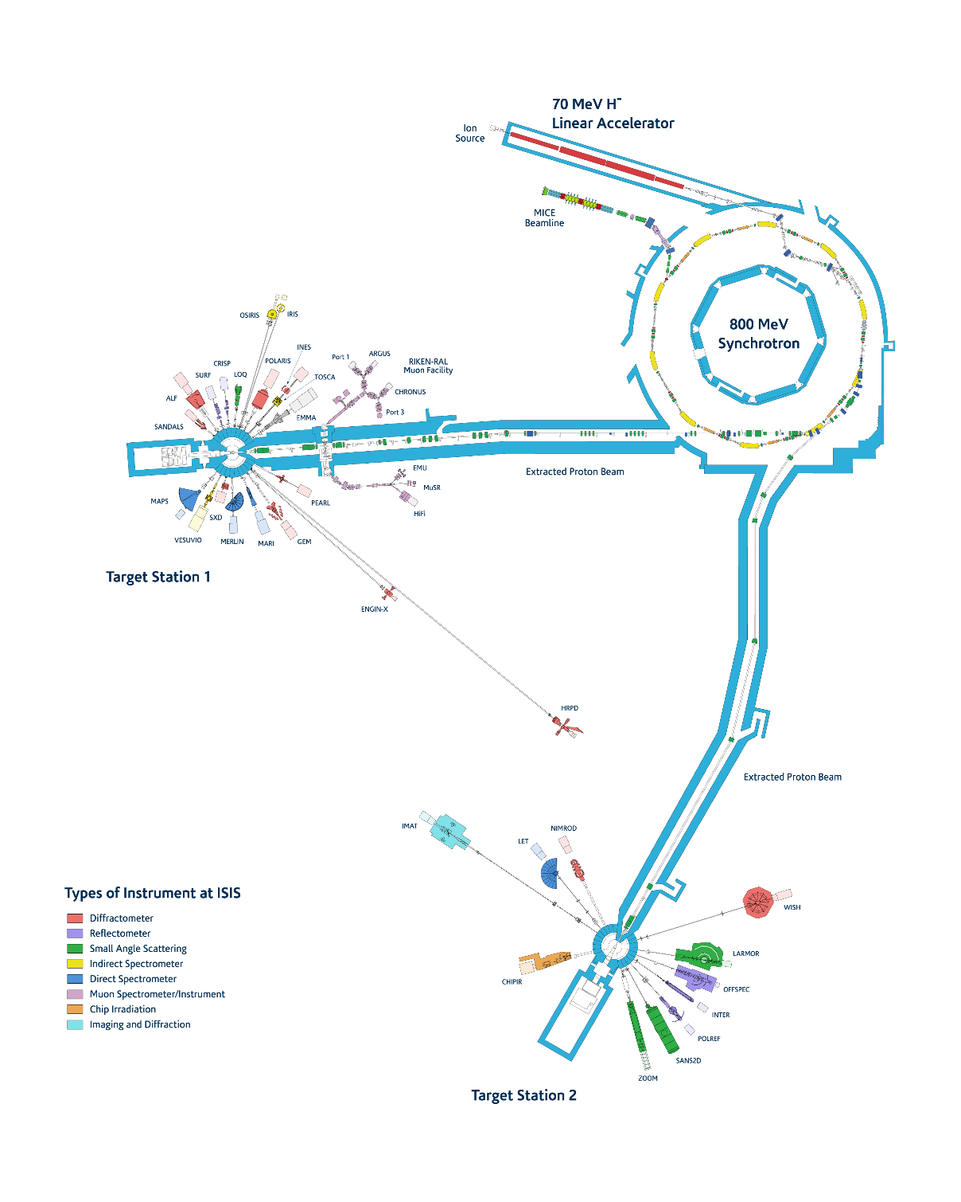
Outline
Introduction to ISIS
Support laboratories
      Chemistry Laboratories
      Characterisation Laboratories
      Deuteration Laboratories
      Bio- Laboratories
      Research Complex
Summary and thoughts

Slide 3
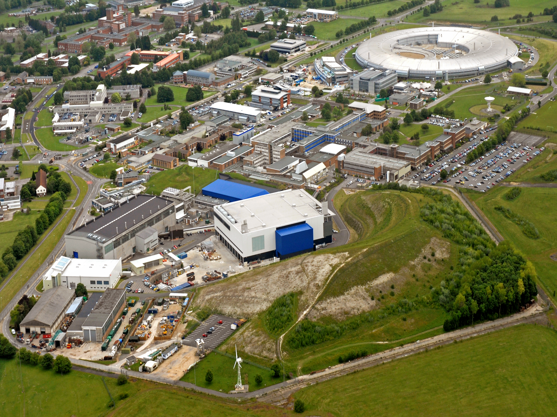


Introduction to ISIS

Slide 4
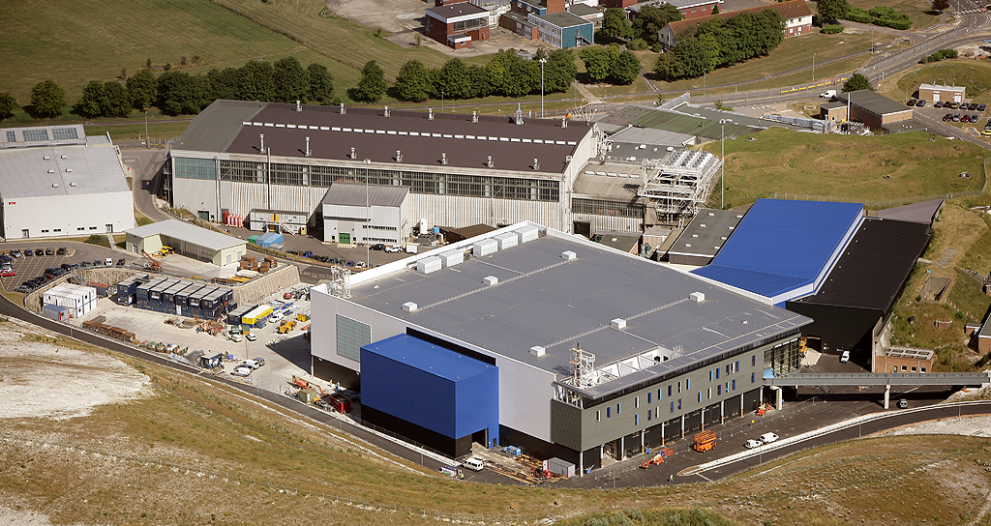
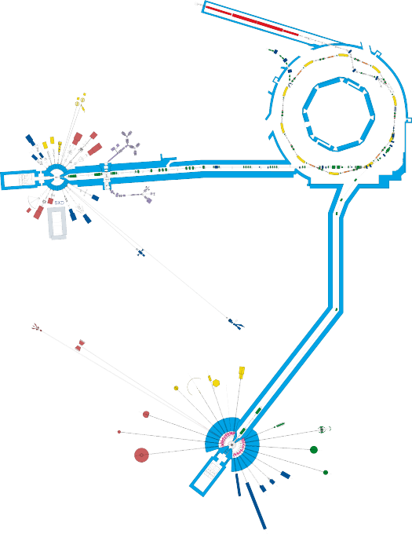
The ISIS Pulsed Neutron and Muon Source
Accelerators
Instruments
Instruments
A World Centre for Condensed Matter Science with Neutrons and Muons

Slide 5
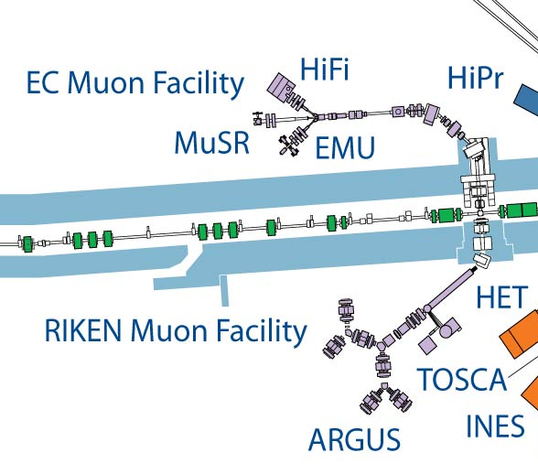
Instrument suite at ISIS
At least two instrument scientist per instrument
Specialist support teams
Cryogenics
Pressure Furnace
Electronics
Motion
Detectors
Instrument control software
Scientific software
Beamline Power supplies
Beamline services (vac, water, etc)
Engineering

Slide 6
Muon science areas
MUONS:
Versatile probes of magnetic, superconducting, molecular systems
Complementary to other techniques ISIS / PSI / J-PARC all have n and μ facilities
Around 60 groups from 15 countries using ISIS muons
Further details:
http://www.isis.stfc.ac.uk/groups/muons/

Slide 7
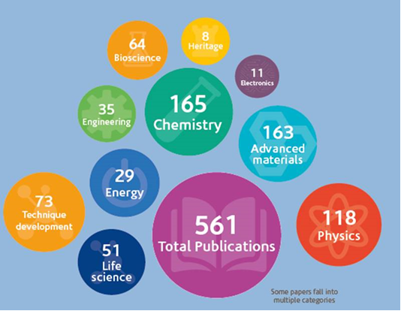
ISIS science areas

Slide 8
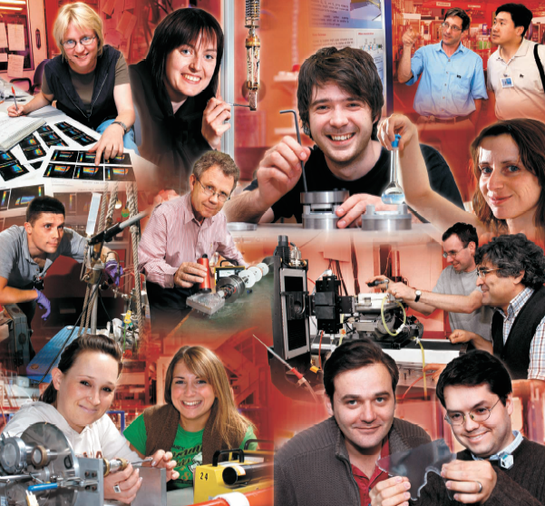
38 Instruments
1000+ Experiments per year
4000+ Instrument-days per year
550+ Publications per year
100+ companies
1600+ strong user base
  775 PhD students
3300+ user-visits every year
4200+ other visitors

Slide 9
Support Laboratories at ISIS
Chemistry Laboratories
Characterisation Laboratories
Deuteration Laboratories
Bio-Laboratories

Slide 10
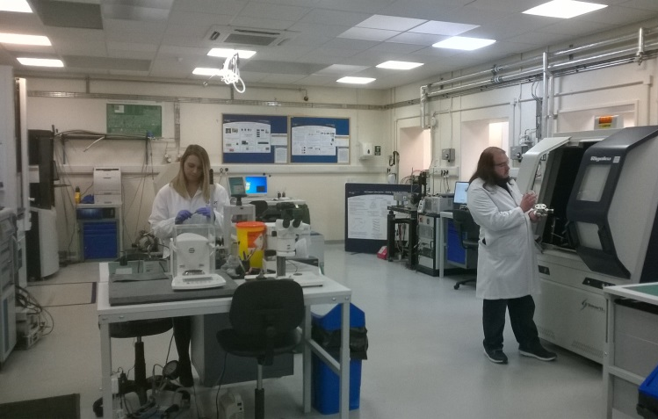
Characterisation Laboratories at ISIS
Started in 2010
~£7 M investment in the laboratory
Over 300+ users per year
Typically instruments are 2-6 weeks waiting time due to high demand and oversubscription.
Materials Characterisation Laboratory functions (% are an estimate):
-Sample screening (20 %)
-Preliminary measurements for beamtime (20 %)
-Complimentary neutron/muon measurements (30 %)
-Follow up/completion measurements for publications (20 %)

Slide 11
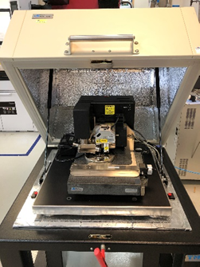

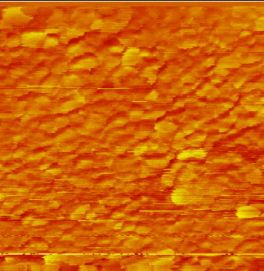
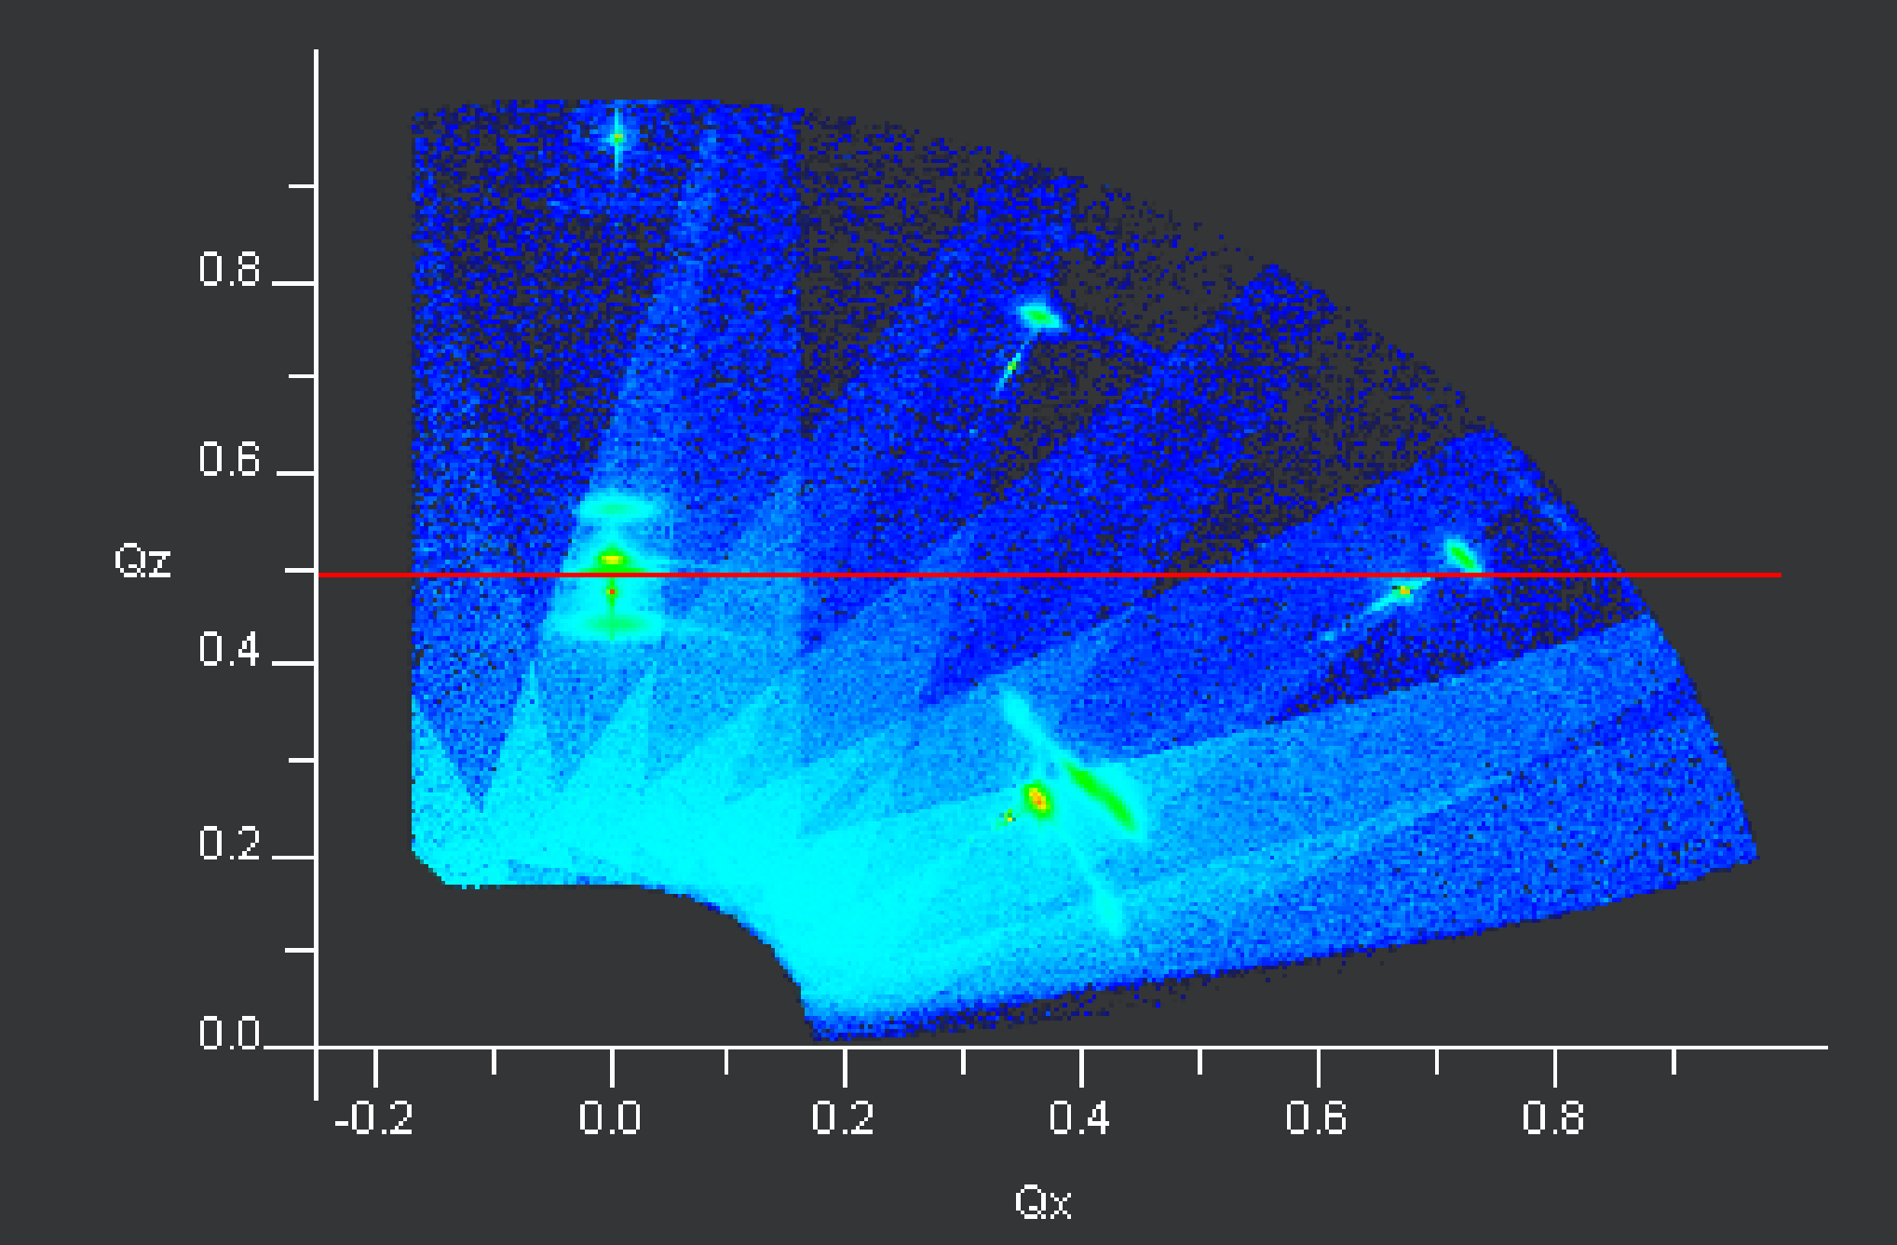
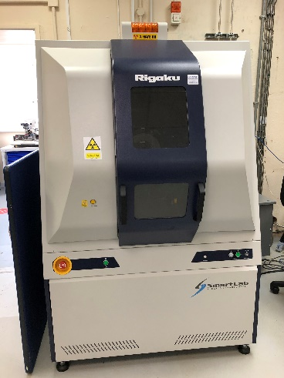
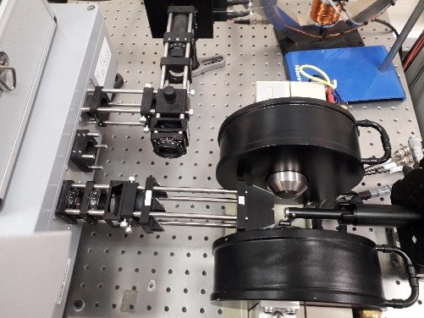
Equipment – thin films
Atomic Force Microscope
Surface topography (tapping mode) thin films, Si blocks etc. Can also perform MFM, C-FM and liquid surface AFM.
AFM/MFM image of a sample
Smartlab High resolution thin film diffractometer
High resolution XRD, Grazing incidence XRD, Pole figures, Reciprocal space mapping, X-ray reflectivity, 2D diffraction
Reciprocal space map of a NiFe/CoFe thin film
Magneto-optical Kerr effect microscope Hysteresis loops and domain imaging of thin films or samples which have a reflective surface. Transverse, longitudinal and polar moke. Dipole and quadrapole magnet systems. Flow cryostat to 4 K.

Slide 12
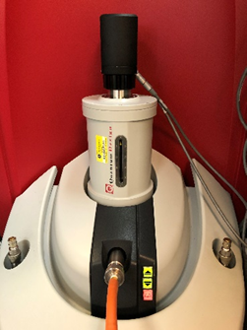
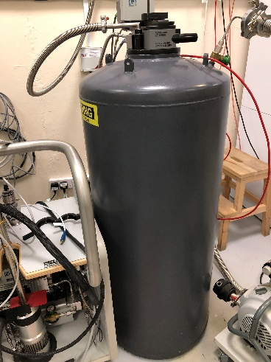
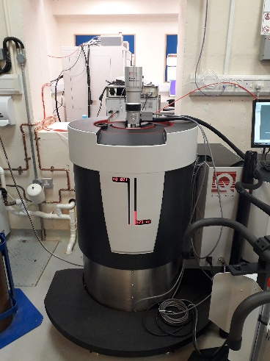
Equipment – Bulk Properties
Magnetic Property Measurement System (Squid) - ±7 T.
Capable of VSM, DC measurements. Options include ACMS, horizontal rotators, oven option (1000 K), 3He fridge (390 mK).
Physical Property Measurement System – ±9 T,
1.8-400 K. Measurement options include ACMS, Heat capacity, resistivity, Transport
Physical Property Measurement System Dynacool
Field ± 9 T 1.8-400 K. Measurement options include ACMS, Heat capacity, VSM, Thermal transport, Electrical transport, Resistivity, Ferromagnetic resonance. Dilution fridge.
Dilution fridge capable of 50 mK and performing the following measurements – Heat capacity, resistivity, ACMS.

Slide 13
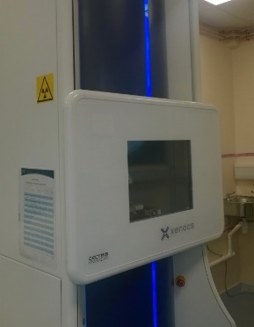
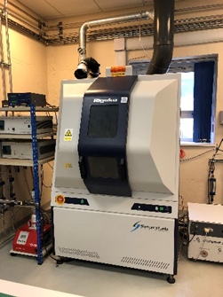
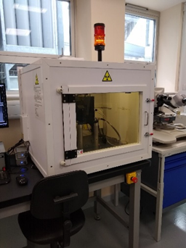
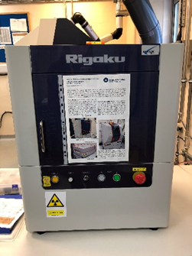
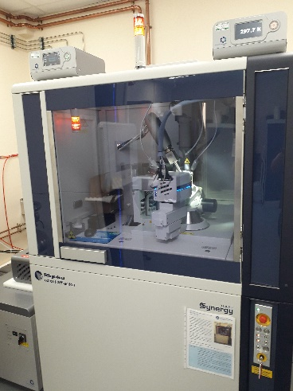
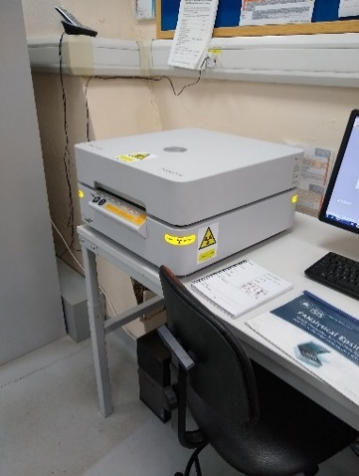
Equipment – Chemical/Structural
Small Angle X-ray Scattering
Linkam stage (80 K), Autosampler, low noise flow cell, thermalized capillary, gel capsule for viscous liquids.
Smartlab High resolution powder diffractometer (rotating anode)
Available with sample environments-High temperature (1200°C) Cryostat (12 K) plus a new cold loading cryostat for quench cooling measurements. Air sensitive sample holders.
Laue Diffraction camera
Can align large crystals ready for beamtime.
Miniflex Benchtop powder XRD
Quick and easy XRD used routinely for sample screening and crystal growers on-site. Can provide a dataset in 10 mins. (Cu Source)
Single Crystal diffractometer
Dual source (Mo and Cu)
cryostream (70 K)
N-Helix (28 K)
X-ray fluorescence
Elemental analysis

Slide 14
Output
Materials Characterisation Laboratory functions:
- Sample screening (~20 %)
- Preliminary measurements for beamtime (~20 %)
- Complimentary neutron/muon measurements (~30 %)
- Follow up/completion measurements for publications (~20 %)

Slide 15
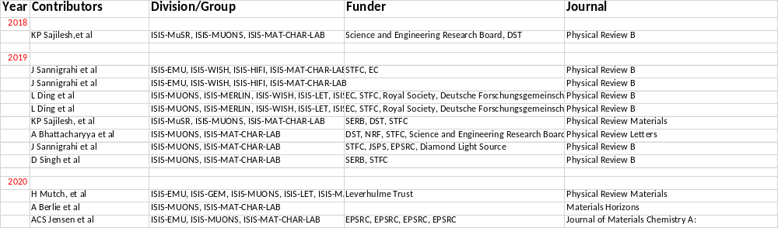
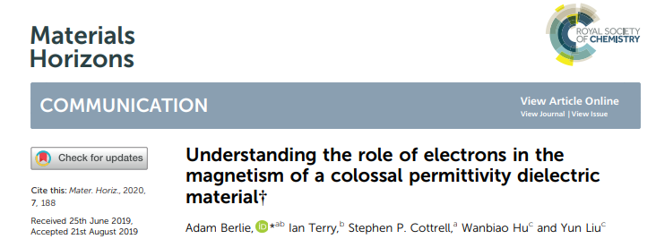
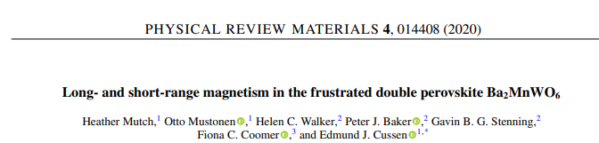
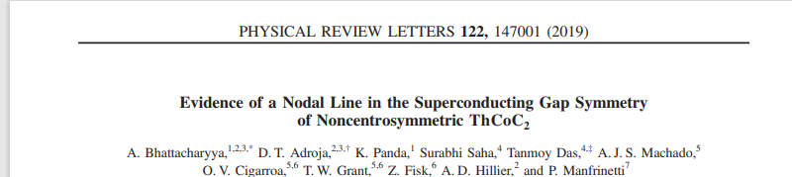
Output from muons

Slide 16


Slide 17
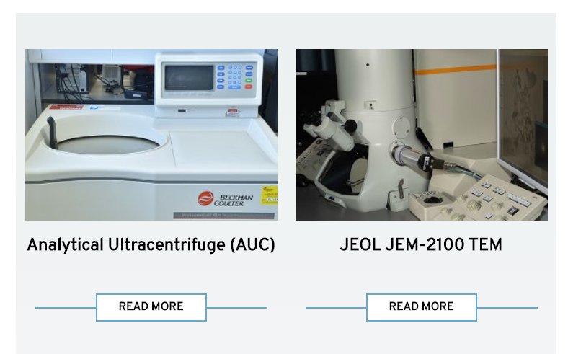
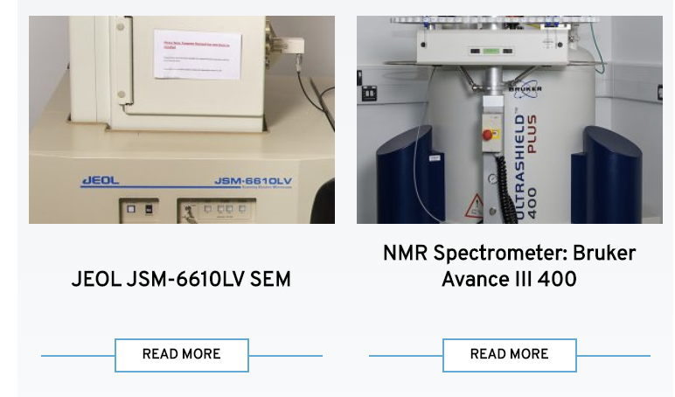
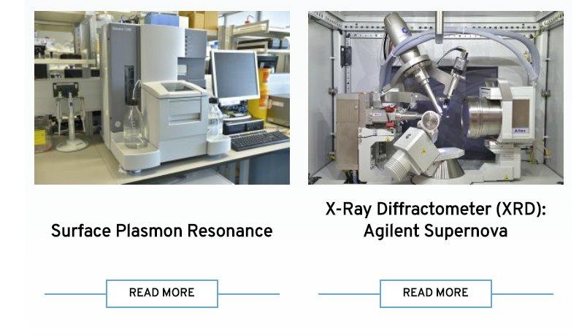
Again more equipment
Also, space available for research teams

Slide 18
Conclusion
Available for all users
  ISIS users have access to a wide range of equipment and expertise
Production and characterisation of sample near experiments
Enables quick characterisation during beamtime
Wide range of equipment to serve many areas
Becoming more popular with users
Enables users without this equipment to characterise samples before beamtime – saving beamtime
However, not cheap!
  Needs Support
  Needs Maintenance
  Needs equipment

Slide 20
ISIS Chemistry Laboratories

Slide 21
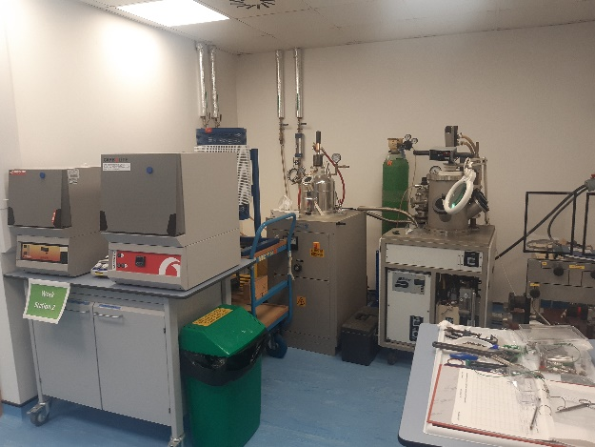
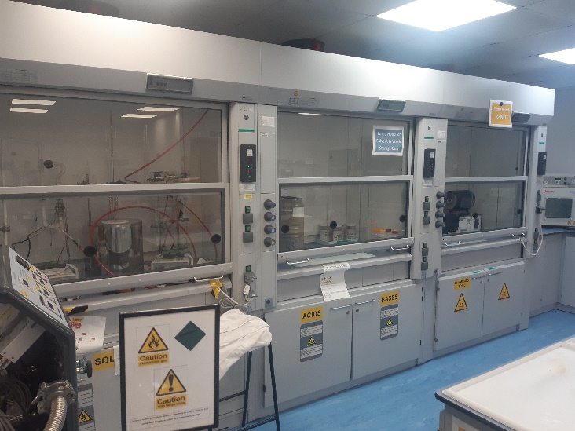
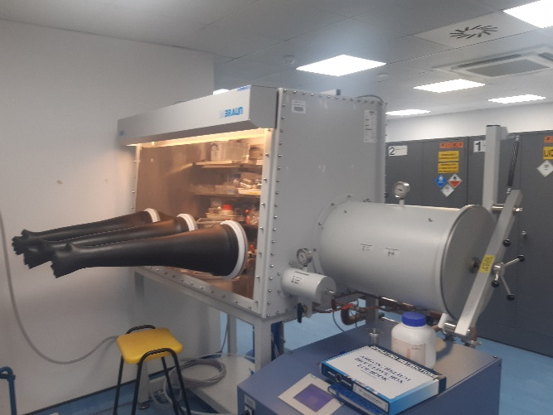
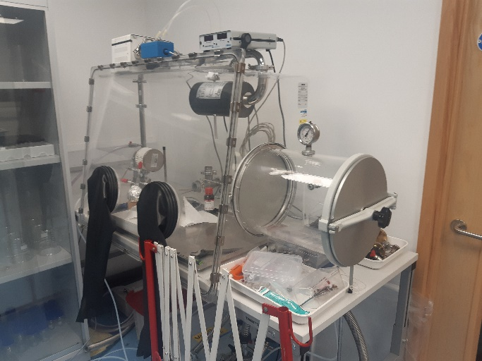
Chemistry Laboratories at ISIS
Wet laboratories
  Usual equipment found in a Chemistry lab
Furnaces
    Tube furnaces
    Arc furnaces
Fume hoods
Gloves boxes
Dry Boxes

Slide 22
ISIS Deuteration Laboratories

Slide 23
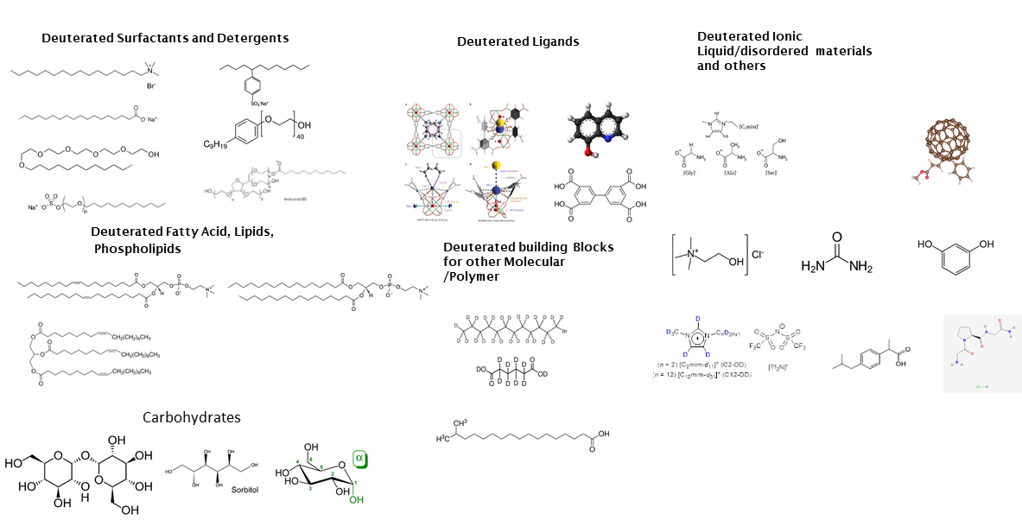
Deuteration Laboratories - Capabilities

Slide 24
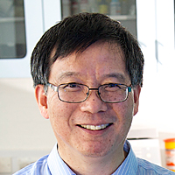
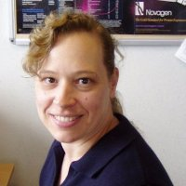

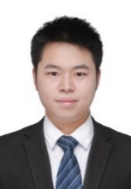
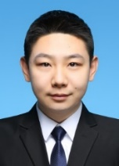
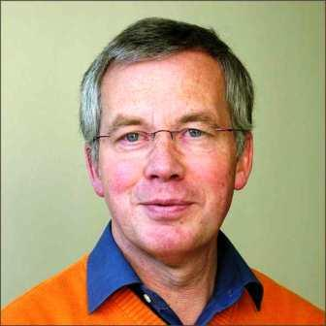







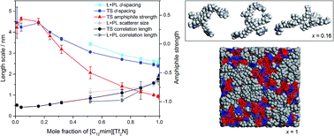
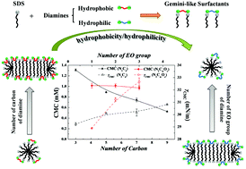
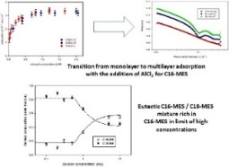
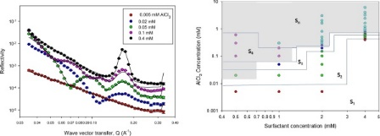
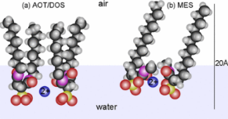
Deuteration Laboratories – Delivering Science
Enabling Science
Producing Science
Faraday Discussions (2017) Soft Matter, (2017) JCIS, 2018,516, 456-465
JCIS, 2018, 512, 231-238 Langmuir, 2017, 33 (38), 9944–9953

Slide 25
ISIS Biology Laboratories

Slide 26
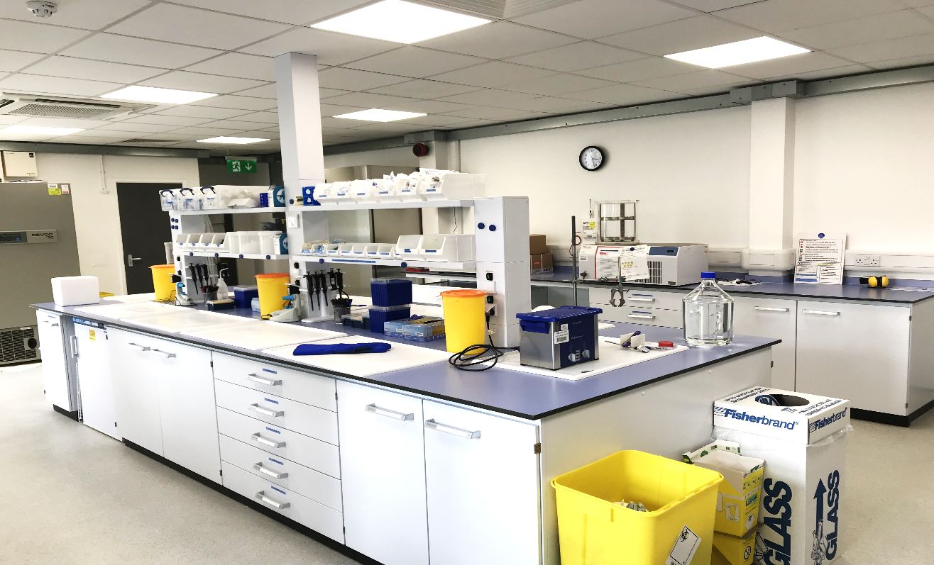
TS1 Bio-laboratory
Operates at Containment Level 1(CL1)
Instruments include –
LB Dipping trough
Freeze dryer
UV transilluminator
Tip sonicator
Used for
Molecular biology
Lipid Bi layer depositions
Sample preparation

Slide 27
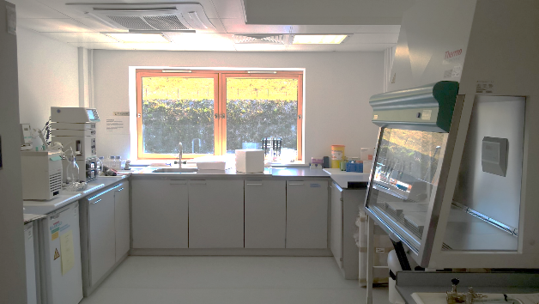
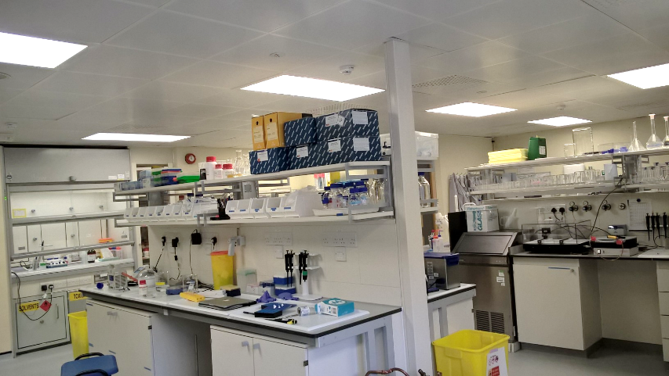
TS2 Bio-laboratory
Operates at Containment level 2 (CL2)
Bacterial cell culture Suite has -
CL2 microbiological safety cabinet
2L Bio Flo fermenter
Super speed centrifuge
Incubators and Shakers
Autoclave
Analytical Suite has –
Malvern Zeatsizer –DLS
QCM-D
FT-IR
Sample preparation using -
Langmuir Blodgett dipping trough
Akta protein purifier

Slide 28
Support Provided by Biolab Team
Assist with cloning and overexpression of proteins and lipids using Bacterial or Mammalian cell culture systems.
Preparation and analysis of samples before beam time experiment.
Supervise and support students or staff using labs for sample preparation.
Provide assistance in completing and submitting BIOCOSHH or GM Risk Assessment forms for work involving biological agents.
Provide assistance in ensuring correct regulatory procedures are followed, eg: licences and notifications from HSE.

