Slide 1




TRIUMF Science Week 2020
Searches for new physics with
atoms and molecules
Marianna Safronova
Department of Physics and Astronomy, University of Delaware, Delaware
Joint Quantum Institute, NIST and the University of Maryland, College Park, Maryland

Slide 2
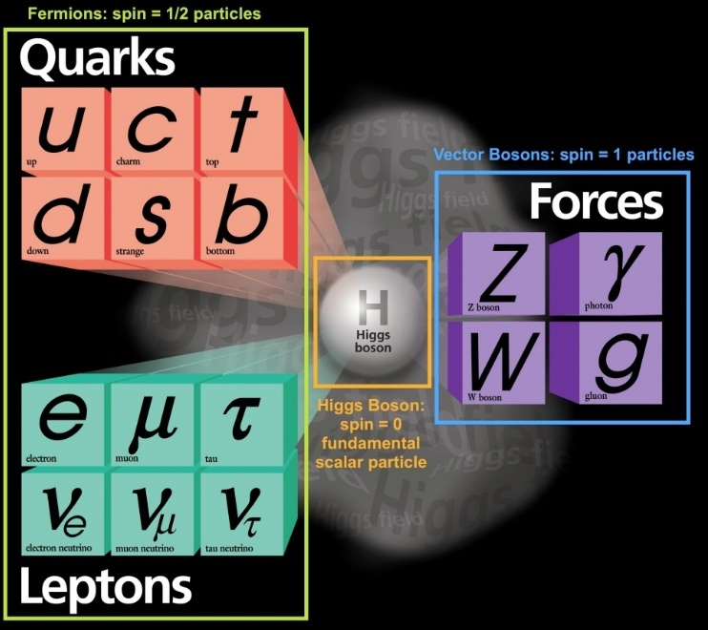
Standard model
2020
+ fundamental physics postulates

Slide 3
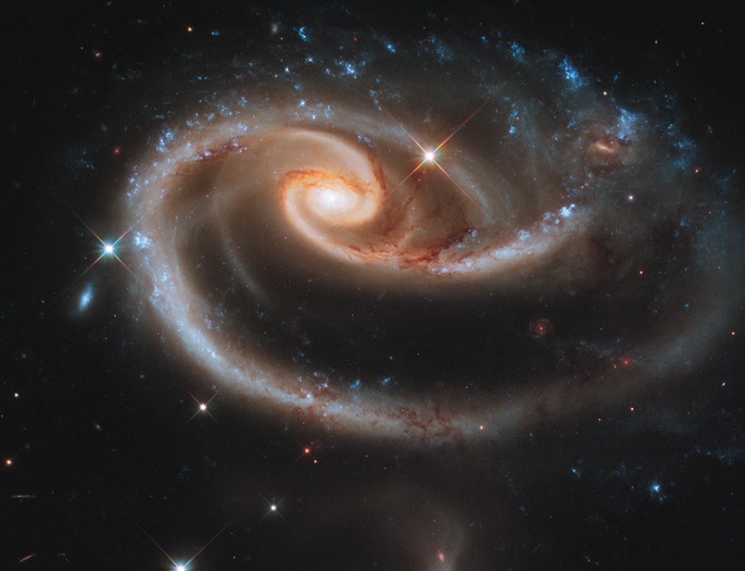
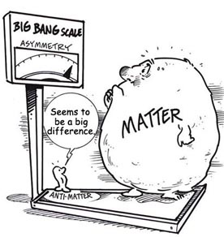
According to the Standard Model
Our Universe can not exist !

Slide 4
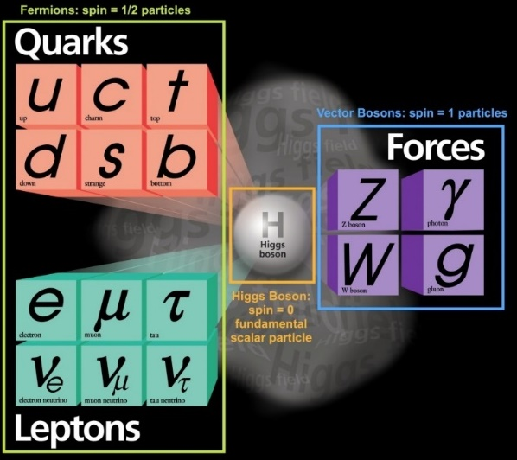
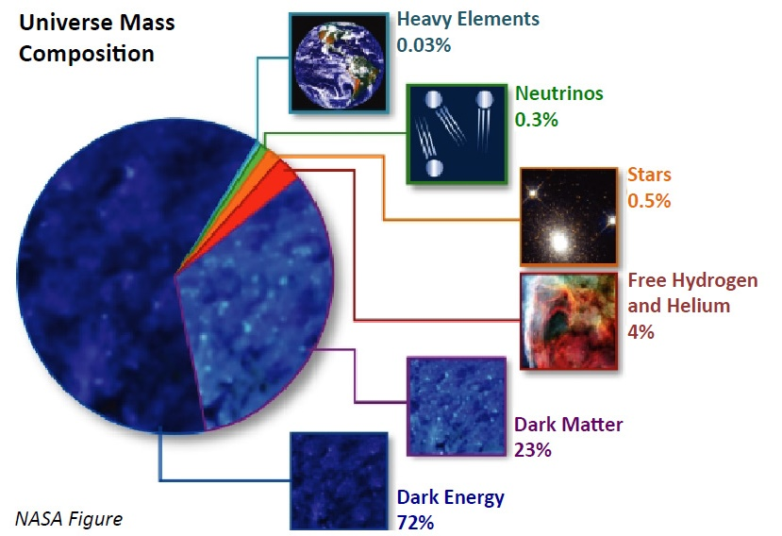
We don’t know what most (95%) of the Universe is!
“Normal”
matter
< 5%
?
?

Slide 5
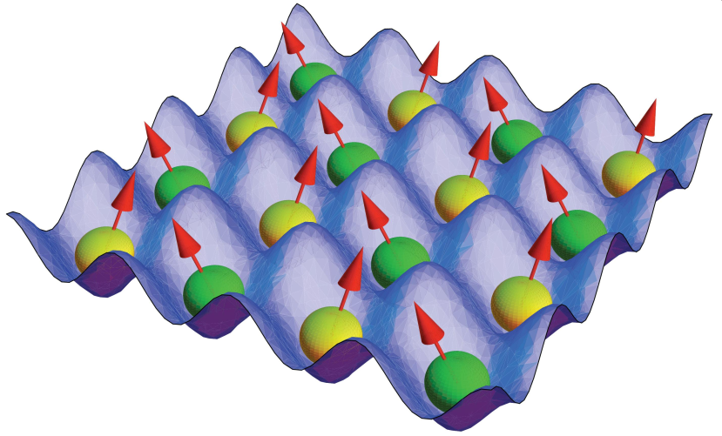
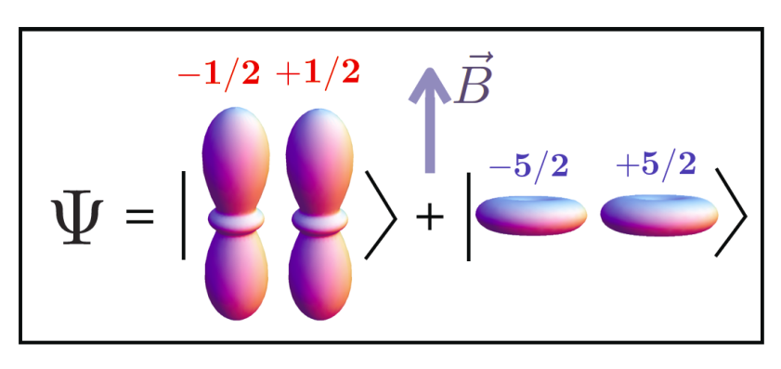
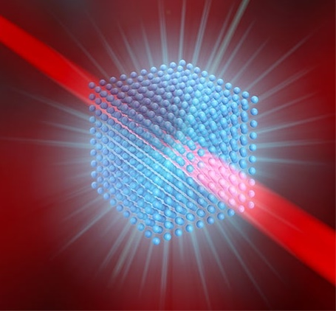
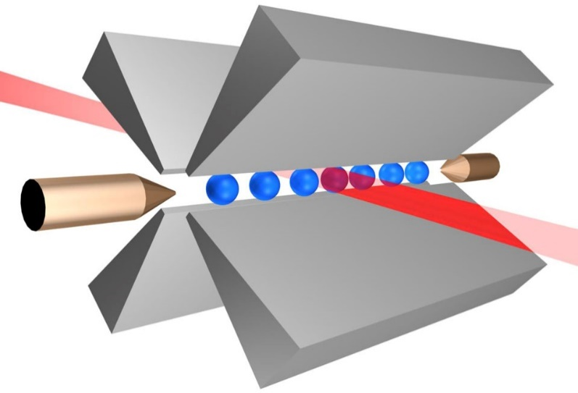
Extraordinary progress in the control of atoms and ions
300K
1997 Nobel Prize
Laser cooling and trapping
2001 Nobel Prize
Bose-Einstein
Condensation
2005 Nobel Prize
Frequency combs
3D
2012 Nobel prize
Quantum control
pK
Image: Ye group and Steven Burrows, JILA
Atoms are now: Ultracold
Trapped
Precisely controlled

Slide 6
RMP 90, 025008 (2018)

Slide 7
Very wide scope of AMO new physics searches
Precision tests of Quantum Electrodynamics
Searches for light dark matter
Atomic parity violation
Search for variation of fundamental constants
Time-reversal violation: electric dipole moments and related phenomena
Searches for exotic forces
Tests of the CPT theorem:
matter-antimatter comparisons
General relativity and gravitation
Lorentz symmetry tests
Search for violations of quantum statistics

Slide 8
Many searches need or will benefit from the use of radioactive isotopes
Precision tests of Quantum Electrodynamics
Searches for light dark matter
Atomic parity violation
Search for variation of fundamental constants
Monday:
TRIUMF at the
Precision Frontier
Beatrice Franke
Time-reversal violation: electric dipole moments and related phenomena
Searches for exotic forces
Tests of the CPT theorem:
matter-antimatter comparisons
General relativity and gravitation
Lorentz symmetry tests
Search for violations of quantum statistics

Slide 9

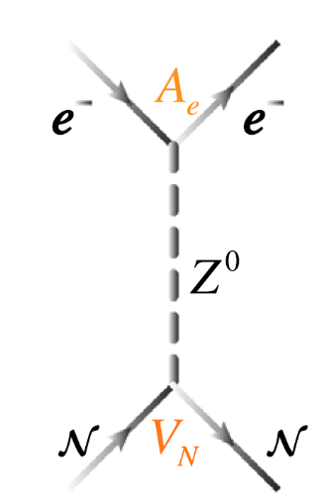
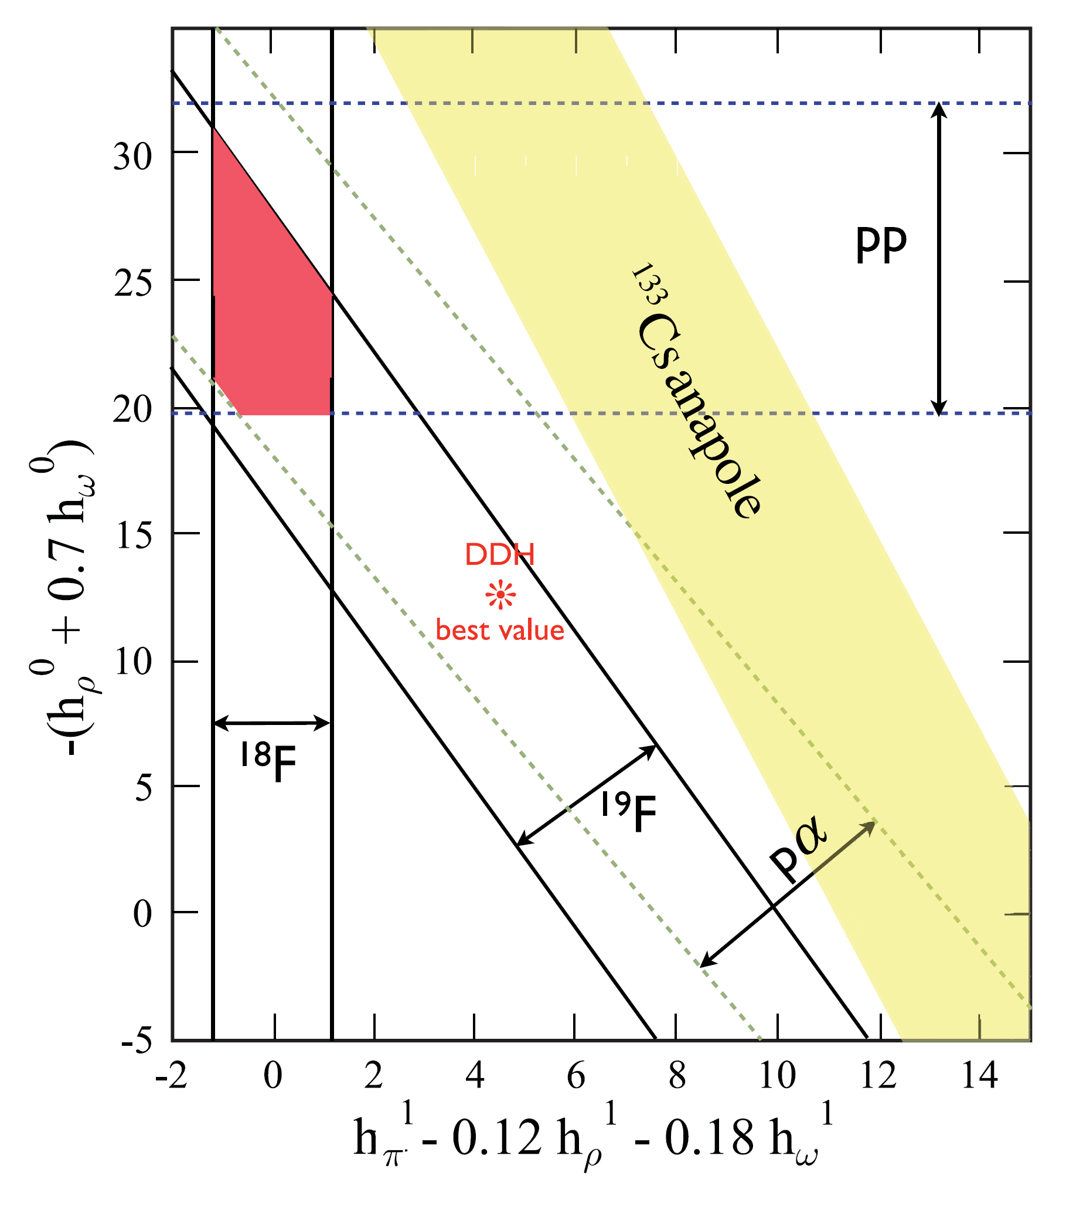
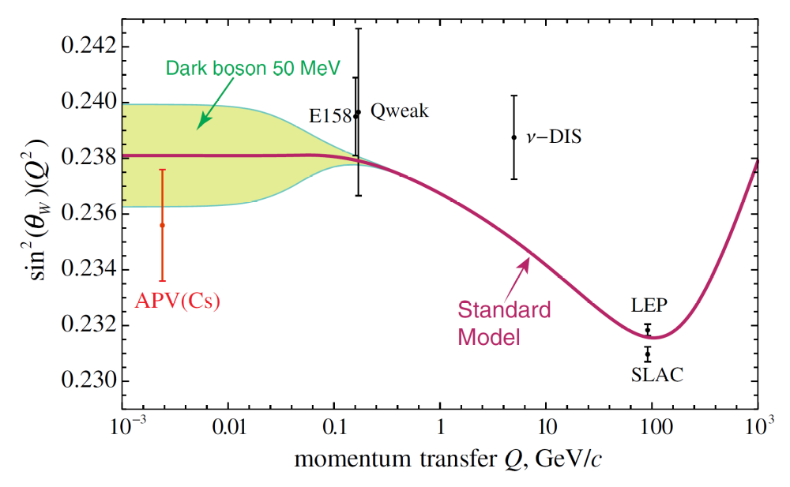
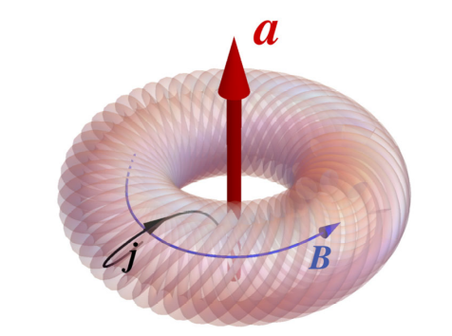
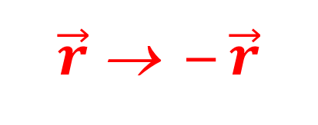
Atomic parity violation with
laser trapped francium
$\vec{r}$→ ─ $\vec{r}$
FrPNC
Z³ enhancement
Ra⁺ at UCSB, Cs, Yb
Forbidden electronic transitions become very weakly allowed due to parity violation
Study parity violation in the nuclei
Optical transition scheme: 7s-8s in Fr
Microwave transition scheme: 7s hyperfine
Z-boson exchange
Constraints on combinations of parity-violating meson couplings
Nuclear anapole moment
Testing standard model and searching for dark matter
Rev. Mod. Phys. 90, 025008 (2018)

Slide 10
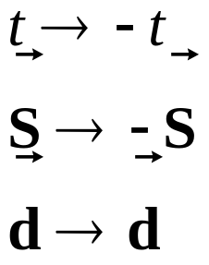
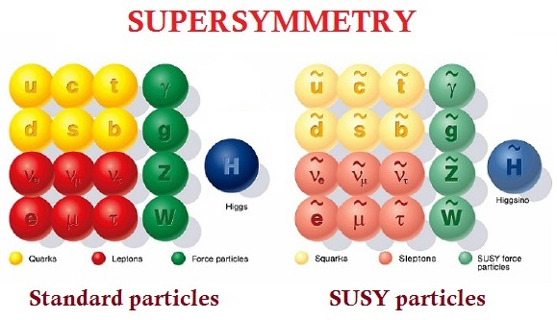
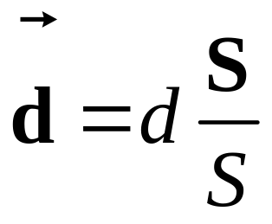
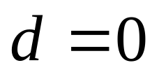
Permanent electric-dipole moment (EDM)
t → ─ t
Time-reversal invariance must be violated for an elementary particle or atom to possess a permanent EDM.
Additional sources of CP-violation lead to much larger EDMs than standard model predicts.
Such EDMs should be observable with current experiments.
S
d
d
S
Need new sources of T- (CP-) violation to explain
matter-antimatter asymetry
without T-violation

Slide 11
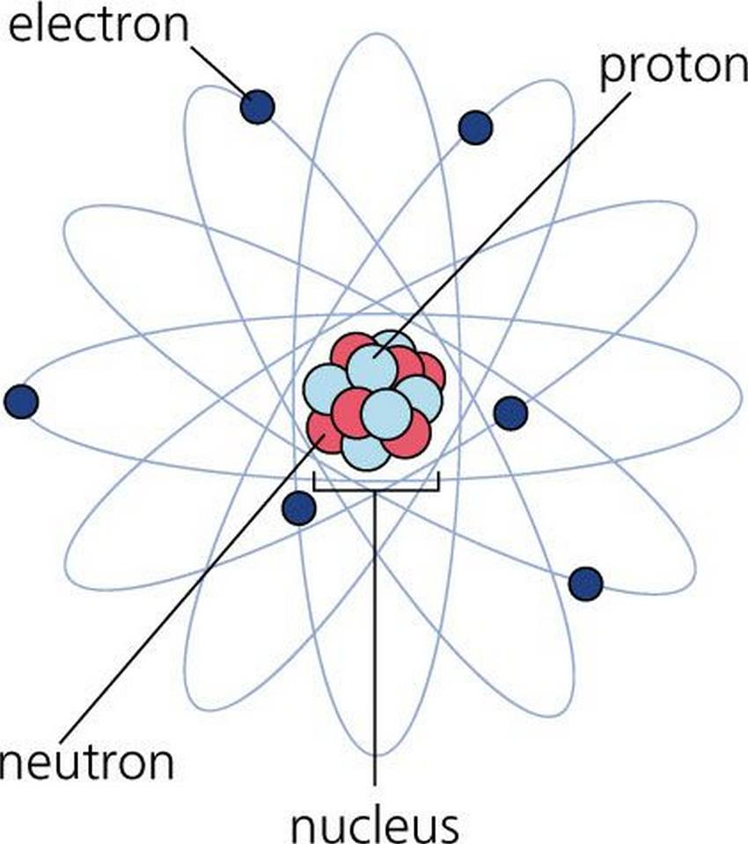
Sources of atomic and molecular EDMs
P, T – violating
electron-nucleon interaction
Paramagnetic atoms
Cs, Tl, Fr (eedm.info)
Molecules
YbF, ThO, HfF⁺, ThF⁺,RaF
YbOH, RaOH
Electron EDM
Ronald Fernando GARCIA RUIZ
Radioactive molecules as laboratories for fundamental physics (Friday)
P, T – violating
nucleon- nucleon
interaction
Nucleon
EDM
Diamagnetic
atoms
Hg, Xe, Ra, Rn
Molecules
TlF
Need heavy atom or a molecule with a heavy atom for larger effect

Slide 12
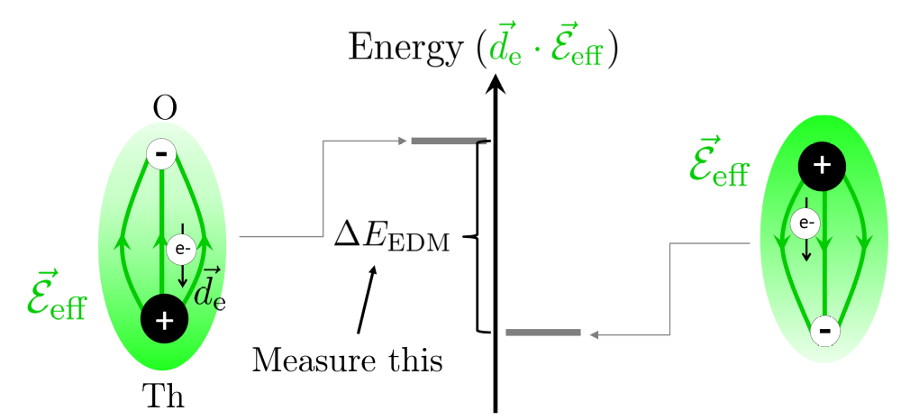

Fundamental idea of electron EDM measurements
An electric dipole moment results in an energy shift in the presence of an electric field, such as the large E-fields present near heavy atomic nuclei.
Apply electric field, reverse, measure the energy splitting between electrons oppositely oriented
relative to the effective molecular field in ThO (84 GV/cm):
http://www.electronedm.org/

Slide 13
Figure is from 2020 USA AMO Decadal survey (Credit: Dave DeMille)
https://www.nationalacademies.org/our-work/decadal-assessment-and-outlook-report-on-atomic-molecular-and-optical-science

Slide 14
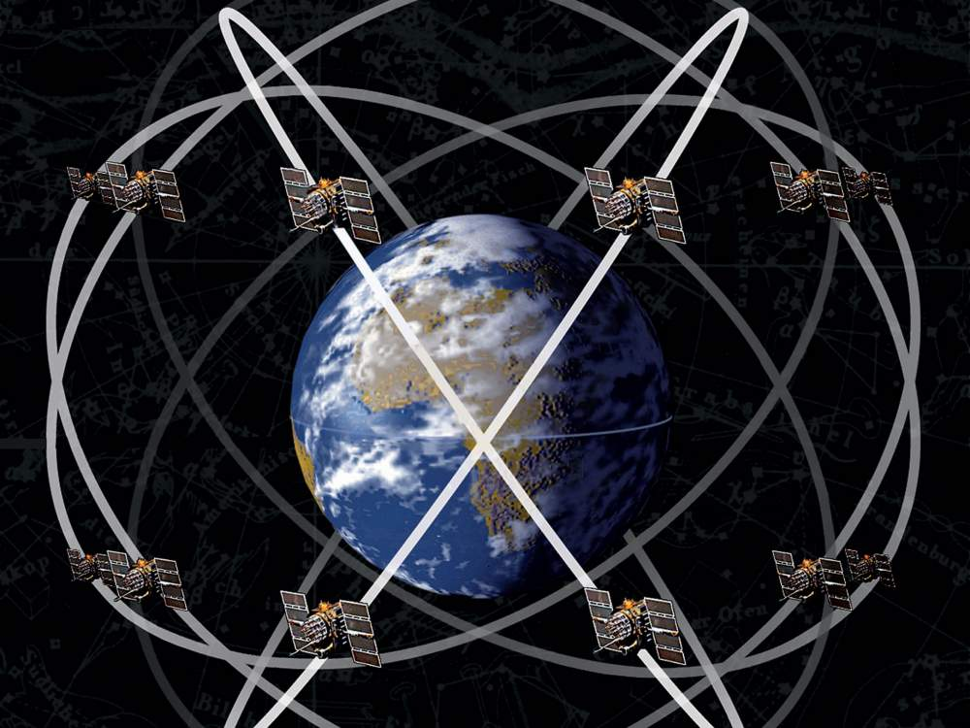
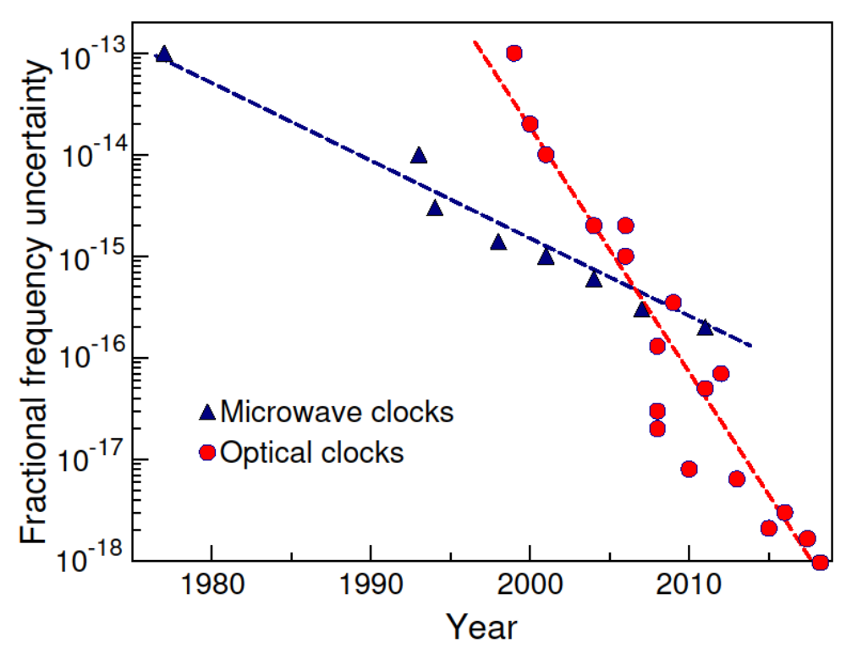
New physics searches with atomic clocks
GPS satellites: microwave
atomic clocks
airandspace.si.edu
Optical atomic clocks will not lose one second in
30 billion years

Slide 15
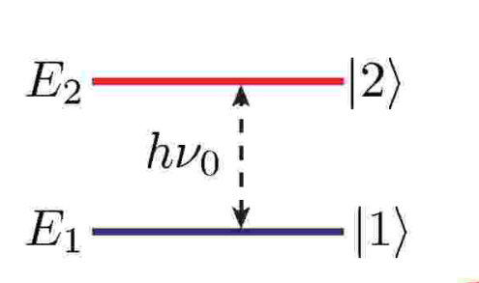

Ingredients for an atomic clock
Atoms are all the same and will oscillate at exactly the same frequency (in the same environment):
you now have a perfect oscillator!
Take a sample of atoms (or just one)
Build a laser and tune it to be in resonance with this atomic frequency
Count cycles of this signal
¹⁷¹Yb⁺
_{ION}
Ludlow et al., RMP 87, 637 (2015)

Slide 16
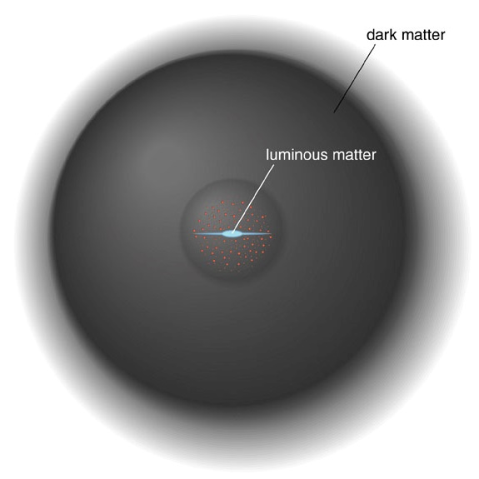
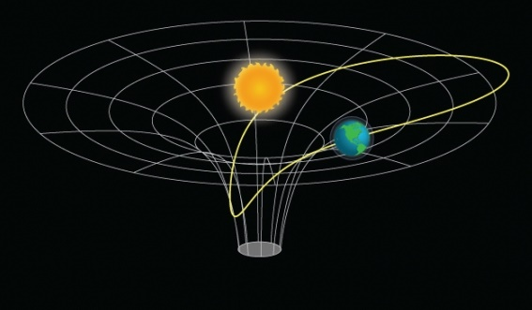
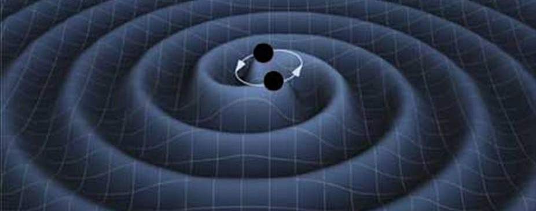
Search for physics beyond the Standard Model with atomic clocks
Dark matter
searches
Image credit: Jun Ye’s group
Search for the violation of Lorentz invariance
Tests of the equivalence principle
α
Image credit: NASA
Are fundamental constants constant?
Gravitational wave detection with
atomic clocks PRD 94, 124043 (2016)

Slide 17
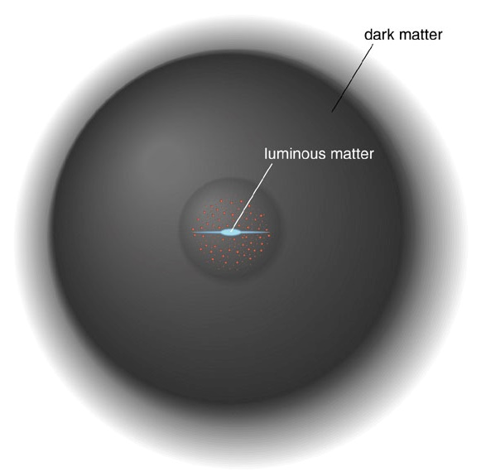
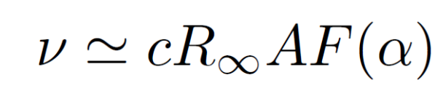
Variation of fundamental constants
Theories with varying dimensionless fundamental constants
String theories
Other theories with extra dimensions
Loop quantum gravity
Dark energy theories: chameleon and quintessence models
…many others
J.-P. Uzan, Living Rev. Relativity 14, 2 (2011)
Dark matter can also cause variation of fundamental constants!
Frequency of optical transitions
depends on the fine-structure constant α.
Tuesday talk
Particle Physics Beyond Colliders:
A theory perspective
Asimina
Arvanitaki
Some clocks are more sensitive to this effect than others
Measure the ratio of two optical clock frequencies to search for the variation of α. Keep doing this for a while.

Slide 18
Slide from Andrew Long’s 2018 LDW talk

Slide 19
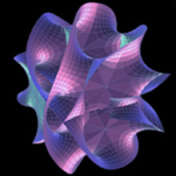
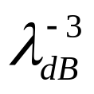
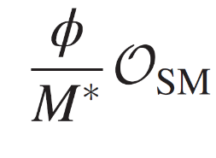
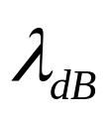
Ultralight dark matter has to be bosonic – Fermi velocity for DM with mass >10 eV is higher than our Galaxy escape velocity.
10⁻²² eV 10⁻¹² eV μeV eV GeV
Simon Knapen, 2018 KITP
Dilatons
Dark matter density in our Galaxy >
is the de Broglie wavelength of the particle.
Then, the scalar dark matter exhibits coherence and behaves
like a wave
A. Arvanitaki et al., PRD 91, 015015 (2015)

Slide 20
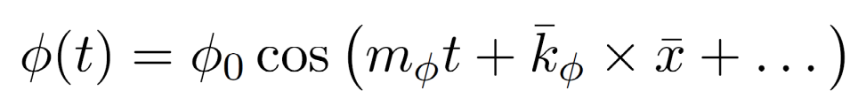
How to detect ultralight dark matter with clocks?
Asimina Arvanitaki, Junwu Huang, and Ken Van Tilburg, PRD 91, 015015 (2015)
10⁻²² eV 10⁻¹² eV μeV eV GeV
Dark matter field
couples to electromagnetic interaction and “normal matter”
It will make fundamental coupling constants and mass ratios oscillate
Atomic energy levels will oscillate so clock frequencies will oscillate
Can be detected with monitoring ratios of clock frequencies over time
(or clock/cavity).

Slide 21
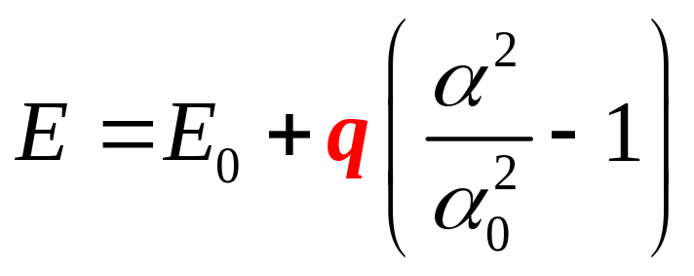
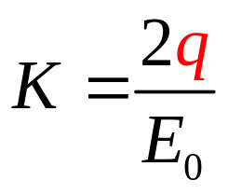
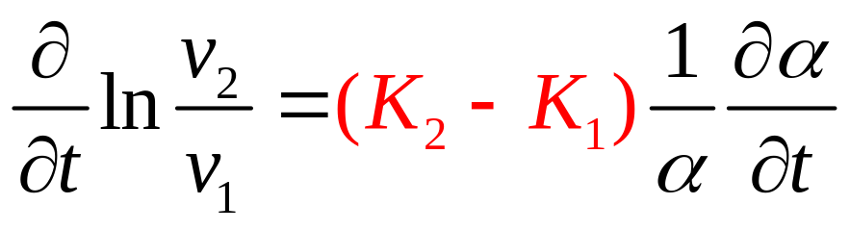
Sensitivity of optical clocks to α-variation/dark matter
Enhancement factor
Can calculate
with high accuracy
Need: large K for at least one for the clocks
Best case: large K₂ and K₁ of opposite sign for clocks 1 and 2
Frequency ratio
accuracy
Test of α-variation
10⁻¹⁸
10⁻²⁰
100
Easier to measure large effects!

Slide 22
To maximize the discovery potential
Need:
most precise clocks
with
(2) largest possible sensitivity factors K to variation of fundamental constants
K=0-6 for present clocks
?
M. S. Safronova, D. Budker, D. DeMille, Derek F. Jackson-Kimball,
A. Derevianko, and Charles W. Clark, Rev. Mod. Phys. 90, 025008 (2018).
Notes:
Raise your hand if you used a GPS

Slide 23
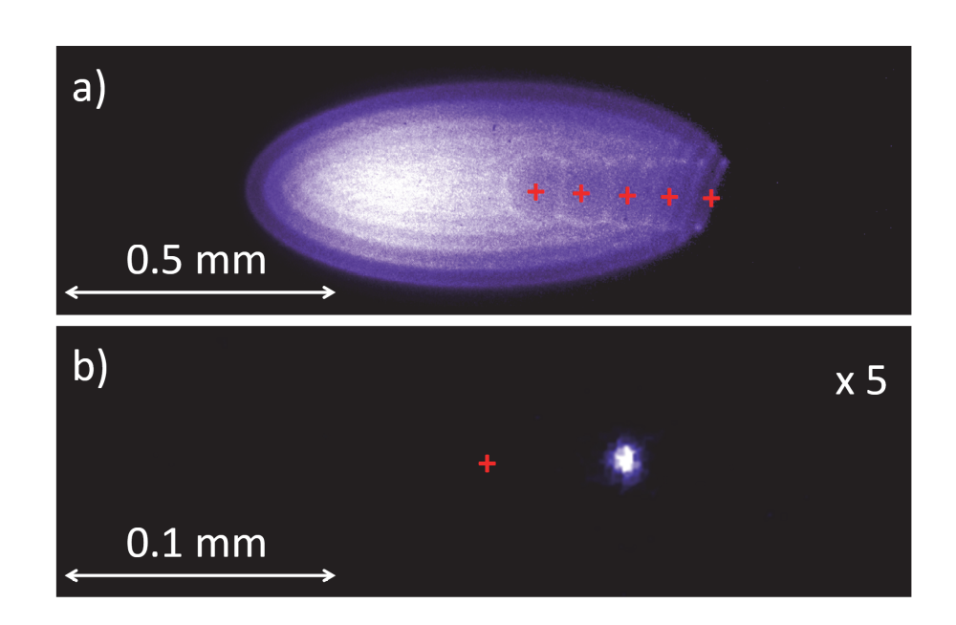
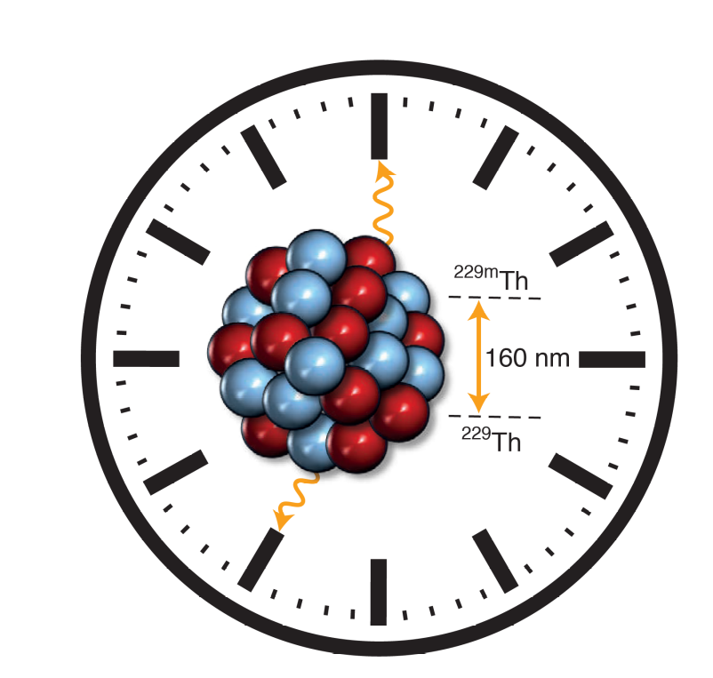
The Future: New Clocks
Science 347, 1233 (2015)
Clocks with ultracold
highly charged ions
First demonstration of quantum logic
spectroscopy at PTB, Germany
Nature 578 (7793), 60 (2020)
Nuclear clock

Slide 24
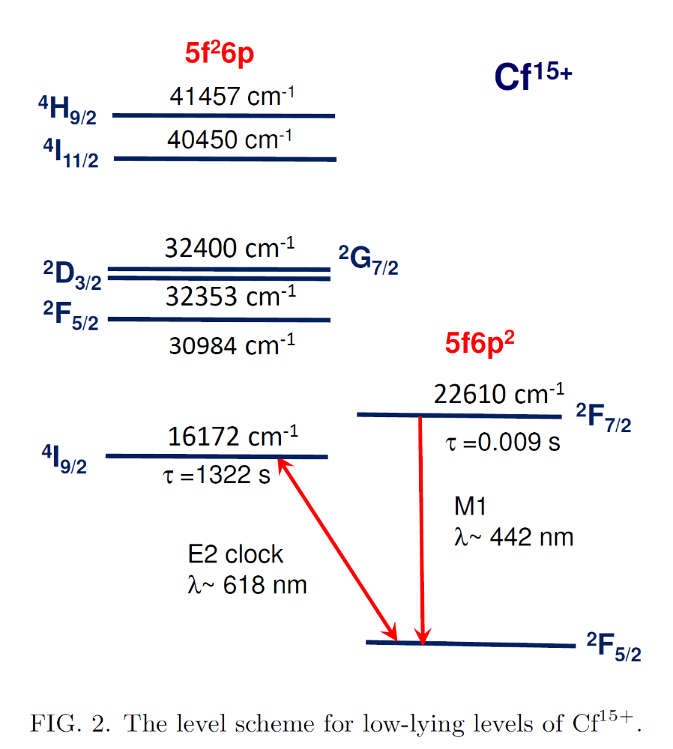
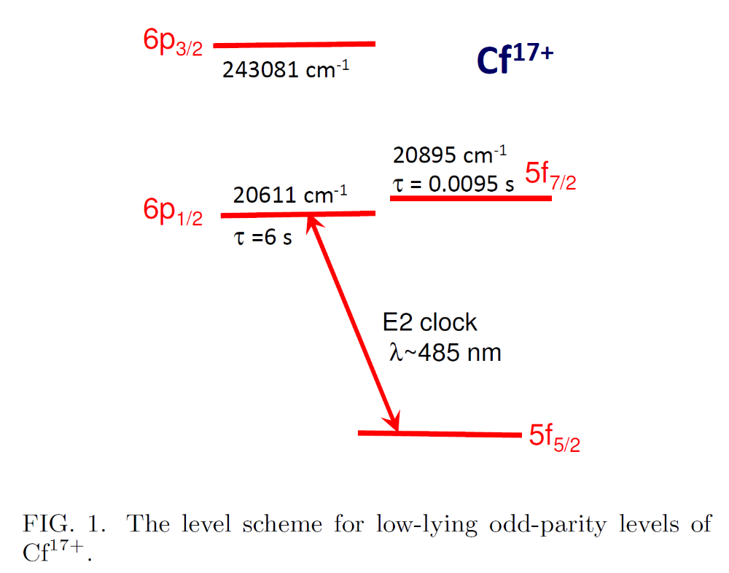
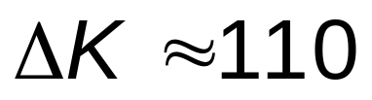
Optical clocks based on the Cf¹⁵⁺ and Cf¹⁷⁺ ions
²⁴⁹Cf I = 9/2 (351 y)
²⁵⁰Cf I = 0 (13.1 y)
²⁵¹Cf I = 1/2 (898 y)
S. G. Porsev, U. I. Safronova, M. S. Safronova, P. O. Schmidt, A. I. Bondarev, M. G. Kozlov, I. I. Tupitsyn, PRA 102, 012802 (2020)

Slide 25
From atomic to nuclear clocks!
Clock based on transitions in atoms
What about transitions in nuclei?
M. S. Safronova, Annalen der Physik 531, 1800364 (2019)

Slide 26
Obvious problem: typical nuclear energy levels are in MeV
Six orders of magnitude from ~few eV we can access by lasers!
MeV
Excited
nuclear
states
Atomic
Nucleus
1.0
0
Ground
state
Only ONE exception!
^{229m}Th
Laser spectroscopic characterization of the nuclear clock isomer ^{229m}Th, Thielking et al., Nature 556, 321 (2018)
Energy of the ²²⁹Th nuclear clock transition
Seiferle et al., Nature 573, 243 (2019)
Nuclear transition
150(3) nm [8.3(2)eV]
Lifetime ~ 5000s
²²⁹Th

Slide 27

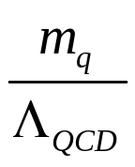
Th nuclear clock: Exceptional sensitivity to new physics
Ground state
Isomer
Thorium nuclear clocks for fundamental tests of physics
8.3eV
Coulomb
energy
Coulomb
energy
GeV scale
Nuclear binding energy
8.3 eV
MeV scale
~ 10⁵
MeV
Thorsten Schumm, TU Wein
Ekkehard Peik, PTB
Peter Thirolf, LMU
Marianna Safronova, UD
Possible 4-5 orders of magnitude enhancement to the variation of α and
but orders of magnitude uncertainty in the enhancement factors.
Provides access to couplings of Standard Model particles to dark matter via other terms besides the d_{e} (E&M), d_{g} (particularly great for detection of relaxions) and d_{mq}
It is crucial to establish actual enhancement!

Slide 28
Great potential for discovery of new physics
Many new physics searches with atoms and molecules need or will benefit from the use of radioactive isotopes
Large enhancements of new physics signals
Unique sensitivities (such as in a nuclear clock)
Need more isotopes (4 or more even isotopes) for new force searches
Unique experimental opportunities (search for sterile neutrinos with trapped radioactive atoms)
Other applications: quantum information with radioactive qubits (need I=1/2)
Significant recent improvements in atomic theory & precision laser spectroscopy for the extraction of nuclear properties (nuclear moments, nucleir radii changes, etc.)

