Slide 1
Variant 1: Add 2nd RFQ (150keV/u)
Pros for RFQ2 | Cons for RFQ2
Adds redundancy to acceleration | Takes effort and RFQ1 is reliable
May design for capture >80% | But, longitudinal emittance will grow
Increase space charge threshold >10micA | Depends almost exclusively on EBIS for all masses
Helps train HQP | Needs new building
150keV/u
RFQ2
DTL
S0
A/q≤6.5
A/q≤6.5
RFQ1
A/q≤30
 | RFQ1 | RFQ2
Injection Energy (keV/u) | 2.04 | 2.04
Extraction energy (keV/u) | 153 | 153
capture (3 harmonic) % | 80 | 80-100
min A | 2 | 2
max A | 30 | 6.5
long emit (keV/u-ns) | 0.5 | ???
max Veff (MV) | 4.53 | 1.06
EBIS
1+ ions

Slide 2
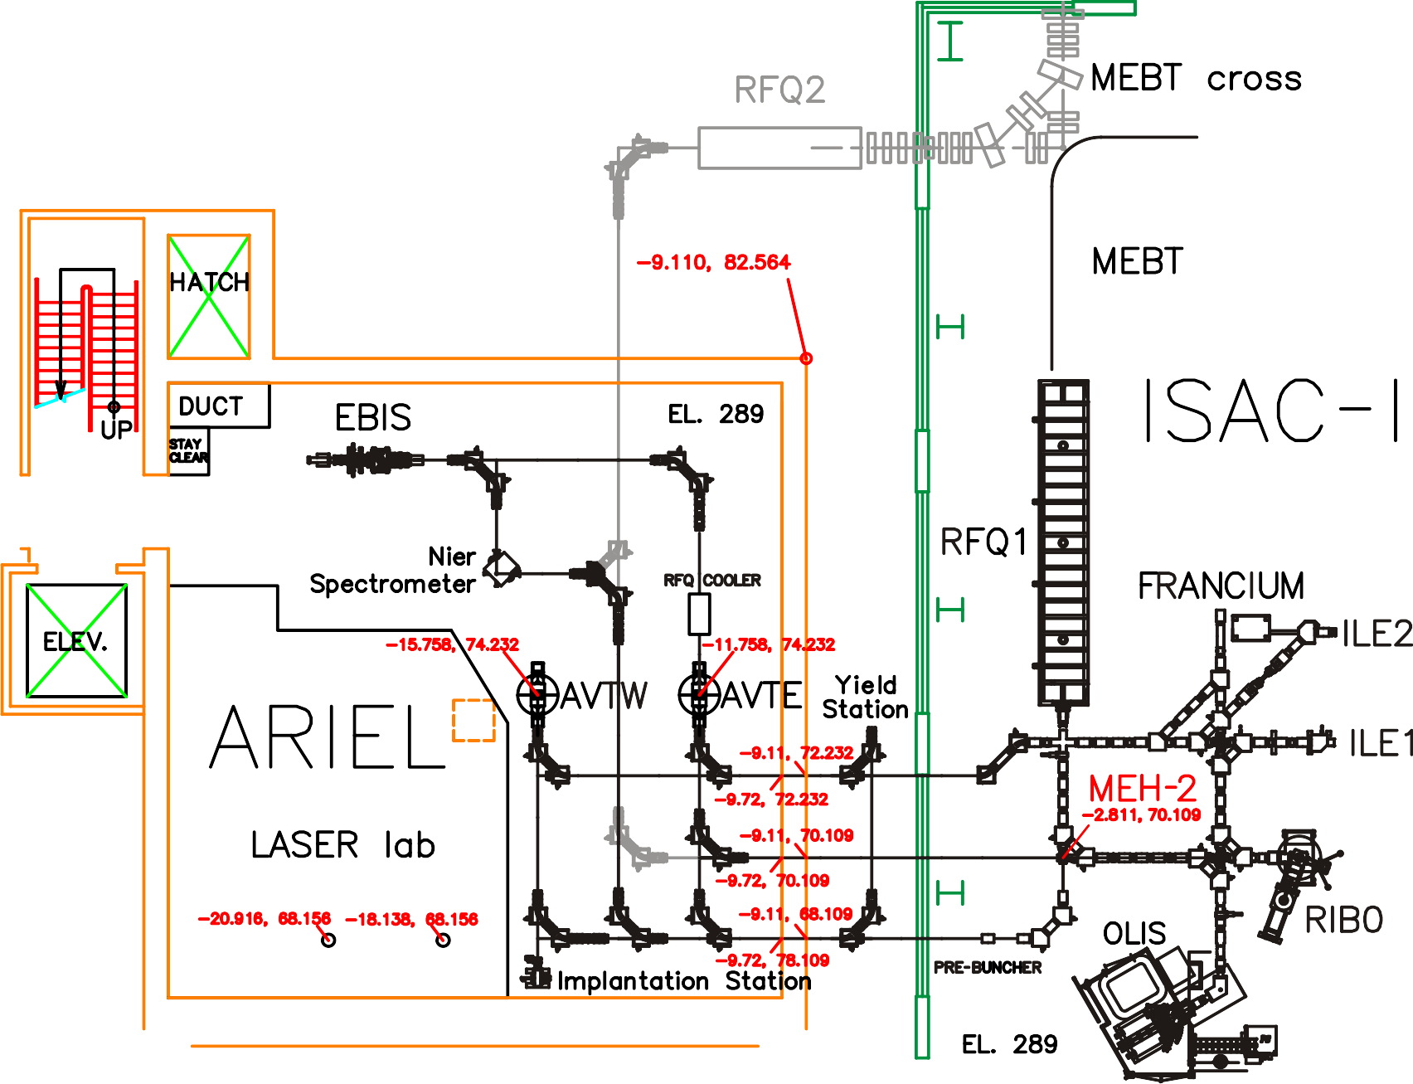
Adding 2nd RFQ (150keV/u)
Lacks a strong motivation without 2nd accelerator path
RFQ1 can be injected with 1+ or EBIS beam up to A<30 so will ~match efficiency of RFQ2 for A>30 and match/better RFQ2 for 7<A<30
RFQ2 could be designed to increase capture above 80% but this would increase longitudinal emittance – capture in DTL may be impacted plus beam quality at user
could be designed to increase space charge threshold above 10micA (present RFQ1 limit)
RFQ2
DTL
2

Slide 3
Variant 2: Add 2nd RFQ (400keV/u)
RFQ3 would inject directly into SCA low beta cryomodule at 400keV/u for 2nd accelerator path
400keV/u
1.5MeV/u
Pros for RFQ3 | Cons for RFQ3
RFQ3 coupled with SCA adds 2nd accelerator path | Some loss in flexibility from initial scheme – EBIS only for 2nd path
Fits in vault, needs only modest enclosure and frees up new LE area
RFQ3
SCA
SCB
A/q≤7
150keV/u
DTL
S0
RFQ1
 | RFQ3 | SCA
Injection Energy (keV/u) | 2.04 | 400
Extraction energy (keV/u) | 400 | 1500
capture (3 harmonic) % | 80 | 100
min A | 2 | 2
max A | 7 | 7
long emit (keV/u-ns) | ~0.5 | ~0.5
max V_{eff} (MV) | 2.8 | 7
Length (m) | 5 | 3.2
A/q≤30
EBIS
1+ ions

Slide 4
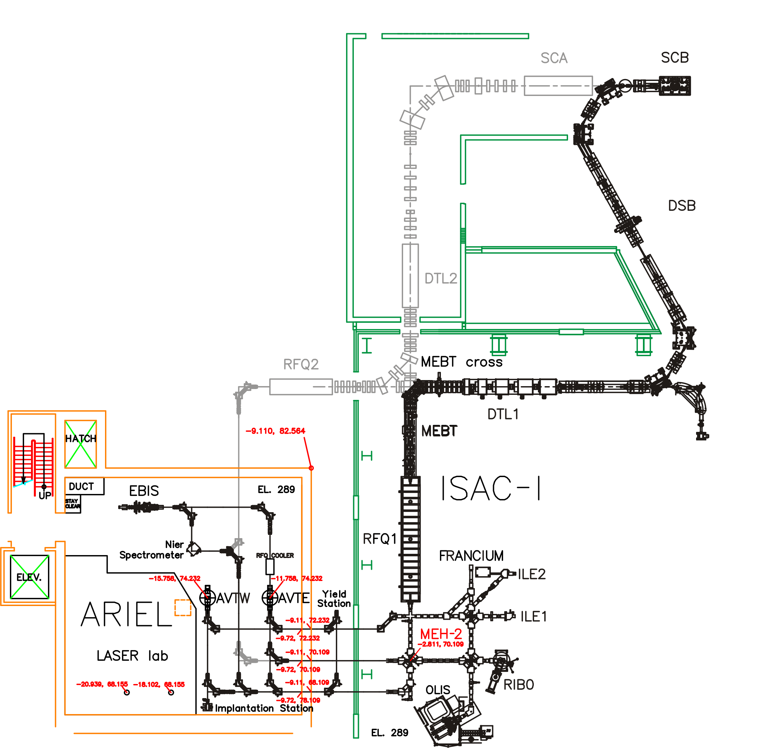
Adding 2nd RFQ to 400keV/u and SCA
LE beamline to new LE area – modest enclosure
New RFQ tailored for A/Q from 2 to 7 (EBIS) with output energy compatible with SCA injection (400keV/u) – similar in size to FRIB RFQ – overcomes any DTL bottleneck in A/Q
New “SCA” CM (7 cavities @ 4.1% and 70MHz)
2 independent post-accelerated RIB beams
Could increase space charge limit for deuterons/alphas (U. Koester talk) but vault shielding would be an issue
18 m
SCC
RFQ2
SCA
LE experiment
HE
ME
LE1
APTW
AETE
ITW
ITE
4

Slide 5
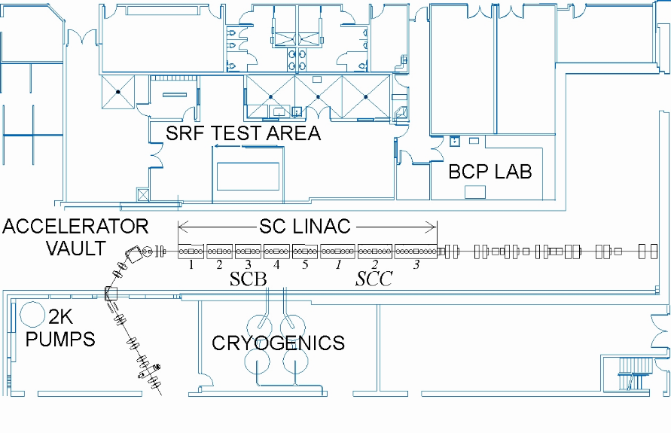
ISAC-II After-burner
Upgrade SCB/SCC cavities by degassing and cables (Z. Yao talk)
Add a high performing cryomodule with 8 cavities at beta=0.14 and f=106MHz
Gain is 2MV/cavity or 16MV for the cryomodule
Add a stripping foil between present ISAC-II and new CM to get to 2<A/q<3.5 depending on A – all masses >10MeV/u
strip
 | SCD
Transmission | 100
min A | 2
max A | 7
long emit (keV/u-ns) | ~0.5
max Veff (MV) | 16
Length (m) | 4.2

Slide 6
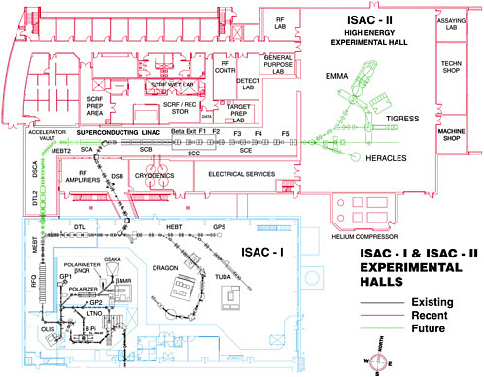
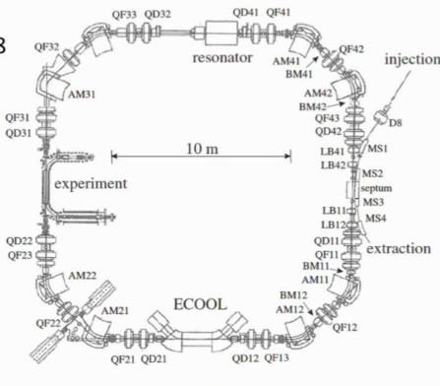
Adding storage ring to ISAC-II
The new 2nd line would feed ISAC-II experiments and could feed a storage ring like TSR
Beam delivery would be independent of Dragon operation
TSR
EBIS

Slide 7


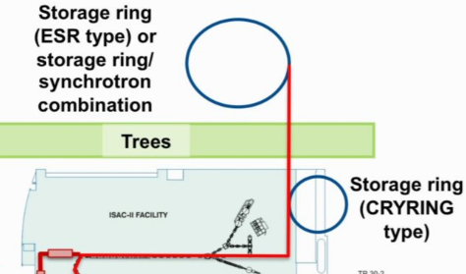
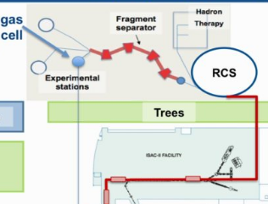
Ring schemes in ISAC-II
Here are additional ring schemes from Oliver’s 2017 Science Week presentation
Storage ring (TSR, CRYRING, ESR) with ISAC-II as injector
Storage ring – synchrotron combo to 450MeV/u, ISAC-II as injector with afterburner
Rapid cycling synchrotron for therapy and fragmentation – with after burner
ISAC-II
ISAC-II

