Slide 1
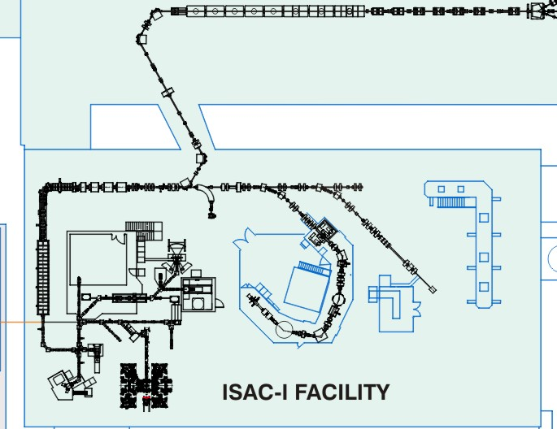
ISAC low energy area optimization
Possible new
low energy area
β-NMR
β-NQR
Osaka
(Polaris)
TTITAN
Francium
low energy beam from ARIEL
Possible new
low energy area
Yield
Griffin

