Slide 1
Quantum Computing and Machine Learning Parallel Summary
Olivia Di Matteo, Wojtek Fedorko

Slide 2
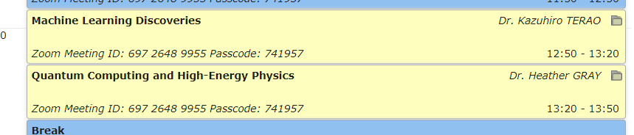
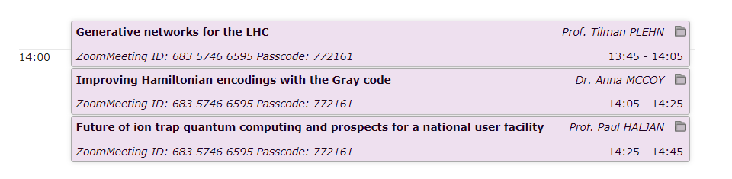
ML and QC talks this week
Aimed to inspire non-obvious uses of ML and QC
Parallel session showcasing specific science applications of ML and QC
Indicative of how we might be applying these technologies going into the future
Not just cats VS dogs:
from experimental design and control to on-line ML, science–domain ML
Generative Model Applications:
-dataset ‘amplification’, Matrix Element, Unfolding
QC for HEP: parton shower simulations, tracking/Quantum Associative Memory, QML
Efficient formulation of quantum many body problem for NISQ devices
Ion trapping QC, strategies for scaling up QCCD, MUSIQC
Case for establishing TRIUMF as a center for QC
Q: ‘When will QC be useful’
A: ‘We will know within 5 years whether it will be’

Slide 3
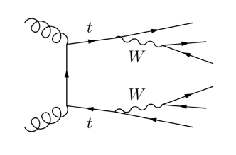
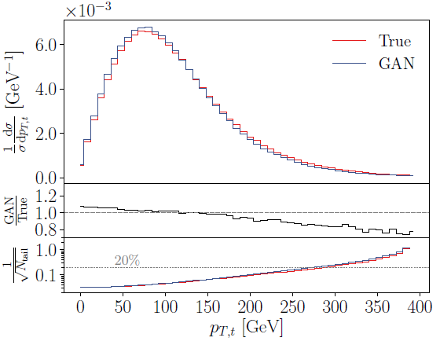
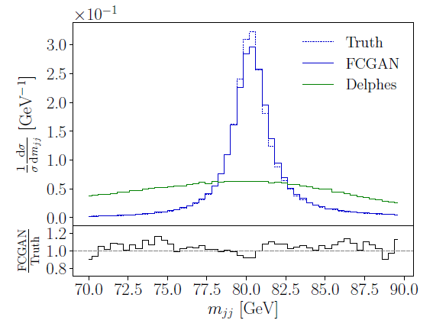
Doing (LHC) science with Generative Adversarial Networks
Matrix Element with GAN
Unfolding with GAN

Slide 4
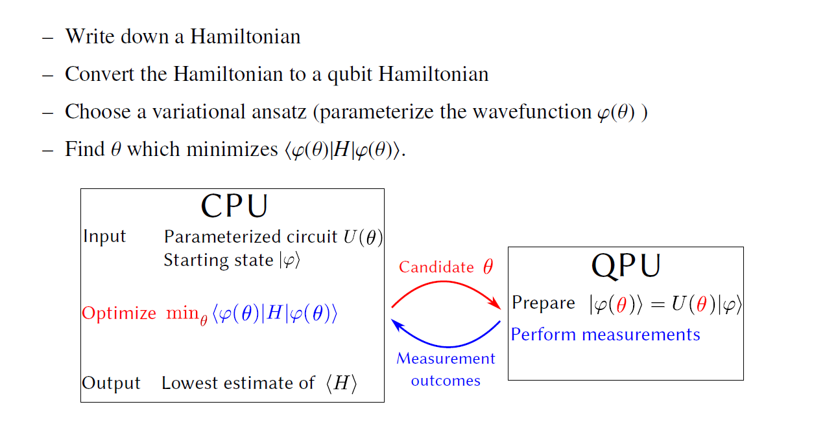
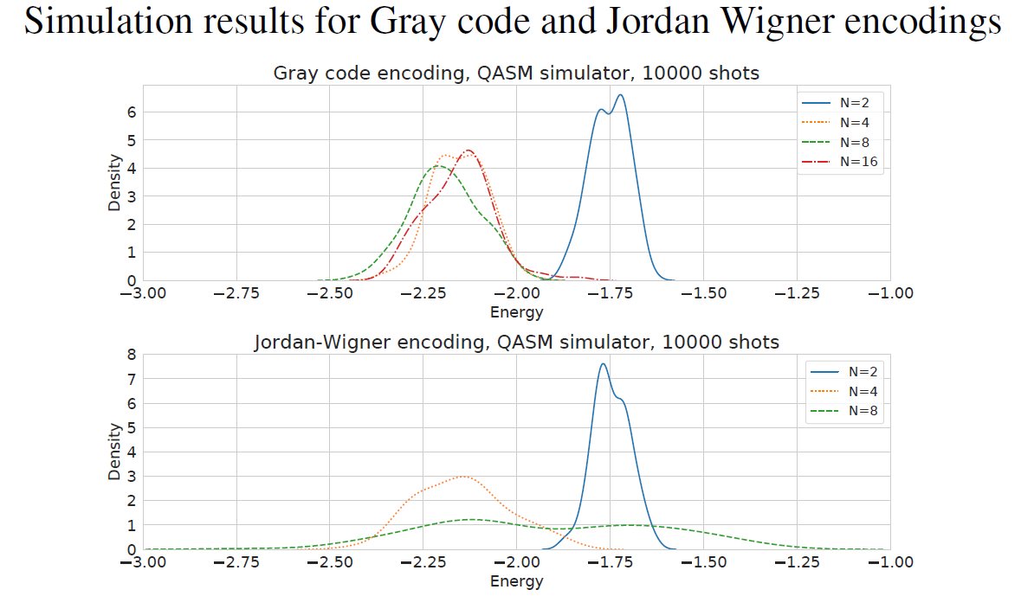
Variational Quantum Eigensolver with clever state encoding

Slide 5
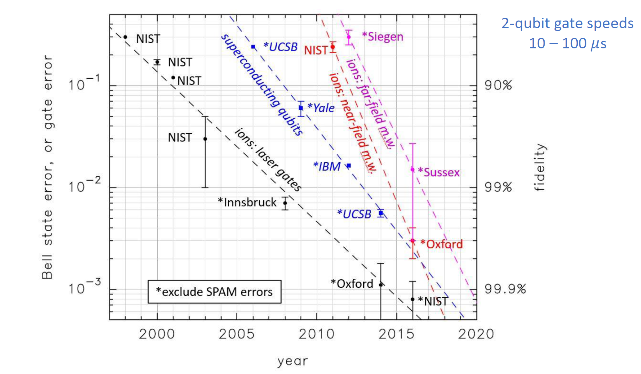
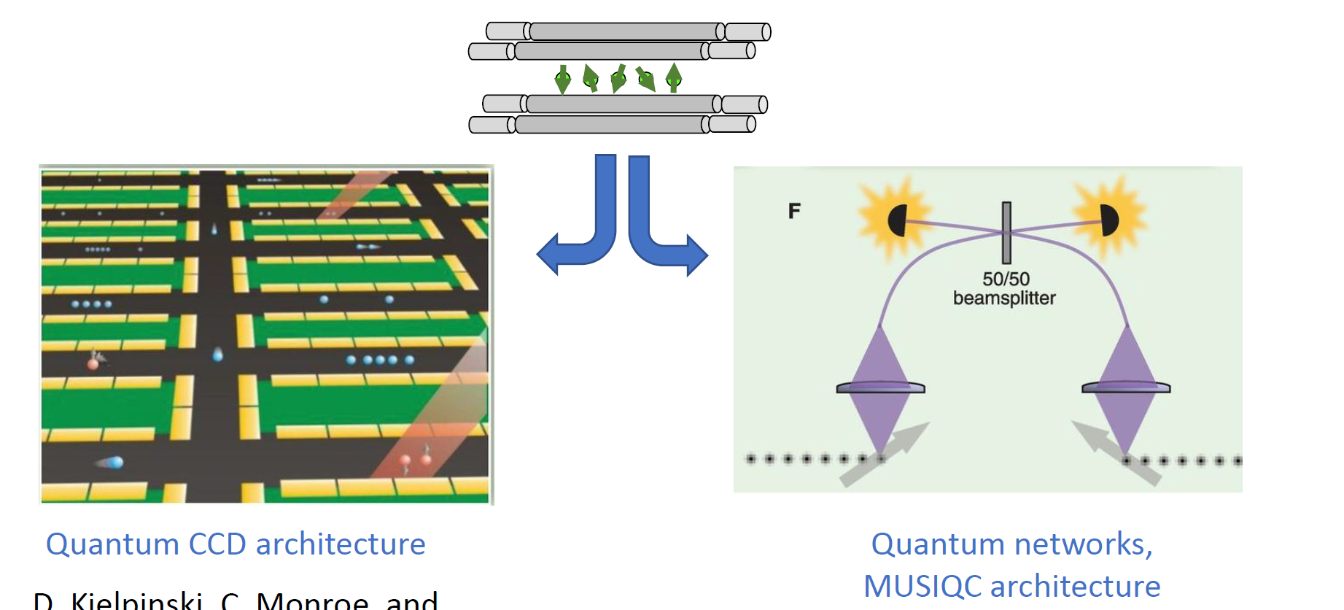
Trapped Ion QC
Progress and comparison to different implementations
Strategies for scaling Ion Trap based QC
Advantages of ion trap QC at TRIUMF:
Good qubits!
The Canadian Advantage: Timely, hands on access to gate based quantum computing hardware, complementing Dwave Xanadu
Local hardware/software network QAI, Quantum BC
Cost Advantage: Leverage local expertise; modest initial investment
User Facility

Slide 6
Discussions
Vision for building up QC and ML expertise, potentially modelled on existing centers e.g. QSCOUT (Sandia), HAICU (Helmholtz), DS teams at SLAC etc.
trapped ion quantum computer (P. Haljan talk)
Worth providing access to modest size device (~10qubits) with scaling path towards ~20
Extend existing machine learning platform to local/national resource
Need exemplified by numerous on-going projects
Current and future ML and QC applications for enhancing science output showcased this week
Leverage synergies between different divisions and research areas

Slide 7
ML at TRIUMF and beyond
ML already playing a big role in research at TRIUMF and wider community. Existing projects (talks throughout the week) in:
  Particle & nuclear physics
  Computational chemistry
  Accelerator physics
  Materials science
  ...

Slide 8
Past and on going events and training activities
Workshop 28 November 2019: Exploring expansion possibilities at TRIUMF to include quantum techniques and applications https://meetings.triumf.ca/indico/event/95/
  Strong endorsement from community for a user facility to be hosted at TRIUMF
Training opportunities:
  Cornerstone Models of QC
  TSI 2020 → 2021
  DS/QC study group
  …

