Slide 1
TRIUMF accelerator expertise in international projects
Bob Laxdal (for Accelerator Division)
TRIUMF Science Week Aug. 17, 2020

Slide 2
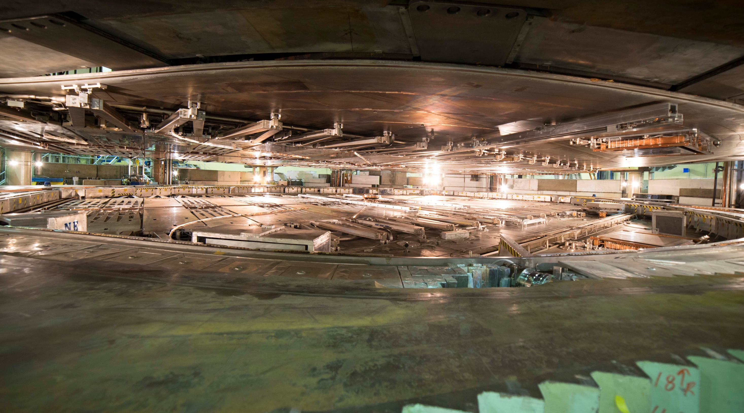
TRIUMF has five decades of experience in building a rich particle accelerator infrastructure that enables cutting-edge research while growing accelerator expertise.
Our mission is to serve as Canada’s particle accelerator centre.

Slide 3
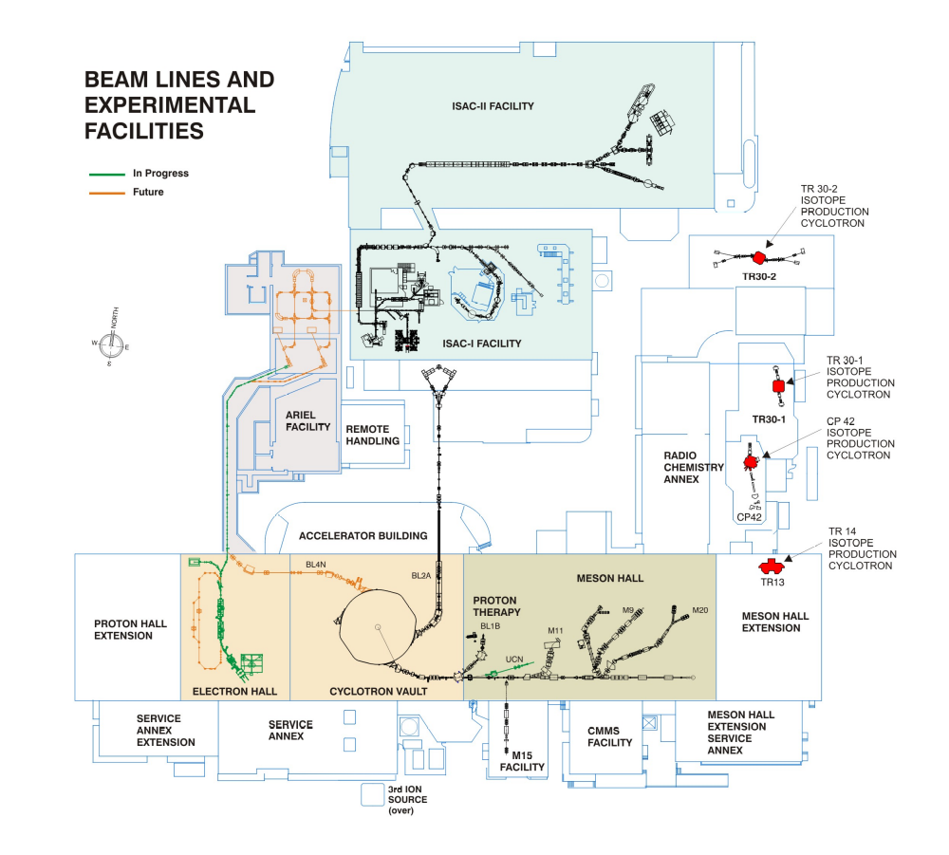
ISAC-II
High energy
This mission is reflected in the wide variety of accelerator technologies that populate the campus.
Our strategy is to use internal projects and external collaborations as springboards to expand core competencies or gain new ones.
Rather than import technology, we typically develop it, accumulating a broad expertise within a relatively small lab.
ARIEL
ISAC-I
Low and
medium
energy
Cyclotrons
for medical
Isotope
production
520 MeV
Cyclotron

Slide 4
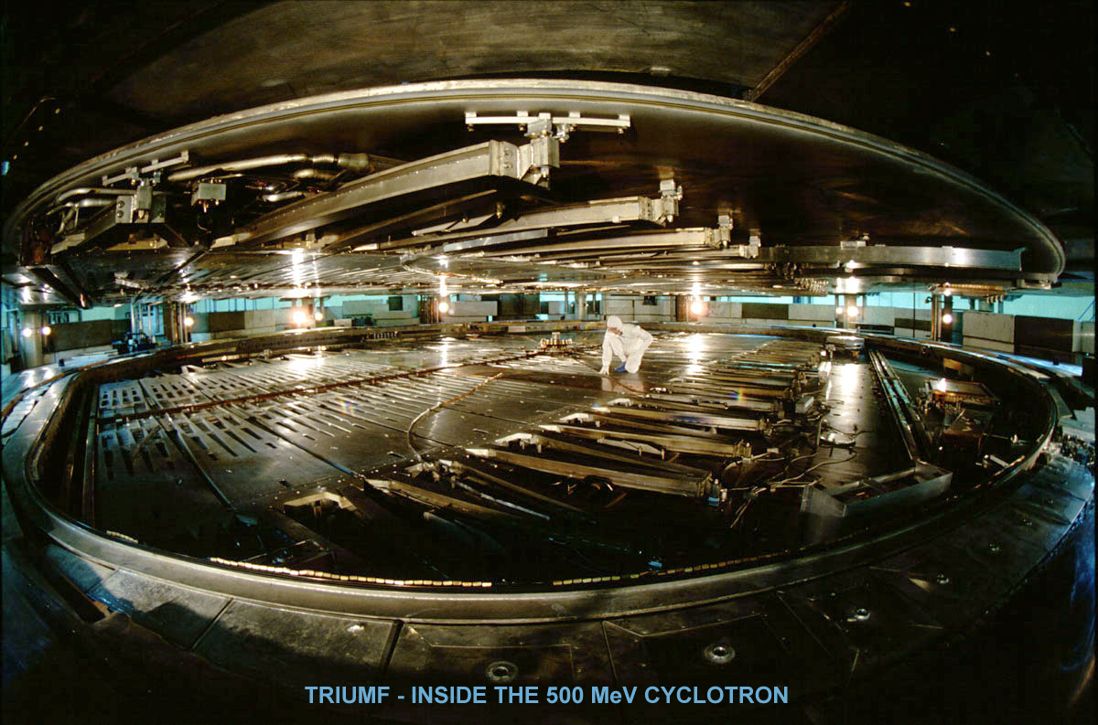
H- Cyclotrons – our first major core competence – also gave us experience in high power rf, high power targets, electrostatic and magnetic beamlines, remote handling, high intensity sources, physics of space charge dominated proton beams

Slide 5
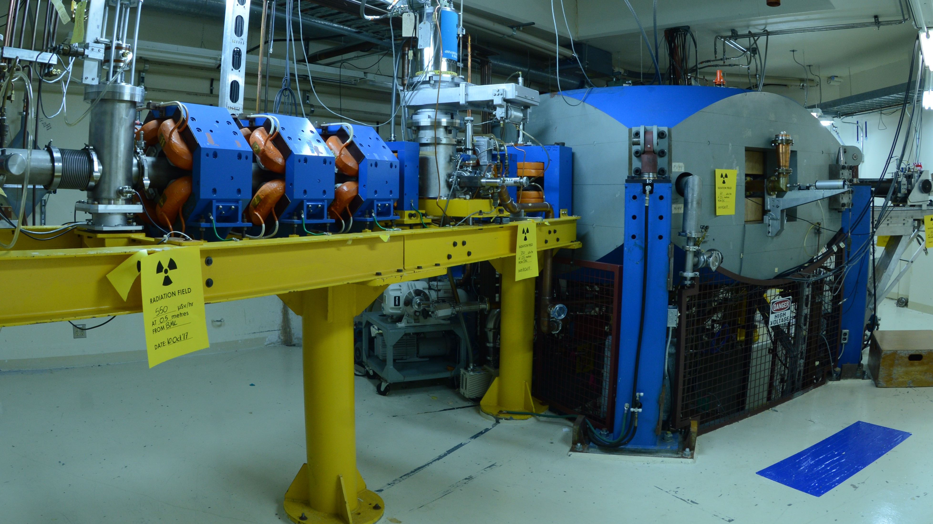
KAON Factory
TR30 Cyclotron
H- Cyclotrons – this core competence was enhanced in the late 80s with the decision to develop the TR30 and TR13 industrial cyclotrons with EBCO (now ACSI)

Slide 6
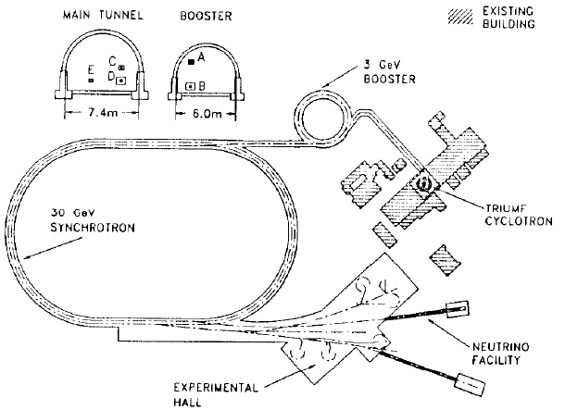
KAON Factory Proposal (1985-1995) – significantly enhanced our skill set – synchrotron design, high intensity beam dynamics, pulsed HV systems

Slide 7
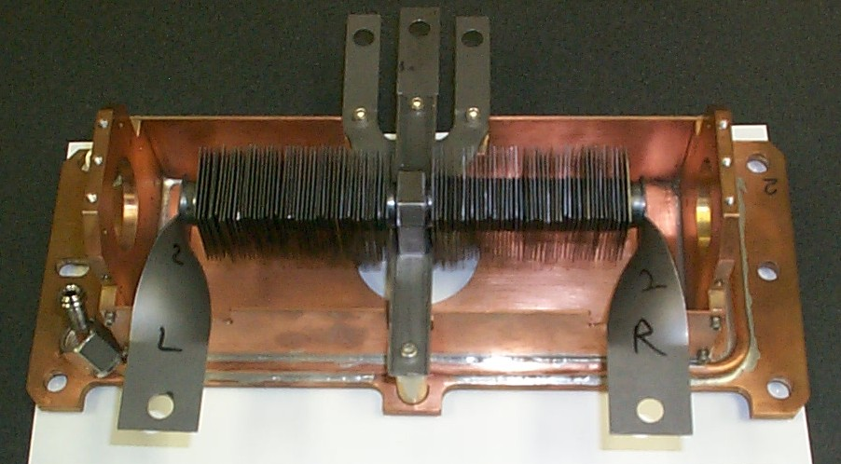
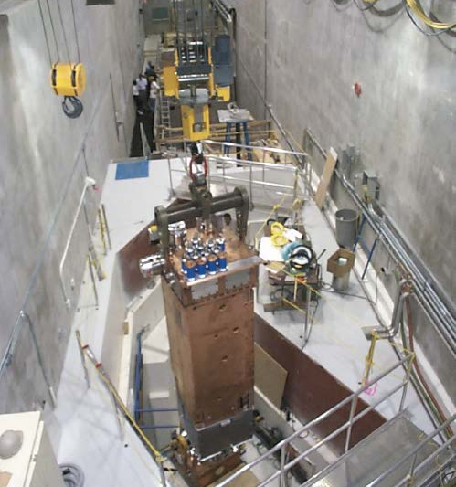
ISAC (1995 - present)
ISAC marked a renaissance
for Accelerator physics and technology at TRIUMF
high power RIB targets,
remote handling,
ISOL ion sources,
laser ion sources,
electrostatic optics,
beam diagnostics for low intensity beams,
ISAC Target Hall

Slide 8
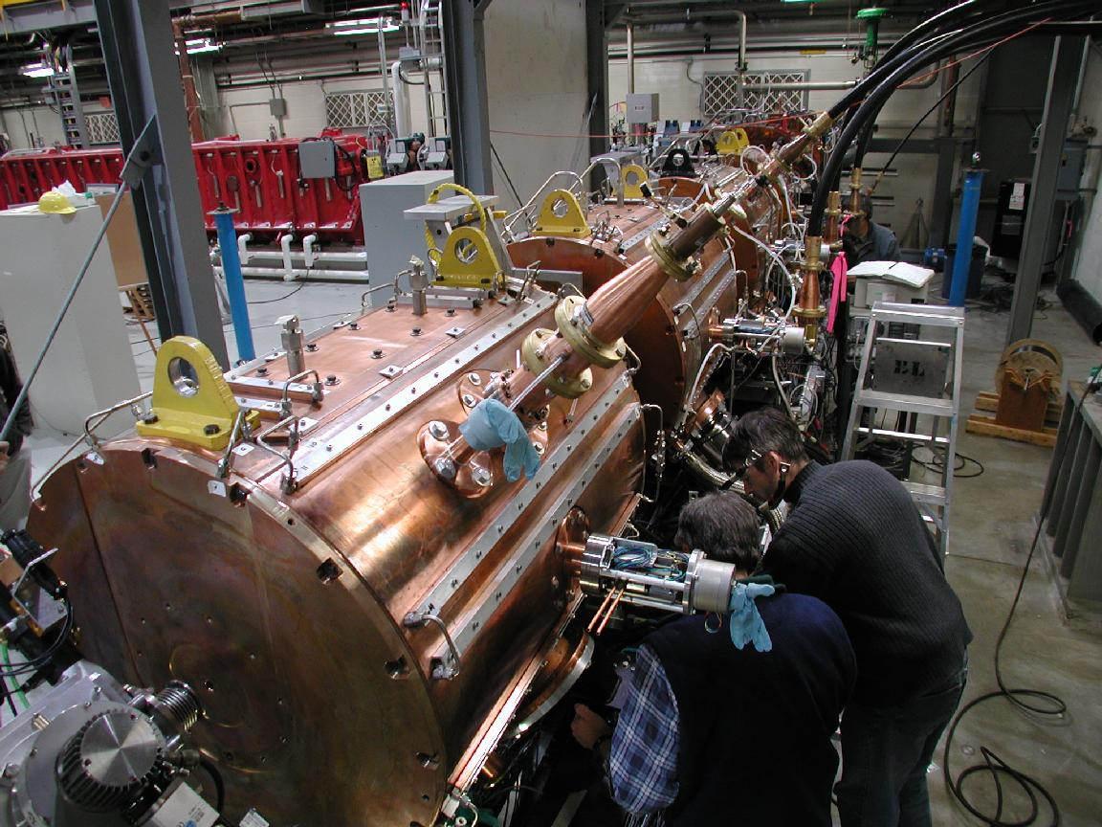
ISAC Post accelerator (1995-2001)
Room temperature linac design and fabrication for heavy ions
ISAC RF Quadrupole
ISAC Drift Tube Linac
RF bunchers/choppers
Low level rf (LLRF) systems
High power rf amplifiers
ISAC DTL with RFQ in the background

Slide 9
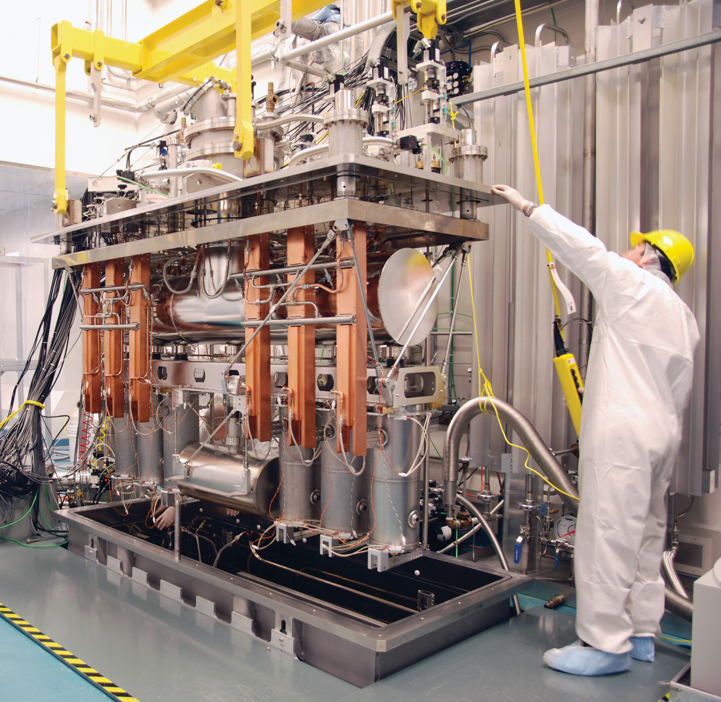
ISAC-II Post accelerator
(2001-2010)
Superconducting RF technology for heavy ions
Cryomodule design and assembly
Design and operation of cryogenic systems
ECR Charge breeders
ISAC-II Cryomodule

Slide 10
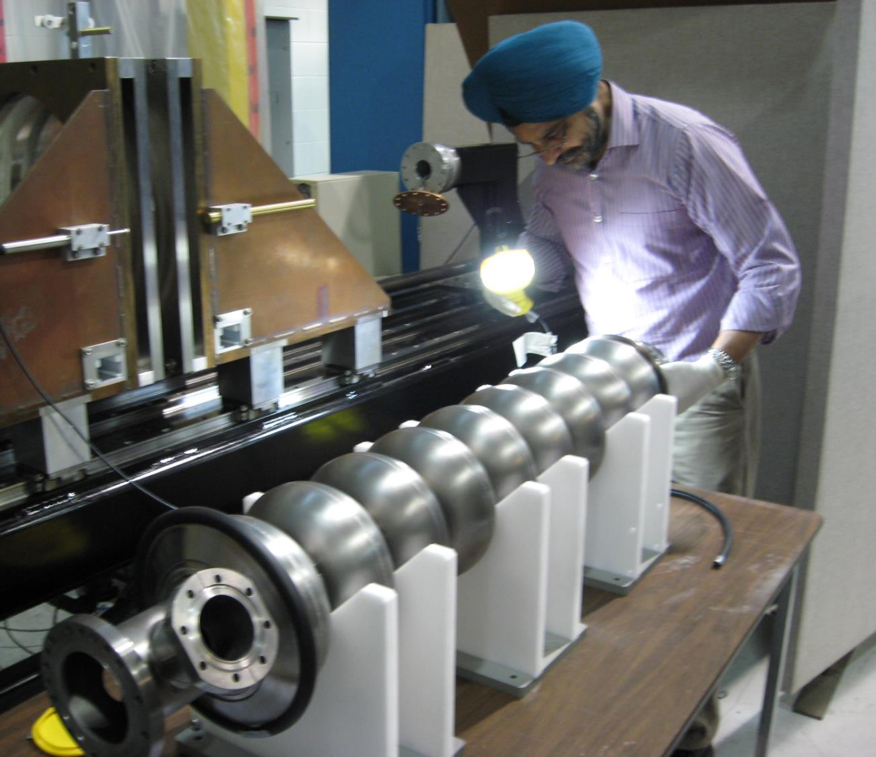
ARIEL e-Linac (2008-2014)
Superconducting RF technology for electrons
High Voltage DC gun
Beam physics of high intensity electrons
High Intensity beam diagnostics
High power klystrons

Slide 11
ARIEL Phase II (2014-present)
High power target design for electrons
ISOL systems
EBIS Charge breeding
Remote handling
High resolution spectrometers
Machine protection systems

Slide 12
Accelerator research at TRIUMF
  The legacy from this on-going development is diverse cutting-edge infrastructure and staff with expertise in a wide range of technologies
  Accelerator science at TRIUMF provides Canada with a world-class platform in
    beam physics and instrumentation
    secondary particle production, and
    SRF technologies.
  Accelerator science supports the high performance and availability of TRIUMF’s accelerator complex, new projects like ARIEL, the training of HQP, and international projects and collaborations.

Slide 13
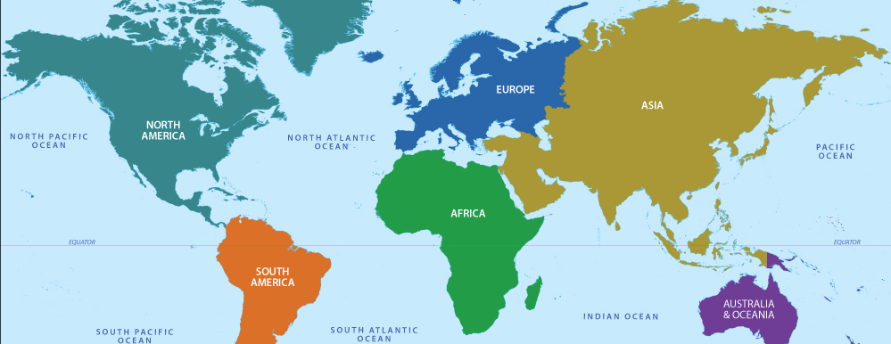
Collaboration map
TRIUMF accelerator scientists are engaged in a number of international collaborations. The international projects aid the community but also nurture our internal expertise while training HQP.

Slide 14
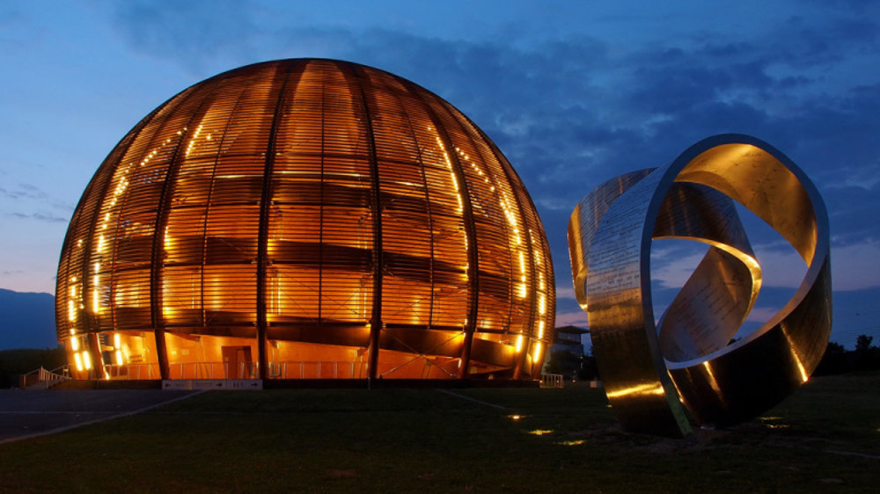
CERN
TRIUMF has had an active engagement with CERN historically with important contributions to LEP, the LHC and ISOLDE.
This continues in the FYP through collaborations and contributions towards LHC, Hi-Lumi , ISOLDE and AWAKE:
Crab cavity cryomodules,
Beam physics,
RIB technology
Beam diagnostics

Slide 15
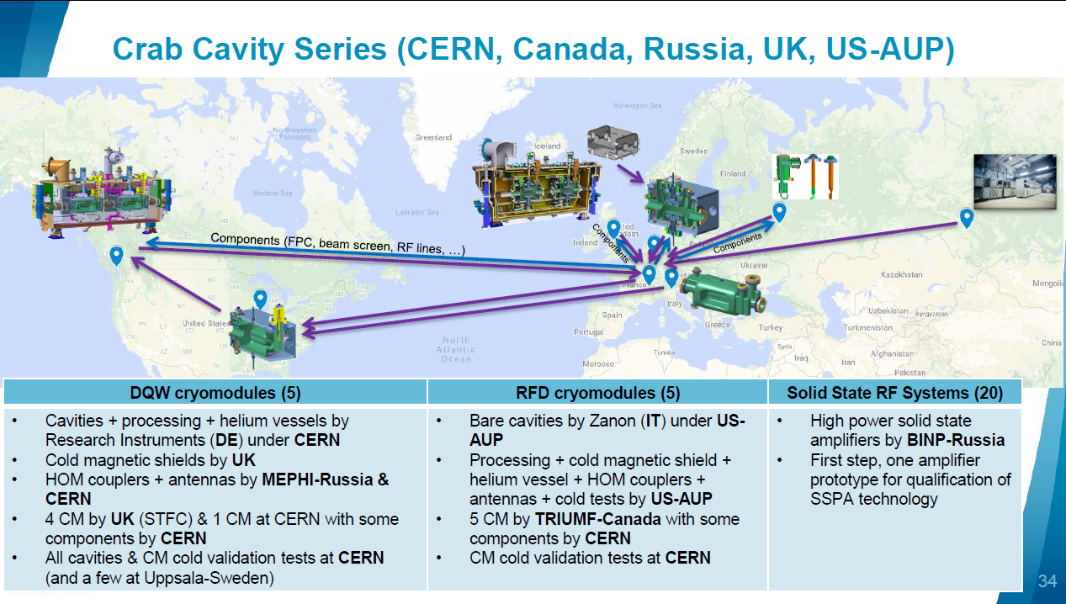
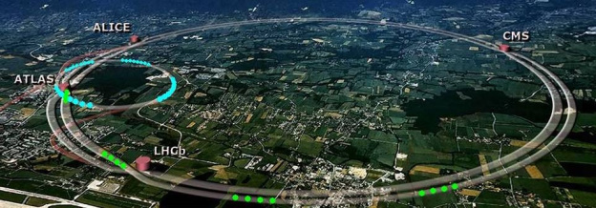
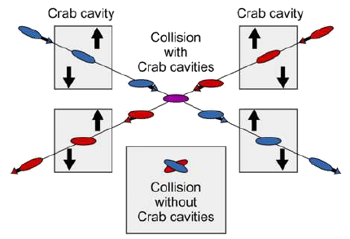
Hi-Lumi Crab Cavities will increase luminosity by skewing the intersecting beams longitudinally at ATLAS and CMS – collaboration with CERN, Russia, UK, USA

Slide 16
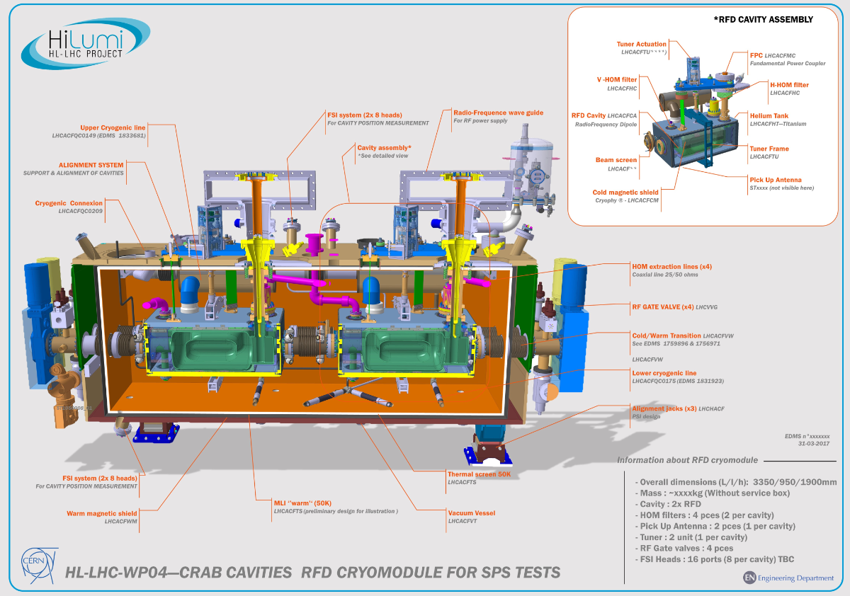
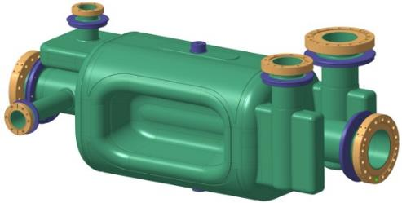



HL-LHC Crab Cavity Cryomodules – TRIUMF scope
TRIUMF is funded to supply five crab cavity cryomodules to the Hi-Lumi upgrade at CERN
The design is a collaboration between CERN, UK and TRIUMF
TRIUMF will receive 10 RF Dipole cavities from US collaboration
TRIUMF will produce and qualify the cryomodules before shipping to CERN
The project advances Canadian core competencies in superconducting rf technologies and supplies critical infrastructure to CERN, supporting both the HL-LHC and the Canadian IPP community
16

Slide 17
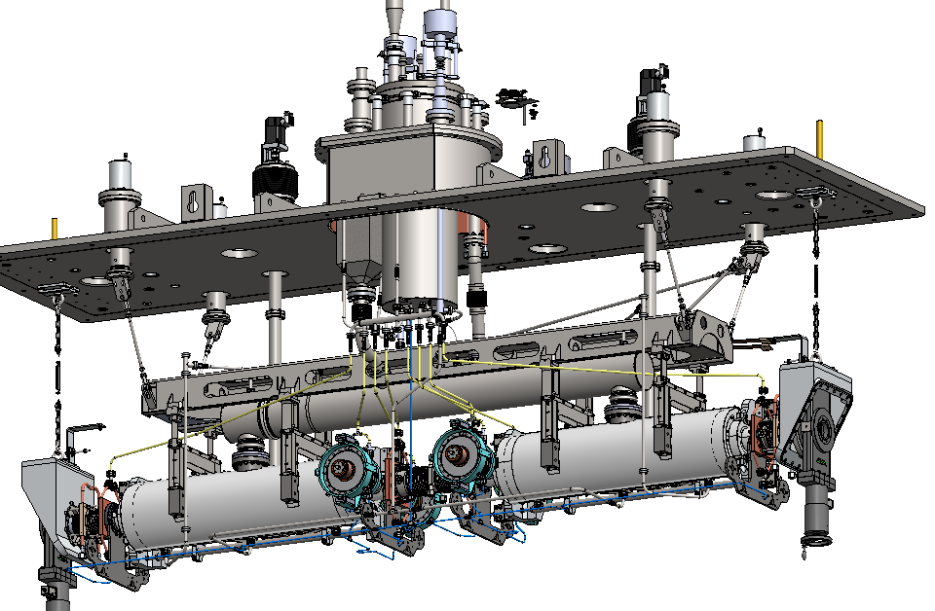
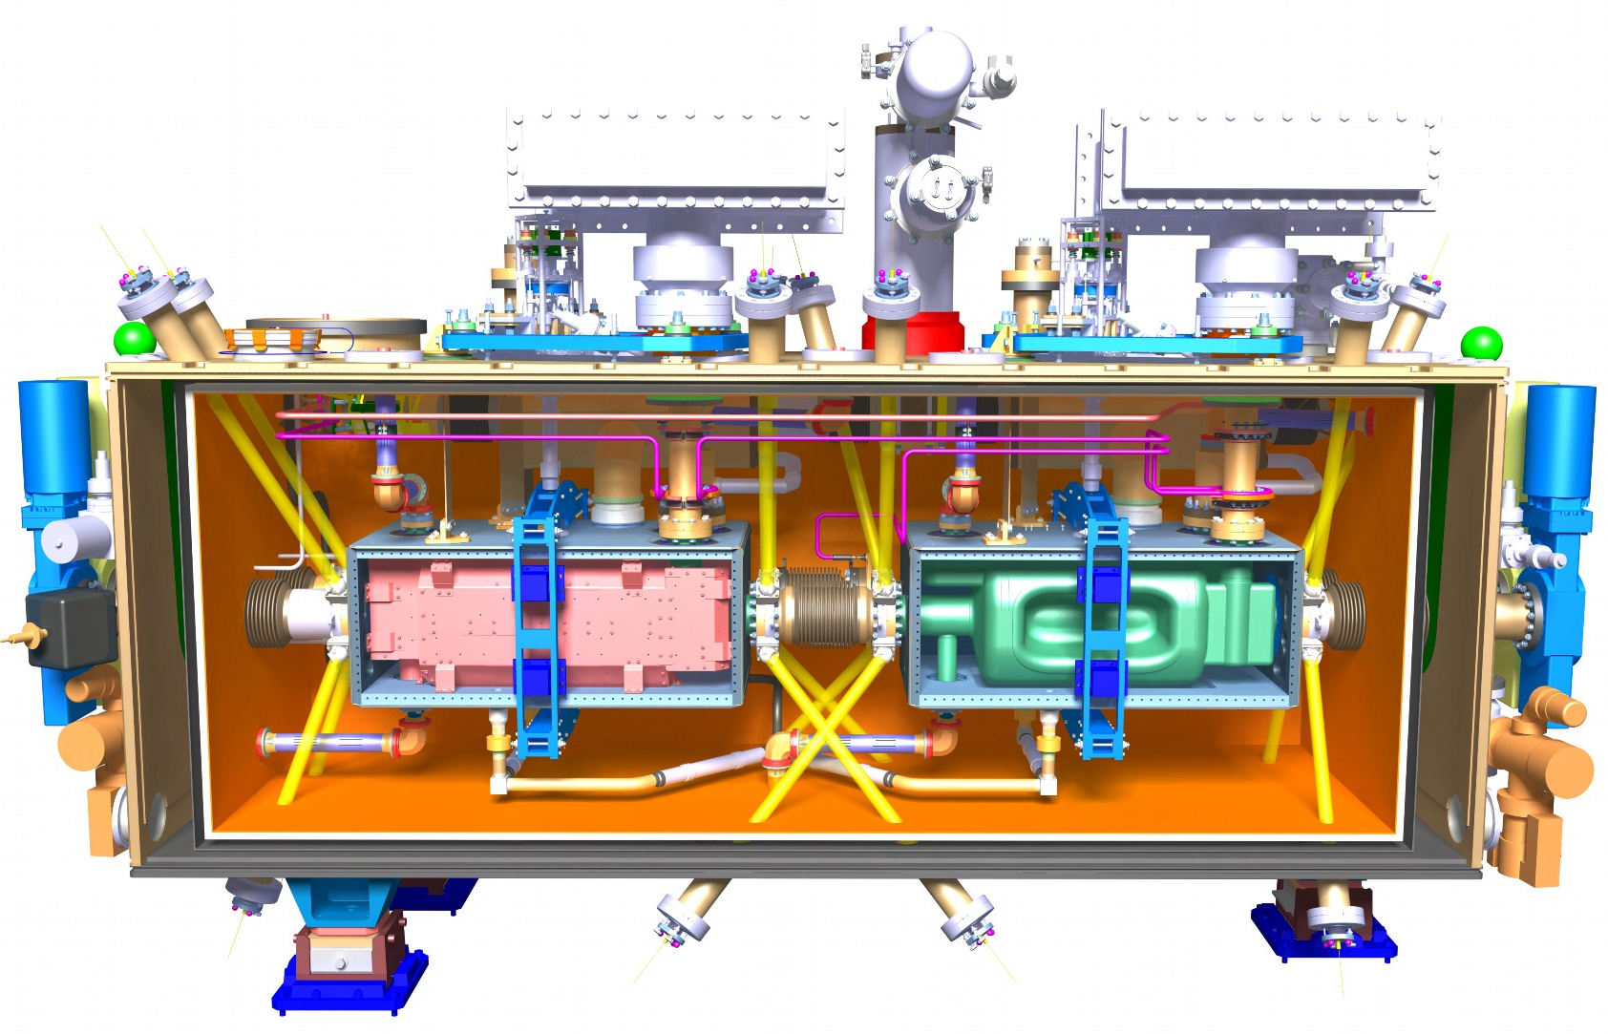
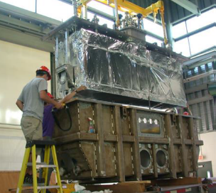
Hi-Lumi Cryomodule vs ARIEL
4K phase separator
Tuner motor
4K-2K Cryoinsert
Support Post
Heat exchanger
Strongback
WPM bracket
Power coupler
The Hi-Lumi cryomodule design borrows from the ARIEL e-Linac module developed and fabricated at TRIUMF.
A prototype will be assembled in 2021 and series production at TRIUMF will span 2022-24
ARIEL Cryomodule
Nov. 12, 2019 Hi-Lumi C&S Review CERN Nov. 2019 - Laxdal
17

Slide 18
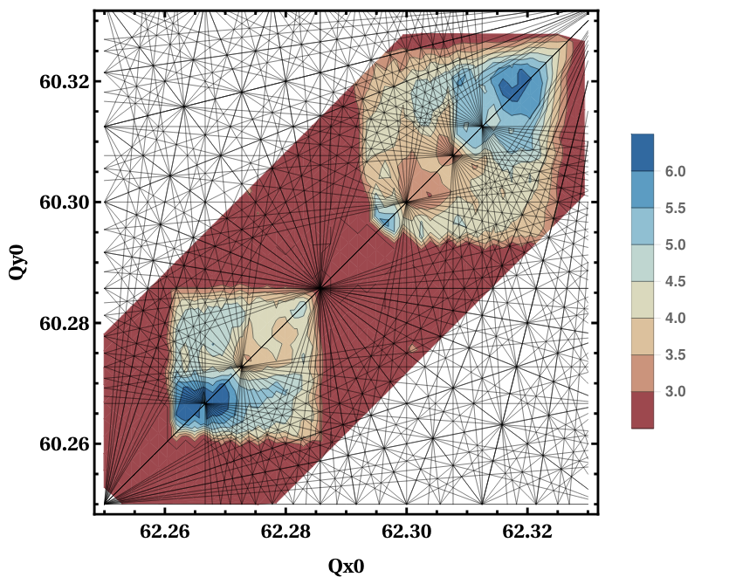
D. Kaltchev, R. Baartman – Beam Physics
Collaboration on Beam Dynamics of High-Luminosity LHC (Extended Domain Tune Scans)
Beam physics studies focus on the general understanding of the impact of resonances to the choice of the optimal working point at collision.
Tune-scans: look for dependencies of the dynamic aperture of HL-LHC on the tune working point (WP) as part of a detailed tracking campaign aimed at luminosity optimization
HL-LHC nominal working point (WP)
Resonance lines
​
DA
Good WP candidate
18

Slide 19
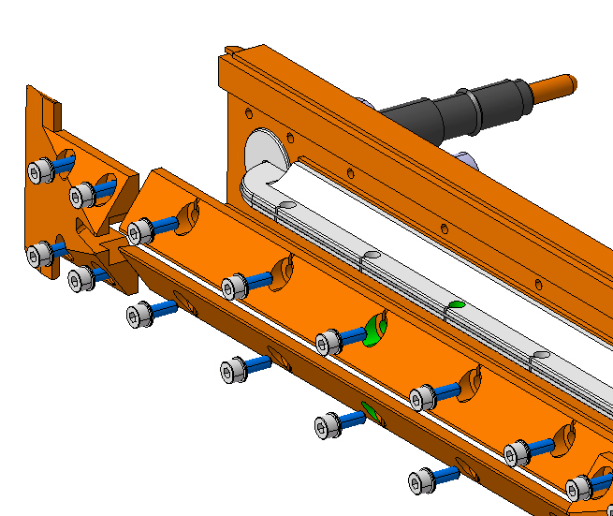
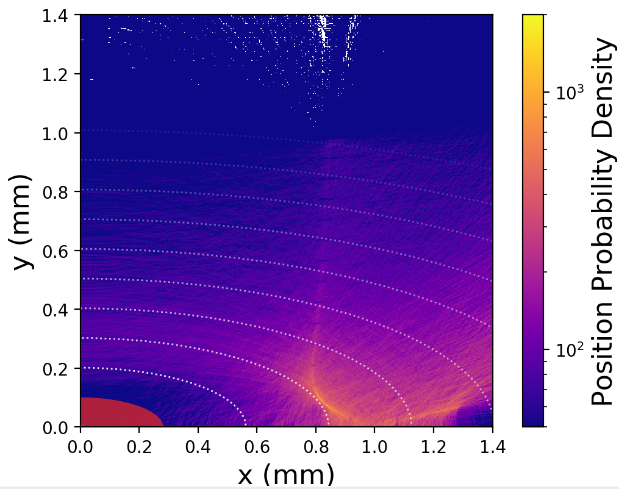
Additional beam physics and potential hardware contribution to HL-LHC
An issue with Hi-Lumi LHC is Beam-Beam Long-Range effects at the interaction regions
TRIUMF (D. Kaltchev) has developed a Hamiltonian based beam physics model of these effects
The effect can be mitigated (confirmed in LHC tests) with the addition of physical wires, running high currents, → TRIUMF’s model helps explain and optimize the wire compensation
Canada via TRIUMF could provide the final wire correctors for HL-LHC
In a separate study, student P. Belanger is using beam loss data from falling particulate (UFOs) in LHC to predict the sources of the contamination
Hardware design of wire corrector
Reconstructed probability density function for the dust position around the beam (0,0).
19

Slide 20

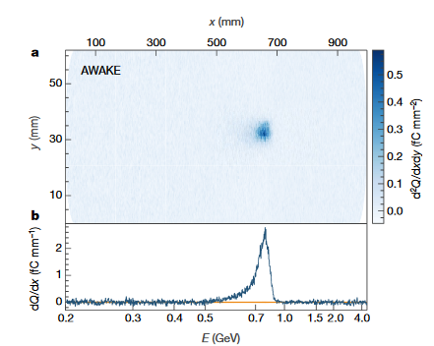
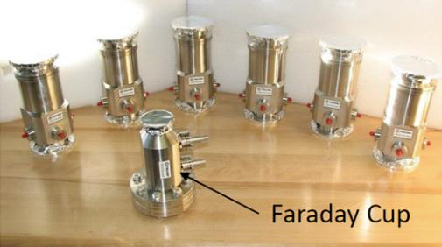
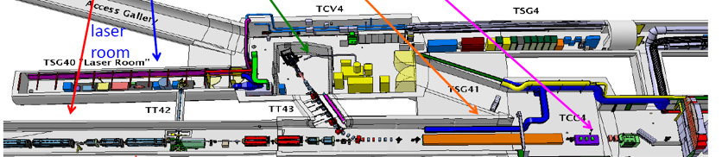
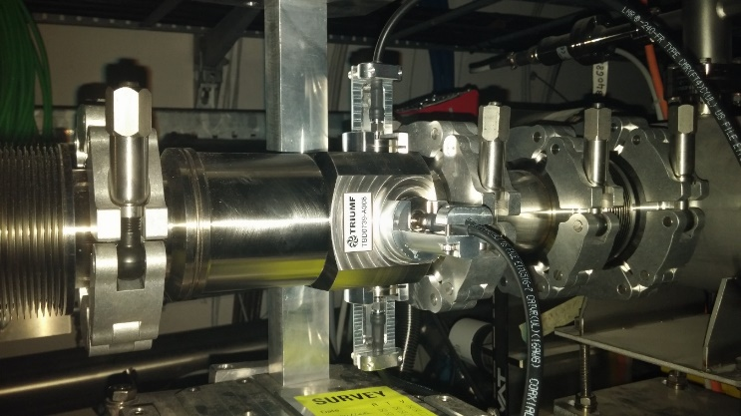
TRIUMF and AWAKE experiment
V. Verzilov – Diagnostics
AWAKE is an R&D experiment at CERN towards developing novel accelerator technologies for future accelerators
Exploits acceleration of electrons by plasma waves driven by high energy protons from SPS
TRIUMF scope (NSERC funded)
  Design and construction of diagnostics (stripline beam position monitors, Faraday cup and associated electronics for electron and common beam lines
  Student funding
Now preparing for AWAKE Run 2

Slide 21
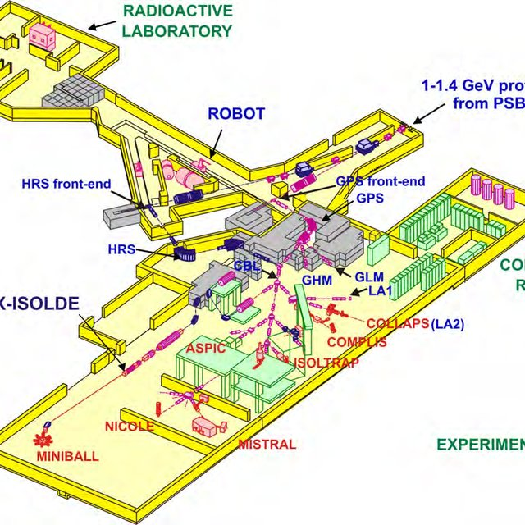
ISOLDE and TRIUMF
Close collaborations on ISOL target and ion source technology, RIB diagnostics and SRF science and technology
Technical collaborations on p2n (proton to neutron converter), FEBIAD ion source, target components longevity, beam diagnostics
co-applicants on a EU Marie-Curie Fellowship program and student exchange
Exchange of technical equipment

Slide 22
J. Lassen – T&IS
Laser Ion Source R&D
international collaborations
In-source spectroscopy of Actinides – U Mainz, GSI-HMI Mainz
Laser Resonance Ionization Spectroscopy – FRIB, RIKEN
next generation all solid state laser ion source – U Mainz, GANIL
TiSa laser dev. network – U Mainz, GSI / HMI Mainz, JYFL, CERN-ISOLDE, KU Leuven, GANIL, U Nagoya
CLS laser spectroscopy & polarizer facility project - RAON
EU Marie-Curie training network LISA (Laser ionization spectroscopy of Actinides) – U Mainz, GSI / HMI Mainz, JYFL, CERN-ISOLDE, KU Leuven, GANIL, U Nagoya & industry partners
student exchange – U Oldenburg, TU Darmstadt
all solid state laser ion source –TRI LIS (2019)

Slide 23
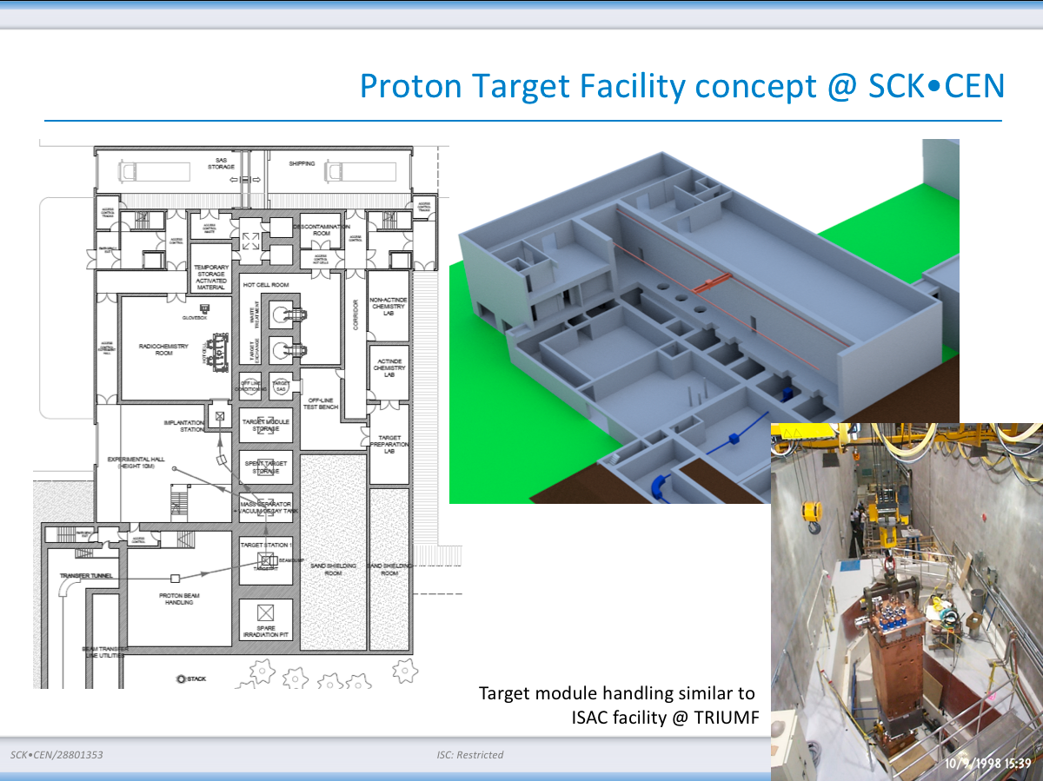
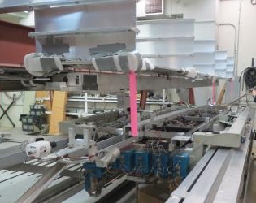
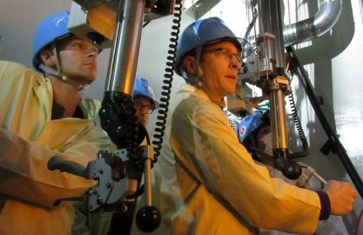
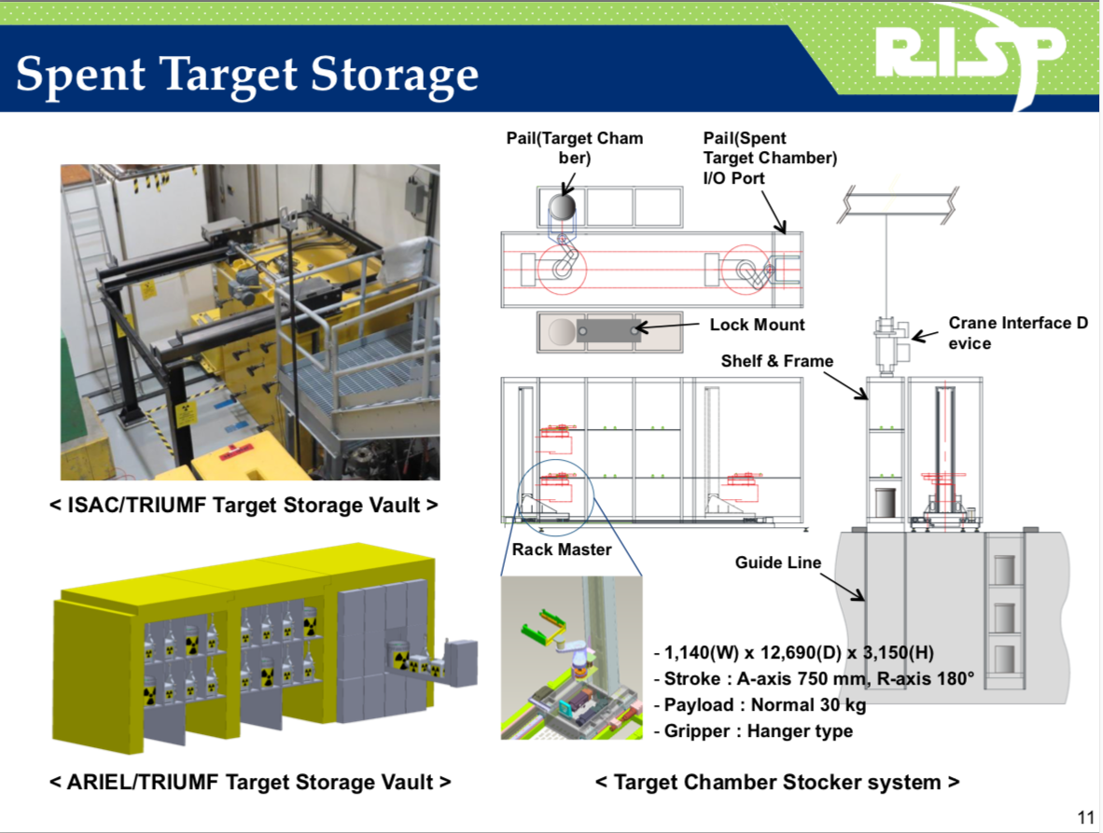
TRIUMF Remote Handling
G. Minor, A. Gottberg, T&IS
TRIUMF is internationally recognized for its leading role in remote handling, hot cell design and operation.
TRIUMF remote handling and target technologies as well as the know-how of HQP are valued by international collaborations (T2K, MYRRHA, RISP)
Examples of international
designs based on TRIUMF RH:
TRIUMF RH specialists assisting in T2K target repair
RH robotics development

Slide 24
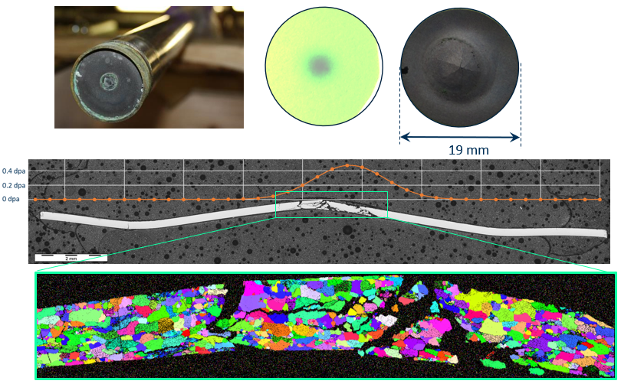
Fundamental TRIUMF R&D for neutrino production e.g. Dune, J-Parc
A. Gottberg, T&IS
Based on TRIUMF’s previous contributions to T2K TRIUMF is well positioned to make contributions to LBNF and J-Parc in
  beam diagnostics and remote handling
  high power target technology
Beam window failure investigations
TRIUMF is an active member of the RaDIATE global collaboration
  Hosted meeting at TRIUMF in Dec. 2019
  Planning a material aging test centre at TRIUMF coupled with simulations to feed global data base

Slide 25
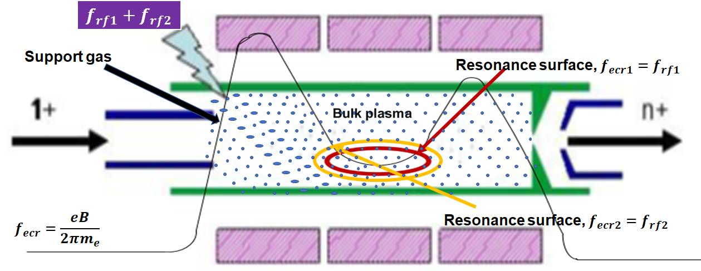
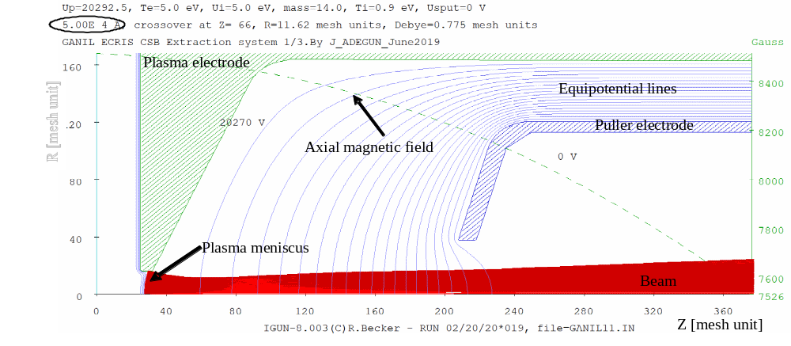
Collaboration with GANIL on ECRIS charge breeder
F. Ames, O. Kester, Beam delivery
GANIL and TRIUMF employ a 14.5 GHz PHOENIX ECRIS for charge state breeding.
Increase of charge breeding efficiency by implementing
  two-frequency heating technique that provides two resonance zones
Improving the beam properties by optimizing the extraction system
  Simulations with the code IGUN©
  Benchmarking with beam emittance measurements

Slide 26
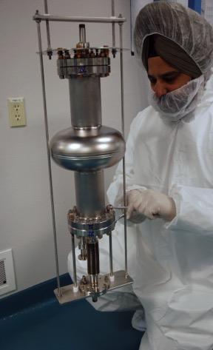
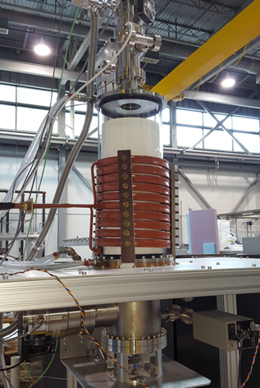
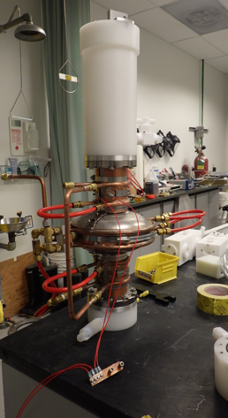
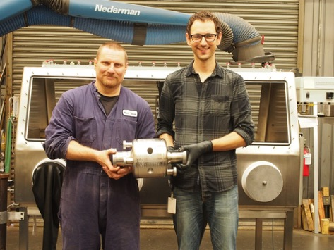
Cavity Treatment High Gradient R&D (ILC)
SRF Group
UHV RF induction oven (NSERC) used to explore various heating/doping recipes
    Program is coupled with fundamental studies using μSR and β-NMR with collaborators from JLab, Cornell, FNAL, Temple U., Lancaster U., HZB, PSI and UVic
Developing vertical electropolishing with Teflon stirrers to augment doping effort
  Collaboration with KEK
Exploring low cost fabrication techniques using reactor grade Nb and TIG welding (NSERC)
High performance cryomodule development with a FNAL led collaboration
Induction Furnace
Vertical EP
Low cost SRF cavity (TRIUMF)

Slide 27
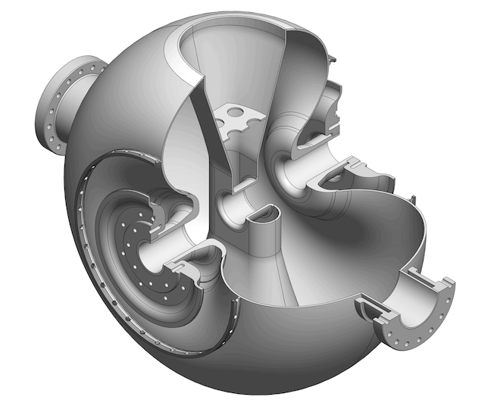
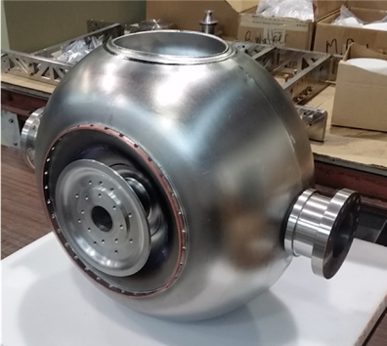
SSR Balloon resonator (TRIUMF, RISP)
Z. Yao, SRF Group
TRIUMF has developed and successfully tested a new variant (balloon geometry) of a single spoke resonator for Hadron acceleration
The cavity shape virtually eliminates the high level multipacting that plagues standard geometries
The cavity design and prototyping was sponsored by RISP (Korea) and is being used in their heavy ion driver linac
TRIUMF is also collaborating with FNAL and Euclid on further advancements

Slide 28
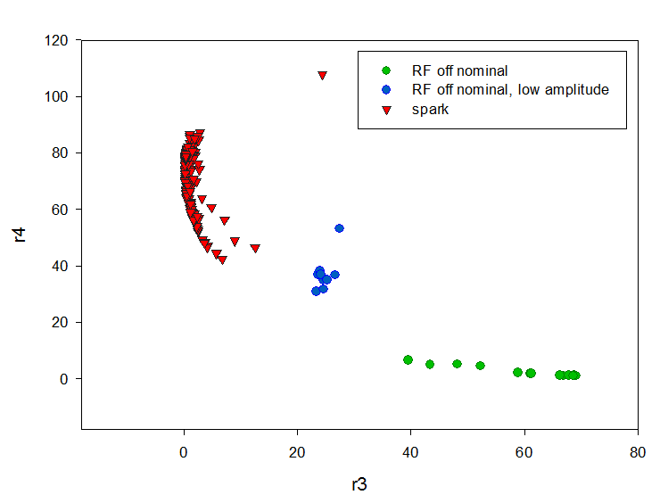

R. Leewe, K. Fong - LLRF
TRIUMF Low Level RF collaborations
TRIUMF’s LLRF group manages the stabilization of all rf systems at TRIUMF and are sought after for collaboration and work for others (IMPCAS, RISP, CIAE)
Spark detection and reaction system within TRIUMF’s cyclotron through fault diagnostic and machine learning
  In collaboration with Prof. Dr. Gerwald Lichtenberg from the University of Applied Science in Hamburg, Germany
  500MeV cyclotron rf spark events are accumulated based on an oscilloscope image then characterized to form a data base for machine learning to guide machine protection

Slide 29
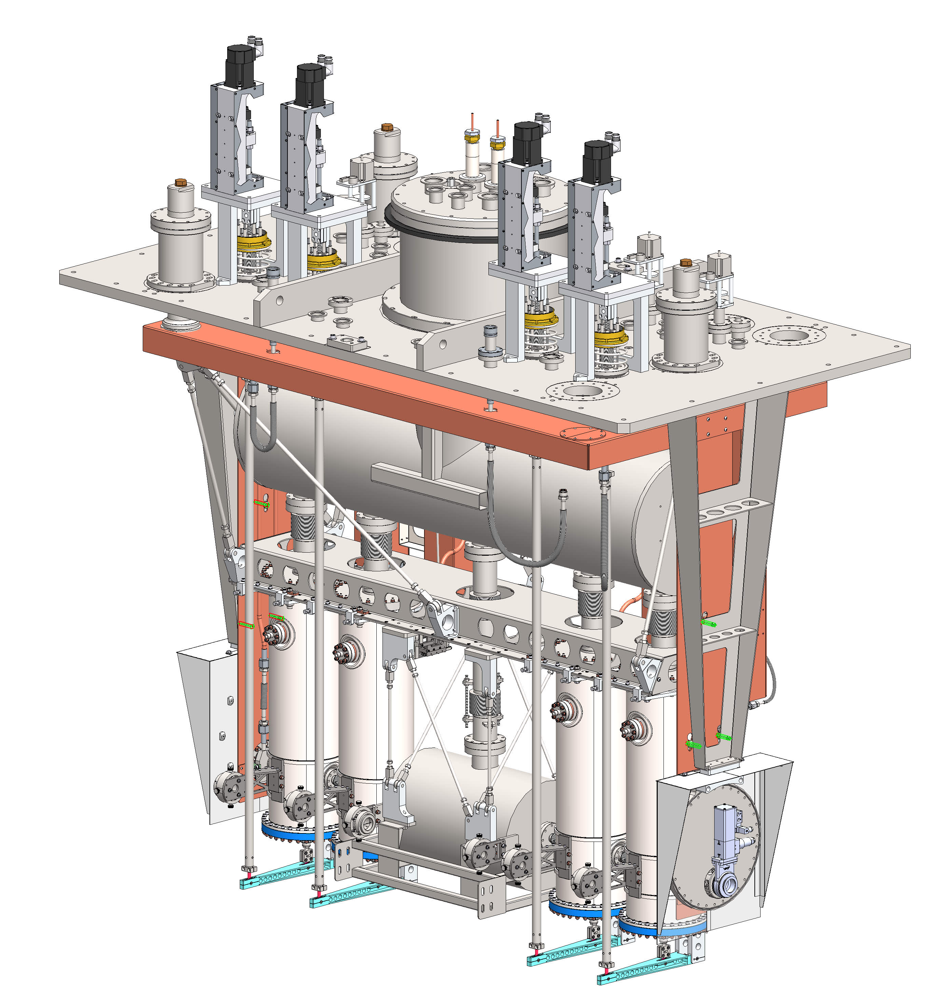
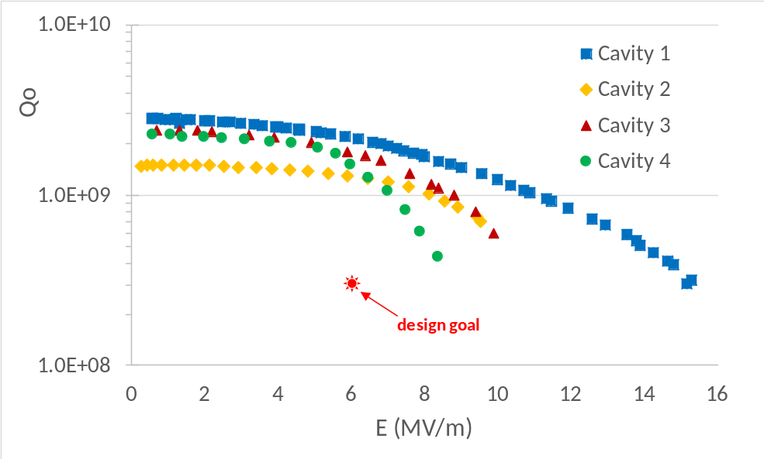
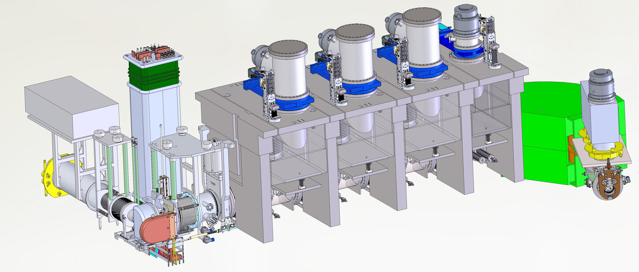
TRIUMF and VECC (Kolkata)
TRIUMF and VECC have been collaborating on mutually aligned projects since 2008 – ANURIB in Kolkata and ARIEL in Vancouver
The latest agreement includes a heavy ion cryomodule and an ARIEL target module and RIB extraction line
The cryomodule will be completed this year (all cavities are now qualified)
The RIB target module and beamline will be delivered in 2022.

Slide 30
General ACC projects
TRIUMF scientists are part of proposals in a broad range of topics to support the Canadian community
  Polarized beams in ring accelerators, spin dynamic (SUPER KEKB, EIC)
  E-linac related FEL research for production of IR and THz radiation
  High intensity proton driver linacs – neutron sources, medical accelerators

Slide 31
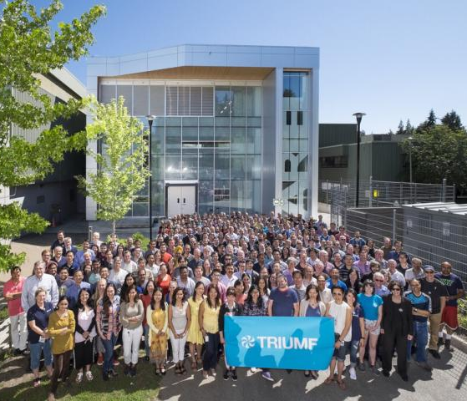
Summary
TRIUMF Accelerator Science has an active program in International collaborations through the next five year plan
The collaborations strengthen our core competences, engage students and support the Canadian science community

Slide 32
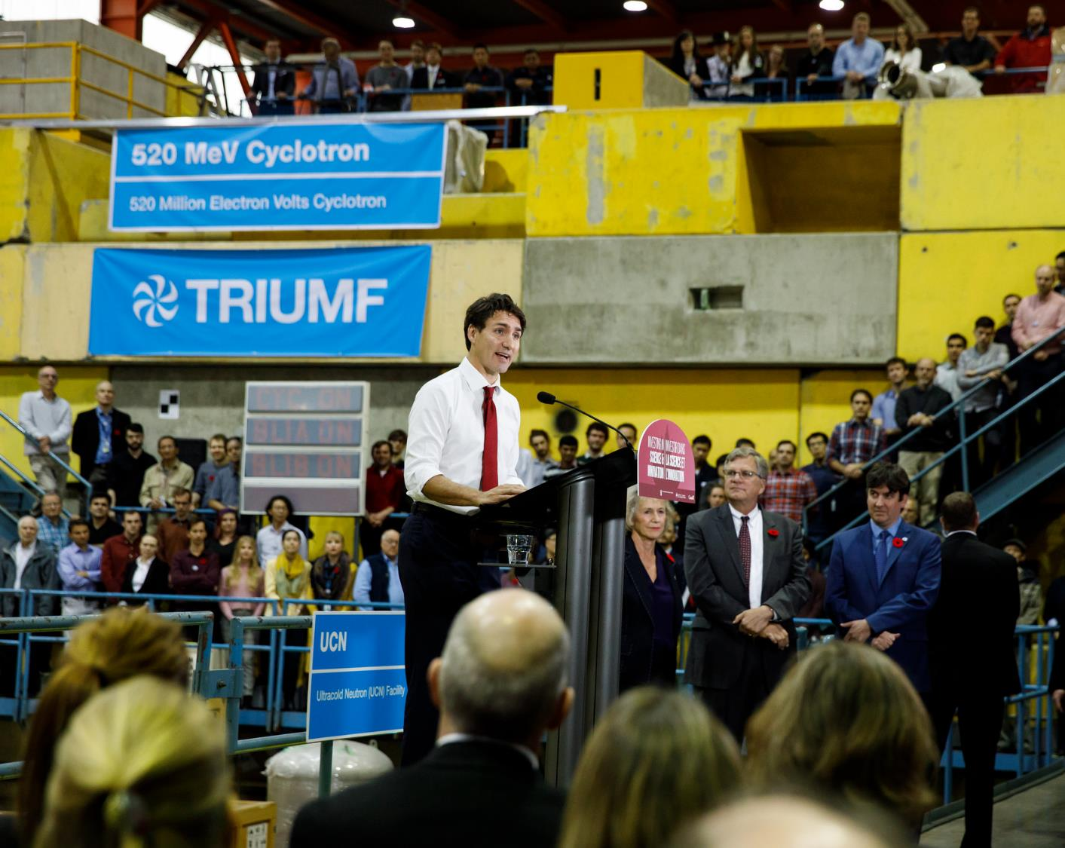




Thank you
Merci
www.triumf.ca
Follow us @TRIUMFLab

Slide 33

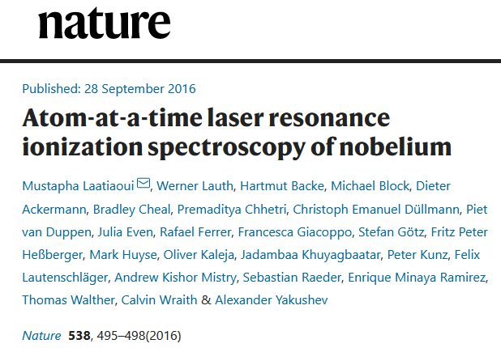
Peter Kunz – T&IS
RADRIS Collaboration
Laser spectroscopy on trans-fermium elements at SHIP/GSI using Radiation Detected Resonance Ionization Spectroscopy
Raeder, S., et. al. Probing Sizes and Shapes of Nobelium Isotopes by Laser Spectroscopy. Phys. Rev.
Lett. 120, 232503 (2018).
Chhetri, P., et. al. Precision Measurement of the First Ionization Potential of
Nobelium. Phys. Rev. Lett. 120, 263003 (2018).

Slide 34
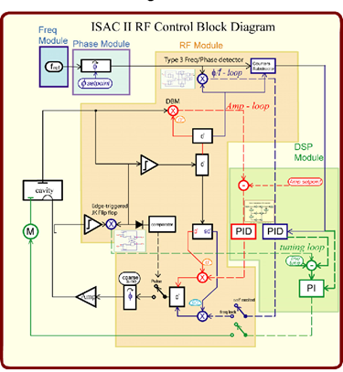
TRIUMF Low Level RF collaborations
K. Fong - LLRF
TRIUMF’s LLRF group manages the stabilization of all rf systems at TRIUMF and are sought after for collaboration and work for others
IMPCAS (China) – 24 LLRF controllers for SRF linac.
RISP (KOREA) – 1 LLRF controller for SRF test area.
CIAE (China) – MOU between TRIUMF and CIAE for continual cooperation.
  Cooperation on RF structure and LLRF control for cyclotrons.
  Exchange of researchers and students.

