Slide 1
U.S. Snowmass Process
TRIUMF Science Week
August 18, 2020
Young-Kee Kim
University of Chicago
Chair, Division of Particles and Fields, American Physical Society

Slide 2
Snowmass
Long-term planning exercise for the particle physics community
Its goal is to develop the community’s long-term physics aspirations.
to define the most important questions for the field of particle physics
to identify promising opportunities to address them

Slide 3
U.S. Strategic Planning Process for Particle Physics
~year-long process
Snowmass Community-Wide “Science” Study
Organized by Division of Particles and Fields (DPF) of APS
Input to P5
~year-long process
P5, Particle Physics Project Prioritization Panel
(subpanel of HEPAP, High Energy Physics Advisory Panel for DOE/NSF funding agencies)
formulate a 10-year execution plan (20 year vision) within funding constraints
Particle Physics is not isolated:
Long-Range Plan for Nuclear Science
Decadal Survey on Astronomy and Astrophysics
….

Slide 4
Particle Physics is Global
Regional processes
  Europe: 7 years, particle physics (primarily accelerator based)
  U.S.: ~8 years, particle physics (accelerator based and non-accelerator based)
  Canada: 5 years, particle and nuclear physics
  Japan, China, Latin America, ….
Year
11 | 12 | 13 | 14 | 15 | 16 | 17 | 18 | 19 | 20 | 21 | 22 | 23 | 24 | 25 | 26 | 27
Europe
U.S.
Canada
Planning
Planning
2007 plan
2013 plan
2020 plan
Planning
Planning
2008 plan
2014 plan
2023 plan
Planning
Planning
Planning
2007 plan
2012 plan
2017 plan
2022 plan
Now

Slide 5
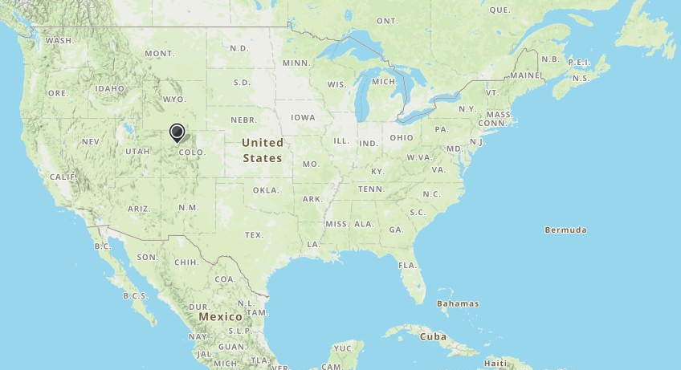
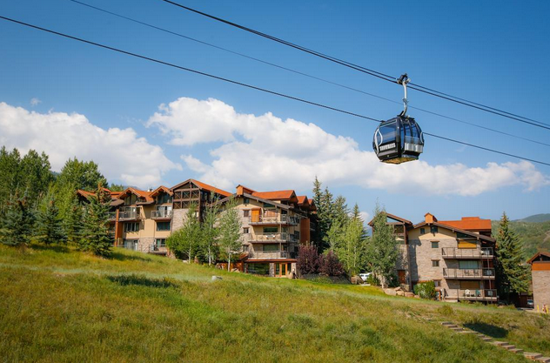
Snowmass: Historical Context
Snowmass Summer Studies: 3 weeks in Summer in Snowmass, Colorado
Vancouver
Snowmass Village
Chicago
Snowmass Village
in the Colorado Rockies near Aspen
“~a thousand physicists gathered for three weeks to talk
about the future of particle physics in the U.S. — and the rest of the world”

Slide 6
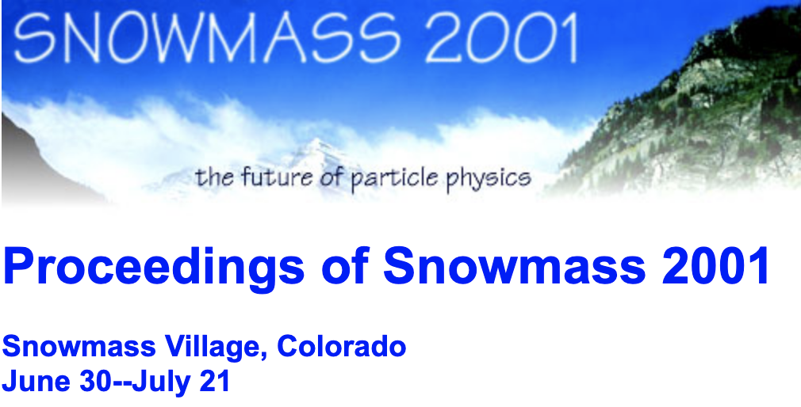
Snowmass: Historical Context
3 weeks in Summer in Snowmass
Snowmass 82 DPF Summer Study on Elementary Particle Physics and Future Facilities, June 28 – July 16
Snowmass 84 DPF Summer Study on the Design and Utilization of Superconducting Super Collider, SSC, June 23 – July 13
Snowmass 86 DPF Summer Study on the Physics of the SSC, June 23 – July 11
Snowmass 88 DPF Summer Study on High-Energy Physics in the 1990s, June 27 – July 15
Snowmass 90 DPF Summer Study on High-Energy Physics: Research Directions for the Decade, June 25 – July 13
Snowmass 94 DPF Summer Study on High-Energy Physics: Particle and Nuclear Astrophysics and Cosmology
in the Next Millennium, June 29 – July 14
Snowmass 96 DPF/DPB Summer Study on New Directions for High-Energy Physics, June 25 – July 12
Snowmass 2001 DPF/DPB Summer Study on the Future of Particle Physics, June 30 – July 21
Snowmass 2013
  Organized by DPF
  Summer 2012 – December 2013 (similar in its scope to 2001 but spread out through ~1 year)
Snowmass 2021
  Organized by DPF with strong participation from related fields (DPB, DAP, DGRAV, DNP)
  Spring 2020 – October 2021
~1 year long; not in Snowmass

Slide 7
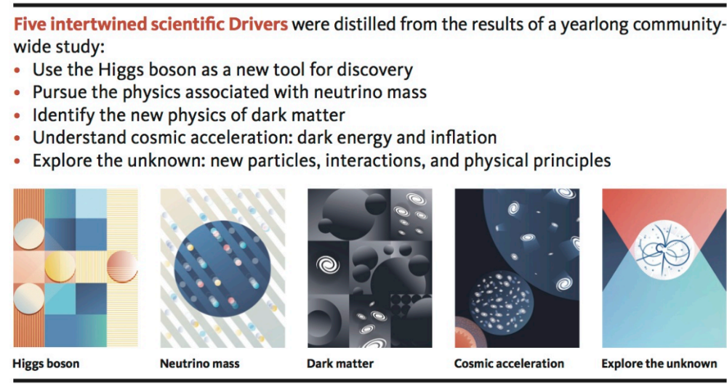

Snowmass Topics led to P5 Science Drivers
Snowmass 2013 Report
Frontiers
  Energy Frontier
  Intensity Frontier
  Cosmic Frontier
Cross-Cutting
  Facilities (Underground and Accelerator)
  Instrumentation
  Computing
  Theory
  Communication
P5 2014 Report
29 recommendations !!

Slide 8
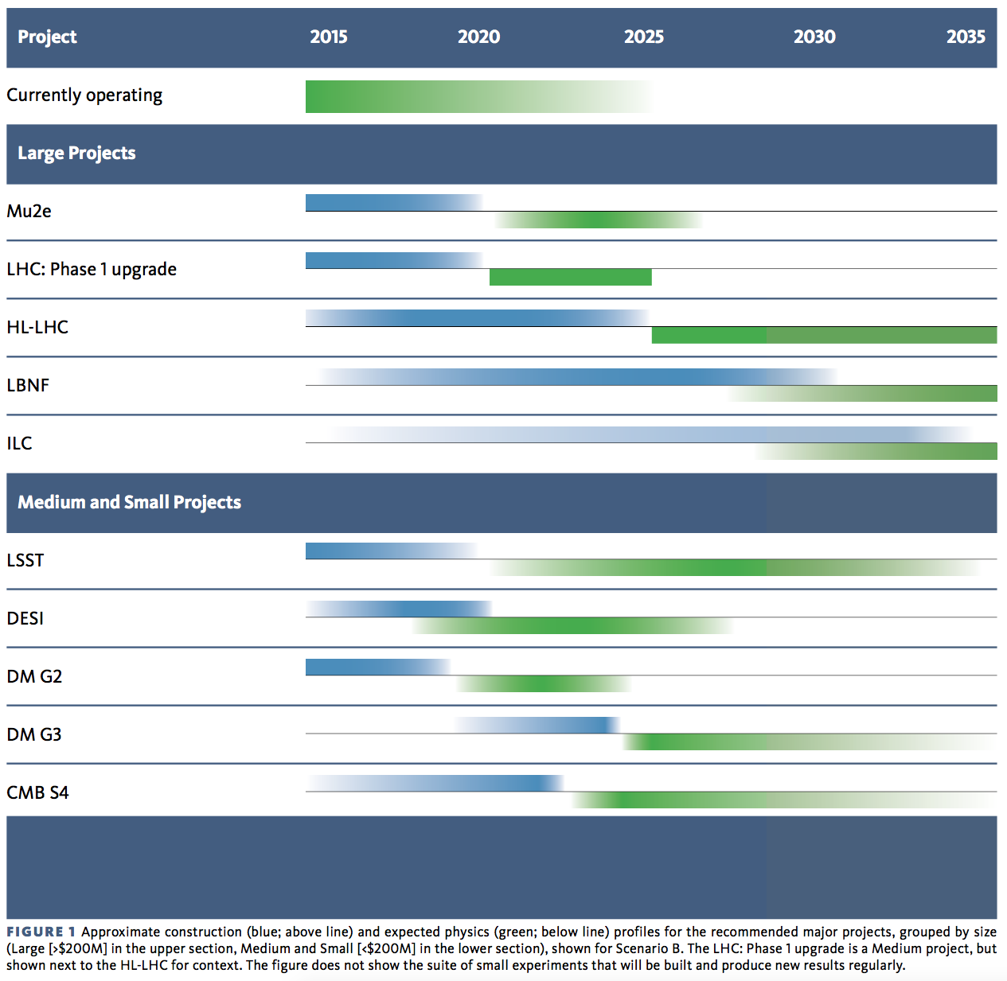
Snowmass 2013 + P5 2014 has been very successful !!
P5 2014 Report
Support a program of projects of all scales (large, medium, small), new ideas & developments
Accelerator science / R&D, instrumentation R&D, computing / software; next gen. education and training
Blue: construction
Green: physics
P5 2014: 10 year plan (Scenario B)
(large projects)
Scientific Drivers
The Unknown (U.S.)
Higgs, the Unknown (Europe)
Neutrino (U.S.)
Cosmic Acceleration (U.S.)
Dark Matter (U.S.)
Cosmic Acceleration (U.S.)

Slide 9
Snowmass 2021
Successful Snowmass 2013 is our guide!
  Implement lessons learned from Snowmass 2013
Snowmass 2021: Ten Frontiers
  Energy Frontier
  Frontiers in Neutrino Physics
  Frontiers in Rare Processes & Precision Measurements
  Cosmic Frontier
  Theory Frontier
  Accelerator Frontier
  Underground Facilities and Infrastructure Frontier
  Instrumentation Frontier
  Computational Frontier
  Community Engagement Frontier

Slide 10
Frontiers and Topical Groups
 | Energy Frontier | Frontiers in Neutrino Physics | Frontier of Rare Processes & Precision Measurements | Cosmic Frontier | Theory Frontier
1 | Higgs Boson properties and couplings | Neutrino Oscillations | Weak Decays of b and c | Dark Matter: Particle-like | String theory, quantum gravity, black holes
2 | Higgs Boson as a portal to new physics | Sterile Neutrinos | Strange and Light Quarks | Dark Matter: Wave-like | Effective field theory techniques
3 | Heavy flavor and top quark physics | Beyond the SM | Fundamental Physics and Small Experiments | Dark Matter: Cosmic Probes | CFT and formal QFT
4 | EW Precision Phys. & constraining new phys. | Neutrinos from Natural Sources | Baryon and Lepton Number Violation | Dark Energy & Cosmic Acceleration: The Modern Universe | Scattering amplitudes
5 | Precision QCD | Neutrino Properties | Charged Lepton Flavor Violation | Dark Energy & Cosmic Acceleration: Cosmic Dawn and Before | Lattice gauge theory
6 | Hadronic structure and forward QCD | Neutrino Cross Sections | Dark Sector at Low Energies | Dark Energy & Cosmic Acceleration: Complementarity of Probes and New Facilities | Theory techniques for precision physics
7 | Heavy Ions | Nuclear Safeguards and Other Applications |  | Cosmic Probes of Fundamental Physics | Collider phenomenology
8 | Model specific explorations | Theory of Neutrino Physics |  |  | BSM model building
9 | More general explorations | Artificial Neutrino Sources |  |  | Astro-particle physics and cosmology
10 | Dark Matter at colliders | Neutrino Detectors |  |  | Quantum information science
11 |  |  |  |  | Theory of Neutrino Physics

Slide 11
Frontiers and Topical Groups
 | Accelerator Frontier | Instrumentation Frontier | Computational Frontier | Underground Facilities and Infrastructure Frontier | Community Engagement Frontier
1 | Beam Phys & Accelarot Education | Quantum Sensors | Experimental Algorithm Parallelization | Underground Facilities for Neutrinos | Applications & Industry
2 | Accelerators for Neutrinos | Photon Detectors | Theoretical Calculations and Simulation | Underground Facilities for Cosmic Frontier | Career Pipeline & Development
3 | Accelerators for EW/Higgs | Solid State Detectors & Tracking | Machine Learning | Underground Detectors | Diversity & Inclusion
4 | Multi-TeV Colliders | Trigger and DAQ | Storage and Processing Resource Assess (Facility and Infrastructure R&D) | Supporting Capabilities | Physics Education
5 | Accelerators for PBC & Rare Processes | Micro Pattern Gas Detectors | End user Analysis | Synergistic Research | Public Education & Outreach
6 | Advanced Accel. Concepts | Calorimetry | Quantum Computing | Integrated Strategy for Underground Facilities and Infrastructure | Public Policy & Government Engagement
7 | Accelerator Technology R&D RF Magnets Targets & Sources | Electronics/ASICS | Reinterpretation and Long-Term Preservation of Data and Code
8 |  | Noble Elements
9 |  | Cross Cutting and System Integration
> 40 liaisons for cross-cutting areas between Frontier Groups and Topical Groups

Slide 12
Create a transparent and inclusive process
DPF Executive Committee + DPF Program Committee + DAP (Astro Phys), DNP (Nuclear Phys), DPB (Accelerator Phys), DGRAV (Gravitational Phys) representatives
  Initial organization work
  Scope of each Frontier + first draft of subgroups of each Frontier
  Facilitate convener nominations and decisions
Nominations for frontier & topical conveners
  General call: community
Conveners
  Balance
    Nominations: senior/junior; theory/experiment; gender; region; labs/universities
    International members added (~10% conveners are from foreign institutions)
  Frontiers
    30 conveners for 10 Frontiers
  Topical groups
    ~240 conveners for ~80 topical groups

Slide 13
Snowmass Early Careers
Snowmass is towards a long-term strategic plan (20 years)
  Voices of early career members are critically important
  Enrich and strengthen involvement of undergraduates, graduate students, postdocs, junior faculty, ….
Organization and Leadership
  Forming representatives for Snowmass Early Careers
    Solicited nominations: > 250 nominated!!
  Key initiatives
    Snowmass Coordination: Snowmass involvement
    Diversity, Equity, and Inclusion
    Survey of the early career membership
    In-reach: Professional development and building cohesion
    Long-Term Organization

Slide 14
Snowmass Advisory Group
DPF Executive Committee
  Chair: Young-Kee Kim
  Chair-Elect: Tao Han
  Vice Chair: Joel Butler
  Past Chair: Prisca Cushman
  Secretary/Treasurer: Mirjam Cvetic
  Councilor: Elizabeth Simmons
  Member-at-Large: Rick Van Kooten
  Member-at-Large: Elizabeth Worcester
  Member-at-Large: Natalia Toro
  Member-at-Large: Andre de Gouvea
  Member-at-Large: Mary Bishai
  Member-at-Large: Lauren Tompkins
  Early Career Member-at-Large: Sara Simon
Editor and Communication
  Editor – Michael Peskin
  Communication – Bob Bernstein
Representatives from Related Fields
  Accelerator Physics: Sergei Nagaitsev
  Nuclear Physics: Yury Kolomensky
  Astro Physics: Glennys Farrar
  Gravitational Physics: Gabriela Gonzales
Representatives from the Int. Community
  Africa / Middle East
    Azwinndini Muronga, Nelson Mandela Metropolitan Univ, South Africa
  Asia / Pacific
    Atsuko Ichikawa, Kyoto University, Japan
    Xinchou Lou, IHEP, China
  Canada
    Heather Logan, Carleton Univ., Canada
  Europe / Russia
    Val Gibson, Cavendish Laboratory, UK
    Berrie Giebels, CNRS, France
  Latin America
    Claudio Dib, Universidad Tecnica Federico Santa Maria, Chile
Steering Group
Monitoring the progress to make sure that all is moving forward smoothly to achieve the goals of the planning exercise

Slide 15
Snowmass Coordination Team
27 Advisory Group members (including 8 Steering Group members)
30 Conveners for 10 Frontier Groups
~240 Conveners for ~80 Topical Groups
42 liaisons for cross-cutting areas between Frontier Groups and Topical Groups
~30 representatives of Early Careers at a given time
~40 LOC members for 2020 Community Planning Meeting and 2021 Community Summer Study
~400 People in the Coordination Team

Slide 16
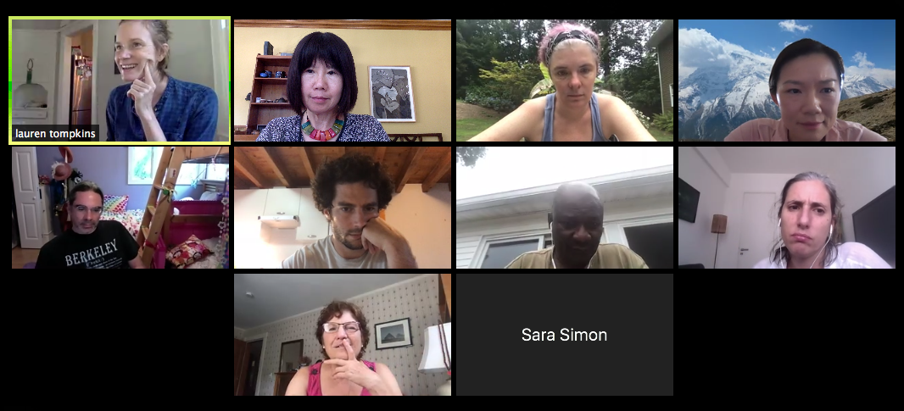
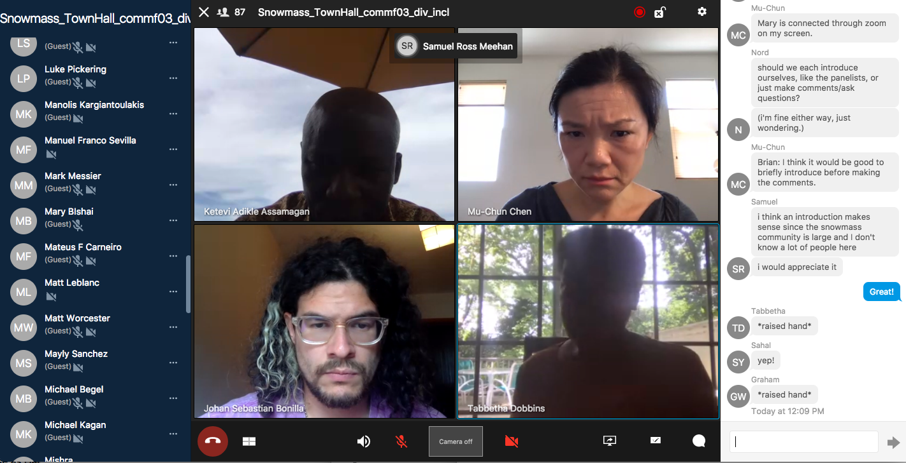
Equity, Diversity and Inclusion
DPF Ethics Task Force
  The Snowmass process is a dynamic exchange of ideas across a large swath of the community, taking place in a variety of virtual (e.g., slack, ZOOM meetings/workshops) and in-person formats.
  Community members must feel safe and supported in engaging in all exchanges.
  DPF Ethics Task Force
    Formed in April 2020
  Activities
    Produced core principles and community guidelines aimed at all facets of Snowmass process
    Is instituting a moderator process to address concerns as they arise on slack
    Will educate our community about microaggressions and proactively work to provide a supportive environment.
Snowmass Diversity & Inclusion Topical Group
  Bi-weekly town hall meetings
    Accessibility (June 1)
    Racial Justice and Supporting Our Black Community Members
    (June 15, June 29)
    Code of Conduct and Accountability (July 13)
  Survey on accessibility
    Perspective of how accessibility applies to the Snowmass process (including COVID-19 impacts)

Slide 17
Snowmass Timeline
Virtual Kick-off
Town Hall
APS April Meeting
European Strategy Update
Community Planning
Meeting (CPM)
Oct. 5-8 Virtual
11/19 | 12/19 | 1/20 | 2/20 | 3/20 | 4/20 | 5/20 | 6/20 | 7/20 | 8/20 | 9/20 | 10/20
Preparation
Letters of Interest
Contributed (“white”) Papers
10 Frontier & 78 Topical Groups: Meetings & Workshops
2021
APS April
Meeting
Community Summer Study (CSS)
July 11-20, 2021
(UW Seattle)
Snowmass
Report
11/20 | 12/20 | 1/21 | 2/21 | 3/21 | 4/21 | 5/21 | 6/21 | 7/21 | 8/21 | 9/21 | 10/21
Contributed (“white”) Papers
10 Frontier & 78 Topical Groups: Meetings & Workshops

Slide 18
“Global” Community Contribution
Letters of Interest (submission : April 1, 2020 – August 31, 2020)
  Informal documents intended to be useful in the first stages of the Snowmass study
  Help conveners to prepare the Snowmass Community Planning Meeting (Nov. 2020)
  Include opinions, interests and proposals that could further be studied
  Maximum of 2 pages of text, plus relevant bibliography
  Submission instructions: https://snowmass21.org/loi
  LoI authors are welcome to make a full writeup as a contributed paper (not required)
Contributed (“white”) Papers (submission : April 1, 2020 – July 31, 2021)
  Scientific or technical articles on relevant physics / technical topics, and reasoned expressions of physics priorities, including those related to community engagement.
  Part of Snowmass proceedings (permanent record of Snowmass 2021)
  Help shape the long-term scientific strategy of particle physics in the U.S.
  Submission instructions: https://snowmass21.org/submissions/
  LoIs are not required in order to submit contributed papers

Slide 19
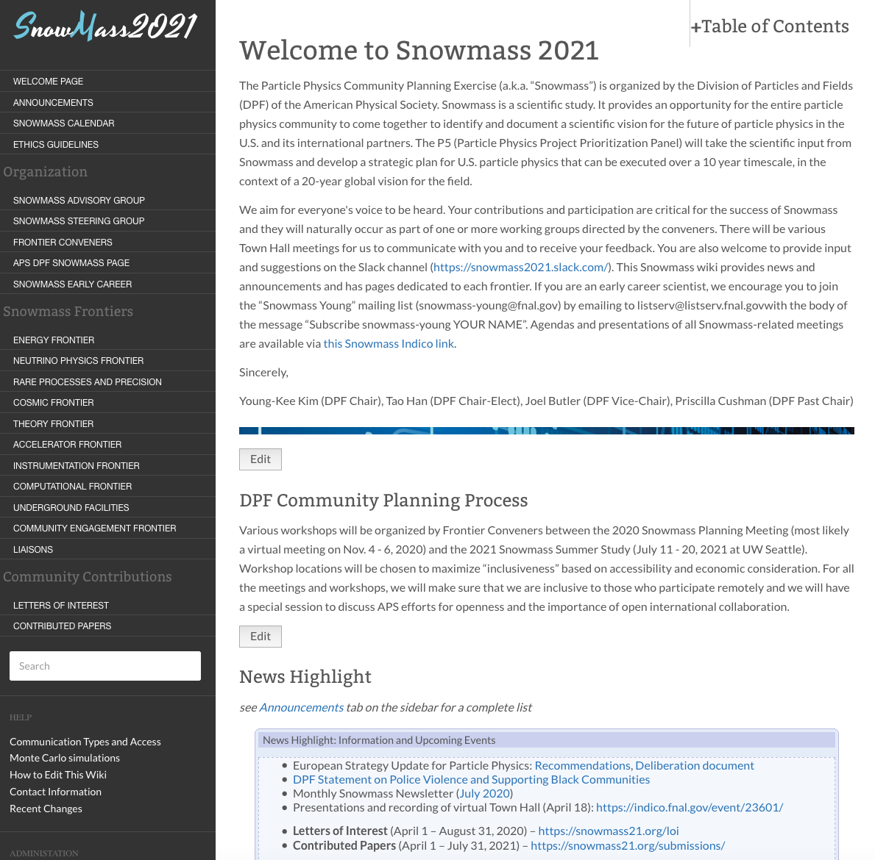
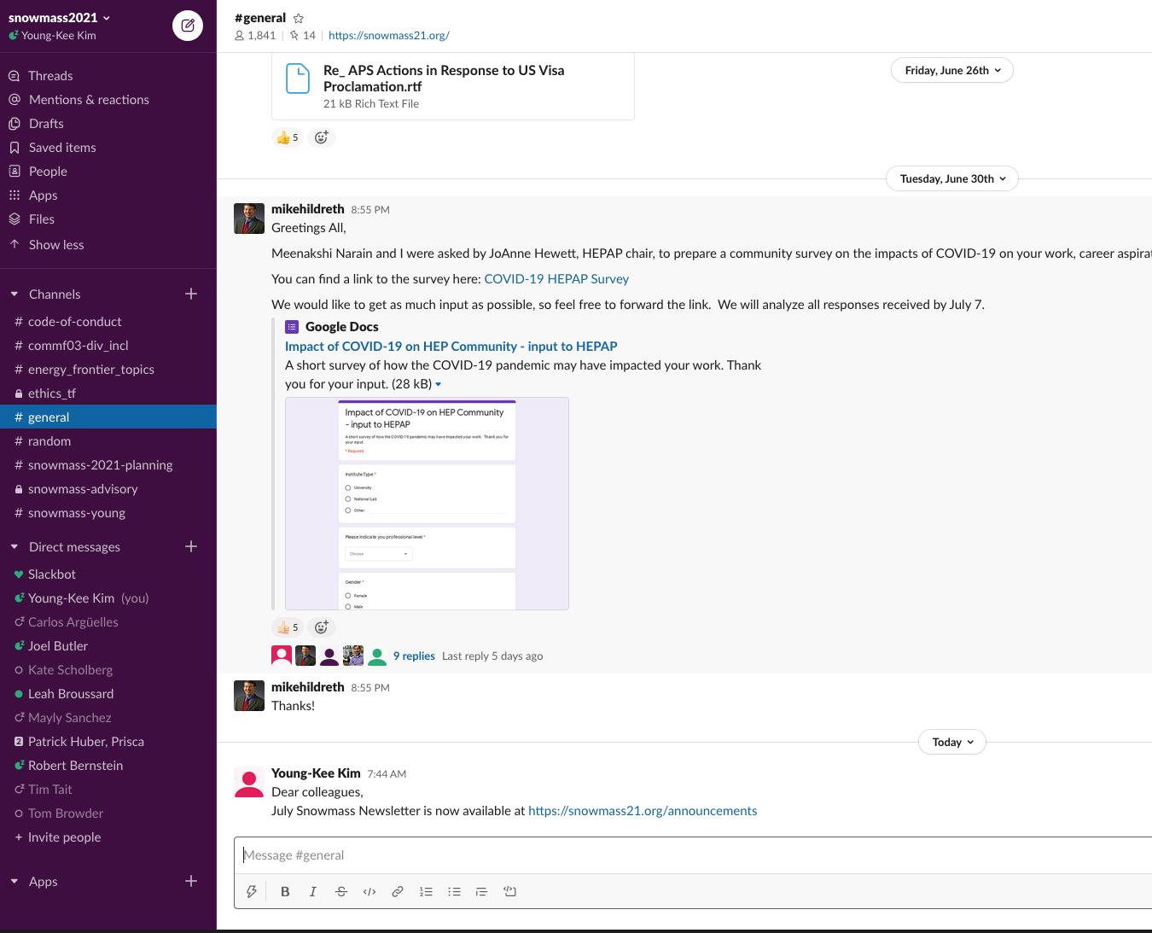
Communication to the community
Snowmass Wiki (https://snowmass21.org/)
  One-stop shop
  Technical liaison: Sergei Chekanov, ANL
  Snowmass email
    snowmass@fnal.gov
    snowmass-young@fnal.gov
    Frontier & Topical group mailing lists
  Slack Channels
  Monthly Snowmass Newsletter

Slide 20
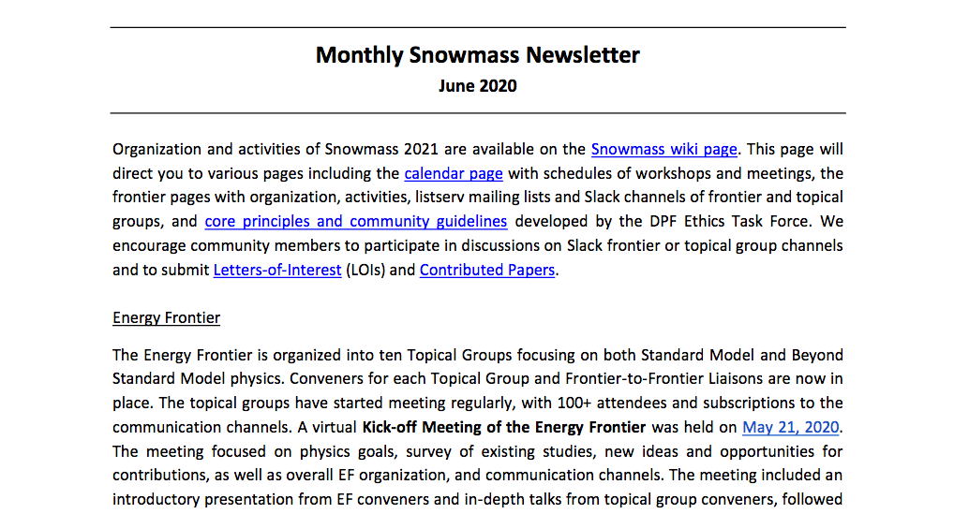
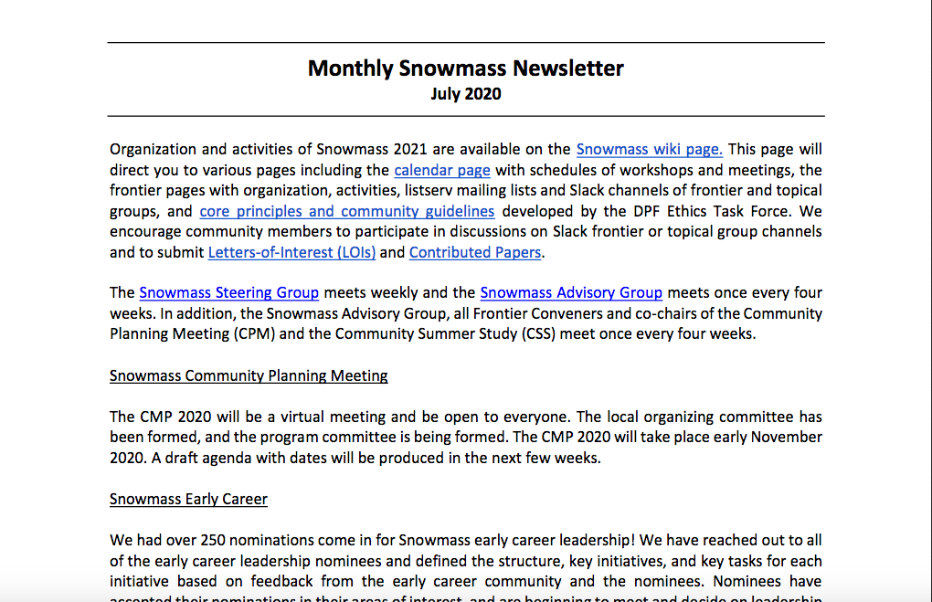
Monthly Snowmass Newsletter

Slide 21
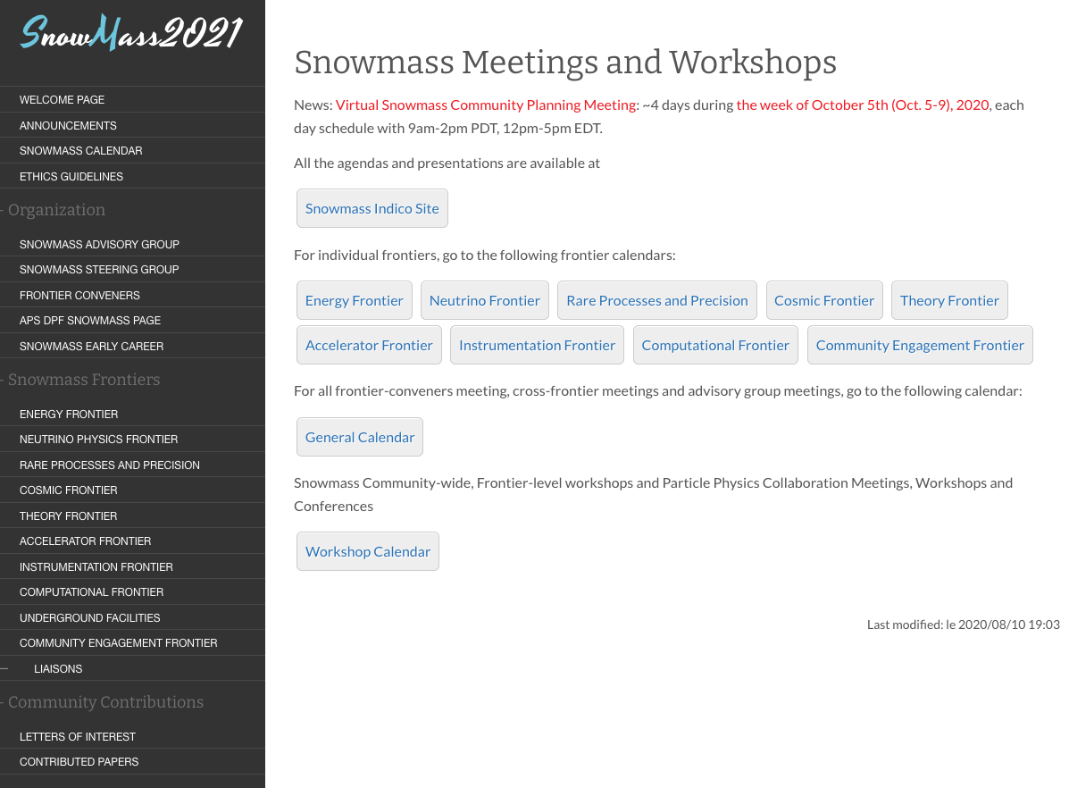
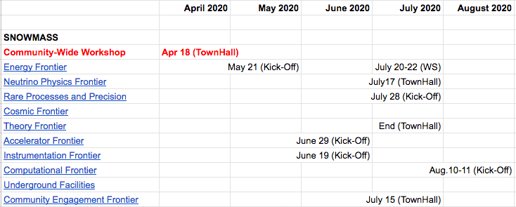
Current Activities and Upcoming Events
Frontier / topical groups: regular meetings, kick-off workshops / town hall meetings, ….
Steering Group (weekly), Advisory Group (monthly)
All Frontier Conveners + Advisory Group (monthly)
Snowmass calendar (Snowmass wiki) Frontier-level workshops and town hall meetings
In addition,
Many more topical group meetings / workshops
There have been some inter-frontier / cross-cutting group meetings / workshops

Slide 22
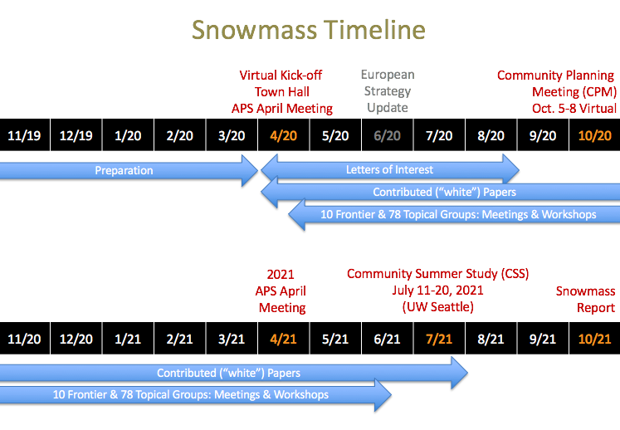
Snowmass 2021: Conclusion
We aim for everyone’s voice to be heard: Everyone from international community
Visit the Snowmass wiki page “often”: One-stop shop https://snowmass21.org/
Snowmass is a community-driven process
  We welcome any comments, suggestions, and concerns from the community
Look forward to strong participation from Canadian colleagues!!

