Slide 1
Overview of the DOE Nuclear Physics (NP) Program
TRIUMF Science Week 2020
August 17-21, 2020

Slide 2


The 2015 Long Range Plan for Nuclear Science
Recommendations:
Capitalize on investments made to maintain U.S. leadership in nuclear science.
Develop and deploy a U.S.-led ton-scale neutrino-less double beta decay experiment.
Construct a high-energy high-luminosity polarized electron-ion collider (EIC) as the highest priority for new construction following the completion of FRIB.
Increase investment in small-scale and mid-scale projects and initiatives that enable forefront research at universities and laboratories.
NP continues to execute on the 2015 LRP Vision

Slide 3
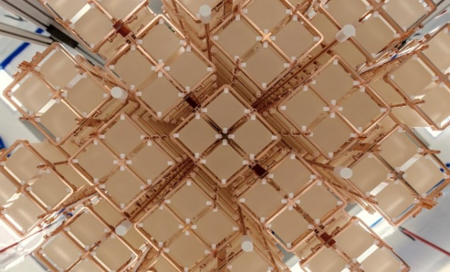
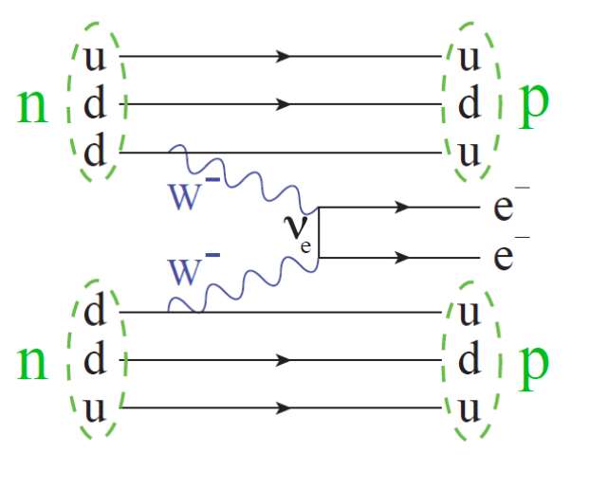
A Most Pressing Priority: Check The Last Box !
How can it be determined whether the neutrino is a Majorana Particle?
Search for Neutrino-less Double Beta Decay (0νββ ): in a selected nucleus, two neutrons decay into two protons and two electrons, with no neutrinos being emitted.
Scientists have been eagerly working to demonstrate the necessary sensitivity
TeO₂ Crystals from CUORE
TeO₂ from CUORE and CUOREcino
1.5 × 10²⁵ years, 90% CL
Ge⁷⁶ from Majorana Demonstrator
1.9 × 10²⁵ years, 90% CL
Ge⁷⁶ from GERDA
8.0 × 10²⁵ years, 90% CL
Xe¹³⁶ from EXO-200
1.8 × 10²⁵ years, 90% CL
Xe¹³⁶ from Kamland-Zen
1.1 × 10²⁶ years, 90% CL
It can only happen if the two neutrinos from the two W⁻ particles annihilate internally because the neutrino is its own anti-particle
FY 2020 Enacted: $1M
Goal is significant forward progress this calendar year.

Slide 4
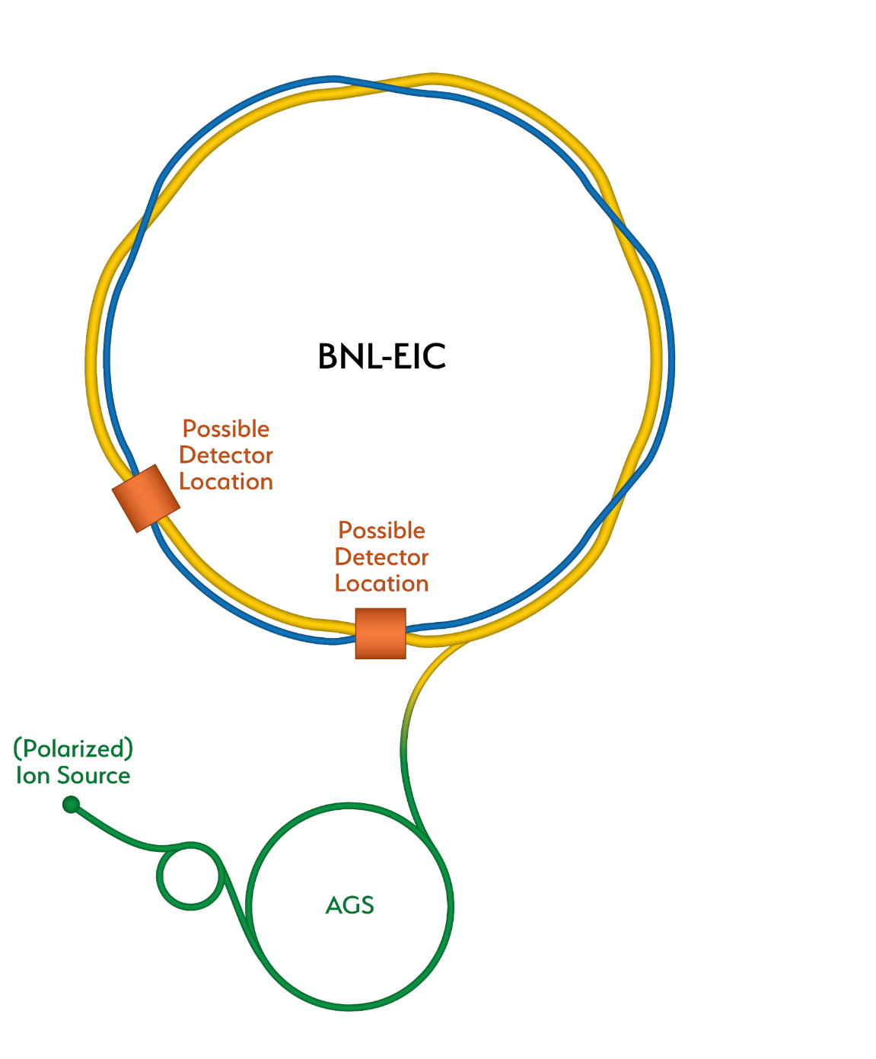
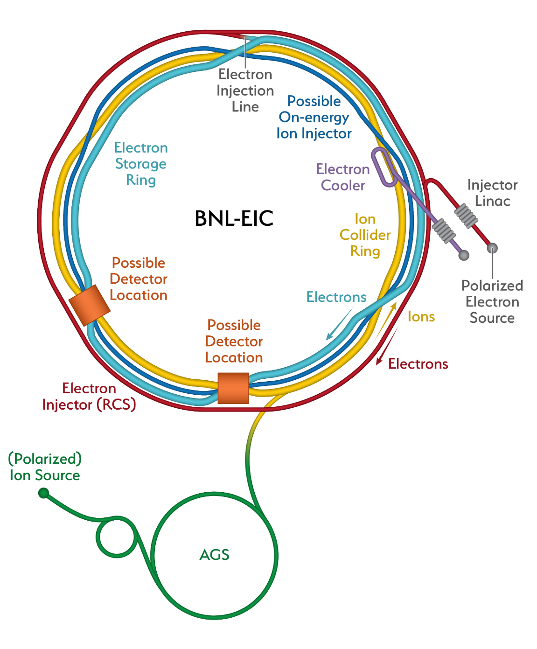
Recent Major Milestone: EIC CD0
eRHIC
The EIC will be located at BNL and with TJNAF as a major partner. The realization of the EIC will be accomplished over the next decade at an estimated cost between $1.6 and $2.6 billion.
Utilize existing operational hadron collider; add electron storage ring, cooling in existing RHIC tunnel and electron injector.
The EIC’s high luminosity and highly
polarized beams will push the frontiers
of accelerator science and technology
and provide unprecedented insights into the building blocks and forces that hold atomic nuclei together.
RHIC
The EIC will be a game-changing resource for the international nuclear physics community. DOE looks forward to engaging with the international community and the international funding agencies about potential collaborations and contributions to the EIC effort, in nuclear, accelerator and computer science.

Slide 5
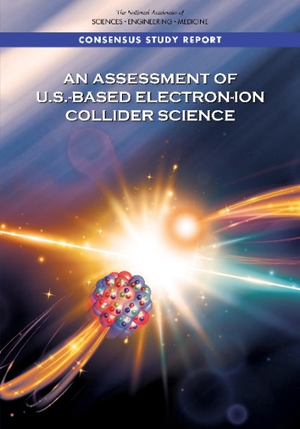
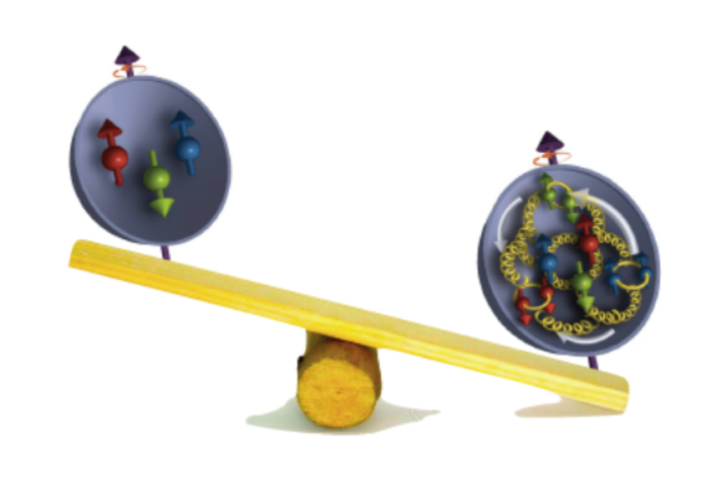
NAS EIC Assessment
NAS Report: AN ASSESSMENT OF U.S.-BASED ELECTRON-ION COLLIDER SCIENCE
“An EIC can uniquely address three profound questions
About nucleons—neutrons and protons—and how they
are assembled to form the nuclei of atoms:
• How does the mass of the nucleon arise?
• How does the spin of the nucleon arise?
• What are the emergent properties of dense systems of gluons?”
The EIC would be a unique facility & maintain leadership in nuclear science
The EIC would maintain leadership in the accelerator science and technology of colliders

Slide 6
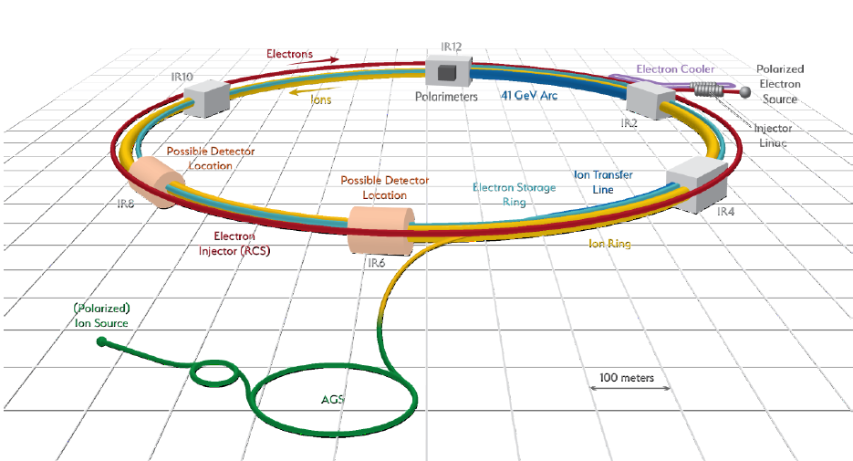
EIC Scope
EIC scope includes the machine upgrades to RHIC asset and two interactions regions
with one of the interaction regions outfitted with a major detector.
Scientific instrumentation for the second interaction region not included in the scope.
6

Slide 7
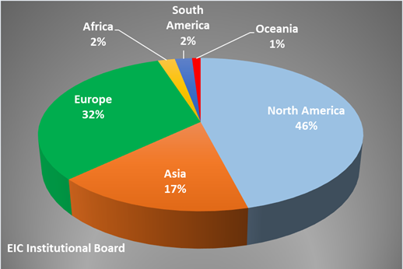
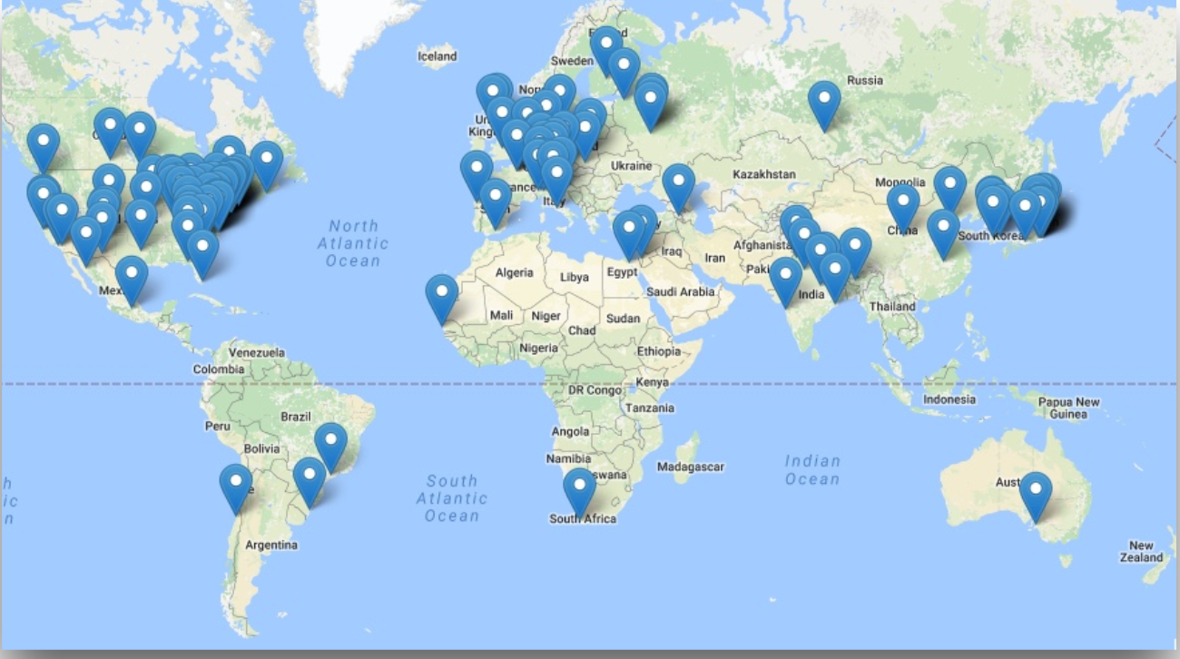
EIC Users Group and International Interest
Formed in 2016; currently:
  >1100 members
  205 institutions
  30 countries

Slide 8
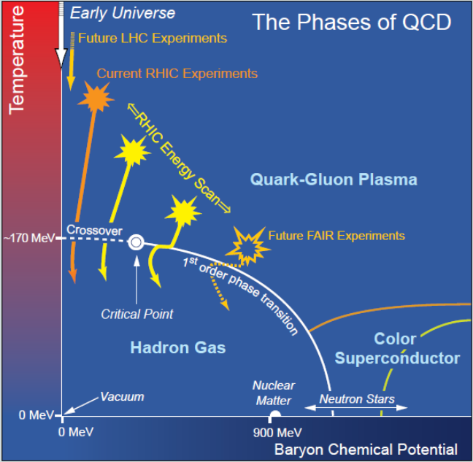
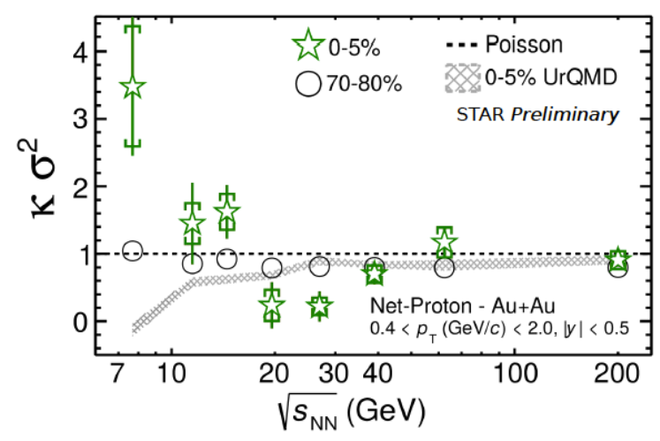
Near-Term at RHIC: Beam Energy Scan II (BESII)
One striking fact is that the liquid-vapor curve can end. Beyond this “Critical Point” the sharp distinction between liquid and vapor is lost. Experimentally verifying the location of fundamental QCD “landmarks” such as the Critical Point is central to a quantitative understanding of the nuclear matter phase diagram.
A primary signature of the Critical Point: non-Poissonian scaled kurtosis (net baryon number fluctuations)
RHIC has Consistently high facility availability (~85%)
No other facility worldwide, existing or planned, rivals RHIC in science reach and versatility as a heavy ion collider. It is the only polarized proton collider in the world.

Slide 9

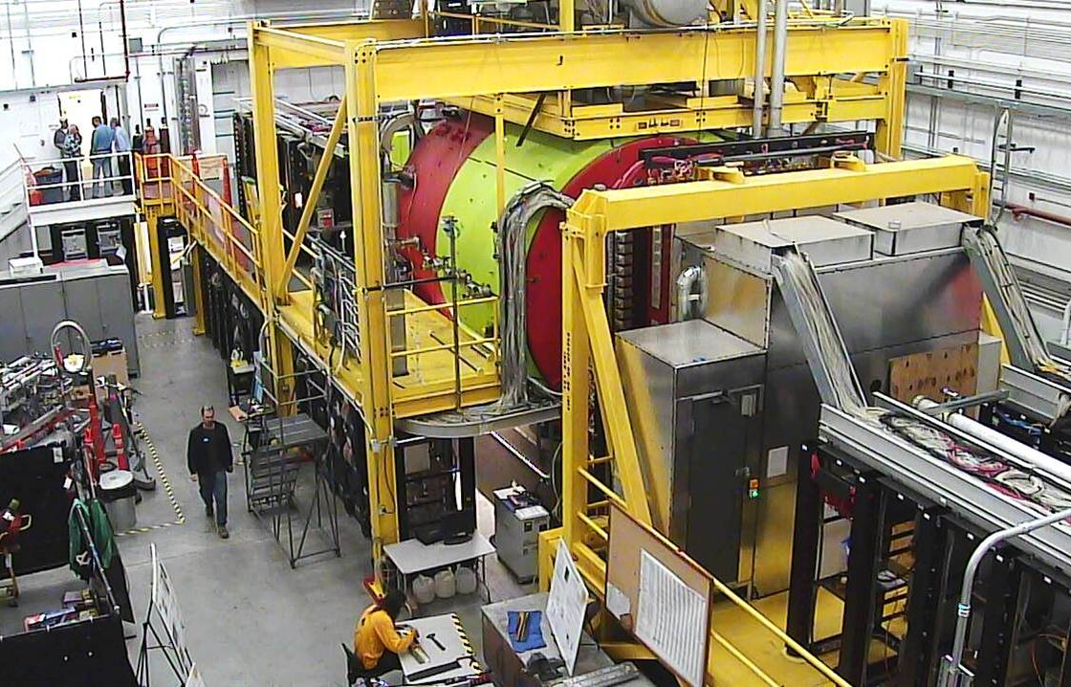
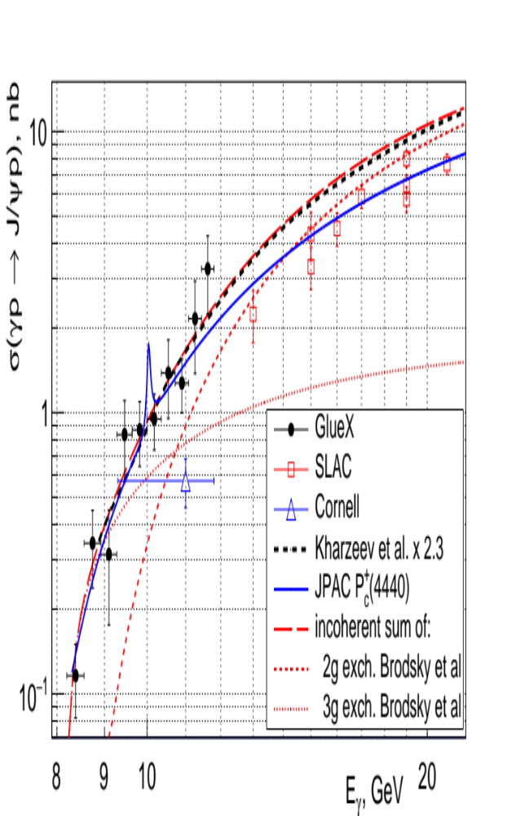
12 GeV CEBAF Science Program is Underway
New results from GlueX illuminate the mechanism of threshold J/Psi production and the upper limit on the pentaquark. The latter provides constraints on the structure of the LHCb pentaquark, favoring a molecular description.
Phys. Rev. Lett. 123, 072001(2019)
(Based on ~25% of collected data.)

Slide 10
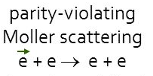
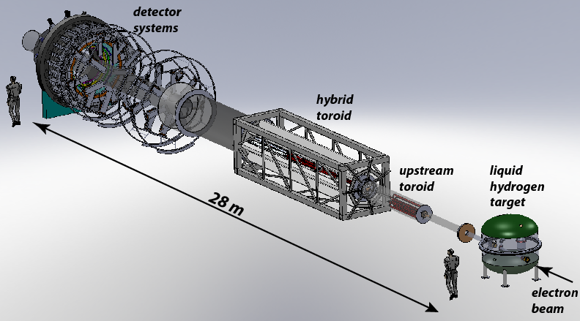
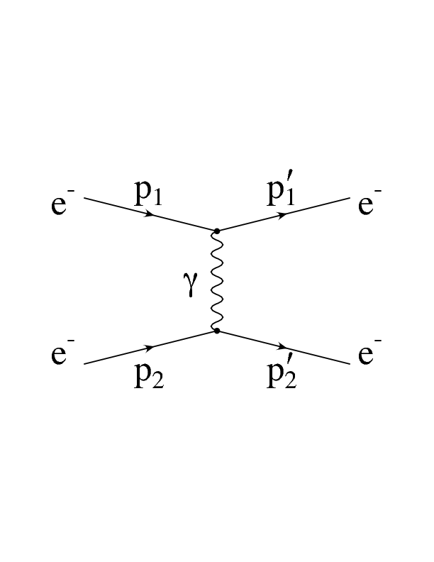
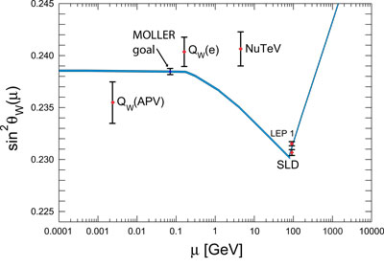
MOLLER: a “Must Do” Experiment To Point the Way to New Science
The scientific world rather desperately needs additional markers due to the consistency thus far of LHC data with Standard Model Predictions. Due to the technical challenge of constructing a next generation accelerator with very high accelerating gradients, those markers will have to come from “indirect” discovery experiments like MOLLER.
Z
In MOLLER, polarized electrons are scattered of unpolarized electrons. The amount of parity violation due to interference of the two possible exchange mechanisms (γ or Z) is precisely predictable in QED. (No messy quarks or color charge, or QCD to worry about, only quantum electrodynamics). The theory is so “clean” that like the g-2 approach, If the level of parity violation is greater than expected, a new particle must be the source of the discrepancy.
Projected sensitivity to Standard Model prediction
FY 2020 Enacted: $2M

Slide 11
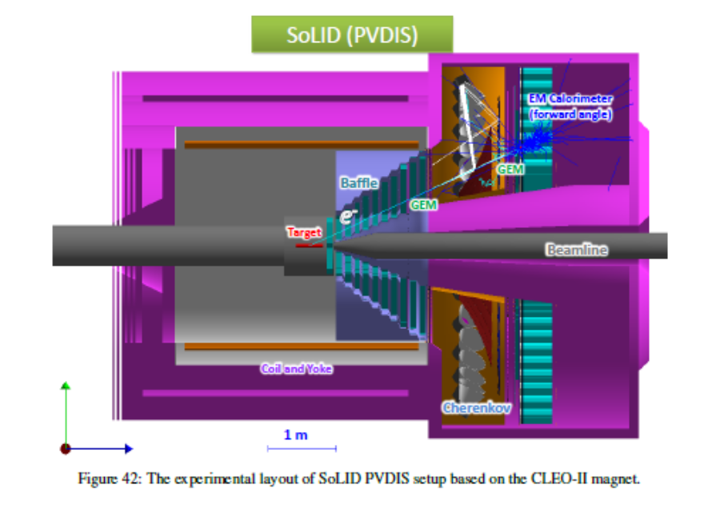
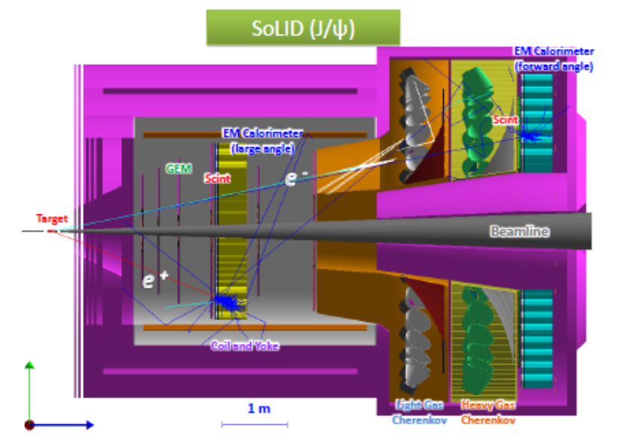
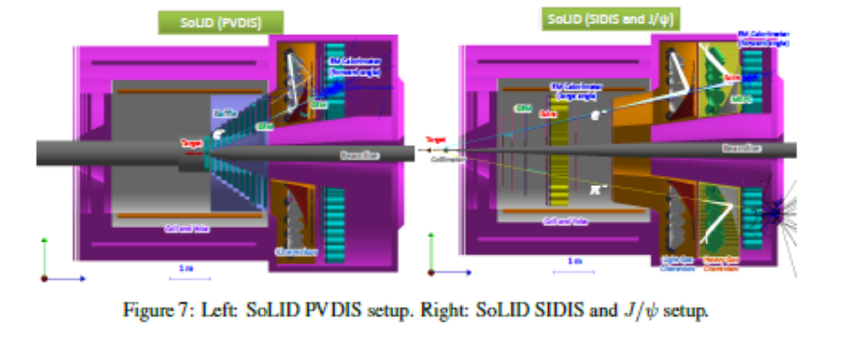
Anticipating SoLID
Pre-Conceptual Design Submitted to DOE February 2020
SoLID Science Review March 8-10, 2021
Possibility for Scientific Complementarity with EIC is Striking

Slide 12
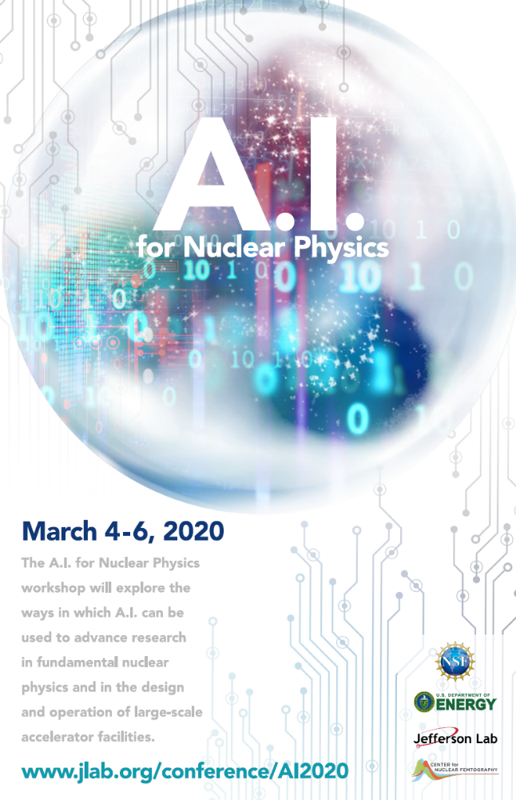
Jefferson Lab On the Move
Workshop on AI for Nuclear Physics
Announcement of the creation of a new Computational Science Division
Joint SC-NIH Workshop next year
A cross-cutting FOA lab call on AI was released in FY2020

Slide 13
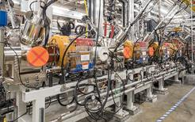
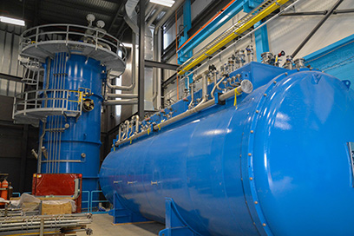
Facility for Rare Isotope Beams is > 94% Complete & “On the Way”
FRIB will increase the number of isotopes with known properties from ~2,000 observed over the last century to ~5,000 and will provide world-leading capabilities for research on:
Nuclear Structure
  The limits of existence for nuclei
  Nuclei that have neutron skins
  Synthesis of super heavy elements
Nuclear Astrophysics
  The origin of the heavy elements and explosive nucleo-synthesis
  Composition of neutron star crusts
Fundamental Symmetries
  Tests of fundamental symmetries,
  Atomic EDMs, Weak Charge
  This research will provide the basis for a predictive model of nuclei and how they interact.
The FY 2021 Request supports:
Completed fabrication and assembly of the linear accelerator (linac) cryomodule, allowing continued installation and testing in the constructed tunnel.
Fabrication, assembly, installation and testing of the experimental systems, and the commissioning of the linac and other components.
 | PYs | FY 2017 | FY 2018 | FY 2019 | FY 2020 | FY 2021 | DOE Total | MSU | TOTAL
FUNDING PROFILE | 318,000 | 100,000 | 97,200 | 75,000 | 40,000 | 5,300 | 635,500 | 94,500 | 730,000

Slide 14
GRETA is “On the Way”
GRETA Project is executing long lead procurement with detector module purchases. The Project just completed OPA pre-CD-2 review and is preparing for a CD-2 ESAAB.

Slide 15
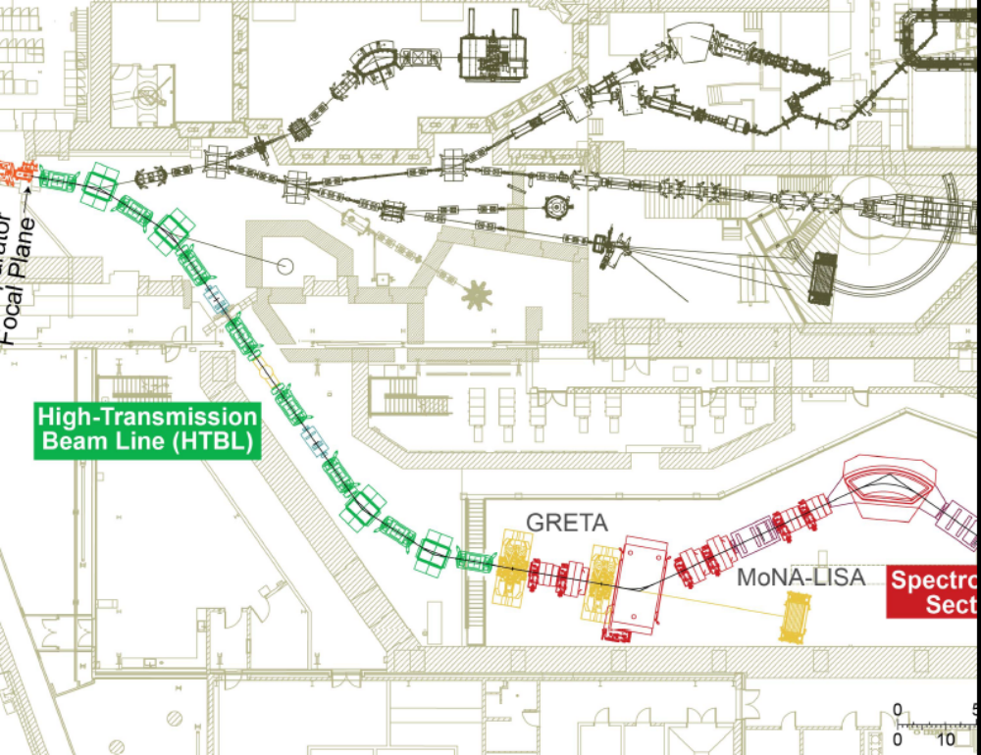
High Rigidity Spectrometer is on a Path
NP and the HRS project have worked together to progress towards a CD-1 ESAAB, which is being scheduled with OPA

Slide 16

The FRIB Theory Alliance is “On the Way”
to deliver excellent research in theory relevant to FRIB
to serve as a focal point for stimulating and continuous interactions between theory and experiment, drawing theory activity toward those problems relevant for the science at FRIB;
to rejuvenate the field by creating permanent positions in FRIB theory across the country;
to attract young talent through the national FRIB Theory Fellow program;
to strengthen theory in areas of most need;
to foster interdisciplinary collaborations and build scientific bridges to wider theory communities;
to coordinate a sustainable educational program in advanced low-energy nuclear theory;
to coordinate international initiatives in the theory of rare isotopes.

Slide 17

Personal Outlook
There is no “daylight” between theory and experiment in a well crafted science program
A theory which does not speak to experiment or allow for critical, skeptical experimental challenges is nothing more than an intellectual curiosity
The tango that needs to happen between experiment and theory 1) advances knowledge quickly; 2) points to necessary new lines of deeper inquiry; 3) points to the need for better theory & exp tools
Theory ?
Experiment ?

Slide 18
FRIB Fellow and Bridge Programs
  Fellow Program
  Diego Lonardoni (Hosting Institution: LANL; 2015-2020)
  Gregory Potel (Hosting Institution: MSU; 2016-2019, now staff at LLNL)
  Kevin Fossez (Hosting Institution: ANL; 2019 - )
  Chloe Hebborn (Hosting Institution: LLNL, 2020 - )
  Christian Drischler (Hosting Institution: MSU, 2020 - )
  Currently calling for partners; new search will take place Fall 2020!
  Bridge Program
  Saori Pastore (Institution: Wash U; start year 2018)
  Maria Piarulli (Institution: Wash U; start year 2018)
  Sebastian Konig (Institution: NCSU; start year 2020)
  TBD (Institution: FSU, search will take place Fall 2020)
  Considering whether there is enough interest to send out a call later this year…

Slide 19



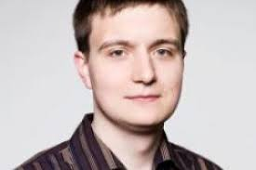
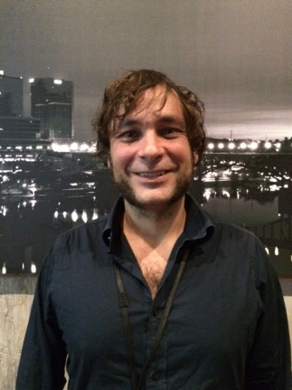
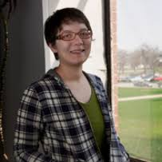

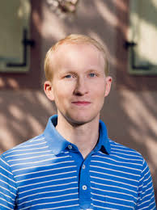
FRIB Theory Effort: A Future That Requires “Shades”
The FRIB Theory Alliance is working hard and very successfully to ensure their will be plenty of talented theory partners for the FRIB theory-experiment tango that is to come

Slide 20
FRIB First Experiments: Proposal Preparation Workshop
The purpose of the workshop is to help users prepare outstanding proposals for the first FRIB Program Advisory Committee Meeting in response to a call that will be issued in the Fall 2020 time frame. Due to COVID-19, the workshop will be held online using the Zoom video conference software….
Later this fall we hope to hold the in-person part of the workshop where interested parties will be able to meet in person with FRIB staff to work out experimental details. An overlapping FRIB Theory Alliance program and JINA-CEE program will offer the opportunity to work with theorists and astrophysical modelers.
May 4-8, 2020 - Online portion of FRIB Proposal Writing Workshop
Fall 2020 - In-person portion of FRIB Proposal Writing Workshop
Fall 2020 (estimated) - Call for Proposals for FRIB PAC
Early 2021 (estimated) - Proposal submission deadline
Spring 2021 (estimated) - FRIB PAC1 Meeting
2022 (estimated) - First FRIB User Experiments

Slide 21
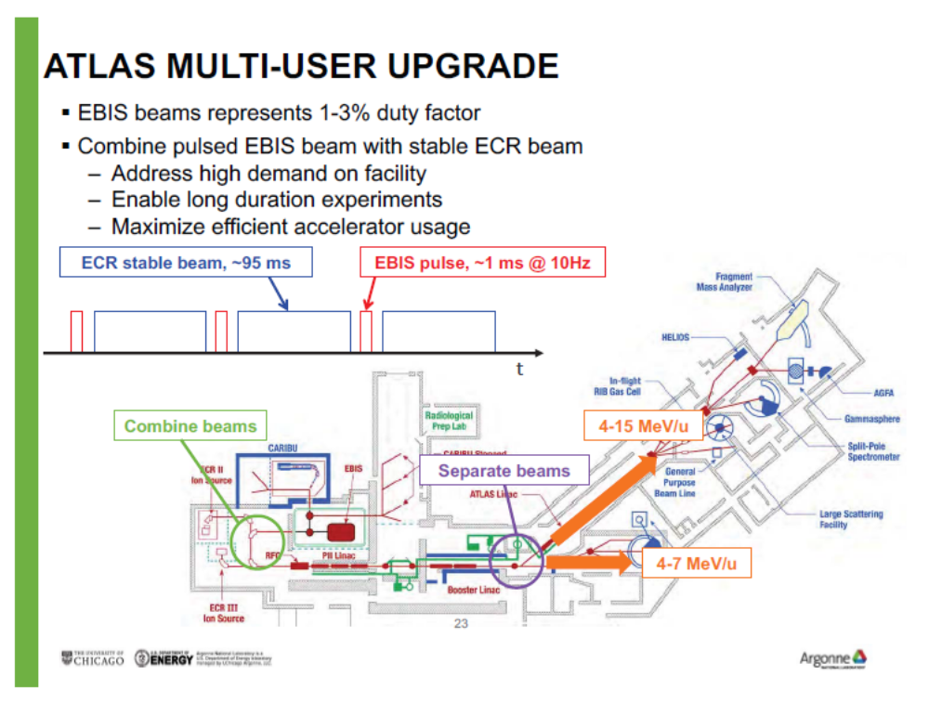
Ongoing Efforts to Enhance Capability for Users

Slide 22
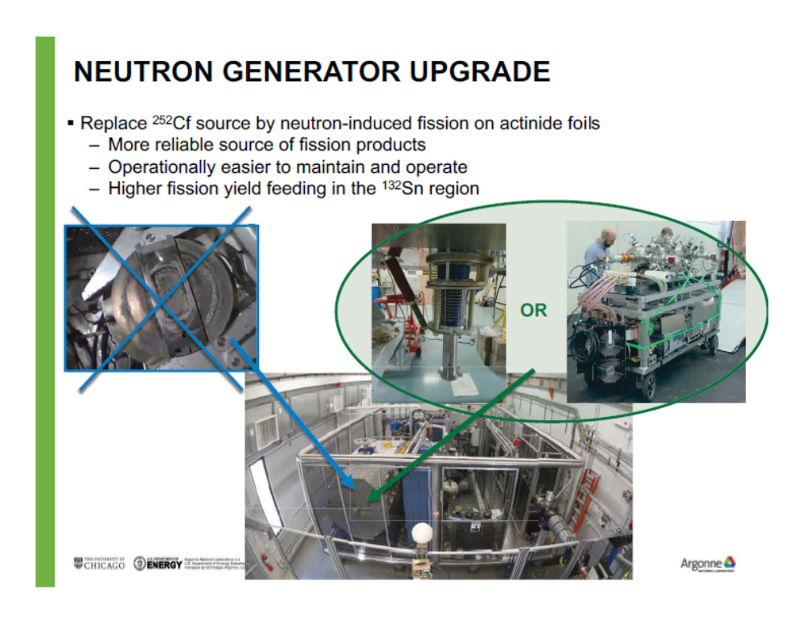
Also in Progress Plan to Upgrade CARIBU

Slide 23
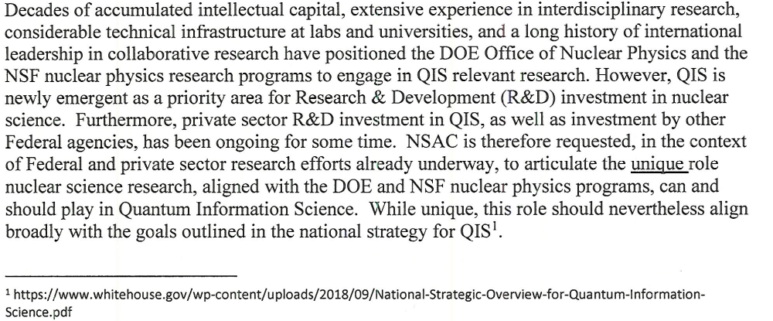
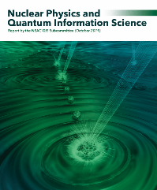
NSAC Assessment of the QIS Role of Nuclear Science is Complete
Peer review process for proposals received in respond to NP FY2019 FOA is concluded
NP awards in response to FOA to be announced very soon
SC process to establish QIS Centers is in final stages

Slide 24
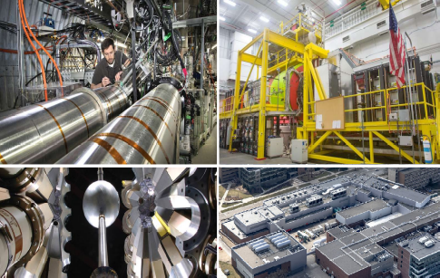
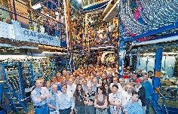
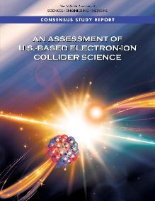
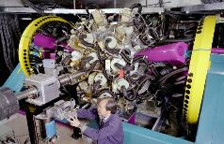
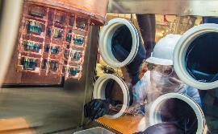
From “Forty-Thousand Feet” Things Look Good
RHIC
JLAB
Hall B
The vision to maintain U.S. leadership continues to be implemented: EIC construction; FRIB construction
ATLAS
At ANL
FRIB
World leading research supported at state-of-the-art NP National User Facilities
Pioneering experiments and research tools (MIEs) are created
Groundbreaking contributions to national cross-cutting priorities continue
FRIB
Underground Double Beta Decay Research
24

Slide 25
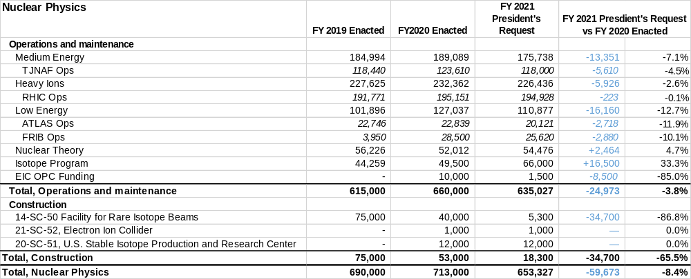
Nuclear Physics “As Appropriated” FY2020 Budget Status
IP and NP Budgets will separate in the FY 2022 Request
Enacted Appropriation: $713,000,000 for NP. Directs $28,500,000 for FRIB operations. Also directs optimal funding for operations, major items of equipment, and other project costs. $1,000,000 provided for the first year of EIC TEC funds, $12,000,000 for the first year of US SIPRC TEC funds, and $40,000,000 for FRIB Construction funds.
FY21 PR: $653.3M House Mark: NP $715M

Slide 26
The SC Microsite on Diversity, Equity & Inclusion.
The direct link is:
https://science.energy.gov/sc-2/research-and-conduct-policies/diversity-equity-and-inclusion/
“The DOE Office of Science (SC) is fully committed to fostering safe, diverse, equitable, and inclusive work, research, and funding environments that value mutual respect and personal integrity. Effective stewardship and promotion of diverse and inclusive workplaces that value and celebrate a diversity of people, ideas, cultures, and educational backgrounds is foundational to delivering on the SC mission. The scientific community engaged in SC-sponsored activities is expected to be respectful, ethical, and professional.
The DOE SC does not tolerate discrimination or harassment of any kind, including sexual or non-sexual harassment, bullying, intimidation, violence, threats of violence, retaliation, or other disruptive behavior in the federal workplace, including DOE field site offices, or at national laboratories, scientific user facilities, academic institutions, other institutions that we fund, or other locations where activities that we support are carried out…”

Slide 27
General Outlook on FY 20201 President’s Request
The experience with FY18, FY19 and FY20 budgets has required readiness for big swings in the budget. FY2021 is similar.
We must stay focused and continue to deliver important outcomes for the nation.
Delivering exciting discoveries, important scientific knowledge, technological advances, and workforce training is what we do.
We need to keep up the good work!

Slide 28
High Level Assessment
The program has approval to build a suite of new tools, big and small, which if successfully constructed promise discoveries and world leading science “as far as the eye can see”
A host of exciting new initiatives are being opened up, many with important implications for competitiveness and security
Nuclear Physics is able to pursue a significant participation in several of these initiatives
Erosion of resources to pursue core research is a continuing concern. The balance between research, projects, and facility operations needs to be watched
Thus far the community is staying resilient and focused, continuing to deliver important outcomes for the nation: exciting discoveries, important scientific knowledge, technological advances, and workforce training
The current situation with COVID-19 holds a number of lessons which must be lasting

Slide 29
Additional Information

Slide 30


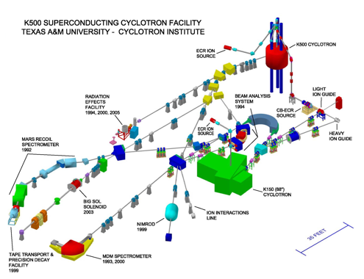
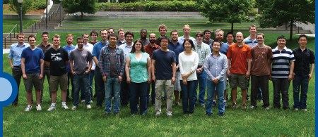

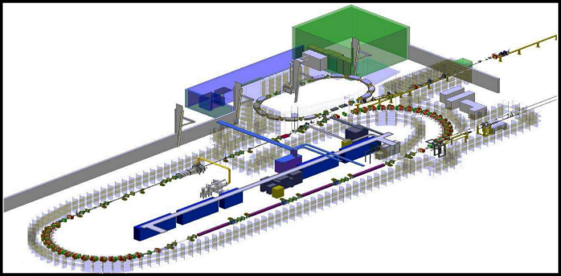
Two NP Centers of Excellence at TUNL and Texas A&M
The Triangle Universities Nuclear Laboratory (TUNL) is Center of Excellence that focuses on low-energy nuclear physics research. TUNL is a consortium Duke University, North Carolina State University, and the University of North Carolina at Chapel Hill comprising about 30 faculty members, 20 postdocs and research scientists, and 50 graduate students.
The Texas A&M University Cyclotron Institute jointly supported by DOE and the State of Texas focuses on conducting basic research, educating students in accelerator-based science and technology, and providing technical capabilities for a wide variety of applications in space science, materials science, analytical procedures and nuclear medicine.
The 88 inch cyclotron also plays a crucial role in space radiation effects chip testing for the Air Force

Slide 31
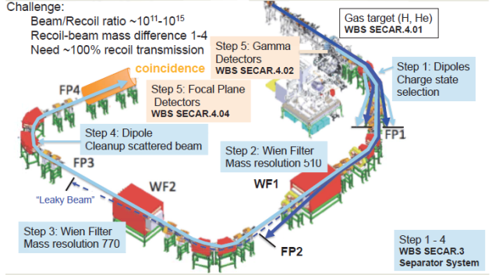
SECAR is “On the Way”
SECAR is close to completion and commissioning has begun

