Slide 1
WinCNR: Windsor Centre for Neutron Research
Drew Marquardt
      Department of Chemistry and Biochemistry
      University of Windsor
TRIUMF Science Week
August 21, 2020
Notes:
Introduce the reason we are here.

Slide 2
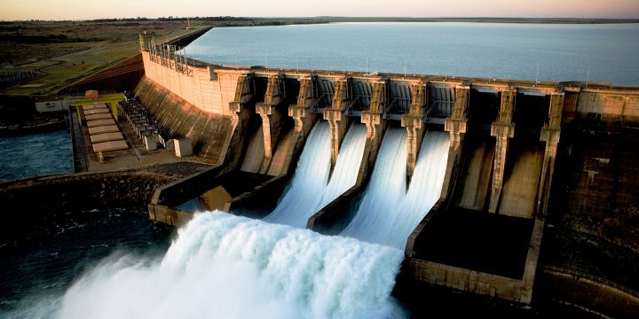
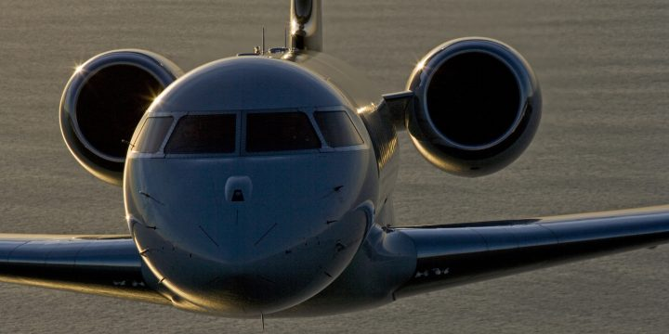
Neutron’s Impact in Canada
Clean environment
  Improved the reliability of turbines in hydroelectric dams.
Economic competitiveness
  Developed methods of reducing scrap waste during manufacturing.
Notes:
Hydro-Québec has used neutron stress-scanning data in research to improve the reliability of turbine runners, which are key components in hydroelectric dams. Turbine runners can cost up to $10M each, and losses in electricity production if one fails can be very costly. Hydro-Québec has used the stress-scanning results to show that optimization of manufacturing processes like welding and heat treatment can improve the lifetime of turbines, often without any increase in the manufacturing cost (http://cins.ca/2015/07/01/hydro/).
Canadian aerospace leaders Bombardier and StandardAero gained knowledge needed to reduce scrap waste and advance methods to make and repair engines

Slide 3
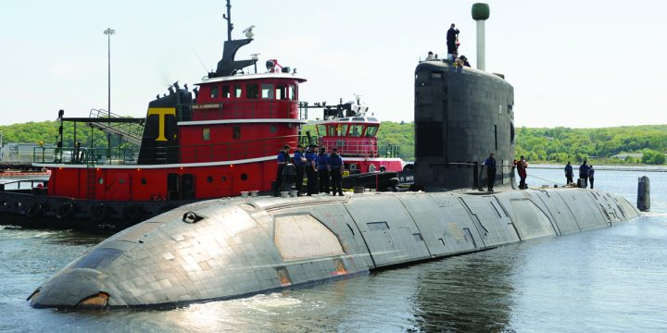

Neutron’s Impact in Canada
Safety and security
  Extended the lives of Canada’s fleets of ships.
Health and food security
  Accelerate the development of drought resistant crops.
Notes:
Defence Research and Development Canada (DRDC) has also gained knowledge to safely extend the useful lives of Canada’s fleets of ships, thereby saving resources for other security needs. It has also leveraged these findings to gain close working relationships with Canada’s allies on projects to manage corrosion and other aging concerns common to many Western navies (http://cins.ca/2014/11/01/defence/; http://cins.ca/2014/05/01/defence-2/).
Developed neutron imaging as a method to accelerate the development of crops, such as by matching genetic variation to observable traits that enhance drought resistance (http://cins.ca/2017/05/04/agriculture/
Another excellent feature is that neutrons are not damaging to plants. Neutron imaging, then, is a ground-breaking (no pun intended) and minimally invasive technique that aims to rapidly visualize plant root architecture in situ (in soil).

Slide 4
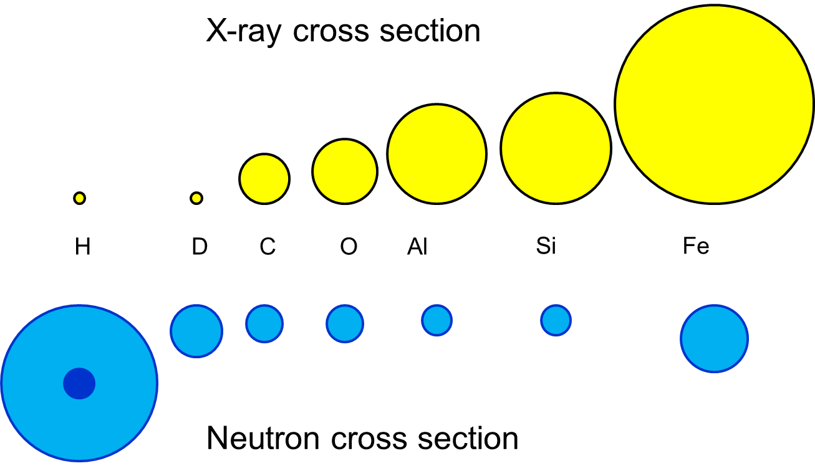
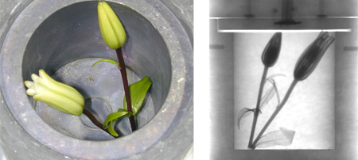
Neutrons
Neutral charge
Highly penetrating
Sensitive to:
  light elements
  isotopes
Magnetic moment
https://phys.org/news/2014-09-darpa-highly-portable-neutron-sources.html

Slide 5
Sources of Neutrons
Fission Reactor → U²³⁵ + n (thermal)
  Expensive ~$1B
Spallation → “blowing chunks” (p,n)
  Expensive ~$1-2B
  High energies
Stripping-Reaction → Be/Li(p,n)
  Low energy = small footprint = inexpensive
  Modular

Slide 6
Sources of Neutrons
Fission Reactor → U²³⁵ + n (thermal)
  Expensive ~$1B
Spallation → “blowing chunks” (p,n)
  Expensive ~$1-2B
  High energies
Stripping-Reaction → Be/Li(p,n)
  Low energy = small footprint = inexpensive
  Modular
  Compact Accelerator Neutron Source (CANS)

Slide 7

Current efforts and the next 10 years
What are we going to do tonight Brain?
Same thing we do every night Pinky. Try to secure Neutrons for Canada
https://wegotthiscovered.com/tv/pinky-brain-returning-animaniacs-revival/

Slide 8




Canadian Neutron Initiative – High level
Create a new, national governance and management framework – Neutrons Canada.
Forge partnerships with neutron sources in other countries.
Build on existing domestic capabilities.
Explore and invest in developing new neutron sources for the long term.

Slide 9
Researcher Led Canadian Initiatives
CFI-IF McMaster et al.
NFRF Windsor et al.
$36M (under review)
Upgrade MNR neutron scattering facilities
Buy into foreign sources
Bridge the next 5-10 years
NFRF- E (awarded)
  $250 K for design study
NFRF- T (LOI under review)
  $24 M for prototype development
Potential long-term source for Canada.

Slide 10
Researcher Led Canadian Initiatives
CFI-IF McMaster et al.
NFRF – Windsor et al.
$36M (under review)
Upgrade MNR neutron scattering facilities
Buy into foreign sources
Bridge the next 5-10 years
NFRF- E (awarded)
  $250 K for design study
NFRF- T (LOI under review)
  $24 M for prototype development
Potential long-term source for Canada.

Slide 11
NFRF-Exploration - $250,000
Windsor-TRIUMF led computational feasibility study
  5-10 MeV proton beams, Be/Li target
Small footprint
Achieve a medium-flux reactor performance
Progress:
  White paper
  PhD Student (UVic/TRIUMF)
  Postdoc (UWindsor/TRIUMF)

Slide 12
NFRF-Exploration Participants
15 Researchers from 11 institutions
University of Windsor
TRIUMF
University of Victoria
McMaster University
Fedoruk Centre
Canadian Nuclear Laboratory
University of Toronto
University of British Columbia
University of Winnipeg
University of Calgary
University of Waterloo

Slide 13
CANS Prototype: Windsor Centre for Neutron Research (WinCNR)
University of Windsor-led initiative to construct and operate a
Compact Accelerator-based Neutron Source (CANS)
New Frontiers in Research Fund – Transformation Stream: $24 M
  40 researchers from 19 institutions spanning 4 countries
Connections to TRIUMF:
Dr. Oliver Kester, Dr. Bob Laxdal and Dr. Alex Gottberg are members of the leadership team and key to the design of the accelerator-target assembly
The PhD student and Postdoc associated with the NFRF-Exploration stream working on CANS design elements are stationed at TRIUMF through the University of Victoria and the University of Windsor.
Notes:
The Windsor Centre for Neutron Research (WinCNR) is a national-scale initiative to build an innovative source of neutrons and operate it for research purposes and for medical isotope production.
There are at least two connections to WRH:
Notably, the accelerator will also produce the medical isotope used for PET scanning.
One of your radiation oncologists, Dr. Ming Pan, is the co-Principal Investigator on the proposal because demonstrating a new cancer treatment is a big part of our proposal

Slide 14
WinCNR: Missions
Construct a world-leading CANS prototype to demonstrate the potential for the technology
Conduct research using the following neutron methods:
  Small-angle neutron scattering:
  Neutron Imaging:
  Boron Neutron Capture Therapy:
Supply Windsor Regional Hospital with
Fluorine-18 isotope for the PET scanner
Notes:
The missions of the Windsor Centre for Neutron Research (WinCNR) include demonstrating a new way to produce neutrons that are bright enough for the Canadian community of materials researchers, and is a strategic priority for this national community.
Once it is built and demonstrated, we expect to operate it for the next 20-30 for research in several areas including those mentioned on the slide, and for medical isotope production (described on next slide)

Slide 15
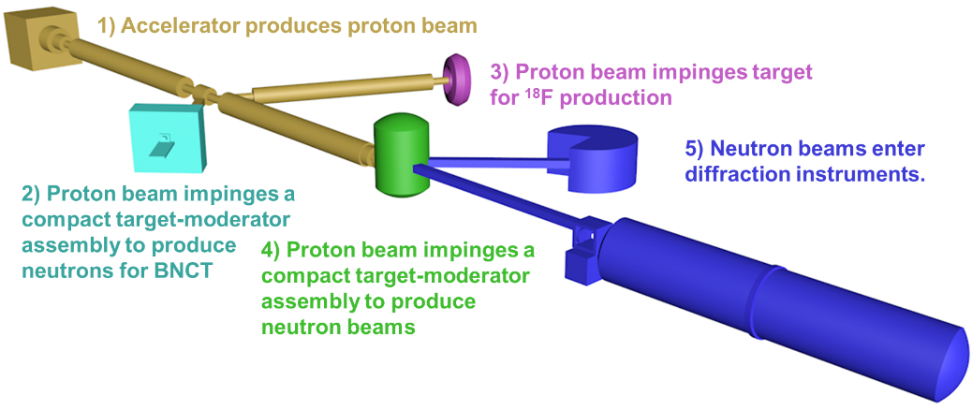
CANS Prototype: WinCNR

Slide 16

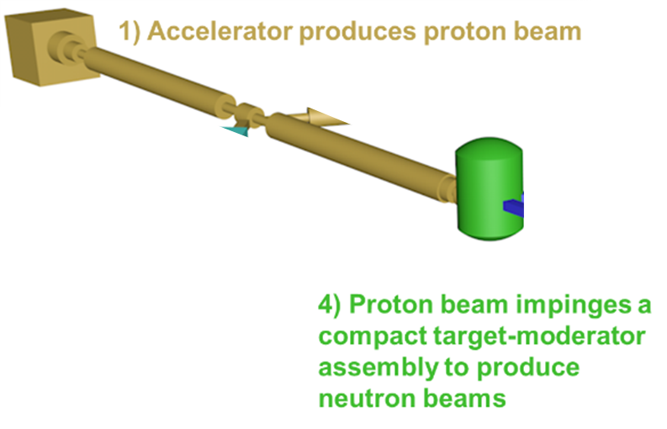
CANS Prototype: Neutron Production

Slide 17
Target-Moderator Research
Accelerator requirements for:
  Neutron scattering
  BNCT
  Isotope production
Target material and geometry
  How to handle the high powers on target
  Multiple targets?
  Optimized extraction strategy
Build from our friends at Julich and in Japan

Slide 18
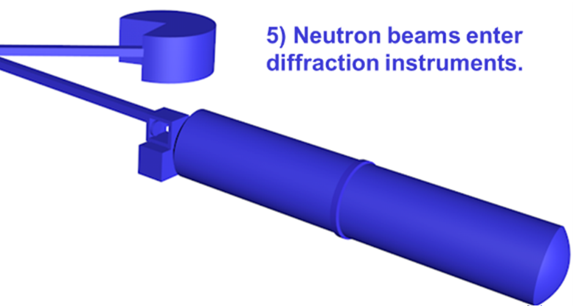
Materials Science Research

Slide 19
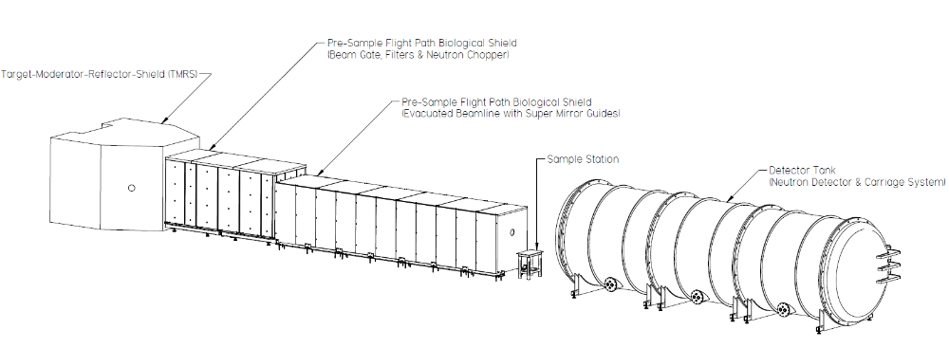
Materials Science Research
Notes:
We have a design

Slide 20
Neutrons for Materials Research
Examine the stresses deep inside industrial materials that X-rays cannot penetrate.
Unravel the structures of biological systems under physiological conditions.
Sensitivity to H to develop technologies such as fuel cells and hydrogen storage materials.
Magnetic property to develop superconductive, magnetic and quantum materials.

Slide 21
Neutron Imaging and Radiography
Internal flaws of metal products
  cracks, inclusions, voids, bubbles, foreign materials, density variations & misalignments
Corrosion within aluminum products
Radioactive objects in its shielding
Authentication of artifacts from archeological digs
Hydrogenous foreign substances in sealed units

Slide 22
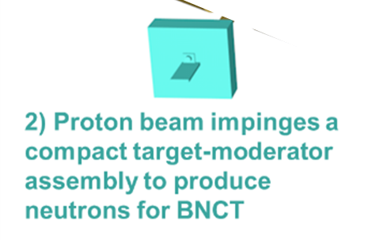
Boron Neutron Capture Therapy

Slide 23
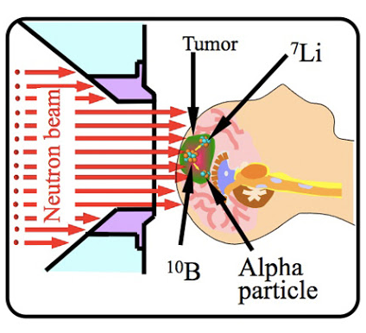
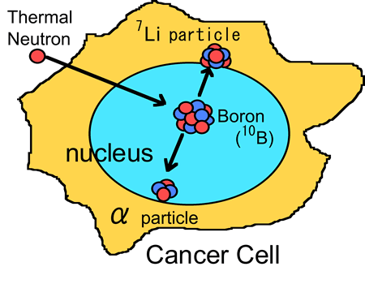
Boron neutron capture: powerful, highly targeted therapy
Inject ¹⁰B agent to target a tumor
Verify ¹⁰B uptake with PET scanner
Irradiate tumor with neutrons
¹⁰B releases α-particle that kills host cancer cell, while leaving surrounding cells intact
WinCNR will be first & only BNCT facility in Canada. BNCT Science leadership:
Dr. Ming Pan (WRH & Western U)
Dr. Lisa Porter (U Windsor)
Dr. Marcus Drover (U Windsor)
Japan Atomic Energy Agency
https://www.jaea.go.jp/english/news/p06071001/index.shtml
Notes:
Dr. Ming Pan (WRH / Western) will lead the cancer therapy research with Prof. Lisa Porter and Marcus Drover (U Windsor)
Boron neutron capture therapy (BNCT) is a form of cancer treatment that is highly promising for cancers that are currently untreatable, such as glioblastoma (brain cancer)
Very few facilities in the world offer BNCT because bright enough neutrons sources are rare. Patients travel around the world to such facilities.
The alpha particles produced by BNCT have a very high energy, but travel only about the width of a single cell, and thus BNCT is a highly localized treatment.
Dr. Ming Pan will lead a clinical trial, while Lisa Porter will develop mouse models for pre-clinical research. Marcus Drover (U Windsor) is an expert in the chemistry of boron compounds.
Radiation produced very low penetrating 5-8 um, thus localized.

Slide 24
Medical Isotope Production

Slide 25
Supplying WRH PET Scanner with FDG
PET scanning requires a radiopharmaceutical:
  [¹⁸F]-fluorodeoxyglucose, known as FDG
  ¹⁸F has a short half-life (~110 min.)
WRH Current Patient Load
  ~700 patients/year and will increase in the next decade
WRH Projected Patient Load by 2030
  ~2500 patients/year which is not sustainable with current FDG supplier in London
WinCNR will begin FDG production after accelerator is commissioned, about 2025
Notes:
Current supply of FDG is produced in London.
Over half of the FDG is lost during the shipment, so London has to ship more than twice the total activity needed to be used for the Windsor patients.
This creates significant radiation safety implications potentially limiting the number of cancer patients Windsor can serve.
A local supply of FDB in Windsor will relieve this limitation.
We aim to begin construction of the WinCNR in 2021. With this in mind we estimate FDG production starting in about 2025.

Slide 26

20-year Outlook - Beyond the prototype
WinCNR Prototype fully operational
  Active materials and BNCT research
  Ongoing and reliable source of FDG for WRH and surrounding
  Further target-moderator research and optimization
How can CANS technology best serve Canada?
  Large scale national user facility
  A series of university sized CANS
  distributed throughout Canada
Governance
  National governance structure
https://images.app.goo.gl/pJH19hQWbhL1CNjb6

Slide 27



Acknowledgements
Dalini Maharaj (UWindsor/TRIUMF)
Mina Abbaslou (UVic/TRIUMF)
Ming Pan (WHR)
Oliver Kester (TRIUMF)
Bob Laxdal (TRIUMF)
Alex Gottberg (TRIUMF)
Zin Tun (McMaster/TVB)
Thomas Gutberlet (Julich)
Daniel Banks (TVB)
Windsor Regional Hospital
Canadian Neutron Initiative
NFRF Team

