Slide 1


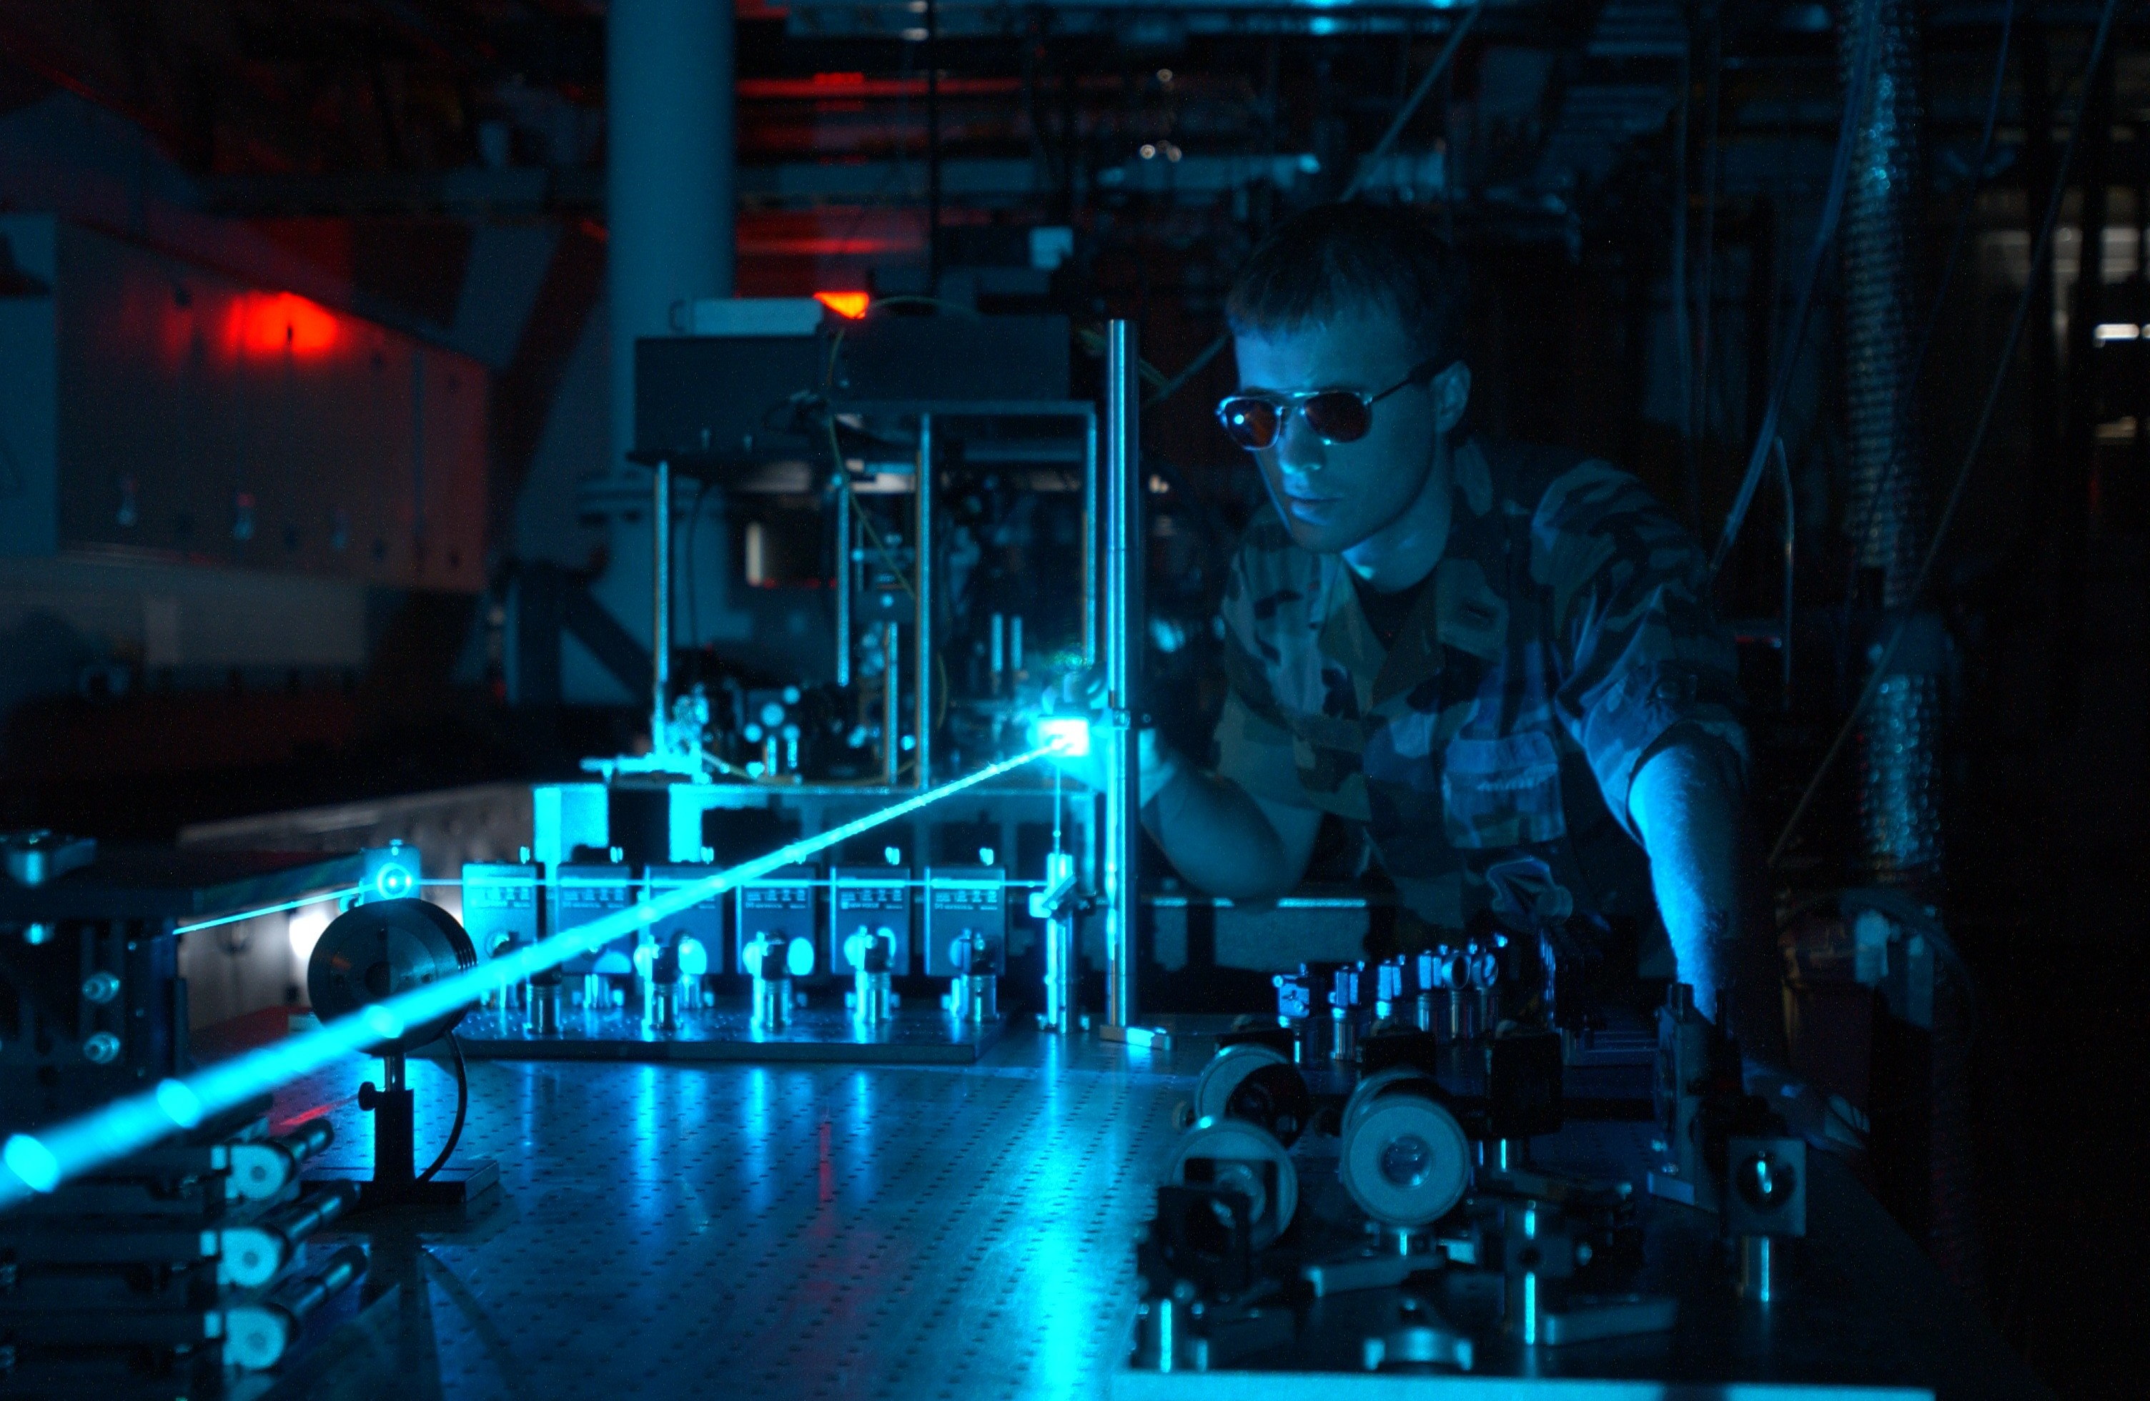

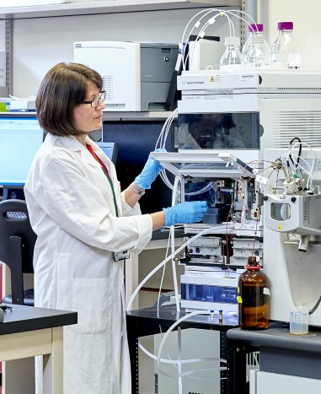
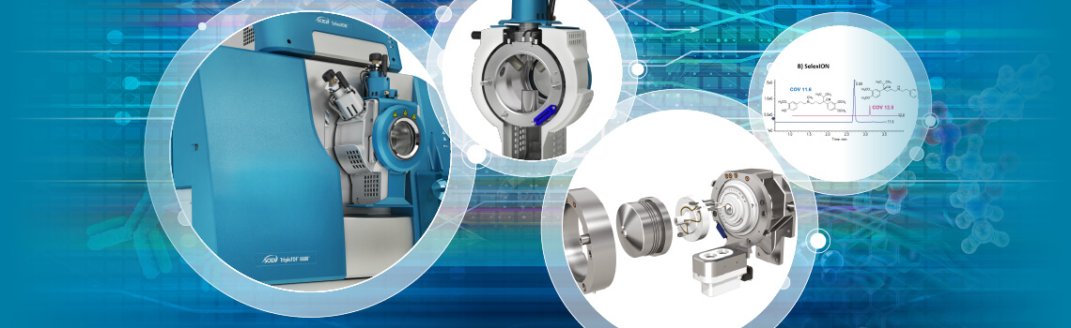
The Hopkins Lab
For gas phase cluster research
Future Canadian Infrastructure for Photon Science
21 August 2020

Slide 2

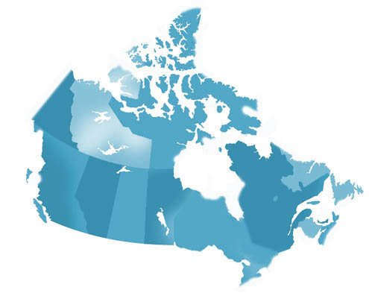
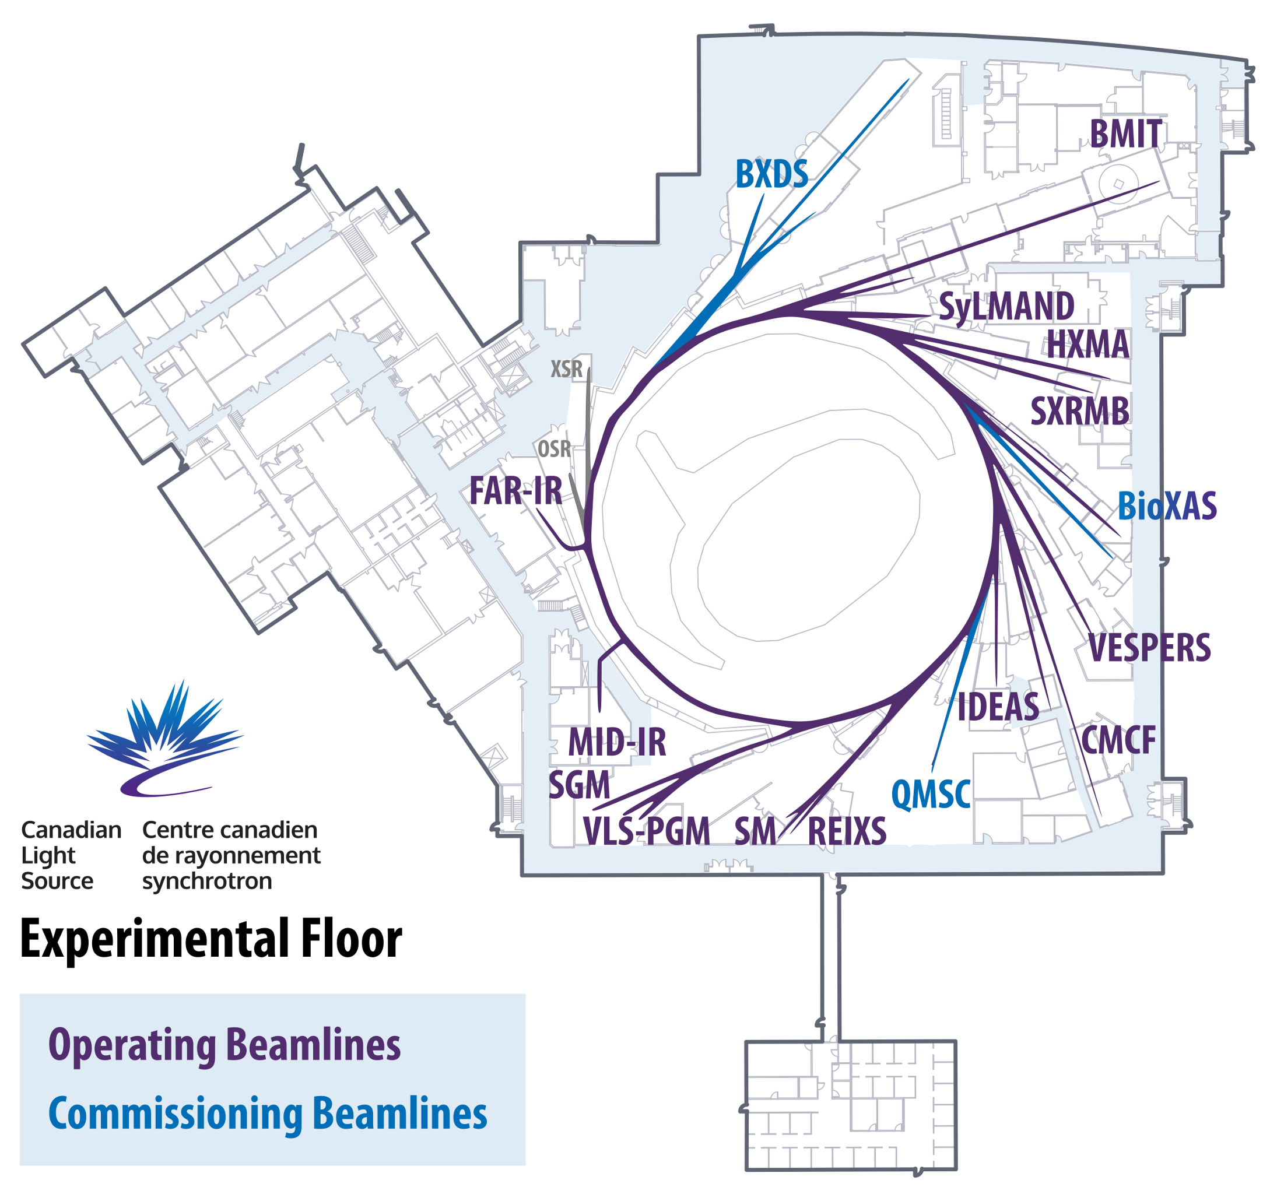
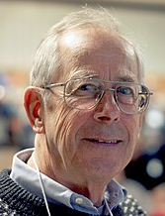
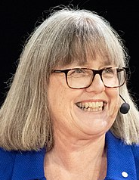

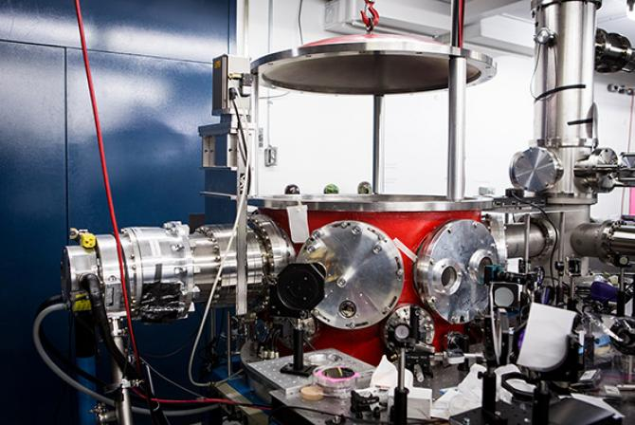
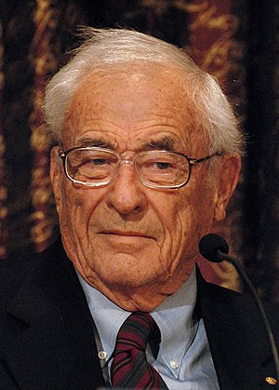
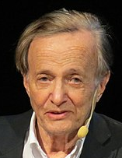
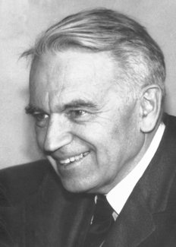
Photonic Science - A Canadian Tradition of Excellence
James Peebles
Cosmic microwave background
Cosmic infrared background
Exoplanet discovery
Physics Nobel Prize 2019
Donna Strickland
Ultrafast optics
Chirped pulse amplification
Physics Nobel Prize 2018
Willard Boyle
Laser technology
Charge-coupled device
Physics Nobel Prize 2009
John Polanyi
Chemical Kinetics
Infrared Chemiluminescence
Chemistry Nobel Prize 1986
Gerhard Herzberg
Electronic Structure of Molecules
Atomic & Molecular Spectroscopy
Chemistry Nobel Prize 1971
Numerous research programs across Canada
Last major investments: 1999, 2003
2 | Slide

Slide 3
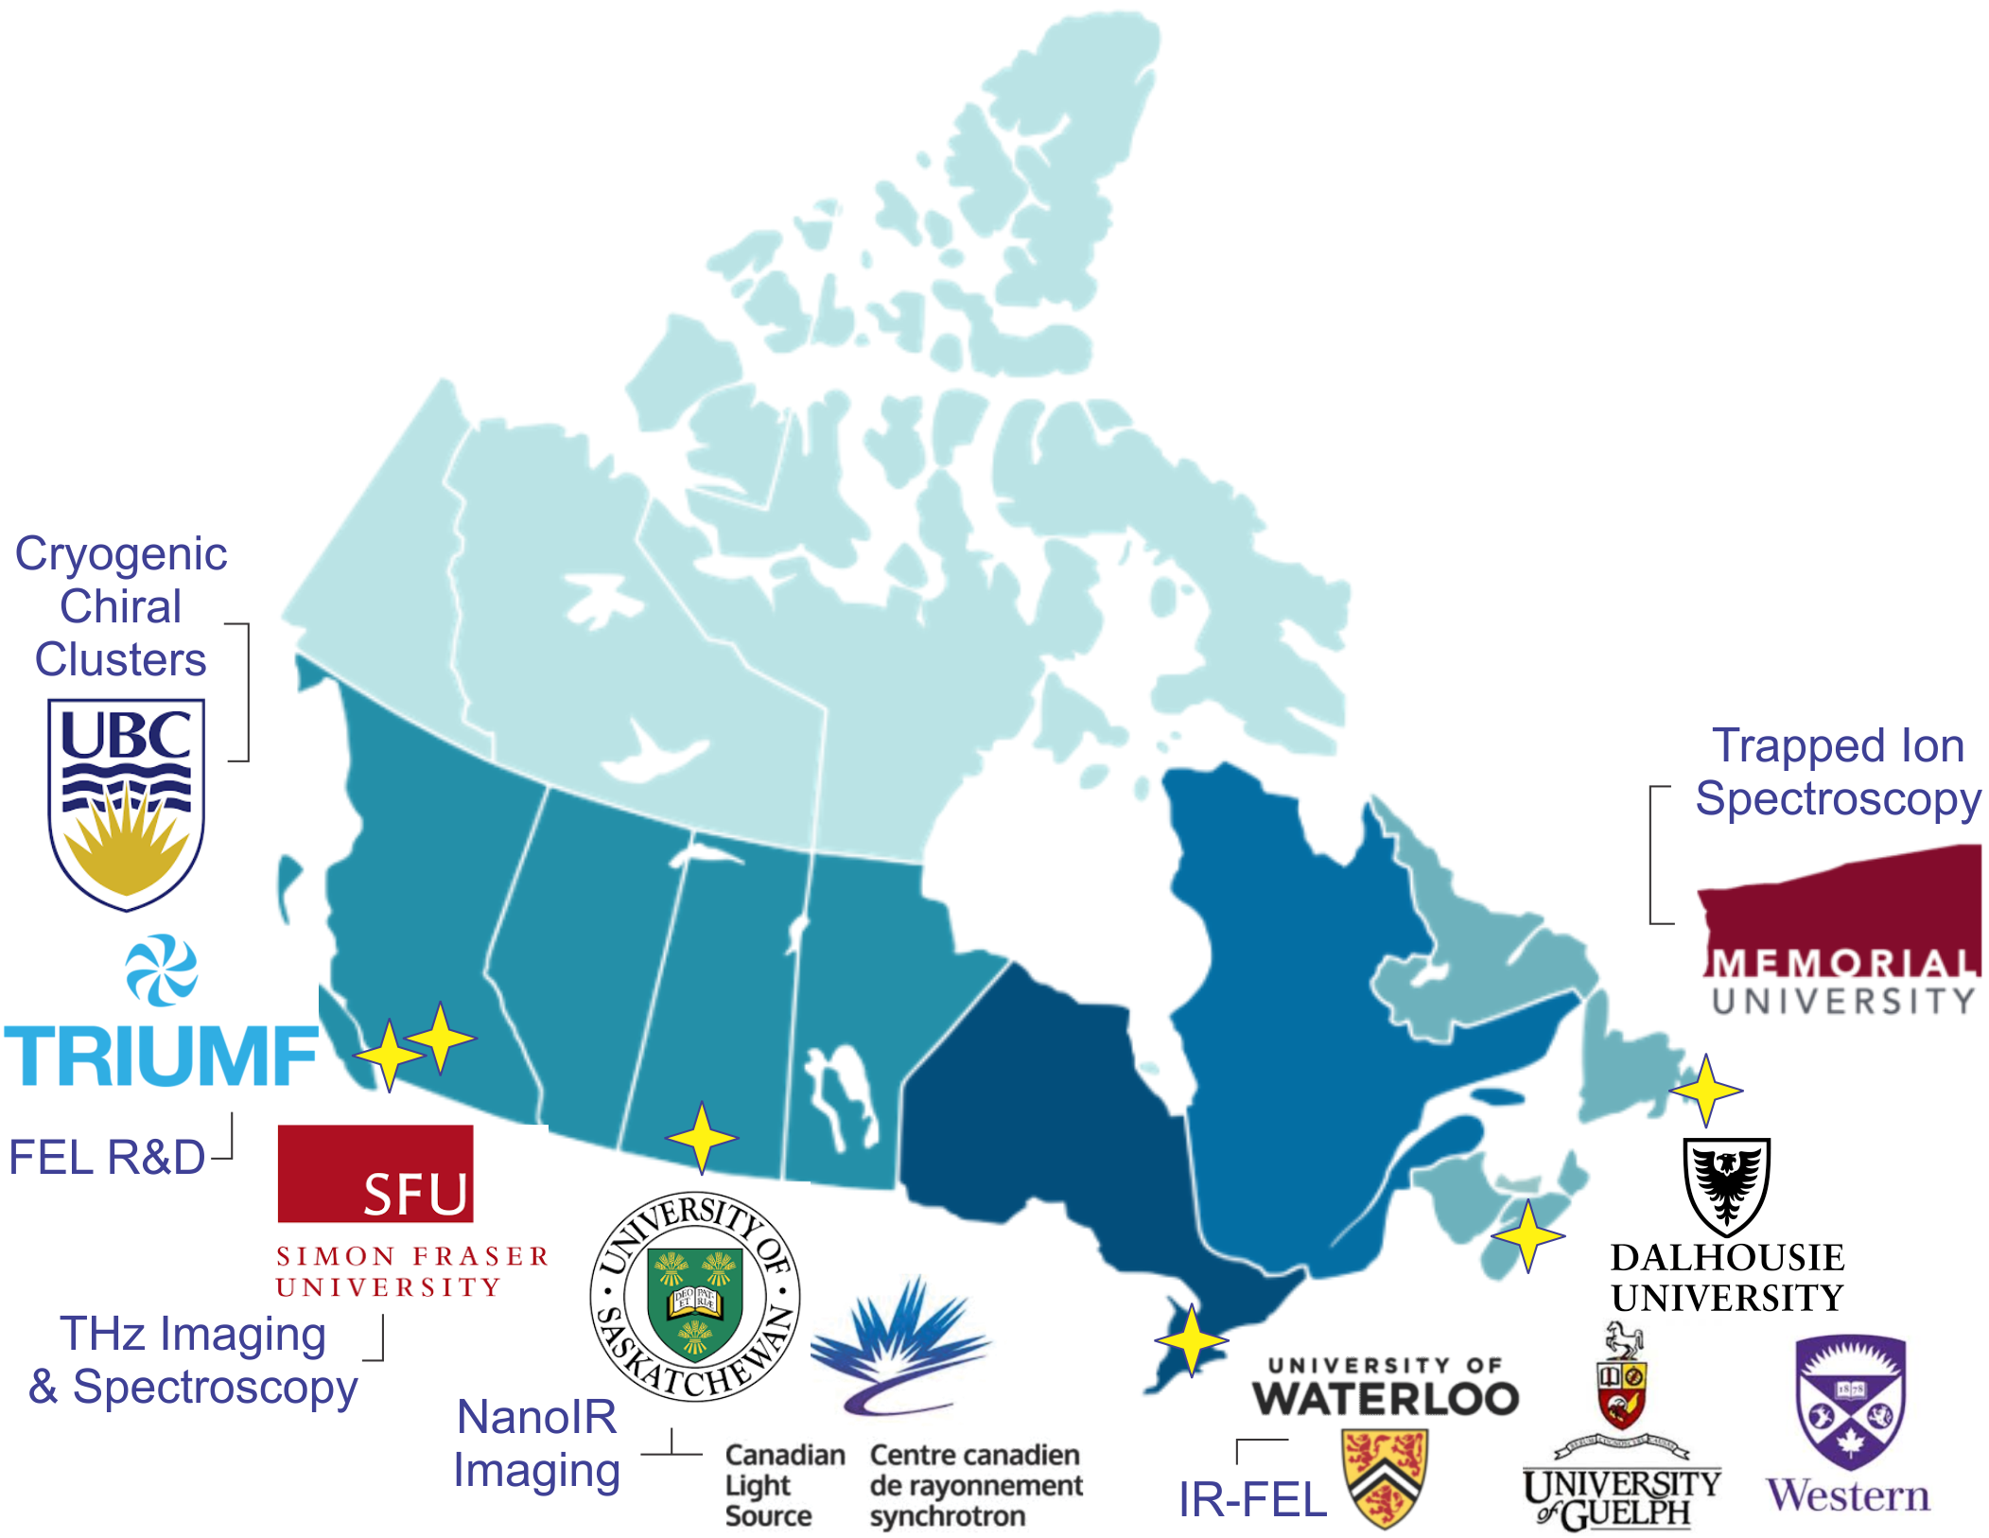
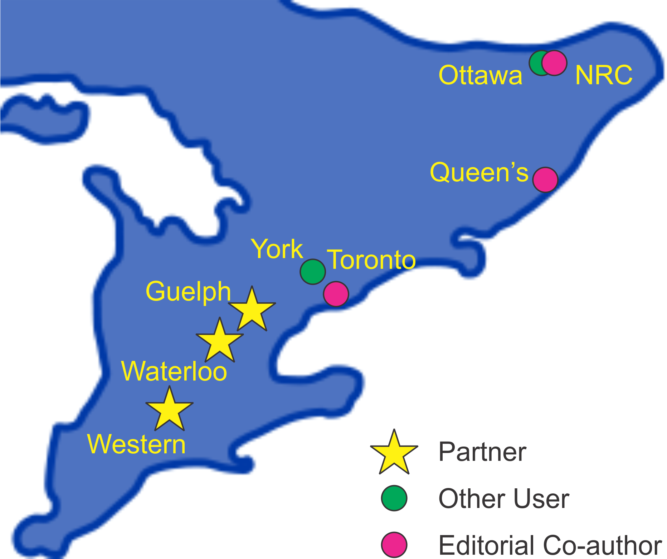
IRFEL Technology - A National Effort (5-10 years)
CFI: 8 Universities, 2 National Research Institutions
...and much wider national support
Hopkins, Verzilov, Kester, et al., Can. J. Phys., 97(12), p. vii (2019)
3 | Slide

Slide 4
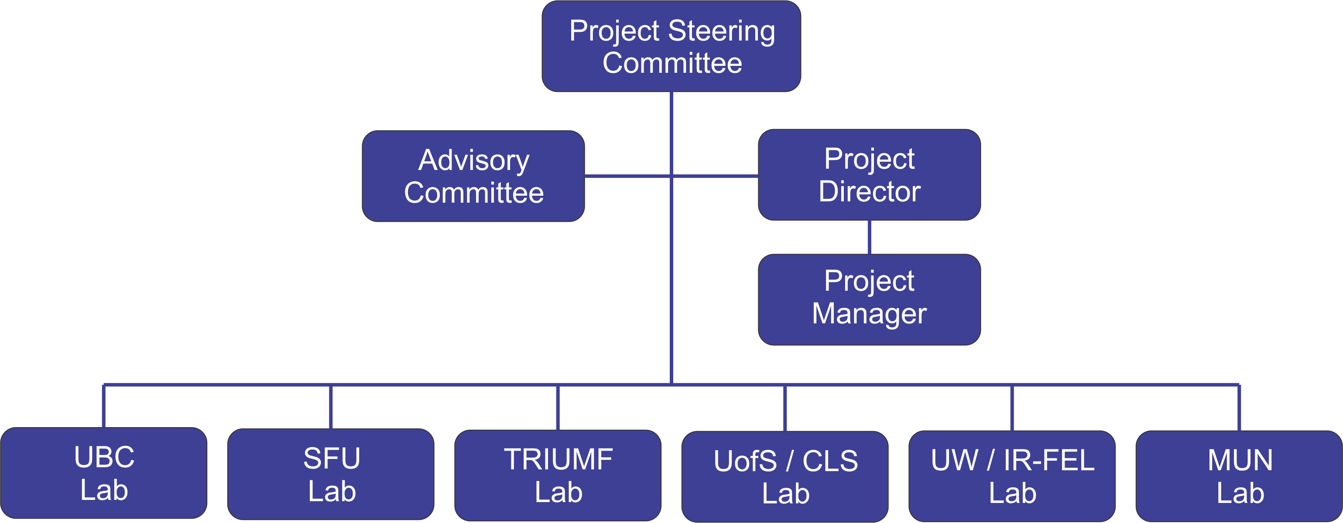
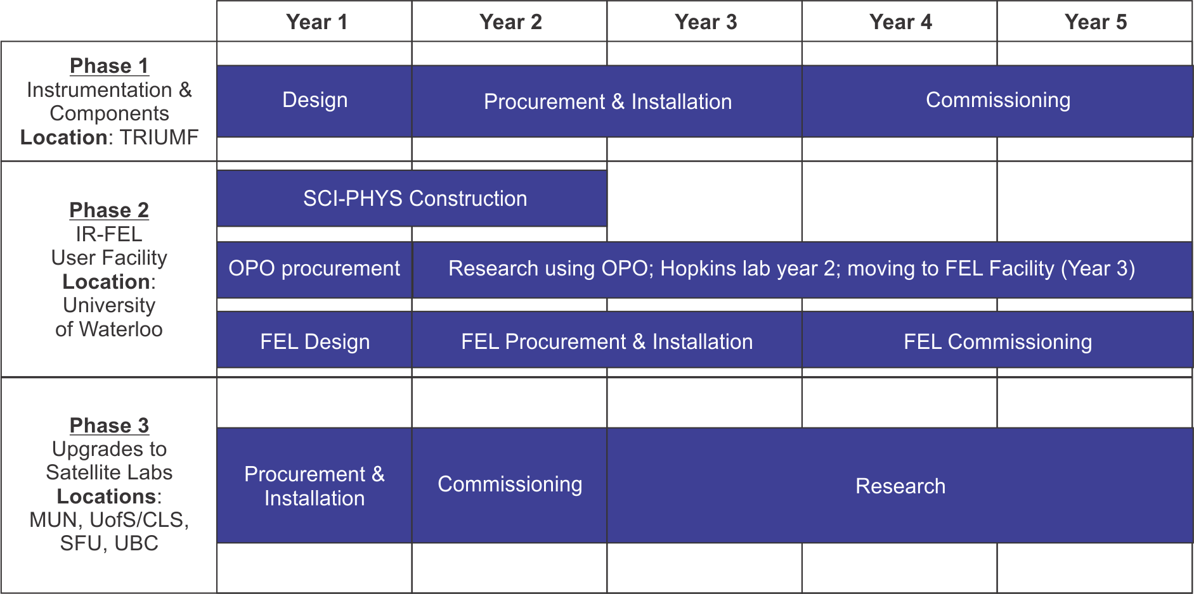
IRFEL Technology - A National Effort (5-10 years)
8 Universities, 2 National Research Institutions
Hopkins, et al., Can. J. Phys., 97(12), p. vii (2019)
4 | Slide

Slide 5
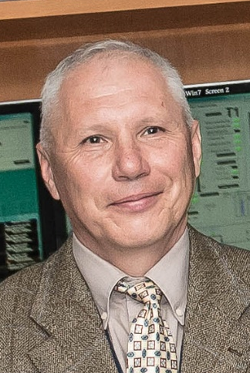
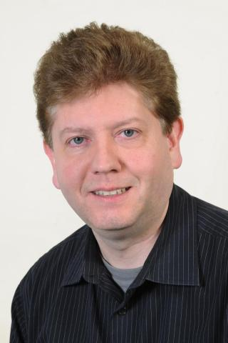
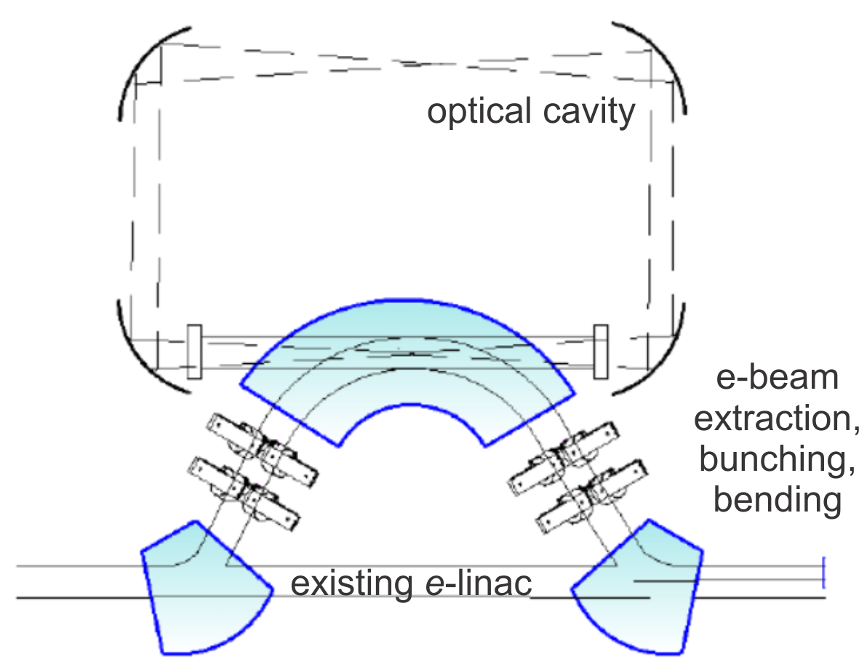
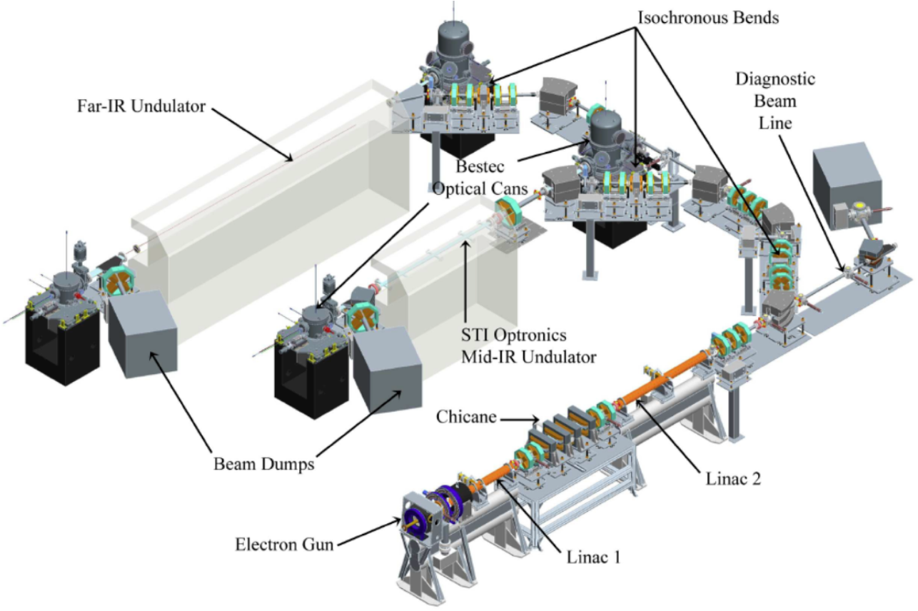
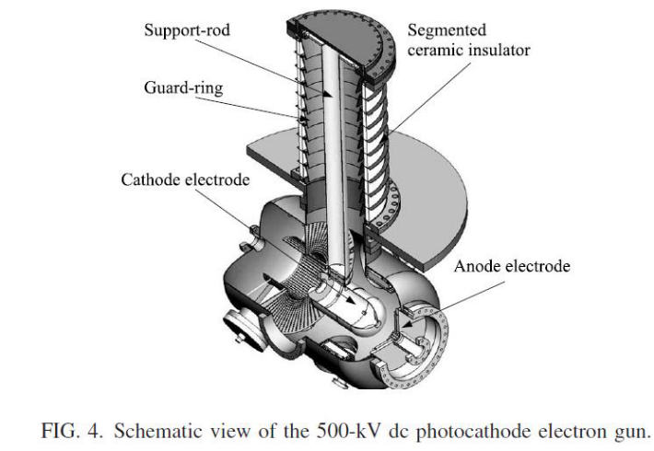
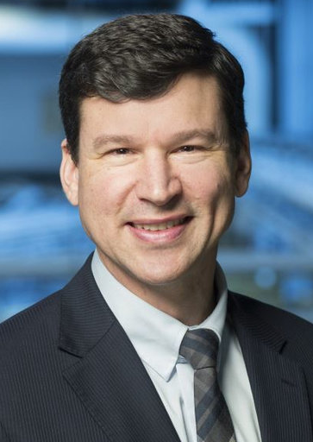
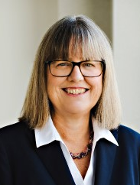
Phase 1: Instrumentation & Component Development
At TRIUMF:
At Waterloo:
An overview of the IR-FEL installation at the Fritz Haber Institute. Source: Schöllkopf, et al., Proceedings of FEL, (2014)
Development of electron diffraction (w/ CLS)
Development of laser seeding (Strickland)
R. Nagai et al, Rev. Sci. Instrum. 81, 033304 (2010)
5 | Slide

Slide 6
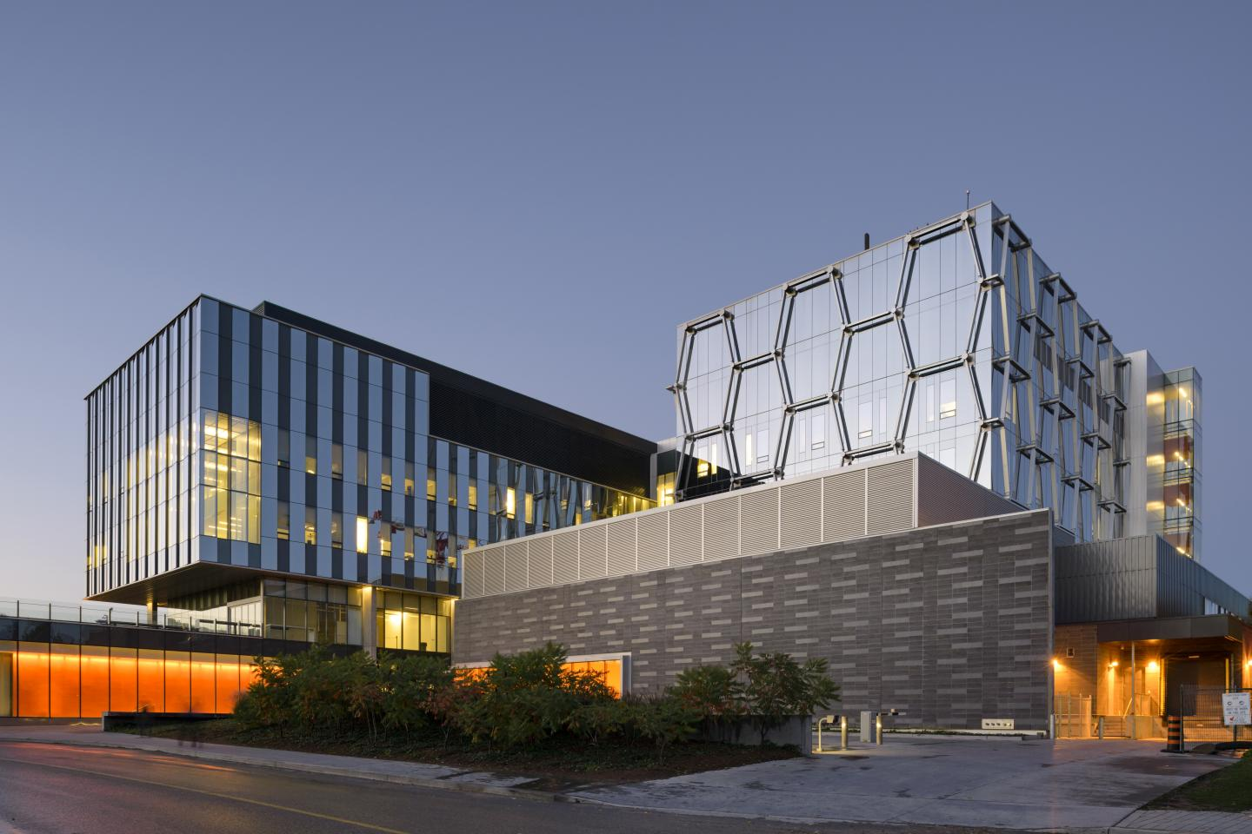
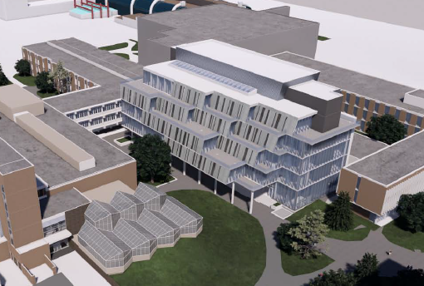
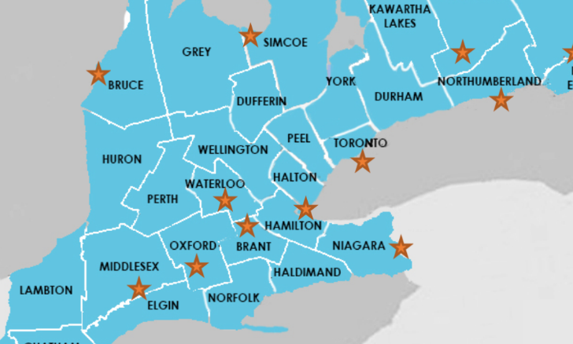
Phase 2: IR-FEL User Facility (Waterloo)
Waterloo Institute for
Nanotechnology
Institute for
Quantum Computing
SCI-PHYS Complex
30 Research Institutes
37,000 Students
2nd in Canada (Chemistry)
2018 Nobel Prize (Physics; Strickland)
11th worldwide (Telecom. Eng.)
~100 km west of Toronto
6 | Slide

Slide 7
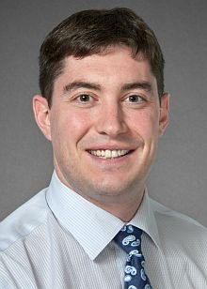
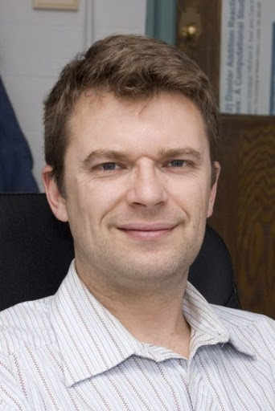
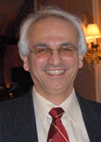
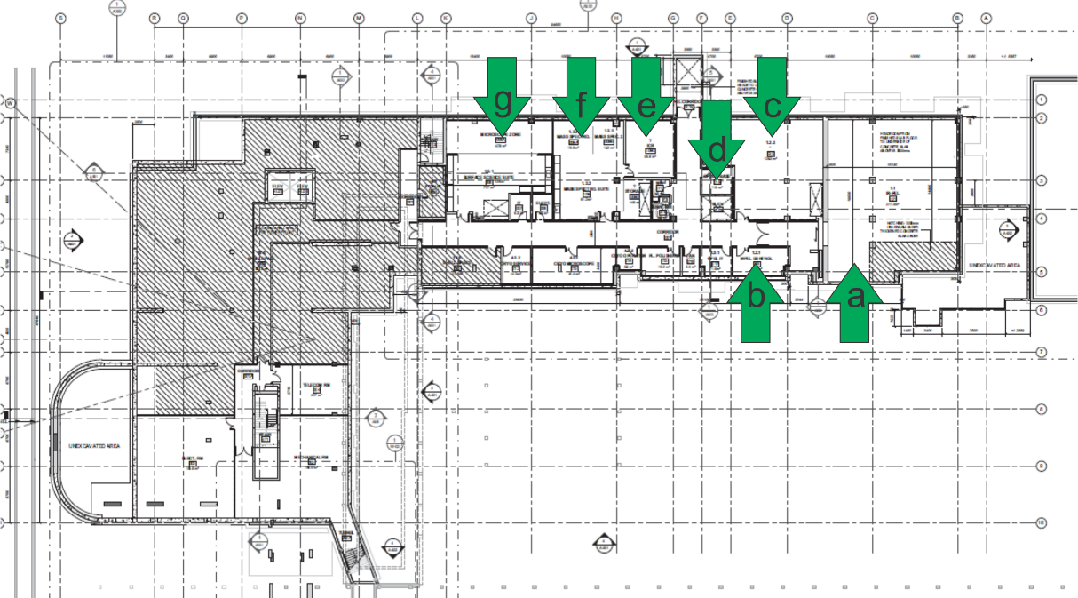
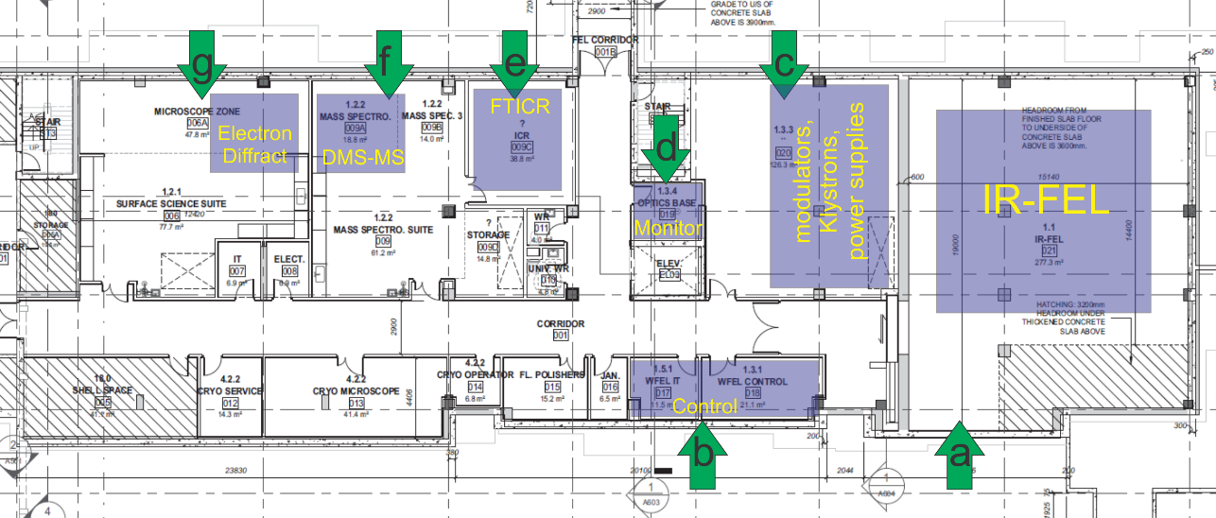
Phase 2: IR-FEL User Facility (Waterloo)
SCI-PHYS Complex
IR-FEL (~450 m²)
User Labs (~275 m²)
Bunker
IT & Control
PS, modulators, kystrons
Optics Base
Mass spectrometry
Electron diffraction
Imaging
Radiolysis
7 | Slide

Slide 8
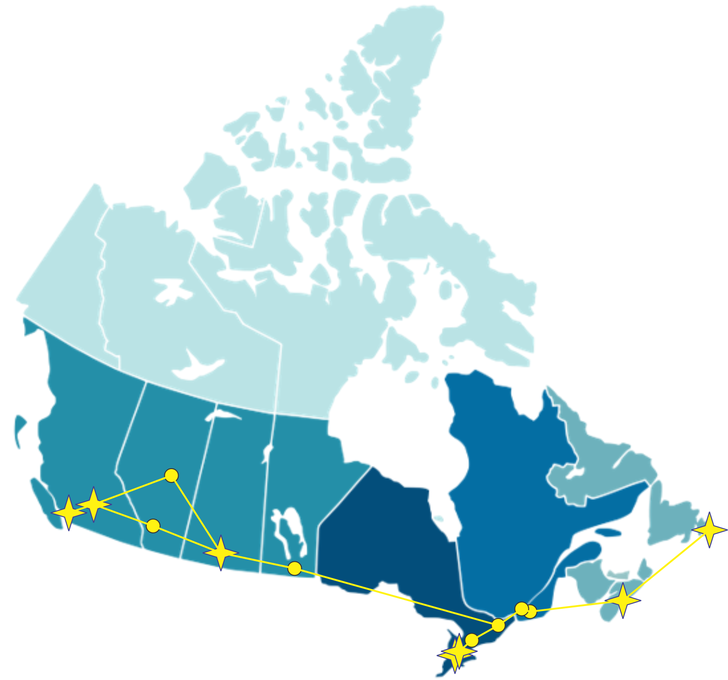


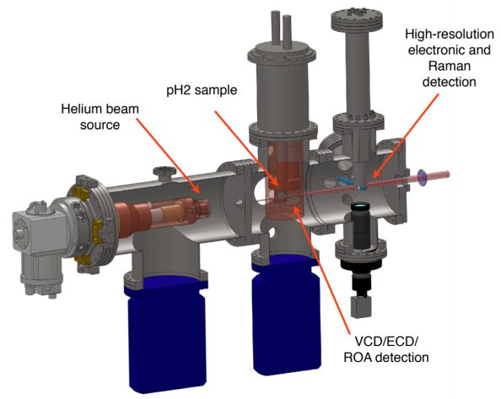
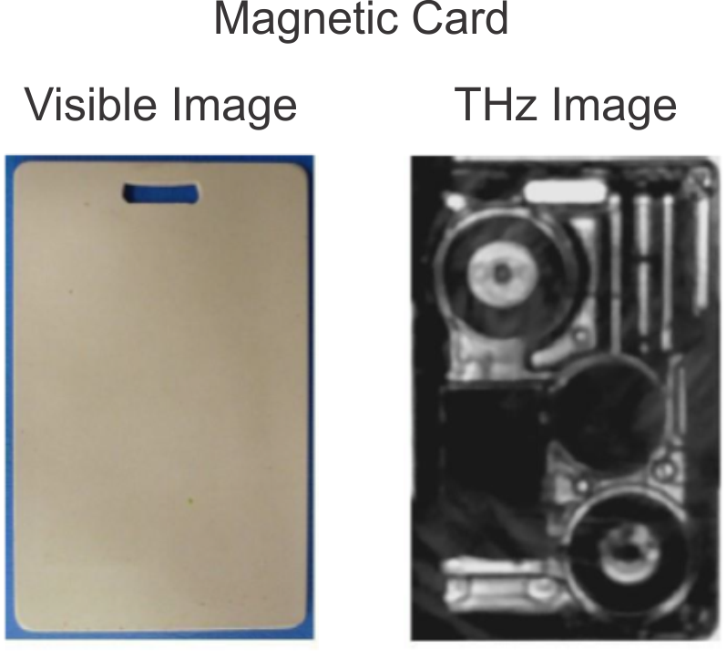
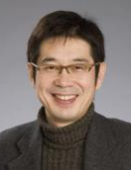
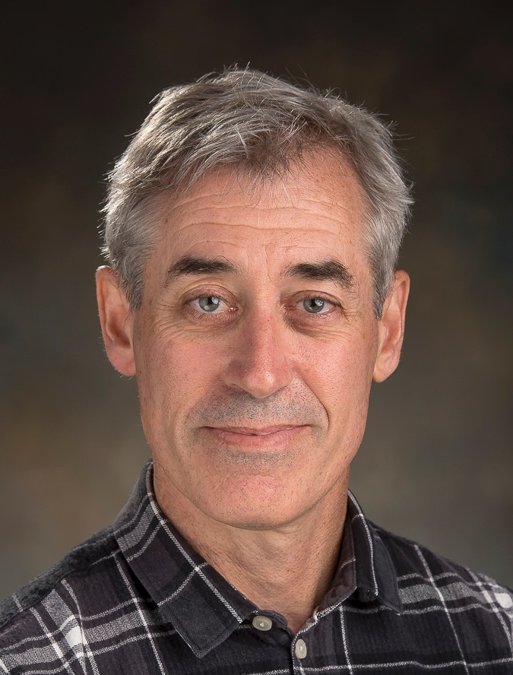



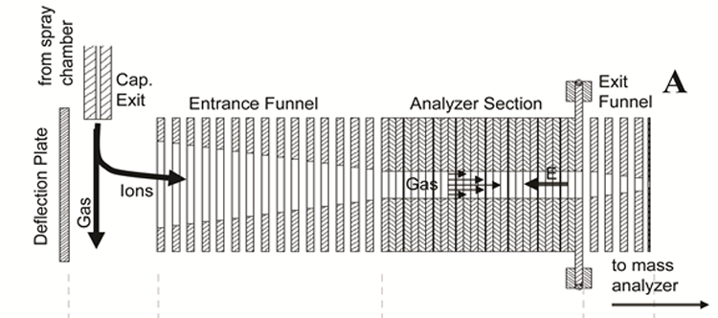
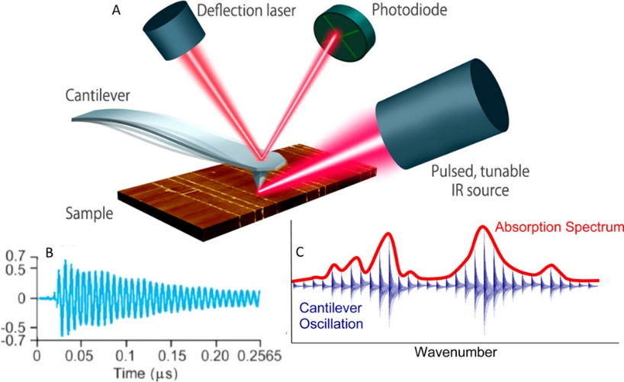
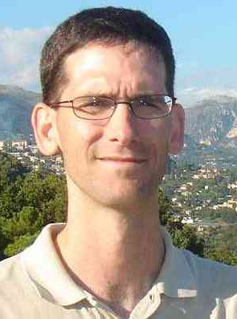
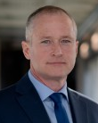
Phase 3: Satellite Laboratories
Cryogenic Clusters
THz Spec. / Imaging
NanoIR Imaging
TIMS-MS^{N}-IRMPD
8 | Slide

Slide 9
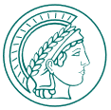


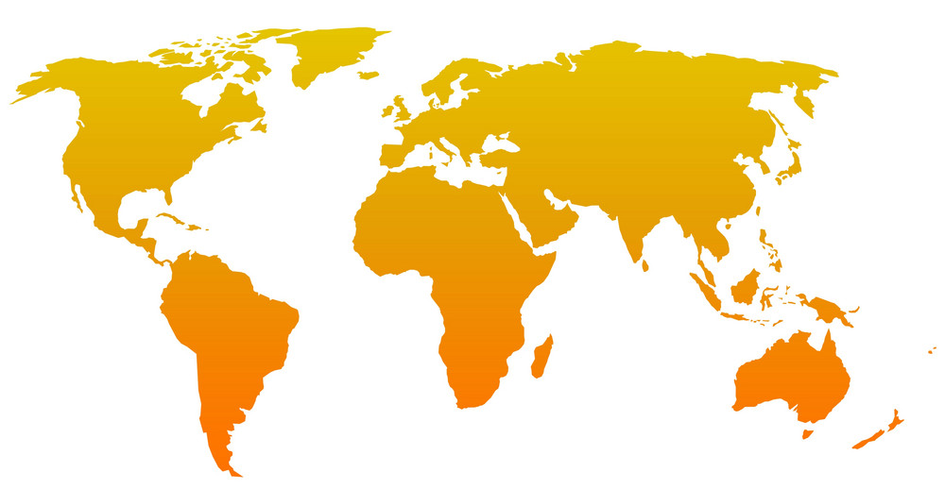










A Potential Partnership / International Network
For exchange of students & ideas
To coordinate and prevent duplication of efforts
9 | Slide

Slide 10
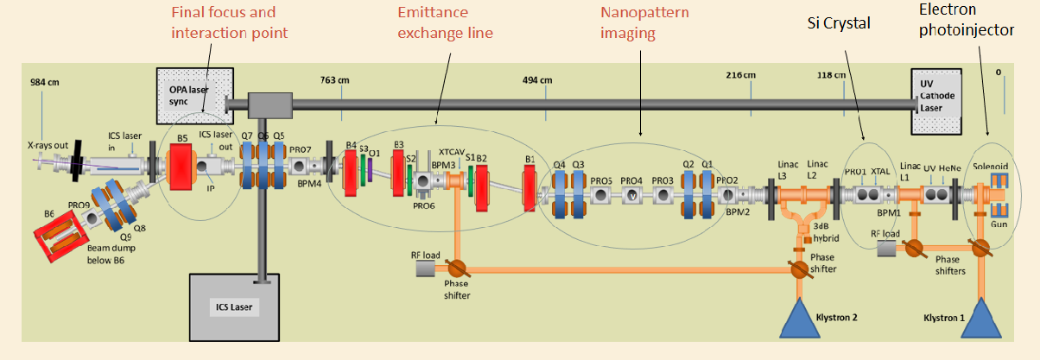
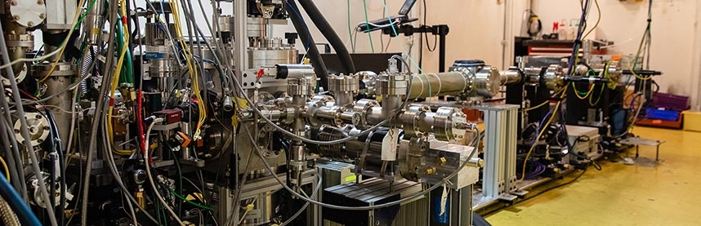
Long Range Perspective (10 - 20 years)
CXFEL (ASU)
CLS 2.0
IRFEL technology sets groundwork for CXFEL
Coherent, short-pulse, tunable, narrow bandwidth
SLAC
MeV-UED
Plans being developed for CLS 2.0
Improved beam characteristics (power, range)
May eliminate IR capabilities
IRFEL technology sets groundwork for MeV-UED
Dynamics of materials (pump-probe)
Low sample damage
10 | Slide

