Slide 1





Laboratory Nuclear Astrophysics
Artemis Spyrou

Slide 2
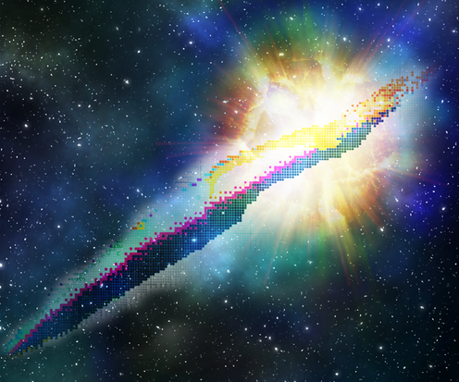
Overview
Nuclear needs for understanding astrophysical events
  Focus on radioactive beam needs relevant for TRIUMF and other radioactive-beam facilities
Facilities
  Producing radioactive beams for astrophysics
  Energy regimes
    High energy
    Low energy
    “stopped” beams
Equipment
  Unique capabilities at TRIUMF and
  elsewhere
  Examples of science results

Slide 3
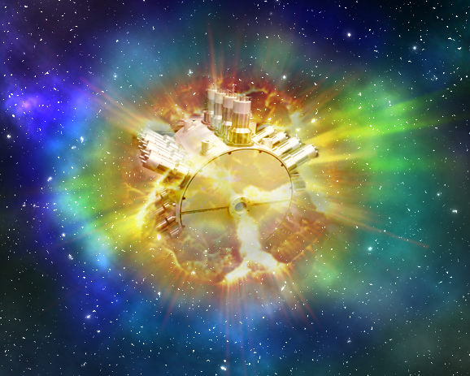

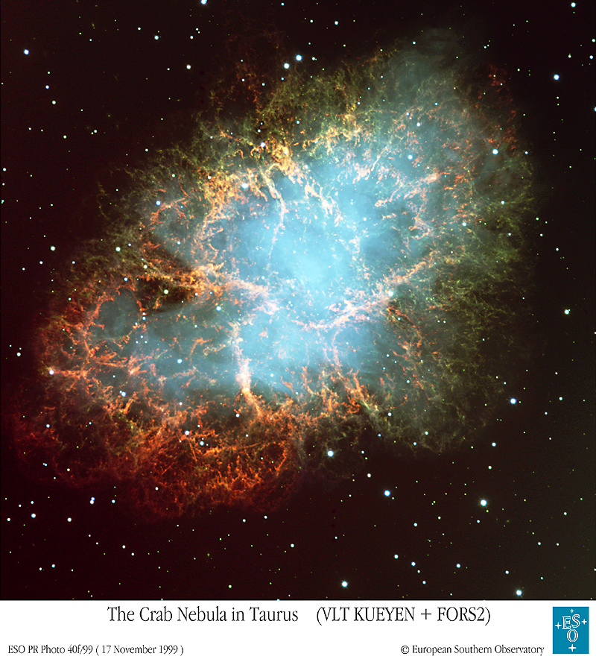
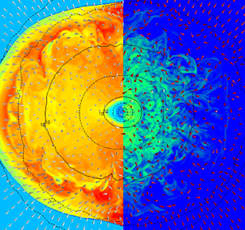
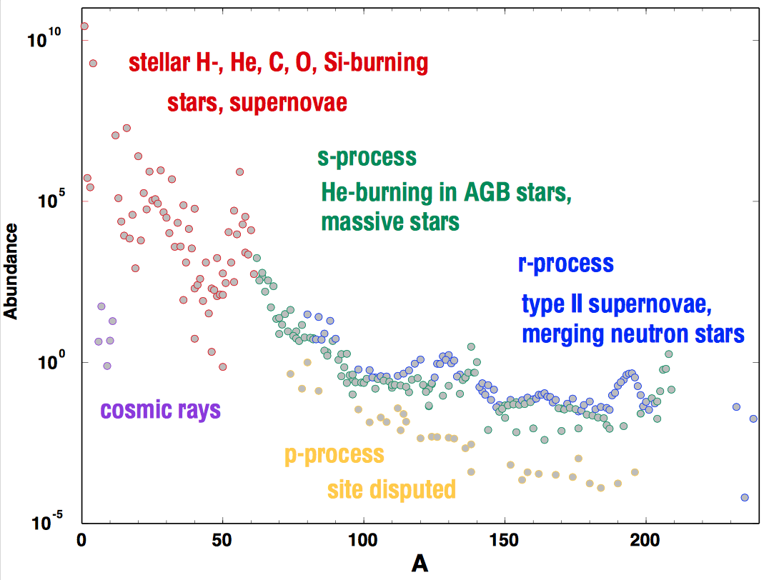
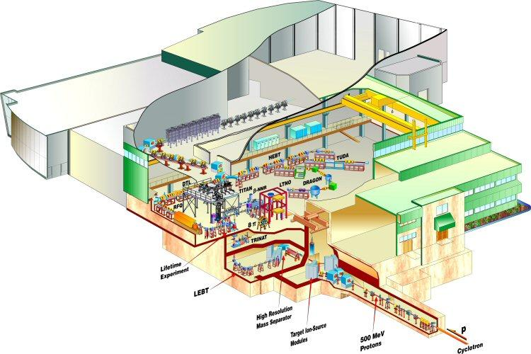
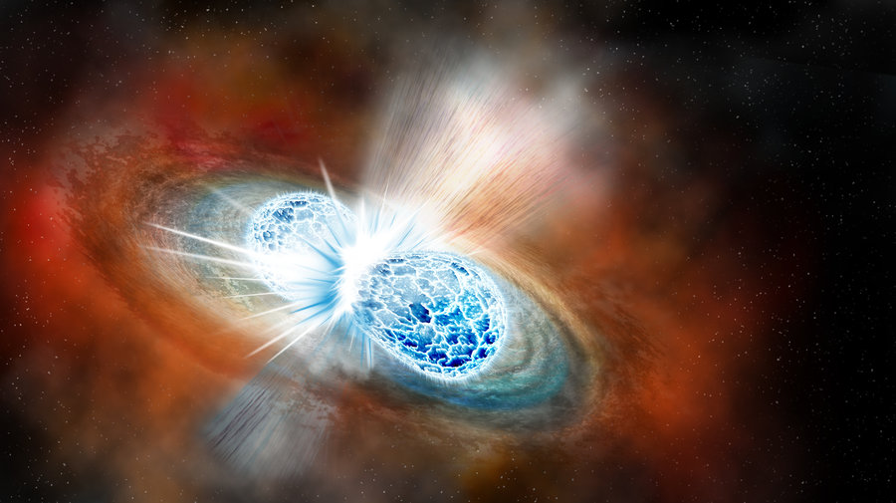
Nuclear Astrophysics
Models
Observations
Input
Nuclear
Astro
Figure Credit: Erin O’Donnel, NSCL

Slide 4
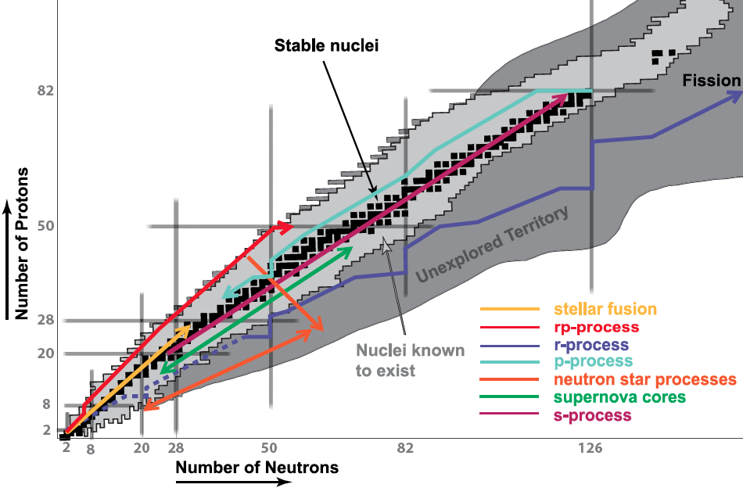
Nuclear Astrophysics
Most astrophysical processes extend into radioactive nuclei
Nuclear properties needed: mass, β-decay half-life, β-delayed neutron emission
Nuclear reaction rates
Current facilities (e.g. TRIUMF, NSCL, RIKEN, GSI, …)
Future facilities (e.g. FRIB, ARIEL, FAIR) will provide access to these nuclei
p-process
s-process
r-process
i-process
νp-process
Supernova EC process
rp-process
Stellar fusion
Neutron star crust
process
Adapted from Frank Timmes / Hendrik Schatz

Slide 5
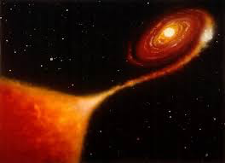
Nuclear Properties needs
Classical Novae
(p,γ) reactions
Remaining reactions hard to measure
Indirect techniques, e.g. β-decay to constrain (p,γ)

Slide 6
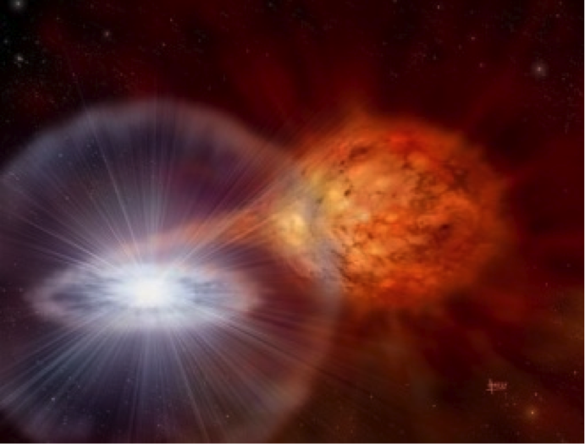
Nuclear Properties needs
X-ray Bursts
rp-process: (p,γ) reactions through
  Direct measurements where possible
  Indirect approaches developed, e.g. (d,n), statistical properties
αp-process: (α,p) and (a,γ) reactions
Fusion of ¹²C + ^{x}C

Slide 7
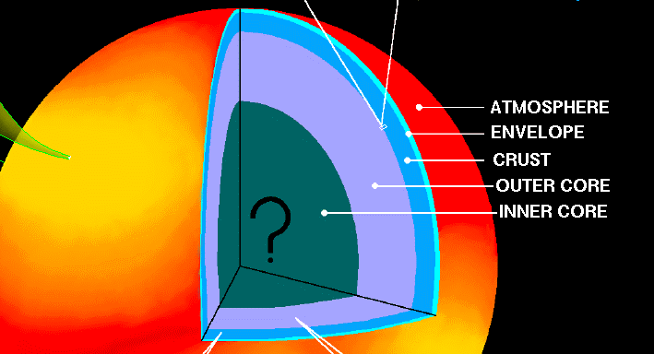
Nuclear Properties needs
Neutron Star Crust process
Mass measurements
URCA cycle studies: β-decay properties (gs-gs transitions)

Slide 8
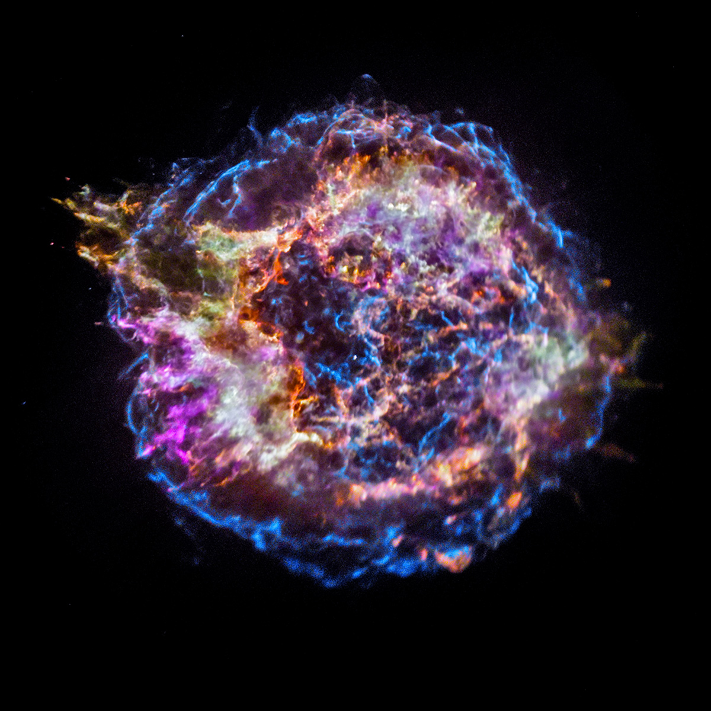
Nuclear Properties needs
νp-process
(n,p) reactions
Supernova EC/β-decay
Charge exchange reactions
Total Absorption Spectroscopy

Slide 9
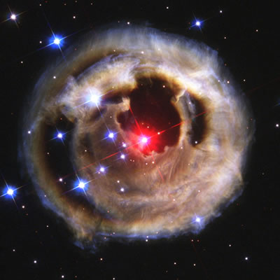
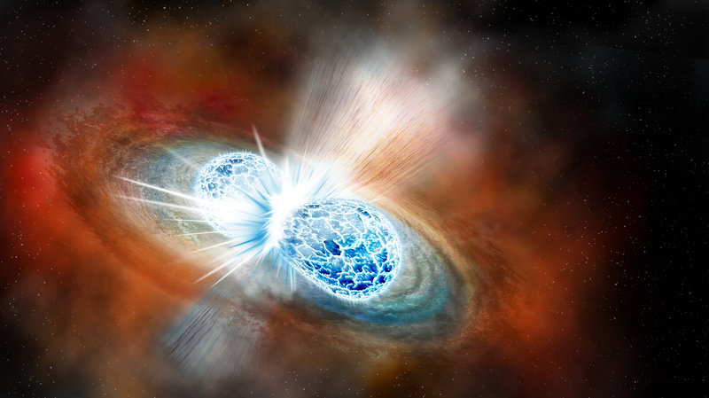
Nuclear Properties needs
s-process
(n,γ) reactions
p-process
(p,γ) and (α,γ) reactions
r-process
Masses
(n,γ) reactions – indirect approaches
β-decay half-lives
β-delayed neutron emission
(α,n) reactions
fission properties
i-process
(n,γ) reactions

Slide 10
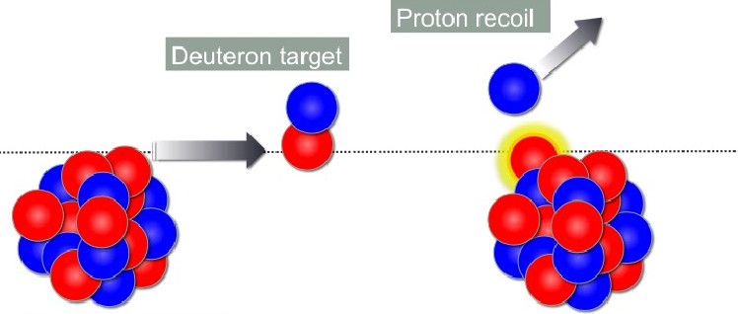
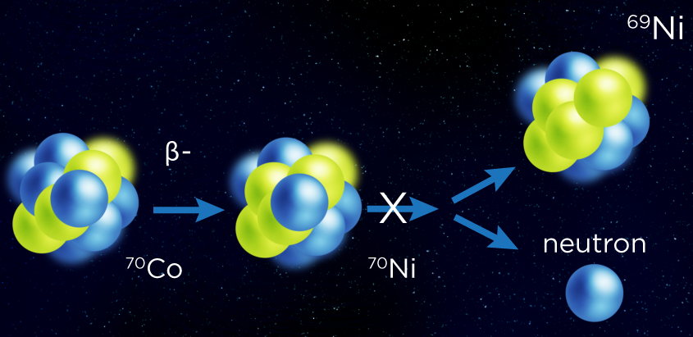
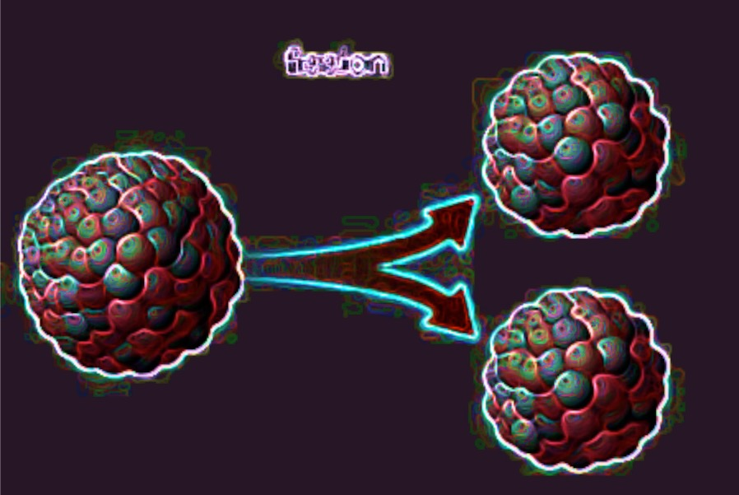
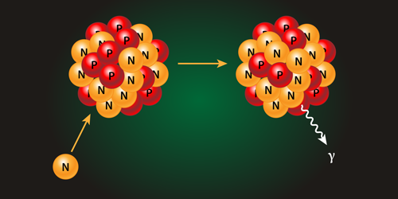
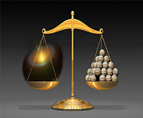
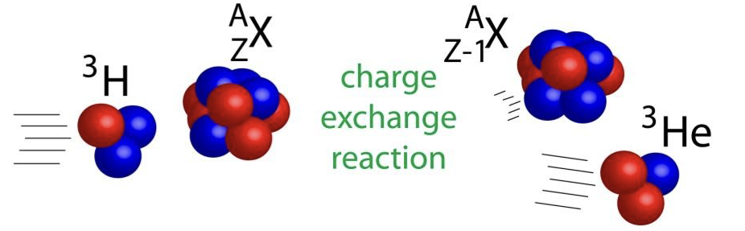
Nuclear Data Needs
β-decay half-lives
Slow
β-delayed neutron emission
Fast
Stopped
Transfer
Stopped
Fast
Fission
Neutron/proton Captures
Masses
Slow
Charge exchange
Fast
Stopped
Fast

Slide 11
National Superconducting Cyclotron Lab
ReAccelerator Facility
“Stopped beam area”
Stopped
Gas Stopper
Reaccelerated/slow
Fast

Slide 12
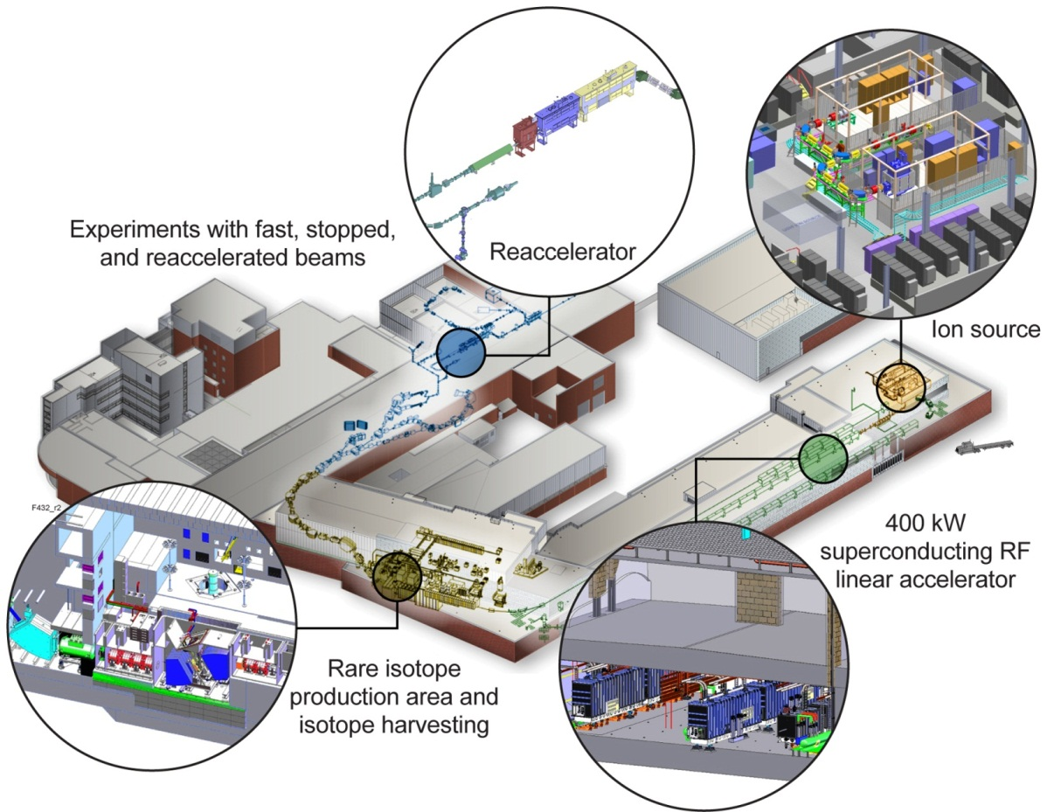

Facility for Rare Isotope Beams, FRIB
Michigan State University Campus
Facility for Rare Isotope Beams (FRIB) Project constructs a $730 million scientific user facility funded by the Department of Energy Office of Science (DOE-SC), Michigan State University, and the State of Michigan
  DOE-SC $635.5 million
  State of Michigan $94.5 million
Planned FRIB completion date is June 2022, managing to early completion in 2021
Reaccelerated/slow
Stopped
Fast

Slide 13
TRIUMF
Slow
Stopped
Complementary facilities
Unique equipment

Slide 14
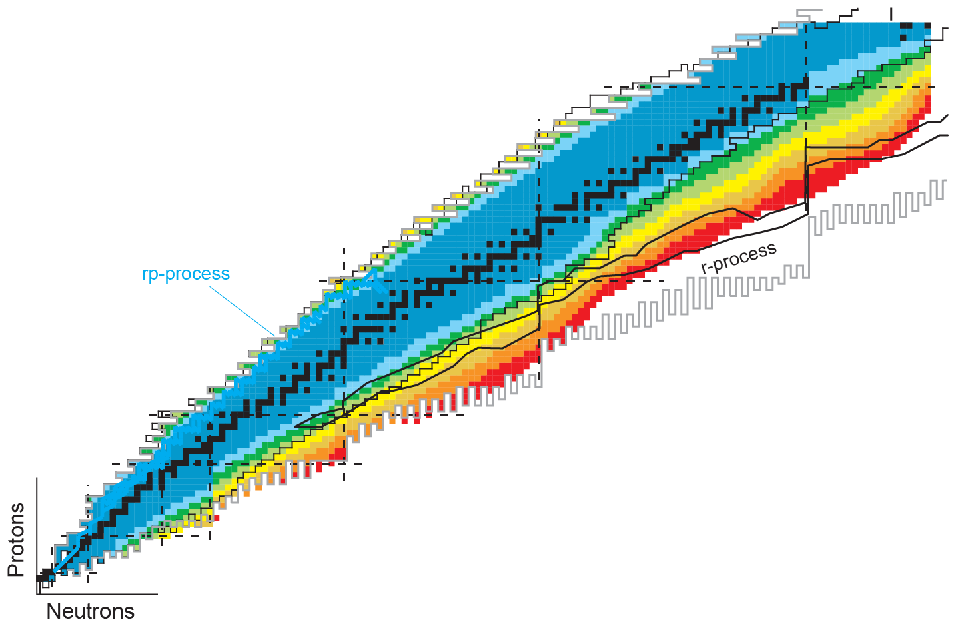
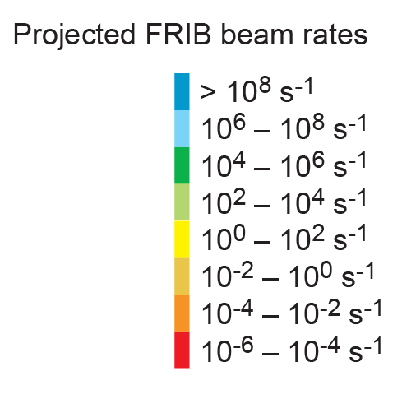
FRIB Rates
Charge Exchange
Transfer, surrogate (n,γ)
β-Oslo – (n,γ), (a,n), (a,p)
TAS, mass measurements
Discrete γ Spectroscopy
βn - measurements
Half-life, ToF mass

Slide 15
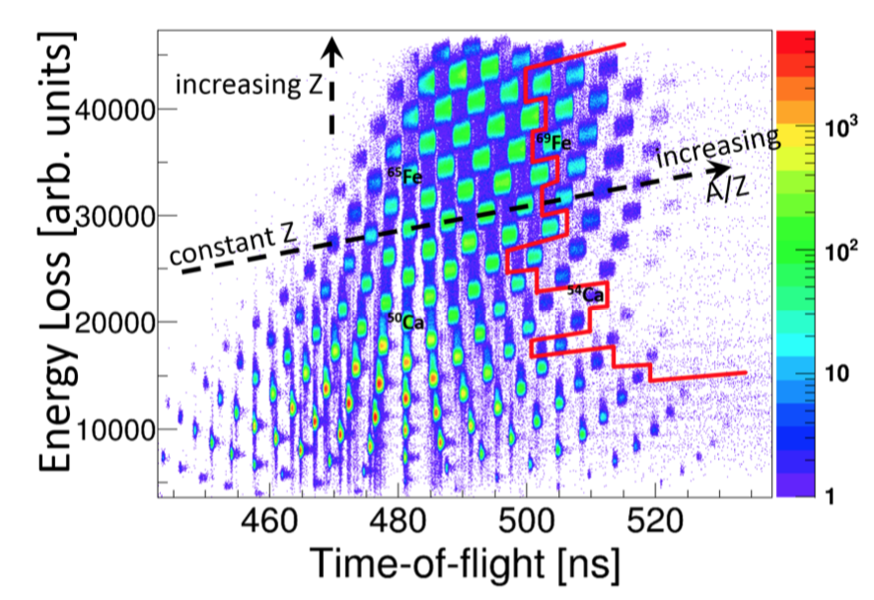
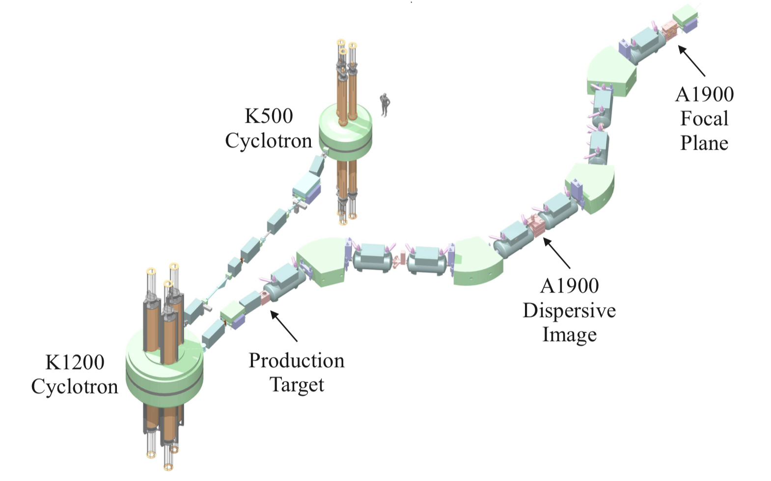
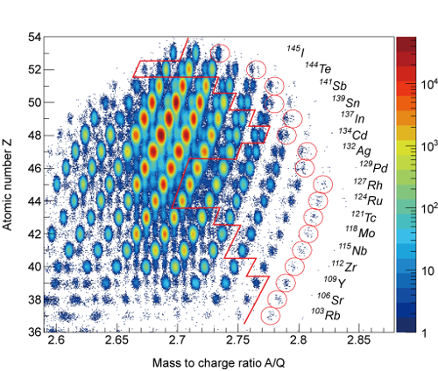
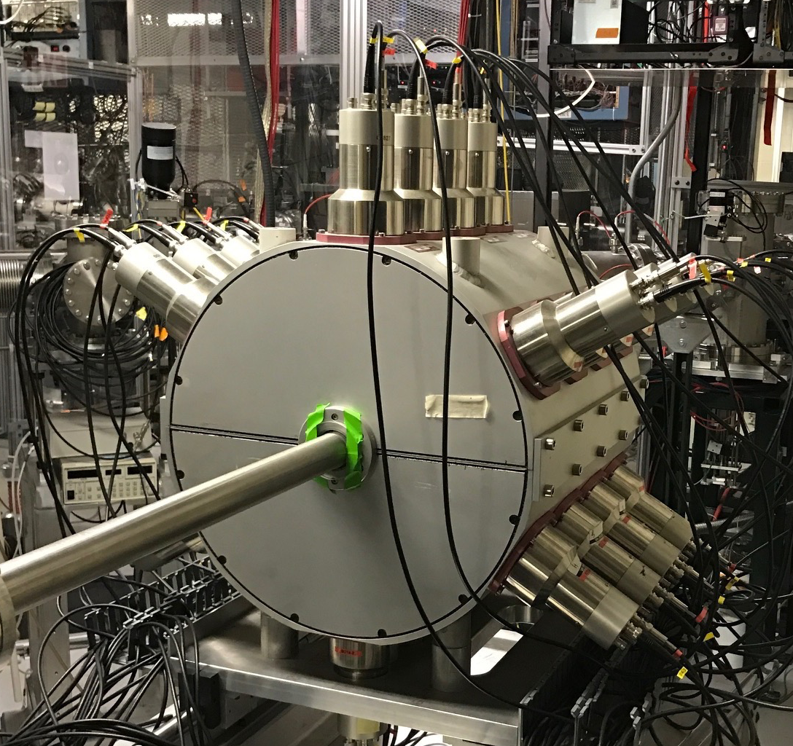
Fast Beams
(NSCL/FRIB, RIKEN, FAIR)
Mass measurements (ToF)
Half-lives
β-delayed neutron emission
Neutron-capture constraints
A1900 @ NSCL
BRIKEN @ RIKEN
SuN @ NSCL

Slide 16
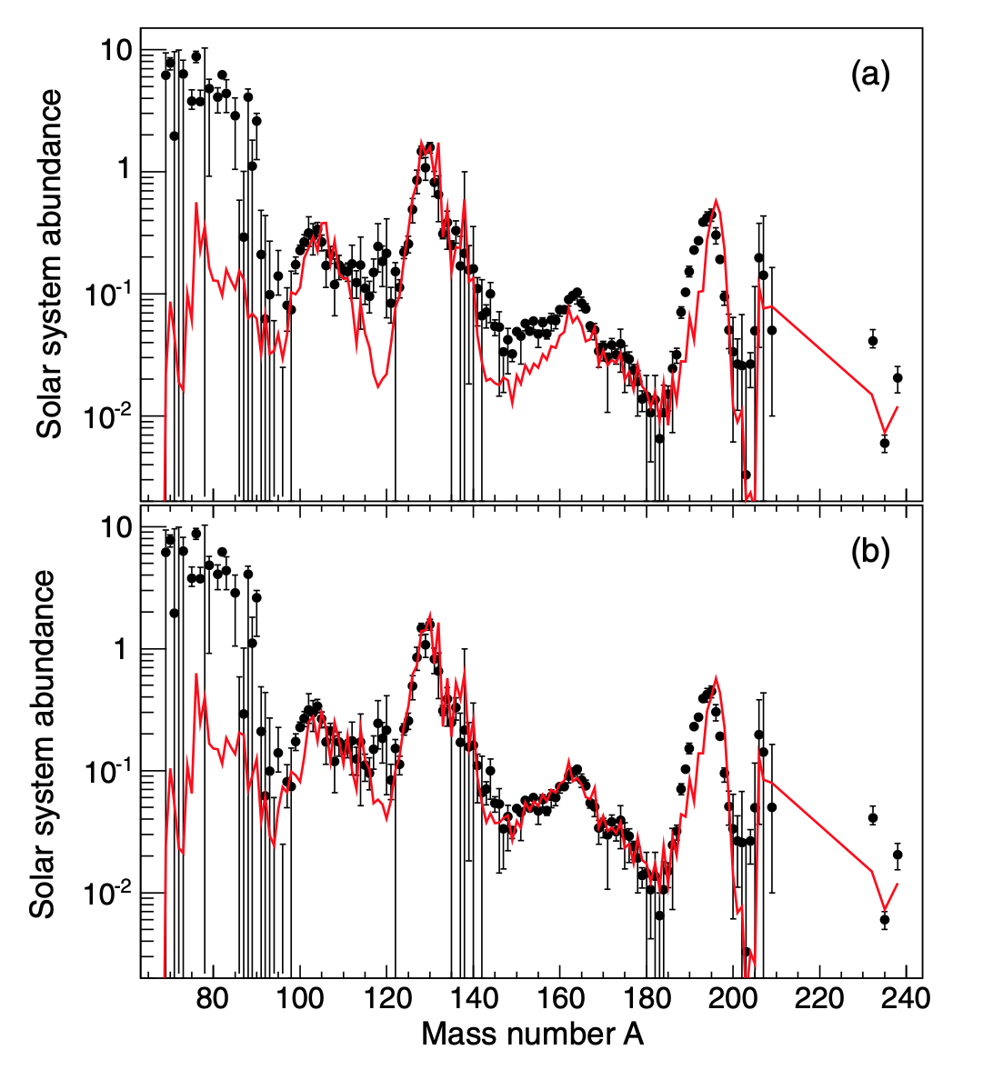
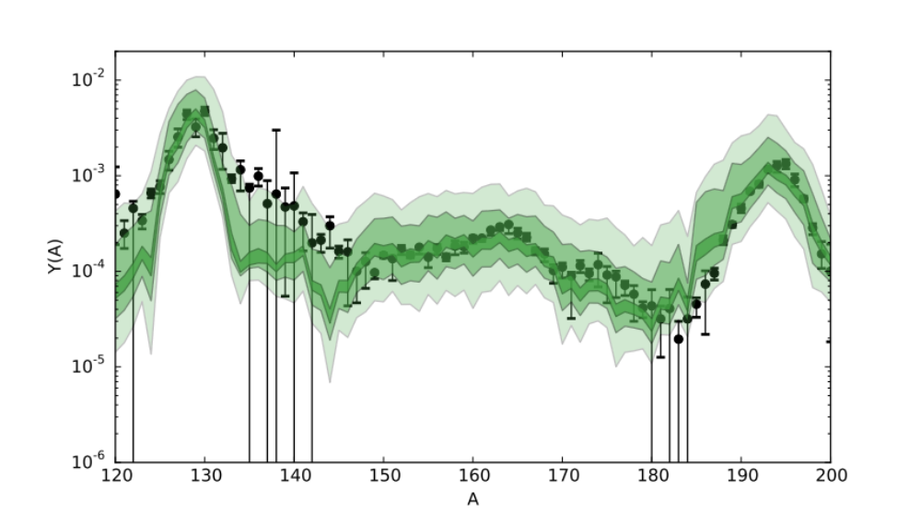
Fast Beams (examples)
(NSCL/FRIB, RIKEN, FAIR)
r process
Indirect neutron-capture constraints: β-Oslo method factor of 2-3 (MSU-Oslo)
r process
With new half-lives
Monte-Carlo variations of (n,γ) rates within a factor
100 – 10 – 2
light – darker – dark bands
Half-life measurements @RIKEN provide better constraints for abundance calculations
Liddick, Spyrou, et. al. PRL 2016
Lorusso, et. al. PRL 2015

Slide 17
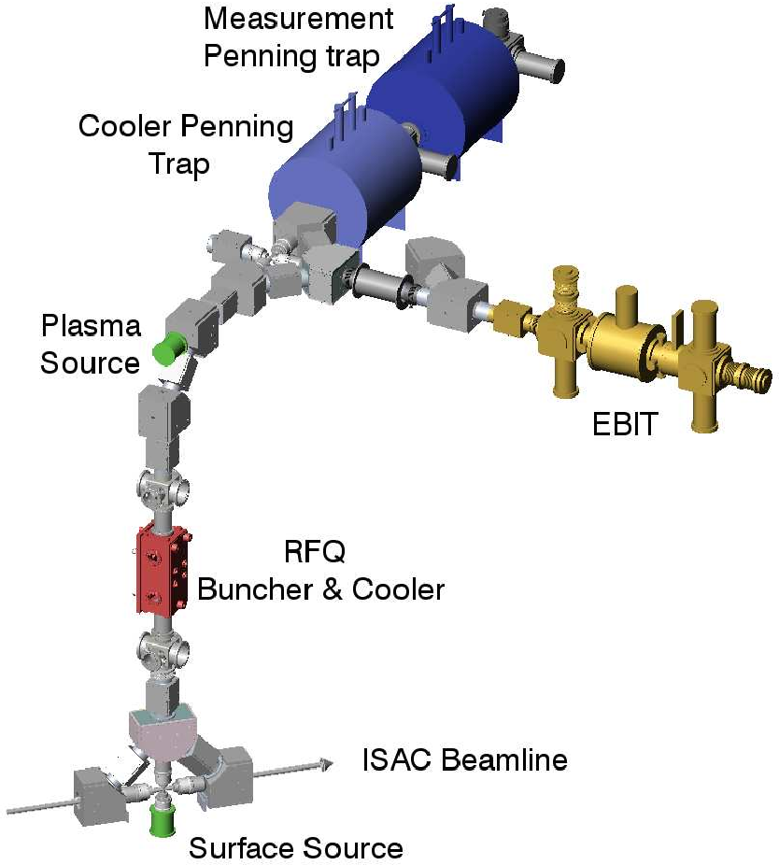
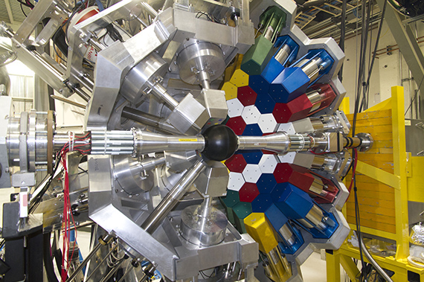
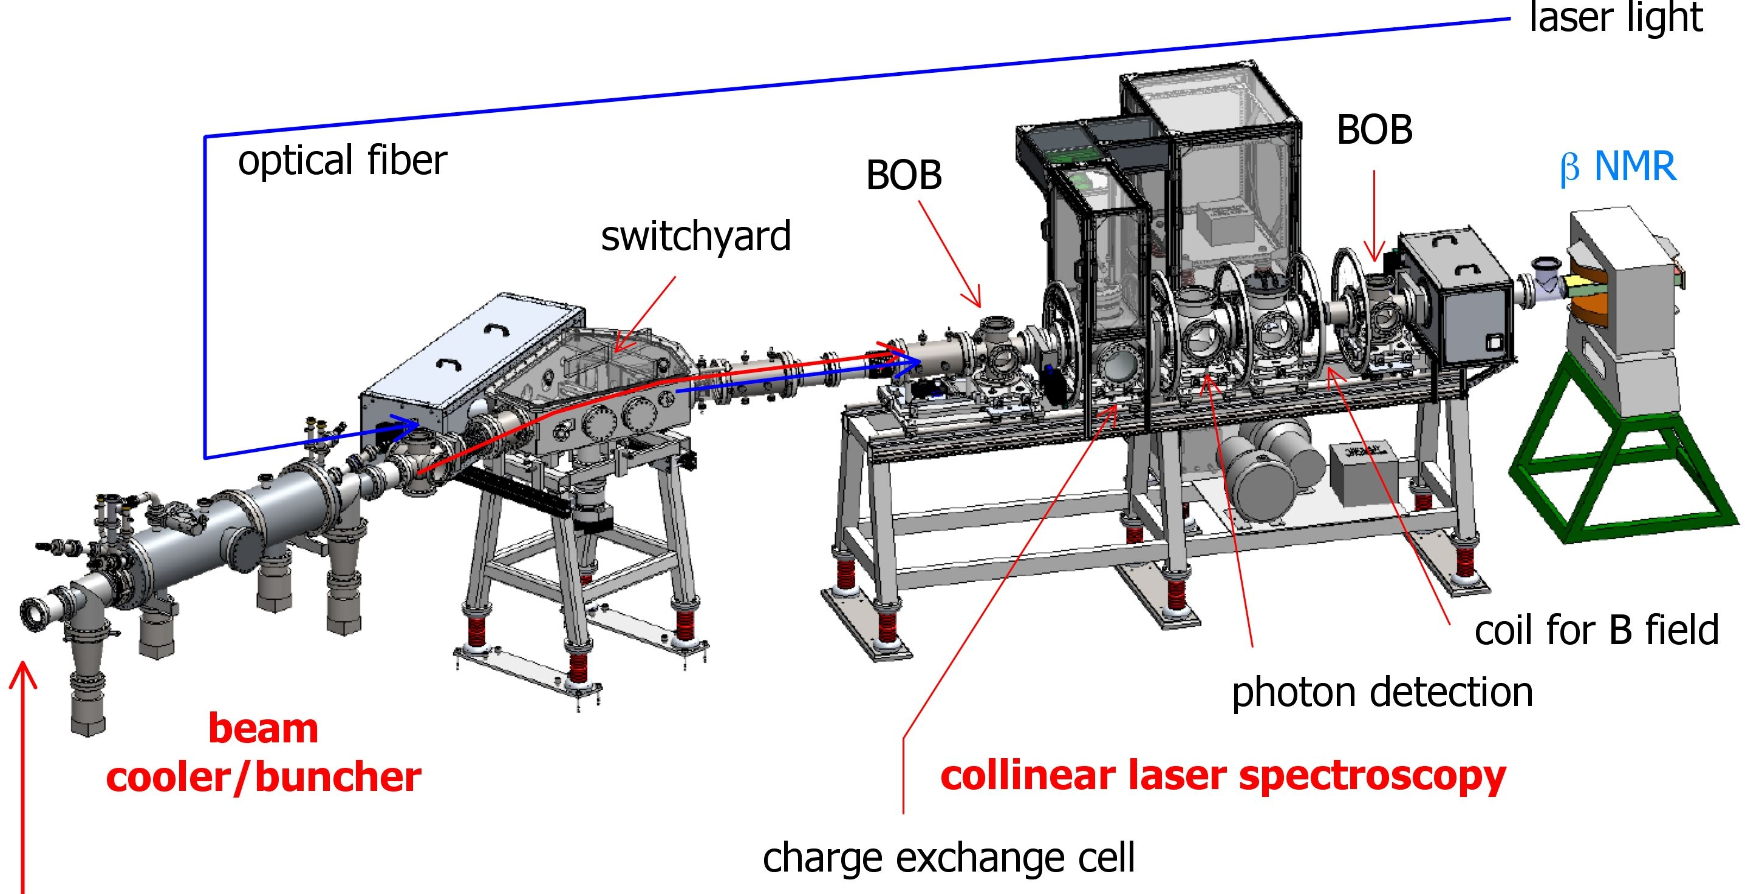
Stopped Beams
NSCL/FRIB, RIKEN, FAIR, TRIUMF, Argonne, …
Mass measurements with traps
Decay spectroscopy
β-delayed neutron emission
Laser Spectroscopy
TITAN @ TRIUMF
GRIFFIN @ TRIUMF
BECOLA
Laser Spectroscopy

Slide 18
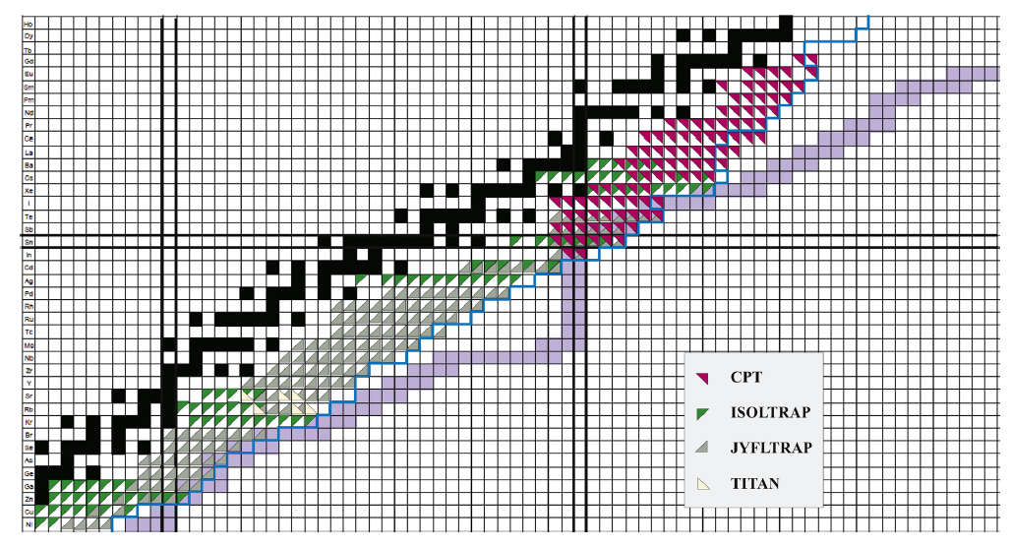
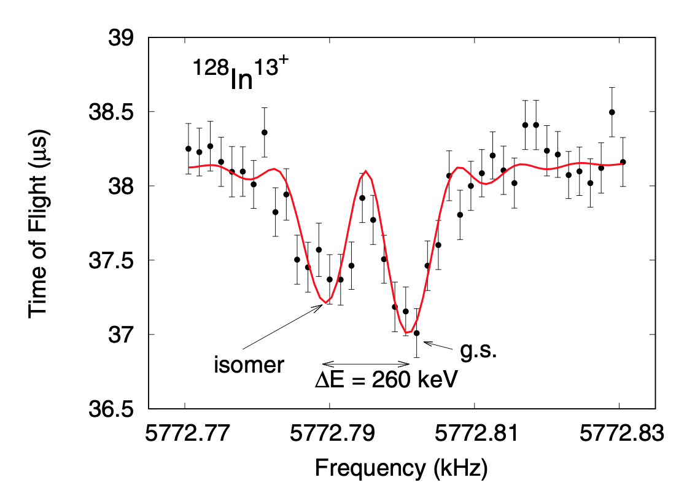
Stopped Beams (examples)
NSCL/FRIB, RIKEN, FAIR, TRIUMF, Argonne, …
Mass measurements at Argonne National Lab
@CARIBU facility
Isomer measurements at TITAN (TRIUMF)
J. A. Clark and G. Savard, Int. J. Mass Spectrom. 2013
Babcock, et al., PRC 2018

Slide 19
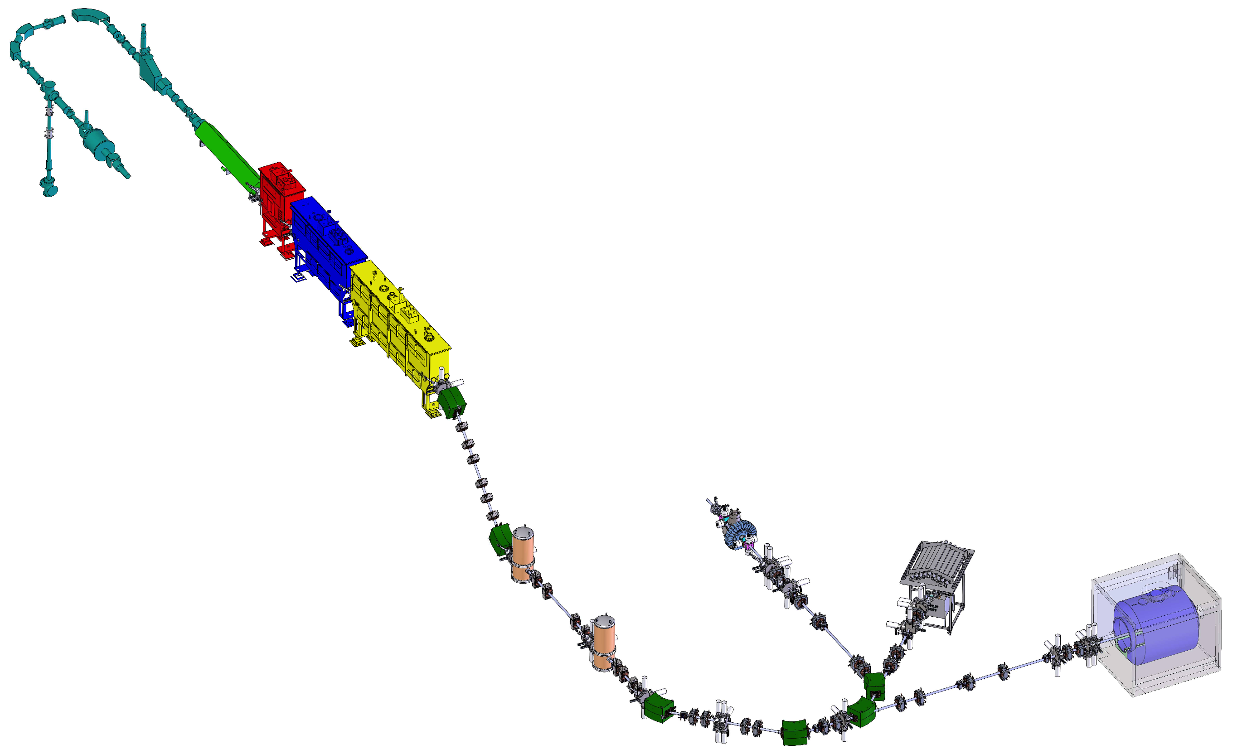
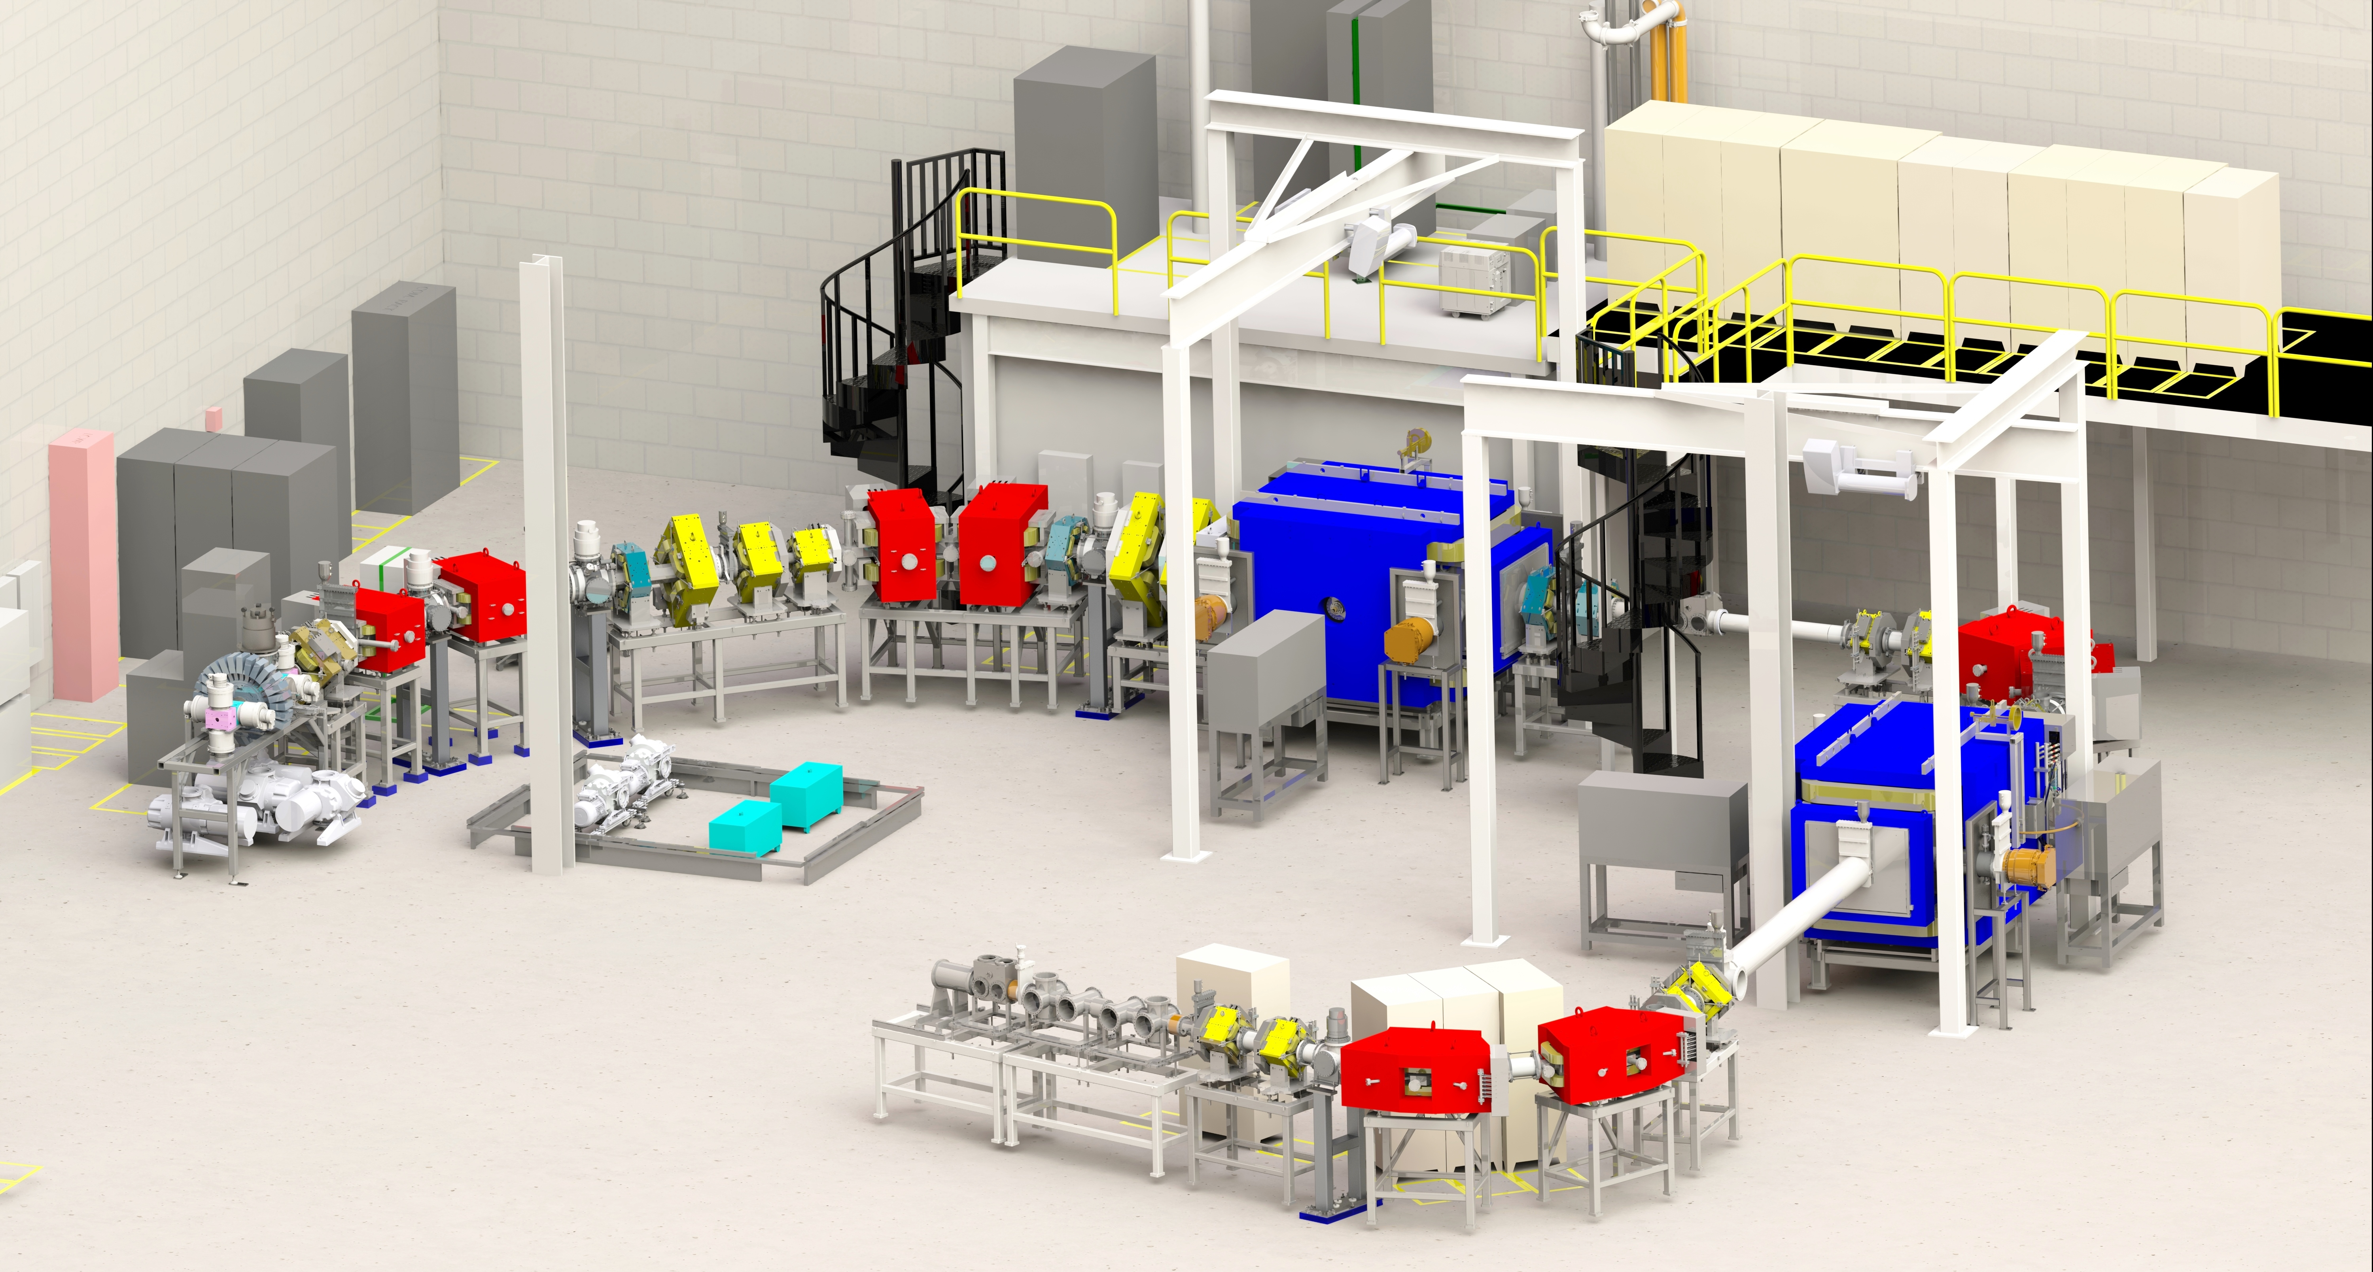
“Slow” Beams
NSCL/FRIB, FAIR, TRIUMF, Argonne, …
Fragmentation facilities have to slow down and re-accelerate the beam
From NSCL gas stopping
²³⁸U 0.3 – 3 MeV/u
⁴⁸Ca 0.3 – 6 MeV/u
SECAR
ReA facility at NSCL/FRIB

Slide 20
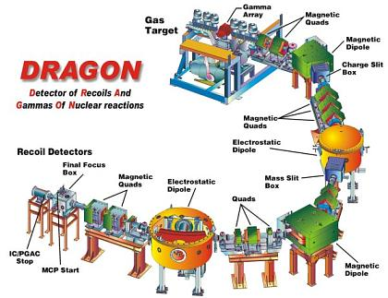
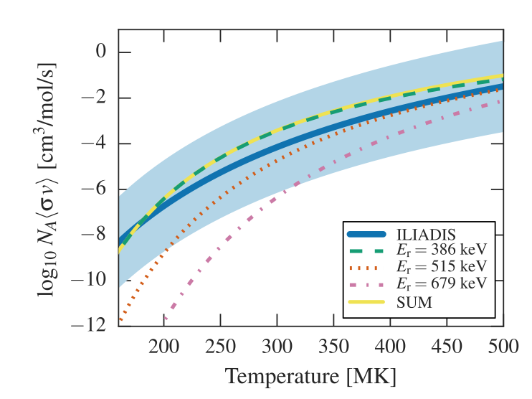
“Slow” Beams (example)
NSCL/FRIB, FAIR, TRIUMF, Argonne, …
Direct measurement of ³⁸K(p,γ)³⁹Ca
Better understanding of Oxygen-Neon novae
@TRIUMF
Lotay, Christian, et al., PRL 2016

Slide 21
Summary
Nuclear input is critical for better understanding astrophysical processes.
Complementary facilities, devices and techniques to address the large variety of data needs.
Nuclear Astrophysics Community has developed and optimized detectors suitable to address big open questions in the field
Next generation facilities will provide access to critical nuclei

Slide 22
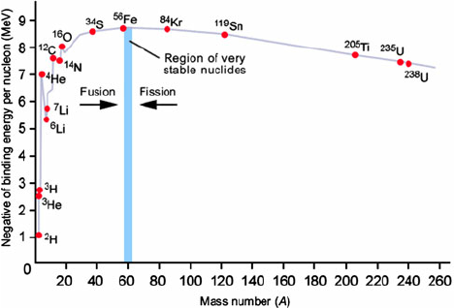
Connections to nuclear physics
Binding energy
Neutron magic numbers
@N=82 and 126
- Different peaks for s and r processes

