Slide 1
IAMI Project at TRIUMF
Esther Schirrmacher
Aug 17, 2020

Slide 2
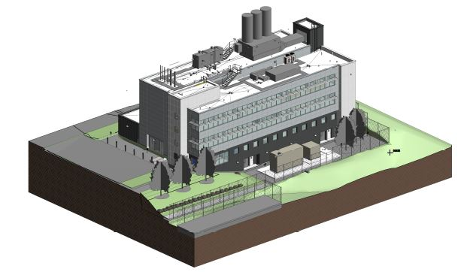
Institute for Advanced Medical Isotopes

Slide 3
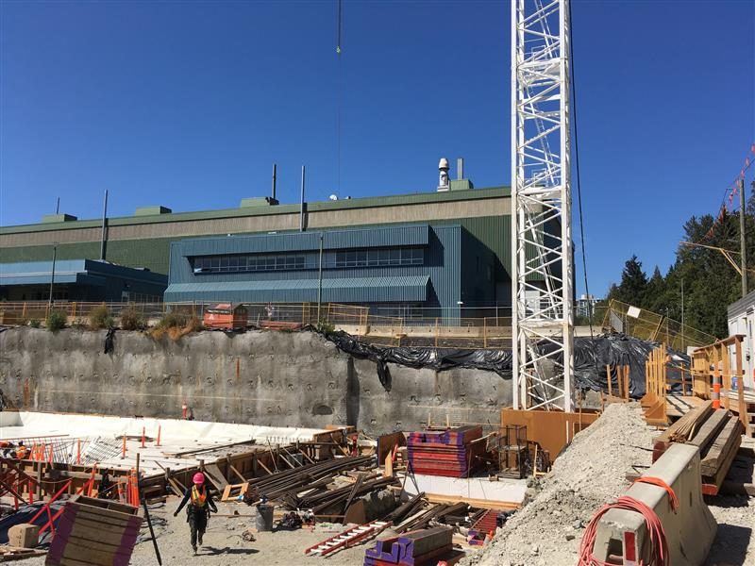
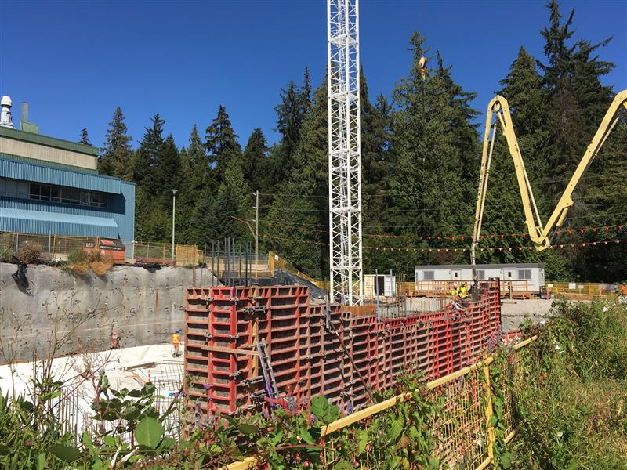
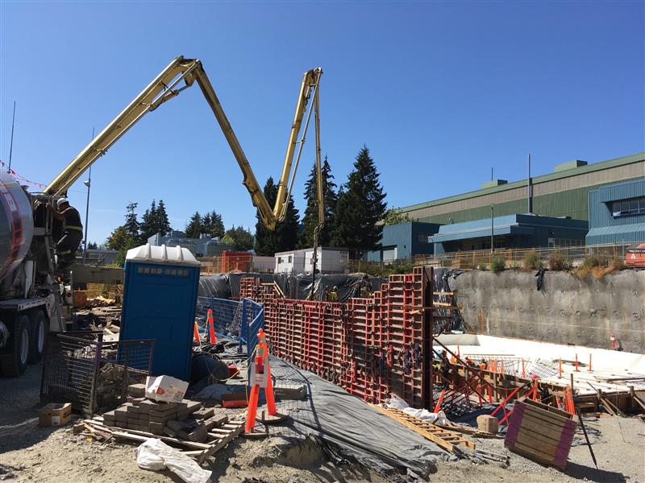

Slide 4
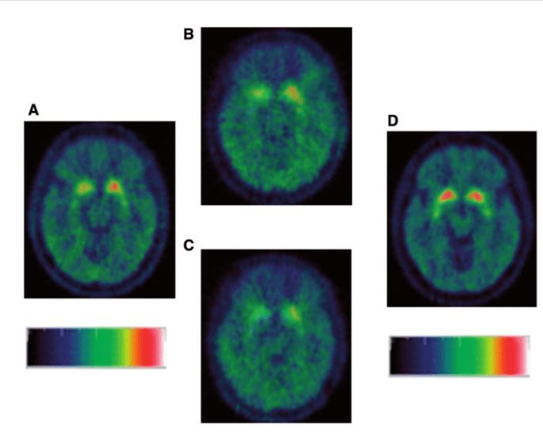
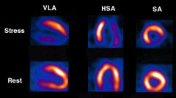
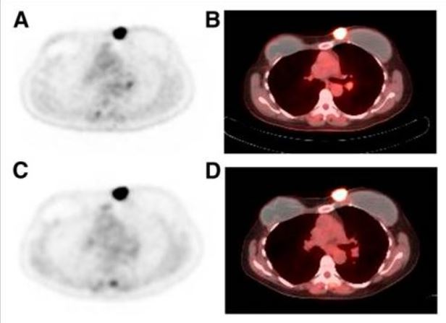
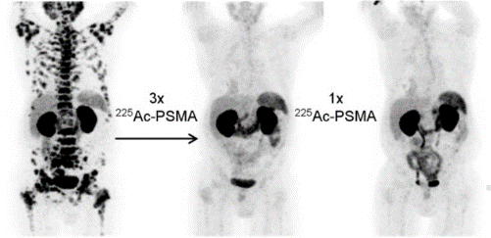
Life Sciences Research: Using Radioisotopes to…
  Understand disease pathophysiology:
  Ex: [¹¹C] RAC (Parkinson’s Disease, neurology)
  Diagnose/Stage patients:
  Ex: [^{99m}Tc] Tetrofosmin (heart attack, cardiology)
  Monitor treatment efficacy
    Ex: [¹⁸F] FDG (breast cancer, oncology)
  Treat patients:
  Ex: [²²⁵Ac] PSMA (Prostate Cancer, oncology)
IAMI

Slide 5
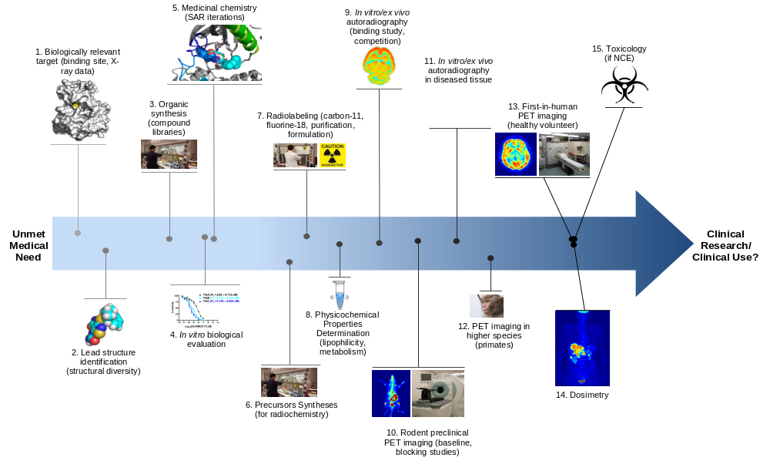
R&D in Life Sciences
Organic chemistry
Computational chemistry
GMP needed
radiochemistry

Slide 6
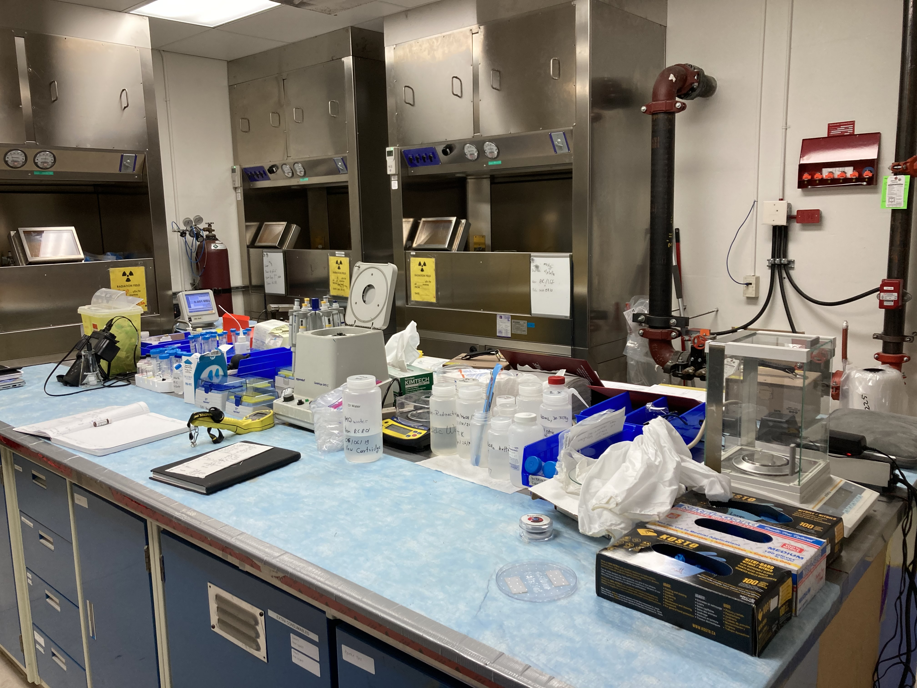
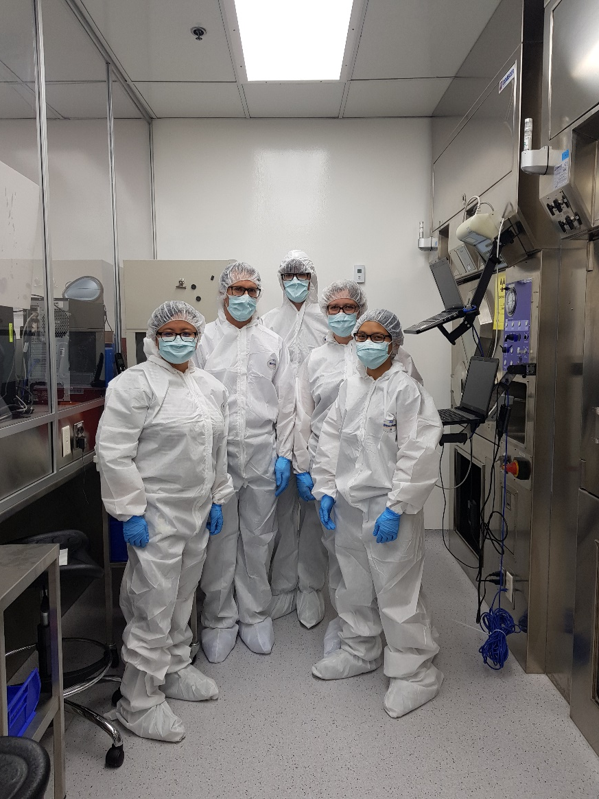
Radiopharmaceutical
Production under GMP
A regular research hotlab

Slide 7
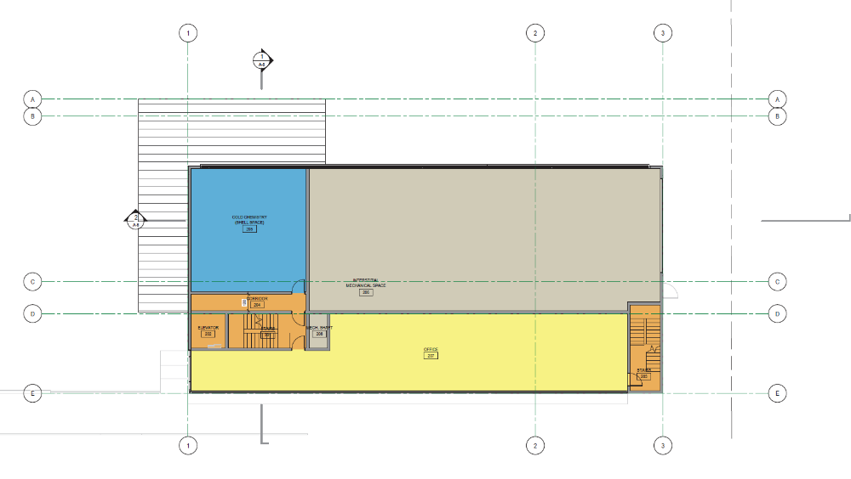
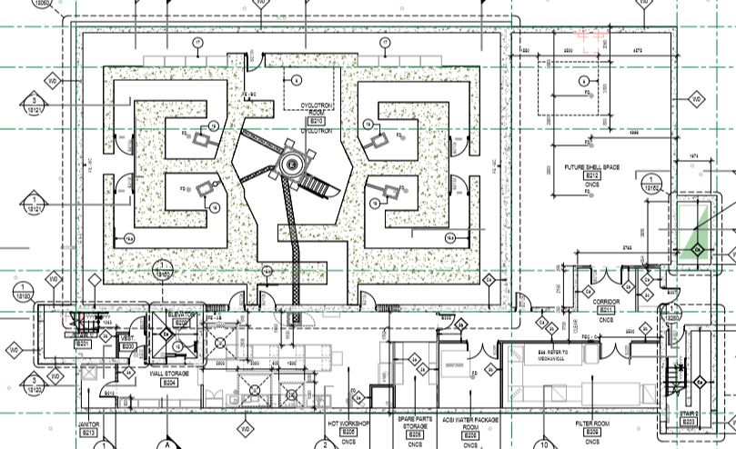
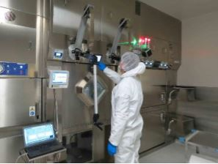
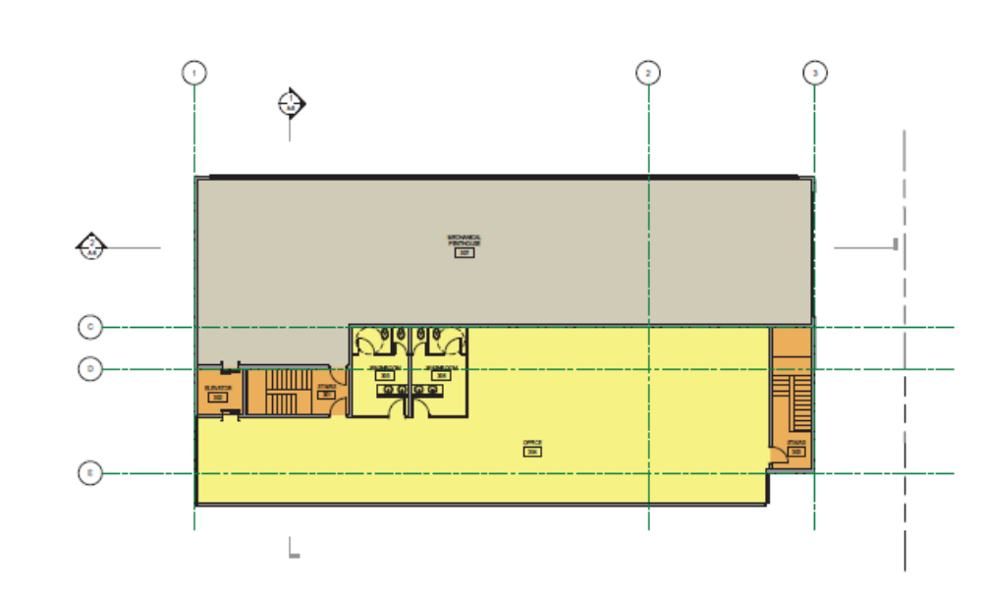
What else?
a TR24 cyclotron
with 2 solid target stations and two target selectors for liquid and gas targets
Office space
On L1 and L2
Lab space (cold and GMP hot)
On G and L1

Slide 8
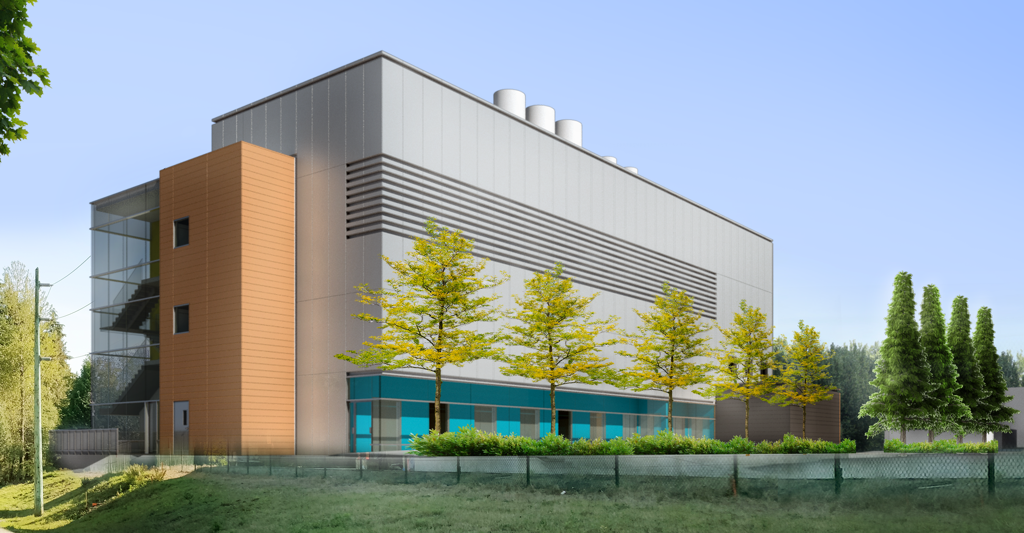
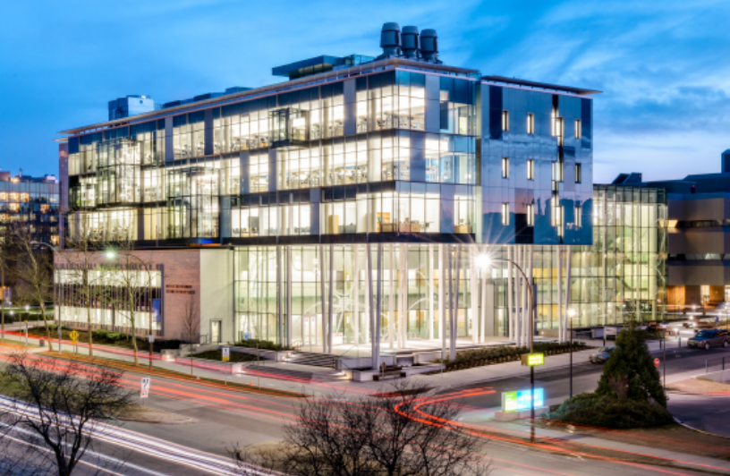



IAMI will feature five focused programs:
  Radiopharmaceutical Development:
    GMP production to support and expand radiopharmaceutical research
  Isotope Supply Security:
    Safe and secure routine production of Tc-99m
    F-18/FDG back-up supply for BC Cancer
  Clinical Imaging with Partners
  New, Targeted Therapeutics:
    R&D on next-generation isotopes, tracers, and therapeutics, including clinical trials
  Drug Development:
    Isotopes as tools to speed drug development
IAMI
Mowafaghian Centre for Brain Health

Slide 9
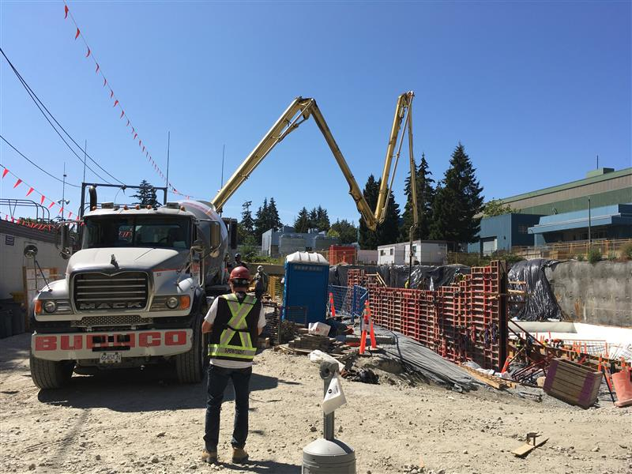

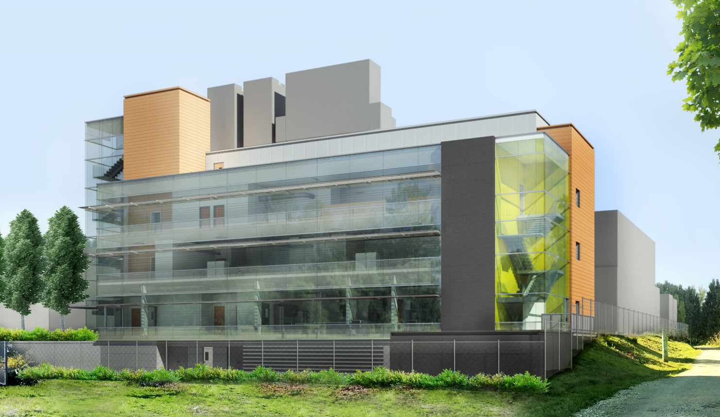
IAMI Timeline
2012:
The idea…
Spring 2019:
Finalized Design and tender
Spring 2020:
Redesign and contract signing
Summer 2020:
Construction begins
Summer 2022:
Construction completed
Winter 22/23(?):
Commissioning completed and operational start

Slide 10




Thank you
Merci
www.triumf.ca
Follow us @TRIUMFLab

