Slide 1


Green Radiochemistry
& Other Stories
Peter J. H. Scott, PhD
Associate Professor
Depts of Radiology, Pharmacology and Medicinal Chemistry
Member of the Rogel Cancer Center
University of Michigan, Ann Arbor MI, USA
pjhscott@umich.edu
TRIUMF Science Week, August 2020
@Scott_LabUM

Slide 2
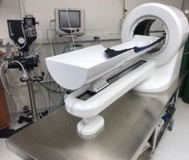
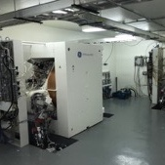
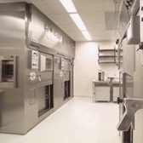
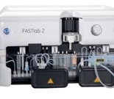
The University of Michigan PET Center
New PET Center opened in 2006 and expanded in 2010
2 x GE PETTrace Cyclotrons
3 x Gallium-68 Generators
9 full-size hot-cells, 4 mini-cells and 1 dispensing hot-cell
10 GE TRACERlab & FASTLab 2 ¹⁸F/¹¹C Synthesis Modules
2 x GE Irene modules (¹⁸F / ⁶⁸Ga / ¹³N)
3 clinical PET-CT, 7 SPECT-CT and 5 SPECT scanners
Radiotherapy stations for ¹⁷⁷Lu, ¹³¹I etc.
Preclinical PET scanners for rodent, nonhuman primate etc.

Slide 3
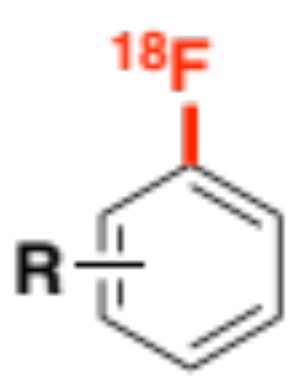

Scott Lab Overview
1. Clinical Operations
2. Clinical Research
3. Novel Tracer Discovery
4. New Radiochemistry
5. New Tech Development
Notes:
Peter Scott’s lab is involved in PET from lab to clinic

Slide 4
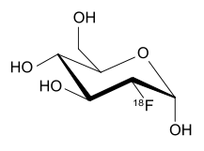
1. PET Utilization for Clinical Care @ UM
Clinical PET utilization at Michigan Medicine doubled between 2014 and 2018 (8-10k patients get scanned per year). Driven by introduction of NETSPOT and ⁶⁸Ga-PSMA, growth in FDG utilization, and migration from cardiac SPECT to cardiac PET;
Current scanner capacity is 2 x PET-CTs for clinical care and 1 PET-CT for clinical research. Two new clinical PET-CT scanners are being proposed to expand clinical bandwidth.
Theranostics (e.g. Lu177 Lutathera (neuroendocrine) and Lu177 PSMA (prostate) taking Nuclear Medicine into a new age of theranostics)

Slide 5
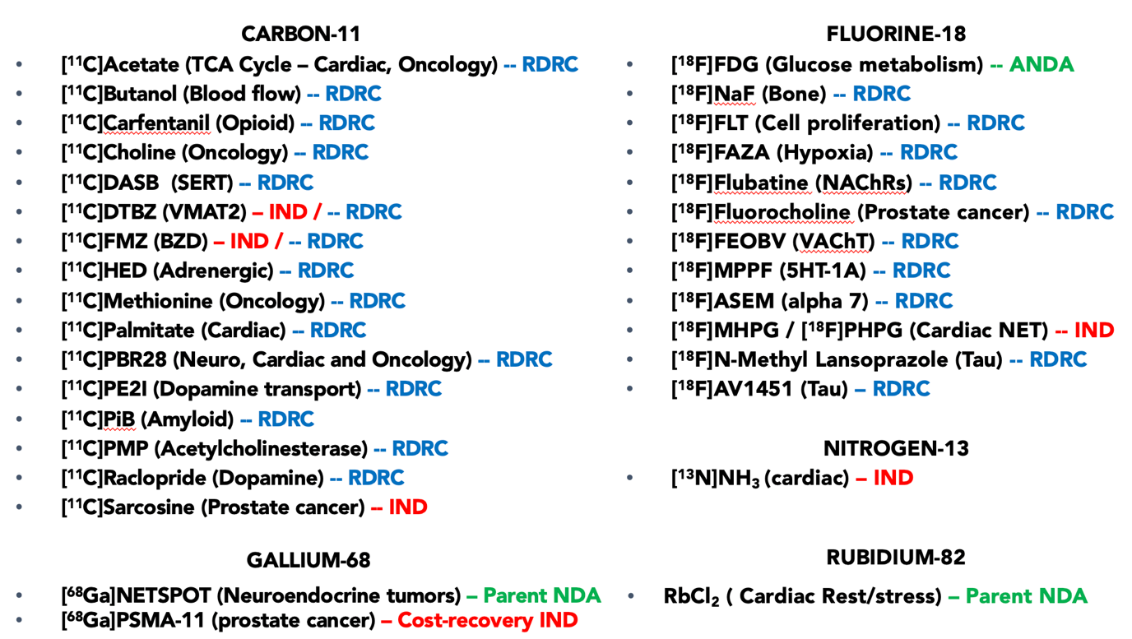
2. Clinical Research
a) Translation of new tracers
b) Menu of established
tracers available to use
Circulation: Cardiovascular Imaging, 2019
IND: 122,511
J Nucl Med, 2014;
55 (3): 396
IND: 109,500
Notes:
Scott’s lab also support clinical research, both through provision of 35 established radiotracers for routine use and translation of new radiotracers into clinical use.

Slide 6
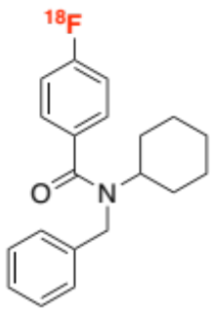
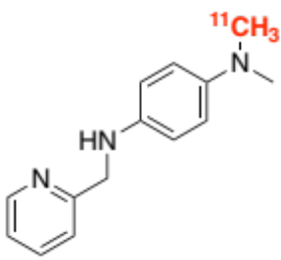
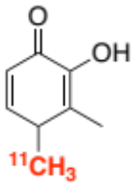
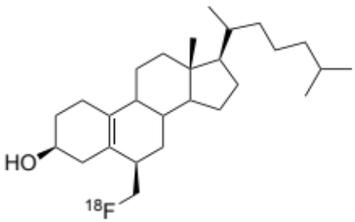
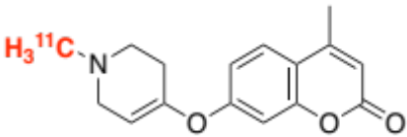
3. Development of new PET radiotracers
1. Neuroinflammation
2. Metal/Protein Aggregates
3. Metal Homeostasis
ACS MCL (2020) ACS MCL (2020)
JPA (2020)
ACS MCL (2015)
J Nucl Med
(2020, S1)
RAGE, CSF1R
Aß, tau, TDP-43, 𝛂-Syn
Iron dysregulation
SynOpen (2019)
ACS MCL (2020)
ACS CN (2015, 2018)
ACS MCL (2018)
4. Cholesterol Metabolism
5. Trapped Metabolite Imaging
Cholesterol trafficking, ATR101
MAO
Notes:
Peter Scott’s lab is involved in PET from lab to clinic

Slide 7
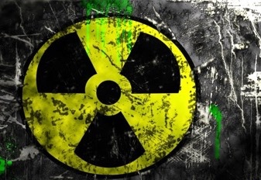
4. Basic Science Research
Radiochemistry Methodology

Slide 8

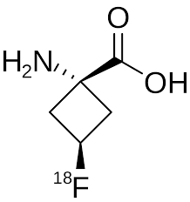
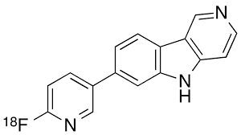
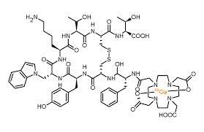
Simplifying Radiotracer Production
There are a number of challenges facing PET drug manufacturers in 2020:
More tracers are garnering FDA approval, including ¹¹C, ¹⁸F and ⁶⁸Ga tracers, mandating increased numbers of more diverse radiosyntheses per day;
Demand for PET drugs is increasing overall (clinical throughput has doubled at UM since 2014);
There is a need to label more complex molecules (e.g. labeling tracers for new imaging targets or labeling complex pharmaceutical assets);
cGMP is increasing regulatory burden (and cost) associated with PET drug manufacture.
My lab is therefore motivated to simplify the synthesis and quality control of PET drugs
Notes:
Scott’s basic science is focused in 2 areas – the first is development, preclinical evaluation and translation of new PET radiotracers, such as his work with Allen Brooks and Ben Viglianit on development of FNP-59 for cholesterol trafficking.

Slide 9

Basic Science A:
Green Radiochemistry
Peter’s Methodology Philosophy
Develop general, mild, high-yielding, and user-friendly labeling procedures;
We’re starting to better understand fluorine-18 and carbon-11, as well as their behavior
Our chemistry must work with diverse substrates – long term goal of our program is to be able to label any molecule!
Our methods must be suitable for clinical production;
Our chemistry must be easy to use, work in different labs and be compatible with many different synthesis modules or manual set-ups - Simple is always better!

Slide 10
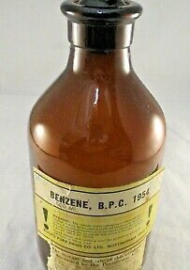
Residual Solvents
Solvents assigned Class by ICH Guidelines based upon toxicity:
  Class III (EtOH, DMSO, Acetone, MEK etc.)
  Class II (MeCN, DMF, DCM, 2-Pentanone etc.)
  Class I (Benzene, CCl₄) – NOT ALLOWED IN THE LAB!
Syntheses employing Class II solvents represent an element of risk to the patient, and thus require daily residual solvent testing. This is time consuming, especially for short-lived ¹¹C doses, and difficult to schedule 8 x 20-30 min GC runs (typically includes blank – 3 x standards – blank – 3 x doses – blank) and is particularly challenging on days with high volume of syntheses;
In the cGMP age, all solvents, reagents etc. require management through an inventory system;
All waste requires disposal as HAZMAT (expensive, especially for waste containing methyl ethyl ketone (MEK) due to regulations stemming from its use in the dry-cleaning industry);
USP<823> gives a provision that for syntheses employing Class III solvents ONLY (for cleaning, synthesis, HPLC, reformulation etc.), then daily residual solvent analysis is not required and the test can be reduced to a periodic QC test (e.g. quarterly like RNP, Osmolality etc.)
Therefore, we have an interest in eliminating Class II solvents from the synthesis of clinical PET drugs

Slide 11

This is Green chemistry…
and Pharmaceutical QbD
The invention, design and application of chemical products and processes to reduce or to eliminate the use and generation of hazardous substances.
Quality should be designed into a product, recognizing that most quality crises and problems relate to the way in which a product was designed in the first place. A high-quality drug product Is a product free of contamination and reliably delivering the benefit promised in the label to the consumer.
Anastas, P. T.; Warner, J. C. Green Chemistry: Theory and Practice, Oxford University Press, 1998, p.30
It quickly became apparent that using ethanol as the only organic solvent would be advantageous – Class III, GC methods in place;
However, perfluoroalkanesulfonate esters ‘known’ to be prone to solvolysis;
But, many ‘standard practices’ in organic synthesis do not translate to radiochemistry because of the tracer concept;
We have explored elimination of Class II solvents from the synthesis of ¹¹C and ¹⁸F-labeled tracers.

Slide 12



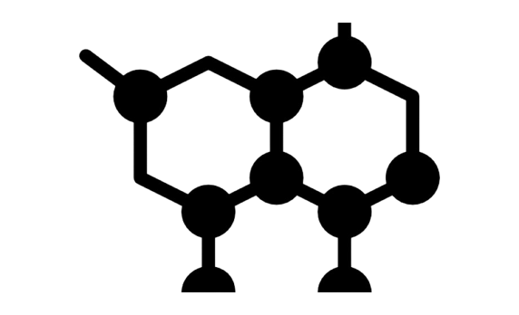
Principles of Green Radiochemistry
Synthesis
Module Cleaning
Reagent
Preparation
Radiolabeling
Purification
Formulation
Use EtOH for cleaning
(acetone is also
green and Class III)
Use EtOH for preparing
reagents (e.g. azeotropic
drying of ¹⁸F)
Use EtOH as
reaction media
(DMSO is also Class III,
but less green)
Use EtOH for HPLC
mobile phase and/or
SPE processing
Formulate doses
in EtOH

Slide 13
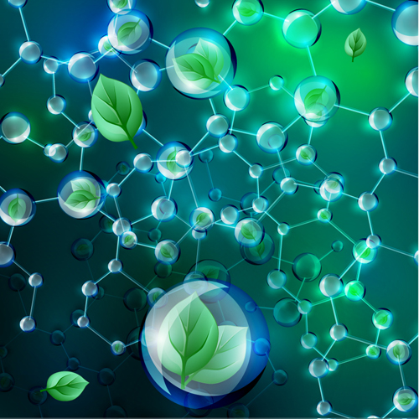
Green Carbon-11 Radiochemistry
 |  | CFN | CHO | DASB | DTBZ | FMZ | HED | MET | OMAR | PBR28 | PIB | PMP | RAC
Clean | Old | Acetone
Synth |  | DMSO | EtOH | MEK | DMF | MeCN | DMF | Acetone | DMSO | MeCN | 3-Pen | DMF | MEK
Purif |  | PrOH | EtOH | MeCN | EtOH |  |  |  | MeCN/MeOH | MeCN | MeCN | EtOH
Clean | Green | Ethanol
Synth
Purif
Carbon-11 radiochemistry can be conducted using ethanol as the only organic solvent for module cleaning, synthesis, HPLC, and reformulation!
See: Shao et al., NMB (2012), ARI (2015)

Slide 14
Green Fluorine-18 Radiochemistry
MeCN is a class II solvent used to azeotropically dry fluoride. Due to the similar BPs of the azeotropes (MeCN=76.5ºC; EtOH=78.2ºC), switching to EtOH is straightforward and does not impact RCY.
Remarkably, aliphatic fluorination reactions could be conducted using 15% EtOH in H₂O as reaction solvent, with some reduction in RCY compared to traditional solvents (DMSO, MeCN); arene substrates were unreactive in EtOH.
See: Stewart et al., Chem Commun (2015)

Slide 15
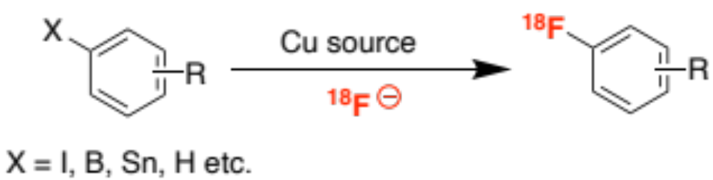
4. Basic Science B: Development of New Radiolabeling Reactions
Copper-mediated Radiofluorination (CMRF)
NIBIB Funded to develop new radiochemistry (R01EB021155)
[For recent work, see: ACIE 2019, JACS 2020, Nature Prot 2020]
Notes:
The second area of basic science research is Scott’s efforts with Melanie Sanford in Chemistry to develop new ways of incorporating PET radionuclides into bioactive molecules

Slide 16
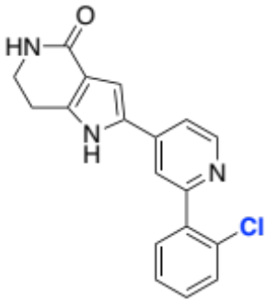
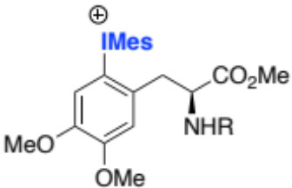
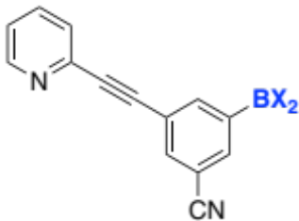
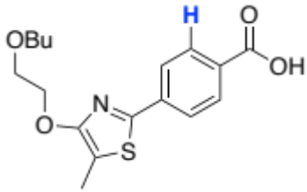
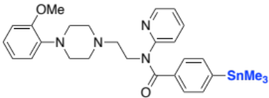
Application of Green Radiochemistry to CMRF
Iodonium Salts
Organoborons
Organostannanes
C-H Fluorination
Aryl Halides
Org Lett (2014)
Org Lett (2015)
Sci Rep (2017)
JLCR (2018), OBC (2019)
Nat Prot (2020)
Org Lett (2016)
ACS Med Chem Lett (2020)
ACIE (2019)
JACS (2020)
Elemental Impurities for Drug Products
Our CMRF methods have been rapidly adopted by the radiochemistry community and used to prepare >100 radiotracers for preclinical and clinical PET imaging [for a review, see: Wright et al., Clin Trans Imaging (2020)];
Green chemistry and QbD principles have informed our method development from day 1;
For example, QbD and green chem informed our decision to use Cu-mediated reactions. It is both a green choice for a catalyst, and has amongst the lowest toxicity of available catalysts.

Slide 17
⁶⁸Ga Targetry
Rodnick et al. (2020)
EJNMMI R&C, Accepted
New automation
Frank et al. (2019)
EJNMMI R&C, 4:24
IoT, big data, AI
Thompson et al. (2016)
ACS Cent Sci, 2:497
5. New Technology

Slide 18
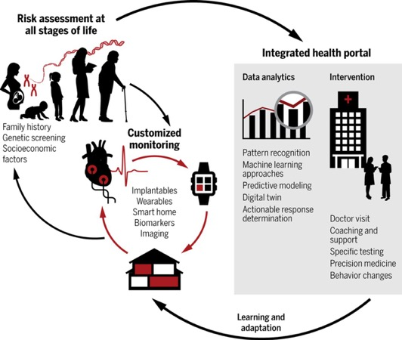
IoT and Precision Health
Radiochemistry
Nuclear Pharmacy
Precision Health
Thompson, ACS Cental Science, 2016.
www.cardinalhealth.com
Gambhir, Science Transl. Med. 2018: 10, eaao3612.

Slide 19
Summary
Nuclear medicine (PET, SPECT and Radiotherapy) are very active areas of research and clinical growth in radiology departments;
A lot of developments have occurred in the community over the last few years that have pushed nuclear medicine into a new era, including FDA approval of new diagnostic PET drugs and radiotherapeutics;
Much of this innovation presents new challenges to the community (cGMP, challenging targets, the transition from getting products FDA-approved to meeting routine delivery etc.), but new developments continue to facilitate this (green radiochemistry, late-stage radiofluorination, IoT, targetry etc.) that will be the exciting future of the field.

Slide 20
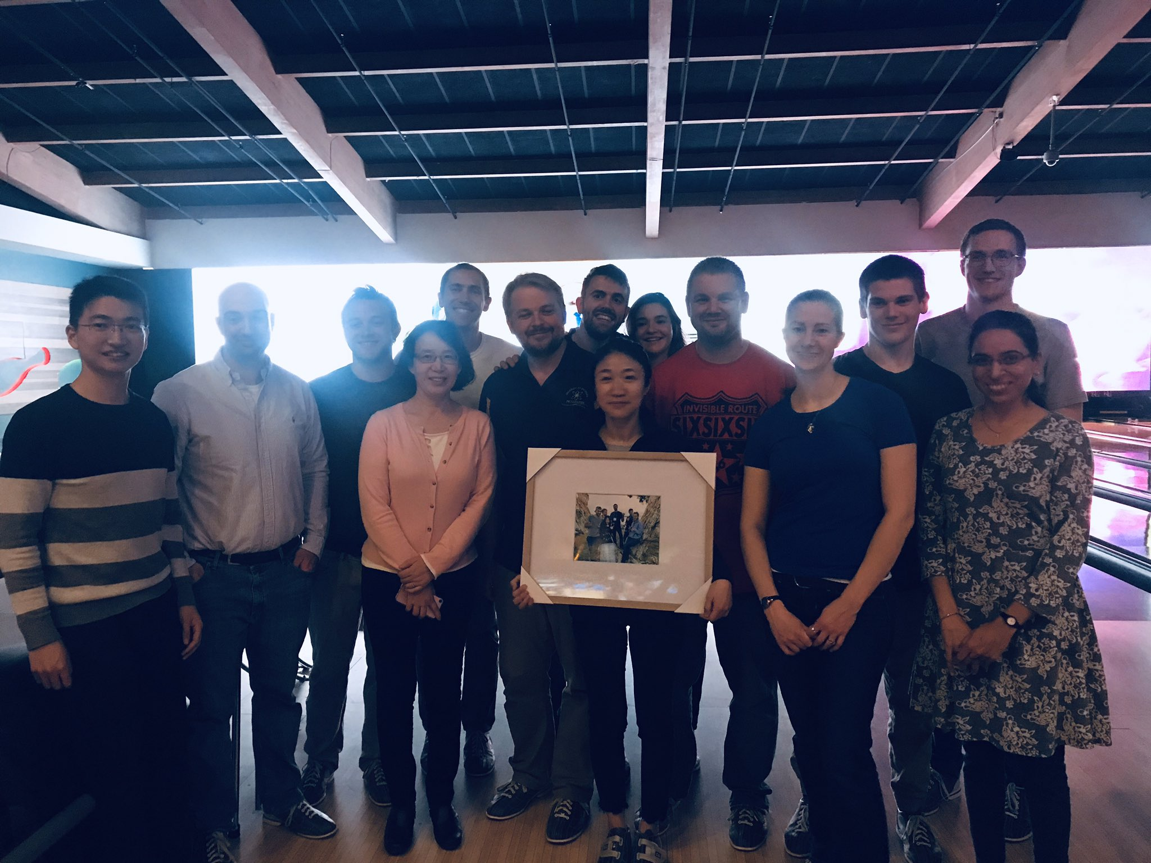



Acknowledgments
Post-doctoral Fellows
Raphael Hoareau, Ph.D.
Ryan Littich, Ph.D.
Melissa Rodnick, Ph.D.
Allen Brooks, Ph.D.
Kuhn-Sam Jang, Ph.D.
Erin Cole, Ph.D.
Andrew Mossine, Ph.D.
So-Jeong Lee, Ph.D.
Matthew McCammant, Ph.D.
Stephen Thompson, Ph.D.
Stefan Verhoog, Ph.D.
Ryan Pakula, Ph.D
Tanpreet Kaur, Ph.D
Eric Webb, Ph.D
Jay Wright, Ph.D
Staff
Phillip Sherman
Jenelle Stauff
Janna Arteaga
Carole Quesada
Louis Tluczek
Surekha Patel
Brian Hockley
Charlie Schneider
Brad Henderson
Timothy Desmond
Mara Clark
Melissa Rodnick
Laura Bruton
Sean Preshlock
Undergraduates
James Sindelar
Daniel Mason
Paul Schnau
Garrett Carpenter
Adam Runkle
Merissa Zeman
Adam Ziolkowski
Stacy Monk
Andrew Glatz
Renee Veresh
Joseph Casamento
Brian Cary
Isaac Jackson
Dale Mallette
Anthony Mufarreh
Austin Zhao
Jonathan Pham
Wade Winton
Nicholas Wiesner
Alex Lapsys
Graduate Students
Jennifer Schmidt,
Anthony Nastase
Dylan Kahl
Andrea Shergalis
Sarah Burriss
Robert Hohlman
Megan Stewart
Alexandra Sowa
Lindsey Drake
Jason Miller
Sean Tanzey
Faculty
Xia Shao, Ph.D.
Allen Brooks, Ph.D.
Yong-Woon Jung, Ph.D.
Collaborators
Prof. Melanie Sanford (UM)
Dr. Katarina Makaravage (UM)
Dr. Naoko Ichiishi (UM)
Dr. Liam Sharninghausen (UM)
Dr. Joseph Topcsewski (UM)
Prof. Ralf Schirrmacher (Alberta)
Dr. Shane Krska (Merck)
Dr. Eric Hostetler (Merck)
Dr. Wenping Li (Merck)
Dr. David Donnelly (BMS)
Dr. Marc Skaddan (AbbVie)
Dr. Tony Giamis (AbbVie)
Dr. Stephen McCraith (RJS)
Dr. Erik Verner (Corvus)
Dr. Neil Vasdev (Toronto/CAMH)
Dr. Katie Gagnon (GE)
Dr. Chirs Parr (GE)
Dr. Jens Frigell
Dr. Carina Sollert (GE)
Brian Prejna (GE)
Funding
NIH, DOE, Alzheimer’s Association, Merck,
AbbVie, RJS, BMS, Corvus, Weston Brain Institute
@Scott_LabUM

