Slide 1

Development of Radiation Hard Semiconductor Sensor Devices for Tracking Detectors in Future Collider Experiments
Thomas Koffas

Slide 2
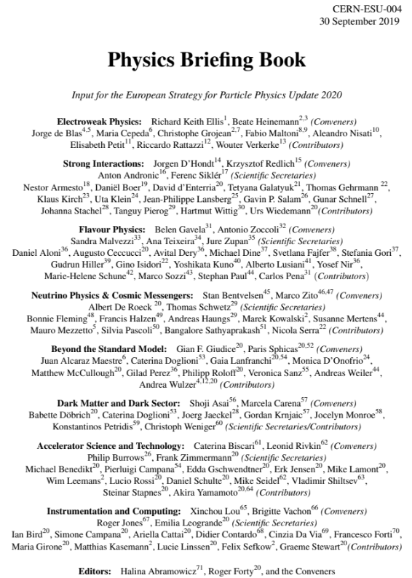

Beyond the HL-LHC: Future Colliders and Technology Challenges
Radiation-hard semiconductor devices in the R&D forefront
of sub-atomic physics community for 25 years
  Led to construction of Si tracking detectors at the LHC and HL-LHC
Focus shifting to meet the technology challenges for future colliders
beyond the HL-LHC
  ILC, CLIC, FCC-ee, CEPC, FCC-hh,…
Extremely high radiation levels close to collision points
  Will exceed 10¹⁷ n_{eq}/cm².
Poses major challenges on semi-conductor technology
  Material quality (defects, doping, radiation effects,…)
  New materials beyond Si (which may reach its limitations)
  Understand physics of radiation damage
    And develop microscopic physics models
  Sensor design, detector layouts, readout ASICs, data handling,…
2020 Update of European Strategy:
“Need to maintain a strong focus on detector R&D to be able to prepare
and eventually realize experimental research programs.”

Slide 3
Technology Challenge Examples
Challenge 2: Radiation Damage
Lattice atoms get moved around…
  → Interstitial site and lattice vacancy
Damage to crystal lattice effects:
  Charge-carrier trapping
    → signal loss
  Leakage current
    → more noise
  Change of N_{eff}/V_{dep}
  → higher bias voltages
Challenge 1: Occupancy
  Increased complexity of event
  Saturate our ability to collect data
Requires radiation-hard
material technology
Requires high granularity

Slide 4

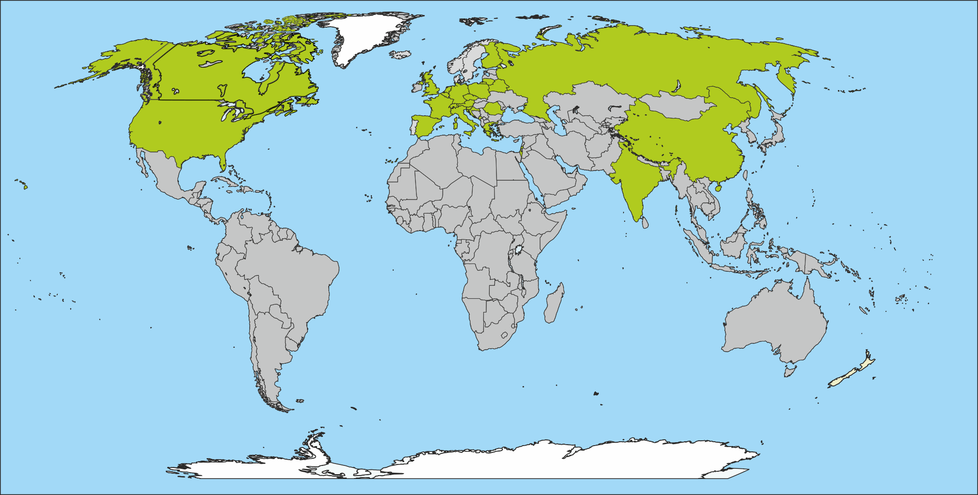


R&D Framework – CERN Collaborations
The RD50 Collaboration
An international collaboration that aims to provide radiation-hard
semiconductor devices for future colliders
New!
63 institutes, 370 members
50 European institutes
8 North American institutes
2 Asian institutes
1 Middle East institute
TIMEPIX 3/4

Slide 5
Material Defects – Epitaxial Wafers
Objective: FABRICATION OF P-N JUNCTIONS & SCHOTTKY DIODES TO INVESTIGATE RADIATION EFFECTS ON Epitaxial Si, CMOS-DOPING COMPATIBLE
GUARD RING
CATHODE
GUARD RING
Several 6” Si wafers of different epitaxial doping levels each
p-type with different epitaxial doping levels : 10¹³, 10¹⁴, 10¹⁵, 10¹⁶, 10¹⁷
10 Wafers /each doping type
0.2 mm
0.2 mm
0.1 mm
0.1 mm
1 – 5 mm
BOND WIRE
IV/CHARGE AMP
P -1e13
P -1e14
P -1e15
P -1e16
P -1e13
P -1e13
P -1e13
P -1e13
Al
Al ∼500 nm
Al
SiO2
∼500 nm
Epitaxial Si
50um
up to 5 different P doping
Substrate
P⁺⁺
* DRAWING NOT TO SCALE!
P -1e17
P -1e13
Al
GND
Al thickness to 500 nm for bonding purposes
Same SiO2 thickness of around 500+ nm
Al metalization on backside several 100’s nm thick to avoid peeling off
Layer of Cr or Ti between Al and SiO2 to guarantee adhesion
Same adhesion layer between Al and Si at the backside

Slide 6
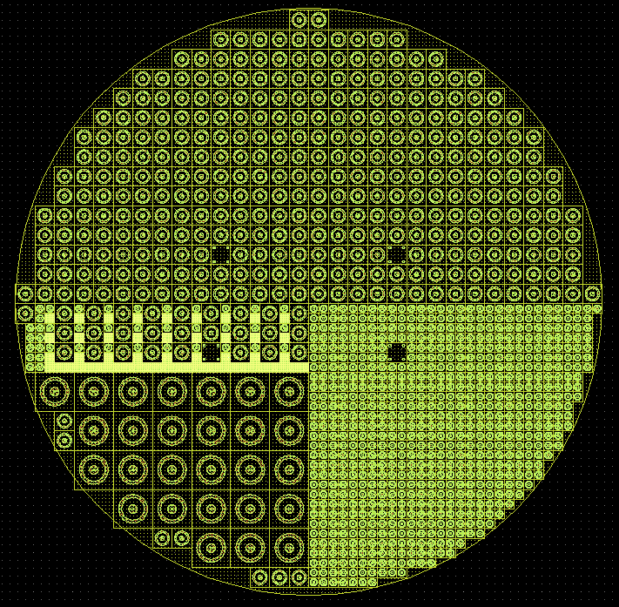
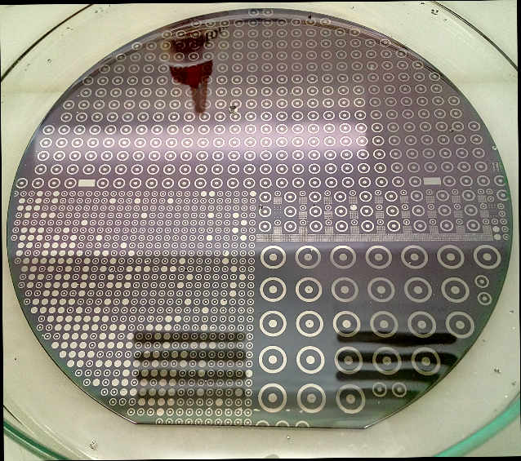
Test Structure Fabrication
6” wafer: 5 flavors
1mm cathode, 25 mm2 device (IV, CV, laser injection)
0.5 mm cathode, 6.25 mm2 device (plus MIP injection)
0.1mm cathode, 0.25mm2 device (TCAD comparison)
cell with previous 3 flavors grouped together
2mm cathode, 100mm2 device (IV/CV, MIP, laser)
Include asymmetric p-n junctions, Schottky diodes
Alignment marks
#1
RAL/ITAC
#4
Carleton/CUMFF
#2
#5

Slide 7
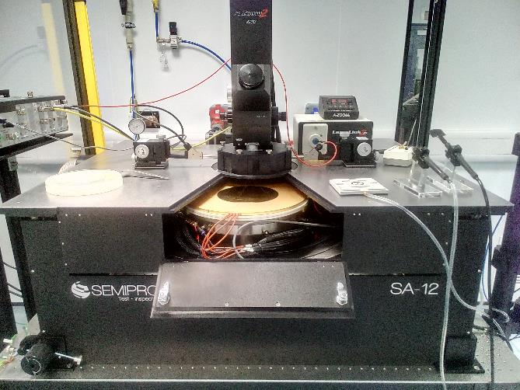
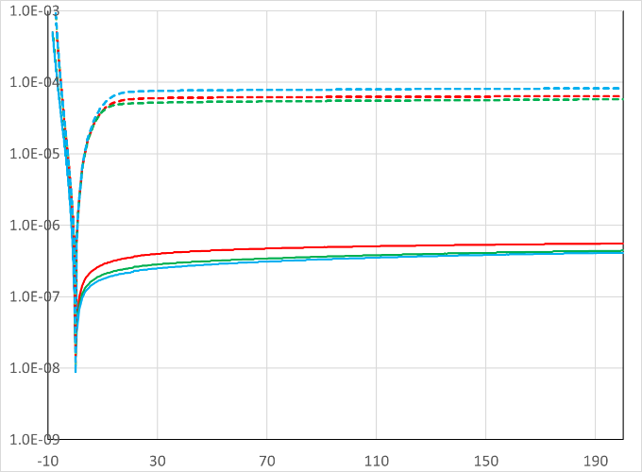
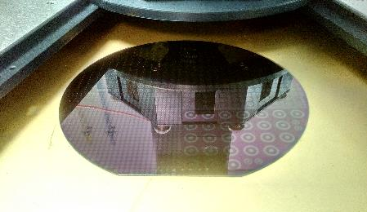
Test Structure Measurements
I [A]
PN
Schottky
V
Preliminary IV tests show Schottky and PN devices to properly work. BV > 200V both for Schottky and PN junction.
Leakage current in reverse mode much higher for PN junctions than for Schottky diodes.
CCE/DLTS studies will require dicing; to be performed at CUMFF
Preparations for irradiations with protons/neutrons started

Slide 8
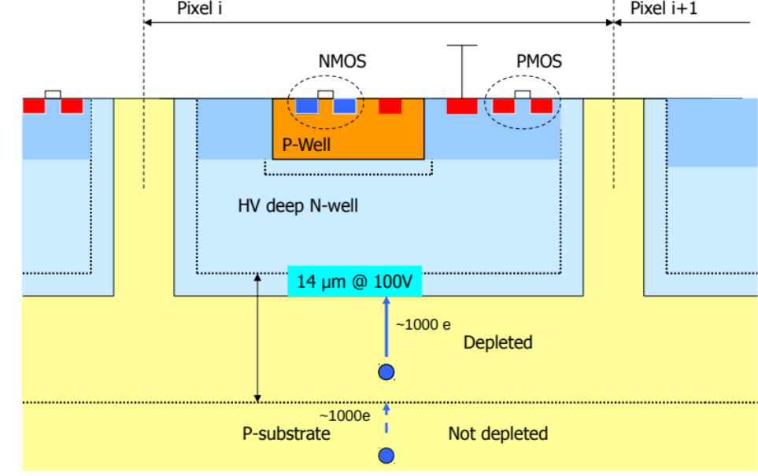
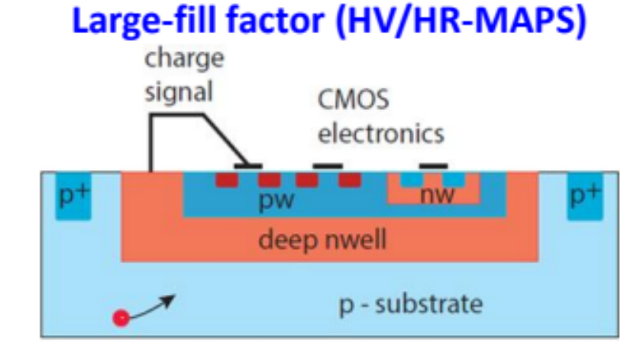
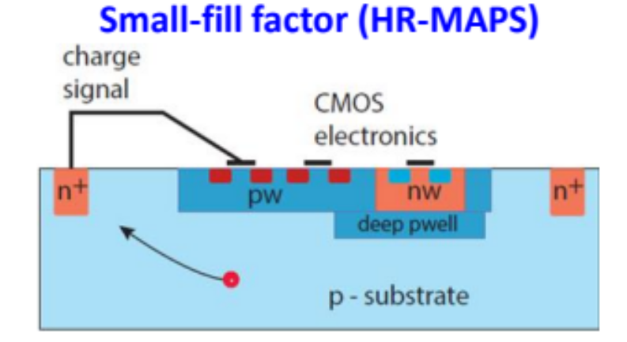
New Structures – Depleted CMOS
Basic idea: explore industry standard CMOS processes for sensors
Commercially available by variety of foundries
Low cost per area; as cheap as chips for large volumes
Thin active layer; usually p-type Cz silicon
Two basic flavors with deep N-well:
HV-CMOS:
Highest possible bias
Smallest drift time
Advantages:
Integration of sensor and RO circuitry in single layer
  Thanks to industry standard process of fabrication
  No need for interconnection with solder bumps
  Fast turn-around production and lower costs
  Thin material thickness (as low as 50μm)
Disadvantages:
Need to demonstrate sufficient radiation hardness
Improve timing resolution to below 13ns
HR-CMOS:
Specialized imaging
processes

Slide 9
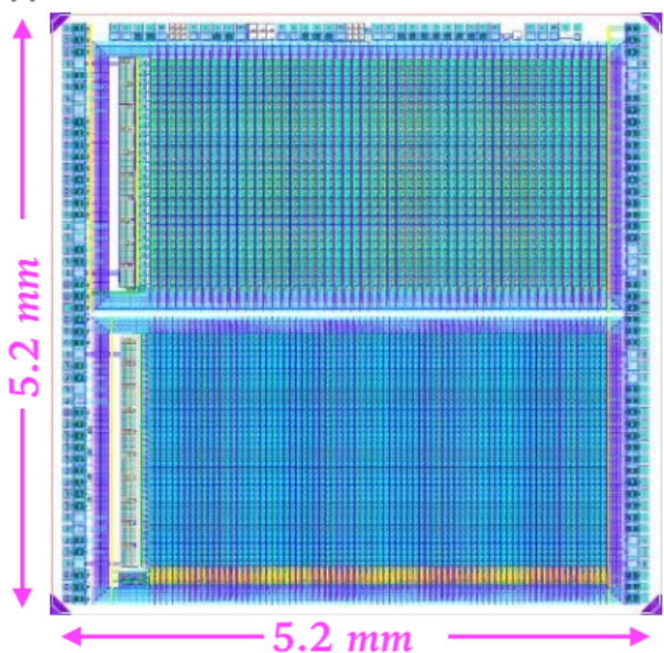
DMAPS-Towards Higher Radiation Tolerance
What is needed?
Increase the allowed substrate biasing
  More signal due to deeper depletion region
  Faster charge collection
Access to HR substrates
Backside processing to bias the sensor from the back
  More uniform electric field lines and depletion region
  Improved charge collection efficiency
Sensor thinning
  Improved charge collection efficiency
Multiple nested wells to isolate LV CMOS RO electronics from substrate biasing
Suitable technology design (circular transistors, triple redundancy)
Access to technology with smaller feature sizes
RD50-MPW1 LFoundry 150nm HV-CMOS process
  p-type substrate, resistivity 3kΩ⋅cm

Slide 10
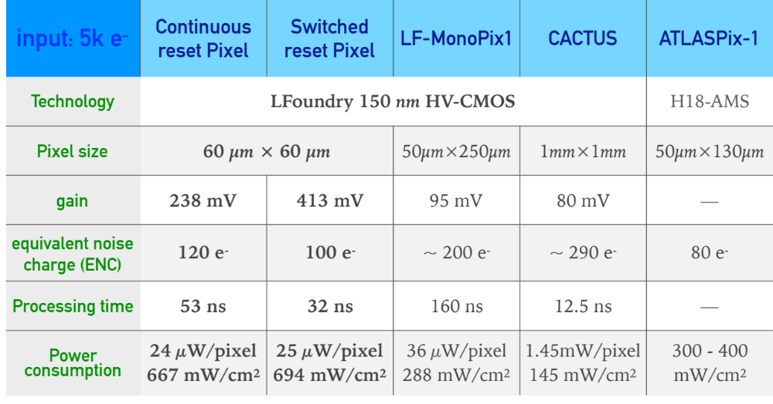
DMAPS-State of the Art
Small pixel size, large gain, low noise, faster processing time
BUT, no demonstrated radiation hardness above ~2×10¹⁵n_{eq}/cm² yet

Slide 11
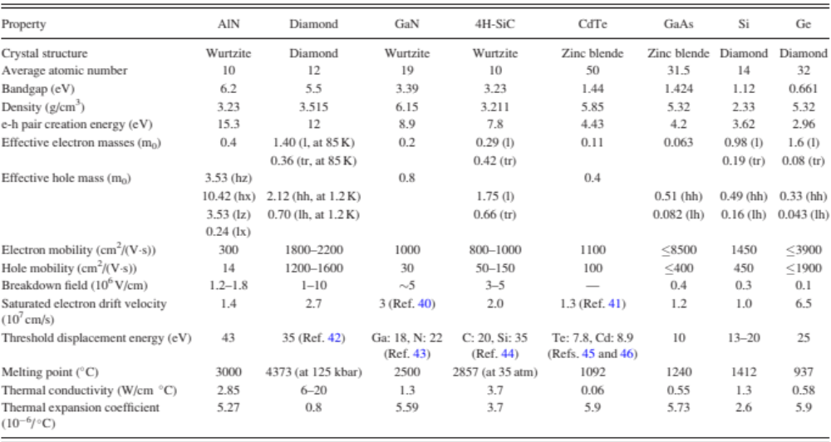
New Materials R&D - GaN
Ideally one would like to push for radiation hardness ≥10¹⁷ n_{eq}/cm².
→ are there semiconductor material that can achieve that?

Slide 12
New Materials R&D - GaN
Ideally one would like to push for radiation hardness ≥10¹⁷ n_{eq}/cm².
→ are there semiconductor material that can achieve that?

Slide 13
New Materials R&D - GaN
Ideally one would like to push for radiation hardness ≥10¹⁷ n_{eq}/cm².
→ are there semiconductor material that can achieve that?
GaN provides such a candidate!

Slide 14
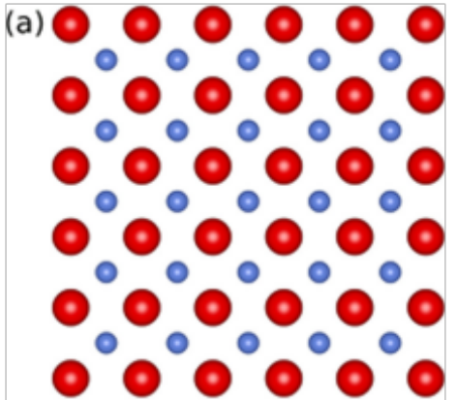
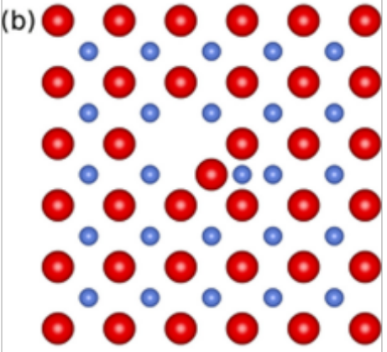
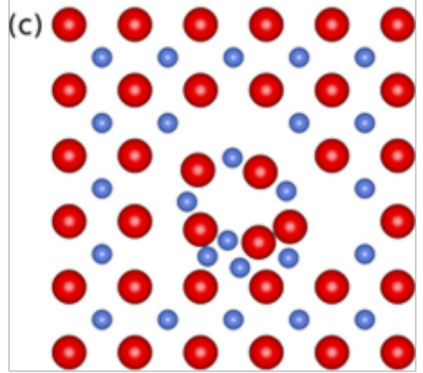
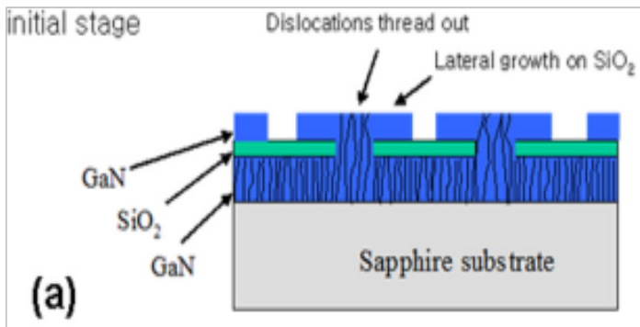
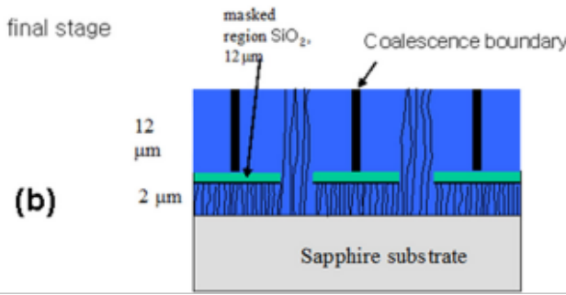
Radiation Damage Effects on GaN
Fundamentally different effects of ionizing (e.g. electron) vs. neutron irradiation
Perfect GaN lattice
Point defects created
by ionizing radiation
Disordered (Gossick) regions
typical of neutron irradiation
Dislocation defect density due to growth on lattice mismatch substrates
results to further deterioration
Loss of carriers due to capture by deep traps decorating dislocations
Impact on the mobility of charge carriers

Slide 15
Radiation Damage Effects on GaN
Fundamentally different effects of ionizing (e.g. electron) vs. neutron irradiation
Better GaN growth methods holds the key to the future
What improves photoelectric performance will also improve radiation hardness
Perfect GaN lattice
Point defects created
by ionizing radiation
Disordered (Gossick) regions
typical of neutron irradiation
Dislocation defect density due to growth on lattice mismatch substrates
results to further deterioration
Loss of carriers due to capture by deep traps decorating dislocations
Impact on the mobility of charge carriers

Slide 16
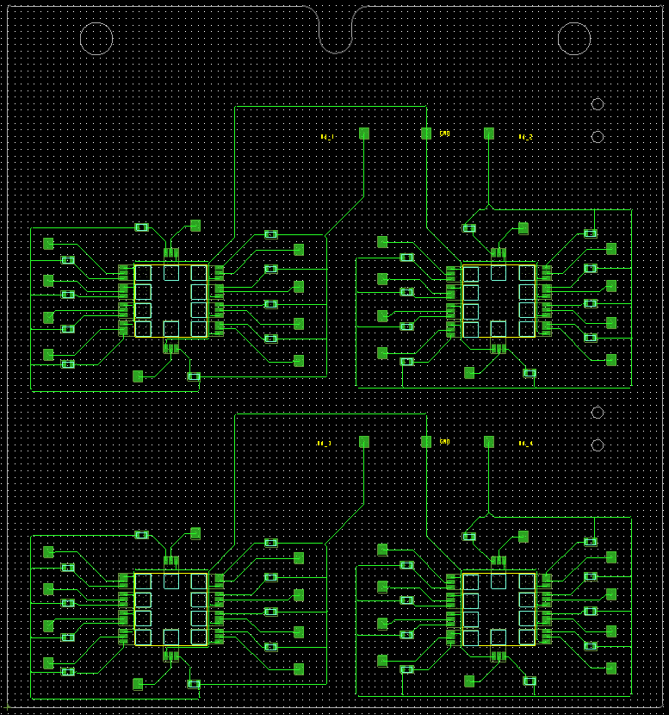
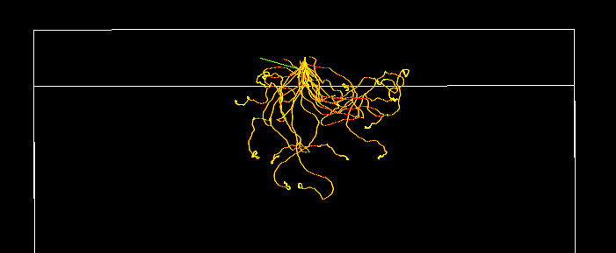

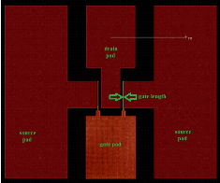
GaN Fabrication Process Radiation Hardness
Collaboration with NRC’s GaN fabrication facility
GaN HEMT structure as rad-hard sensor for ionizing radiation
  GEANT4 simulations of 500 keV normally incident β-particles on a GaN slab demonstrate sufficient energy deposition for detection
  TCAD simulations being performed on modified GaN HEMT to investigate if gain can be achieved in a similar manner to that of LGADs
  Aim to irradiate GaN HEMTs fabricated by NRC with 26MeV p up to fluences of 10¹⁵ [cm⁻²] (TID around 230Mrad [GaN]) to compare with previously irradiated Panasonic GaN FETs used in Strips ITK
HV
1e12
1e13
Vbias
GND
1e14
1e15
PCB holding up to 40 NRC 1x2 mm2 GaN devices, divided into 4 blocks.
Each block of 10 devices receives a different p fluence, up to 1e15 [cm-2]
NRC 1x2 mm2 GaN HEMT layout
Each 1x2 mm2 chip contains 4 HEMTs, differing in gate length

Slide 17
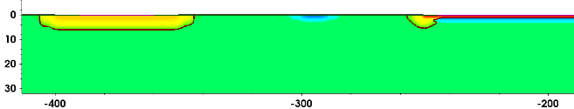
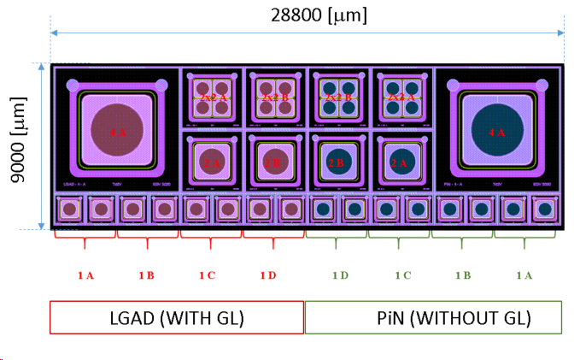
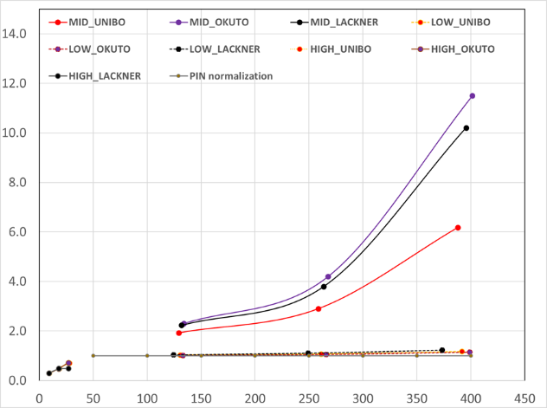
R&D Examples – New Structures
LGAD Project, study radiation effect on Gain Layer (GL) charge amplification
LGAD and PiN diodes share the same layouts on each split
Three different gain layer doses and energy
Fabrication expected July 2020
*
FL#1
P-stop
Cathode
GR
LGAD – 50 um HR epi
Gain
8.8_{fC}
T = 300K
GR floating
Gl Dose: NOMINAL
Gl Dose: HIGH
4.7_{fC}
LGAD
1.7_{fC}
PiN
Gl Dose: LOW
c
c
Vbias [V]

Slide 18
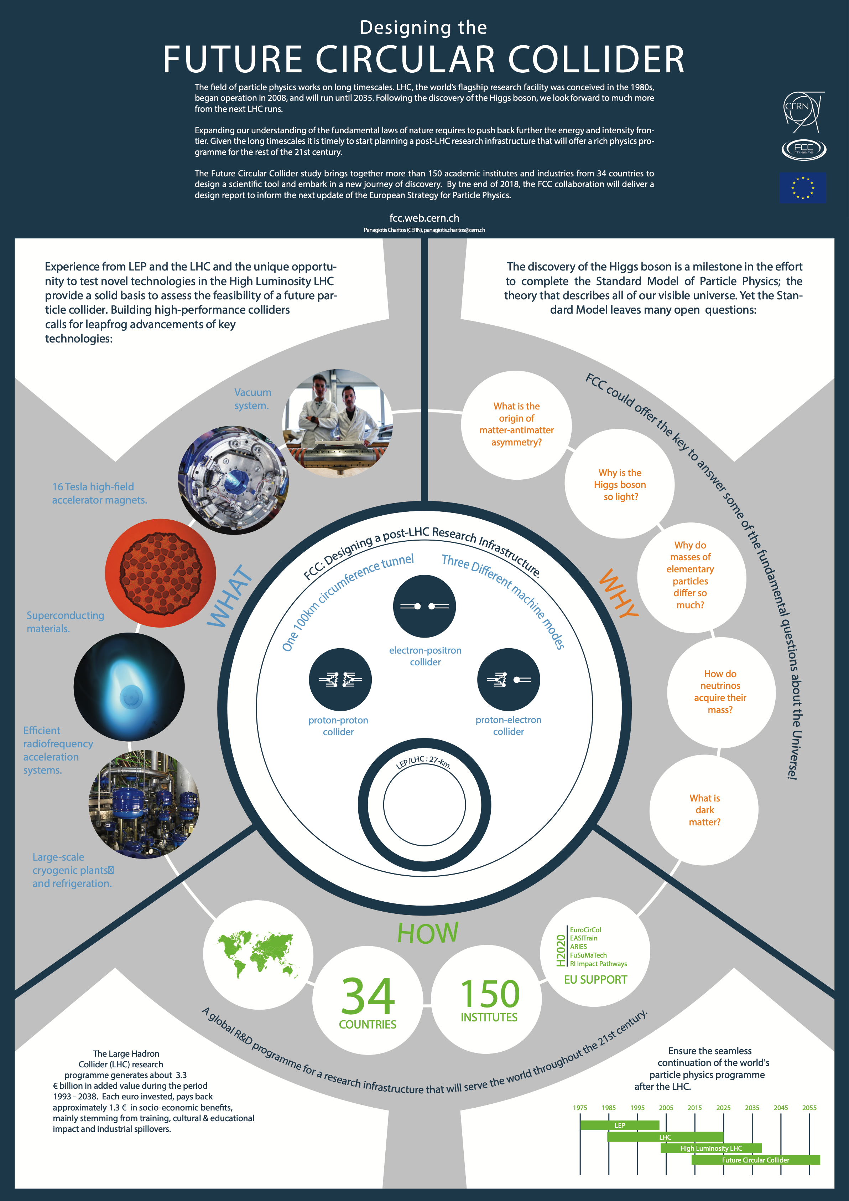

Outlook: FCC-ee/hh Program
Particle physics community gradually shifting focus towards the post-LHC era
Ample physics motivation:
  Uniquely map properties of Higgs and EW gauge bosons
  Improve discovery reach of new particles at highest mass
  Improve sensitivity to elusive phenomena at low mass
  Facilitate search for Dark Matter
  Probe energy scales beyond direct kinematic reach
Physics program implementation requires development of new technologies
  Transition of radiation-hard R&D to new tracking detector development
Focus R&D to specific experimental challenges:
  Tracking detector layout
  Sensor design, granularity, material budget
  Optimize detector sensitive area
  Optimize detector coverage
  DAQ architecture to cope with high data rates
  On-detector readout electronics
  Performance tailored to physics program needs
Normal development/construction cycle
of an approved particle physics experiment

Slide 19
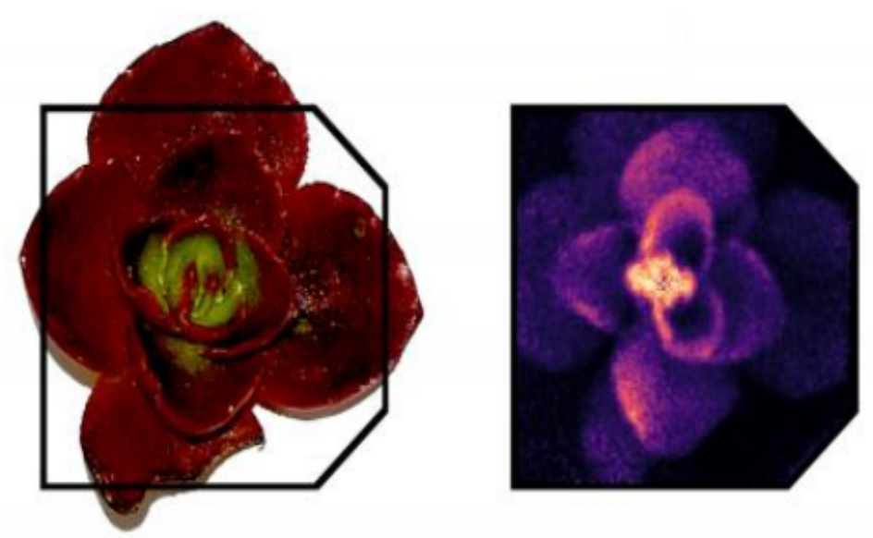
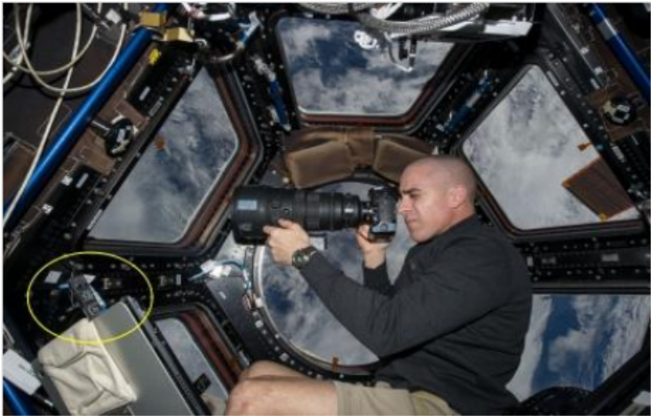
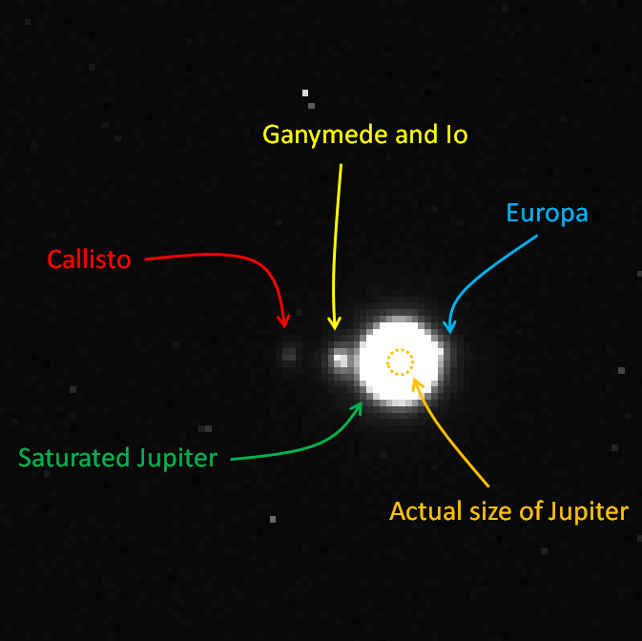
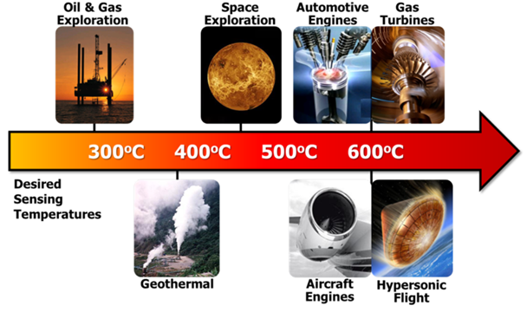
Societal and Economic Impact
Numerous applications with potentially significant economic impact:
  Material fabrication technology, optoelectronics, deep space exploration, nuclear technology, medicine
  Established connection with Timepix/Medipix efforts, one of CERN’s technology transfer vehicles
EXAMPLE: International Space Station
Monitor radiation environment of space station
5 Timepix sensors into laptop USB ports!
EXAMPLE: Ion Beam Radiotherapy Imaging
Requires new methods of radiation dose measurement
  Single-particle tracking, energy deposition, particle type sensitivity
System of Timepix detectors put together
Assembly very similar to ATLAS-ITk
Measure deposition of single ion energy
Allows for high-contrast images
EXAMPLE: NavCam System, JUICE
Harsh radiation environment to survive for 11 years
Fluences within 2 orders of magnitude of LHC!
Total integrated dose could exceed 1MRad
Knowledge transfer between CERN-ESA
GaN
Devices
Credit: Airbus Industries

Slide 20
Summary
International physics community gradually shifting its focus to the post-LHC era
  Excellent opportunity for Canadian sub-atomic physics to join international detector R&D efforts from early on
  Builds on infrastructure and knowledge gained during the ATLAS-ITk project
Ample scope to develop robust R&D efforts on radiation-hard semi-conductor devices
  Aim to reach fluences at 10¹⁷ n_{eq}/cm² where Si may actually fail
Enhance Canadian presence at CERN in international collaborations other than ATLAS
  By participating in the RD50 collaboration and the Medipix/Timepix collaborations
Allows for Canadian participation in major future CERN collider projects
  FCC-ee and FCC-hh whose combined program will cover the next seven decades
Wide range of commercial applications already appearing
  Deep space exploration, material studies, medical imaging,…
Excellent example of basic science research resulting
in great technological advances

