Slide 1
New machine projects
Oliver Kester
Associate Lab Director – Accelerator division
TRIUMF Science week, accelerator science, July 12, 2017

Slide 2
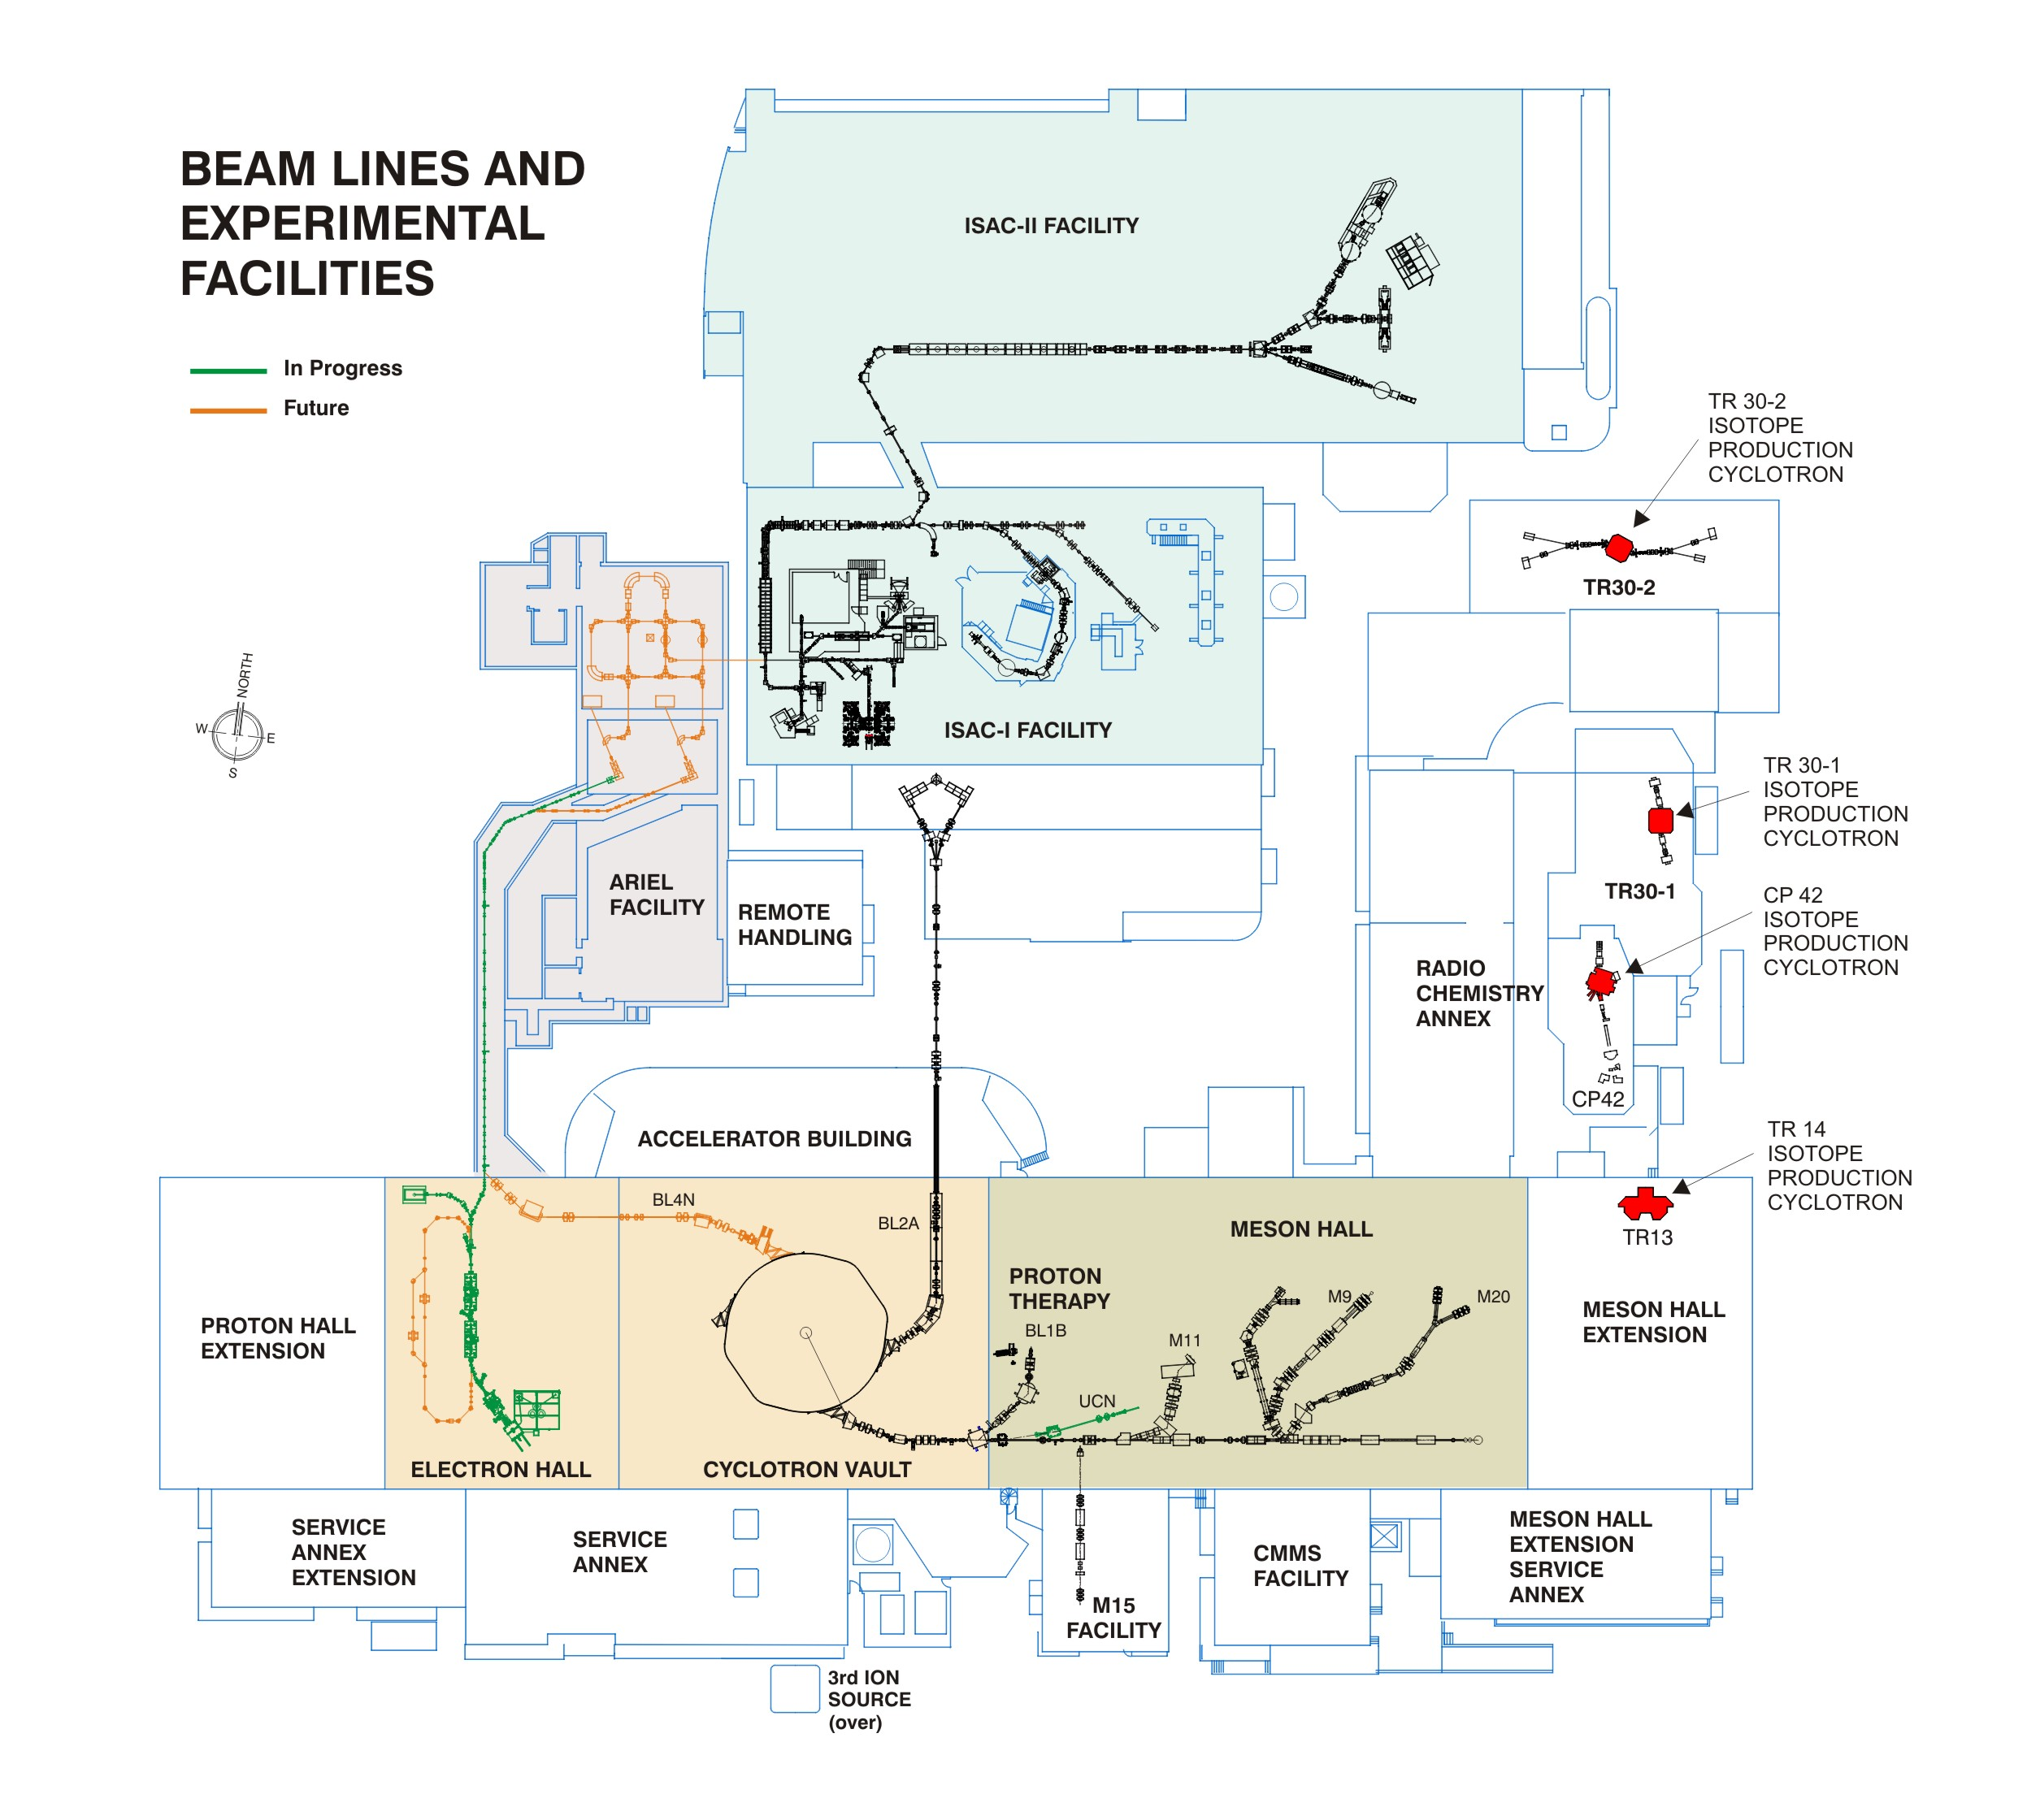
Motivation and outline
This is the summary on our discussion on Potential design studies or construction of new accelerators at TRIUMF:
Heavy ion storage ring or synchrotron at TRIUMF
High efficiency proton accelerator for isotope production
Second linac injector into ISAC-II
- ARIEL-III second acc path

Slide 3
Examples for heavy ion ring machines
Synchrotrons
Examples are PS Booster (157m, CERN), SIS18 (216m, GSI), CSRm (161m, IMP Lanzhou)
Typical injection energies 5 - 15 MeV/u
(SIS18, 11.4 MeV/u)
Extraction energy (protons) – 1.5 – 4 GeV
(SIS18 4 GeV)
Extraction energy for Pb or U depending on the charge state 100 MeV/u – 1 GeV/u
Typical size 50 – 300 m circumference
(Big synchrotrons like PS at CERN or AGS at BNL are in the 600 – 1000 m class)
Smaller synchrotrons are used for tumor therapy
→ up to 450 MeV/u.
Storage Rings
Examples are TSR (55m, MKI-K Heidelberg), ESR (108 m, GSI), CSRe (129 m, IMP Lanzhou), CRYRING (54 m, GSI)
Typical energies 1 - 500 MeV/u and magnetic rigidities 1.4 - 10 Tm for heavy ions.
Typical size about 50 - 150 m circumference
Highly charged ions required ²³⁸U⁷³⁻⁹²⁺
Precise energy definition using cooling techniques stochastic- and/or electron-cooling

Slide 4
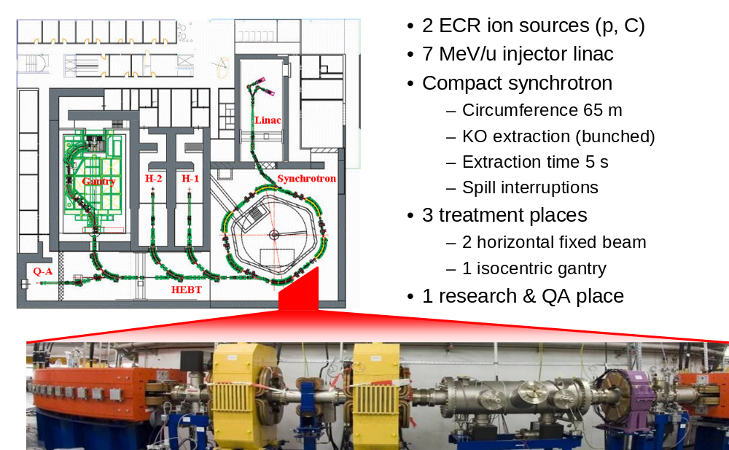
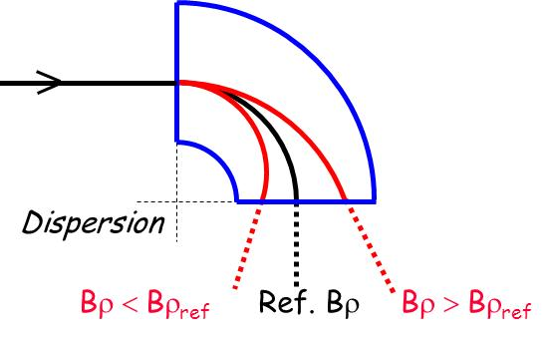
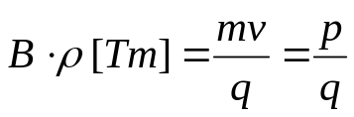
Heavy Ion Tumortherapy Center Heidelberg
Very compact synchrotron – 65 m circumference
430 MeV/u 12C ions
Multiturn-Injection at 7MeV/u energy
Slow extraction over several seconds – even more complicate due to resonance extraction
Large energy swing of > 60 →
ratio of the magnetic rigidity of the injected beam and the extracted beam is
proportional to the square
root of the energy swing!

Slide 5
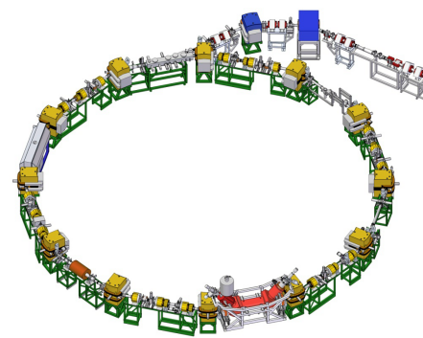
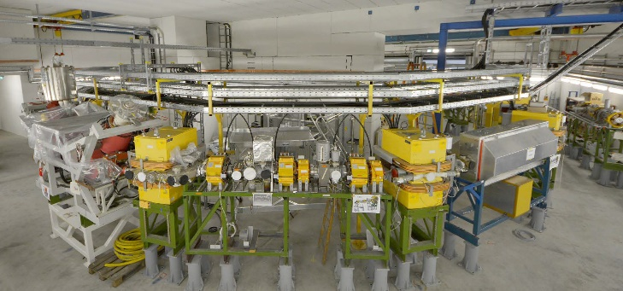
Storage ring for rare isotope research – CRYRING (GSI)
Very compact storage ring – 54 m circumference
Highest rigidity – 1.44 Tm (15-20 MeV/u heavy ions, 1.2 m bending radius)
Lowest rigidity – 0.054 Tm
Fast magnet ramping up to 7 T/s
Collinear laser spectroscopy
Internal targets: gas target, electron target
Spectrometers for ions, photons, electrons
→ capture and transfer reactions at the
internal gas-jet or droplet target,
atomic physics in storage rings
Scaled versions are the TSR and the ESR
with similar features
Physics book: CRYRING@ESR, M. Lestinski, Y. Litvinov, T. Stoehlker et al., The European Physical Journal Special Topics 2016, Volume 225, Issue 5, pp 797–882

Slide 6
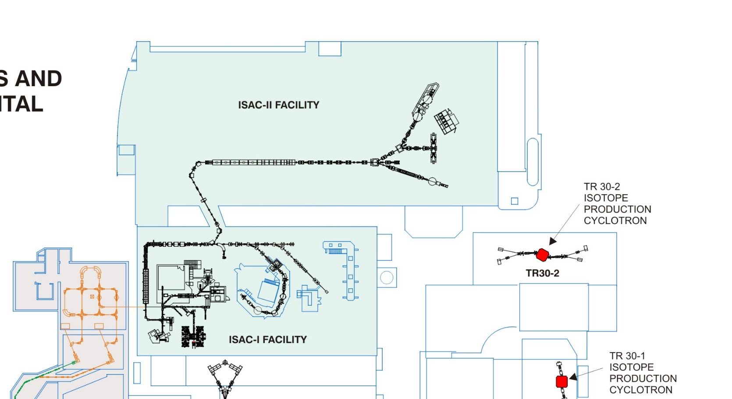
Storage ring / synchrotron at TRIUMF
Storage ring TSR, CRYRING or ESR like
→ ISAC-II as injector, energy suitable for fragmentation
Storage ring – synchrotron combination
up to 450 MeV/u
→ ISAC-II as
injector
> 6 MeV/u
Same rings but
second injector
linac to run
ISAC-I and –II
independent
Storage ring (ESR type) or storage ring/synchrotron combination
trailers
Trees
Storage ring (CRYRING type)
Trees
Office building

Slide 7
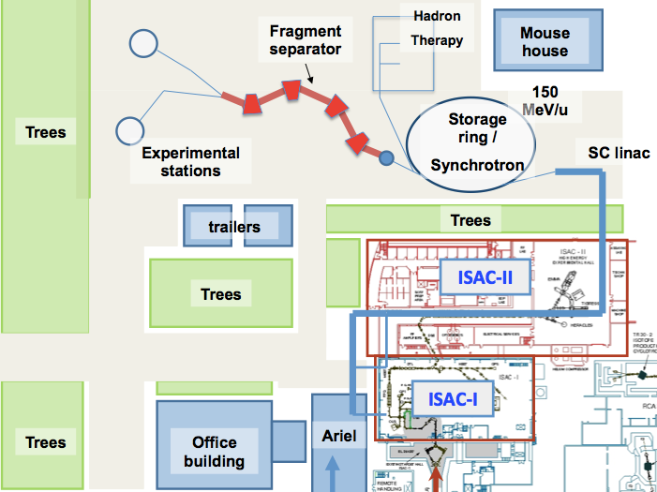
Rapid cycling synchrotron (RCS)
gas cell
Rapid cycling synchrotron for tumor therapy and secondary fragmentation
550 MeV/u for ¹²C⁶⁺ and
150 MeV/u for A/q = 4
With gas cell
→ fragments can
be fed back into
ISAC or ARIEL beam
lines.
The RCS needs EBIS
and second linac
injector for ISAC-II
an additional cryo
modules (2-3).
RCS
trailers
Trees
Trees
Office building

Slide 8
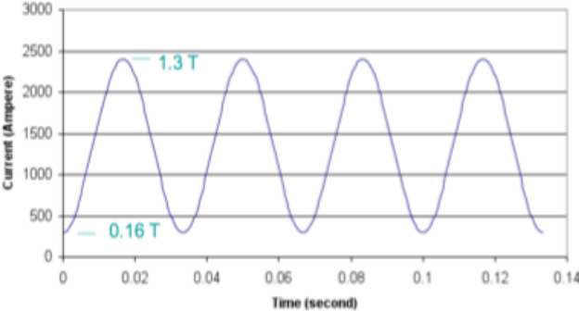
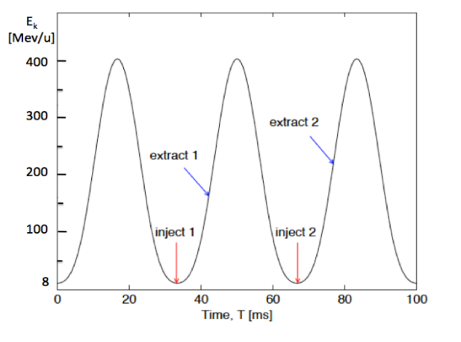
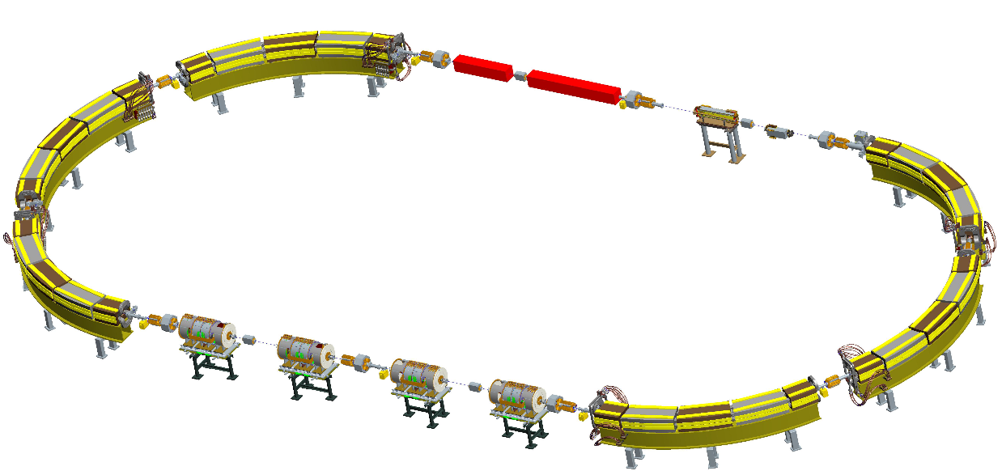
Rapid cycling synchrotron features
The magnet current oscillates sinusoidally (plus a
constant), just like a transformer!
Beam is extracted once per cycle ~10⁸ particles per pulse
Small bore & beam intensity → 15 or 30 pulses per second
Advantage for treatment:
- rapid cycling beam intensity is (about) 100 times smaller
- smaller horizontal beam size, smaller bore
Challenge for the RF – fast frequency swing
S. Peggs et al., EPAC2002, Paris, France, p.2754

Slide 9
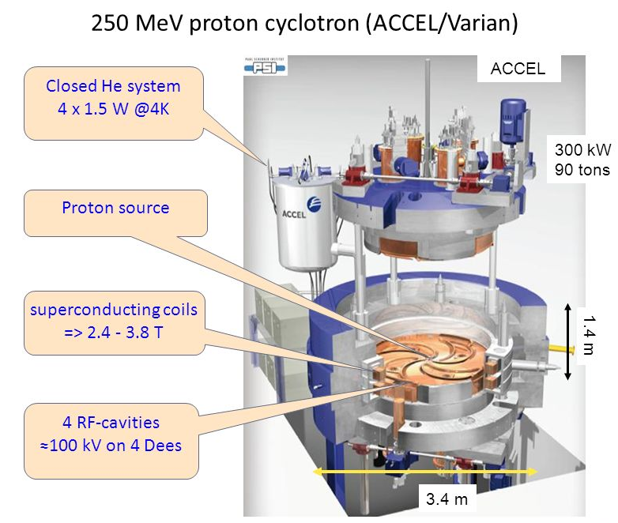
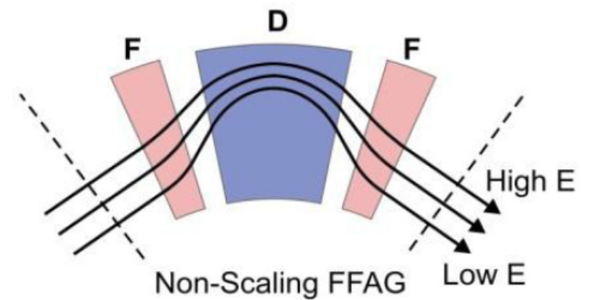
SC cyclotron and FFAG accelerator
TRIUMF has strong base and core competence in cyclotrons in particular
A SC cyclotron is very compact due to the strong magnetic field. The problem is the extraction of particles due to small orbit separation.
The energies ac SC cyclotron can reach 100-200 MeV for protons, a range not well covered
Fixed Field Alternating Gradient accelerator (FFAG) – large acceptance no
magnetic field ramping
→ Combination for
82Sr production and
other isotopes,
225Ac?

Slide 10
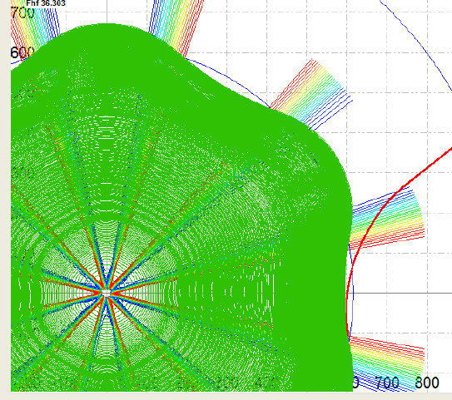
Innovative cylotron
Extraction by stripping
Multiple beams simultaneous extraction
up to 1 mA beam (high power)
Today’s medical synchrotrons support at most two simultaneously extracted beams.
Variable energy and variable intensity
Turn separation not an issue
Innovative H₂⁺ extraction (P. Mandrillon)
FFAG type magnet arrangement
→ high acceptance
One of ways to increase beam power on the target is beam rastering!
Size should fit into the CP42 vault.

Slide 11
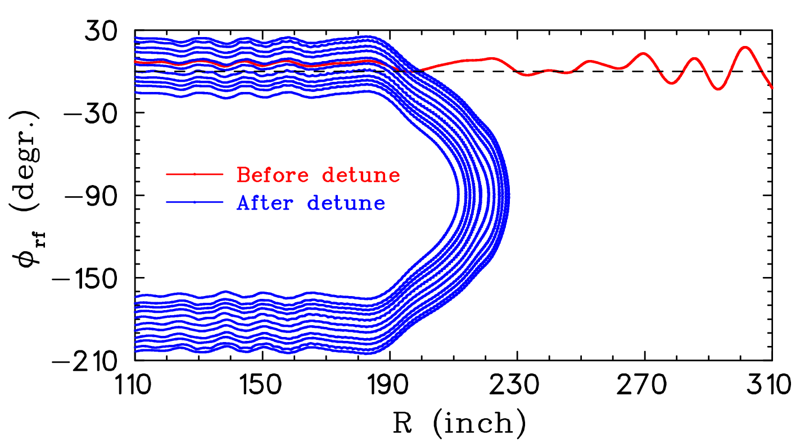
U-turn application
TheUse of internal targets –”Thin" targets are almost transparent to the beam
Beam Recirculation through thin target – re-acceleration of particle that are not used for nuclear reaction
→ It is more efficient to reuse primary beam than to get new beam accelerated from zero
Or applying recently developed at TRIUMF “U-Turn” tune
beam would pass the target few times, then
start deceleration, pass the target again
and would be decelerated down to low
energies and dumped.
We would keep and strengthen our core
competency and know how at TRIUMF.
TRIUMF would re-establish its leading
position as a premier cyclotron lab.

Slide 12
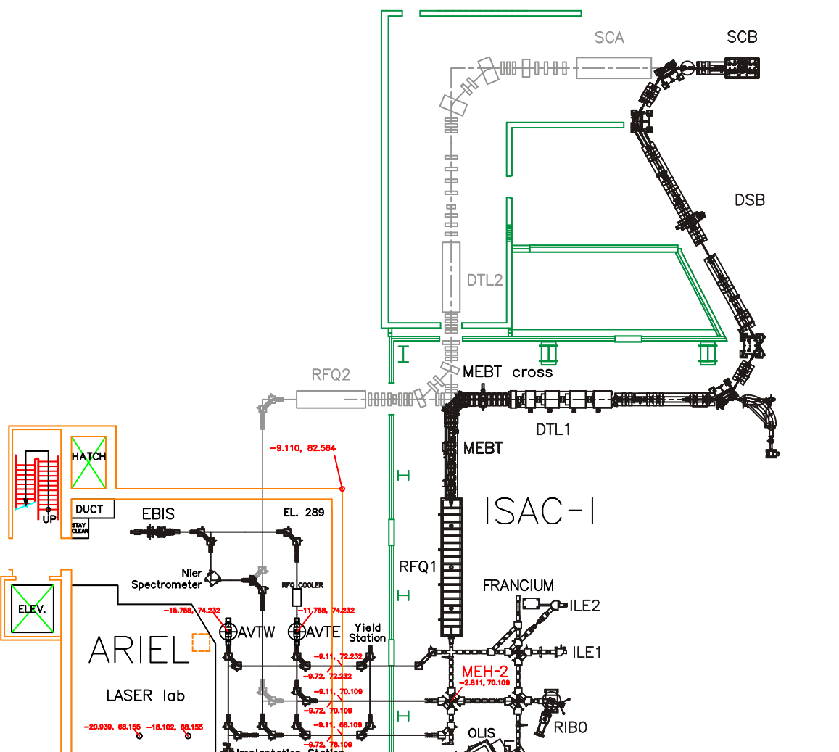
ARIEL-III second accelerator path
New RFQ tailored for A/Q from 4 to 7 (charge bred beams) with output energy compatible with the ISAC-I DTL
New DTL injector with fix energy
(IH-structure)
A possible “SCA” section to go to higher energy
→ this will provide two independent
post-accelerated RIB beams
→ the beam is pulsed (EBIS
extraction)

Slide 13
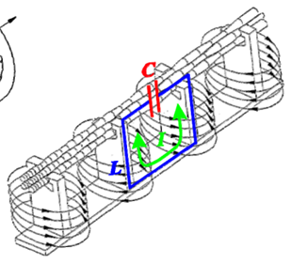
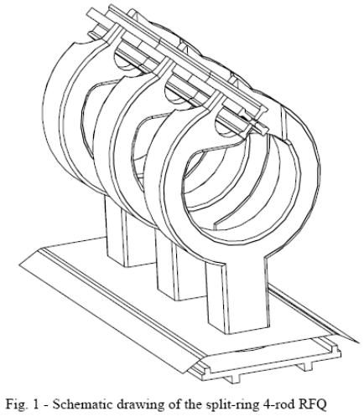
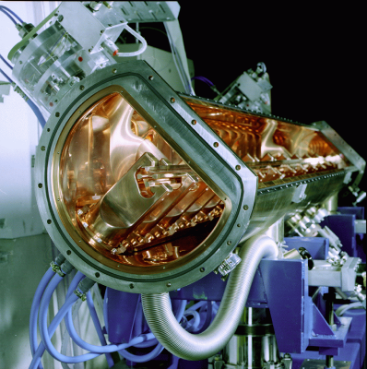
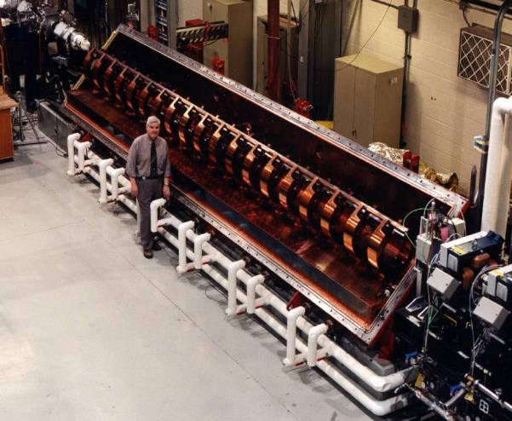
RFQ – first stage
RFQ could be a 4-Rod, developed at Frankfurt University – 106.08 MHz
energy up to 300 keV/u
(GSI – 108.48 MHz or CERN -101.28 MHz)
ISAC-I RFQ is a Split-ring RFQ, 35.36 MHz
V_{rf max}
I_{rf max}

Slide 14
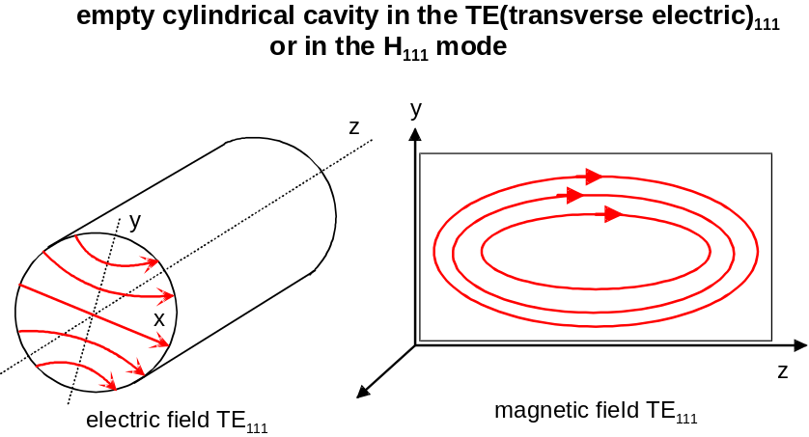
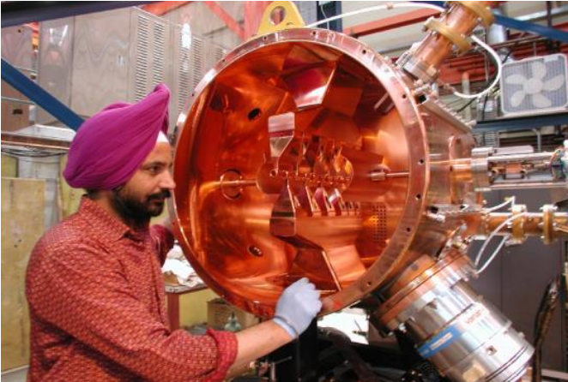
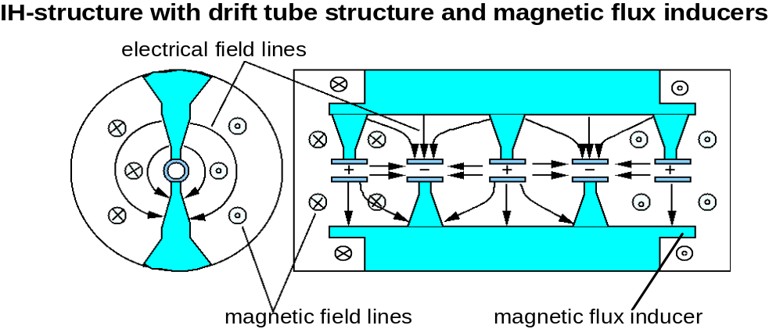
DTL: IH-structure
Most sophisticated structure providing highest performance – high shunt impedance, using KONUS beam dynamics
Energy boost up to 1.5-2 MeV/u
Used at ISAC-I – typical frequency range 50-200 MHz

Slide 15
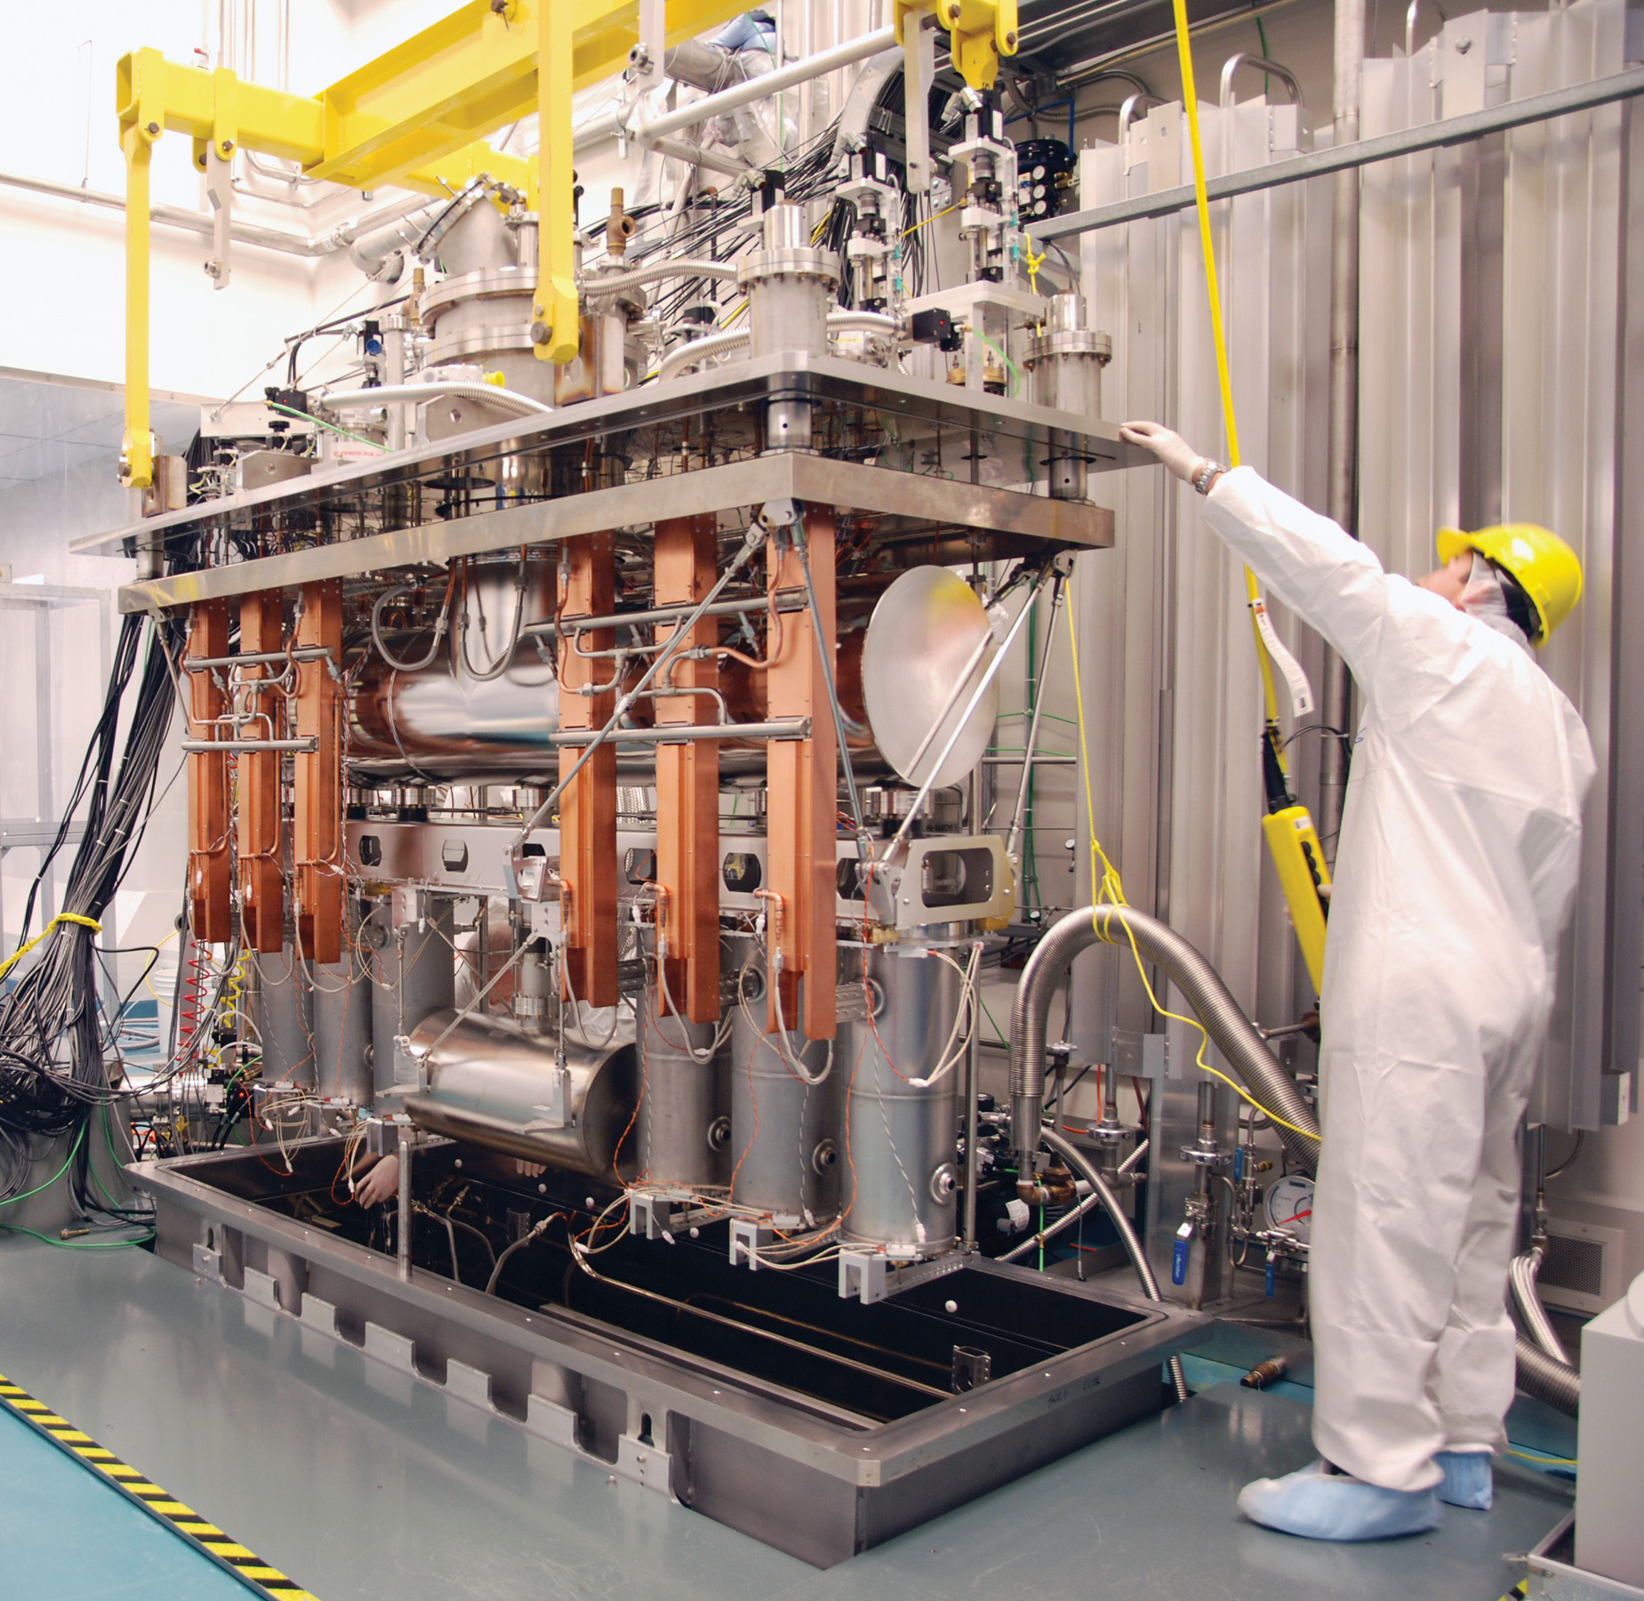
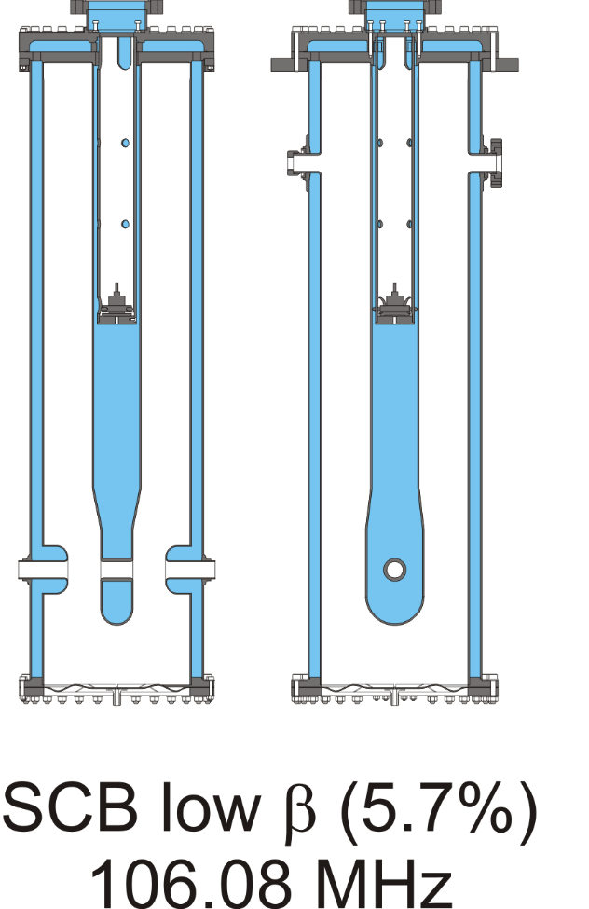
Additional ISAC-II cryo module
ISAC-II has 40 superconducting cavities housed in 5 cryomodules.
30 MV of effective accelerating voltage
A new cryomodule using four β = 0.057 cavities can add about 5 MV acceleration voltage.
With the new IH-structures
we could boost the
energy of ISAC-II to
7 MeV/u for A/q=7 or
~19 MeV/u for A/q = 2
15

Slide 16
Summary: TRIUMF options for ring accelerators
Design study for a ring accelerator – options
Storage ring TSR, CRYRING or ESR like, ISAC-II as injector.
Storage ring – synchrotron combination up to 450 MeV/u, ISAC-II as
injector > 6 MeV/u, Second linac, 2-3 cryo modules to be added.
Rapid cycling synchrotron for tumor therapy and secondary fragmentation.
550 MeV/u for ¹²C⁶⁺ and 150 MeV/u for A/q = 4
→ With stop gas cell fragments can be fed back into ISAC
Needs EBIS and second linac injector for ISAC-II and additional cryo modules.
Design study on SC cyclotron/FFAG combination for isotope production.
Design and construction of the ARIEL-III linac – second linac injector.

