Slide 1
Collaborations
Who Project MoU?
CERN AWAKE Yes
HL-LHC Beam-Beam Yes
HL-LHC Warm insertion magnets yes but no
HL-LHC crab cavity cryomodules No
FCC-hh design study participation
ISOLDE-ISAC about to be signed (see Alex's talk)
GEANT4 Fred Jones on visualization, Peter Gumplinger
KEK Sundry … some useful exchanges continuing Yes
FNAL LBNF: just an idea at this point. no
VECC additional RIB ISOL and srf technology Yes
Daresbury HL-LHC (crab), SRF tech., ERL photogun. No

Slide 2
AWAKE @ CERN

Slide 3

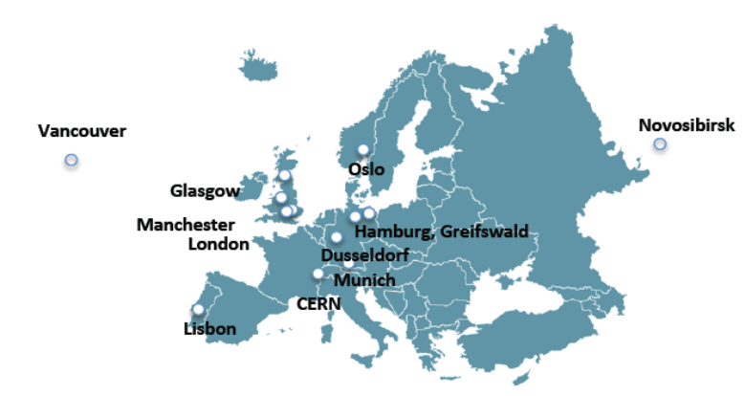
What is AWAKE
AWAKE: Advanced Proton Driven Plasma Wakefield Acceleration Experiment
  –Use SPS proton beam as drive beam (Single bunch 3e11 protons at 400 GeV) to excite wakefields in plasma channel
  –Inject electron beam as witness beam and accelerate them at a rate of 200MV/m
Proof-of-Principle Accelerator R&D experiment at CERN
  –First proton driven plasma wakefield experiment worldwide
  –First beam received in December of 2016
AWAKE Collaboration: 16 Institutes world-wide:

Slide 4
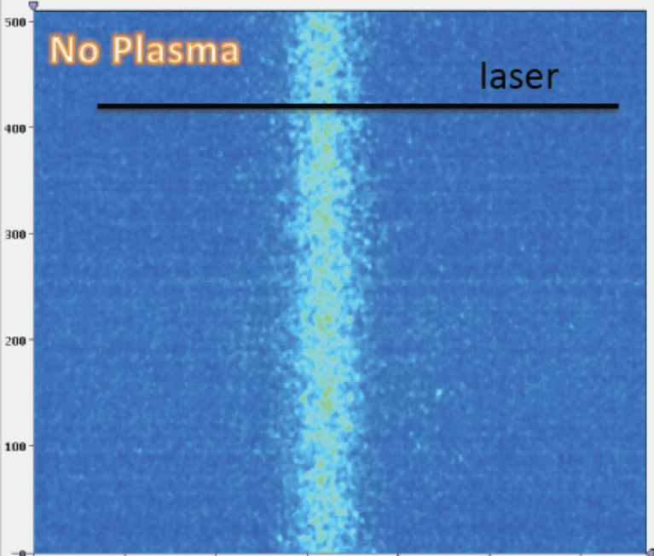
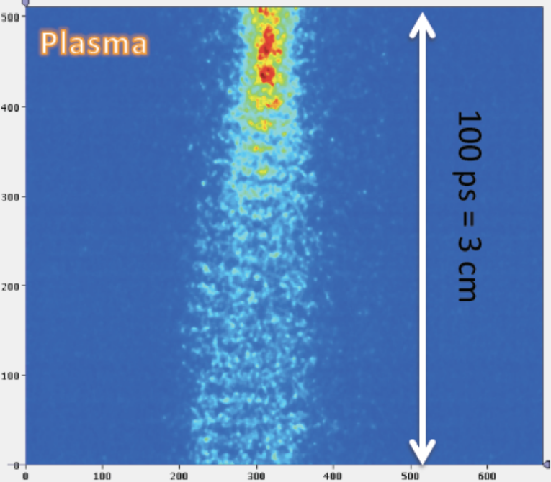
Self-modulation Instability (SMI)
To efficiently drive wakefields in plasma the long proton bunch has to be modulated at the wavelength of plasma oscillations.
This is achieved through the interaction of the proton bunch with the plasma wave excited within its body, a self-modulation instability.
The effect was experimentally observed by the AWAKE collaboration at the end of 2016.

Slide 5
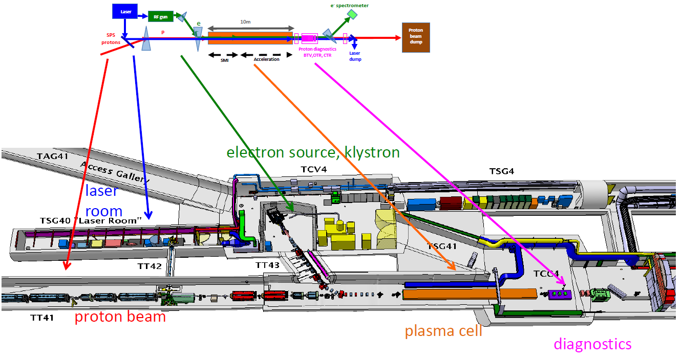
Baseline Design of the AWAKE experiment
Plasma cell
  Rubidium vapour source
Proton beam
  drives the plasma wakefield + undergoes SMI
  LHC-type, 400 GeV/c, 3E11 protons/bunch, 400 ps long
Laser beam:
  ionizes the plasma + seeds the SMI
  4.5 TW laser, 100 fs, λ=780nm
Special Diagnostics
  BTVs, OTR, CTR
Electron source and beam line
  Witness beam to ‘surf’ on the wakefield and get accelerated
  16 MeV/c, 1.2 E9 electrons/ bunch, 4ps long

Slide 6
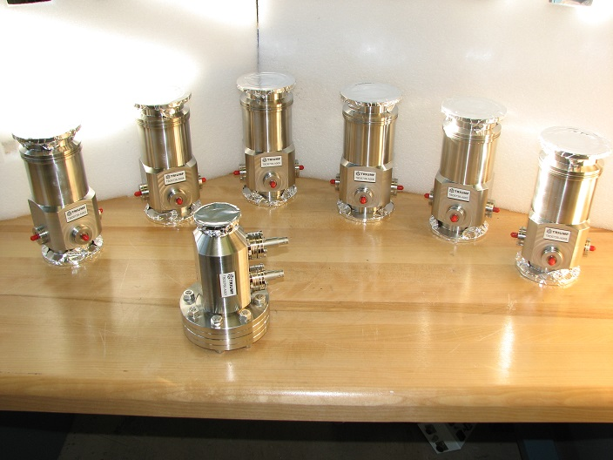
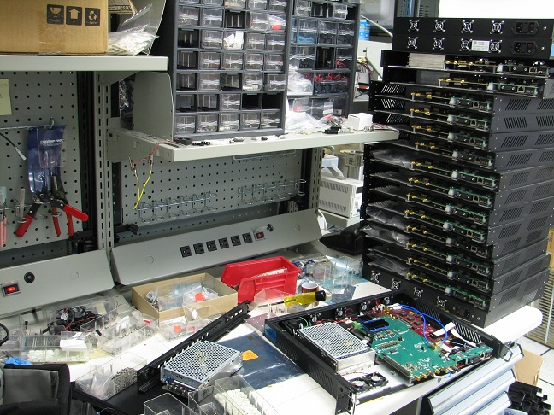
TRIUMF contribution to AWAKE
Mostly comes to beam instrumentation through NSERC grant
  40 mm BPM were shipped in December 2016
  60 mm BPM and the FC were shipped in February 2017
  Faraday Cup electronics was delivered in April 2017
  BPM electronics is shipped in mid of July 2017
  Installation and commissioning end of July –beginning of August 2017
Beam Position Monitors
BPM electronics
Faraday Cup

Slide 7
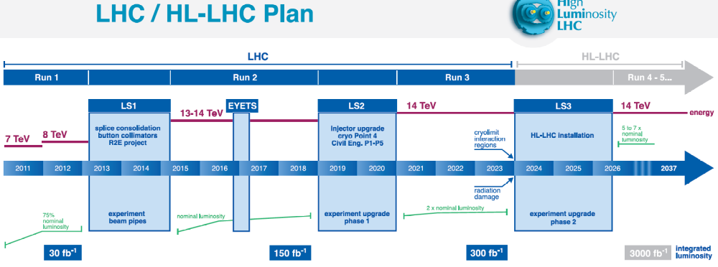

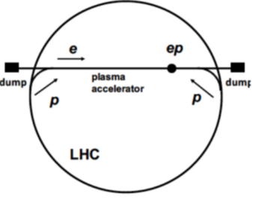
Experiment Program
All installations to be completed by the end of 2017 interleaved with self-modulation proton beam studies. Electron plasma acceleration science until LS2 in 2019. TRIUMF hosts a collaboration meeting in 2019.
After LS2 – proposing Run II of AWAKE (during Run 3 of LHC 2021-2023).
  Goals are stable acceleration, high efficiency capture and acceptable beam parameters after the plasma cell.
  Shorter proton bunch after HL LHC upgrade
  Shorter electron bunch at higher 50 MeV energy
  Scalable plasma source
After Run II (2026) – particle physics driven applications

Slide 8
Projected work and budget
TRIUMF participation in the AWAKE can be expanded
  Upgrade of the electron source to 50 MeV and <300fs bunch length.
  Diagnostics: BPM electronics requires better sensitivity down to 50pC with the same position resolution as at present. Will require $200,000. There is a chance to expand within the subject towards measuring very short bunch lengths
  Chance of training students on various aspects of the experimental set-up.
  Collaborate and develop expertise in wake-field acceleration and other related technologies: short period plasma undulator, electron bunching via self-modulation in plasma, etc.

Slide 9
Hi-Lumi @ CERN

Slide 10
HL-LHC: Beam-Beam Simulations

Slide 11
Beam-beam studies: Figure of merit, tools, methodology
What is motivation?
Luminosity
Figure of merit
Dynamic Aperture (DA) in H &V phase planes
  Avoid working points (Qx,Qy) with small DA in either H or V
Main tool
Particle tracking through MC lattice(s)
Methodology
DA versus ensemble of lattices with errors
  DA versus tune scan (1D or 2D scans)
    DA versus X/Y split

Slide 12

Beam-beam Studies: Large combinatorial problem
Benchmark simulations against known LHC working points
Then embrace HL-LHC in all its variants
Systematically add in all effects.
Perform tune scans (this is a Dobrin/TRIUMF specialty) for all cases
Given finite resources, we focus on the following (in decreasing order) of priority:
  IP schemes & beta squeeze
  Luminosity levelling
  Magnet multipole errors
  Deliberate use of octupoles (Landau damping)
  Crab crossing (half or full angle compensation)
  Flat Beams – may pursue even if CC is a success
  Wire compensation

Slide 13
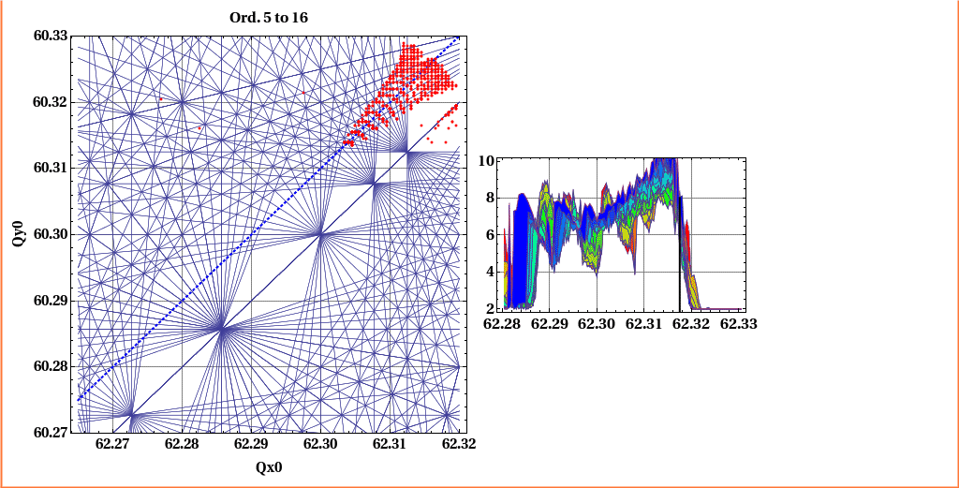

Tune scans

Slide 14
HL-LHC Warm insertion Quads

Slide 15
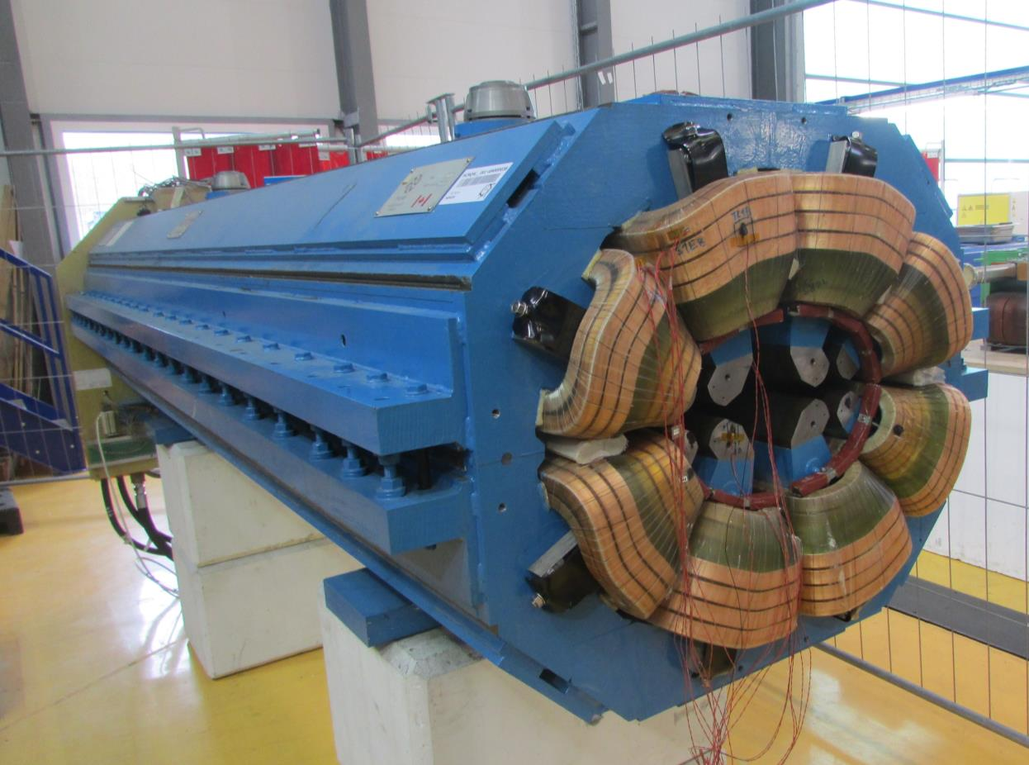
MQW-38

Slide 16
Many MQW would reach end of life because of radiation damage to polymer-based components well before integrated luminosity reaches 3000 fb^-1 (if nothing is done)
Comprehensive investigations and fault analysis by CERN gives confidence in solutions and MQW quantity
Already some actions taken as per LHC-MW-EC-XX docs
Most MWQ will survive, but a few must be replaced
Replacement, not refurbishment
  Pro refurb: only polymers will be damaged, not iron
  Contra: destructive dis-assembly, re-alignment difficulty, working with & disposing radioactive materials
  Contra: MQW in use; must wait too long for cool down of radio-activation
Pro-active replacement of selected MQWs avoids excessive dose to workers because fewer interventions will be needed to perform repairs in LHC tunnel

Slide 17
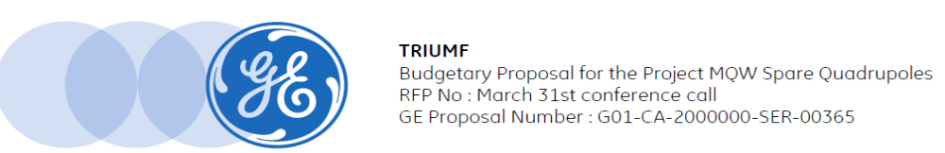
GE Budgetary Quote
Item | GE Cost Ca$
Tooling | $ 1,797,100
Prototype | $ 5,651,200
8 Production Magnets | $ 6,849,500
Demobilization | $ 113,000
GE total budgetary price | $ 14,410,800
Escalated to 2019 | $15,852,000
Tungsten & Cu shield materials | $346,000
Supervisory overhead | $630,000
Grand Total (2019) | $16,818,000
For comparison:
TRIUMF cost estimate based on inflationary escalation of 1999-2002 cost of prototype and 17* production magnets: $8.4 + overhead.
Our conclusion: GE padded prototype cost with insurance and profit margin.
* Later increased to 52

Slide 18
Hi-Lumi LHC / Crab Cavities

Slide 19
CERN will be installing CRAB cavities near CMS and ATLAS before Long Shutdown 3 (2024-2025) in order to increase the LHC Luminsosity
The cavities come in two flavours the Double Quarter Wave (DQW) originally developed by BNL and the RF Dipole originally developed by ODU
DOE Accelerator Upgrade Project (AUP) plans to complete 8(+2) RFD cavities as part of a US contribution
TRIUMF has produced Cryomodules for ISAC-II, e-Linac and VECC
The RFD HiLumi cryomodules are similar in size and function to the RFD cryomodules with two RFD cavities per CM
TRIUMF proposes to deliver 4(+1) CMs as a Canadian contribution to HiLumi

Slide 20
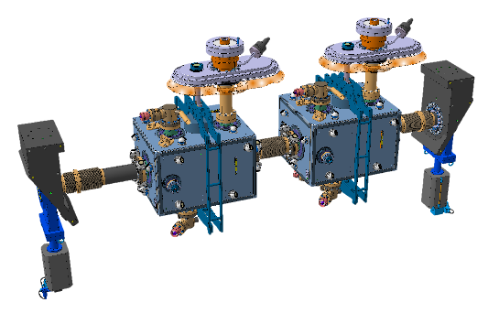
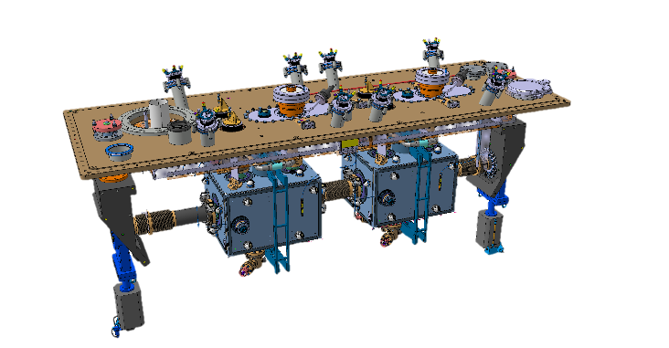
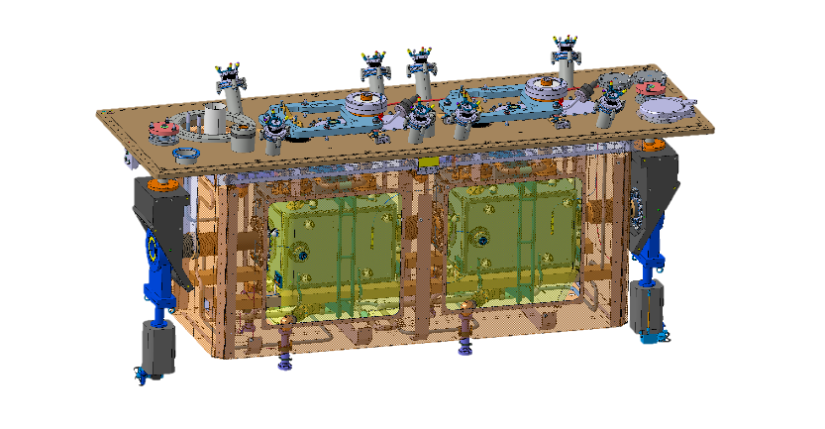
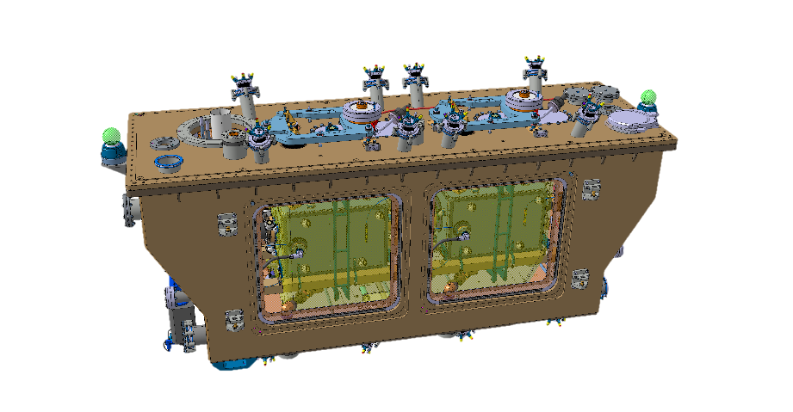
Rough assembly sequence – like ARIEL
Assembly infrastructure exists from e-Linac assembly

Slide 21
Roles for TRIUMF
Hi-Lumi
  U.S. Accelerator Upgrade Project (AUP) is currently ready to go for Gate 1 approval to deliver 10 RFD (8+2) cavities
  UK is currently penciled in to assemble RFD cryomodules but the funding is unclear – TRIUMF could supply these (4+1)
  This is equivalent to 5 ACMs for e-Linac
    DOE would provide the jacketed cavities – fully processed except for final HPWR
  TRIUMF has a history of supplying `in kind’ contributions to CERN – twin aperture quads for LHC
  TRIUMF would install
    Couplers – from CERN, HOM couplers (DOE), pick-up CERN
    Tuners - TRIUMF
    Hermetic unit assembly – Valves, WCT, CCT, couplers
    Strongback, Helium reservoir
    LN2 shield, Mu metal, Vacuum vessel, ….

Slide 22
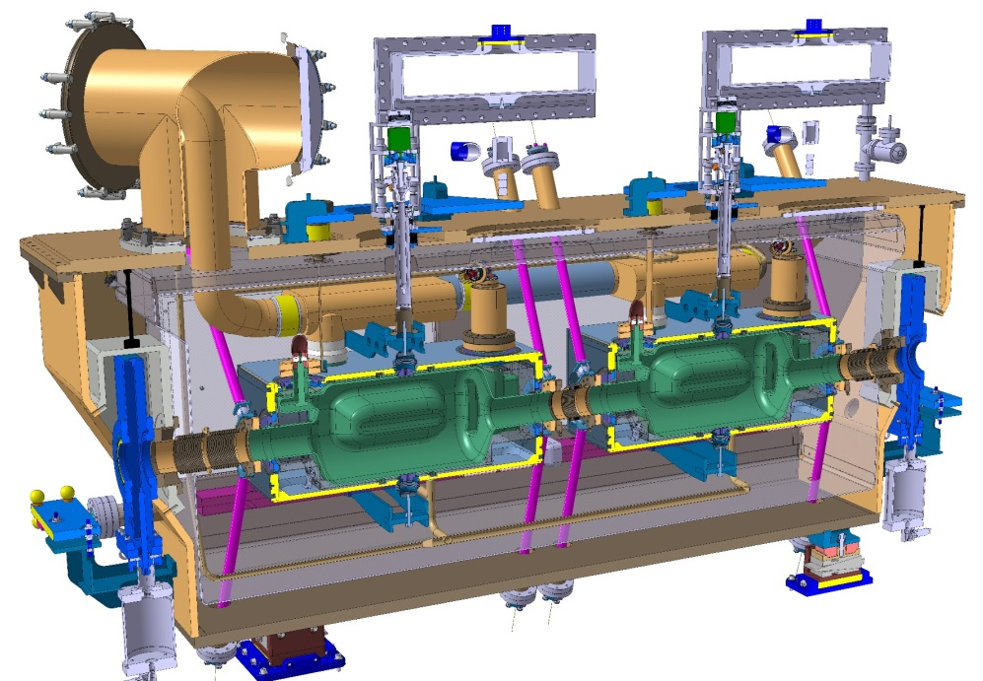
Summary/CrabCavities
Opportunity exists for Canada (and North America) to supply significant technical infrastructure to Hi-Lumi – supports Canadian IPP community
Advances core competency in SRF and CMs
TRIUMF well placed due to complimentary design of ARIEL cryomodules
4-5 CMs is a reasonable size project that is within TRIUMF’s capabilities
Grow collaboration with US institutes – FNAL, Jlab, ODU

Slide 23
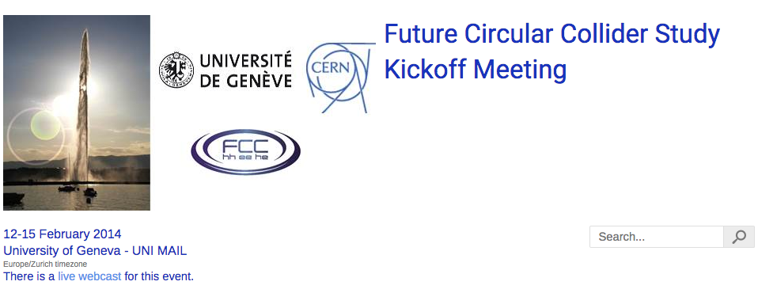
FCC study

Slide 24
GEANT4

Slide 25
Geant4: collaboration and software
A complete set of software for constructing particles-in-matter simulations: particles, tracking, geometry, materials, fields, diverse physics models, visualization, analysis.
The collaboration http://geant4.cern.ch/
  117 members, ~50 institutions (including CERN, SLAC, KEK, Fermilab, IN2P3, INFN, UK/STFC, ESA, TRIUMF) in ~20 countries. 16 Working Groups.
  TRIUMF involvement: Oversight Board, Steering Board, 5 working groups
The software
  Design factors: object-oriented design, written in C++, scalable to very large and diverse applications, easily modified and extended, allows many developers to work simultaneously. Industrial-grade code management and testing procedures.
  Free and open code with liberal licensing conditions allowing commercial use.
  Many Geant4-based tools: GATE, GRAS, WCSim, G4GLsim, musrSim, G4Beamline
The users
  Earliest users: high-energy physics (simulation needs of LHC experiments).
  Today: particle and nuclear physics, medical physics (therapy, dosimetry, imaging), space-based experiments/missions, underground physics, and accelerator physics.
TRIUMF membership enables us to:
  Maintain expert knowledge, maximally help users, fix problems fast, contribute code, implement features we want, upgrade computing skills, attract excellent students, help advance simulation-based studies worldwide!

Slide 26
Geant4 at TRIUMF
Particle Physics
  Atlas, T2K-ND280, HYPER-K (proposed), PIENU, DEAP/CLEAN, AAPS muons
Nuclear and Atomic Physics
  TIGRESS, TRINAT, EMMA, ARIEL photofission target, 8Li (Kiefl), Mu+H2, ALPHA
Fundamental symmetries: UCN (neutron spin & gravity field added by P.G.)
Materials science: M9B study (muon spin tracking), musrSim
Medical Physics: WavePET, XEPET, LXe
Accelerators and Beam Lines: BL2A, ISAC target module, ARIEL converter, eLinac momentum collimator, eLinac full sim (gun to target), M9B study, advanced visualization of beams and beam lines (2 co-op students). Potential: frictional muon cooling, BL1A, BL4N (collimation), diagnostics.
Other Canadian users: McGill, ULaval+CHUQ (imaging & brachytherapy); PICASSO, super-CDMS (backgrounds, phonon transport), HALO; AECL. Many co-op and graduate students.
Conclusions
  TRIUMF’s diversity of experiments and pursuit of advanced detectors entail that we and our collaborators use Geant4 widely and have received much from it.
  The Geant4 Collaboration continues with vital development and support work to which we can contribute and from which we can benefit.

Slide 27
LBNF and TRIUMF

Slide 28
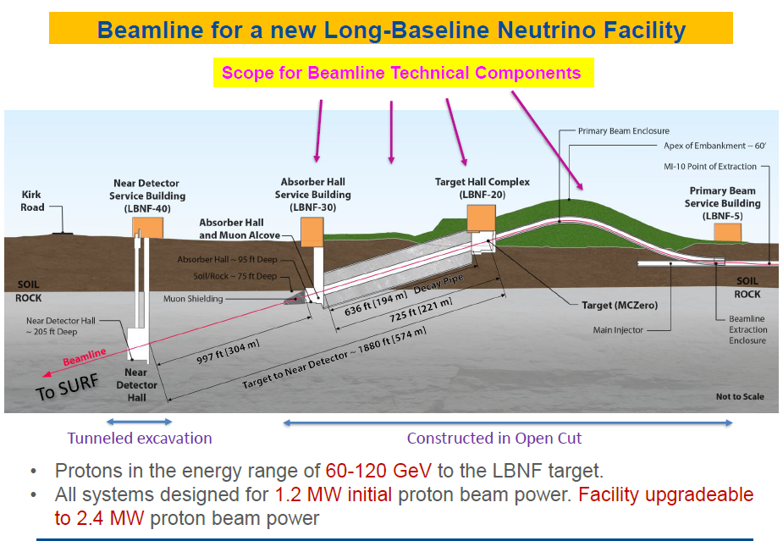

Slide 29
A role for TRIUMF?
LBNF is a challenging project south of the border with significant science potential
There are also a lot of interesting technical challenges
Can TRIUMF play a similar role with LBNF as we have done with T2K?
An obvious area where our expertise would be welcome is in the neutrino production area

Slide 30
VECC and TRIUMF

Slide 31
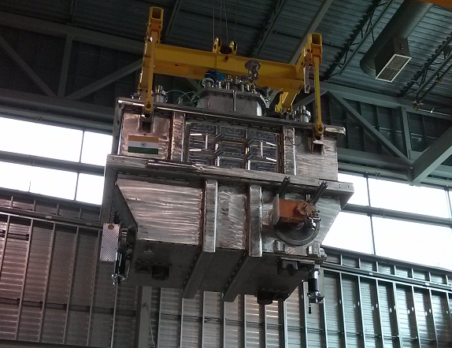
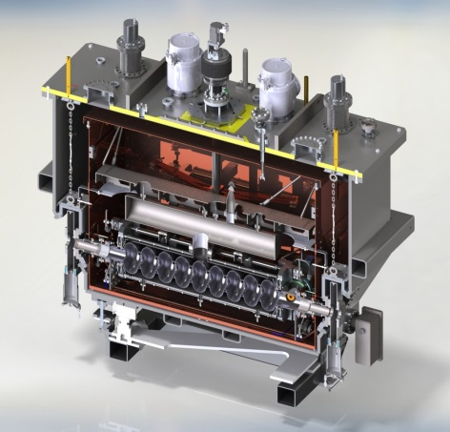
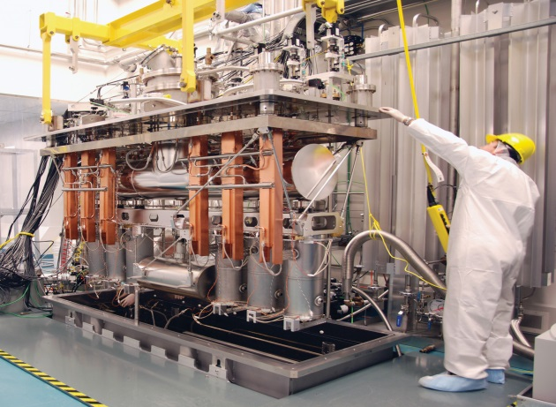
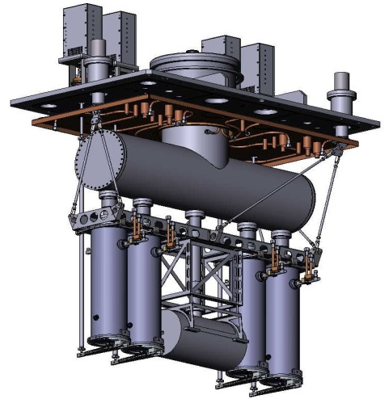
VECC COLLABORATION
TRIUMF has had an active collaboration with VECC Kolkata over the last seven years.
The main deliverable from the collaboration was the joint design and production of two injector modules one for TRIUMF and one for VECC (commissioned in 2016).
We are now engaged in collaborating on ARIEL target hall equipment and a new heavy ion cryomodule containing 4 QWRs for delivery to VECC
Future projects will be discussed with VECC as required including additional RIB ISOL technology and superconducting rf technology

Slide 32
Collaborations
Who Project MoU?
CERN AWAKE Yes
HL-LHC Beam-Beam Yes
HL-LHC Warm insertion magnets yes but no
HL-LHC crab cavity cryomodules No
FCC-hh design study participation
ISOLDE-ISAC about to be signed (see Alex's talk)
GEANT4 Fred Jones on visualization, Peter Gumplinger
KEK Sundry … some useful exchanges continuing Yes
FNAL LBNF: just an idea at this point. no
VECC additional RIB ISOL and srf technology Yes
Daresbury HL-LHC (crab), SRF tech., ERL photogun. No

