Slide 1
SRF DEVELOPMENTS AT TRIUMF
Vladimir Zvyagintsev
RF/SRF Department, Accelerator Division, TRIUMF
July 12, 2017
Accelerator Science Workshop
TRIUMF, Vancouver, Canada

Slide 2
RF PROJECTS AT TRIUMF

Slide 3
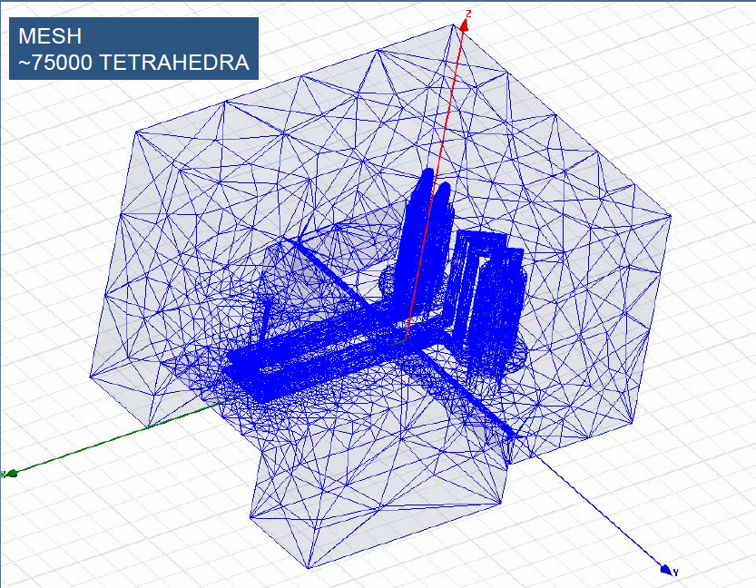
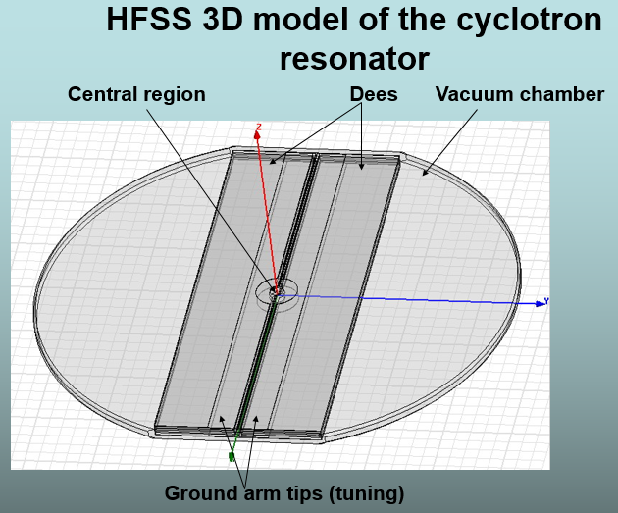
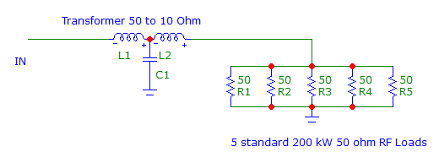
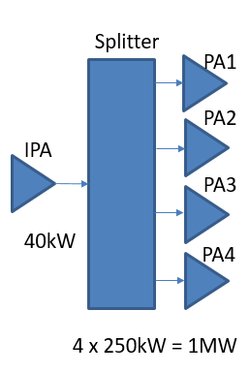
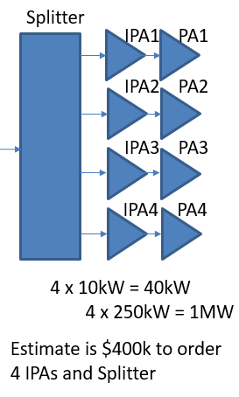
Cyclotron RF Projects
Future upgrade of Cyclotron for 400 µA current will require R&D for the RF Amplifier and Resonator
Study of Resonator for mitigation of parasitic modes and rf leakage effects
RF Amplifier HFSS and experimental
Study
IPA Upgrade
For better tunability for optimized stable regime of RF Amplifier
1 MW CW RF Load is required also to improve tuning and troubleshooting for operation ~$100k

Slide 4
ISAC-I RF Upgrades for A/Q=7 beams at 1.5MeV/u
Tube RF Amplifier Systems =$31k
DTL 1
Buncher1
DTL 2
Buncher2
DTL 3
Buncher3
DTL 4
DTL 5
Prf 3.8kW 9.5kW 9.5kW 7.7kW 16.1kW 13.8kW 22.2kW 24.3kW
Necessary upgrades and budget estimate
Replace cable Additional water cooling
with rigid TL for resonators
$15k + $8k + $8k = $31k
________________________________________________________________________________________________________
Solid State RF Amplifiers =$102k
DTL Driver
DTL Driver
DTL Driver
DTL Driver
DTL Driver
MEBT Driver
Rotator
Prf 500W 500W 500W 500W 500W 2kW 3kW
Budget estimate to order RF Amplifiers
5 x $10k = $50k + $20k + $32k = $102k
__________________________________________________________________________________________________
Total = $131k

Slide 5
SRF PROJECTS AT TRIUMF

Slide 6
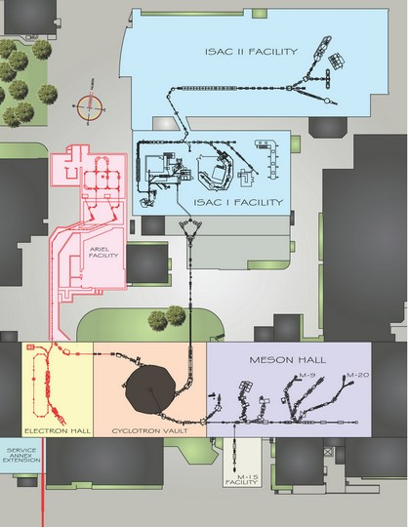
INTRODUCTION
The TRIUMF SRF program began in 2000 to support the design and development of the ISAC-II heavy ion linac with the addition of infrastructure to support SRF activities
We now have two SC linacs in operation – the 40MV ISAC-II heavy ion linac and the 30MeV ARIEL 1.3GHz electron linac
TRIUMF also hosts important diagnostics in material science – muSR and betaNMR
We have an active program in student based SRF research to augment are operational capabilities
SRF Facility
ISAC-II
betaNMR
muSR
eLinac

Slide 7
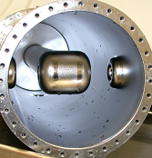
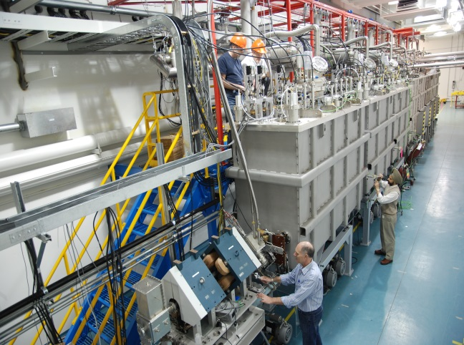
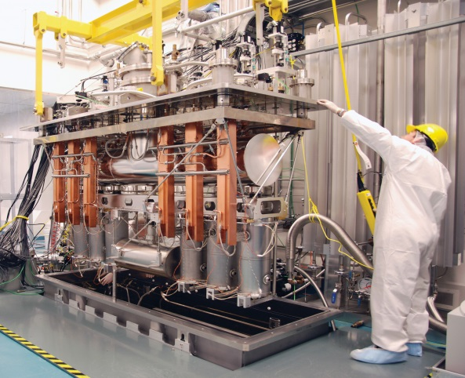
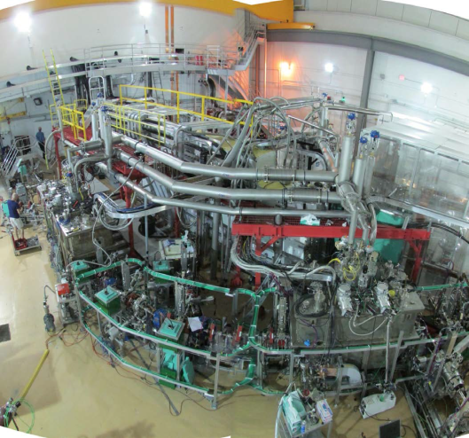
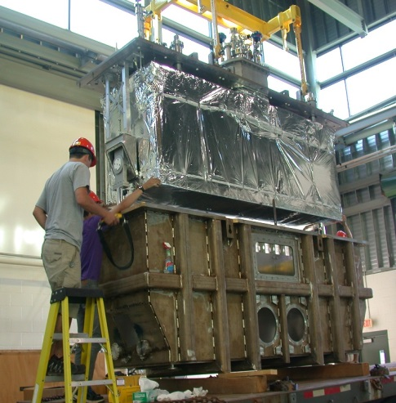
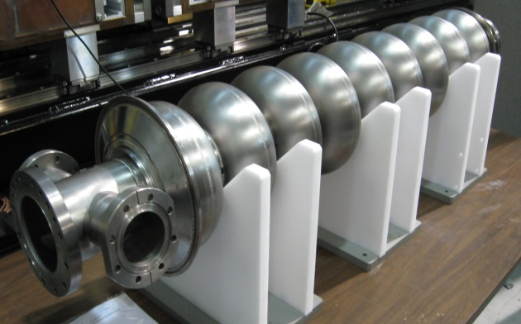
SRF Accelerators
40MV ISAC-II SRF heavy ion linac @ 106MHz - operational since 2006
30MV ARIEL SRF 10mA electron linac @ 1.3GHz – first beam 2014

Slide 8
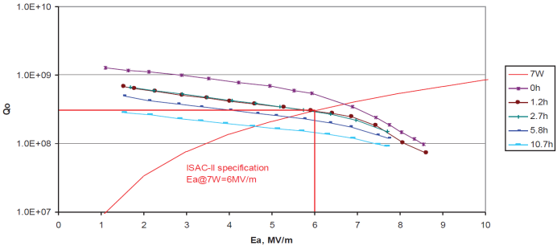
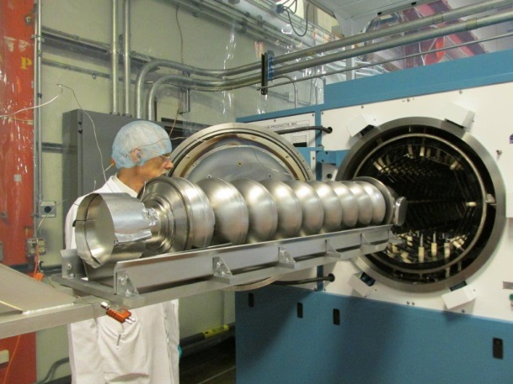
ISAC-II HEAVY ION LINAC
Add degassing oven.
  Heat treat cavities (650C 8 hrs) over a five year period
  Eliminate Q-disease (hydrogen) and improve Q and gradient through Nitrogen infusion

Slide 9
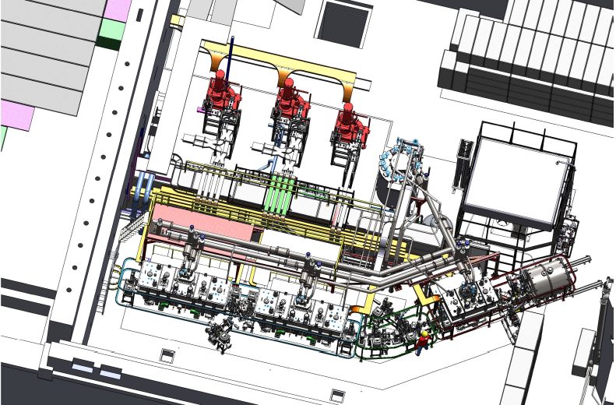
ARIEL e-Linac –> 50MeV
1.3GHz SRF Electron Linac (10mA)
23 MeV demonstrated from two cavities in 2014
Install 30MeV capability in mid 2017 – 30MeV now in commissioning (ramp up power 2018 )
A third cryomodule needed to bring the linac to the initial specification
  Implications for SRF, RF, cryogenics and supporting technologies
10MeV
30MeV
50MeV
50kW
50kW
50kW
50kW
50kW
ICM
ACM1
ACM2
Gun
50kW
50kW
50kW
50kW
50kW
2014
2017
20xx

Slide 10
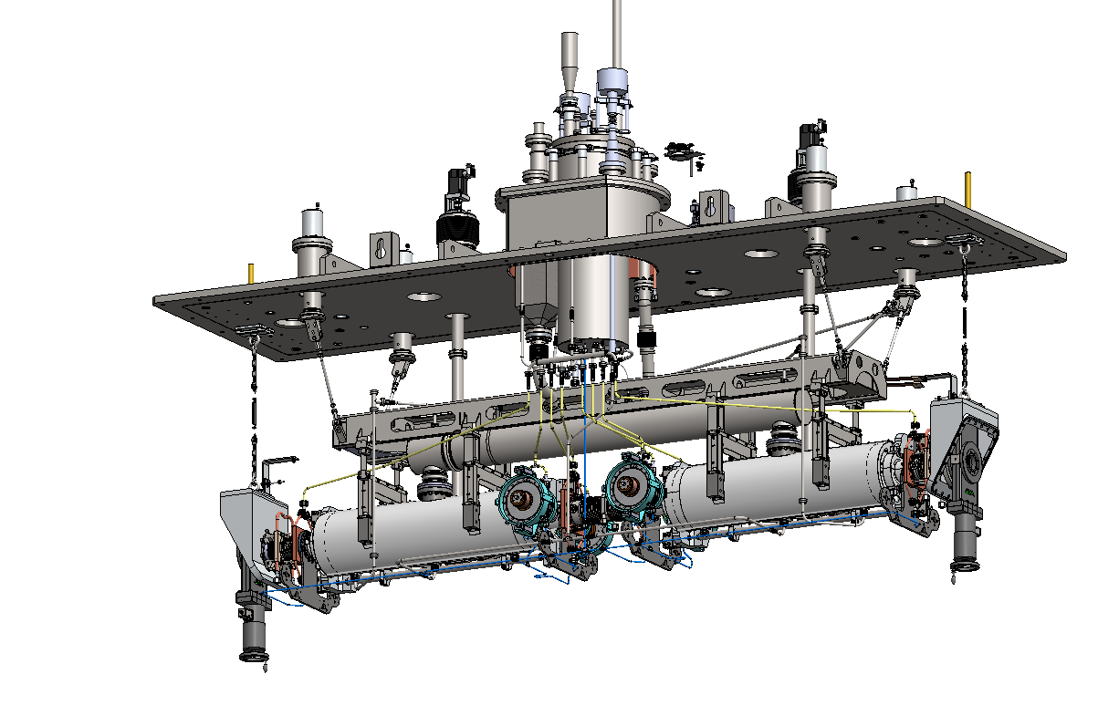
ARIEL Cryomodules – 1.5M$
Houses
two nine-cell 1.3GHz cavity
four 50kW power couplers
HOM coaxial dampers
Features
4K/2K heat exchanger with JT valve on board – allows standard 4K cold box
scissor tuner with warm motor
LN2 thermal shield – 4K thermal intercepts via syphon
Two layers of mu-metal
WPM alignment system
4K phase separator
4K-2K Cryoinsert
Support Post
Heat exchanger
Strongback
WPM bracket
Power coupler

Slide 11
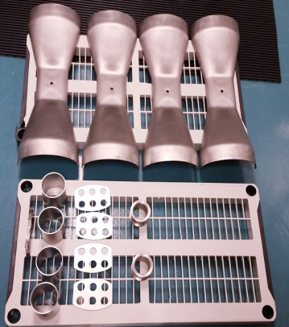
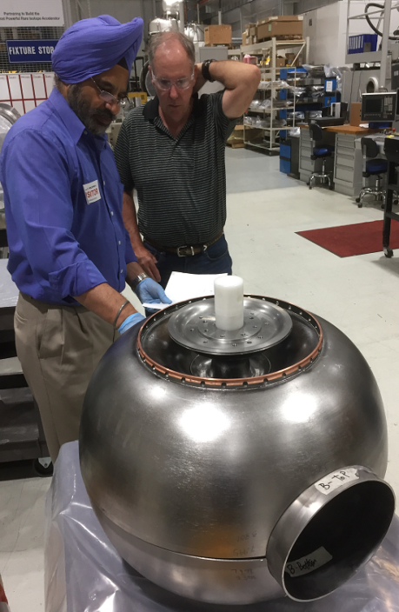
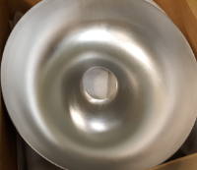
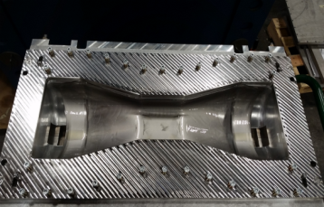
Cavity and processing Developments
With the closure of PAVAC and AES both Canada and North America are severely diminished in terms of cavity production – implications for large global projects like ILC
EACB would be another opportunity to grow an indigenous supplier of ILC type cavities
TRIUMF latest experience in forming, brazing and spinning for SSR cavities for RISP means that more steps can be done in TRIUMF machine shop as required
SSR1 Parts

Slide 12
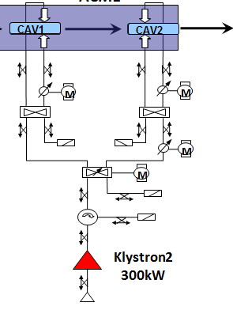
E-Linac RF Drive System
Presently there are two 300kW CPI klystrons – sufficient for each of EACA and EACB modules - We need a rf source for EINJ rated at ~150kW to reach final e-Linac specification
EINJ
EACA
EACB
CAV
CAV1
CAV 1
CAV 2
CAV2
M
M
M
M
M
Klystron2
300kW
150kW
Klystron1
300kW

Slide 13
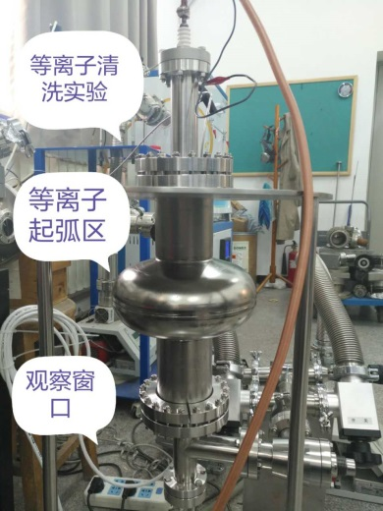
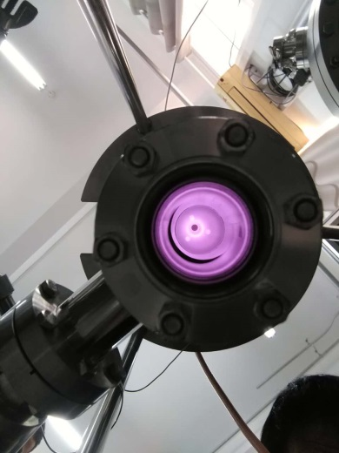
ARIEL E-LINAC – plasma cleaning
ERL mode operation would largely eliminate beam loading and so would allow higher gradient operation
Higher gradients for EACB cavities
Develop plasma cleaning for in-situ refurbishing of E_{acc} if required.
Success demonstrated in SNS tunnel – e-linac module design well suited
Plasma cleaning on PKU single cell
TRIUMF has started collaboration with PKU on 1.3GHz single cell cleaning. Initial recipe 6 hours cleaning with Ar/O₂ 50/50 at 300mTorr and 8MHz 120W RF.
S. Kim – TTC MSU
Zhongyuan Yao

Slide 14
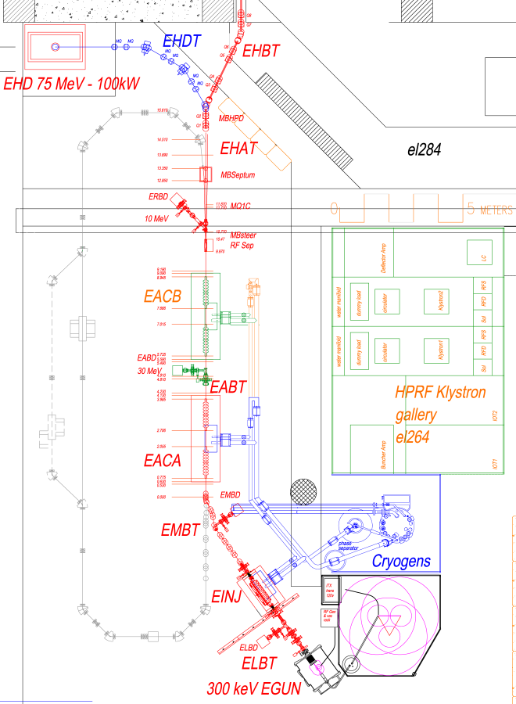
Recirculating cavity issues
RLA
Single user mode only
ERL
Dual-use possible with two interleaved bunch trains into 1.3GHz buckets
650MHz pulse train - single pass acceleration for RIB production – low brightness
650MHz/n pulse train for ERL – high brightness – new gun required
650MHz rf separator used to separate the beams
HEBT
75MeV 100kWDump
ERL Dump
ACM2
Shielding Wall
30MeV Dump
Klystron Gallery
ACM1
MEBT 10MeV Dump
RIB
ICM
LEBT
E-Gun
650MHz
ERL

Slide 15
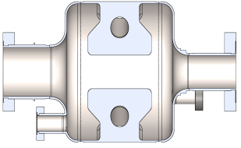
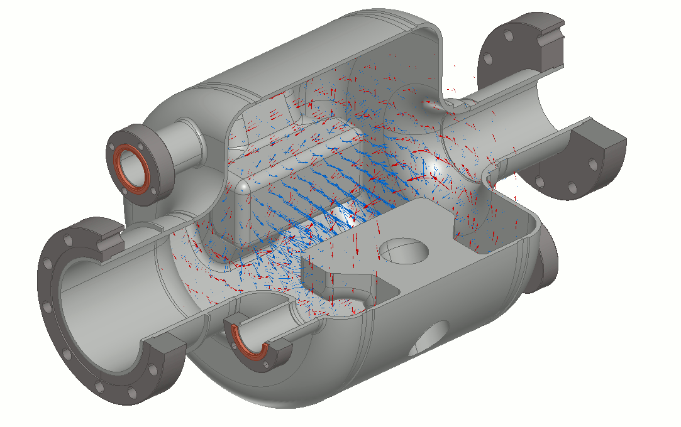
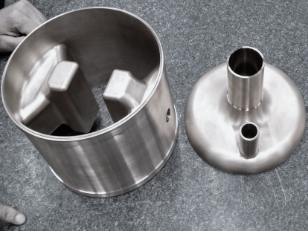

RF Separation of Interleaved Beams
Transport
to ARIEL
to ERL ring
decelerated bunches
to RIB production
Simultaneous beam delivery to both RIB production and an ERL/FEL requires RF separation of interleaved bunches
cavity is almost complete – for operation will require
  Rf ancillaries - FPC and HOM coupler, tuner
  Cryomodule, 4K transfer line
  650MHz rf source and LLRF
Separation Complex
1.3 GHz SRF Cavities
THz/IR FEL
$→$ Electric Field
$→$ Magnetic Field
Courtesy Douglas W. Storey
650 MHz eGun

Slide 16
GLOBAL SRF FRONTIERS

Slide 17
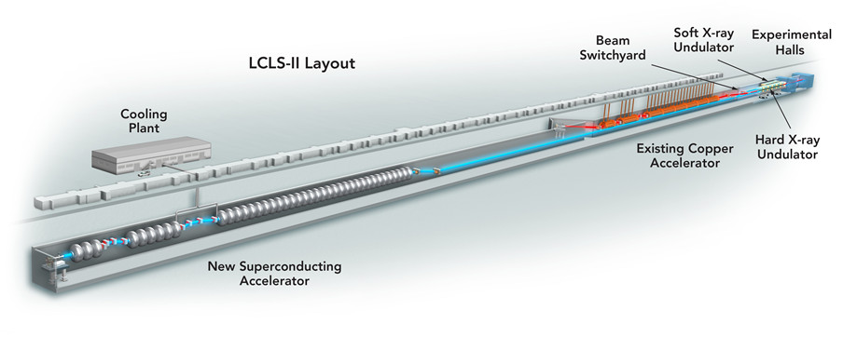
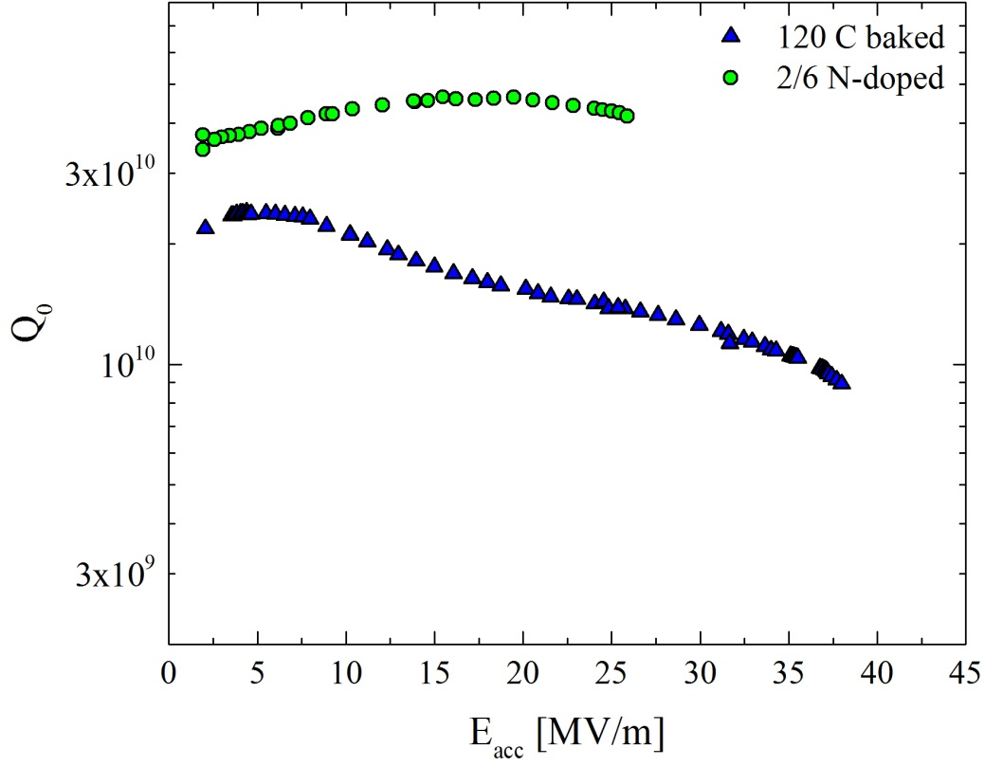
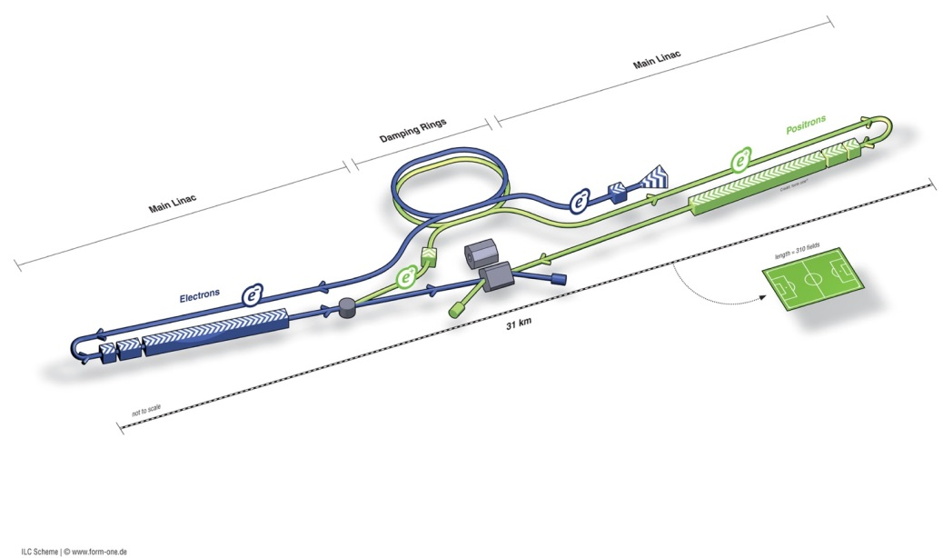
HIGH Q AND HIGH GRADIENT
LCLS-II
ILC
HFQS
120C bake
A. Grassellino – TTC Saclay
N Doping at T > 800C proven to manipulate mean free path, but constantly throughout several microns, giving high Q .
120C bake known to manipulate mean free path at very near surface on clean bulk, and produce the highest gradients.

Slide 18
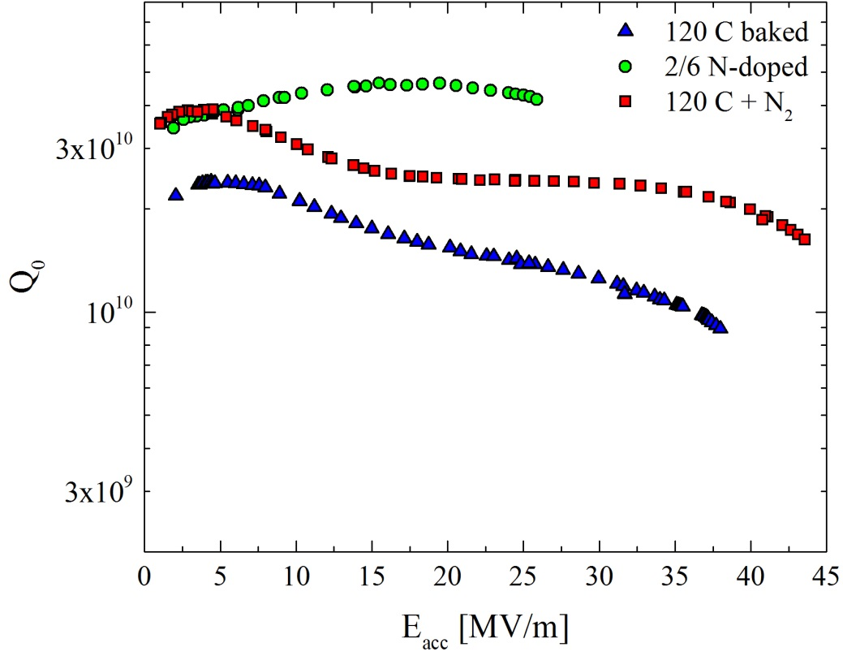
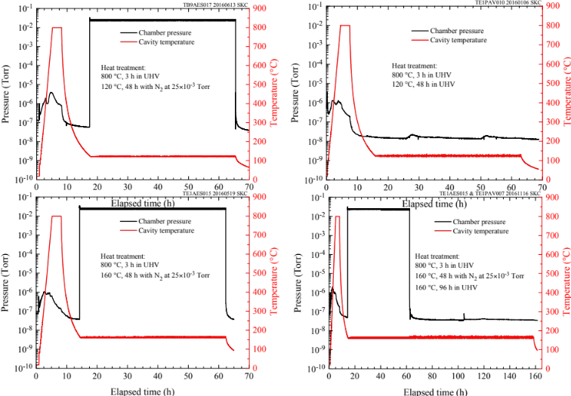
HIGH Q AND HIGH GRADIENT
LCLS-II
X2
ILC
A. Grassellino – TTC Saclay
The new N₂ infusion treatment (FNAL) raises Q (above ILC baseline) and extends the reachable field beyond B_{c1}. It was proposed to create few to several nanometers of nitrogen enriched layer on top of clean EP bulk, to attempt to bring together the benefit of the Q and gradient.

Slide 19
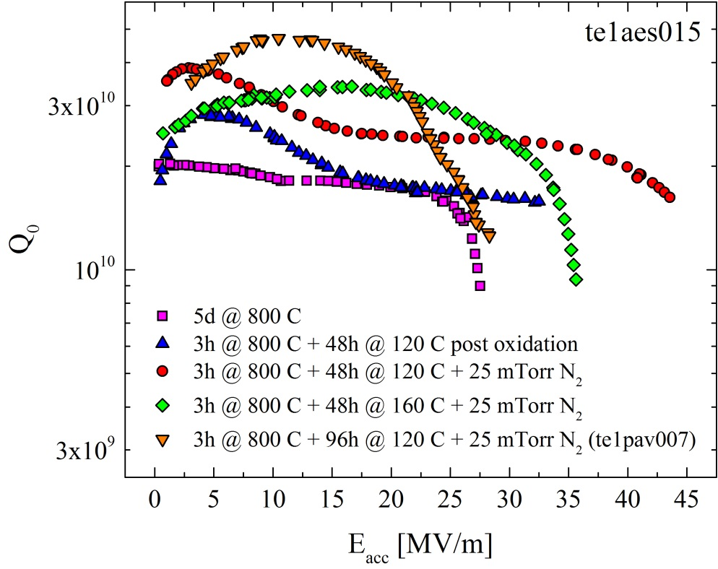
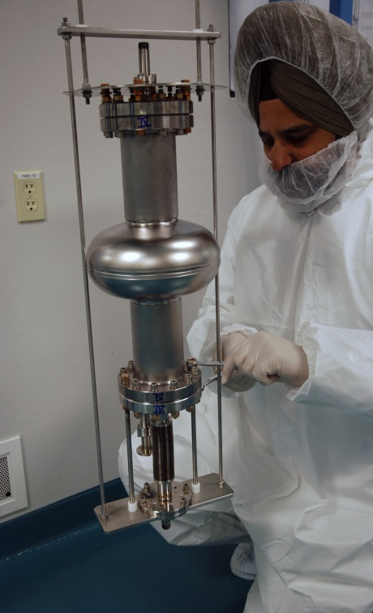
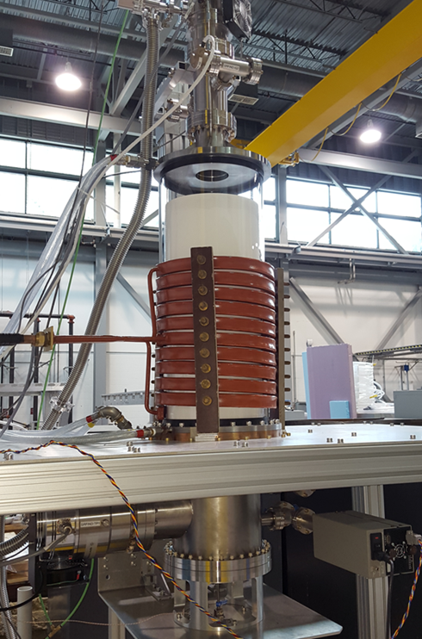
NITROGEN TREATMENT AT TRIUMF
Variations in the infusion process produce significant variations in the performance – requires optimization
Now commissioning a UHV RF induction oven to process single cell 1.3GHz cavities – goal is to explore various doping and infusion recipes.
Also investigate infusion at lower frequencies with co-axial resonators -> ISAC-II
A. Grassellino – TTC Saclay

Slide 20
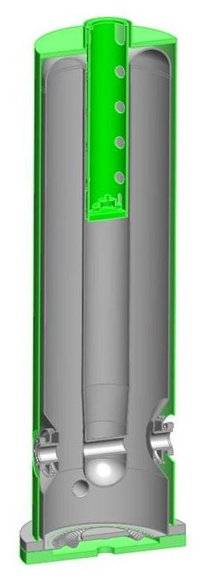
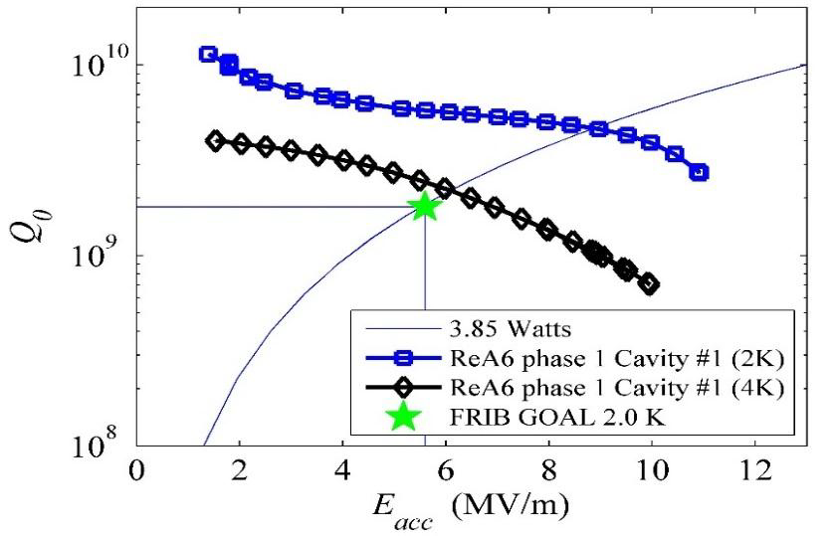
MFQS IN LOW BETA CAVITIES
  Strong Medium Field Q-Slop (MFQS) exists in low frequency and low β resonators.
  Presently facilities are choosing to operate at 2K even at low frequency to avoid MFQS, such as FRIB and RISP.
Some evidence for a weakening of the energy gap at high field
More data is required to explain this effect – can doping/infusion help
FRIB 80.5MHz β=0.085 QWR
K. Saito – SRF2015

Slide 21
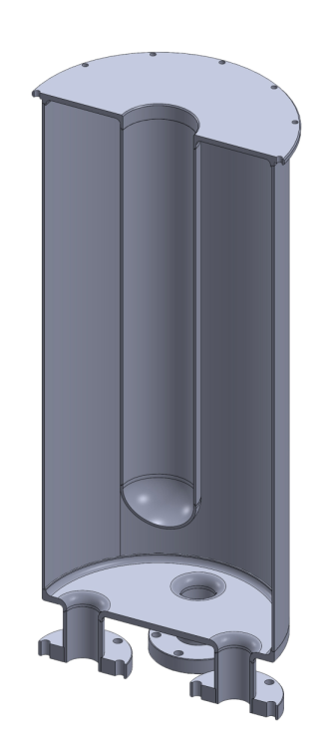
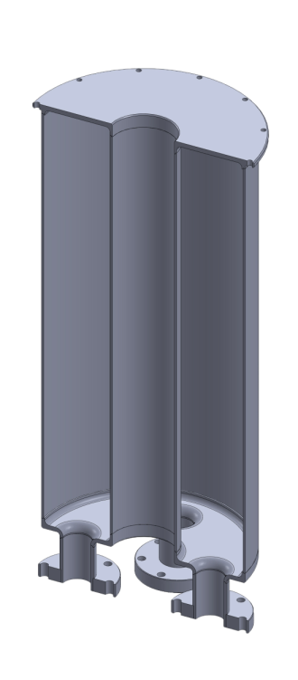
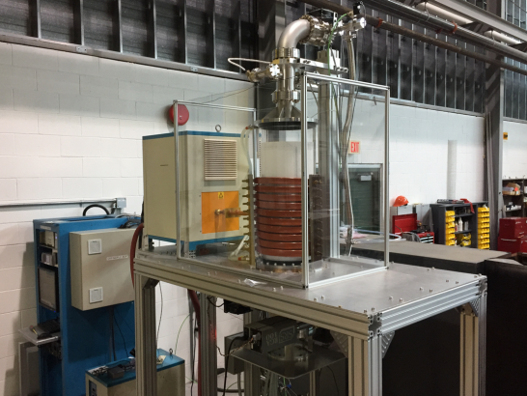
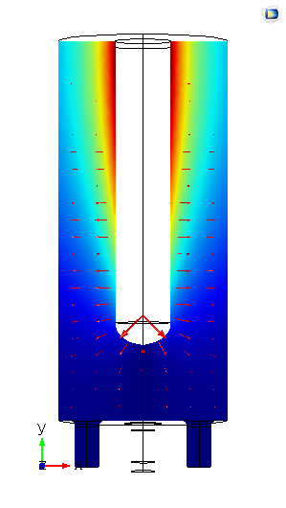
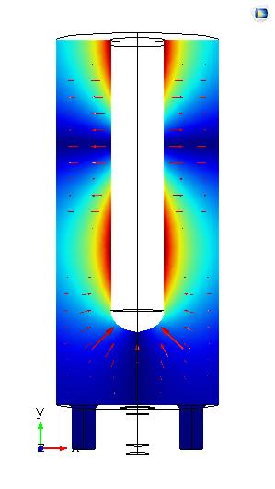
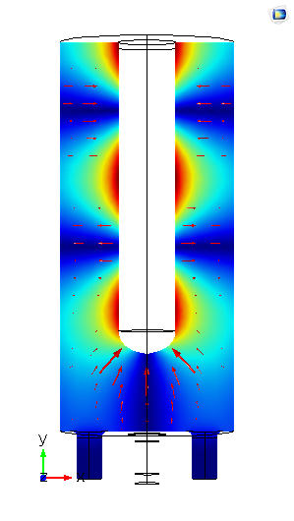
MULTI-FREQUENCY COAXIAL RESONATORS
Two new TEM mode coaxial resonators (QWR and HWR) are being fabricated to systemically study field dependence of RF surface resistance in low beta cavities.
Cavities sized to fit the RF induction oven – allows unique optimization of heat treatments and doping/infusion as a function of RF frequency.
Cavities can be excited at fundamental (200MHz) plus higher harmonics to allow direct comparisons of results.
Allows unique set of measurements to characterize field dependent loss mechanisms in SRF cavities.
QWR
HWR
RF field distribution of TEM modes

Slide 22
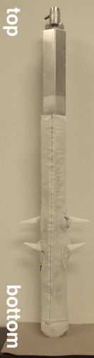
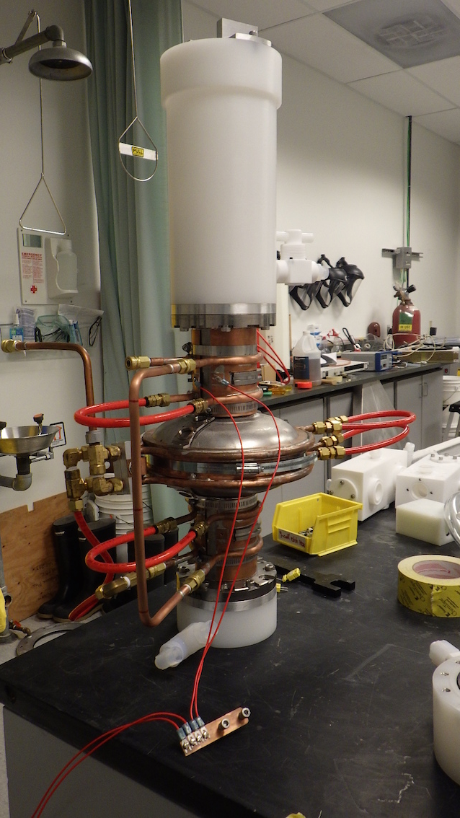
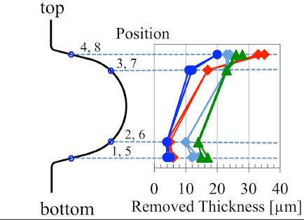
VERTICAL EP DEVELOPMENT
Electro-polish treatment is needed for N-doping – need to remove 5micron layer after doping
TRIUMF SRF is developing vertical EP with Teflon stirrers to augment the doping effort – process being optimized
paddles

Slide 23
NEW MATERIAL – Nb₃Sn
A15 intermetallic alloy of niobium and tin.
Nb₃Sn has a higher critical temperature than Niobium (18K vs 9K)
  Allows operation at 4K rather than 2K
  Big cryo. cost savings.
Nb₃Sn has a higher metastable magnetic field limit than Niobium (400mT vs 200 mT)
  Could allow operation at higher gradients.
  Presently suffers from quench at moderate fields.
Green: tin
Red: niobium
Parameter | Niobium | Nb₃Sn
T_{c} | 9.2 K | 18 K
B_{sh} | 219 mT | 425 mT
Δ/k_{b}T_{c} | 1.8 | 2.2
λ at T = 0 K | 50 nm | 111 nm
ξ at T = 0 K | 22 nm | 4.2 nm
GL parameter κ | 2.3 | 26

Slide 24
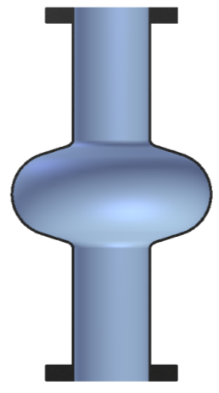
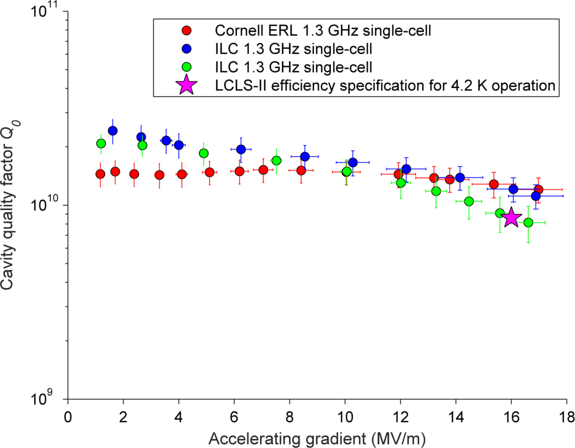
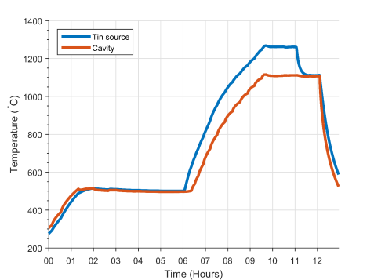

Nb₃Sn COATED ILC SINGLE CELL
Coating chamber in UHV furnace at 1100 C
D. Hall – TTC Saclay
Nb cavity substrate
Sn Vapor
Bath T=4.2K
Auxiliary Heater for Sn container at 1200 C

Slide 25
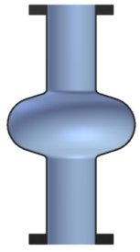

Nb₃Sn COATING AT TRIUMF
Nb₃Sn coating technique can be studied at TRIUMF with RF induction oven on either samples, single cell cavities or coaxial resonators.
Applying Nb₃Sn film on low beta cavities and other complicated geometry cavities can be explored.
Cornell’s results encourage to operate cavities at 4K and moderate gradient.

Slide 26
MULTILAYER FILMS
SC / insulator / SC multilayer films (SIS) was proposed by A. Gurevich, App. Phys. Lett. 88, 012511 (2006).
Suggests that SIS layers could reach very high fields before vortex penetration.
T. Kubo – TTC Saclay

Slide 27





Material Science Probes at TRIUMF – muSR and β-NMR*
TRIUMF has two world class material science probes in muSR and betaNMR – utilize the beta decay of a beam of polarized muons or 8Li ions respectively as probes of local magnetism
TRIUMF muSR samples near surface fields (100µm) and betaNMR samples surface fields (0->200nm)
Method
Imbedded probes decay with emitted positrons or electrons correlated with direction of spin. Spin precession dependent on the magnetic field of the imbedded probe
µ⁺, ⁸Li
Atomic lighthouse
* More from Tobi and Rob Kiefl

Slide 28


FIELD OF FIRST FLUX ENTRY WITH muSR
Sample: Fine grain RRR niobium sample 1400°C annelead then 120° bake in vacuum and retested.
Finding: Baking at 120C in vacuum enhances the field of first flux entry from 174 mT to 188 mT.
µ
Dirty layer
Enhancement by 6%
Implantation depth 100µm
Bulk Nb
B
T. Junginger – TTC MSU

Slide 29




FIELD OF FIRST FLUX ENTRY WITH muSR
Samples: Nb 1400°C annealed, MgB₂ (50-300nm) and Nb₃Sn (1-3.5µm) on niobium.
Findings: A layer of a higher T_{c} material on niobium can enhance the field of first entry by about 40% from a field consistent with H_{c1} to a field consistent with H_{sh}.
This enhancement does not depend on material or thickness suggesting that superheating is indeed induced in niobium by the overlayer which is inconsistent with both models.
T. Junginger – TTC MSU
Meissner state
Coating
(50-3500 nm)
µ
Intermediate state
Implantation depth 100µm
Bulk Nb
Theoretical B_{c1}
Theoretical B_{sh}
B
Vortex state

Slide 30






HIGH FIELD SPECTROMETER FOR beta-NMR
beta-NMR is a unique facility to characterize magnetic properties of materials at surfaces and film interfaces.
Perfect for SRF characterization of materials since it can probe the superconductor through the London layer.
muSR at TRIUMF fixed implantation depth (≈100µm) while LE-muSR at PSI limited to 25 mT parallel fields.
TRIUMF will provide a unique facility in the world for diagnosing new treatments (doping), new materials (Nb3Sn) and new structures (SIS layer) with variable implantation depth and parallel magnetic field up to 200mT.
H
B
8Li range
T. Kubo – TTC Saclay

Slide 31
CONTRIBUTIONS ON OTHER PROJECTS

Slide 32




SRF/RF Work for Others
RF department is engaging in Work for Others
  Maintains core competence – engages students
  Cavity testing for RISP (QWR/HWR) and PKU (single cell)
Variable couplers for FRIB and RI
LLRF systems for Cornell, RISP and IMP
Variable couplers for FRIB
RISP QWR Cavity Test

Slide 33




SRF/RF Work for Others
RISP project in Korea
    Design and fabrication of two SSRs – 325MHz β=0.3
TRIUMF Machine Shop and SRF team successfully formed Nb parts for SSR1 – developing other local fabricators for brazing and spinning
SSR1 spokes + fixture
SSR1 cavity - RISP

Slide 34




VECC COLLABORATION
TRIUMF has had an active collaboration with VECC Kolkata over the last seven years.
The main deliverable from the collaboration was the joint design and production of two injector modules one for TRIUMF and one for VECC (commissioned in 2016).
The latest deliverable is a new heavy ion cryomodule containing 4 QWRs for delivery to VECC – we will be starting this in 2017.

Slide 35

RFD Cryomodule
DOE (FNAL) is supplying 8(+2) RF Dipole cavities (ODU design) to CERN for HiLumi
CERN requires 4(+1) Crabbing cryomodules
Similar size and technology as the e-Linac Accelerating Cryomodules (ACM)
Propose to design/build the CMs as part of a HiLumi hardware contribution from Canada

Slide 36




SRF at TRIUMF
SRF department supports
  Internal projects
    ISAC-II heavy ion linac, ARIEL e-Linac,
  Student education
    Fundamental and technical SRF
  External collaborations and Work for others (FRIB, IHEP, IMP, CERN, RISP, FNAL, VECC, Cornell, JLab, Temple)

