Slide 1
CANREB Steering Committee - EBIS
Leigh Graham
31st August 2017

Slide 2
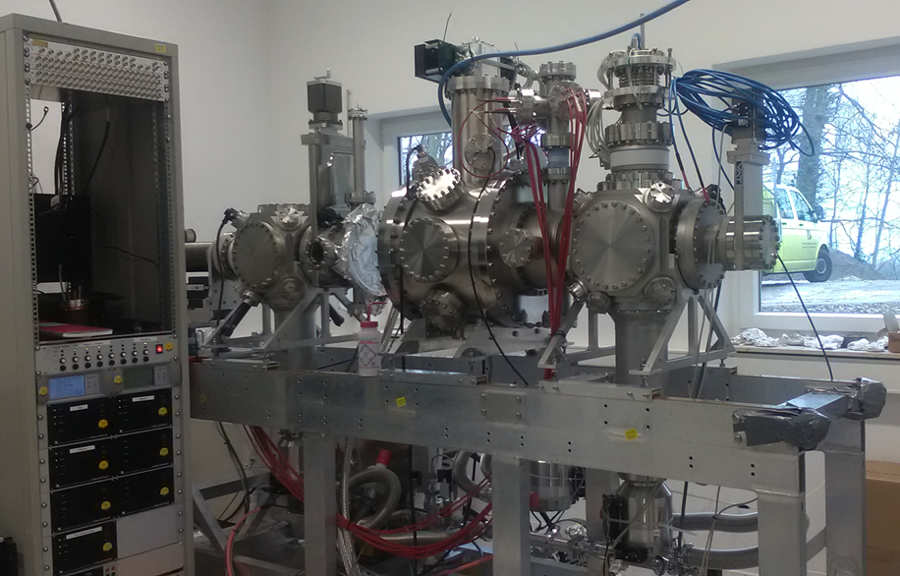

At the time of the Last Steering Committee – Feb 2017
Gun – Yet to be installed and tested
Collector – Installed but no voltage applied
Magnet – Yet to be cooled to 4K
Drift Tubes– Yet to have voltage applied when cooled to 4K
Ultimately
Yet to produce an Electron Beam!!!
1
Notes:
Michael has the bulk of the simulations in place. He has taken an ion bunch from Brads RFQ which Suresh than passed through the proposed EBIS matching optics and hopefully that will give a good indication of the acceptance. At this stage it is a debugging procedure.
The Foundations of the Extraction code including the charge breeding capability (DITHER code) is in place but no extensive work will be continued here until the injection is complete.
Once the injection and extraction is complete we will optimise the `potential` EBIS parameters.

Slide 3
Accomplished Timeline
March 2017
April 2017
May 2017
June 2017
July 2017
August 2017
First Beam
Charge Breeding
Laser -Ion Source
High Voltage Enclosures
2
Notes:
The underlined text are the main focuses of each month and the bullet points are the necessary steps. This is of course a very crude timeline.

Slide 4
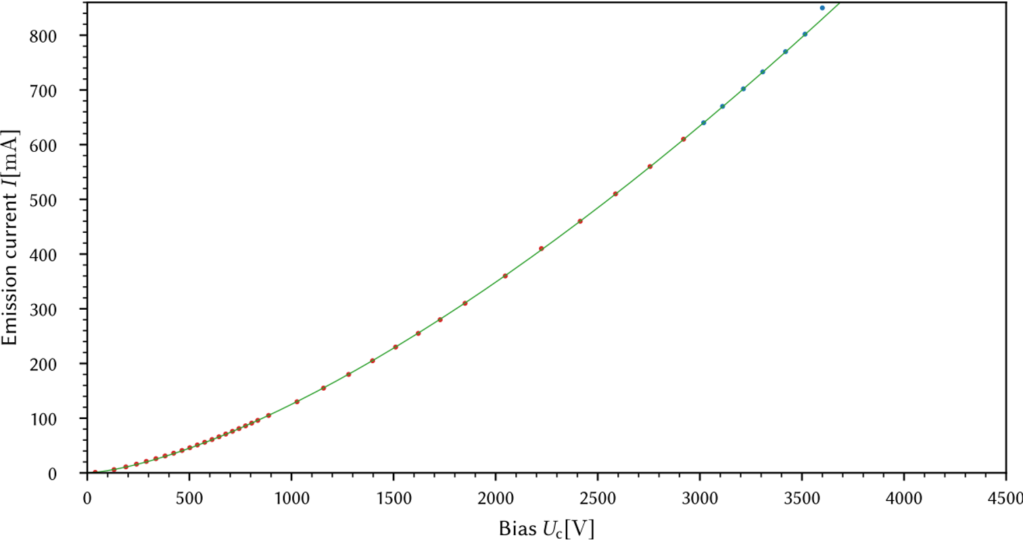

Accomplished Timeline
March 2017
April 2017
May 2017
June 2017
July 2017
August 2017
First Beam
Charge Breeding
Laser -Ion Source
High Voltage Enclosures
Maximum Electron Beam Measured 1 Amp !!
2
Notes:
The underlined text are the main focuses of each month and the bullet points are the necessary steps. This is of course a very crude timeline.

Slide 5
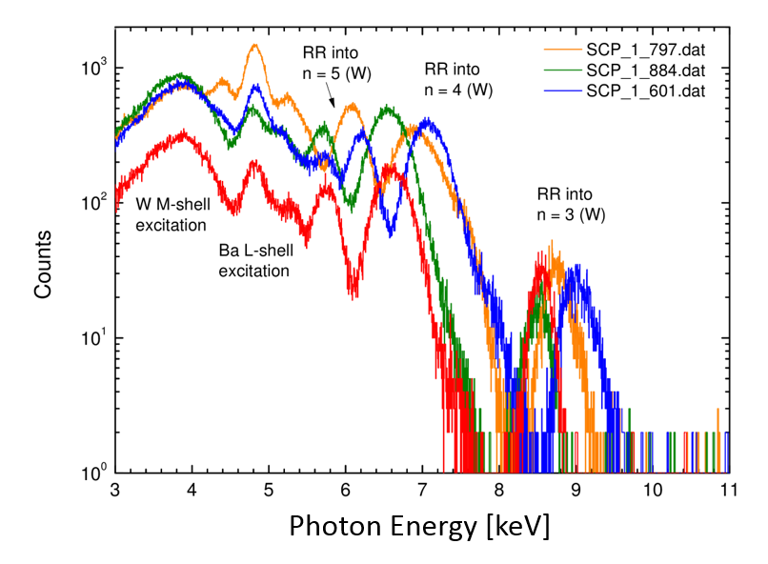
Accomplished Timeline
March 2017
April 2017
May 2017
June 2017
July 2017
August 2017
First Beam
Charge Breeding
Laser -Ion Source
High Voltage Enclosures
Maximum Electron Beam Measured 1 Amp !!
Charge Breeding – Background Ions
2
Notes:
The underlined text are the main focuses of each month and the bullet points are the necessary steps. This is of course a very crude timeline.

Slide 6
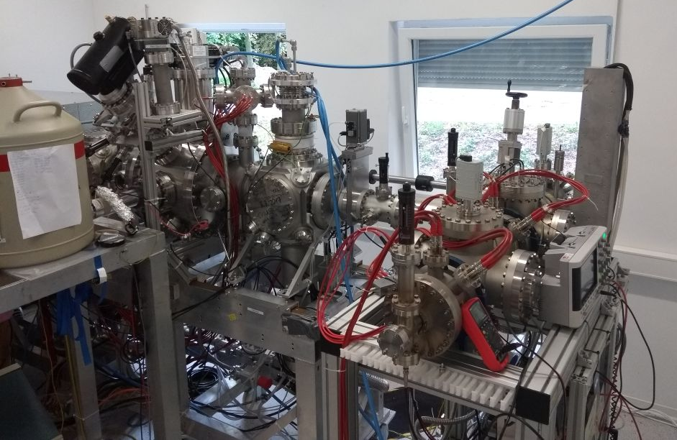
Laser-Ion Source
The Laser-Ion source (Nd:YAG, 50 mJ, 8 ns and 1064 nm) will be shipped to TRIUMF for use during the Installation/testing stages.
Image Charge Detector has been developed at MPIK to measure the charge (No. ions) on injection and extraction to EBIS -tested using Cu ions.
Injection – Extraction -Efficiency measurements to be reported in the near future -milestone
3

Slide 7
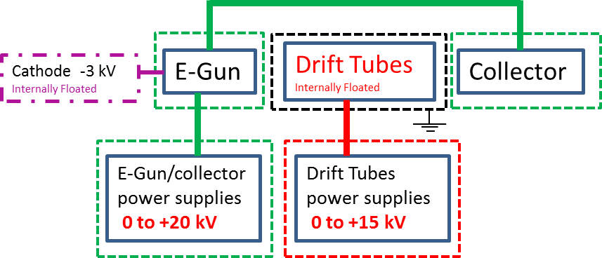
High Voltage Design
CANREB EBIS High Voltage Design – Document 144792
New High Voltage design for the EBIS has now been approved:
    Reduced the biasing power supplies substantially.
    Eliminates the need for a cage around the entire EBIS system easing spatial restrictions and providing easier access during operation.
    Still meets the requirements - Document – 92042
Biasing power supplies have now been exchanged.
4

Slide 8
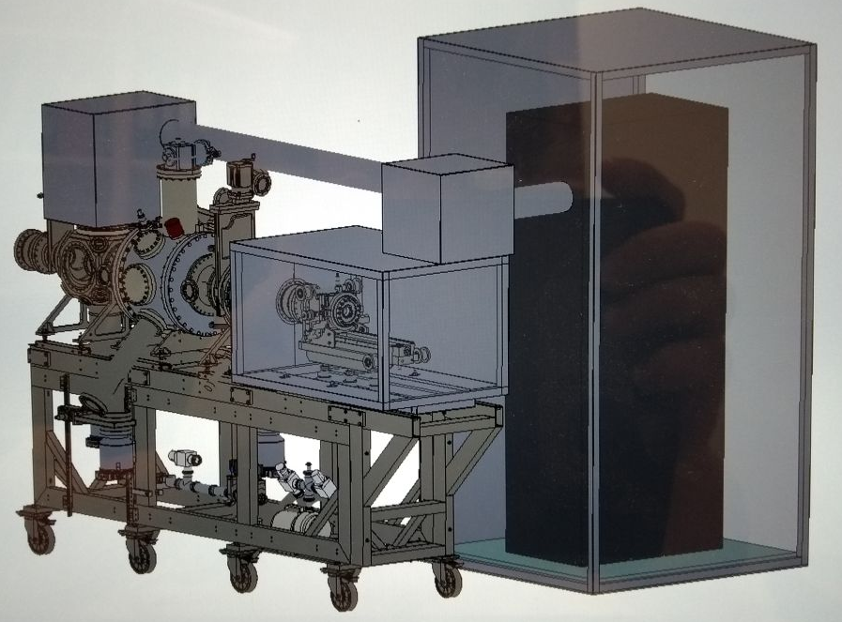
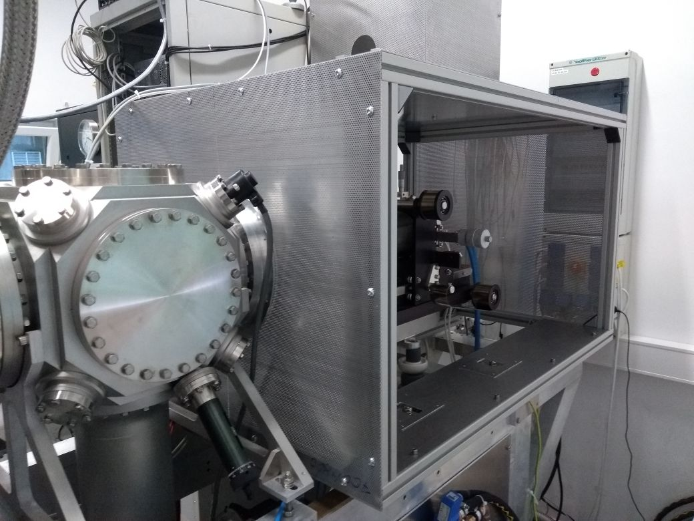
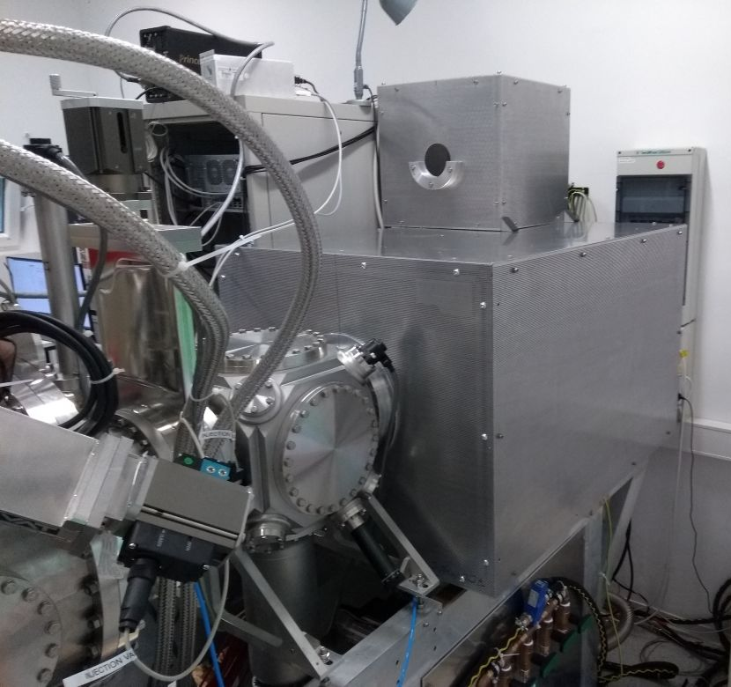
High Voltage Enclosures at MPIK
High Voltage safety enclosures are currently being Designed, Manufactured, Assembled and Tested at MPIK but will be shipped with the EBIS.
The CAD drawings will be made available so the enclosures can be easily integrated with the High Voltage platforms being designed at TRIUMF.
5

Slide 9
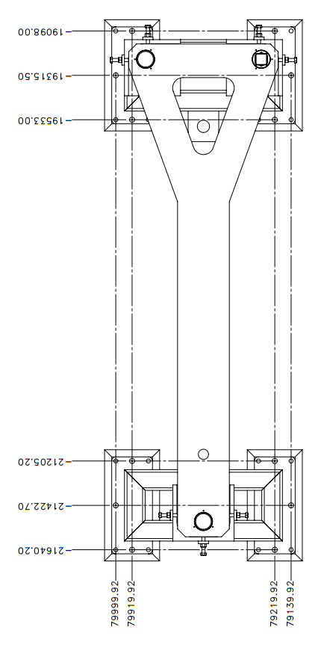
Integration and Test Plan
An integration and test plan for the EBIS has been reviewed. Below is the status of some of the items included:
Mounting stand – Being Manufactured
HV Platforms – Concept Reviewed
Reviewing HV enclosures and preparing for integration with HV platforms – inclusion of interlocks (Potential modifications at TRIUMF) – Being Discussed
Transformers – Order in progress
Cabling and Services – Documentation in progress
Internal and external alignment – Being Discussed
Controls – Documentation in progress
High Level Applications - Being thought out
7

Slide 10



Looking Forward
Sept 2017
Oct 2017
Nov 2017
Dec 2017
Jan 2018
High Voltage @MPIK
HV enclosures finished
Testing of HV platforms
Optimization and Scientific Data Collection
Optimizing and characterizing the injection/extraction of ions (utilizing the HV platforms)
Preparation
EBIS packing for shipment.
EBIS Arrival
Let the Installation and commissioning begin
8
Notes:
The underlined text are the main focuses of each month and the bullet points are the necessary steps. This is of course a very crude timeline.

