Slide 1
ARIEL RIB Diagnostics Progress Report
Diagnostics Group
August 31, 2017

Slide 2
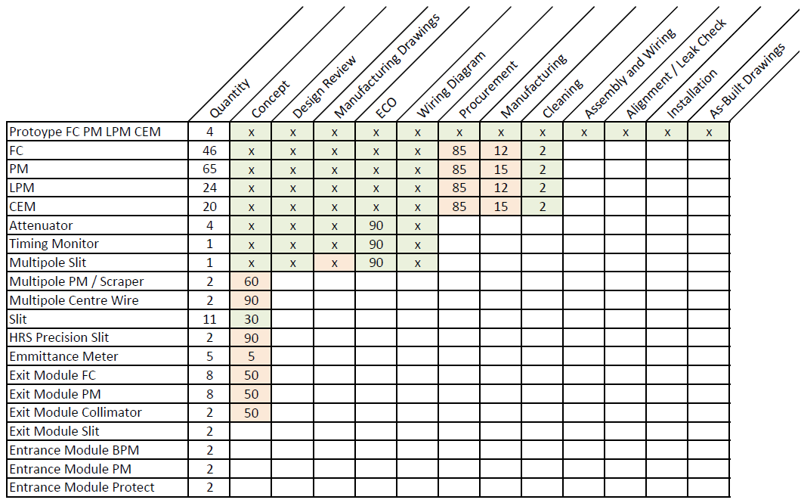
Overall Progress (%)
Notes:
Prioritizing first devices as there are lots of them
Others are unique devices

Slide 3
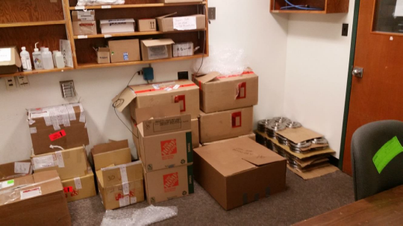
Common diagnostics production (FC.PM,LPM,CEM)
Purchased parts: about 85% received
  Set-up in assembly area or stored in the adjacent room
Machined parts: about 13% received.
  Slippage of the schedule by 1 month is possible but should not cause many issues as we prioritize needs with the vendor. (Original final delivery date was Sept 4, 2017)
Welded assemblies: only 1 welded item has been received so far.
  Estimate another 3 weeks before we start to see completed and tested welded assemblies

Slide 4
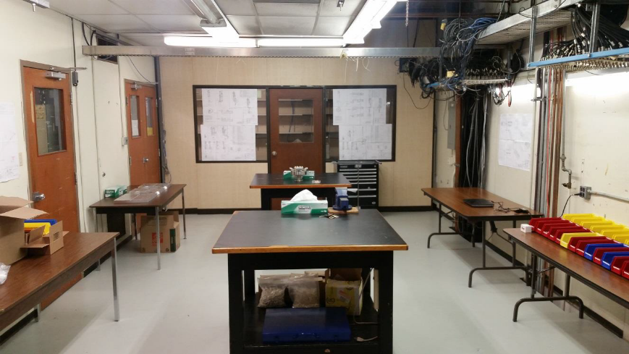
Common Diagnostics Production (FC, PM, LPM, CEM)
Assembly room has been identified and temporarily renovated for our needs
  Messon Hall, Level B1 rooms 6,7 and 8
  Set-up for assembly is ongoing
All non-UHV machined parts we have received have been cleaned and stored for assembly
Technicians in process of cleaning & storing received UHV components
Expecting co-op student to join next week.

Slide 5
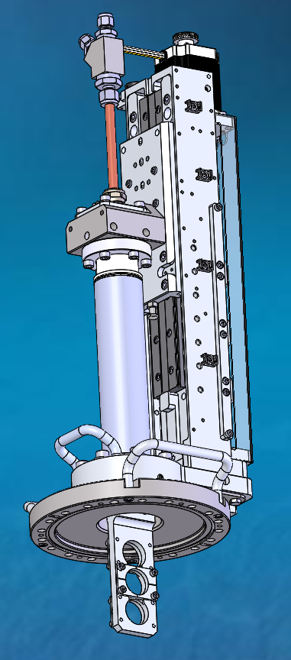
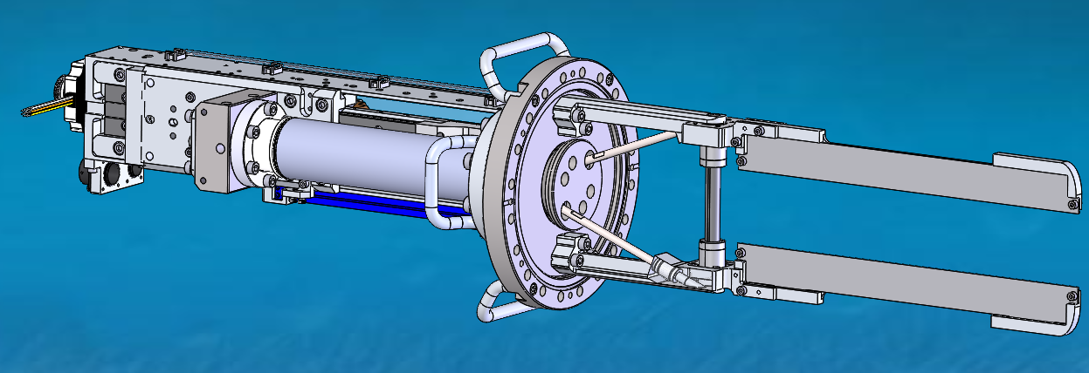
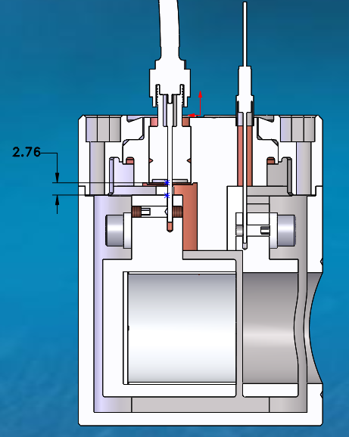
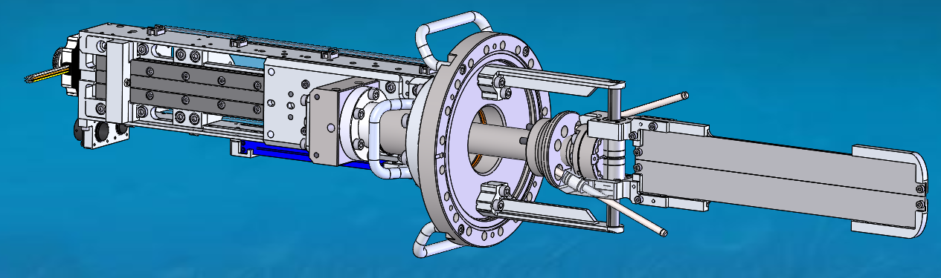
Special Diagnostics
Timing Monitor, Attenuator and Multipole Slit
  Design review was completed in July
  Detail design is completed and ECO is waiting for approval
Detail design has started for the other multipole diagnostics (wire scanner, horizontal slit and centering rod/wire)

Slide 6
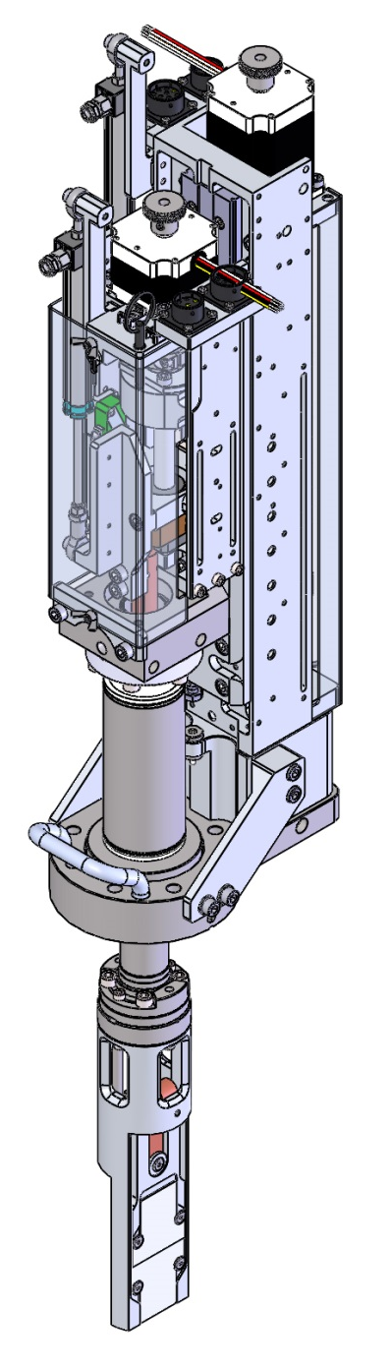
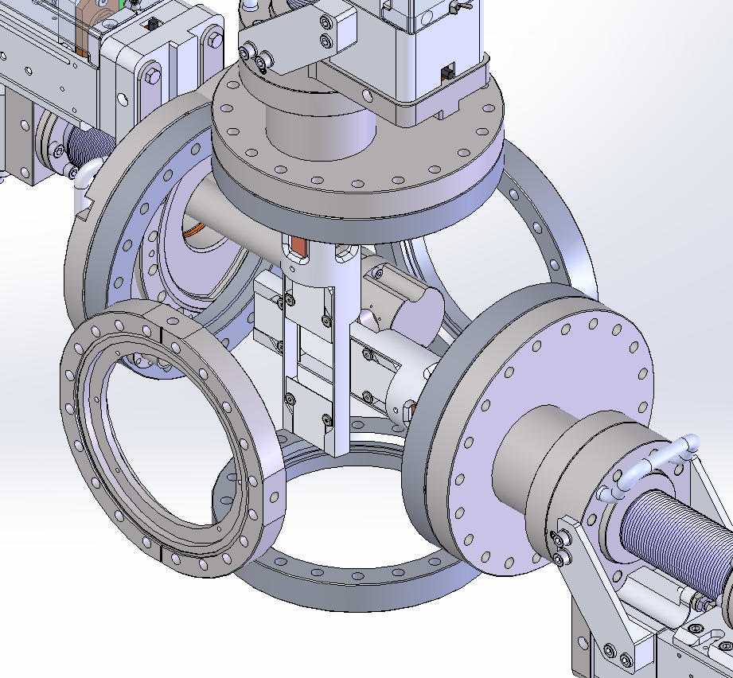
Special Diagnostics - RIB Slits
ARIEL requires both standard (100µm) and precision (10µm) slits.
Devices are based on existing diagnostic designs
Precision slits will use the addition of a 1µm linear encoder and precision homing switch to achieve the improved accuracy

Slide 7
New Electronics
In-house electronics have been developed by Daryl Bishop’s group.
The electronics requirements document has been released.
The first prototype is presently being tested.
  HW + FW tested and working; refinements ongoing
Developers looking for improvements
The goal is to complete prototype testing in mid-September.

Slide 8
Low noise cables
Cables generate noise due to triboelectric effect. Suppressing this noise is especially important for wire scanning devices where measurements are taken while the monitor is in motion.
Special low-noise cables were tested using commercial charge-integrating electronics
Low noise cables is connected to Channel A
Ordinary RG-58 is connected to Channel B
Integration time 0.1s
Vertical axis: measured current in pA
Horizontal axis: time in sec

Slide 9
Problems and Risks Identified
Beam line assembly drawings are still not available which complicates assembly and prioritization.
Delays in procurement and manufacturing may lead to slippage in the schedule.
Help with cleaning and assembly may be required. Operations personnel may be available during shutdowns for help

