Slide 1
CANREB Steering Committee Review
Project Milestones
Asita Perera
Project Manager
2017-08-31

Slide 2
Outline
Installation & Commissioning Milestones
Project milestone evolution
Critical path systems
Near critical path systems

Slide 3
Installation & Commissioning Milestones

Slide 4
Milestone Evolution 2014-2016
UID | Milestone | Completion in IIA | Feb 2017 SC | Current Rev084 (08/17) | Δ Feb-Aug (month) | Comment
607 | HRS – Concept design review by an experts committee | 2014-05-01 | 02/2015 | 02/2015 | - | Completed
608 859 860 | HRS – Design review and approval by TRIUMF EBIS – System design review and approval by TRIUMF EBIS – Ordering of superconducting magnets and pumps | Q1.2015 | 09/2015 07/2015 03/2015 | 09/2015 07/2015 03/2015 | - - - | HRS mfg dwgs released. No explicit TRIUMF review in schedule. Completed. Completed Completed
256 1341 | HRS - Start manufacturing EBIS – UHV chambers and vacuum system design done | Q2.2015 | 05/2016 05/2015 | 05/2016 05/2015 | - - | Completed Completed
851 838 | Nier Spectrometer - Design review and approval by TRIUMF RFQ Buncher - Design review and approval by TRIUMF | Q3.2015 | 05/2015 06/2016 | 05/2015 06/2016 | - - | Completed External review completed 06/2016
1639 864 | HRS – Vendor integration and testing completed EBIS - Magnet delivery and off-line test | Q4.2015 | 03/2017 05/2016 | 03/2017 05/2016 | - - | Completed Magnet repaired, completed

Slide 5
Milestone Evolution 2016-2018
UID | Milestone | Completion in IIA | Feb 2017 SC | Current Rev084 (08/17) | Δ Feb-Aug (month) | Comment
847 268 1345 743 | Nier Spectrometer - Start manufacturing HRS - System in TRIUMF EBIS - Design of electron gun and electrodes RFQ Buncher - Start components Integration | Q2.2016 | 03/2016 04/2017 08/2015 09/2017 | 03/2016 08/2017 08/2015 09/2017 | - +4 - - | Completed Completed Completed
868 | EBIS - Charge breeding tests at MPIK | Q3.2016 | 04/2017 | 01/2017 | -3 | Completed
283 746 | HRS - Set-up at ARIEL & Ready for System Integration RFQ Buncher Ready for System Integration | Q4.2016 | 03/2018 07/2018 | 07/2018 05/2018 | +4 -2 | Consider shorter optimization time
871 | EBIS - Set-up at ARIEL | Q2.2017 | 01/2018 | 05/2018 | +4
872 695 | EBIS - Injection-Extraction tests Nier Spectrometer - Set-up at ARIEL & Ready for System Integration | Q3.2017 | 04/2018 05/2018 | 07/2018 03/2018 | +3 -2 | Accelerate assembly & installation
1356 | EBIS - Ready for System Integration | Q4.2017 | 05/2018 | 08/2018 | +3
771 | Release Commissioning Plan | Q1.2018 | 04/2018 | 04/2018 | -
777 775 | Commissioning of RFQ-EBIS-NIER with stable Ion Source Commissioning of HRS with stable Ion Source | Q2.2018 | 11/2018 11/2018 | 12/2018 11/2018 | +3 - | Could be earlier w/ shorter optimization

Slide 6
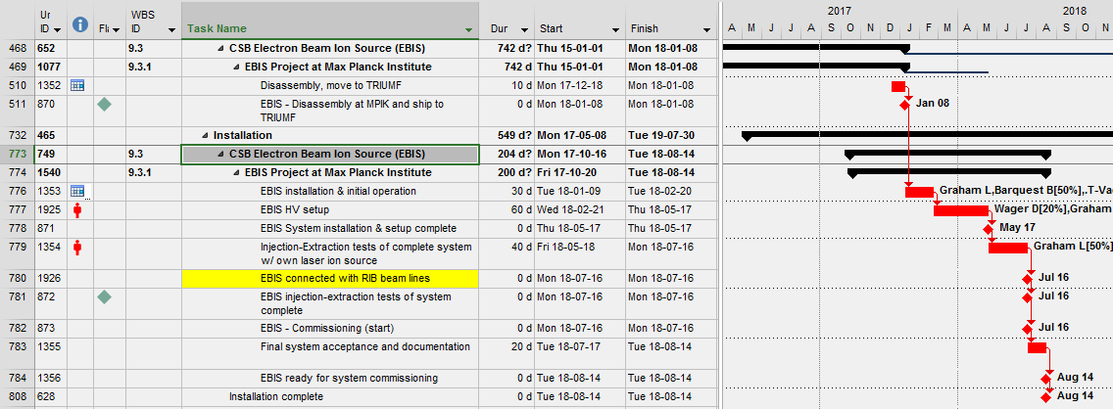
CANREB Project Critical Path: EBIS

Slide 7
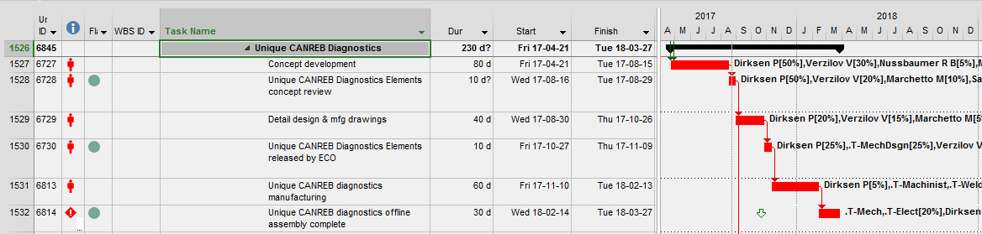
CANREB Diagnostics (ARIEL-II P1 Schedule)
Issue: Unique CANREB Diagnostics assembled later than required (2018-01) for installation on beam line.
Mitigation: Flexibility exists to install them in 2018-03 per current timing.

Slide 8
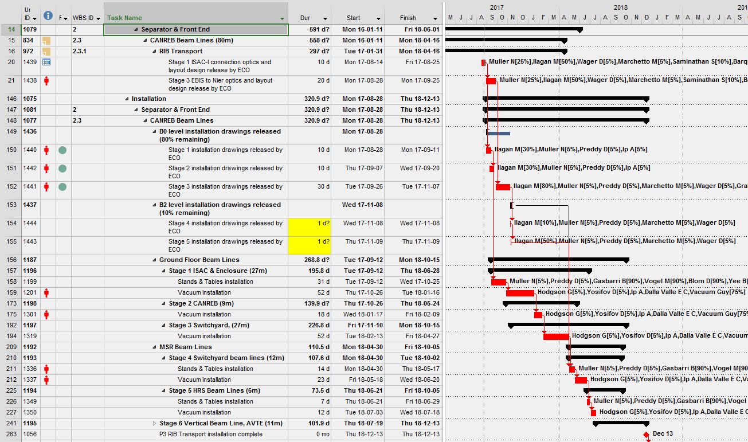
Beam Line Installation (ARIEL-II P3 Schedule)

Slide 9
Near Critical Path
The following CANREB Project systems are near the critical path by the stated schedule float:
RFQ Buncher, ~0.5 months float
HRS Magnets, ~1 month float
HRS Test Ion Source, ~0.5 months float
Nier Magnets, ~5 months float

Slide 10
Questions?

