Slide 1


One-Neutron Transfer into ²²Ne
Beau G. Greaves
WNPPC2018
Notes:
Preliminary look into
Collected over summer (recent)

Slide 2
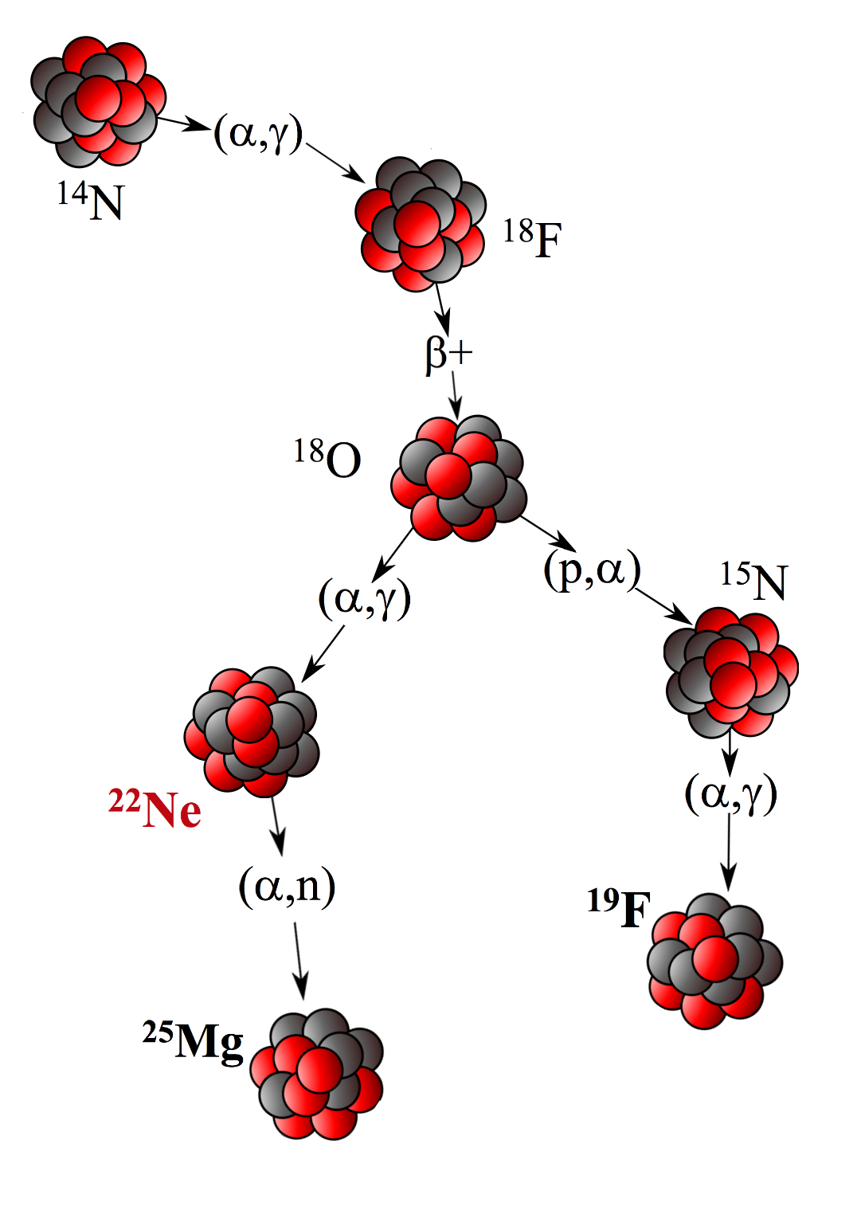
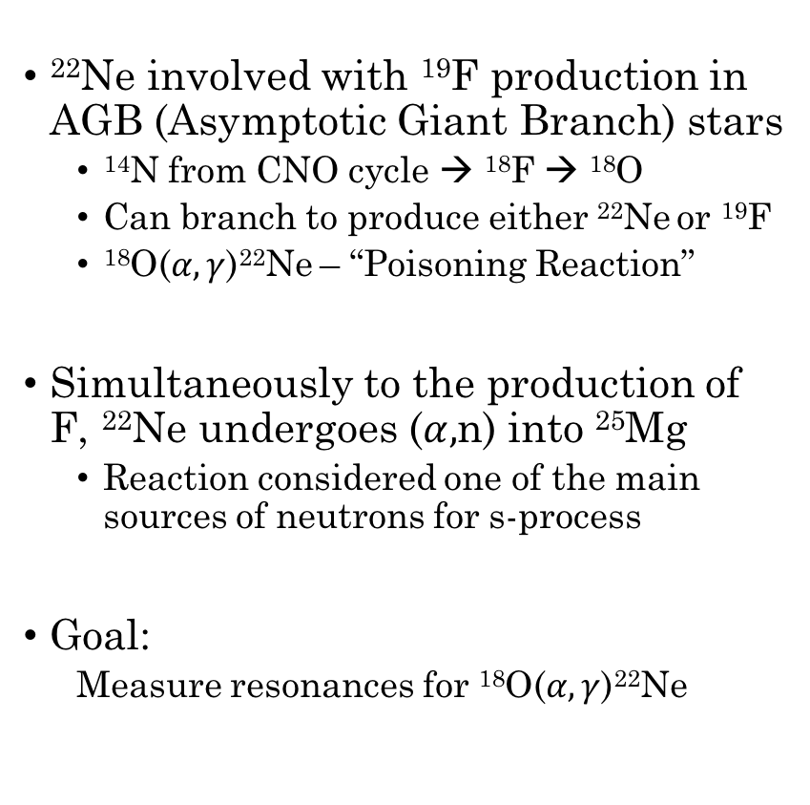
Motivation
²²Ne involved with ¹⁹F production in AGB (Asymptotic Giant Branch) stars
  ¹⁴N from CNO cycle → ¹⁸F → ¹⁸O
  Can branch to produce either ²²Ne or ¹⁹F
  ¹⁸O($α,γ$)²²Ne – “Poisoning Reaction”
Simultaneously to the production of F, ²²Ne undergoes ($α,$n) into ²⁵Mg
  Reaction considered one of the main sources of neutrons for s-process
Goal:
  Measure resonances for ¹⁸O($α,γ$)²²Ne
Notes:
plays a large role in nucleosynthesis
Key player in nucleosynthesis
unusually low F abundance
a capture outgoing neutron into Mg in same environ
s-process responsible for approx half elements >Fe
study resonance struct of 22Ne
->insight into Rx rates in AGB stars for wide range
AGB - asymptotic giant branch

Slide 3
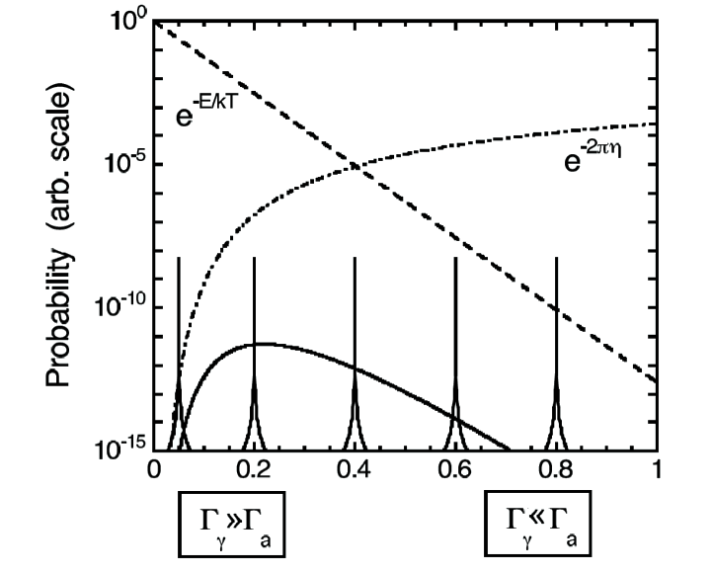
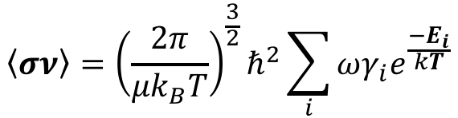
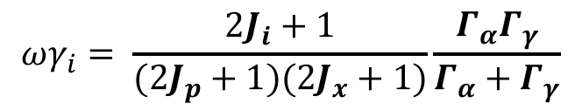

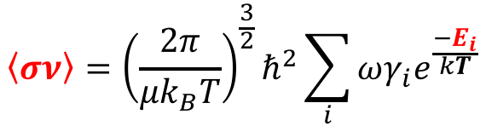
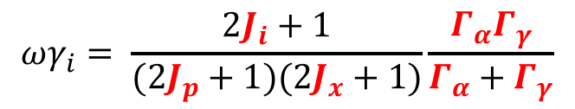

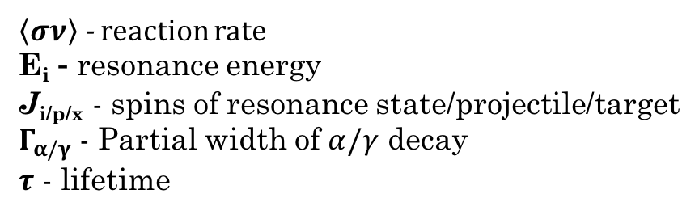
Motivation
Breit-Wigner Expression
$$\left\langle σν\right\rangle ={\left(\frac{2π}{μk_{B}T}\right)}^{\frac{3}{2}}ℏ^{2}\sum_{i}{ωγ_{i}e^{\frac{{−E}_{i}}{kT}}}$$
$$\left\langle σν\right\rangle ={\left(\frac{2π}{μk_{B}T}\right)}^{\frac{3}{2}}ℏ^{2}\sum_{i}{ωγ_{i}e^{\frac{{−E}_{i}}{kT}}}$$
$$ωγ_{i}= \frac{2J_{i}+1}{({2J}_{p}+1)(2J_{x}+1)}\frac{Γ_{α}Γ_{γ}}{Γ_{α}+Γ_{γ}}$$
$$ωγ_{i}= \frac{2J_{i}+1}{({2J}_{p}+1)(2J_{x}+1)}\frac{Γ_{α}Γ_{γ}}{Γ_{α}+Γ_{γ}}$$
$=g\left(1−B_{α}\right)B_{α}\frac{ℏ}{τ}$
$=g\left(1−B_{α}\right)B_{α}\frac{ℏ}{τ}$
T (GK)
$\left\langle σν\right\rangle$ - reaction rate
E_{i} - resonance energy
J_{i/p/x} - spins of resonance state/projectile/target
$Γ_{α/γ}$ - Partial width of $α/γ$ decay
$τ$ - lifetime
Iliadis 2007
Nuclear Physics of Stars
Notes:
Nucleosynthesis to occur ->Temp + Coulomb = Gamow (highest Rx prob)
combine with resonance -> Breit Wigner -> rx rate
2 Cases: Ga or Gg dominant
(smaller dominates)
Gg at temp above 3.5 GK -> lifetime useful
Ga at temps in stars -> Spins & Res, no time

Slide 4
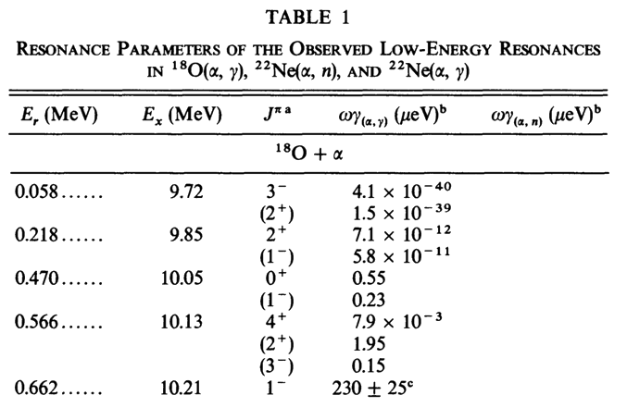
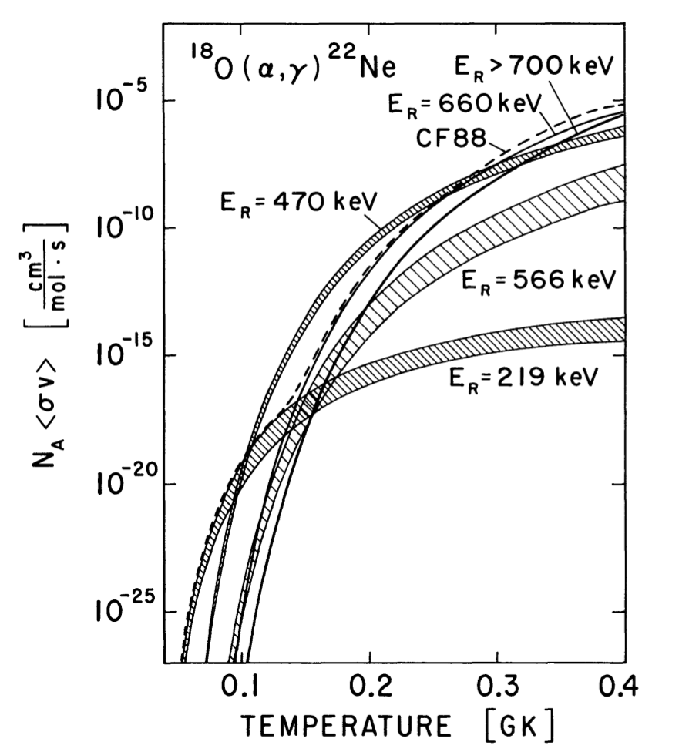

Motivation
From $γ$-Spectroscopy
From DSAM
From Transfer Reaction
Käppeler et al. 1994
Notes:
factor of 2.5 uncertainty due to unknown spins
Temperature range of interest is 0.1 - 0.3 GK
In this range:
primary resonance is .470 MeV
excitation 10.13 MeV

Slide 5

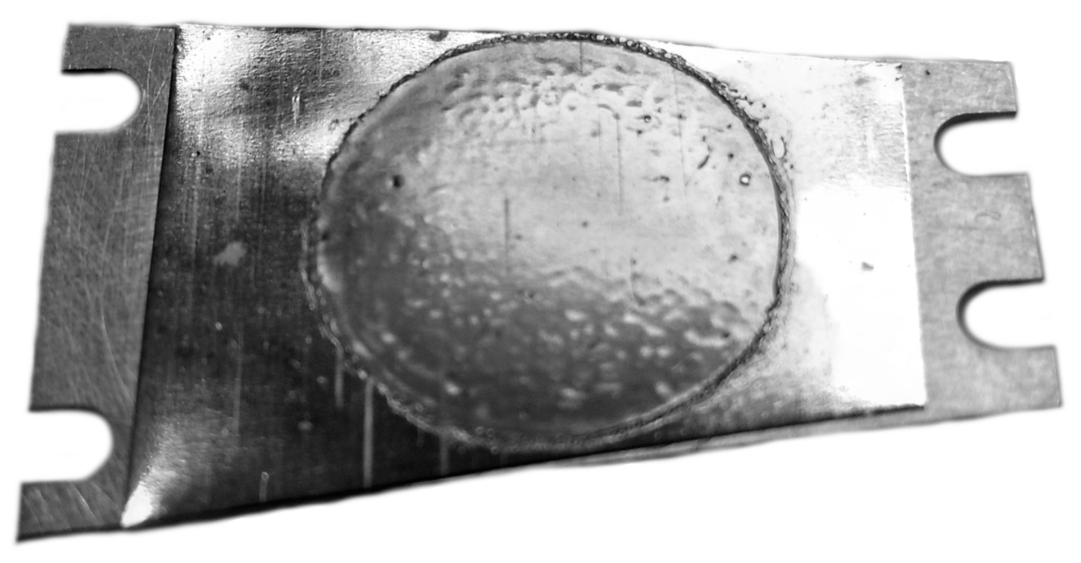
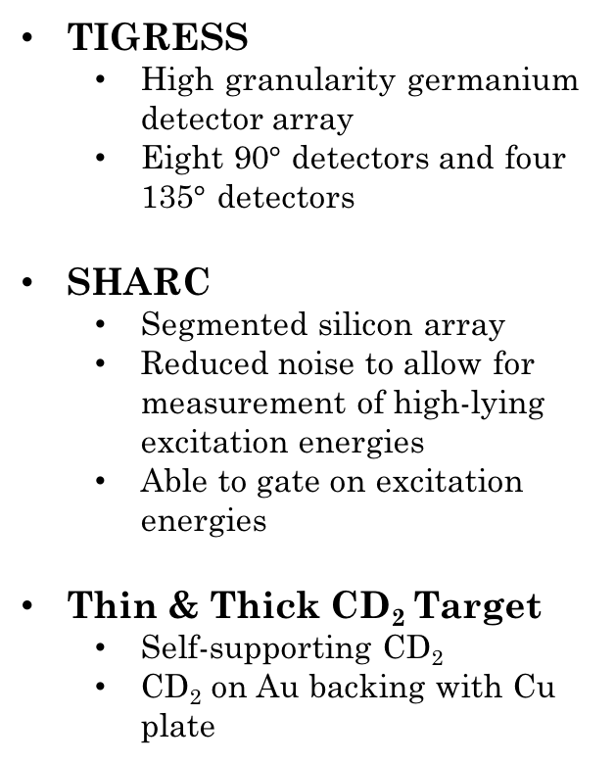
Setup
Experiment S1702 – ²¹Ne(d,p)²²Ne
  High beam energy: 165 MeV
  Low beam energy: 100 MeV
TIGRESS
  High granularity germanium detector array
  Eight 90$°$ detectors and four 135$°$ detectors
SHARC
  Segmented silicon array
  Reduced noise to allow for measurement of high-lying excitation energies
  Able to gate on excitation energies
Thin & Thick CD₂ Target
  Self-supporting CD₂
  CD₂ on Au backing with Cu plate
Notes:
Experiment carried out in ISAC II at TRIUMF
Incident on target in SHARC coupled with TIGRESS
T has BGO compton suppression shields
High granularity means lots of channels, critical for doppler shift
– TRIUMF-ISAC Gamma Ray Escape-Suppressed Spectrometer
– Silicon Highly-segmented Array for Reactions and Coulex
~5*10^8 pps intensity

Slide 6
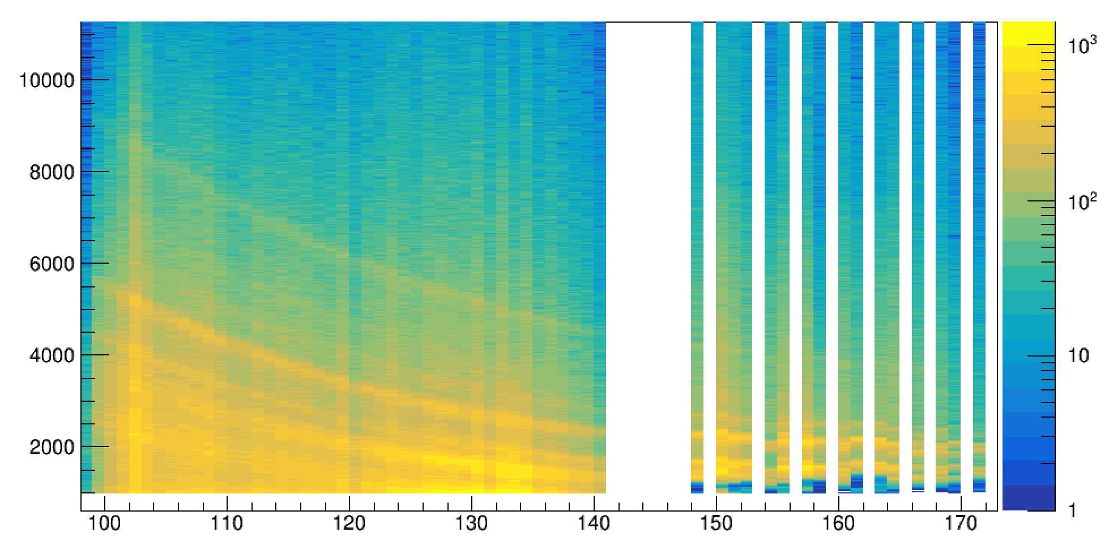
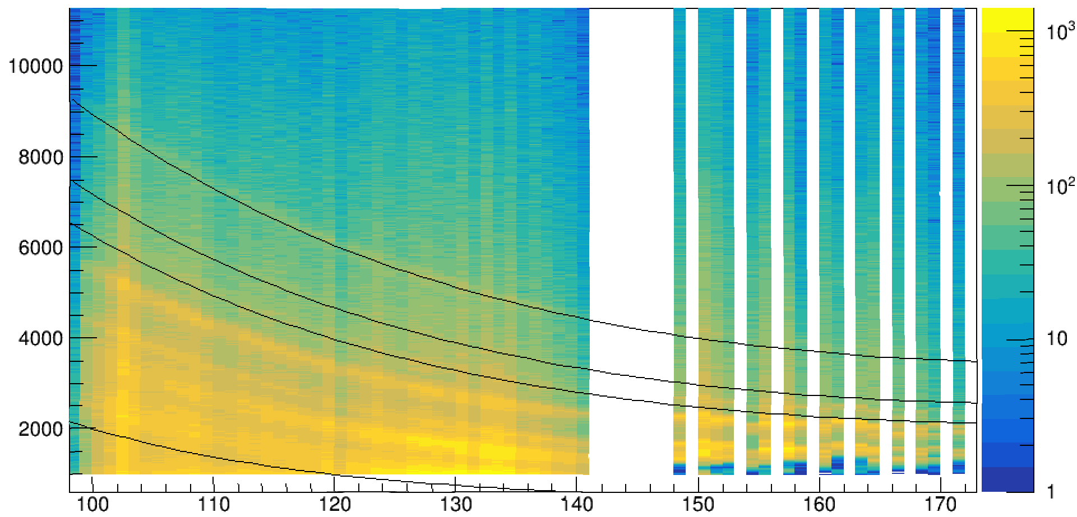
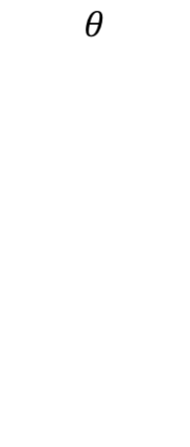
Angular Distribution of Particles
1274 keV – 2+
3357 keV – 4+
E_{p}
(keV)
4456 keV – 2+
9725 keV
$$θ$$
Notes:
energy of recoiling protons
clear example of noise reduction
->software cut in this case, but measured lower
Only back scattered protons - thin currently undergoing a proper calibration
Kinematic lines - excitation energies
Black kinematic guidelines pre-calculated & overlaid – not based on data measured

Slide 7
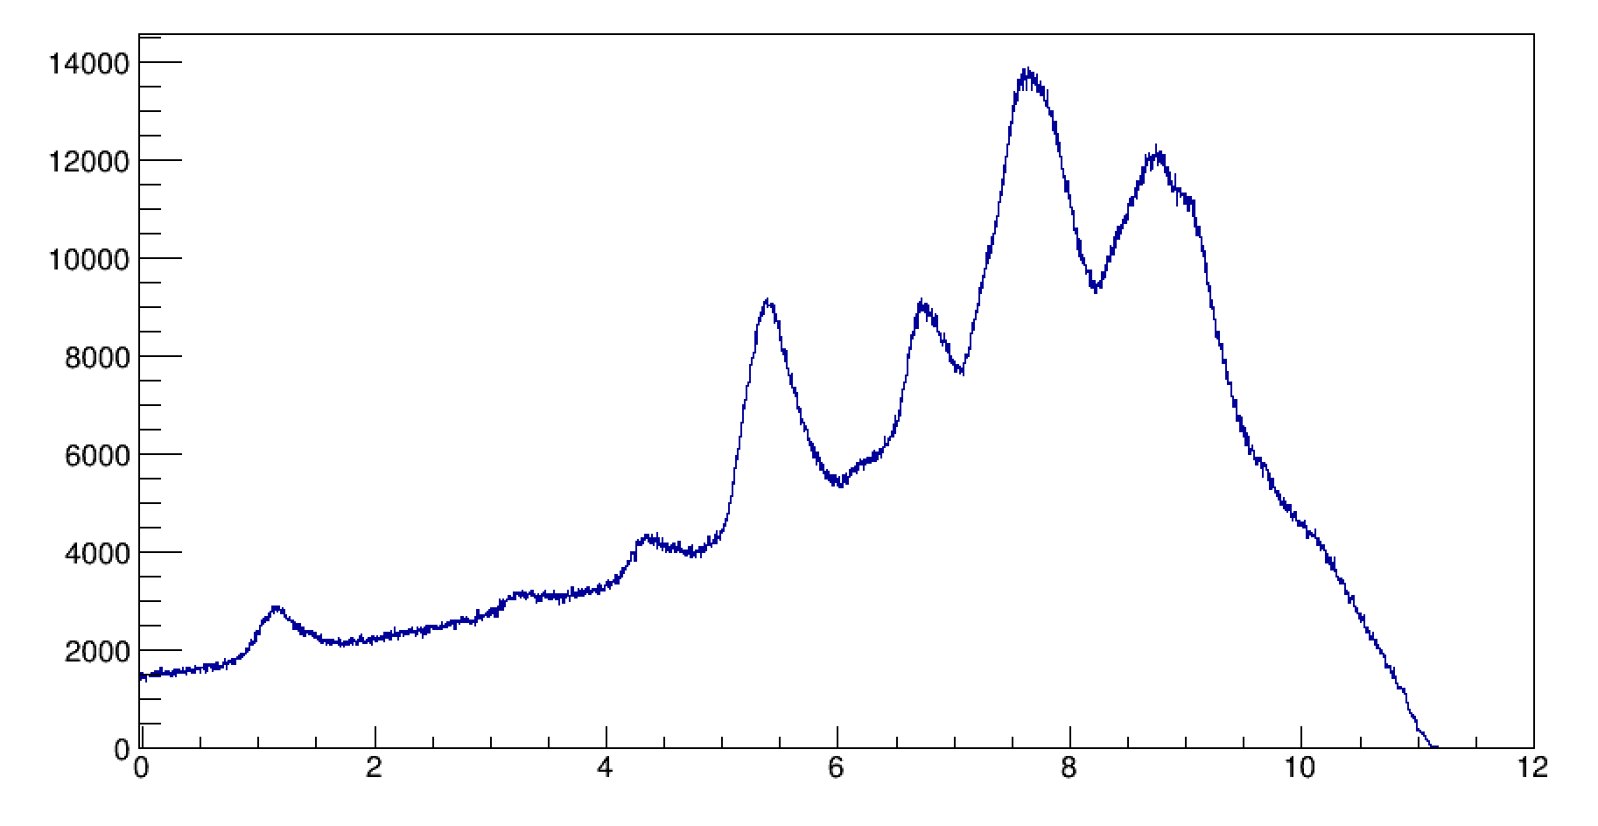
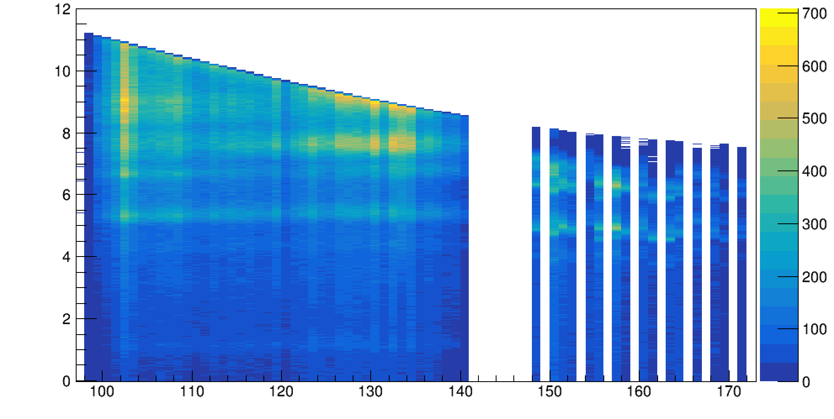
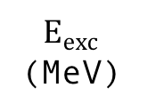
Excitation Energies
$E_{exc}$
(MeV)
$$θ$$
Notes:
Produce excitation energy spectrum using angular dependence of momentum transfer to determine energy in 22Ne
From this we get a first look into the levels
Not that helpful, but we have a guideline

Slide 8
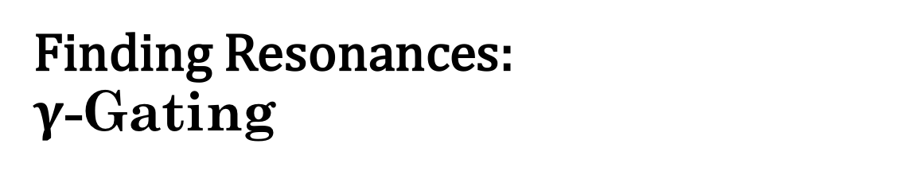
Finding Resonances:
$γ$-Gating
10050 keV
9850 keV
9045 keV
$E_{exc}$
(MeV)
7921 keV
6819 keV
5363 keV
4456 keV
3357 keV
3182 keV
1274 keV
$$θ$$
Notes:
Problem with resonances: low statistics comparted relative to data set
Method of fixing – gate on photon emission specific to excitation energy

Slide 9
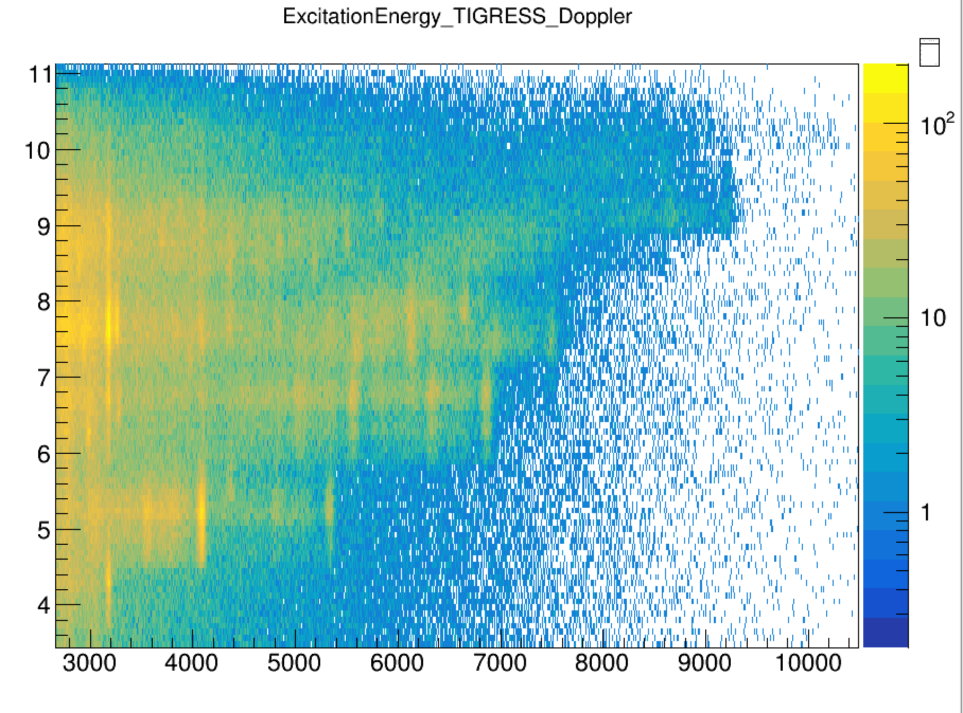
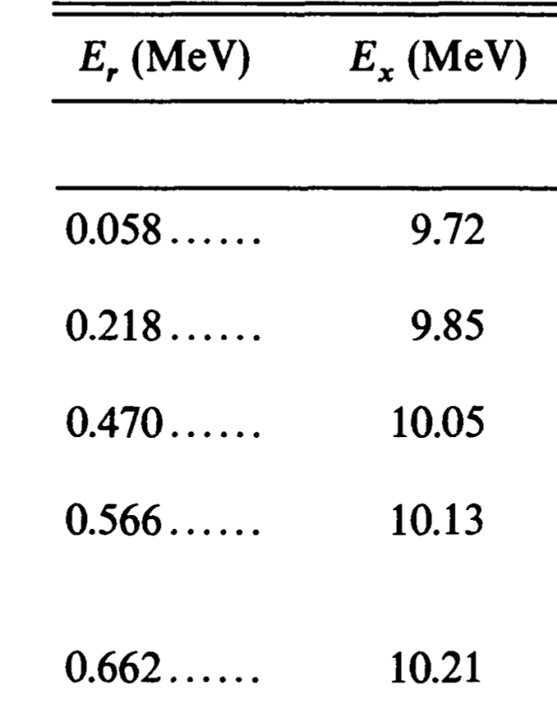



Preliminary Observations
$E_{exc}$
(MeV)
$E_{γ}$ (keV)
7.42 MeV
8.97 MeV
9.85 MeV
9.18 MeV
9.72 MeV
8.56 MeV
$E_{exc}$(MeV)
$E_{exc}$(MeV)
Notes:
Using thick
By gating on gamma emission, clear peaks in excitation energy
-> Resonances
Gates:
7300 – 7500
7980 – 8150

Slide 10



Preliminary Observations
$E_{exc}$
(MeV)
$E_{γ}$ (keV)
10.21 MeV
9.05 MeV
9.05 MeV
10.21 MeV
10.21 MeV
$E_{exc}$(MeV)
$E_{exc}$(MeV)
$E_{exc}$(MeV)
Notes:
Resonances continued,
first time measuring with gamma spec
immediately suggests gamma transitions
--->Never measured before from these excitations
Gates:
9010 – 9175
9215 – 9375
10000 – 10480

Slide 11
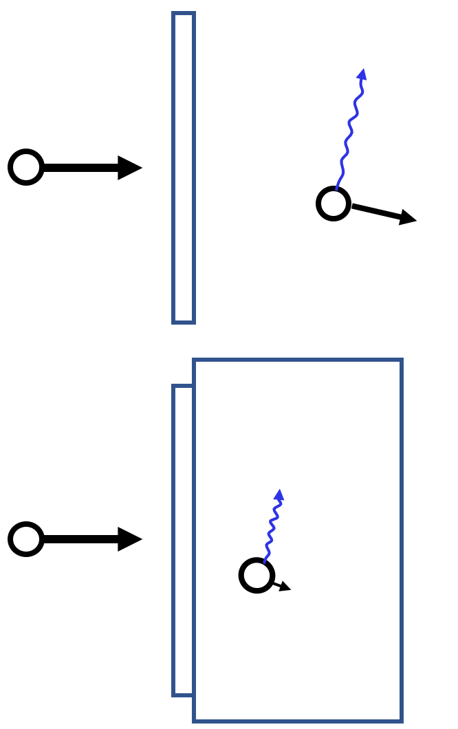
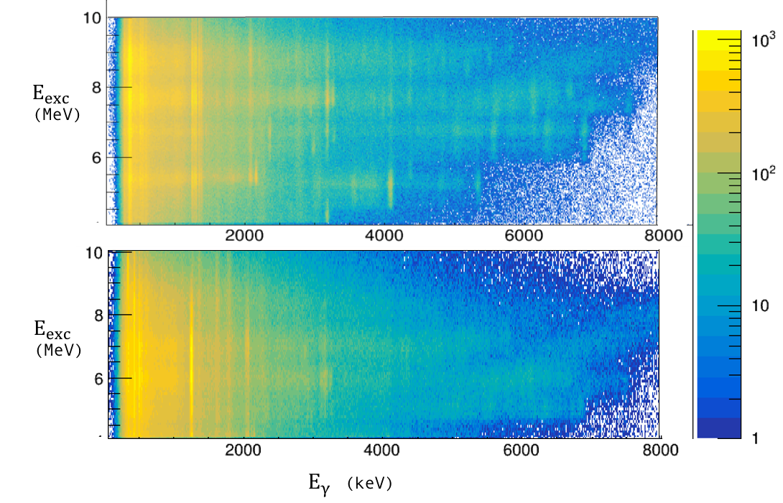
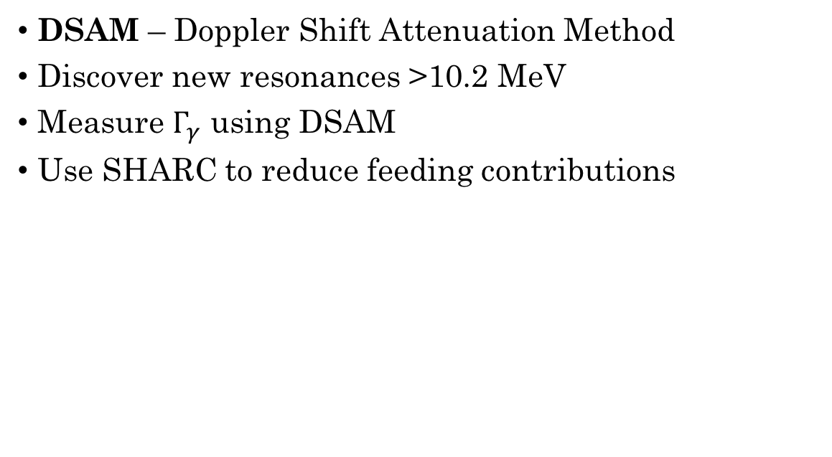
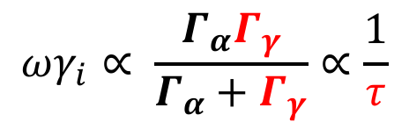
Application of DSAM
DSAM – Doppler Shift Attenuation Method
Discover new resonances >10.2 MeV
Measure $Γ_{γ}$ using DSAM
Use SHARC to reduce feeding contributions
$$ωγ_{i}∝ \frac{Γ_{α}Γ_{γ}}{Γ_{α}+Γ_{γ}}∝\frac{1}{τ}$$
Thick
Thin
Notes:
photons emitted by in flight nuclei
using backed target of known material
-->simulate stopping power
with initial beam energy, use angular dependent doppler shift to determine how fast particle travelled during decay
-->when it decayed in target
lifetimes correspond to resonance strength in Gg region

Slide 12
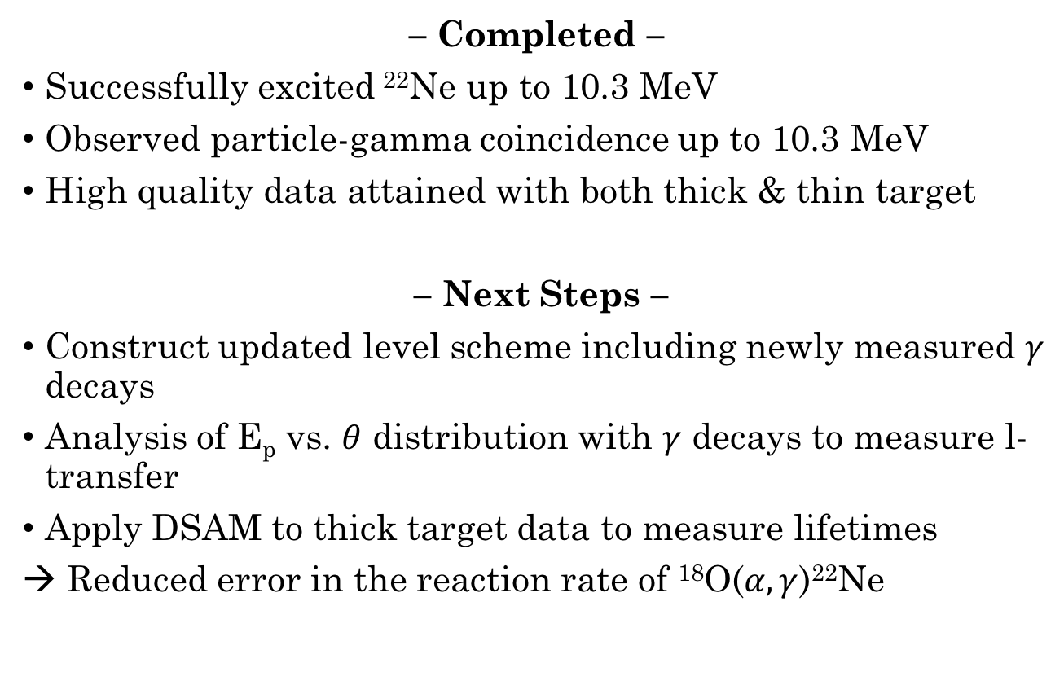
Conclusions
– Completed –
Successfully excited ²²Ne up to 10.3 MeV
Observed particle-gamma coincidence up to 10.3 MeV
High quality data attained with both thick & thin target
– Next Steps –
Construct updated level scheme including newly measured $γ$ decays
Analysis of E_{p} vs. $θ$ distribution with $γ$ decays to measure l-transfer
Apply DSAM to thick target data to measure lifetimes
→ Reduced error in the reaction rate of ¹⁸O($α,γ$)²²Ne

Slide 13

Acknowledgements
University of Guelph – Dennis Mücher, Christina Burbadge, Joseph Turko, Andrew Maclean, Devin Hymers, Tomer Rockman, Eva Kasanda, Carl Svensson
TRIUMF – Stephen Gillespie, Guy Stoppi, Soumendu Bhattacharjee, Adam Garnsworthy, Bruno Olaizola, Greg Hackman, Daniel Levy
University of Toronto – Tom Drake
Simon Fraser University – Krzysztof Starosta
Thank you for listening!

Slide 14






Reducing Feeding:
Gating on E_{exc}
10050 keV
9850 keV
$$τ_{\left(2+,3−\right)}$$
9045 keV
$$τ_{\left(2+\right)}$$
7921 keV
6819 keV
$$τ_{2+}$$
$$τ_{2+}$$
$$τ_{2+}$$
5363 keV
4456 keV
3357 keV
$$τ_{2+}$$
$$τ_{2+}$$
$$τ_{2+}$$
$$τ_{2+}$$
3182 keV
1274 keV
Notes:
Now we want to find lifetimes.

Slide 15
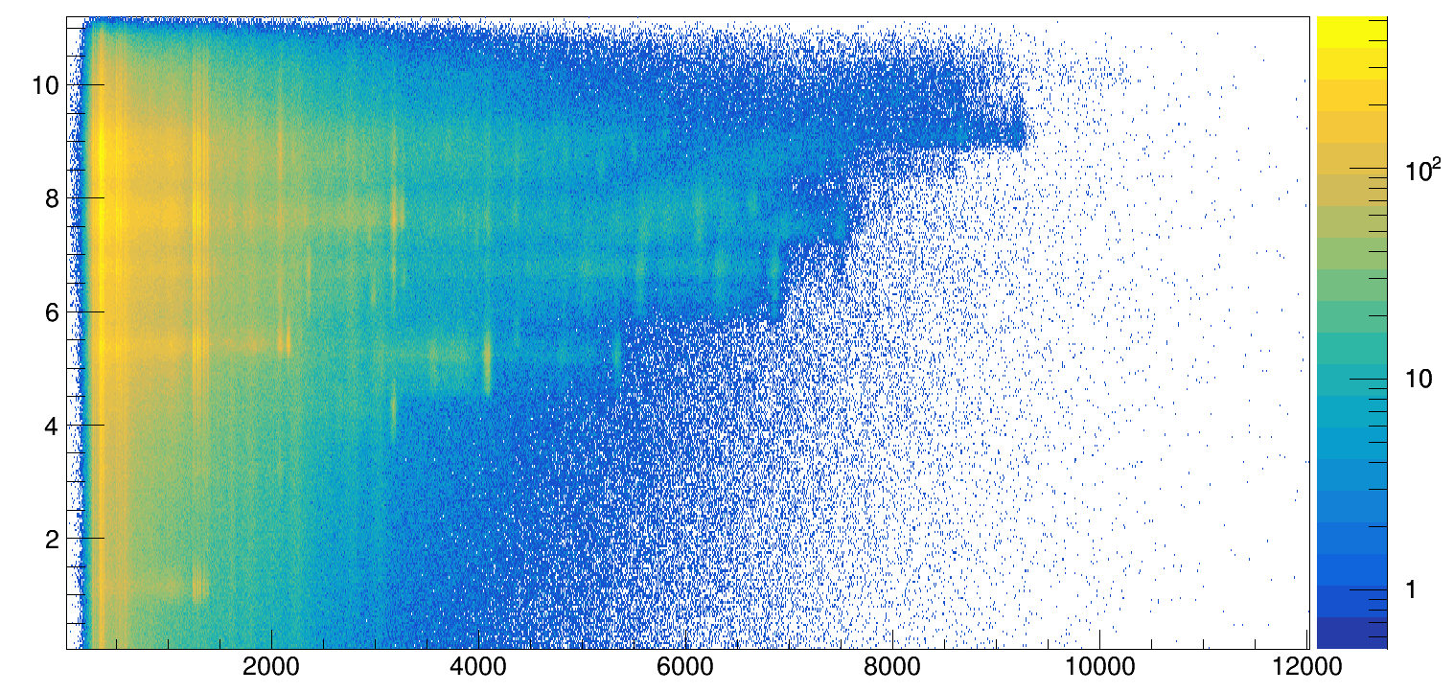
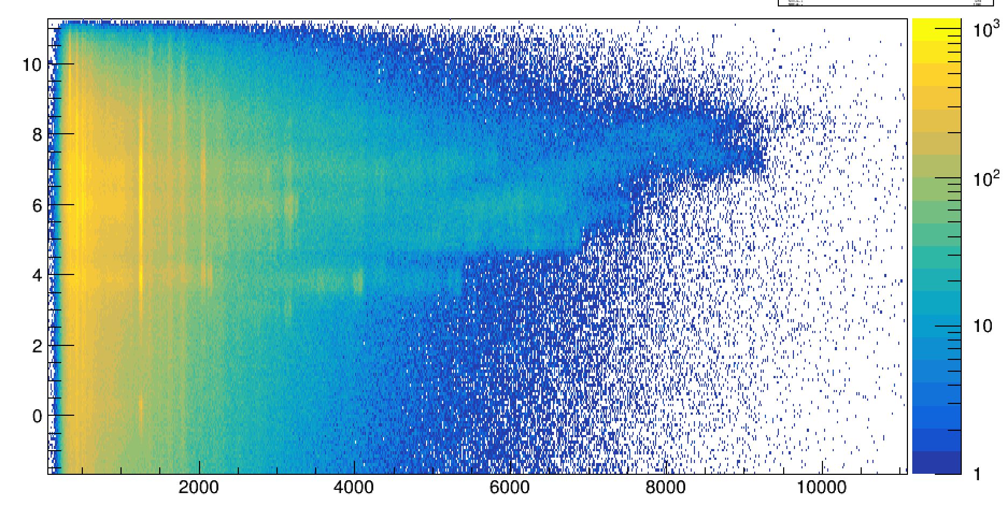


Thick vs. Thin
Excitation Data
Thick
Target
$E_{exc}$
(MeV)
$E_{exc}$
(MeV)
Thin
Target
$E_{γ}$ (keV)
Notes:
Thick vs thin,
clear differences
worth noting less spread in thick due to stopping in target
thin does not have proper doppler calibration

Slide 16
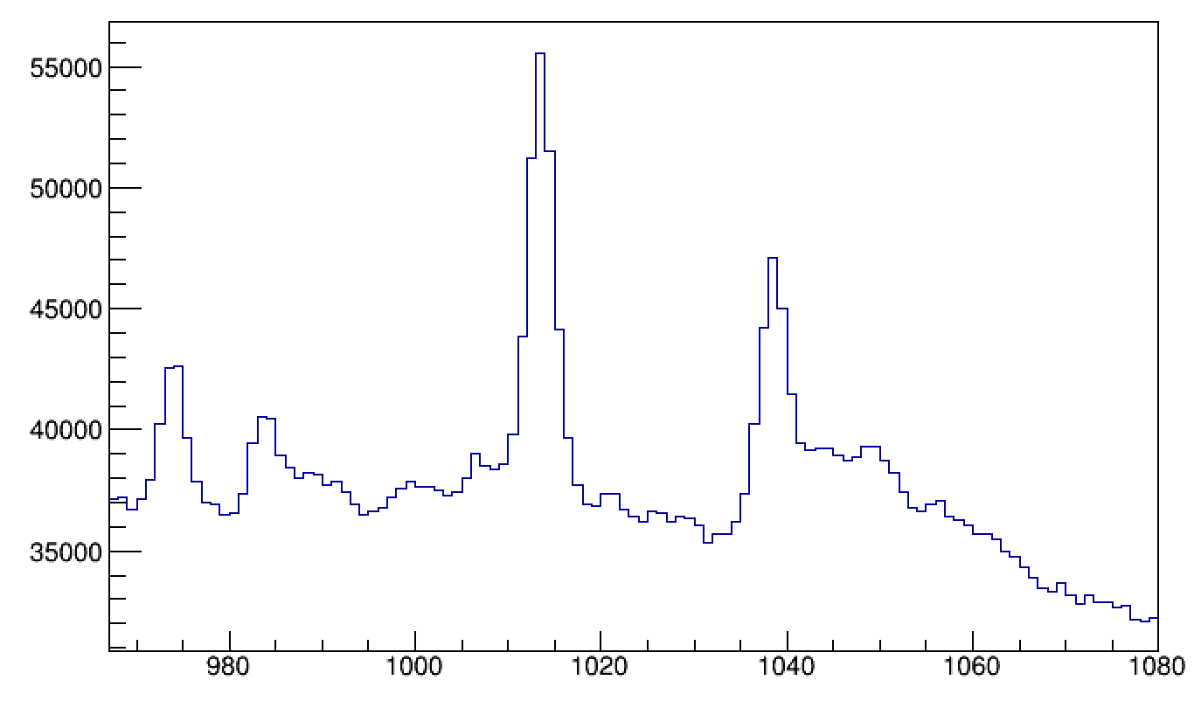

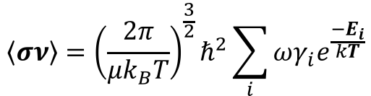
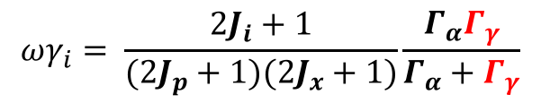

Application of DSAM
DSAM – Doppler Shift Attenuation Method
Determine lifetime through line-shape analysis in data alongside simulations
Able to gate on excitation energy using ejectile to avoid feeding
Stopped component
$$\left\langle σν\right\rangle ={\left(\frac{2π}{μk_{B}T}\right)}^{\frac{3}{2}}ℏ^{2}\sum_{i}{ωγ_{i}e^{\frac{{−E}_{i}}{kT}}}$$
$$ωγ_{i}= \frac{2J_{i}+1}{({2J}_{p}+1)(2J_{x}+1)}\frac{Γ_{α}Γ_{γ}}{Γ_{α}+Γ_{γ}}$$
Decelerating nuclei
$=g\left(1−B_{α}\right)B_{α}\frac{ℏ}{τ}$
$E_{γ}$ (keV)
Notes:
Continuing with the thick target
photons emitted by in flight nuclei
using backed target of known material
-->simulate stopping power
with initial beam energy, use angular dependent doppler shift to determine how fast particle travelled during decay
-->when it decayed in target
F(t) – doppler attenuation factor

Slide 17
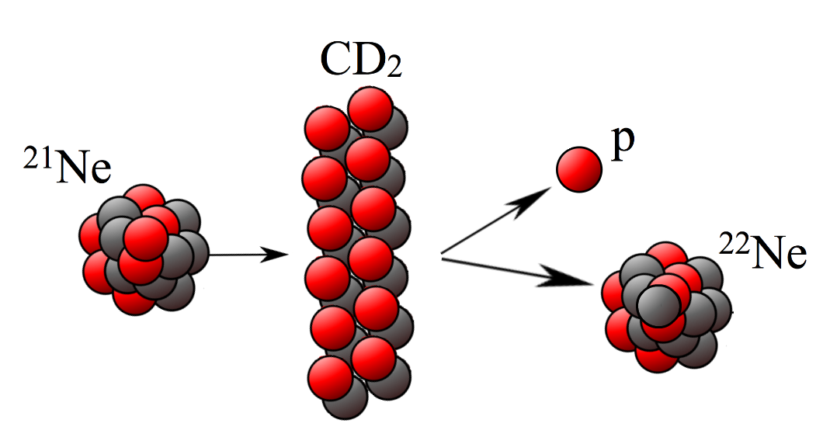
Method
Gamma Spectroscopy on Transfer Reaction
– 2 Methods –
High Energy Beam with Thin CD₂ target
  High proton energy precision
  Measure spectroscopic factors
  Confirm resonances and determine exact location using gamma spectroscopy
Lower Energy Beam with Thick Backed CD₂ Target
  DSAM to measure lifetimes
Notes:
Able to measure gamma + ejectile
take advantage of p res for particle angular distribution + g-g correlation
Low beam allows confirmation of that which we see with high beam
High energy: 165 MeV (7.89 MeV/u)
Low energy: 100 MeV (4.79 MeV/u)
Intensity: 5e+8 pps

Slide 18


