Slide 1



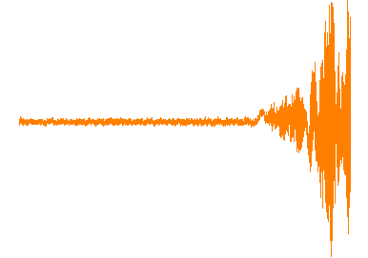
Simulations for PICO-40L Radioactive Source Calibration
Gevy Cao, Supervisor: Tony Noble
Queen’s University
February 16, 2018

Slide 2
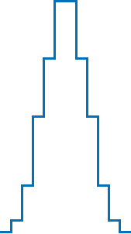
PICO Detectors
1
©SNOLAB http://snolab.ca/sites/default/files/PICO60Run2-2.png
©Fermilab http://astro.fnal.gov/wp-content/uploads/2014/07/coupp_image4kg.png

Slide 3
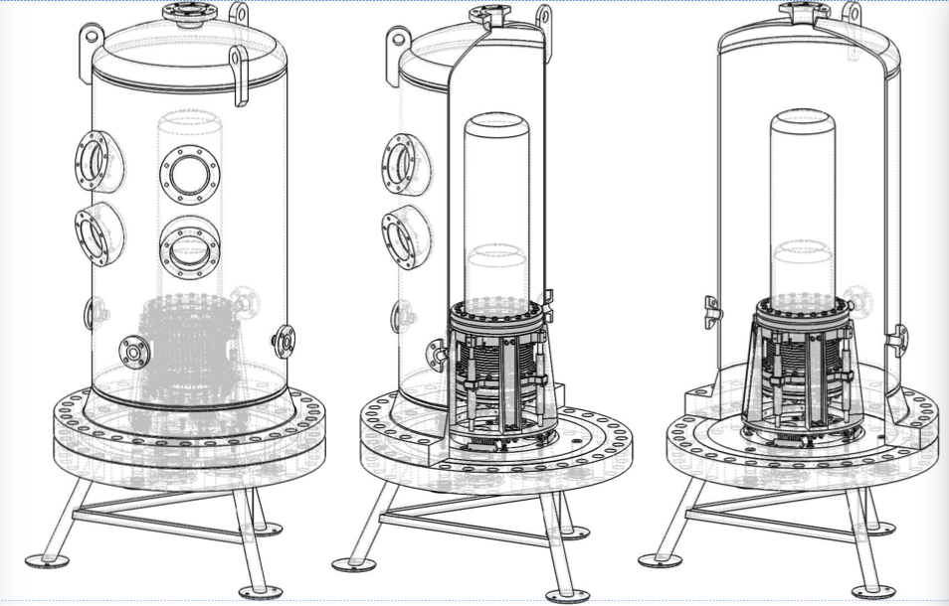
PICO-40L VS PICO 60
7.3’’
82’’
36’’
24’’
2
© Mike Crisler

Slide 4
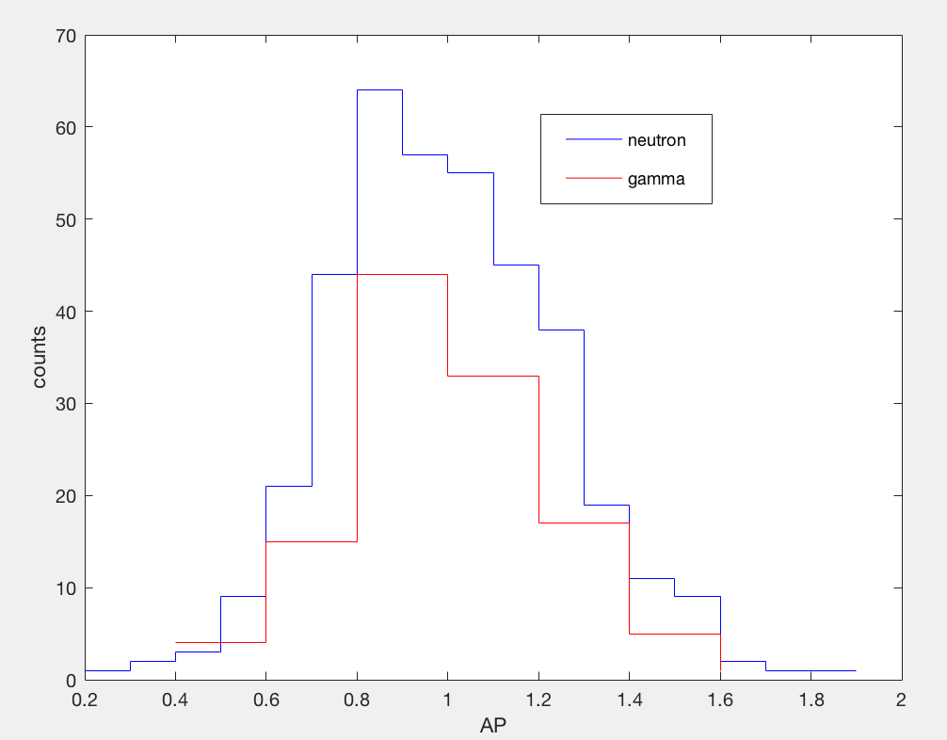

Calibration Sources
Calibration Sources:
  Neutron (AmBe-241, Cf-252)
  Gamma (Ba-133, Co-60)
WATER
ACOUSTIC
TRANSDUCER
C3F8
VIDEO CAMERA
ΔE
HYDRAULIC
FLUID
WIMP, neutron
FAST COMPRESSION
3
©Guillaume Giroux

Slide 5
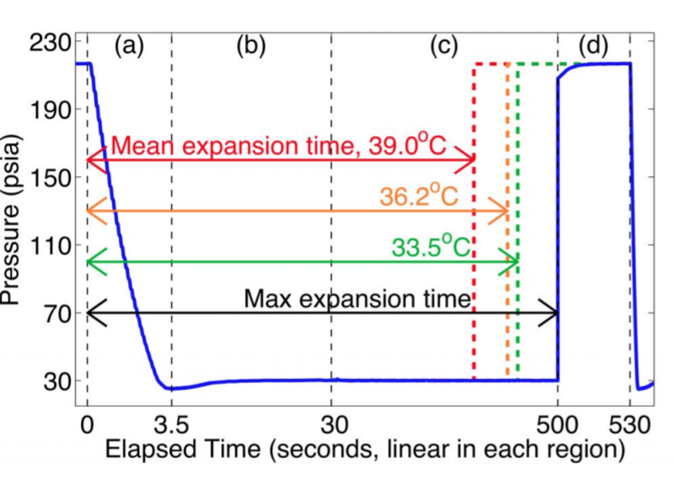
PICO-40L Calibration
Simulate the position of the sources such that the desired event rate meets:
At least 200 events/week
Allow 100s expansion time –> 75% livetime
©Mike Crisler
4

Slide 6
PICO-40L Calibration
GEANT4 Simulations:
Inputs:
- Source type (n or ɣ)
Source Position
Source particle energy distribution
Number of events
…
Outputs:
Interaction atom (Carbon/Fluorine/e+/e-/ ɣ)
Energy deposited
Position of the interaction
Tracking ID
Initial energy of the particle
5

Slide 7
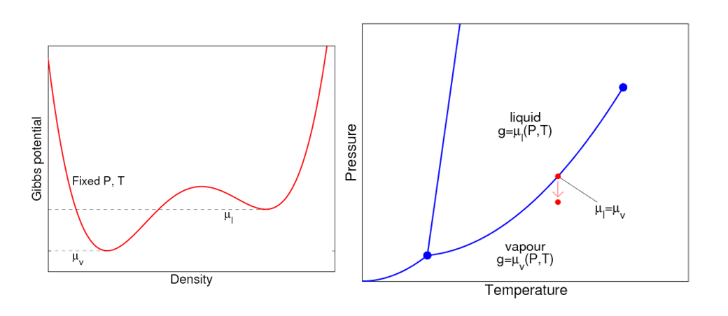
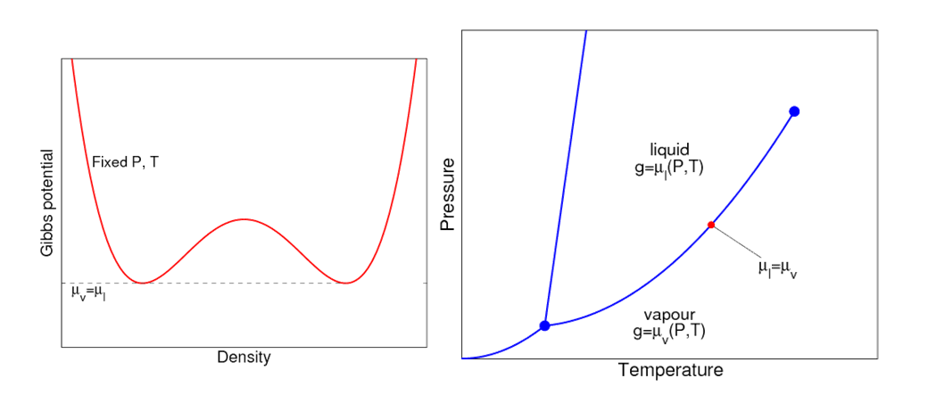
PICO-40L Calibration
Gibbs potential
Phase diagram
ΔE
6

Slide 8
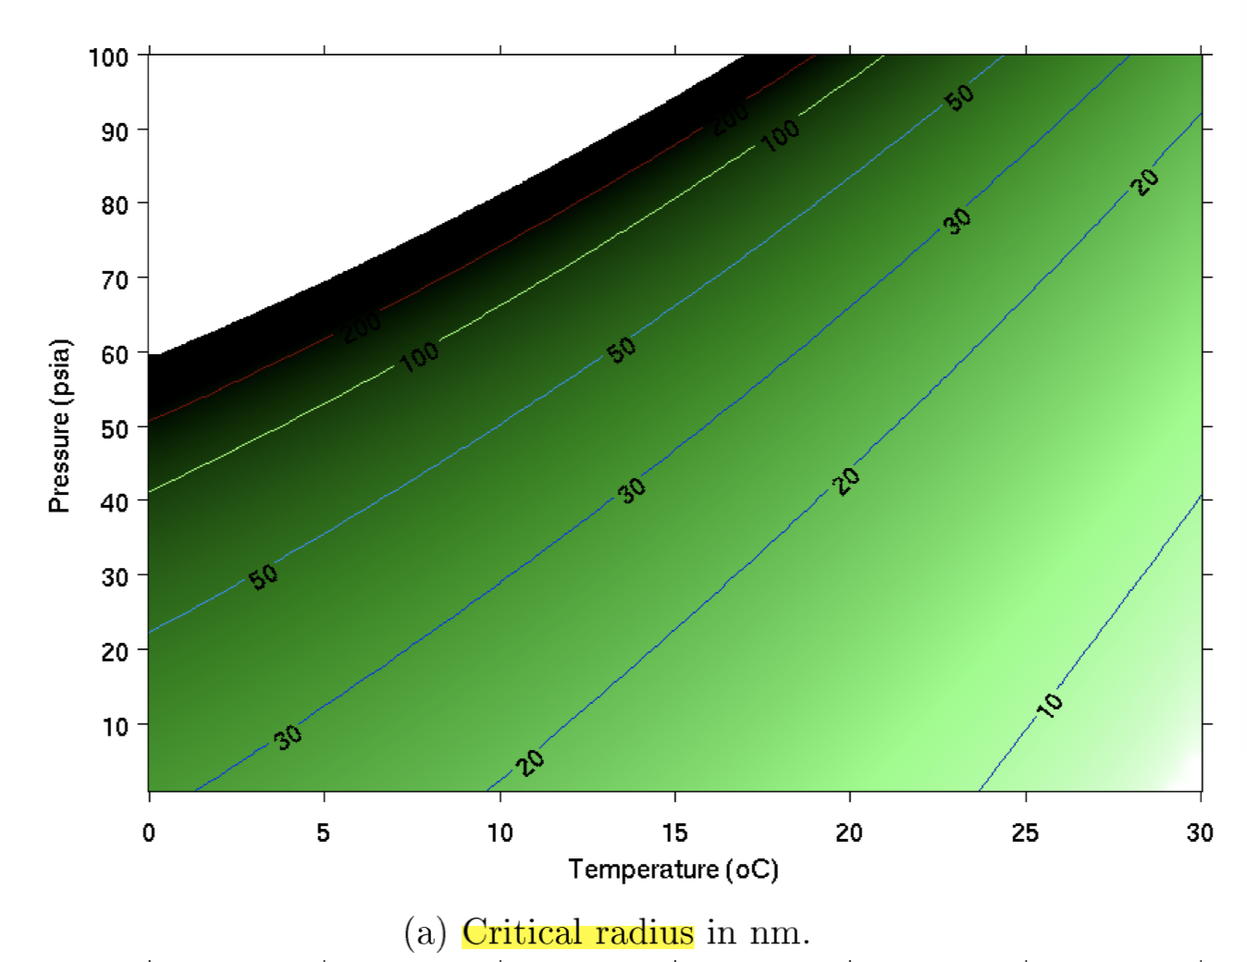
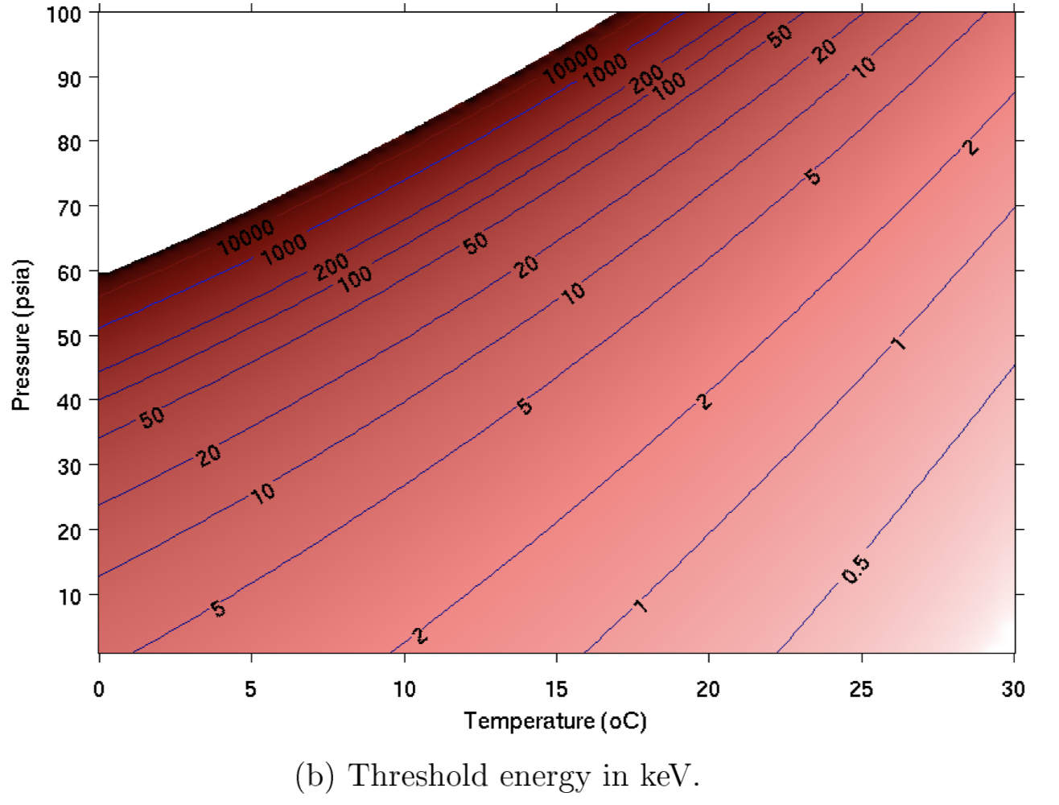
Detector Threshold
- Detector threshold: ~3keV within 48 nm at 30psi and 14 ℃
©Alan Robinson
7

Slide 9
Event Flux
Q: Does the energy deposited by X particle exceed the energy threshold, and is the radius of deposition smaller than the critical radius?
8

Slide 10
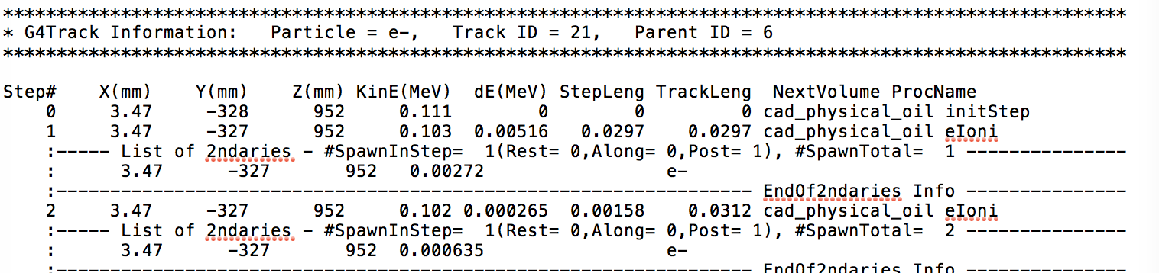
Parsing Track Length
In mm
9

Slide 11
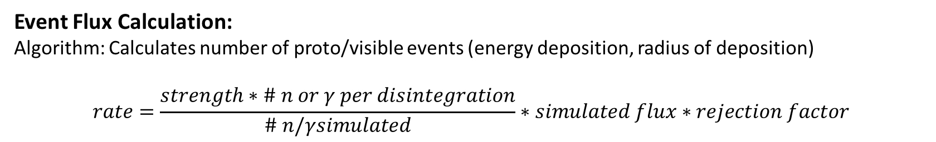
Event Flux
Q: Does the energy deposited by X particle exceed the energy threshold, and is the radius of deposition smaller than the critical radius?
Event Flux Calculation:
Algorithm: Calculates number of proto/visible events (energy deposition, radius of deposition)
$$rate=\frac{strength∗\# n or γ per disintegration}{\# n/γsimulated}∗simulated flux∗rejection factor$$
10

Slide 12
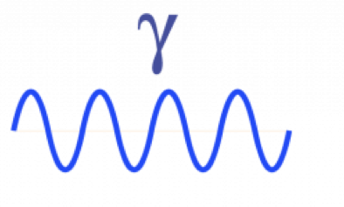

Nature of the Interactions
C/F
C/F
n
e⁻
C/F
C/F
~10nm,~100keV
e$−$
~100 μm , ~1 keV
11

Slide 13
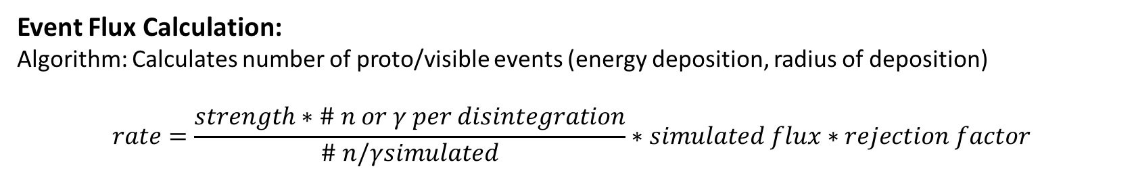
Event Flux
Q: Does the energy deposited by X particle exceed the energy threshold, and is the radius of deposition smaller than the critical radius?
Event Flux Calculation:
Algorithm: Calculates number of proto/visible events (energy deposition, radius of deposition)
$$rate=\frac{strength∗\# n or γ per disintegration}{\# n/γsimulated}∗simulated flux∗rejection factor$$
12

Slide 14
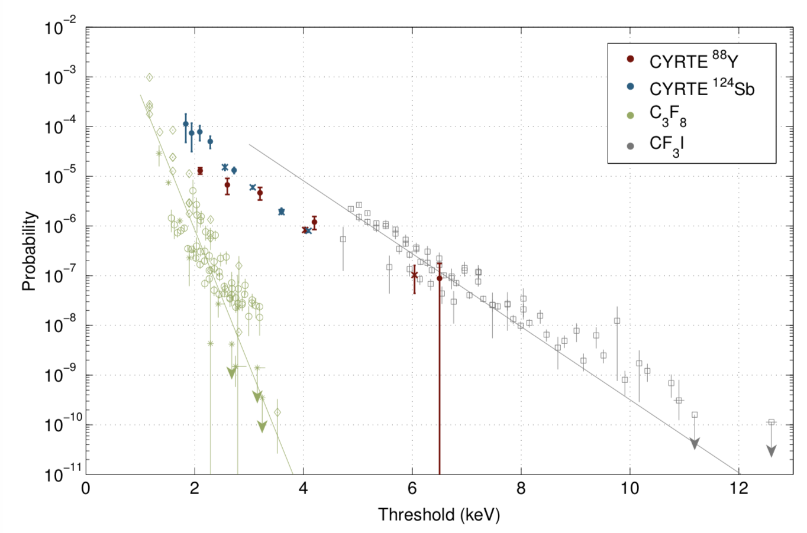
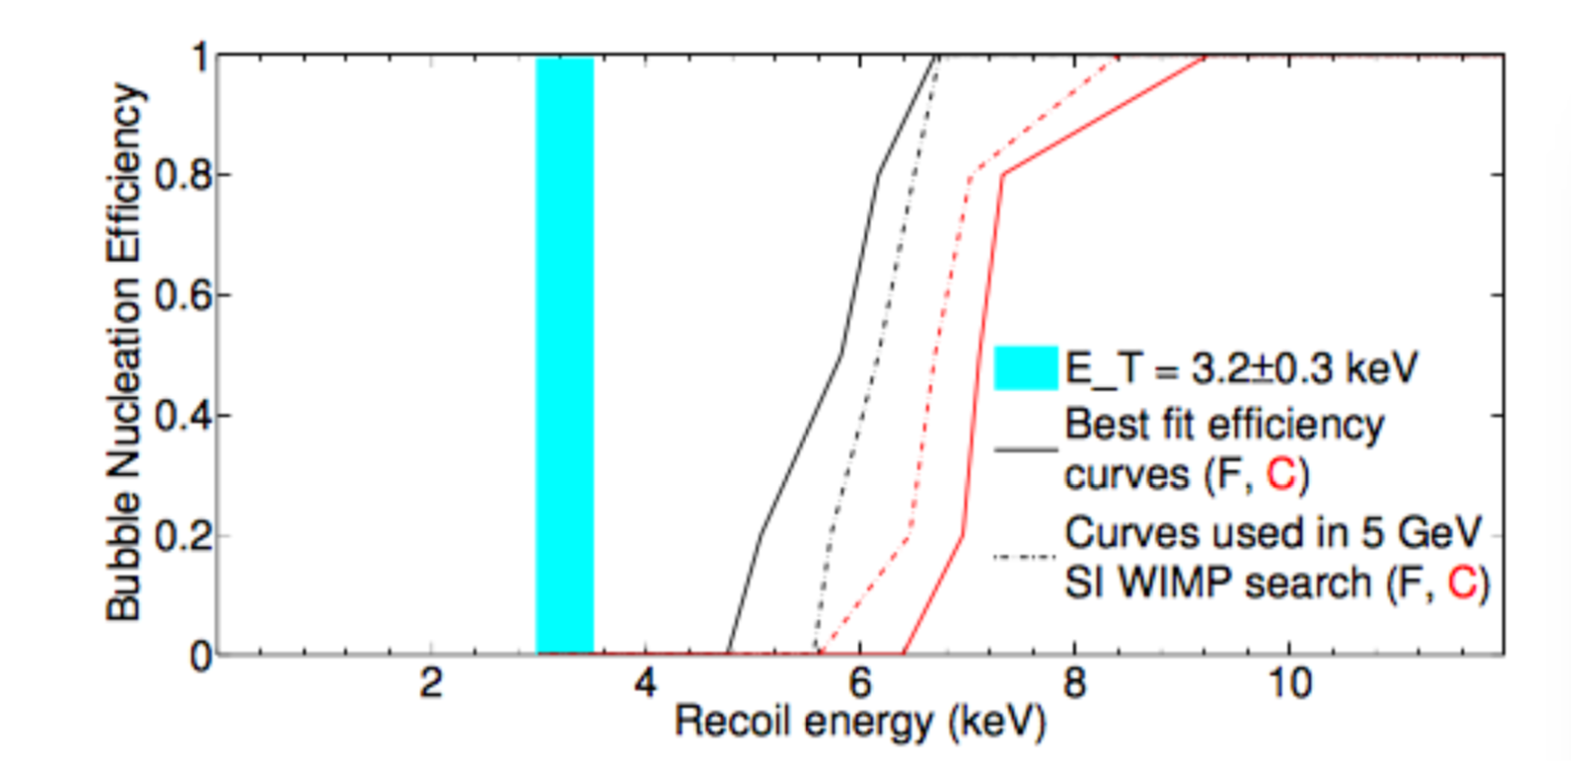
Nucleation Efficiencies
Gamma Efficiency
Neutron Efficiency
©Chanpreet Amole
©Alan Robinson
13

Slide 15
Alternative?
$$rate=\frac{strength∗\# n or γ per disintegration}{\# n/γsimulated}∗simulated flux∗rejection factor$$
Rejection Factor:
PICO 60: 1.80x10⁻¹⁰±3.8x10⁻¹¹
PICO 2L: 2.2x10⁻¹¹ ±1.2x10⁻¹¹
14

Slide 16
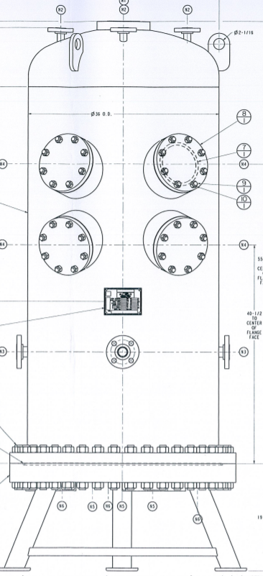
For gamma sources
Results & Conclusion
Successful calibration if:
Neutron sources placed at least 20cm away from the Pressure Vessel
Gamma sources placed inside the PV, 15cm away from active liquid
For neutron sources
15

Slide 17
Questions?
16

Slide 18
Results
Radioactive Sources | Position | Expected Visible Rate | Expected Expansion Time [s] | Radioactive Strength to date [bq]
AmBe-241 | 20cm outside of PV | 1/3 min | 145 | 66 neutrons/s
Cf-252 | 20cm outside of PV | 1/3.4 min | 170 | 1.67
Ba-133 | 15.24cm inside of PV | 1/3 min to 1/26min | 145 | 1.6e7
Co-60 | 15.24cm inside of PV | 1/4min to 1/30 min | 210 | 7e5

