Slide 1

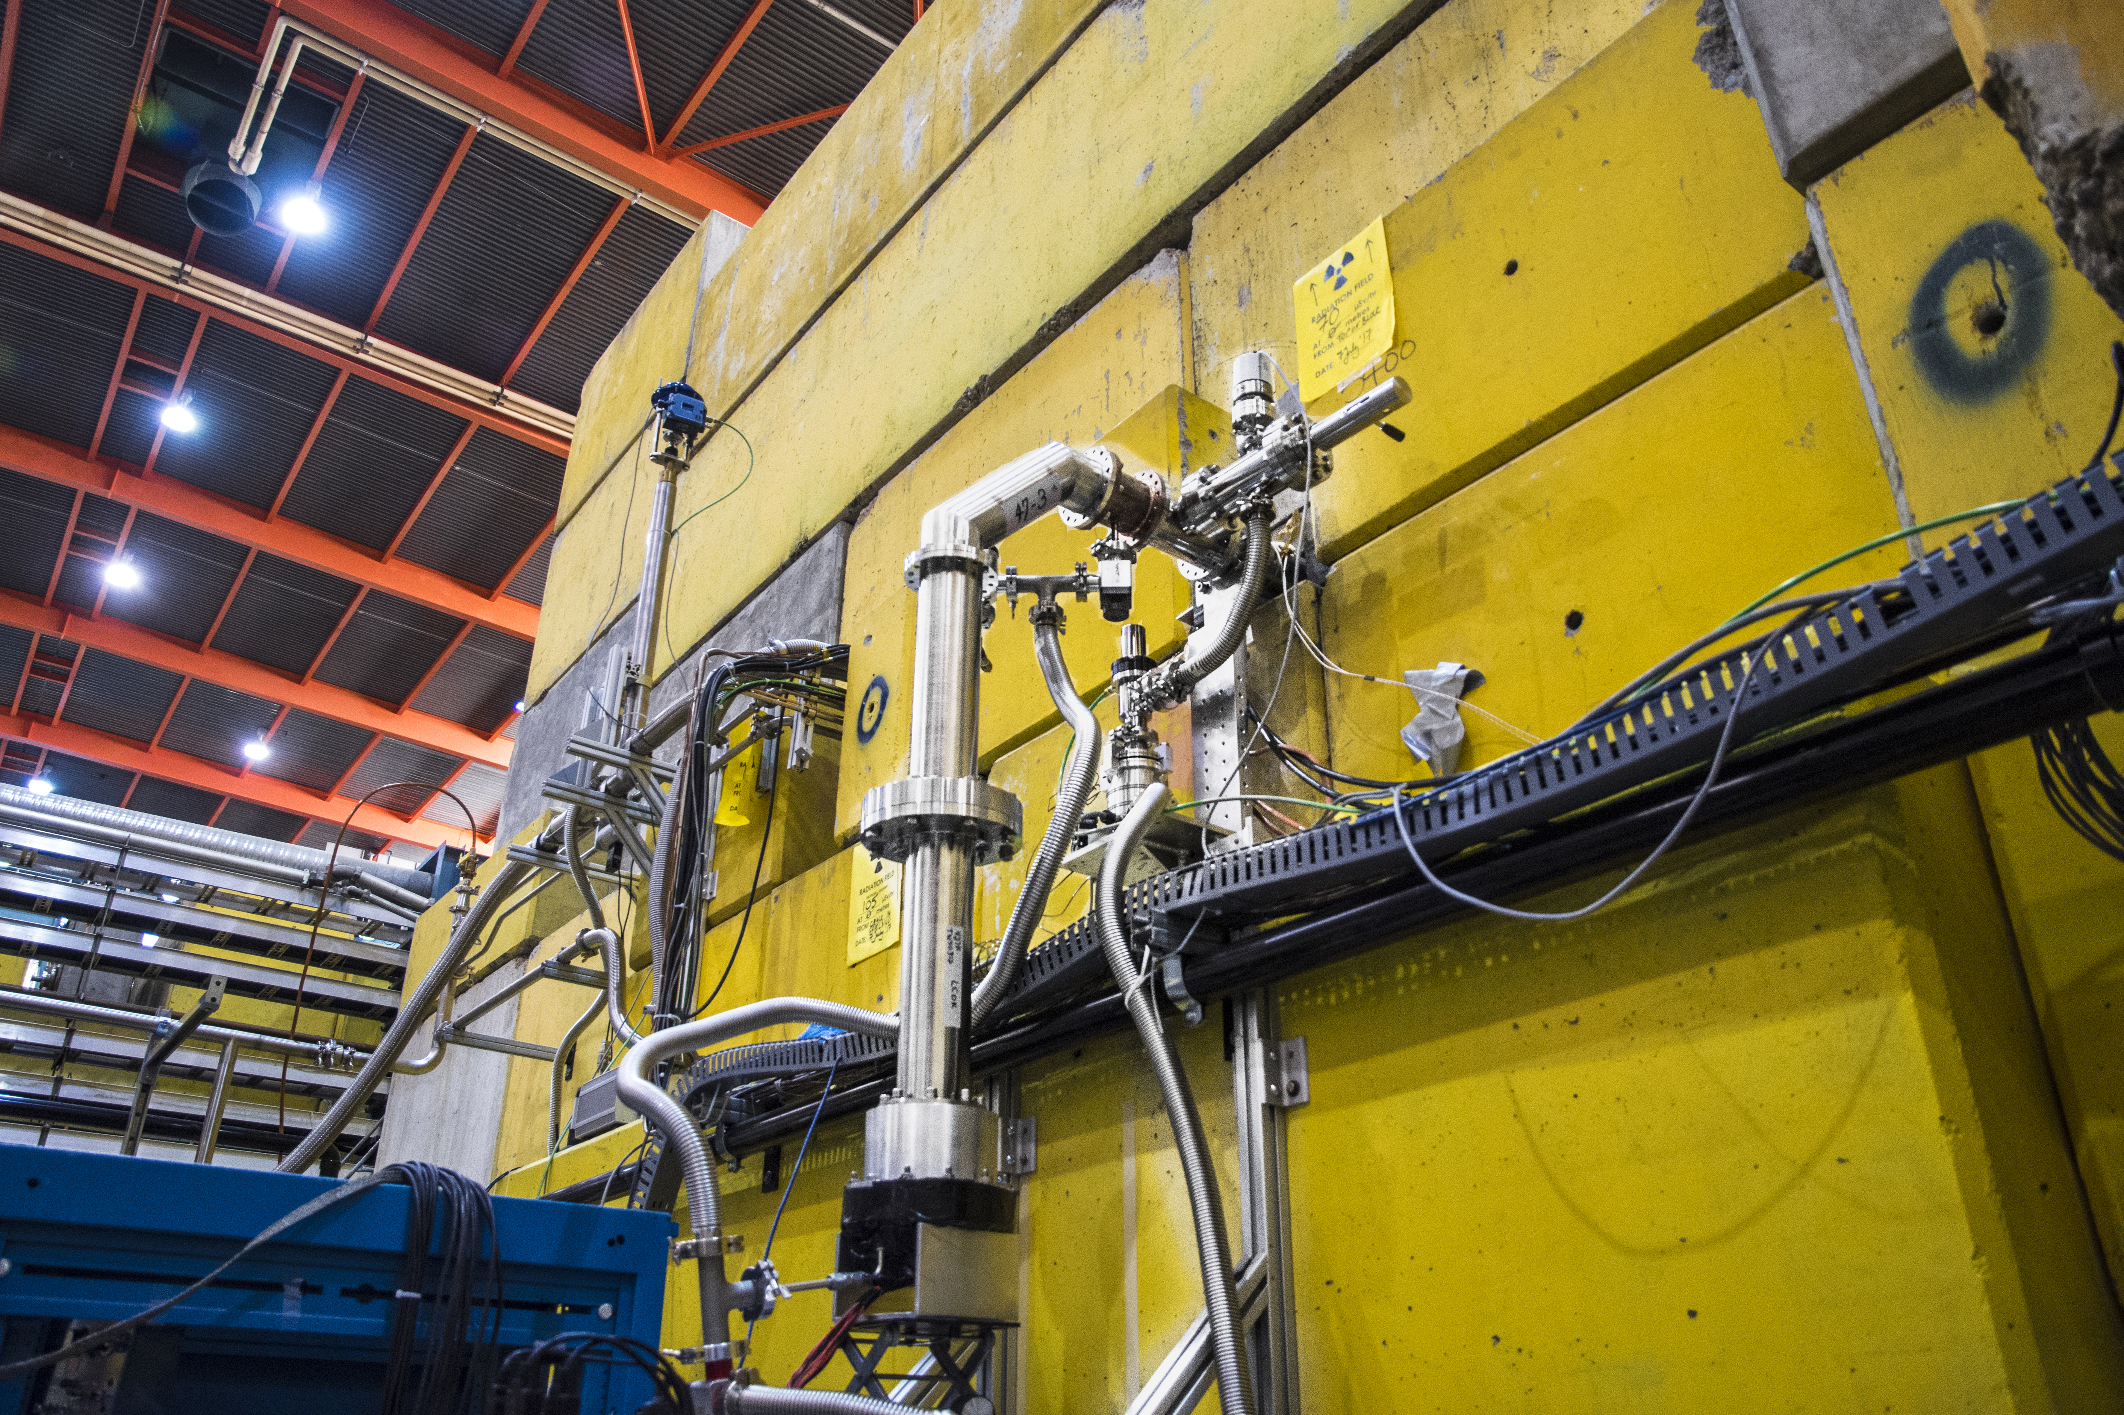
First UCN
Ruediger Picker
Research Scientist, TRIUMF
for the TUCAN collaboration
KEK-TRIUMF Symposium
Dec 14, 2017

Slide 2
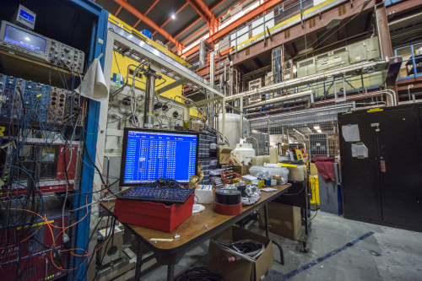
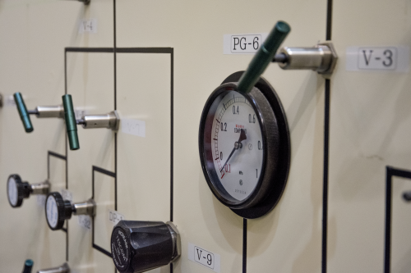
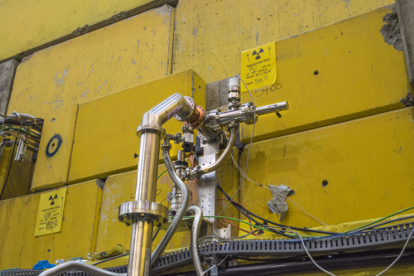
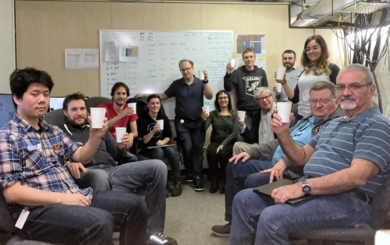
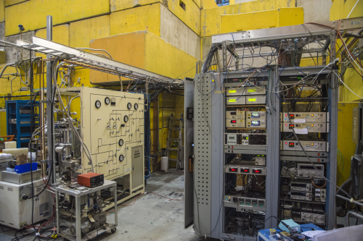
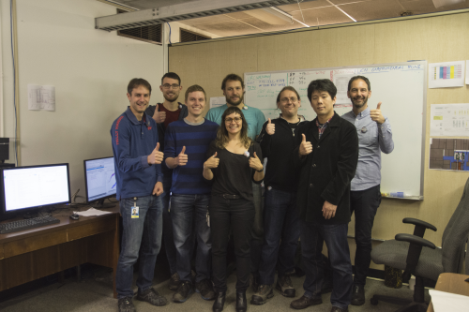
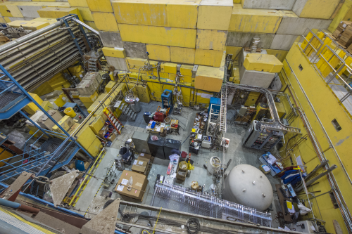
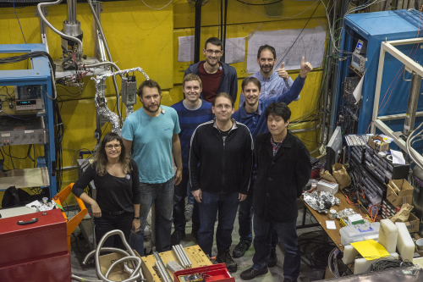
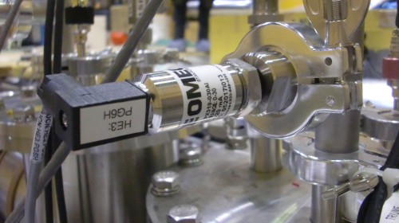
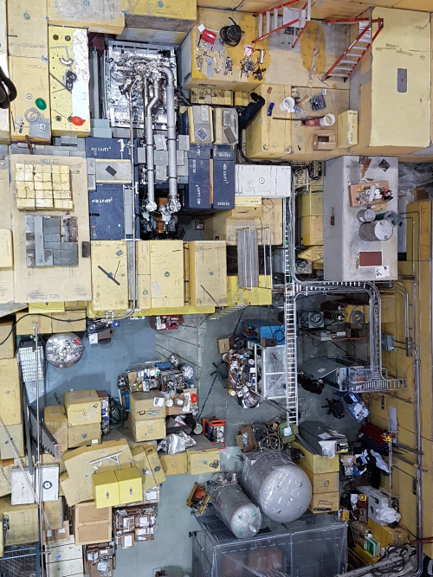
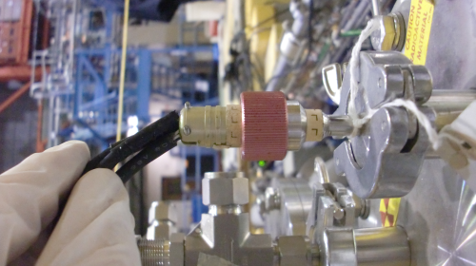
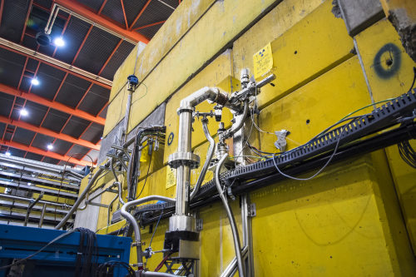
Experimental program excerpt
Produce first UCN
Understand source performance
  UCN storage lifetime measurement in source: assessment of wall quality
  Same as above for various He temperatures: what temp. is ideal?
  Repeat 2a) daily: source stability
Explore higher proton currents: production ↑, temp ↑ and lifetime ↓
Compare UCN production volume heating through heaters and proton current: benchmark of simulations
Measure properties of UCN hardware: detectors, guides etc

Slide 3
UCN source progress this summer
After installation and successful cooling test during the 2017 shutdown
Two unsuccessful cooling attempts this summer: needle valve in ³He line clogged at low temperature
Reason: probably contamination of 3He system with nitrogen or water
Mitigation:
  fixed leak in ³He pump,
  better instrumentation of cold trap
  thorough leak check of whole ³He system
  added one additional valve to isolate system better
  continued pumping to minimize contamination
lHe operation shall started Monday, Nov 6

Slide 4
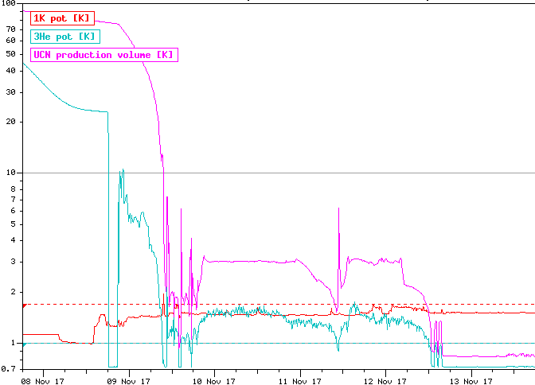
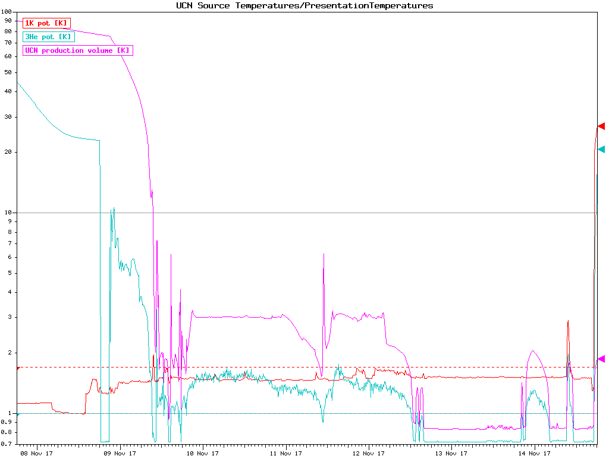
UCN source cooldown
Starting 3He pumps
Starting to fill UCN prod volume
Monday Nov 13: first UCN production at TRIUMF and in Canada!
prod volume filled
0.83K!

Slide 5
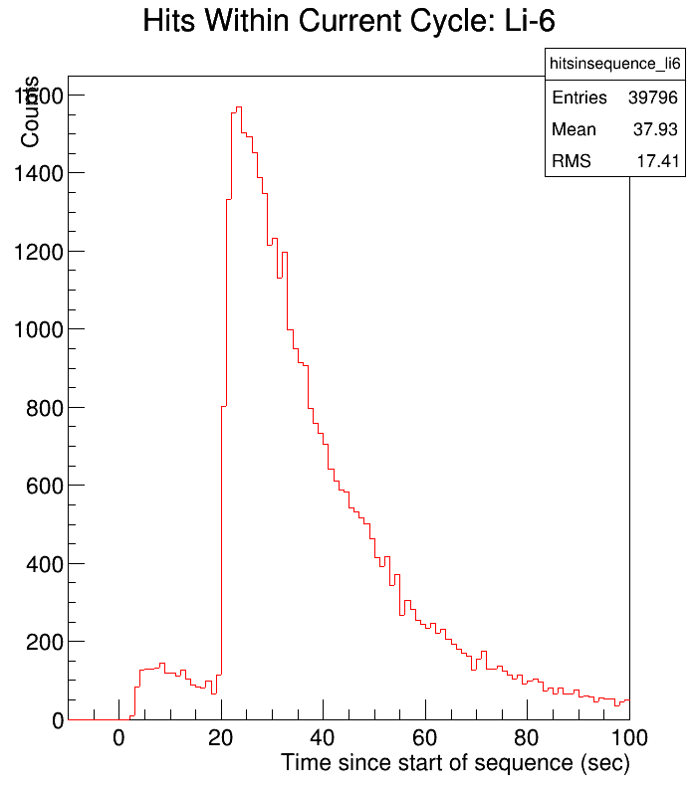
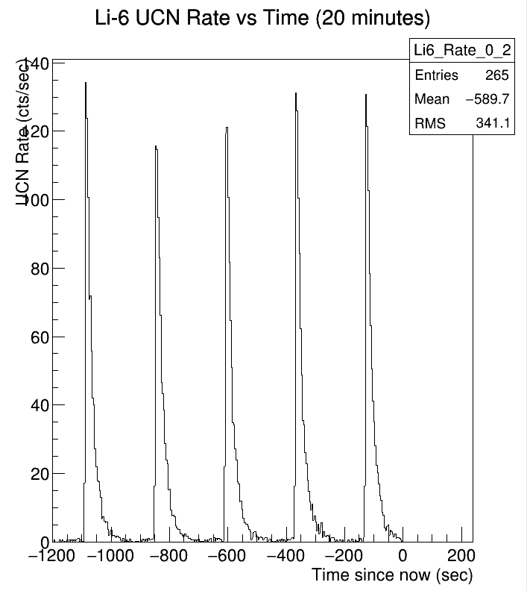
First UCN production
50 nA, 60s beam on target, with UCN valve closed
After beam on, open IV1 and detect UCN
All plots in this presentation are created from our online
displays and therefore are very preliminary!

Slide 6
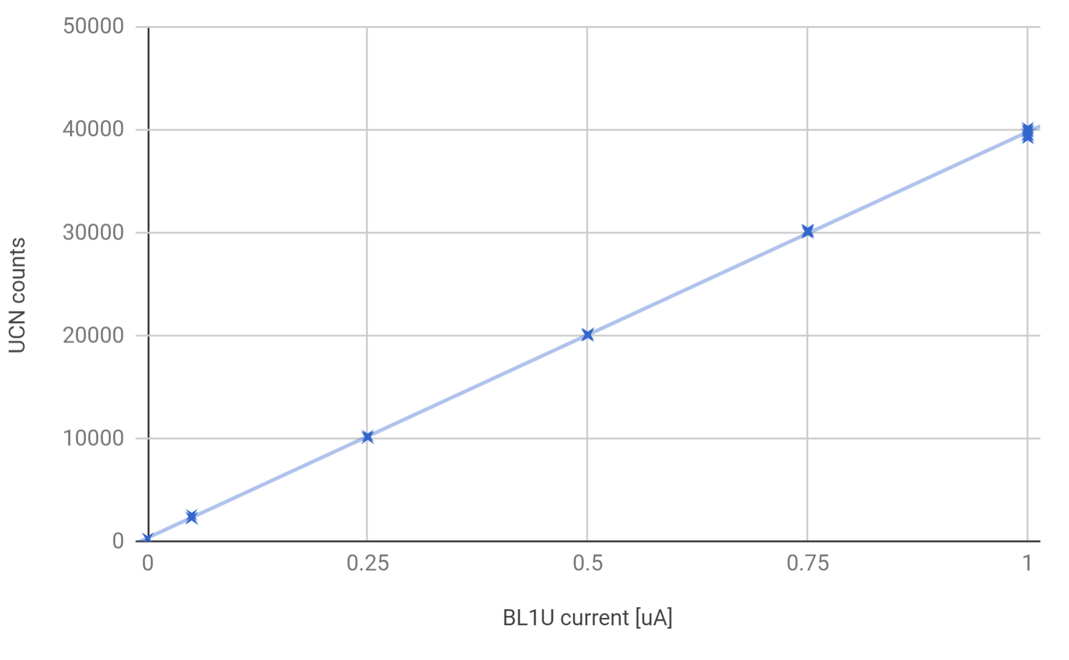
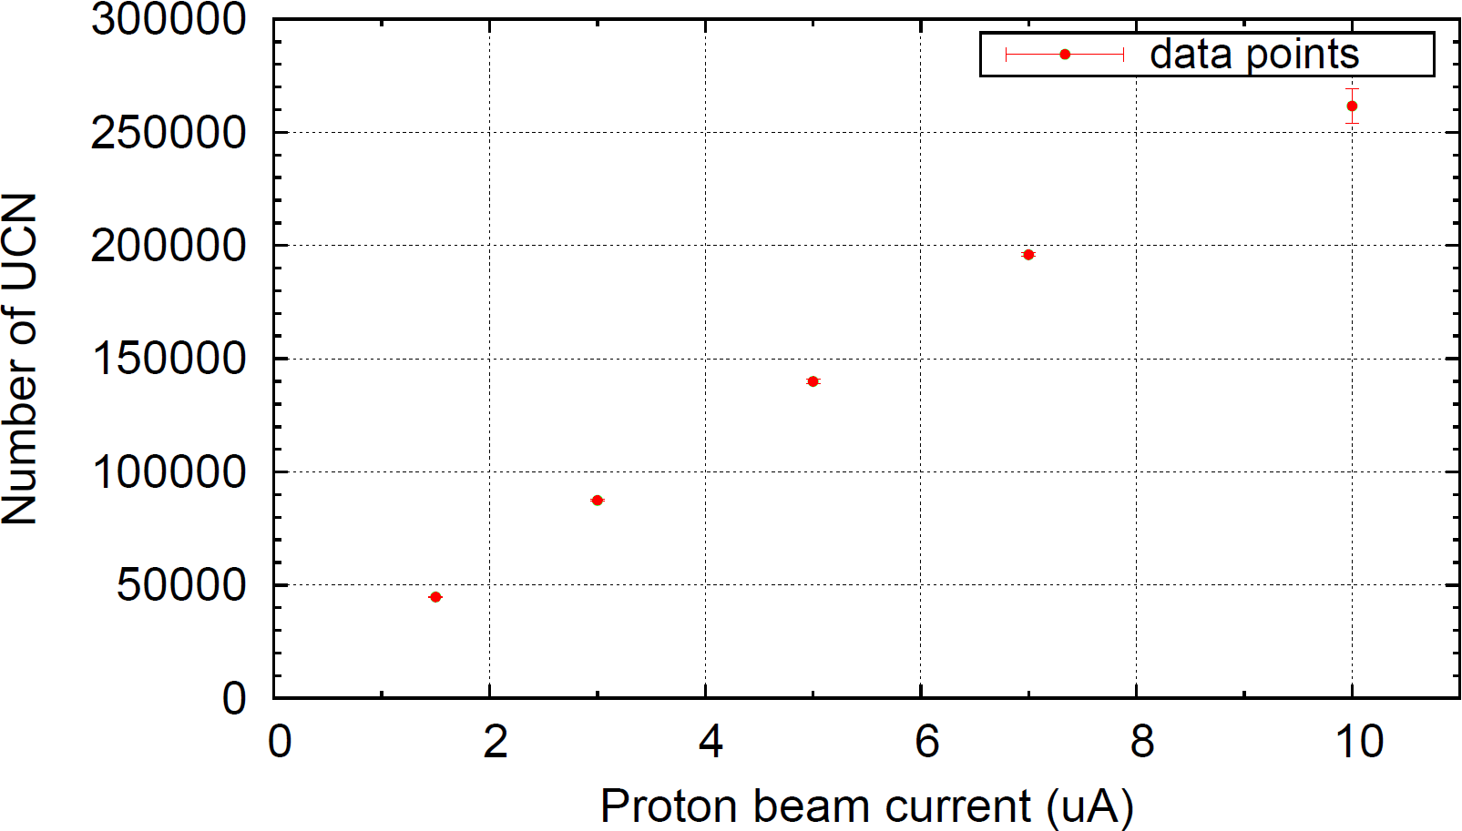
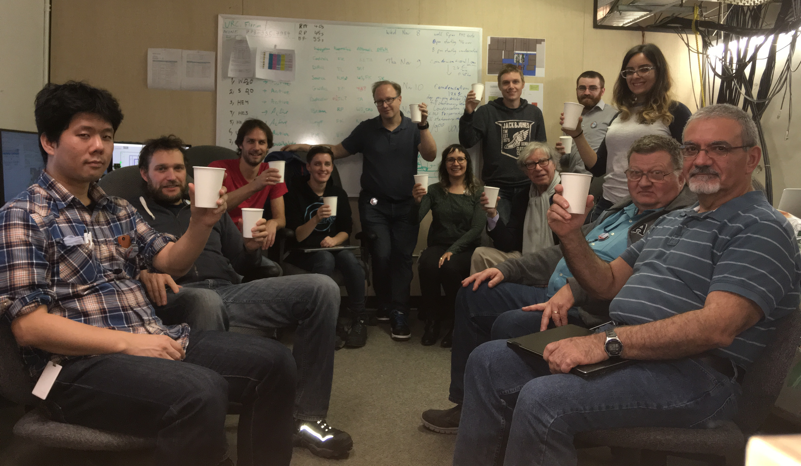
Then ramping up from 0.05uA to 1uA
Want to see linearity in beam current
Maximum UCN countrate 47000 at 1uA
✓
preliminary
RCNP best shot 80000
We have non optimized UCN valve, longer UCN guides and an aluminum foil before the detector
By far enough UCN to do our measurement program (I assumed 10000 for my estimate)
✓
✓

Slide 7
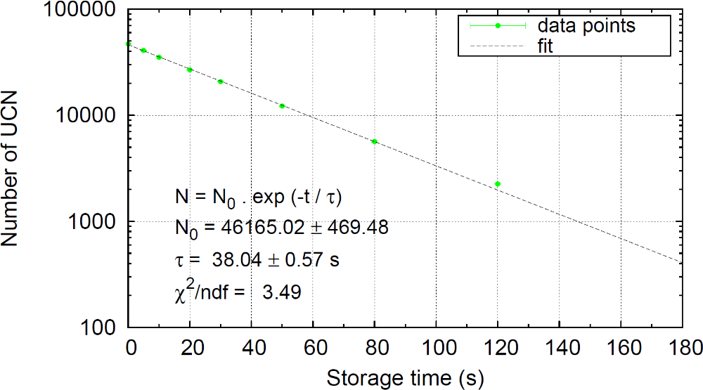
UCN storage lifetime in source
Change delay between proton beam off and UCN valve open between 0 and 170s
Result 38 s (best 80s at RCNP)
Upscattering lifetime in superfluid helium at 0.85K: 253 s
Taking this and the neutron decay lifetime into account we get a wall lifetime of 48 s
preliminary

Slide 8
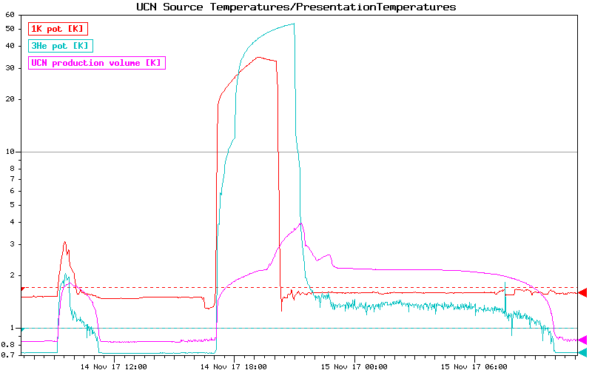
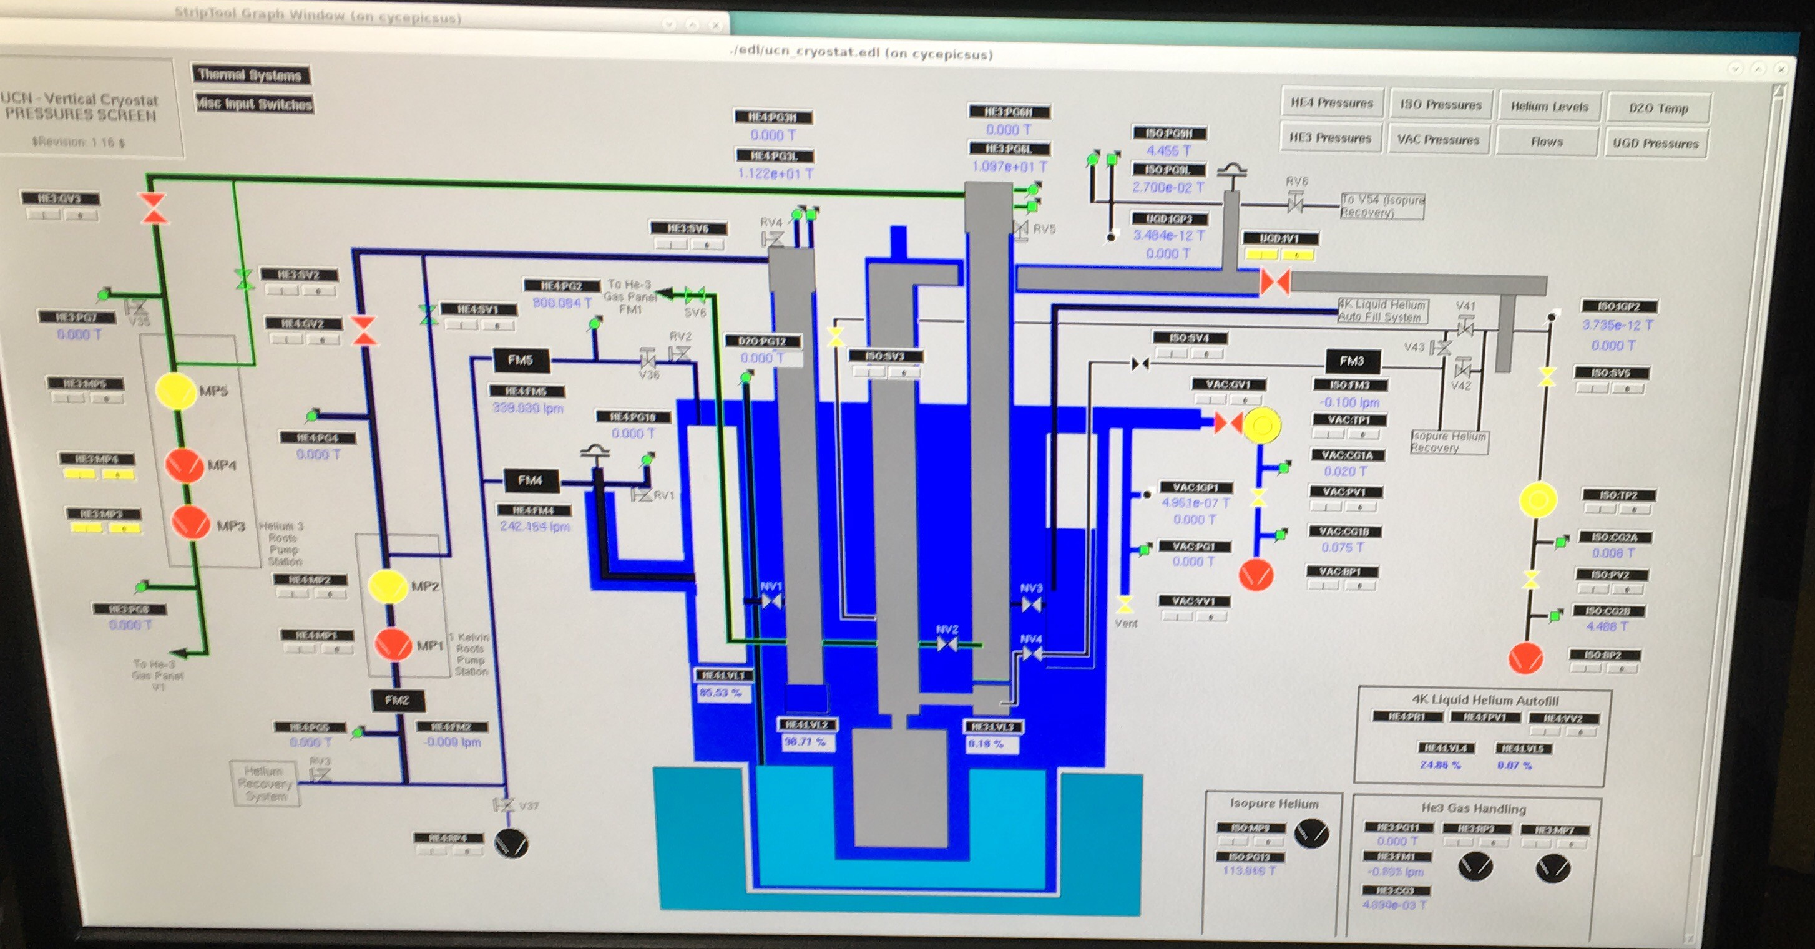
The Hangover day (aka testing emergency procedures…)
Lhe transfer clogged,
cryostat could not be filled
PLC fuse blew: stopped
pumps, closed valves
UCN storage lifetime

Slide 9
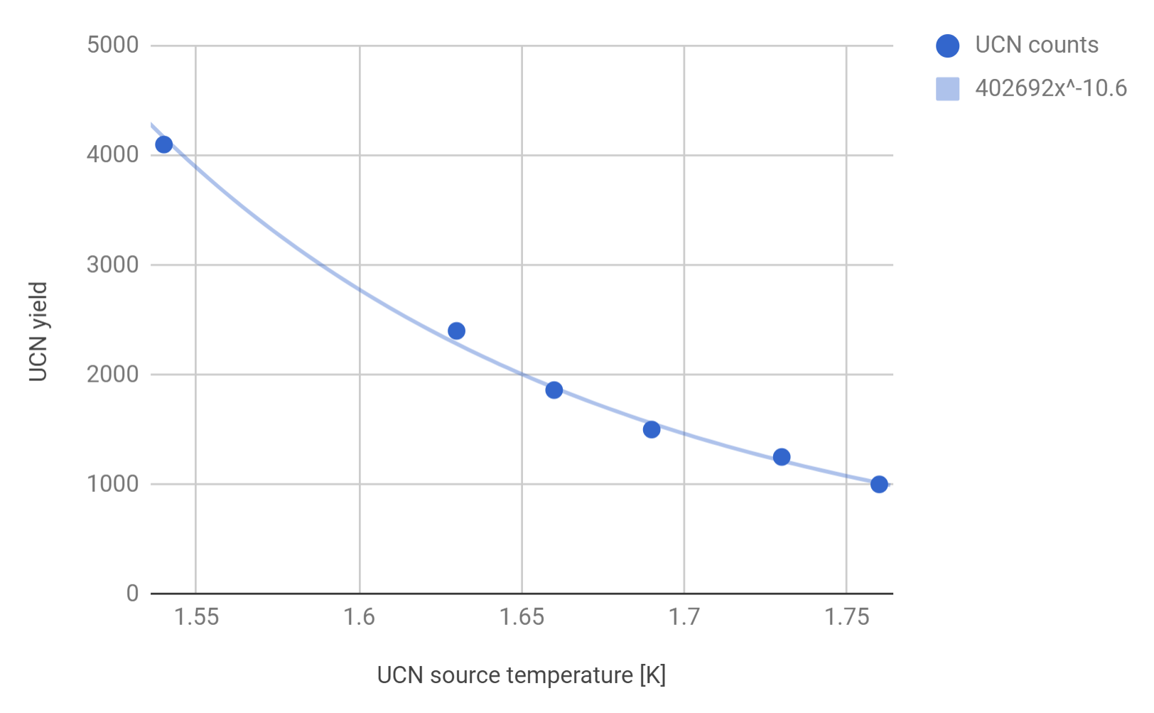
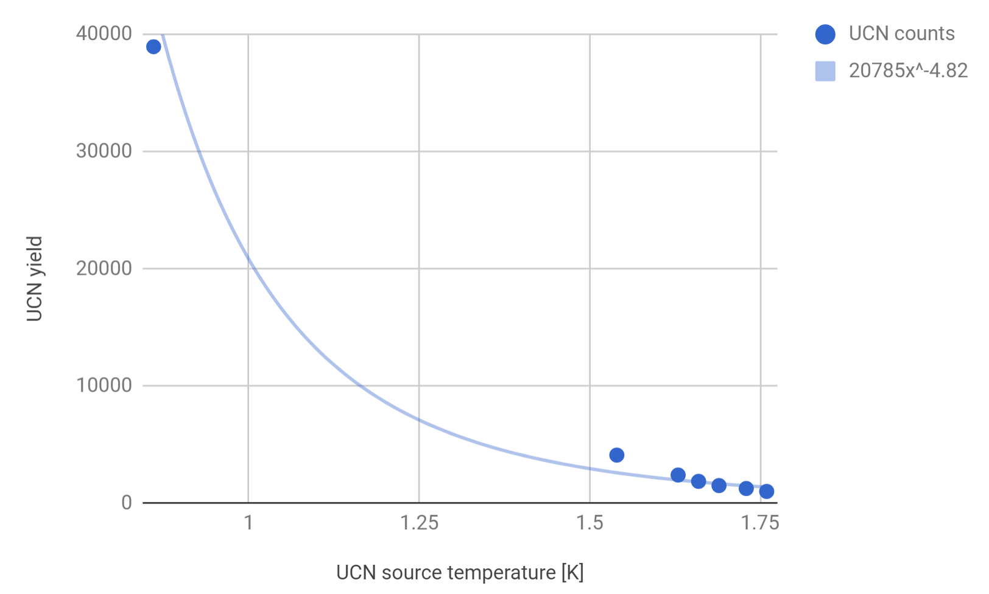
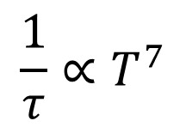
Using the warm-up: production vs temperature
preliminary
preliminary
not a good fit…
$$\frac{1}{τ}∝T^{7}$$

Slide 10
The Hangover day (aka testing emergency procedures…)
Lhe transfer clogged,
cryostat could not be filled
PLC fuse blew: stopped
pumps, closed valves
Resuming exp program
UCN storage time

Slide 11
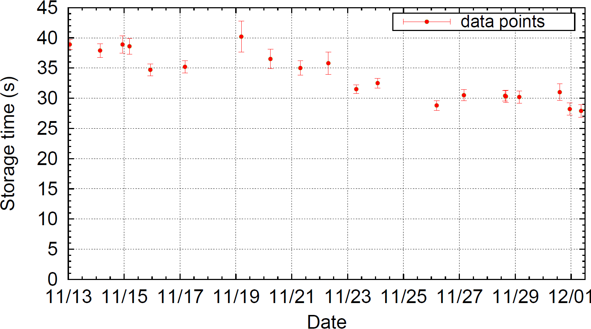
Storage lifetime evolution over 18 days of running
preliminary

Slide 12
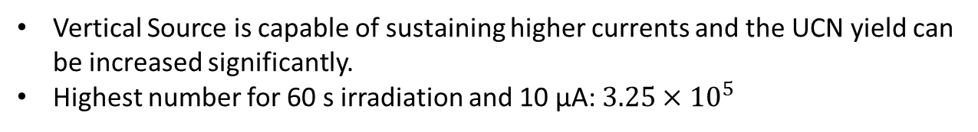
Increasing proton current up to 10 uA
30 s irradiation time
Vertical Source is capable of sustaining higher currents and the UCN yield can be increased significantly.
Highest number for 60 s irradiation and 10 µA: $3.25×{10}^{5}$

Slide 13
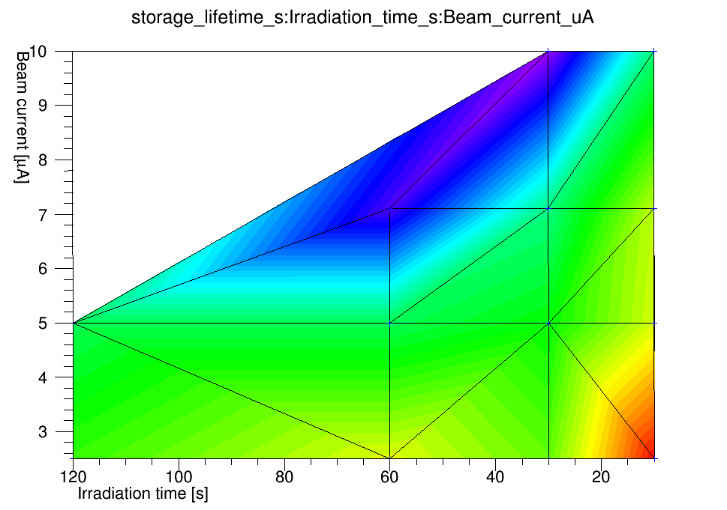
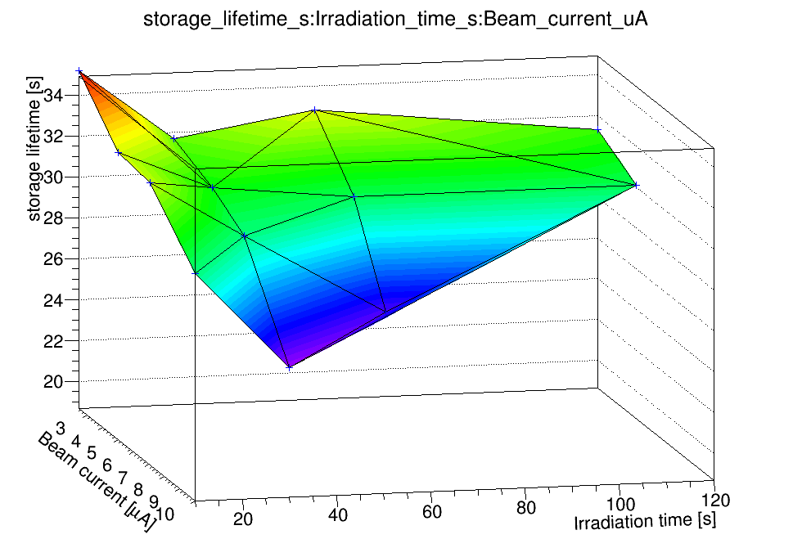
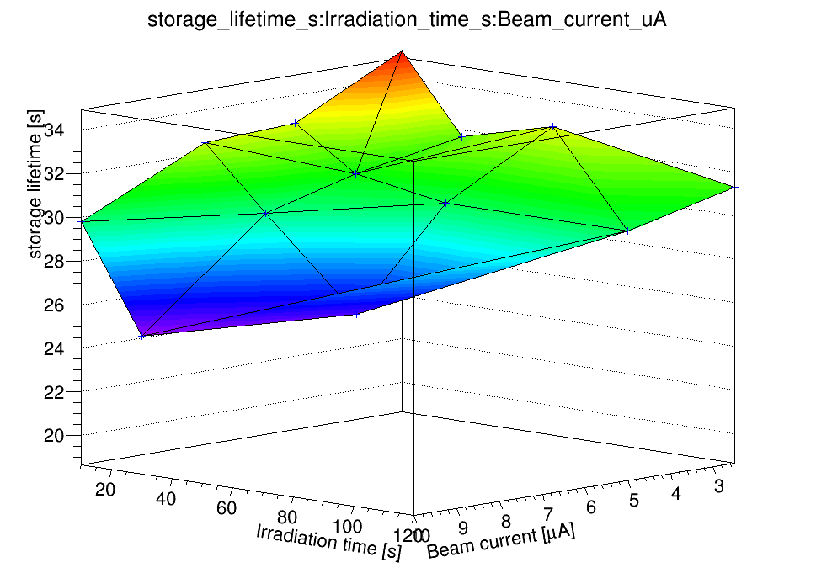
Storage lifetimes for higher currents and different irradiation times
preliminary
Lowest point 7 µA and 60 s irradiation: 25 s storage lifetime
Could not measure 10 µA above 30 s

Slide 14
Experimental program excerpt
✓
Produce first UCN
Understand source performance
  UCN storage lifetime measurement in source: assessment of wall quality
  Same as above for various He temperatures: what temp. is ideal?
  Repeat 2a) daily: source stability
Explore higher proton currents: production ↑, temp ↑ and lifetime ↓
Compare UCN production volume heating through heaters and proton current: benchmark of simulations
Measure properties of UCN hardware: detectors, guides etc
✓
Nov 20
✓
✓
Nov 17,18,19
Nov 20
✓
✓
Nov 24-Dec 1

Slide 15
What we could not do…
Dec 1: 2h power outage at TRIUMF
IOC/PLC communication could only be restored on Dec 2 evening
The cryostat was too warm to resume operation before the end of the beam time Dec 4
We could not
  Take baseline data for the transmission of two UCN parts (rotary valve and the 90 degree bend)
  Remove the Al foil in front of the ⁶Li detector
  Spoil the UCN production volume on purpose with Ni or H2O to determine its effect on the neutron storage lifetime

Slide 16
Experimental program continuation
new valves, switches (UCN source valve, Y switch, detector switch and EDM cell plug)
storage lifetime measurements of UCN hardware
polarizer (SC?), analyzer
storage in EDM cell
Ramsey cycles
What is the priority of these? Relevance for new source?
I suggest to prioritize the new UCN source in the next 6 months and plan no cooldown and run during schedule 134 (May to September)

Slide 17
Conclusion
We are very happy that we have achieved the milestone of UCN production at TRIUMF!
This was only possible because of an amazing group effort. Thanks to:
  Our undergrads!
  The whole UCN group: everybody took on what needed to be done.
  Support from other groups at TRIUMF.
Next:
  Maintenance of the source during the shutdown
  Continue experimental program but put focus on new UCN source

Slide 18
Thank you!

