Slide 1
Wako Nuclear Science Center (WNSC)
High Energy Accelerator Research Organization (KEK)
20171214-15,KEK-TRIUMF Collab. Meeting
H. Miyatake , WNSC, IPNS, KEK
Scientific activities of KEK-WNSC at RIBF
->KEK Isotope Separation System (KISS)
for nuclear spectroscopy in heavy nuclear region
-> Multi-Reflection Time-Of-Flight Mass Spectrograph (MRTOF-MS)
for direct mass determination of nuclei

Slide 2
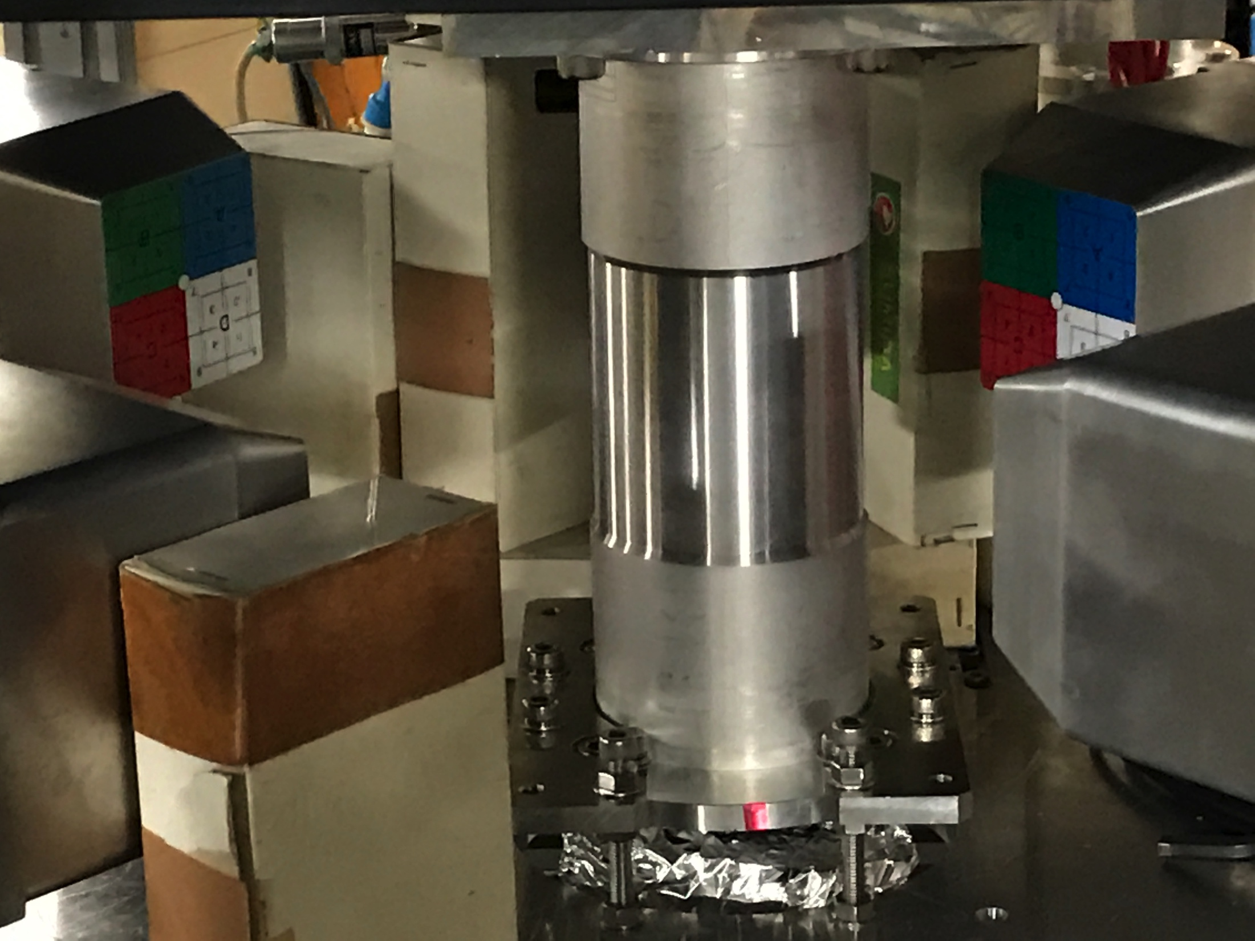
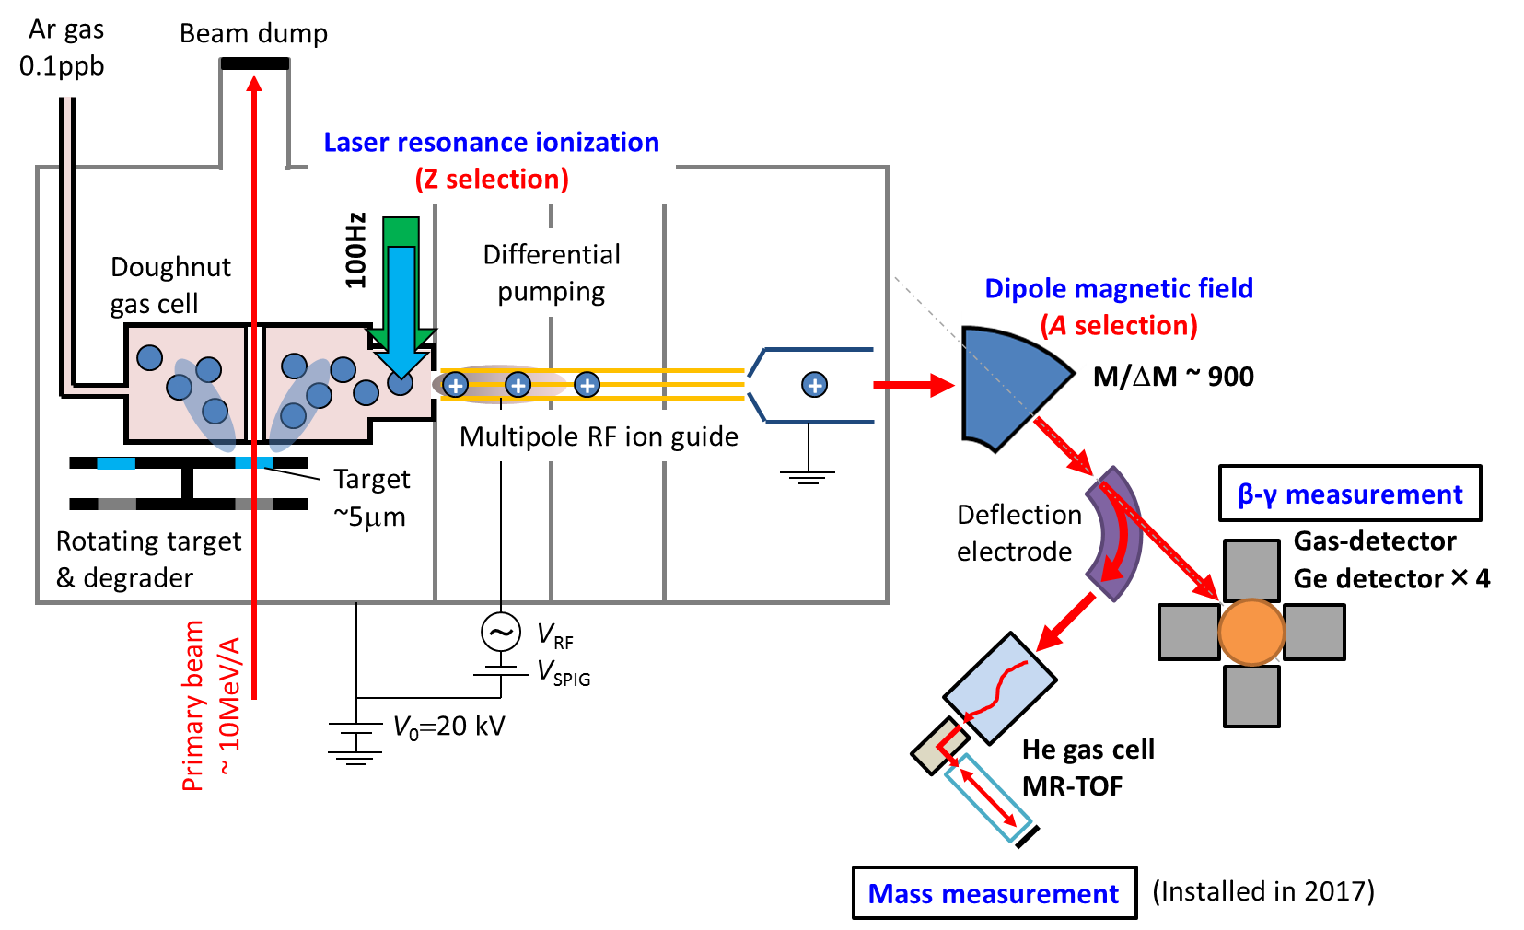

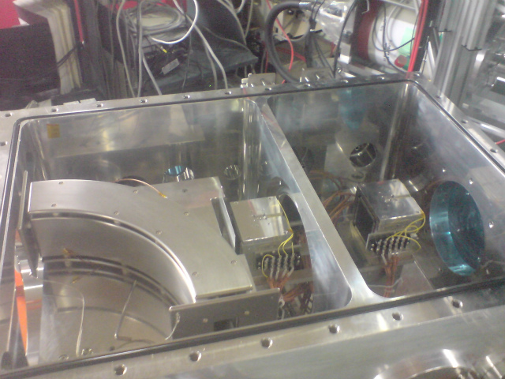

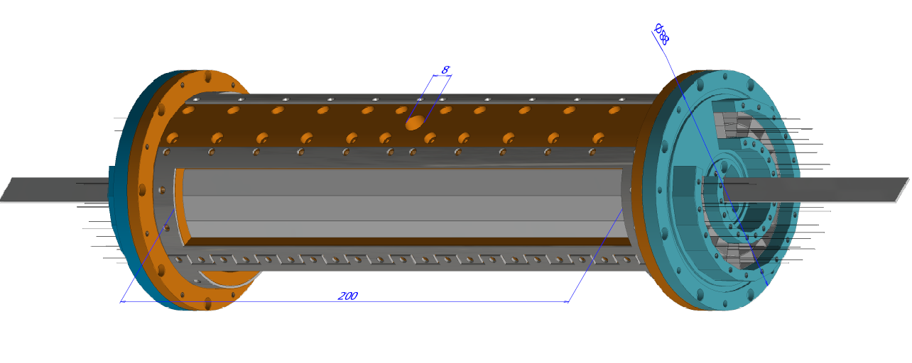
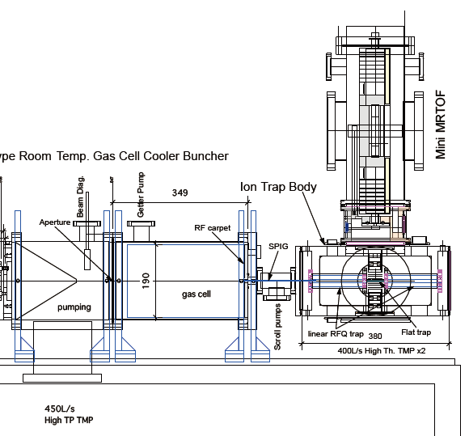
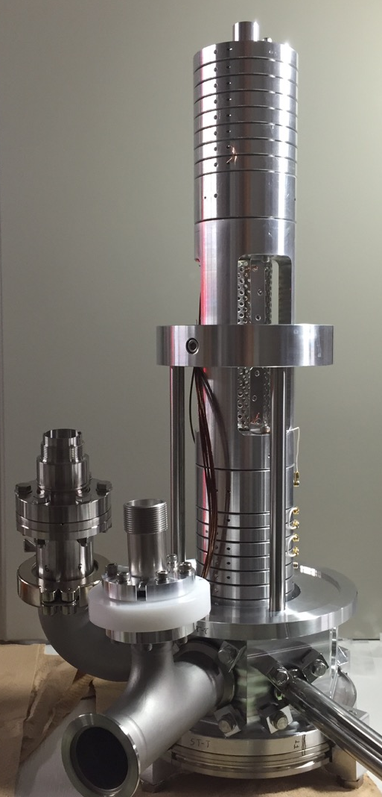
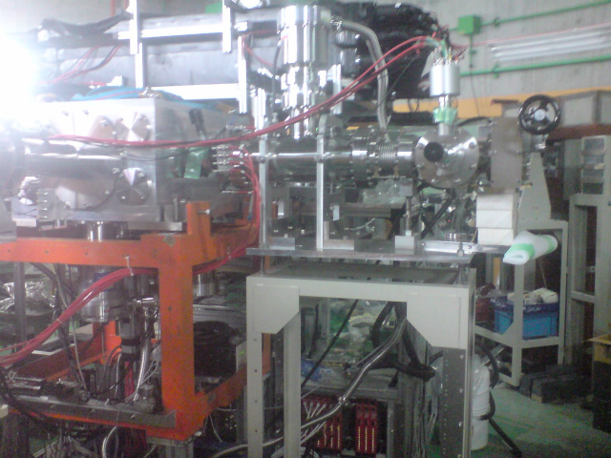
KISS (KEK Isotope Separation System)
Y. Hirayama et al., NIMB 412 (2017) 11-18.
~50kPa
Decay measurement
10⁻⁴kPa
30Pa
0.1Pa
10⁻⁴Pa
M. Mukai et al., accepted to NIMA
Tape
KISS
beam
Deflector
(already tested)
β
Steerer
helium gas cell ion cooler
Multi-trap ion buncher
MRTOF-MS
Decay meas. St.
SUS
IBS-KEK collaboration
KISS beam
BG
200 mm
2 layers
×16 segmented
proportional
gas counters
EQQ
(already tested)
KISS beam
Mesh
&
Myler foil
ΔΩ = 79% (4π)
E_{thr.} ~ 140 eV
E_{min.} ~ 100 keV
Mini-MRTOF-MS
(under tuning)
He gas cell ion cooler
(coming soon)
Multi-trap ion buncher (coming soon)

Slide 3
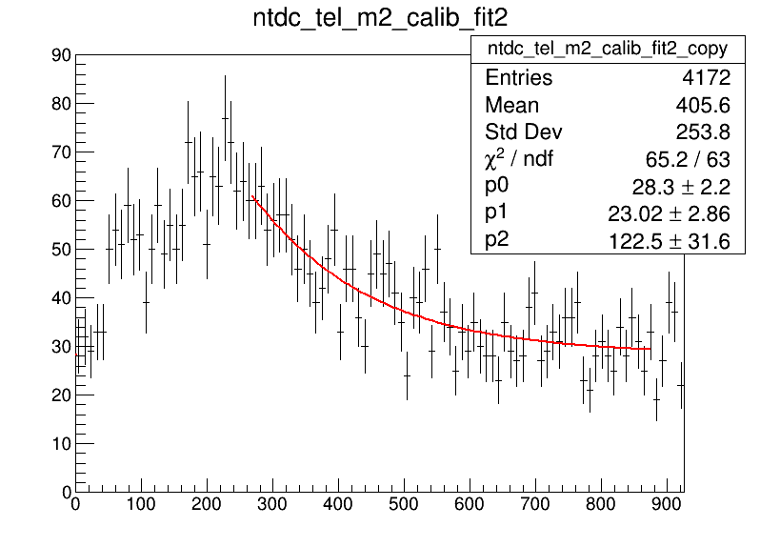
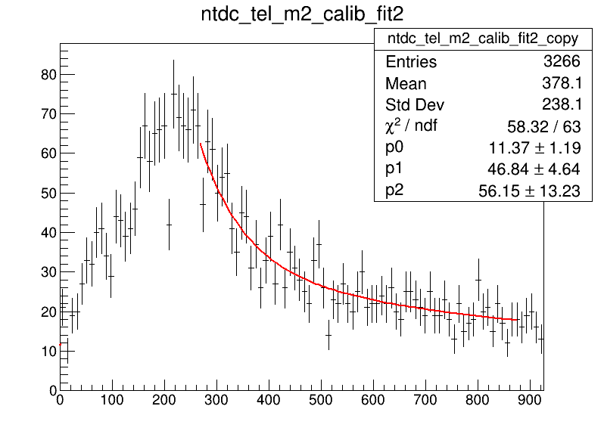
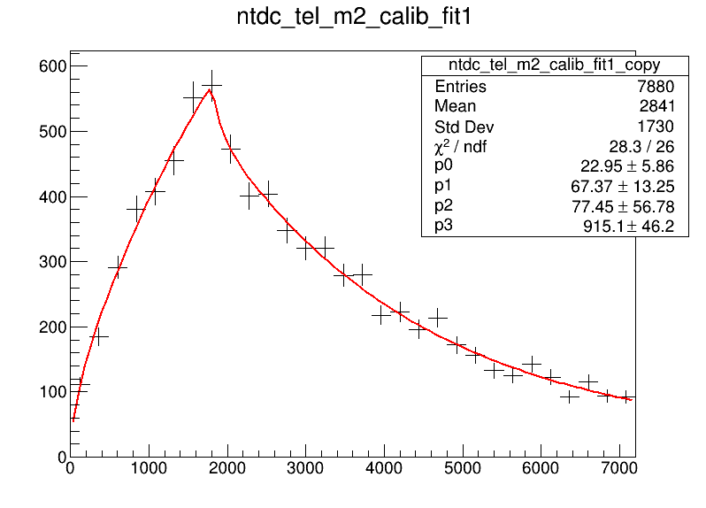
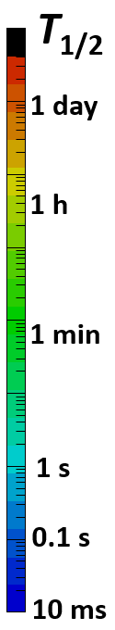
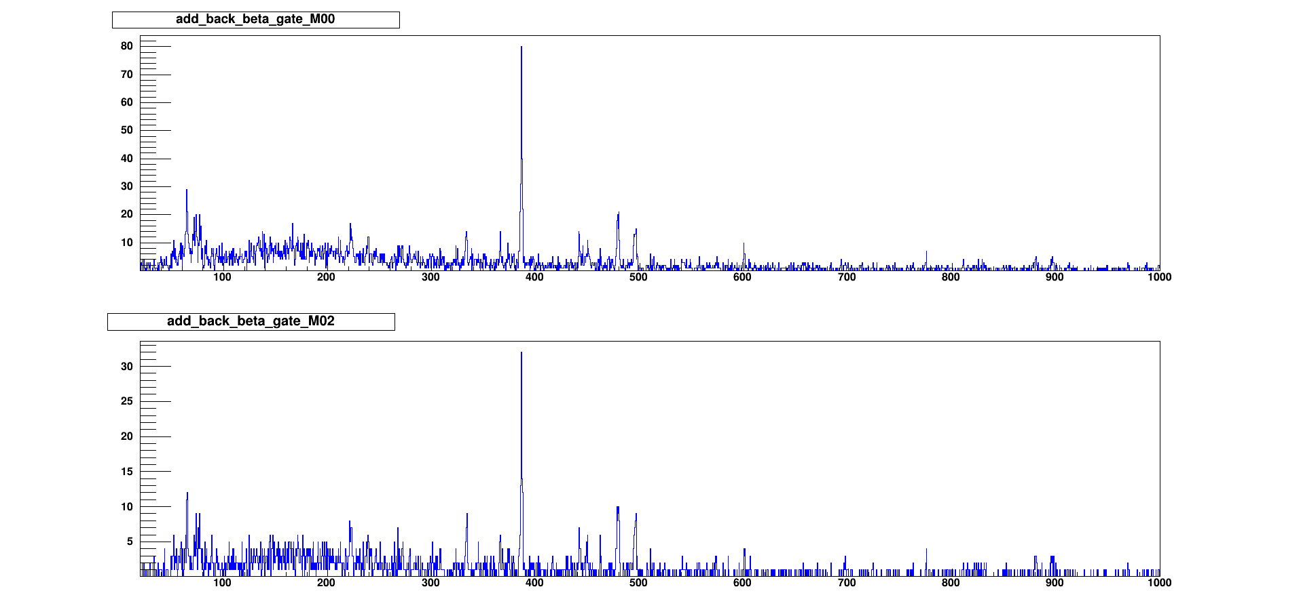
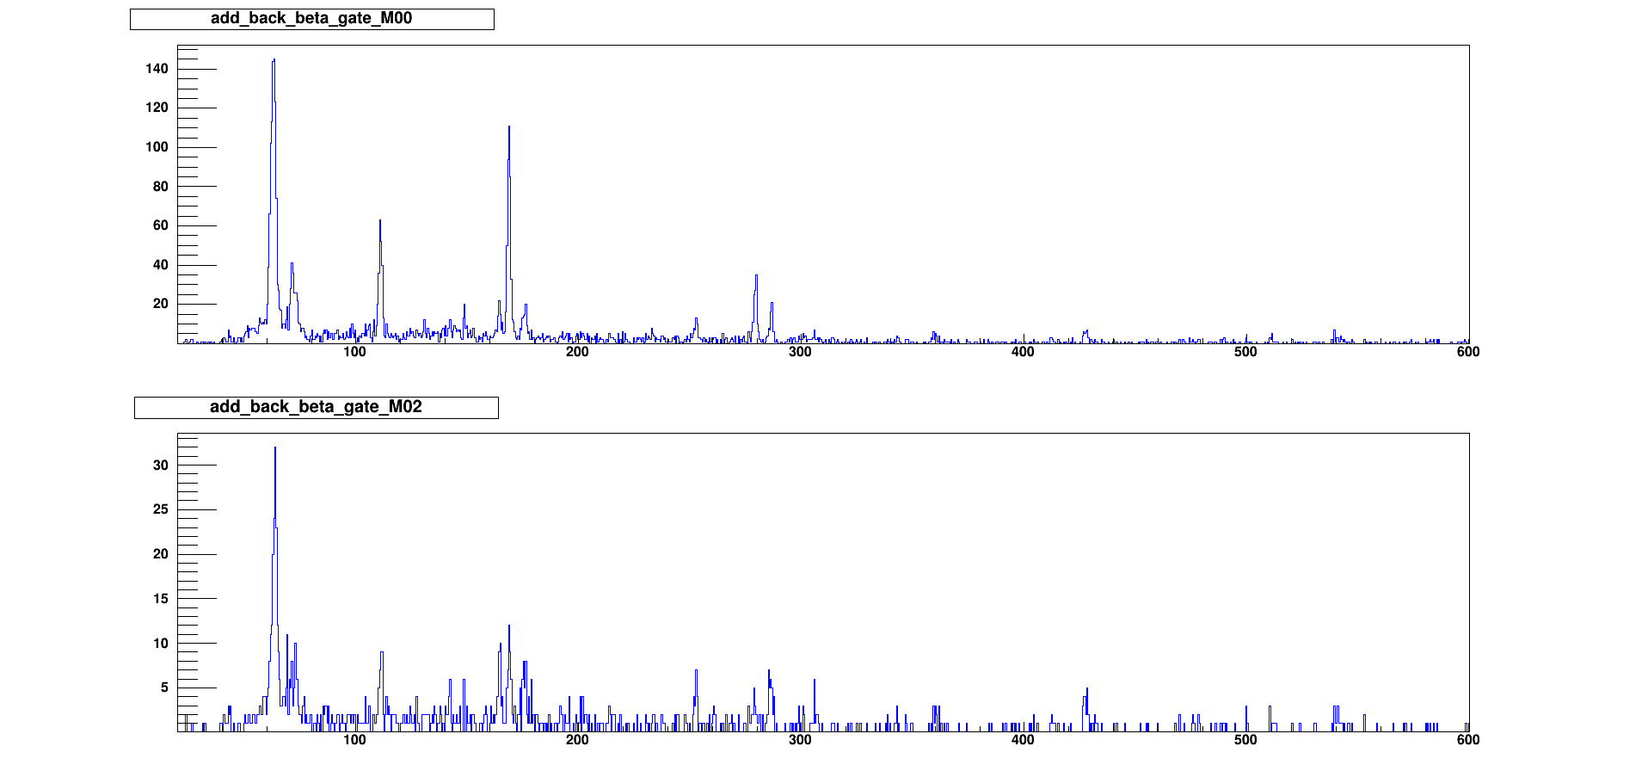
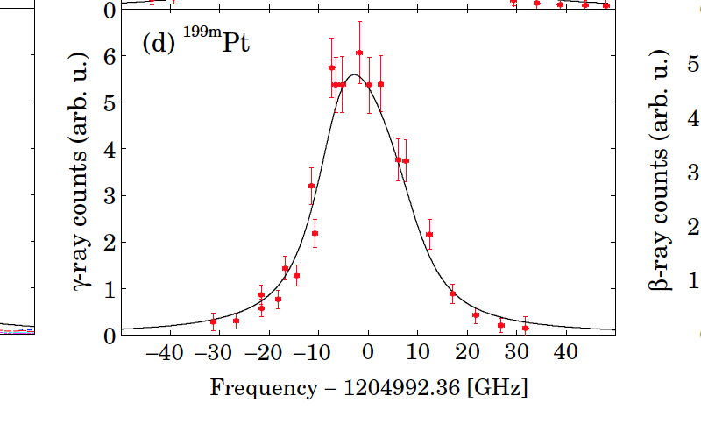
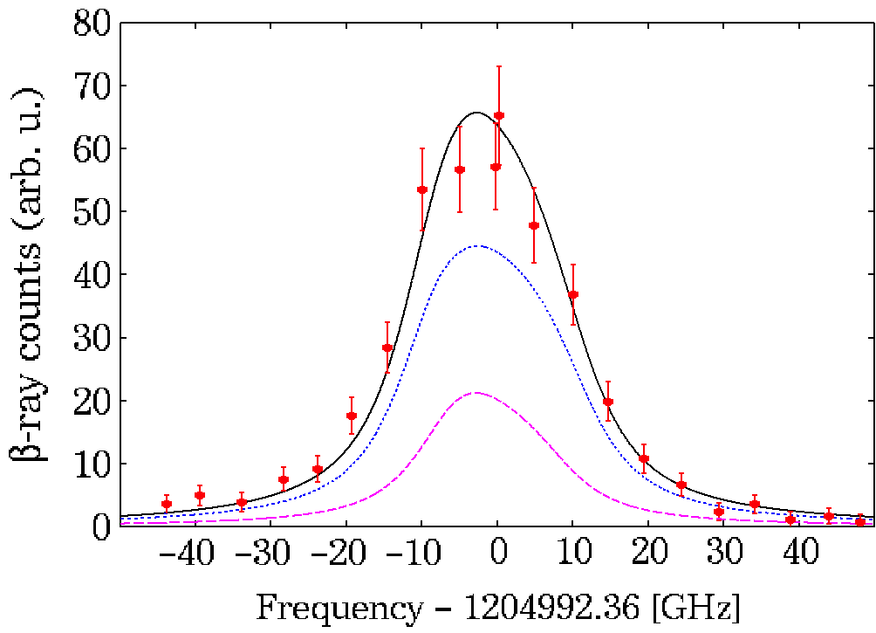
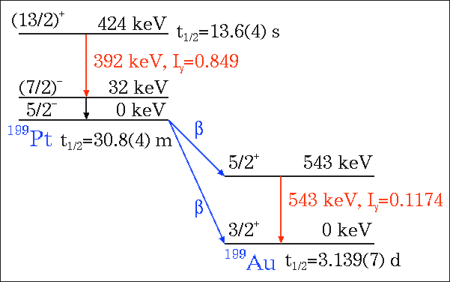
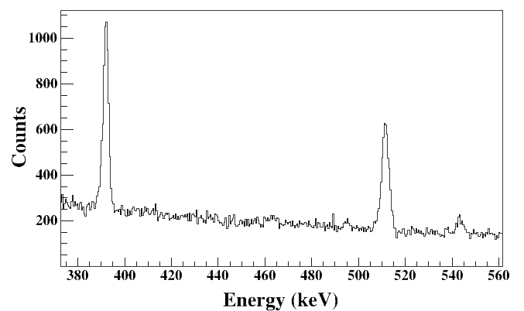
Decay & laser spectroscopy @KISS
¹⁹⁸Os
t_{1/2}=2.0(5) m
New obs.
¹⁹⁷Os
t_{1/2}= 2.8(6) m
→ 100(20) s !!
¹⁹⁹Ir
t_{1/2}= 6(+5/-4) s
→ 77(57) s !!
KUTY : H. Koura, et al., http://wwwndc.jaea.go.jp/CN14/index.html
Expected ：T_{1/2}
Au
measured region
Pt
¹⁹⁸Pt
Ir
²⁰³Ir
Preliminary
1 h
Os
²⁰²Os
1 h
¹³⁶Xe :
20pnA
¹⁹⁷Os
386
¹⁹⁵Os
48.4(52) s
Re
²⁰¹Re
222
0.56(12) s
168
168
279
Stage I
52
386
111
250pnA
W
²⁰⁰W
64.5
56(13) s
148
6.5(11) min
¹⁹⁹Ta
70.7
73.5
77.0
111
²³⁸U :
500pnA
Ta
Stage II
@ present RIBF
239
365
449
478
279
222
333
441
495
600
148
Hf
1 s
Eγ(keV)
1 s
775
Lu
Stage II @RIBF upgrade
Waiting
region
Preliminary
10pμA
Yb
^{199m}Pt
Y. Hirayama et al.,PRC.
96. (2017) 014307.
^{199g}Pt
ε_{ext}=0.1%
120
121
122
123
124
125
126
127
392
543
Νευτρον νυμβερ
^{199m}Pt
• Lifetimes of 11 n-rich isotopes (Pt, Ir, and Os)
• ¹⁹⁸Os: newly identified with half-life of 2 min..
• Some isomeric states newly assigned
• HFSs of 4 n-rich isotopes (¹⁹⁹Pt, ¹⁹⁶⁻¹⁹⁸Ir)
Further details -> Hirayama-san’s talk
line shape calibration:
Doppler=1.0 GHz @300K
Laser intrinsic linewidth=3.4 GHz
gas-pressure+laser-power broadening=12.1 GHz

Slide 4
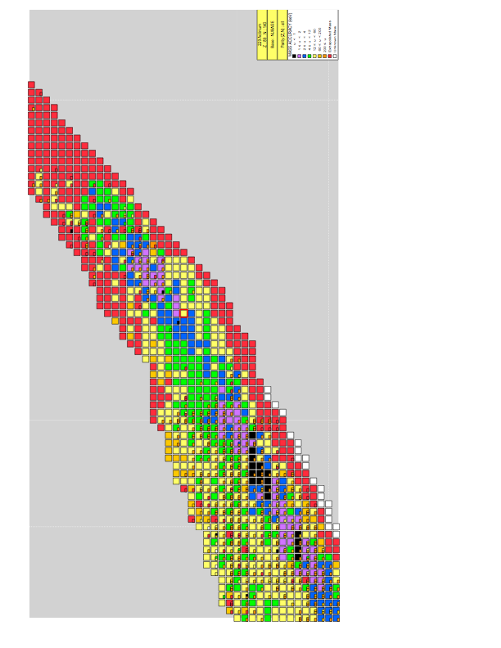

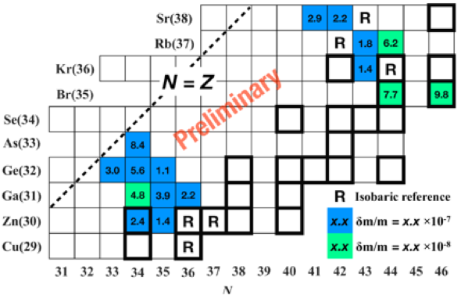
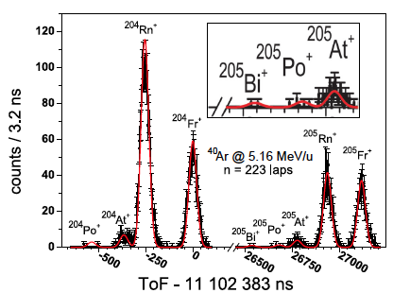
Direct mass measurement with MRTOF-MS
in 2016-2017
S. Kimura et al, arXiv.1706.00186
P. Schury ea.al, NIM B407(‘17)160.
Y. Ito, et al., arXiv: 1709.06468v1
• suitable for the heavy nuclides
→δm<100keV at 100 ions
• fast measuring time ≤20 ms
→available for short-lived nuclides
• compact (~1m)+simple principle
→many applications
Fusion-evaporation
⁴⁸Ca + ^{203,205}Tl/²⁰⁸Pb
¹⁸O/¹⁹F + ²³²Th/²³⁸U
104Rf
103Lr
102No
101Md
Transfer
¹⁸O/¹⁹F + ²³⁵U/²³⁸U
100Fm
99Es
98Cf
97Bk
• high sensitivity
←identification with 2 ²⁰⁵Bi ions
• high efficiency
←simultaneous measurements
for 9 isotopes
Fusion-evaporation
¹⁸O/¹⁹F + ²⁰⁸Pb/²⁰⁹Bi
96Cm
95Am
Fusion-evaporation
⁴⁸Ca + ¹⁶⁹Tm/¹⁶⁵Ho
94Pu
155
93Np
92U
91Pa
90Th
²³⁵U
²³⁸U
150
89Ac
88Ra
87Fr
86Rn
85At
84Po
145
83Bi
MRTOF-MS
@GARIS II
82Pb
^{204, 206-208}Pb
140
115
120
125
130
135
• Masses of more than 80 isotopes were measured in 2016-2017
• More than 30 masses of them were directly measured for the first time
• 4 of them (²⁴⁶Es, ^{249, 250, 252}Md) were newly determined
• Highest precision of 3.5x10⁻⁸ (2.8 keV!!) using 10⁴ ions was achieved for ⁶⁵Ga⁺
→ Feasible for accurate mass measurements in A=60~80 proton-rich mass region
relevant to the rp-process
Further details -> Wada-san’s talk
P. Schury et al, PRC95(‘17)011305R

Slide 5
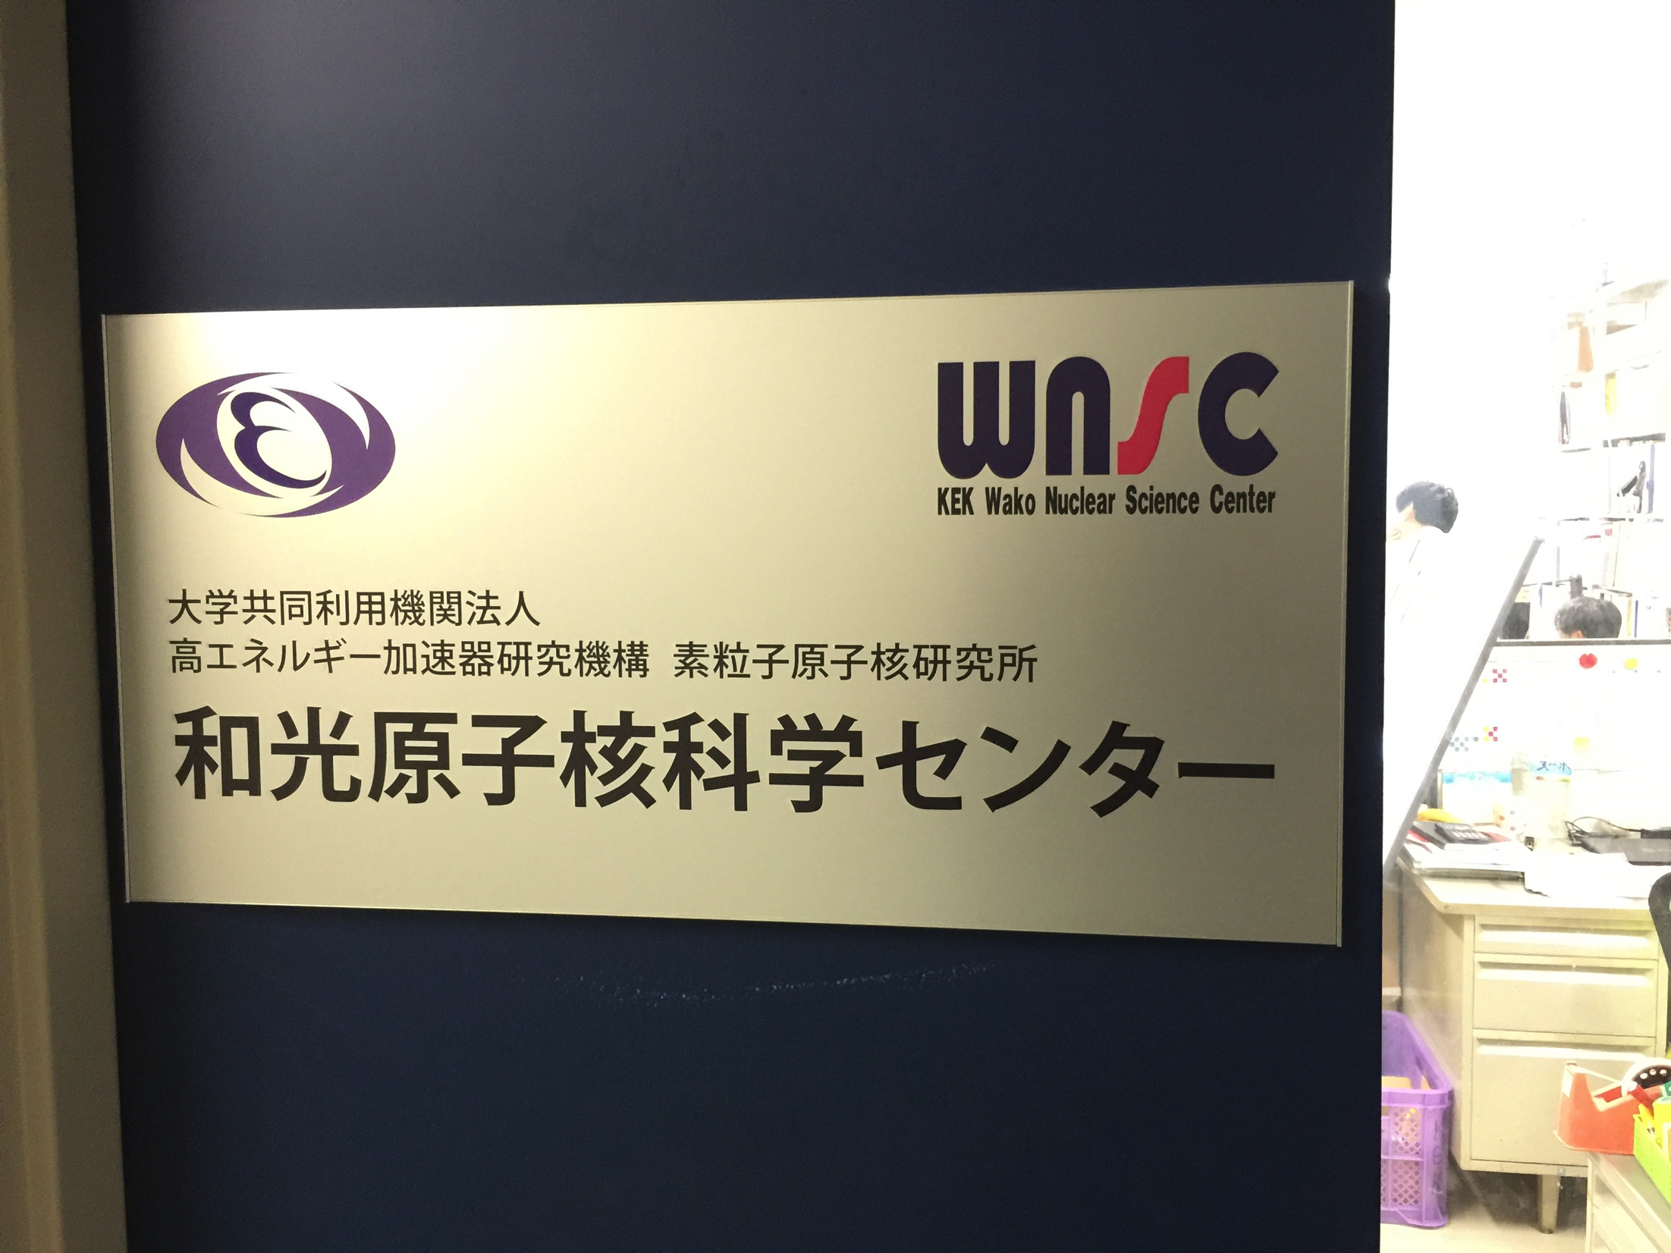
WNSC: Wako Nuclear Science Center @ RIBF
Institute of Particle and Nuclear Studies, KEK
Scientific staff:
  H. Miyatake, M. Wada,
  Y.X. Watanabe, Y. Hirayama, P. Schury
Technical staff:
  M. Oyaizu, Y. Kakiguchi
Secretary: M. Izawa
SLOWRI, MRTOF
KISS, Laser-spectr.
MNT reaction, Gamma-spectr.
MR-TOF, KISS
SSRI-pns: Steering Committee
Chair: M. Wada (KEK)
H. Ueno (RIKEN), G. Georgiev (Orsay), A. Andreyev (York), H. Watanabe (Beihang), K.Y. Kwon (IBS), Y. Watanabe (KEK), K. Morita (Kyushu U.)
for group activities,
→http://research.kek.jp/group/wnsc/en/
for contact the SSRI-PNS
→SSRI-PNS_contact@kek.jp

Slide 6
End

Slide 7
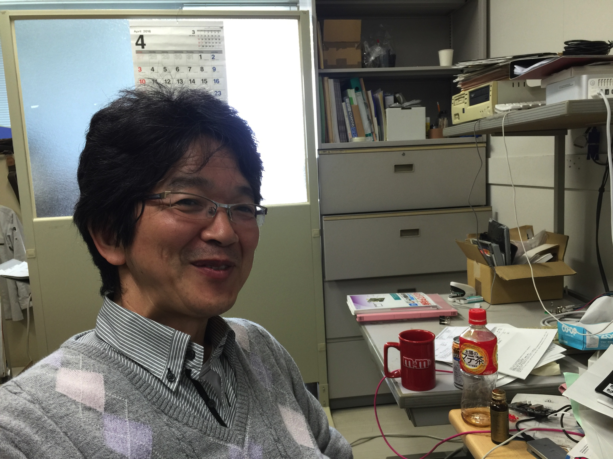
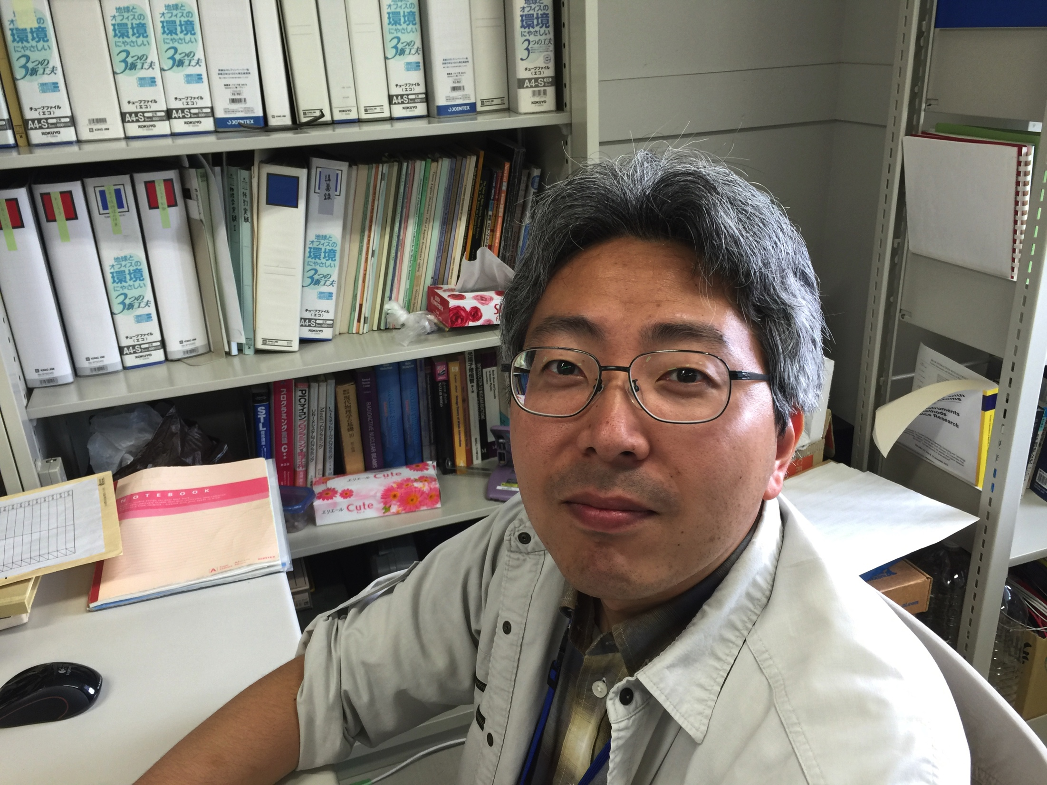
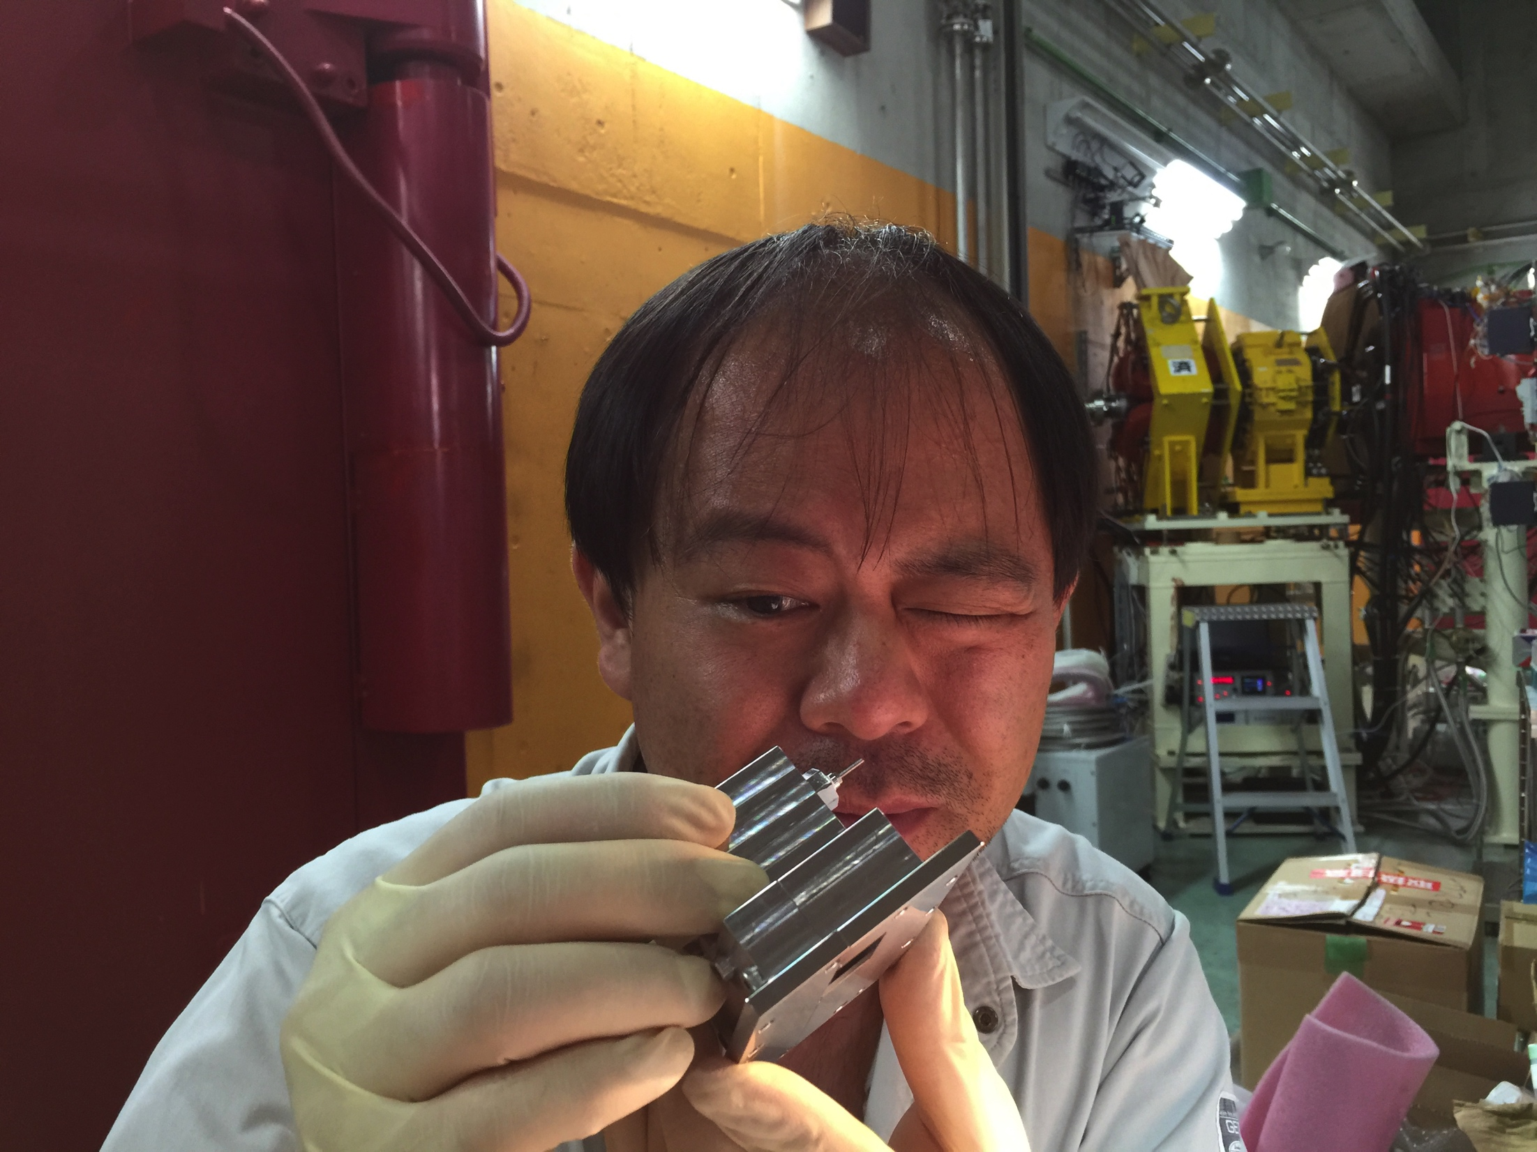
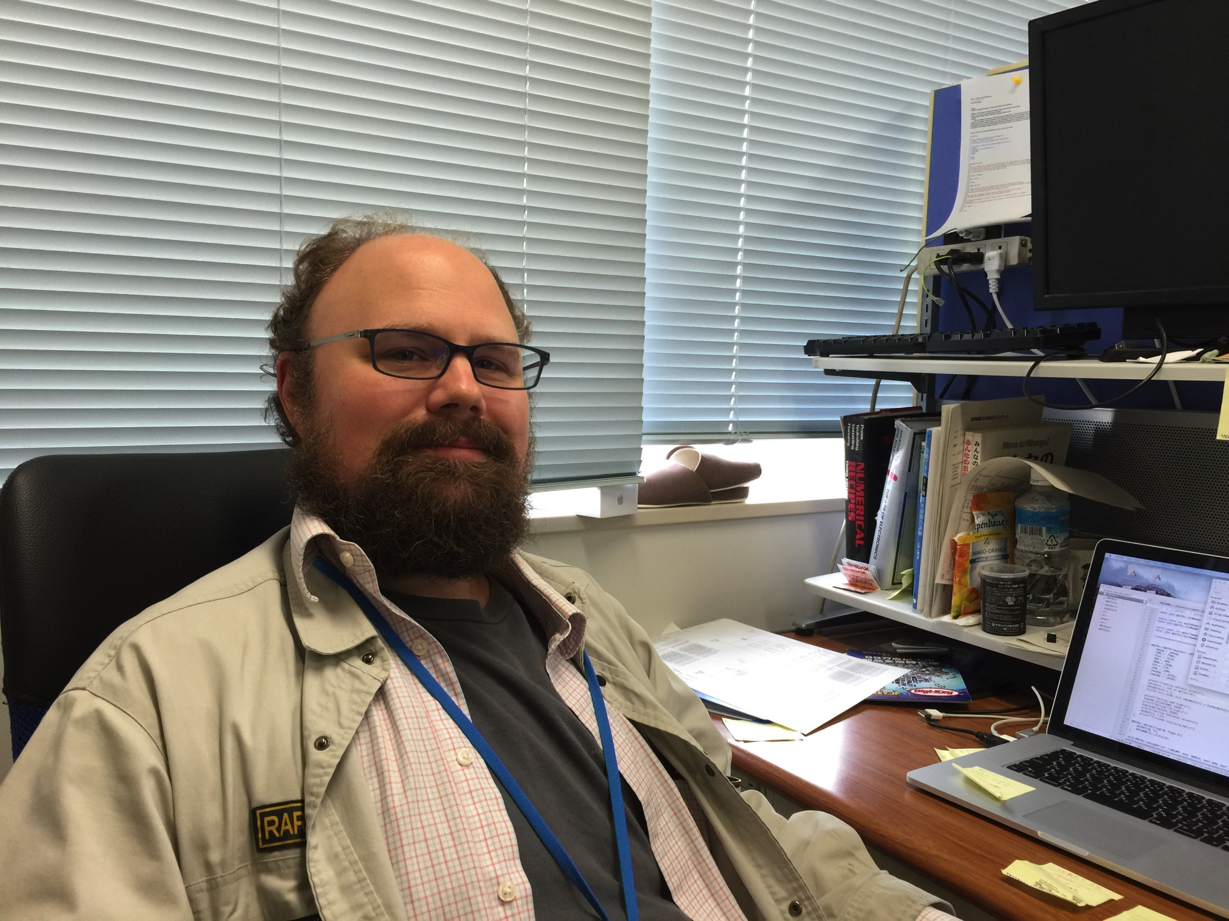
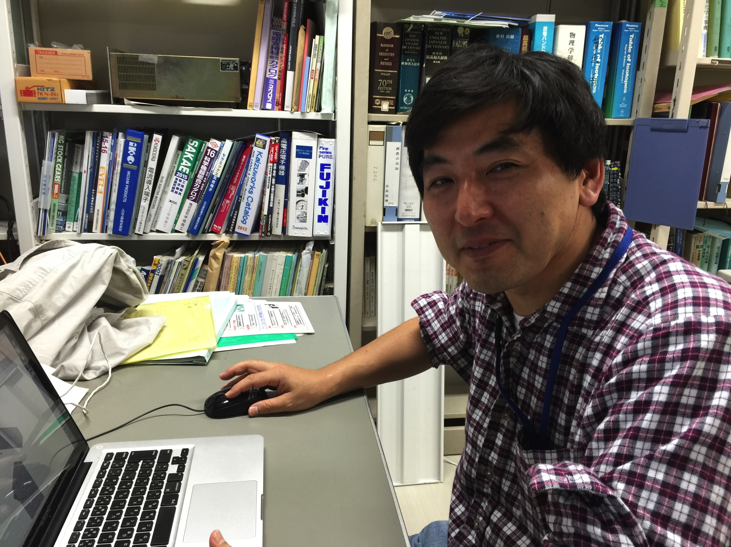
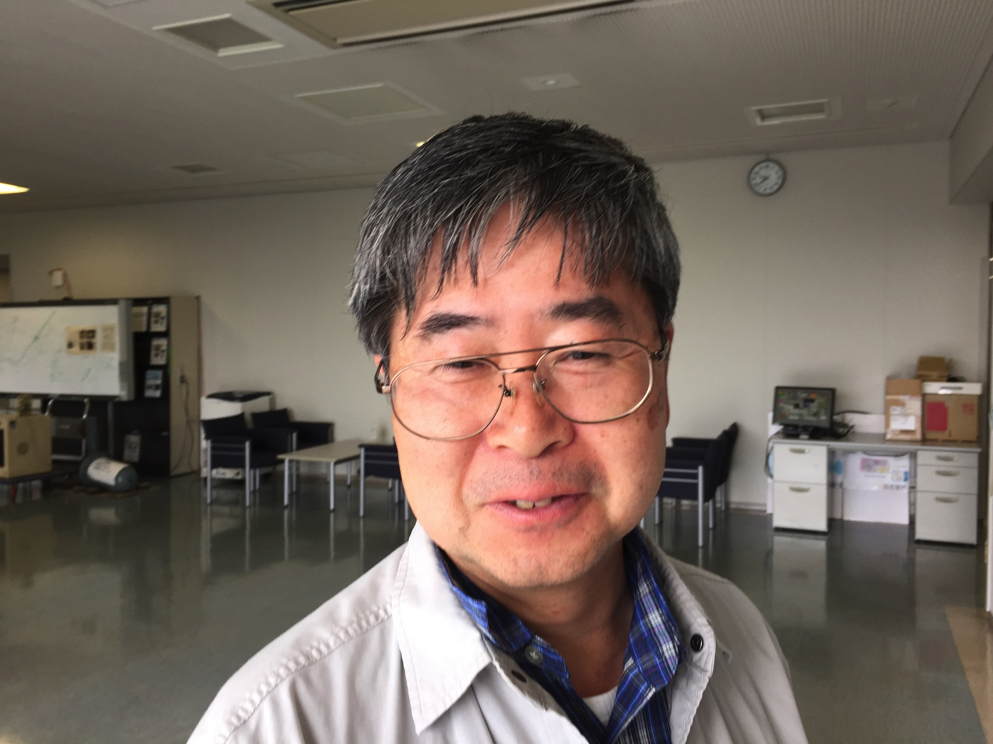
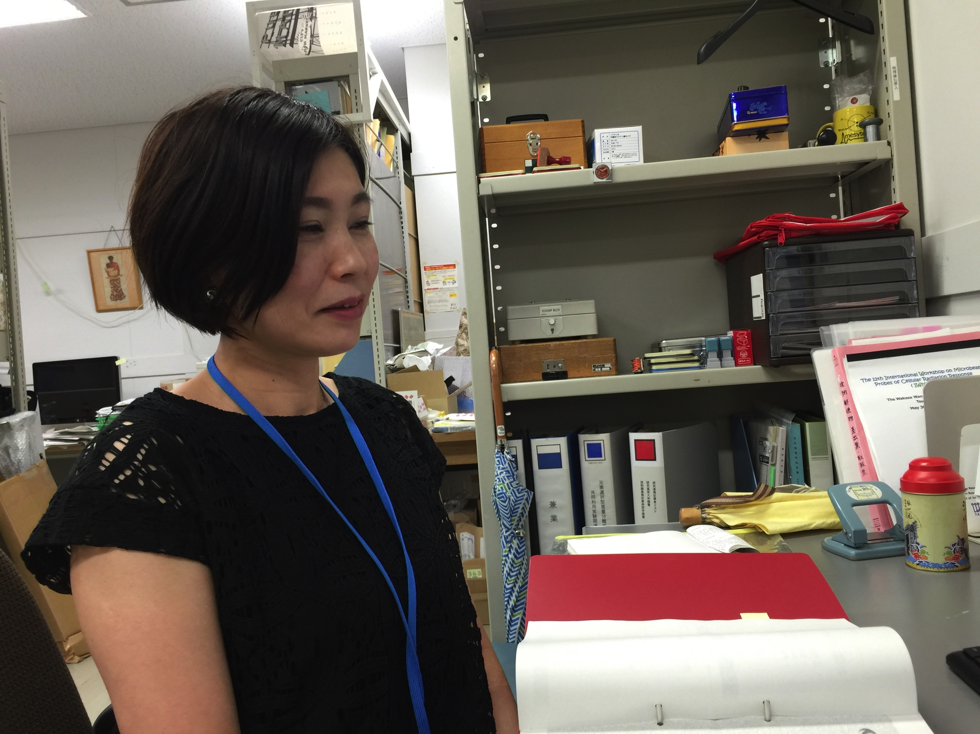
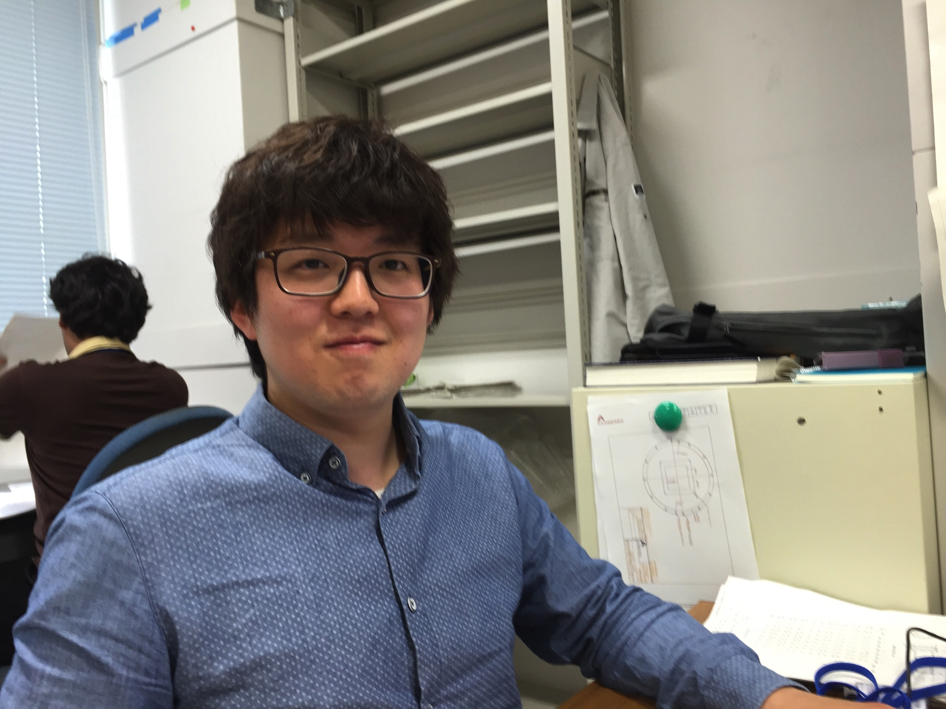
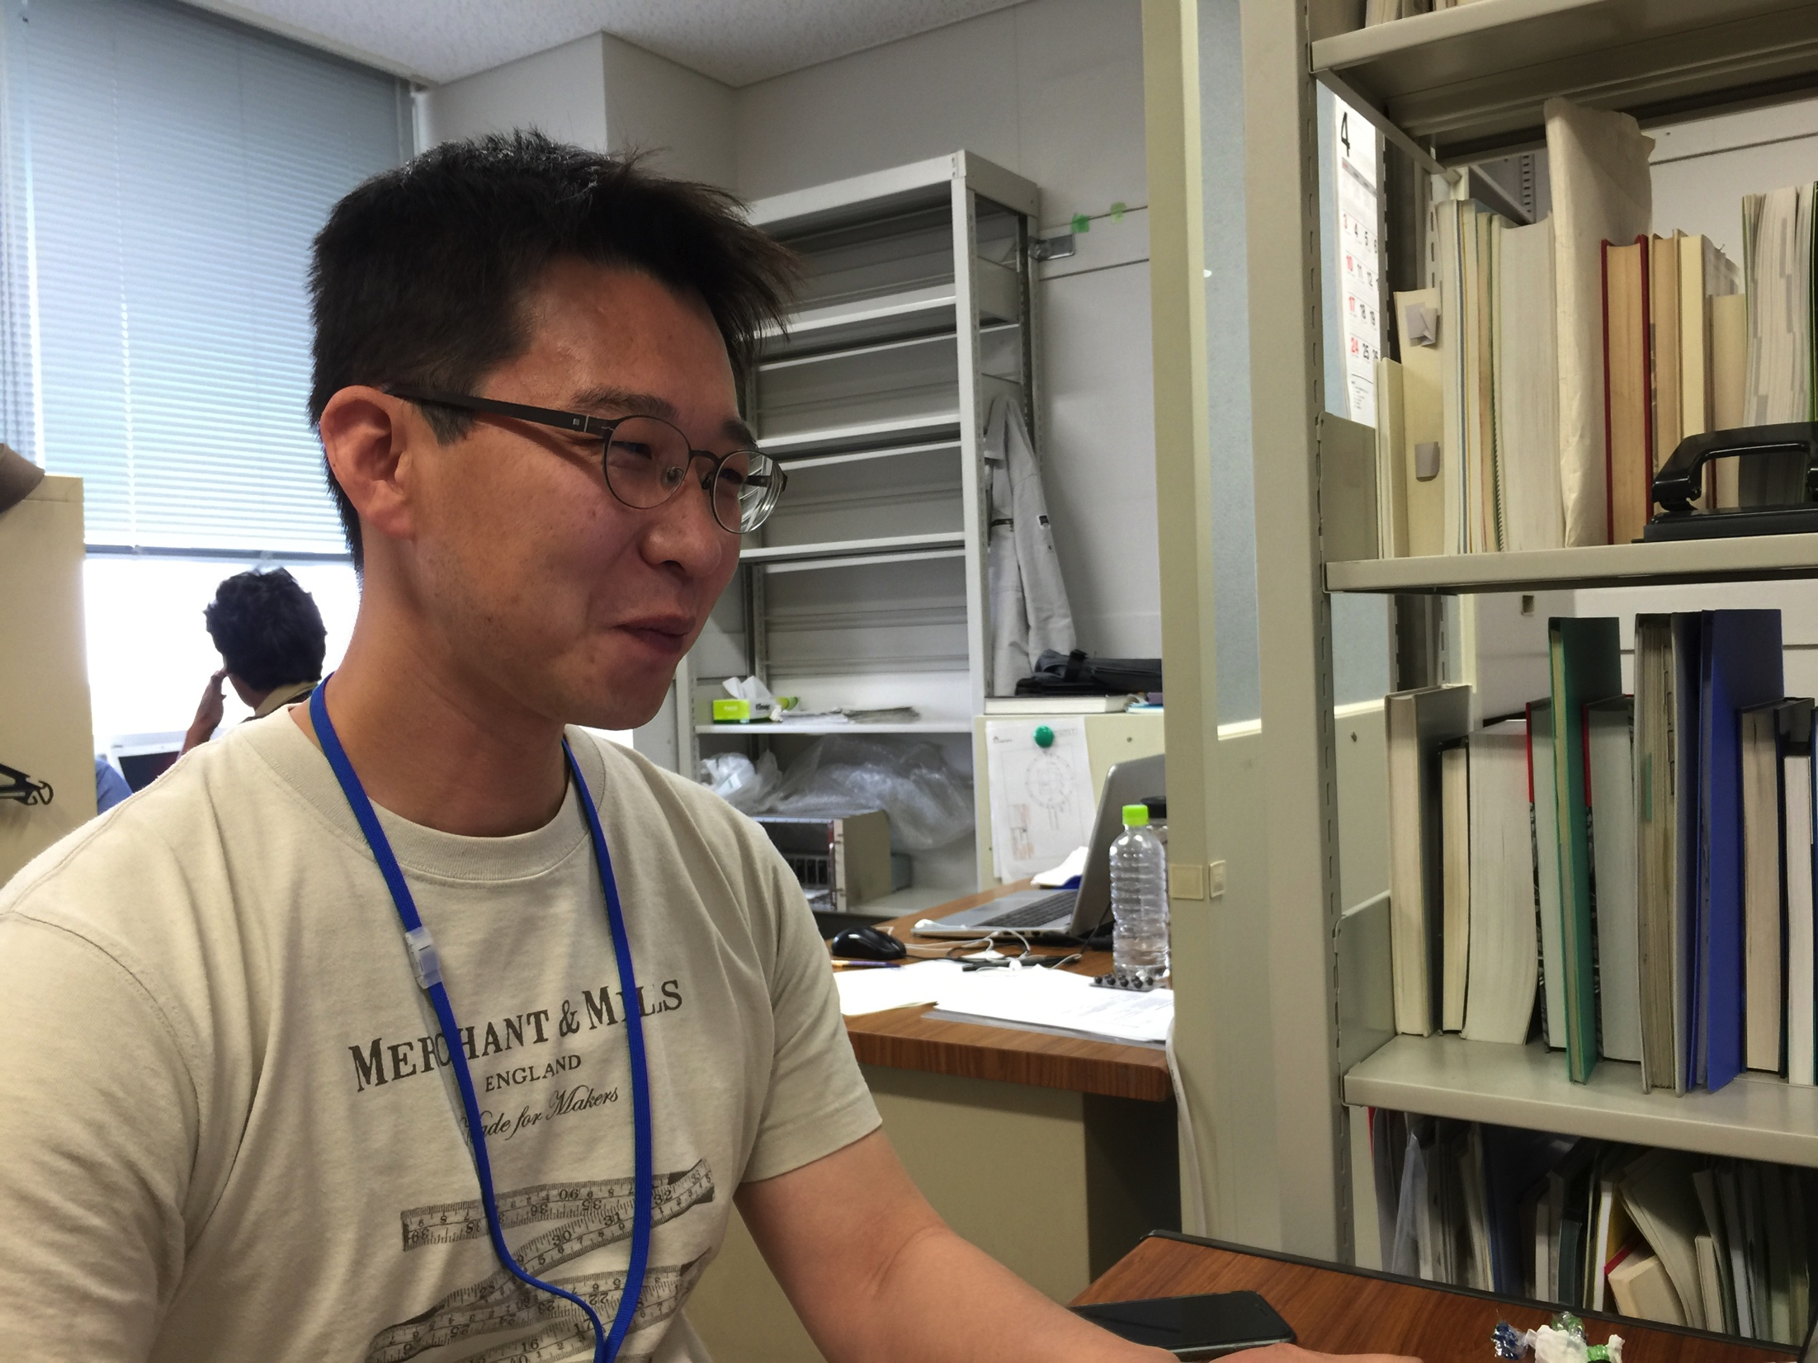
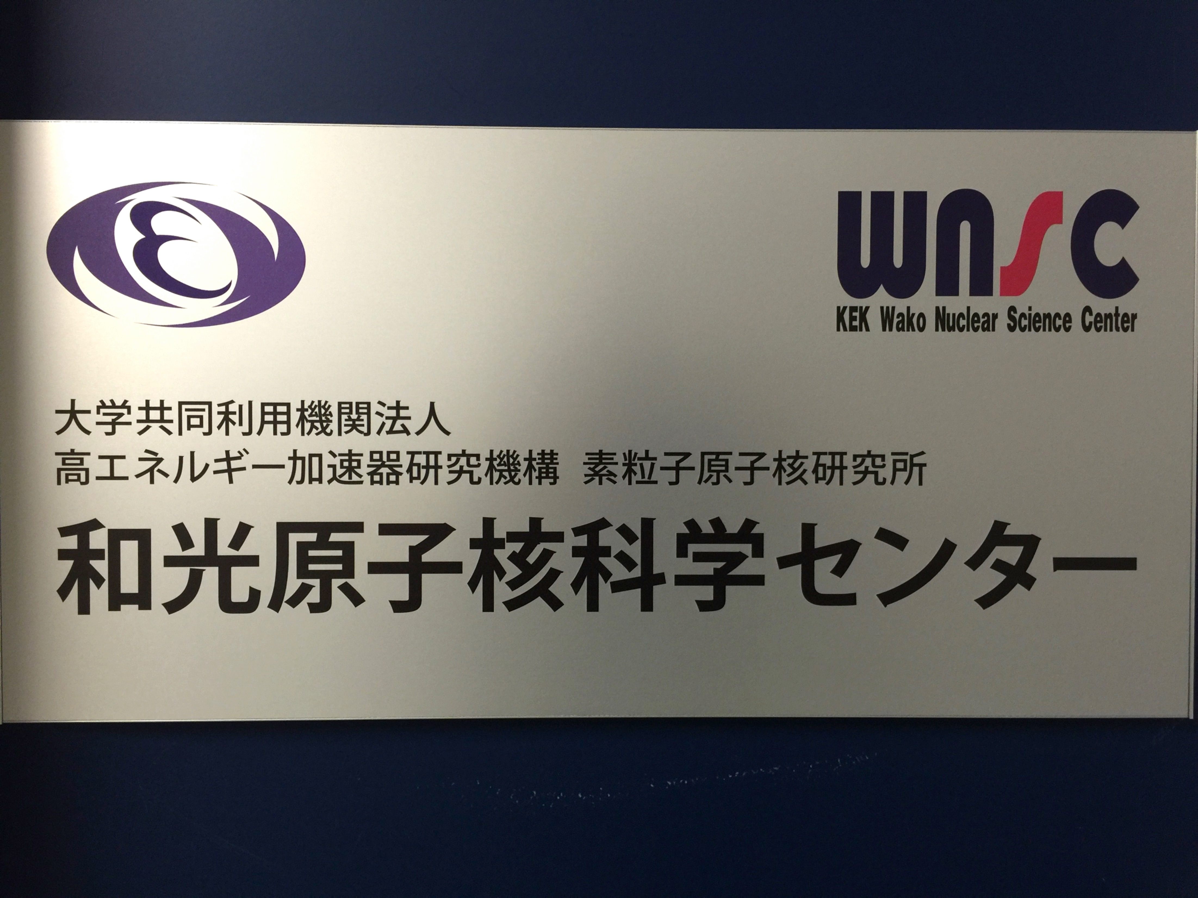
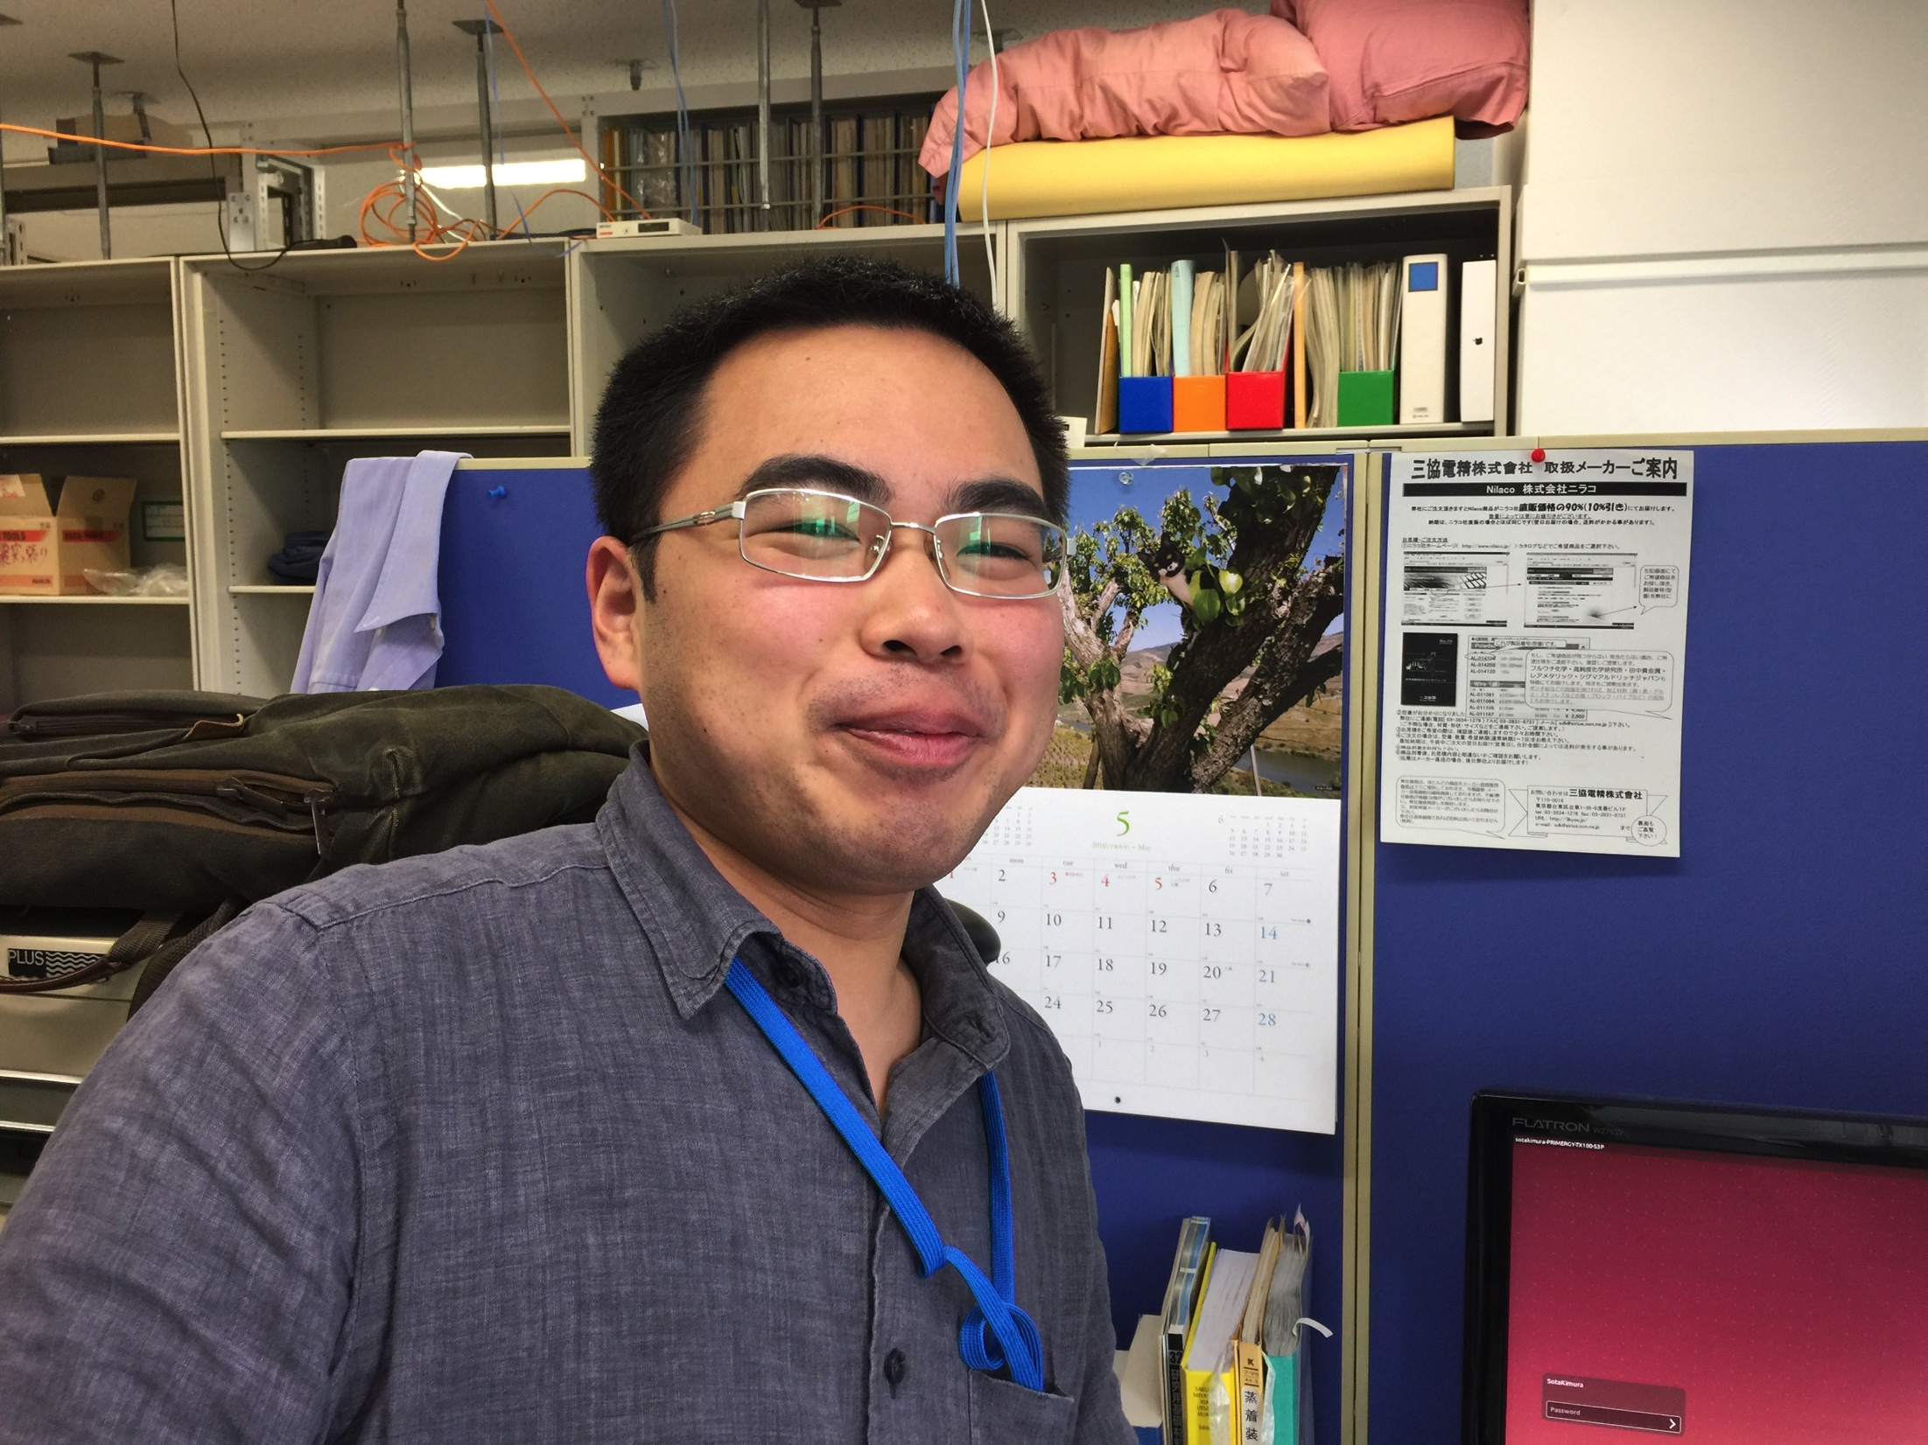
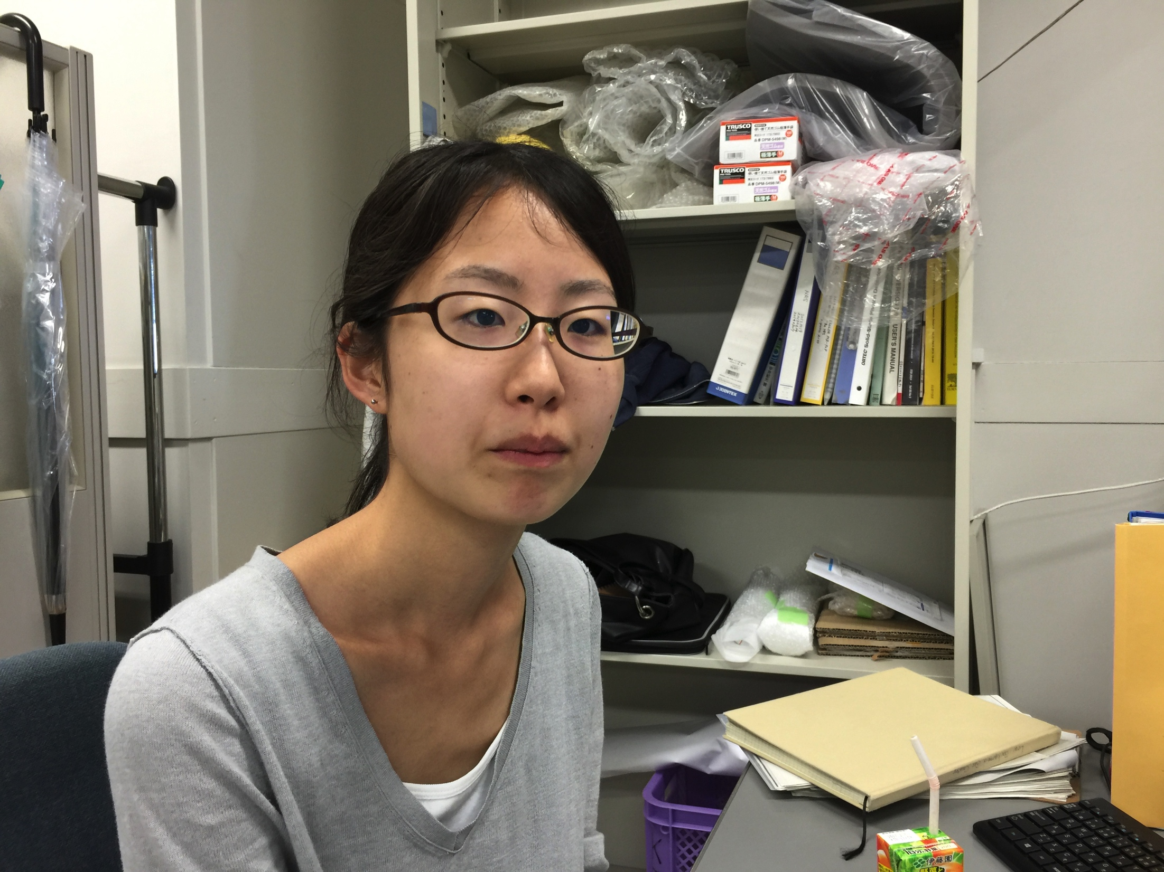
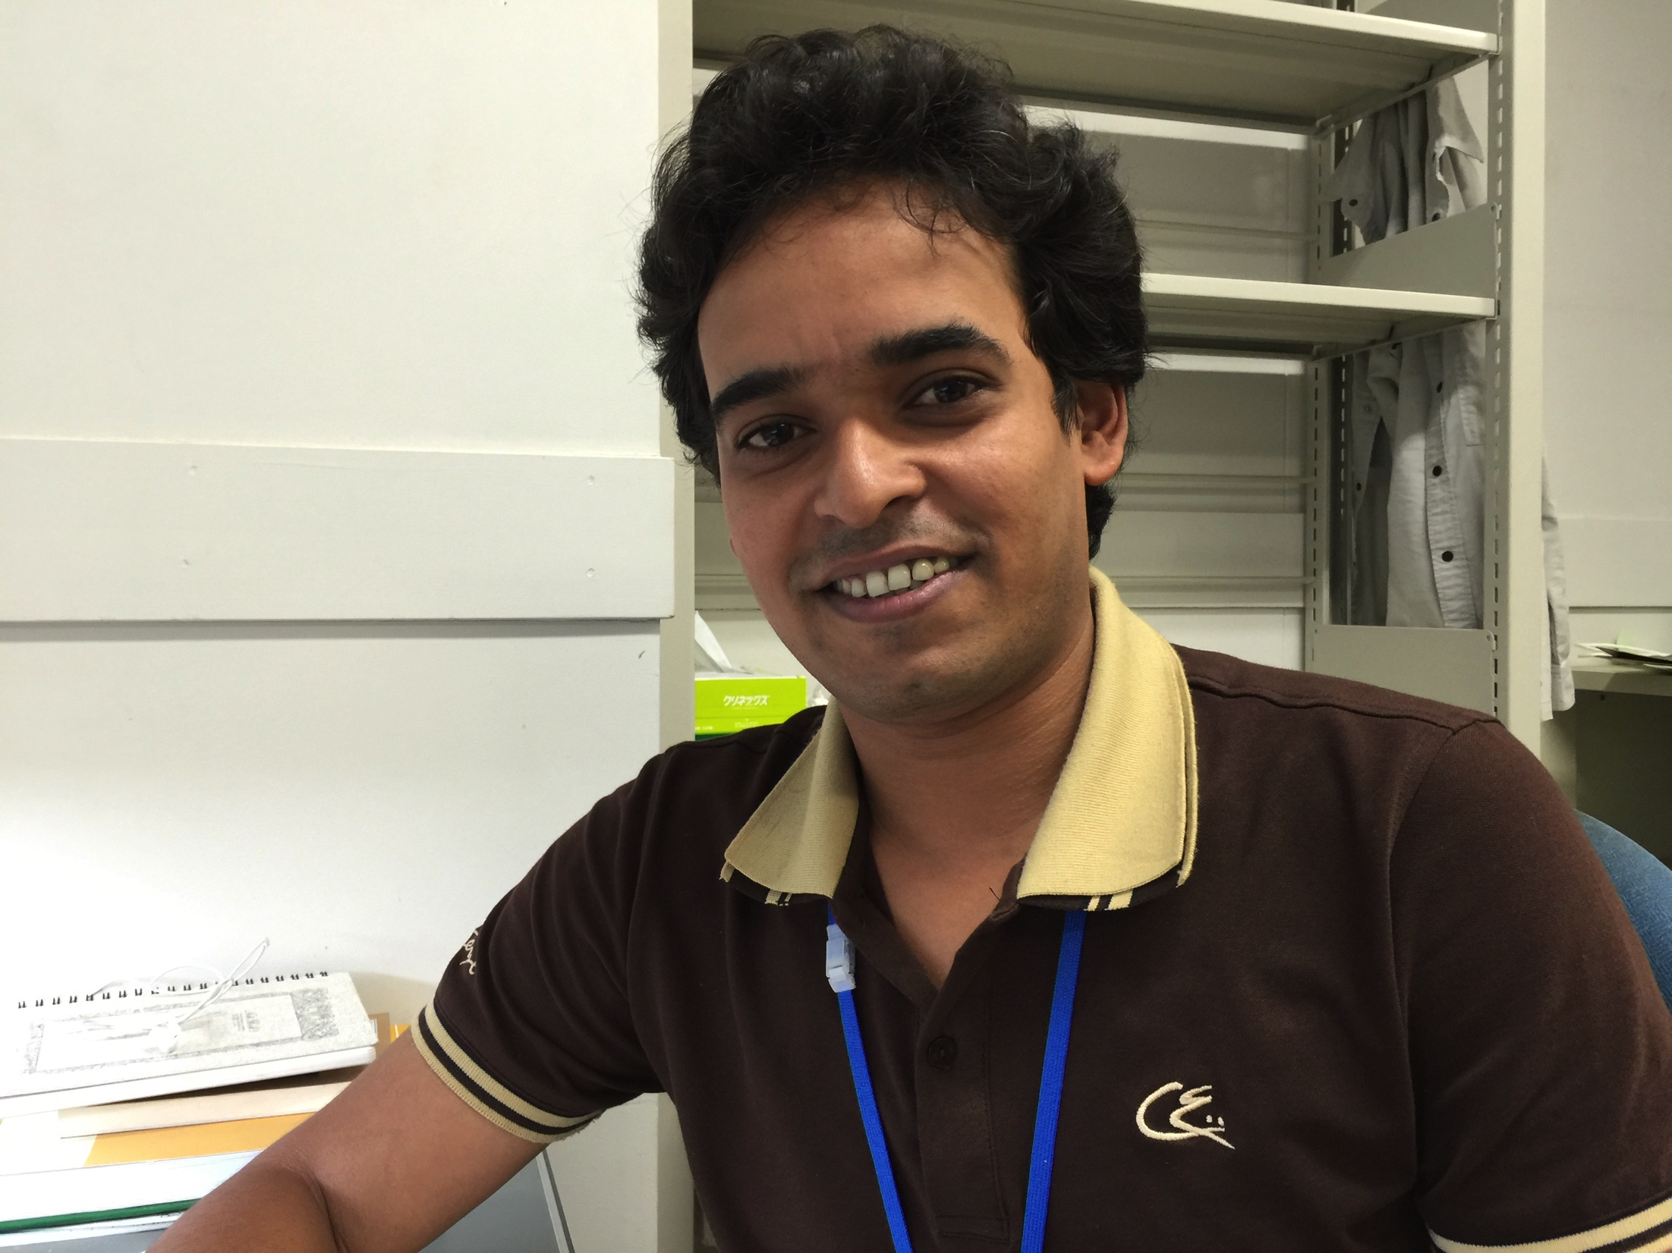
Staffs and Students at WNSC
Wada, Michiharu
Watanabe, Yutaka
Hirayama, Yoshikazu
Schury, Peter H.
Kakiguchi, Yutaka
Oyaizu, Michihiro
Izawa, Machiko
Park, Jinhyung (IBS)
Moon, Jun-young (IBS)
for group activities,
→http://research.kek.jp/group/wnsc/en/
for contact the SSRI-PNS
→SSRI-PNS_contact@kek.jp
Kimura, Sota
Mukai, Momo
Murad Ahmed, MD.

Slide 8
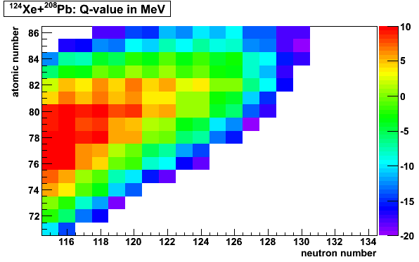
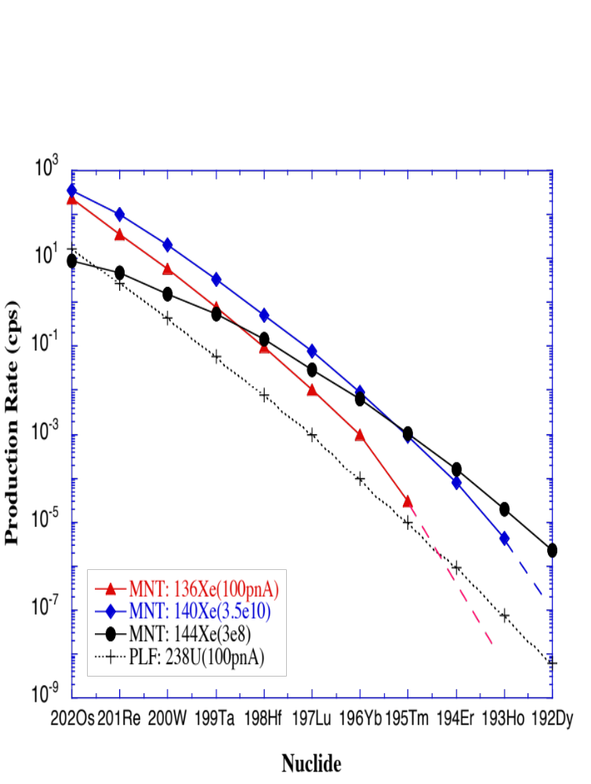
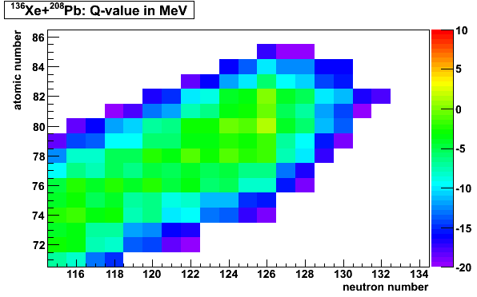
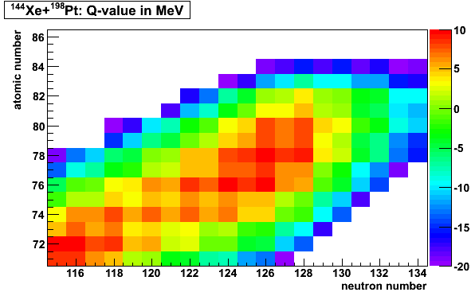
How to reach the “Blank spot” ?
Multi-nucleon transfer reactions (MNT) with
n-rich RNBs (~10 MeV/u)
proposed by C.H. Dasso et al., PRL73(‘94)1907.
¹⁴⁰Xe
waiting nuclei
N/Z=1.43
¹²⁴Xe(stable)
+ ²⁰⁸Pb
N/Z=1.51
^{140, 144}Xe + ¹⁹⁸Pt
seems to be the best ?
but,
¹³⁶Xe + ¹⁹⁸Pt is realistic
¹⁴⁴Xe
¹³⁶Xe
¹³⁶Xe(stable)
+ ²⁰⁸Pb
¹⁴⁴Xe(raidioactive)
+ ¹⁹⁸Pt
from 10¹⁴ fis/s
induced by
40 MeV deuteron
N/Z=1.57
Notes:
8

Slide 9
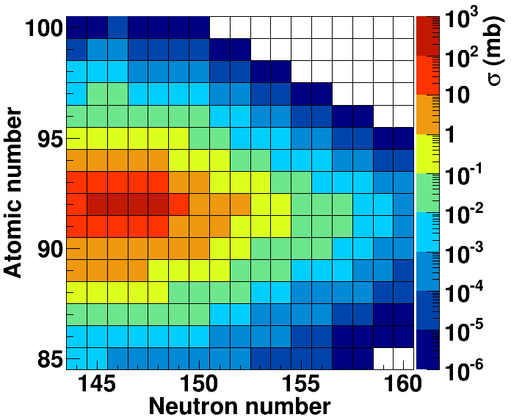
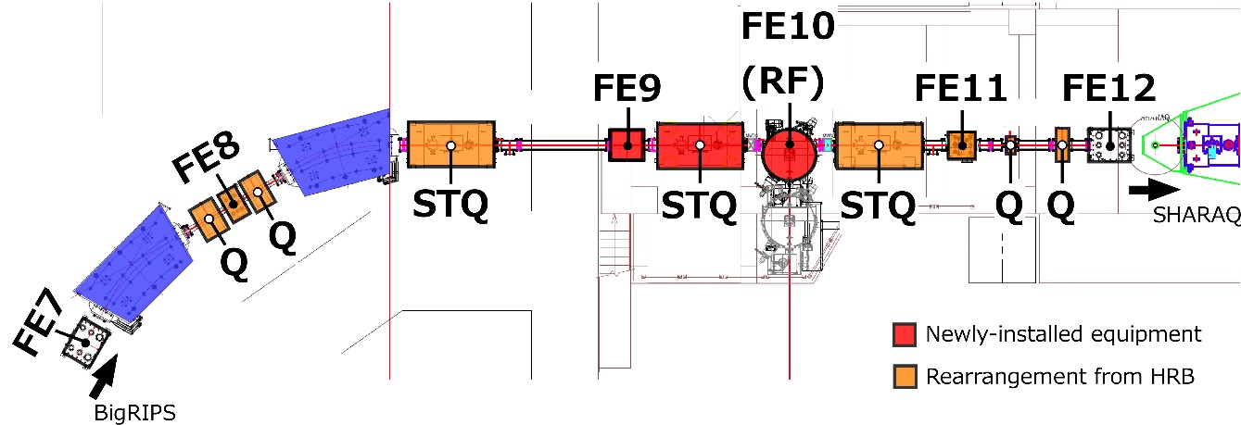


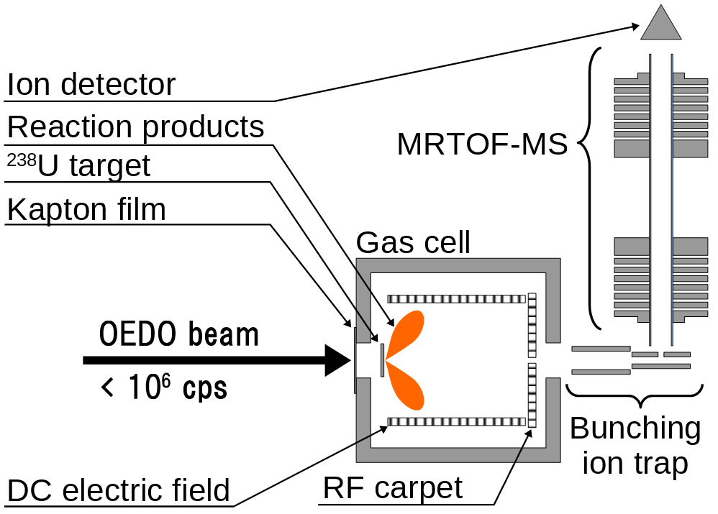
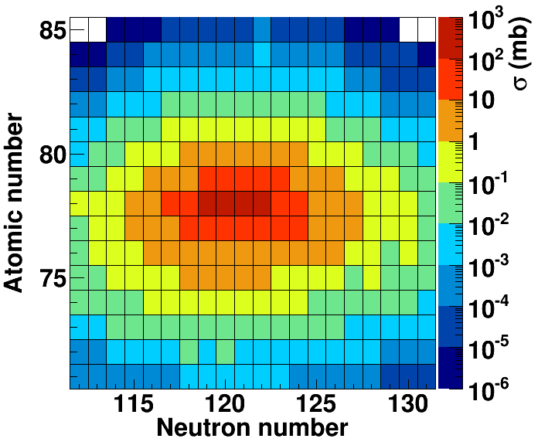
Future’s option: Low energy neutron-rich RI beams with OEDO
OEDO (Optimized Energy Degrading Optics for RI beam)
¹⁴²Xe (E_{lab} = 8 MeV/A) + ²³⁸U
Energy-degrading system for RI beam with an RF deflector for beam focus
known
²³⁸U
¹⁴²Xe (E_{lab} = 8 MeV/A) + ¹⁹⁸Pt
Isotope separator
¹⁹⁸Pt
100 μb ~ 100 counts/day
(10⁶ pps, 10 mg/cm²,
ε_{extraction} = 20%)
Cooled He gas cell efficiency

Slide 10
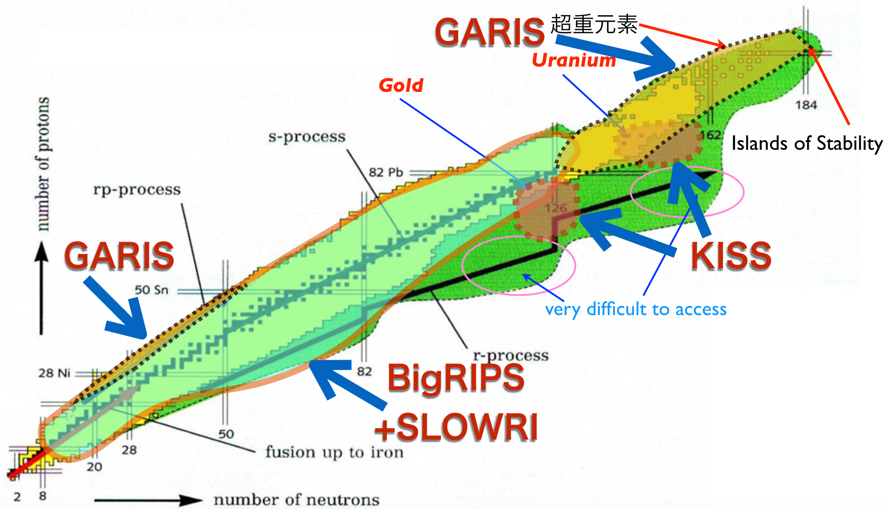
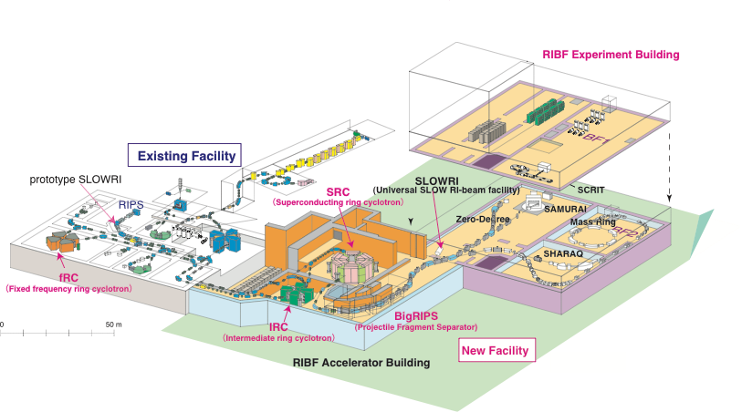
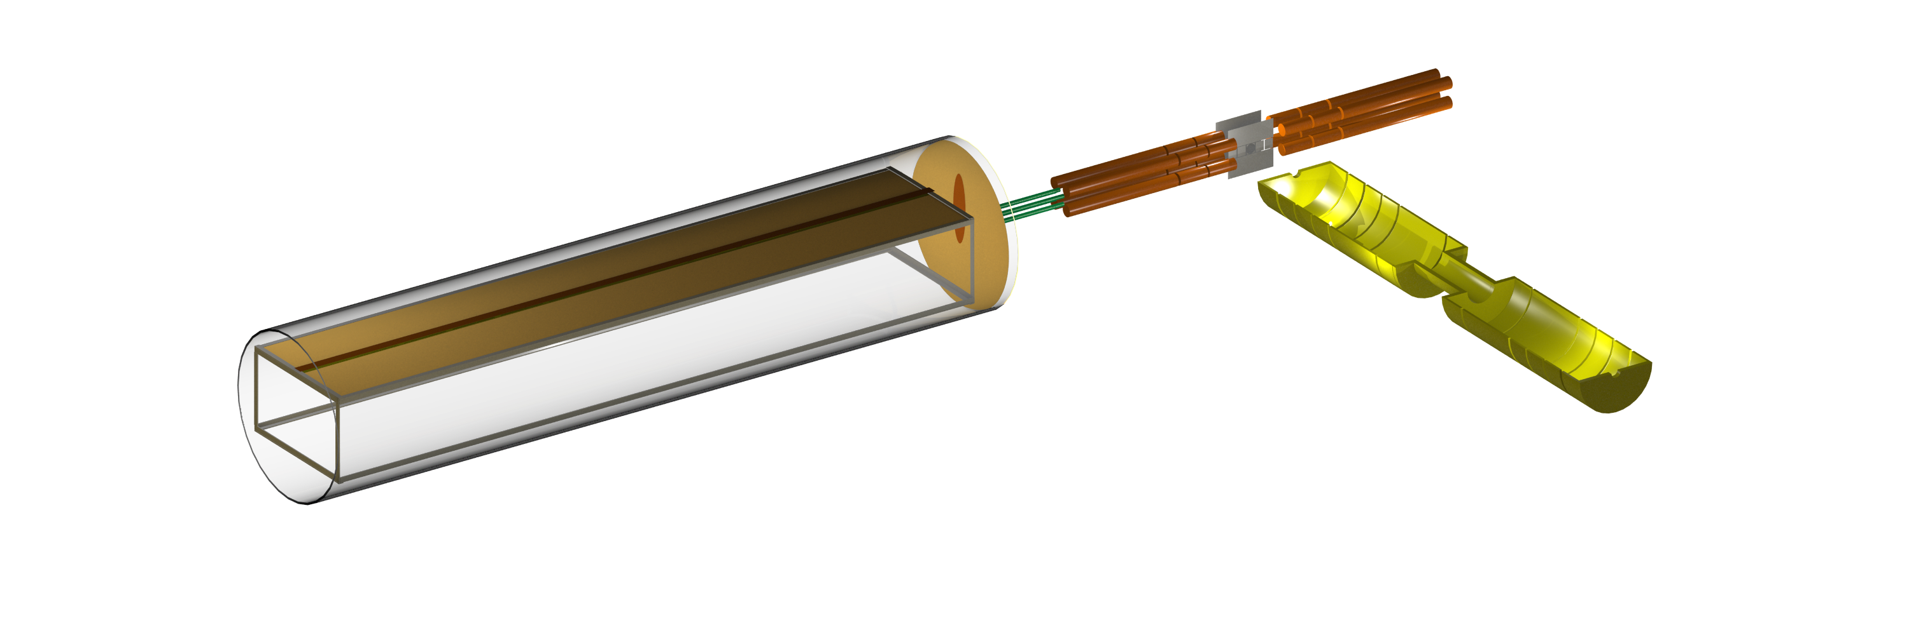

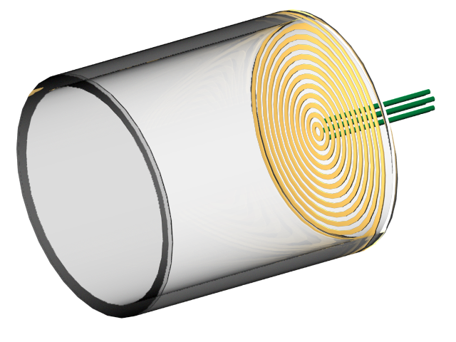
Comprehensive mass measurement
with MRTOF-MS
GARIS
Ion Traps
KISS
BigRIPS
+SLOWRI
150 cm He 200 mbar
MRTOF
30 cm He 100 mbar
BigRIPS
200 MeV/u
GARIS
30 cm He 1 mbar
5 MeV/u
KISS
30 keV
Pin Hole

Slide 11

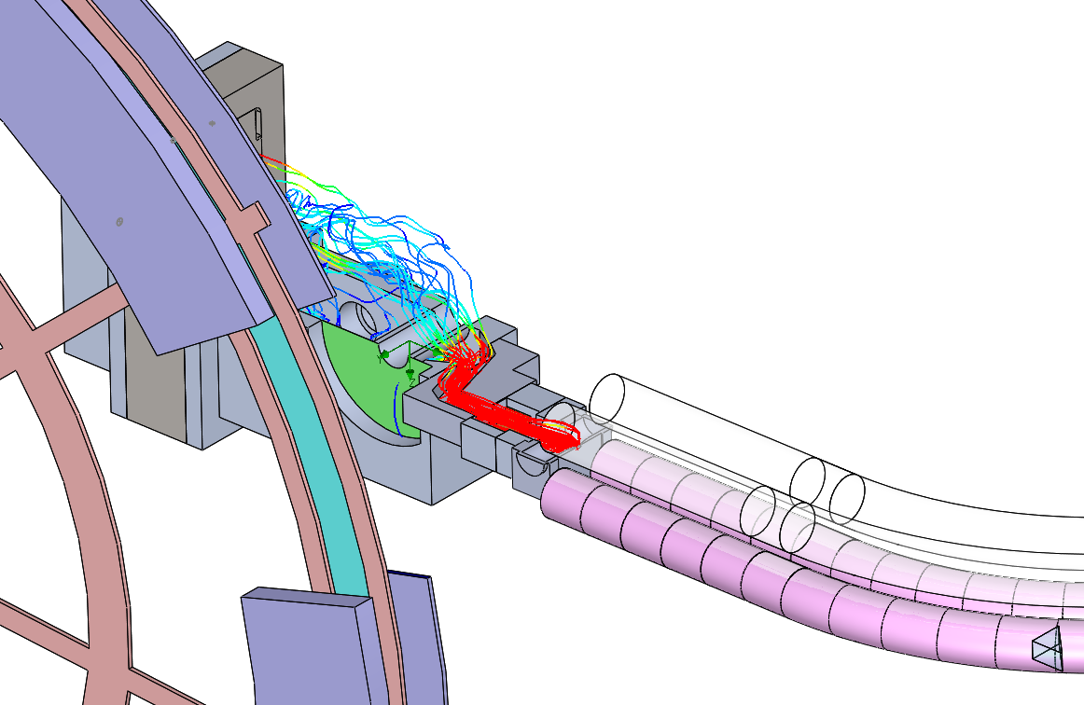
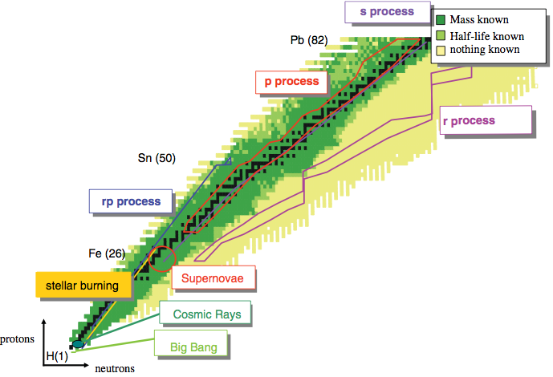
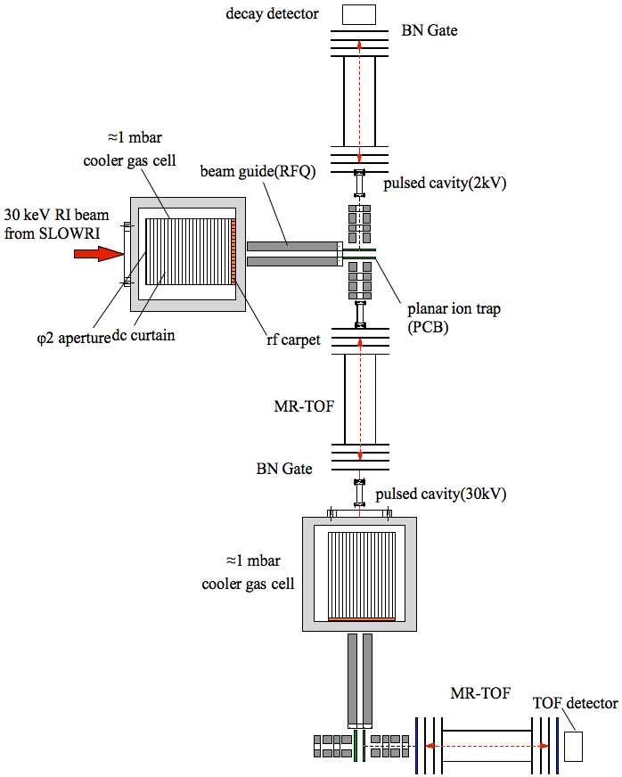
Future’s plan: KISS Stage II & MRTOF
-Comprehensive study of element synthesis with precise spectroscopy-
KISS upgrade
Beam dump (~20kW)
²³⁸U beam
11 MeV/A
10 pμA
S-shape RF quadrupole
ion-guide
Mass
Lifetime
Decay scheme
Rotating ¹⁹⁸Pt-target
(~ 7 kW)
Collinear 3 color lasers
radii
moment
Ion. pot.
from SLOWRI
High pure RI
spectroscopy line (HPSP)+MRTOFs
β-delayed neutron

Slide 12
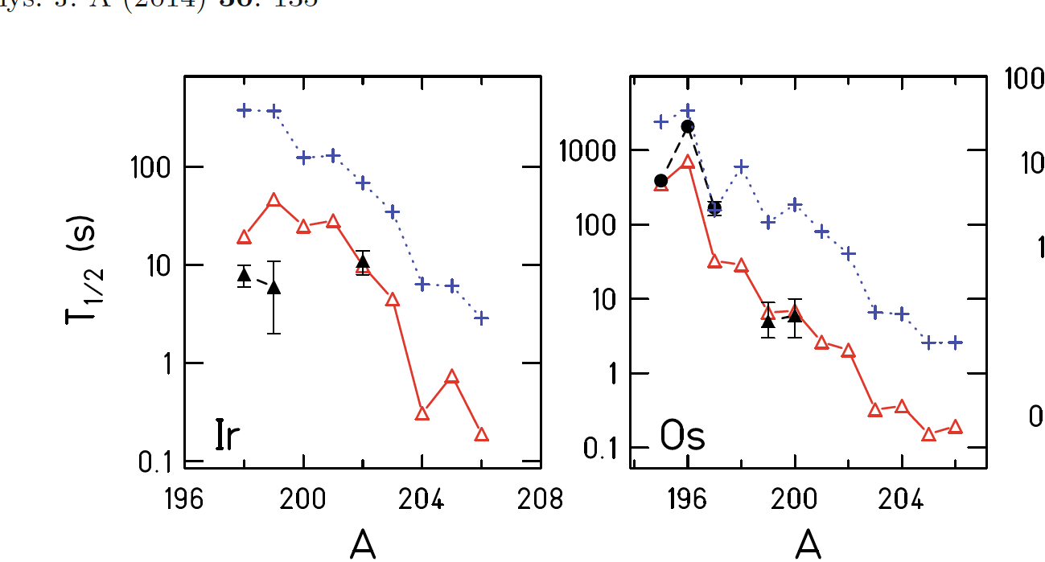

Preliminary lifetime systematics of Ir and Os isotopes
from T.K. Nieto et al., EPJ A50(’14)135.
(PF@GSI)
Expt. KISS (MNT)
(Very preliminary)
Preliminary
• Measured half-lives of ¹⁹⁹Ir would become close to the DF3 predictions.
• Newly obtained half-life of ¹⁹⁷⁻⁸Os would be longer than the DF3 by a factor around 2-3.

