Slide 1
“Realistic beam power projection
MR power supply upgrade is the highest priority in KEK
Power upgrade to 1.3MW for HyperK is the highest priority in KEK PIP (project implementation plan) among projects whose fund need to be newly requested to the Gov.
KEK is making and will make best effort to realize the power upgrade
However, we cannot promise multi-year plan due to single year funding scheme in Japan

Slide 2
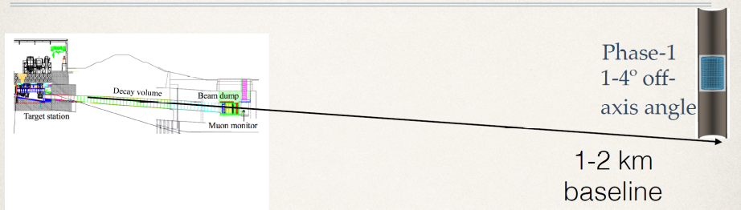
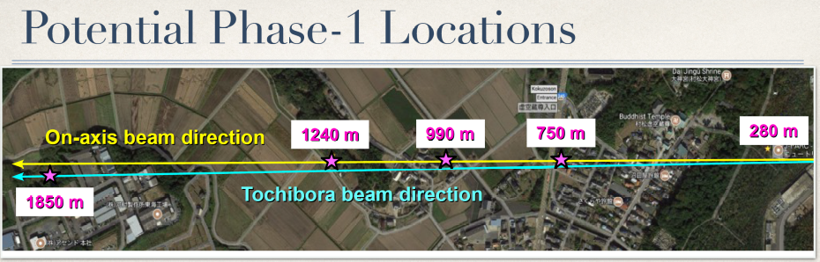
Intermediate water Cherenkov detector
Background situation seen from Japan
Proposed as a separate experiment to J-PARC PAC
  Stage-1 Status is granted (Science merit is good and technically sound)
JST Master plan for large projects (2017)
  Included in the proposed package for Hyper K as new “near detector”, technical detail (not even specify water cherenkkov)
  10 oku-Yen for facility (japan), 30-oku yen for detector (external fund incl international contribution)
MEXT roadmap 2017 for large projects
  Same as in JST master plan
KEK Project Implementation plan (PIP) 2016
  Prioritization process
  Proposed package from proponent
    Include near detector same as Master plan/Roadmap
  Committee recommendation and KEK-PIP
    Did not explicitly contain near detector

Slide 3
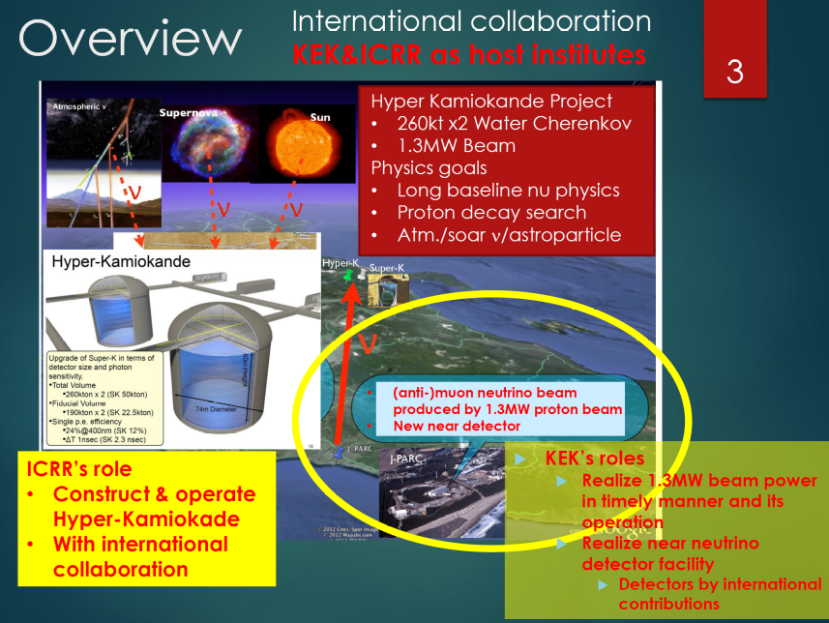
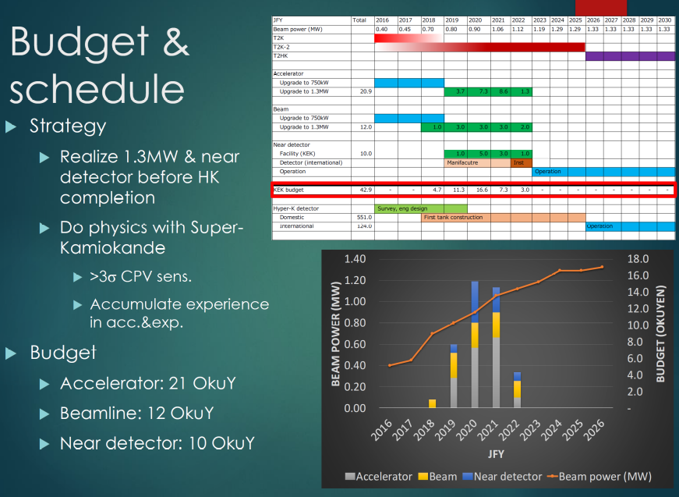
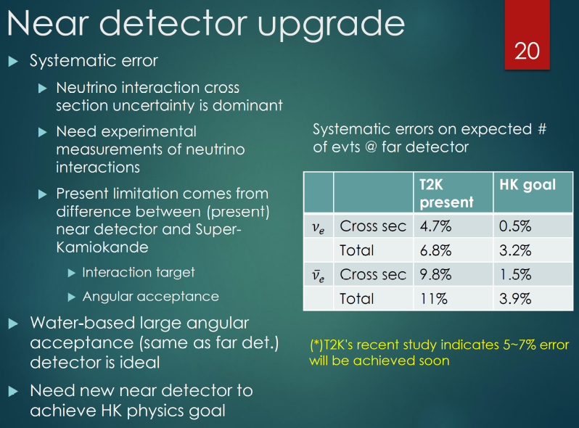
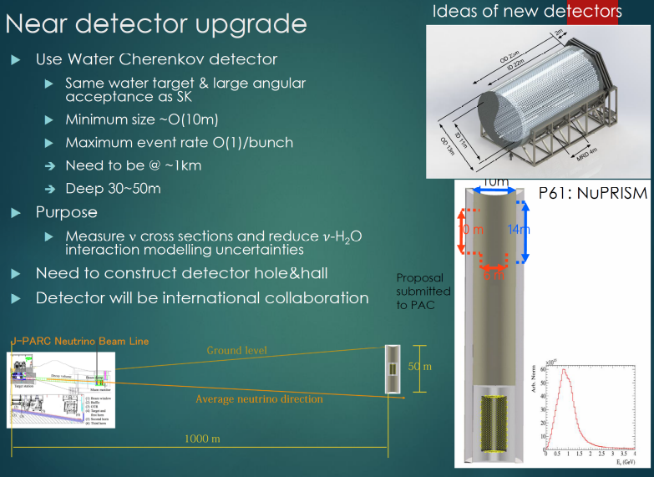
KEK-PIP presentation

Slide 4
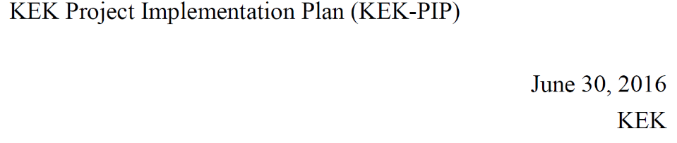
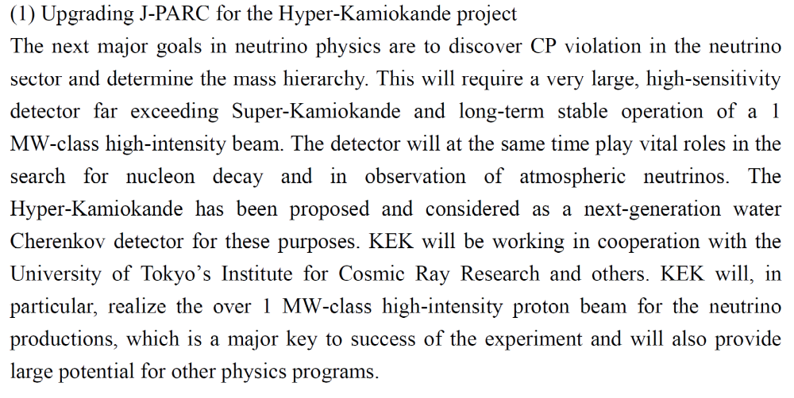
KEK-PIP

Slide 5
Potential funding scenario for IWCD
First of all, we, in KEK, haven’t discussed yet in detail, so today we can not say official answer.
First, neutrino community need to decide how to proceed with IWCD
  Whether separate collaboration?
  Absorbed in HyperK？
Then the collaboration may request host institutions, ICRR and KEK
KEK and ICRR discuss how to handle this
(Assuming KEK will handle)
Two possible major steps have to be taken
  PAC type of review
    In order for KEK/IPNS to “approve” the project and make commitment, “PAC” type of review committee is needed to assess physics importance and technical feasibility. This could be HKAC or sub committee.
    If the committee endorse the project, then the director makes decision based on the recommendation
  PIP
    In addition, in order for a project to be in the queue of funding request, it is need to be listed in the KEK-PIP.
    KEK-PIP is released in 2016.
    We heard that KEK-DGs plan is that KEK-PIP should be stable as long as about 6 years which is the period of middle term plan

