Slide 1

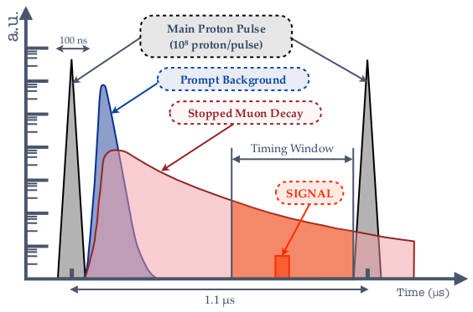
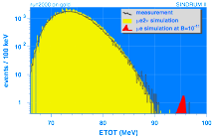
COMET mu-e conversion search at J-PARC
Mu-e conversion search using high-intensity pulsed proton beam (8GeV) at J-PARC
  Precise pulsing is mandatory to reject the beam induced BG
Sensitivities
  < 10⁻¹⁴ in Phase-I
  < 10⁻¹⁶ in Phase-II
    Current best limit by SINDRUM II
    BR < 7x10⁻¹³ @ 90% C.L.
Current activities (Dec. 2017)
  1st attempt of 8GeV acceleration/extraction test in January 2018
    Diamond detector as a proton beam monitor
  Facility construction in progress with strong supports by J-PARC/KEK
    New primary beamline
    Superconducting magnet system
  Detector / software preparation by the collaboration members
  Collaboration growth
    Dresden Technical Uni. (2016)
    Clermont-Ferrand (France) & Monash Univ. (Australia) (2017)
    Some more groups (in Asia and Europe ) showing interest to join COMET
    TRIUMF?
BR[μ⁻ + Au →e⁻ + Au] < 7 × 10⁻¹³
SINDRUM II
Main BG source:
π⁻+(A,Z)→(A,Z-1)*, (A,Z-1)* →γ+(A,Z-1), γ→e⁺e⁻
Prompt timing
Other sources:
μ⁻ decay-in-flight, e⁻ scattering, neutron streaming
Slides by Satoshi MIHARA

Slide 2
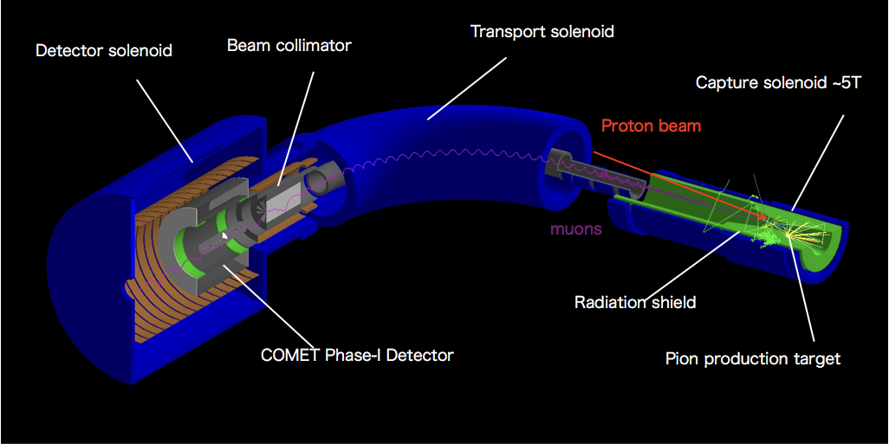
COMET Phase-I

Slide 3
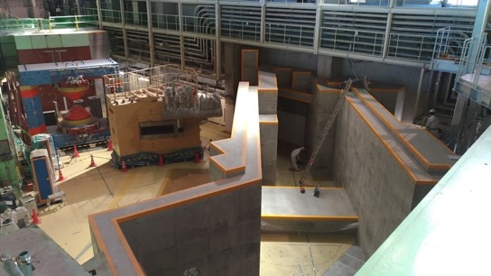
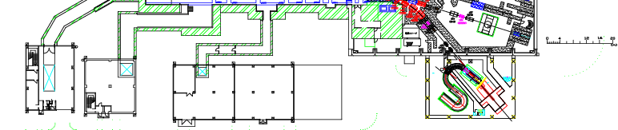
COMET Facility Construction
COMET Primary Beamline
  [Switching Yard] Beamline components installation almost done
  [HD Hall] Beamline walls and magnet power supply stage in construction followed by magnet installation
View from here
HD Hall
Switching yard
New beamline for high-p/COMET available at the end of JFY 2019
8GeV conditioning using an existing line (K1.8) and T1 target
COMET Hall
Slides by Satoshi MIHARA

Slide 4
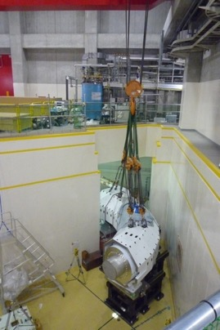
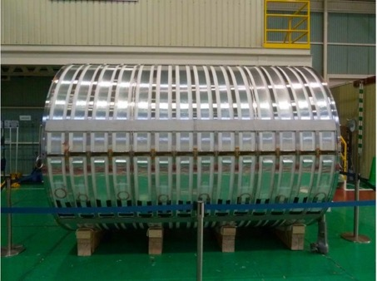
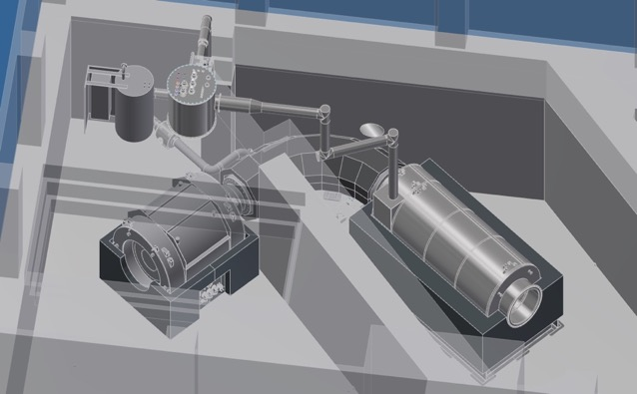
COMET Facility Construction
Detector Solenoid Coil
to be installed in a cryostat
Precise alignment of TS
Superconducting Magnets
  Capture Solenoid Coil winding in progress
  Precise alignment of Transport Solenoid and its conditioning in preparation
  Bridget (Collimator) Solenoid will be constructed in 2018
  Detector Solenoid Cryostat will be constructed in 2018-2019
Cryogenics System
  Refrigerator test OK
  Helium transfer tubes and peripheral are being designed
TransferTube
to MTS
CurrentLeadBox
TransferTube
to PCS
ColdBox
Pion
Capture
Solenoid
Muon
Transport
Solenoid
Detector
Solenoid
Slides by Satoshi MIHARA
Global design of LHe transfer

Slide 5
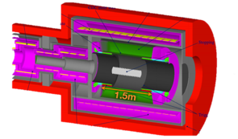
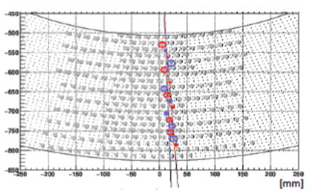
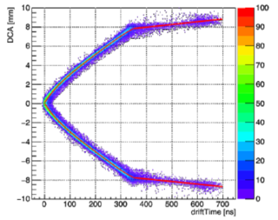
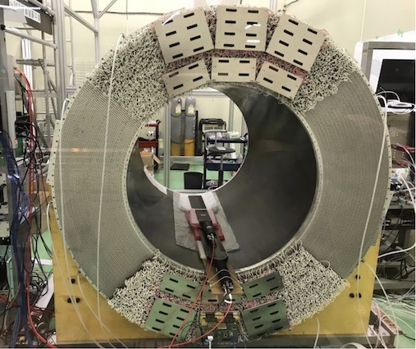
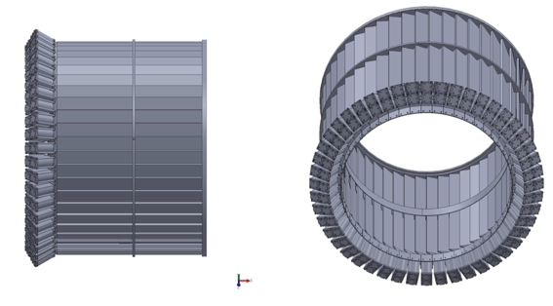
COMET Phase-I Detector Preparation
CDC (the main detector of COMET Phase-I ) surrounding the muon stopping target
  being tested with CR
Trigger hodosocpe at both ends of the spectrometer magnet
CR test data; performance as expected
Trigger hodoscope design ready
Construction in 2018-2019
Slides by Satoshi MIHARA

Slide 6
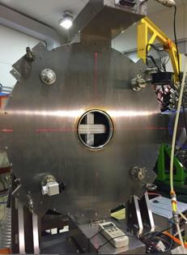
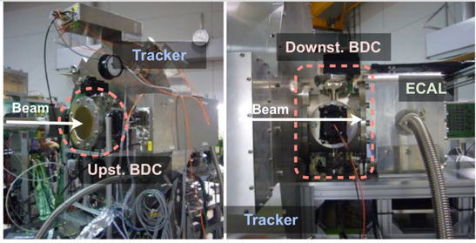
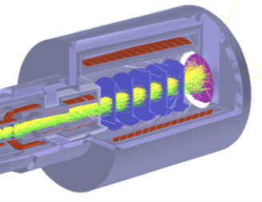
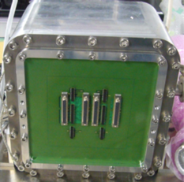
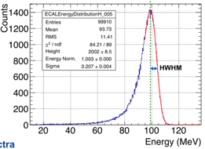
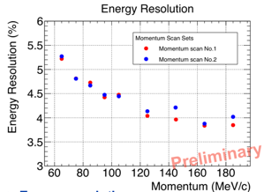
COMET Phase-II Detector R&D
COMET Phase-II Detector R&D in progress
  Used in the muon beamline study
  Straw-tube tracker operational in vacuum & LYSO calorimeter
  Electronics R&D dedicated for this is also in progress
Performance test of the tracker and Ecal in series with e beam at Tohoku U.
Straw-tube tracker
Straw-tube tracker prototype operational in vacuum
Ecal prototype (4x4, 2x2cm² – 12cmL LYSO) in a vacuum chamber
LYSO Calorimeter
Slides by Satoshi MIHARA

Slide 7
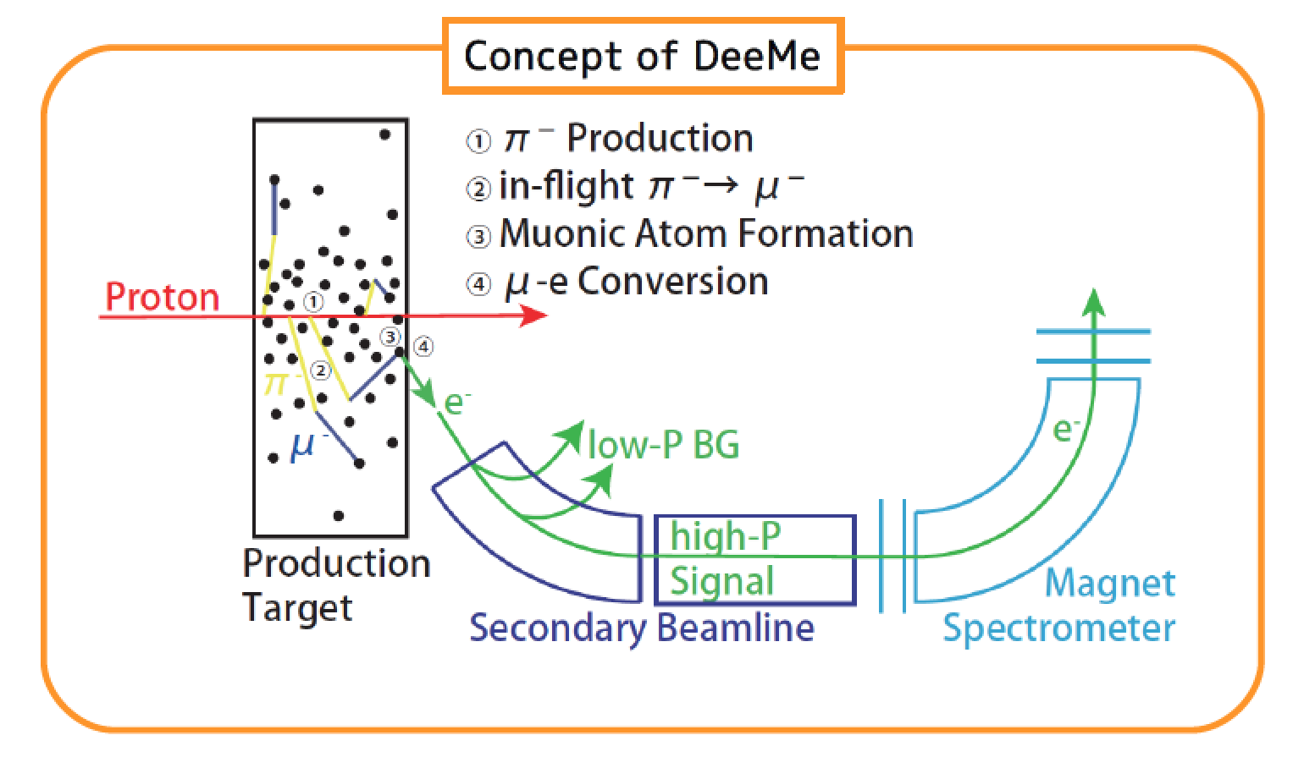
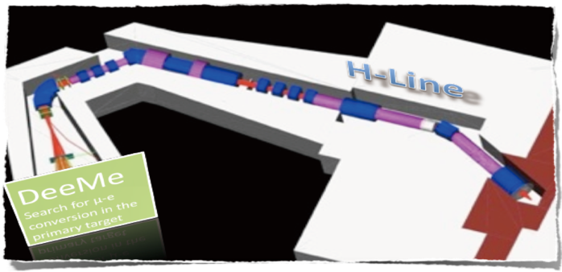
DeeMe at J-PARC MLF
“Quick and Dirty” mu-e conversion exp
Excellent extinction/purity
  1e-19 observed
Everything happens in
the target…

Slide 8
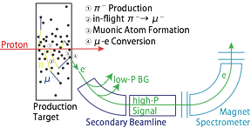
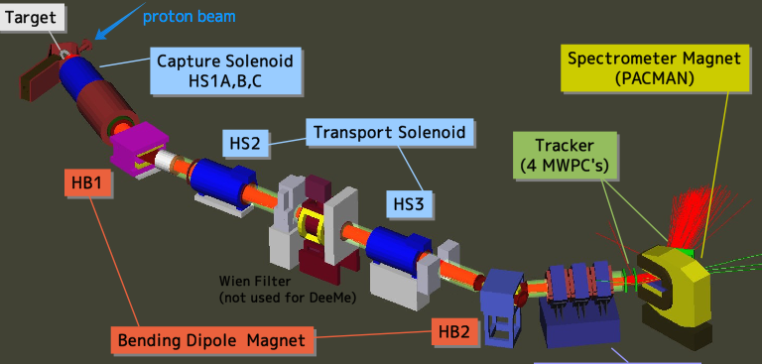
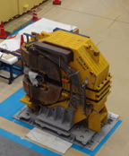
DeeMe: Search for μ-e Conversion
IMSS/Muon PAC: Stage-2 Approved
J-PARC/RCS: High-Power High-Purity Pulsed Proton Beam.
Production Target as μ-stopping target.
H-Line/MLF: Large-Acceptance Beam line.
State-of-the-Art MWPC Technology
Potential S.E.S. — BR~5 x 10⁻¹⁵
(8 x 10⁷ sec of data taking with SiC target)
Approved for the run with graphite target
  S.E.S. — 1 x 10⁻¹³ (2 x 10⁷ sec)
H-Line and DeeMe Spectrometer w/PACMAN
Magnet leased from TRIUMF is waiting for the installation to H-Line.

Slide 9
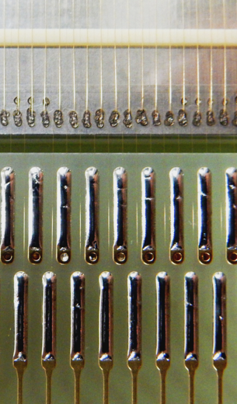
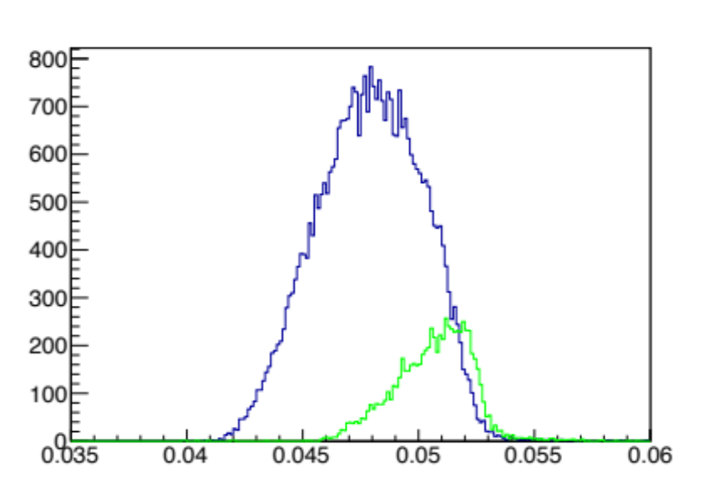
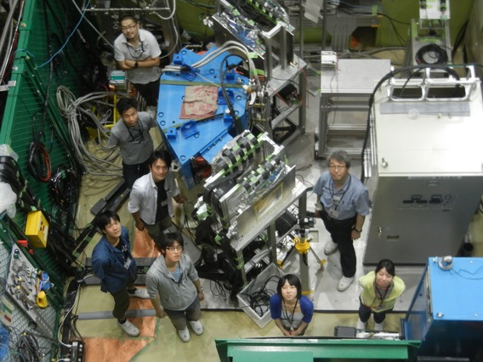
DeeMe Updates 2017
A Fast HV-switching MWPC
Sense/Potential wire spacing: 0.75 mm
PACMAN magnet is ready:
  Field measurement was done.
  Lease agreement w/TRIUMF was updated in the last April.
Four of fast HV-switching MWPCs have been fabricated.
Performed Decay-in-Orbit measurements (in a momentum range 55-65 MeV/c) at D2 area J-PARC MLF in the last March/June 2017 in order to confirm spectra recently calculated by Czarnecki et al..
  Four MWPCs, DAQ, everything worked:
  detector system is ready.
  Analysis is underway: practice for the μ-e conv. analysis.
We can start run once H-Line becomes available.
Published in PTEP
DOI: 10.1093/ptep/ptw193
μ⁺ calibration data
Blue: lower B field
Green: higher B field
Michel Edge of μ⁺ decay
Δp may different from
H-Line measurement:
no PACMAN
no He bag @ D2
DIO measurement @ D2, June 2017
e⁺ Momentum (GeV/c)

Slide 10
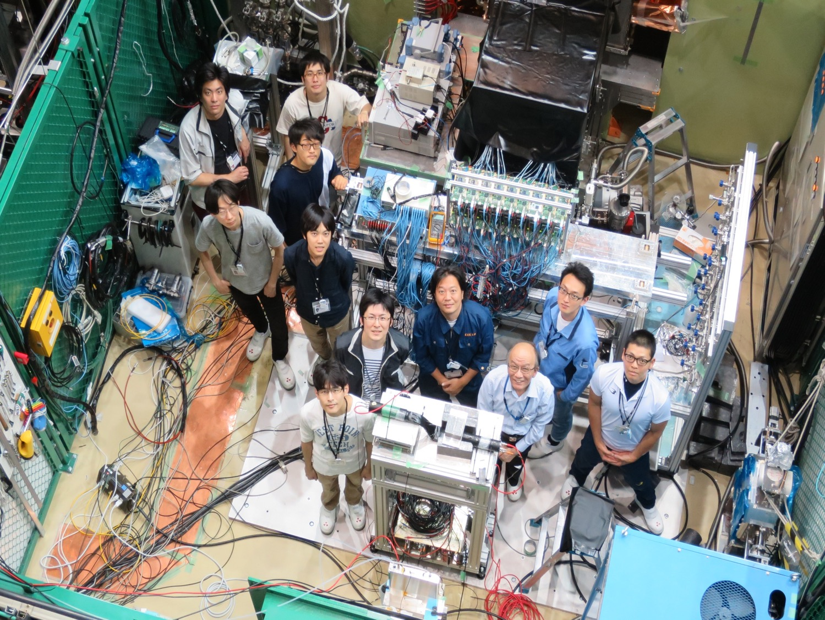
MuSEUM Experiment

Slide 11
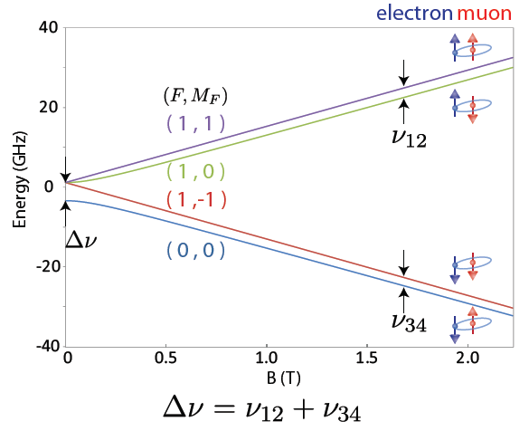
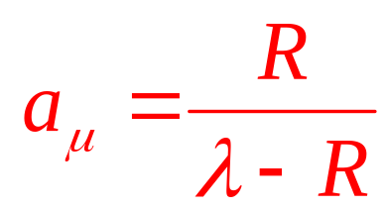
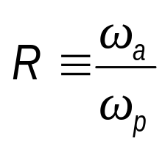
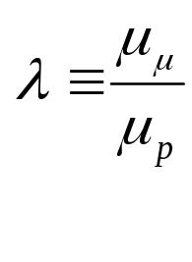
Precise Measurement of Mu HFS at J-PARC MUSE
e⁻
μ⁺
Hyperfine Structure
Zeeman Splitting
4463 MHz
e⁻
μ⁺
・Pure leptonic system suitable for the precise check of QED.
ν_{HFS}(exp) 4463.302 765(53) MHz (12 ppb]) LAMPF1999
μ_{μ}/μ_{p}=3.18334524(37) (120ppb)
・Strong relationship to muon g-2 measurement
HF
⇒
HF
ZF
ZF
From g-2 strage ring
From Muonium HFS
Our final goal at H line are HFS ~2ppb,
μ_{μ}/μ_{p}~20 ppb
ν₁₂+ν₃₄=Δν_{HFS}
ν₁₂−ν₃₄ ∝ μ_{μ}/μ_{p}

Slide 12

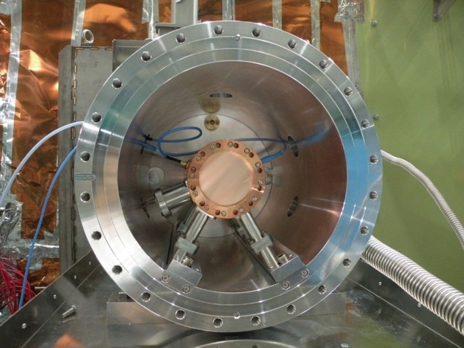
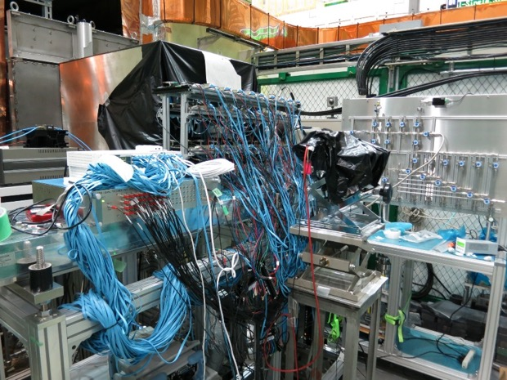
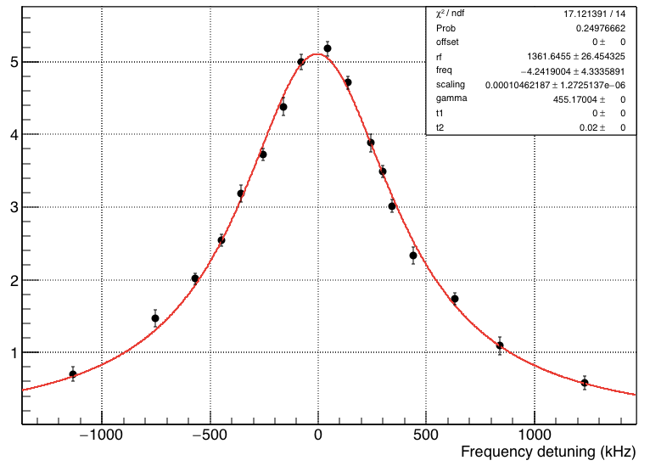
Zero field measurement at D Line
Important milestone for HF measurement

Slide 13
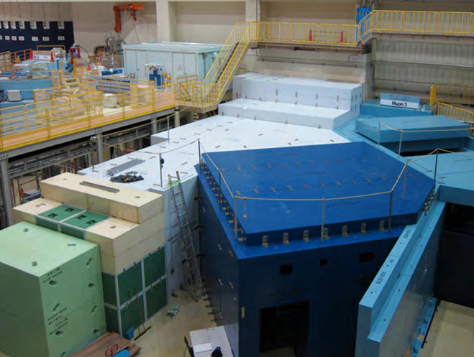
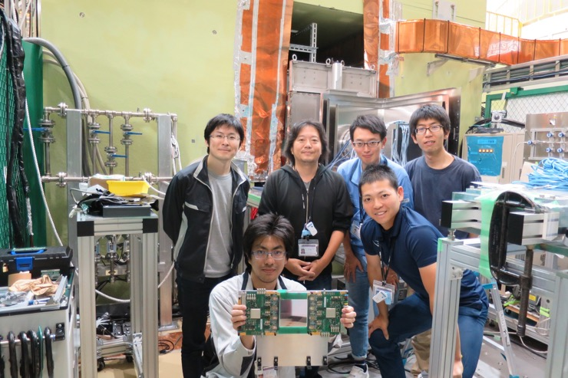
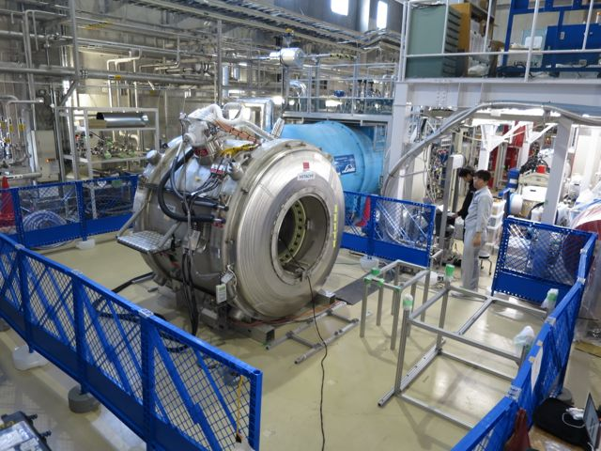
Preparation for HF measurement at H Line
H1 Area for Mu HFS Exp.
New silicone stripe detector
Homogenous Field <1ppm
MRI Magnet for HF

Slide 14
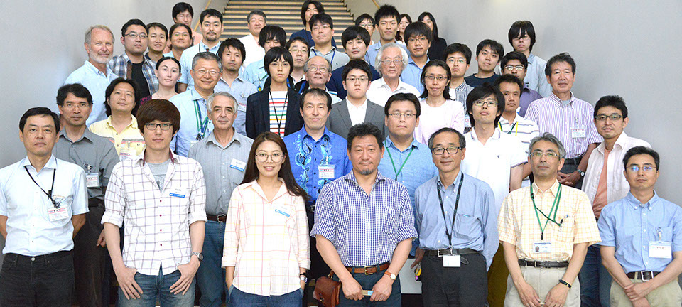
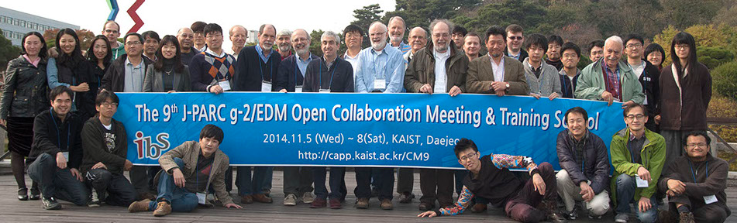
Muon g-2/EDM at J-PARC

Slide 15
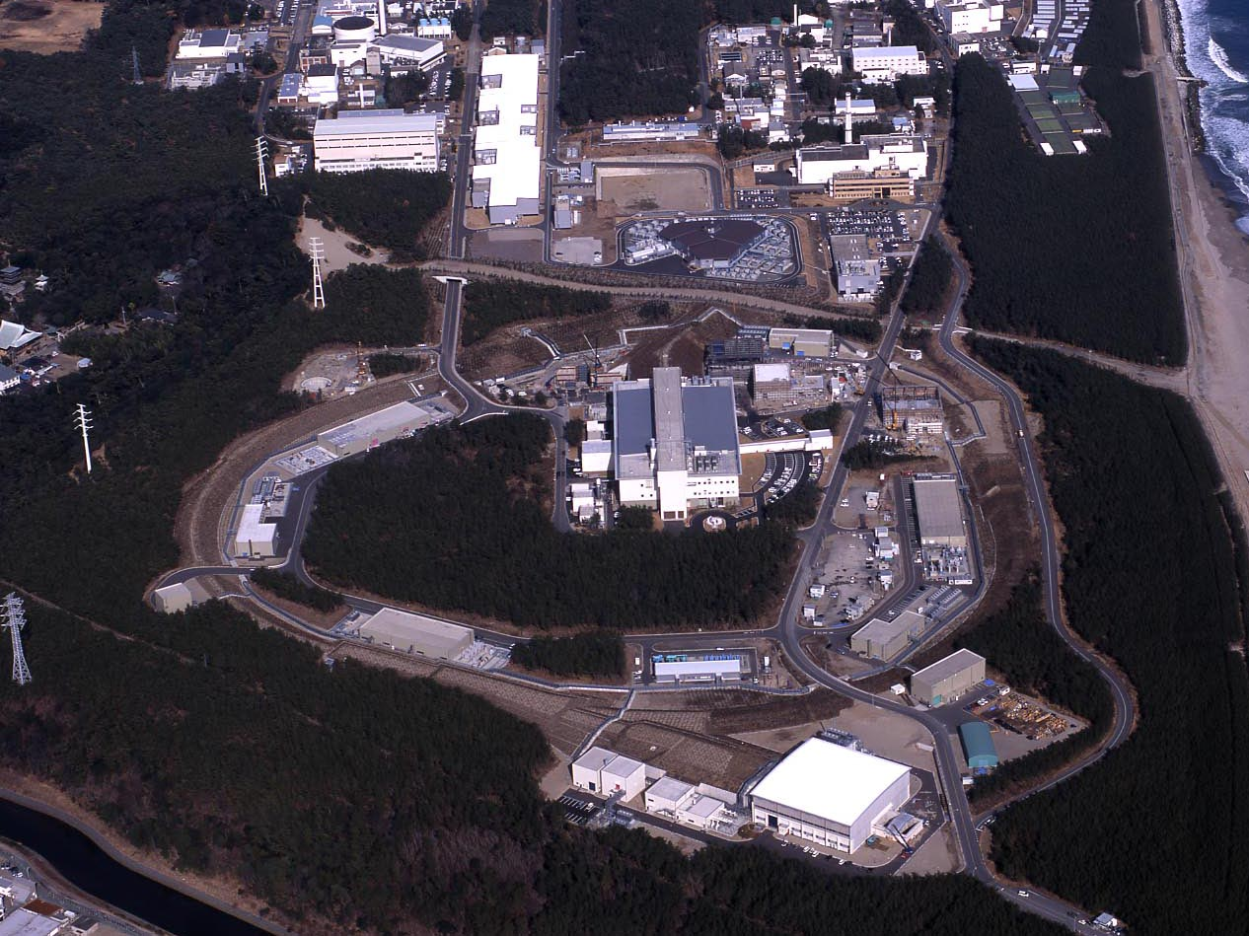
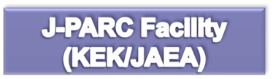



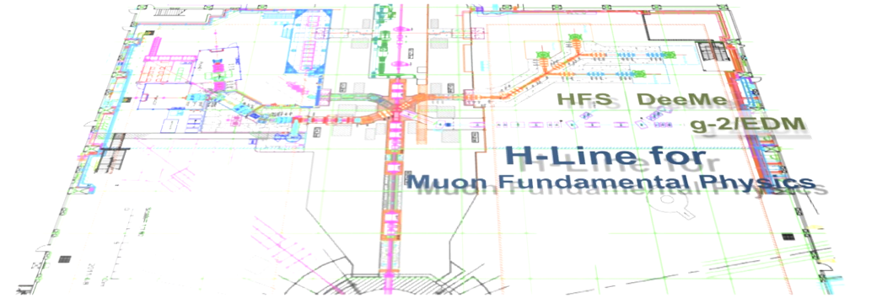

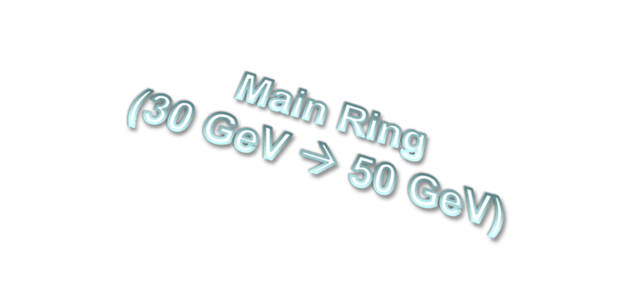


Bird’s eye photo in Feb. 2008

Slide 16
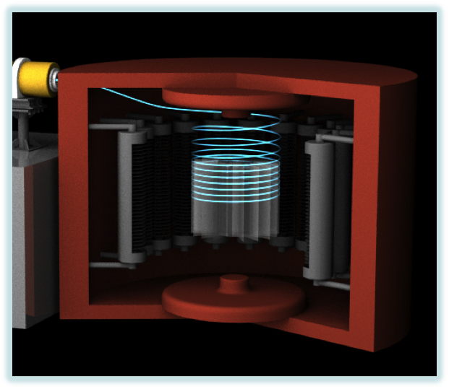
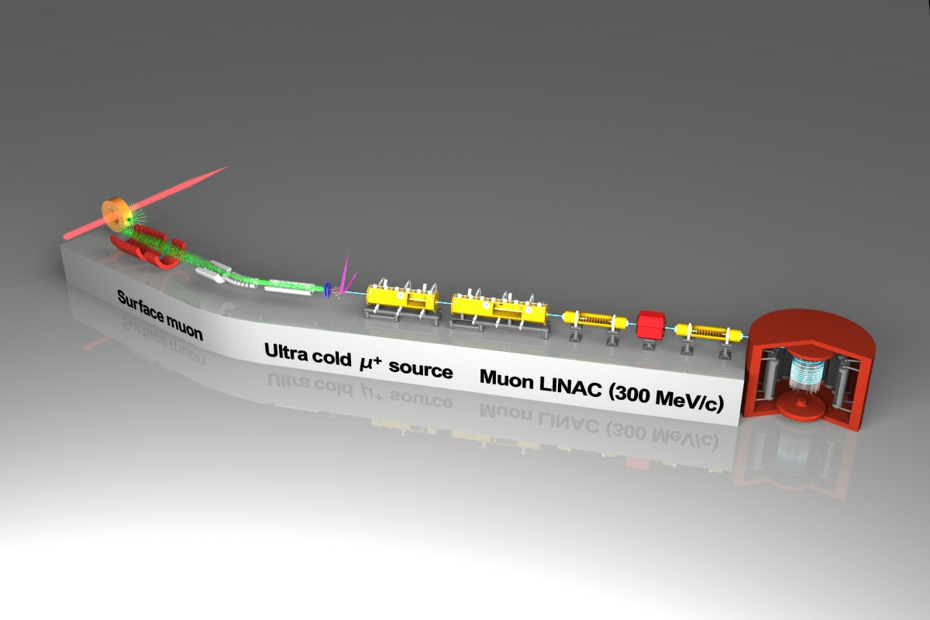
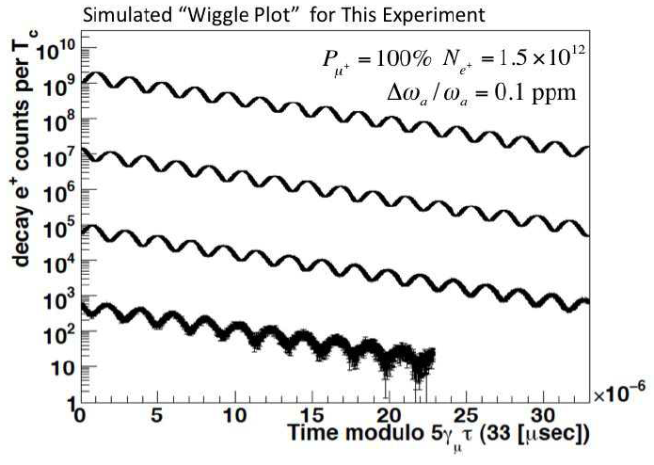
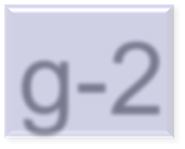
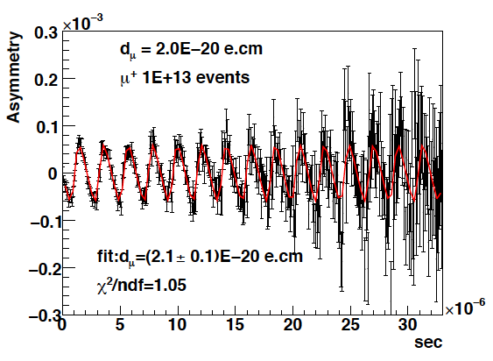
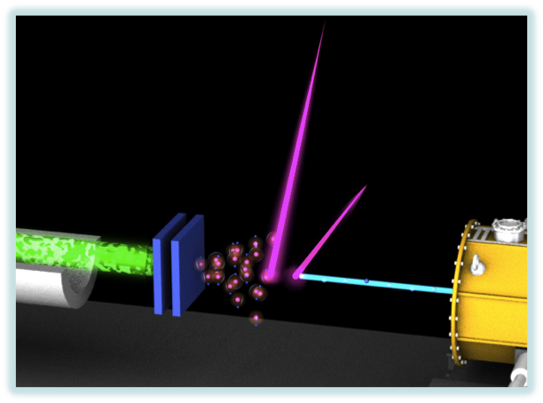


3 GeV proton beam
( 333 uA)
g-2
Silicon Tracker
Surface muon beam
(28 MeV/c, 4x10⁸/s)
66 cm diameter
Muonium Production
(300 K ~ 25 meV)
Super Precision Magnetic Field
(3T, ~1ppm local precision)
Resonant Laser Ionization of Muonium (~10⁶ μ⁺/s)
EDM
23

Slide 17


















Magic vs “New Magic”
Complimentary!
BNL/Fermilab Approach
J-PARC Approach
14m diameter
22

Slide 18







What’s Different?
Tertiary Muon Beam
  Widely spread over phase space
  Contamination of pion
Electric Field for Focusing ⇒ Magic Momentum
Electric Focusing
~10 cm
Injection
No Focusing
⇒ Any Momentum
Ultra-Cold Muon Beam
Can be contained in the detection volume w/o focusing
Yield?
No Focusing
~10 cm
Injection
21
< 10 cm spread over 10 km travel

Slide 19



Experimental Site
Material and Life science Facility
Parking lot
g-2/EDM
storage magnet
muon linac
muon
production
target
sparation neutron
source

Slide 20
Overview ~cont’d
Muon linac design
5.6 keV
β=0.01
0.3 MeV
β=0.08
4.5 MeV
β=0.3
40 MeV
β=0.7
212 MeV
β=0.9
USμ
RFQ
IH-DTL
DAW CCL
Disk-loaded
(DL)
3.2 m
324 MHz
1.4 m
16 m
1296 MHz
15 m
~40m in total
Basic design for all structures was finished.
  M. Otani et al., Phys. Rev. AB, 19, 040101, 2016.
  Y. Kondo et al., J. Phys.: Conf. Ser. 874 012054 (2017) [link]
Next goal is demonstration of muon acceleration.
Slides by Masashi OTANI

Slide 21







Thus far
2014
2015
2016
2017
acceleration(2017/10)
Asembly@J-PARC (~2015/5)
μ⁺deceleration & BPM(2016/2)
Mu⁻ observation (2016/12)
Disassembly at RAL (2014/8)
Slow μ⁺ profile (2017/3)
Lead by RIKEN-RAL group
Slides by Masashi OTANI

Slide 22


Acceleration test setup
@J-PARC MLF D2
μ⁺ (~3MeV)
Mu⁻ generation
(3 MeV→<keV)
Electro-static lens (5 keV)
Proto-type RFQ (90 keV)
[J-PARC RFQ #0]
2 m
 | H- | μ
Injection (keV) | 50 | 5.6
Extraction | 810 | 89
IntervaneV(kV) | 81 | 9.1
Power (kW) | 180 | 2.3
4.3 m
Space 84mm
Beam diagnostic (quadrupole pair and bending magnet)
MCP detector
Slides by Masashi OTANI

Slide 23


Simulation results
Transport efficiency
Expected tof
Sufficient events for demonstration
(~100 events / 2days)
Slides by Masashi OTANI

Slide 24

Result with Mu⁻
Preliminary
Measured ~ 0.5 mHz, expected ~ 0.6 mHz, details are being under investigation
Succeeded to accelerate muon!
Slides by Masashi OTANI

Slide 25

Data taking (24th ~30th )
Mu⁻ production
μ⁺ (~3MeV)
M. Otani (KEK/J-PARC)
R. Kitamura (Tokyo)
5.6 keV
RFQ
Y. Kondo
(JAEA/J-PARC)
90 keV
Y. Sue
(Nagoya)
Y. Nakazawa
(Ibaraki)
D-plate
MCP
25

Slide 26

Material Science with Muon

Slide 27




Muon-D2
Non-destructive element analysis using µ⁻ X-ray
Demonstration of bulk sensitive light-element-analysis on interstellar object
It is demonstrated on a carbon-rich meteorite that the element-specific muonic X-ray spectroscopy can provide information on the content of light elements deep within the specimen, paving a path to the application of the technique to the specimens brought back by the “Hyabusa II” mission in the future.
K. Terada, K. Ninomiya, T. Osawa, S. Tachibana, Y. Miyake, M. K. Kubo, N. Kawamura,
W. Higemoto, A. Tsuchiyama, M. Ebihara & M. Uesugi, Sci. Rep. 4, 5072 (2014).
Notes:
負ミュオン特性X線のエネルギーが通常の蛍光X線のそれの約２００倍と高エネルギーで透過力があることを利用し、隕石中の軽元素である炭素を同定することに成功した。

Slide 28





Muon-D2
Possible intake of atomic hydrogen into deep Earth
Potential impact on the model of hydrogen circulation in rocks within the Earth
◆ Implanted muon has been found to be in a neutral atomic state (“muonium”) in Stishovite that is present in the lower Mantle.
◆ Because implanted muon simulates electronic state of interstitial hydrogen in matter, the observation suggests that hydrogen can exist as neutral atom at the interstitial sites in the lower mantle, contrary to the current consensus that hydrogen would be present only as water (H⁺ and OH⁻) at substitution sites.
Quartz
Hydrogen (H⁰)
Muonium (Mu⁰)
Stishovite
e⁻
e⁻
p⁺
≒
µ⁺
N. Funamori et al., Scientific Reports 5, 8437 (2015)

Slide 29




Muon-D1
Element-Strategy-Initiative: Materials for electronic devices
Bipartite magnetic parent phases in the iron oxypnictide superconductor
Mesoscopic phase separation
LaFeAsO1-xHx
µSR spectra
Magnetic phase
}
AF1
Nonmagnetic phase
SC1
SC2
AF2
Mapping out T_{N} versus H content x
M. Hiraishi, S. Iimura, K. M. Kojima et al., Nat. Phys. 10, 303 (2014).
Notes:
水素置換鉄系超伝導体LaFeAs(O,H)での新たな磁性相の発見において、ミュオンはその特徴を生かして迅速に電子相図を決めるという重要な役割を果たした。

Slide 30





Muon-D1
IMSS-CMRC project: Geometrical electronic correlation
Novel magnetic frustration in iridium spinel compound CuIr₂S₄
High sensitivity of muon allowed to unravel the novel magnetism so far overlooked.
~0.08µ_{B}
Two off-diagonal exchange interaction between Ir⁴⁺ ions (d-d and d-p-d hopping) leads to a quadrupolar state competing with spin-singlet ground state.
Nasu and Motome, arXiv.1404.2426
K.M. Kojima, R. Kadono, M. Miyazaki, M. Hiraishi, I. Yamauchi, A. Koda, Y. Tsuchiya, H. S. Suzuki, and H. Kitazawa, Phys. Rev. Lett. 112, 087204 (2014).
Notes:
ミュオンが高感度な磁性プロー笛あることを活かし、CuIr2S4というスピネル型イリジウム化合物で従来見落とされていた新規な磁性を発見した。

Slide 31



Industrial Use of Muon〜Li Battery〜
Clarify Li diffusion behavior in the cathode materials
【Motivation】 In order to develop a new cathode material with high working voltage, we have measured a Li-diffusion coefficient of several olivine type compounds with muSR, since mSR provides information on Li-diffusion even in the materials containing magnetic ions.
Related papers using the data obtained in J-PARC;
1) M. Mansson and J. Sugiyama, Physica Scripta 88, 068509 (2013).
2) J. Sugiyama et al., Phys. Rev. B 85, 054111 (2012).
3) J. Sugiyama et al., Phys. Rev. B 84, 054430 (2011).
The muSR spectra for LiFe_{0.5}Mn_{0.5}PO₄ measured at (a) 100 K and (b) 300 K.
The decrease in relaxation rate at 300 K is caused by Li-diffusion.
The temperature dependence of (a) the field distribution width Δ and (b) the hopping rate ν for LiFe_{1-x}Mn_{x}PO₄. The ν(T) curve shows that Li is the most mobile in the x=0.8 sample.
【Impact】 Such cathode material leads to a Li-ion battery with safe and high energy capacity, which is suitable for the future electric cars.

Slide 32





The fist observation of ultra slow muons at U-Line
At the commissioning on Feb. 21st right after MLF recovery!
Ultra Slow Muon Yield
MCP Events
TOF
0.73 μs
Ultra Slow Muons
Laser Delayed Timing against Proton
Mu Target (W)
Magnetic Bend （Mass Separation）
Background by decay positron
Time
Ultra Slow Muons
Arrival timing of Surface Muons
Laser Timing
Background
Electric Bend
Surface muon
Ionization Lasers
ＭＣＰ
2016 Feb. 21st １/１０ min
2017 June
550 events/s@MCP → 2000/s@1MW
Top view of the Ｕ－Ｌｉｎｅ

Slide 33

Muon
Experiment
A Famous Picture from TRIUMF M15

Slide 34
Summary
Muon precision measurements continues to be attractive area of particle physics
Muon is a unique probe in Material Science, too
CW@TRIUMF and Pulsed@J-PARC
→A perfect combination to produce even more interesting results in the next decade!

