Slide 1


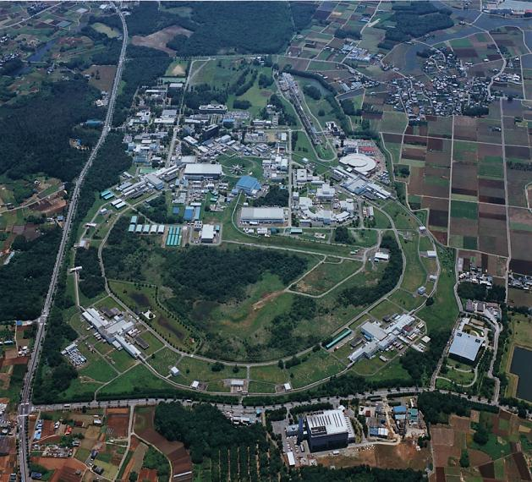
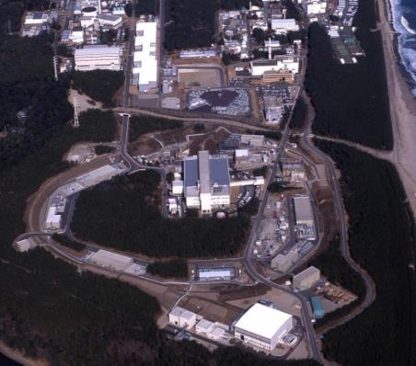
KEK
High Energy Accelerator
Research Organization
KEK Update
TRIUMF-KEK Scientific Symposium
December 14, 2017
M.Yamauchi
KEK

Slide 2
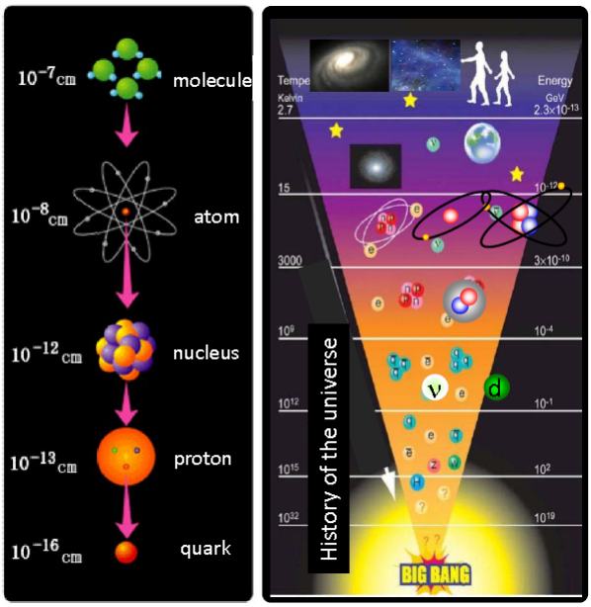
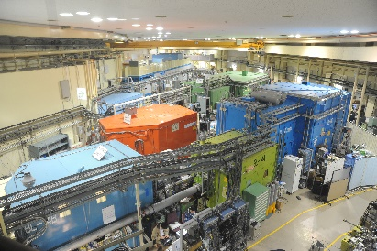

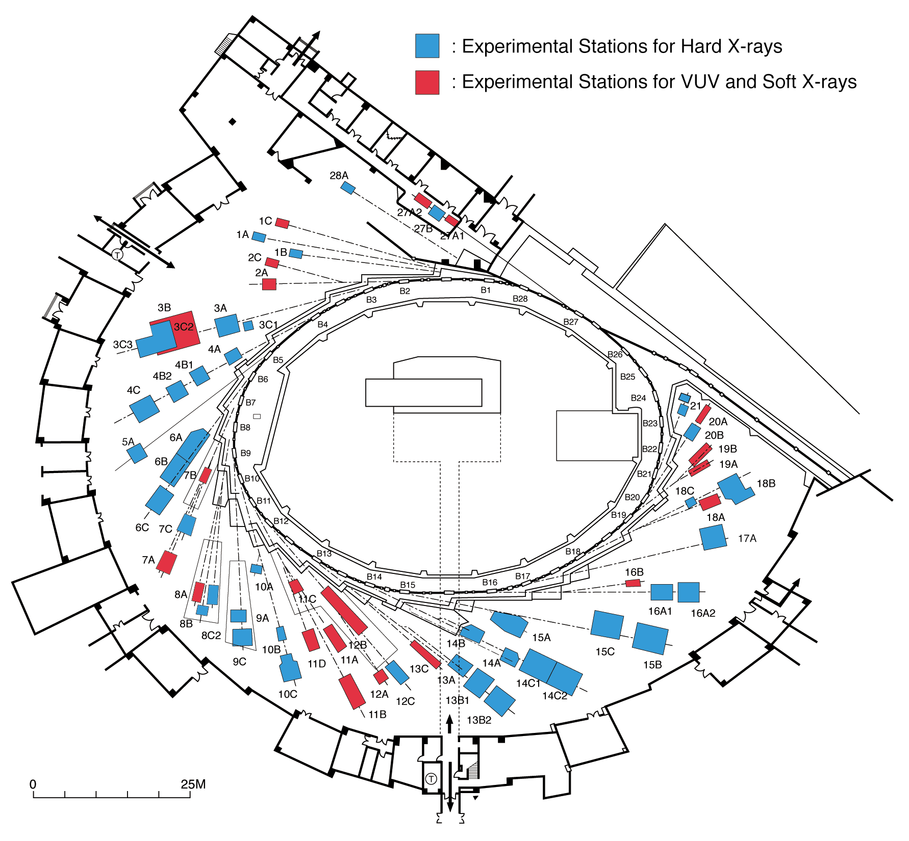
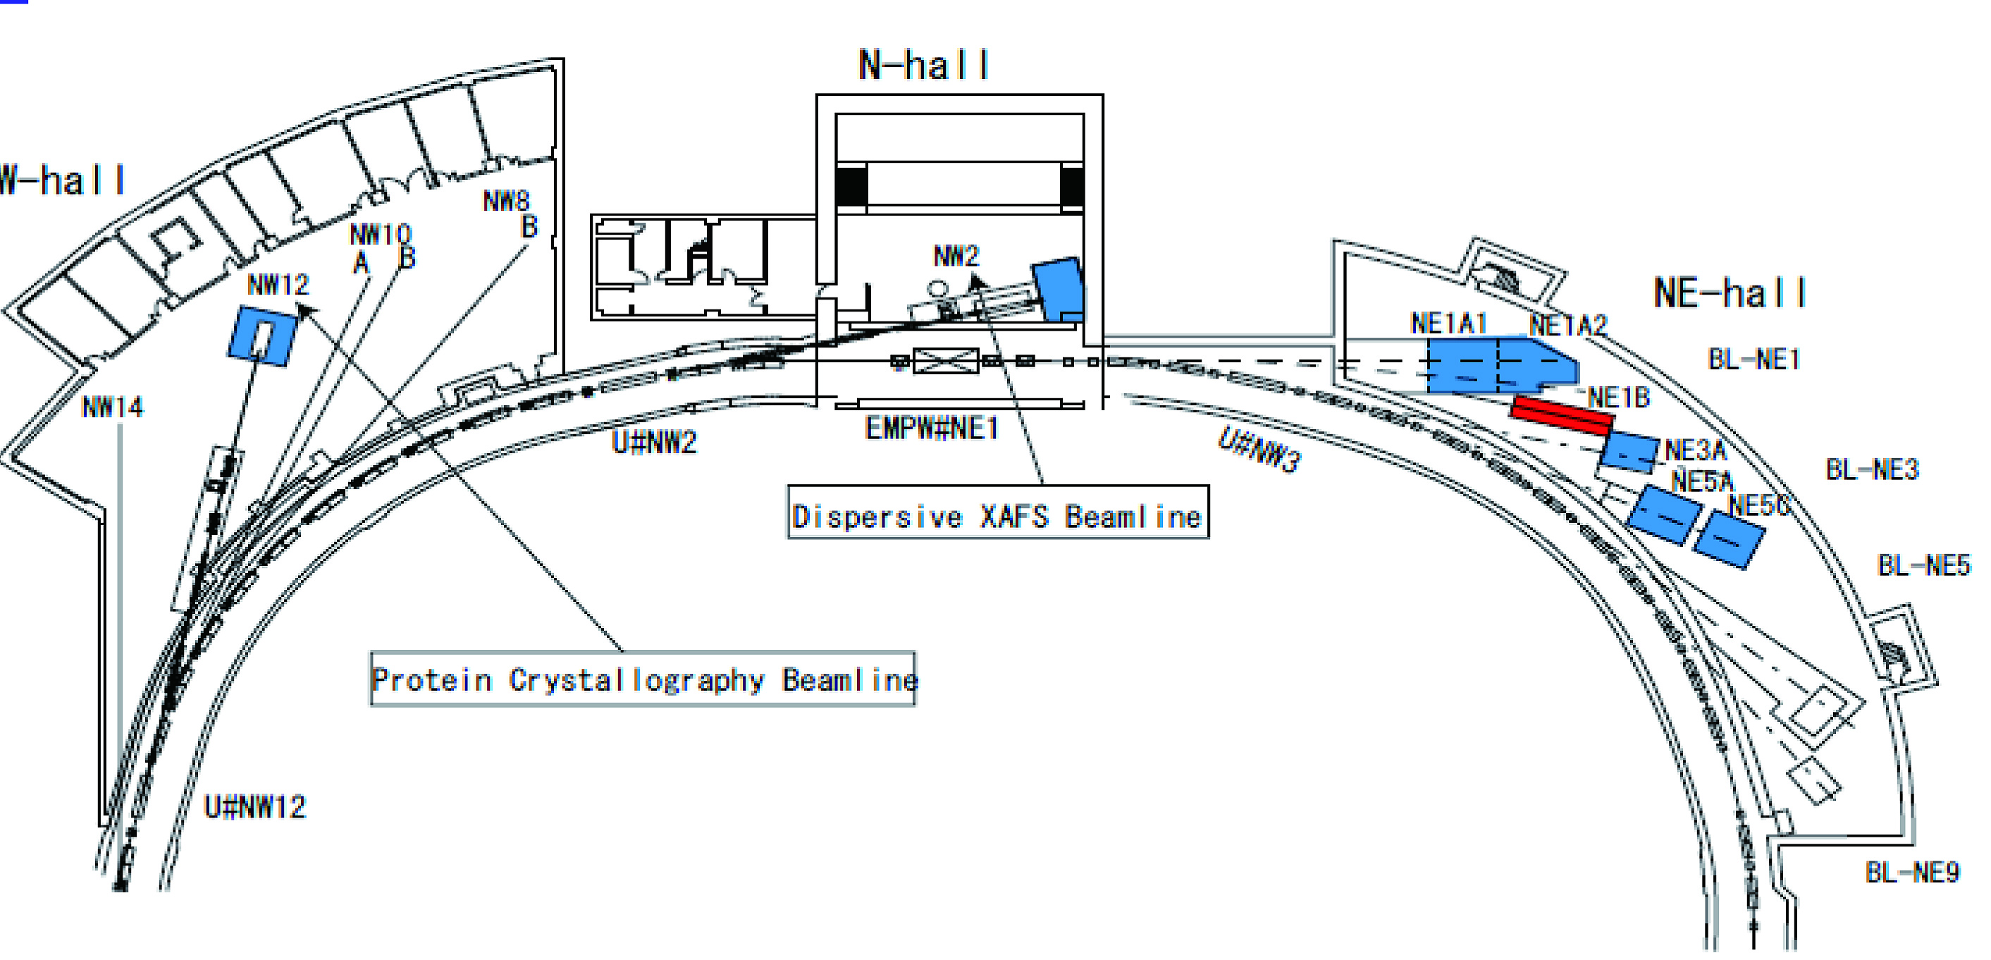
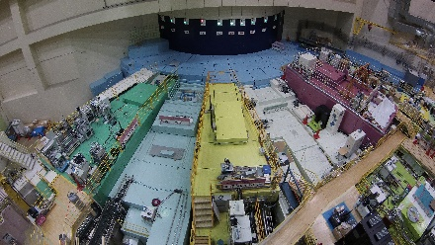
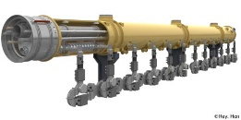
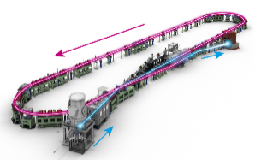

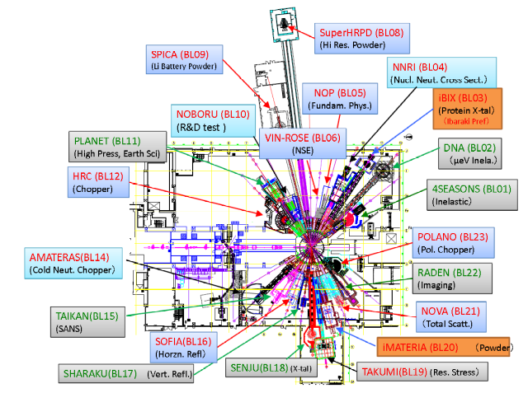
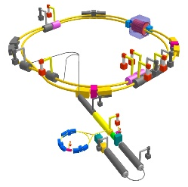
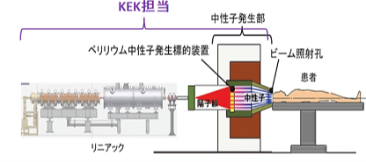
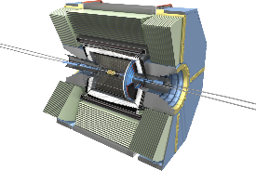
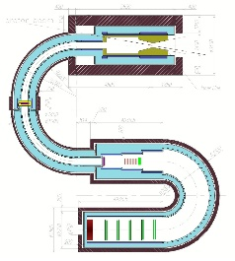
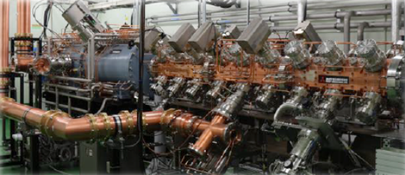
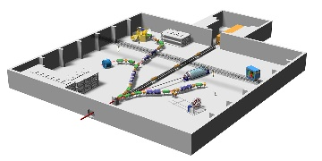
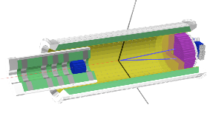
Diversity in accelerator based sciences
Pursuing fundamental laws of nature
Pursuing origin of function in materials
Basic science
Material science
and its applications
Photon factory
X-ray as a probe
Accelerators
Technical development
and its applications
技術の波及
J-PARC MLF
neutron and μ
as a probe
Superconducting
accelerator
T2K neutrino exp.
Energy recovery linac
SuperKEKB
and Belle II
Accelerator-
based BNCT
COMET
J-PARC
Hadron hall

Slide 3
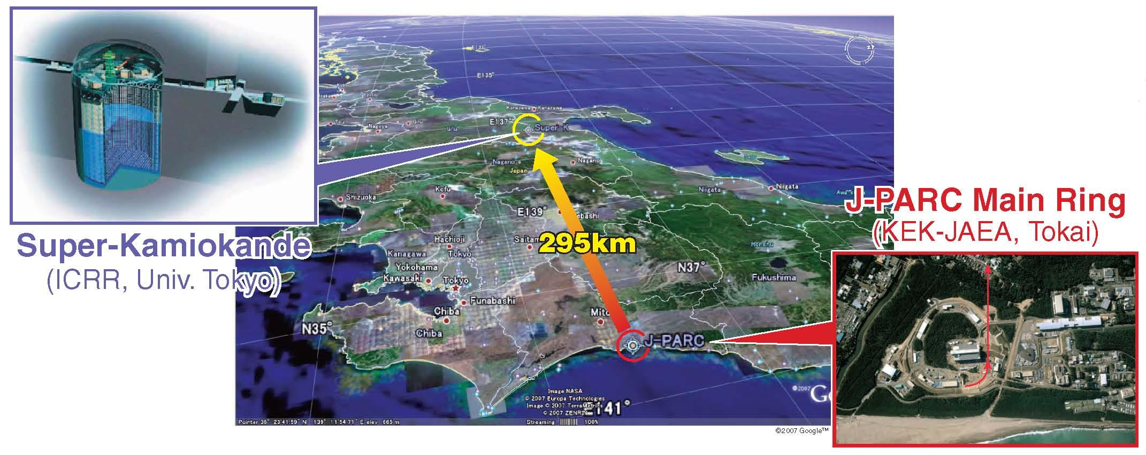
T2K (Tokai to Kamioka) experiment
2010~ (Running)
High intensity ν_{μ} beam from J-PARC MR to Super-Kamiokande
Observation of ν_{μ} → ν_{e} (2013)
Updated goals
  Precise measurement of ν_{e} appearance
  Precise measurement of ν_{μ} disappearance
  ➔ CPV phase, contribution to mass hierarchy determination

Slide 4
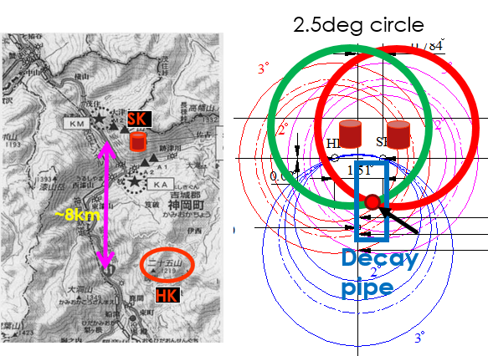
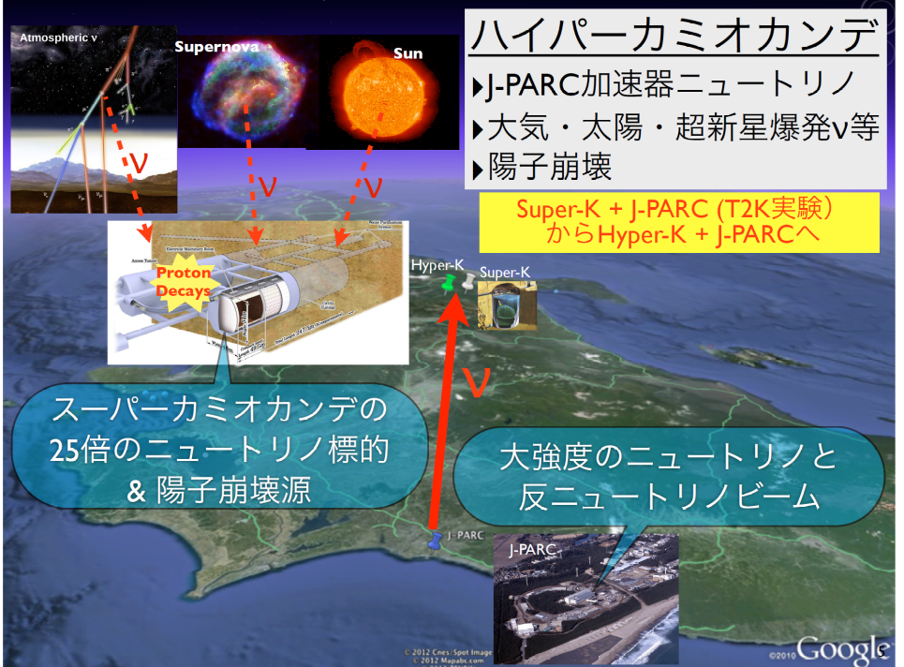
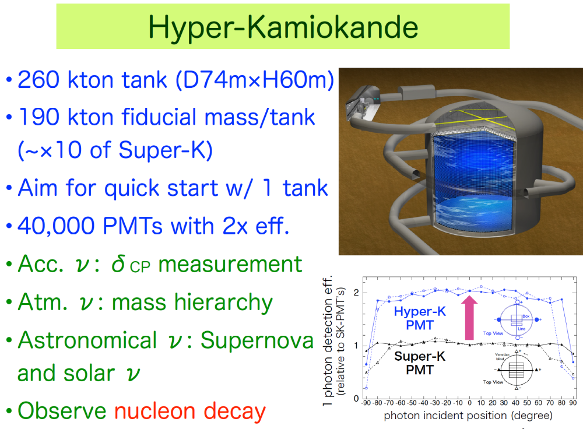
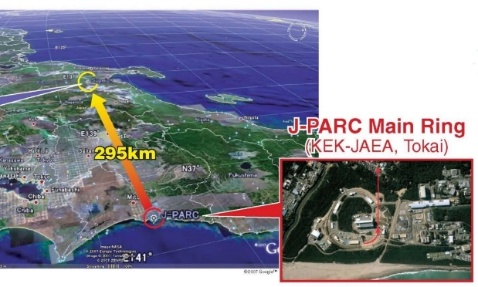
Hyper-Kamiokande (U. of Tokyo)
Next-generation Water Cherenkov detector
  260kt (190kt fid. mass) x 2
  Staging
Detector location (candidate)
  ~8km south of SK
  295km from J-PARC, @ same off-axis angle
  650m overburden (1755m W.E.)
Physics goals
  Accelerator neutrino
    CPV in neutrino
  Non-accelerator/Astroparticle
    Discovery of proton decay
    Atm-nu
    Solar-nu
    Supernova (relic) nu
ICRR/UT will take primary responsibility
Listed in the 2017 MEXT Roadmap of the Large Research Infrastructure

Slide 5
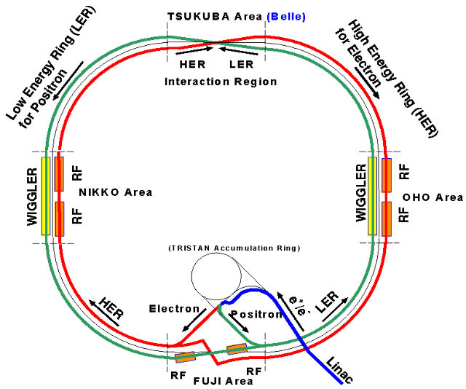
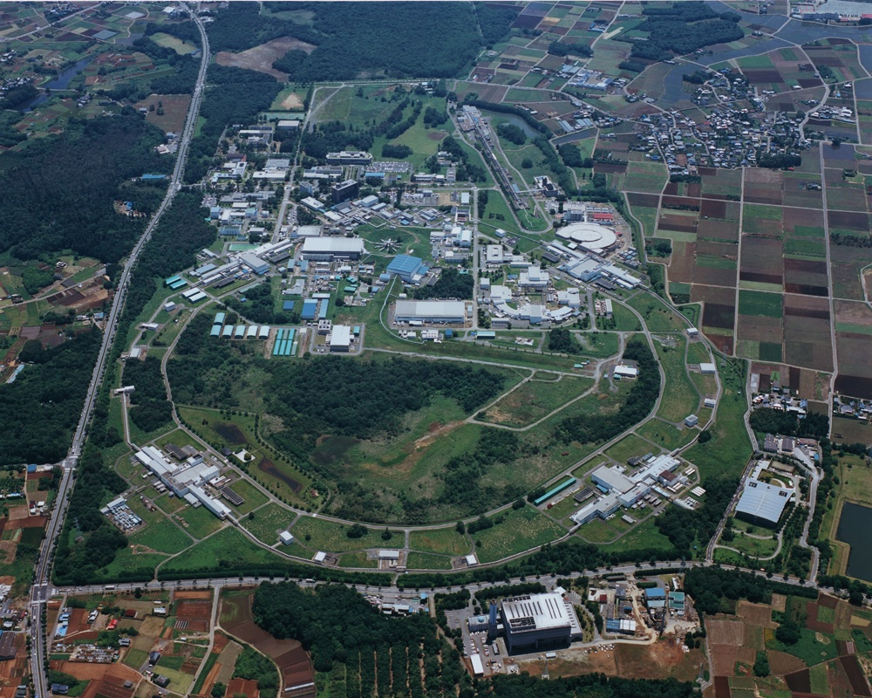
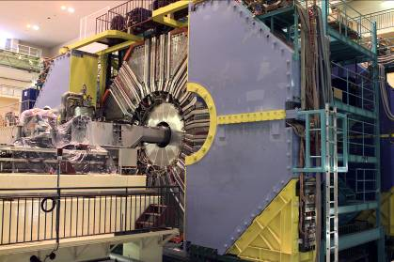
KEKB and Belle
SuperKEKB and Belle II

Slide 6
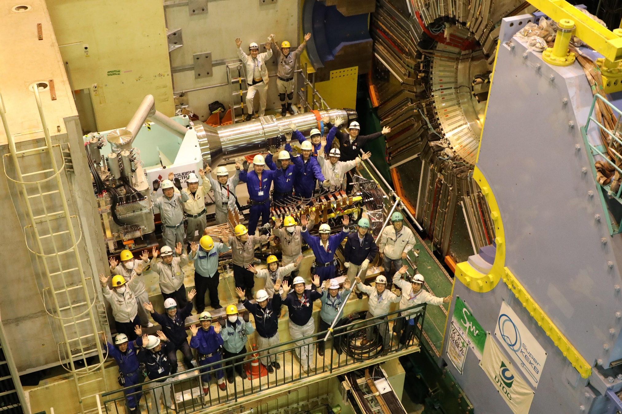
Belle II is now at IP

Slide 7
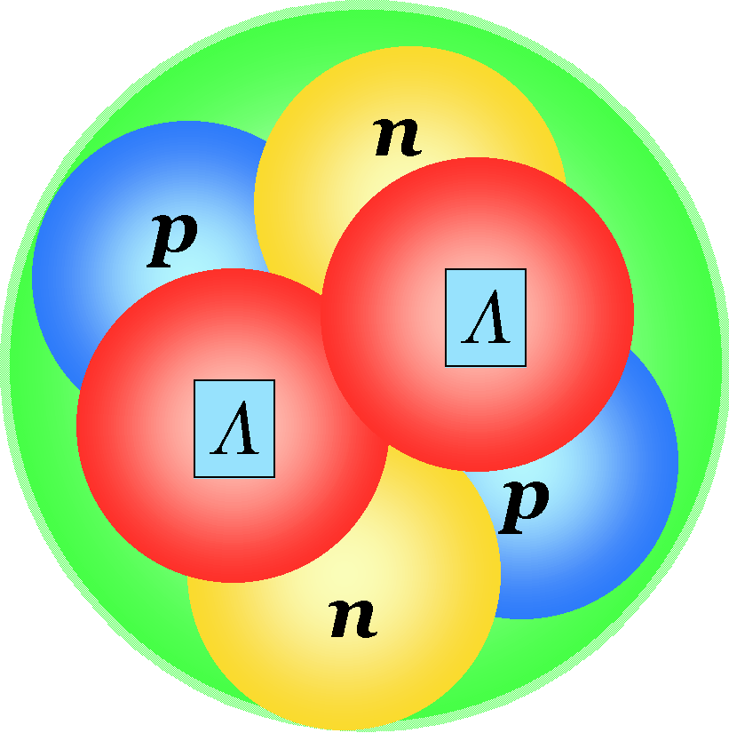
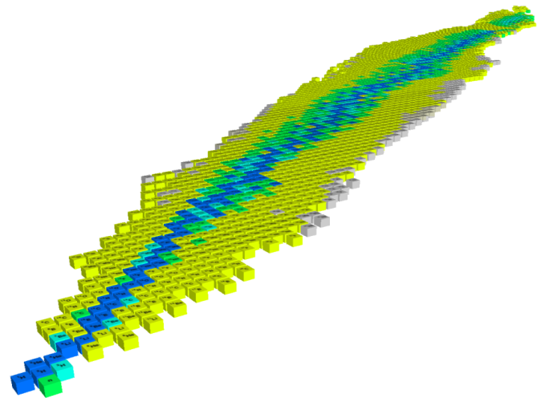
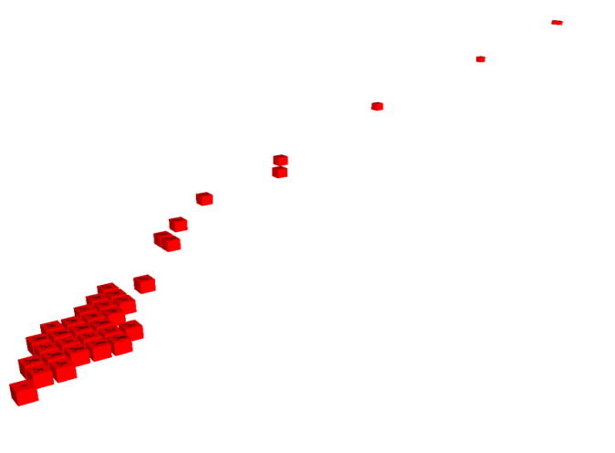

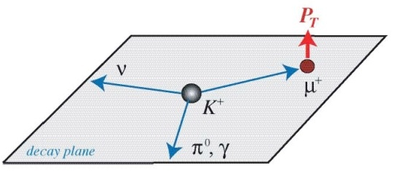
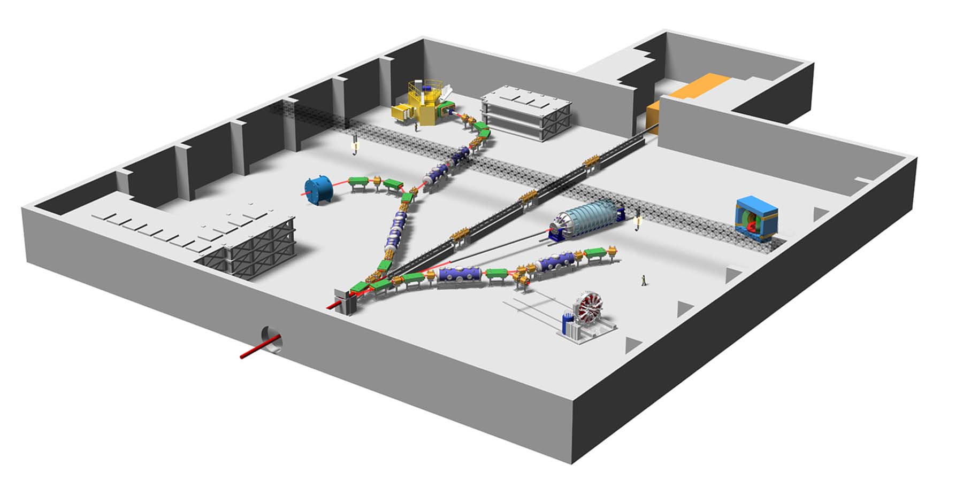
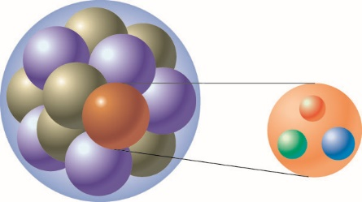
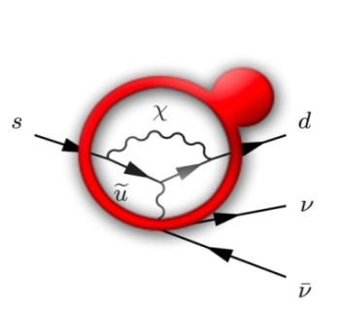
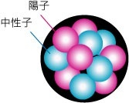


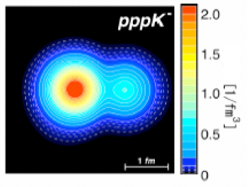
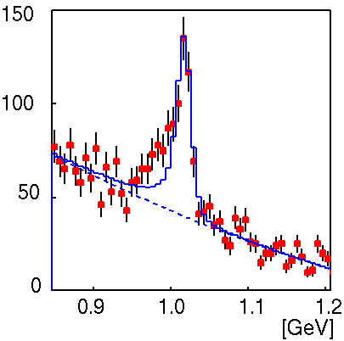
Nuclear and Particle Physics at J-PARC
d
Hypernuclei
u
s
u
T-viola-
tion
Strangeness
d
_{ΛΛ}He
Pentaquark Θ⁺
⁶
E19
ΛΛ, Ξ Hypernuclei
Z
K⁰ → π⁰ νν
-2
Λ, Σ Hypernuclei
_{L}
-1
Λ,Ξ
N
0
SKS
K1.8
E14
K1.8BR
KL
K1.1
High p
(not yet)
K meson
Implantation of
Kaon and the
nuclear shrinkage
K1.1BR
Quark
Ｋ⁻
φ
Proton Beam
Free quarks
Bound
quarks
Ｘray
E17
Why are bound quarks haevier？
Kaonic atom
Kaonic nucleus
Mass without Mass Puzzle
Notes:
On the other hand, the hadron experimental hall looks like this.
● Proton beam comes here and various kaon beam lines are prepared, where K=1.8 means kaons with momentum of 1.8 GeV/c.
● At SKS, hypernuclear spectroscopy will be performed for a variety of nuclei. ● In particular, searches for double hypernucleus and pentaquark are the highlights in here.
● In this beamline, kaon implantation is planned. When kaon is implanted inside the nucleus, there is a possibility that high density matter is created. ● Kaonic atom and kaonic nucleus will be studied.
● This beam line is the neutral kaon line to study CP violation, and ● this line is for T-violation experiment.
● Finally, this line, which is not yet completed, is dedicated to the study of chiral symmetry, namely, the mass generation mechanism of bound quarks.
7

Slide 8
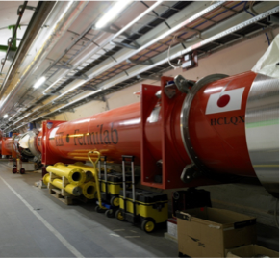
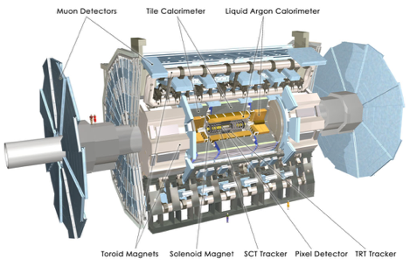
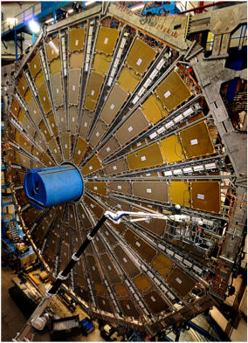

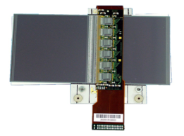

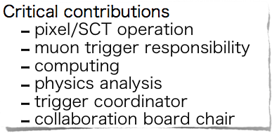
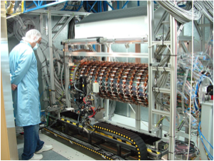
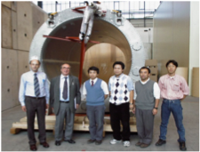


Japanese Activities at LHC/ATLAS
100%
20%

Slide 9
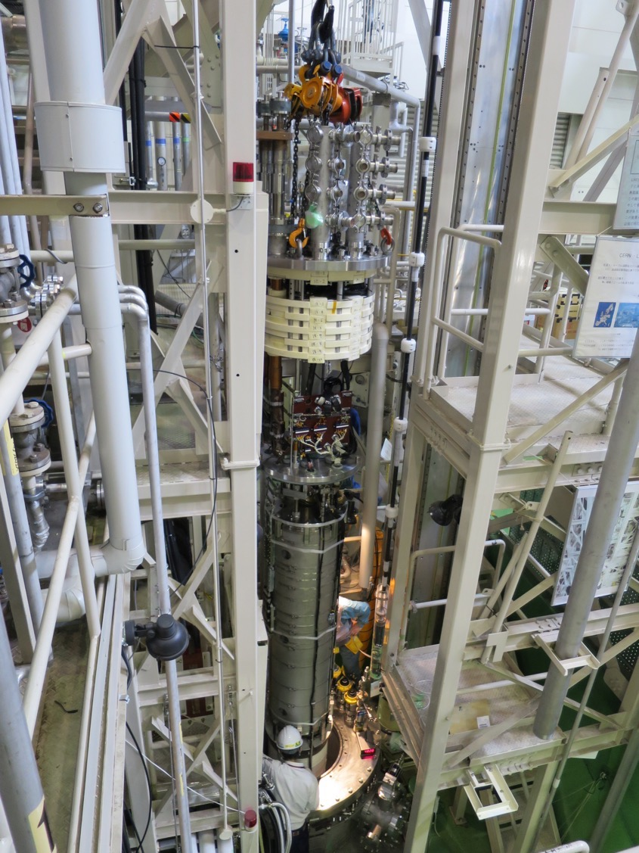
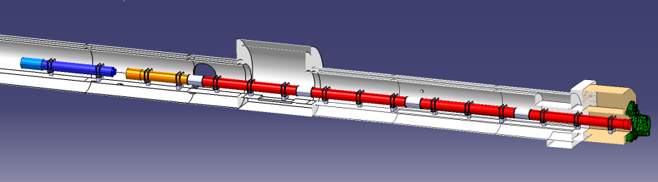
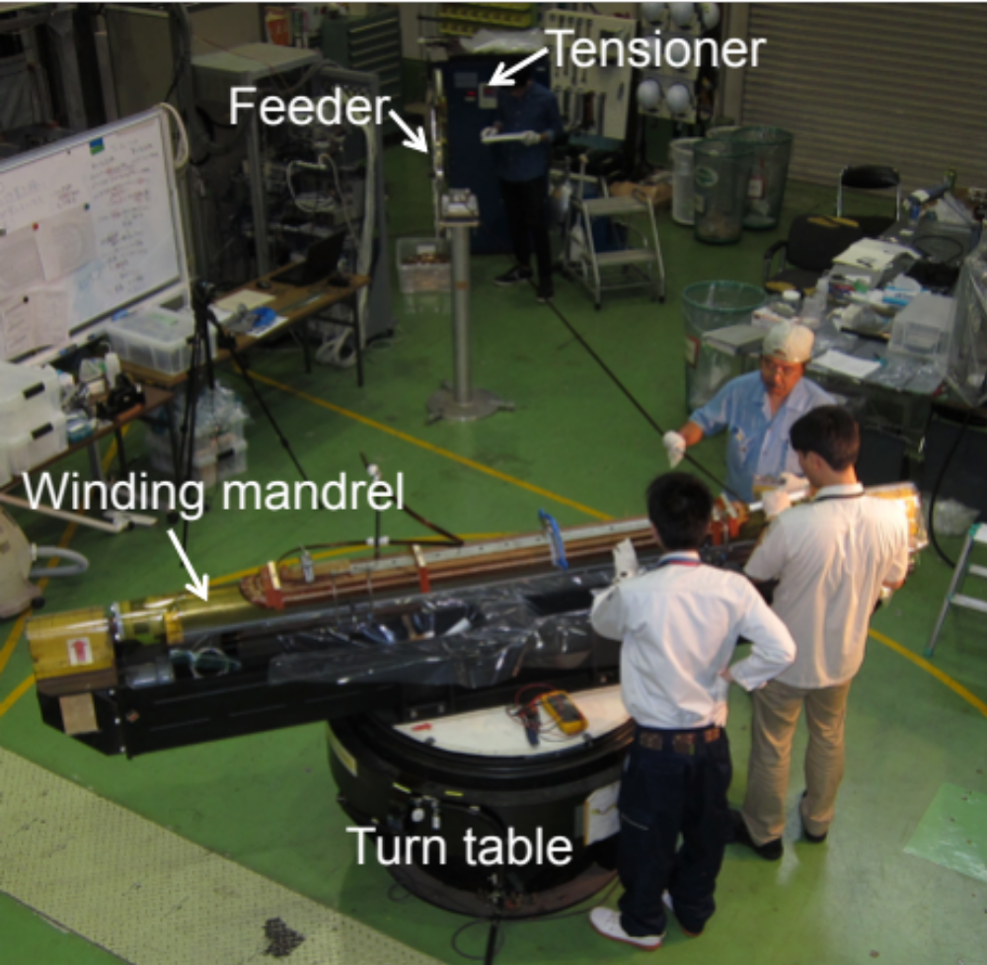





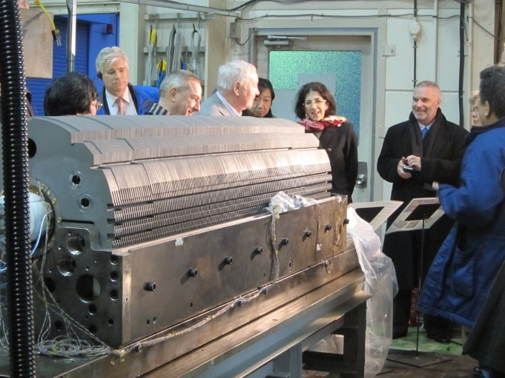
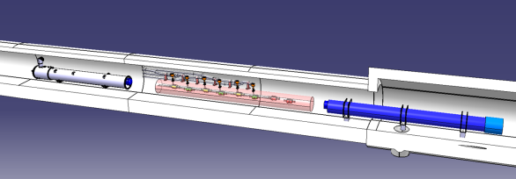


Contribution to HL-LHC
2m Model coil production and test at KEK
2016 May
ATLAS
CMS
Q1-Q3 : R&D, Design, Prototypes and in-kind USA
D1 : R&D, Design, Prototypes and in-kind JP
MCBX : Design and Prototype ES
HO Correctors: Design and Prototypes IT
Q4 : Design and Prototype FR
2015 May
2016 Feb
CC : R&D, Design and in-kind USA
CC : R&D and Design UK

Slide 10
Detector Technology Development
Pure and Applied Sciences
and more …
SR/FEL
Xray
LHC
Nano
technology
Neutron
Science
S.C. device
Cryogenics
Belle II
Laser
Pixel
technology
Interactive
Researches and
Developments
Liq TPC
DM / ν
ΜPGD
ILC
Liquid TPC
CMB
FIR astronomy
DAQ
μ-electronics
Single photon
sensoor
J-PARC
μ-lithography
Generic detector
technologies
Gamma
camera

Slide 11
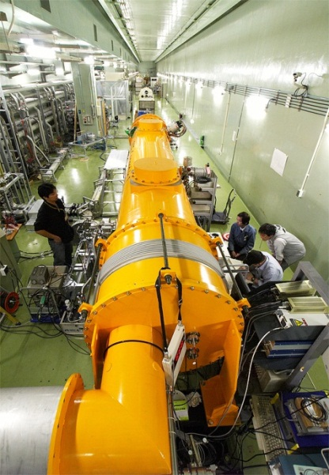
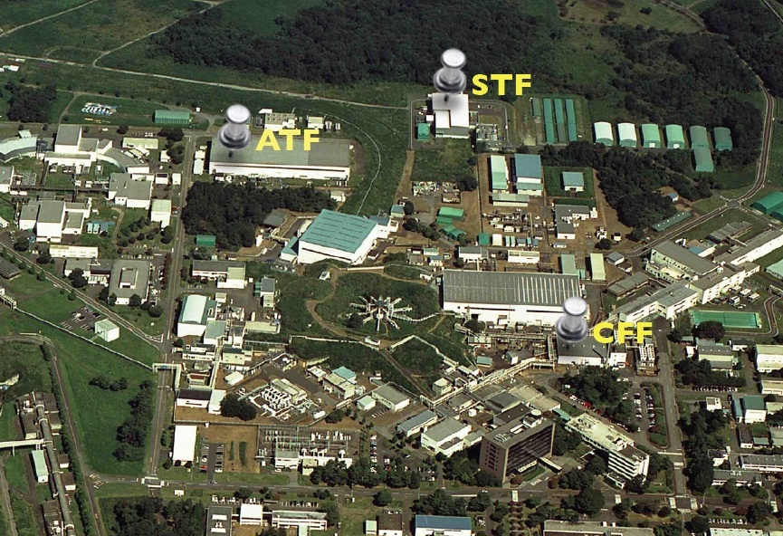

ILC R&D at KEK

Slide 12





1. Cost reduction in Nb material preparation
Optimize the ingot purity with a lower residual resistivity ratio (RRR).
Simplify the manufacturing method such as forging, rolling, slicing and tube forming.
 | 2016 | 2017 | 2018 | 2019
KEK Masashi Yamanaka
Feasibility study using
3-cell cavities (ongoing)
Preparing
materials
Manufacture
8x9-cell cavities
Evaluation
(Vertical&Horizontal tests)
Medium or High RRR sheet for cells
Low RRR tube
for stiffener and beam pipe
Quality of Nb for the end part will be optimized at this stage.

Slide 13


2. High-Q high-gradient SRC with nitrogen infusion
Confirm reproducibility of the nitrogen infusion method to improve Q and field gradient of SC RF cavity.
High statistics test of the yield by fabricating 8 9-cell cavities.
example of Cornell
Anna Grassellino, FNAL
 | 2016 | 2017 | 2018 | 2019
KEK Hitoshi HAYANO
FNAL process
1 cell processing
Performance test
Preparation for cryomodule
Preparation of vacuum furnace
3-9cell performance
8 - 9cell cavities fabrication
Performance test

Slide 14
ILC Status in Japan
Japanese HEP community proposed to start ILC as a Higgs factory with 250GeV collision energy, which was supported by LCB and ICFA at the Ottawa meeting in November 2017.
LCB/ICFA suggested to redefine ILC as “an international project led by Japanese initiative” such as E-XFEL and FAIR in Germany.
The statement of LCB/ICFA was discussed at the ILC Advisory Panel at MEXT. Design of the “international project led by Japan” will be the key in the next step. KEK is starting the project design team.
Hopefully we will see some conclusion from the Advisory Panel in early 2018, which will be examined by Science Council of Japan.

Slide 15















Symphonic use of photon, neutron and muon
KEK・Institute of Materials Structure Science
Structural Biology Research Center
Condensed Matter research Center
Photon
Neutron
Muon
Positron
Tokai Campus
Tsukuba Campus
Neutron & muon
at J-PARC
Photon &
slow positron
at PF and PF-AR
Slow positron
Surface structure
Muon
Comprehensive understanding
of materials structure
Synchrotron
Local magnetic moment
Crystal structure
Electronic structure
Neutron
Magnetic structure
Excitations

Slide 16


Light source facilities at KEK
PF：2.5 GeV, 450mA e⁻ (since 1982)
PF-AR : 6.5 GeV, 60mA e⁻ (since 1997)
Exp station: ~50, Users: >3000/year

Slide 17







Material and Life Science facility at J-PARC
Materials and Life science using world top –class pulse neutron and muon beams
U-Line
Neutron
Sensitive to light elements, Complementary to photon factory
Muon
Sensitive to magnetic field in matter
Muon Tatget Source
S & H Line
Neutron Target Station
First Neutron Beam: 30 May, 2008
First Muon Beam: 26 Sept., 2008
First User Program: 26 Dec., 2008
Running at 500kW
~200 day/year (176 days in JFY 2012)
23 Beam Ports for Neutron Instruments
4 Beam Ports for Muon Instruments

Slide 18
Summary and Outlook
KEK has a diverse physics program: T2K, Belle II, muon physics, UCN, nuclear physics, and so on, where close collaboration with Canadian scientists are going on as key frameworks of the experiments.
KEK has a diverse material and life science program with symphonic use of multiple probes: X-ray, neutron, muon and slow positron. We hope to develop more industrial applications.
Industrial application of the accelerator technology is an important direction KEK has to take in the near future. We hope to further discuss with TRIUMF on the possible collaboration.

