Slide 1
Gerardo Dutto
A Promoter of Sciences
and their
Applications to Mankind
Franco Mammarella, 2021 – February 22

Slide 2
Introduction
Many have spoked eloquently about Gerardo’s career and friendship. I truly honoured to add my story to yours. Preparing this brought many fond memories back.
Gerardo made remarkable contributions to the field of accelerator science as Physicists , Engineer and Manager
Gerardo greatly contributed to advance and promotion of accelerator technologies for the benefit of mankind.
Gerardo’s interests beyond the physics community stemmed by the belief that science shall not remain in the Ivory Tower.

Slide 3
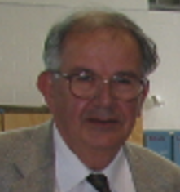
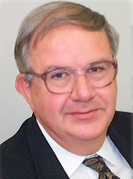
Personality
Behind those achievements there was a Personality. A few key points stood out.
An inspirational and charismatic leader who worked smartly and hard to build relationship, networks and competency in his collaborators
A true Director of Orchestra: natural at connecting people from different cultures and backgrounds (the mastermind behind many physics applied solutions)

Slide 4
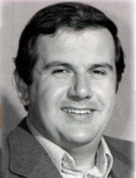
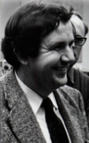
Personality
And a Person driven by:
  Passion and selfless dedication to his team, his job and to his laboratory
  Caring and loyalty to his fellow men
  Trust and goodwill as pillars of lasting relationships
Ingenuous and innovative, with many new ideas
Generous

Slide 5
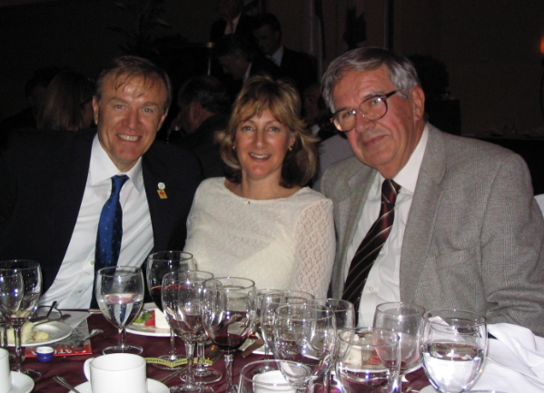
Outside Interests
Gerardo was not just passionate about Physics and accelerators. He had other passions:
  Music and Opera
  Culturally curious
  Loved networking events

Slide 6
Key Contributions
Gerardo’s work in accelerator’s physics and technologies, produced
  Mutually fruitful international collaborations both for TRIUMF and other countries (examples: Italy, China, Russia, Japan)
Fostered a culture of collaborations among people and nations, regardless of creed or backgrounds, through friendship, goodwill and meaningful lasting relationships.
Keen team builder. Had an eye for talents and pursued them. He was an amazing persuasive scouter.
Prepared the next generation of Accelerators physics leaders, by giving them opportunity to grow professionally.

Slide 7
Achievement - Highlights
Pioneering work in the improvements of both efficiency and reliability of the TRIUMF cyclotron.
Promotion of high current cyclotrons producing Isotopes for medical applications (EBCO, ACSI, Best Cyclotrons)
Influence in the creation of the Association of Italian Researchers and Professionals in Western Canada (ARPICO)
Connected Science and Academia with Business.
As a promoter, he made sure that Italian delegations to Vancouver would have TRIUMF in their schedule. He is remembered for giving VIP welcome to Italian delegations who visited TRIUMF.

Slide 8
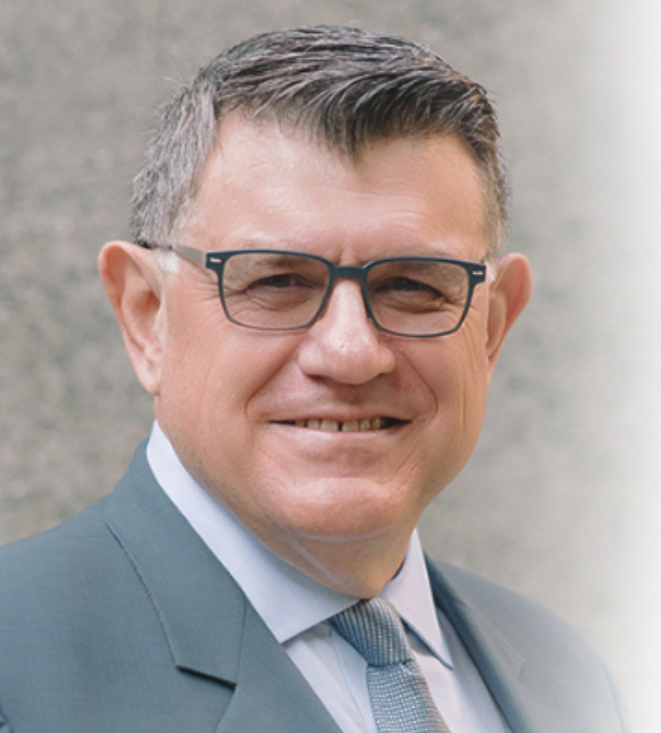
Quote
Quote from the current president of Italian Chamber of Commerce-CW, Celso Boscariol:
  ‘’Gerardo was a titan in his chosen field of endeavour. His work strengthened political, economic and cultural ties between Canada and Italy and the broader European Union.’’
  ‘’As an ambassador for the scientific and research community, Gerardo brought science and enlightment to the boardroom and business to the laboratory all in pursuit of making our lives better!’’

Slide 9
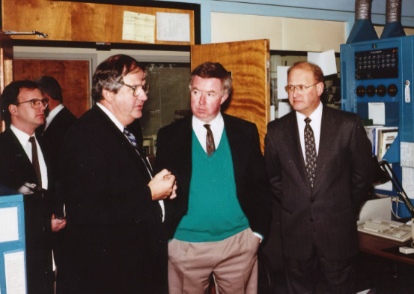
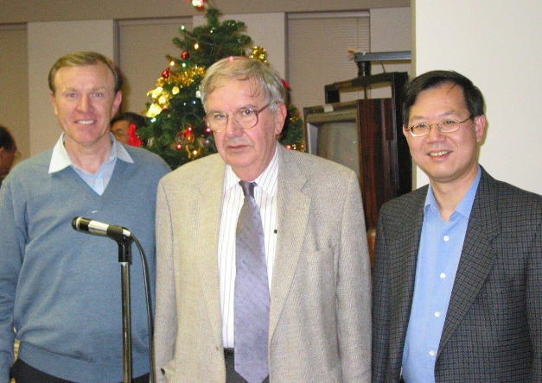
Community Engagement
With Joe Clark, Canada MP
and
Stan Hagen BC MLA ,
KAON promotion,
(1991 circa)
With Richard Lee, BC MLA ,
Christmas Party
(2002)

Slide 10
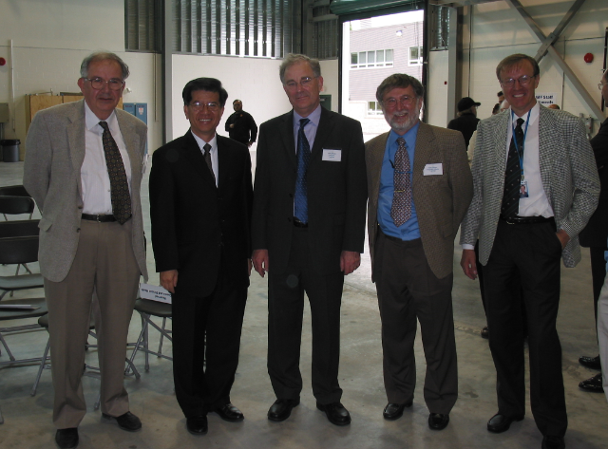
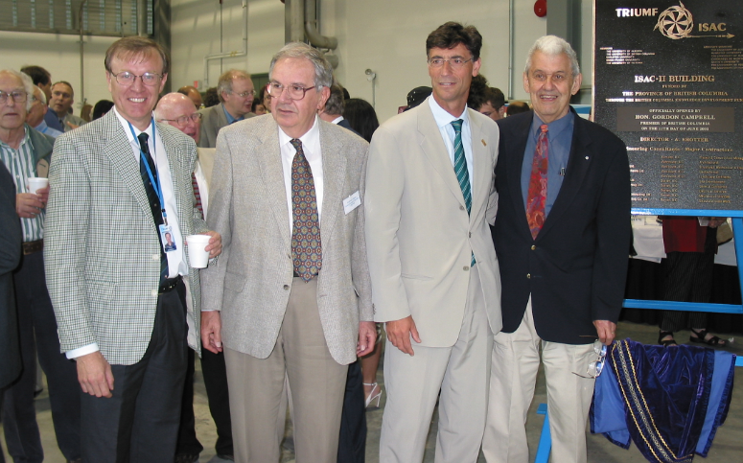
Community Engagement
ISAC-II – Opening Ceremony (2003)– with Dr. Vogt,
& G. Visetti, Italian Consul General
ISAC_II Opening Ceremony – with Raymond Chan, MP
A. Shotter, P. Schmor & F. Mammarella

Slide 11
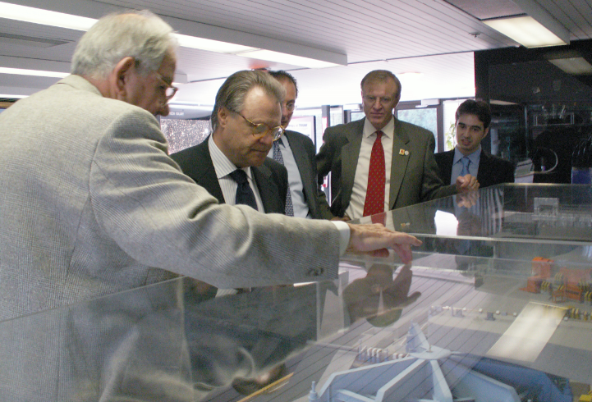
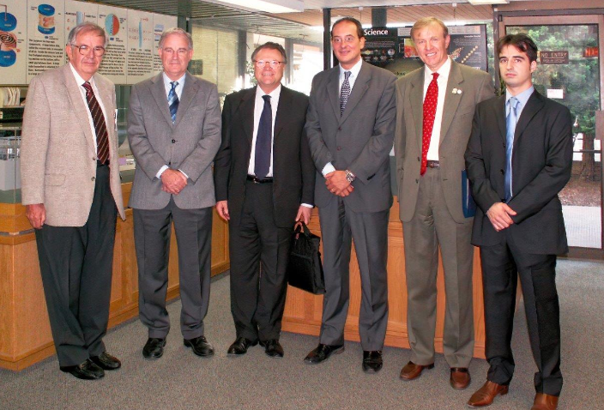
Community Engagement
Visit of Italian Ambassador Gabriele Sardo to TRIUMF (2006)

Slide 12
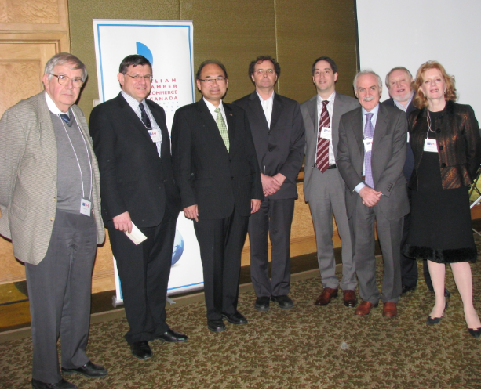
Community Engagement
Gerardo at the CETA Promotion meeting (2009), organized by the ICC-CW with
C. Boscariol, President ICC-CW,
John Yap, BC MLA,
Prof. Kurt Huebner, UBC Centre for European Studies
F. De Conno Consul General of Italy,
E. Iachelli, Executive Director, ICC-CW, etc.

Slide 13
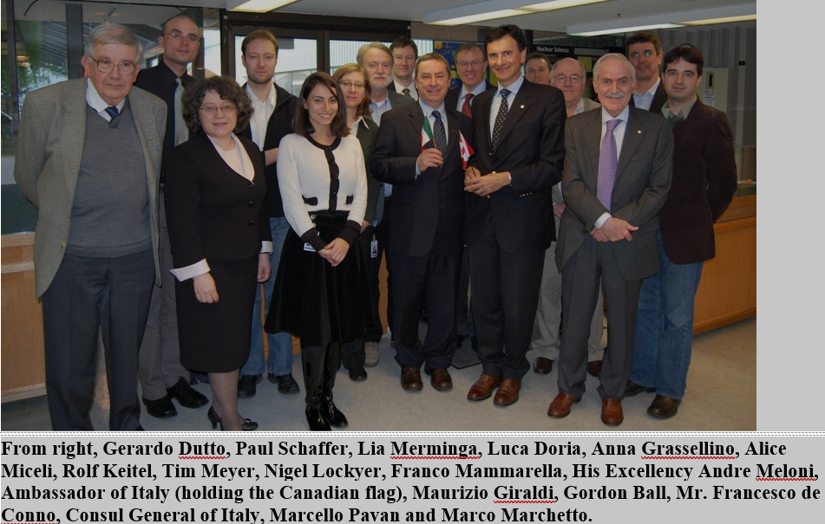
Community Engagement
TRIUMF Visit of Ambassador Andrea Meloni (2010)

Slide 14
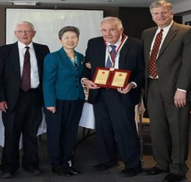
Special Awards
2004: the President of Italy awards Gerardo with the Order of ‘’Cavaliere della Stella della Solidarieta’ for his distinction in ‘’promoting meaningful and productive relationships and collaborations between Italy and other Countries’’
2015: Gerardo receives from the People’s Republic of China the "Friendship Award’’
the utmost prize for ‘’foreign experts who made outstanding contributions to the country’s economical and social progress’’

Slide 15
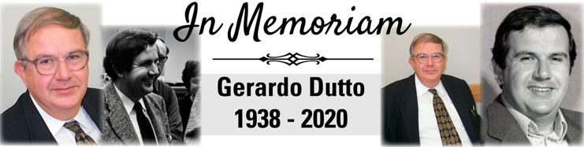
Gerardo’s Legacy
TRIUMF as a Hub of expertise for cyclotrons and linear accelerators’ technologies.
A Medical isotope industry built upon Cyclotron applications:
→ Cyclotron-produced Technetium-99m approved by Health Canada (17 Dec-2020).
Fostered a culture of outreach bridging the physics community with the rest of society regardless of political, cultural or geographical barriers.
Thank you Gerardo for your inspiration and mentoring!
‘’The influence of your ‘work will be felt and appreciated for decades to come!’’

Slide 16
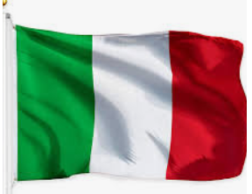
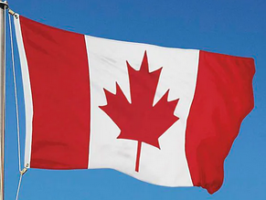


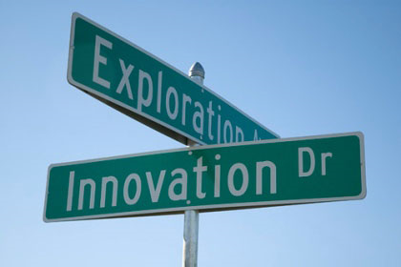
Thank You
Merci
Grazie!
TRIUMF: Alberta | British Columbia
Calgary | Carleton | Guelph | Manitoba | McMaster | Montréal | Northern British Columbia | Queen’s | Regina | Saint Mary’s |
Simon Fraser | Toronto | Victoria | Winnipeg | York

