Slide 1
Gerardo’s leadership and science impact
Jean-Michel Poutissou
Senior scientist emeritus and Tara chair

Slide 2
Cyclotron division Guru
Main cyclotron performance:
100 microamp task force
Polarized beam operation
350 microamps development
Multiple extractions
Reliability

Slide 3
Cyclotron division management
( over 22 years)
How to construct and defend a budget
  Divisional consultations at infinitum
  OPCOM scrutiny
  Final teeth pulling amongst division heads
How to get advice and monitor projects
  Advisory committees
  Expert oversight
Dutto was the early version of Linkedin for accelerator expertise.
Who overspent his travel budget most ( Gerardo or Erich )
Le quoi qu’il en coûte est devenu hors de prix
( No matter how much it cost has become too expensive)

Slide 4
Vision/leadership
Leadership is laying the track not driving the train
One example related to the science division.
12C( alpha, gamma) reaction at TISOL
The Red Giant program (1993)

Slide 5
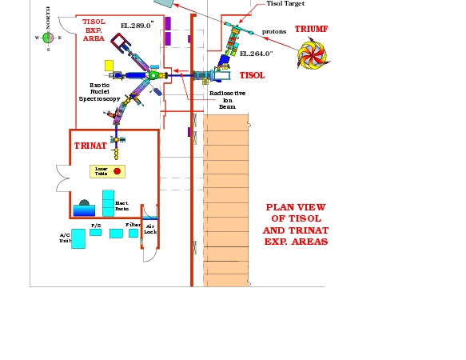
RED GIANT at TISOL
R. E. Azuma, L. Buchmann, F. C. Barker, C. A. Barnes, J. M. D’Auria, M. Dombsky, U. Giesen, K. P. Jackson, J. D. King, R. G. Korteling, P. McNeely, J. Powell, G. Roy, J. Vincent, T. R. Wang, S. S. M. Wong, and P. R. Wrean
Department of Physics, University of Toronto, Toronto, Ontario, Canada M5S 1A7
TRIUMF, 4004 Wesbrook Mall, Vancouver, British Columbia, Canada V6T 2A3
Department of Theoretical Physics, Research School of Physical Sciences Engineering, Australian National University, Canberra, Australian Capital Territory 0200, Australia
W. K. Kellogg Laboratory, California Institute of Technology, Pasadena, California 91125
Department of Chemistry, Simon Fraser University, Burnaby, British Columbia, Canada V5A 1S6
Department of Physics, University of Alberta, Edmonton, Alberta, Canada T6G 2J1

Slide 6

Red Giants
¹⁶N beta delayed alpha emission
¹⁶N beam( Dombsky/d’Auria)
4T solenoid not funded by NSERC
Negotiated a set of 4T SC coils to be made by INR by the Lobashev group.
New method found to get rid of electrons
1993 Red giant publication in famous astrophysics newpaper:
The Toronto Star

Slide 7
Red Giant Experiment
Lothar Buchmann is a bright nuclear astrophysics post doc fellow at SFU, U of Toronto/TRIUMF but no Canadian University were considering hiring him in a permanent position and Kaon was in the way at TRIUMF, back in 1993.
Gerardo’s helps to retain one of the best nuclear astrophysicist at TISOL and TRIUMF, later at ISAC .
Lothar is hired in the ISIS group while I find a science division position
Also Igor Sekachev is hired in the vacuum group

Slide 8
Parity experiment and Triumf polarized beam
Most demanding cyclotron performance
Strong experimenter/ cyclotron expert interactions
World class development of polarized ion sources ( see P.Schmor/A.Zelensky/P.Levy/Y.Mori)
Gerardo’s support crucial

Slide 9
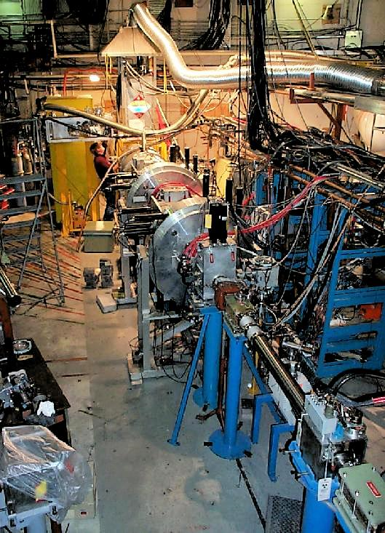
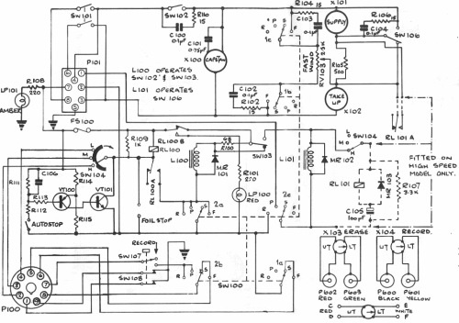
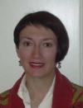
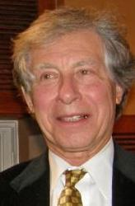
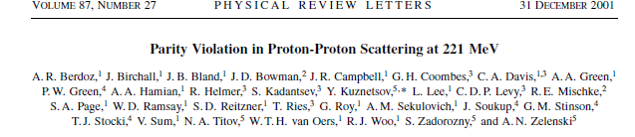
Parity experiment
Sample diagram

Slide 10
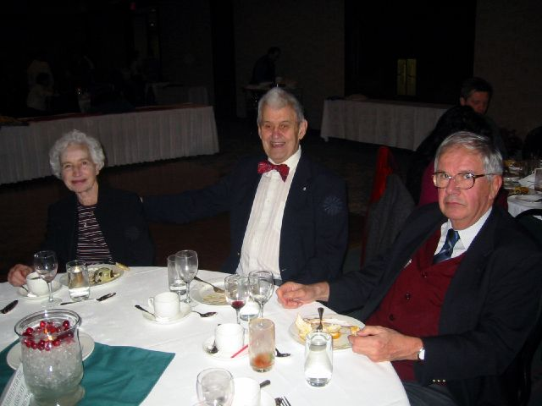
Xmas party 200?
Erich Vogt
Dorothy Sample
Gerardo Dutto

Slide 11
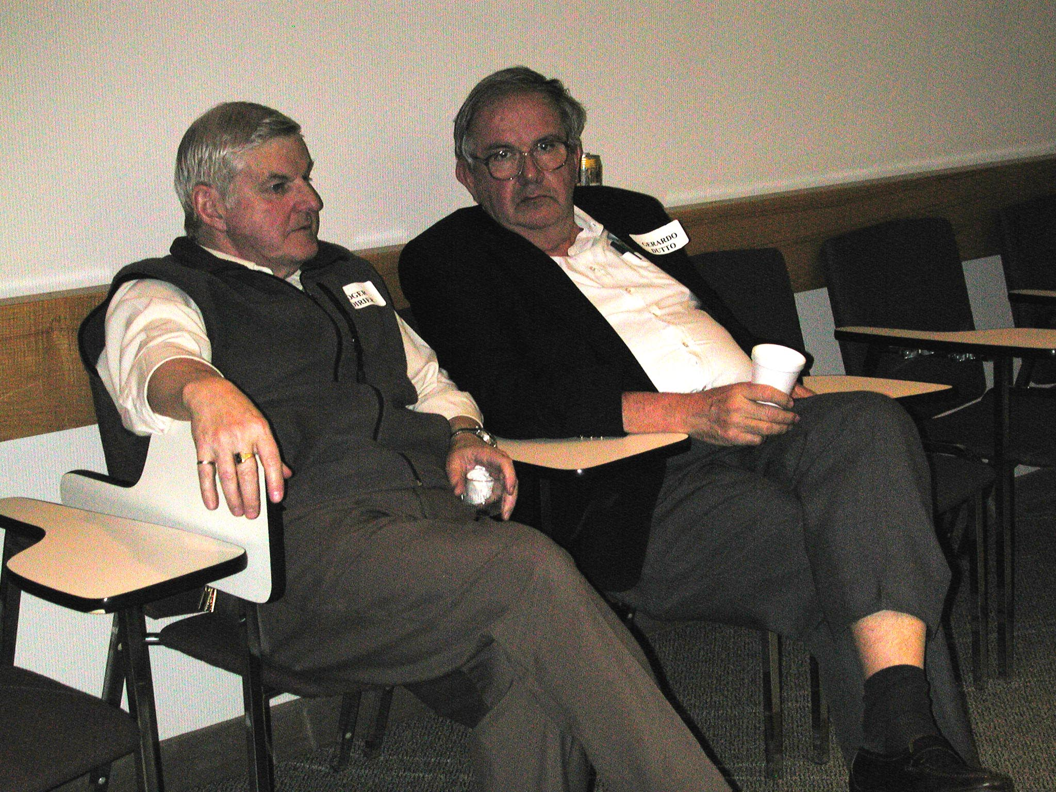
Cyclotron most wanted men

Slide 12
Thank you/Merci/ Grazie
The cyclotrons/accelerators at TRIUMF and TR13,24,30… elsewhere, the many users and your colleagues are thanking you for your leadership and dedication.
They won’t forget you, Gerardo
And don’t worry ,Yuri Bylinskii will make sure the 500 MeV cyclotron remains as reliable as you left it.

