Slide 1
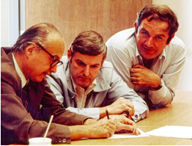
Dr. Gerardo Dutto
Symposium
Introduction
Yuri Bylinski, TRIUMF

Slide 2



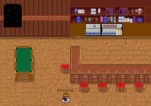
Organizational remarks
Mute your microphones
Turn on your cameras
Ask your questions in the Chat
Switch to Virtual Social Site Gather.Town from the meeting main page after end of all talks

Slide 3
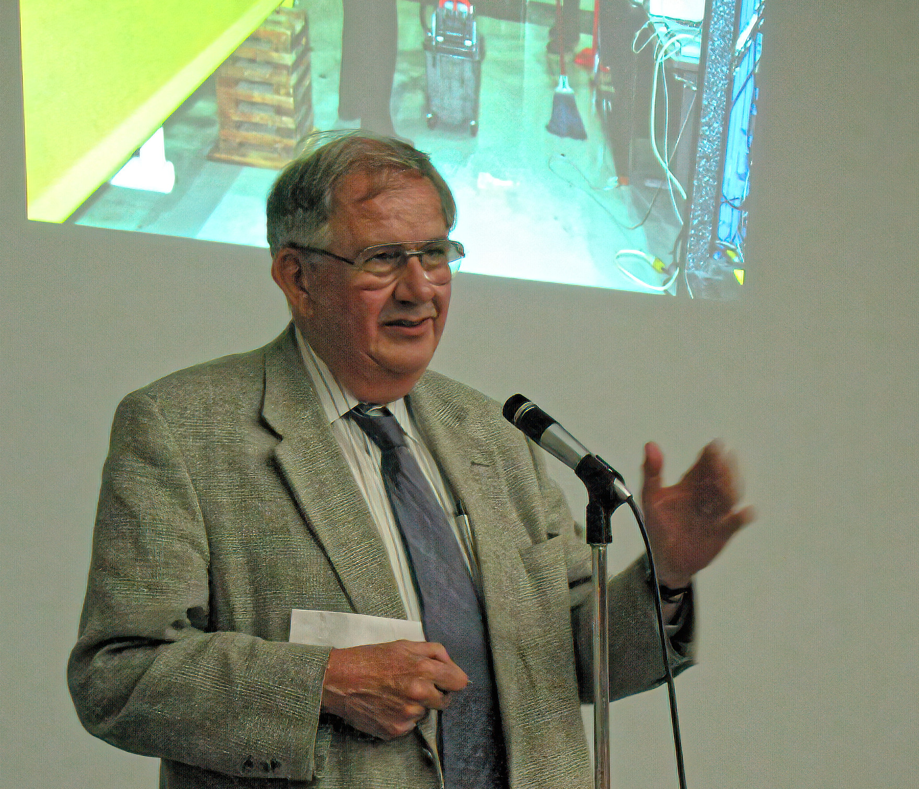
Welcome All Gerardo’s Good Friends!
It is one year since Gerardo left us
This is an International Meeting, thus - odd time for those in the other parts of the world, sorry 🙁 🥱
We planned initially in-person event
But, finally, decided to adopt to the “new normal”

Slide 4
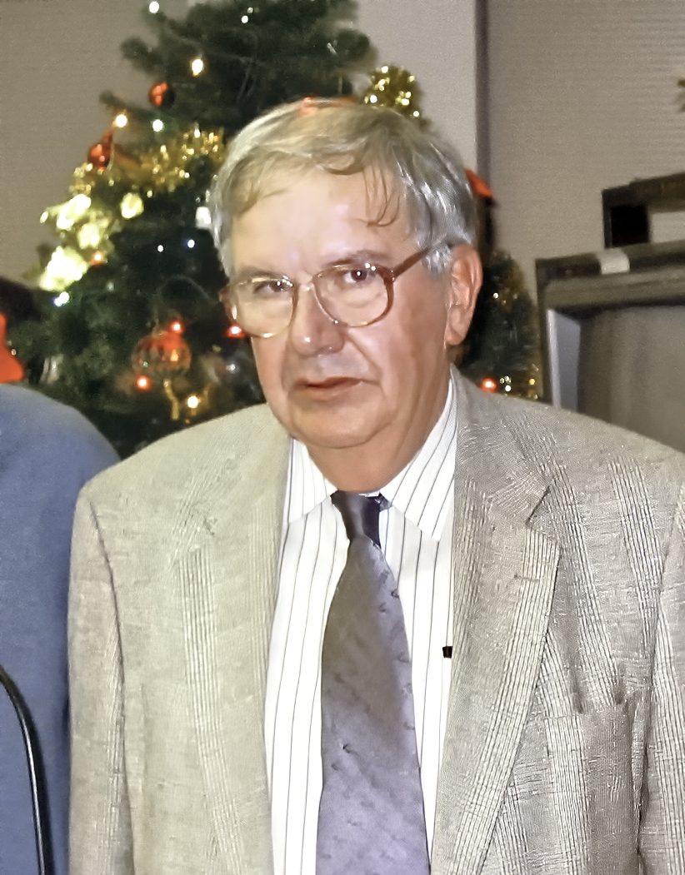
TRIUMF Career Milestones
Joined TRIUMF in December 1970
Worked for Beam Dynamics Group
Lead several cyclotron upgrade initiatives
Head of the Cyclotron Division 1981-2003
Fostered development of medical cyclotrons TR19 & TR30 and their transfer to industry
Spearheaded TRIUMF new science path with ISAC
Nursed cutting edge technologies:
  H- ion sources
  Modern linacs
  Superconducting RF
Played key roles in organizing international conferences on Cyclotrons, Linacs, Particle Accelerators

Slide 5
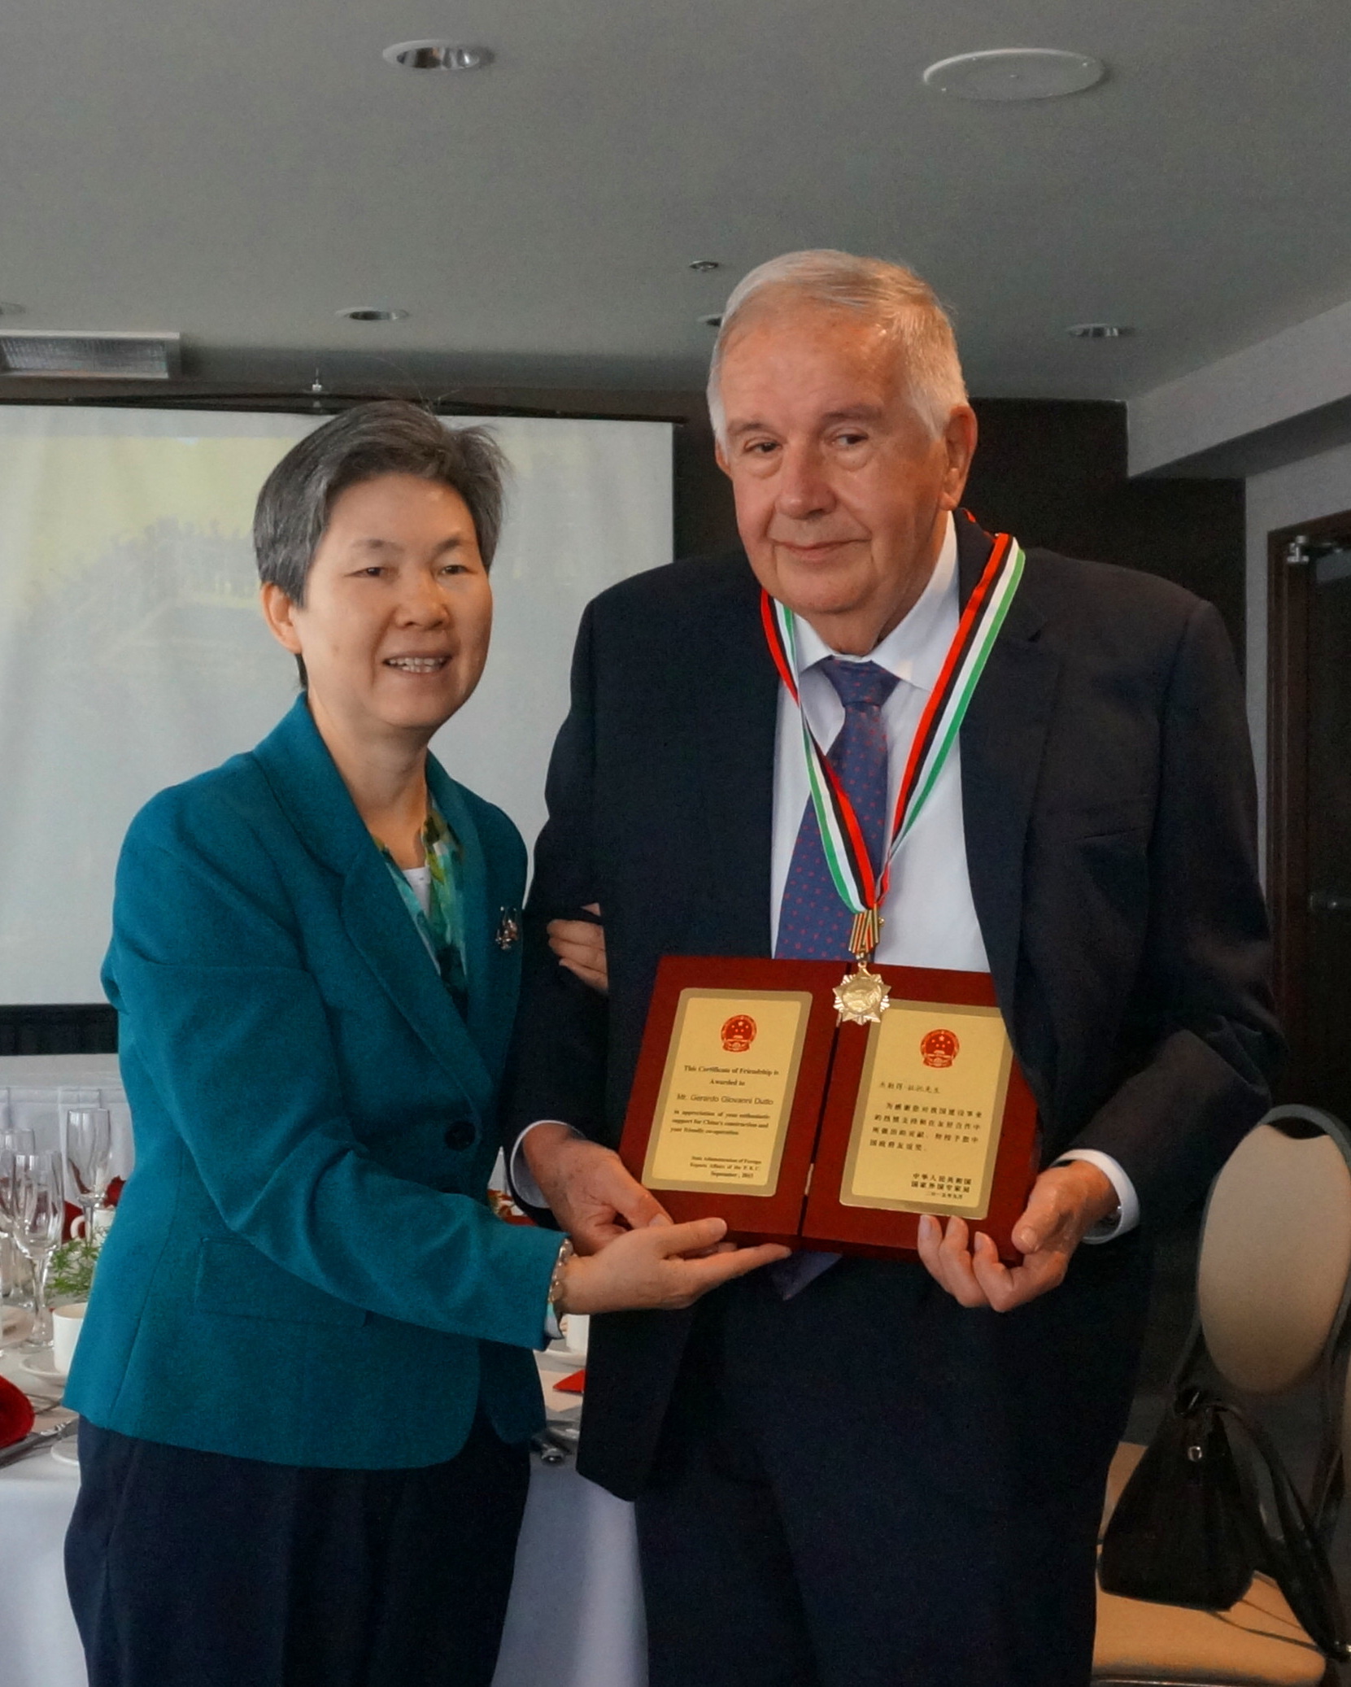
Recognitions and Awards
In 1998 Dr. Dutto was chosen as a Fellow of the American Physical Society `For contributions to the development of high-intensity H- cyclotrons both as meson facilities and for production of proton-rich radioisotopes’
In 2004, Gerardo received Italian Order of ‘Cavaliere della Stella della Solidarieta’ “for promoting meaningful and productive relationship and collaborations between Italy and other countries”
In 2015 Chinese government awarded him the Friendship Prize, China’s highest award for "foreign experts who have made outstanding contributions to the country's economic and social progress” for his efforts in helping them develop their cyclotron-building expertise

Slide 6
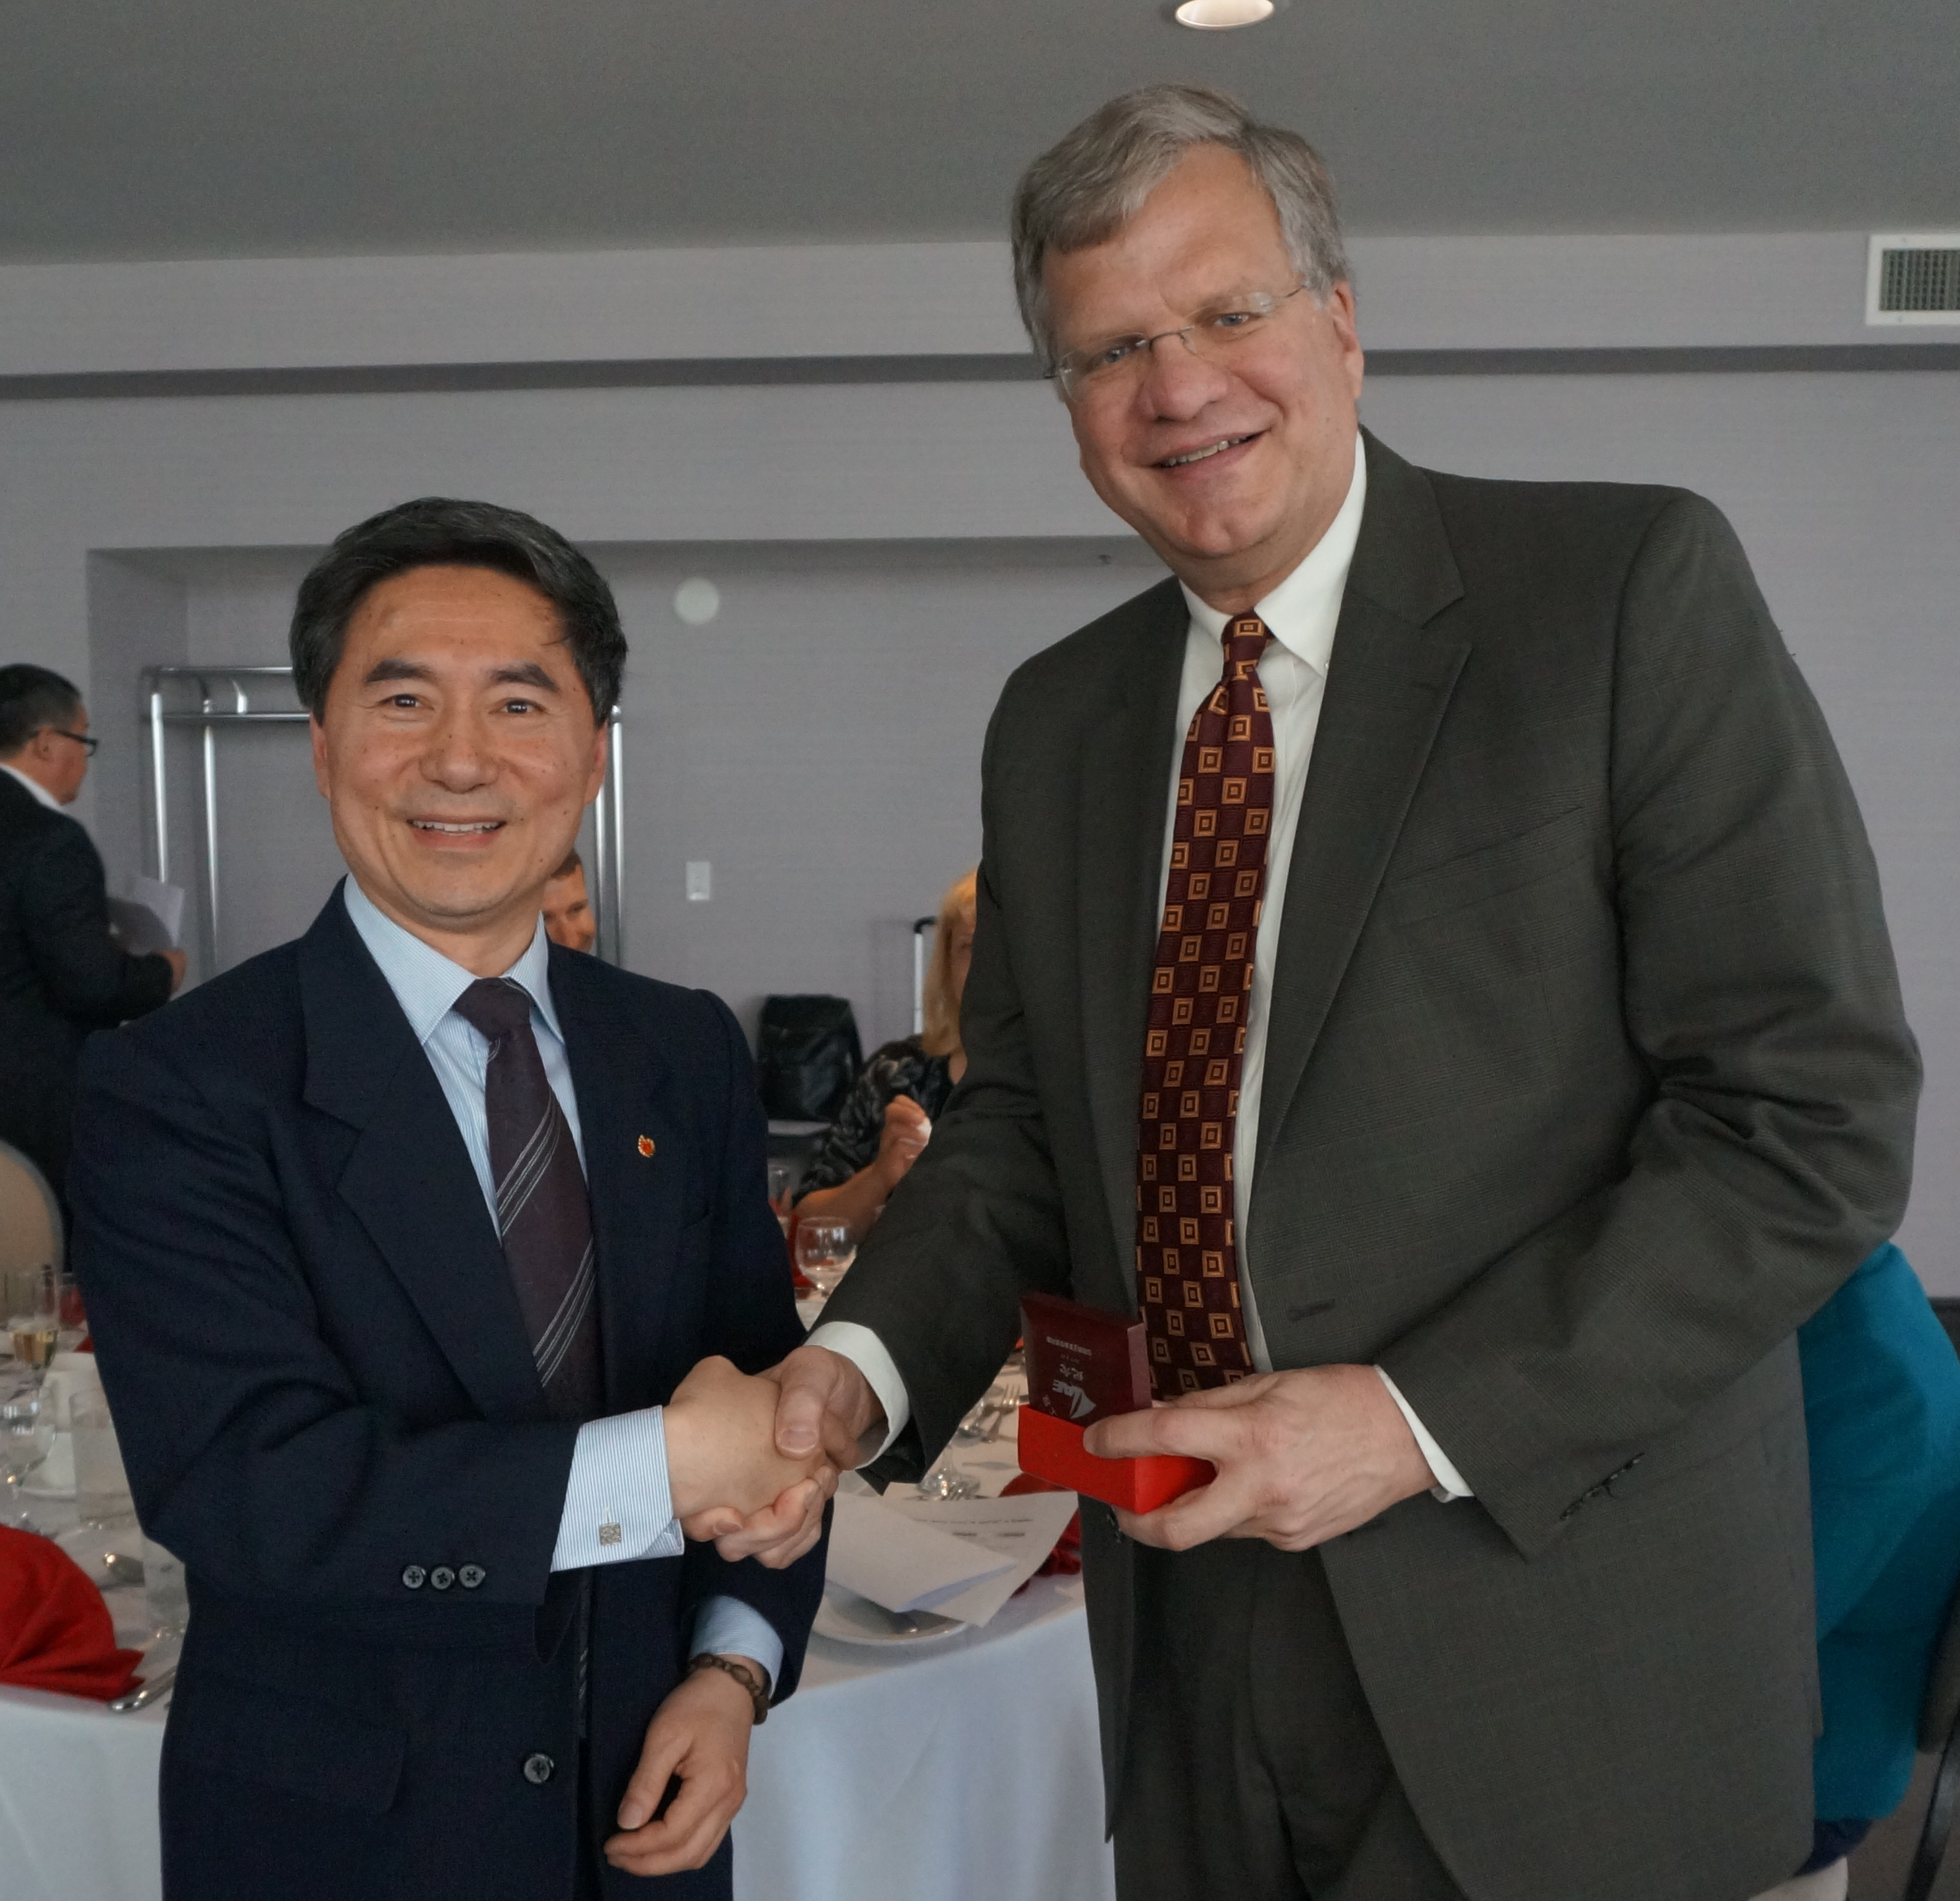
Jonathan Bagger, TRIUMF Director Comments at the Chinees Award Ceremony
Gerardo believed strongly in international partnerships and established close ties with our sister labs around the world. He was extremely supportive of the cyclotron community, and they were supportive of us.
He was adventurous in pursuing connections with both Russia and China – long before it was trendy to do so. Scientists appreciated his efforts to bridge East and West.
Gerardo was a people person and a talented team builder. He went continuously after talented young people, persuading many of them to work for TRIUMF. And, to a large extent, the strong cyclotron team, that TRIUMF is so proud of, was brought together by Gerardo.

Slide 7
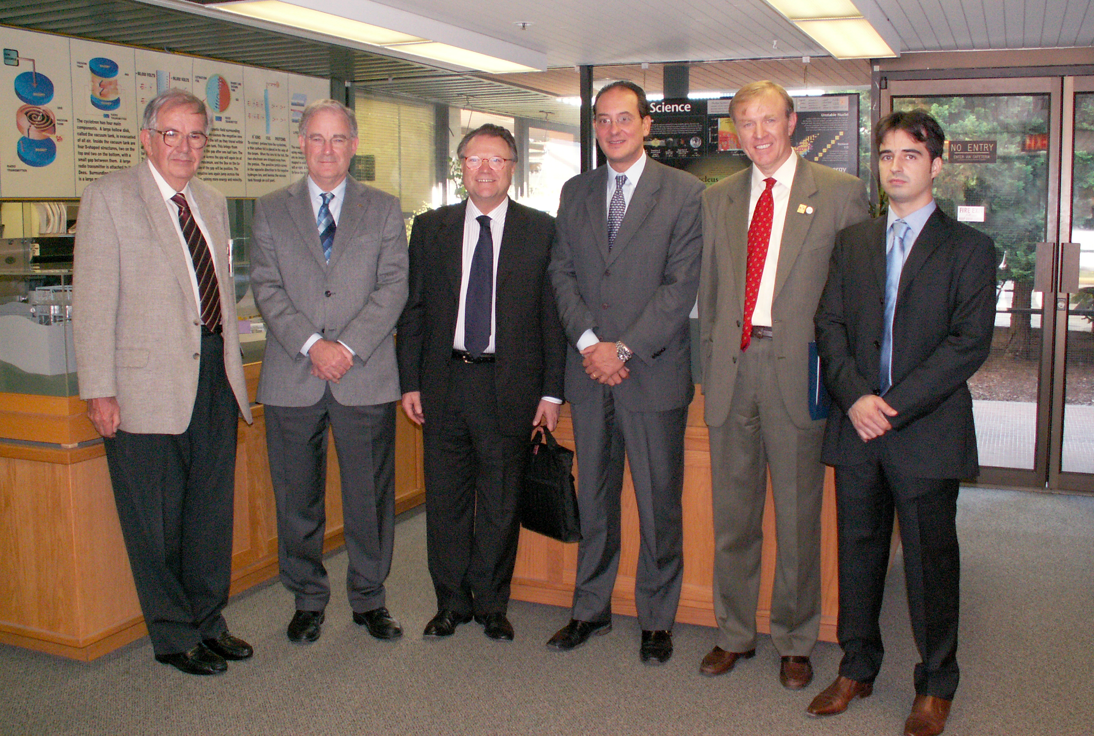
Building Bridges
Gerardo has left us a multi-drawer archive of his visitors from all over the world
Recently we have processed* it and placed in a database
  1982-2004
  ~220 visitors
  110 institutions
  27 Countries
It’s a treasure!
  12+ visitors have joined TRIUMF as a result
* Courtesy to P. Dela Zilwa

Slide 8
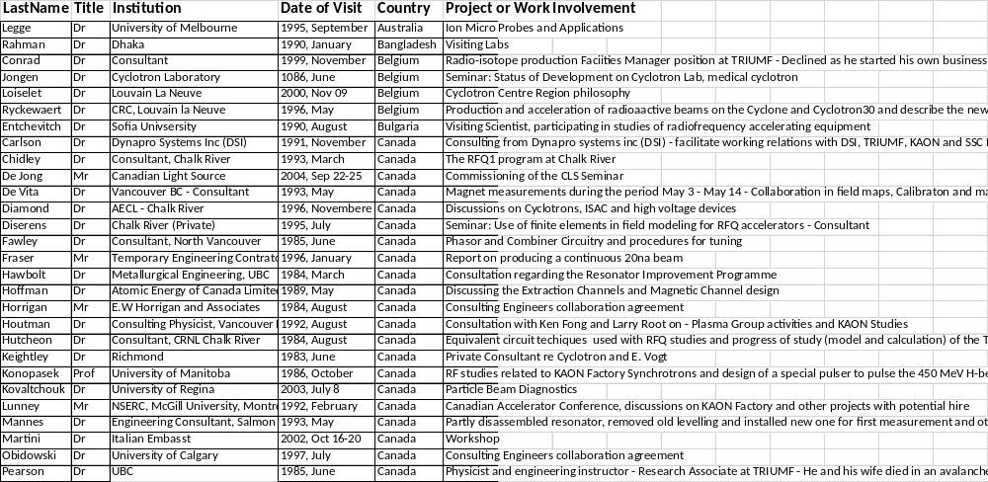
Cyclotron Division Visitors Archive

Slide 9
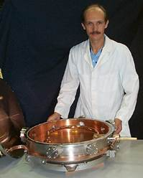
My story at TRIUMF
There is a story behind every visitor. Here is mine:
1985-2001 – employed by INR, Troitsk, Russia
First visit to TRIUMF – 1996 (6 visits in total)
Lead ISAC Rebuncher project at INR, 1997-1999
Joined TRIUMF in 2001
RF Group Leader 2003-2007
Accelerator Systems Department Head since 2007

Slide 10
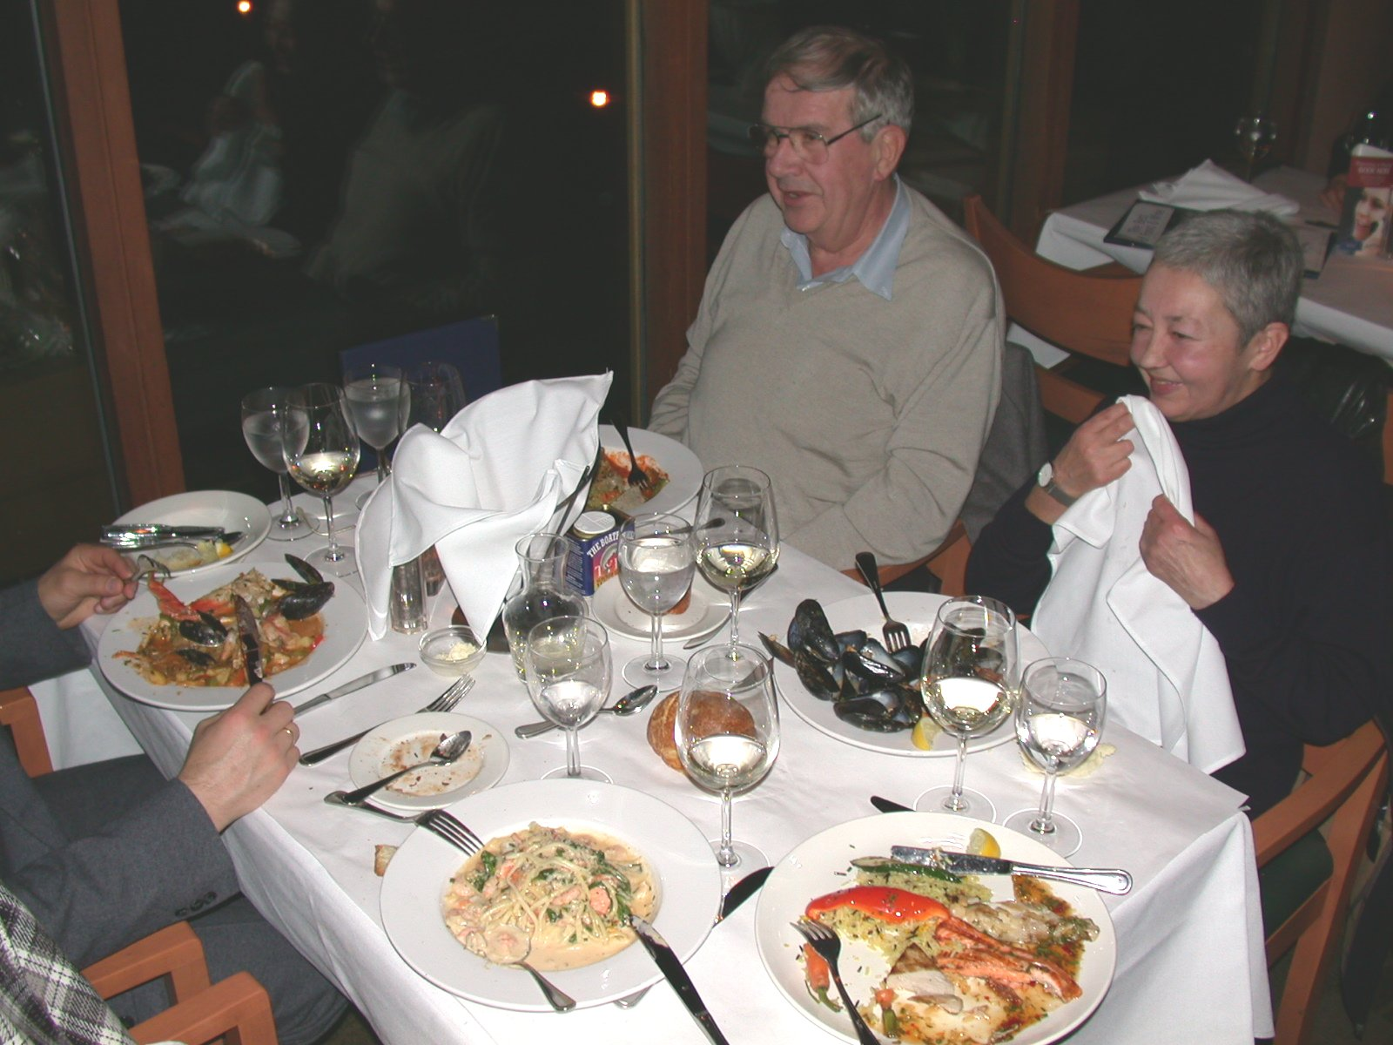
Transition to TRIUMF
  I was offered a position in 2000 while being a fellow at CERN
  It has taken a year to get a Permanent Resident visa in Canadian Consulate, and only after Gerardo engaged his connection with Canadian MP
  There was a dozen of communications with Gerardo through that time
  He visited our place in France during RIB conference
  Gerardo met my family in Vancouver airport with flowers for my wife, even though we missed our connection in London and arrived a day later
  I was quite slim at that time, and Gerardo commented: They didn’t feed you well there, but don’t worry – we can fix it!

Slide 11

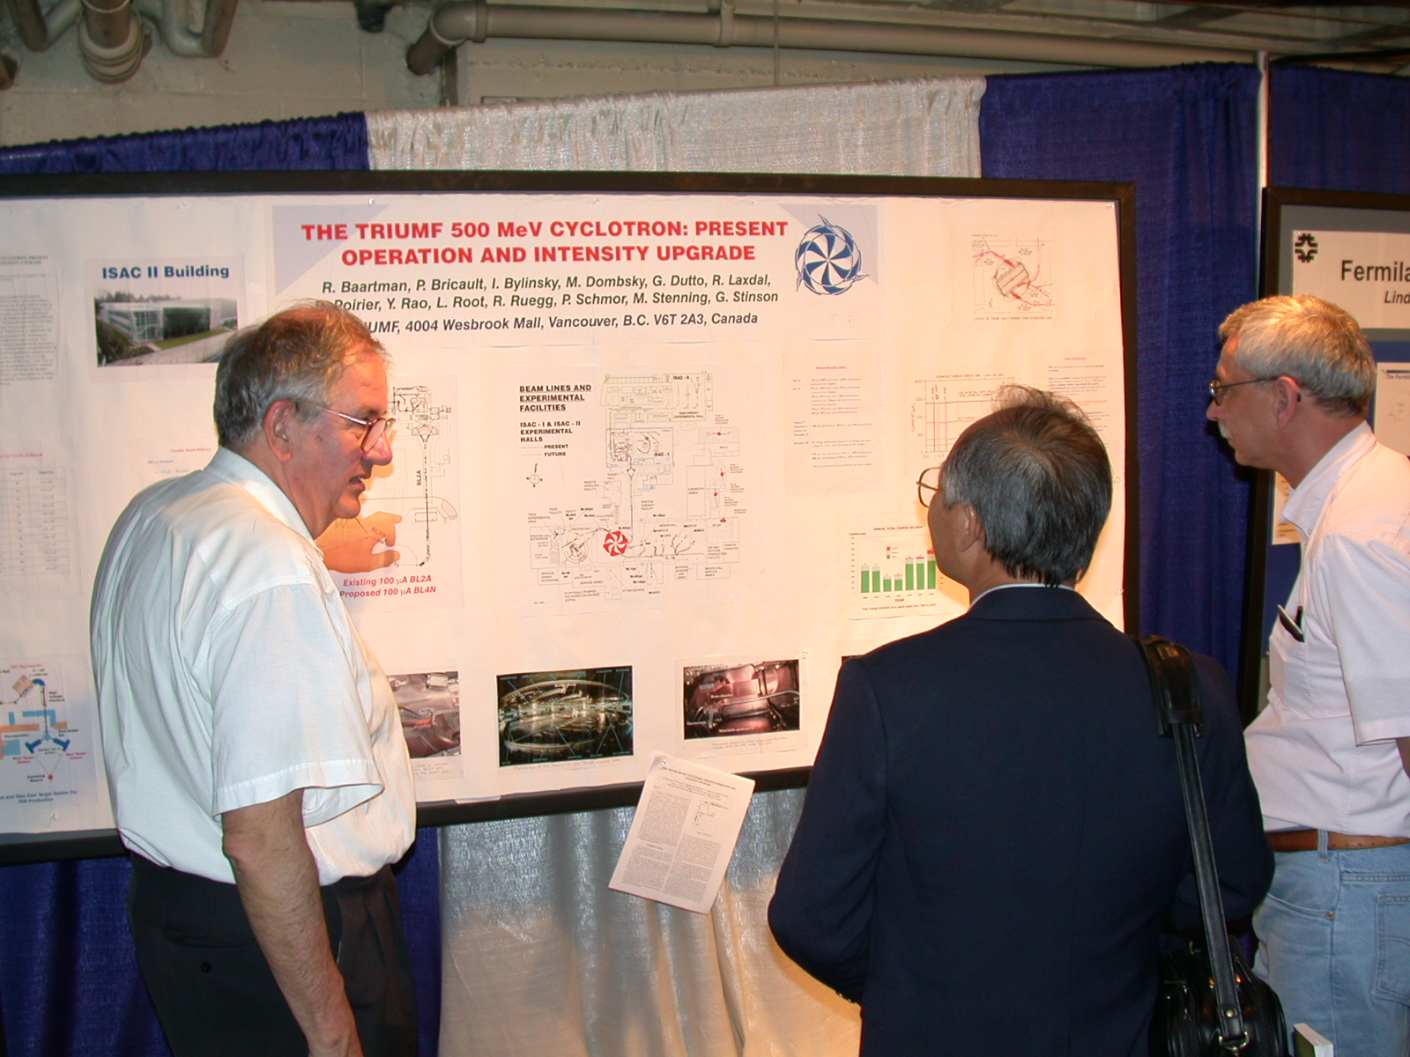
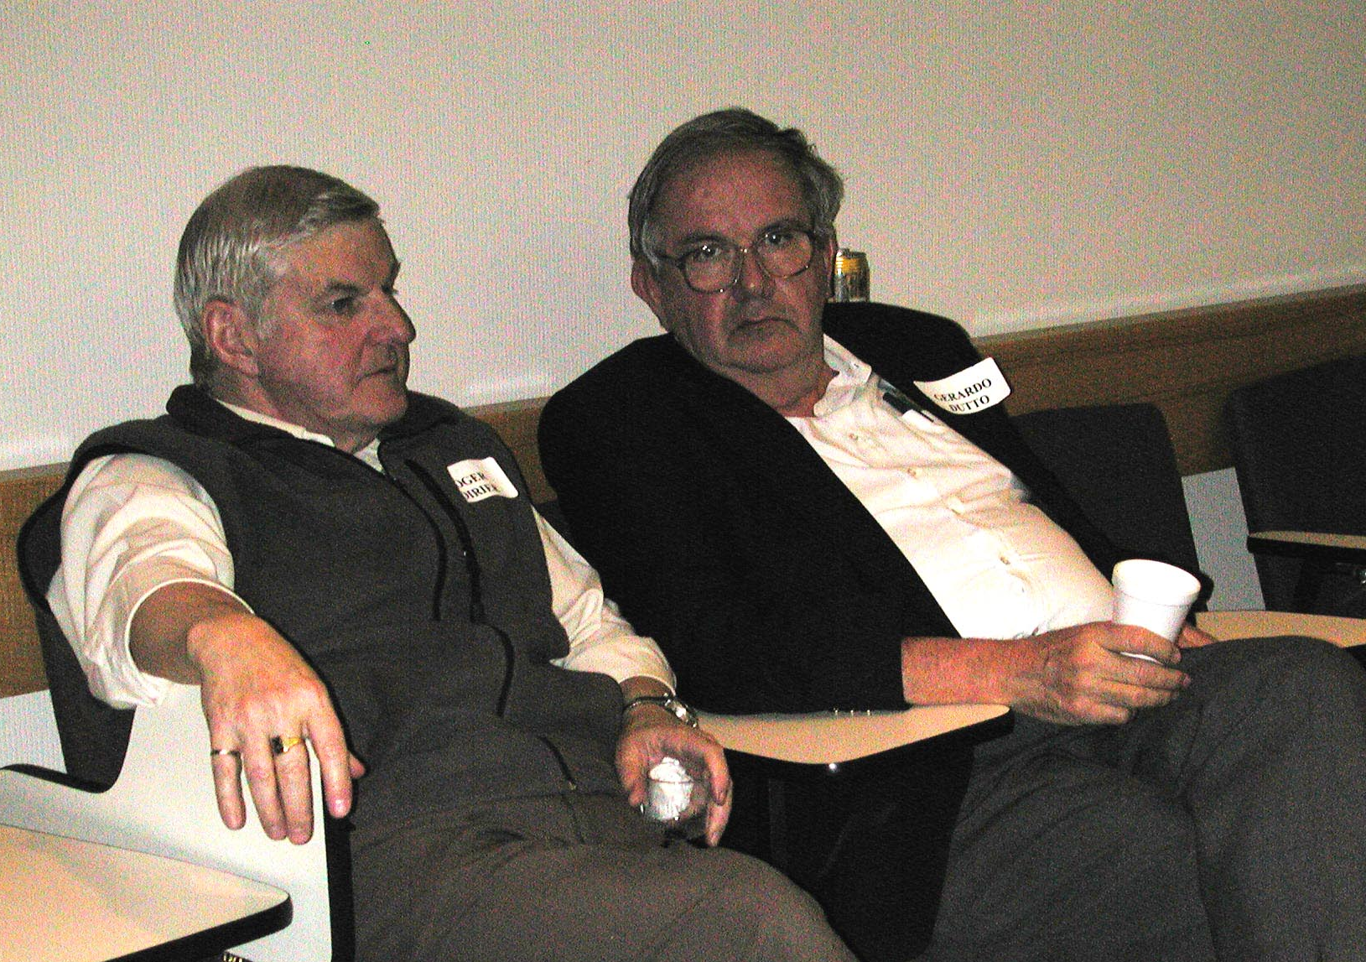
Anecdotal stories about Gerardo
Being a scientific paper coauthor with Gerardo was always a “pulling teeth” exercise
  Gerardo would go over and over the content, polishing it to perfection in his standard
  He started actively using computer only after retirement, so paper editing was in hand-writing and some cryptography skills required to go over Gerardo’s scribbles
  But! That worthed it: we had many good papers and presentations
Gerardo’s “therapy” sessions
  Personnel tensions were ironed out by inviting conflicting parties to the boss’s office and talking in person
  There were also soft sessions starting with: “How are you doing…” – to find out what people are thinking, worried about, in need of anything

Slide 12
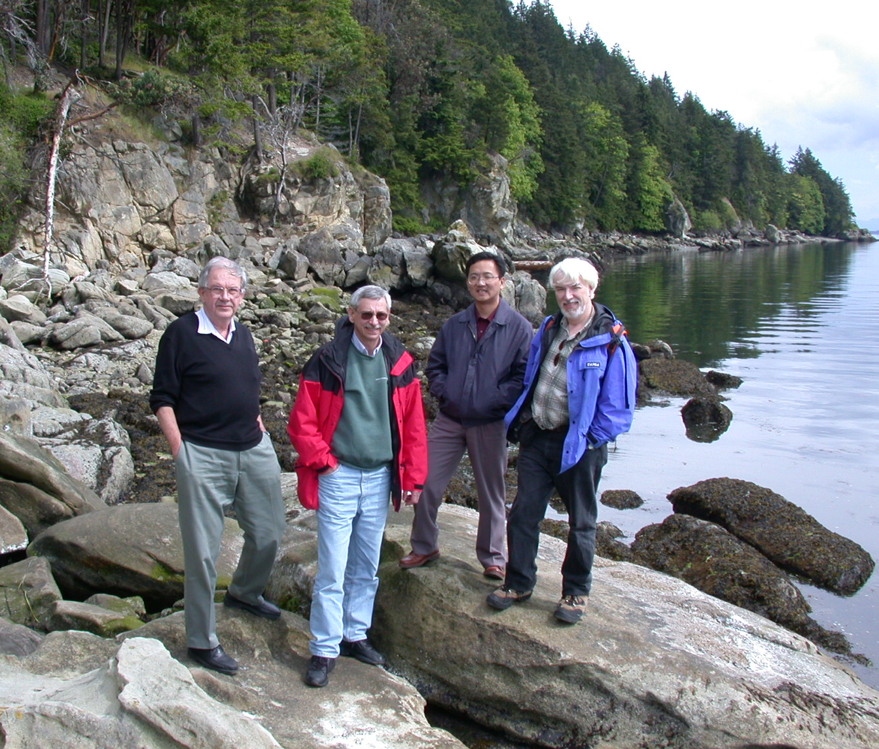
Who was Gerardo Dutto?
Team builder
Leader with deep care of people
Builder of bridges
  Engaged experts from around the world to help TRIUMF
  Assembled teams to help others
One of TRIUMF’s culture founders
Persevering innovator
Dear colleague and friend

Slide 13
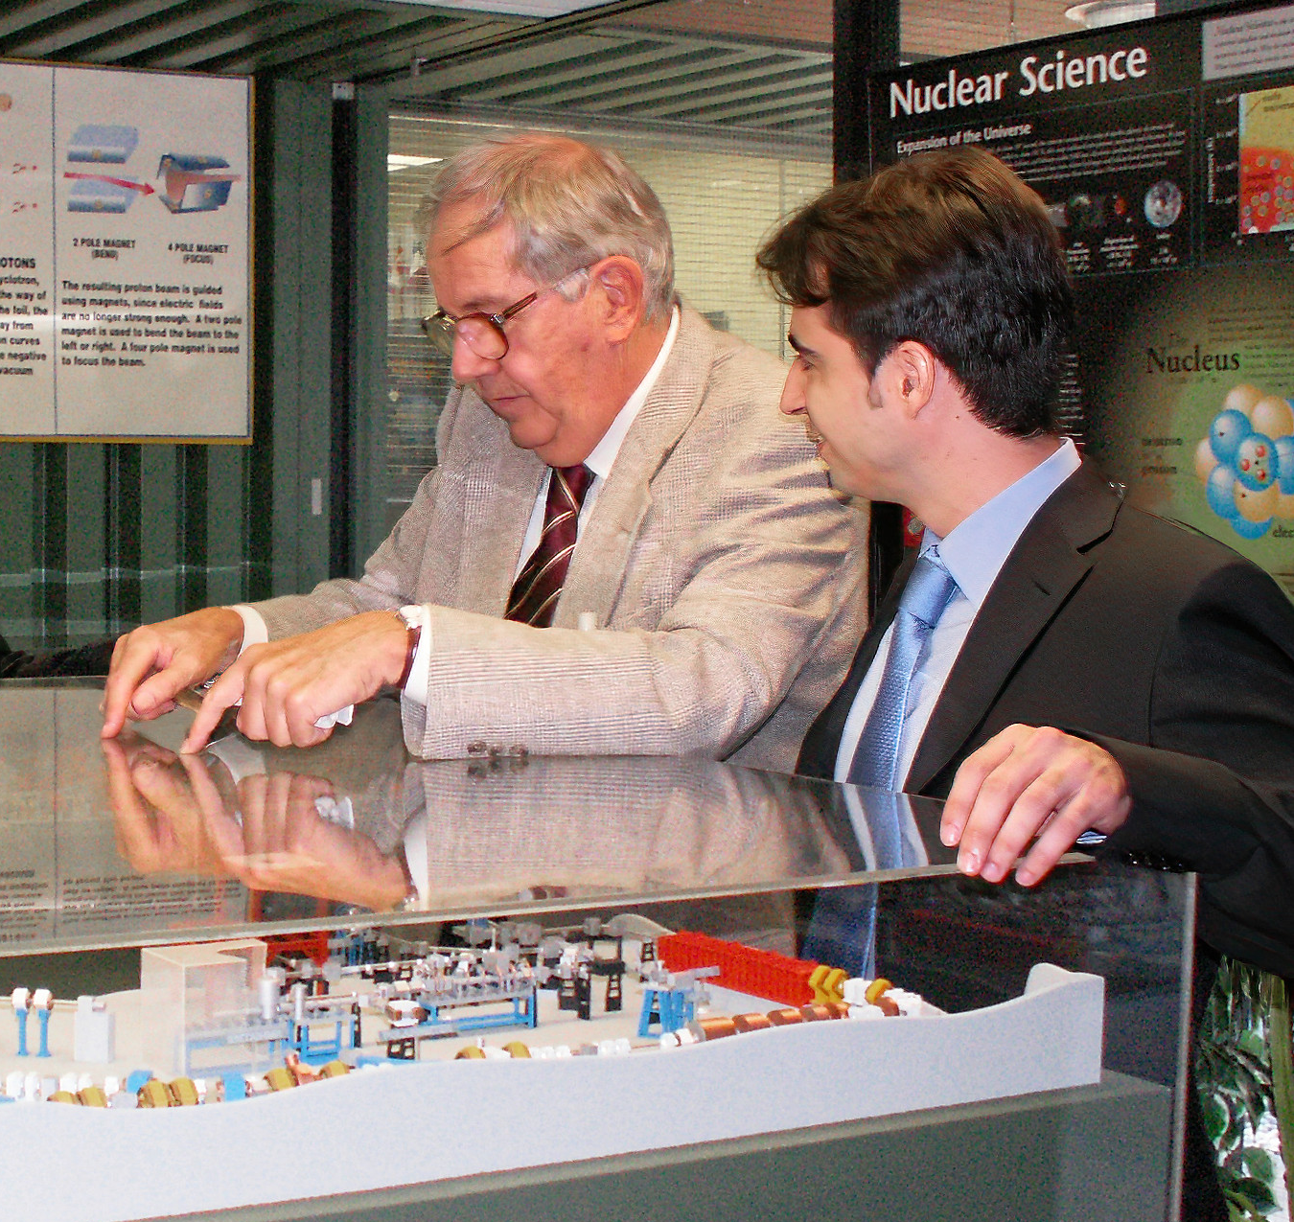
Gerardo Dutto award/scholarship proposal
Several fellowships have been established in the past, honoring TRIUMF prominent scientists:
  Erich Vogt
  Otto Hauser
  Michael Craddock
  and others
We are proposing an initiative to form an award/scholarship in memory of Dr. Gerardo Dutto
  to attract young talents to TRIUMF
  to assist in building up expertise of young specialists via international exchange.
TRIUMF will work with industrial and scientific partners who greatly benefitted from Gerardo’s enthusiastic and generous contribution to their success story
We invite private donations from Gerardo’s fellow colleagues and friends into this endowment foundation

Slide 14
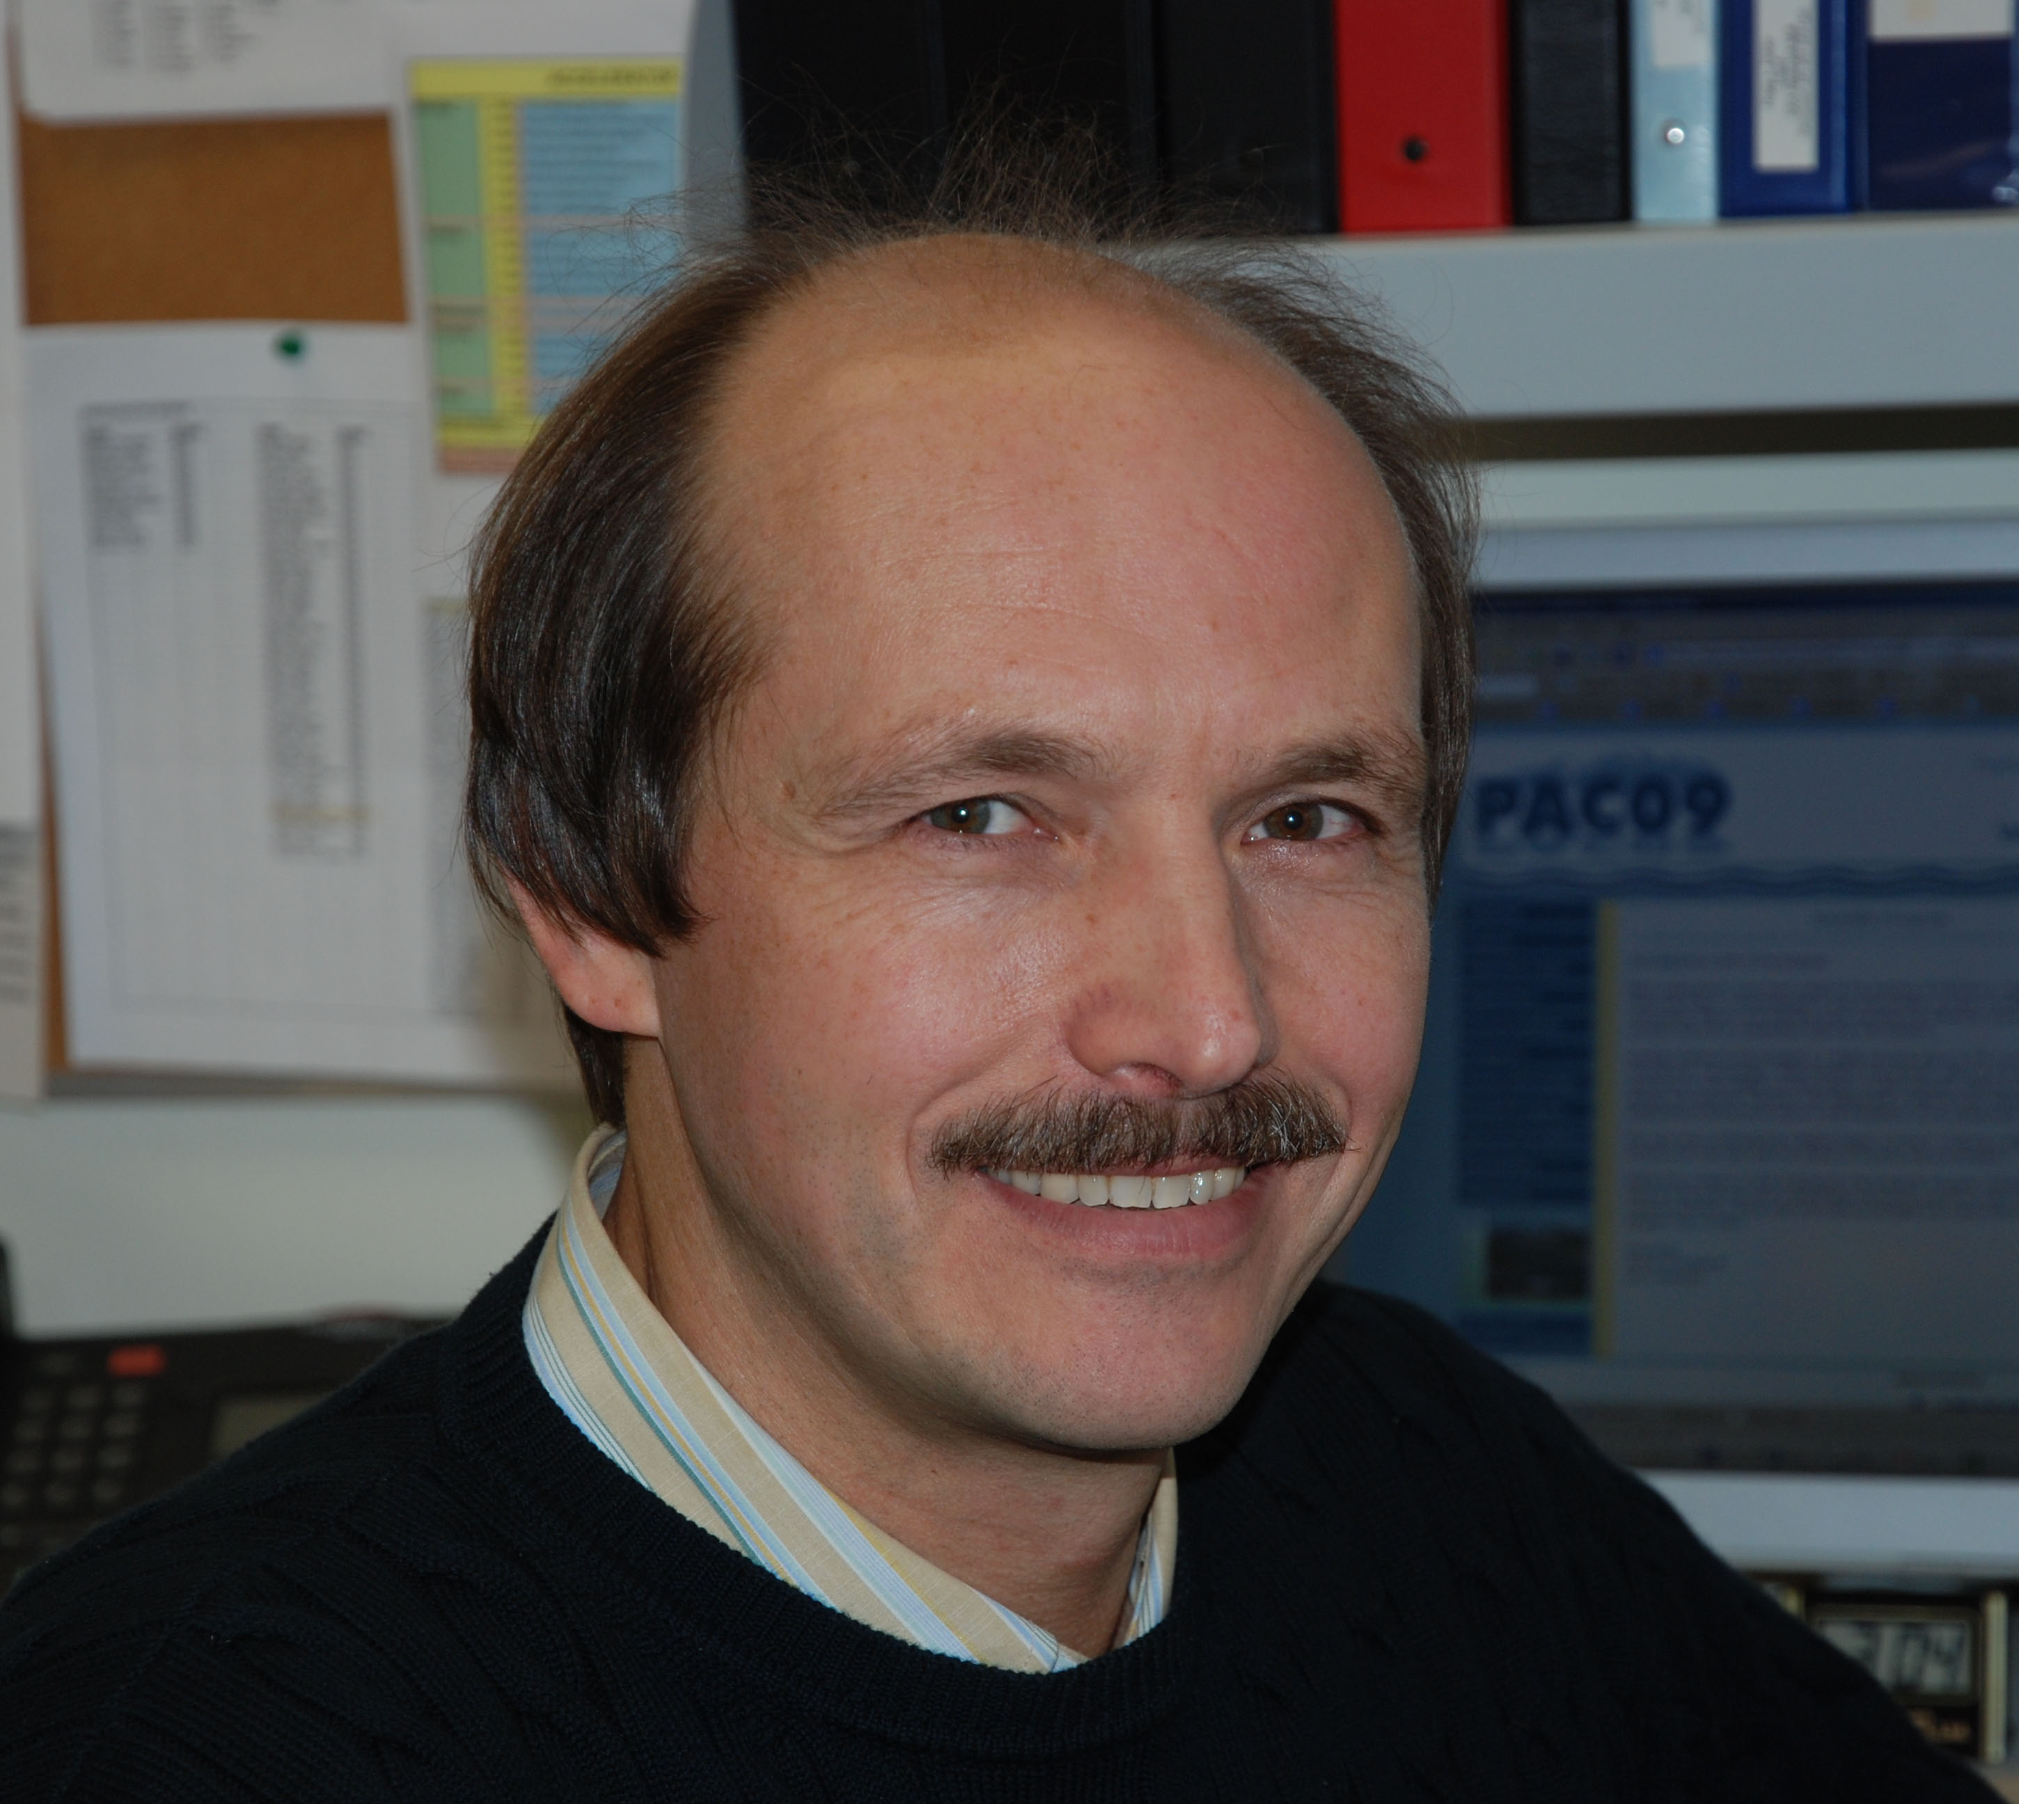
Gerardo Dutto award/scholarship proposal
TRIUMF will form a committee to develop terms of reference and to operate the foundation
We will announce all details of the fund formation and execution to the broader community when settled
TRIUMF will match one-to-one all private contributions
TRIUMF is a registered charity
  We will provide receipts for tax return on donations
Your feedback towards formation and application of the fund would be very welcome and appreciated
Send your suggestions to Yuri Bylinski
  Email is on the web page of this event

Slide 15
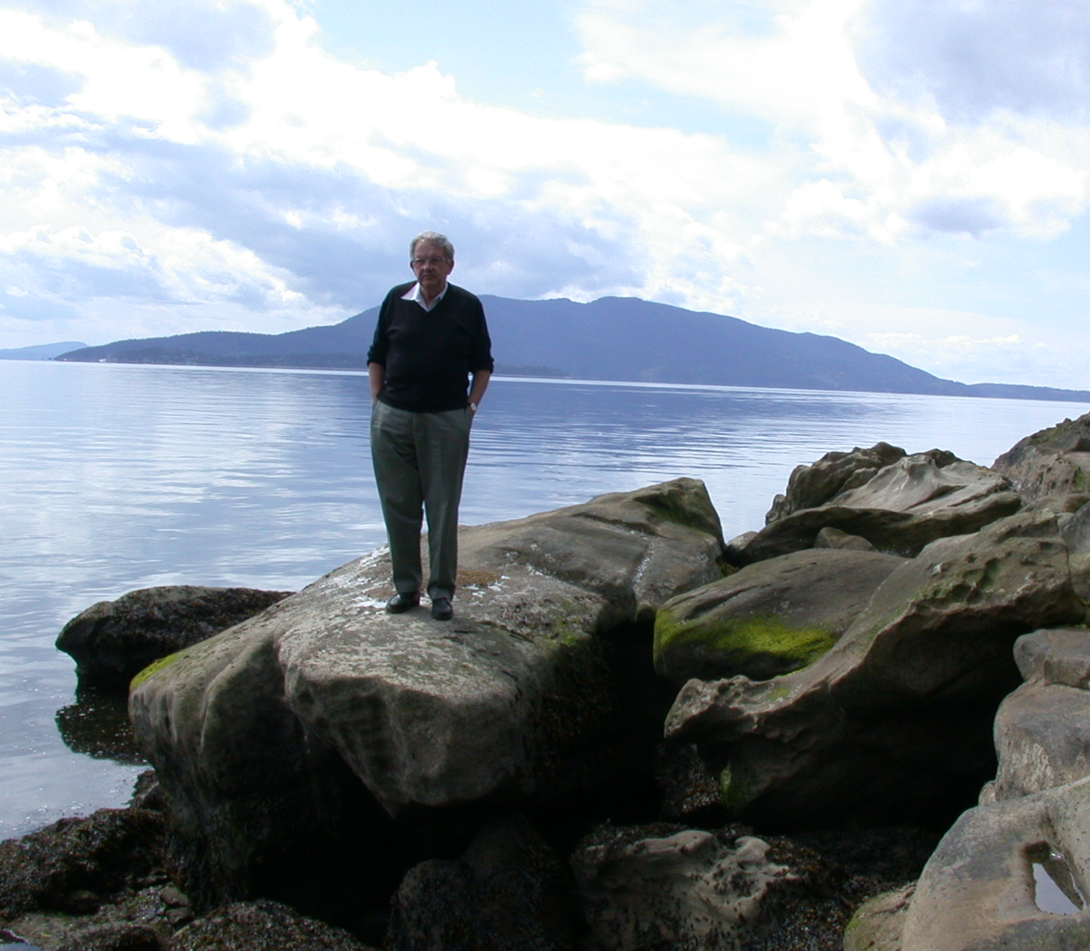

Thank you
Merci
Grazie
Спасибо

