Slide 1

Optically Pumped Polarized Ion Sources development at TRIUMF
Gerardo Dutto memorial symposium
Anatoli Zelenski
February 22, 2021

Slide 2

Workshop on high–energy spin physics, Protvino, 1983
G.Budker, G.Dimov,…- polarized H⁻ ion beam strip injection to circular accelerators, 1977, Pol. H⁻ ion beam intensity was ~5 µA.
Yaroslav Derbenev
“Siberian snake” proposal, 1974
Anatoli Zelenski
A new polarized source technique.
Equal intensity for polarized and
un-polarized proton beams.
Notes:
2

Slide 3
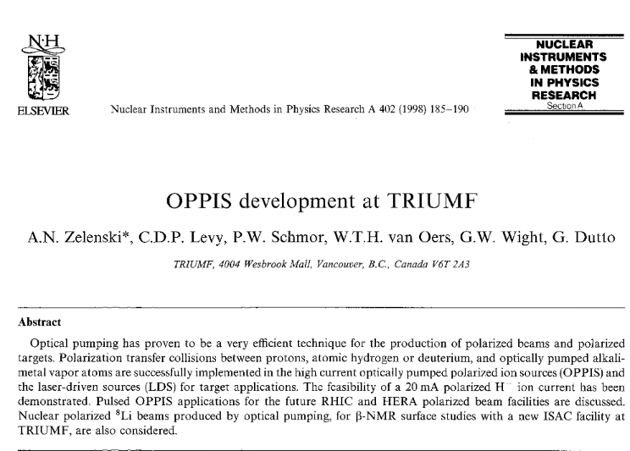
M.McDonald, R.Ruegg, K.Jaahmanna

Slide 4
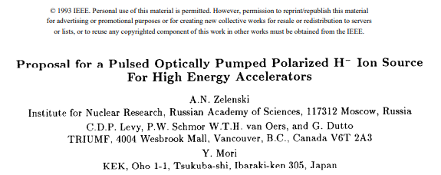

Slide 5
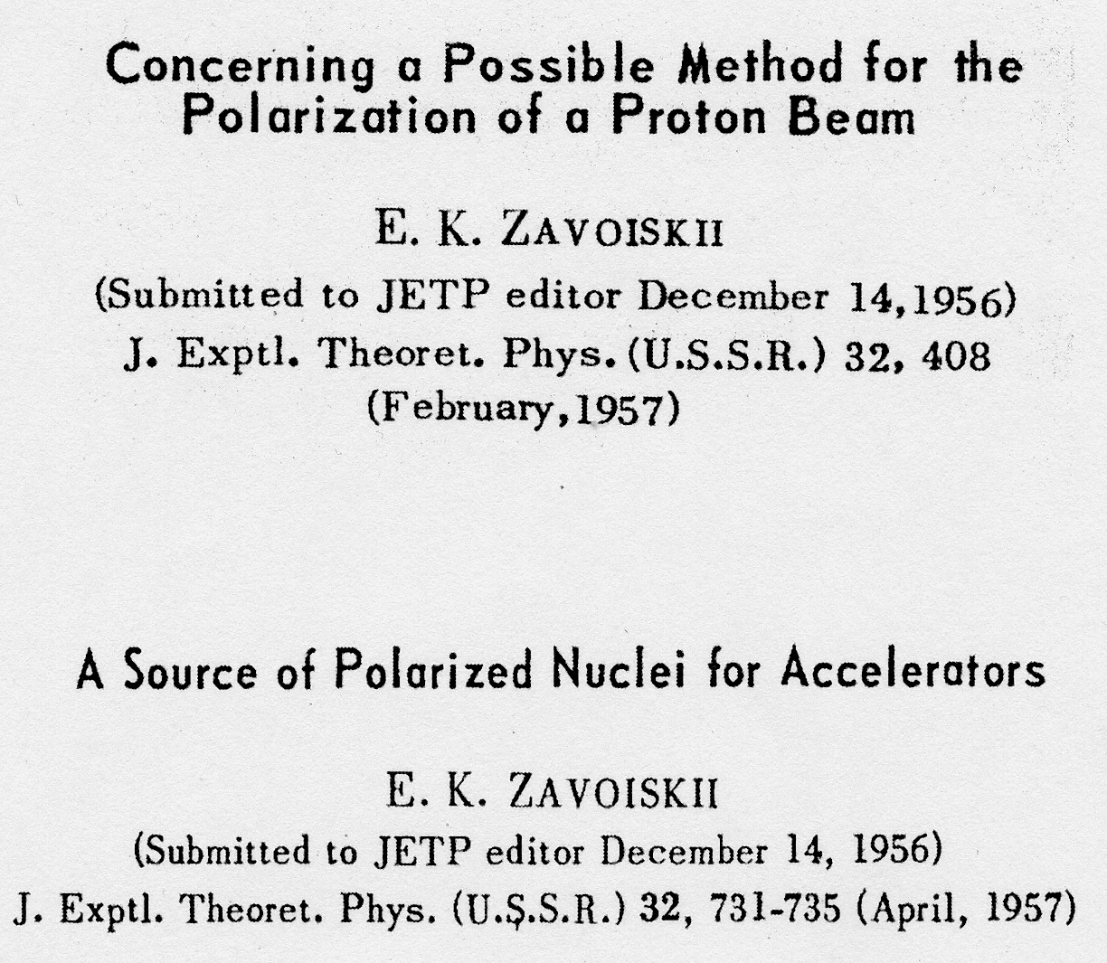
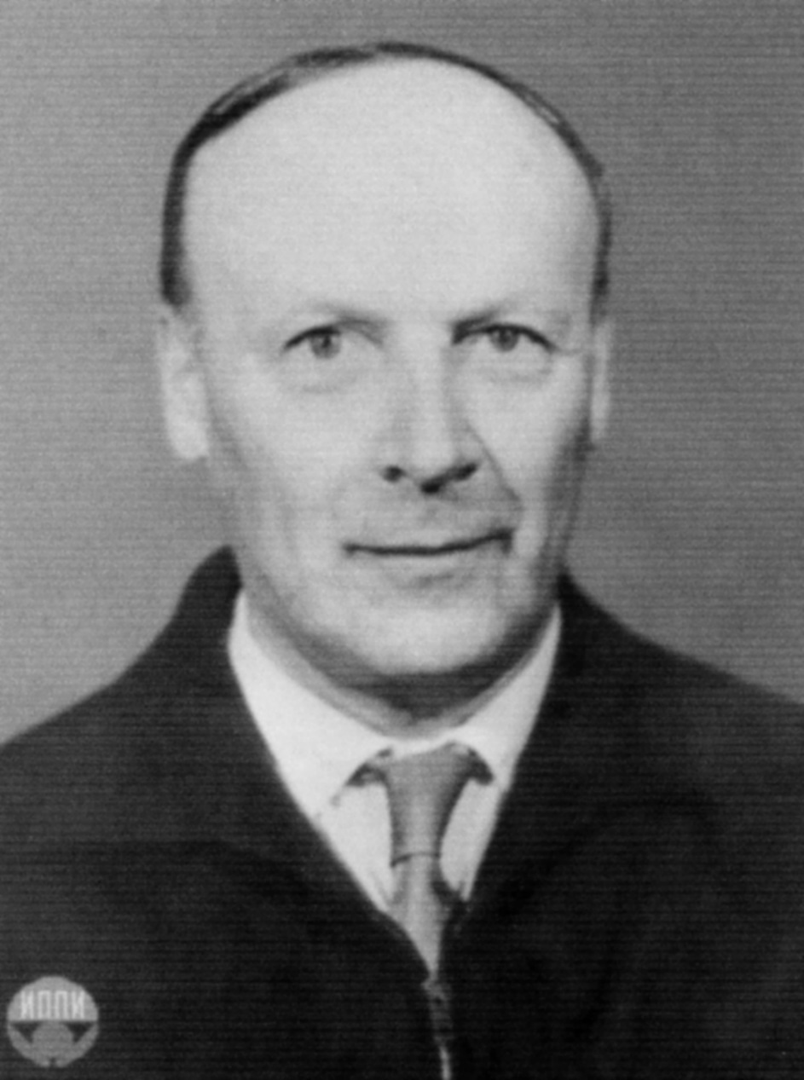
New polarization techniques proposed by E.K. Zavoiskii.
Spin-transfer polarization technique
Lamb-shift source technique

Slide 6
Proton polarization techniques
Ionization
ABS
Dissociator
Separating
6-pole magnet
RF
transition
ECR ionizer
→ H⁺
LDS
Cs cell
→ H⁻
Optically-
Pumped cell
Cs beam
→ H⁻
Plasma ionizer
→ H⁻
Optical pumping
OPPIS
Proton
source
Optically-
Pumped cell
Sona
transition
Na cell,8%
→ H⁻
H⁰
Source
Optically-
Pumped cell
He cell,70%
→H⁺
Polarization
Transfer to
protons
Polarization by electron spin

Slide 7
SPIN -TRANSFER POLARIZATION IN PROTON-Rb COLLISIONS
Laser-795 nm
Optical pumping
Rb: NL(Rb) ~10¹⁴ cm⁻²
Na-jet ionizer cell:
NL(Na)~ 3•10¹⁵ cm⁻²
Rb⁺
Rb⁺
Proton
source
H⁺
H⁺
Sona
transition
Ionizer
cell
H⁻
1.5 kG field
ECR-29 GHz
Н⁺ source
~50 mA, 2.8keV
Supperconducting solenoid 25 кГс
Charge-exchange collisions:σ ~10⁻¹⁴ cm²
Electron to proton polarization transfer
Laser beam is a primary source of angular momentum:
10 W (795 nm) 4•10¹⁹ hν/sec 2 A, H⁰ equivalent intensity.
Notes:
7

Slide 8
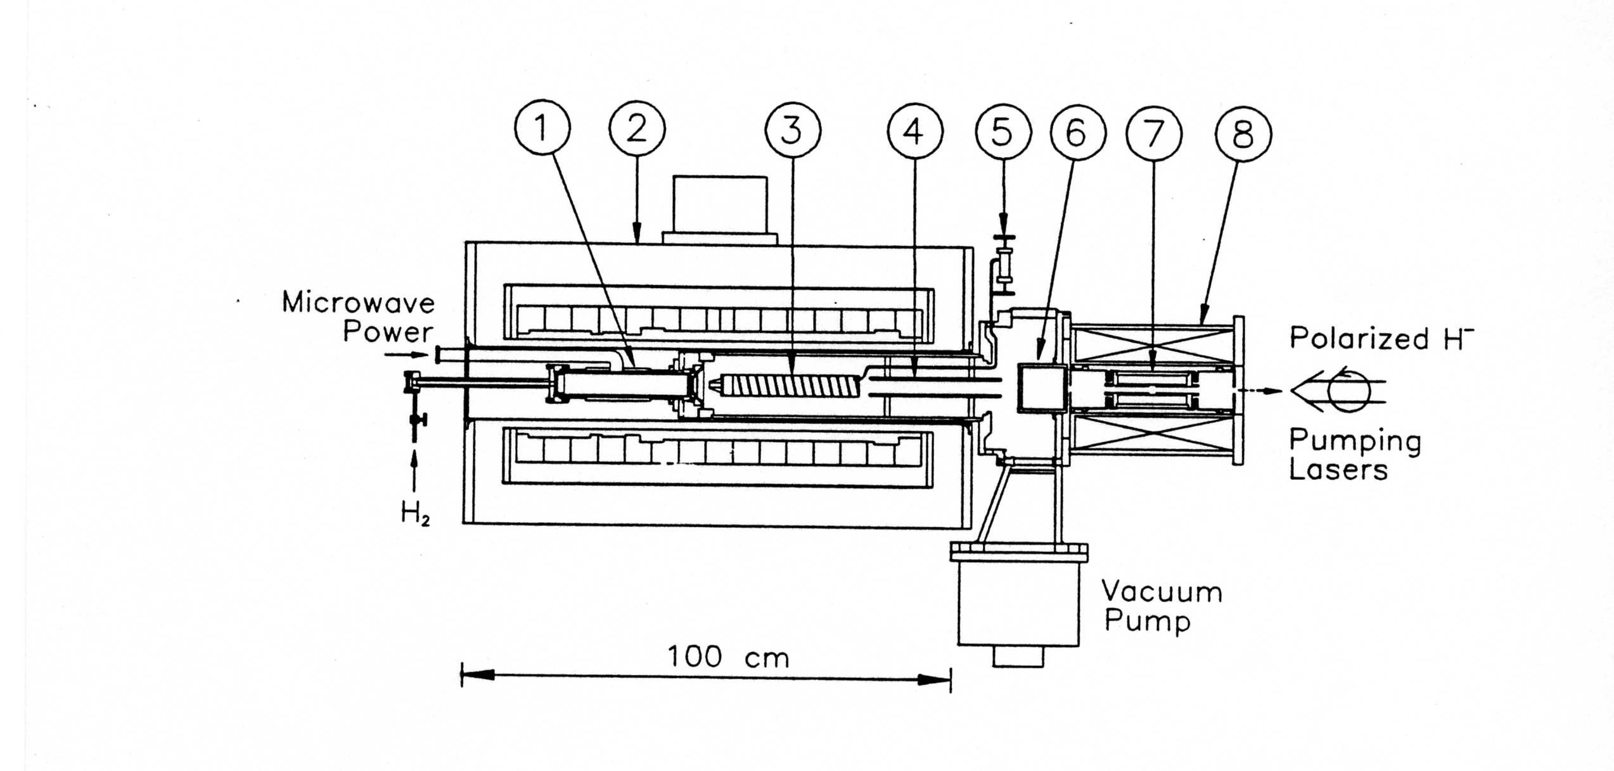
The TRIUMF Optically Pumped Polarized Ion Source, 1983-2000
1- 28 GHz ECR proton source; 2-25 kG superconducting solenoid; 3-Optically-pumped Rb-vapor cell;
4-deflecting plates;5-Rb feeder;6-Sona transition;7-sodium ionizer cell; 8-ionizer solenoid.

Slide 9
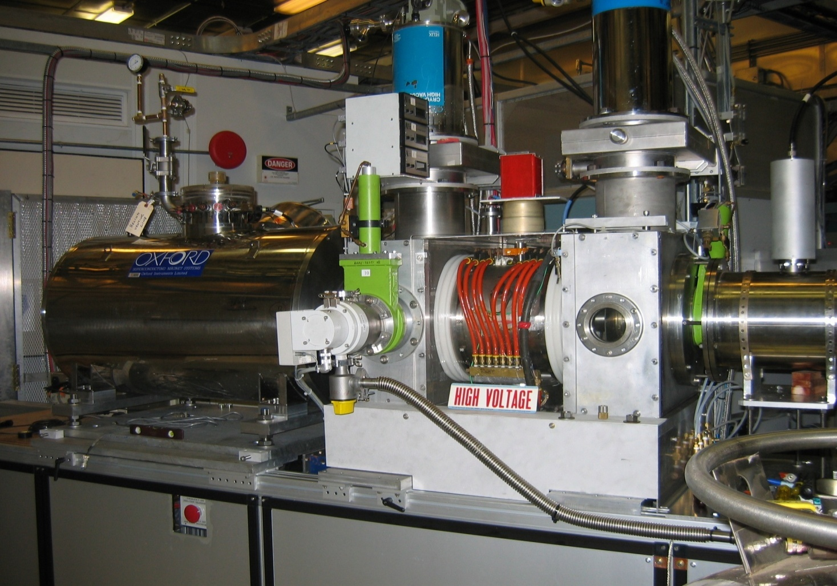
Optically-Pumped Polarized H⁻ Ion Source (OPPIS) at RHIC,
(originally developed in collaboration between KEK, BNL, TRIUMF and INR Moscow).
RHIC OPPIS produces
reliably 0.5-1.0mA
(maximum 1.6 mA)
polarized H⁻ ion current.
Pulse duration 400 us.
Polarization at 200 MeV
P = 85%.
Beam intensity (ion/pulse)
routine operation:
Source - 10¹² H⁻/pulse
Linac (200MeV) - 5∙10¹¹
AGS - 1.9∙10¹¹
RHIC - 1.8∙10¹¹
(protons/bunch).

Slide 10
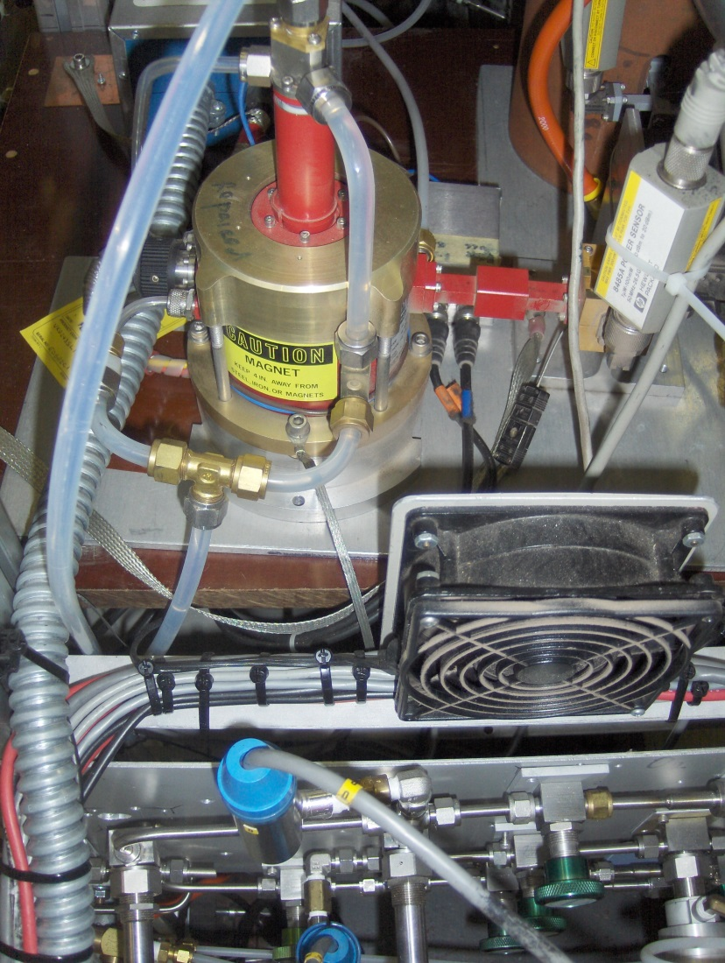
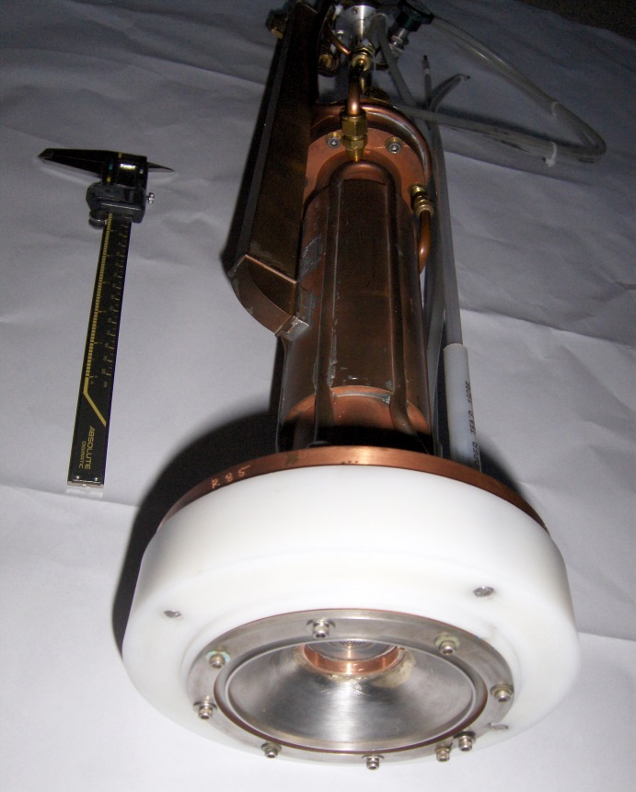
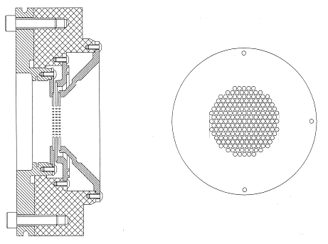
ECR primary proton source.
Multimode cavity
Transverse RF power
Input.
29.2 GHz, 1.2 kW dc
Extended Interaction
Ocsillator tube
3-grid multihole
Proton extraction
system

Slide 11
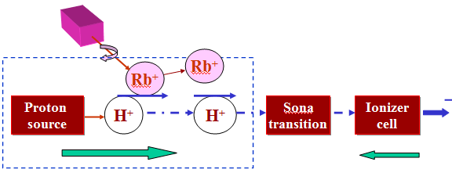
OPPIS with atomic H⁰ injector
High-brightness proton beam inside strong 2.5 T solenoid field
produced by atomic H beam ionization in the He-gas ionizer cell
H⁻
H0
Atomic H
injector
He-cell
25 kG
1.5 kG
The primary proton beam and
Equivalent atomic H intensity
current is 2.5 A at 6.5 keV beam energy !

Slide 12
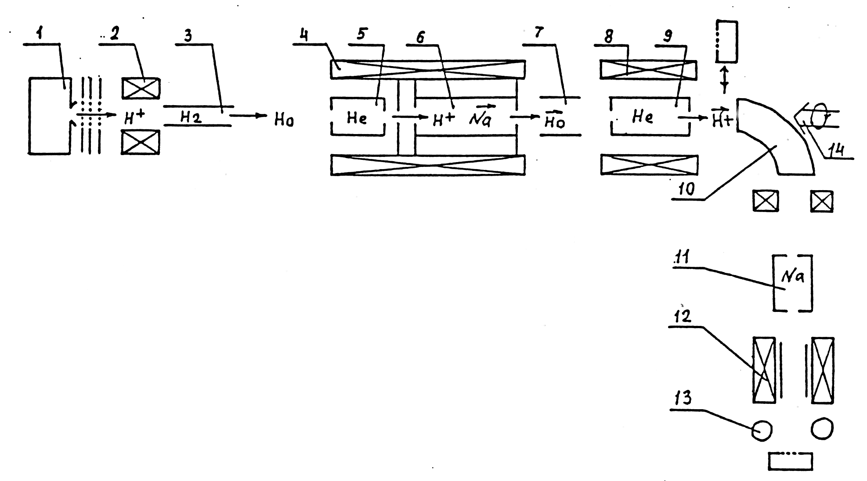
Pulsed OPPIS with the atomic hydrogen injector at
INR, Moscow, 1982-1990. First generation
Atomic H⁰ injector
Helium ionizer cell
Lamb-shift polarimeter
H⁻ current- 0.4mA
H⁺ current- 4.0 mA, P=65%, 1986

Slide 13
SPIN-TRANSFER POLARIZATION TECHNIQUE MILESTONES
1956 - E.K.Zavoiskii, Kurchatov Institute, Moscow - proposal . Polarized electrons capture from ferromagnetic foils, or paramagnetic vapors.
1969 – M. Kaminskiy, (USA) – experiment. Deuterons + magnetized nickel crystal.
1972 – B. Ad’yasevich, Kurchatov Institute, Moscow – experiment. Protons on polarized by 6-pole hydrogen.
1978 – G.Witteveen, Univ.Technology, Netherlands –experiment. Protons +polarized by 6-pole magnet Na-vapor. Optical pumping was mentioned. Weak field, low polarization.
1978 – E.Shamovskiy, Y.Shatunov, Budker Institute, Novosibirsk – proposal. Protons + Cs polarized by 6-pole. For the first time, the necessity of high field in neutralization region was pointed out. Optical pumping was mentioned too.
1979 – L.W.Anderson, Univ. of Wisconsin – proposal. Optical pumping of Na-vapor by commercially available lasers. High field in the Na-cell to prevent depolarization.
1981- A.Zelenski, INR Moscow -proposal to avoid emittance grows, by using atomic H-injector and He- ionizer cell placed in the same strong magnetic field as optically- pumped Na-vapor cell. Optical pumping of the high–thickness Na-cell by the pulsed dye laser.
1981 – Y.Mori, W.Cornelius, KEK,LAMPF - proposal to use ECR-proton source in the high field to avoid beam emittance growth.
1983 – Y.Mori, KEK – experiment. The first operational OPPIS with the ECR primary proton source (40 uA, P=50%).

Slide 14
SPIN-TRANSFER POLARIZATION TECHNIQUE MILESTONES
In earlier 1980s four groups at:
KEK (Japan), INR Moscow, LAMPF (USA) and TRIUMF (Canada) have started new spin-transfer polarization technique development for new generation of high-intensity accelerators (meson factories).
The intensity of polarized H⁻ion sources was just a few uA.
The result of this work is about 1000 times beam intensity increase!!!
1983 -TRIUMF –superconducting solenoid 25kG, 28 GHz ECR source. CW-pumping lasers.
1984 – A.Zelenski, INR –exp. Pulsed OPPIS – H⁻ current 0.1 mA. H⁺ - 1.0 mA.
1985 - H⁻ current 0.4 mA. H⁺ - 4.0 mA, P=65%
1995 -TRIUMF –exp. DC OPPIS – H⁻ current 1.0 mA. P=75%.
1999 -TRIUMF-Polarized H⁻ current of a 10.0 mA achieved in the pulsed OPPIS. P = 40% (limited by available solenoidal field strength ).
1999 - OPPIS development for RHIC was completed at TRIUMF. Final tests with TRIUMF superconducting solenoid. H⁻ current 1.6 mA, P = 85%.
2000 - The first OPPIS operation at RHIC.
2002 –2003 – RHIC OPPIS operation. 0.5 mA at 200 MeV. P = 80 %.
2006 – Polarization-86%

Slide 15
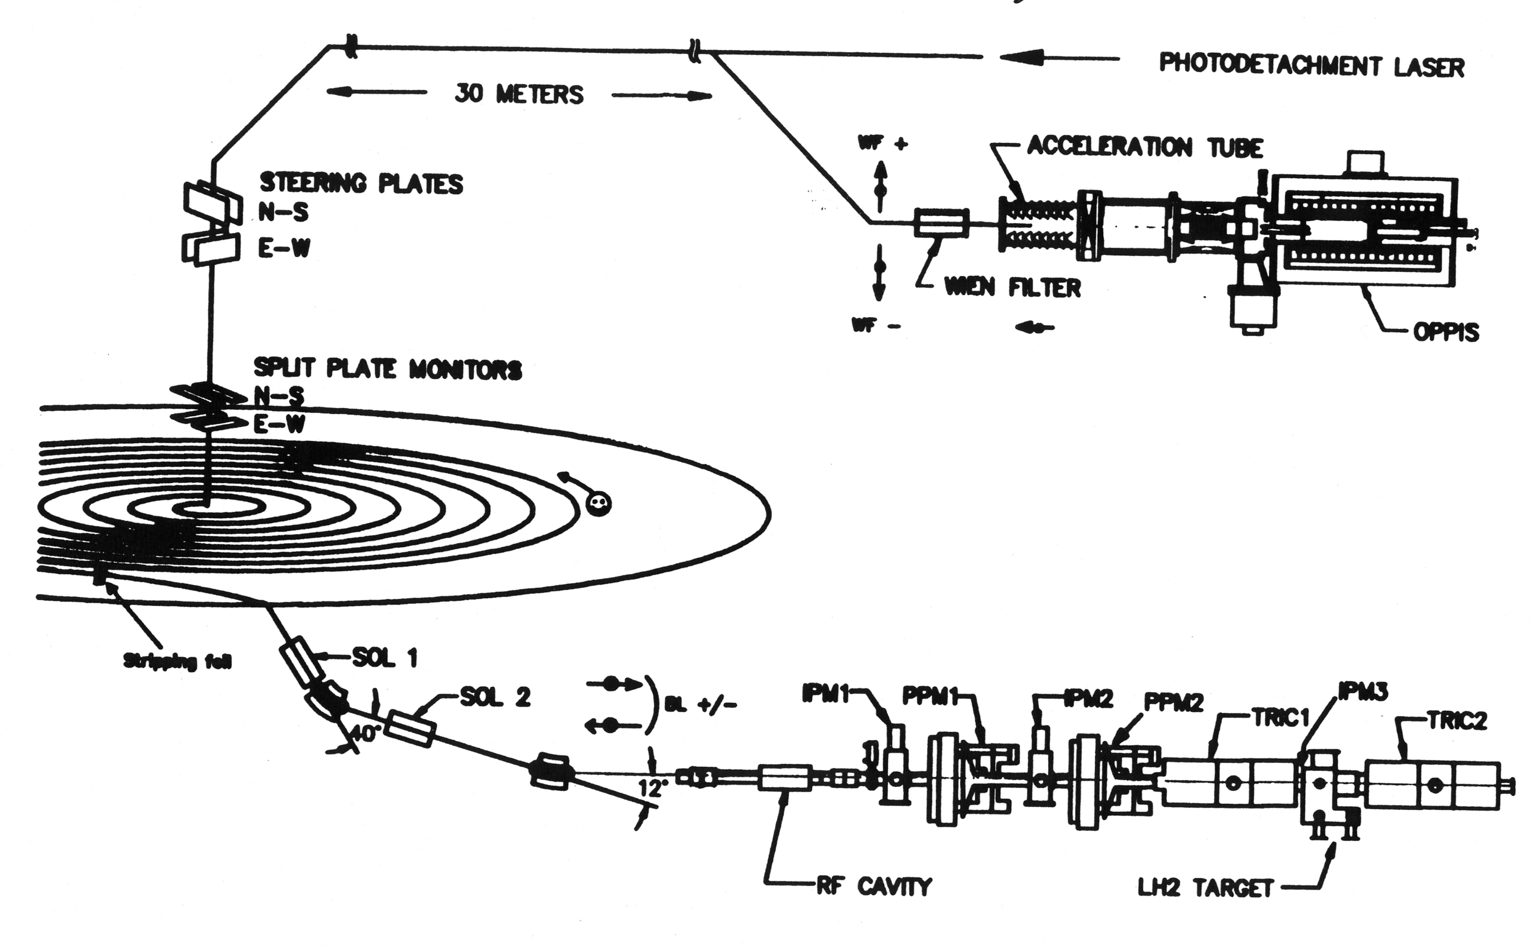
Parity experiment-E497 at TRIUMF.
300 keV polarimeter
Spin-correlated beam intensity
modulations: < 10⁻⁵
Polarization modulations: < 0.1%
Energy modulations: < 10⁻³ eV.
200 MeV polarimeter
OPPIS- polarized H-ion source; SOL- 1,2 –spin-precession solenoids; IPM- beam profilometers; PPM- scanning polarimeters; TRIC-1,2- ionization chambers – beam current detectors.

Slide 16
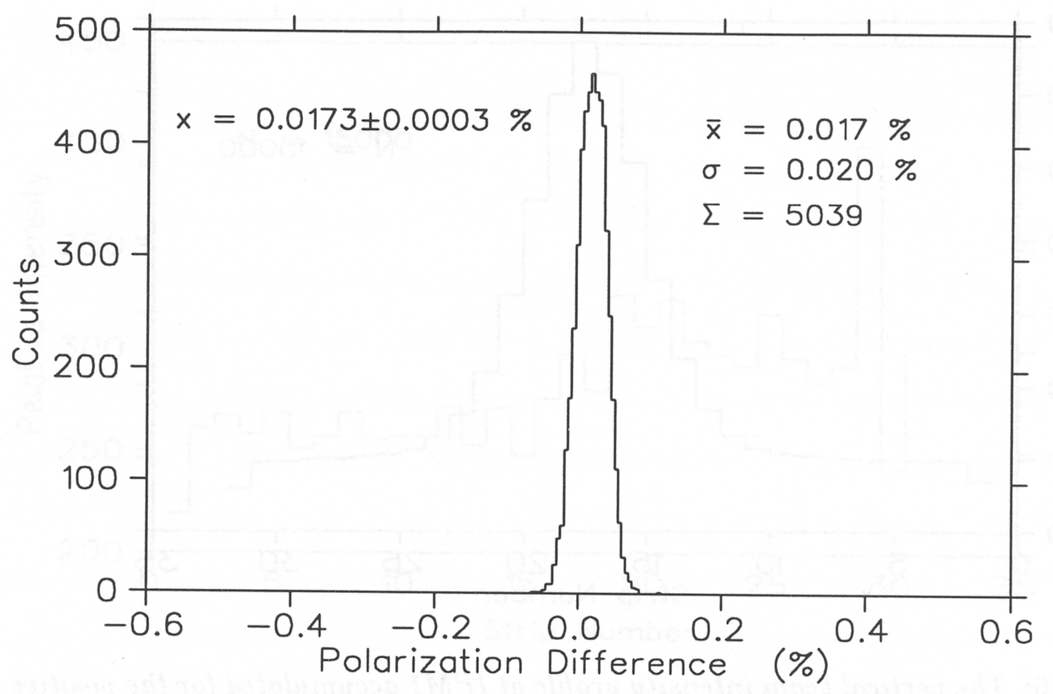
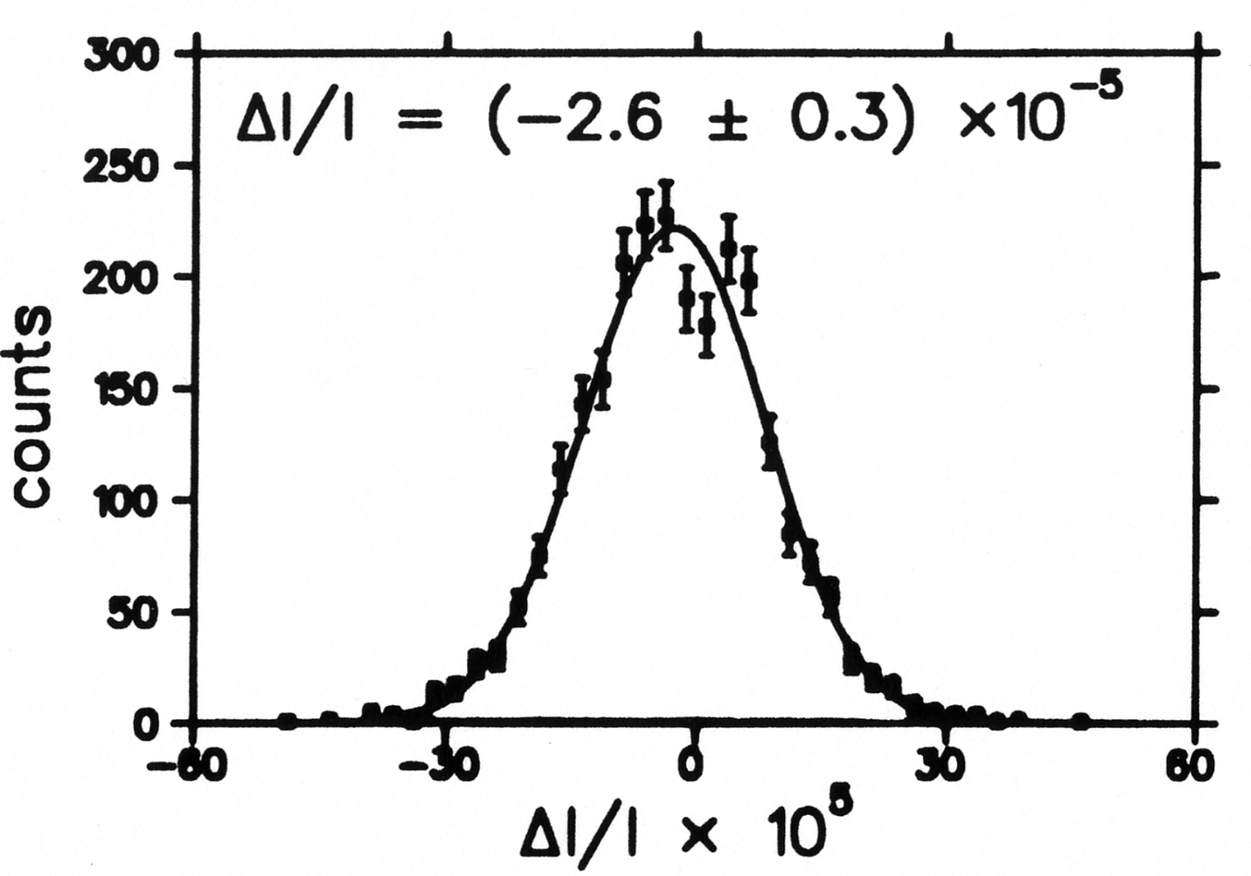
Spin-flip correlated beam intensity modulations in the OPPIS.
ΔP=0.02%
Spin – flip in the OPPIS is produced by the pumping laser frequency shift (95 GHz shift is required for the 25 kG field in the optically-pumped Rb vapor cell) and circular polarization direction reversal.
The laser frequency control and stabilization system reduced the polarization modulation to less than 0.1% and spin flip correlated beam intensity modulations to ~10⁻³ % level.

Slide 17
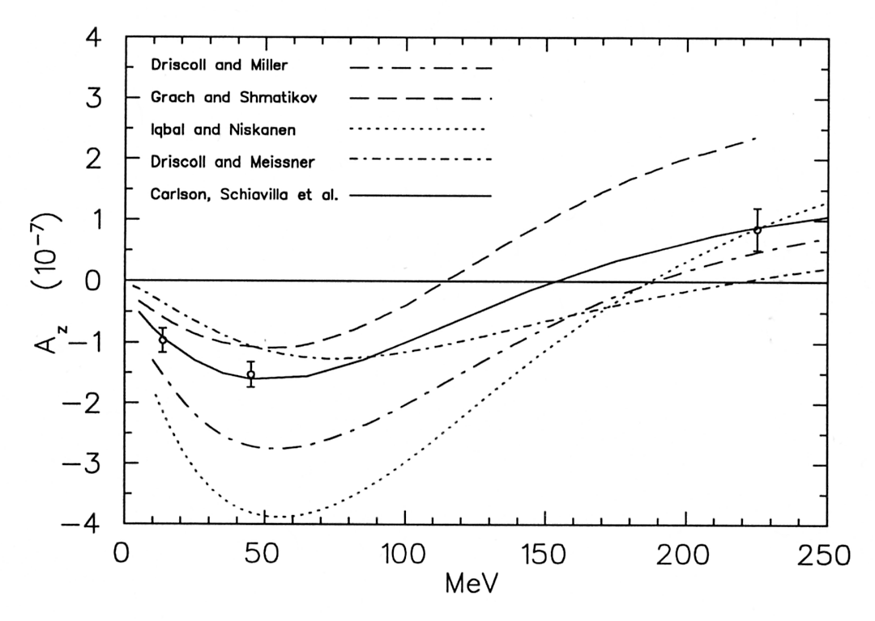
A_{z} measurement at 221 MeV proton beam energy at TRIUMF.
At 221 Mev beam energy only
J=2 (³P₂ ¹D₂) partial wave
contribute to Az.
E497
σ ⁺ - σ ⁻
σ ⁺ + σ ⁻
A_{z}=
E497: A_{z}= (0.84+/- 0.29+/- 0.17) 10 ⁻⁷
Solid line –calculations in the single meson exchange model.
Experments: 13.6 МэВ (Bonn)
and 45 МeV(SIN).
Dashed line- calculation in direct
quark model.

Slide 18
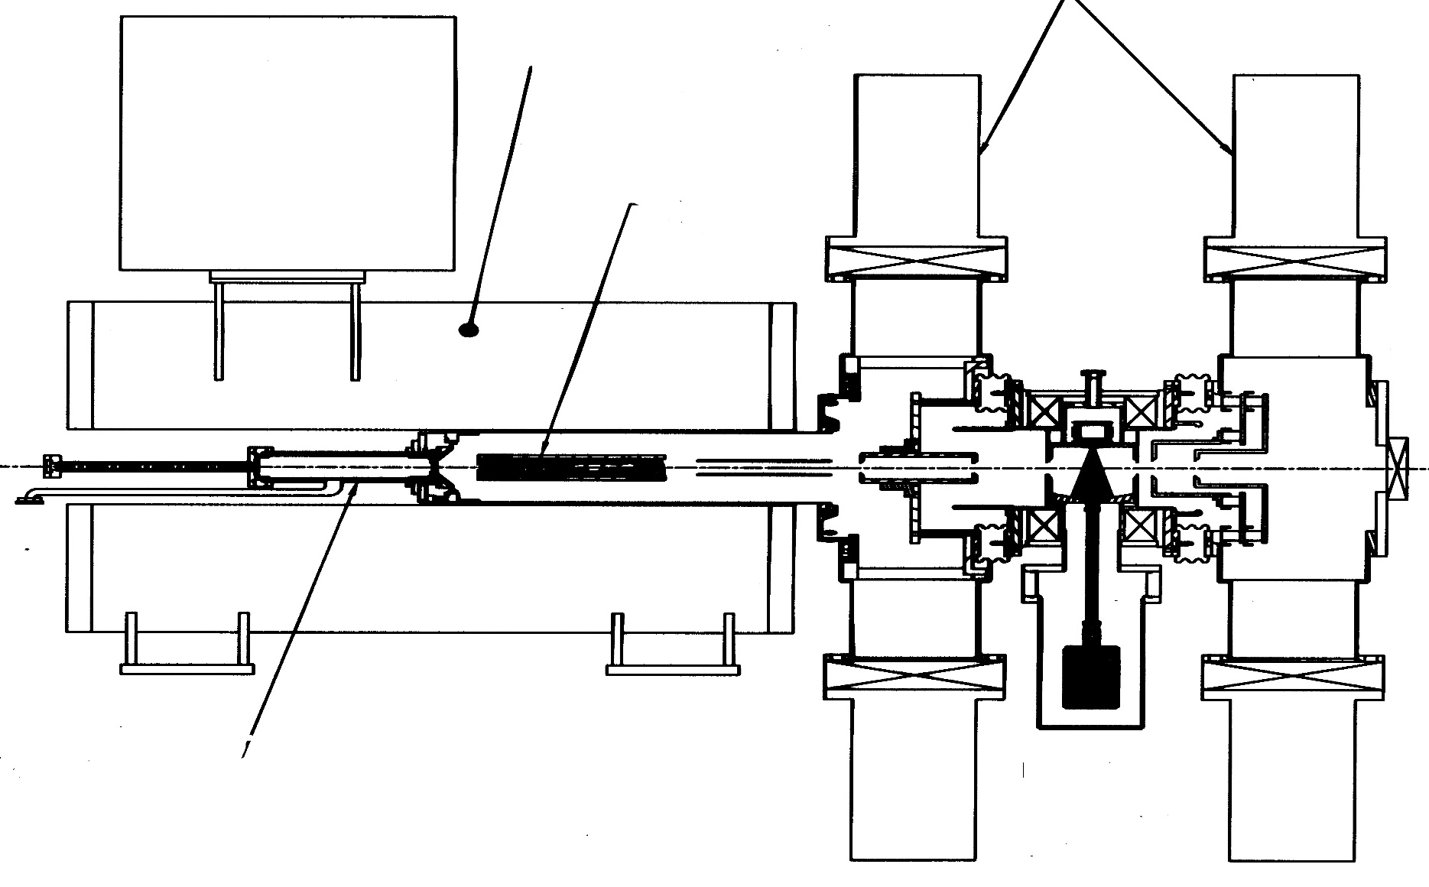
ECR based RHIC OPPIS, 2000-2012
Y.Mori, KEK-1986-90 first operational OPPIS
SCS solenoid
Cryopumps
SCS -solenoid
Rb-cell
Probe
laser
Pumping
laser
29.2 GHz ECR
proton source
Na-jet
Ionizer
cell
Sona-transition
Notes:
18

Slide 19
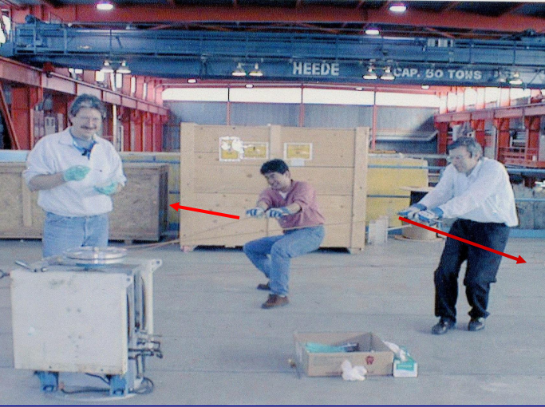

Slide 20
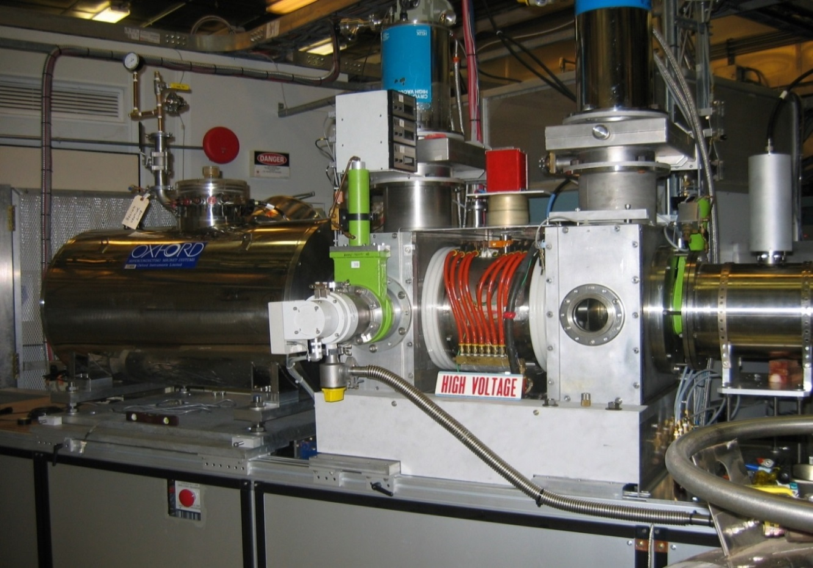
ECR-based OPPIS at RHIC, 2000-2012
RHIC OPPIS produces
reliably 0.5-1.0mA
polarized H⁻ ion current.
Polarization at 200 MeV:
P = 80%.
Beam intensity (ion/pulse)
routine operation:
Source - 10¹² H⁻/pulse
Linac - 5∙10¹¹
AGS - 1.5-2.0 ∙ 10¹¹
RHIC - 1.5∙10¹¹ /bunch
A 29.2 GHz ECR-type source is used for primary proton beam generation.
The source was originally developed for dc operation.
KEK-BNL-TRIUMF-INR, Moscow Collaboration
Notes:
20

Slide 21
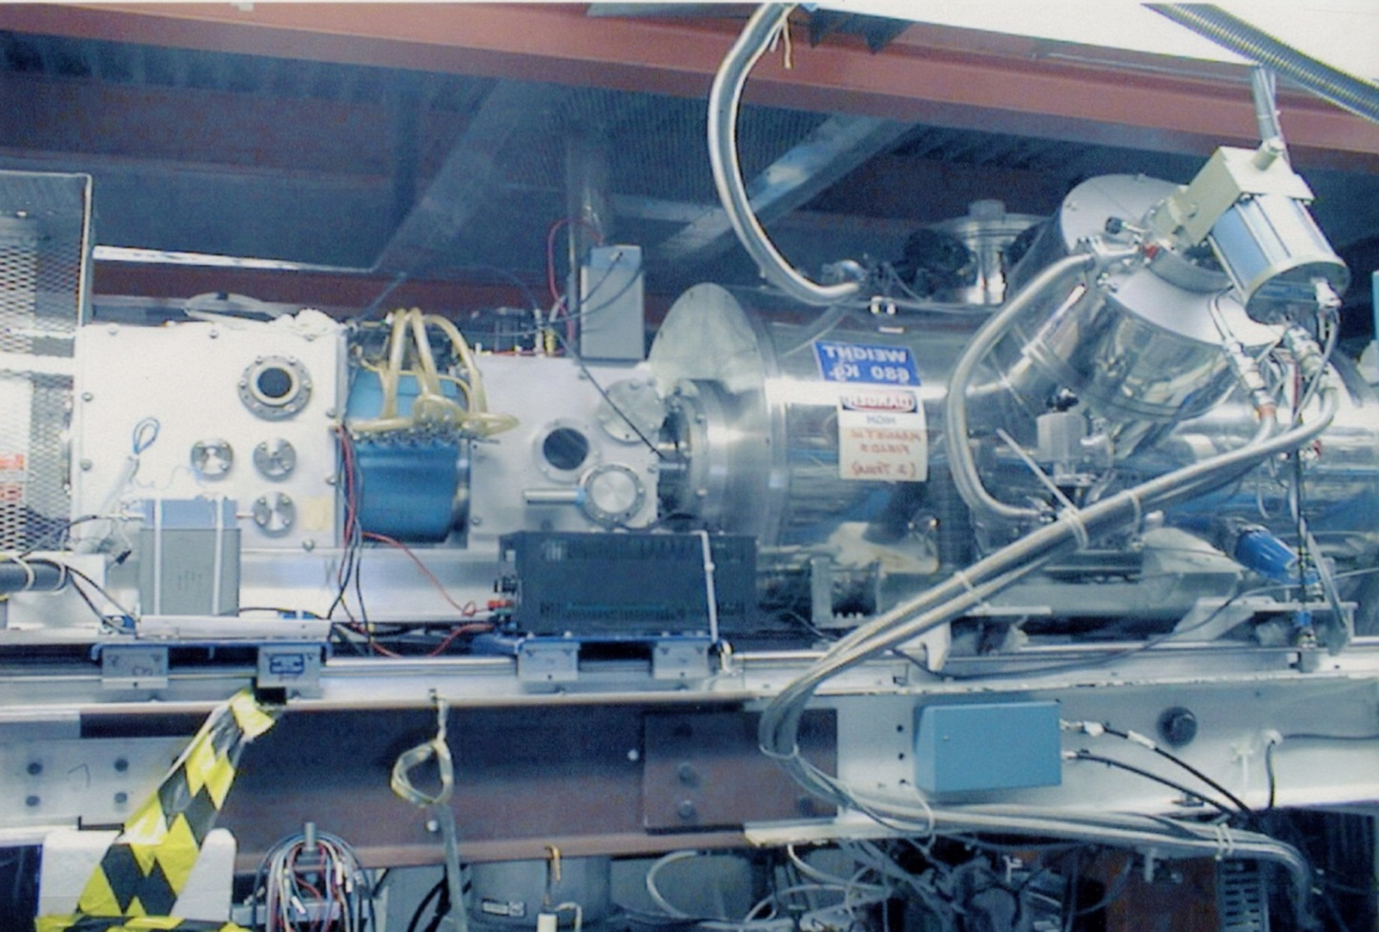
Pulsed OPPIS at TRIUMF, 1997-99.
Second generation. Motivated by proposals for polarized beam for FNAL and HERA
Atomic H0 Injector
A pulsed H⁻ ion current of a 10 mA was obtained in 1999
Polarization 40% limited by solenoid field

Slide 22
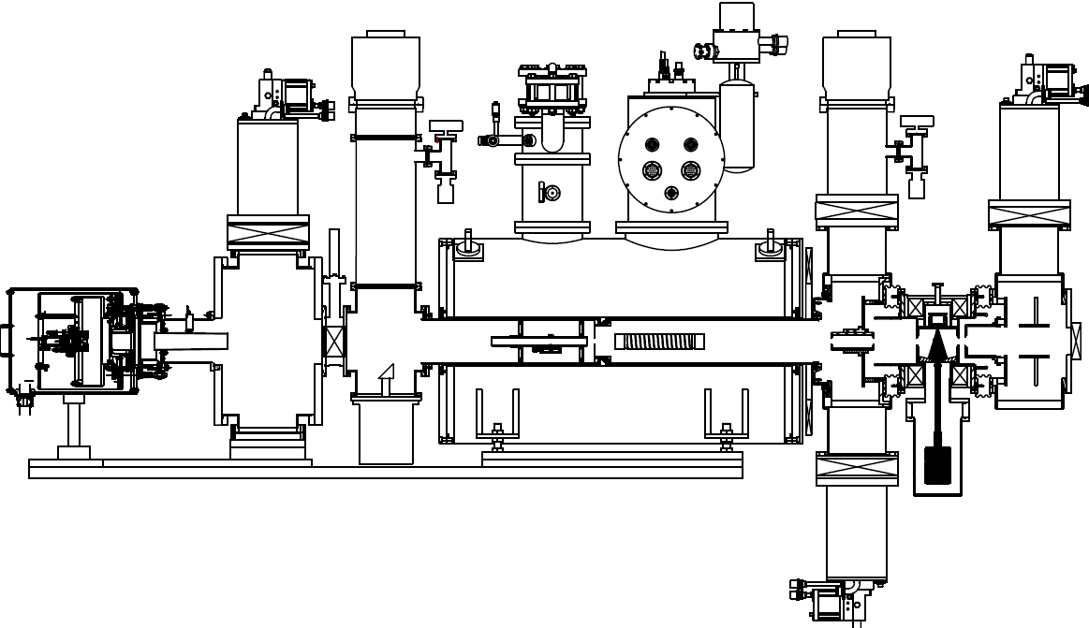
OPPIS with atomic H⁰ injector and He-ionizer cell at RHIC, 2012-19
TMP1
CP1
Neutralizer
H₂-cell
He-ionizer
cell
Sona
transition
Na-jet
cell
Atomic H
injector
Rb-cell
H⁰
H⁺
H⁰
H⁻
H⁺
H2
He
Rb
Na

Slide 23
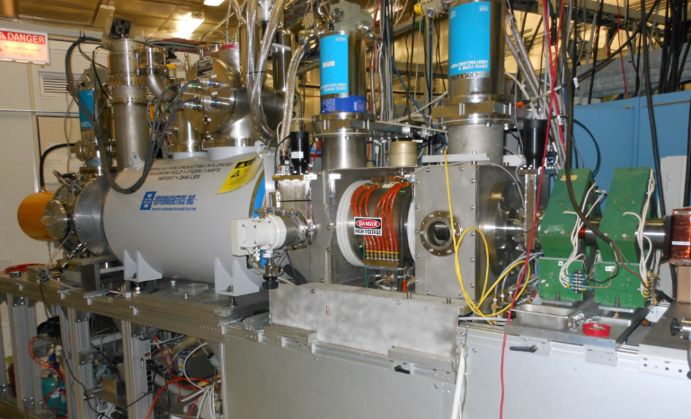
The RHIC OPPIS with atomic hydrogen injector, Run-2013-21
BNL, BINP, Novosibisk, INR, Moscow- collaboration

Slide 24
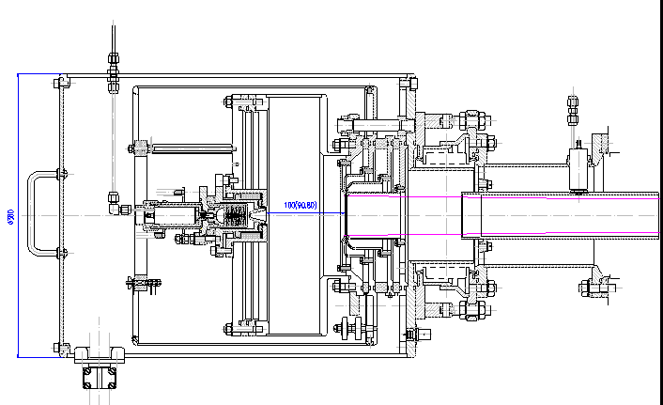
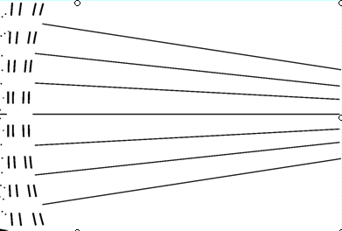
“Fast Atomic Beam Source”, FABS, BINP, Novosibirsk,2011
Plasmatron
4-grid proton
extraction system
~ 2.5 A
equivalent
H⁰ beam
H2 Neutralization cell
FABS produces 100-150 mA equivalent H0 beam intensity
Within the Na-jet ionizer acceptance.

Slide 25
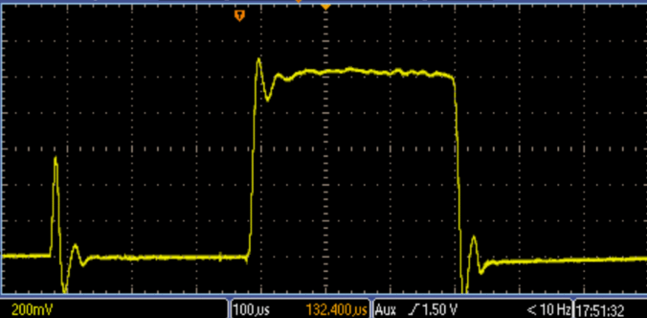
H⁻ ion beam current accelerated to 200 MeV, June-2017
1.05 mA
Rb-cell
Temp.-105 deg.
300 us

Slide 26
Beam intensity and polarization at 200 MeV
Reliable long-term ∙operation of the source was demonstrated.
“Perhaps even more impressive was Gerardo’s commitment to cyclotron operation reliability”.
Rb-cell thickness-NL X 10¹³ atoms/cm² | 4.5 | 5.5 | 7.5 | 10.4
Linac Current, μA | 440 | 520 | 740 | 1050
Booster Input ×10¹¹ H⁻/pulse | 10.0 | 12.0 | 14.0 | 17.1
Pol. %, at 200 MeV | 86 | 86 | 84.5 | 83

Slide 27
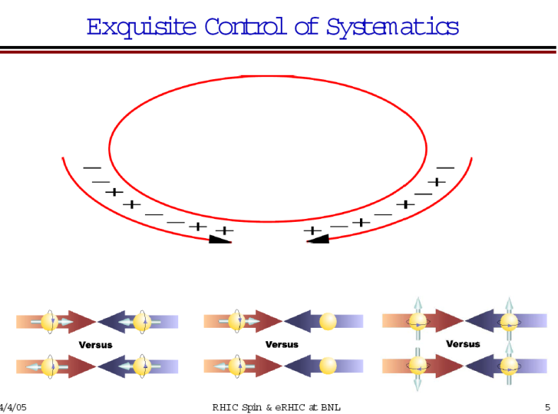
RHIC Polarized beam in Run 2013-17
OPPIS
1.0 mA x 300us→18∙10¹¹ polarized H⁻ /pulse
9.0 ∙10¹¹ polarized H⁻ /pulse at 200 MeV
routinely in Run-17, Polarization-85%
LINAC
Booster
(2.5-3.0) ∙10¹¹ protons /pulse at 2.3 GeV
AGS
(2.0-2.5) ∙10¹¹ p/bunch, P-70%
~1.8∙10¹¹ p/bunch, P~65-75% at 100 GeV
P ~ 60-65% at 255 GeV
RHIC
Notes:
27
27

Slide 28
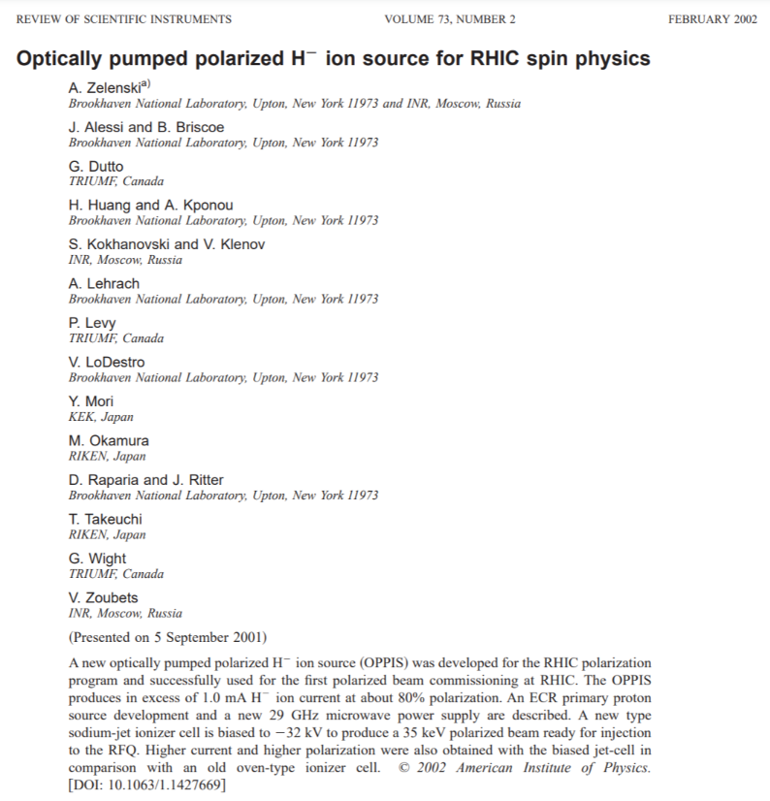
Gerardo was a `people’ person with an amazing ability
to bring people together.
He strongly believed that science and opportunity
should not be restricted by borders and he developed
meaningful and productive bridges.

