Slide 1
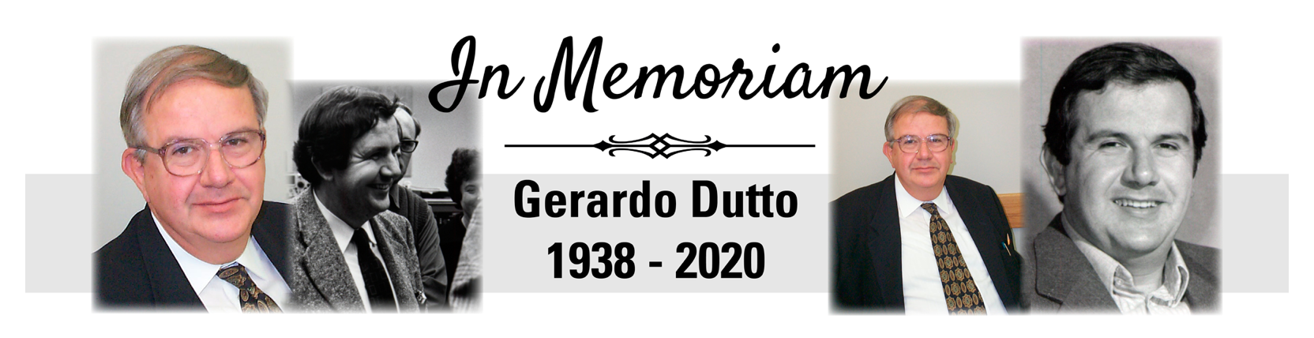
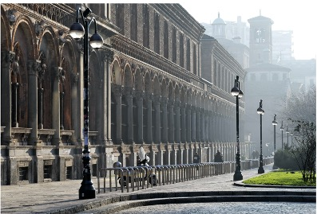


Symposium organized by TRIUMF, 7 December 2020
Few recollections
from Gerardo’s time in Milano
Angela Bracco
Università di Milano
and INFN

Slide 2

Let us go back to the beginning of the sixties
The situation of the Nuclear Physics group in Milano
At the end of the fifties beginning of the sixties in Milano there was a nuclear Physics group headed by Prof. Ugo Facchini \\\ 1working at the laboratory CISE with a neutron beam generated by 200 keV and 3.5 MeV protons from van de Graaf
The experience developed there and the necessity to make steps forward in the study of nuclei, nuclear reaction
and nuclear applications led the group to the propose a project for the construction of a cyclotron
The cyclotron of Milan was then built in the period 1960-65, it was the first Italian cyclotron
In addition to the University and INFN it also received local funding from companies and the Municipality of Milan.
It is interesting to underline the great willingness of the Lombard business world that at that time was keen to finance basic research activities, without immediate technological repercussions.

Slide 3
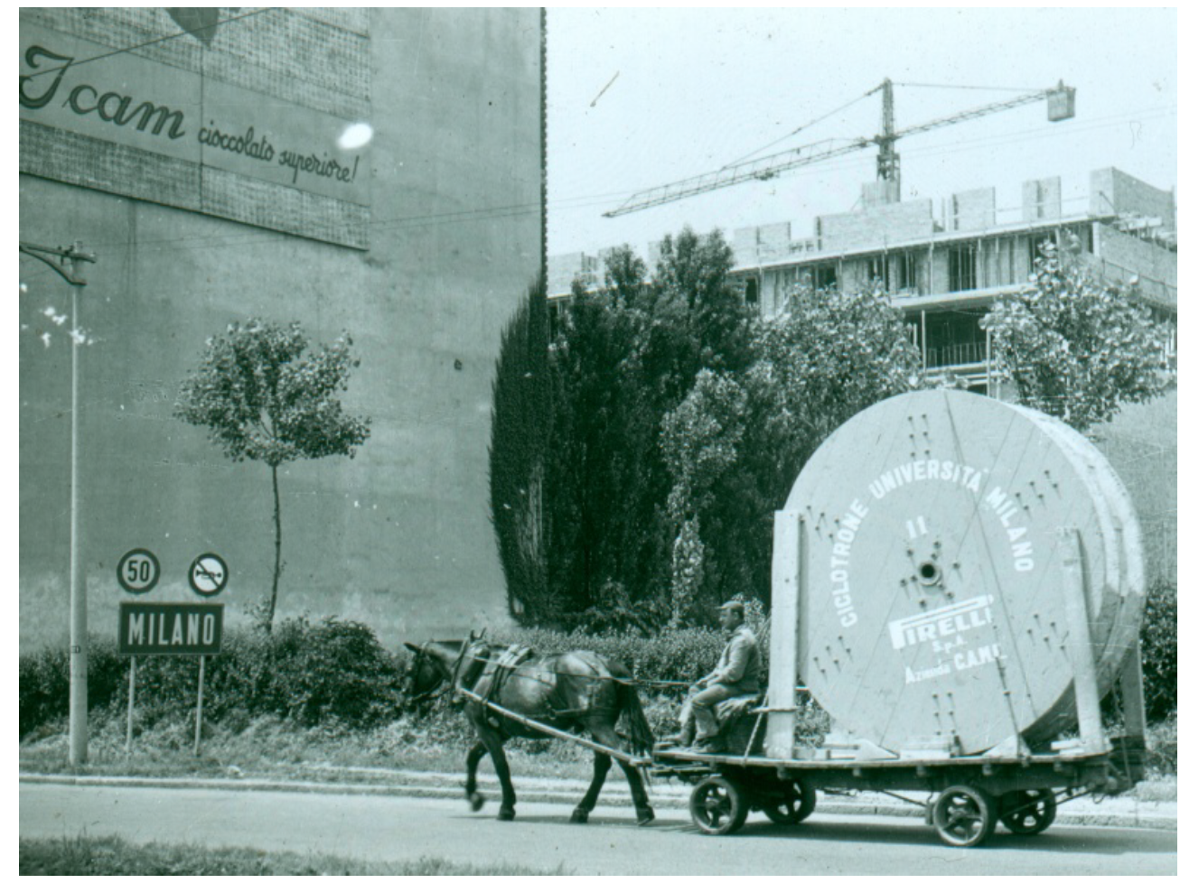
this project was an exemplary case of success due to the synergy between developments in fundamental research and technological developments dictated by research in industry.
(for example those for cables and windings by Pirelli).
Transport of the copper cable for winding the coils of the
first cyclotron in Milan in the early 1960s.

Slide 4
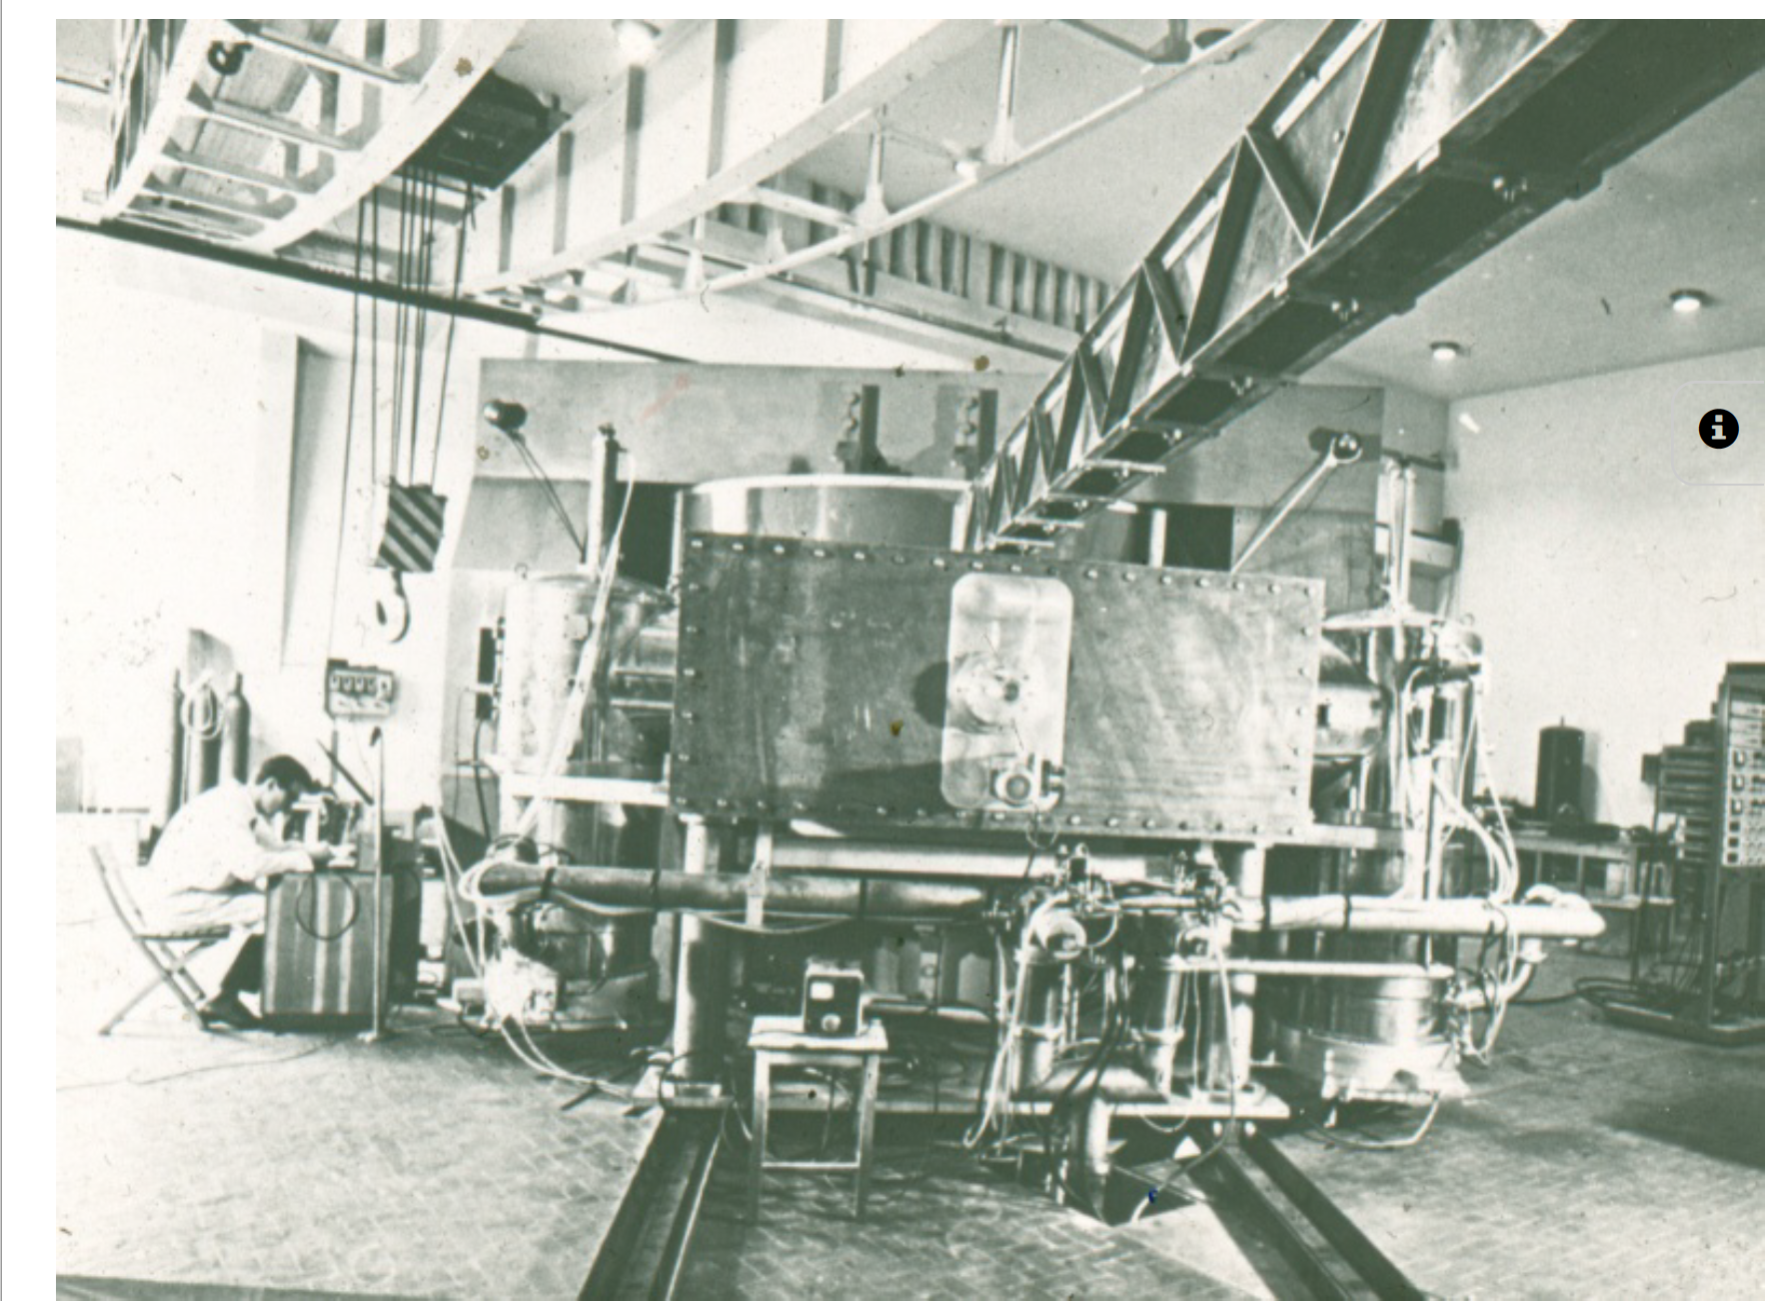
Un apposito capannone ed altri edifici furono costruiti per ospitare la macchina e i laboratori di ricerca e alla direzione del progetto ci furono Tagliaferri, Succi e Resmini.
These scientists were the mentors of
Gerardo Dutto

Slide 5
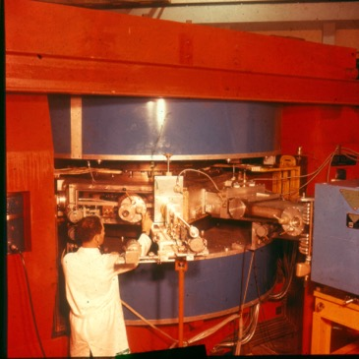
Gerardo made a significant contribution to this cyclotron
and to him, for example, we owe the design of a valve on the beam extraction channel that has always been called the "Dutto valve"
(as a student I have learned about it before
meeting him)
a story very similat to the «Dutto Plates» for vertical centering of the first few turns of the beam at TRIUMF Center Region Cyclotron, a 3 MeV full sized prototype of the main cyclotron center region

Slide 6
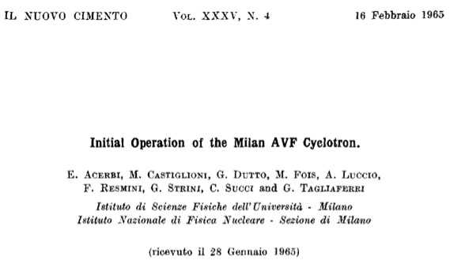
First AVF cyclotron in Europe, 2nd in the world
Builded by Succi, Resmini, Acerbi et al.
To save money they :
Are not using trimming coils (it works)
Frequency fixed at 20510 kHz → only protons
Beam only in the night (not radiation shields)
Electrostatic extractor not used
Negative H⁻ ions are accelerated up to a radius
where is positioned an aluminum foil → H⁺
H⁺ are switched off by the magnetic field

Slide 7
Proton beams of the Milan cyclotron
Easy extraction (efficiency of the 100%).
Proton energy, fixed by the position of the stripping foil: Ep= 14 → 44 MeV.
An energy change takes few minutes.
With magnetic analysis ∆Ep → 20 keV
Good beams for excitation functions
14 → 44 MeV energy range of interest for the onset of different reaction mechanisms.

Slide 8
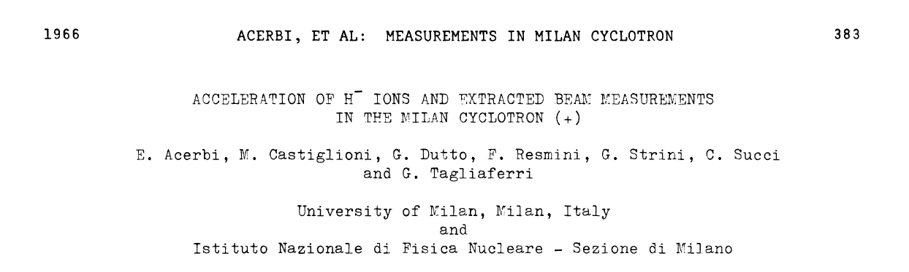
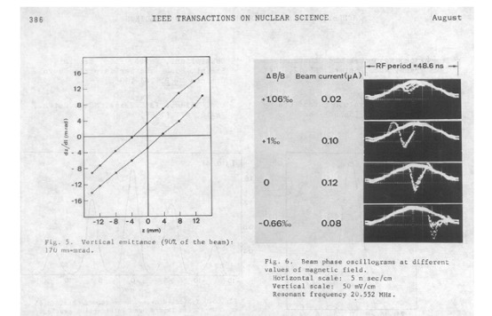
From 1965 to 1970 there
are a number of scientific
contributions to
Congresses by the Ciclotron group of Milan
with the presence of Gerardo Dutto.

Slide 9
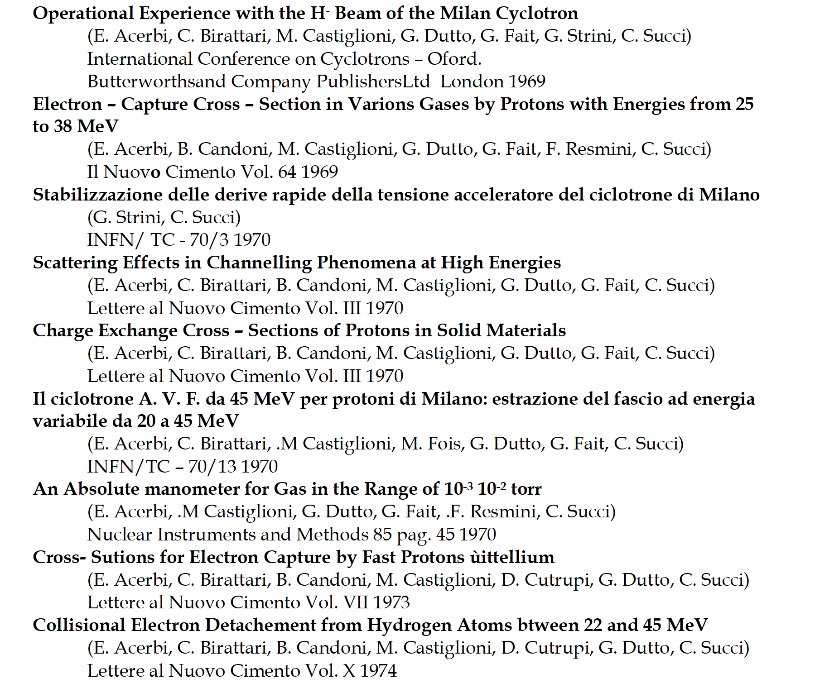

Several papers on Nuovo Cimento
the Journal of SIF

Slide 10

In Summary
His short period in Milano was very important for his training and to develop his passion on
the construction and developments of particle accelerators
In spite of the short period spent here he left a very good memory for his ability and capability to be
an innovator and bring new ideas
He kept important scientific ties with the accelerator group in Milano, particularly at the time in which the
Supercondicting cyclotron was built (partly in Milano and then in Catania).
But also later during his longstanding involvement in research work in the field of accelerator technologies, with which
he greatly contributed by collaborating around the world, Milano and Italy were among them
His legacy is precious also in Milano for the many projects carried out at our laboratory LASA
(see the presentation of Dario Giove)
…..and his desire and to make always progresses at the top level will stay with us indelebly

