Slide 1
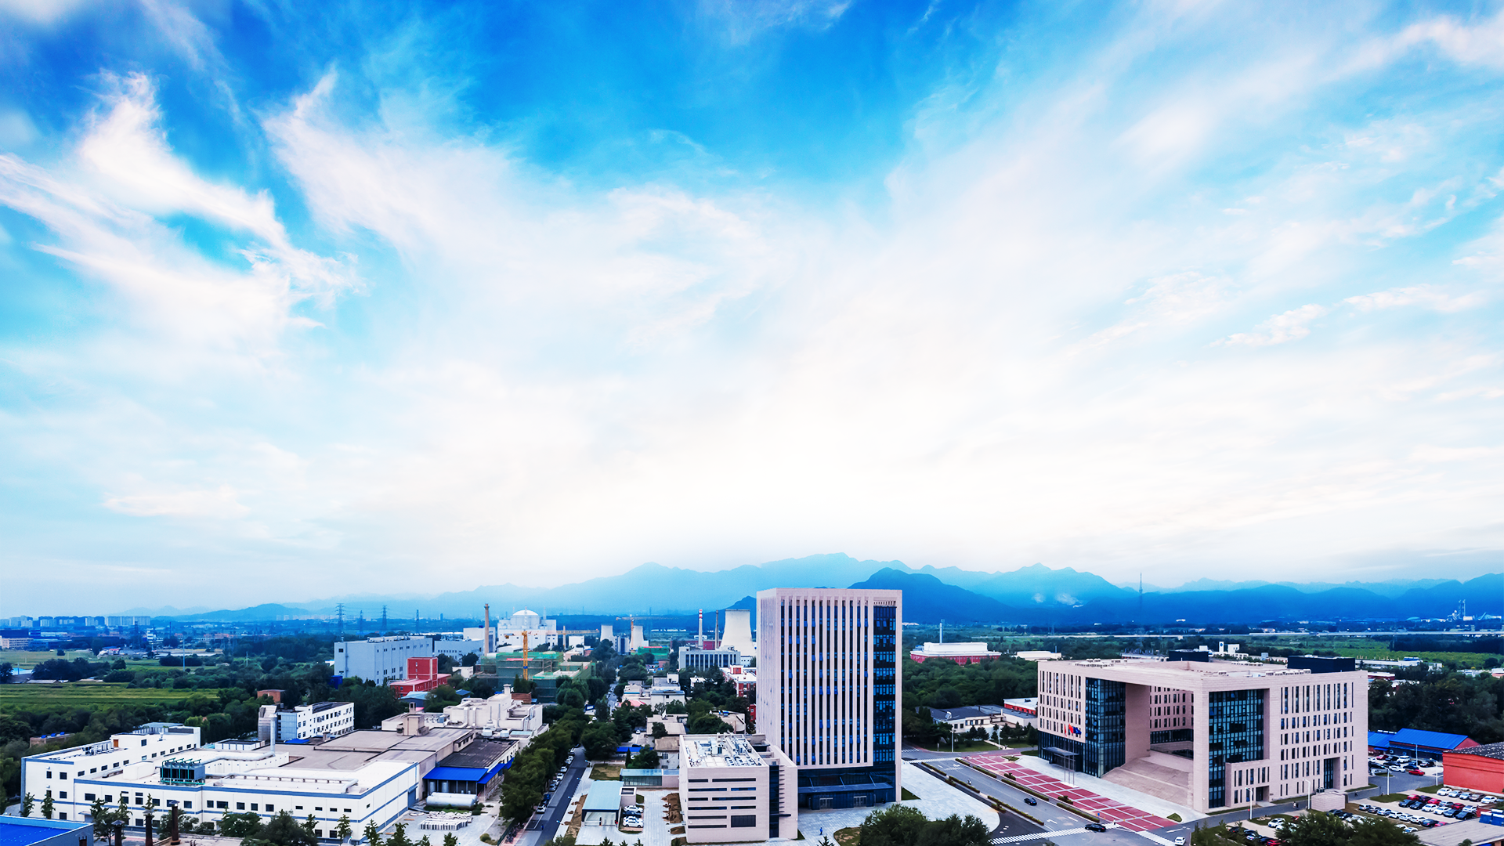

Memorial Symposium for Dr. Gerardo Dutto
International Collaborations for 100MeV
High Intensity Cyclotron Construction at CIAE
Tianjue Zhang
China Institute of Atomic Energy
2021.02.22

Slide 2

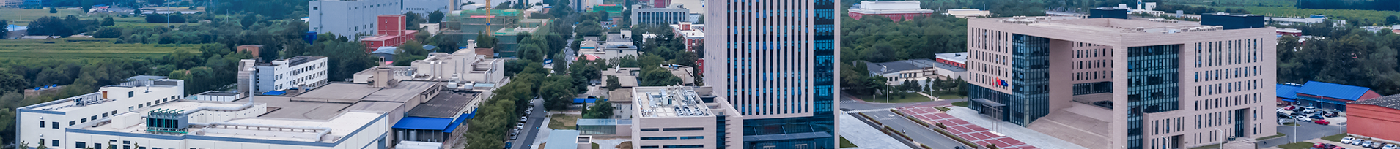
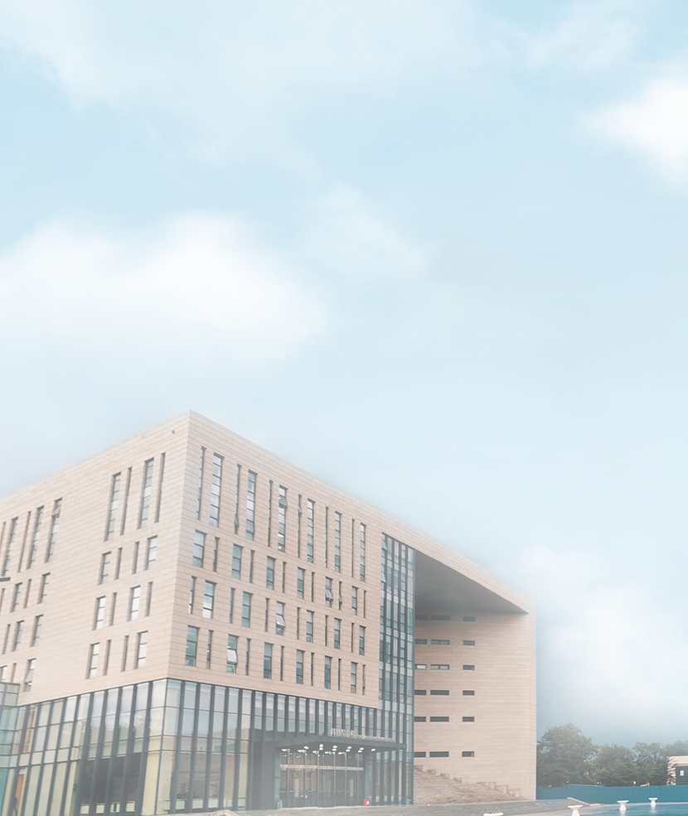
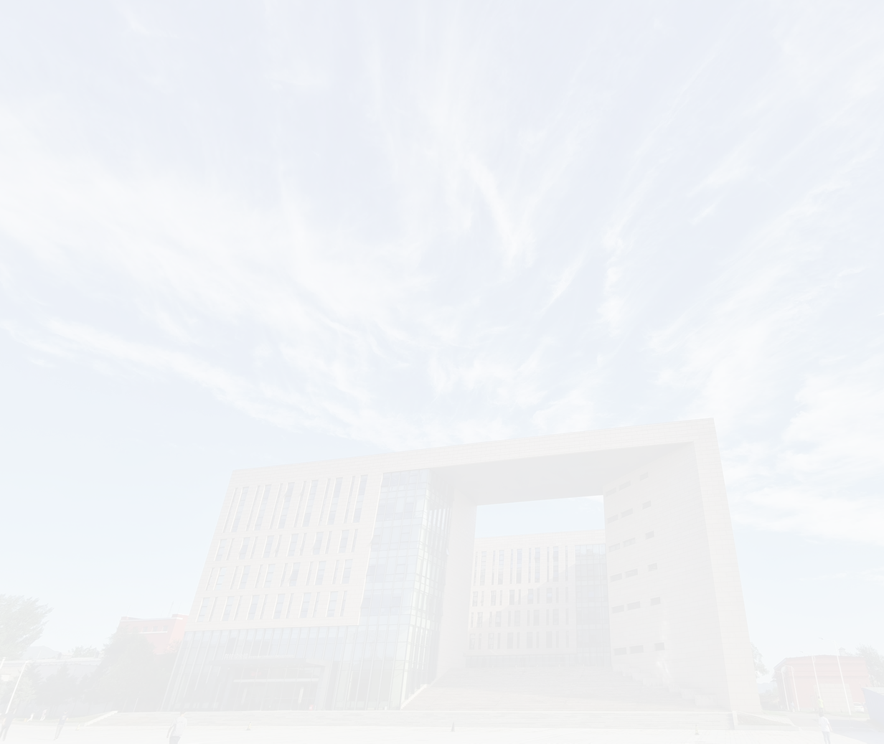
Plan of Talk
International Collaborations, only way for the construction of CYCIAE-100 for us
  2000-2002, Brewing and launching the International Collaborations for the construction of CYCIAE-100
  2004, on APAC and ICCA, the basic design started and presented
Since then, we have the world, the dream team of cyclotron construction
  Collaboration between TRIUMF and CIAE
  PSI, LNS , GANIL, RIKEN, iThemba and the international cyclotron community
  CYCIAE-100 has been built, but the dream has no end.
  CIAE are growing with international cyclotron community together

Slide 3
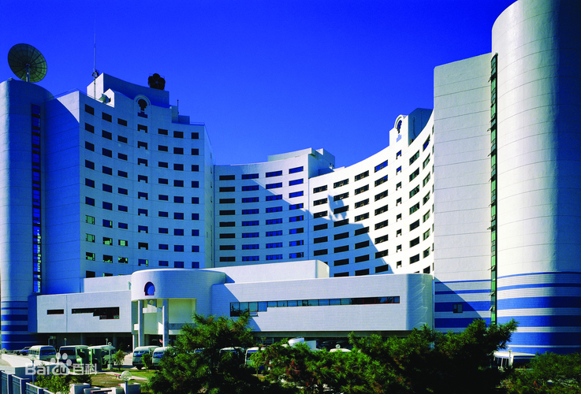
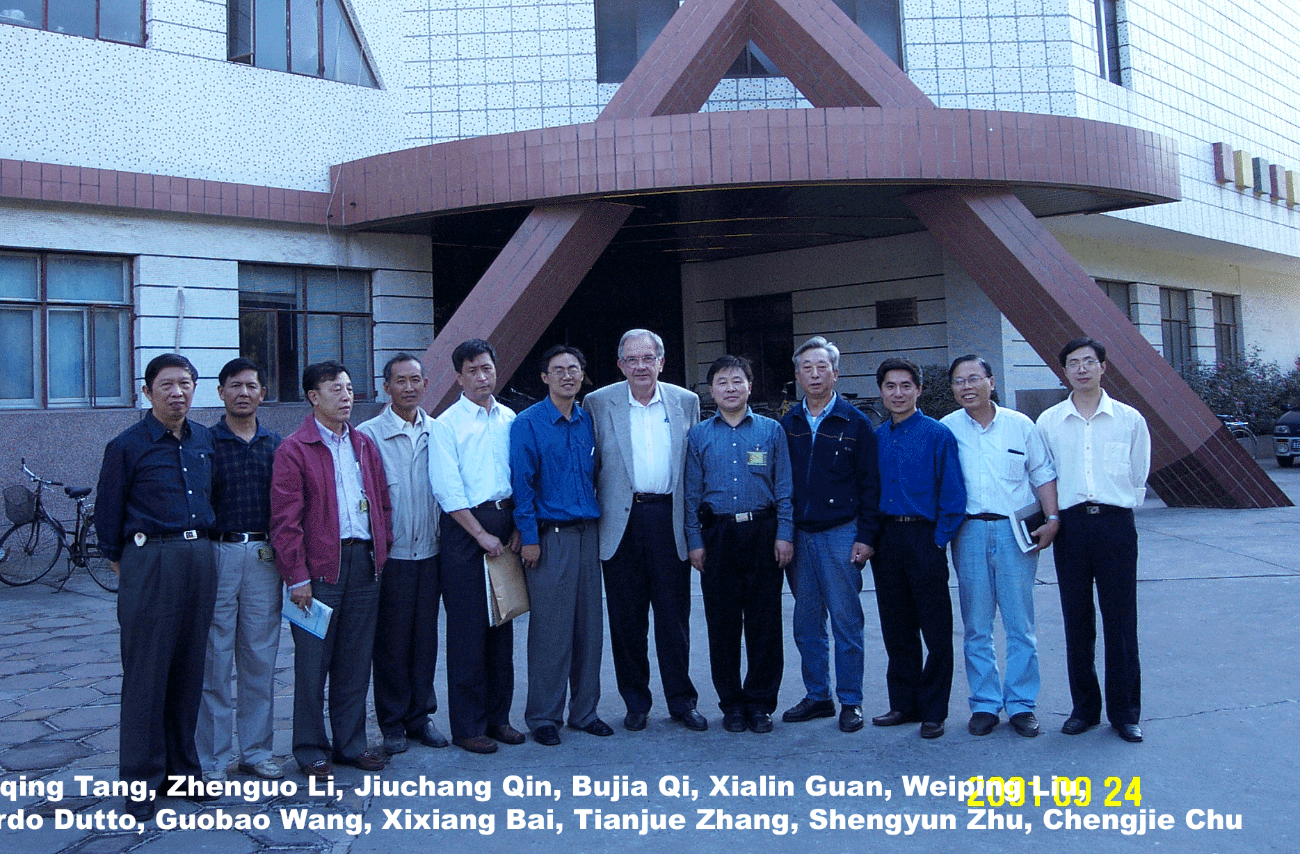
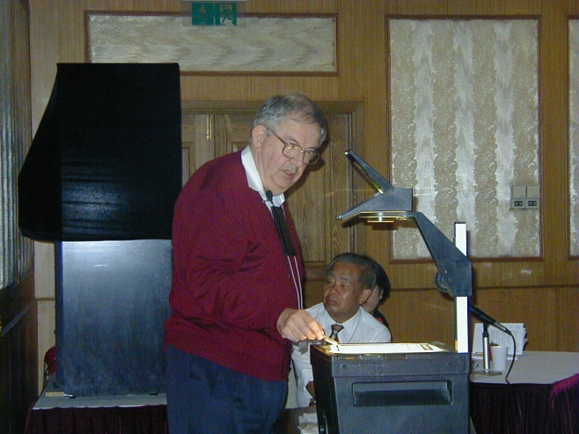
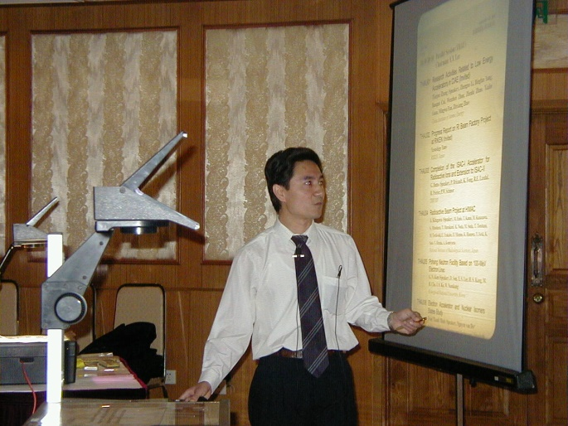
01
International Collaborations, only way for the construction of CYCIAE-100 for us
Back 20 years ago, at the Media Center Hotel in Beijing, I first met Gerardo on the APAC-2001 conference.
Feel like old friends at the first meeting
On APAC-2001,
Media Center Hotel in Beijing
At CIAE 2001 09
攻克了、吸收高阶谐波等技术
One year before then, I asked Professor Chen Jia'er, director of NSFC, to express to Gerardo the idea of collaboration between the two institutes, before he went to visit TRIUMF
During APAC-2001, I invited Gerardo to visit CIAE
Invited Presentation on APAC-2001
Where we started
Notes:
首次提出并研制成功 双内杆高频谐振腔，精准调控加速电压，
中心区60kV有效避免打火，高能区120kV显著降低束流损失。
攻克了抑制基波震荡、幅相串扰等技术；实现长周期高可靠性运行

Slide 4
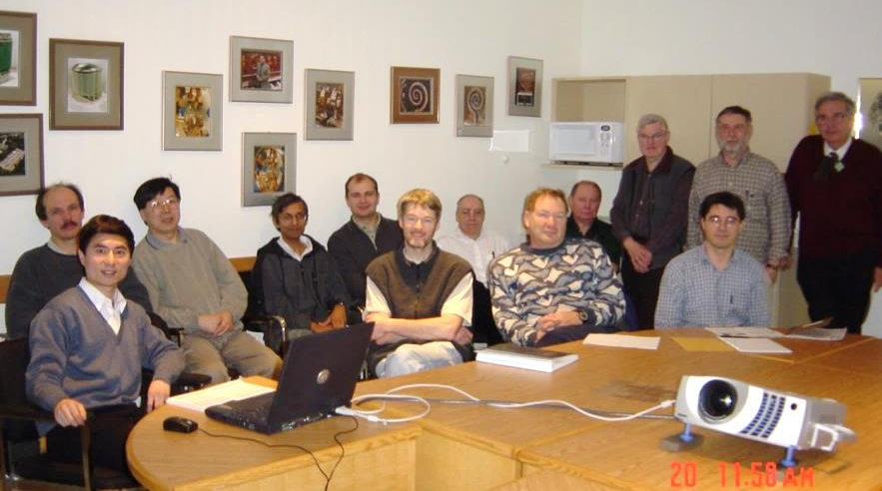
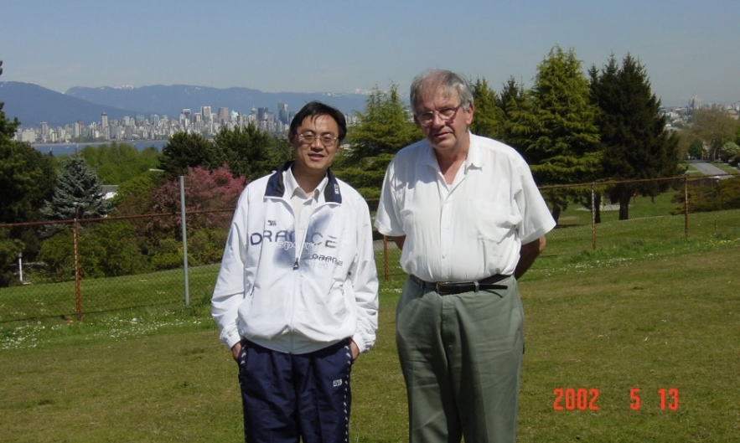
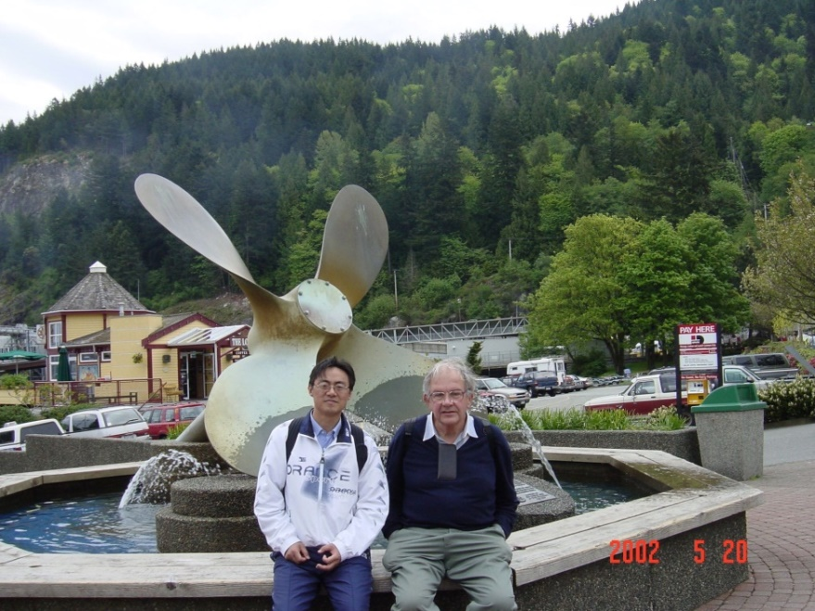
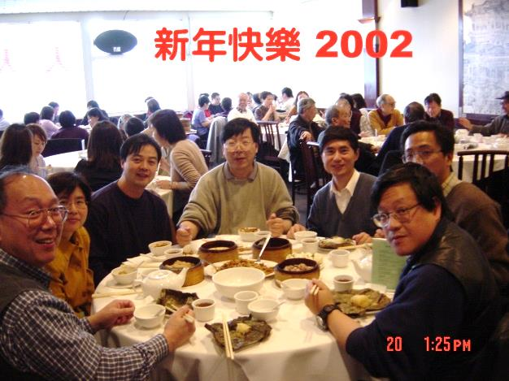
01
International Collaborations, only way for the construction of CYCIAE-100 for us
In February 2002, I visited TRIUMF to promote International Collaboration between TRIUMF and CIAE.
Draft the MoU on those trip, signed in June 2002
At TRIUMF 2002 02
Dr. WP Liu’s visit in May
攻克了、吸收高阶谐波等技术
The front, from left to right: Tianjue Zhang，R.Laxdal，L.Root，R.Baartman
The back, from left to right: Y.Bylinsky, D.Yuan, K.Jayamanna, I.Sekachev, P.Bricault, G.Stinson, R.Poirier, P.Schmor, G.Dutto
Spent the Chinese New Year in Vancouver
During APAC-2001, I invited Gerardo to visit CIAE
In the year 2002
Notes:
首次提出并研制成功 双内杆高频谐振腔，精准调控加速电压，
中心区60kV有效避免打火，高能区120kV显著降低束流损失。
攻克了抑制基波震荡、幅相串扰等技术；实现长周期高可靠性运行

Slide 5
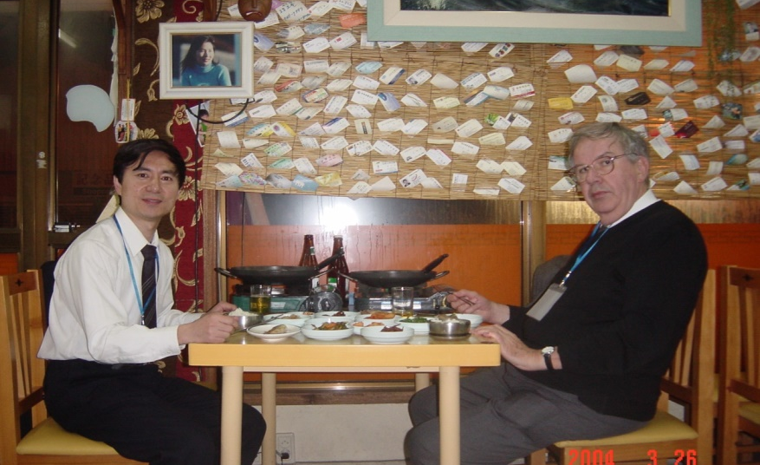
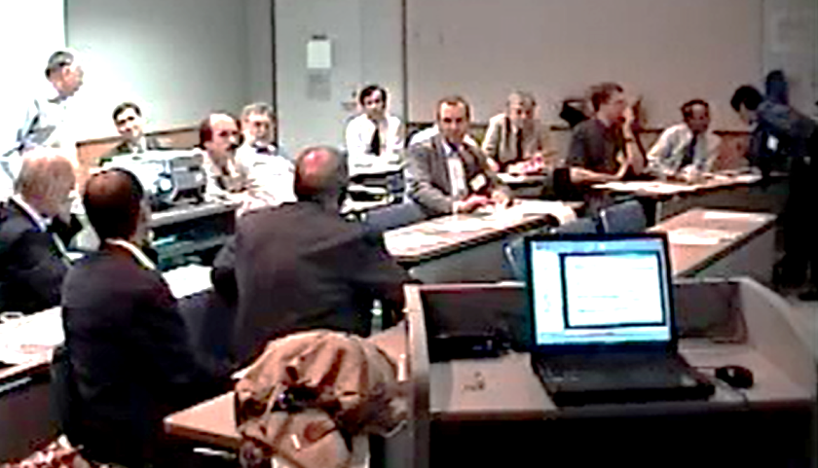
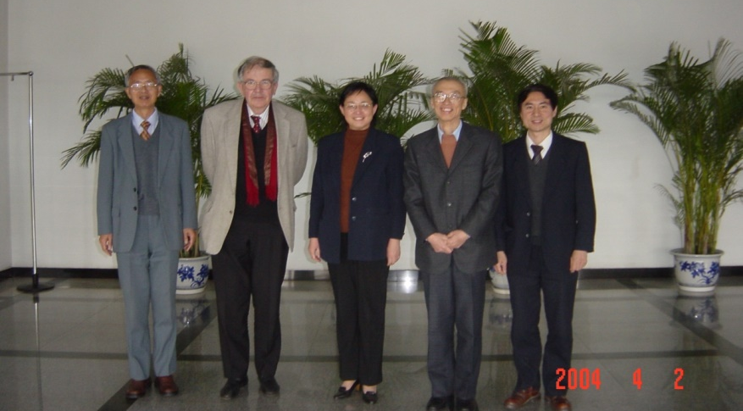
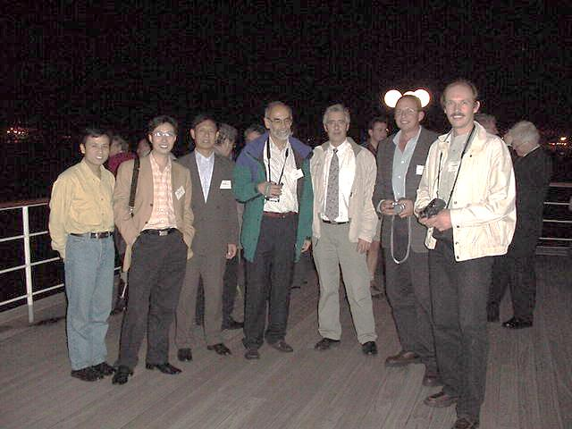
01
International Collaborations, only way for the construction of CYCIAE-100 for us
In the year 2004, Gerardo and I attended APAC-2004. He introduced me to Bill Weng, BNL, Chiarman of...
and introduce my paper about CYCIAE-100 design to Rubbia Group in Italy
On APAC 2004 03
On ICCA-2004, Tokyo
攻克了、吸收高阶谐波等技术
At the ICCA-2004, we invited about 30 experts from cyclotron community to review the technical design of CYCIAE-100 (22+11)
18 pages of finding, comments and suggestions
Fully joined into the cyclotron community.
Side Meeting with violent typhoon
During APAC-2001, I invited Gerardo to visit CIAE
In Beijing 2004 04, Prof Chen
CIAE, PSI, TRIUMF people at ICCA
In the year 2004
Notes:
首次提出并研制成功 双内杆高频谐振腔，精准调控加速电压，
中心区60kV有效避免打火，高能区120kV显著降低束流损失。
攻克了抑制基波震荡、幅相串扰等技术；实现长周期高可靠性运行

Slide 6
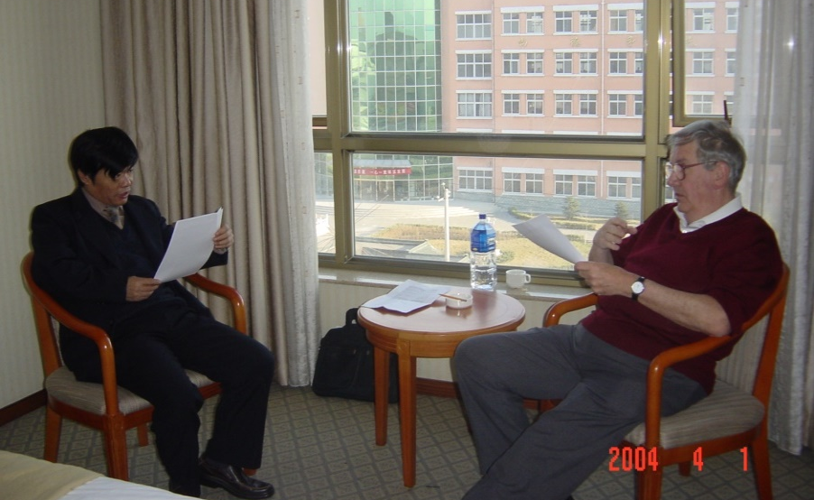
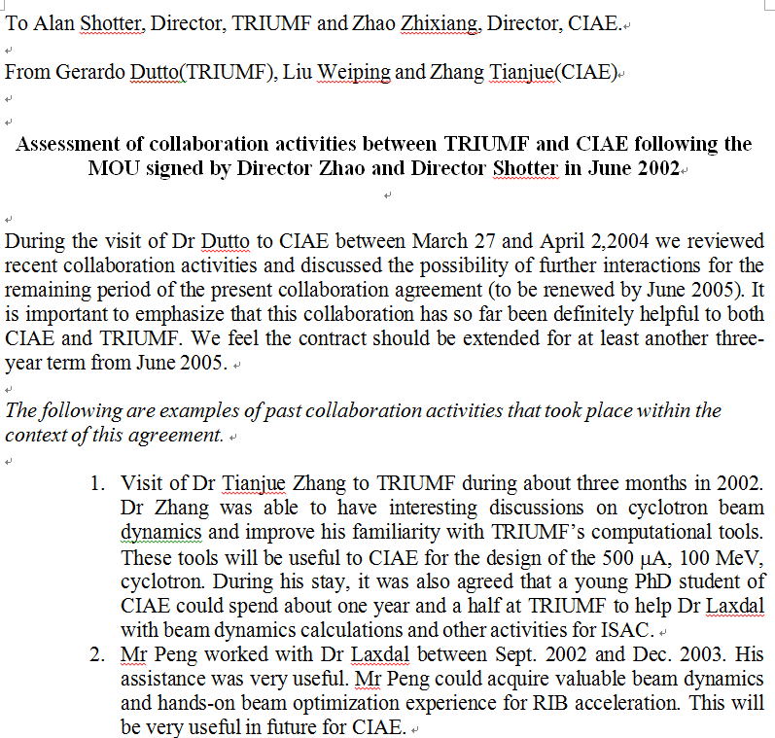
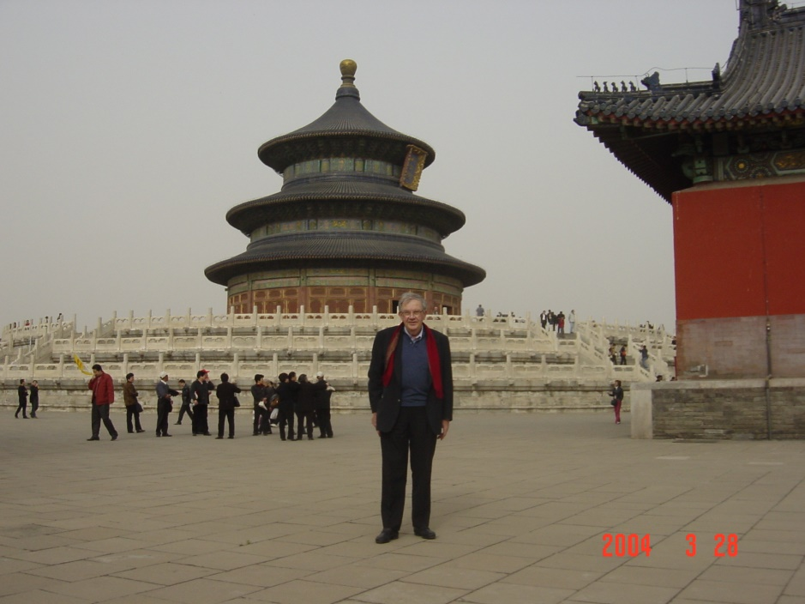
01
International Collaborations, only way for the construction of CYCIAE-100 for us
Dr.Dutto was stay at CIAE for one week after APAC-2004.
Assessment of collaboration activities between TRIUMF and CIAE following the MOU signed in June 2002
At CIAE, 2004 04
In Beijing 2004 04, Prof Chen
Talk: The recent progress of TRIMUF 500 MeV cyclotron and ISAC program
Review the technical design of CYCIAE-100
Visiting the CRM teststand and 30MeV Cyclotron
During APAC-2001, I invited Gerardo to visit CIAE
Assessment of collaboration activities between TRIUMF and CIAE following the MOU signed in June 2002
In the year 2004
Notes:
首次提出并研制成功 双内杆高频谐振腔，精准调控加速电压，
中心区60kV有效避免打火，高能区120kV显著降低束流损失。
攻克了抑制基波震荡、幅相串扰等技术；实现长周期高可靠性运行

Slide 7
Plan of Talk
International Collaborations, only way for the construction of CYCIAE-100 for us
  2000-2002, Brewing and launching the International Collaborations for the construction of CYCIAE-100
  2004, on APAC and ICCA, the basic design started and presented
Since then, we have the world, the dream team of cyclotron construction
  Collaboration between TRIUMF and CIAE
  PSI, LNS , GANIL, RIKEN, iThemba and the international cyclotron community
  CYCIAE-100 has been built, but the dream has no end.
  CIAE are growing with international cyclotron community together

Slide 8
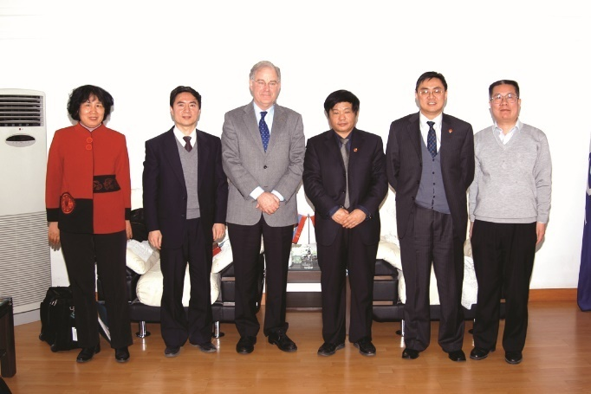
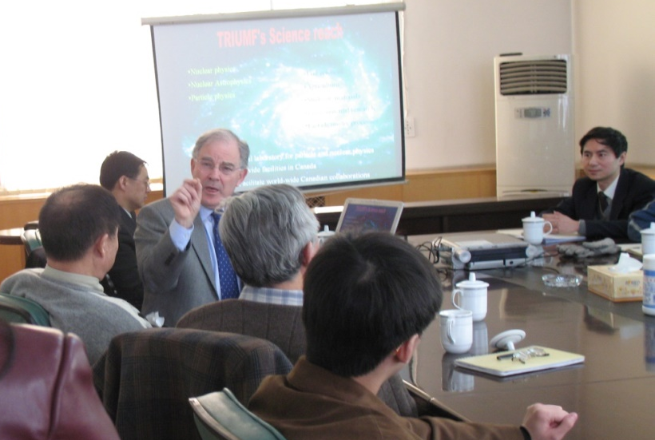
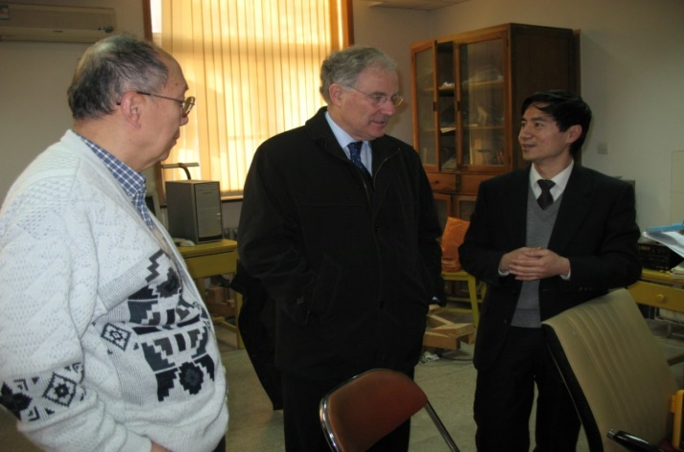
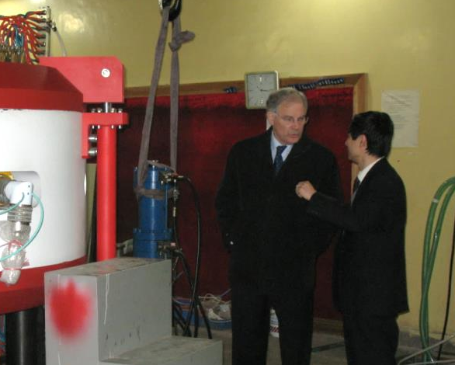
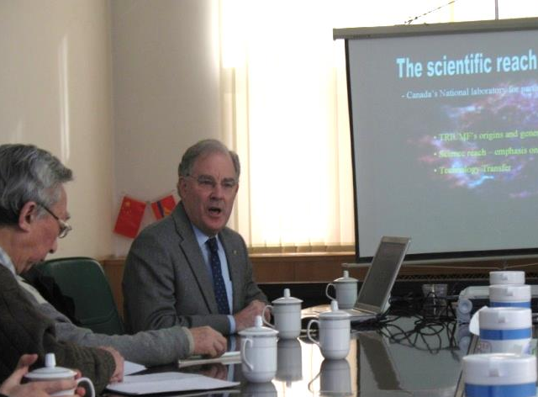
02
Since then, we have the world, the dream team of cyclotron construction
Three TRIUMF directors and more than 20 scientists and engineers visited CIAE
16 young scholars from CIAE visited TRIUMF for long term or a short period
Collaboration activities between TRIUMF and CIAE
In Beijing 2004 04, Prof Chen
Common research interests and similar projects ISAC and BRIF
Director Shotter and Director Zhao
2007_02_05, Director Shotter visited CIAE
During APAC-2001, I invited Gerardo to visit CIAE
RF Room, with Shuyao
Visiting CRM
From 2004 to 2014
Notes:
首次提出并研制成功 双内杆高频谐振腔，精准调控加速电压，
中心区60kV有效避免打火，高能区120kV显著降低束流损失。
攻克了抑制基波震荡、幅相串扰等技术；实现长周期高可靠性运行

Slide 9
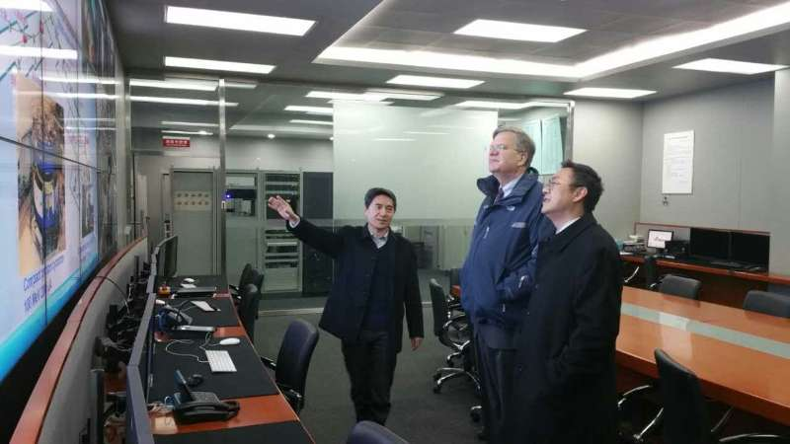
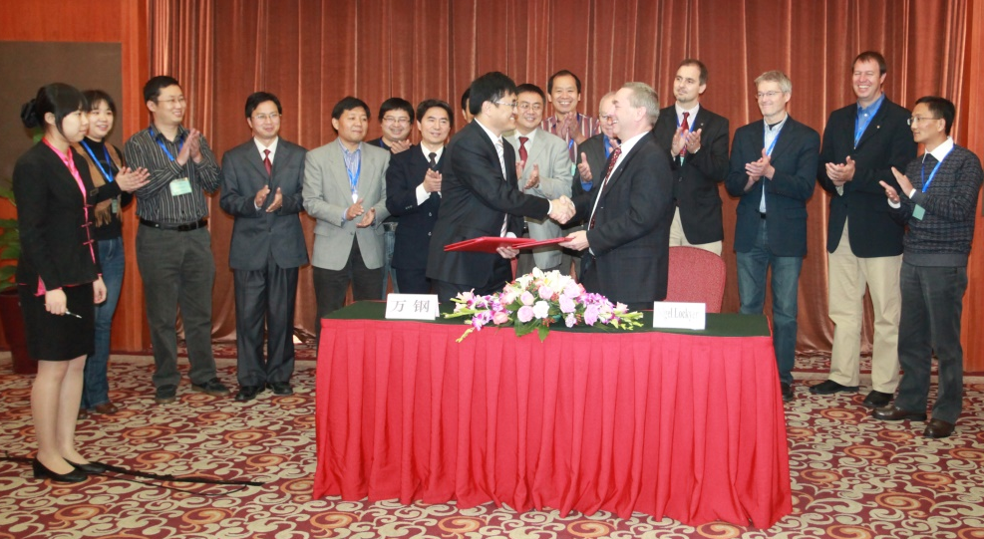
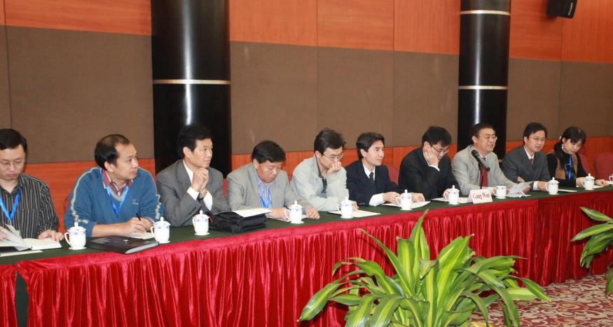
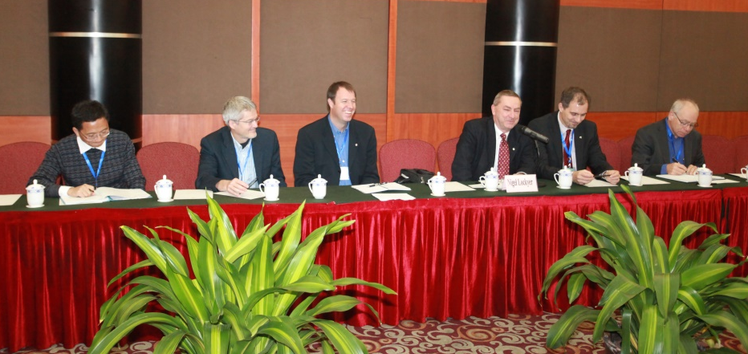
02
Since then, we have the world, the dream team of cyclotron construction
Three TRIUMF directors and more than 20 scientists and engineers visited CIAE
16 young scholars from CIAE visited TRIUMF for long term or a short period
Collaboration activities between TRIUMF and CIAE
In Beijing 2004 04, Prof Chen
Common research interests and similar projects ISAC and BRIF
Director Jonathan Bagger
Director Shotter and Director Wan
2011_10_22, Director Nigel Lockyer, MoU between TRIUMF-CIAE signed for five years
During APAC-2001, I invited Gerardo to visit CIAE
From 2004 to 2014
Notes:
首次提出并研制成功 双内杆高频谐振腔，精准调控加速电压，
中心区60kV有效避免打火，高能区120kV显著降低束流损失。
攻克了抑制基波震荡、幅相串扰等技术；实现长周期高可靠性运行

Slide 10
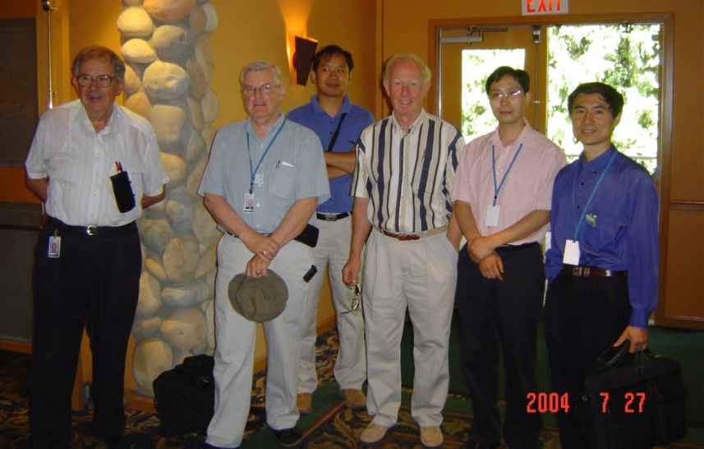
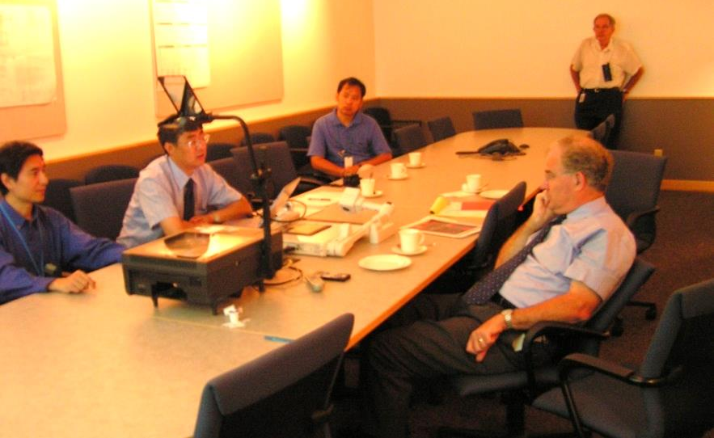
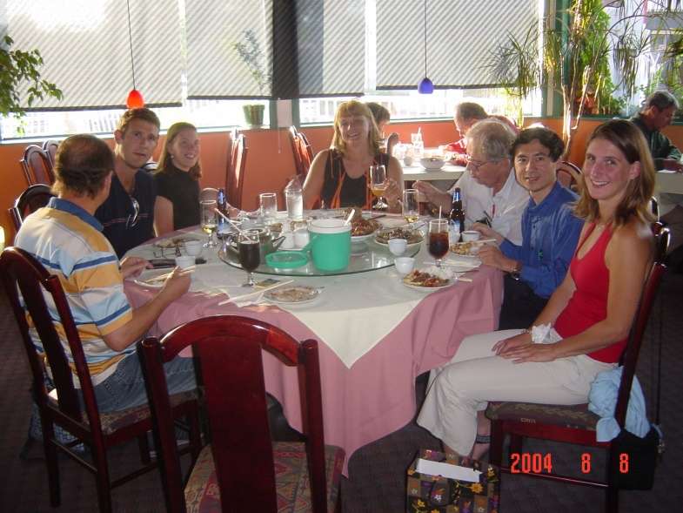
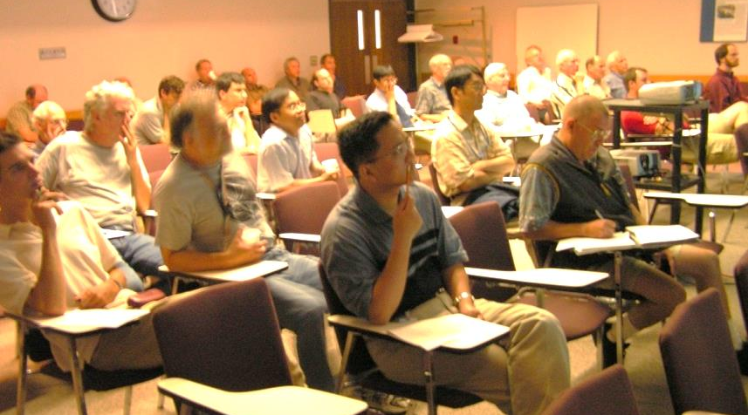
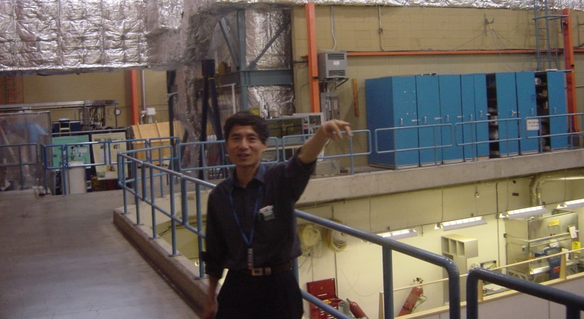
02
Since then, we have the world, the dream team of cyclotron construction
Three TRIUMF directors and more than 20 scientists and engineers visited CIAE
16 young scholars from CIAE visited TRIUMF for long term or a short period
Collaboration activities between TRIUMF and CIAE
In Beijing 2004 04, Prof Chen
Intensive personnel exchange following
In TRIUMF, 2004 07
In TRIUMF, 2004 07
Tianjue Zhang visited Vancouver in 2004, 2006, 2008 and more
Weiping Liu visited in 2004 ….
During APAC-2001, I invited Gerardo to visit CIAE
Gerardo’s birthday party, 2004 08
From 2004 to 2014
Notes:
首次提出并研制成功 双内杆高频谐振腔，精准调控加速电压，
中心区60kV有效避免打火，高能区120kV显著降低束流损失。
攻克了抑制基波震荡、幅相串扰等技术；实现长周期高可靠性运行

Slide 11
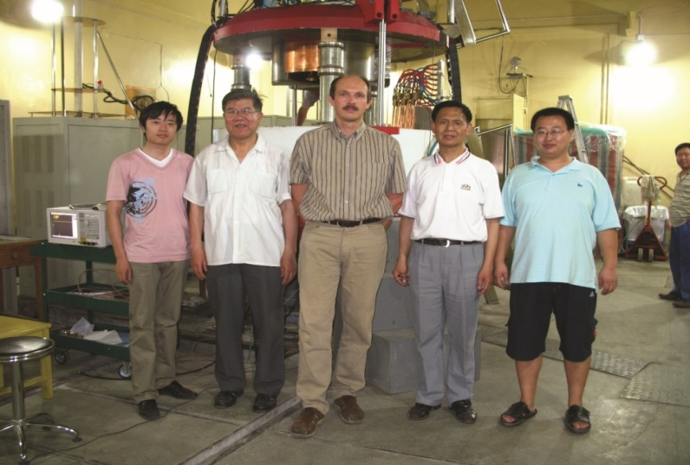
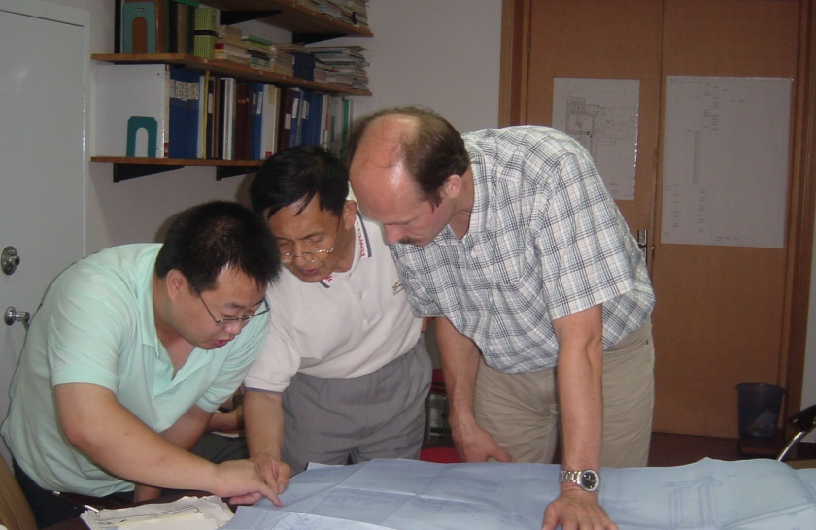
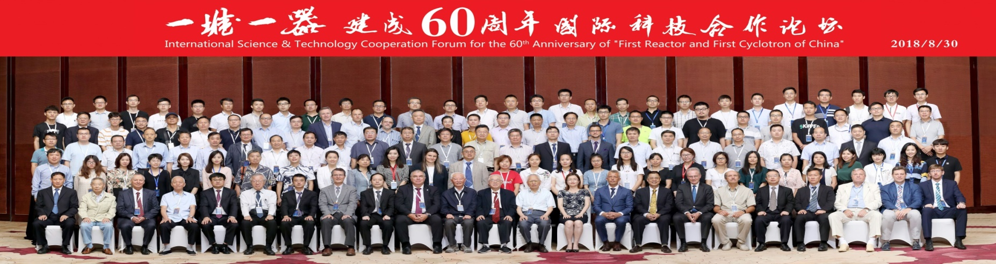
02
Since then, we have the world, the dream team of cyclotron construction
Three TRIUMF directors and more than 20 scientists and engineers visited CIAE
16 young scholars from CIAE visited TRIUMF for long term or a short period
Collaboration activities between TRIUMF and CIAE
In Beijing 2004 04, Prof Chen
Intensive personnel exchange following
At CRM test stand, 2007 07 06
In my office, 2007 07 06
Yuri visited Beijing two times in 2007 07 06 etc,
In 2018, he has been invited as an honored guest for 60th anniversary of the FRFC in China.
During APAC-2001, I invited Gerardo to visit CIAE
From 2004 to 2014
Notes:
首次提出并研制成功 双内杆高频谐振腔，精准调控加速电压，
中心区60kV有效避免打火，高能区120kV显著降低束流损失。
攻克了抑制基波震荡、幅相串扰等技术；实现长周期高可靠性运行

Slide 12
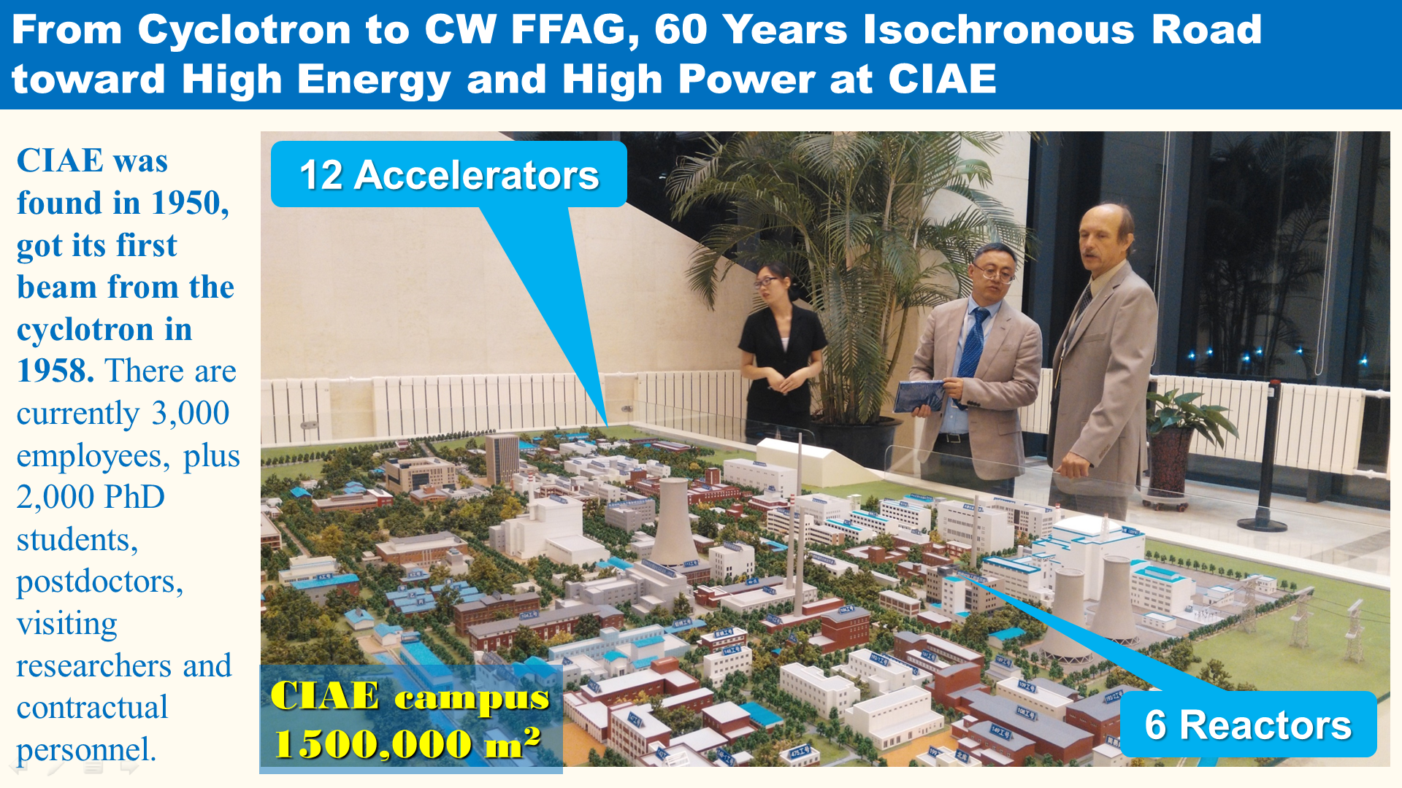

Slide 13
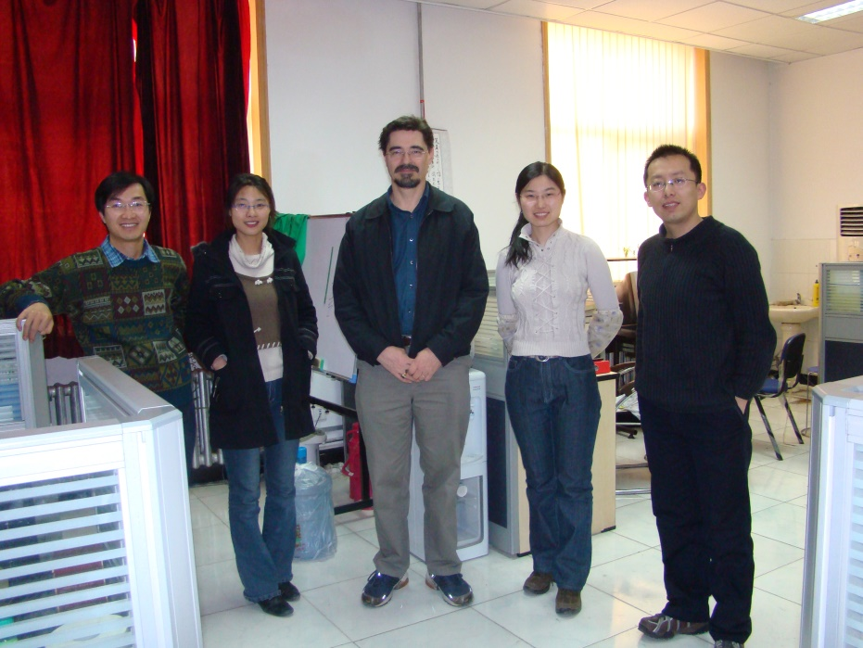
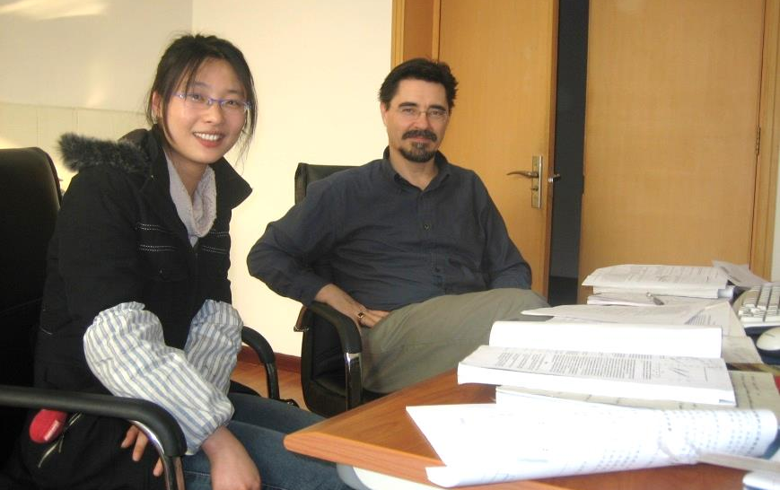
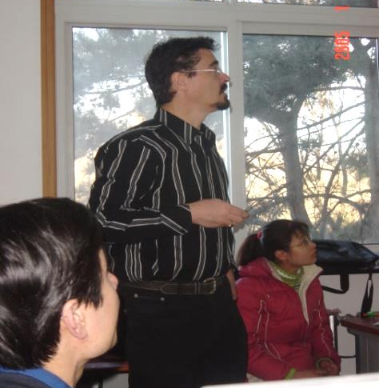
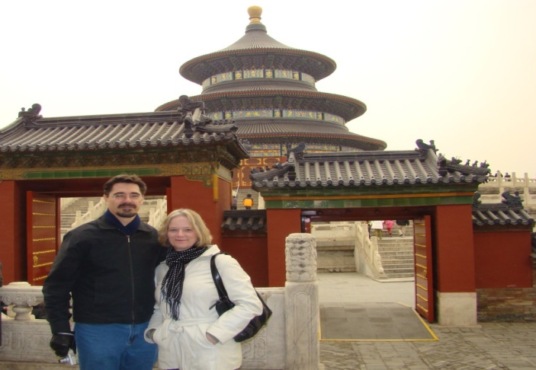
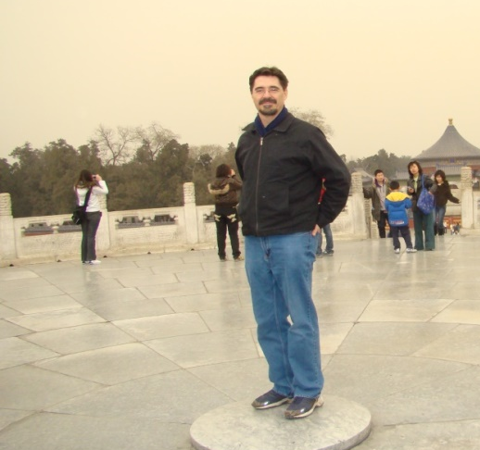
02
Since then, we have the world, the dream team of cyclotron construction
Three TRIUMF directors and more than 20 scientists and engineers visited CIAE
16 young scholars from CIAE visited TRIUMF for long term or a short period
Collaboration activities between TRIUMF and CIAE
In Beijing 2004 04, Prof Chen
Intensive personnel exchange following
Accelerator Physics Group
Two lines Injection system
Rick visited Beijing two times, 2005_01, 2008_02
During APAC-2001, I invited Gerardo to visit CIAE
From 2004 to 2014
Notes:
首次提出并研制成功 双内杆高频谐振腔，精准调控加速电压，
中心区60kV有效避免打火，高能区120kV显著降低束流损失。
攻克了抑制基波震荡、幅相串扰等技术；实现长周期高可靠性运行

Slide 14
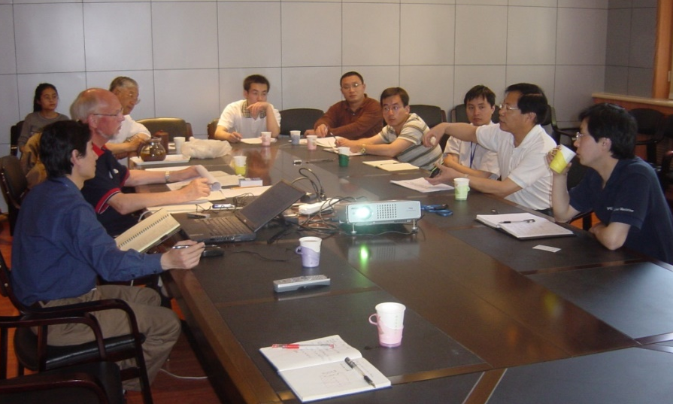
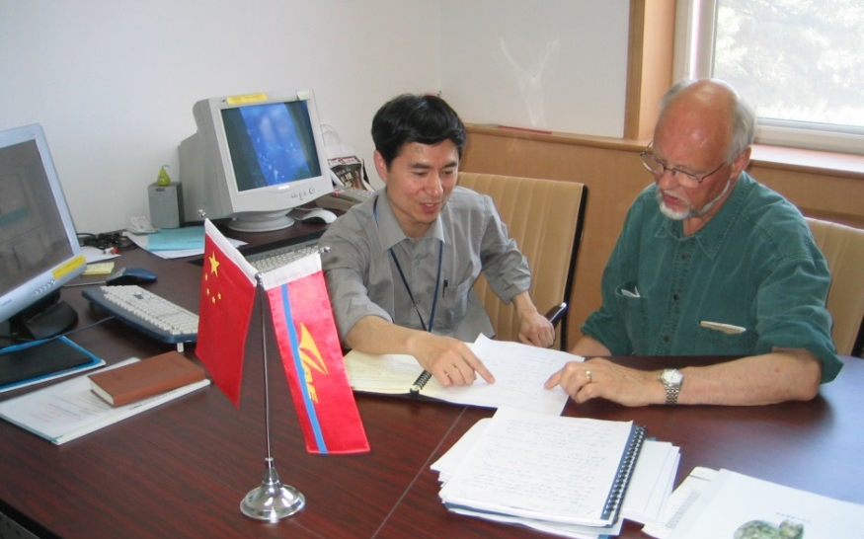
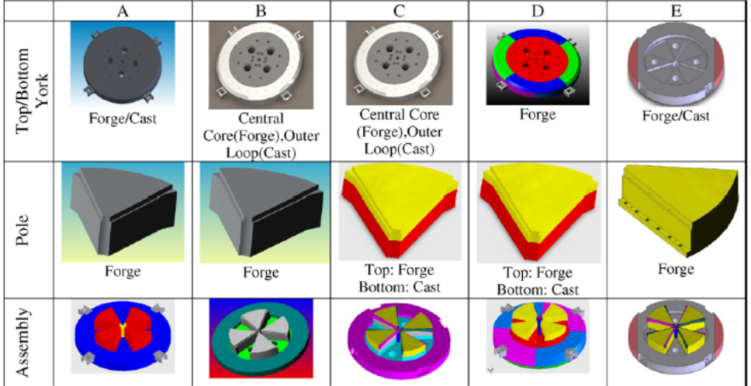
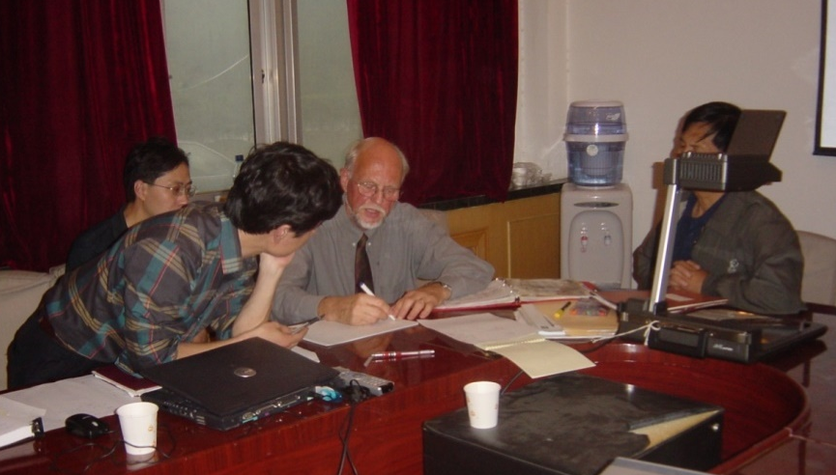
02
Since then, we have the world, the dream team of cyclotron construction
Three TRIUMF directors and more than 20 scientists and engineers visited CIAE
16 young scholars from CIAE visited TRIUMF for long term or a short period
Collaboration activities between TRIUMF and CIAE
In Beijing 2004 04, Prof Chen
Intensive personnel exchange following
Magnet Structure, Final decision
In my office, extraction discussion
George visited Beijing two times, 2004_10 and 2005_05
During APAC-2001, I invited Gerardo to visit CIAE
From 2004 to 2014
Notes:
首次提出并研制成功 双内杆高频谐振腔，精准调控加速电压，
中心区60kV有效避免打火，高能区120kV显著降低束流损失。
攻克了抑制基波震荡、幅相串扰等技术；实现长周期高可靠性运行

Slide 15
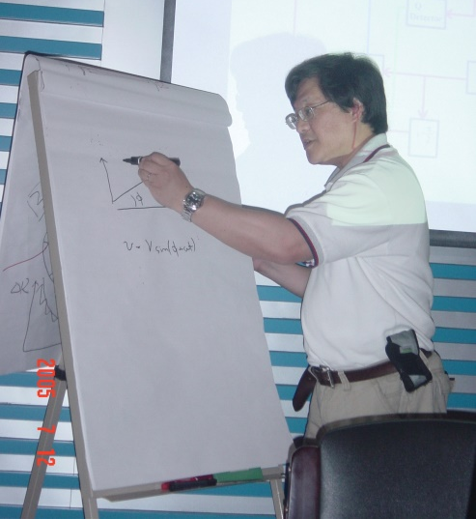
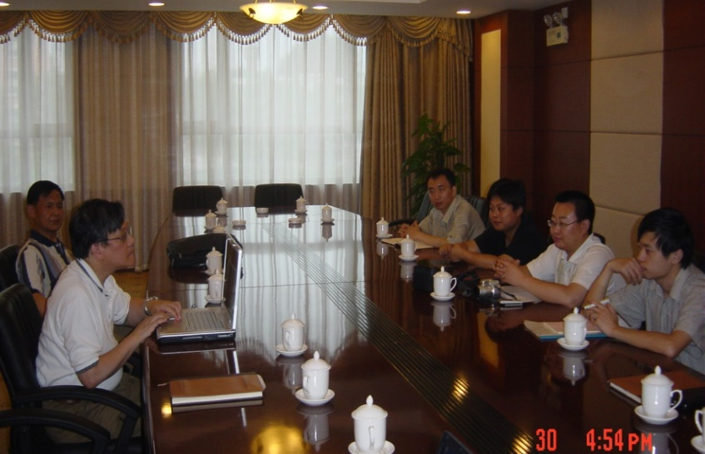
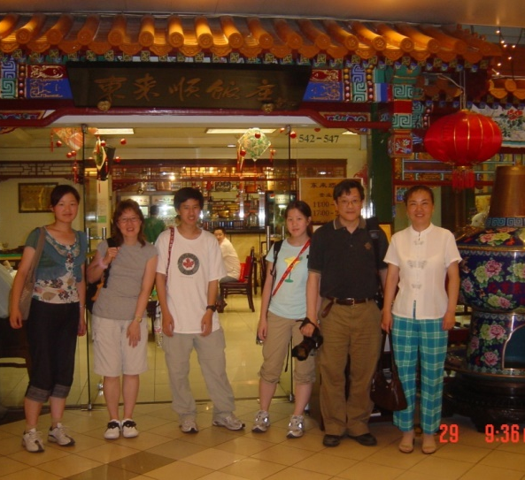
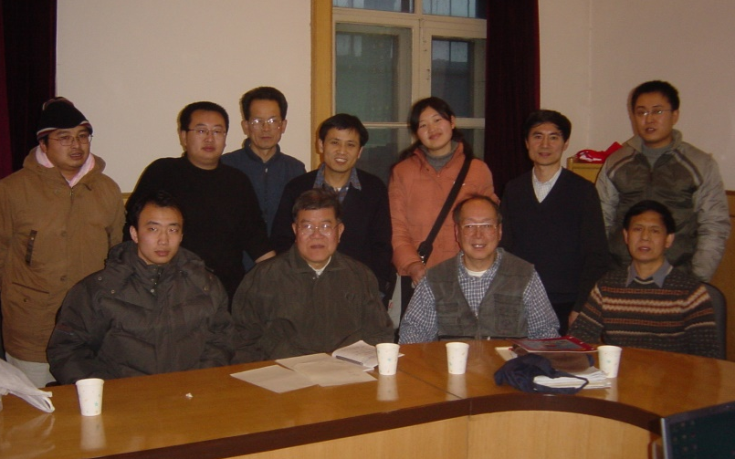


02
Since then, we have the world, the dream team of cyclotron construction
Three TRIUMF directors and more than 20 scientists and engineers visited CIAE
16 young scholars from CIAE visited TRIUMF for long term or a short period
Collaboration activities between TRIUMF and CIAE
In Beijing 2004 04, Prof Chen
Intensive personnel exchange following
Work hard with RF Group, and also enjoy Chinese culture
Magnet Structure, Final decision
Ken visited Beijing many times, 2005_07_12, 2006_06_28
Shuyao many times, 2005_01_24, 2008_10_22
Michael Laverty, 2007_11
During APAC-2001, I invited Gerardo to visit CIAE
From 2004 to 2014
Notes:
首次提出并研制成功 双内杆高频谐振腔，精准调控加速电压，
中心区60kV有效避免打火，高能区120kV显著降低束流损失。
攻克了抑制基波震荡、幅相串扰等技术；实现长周期高可靠性运行

Slide 16





02
Since then, we have the world, the dream team of cyclotron construction
Three TRIUMF directors and more than 20 scientists and engineers visited CIAE
16 young scholars from CIAE visited TRIUMF for long term or a short period
Collaboration activities between TRIUMF and CIAE
Yinong visited CIAE in 2007, extraction with combination magnet
In Beijing 2004 04, Prof Chen
Intensive personnel exchange following
Visited CIAE before ICCA-2010
In my office, extraction discussion
Mike Craddock 2010 09 05
Gerardo & Werner 2007 06
Paul & Phil 2007 10
Yinong 2007 04
During APAC-2001, I invited Gerardo to visit CIAE
From 2004 to 2014
Notes:
首次提出并研制成功 双内杆高频谐振腔，精准调控加速电压，
中心区60kV有效避免打火，高能区120kV显著降低束流损失。
攻克了抑制基波震荡、幅相串扰等技术；实现长周期高可靠性运行

Slide 17






02
Since then, we have the world, the dream team of cyclotron construction
2004_11_Ian
2007_02_28_Milton
2006_06_06_Igor
2007_05_28_Phil & Ann
2005_12_14 Bill_GYLES

Slide 18





02
Since then, we have the world, the dream team of cyclotron construction
2009 12, Tianjue Visited TRIUMF
2006_07_22-08_15 Visited TRIUMF

Slide 19
02
Since then, we have the world, the dream team of cyclotron construction
Gerardo Dutto, Igor Sekachev, Ken Fong, George Mackenzie, Mike Craddock, Qiwen Zheng, Shuyao Fang, Tom Kuo, Dick Yuan, Paul Schmor, Alan Shotter, Bruce Milton, Yi-Nong Rao, Yuri Bylinski, Robert Laxdal, Michael Laverty, Richard Baartman, Nigel Lockyer, Jonathan Bagger, etc. from TRIUMF and, Tianjue Zhang, Hongjuan Yao, Yinlong Lv, Bin Ji, Sumin Wei, Zhenguo Li, Jiansheng Xing, GaofengPan, Fang Yan, Zhiguo Yin, Xianlu Jia, Baoqun Cui, Chengjie Chu, Weiping Liu, Yanyun Ma, Xiaoliang Fu, etc. from CIAE.

Slide 20




02
Since then, we have the world, the dream team of cyclotron construction
Three PSI division heads promoted Collaboration and about 10 scientists and engineers visited CIAE
High Intensity Problems, Revisited or Cyclotron Operation Beyond Limits
Collaboration activities between PSI and CIAE
At PSI
At CIAE
Intensive personnel exchange following
Th. Stammbach, Peter and Tianjue
Daniela Kiselev, Yuri and Tianjue
Tianjue visited PSI 2005, with Th. Stammbach
Mike Seidel visited CIAE 2012
Daniela Kiselev visited CIAE 2018
PSI Injector II
From 2004 to 2014
Notes:
首次提出并研制成功 双内杆高频谐振腔，精准调控加速电压，
中心区60kV有效避免打火，高能区120kV显著降低束流损失。
攻克了抑制基波震荡、幅相串扰等技术；实现长周期高可靠性运行

Slide 21





02
Since then, we have the world, the dream team of cyclotron construction
Three PSI division heads promoted Collaboration and about 10 scientists and engineers visited CIAE
High Intensity Problems, Revisited or Cyclotron Operation Beyond Limits
Collaboration activities between PSI and CIAE
In Beijing 2004 04, Prof Chen
Intensive personnel exchange following
100 MeV RF system Design
100 MeV RF system Design
Peter Sigg visited CIAE many times, 2005_08, 2010_01_17 - 01_27
2012_04_04
During APAC-2001, I invited Gerardo to visit CIAE
100 MeV RF & 230 MeV RF discussion
800 MeV RF Concept Design
From 2004 to 2014
Notes:
首次提出并研制成功 双内杆高频谐振腔，精准调控加速电压，
中心区60kV有效避免打火，高能区120kV显著降低束流损失。
攻克了抑制基波震荡、幅相串扰等技术；实现长周期高可靠性运行

Slide 22




02
Since then, we have the world, the dream team of cyclotron construction
Three PSI division heads promoted Collaboration and about 10 scientists and engineers visited CIAE
High Intensity Problems, Revisited or Cyclotron Operation Beyond Limits
Collaboration activities between PSI and CIAE
Intensive personnel exchange following
Th. Stammbach, Peter and Tianjue
At CIAE, 800 MeV basic considerati
Werner Joho visited CIAE, 2007 06, with Gerardo,
2009_10
A Adelmann visited CIAE 2009_11_29 - 12_10
During APAC-2001, I invited Gerardo to visit CIAE
800 MeV simulatio
Young people visited PSI, Jianjun, Sumin, Yuanjie, Chuan
From 2004 to 2014
Notes:
首次提出并研制成功 双内杆高频谐振腔，精准调控加速电压，
中心区60kV有效避免打火，高能区120kV显著降低束流损失。
攻克了抑制基波震荡、幅相串扰等技术；实现长周期高可靠性运行

Slide 23




02
Since then, we have the world, the dream team of cyclotron construction
Three PSI division heads promoted Collaboration and about 10 scientists and engineers visited CIAE
High Intensity Problems, Revisited or Cyclotron Operation Beyond Limits
Collaboration activities between PSI and CIAE
Intensive personnel exchange following
Sumin Wei, at PSI
Yuanjie Bi, at PSI
Jianjun visited PSI two time for two years, 2009
Sumin, Yuanjie and Chuan visited PSI for one year
During APAC-2001, I invited Gerardo to visit CIAE
Phys. Rev. STAB 14, 054402 (2011)
From 2004 to 2014

Slide 24






02
Since then, we have the world, the dream team of cyclotron construction
仿真
开发了多束团空间电荷效应的大规模束流动力学并行计算程序
100MeV强流回旋加速器
每秒4500万个束团加速 全过程仿真
欧洲 PSI
大型回旋加速器束流功率升级
美国 MIT
800MeV回旋加速器设计
仿真结果表明聚焦力强、可实现高达1mA的强流加速
日本 RIKEN
分离扇回旋加速器注入的空间电荷效应设计仿真
100MeV强流回旋加速器性能仿真
南非国家实验室回旋加速器改造工程
第一次实现了回旋加速器从粒子产生、注入、加速到引出的全过程数值仿真
Notes:
基于该算法开发了 国际首套大规模束流动力学并行计算程序，首次实现从粒子产生、注入、加速到引出的全过程数值仿真；完成100MeV紧凑型回旋加速器高能量、高功率设计。
软件还成功用于瑞士、美国、日本和南非的项目。

Slide 25



02
Since then, we have the world, the dream team of cyclotron construction
2007_11_Wolfgang&Markus
2007_09_Marek

Slide 26




02
Since then, we have the world, the dream team of cyclotron construction
It is Dr Luciano Calabretta promoted Collaboration between LNS and CIAE
2006
Collaboration activities between LNS and CIAE
Intensive personnel exchange following
Luciano at CIAE, double check …
Tianjue at LNS, 2007
Tianjue Zhang visited LNS in 2007, after ICCA-2007
Zhiguo, Fengping, Junqing visited LNS for one year
During APAC-2001, I invited Gerardo to visit CIAE
From 2004 to 2014

Slide 27




02
Since then, we have the world, the dream team of cyclotron construction
It is Dr Luciano Calabretta promoted Collaboration between LNS and CIAE
2006
Collaboration activities between LNS and CIAE
Intensive personnel exchange following
Santi at CIAE, mechanical design
Caruso at CIAE, RF test
Caruso visited CIAE many times 2007_12
Santi visited CIAE 2007_11
……
During APAC-2001, I invited Gerardo to visit CIAE
From 2004 to 2014

Slide 28






02
Since then, we have the world, the dream team of cyclotron construction
2007_10_01-04, ICCA-2007
Side Meeting for discussion of CYCIAE-100 construction design, during the ICCA-2007

Slide 29






02
Since then, we have the world, the dream team of cyclotron construction
In 2012, when I had a Scientific Visit to TRIUMF, Gerardo and I sent Lowry an email.
Prof Fan and Tianjue visited iThemba 2013 01.
Collaboration activities between iThemba and CIAE
Two iThemba-CIAE workshops were held
Two doctors from iThemba work on Simulation in CIAE
Young scholars from CIAE work on RF electronics in iThemba
Santi at CIAE, mechanical design
From 2004 to 2014

Slide 30
Plan of Talk
International Collaborations, only way for the construction of CYCIAE-100 for us
  2000-2002, Brewing and launching the International Collaborations for the construction of CYCIAE-100
  2004, on APAC and ICCA, the basic design started and presented
Since then, we have the world, the dream team of cyclotron construction
  Collaboration between TRIUMF and CIAE
  PSI, LNS , GANIL, RIKEN, iThemba and the international cyclotron community
  CYCIAE-100 has been built, but the dream has no end.
  CIAE are growing with international cyclotron community together

Slide 31




03
CYCIAE-100 has been built, but the dream has no end.
Dr Gerardo Dutto won The Chinese Government Friendship Award, 2015
Consul General Liu Fei presented award to Dr. Gerardo Dutto, 2016
Collaboration activities
between international cyclotron community
Collaboration between international cyclotron community, more convenient
The Chinese Government Friendship Award
Thomas Planche just host FFA-2020 by net
2 GeV, Proposed by CIAE
Energy: from 30 MeV to 100 MeV
Beam Intensity: from 0.5 pA to 520 μA
CYCIAE-100
From 2014 to ……
Notes:
首次提出并研制成功 双内杆高频谐振腔，精准调控加速电压，
中心区60kV有效避免打火，高能区120kV显著降低束流损失。
攻克了抑制基波震荡、幅相串扰等技术；实现长周期高可靠性运行

Slide 32







03
CYCIAE-100 has been built, but the dream has no end.
Dr Gerardo Dutto won The Chinese Government Friendship Award, 2015
Consul General Liu Fei presented award to Dr. Gerardo Dutto, 2016
Collaboration activities
between international cyclotron community
Collaboration between international cyclotron community, more convenient
They visited CYCIAE-230
Yuri & Daniela were invited as honored guest for 60th anniversary of the FRFC in China, in 2018
From 2014 to ……
Notes:
首次提出并研制成功 双内杆高频谐振腔，精准调控加速电压，
中心区60kV有效避免打火，高能区120kV显著降低束流损失。
攻克了抑制基波震荡、幅相串扰等技术；实现长周期高可靠性运行

Slide 33












The Cyclotrons at CIAE since 1958
常温①
常温②
常温③
超导Ⅰ
超导Ⅱ
100MeV回旋
空天应用
Y-120回旋
我国第一台
回旋加速器
30MeV回旋
100MeV回旋
230MeV回旋
第二代
高温超导回旋
我国首台强流紧凑型回旋加速器
国际最高束流功率紧凑型回旋
我国首台超导回旋加速器
70年代
2009年
2012年
2019年
2021年
1958年
1994年
2014年
2020年
BNCT回旋和空间中心50MeV回旋
我国首台等时性回旋加速器
我国首台自主知识产权PET回旋原理样机
PET回旋
工程样机
北大、同辐
出口
等共10台
国家重点
研发项目
技术出口
物理设计
70MeV回旋
250MeV
超导回旋
Y-120回旋改造
10MeV回旋
14MeV回旋
14MeV回旋
Notes:
最后总结一下，我参加了我国第一台回旋加速器退役和30MeV建造；主要负责100MeV高功率和230MeV超导回旋加速器的研制，以及紧凑型回旋加速器的型谱化工作；目前，还有两台加速器已安装完成，开始调试，空天应用项目立项开始研制

Slide 34

03
CYCIAE-100 has been built, but the dream has no end.
From 2014 to ……, where to go ? Comments & suggestion are very welcome

