Slide 1
High intensity cyclotrons for medical isotope
A personal perspective

Slide 2
01 Some history
Isotope cyclotrons before the TR30
02 TRIUMF’s entry
What was the motivation?
03 Design
Our key principles
04 Personal notes
The agenda

Slide 3
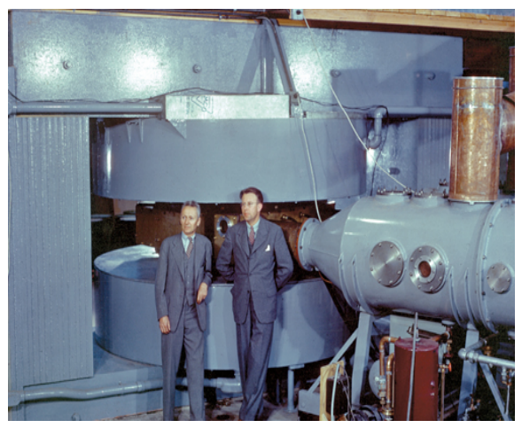
In the beginning
Isotope production started on physics research machines
Time conflicts
Expensive to operate
Complex
But a great way to prove the usefulness - so let’s make dedicated machines

Slide 4
Generation 1
Scaled down, simplified versions
Significant loss rates
Hard to maintain (in a production context)
Required experience to run well
Extraction was typically the achilles heel
Demonstrated the business case

Slide 5
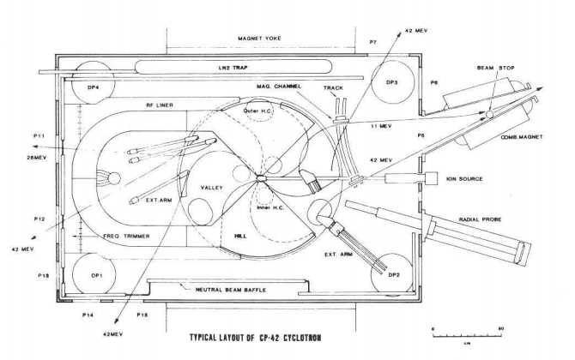
Generation 2
The CP42
The Cyclotron Corp (TCC) - had been selling H⁺ since 1967
In the late 70’s recognized that H⁻ would solve extraction issues
Was so successful they 6 sold before first one delivered => bankrupted TCC

Slide 6
CP42 - continued
The basic approach worked and it could be turned into a workhorse production system
~200 uA extracted
Still suffered from loss issues
Required a significant degree of expertise to operate
Stability issues

Slide 7
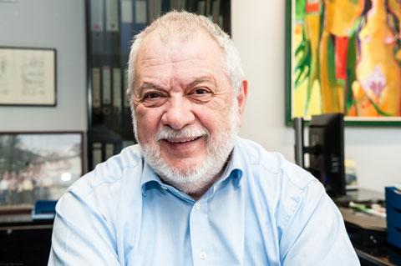
3rd Generation - IBA
Yves Jong
In the mid 80’s
Recognized the benefits of the deep valley designs (from SCC)
Combined with H⁻
Founded IBA with an economic development grant
Key: Had funding to build prototype

Slide 8
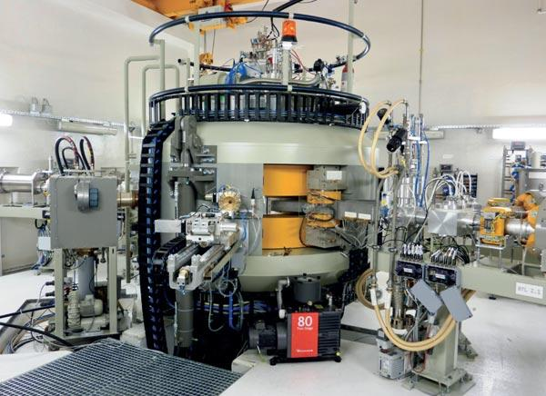
Cyclone-30
Successful prototype
Promised 400 uA
Modern systems
Low power consumption
Easier operation - turn key facility
Nordion was very impressed!

Slide 9
Nordion wished to purchase the Cyclone-30 and operate it at TRIUMF!
But didn’t they have some of the world’s best cyclotron expertise?
Notes:
Circa late 87

Slide 10
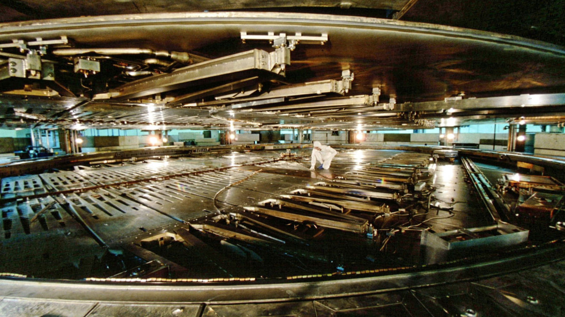
Motivation
TRIUMF
State of the art H⁻ ion source
Expertise in all cyclotron disciplines
Experience operating the CP42
Strong contacts with the WW cyclotron community
Commercialization would enhance the KOAN bid
Time to make a deal
Notes:
Star wars -> new source for Triumf
Magnets, vacum, rf ...

Slide 11
Commercial Design methodology
2 Schools of thought
Over engineer
Under engineer
And the simplify/reduce the design as you learn
Costs more
High probability first unit will succeed
Well suited to low volume production and/or high stakes - think satellites
Improve the design as things break and you learn
First unit is cheaper
May suffer from poor initial impressions
Well suited to high volumes - think cars

Slide 12
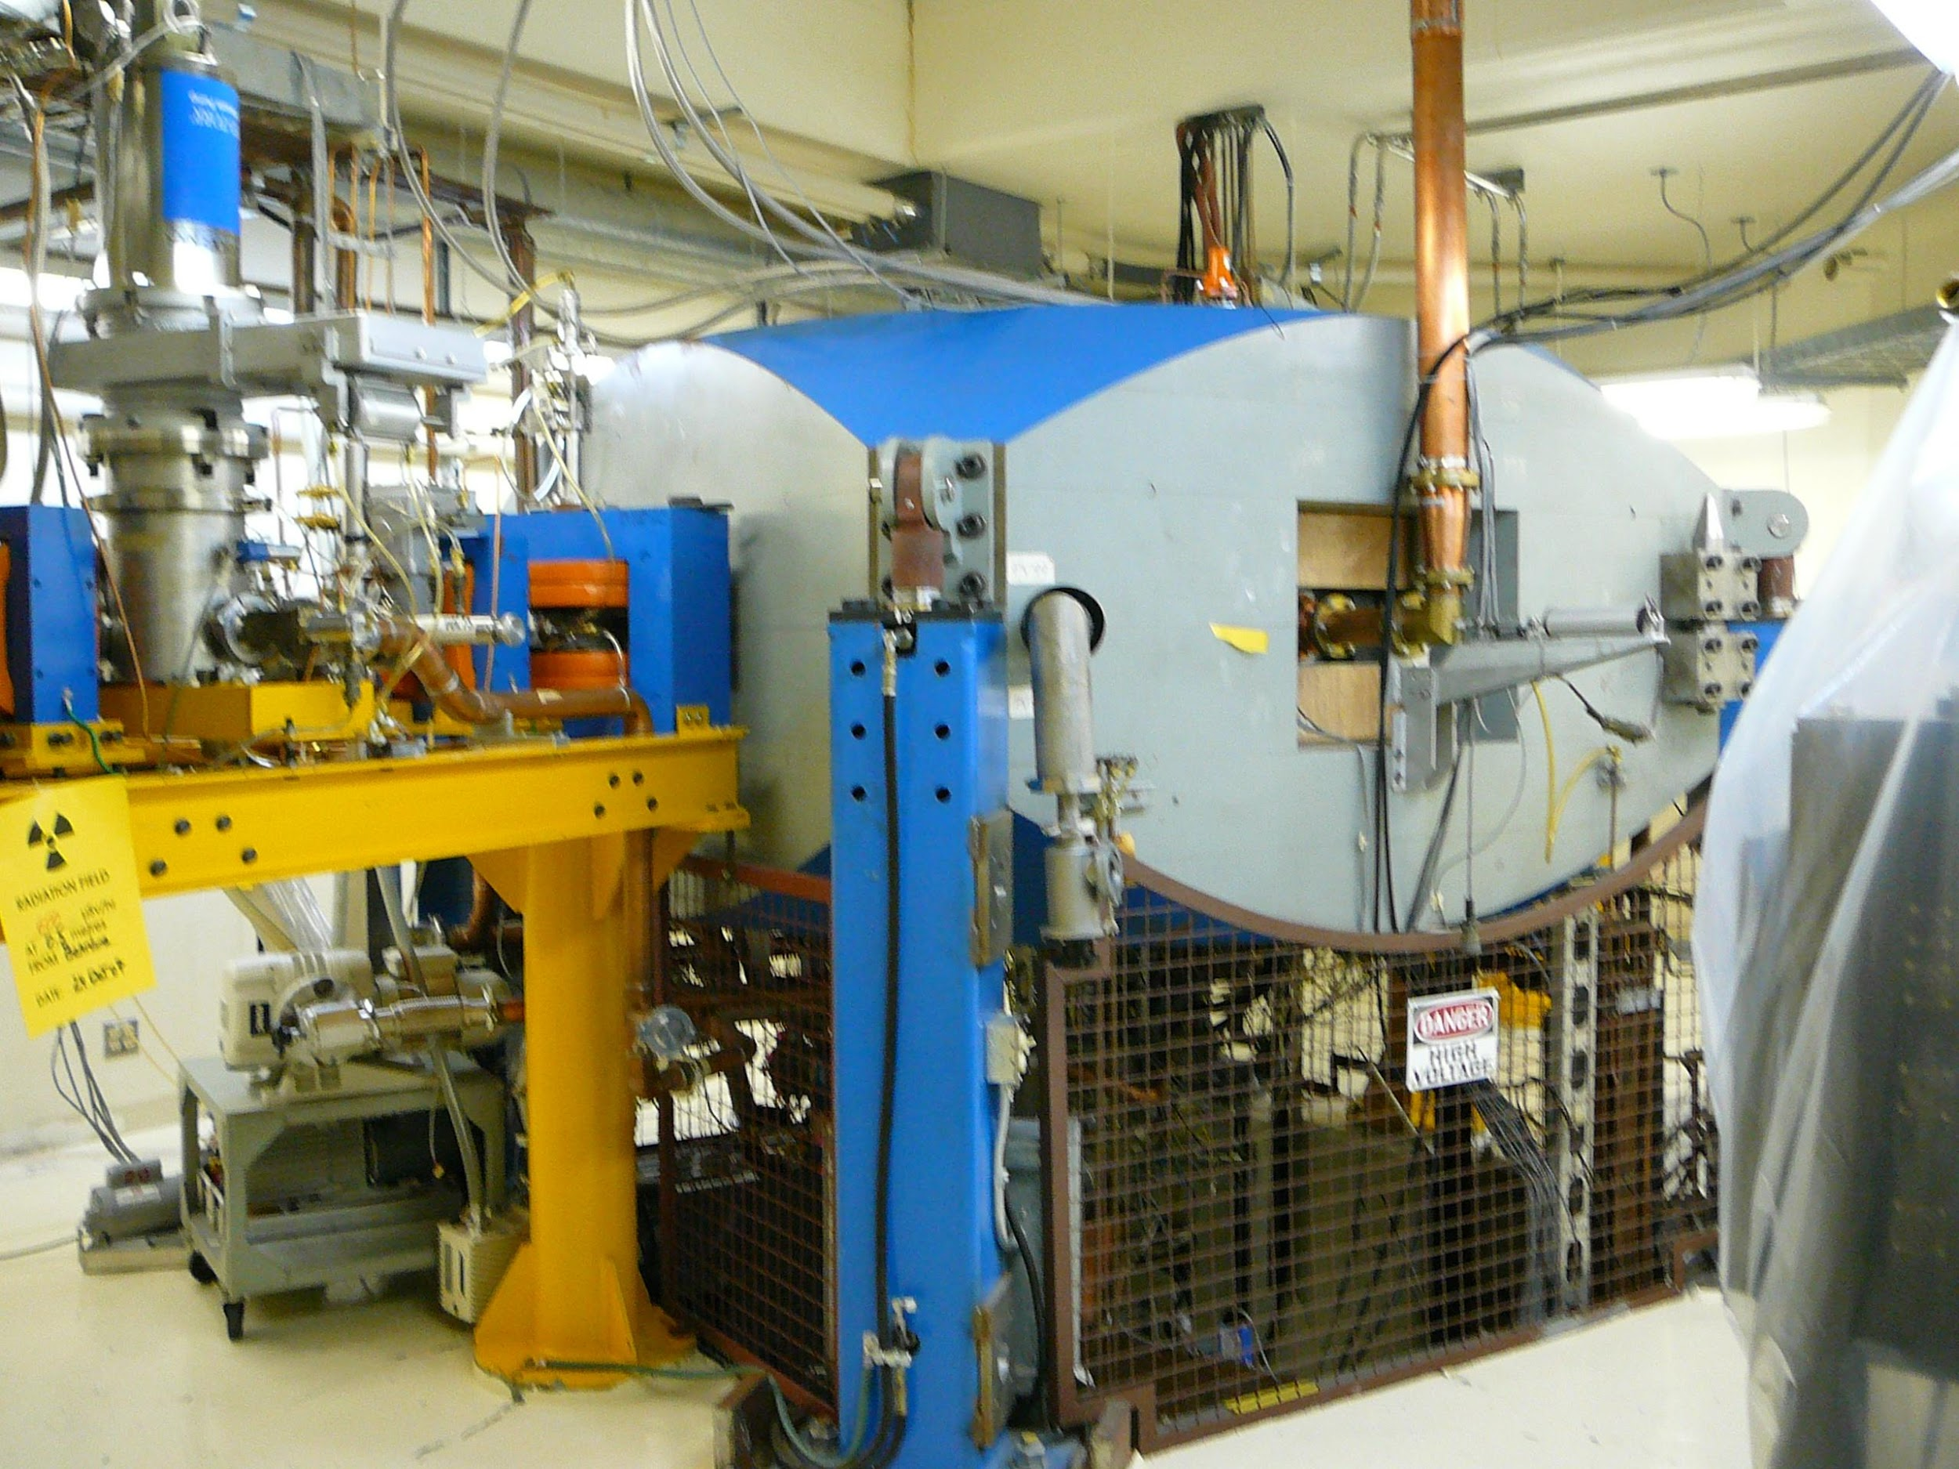
TR30
Our approach
Maximize gap
Nothing in the gap - dees in valleys
External source - axial injection
Good vacuum - optimize materials
Lots of cooling
Careful physics design of every element
Use proven designs
Results in stability and low loses
If it works well it will pay for itself!
Notes:
Star wars -> new source for Triumf
Magnets, vacum, rf ...

Slide 13
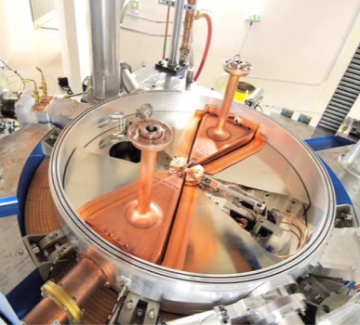
Construction
Once EBCO/TRIUMF convinced Nordion
Turn key system
Same delivery timeline as Cyclone-30
Which meant
Simultaneous design & build
Work divided between many expert teams
Installation and commissioning while building under construction
Notes:
design/build is common in research but risky in business
source, injection, RF, RF controls, magnets, vacuum, safety, facilities, cyclotron design

Slide 14
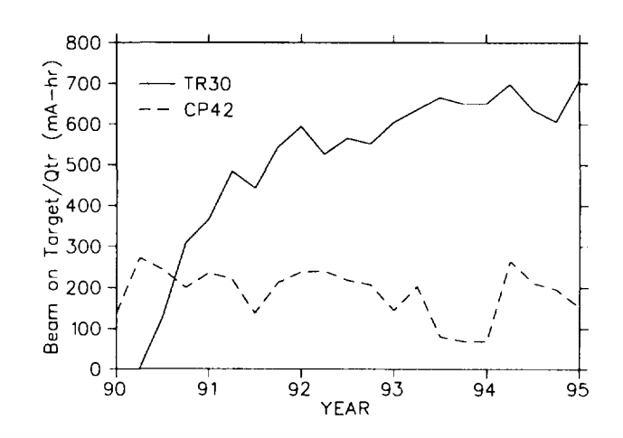
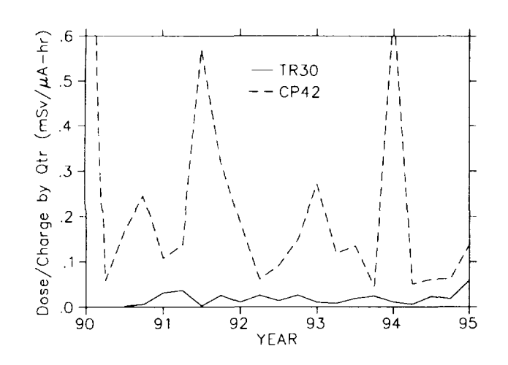
These two plots say it all!
Plenty of beam, low dose

Slide 15
Follow on
With the success of the TR30 for Nordion we were able to
TR30/15 for Taiwan
  Won a very competitive bid
  Dual particle
  24 month start to finish
1 mA TR30 upgrade
  Without significant downtime
  Dual 500 uA beams
Ebco/ ACSI has successfully sold TR30s and follow on designs ever since

Slide 16
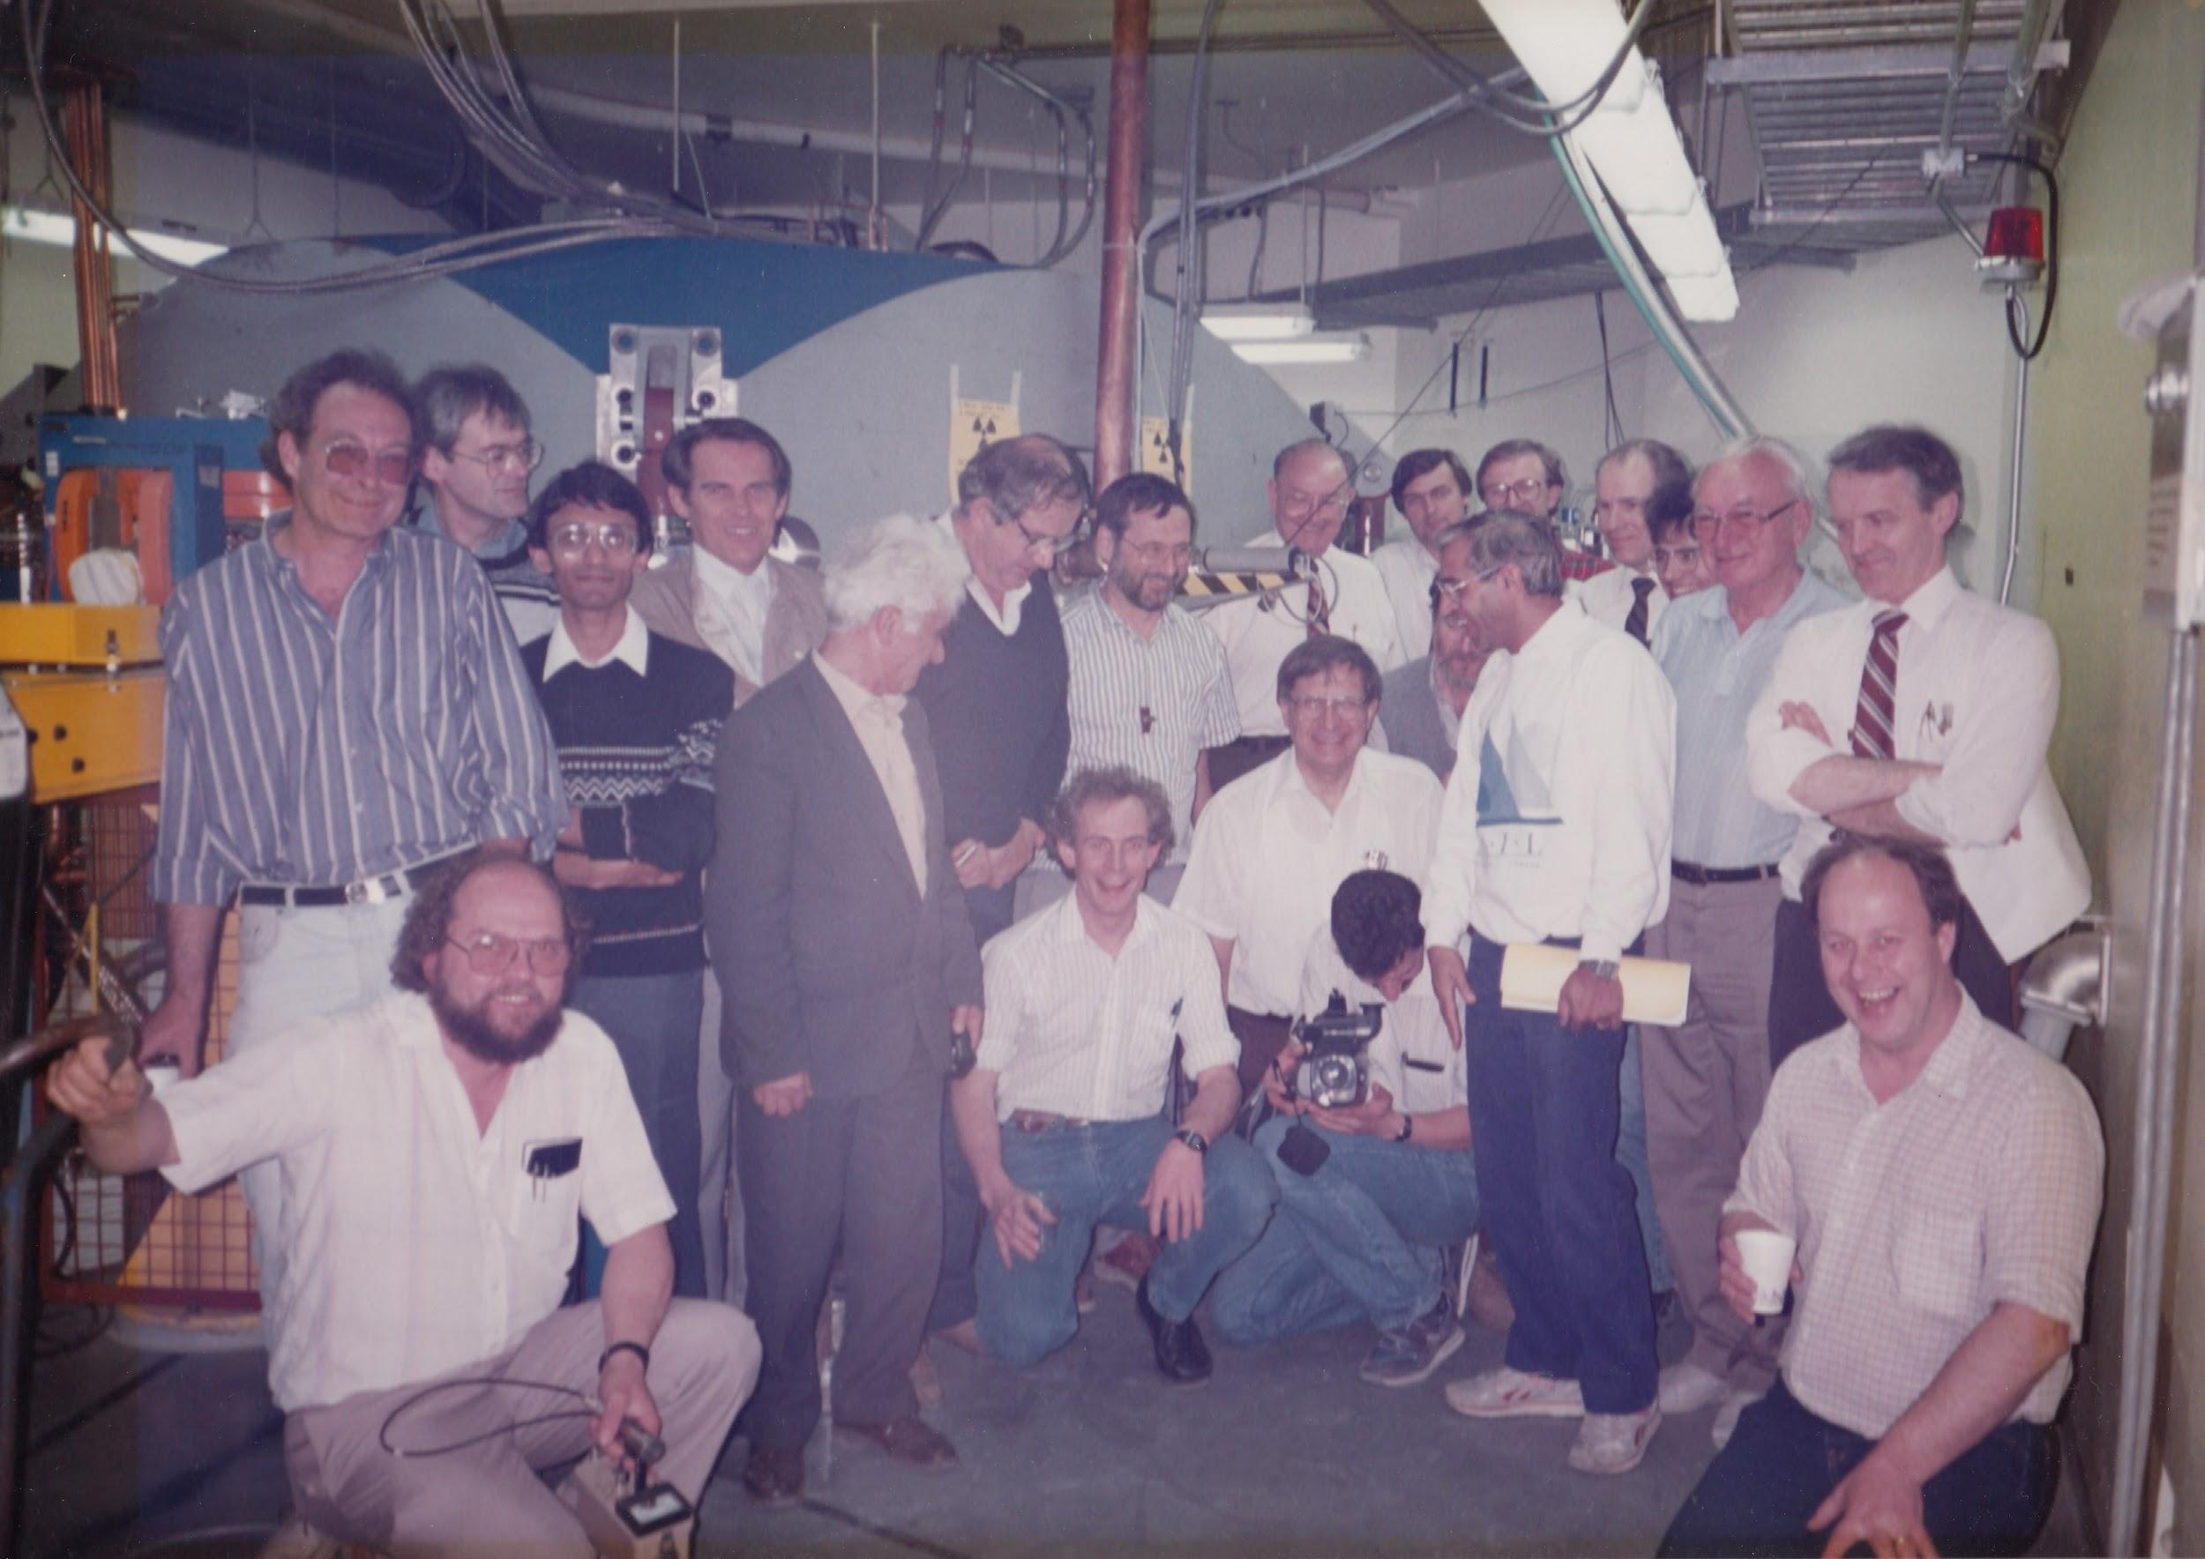
Some of the TR30 Team
Notes:
It was a very large - nearly every part of the cyclotron division was involved in some way.

Slide 17
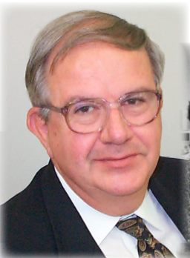
Personal Notes
From Gerardo I learned:
It is always good to get a second (or 3rd) opinion
Don’t wait to perfect something - try it - see what you learn
Where people sit can affect who they collaborate with
You never know when a colleague or contact may be helpful

Slide 18
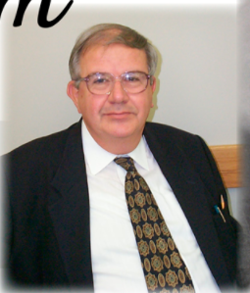
Personal Notes
I have Gerardo to thank for:
Encouraging me to apply to the TRIUMF postdoc
Providing the opportunity to do the initial TR30 scoping and then having a central role in the design and commissioning
Providing cover from those I had rubbed the wrong way
The opportunity to lead the design of the B70 (Best Cyclotron)

