Slide 1
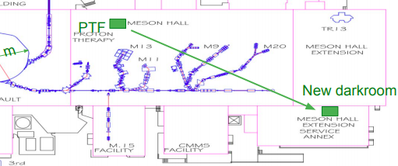
Neutrino
Hyper-K Canada Virtual Meeting held on January 7,8,11
  Status reports on HK related work, planning for 2020 CFI-IF implementation, planning for 2022 CFI-IF application
Shubham Garode, engineering masters student from Vishwakarma Institute of Information Technology finished internship at TRIUMF in December 2020 and completed masters degree
  Success as pilot run for future internships – significant contributions to design of multi-PMT and CERN test experiment, major involvement in GAPS
  New student has started remote internship
Move of PTF from Meson Hall to MESA progressing. Expect to be out of Meson Hall by beginning of February
ALPHA
Expecting to ship the ALPHA-g TPC back to CERN within a couple of weeks

Slide 2


SuperCDMS and CUTE
Update for SMM, January 2021
SuperCDMS
Passed “Director’s Review” at SLAC in preparation for DOE re-baselining review coming up in February
SuperCDMS infrastructure at SNOLAB mostly in place (seismic platform, cleanroom, crane, …)
Shielding: last part (outer water tanks) to be delivered in February
Cryostat: order process has started
Crucial tests for readout wiring completed
DAQ test at TRIUMF delayed due to readout electronics production issues; test rescheduled for February/March
Overall project delayed by about a year due to a combination of technical issues and the pandemic
CUTE
Three long runs (4-6 weeks each) with varying payloads completed since August, despite Corona restrictions
Continuously improving facility for remote operations
Making progress in improving noise conditions; collecting data on facility background
Progress on detector testing and acquiring science quality data is impacted by access restrictions to SNOLAB
Awaiting delivery of hardware (detectors, readout wiring) from our US colleagues to perform first test of new SuperCDMS detectors

Slide 3
SuperCDMS and CUTE
Update for SMM, January 2021
TRIUMF – Detector work
Detector test facility at TRIUMF operating continuously since June 2020
Improvements on remote operations mean that personnel access is only needed once or twice a week
Collecting data with low-threshold (eV scale) cryogenic detectors
Developing calibration methods based on optical/IR photons, using LEDs mounted inside the cryostat
Studying performance dependence on detector history (voltage bias history, exposure to optical/IR photons)
TRIUMF – DAQ work
Preparations complete for full DAQ test, awaiting delivery of readout boards from the US
Test of Signal Distribution Unit completed

Slide 4
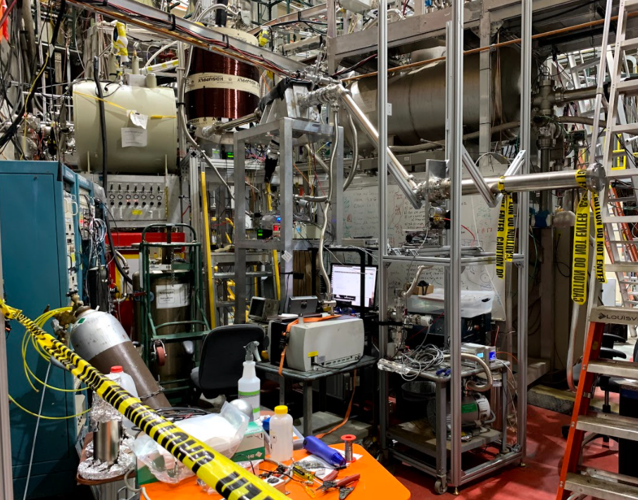
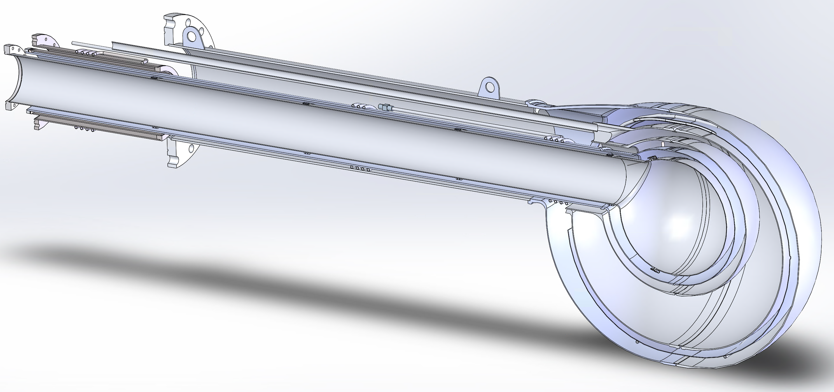
Testing the UCN coating for the new UCN source at LANL
Central new UCN source component too long for standard guide coating process
New company’s coating has to be qualified
UCN beam time and storage tests in guide coated with new process at LANL Dec 2020
Result: UCN storage lifetime at least as good as for the standard process
Moving on with build of central component
round
house
polarizing
magnet
switcher
TUCAN drop
89 cm
VAT valve
New UCN guide
2.7 m
UCN storage volume
Central component of new UCN source
Test setup at LANL December 2020

Slide 5
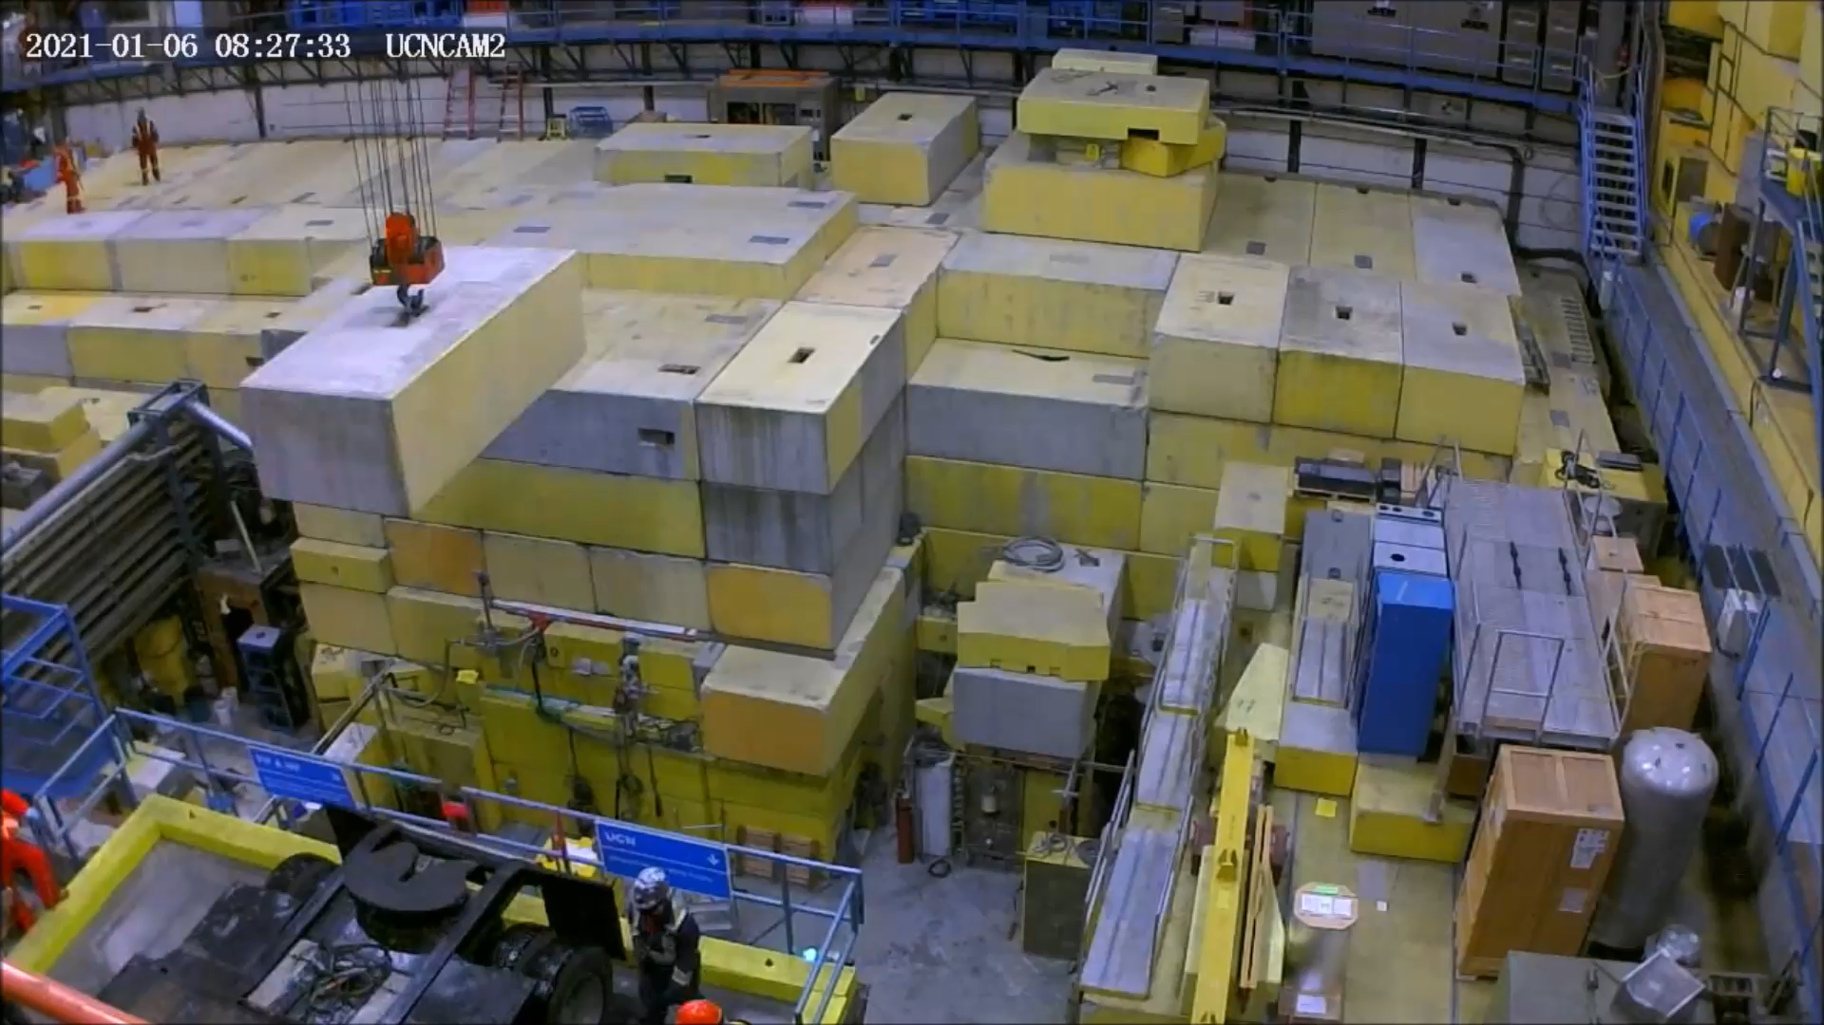
Shutdown 2021 update – Vertical Source Uninstall
UCN is on schedule with the vertical source removal.
UCN physicists are putting a lot of manual labor hours in to make it happen.

