Slide 1
Recent and Future Studies of Astrophysical Reactions at TRIUMF
Dr. Matthew Williams
TRIUMF Science Week | 16th August 2021
mwilliams@triumf.ca

Slide 2
Talk Outline
Nuclear Astrophysics.
  Nuclear reactions in stars.
  Thermonuclear reaction rates.
Recent Measurements of Astrophysical reactions at TRIUMF:
  Direct measurements of radiative capture with DRAGON: ⁷Be(𝛼,𝛾)¹¹C
  EMMA’s first science campaign: ⁸³Rb(p,𝛾)⁸⁴Sr
  Exploiting mirror symmetry with TIGRESS+SHARC: ²³Ne(d,p)²⁴Ne.
  Direct measurements of the rp-process with IRIS: ⁵⁹Cu(p,𝛼)⁵⁶Ni
Looking to the Future:
  Exploring the weak r-process with EMMA and novel targets: ⁹⁴Sr(𝛼,n)⁹⁷Zr
  A precision-era for DRAGON: ²⁰Ne(p,𝛾)²¹Na (collab. w/ GRIFFIN) & ⁷Be(p,𝛾)⁸B
  Neutron capture via Surrogate Reactions with TIGRESS+SHARC: ⁹³Sr(d,p𝛾)⁹⁴Sr
Dr. M. Williams

Slide 3
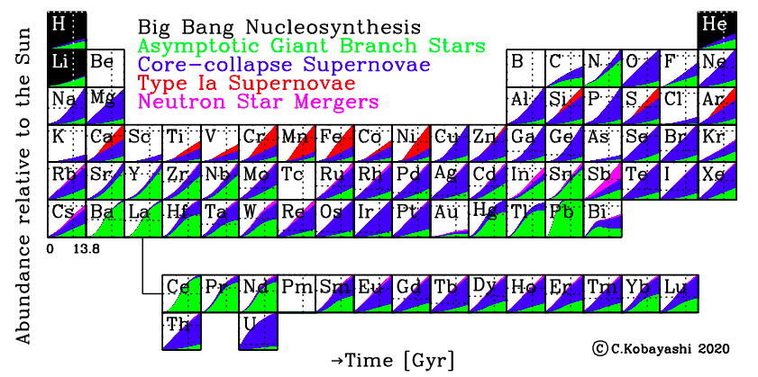
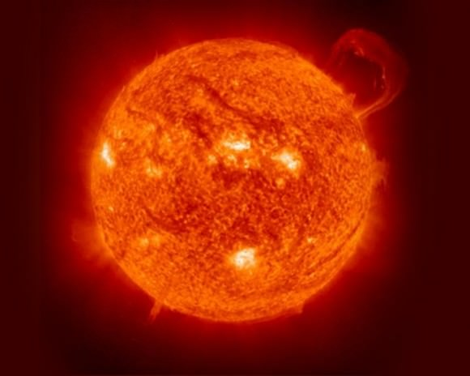
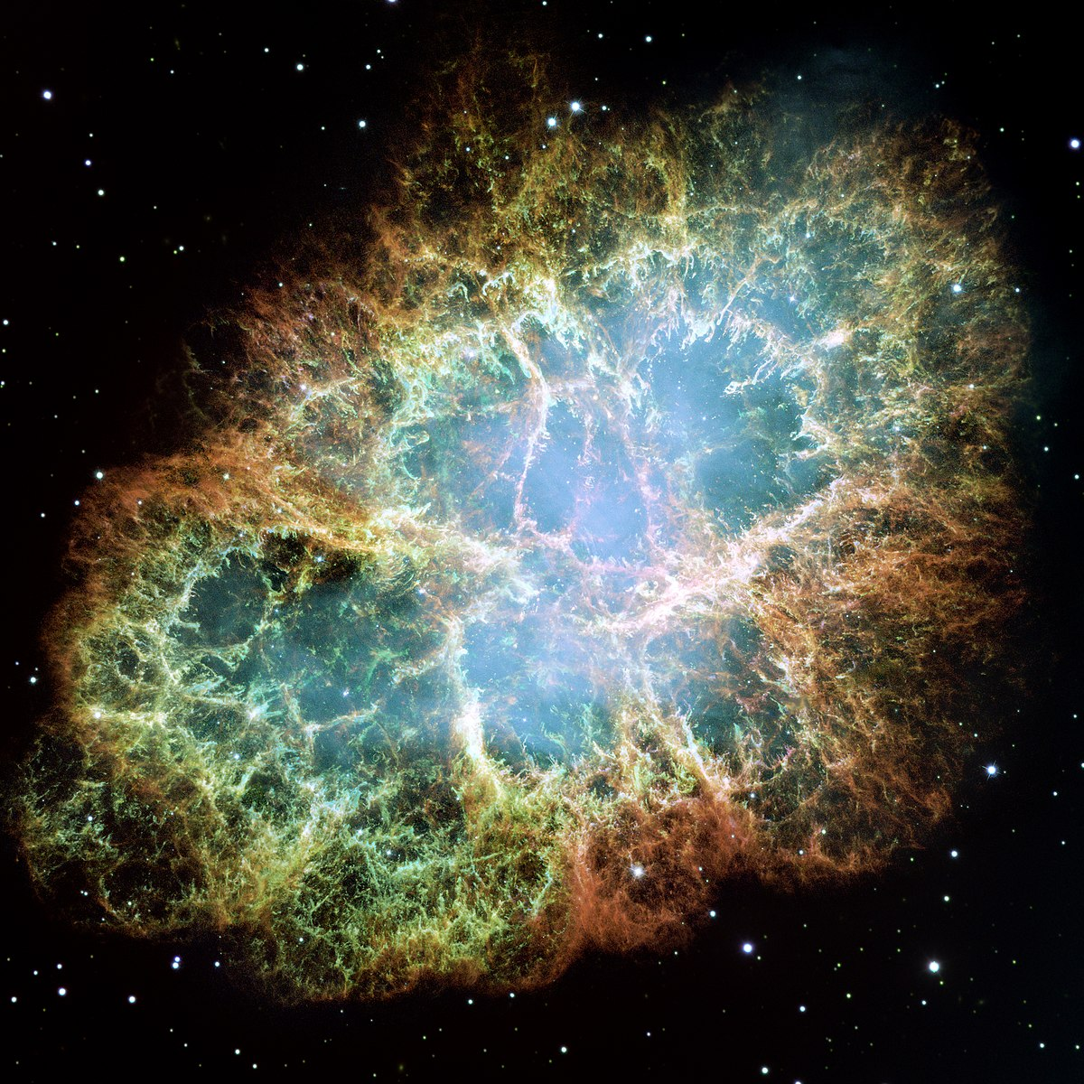
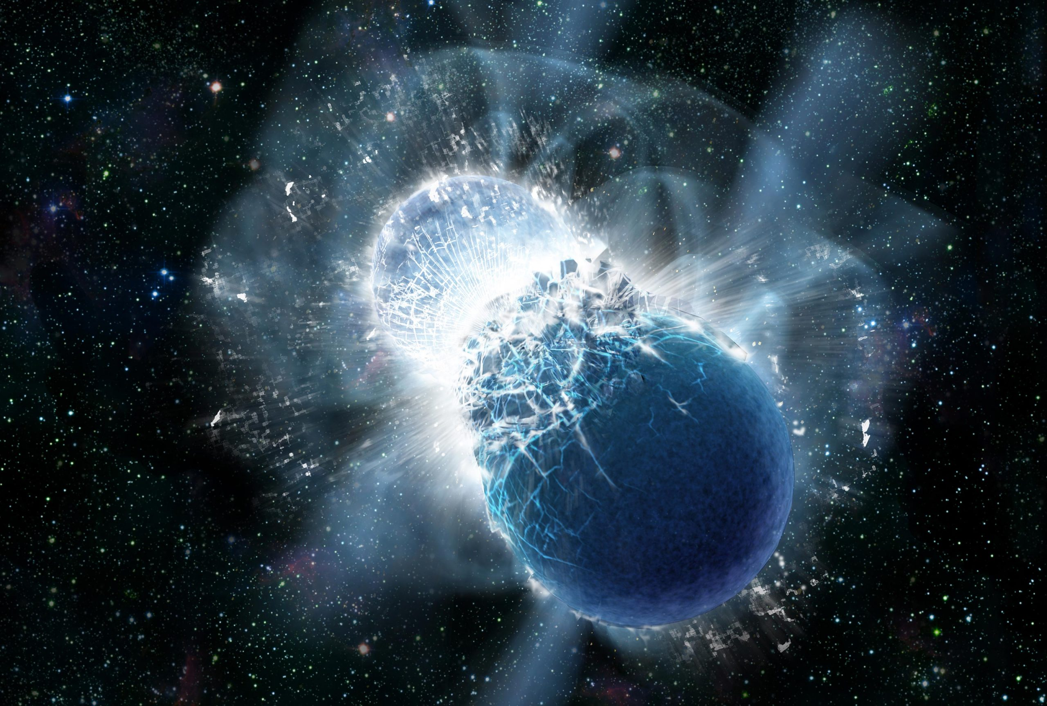
Origin of the elements
+ …

Slide 4
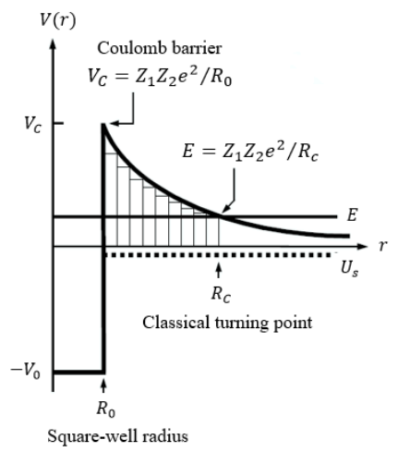
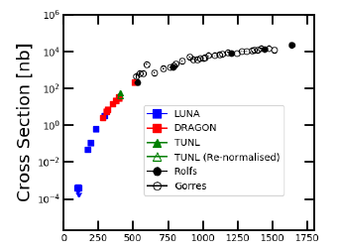
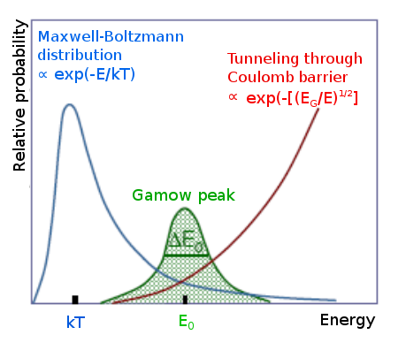

Nuclear reactions in stars
All astrophysical environments where significant nuclear reactions occur have two characteristics in common: they are HOT and DENSE.
²²Ne(p,𝛾)²³Na [1]
In stars, there is a “goldilocks zone” where reactions are most likely to proceed => the Gamow Window
Coulomb barrier gives rise to strong energy dependence of reaction cross sections
[1] M. Williams, A Lennarz, A.M. Laird et al., Phys. Rev. C, 102 (2), 035801 (2020).
.

Slide 5


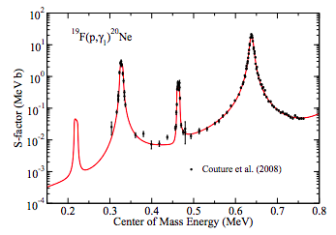
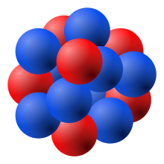







Nuclear Reactions
Breit-Wigner Formula:
Particle Emission
Compound Nucleus
$$+$$
Resonance Strength:
$$+$$
For narrow resonances:
$$S_{p}$$
Radiative Capture
$$+$$
$$γ$$
Experimental studies of nuclear reactions can be sub-divided into two broad categories:
Direct Measurements: ”re-create the conditions of the star” by colliding nuclei at energies close to (or ideally, within) the Gamow window.
In-direct measurements: probe the characteristics of nuclei, combining measurements with nuclear models to extract parameters that ultimately determine nuclear cross-sections
Dr. M. Williams

Slide 6
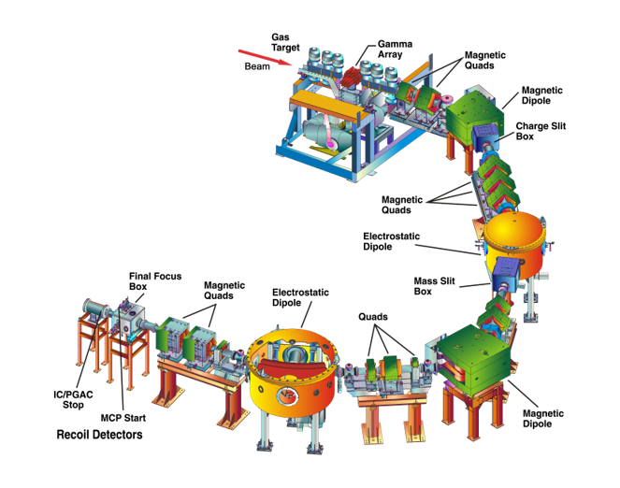
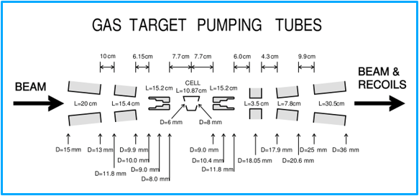
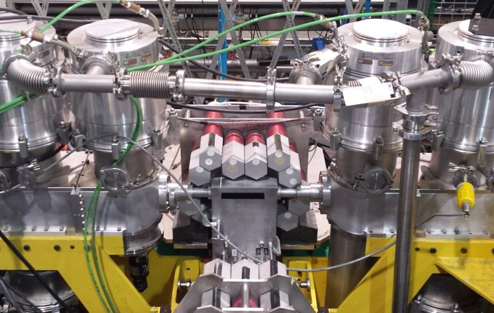
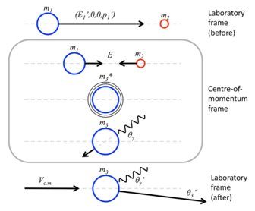
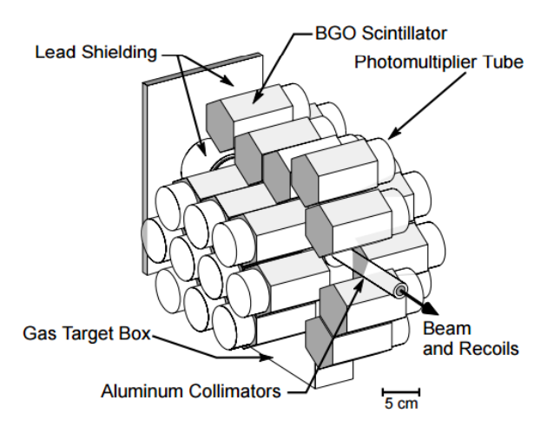
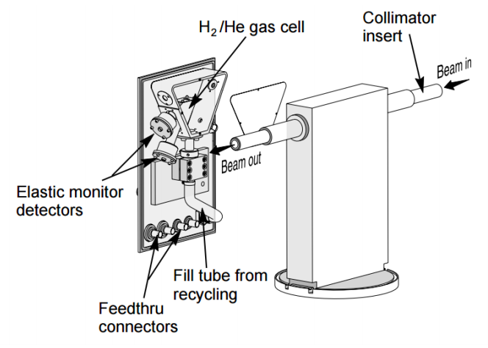
Radiative Capture with DRAGON
Radiative capture of protons and alphas are ubiquitous in nuclear astrophysics.
H and He are most abundant elements.
Lowest Z means low Coulomb barrier.
Often the only open channel.
Radiative capture on short-lived isotopes requires inverse kinematics.
Dr. Matthew Williams

Slide 7
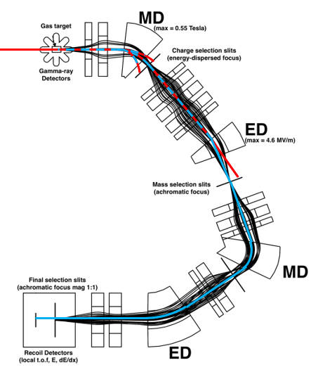
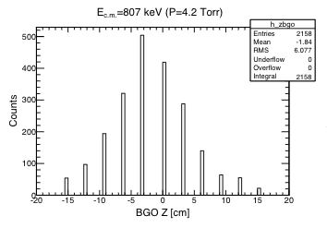
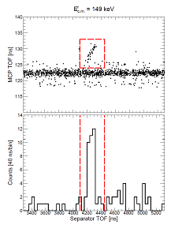
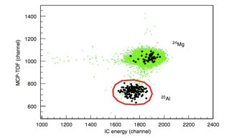
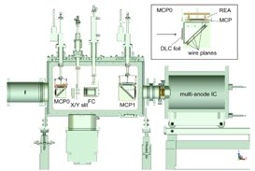

Recoil Detection
Beam:
Recoils:
MCP Local-TOF
Target Position ∝ E_{r}
Beam suppression:
>1x10¹⁵

Slide 8
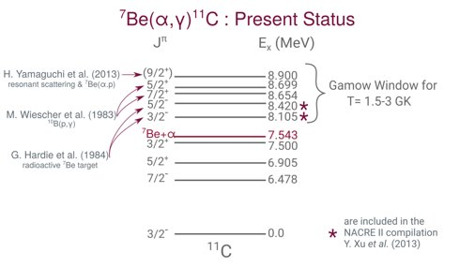
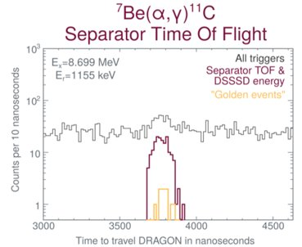
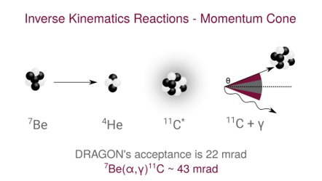
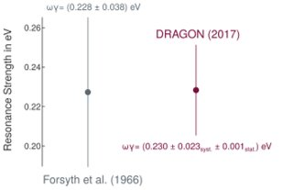

Constraining the 𝛎p-process: ⁷Be(𝝰,𝛄)¹¹C
Reaction rate uncertain due to unmeasured resonances
(PIs: Thanassis Psaltis, Alan Chen, Chris Ruiz)
⁷Be(𝝰,𝜸)¹¹C is a possible breakout reaction from pp-chains.
Affects the proton-to-seed ratio available for the 𝝼p-process in CCSNe.
Influential in determining abundance of p-nuclei in A=100-110 mass range.
Test with ⁶Li(𝝰,𝜸)¹⁰B
A. Psaltis et al. (in preparation)

Slide 9
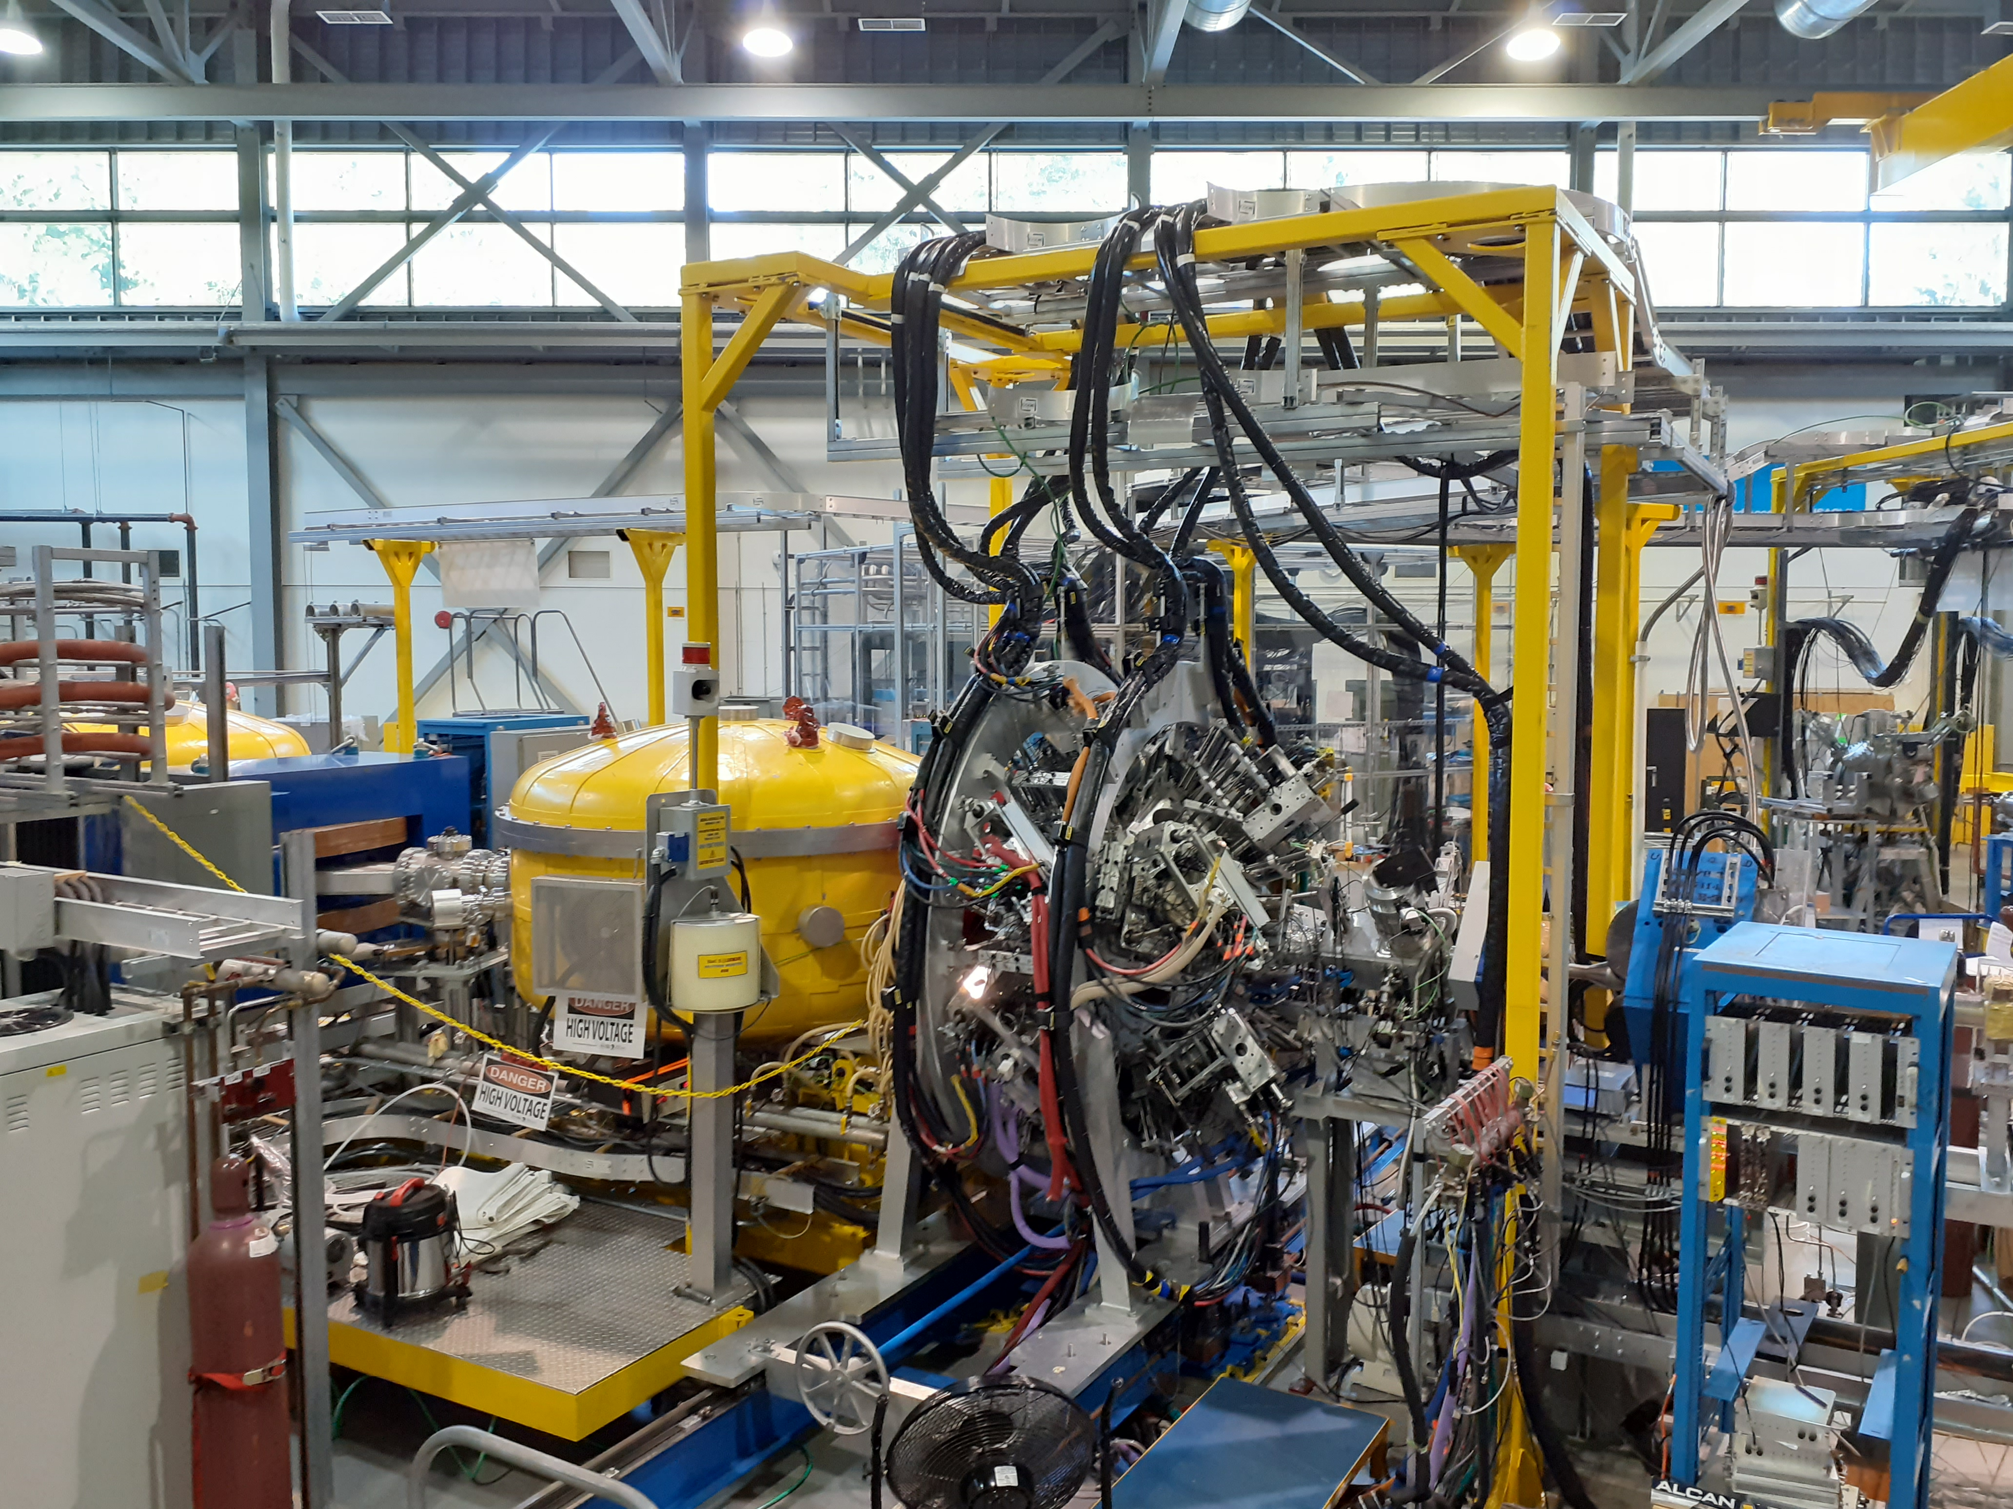
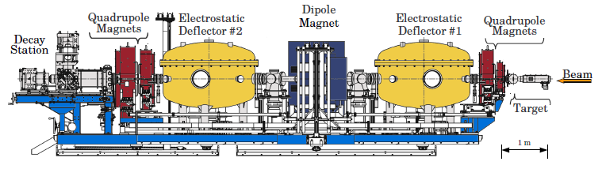
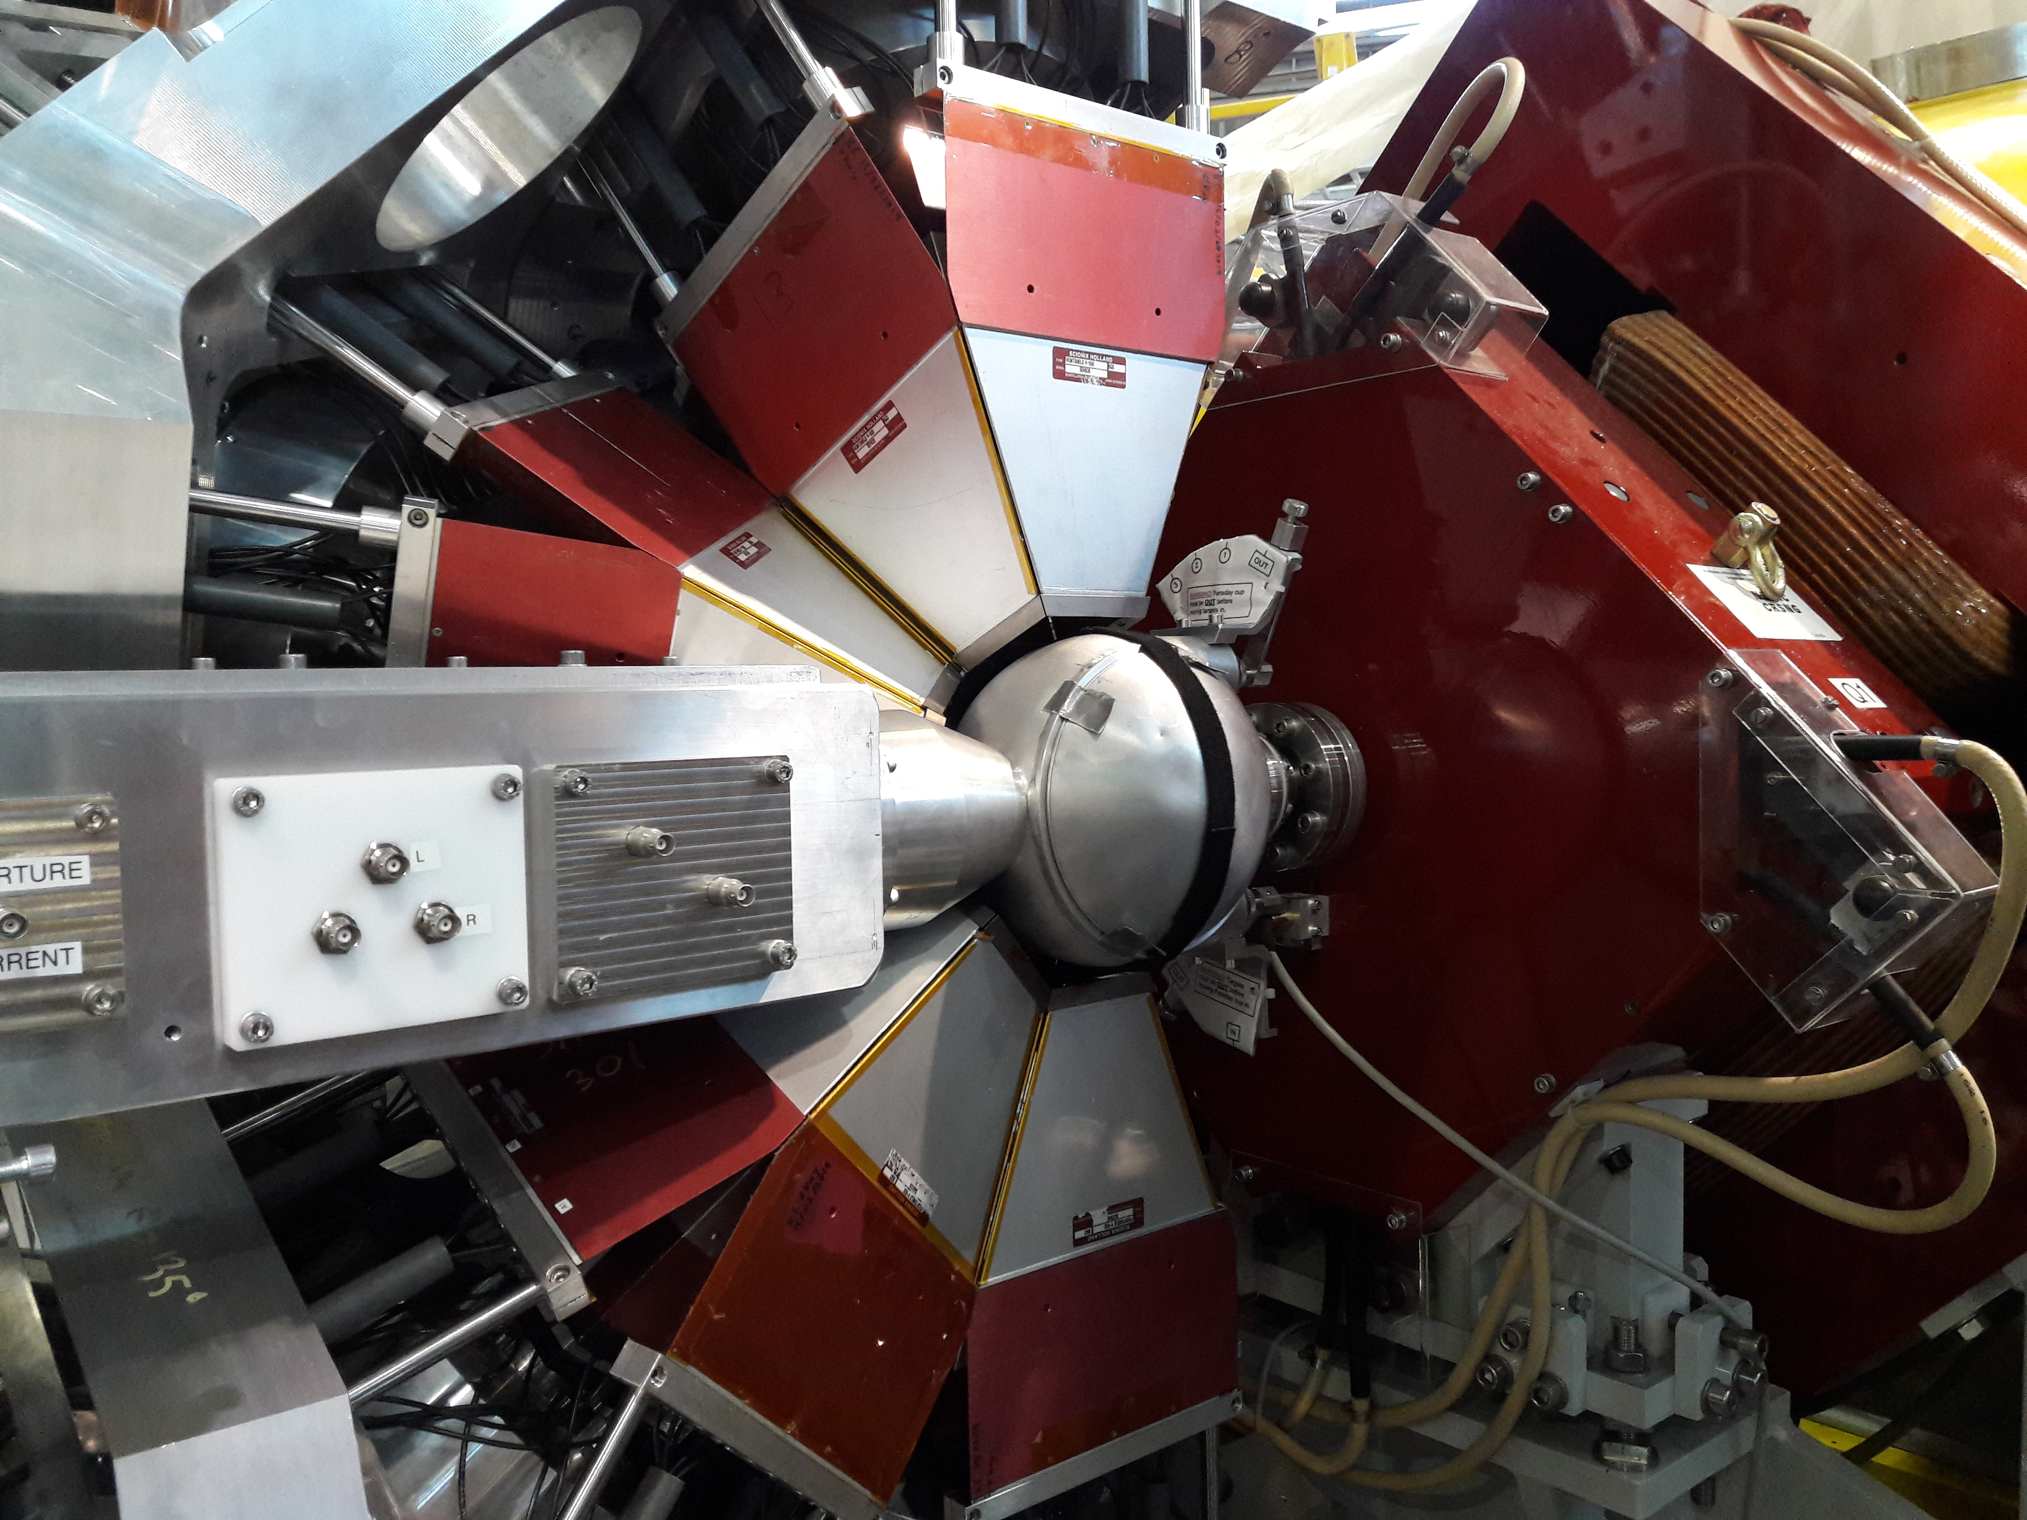
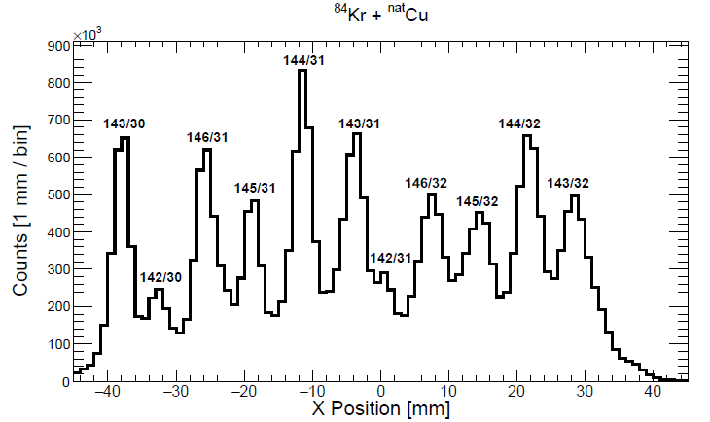
First Science result for combined EMMA+TIGRESS set-up.
m/q spectrometer designed to separate unreacted beam and disperse products onto the focal plane.
EMMA was fully-commissioned in 2018 after a series of test measurements: [B. Davids, M. Williams, N.E. Esker, et al. Nucl. Instr. Meth. A, 930:191 – 195, 2019.]
Array of electronically-segmented, Compton-suppressed, HPGe detectors for in-beam 𝛾-ray spectroscopy.
Moved to the EMMA beam-line during 2019.
At the same time, the DAQ system was upgraded to a trigger-less system developed originally at GRIFFIN

Slide 10
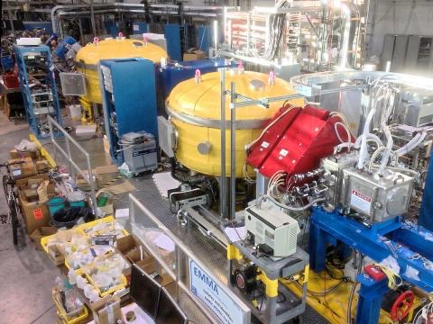
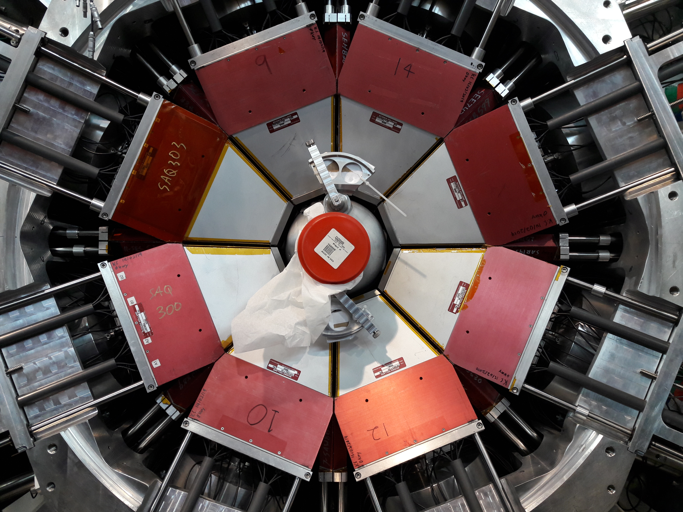

First science result with EMMA+TIGRESS: ⁸³Rb(p,𝛾)⁸⁴Sr
PIs: Gavin Lotay & Barry Davids
The ⁸³Rb(p,𝛾)⁸⁴Sr reaction is important for determining the production of the p-nuclide: ⁸⁴Sr
Currently, the origins of the p-nuclei are unclear due in-part to lack of nuclear cross section data, which is extremely challenging to obtain for radiative capture in the relevant mass region.
We undertook a measurement using a radioactive ⁸³Rb beam impinged on a CH₂ target to populate ⁸⁴Sr
2⁻, 3⁻
$S_{p}=8.8$MeV
⁸³Rb + p
2⁺
793 keV
Detect recoils in coincidence with low-lying transitions in⁸⁴Sr
0⁺
⁸⁴Sr
Dr. Matthew Williams

Slide 11
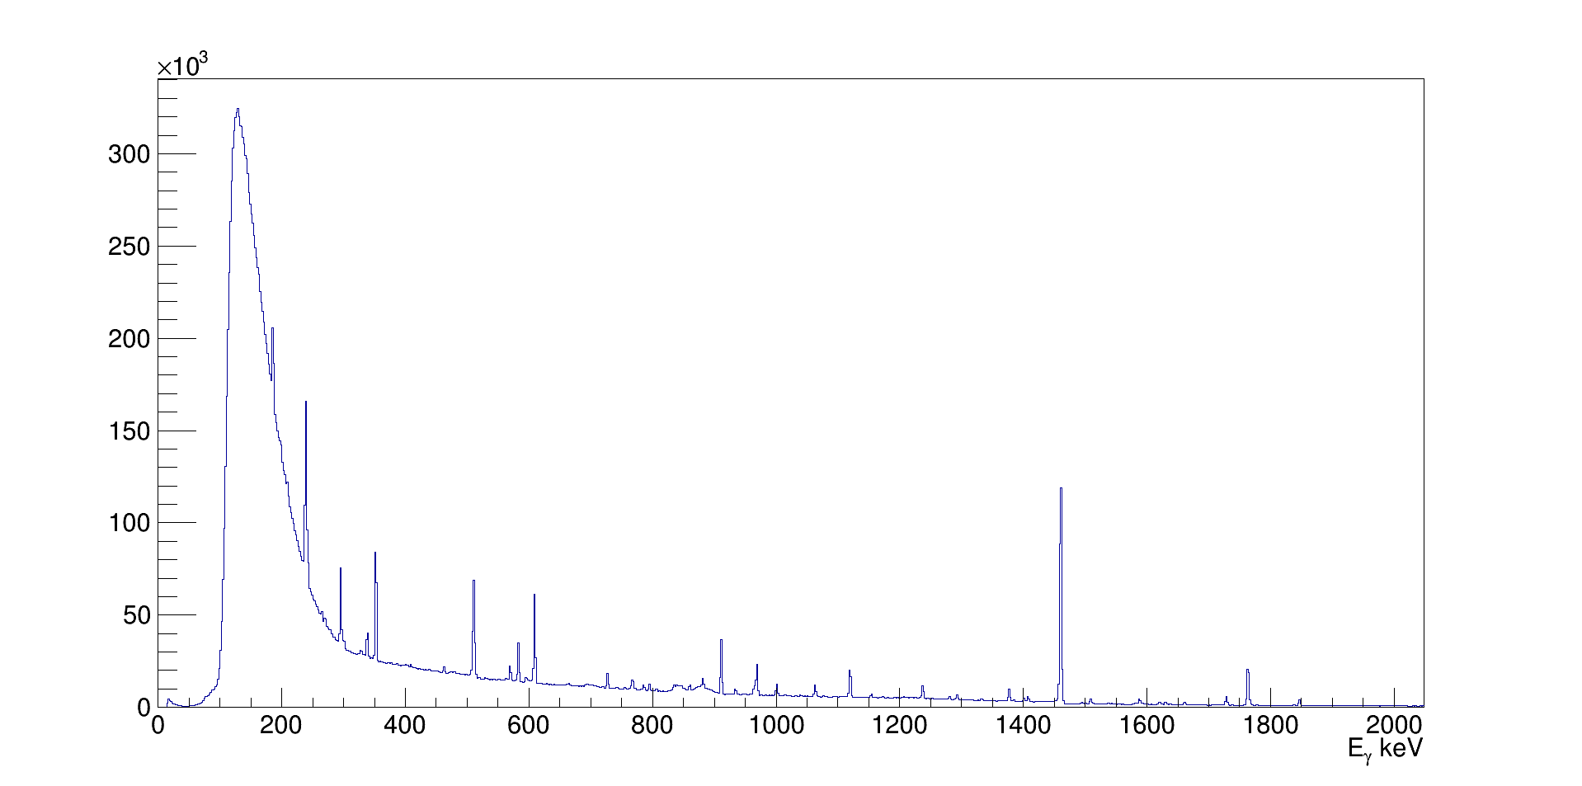
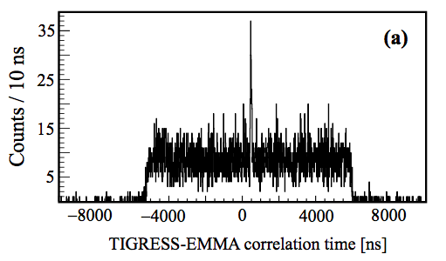
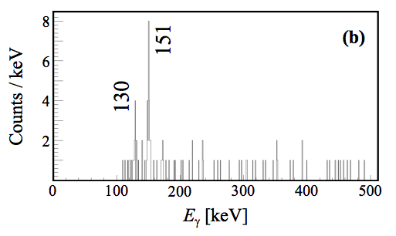

Benchmark Technique: ⁸⁴Kr(p,𝛾)⁸⁵Rb
EMMA not optimized for beam suppression to the same extent DRAGON is, so tested with ⁸⁴Kr
Without an EMMA event we just see room background, but…
Timing Peak
$S_{p}=7$MeV
⁸⁴Kr + p
1/2⁻
281 keV
3/2⁻
151 keV
5/2⁻
⁸⁵Rb

Slide 12
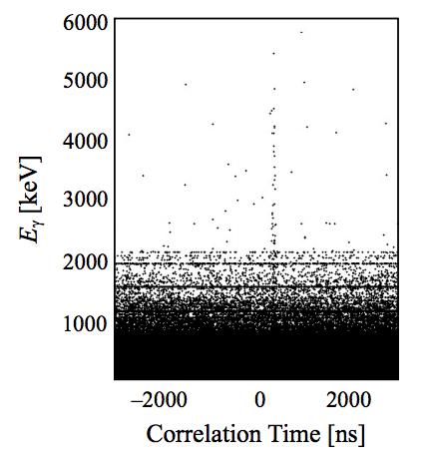
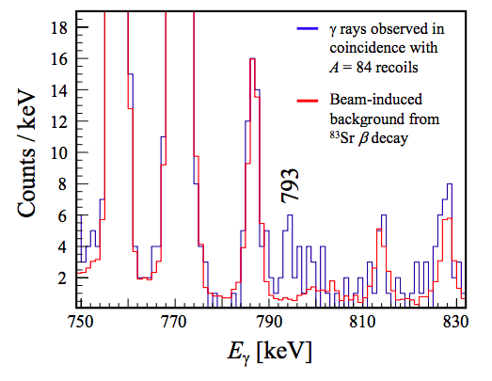
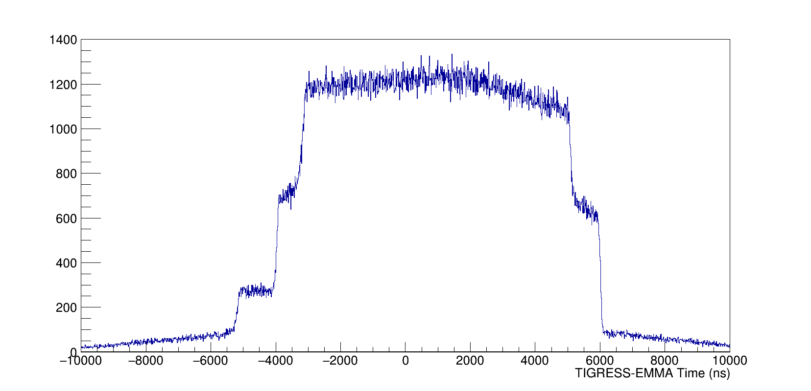

⁸³Rb(p,𝛾)⁸⁴Sr
Too much background from decaying RIB contaminant ⁸³Sr scattered on EMMA’s aperture.
However, plotting timing vs 𝛾-ray energy reveals a smoking gun signature…
Gating on time reveals the 𝛾-ray of interest above background.
2⁻, 3⁻
$S_{p}=8.8$MeV
⁸³Rb + p
2⁺
793 keV
0⁺
⁸⁴Sr

Slide 13
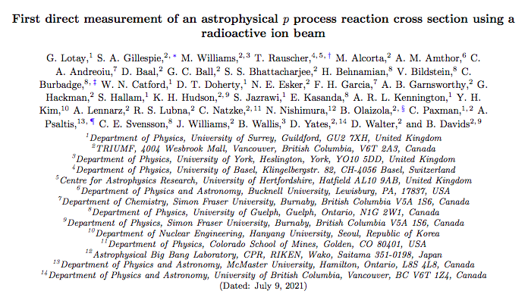
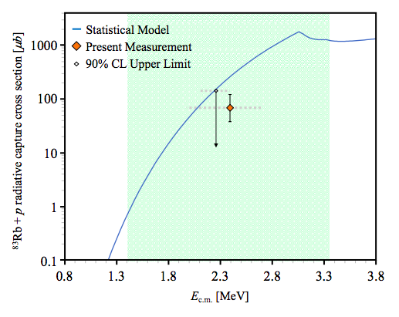
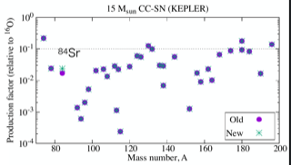
⁸³Rb(p,𝛾)⁸⁴Sr
We use gamma-cascade models to convert the partial cross section to a total cross section.
Our calculated cross section is approximately a factor 4 lower than the Non-smoker prediction.
Astrophysical model calculations show an increase in the ⁸⁴Sr yield predicted in a 15M⊙ supernovae.
Principal Investigators: G. Lotay & B. Davids
Analysis by S.A. Gillespie, M. Williams & S.S. Bhattacharjee
Theoretical calculations by T. Rauscher & N. Nishimura (astro)

Slide 14
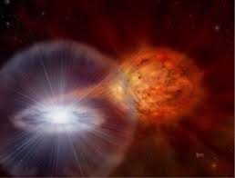
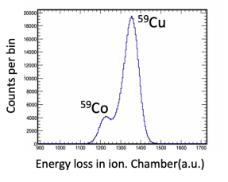
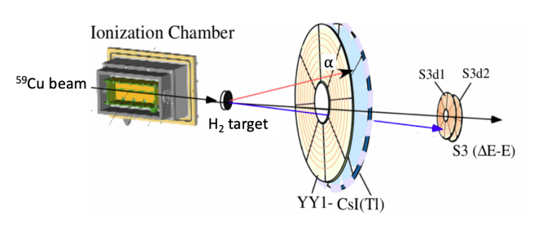
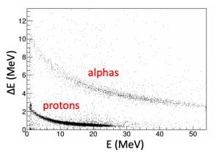
Direct measurements of the rp-process with IRIS
(PI: Jaspreet Randhawa)
A direct measurement of ⁵⁹Cu(p,𝜶) at E_{c.m.} = 6 MeV was performed at IRIS
The ⁵⁹Cu(p,𝜸)/(p,𝜶) ratio is influential in determining XRB light curves powered by the rp-process
Also influential in the 𝝂p-process.
Solid H₂ target (50 𝜇m) grown on cryogenically cooled Ag foil.
𝛼-particles tagged by their 𝛥E/E signature in YY1-CsI detectors.
Beam identified event-by-event with an upstream ion chamber.
(Intensity of ~4x10³ pps)
Dr. Matthew Williams

Slide 15
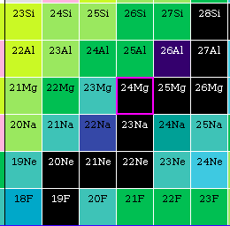
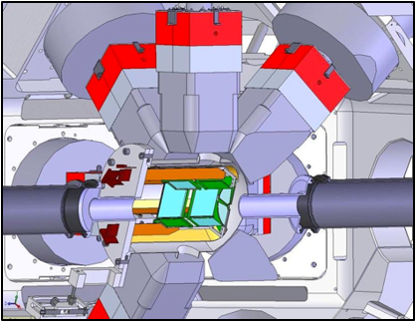
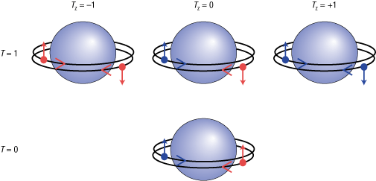

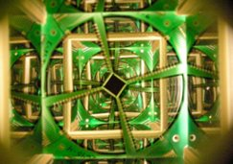
Exploiting Mirror Symmetry with TIGRESS+SHARC
Studies of the reaction and/or nucleus of interest are sometimes too technically challenging.
Can use a phenomenon in the strong nuclear force that nuclei with protons and neutrons exchanged behave very similarly, to infer properties of states in ²⁴Si by measuring analogue states in the ²⁴Ne mirror.
This is the case for ²³Al(p,𝛾)²⁴Si important for XRBs.
Study ²³Ne(d,p)²⁴Ne transfer with TIGRESS+SHARC to access IAS of ²⁴Si
Use the Force…
Dr. Matthew Williams

Slide 16
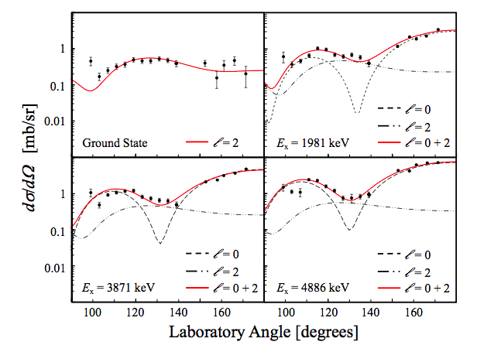
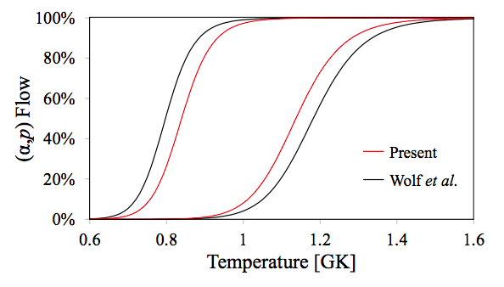
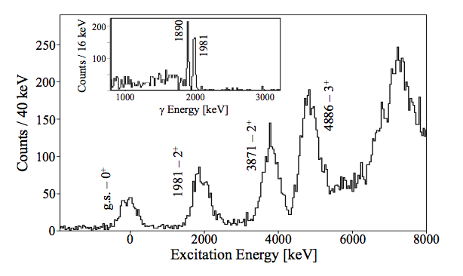

First measurement of ²³Ne(d,p)²⁴Ne
Observed isobaric analogue states of interest for ²³Al(p,𝛾)²⁴Si.
Able to extract angular distributions and spectroscopic factors from ADWA analysis.
The resulting resonance strengths constrain the temperature range activating (𝛼,p) reactions in XRBs.
Lotay, et al. submitted to PRL (2021)
Dr. Matthew Williams

Slide 17




Future Plans: a Precision-era for DRAGON
²⁰Ne(p,𝛾)²¹Na – (PI: Fred Sarazin):
Collaboration with GRIFFIN group to couple 6 HPGe detectors to the DRAGON target.
Will provide the selectivity needed to explore the halo structure of subthreshold state in ²¹Na
⁷Be campaign using new graphite ISAC target:
(p,p’) and (𝛼,𝛼’) measurements with SONIC. (PIs: Carl Brune and James de Boer, respectively)
Intense beam will allow first precision inverse kinematics study of ⁷Be(p,𝛾)⁸B (PI: M. Williams)
Adelberger et al., Rev. Mod. Phys., 83(1):195, 2011.
Dr. Matthew Williams

Slide 18


Exploring the weak r-process using EMMA and novel Si(He) targets.
First cross section measurement of ⁹⁴Sr(𝛼,n)⁹⁷Zr for the weak r-process:
(PIs: M. Williams, A.M. Laird, C. Aa. Diget)
Will make fist use with an RIB of novel Helium sputtered targets, shown to have number density comparable to extended gas targets.
Use similar technique pioneered in the ⁸³Rb(p,𝛾)⁸⁴Sr study to identify the reaction channel.
Explain anomalous abundance patterns in the first r-process peak observed in the oldest observed stars.
V Godinho et al., ACS Omega, 1:1229–1238, 2016.
J Bliss, et al., JPhysG, 44:054003, 2017.
Dr. Matthew Williams

Slide 19


Exploring the r-process with the Surrogate Reaction Method using TIGRESS+SHARC
Measure the ⁹³Sr(d,p𝛾)⁹⁴Sr reaction to infer ⁹³Sr(n,𝛾)⁹⁴Sr cross-section using the SRM:
(PI: Richard Hughes, LLNL)
Advances in theoretical approaches to surrogate reactions allow accurate measurements of important (n,𝛾) reaction rates for astrophysics.
Will use TIGRESS+SHARC to measure ⁹³Sr(d,p𝛾)⁹⁴Sr around the ⁹⁴Sr neutron separation energy.
Observed low-lying transitions as a function of E_{x} provide constraints on HF-model calculations.
Ratkiewicz, A., et al. PRL 122 (2019), 052502.
Dr. Matthew Williams

Slide 20
Thank you, Merçi

Slide 21


⁷Be(𝛼,𝛾)¹¹C
⁸³Rb(p,𝛾)⁸⁴Sr
⁵⁹Cu(p,𝛼)⁵⁶Ni
²³Ne(d,p)²⁴Ne

