Slide 1
SRF and Beam Physics Research at UVic and TRIUMF
Tobias Junginger

Slide 2
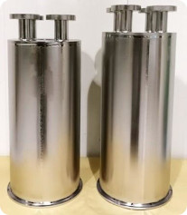
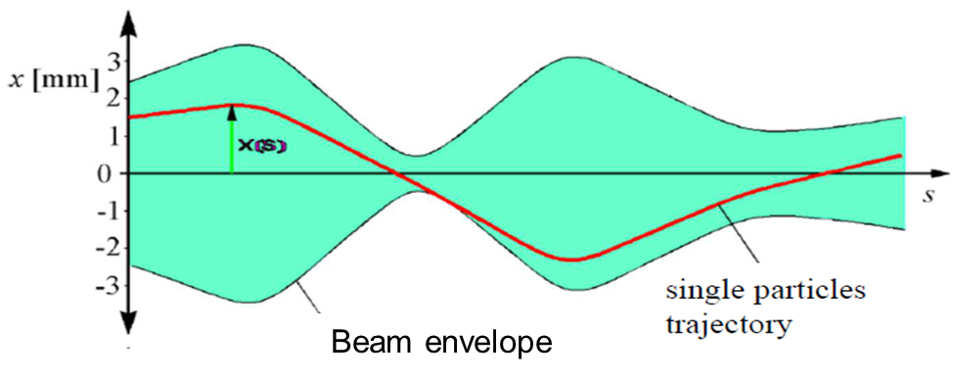
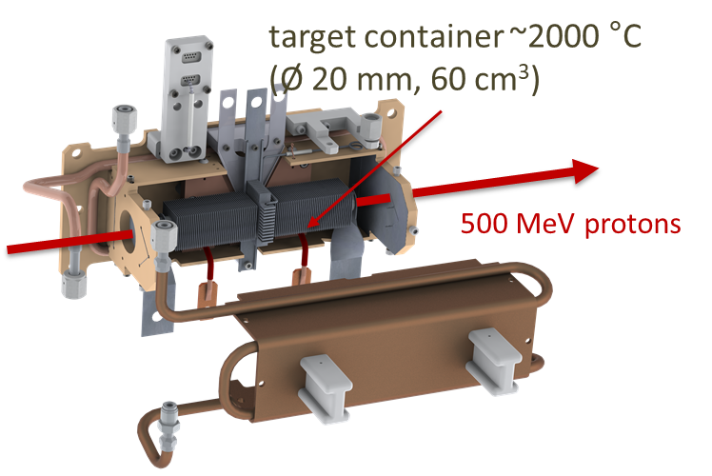
UVic/TRIUMF Accelerator Research
UVic is the lead University of the ARIEL project with PI D. Karlen
15 UVic graduate students in accelerator physics
One graduate lecture course taught by the adjunct faculty each year at TRIUMF and broadcasted nationwide
Undergraduate lecture course and undergraduate projects offered at UVic
RESEARCH FOCUS at TRIUMF
Beam physics and instrumentation (O. Kester, R. Baartman, T. Planche)
Superconducting RF (R. Laxdal)
Target Material and Target ion sources (A. Gottberg)
Projects at UVic
Cryocooler based fundamental SRF studies (NSERC funded)
Surface and Materiel Science Studies at the Electron Microscopy Facility (A. Blackburn)
Application of SRF technology to quantum computing (R. de Sousa)
Beam Dynamics studies for SuperKEKB (M. Roney)
Scope/Disclaimer: This talk focuses on fundamental SRF and beam physics research with UVic involvement.
Target materials and target ion sources developments are covered by Carla Babcock in the previous talk

Slide 3
Outline
Fundamental SRF studies
  Coaxial cavity research
  Material Science with muSR, betaNMR etc
  SRF technology for quantum computing
Beam Physics
  Model based beam tuning
  Optimized ion sources
Projects beyond TRIUMF’s physical boundaries
  SRF Cryomodule Developments
  A Canadian compact neutron source
  Dielectric Wall Accelerator
  Super KEK-B with polarized beams

Slide 4
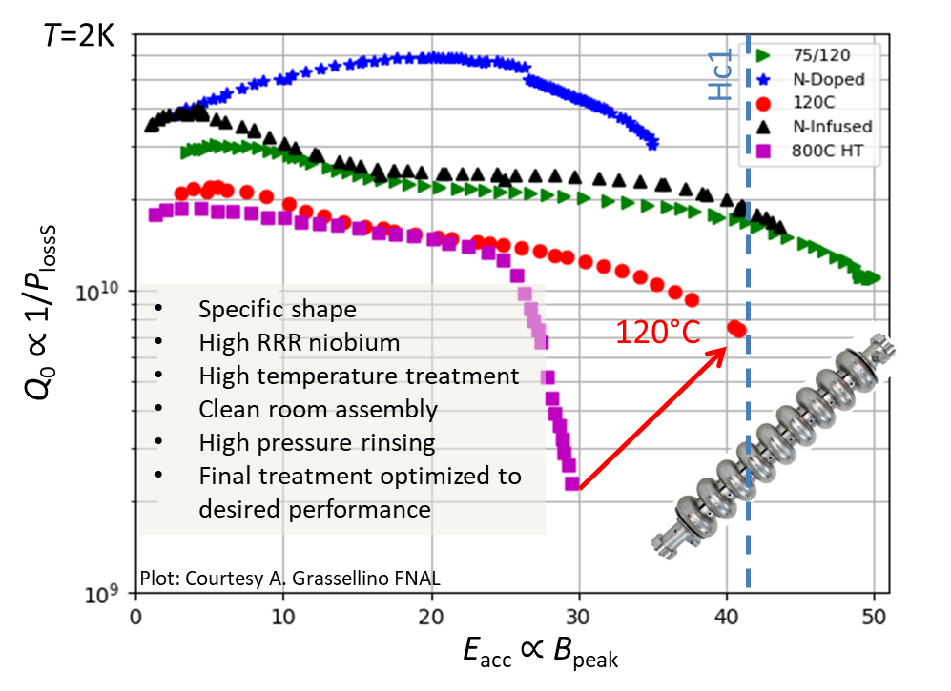
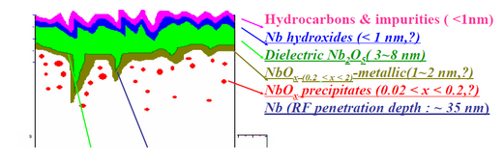
Motivation for fundamental SRF research
SRF is highly efficient but complex technology
Supercurrents only flow within a few tens of nanometres
  Performance is very sensitive to near surface material properties which can be engineered by heat treatments in vacuum or low pressure gas atmosphere
Maximum quality factor and accelerating gradient depend on surface treatment but also on RF frequency, cavity shape (surface field configuration), ambient magnetic flux in a correlated and not fully understood way

Slide 5
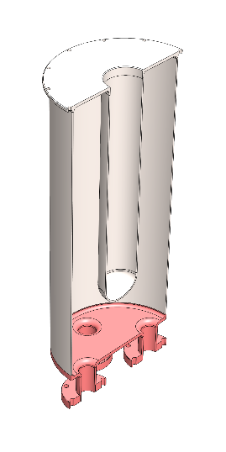
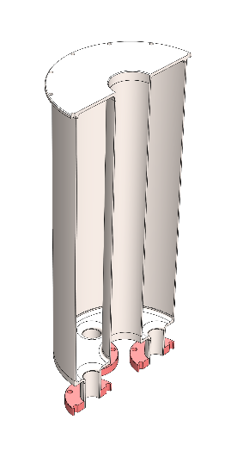
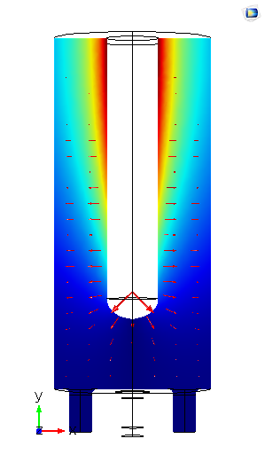
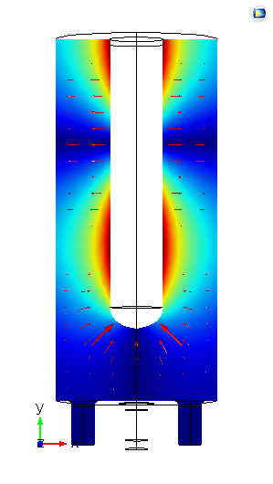
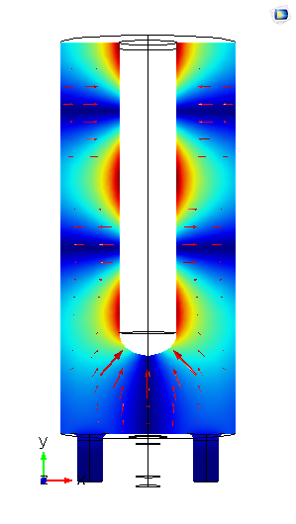
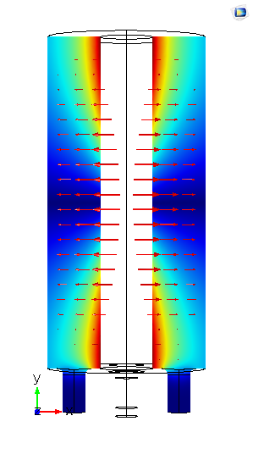
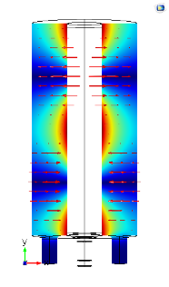
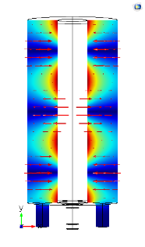
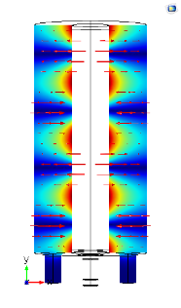
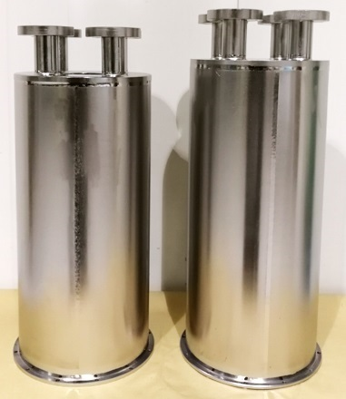
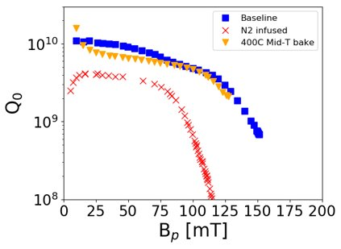
Coaxial Research Cavities at TRIUMF
Most SRF research done on high frequency, high beta, elliptical cavities.
Ion accelerators need low frequency, low beta coaxial cavities
TRIUMF has dedicated coaxial cavities for fundamental SRF research
  Multiple modes (=multiple frequencies)
Two new baking procedures tried for the first time on coaxial cavities
  Encouraging results but below expectation (P. Kolb et al. SRF2021)
QWR
HWR
QWR
217 MHz
T=2K
QWR: Quarter Wave Resonator
HWR: Half Wave Resonator
P. Kolb et al. Phys. Rev. Accel. Beams 23, 122001

Slide 6
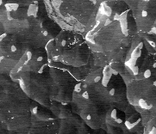
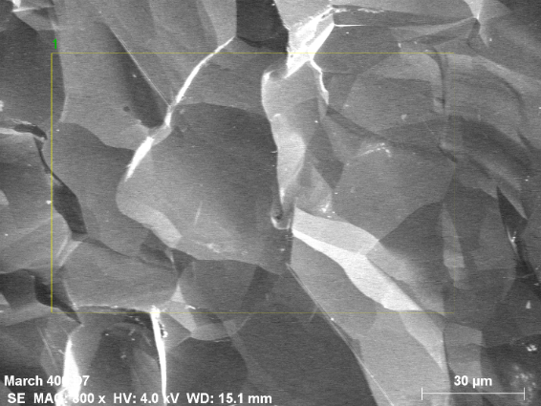
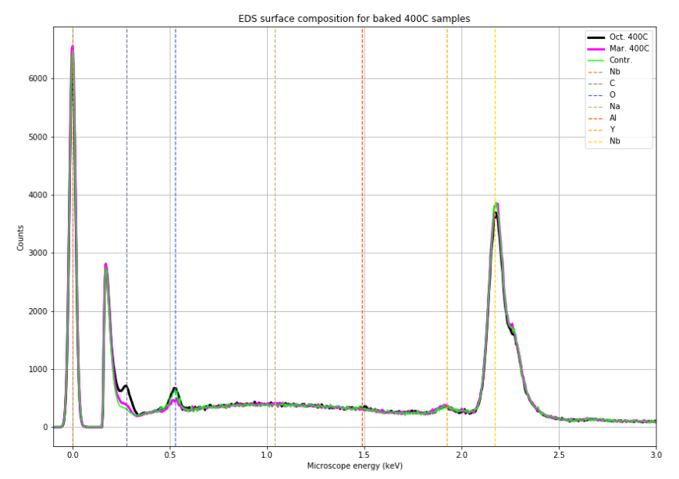
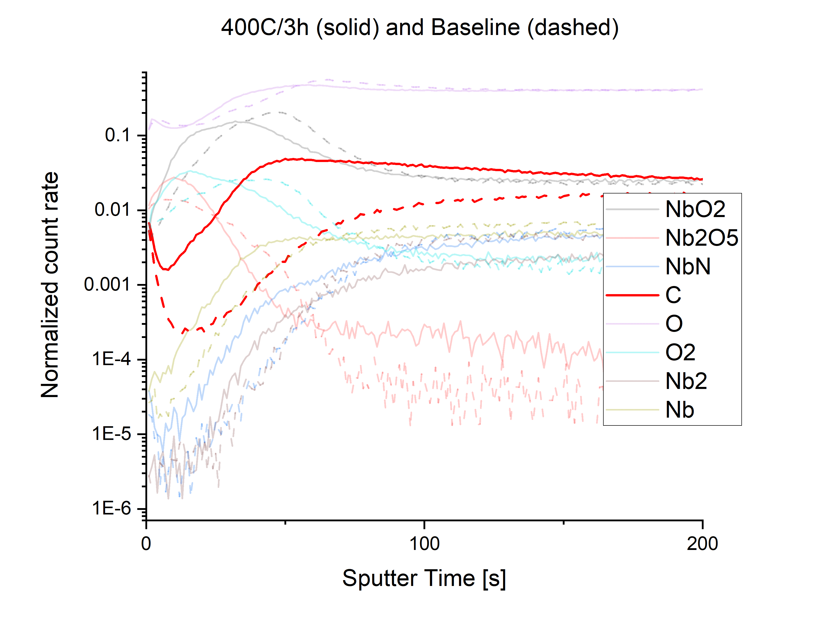
Coaxial Research Cavities at TRIUMF
Two new baking procedures tried for the first time on coaxial cavities
Unlike for traditional procedures there is no material removal (chemistry) after baking. Very clean environments required
Material analysis with SEM/EDX shows signs of carbon contamination (Summer project D. Hedji)
SIMS depth profile shows that carbon contamination is most pronounced in relevant near surface region
Furnace cleaning: Wiping down surfaces with methanol, cleaning burn-off at 100°C reduced carbon content
400°Cavity Witness Sample
After Furnace Cleaning
SEM image before and after furnace cleaning
EDX: Reduced carbon peak after cleaning
SEM: scanning electron microscopy, EDX: energy dispersive X-Ray spectroscopy, SIMS: Secondary ion mass spectroscopy

Slide 7
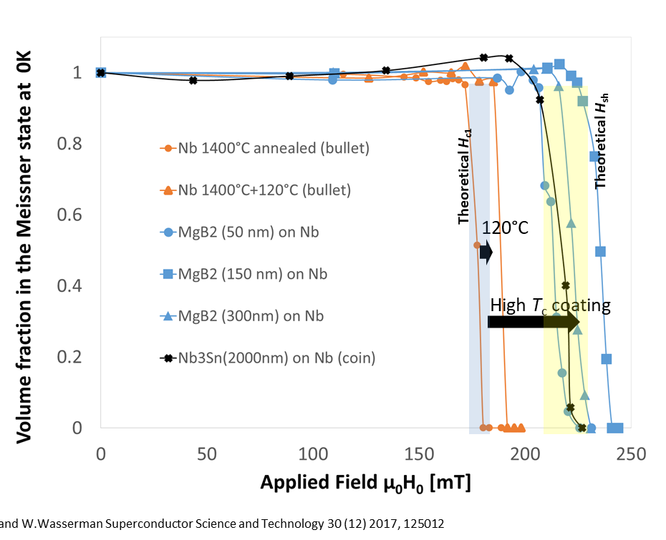
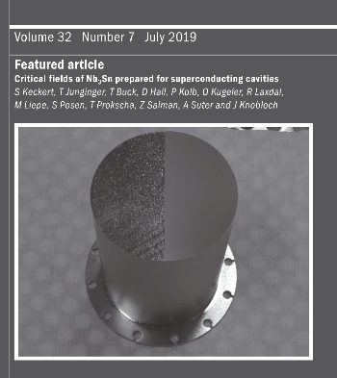
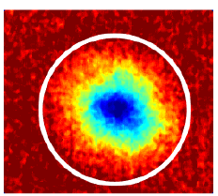
SRF sample studies
Sample studies are done to optimize cavity treatments but also as predictive tools for SRF performance
  e.g. field of first vortex penetration is indicative of maximum achievable accelerating gradient
We use a wide variety of local and external methods including
  SEM/EDX, TEM (UVic), SIMS (UWO)
  muSR (TRIUMF, PSI), betaNMR (TRIUMF)
  Neutron tomography (HZB)
  Vibrating sample magnetometry (ISIS, UK; to be developed at UVic with NSERC funding)
Layered superconductors
increase field of first vortex penetration.
T. Junginger et al. Superconductor Science and Technology 30 (12), 125012 (2017)
Nb3Sn cavities can be operated in a metastable state above Hc1. Current limitations are not intrinsic.
S. Keckert, T. Junginger et al. Superconductor Science and Technology 32 (7), 075004 (2019)
Flux trapping depends on surface treatments and can be visualized with polarized neutron tomography.
W. Treimer, T. Junginger, O. Kugeler
Applied Sciences 11 (14), 6308 (2021)

Slide 8


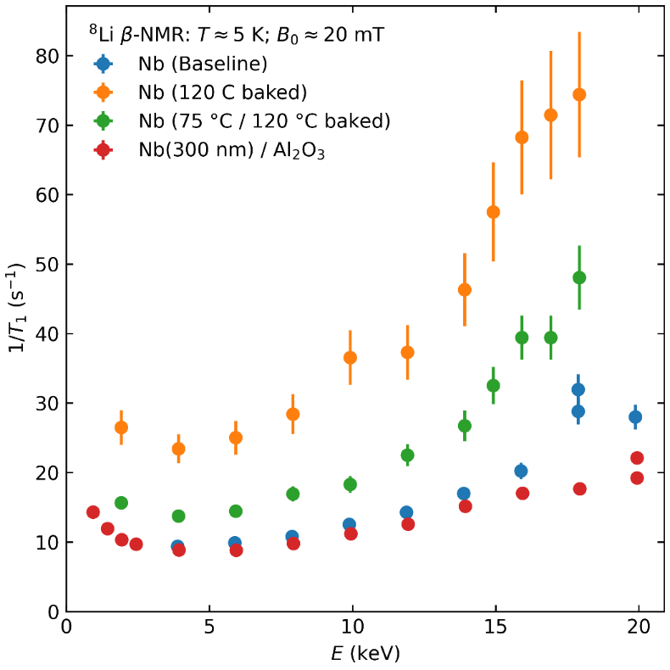
β-NMR + SRF @ TRIUMF
beta-NMR can probe magnetic fields with nanometric depth-resolution
With β-SRF we have added facility to test samples in high parallel field (200 mT). Successfully commissioned last week and provides world-wide unique capability
Method is sensitive to changes by surface treatments (E. Thoeng et al SRF2021)
New high field magnet
Low field magnet
Extension of parallel field spectrometer

Slide 9
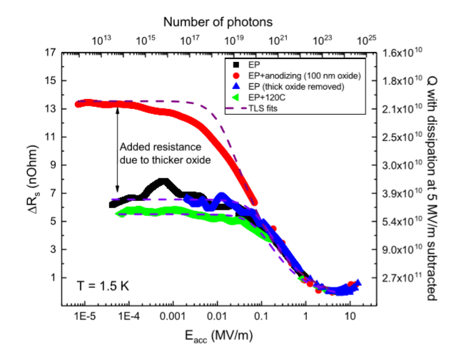
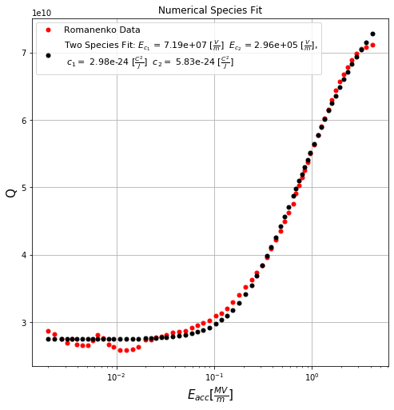
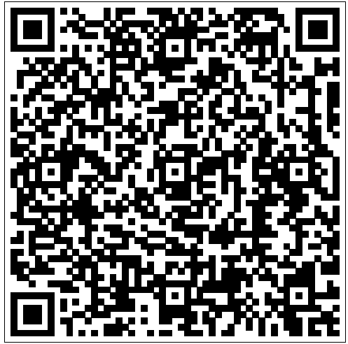
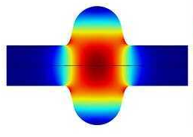
SRF for Quantum Computing
Main mechanism for quantum decoherence in current quantum hardware are two level systems in amorphous oxides
SRF cavites can increase coherence times and be used as a testbed for theoretical models
Low field data is available in the literature but published analysis does not take into account the variation of the electric field on the cavity surface.
Fitting data to different theoretical models can reveal origin of decoherence
Summer project
Noah Gorgichuk
Romanenko et al. PRL 119, 264801 (2017)

Slide 10
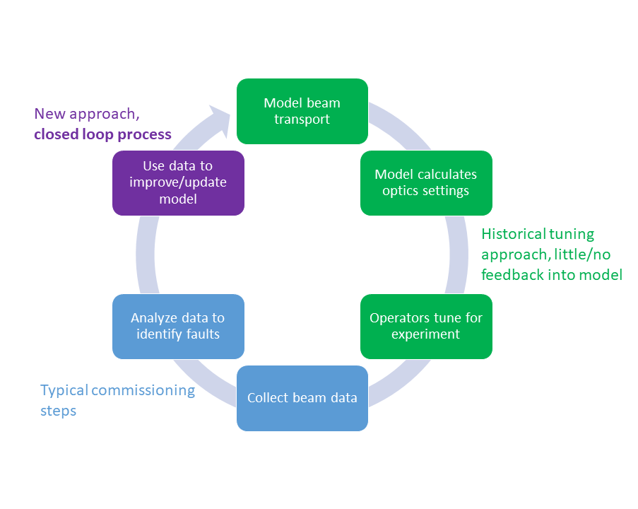
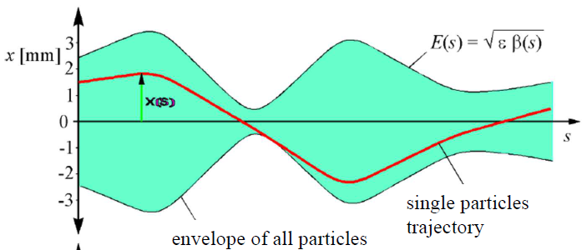
Model based beam tuning
Using beam physics models (usually used for design of accelerators) during beam operation
Models rely on a code developed at TRIUMF (Rick Baartman) that describes the beam envelope throughout the entire accelerator instead of individuals particles
Enables improved automation of various tuning processes
Ph.D. Olivier Shelbaya
M.Sc. Spencer Kiy
Beam envelope

Slide 11
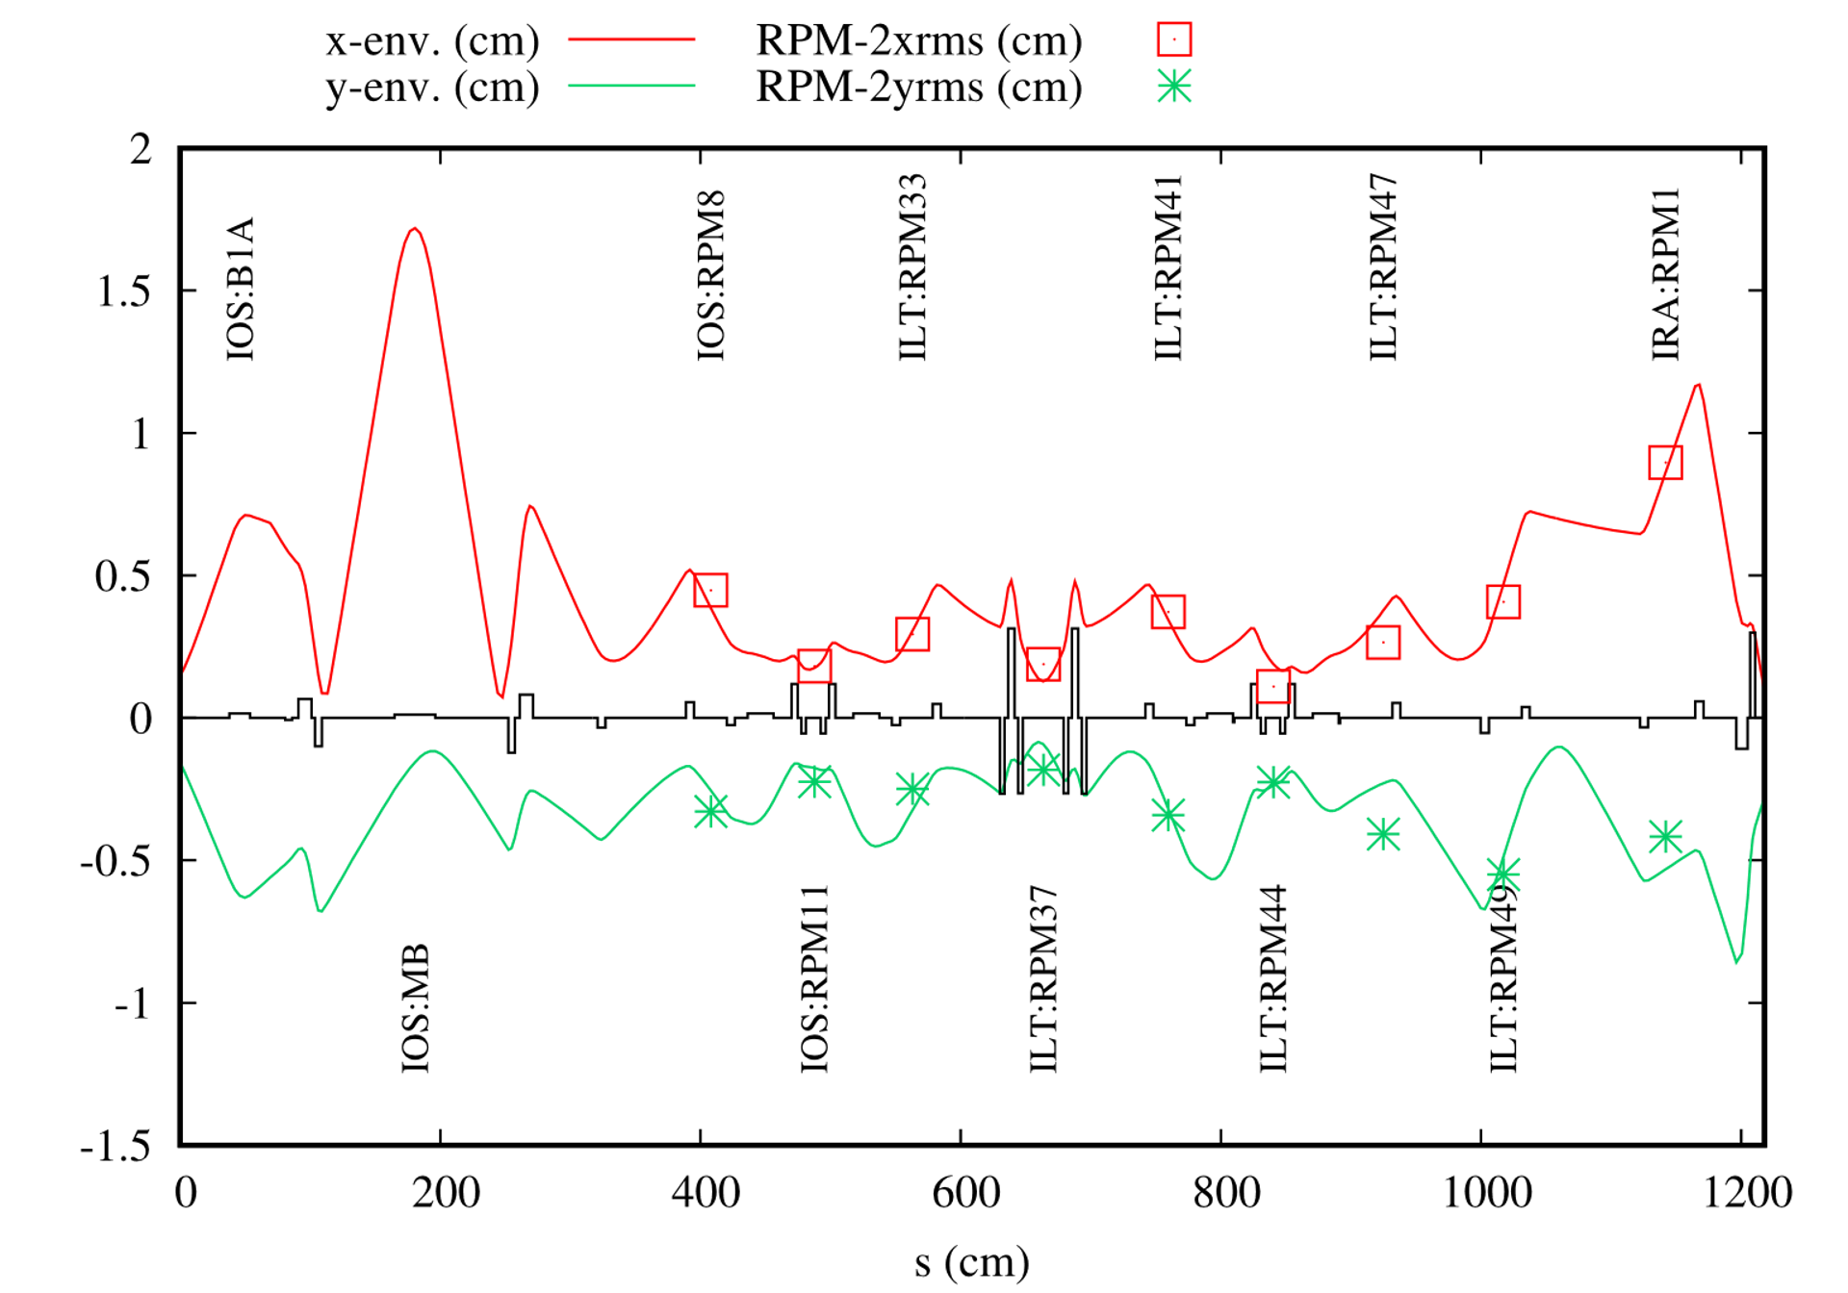
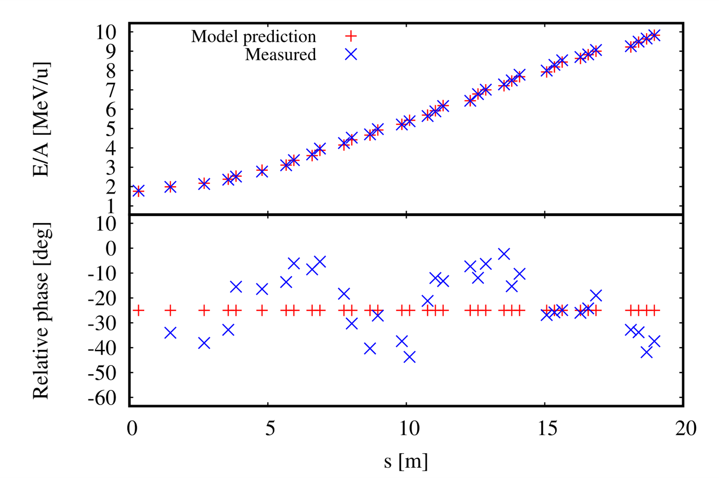
Model based beam tuning
7Li from off-line ion source (OLIS) to the ISAC RFQ, simulated envelope vs measured beam size at profile monitors.
Profile monitor data was used in a transoptr optimization to fit the initial beam conditions (O. Shelbaya).
Comparison of model calculated tune for the ISAC-II heavy ion linac to observations.
Successfully delivered beam to an experiment (IRIS S1834) with model-set cavity phases for the first time.
See poster from Spencer Kiy on Tuesday for more on model-based tuning of ISAC-II linac

Slide 12
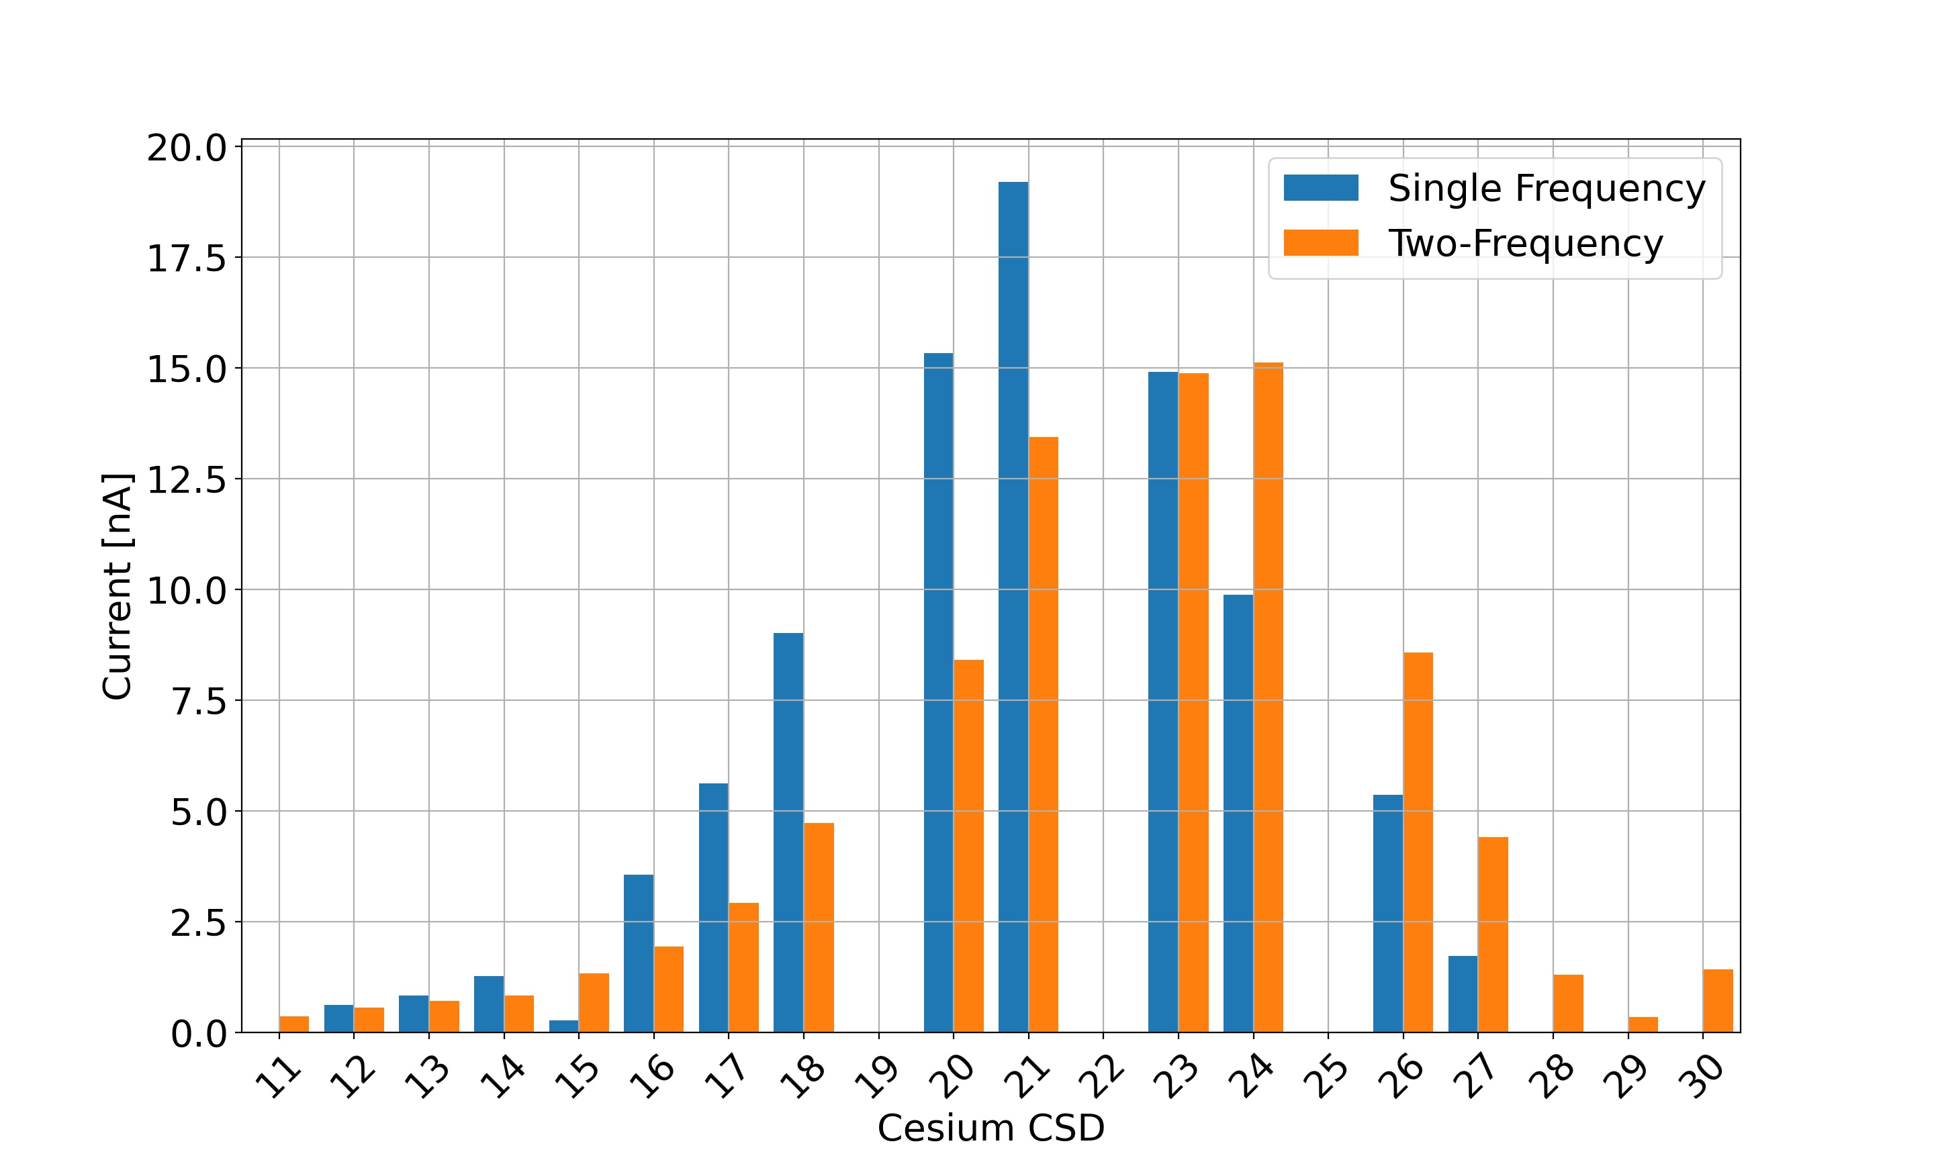
Optimization of the Charge State Booster
Fundamental problem: Beam properties provided by the particle source cannot be improved in the accelerator.
Research Goal: Improve beam quality, intensity and charge state of post-accelerated beams in the ISAC charge state booster
  Systematic investigation and optimization of the charge state booster extraction system
  Implement two-frequency heating of the ECRIS CSB
  Ph.D. project of Joseph Adegun, see poster session tomorrow

Slide 13
Accelerator Projects outside of TRIUMF’s physical boundaries
20 year vision - What will TRIUMF look like?
The major revolution will come from the expansion of TRIUMF outside of its physical boundaries, allowing us to play a key role in the forthcoming knowledge-based economy as the owner of Canada's accelerator-related expertise.

Slide 14
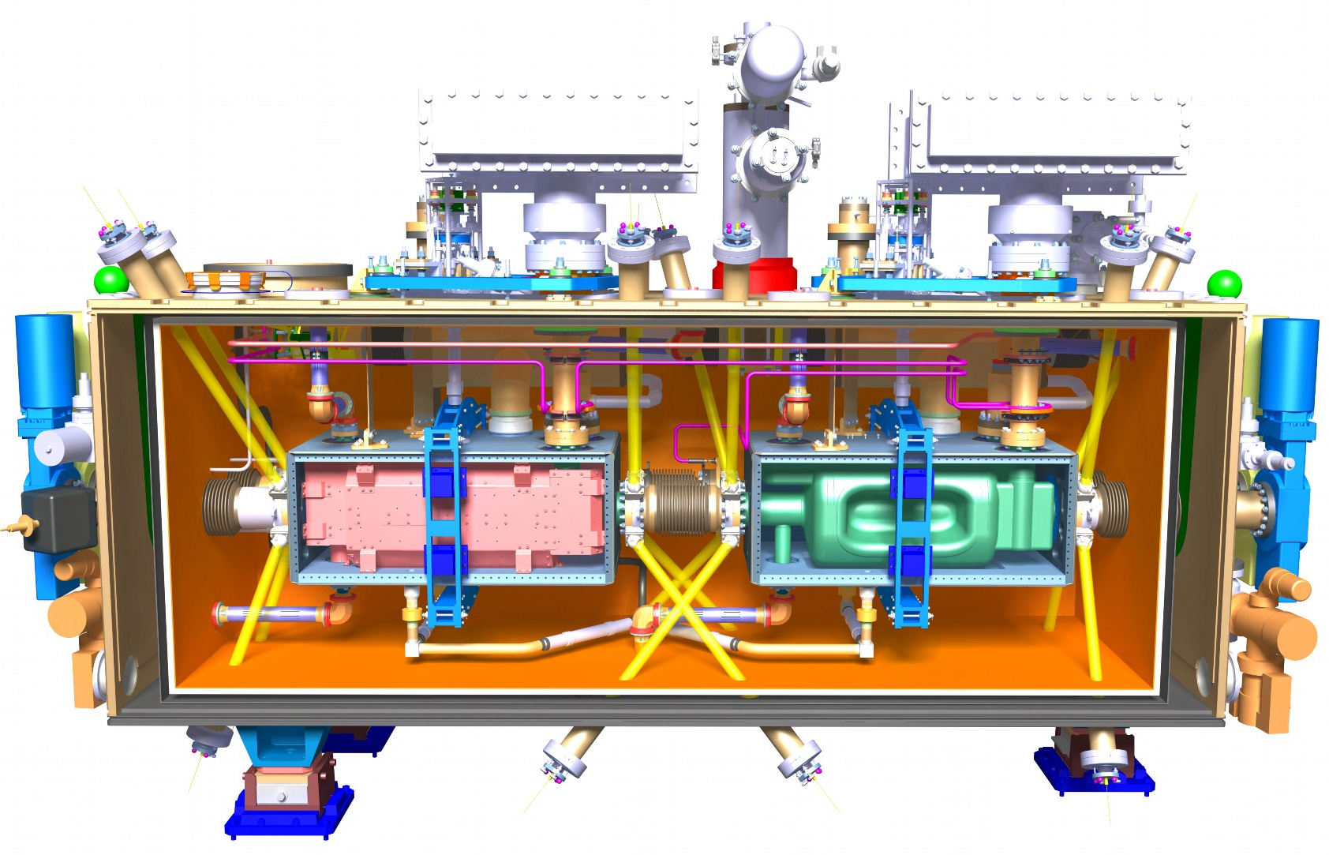



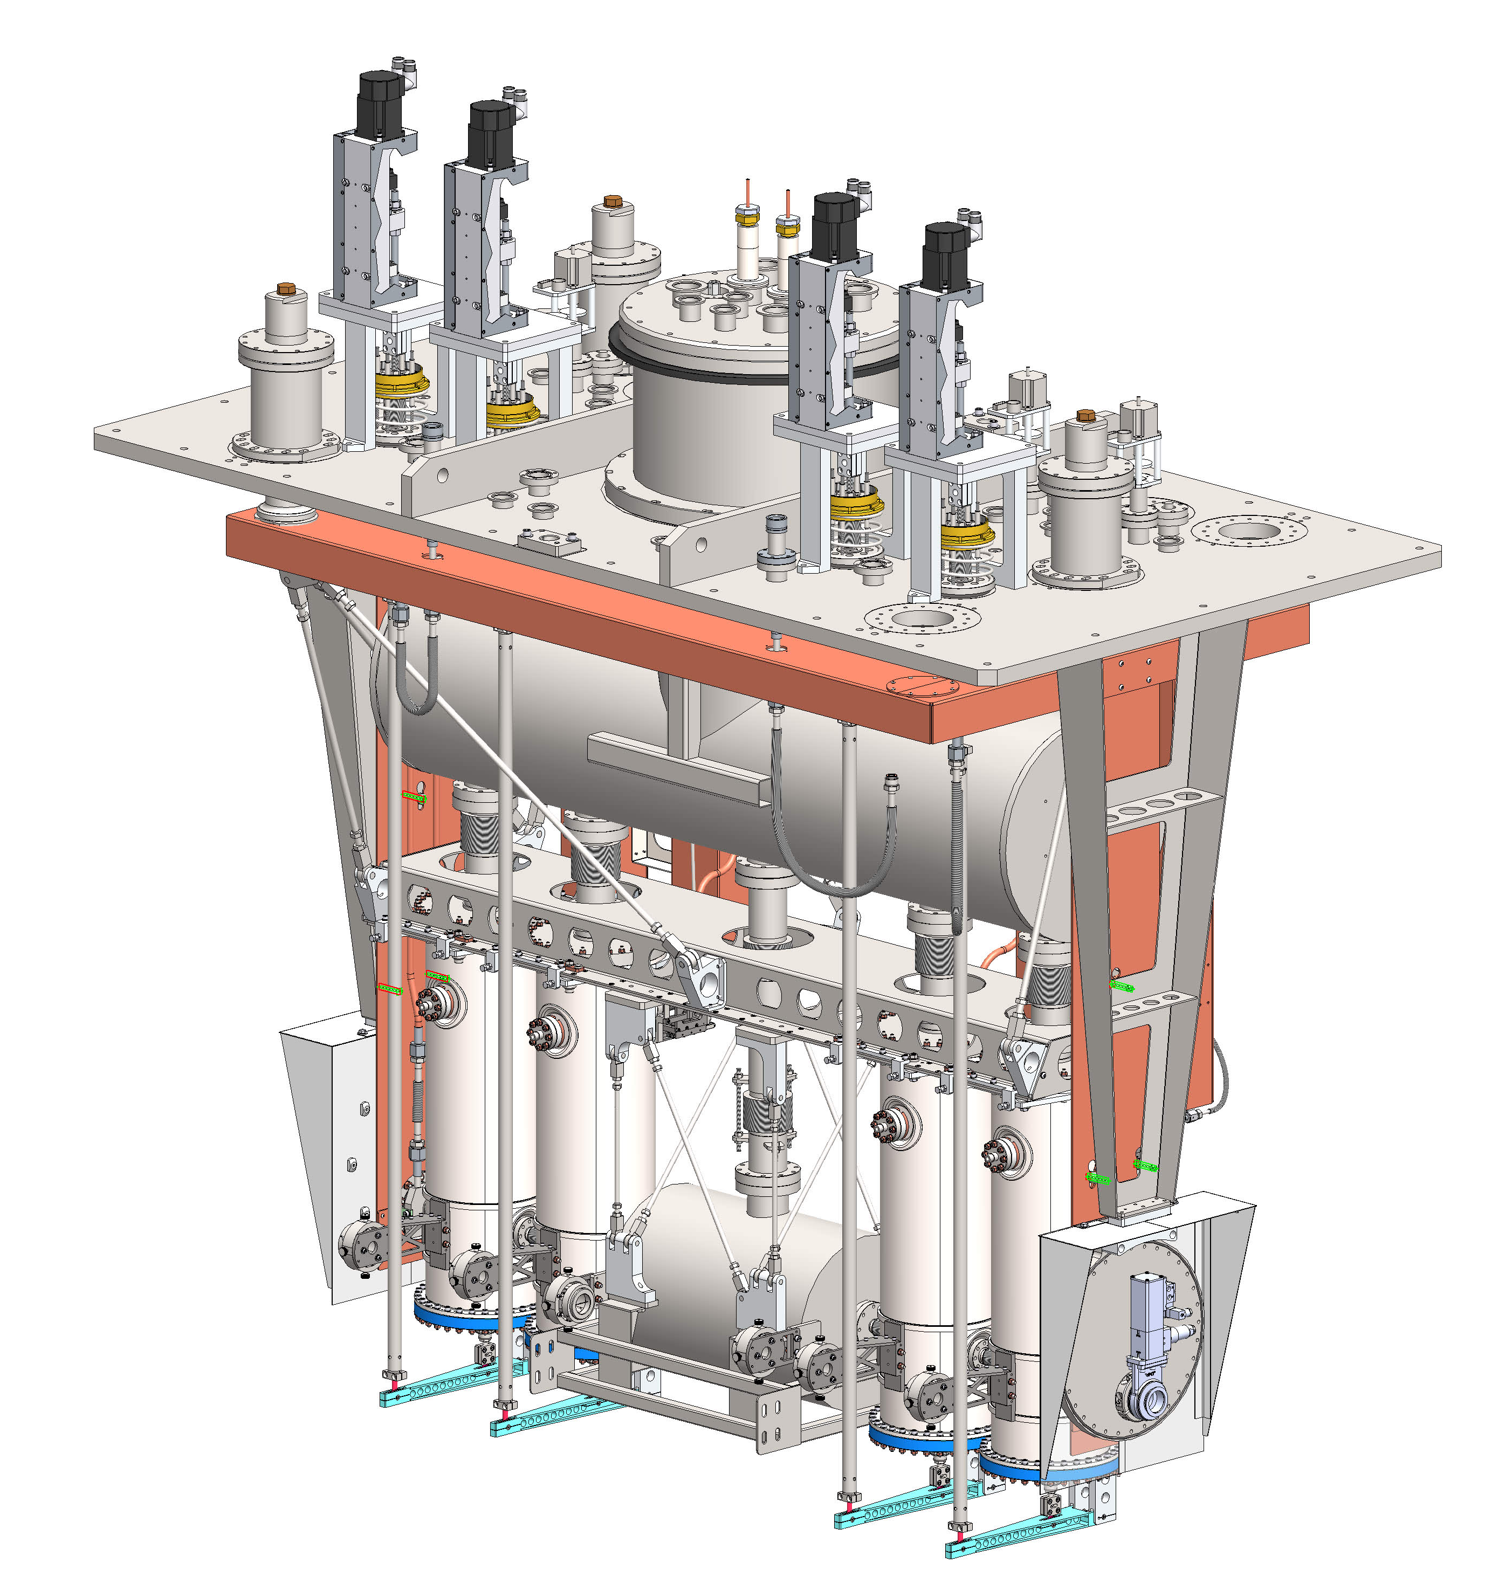

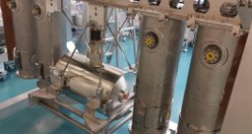
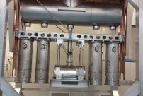
TRIUMF Cryomodule Development
TRIUMF SRF group produces cryomodules for the in-house linacs at ISAC-II and ARIEL as well as for external projects
Currently seeking CFI funding for major infrastructure upgrade for ISAC-II energy upgrade and participation to international projects (EIC, ILC)
Five HiLumi LHC crab cavity cryomodules will be assembled in 2022-24
Cryomodule for VECC (Kolkata) scheduled for cold test in Nov. 2021 with delivery in early 2022.

Slide 15
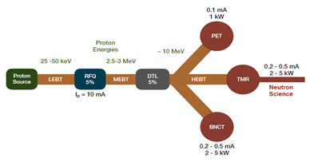
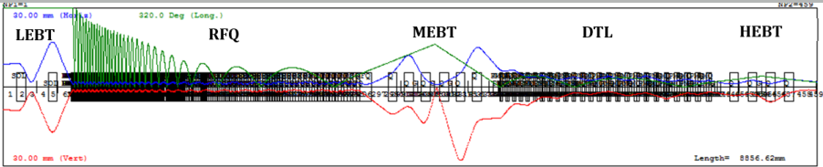
Compact Accelerator-based Neutron Source for Canada
Compact Accelerator-based Neutron Sources (CANS) can provide intense neutrons with a capital cost significantly lower than a spallation source
TRIUMF is designing a Prototype Canadian CANS (PC-CANS) to be located at the University of Windsor
PC-CANS is based on a high intensity linear proton accelerator (RFQ+DTL) and multiple target stations for science and medical purposes
Status: Conceptual design studie stowards a CFI funding proposal.
Schematic of a PC-CANS
R. Laxdal et al. https://arxiv.org/abs/2104.10226
End to end simulation of p-LINAC in Trace-3D code
Longitudinal
Horizontal
PhD Mina Abbaslou
Vertical

Slide 16
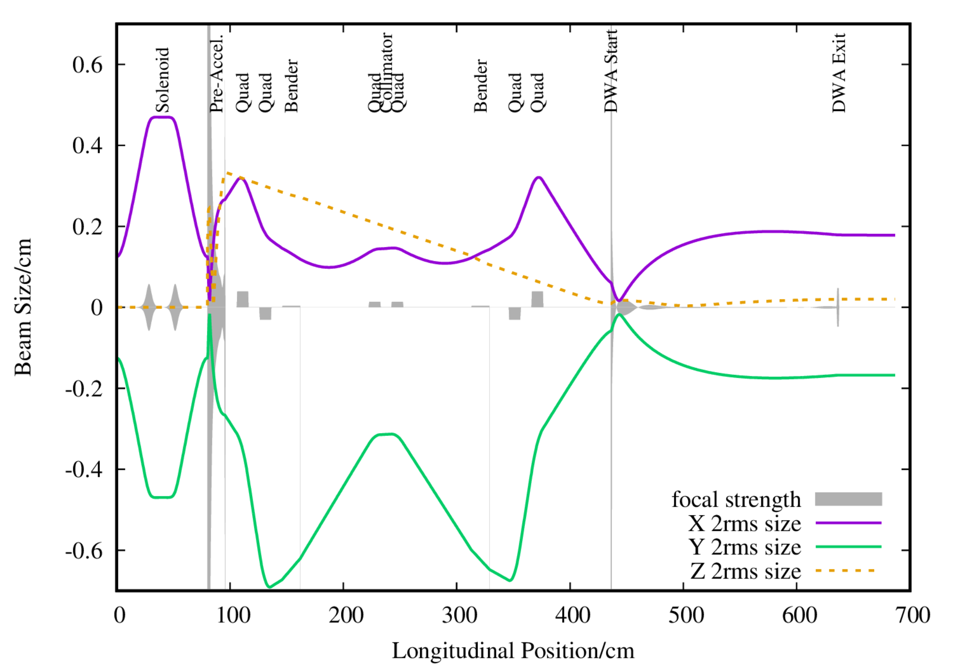
Dielectric Wall Accelerator Design
A dielectric wall accelerator is a type of induction accelerator that can provide a technical solution for a compact variable energy accelerator
Initially patented in 2001 but only recent developments in high gradient insulators and dielectrics promise technical feasibility
Proposed by McGill Medical Physics Unit for proton therapy
TRIUMF provided design in TRANSOPTR (R. Baartman's code) with custom subroutine.
PhD work
Paul M. Jung

Slide 17
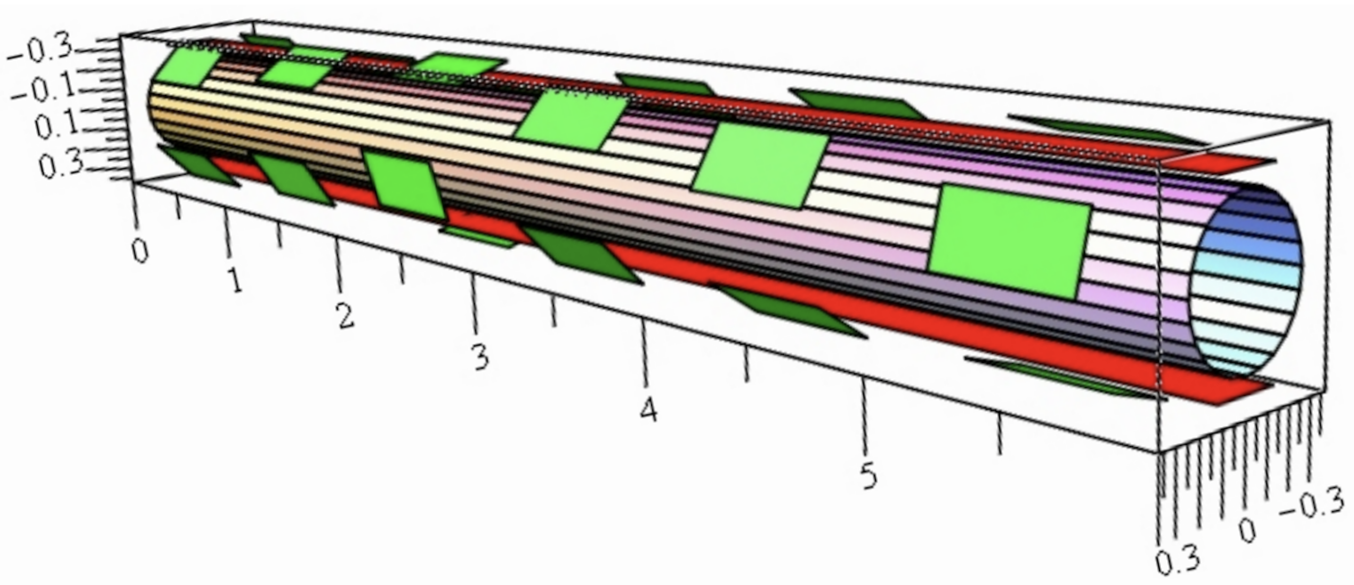
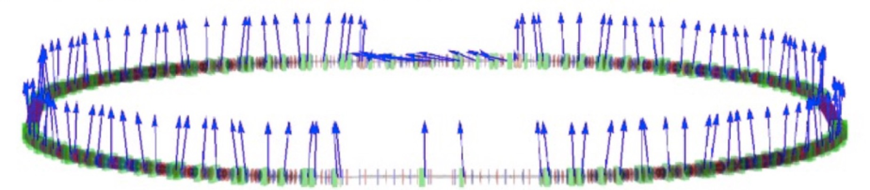
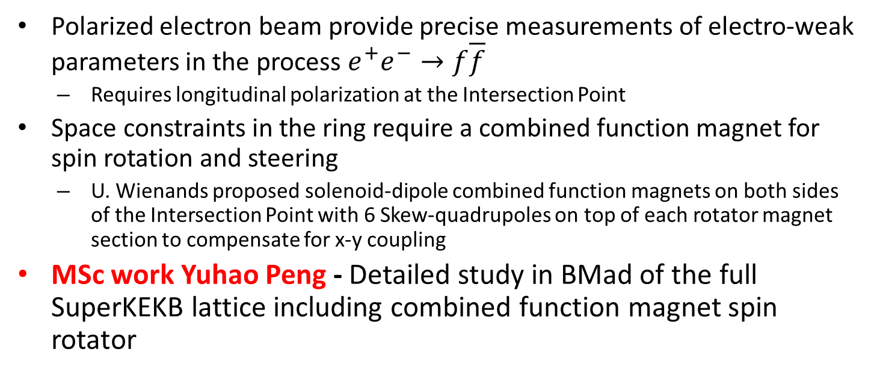
Polarized Beams for SuperKEKB
Polarized electron beam provide precise measurements of electro-weak parameters in the process $e^{+}e^{−}→f\overline{f}$
  Requires longitudinal polarization at the Intersection Point
Space constraints in the ring require a combined function magnet for spin rotation and steering
  U. Wienands proposed solenoid-dipole combined function magnets on both sides of the Intersection Point with 6 Skew-quadrupoles on top of each rotator magnet section to compensate for x-y coupling
MSc work Yuhao Peng - Detailed study in BMad of the full SuperKEKB lattice including combined function magnet spin rotator
Courtesy of I. Koop et al.
Courtesy of U. Wienands
Collaborators: D. Zhou (KEK), U. Wienands (ANL), D. Sagan (Cornell), B. Parker (BNL)

Slide 18

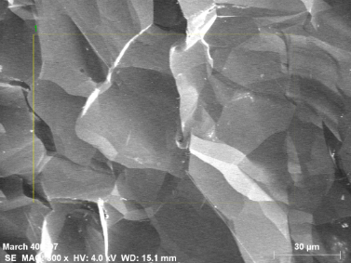
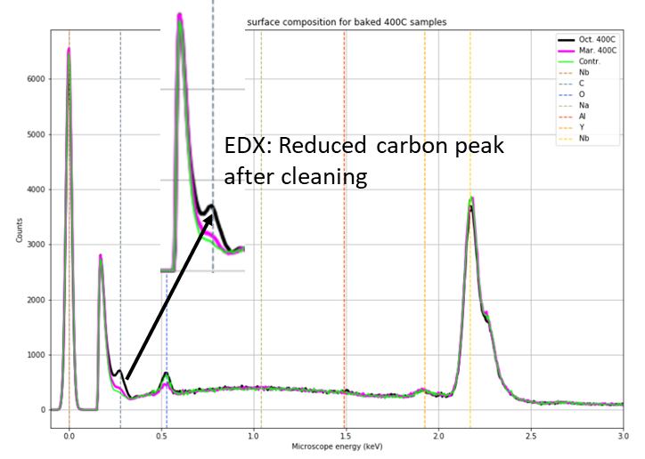
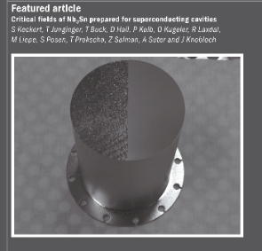
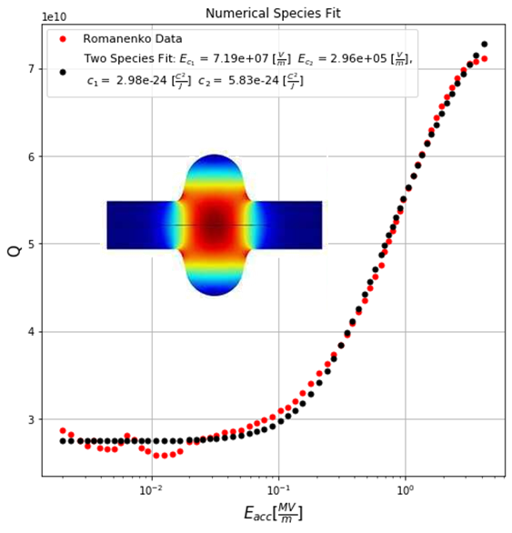

Thank you for your attention
TRIUMF with UVic as key partner is the center for accelerator research in Canada

Slide 19
Backup slides

Slide 20
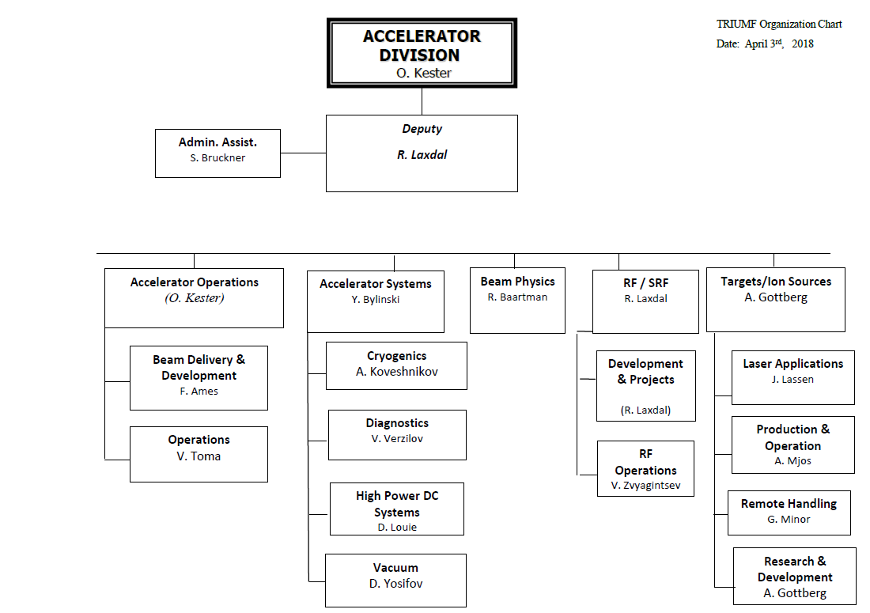
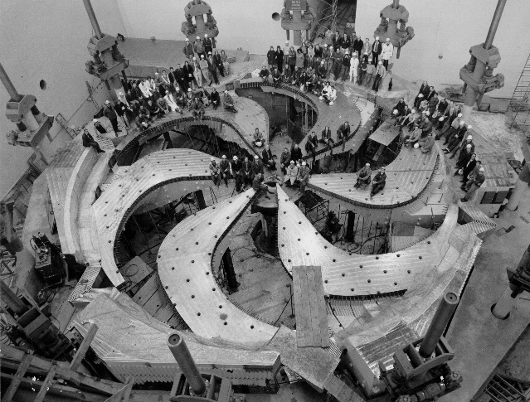
UVic adjunct faculty in Accelerator Division
TRIUMF Accelerator Research focus
Beam physics and instrumentation (O. Kester, R. Baartman, T. Planche)
  Intense beams, Particle sources, beam diagnostics (including High Luminosity-LHC and AWAKE at CERN)
Superconducting RF (R. Laxdal, T. Junginger)
  Cavity and cryomodule engineering (including High Luminosity-LHC) and material research
Target Material and Target ion sources (A. Gottberg)
  Science and technology for the production, ionization, formation of secondary particle beams and handling of highly radioactive components

Slide 21

State of the art Nb cavities
T=2K
Nb is reaching fundamental limits in quality factor and accelerating gradient.
  Some cavities reach fields exceeding H_{c1}
Unfortunately so far we can have only one or the other and only for elliptical niobium cavities.
For performance beyond the state of the art new materials need to considered. However all alternative materials perform weaker than Nb up to know
Hc1
Q₀ ∝ 1/P_{lossS}
Specific shape
High RRR niobium
High temperature treatment
Clean room assembly
High pressure rinsing
Final treatment optimized to desired performance
120°C
Plot: Courtesy A. Grassellino FNAL
E_{acc} ∝ B_{peak}
Two challenges
Higher accelerating gradients
Push the performance of non elliptical cavities
Notes:
Eacc propto B…….

Slide 22
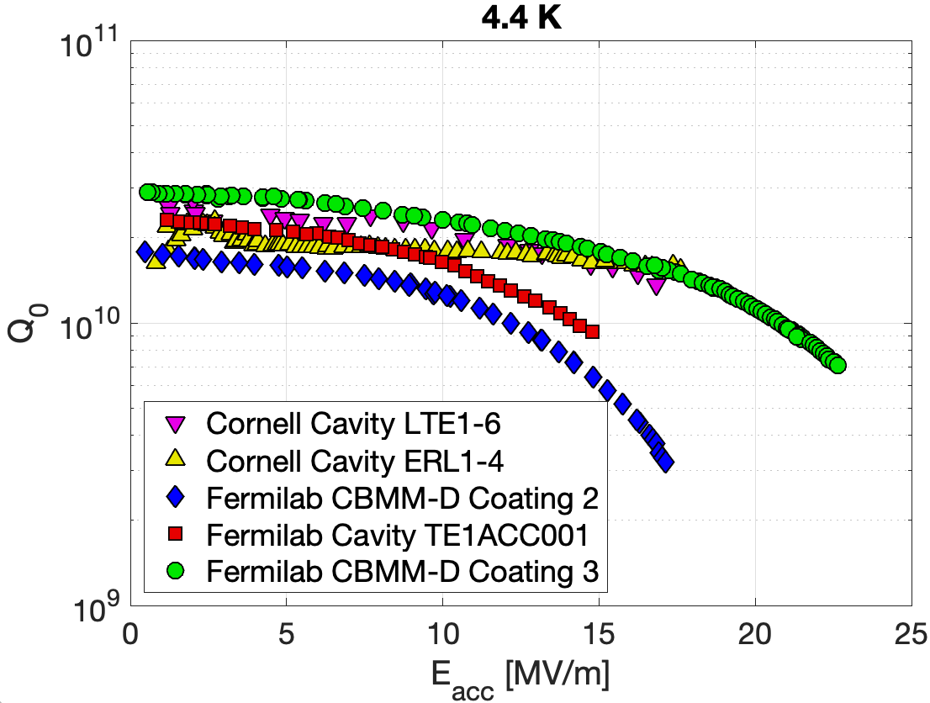

Beyond Nb - Critical Fields of Nb₃Sn
Results from Cornell and FNAL show that Nb₃Sn 1.3 GHz cavities are reaching up to 22.5 MV/m (95 mT)
  Quality factors at 4.2 K can be as high as for Nb at 2 K
Measurements from both bulk µSR (TRIUMF) and LE-µSR (PSI), as well as RF measurements with a specialized sample test cavity to determine the DC and RF critical fields of Nb₃Sn prepared for SRF application
  Potential for high E_{acc} still needs to be demonstrated
S Keckert, T Junginger, T Buck, D Hall, P Kolb, O Kugeler, R Laxdal, M Liepe, S Posen, T Prokscha, Z Salman, A Suter and J Knobloch, “Critical fields of Nb3Sn prepared for superconducting cavities”, SUST, Volume 32 Number 7 July 2019
Review of Muon Spin Rotation Studies of SRF Materials

Slide 23



SIMS + SEM sample study
EDX generally only gives the elemental composition for a fixed depth
Secondary ion mass spectroscopy (SIMS) can provide depth can provide depth resolved elemental composition
Most SIMS traces are very similar, except Carbon.
Baseline
N2 infused
400°Cavity Witness Sample
Witness samples for baseline test and 400°C treatment
Witness samples for N2 Infusion compared with a sample from Fermilab (High performing)
SIMS analysis performed at U Western Ontario

Slide 24



μSR - Field of first flux entry measurements
Nb₃Sn and MgB₂ with 50-2000 nm thickness on niobium
Muons implanted 130 µm in the bulk
Field of first vortex penetration H_{vp} is when the volume fraction in the Meissner state significantly deviates from 1
Arbitrary field direction – Quick loss of polarization
Coating
(50-2000 nm)
A layer of a higher T_{c} material on niobium can enhance H_{vp} by about 40% from a field consistent with H_{c1} to a field consistent with H_{sh}.
  This enhancement does not depend on material or thickness
  This suggests that the superconductor-superconductor (SS) boundary is providing effective shielding up to the superheating field of niobium, while the superconductor-vacuum (SV) boundary is not providing shielding above its lower critical field
  Revealing screening mechanism will require measurements in the London layer at parallel fields of about 200 mT
Theoretical H_{sh}
Theoretical H_{c1}
µ
Polarization
Nb
120°C
Implantation depth 100µm
B
High T_{c} coating
Oscillation caused by penetrating field
Time [µs]
T. Junginger, R.E Laxdal and W.Wasserman Superconductor Science and Technology 30 (12) 2017, 125012
Notes:
Include 120C! Clean up!

Slide 25

Dielectric Wall Accelerator

