Slide 1
Results in Scientific Computing
Lightning talks

Slide 2
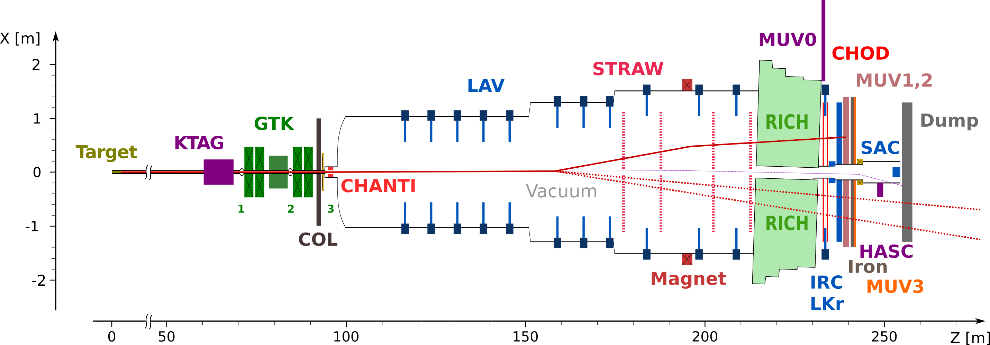
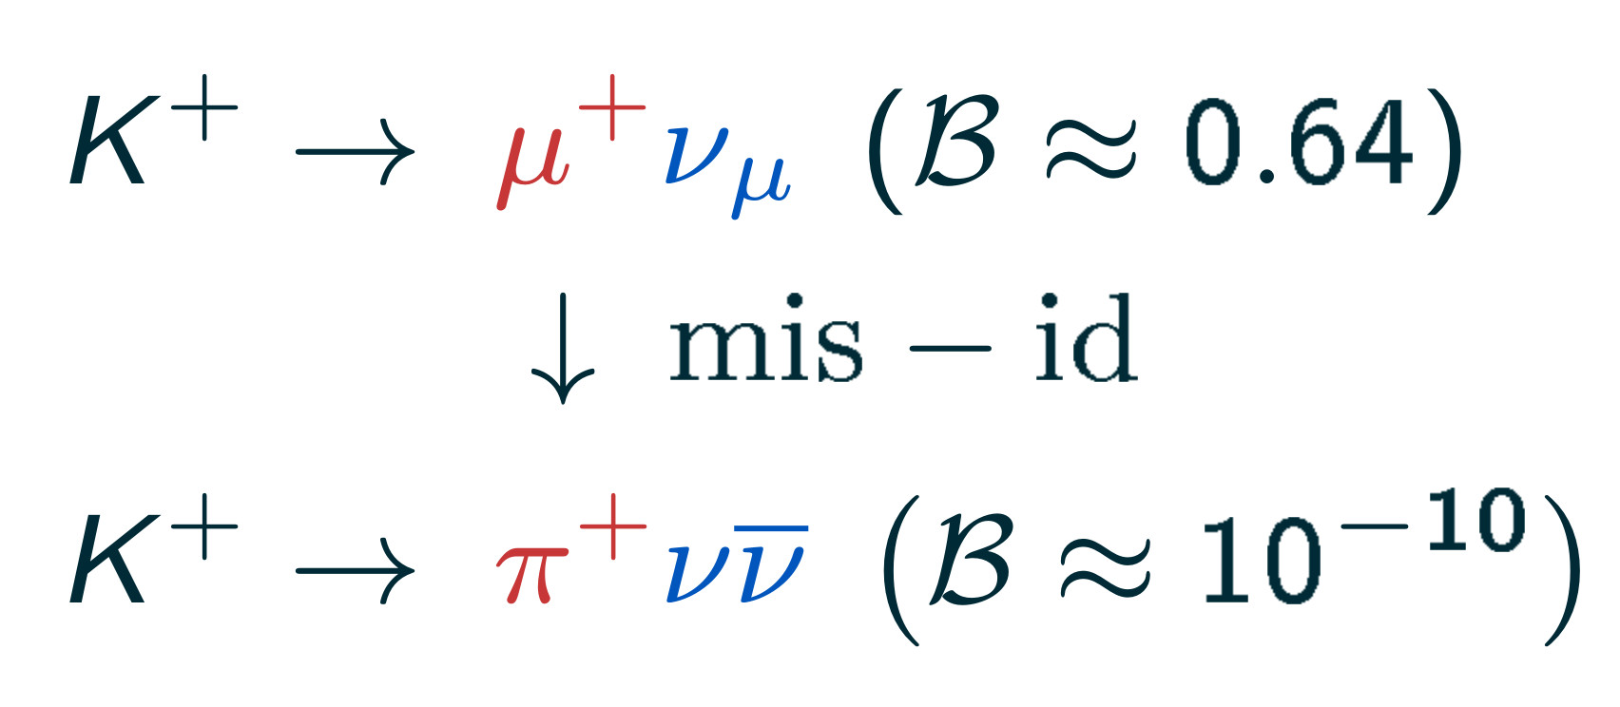
Calorimetric Particle Identification at NA62
B. Velghe, D. Bryman, W. Fedorko, M. Yu
Main goal: Study the rare K →πνν decay
Probe for new physics
Kaon decay-in-flight: Main backgrounds are the common kaon decay modes (K →μν, K →ππ, etc.)
Multiple handles:
Event kinematics,
K/π timing O(100 ps),
Track multiplicity,
μ/ɣ vetos,
Particle identification.
Particle identification systems:
RICH, MUV3, and calorimeters (LKr, MUV1 and MUV2) Overall Muon rejection > 10⁷

Slide 3
CNN-Based Approach for "CaloPID"
Focus on three calorimeters:
LKr: Electromagnetic calo.
MUV1 & MUV2: Hardronic calo
No depth information, the 3D shower is projected on a 2D plane by the readout.
Direct correspondence with a 5-channel image
Data driven approach, training, validation and testing samples selected directly from the data.
Independent test sample (minimum bias) used for the final evaluation.

Slide 4
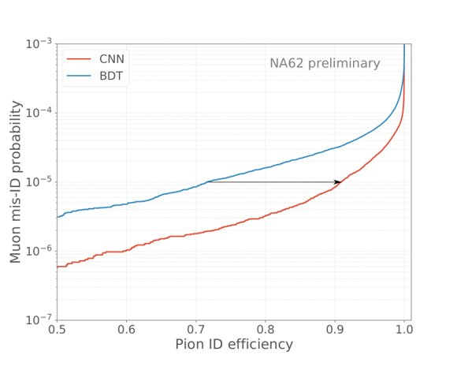
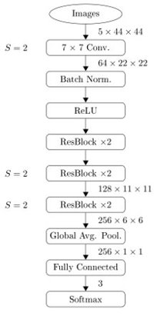
Significant Improvement of the μ/π ID
Architecture derived from ResNet
Pion acceptance can be increased from 72 % to 92 % over the 15 to 50 GeV/c (muon mis-id 10⁻⁵)

Slide 5
Machine Learning for Pion Identification and Energy Calibration with ATLAS detector
ATL-PHYS-PUB-2020-018
Dilia María Portillo,
Alison Lister,Max SwiatlowskI, Wojtek Fedorko, Russell Bate
17-08-2021
TRIUMF Science Week 2021

Slide 6
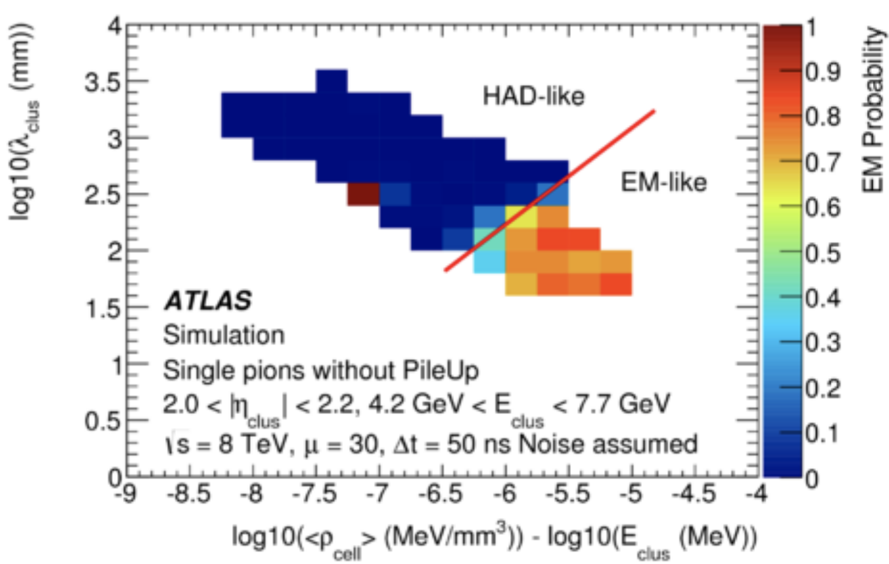
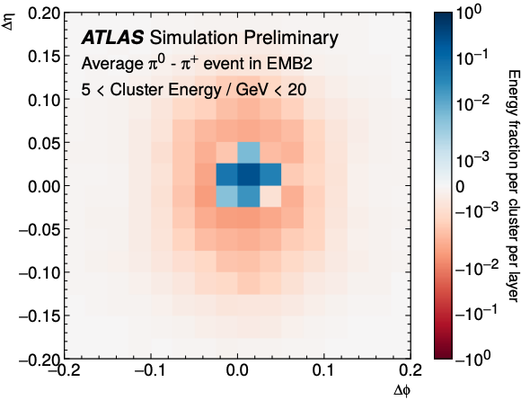
Overview
Hadronic Calibration in ATLAS
Hadronic showers are mostly composed of pions
$π^{0}$: Captured by the electromagnetic calorimeter
$π^{±}$: Require the dense material in the hadronic calorimeter to be stopped
Baseline hadronic reconstruction in ATLAS uses clusters of calorimeter cells
Currently, clusters are calibrated in two steps:
Classified as electromagnetic or hadronic calculating the EM probability $P_{clus}^{EM}$
Calibration of its energy
Can we use deep learning to improve these techniques?
Neural Networks trained on calorimeter images can classify clusters and predict their energies
Studied DNNs, CNNs, and DenseNet
Notes:
Represent the signal in the ATLAS calorimeter layers as pixelated images
Neutral pions -> decay promptly to photon pairs with compact showers that are mostly captured by the electromagnetic calorimeter
charged pions -> have more irregular showers that often require the dense material in the hadronic calorimeter to be stopped.
Currently done with the local cell weighting (LCW) technique
- only the central barrel of the detector is considered, with |η| < 0.7 :
- 3 EM & 3Tile (hadronic)
- EM calo: LAr (|η| < 3.2)
- HAD calo: (3 barrel) Tile ( |η| < 1.7), 2 endcap copper/LAr (1.5 < |η| < 3.2)
- The energy measurements of the calorimeter, and therefore the raw energy of the topo-clusters, are calibrated to the electromagnetic scale.
Topo-clusters corresponding to electromagnetic showers are therefore expected to have an energy measurement that is close to the true deposited energy, while hadronic showers are generally expected to under-predict the true deposited energy due to the non-compensating signal formation in the calorimeter.
ML techniques can use shower shape information to improve efficiency
First step towards fully exploiting the highly segmented calorimeter for low-level hadronic calibration!

Slide 7
Cluster identification performance
The ML techniques all do an excellent job of distinguishing $π^{0}$ from $π^{±}$ showers
Dramatic improvements compared to the current classification method using
~ 8 times
improvement
Notes:
CNN gives the best performance for classifying electromagnetic (pi0) vs hadronic showers (p+-)
Does well across pT even though the networks were never actually given the cluster energy
Increasingly better performance at higher energies
Not explicitly trained on energy - variation in shower shape with energy
enough to give good separation in every energy range
▸ One approach is to use cell energy deposits in the EM
barrel & TileCal as inputs to a fully-connected (dense)
neural network (DNN).
▸ Alternatively, we can
treat energy deposits
in the calorimeter
layers as images in
, and use these
as inputs to a
convolutional neural
network (CNN).

Slide 8
Pion Energy Calibration
After classifying a cluster, need to calibrate its energy
Energy regression goal: Correctly predict the true energy deposited in the cluster.
Quantified by measuring the cluster energy response: $R=\frac{E^{reco}}{E^{truth}}$ that should be $∼1$
Regression performance for charged pions
Before Calibration
After calibration
Notes:
After classifying a cluster, need to convert the signal into an energy measurement
Raw “EM” scale under-estimates Response
DNN regression does an excellent job nearly everywhere

Slide 9
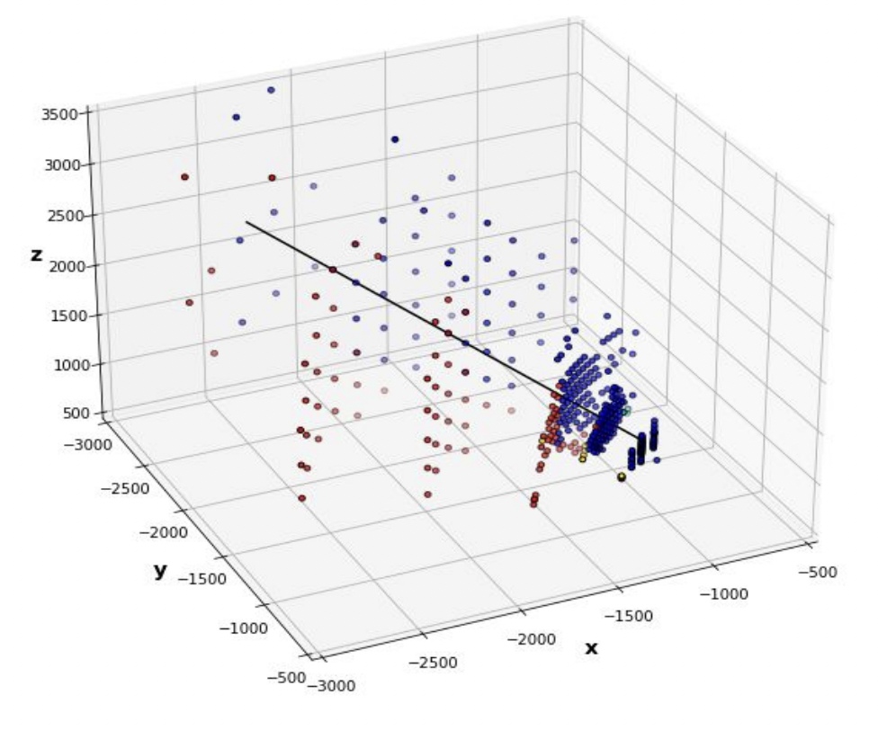
Outlook
Promising results for pion classification and energy calibration with deep-learning!
Looking forward studying more complex scenarios:
First look at the performance with jets
$π^{+}$, $π^{−}$ and $π^{0}$ mixed in a 1:1:1 ratio
Roughly correspond to the expected distribution in jets
Another handy way to represent energy deposits is as a point-cloud
Points contains cell info & cluster-level info.
Allows for combining signals from the inner detector (tracks) and from calorimeter (clusters)
Notes:
First step towards fully exploiting the highly segmented calorimeter for low-level hadronic calibration!

Slide 10
Beamline Tuning with Reinforcement Learning
David Wang, Paul Jung, Olivier Shelbaya, Spencer Kiy, Wojtek Fedorko, Rick Baartman, Oliver Kester

Slide 11
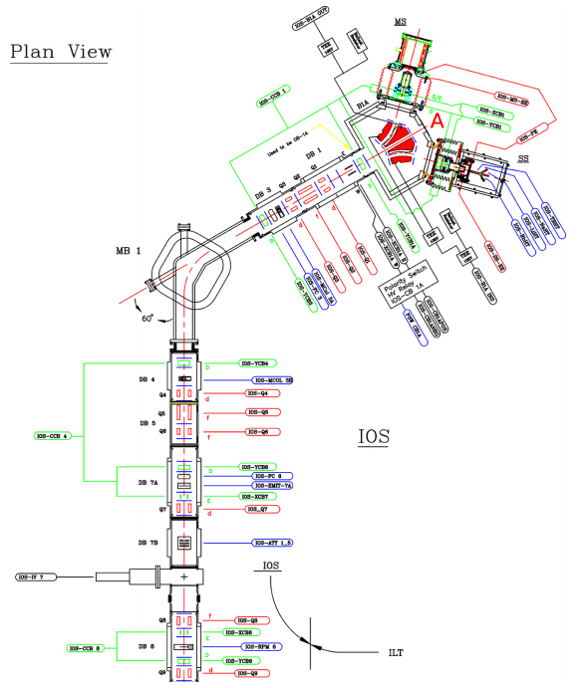
OLIS Beamline
Starting point for AI-tuning
Low current
Non-radioactive
Manual tuning by operators takes many hours, taking away from research beam time
Goal for reinforcement learning agent:
Optimize beam transmission
Offset unknown misalignments
Improve speed and accuracy of tuning
OLIS Beamline
Source: Beam Physics Note TRI-BN-20-13R, Olivier Shelbaya

Slide 12
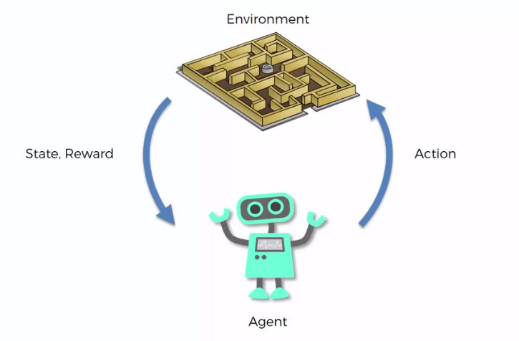
Reinforcement learning
Source: https://towardsdatascience.com/getting-started-with-reinforcement-q-learning-77499b1766b6
Challenges of beamline environment:
Partially observed (only a few measurable spots)
Continuous and large action spaces
Proposed Algorithm: Recurrent Deep Deterministic Policy Gradients (RDPG)
Actor-critic algorithm utilizing actor and critic networks to optimize agent learning
Long Short-term Memory (LSTM) networks to operate in partially observed environment
$$o_{t−l}$$
$$o_{t−l+1}$$
$$.$$ $$.$$ $$.$$ $$o_{t}$$
$$h,c$$
$o_{t}$ : observation
for example, current measured at 2 faraday cups
$a_{t}$ : predicted action
for example, angles to rotate each steerer
$l$ : memory length of LSTM actor
$h,c$ : hidden states of LSTM actor
LSTM
actor
$$a_{t}$$

Slide 13
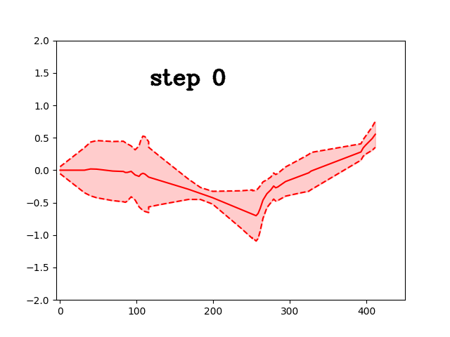
Current Progress and Next Steps
Beamline simulation
Approximate as a Gaussian particle distribution
Analyze in only 1 dimension
Use centroid (solid line) and envelope (dotted line) to determine transmission
Current model trains well on simulation
Using realistic observations but artificial reward function
Plans:
More realistic simulations of measurement and reward
Develop strategy and tools for real beamline tuning
Extend to ISAC and other beamlines

Slide 14
Quantum Computing for Nuclear Physics: Improving Hamiltonian Encodings with the Gray Code
Peter Gysbers
O. Di Matteo, A. McCoy, T. Miyagi,
R. Woloshyn, P. Navrátil
Phys. Rev. A 103, 042405 (2021)
arXiv: 2008.05012
Science Week – Aug 17, 2021

Slide 15
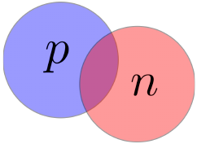
The Nuclear Many-Body Problem
General goal: solve the Schrodinger equation
This project: the deuteron
Method: solve for coefficients of an ansatz

Slide 16
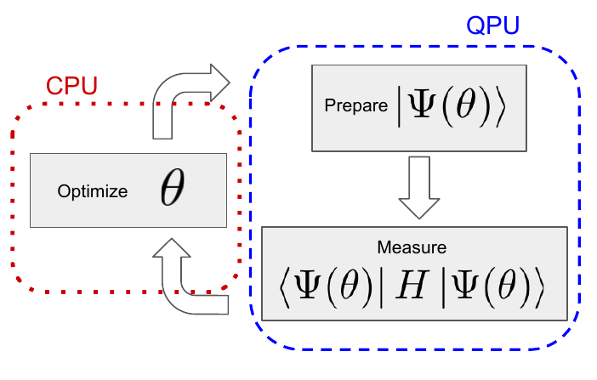
Variational Quantum Eigensolver (VQE)
Hybrid algorithms are most useful on current (noisy & small) devices

Slide 17
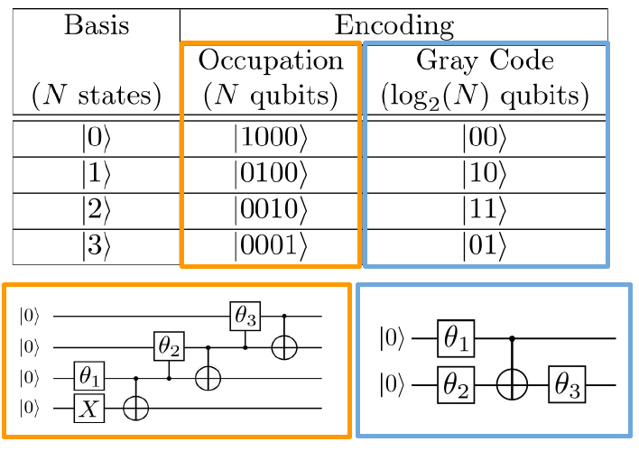
Encodings and Circuits
Occupation (one-hot) encoding vs. Gray code encoding

Slide 18
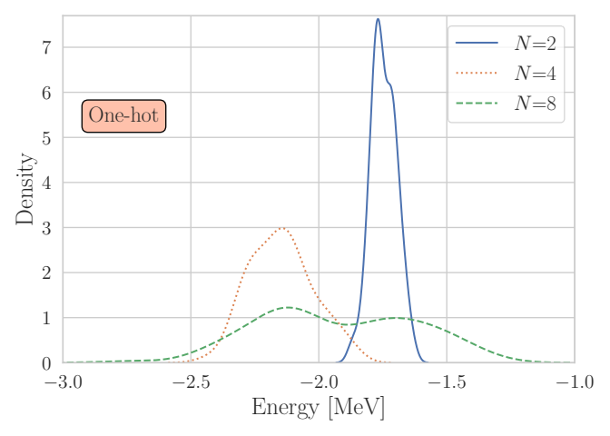
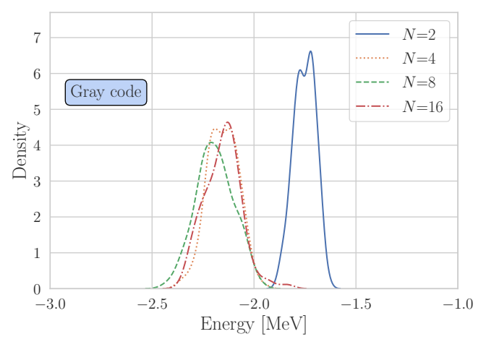
Results
Occupation (one-hot) encoding vs. Gray code encoding
VQE trials: 100

Slide 19
Thank you Merci
www.triumf.ca
Follow us @TRIUMFLab

Slide 20
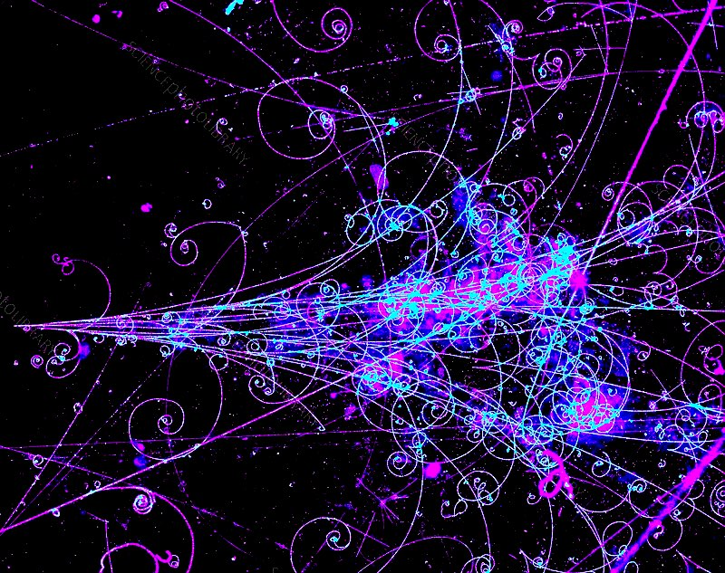
Towards Calorimeter Data Generation
with Quantum Variational Autoencoders
Abhishek Abhishek, Eric Drechsler, Wojtek Fedorko
TRIUMF Science Week, 16. August 2021

Slide 21
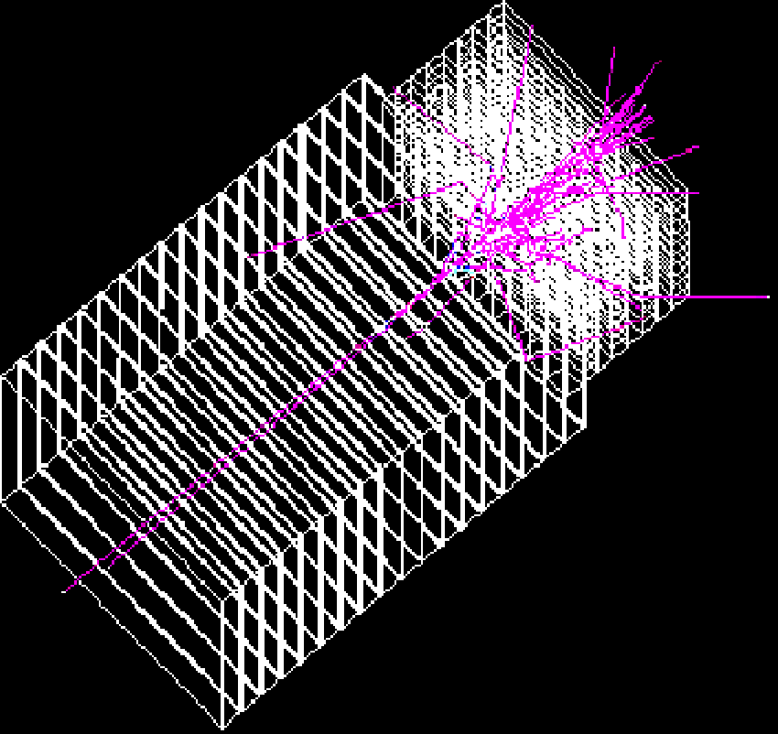
HL-LHC Computing Bottleneck: Calorimeter Shower Simulation
Representation of single
GEANT4 simulated EM shower
Cross-section ATLAS Detector
A. Abhishek, Eric Drechsler, Wojtek Fedorko, Calorimeter Shower Generation with QVAE, 16. August 2021

Slide 22
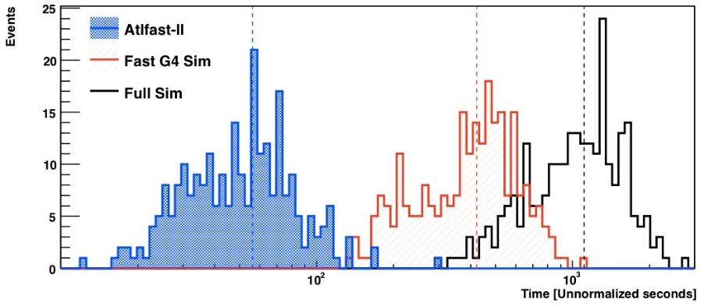
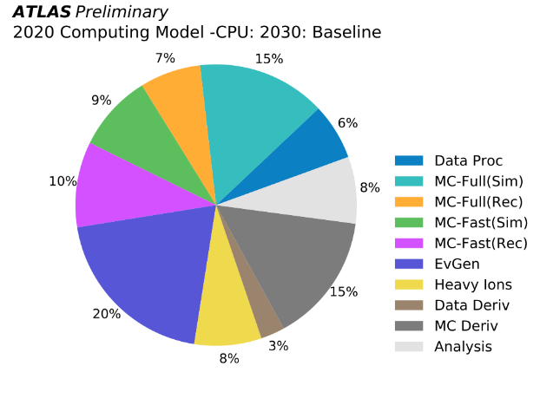
HL-LHC Computing Bottleneck: Calorimeter Shower Simulation
Representation of single
GEANT4 simulated EM shower
Cross-section ATLAS Detector
EPJC 70, 823–874 (2010)
CPU time for simulating 250 ttbar events
A. Abhishek, Eric Drechsler, Wojtek Fedorko, Calorimeter Shower Generation with QVAE, 16. August 2021

Slide 23
Generative Models for Synthetic Shower Generation
Step 1: Training the Model
Step 2: Generating Synthetic Data
Real/Simulated Data
Random Input
Loss Minimisation
~ hours
~ milliseconds
Model
Model
Reconstructed/Synthetic
Data
Synthetic Data
(independent random samples)
A. Abhishek, Eric Drechsler, Wojtek Fedorko, Calorimeter Shower Generation with QVAE, 16. August 2021

Slide 24
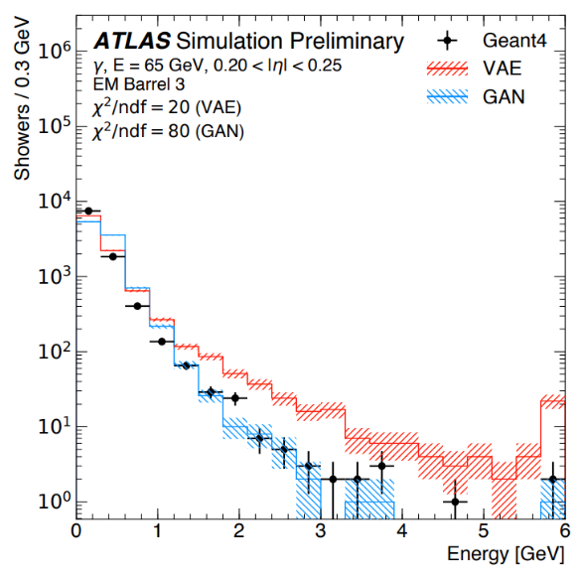
Generative Models for Synthetic Shower Generation
Step 1: Training the Model
Step 2: Generating Synthetic Data
Real/Simulated Data
Random Input
Loss Minimisation
~ hours
~ milliseconds
Model
Model
Reconstructed/Synthetic
Data
Synthetic Data
(independent random samples)
Example: Variational Autoencoder trained with modified loss
ATL-SOFT-PUB-2018-001
Total Energy
Energy per layer
A. Abhishek, Eric Drechsler, Wojtek Fedorko, Calorimeter Shower Generation with QVAE, 16. August 2021

Slide 25
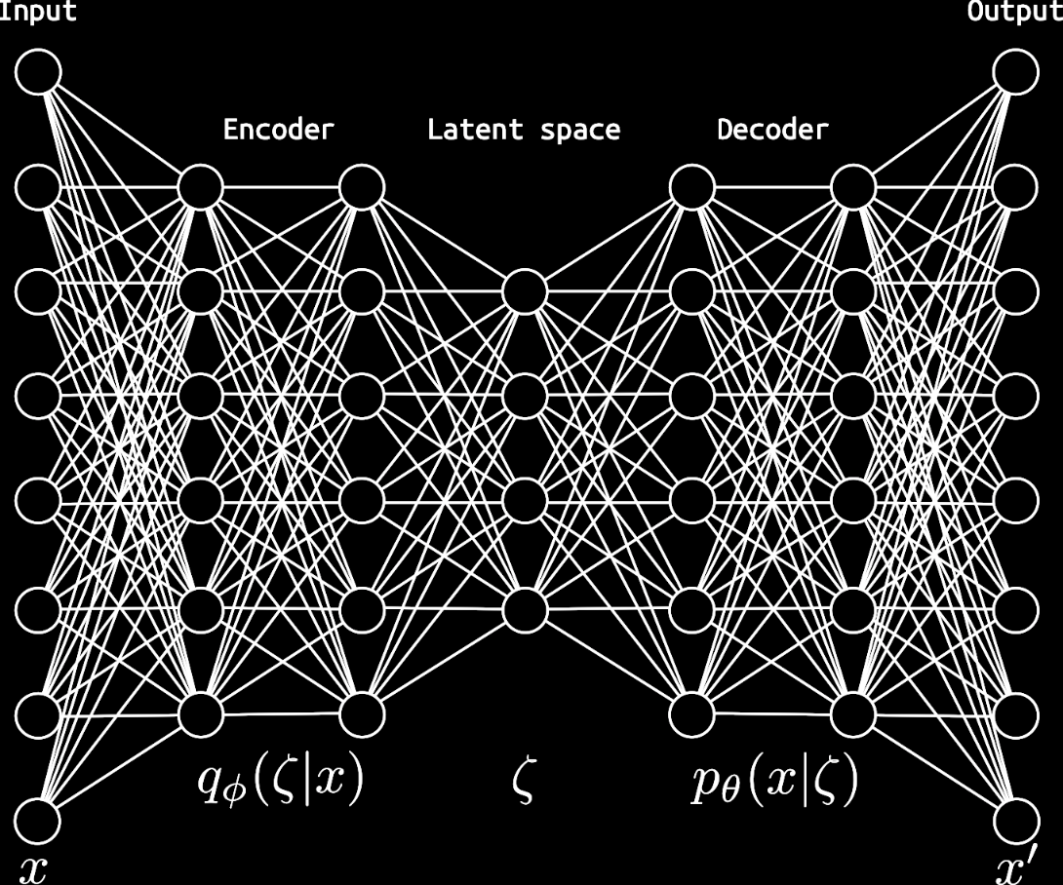
Discrete Variational Autoencoders
arxiv:1609.02200
Discrete VAE
Flat Approximating Posterior
Standard VAE
Hierarchical Approximating Posterior
Prior: Restricted Boltzmann Machine
Prior: Restricted Boltzmann Machine
Approximating
Posterior
Prior
Decoder
Discrete
Latent Space:
A. Abhishek, Eric Drechsler, Wojtek Fedorko, Calorimeter Shower Generation with QVAE, 16. August 2021

Slide 26
Quantum Variational Autoencoders
arxiv:1802.05779
Prior: Quantum Boltzmann Machine
Quantum VAE
qbits on DWave QPU
Restricted BM
State Probability
State Energy
Hierarchical
Approximating
Posterior
Quantum Boltzmann Machine
Decoder
Quantum BM
State Probability
State Energy
A. Abhishek, Eric Drechsler, Wojtek Fedorko, Calorimeter Shower Generation with QVAE, 16. August 2021

Slide 27
Science, Community, Training, Collaboration
Undergraduate coop programs
Master of Data Science (UBC), UBC EngPhys, BCIT Capstone projects
MITACS GRA, GRI
Data Science Study Group w/ GAPS
Courses/ certificates
Paper reading
Summer Schools, TRIUMF Summer Institute 2020/2021: Cornerstone Models of Quantum Computing

