Slide 1
Top Risks and Mitigating Actions:
Development Test Centers and Test Results
Kevin Chen
Feb 22, 2018

Slide 2
Outline
Overview of technically challenging areas
Approach to Risk Mitigation
Result highlights

Slide 3
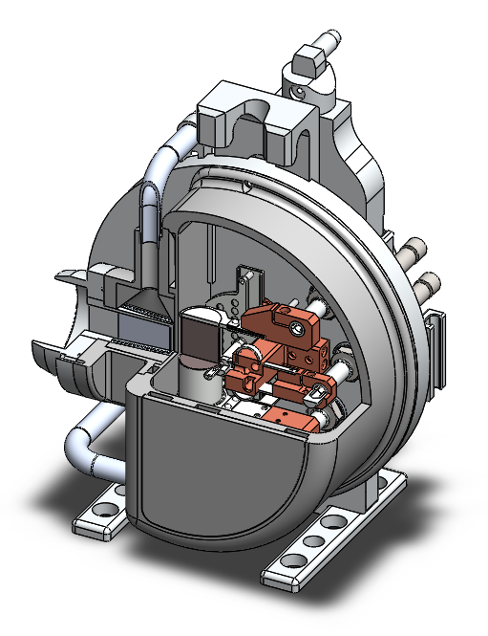
Technically Challenging Area: Target Vessel
Technical Challenges:
Electron to Gamma Converter
  Energy deposition by beam
  Cooling
Gamma Window
  Cooling
Target heating to 2200°C
  High power connectors
  Target vessel cooling
Target vessel manufacturability
  Welding techniques for HTV backplate
  Weld stresses due to thermal effects

Slide 4
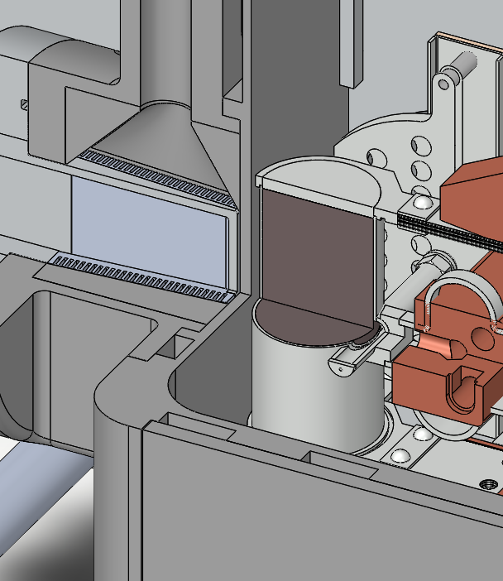
Technically Challenging Area: Target Vessel
Technical Challenges:
Electron to Gamma Converter
  Energy deposition by beam
  Cooling
Gamma Window
  Cooling
Target heating to 2200°C
  High power connectors
  Target vessel cooling
Target vessel manufacturability
  Welding techniques for HTV backplate
  Weld stresses due to thermal effects

Slide 5
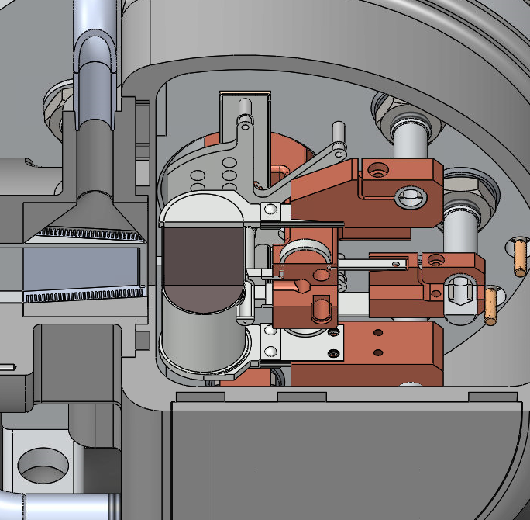
Technically Challenging Area: Target Vessel
Technical Challenges:
Electron to Gamma Converter
  Energy deposition by beam
  Cooling
Gamma Window
  Cooling
Target heating to 2200°C
  High power connectors
  Target vessel cooling
Target vessel manufacturability
  Welding techniques for HTV backplate
  Weld stresses due to thermal effects

Slide 6
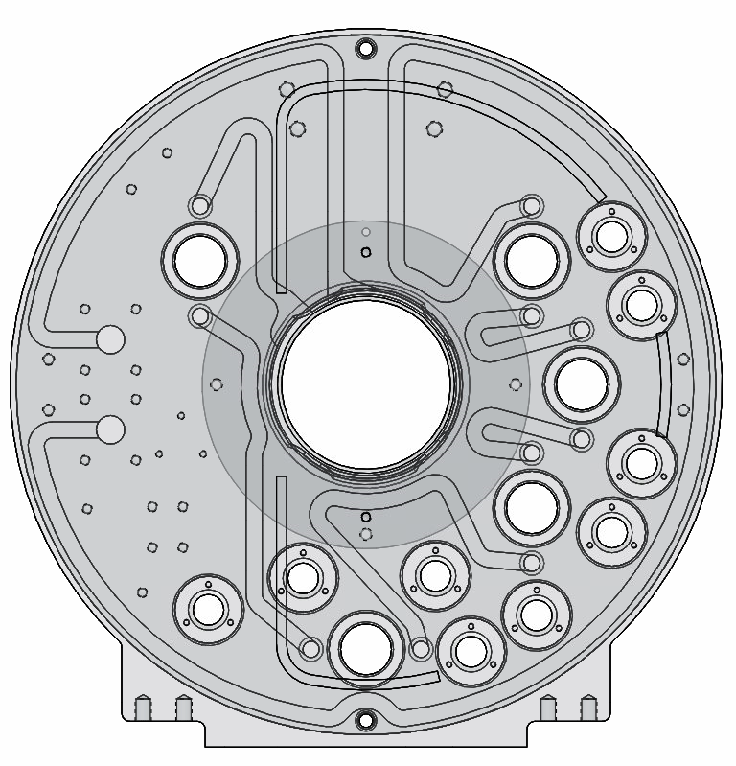
Technically Challenging Area: Target Vessel
Technical Challenges:
Electron to Gamma Converter
  Energy deposition by beam
  Cooling
Gamma Window
  Cooling
Target heating to 2200°C
  High power connectors
  Target vessel cooling
Target vessel manufacturability
  Welding techniques for HTV backplate
  Weld stresses due to thermal effects

Slide 7
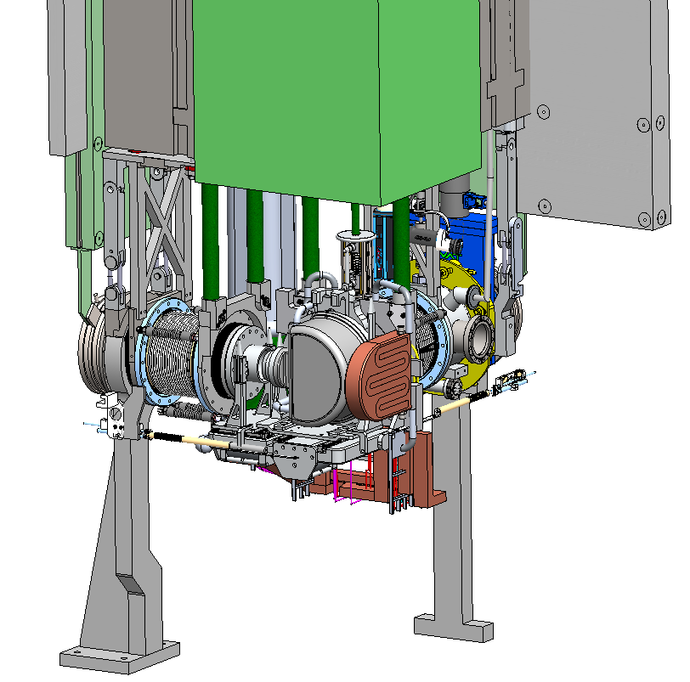
Technically Challenging Area: Target Station
Technical Challenges
Coupling Mechanism
  Compliance on connectors
  Accurate and repeatable vacuum connection
High voltage feedthrough
  Material selection for high voltage operation
  Design for material properties
Extraction Electrode Movement
  Accurate and repeatable placement

Slide 8
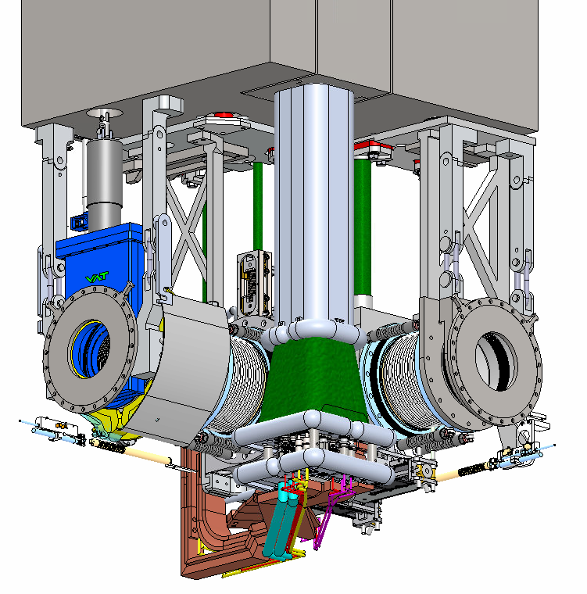
Technically Challenging Area: Target Station
Technical Challenges
Coupling Mechanism
  Compliance on connectors
  Accurate and repeatable vacuum connection
High voltage feedthrough
  Material selection for high voltage operation
  Design for material properties
Extraction Electrode Movement
  Accurate and repeatable placement

Slide 9
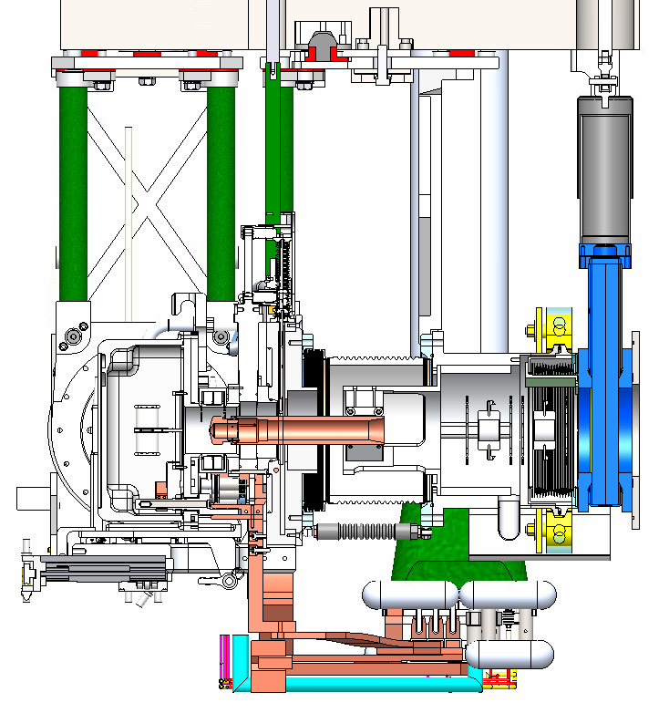
Technically Challenging Area: Target Station
Technical Challenges
Coupling Mechanism
  Compliance on connectors
  Accurate and repeatable vacuum connection
High voltage feedthrough
  Material selection for high voltage operation
  Design for material properties
Extraction Electrode Movement
  Accurate and repeatable placement

Slide 10
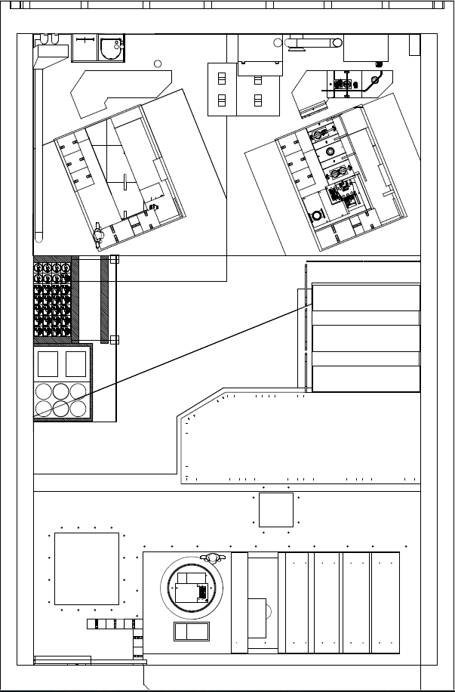
Technically Challenging Area: Operations
Technical Challenges
Target material production
  Synthesis of ARIEL targets for optimal release of purer neutron rich isotopes
Ion source optimization
  Validation of simulations for RIB transport and CANREB
Target Vessel Extraction/Installation
  Accurate and repeatable process
  Rescue stuck target vessels
Design for operability and maintainability
  Manipulator reach and access
  Maintenance and End of Life disassembly
Target station vacuum interface
  Allow vertical extraction of modules in case of failure

Slide 11
Technically Challenging Area: Operations
Technical Challenges
Target material production
  Synthesis of ARIEL targets for optimal release of purer neutron rich isotopes
Ion source optimization
  Validation of simulations for RIB transport and CANREB
Target Vessel Extraction/Installation
  Accurate and repeatable process
  Rescue stuck target vessels
Design for operability and maintainability
  Manipulator reach and access
  Maintenance and End of Life disassembly
Target station vacuum interface
  Allow vertical extraction of modules in case of failure

Slide 12
Technically Challenging Area: Operations
Technical Challenges
Target material production
  Synthesis of ARIEL targets for optimal release of purer neutron rich isotopes
Ion source optimization
  Validation of simulations for RIB transport and CANREB
Target Vessel Extraction/Installation
  Accurate and repeatable process
  Rescue stuck target vessels
Design for operability and maintainability
  Manipulator reach and access
  Maintenance and End of Life disassembly
Target station vacuum interface
  Allow vertical extraction of modules in case of failure

Slide 13
Technically Challenging Area: Operations
Technical Challenges
Target material production
  Synthesis of ARIEL targets for optimal release of purer neutron rich isotopes
Ion source optimization
  Validation of simulations for RIB transport and CANREB
Target Vessel Extraction/Installation
  Accurate and repeatable process
  Rescue stuck target vessels
Design for operability and maintainability
  Manipulator reach and access
  Maintenance and End of Life disassembly
Target station vacuum interface
  Allow vertical extraction of modules in case of failure

Slide 14
Technically Challenging Area: Operations
Technical Challenges
Target material production
  Synthesis of ARIEL targets for optimal release of purer neutron rich isotopes
Ion source optimization
  Validation of simulations for RIB transport and CANREB
Target Vessel Extraction/Installation
  Accurate and repeatable process
  Rescue stuck target vessels
Design for operability and maintainability
  Manipulator reach and access
  Maintenance and End of Life disassembly
Target station vacuum interface
  Allow vertical extraction of modules in case of failure

Slide 15
Approach to Risk Mitigation

Slide 16
Approach to Risk Mitigation
Drive design and de-risk project
Minimize test design and setup time, maximize knowledge gained
  Leveraging existing infrastructure and facilities
  Simple test setups
Test for reliability and usability
Test components -> test simple systems -> test integrated systems

Slide 17
Risk Mitigation: Tests and Development
HTV Development
Target Station Development
Operations Development
High Power Connector Test Stand
HVFT Purge Test
Remote Handling Mockup Tests
Converter Tests at
E-Linac
HVFT Material testing
Target Vessel Exchange tool tests
ARIEL Corrosion Erosion test (ACE)
Pillow Seal Testing
ARIEL Ion Source Development
Extraction Electrode Feedthrough Test
ARIEL Target Material Development
Target Vessel Coupling Test Stand
TV Coupling Piston Leak Test
ARIEL Thermal Test Stand (ATTS)
Pumping & Heating Investigation Stand
(PHI)
Target and Ion Source Acceptance Stand (TISA)
Meeting requirements for safety, reliability, and beam production

Slide 18
Risk Mitigation: Test Stands
HTV Development
Target Station Development
Operations Development
High Power Connector Test Stand
HVFT Purge Test
Remote Handling Mockup Tests
Low Resource Req: 8
<$2000 non recoverable mat’l cost
<1 wk FTE
Converter Tests at
E-Linac
HVFT Material testing
Target Vessel Exchange tool tests
ARIEL Corrosion Erosion test (ACE)
Pillow Seal Testing
ARIEL Ion Source Development
Extraction Electrode Feedthrough Test
ARIEL Target Material Development
Target Vessel Coupling Test Stand
TV Coupling Piston Leak Test
ARIEL Thermal Test Stand (ATTS)
Pumping & Heating Investigation Stand
(PHI)
Target and Ion Source Acceptance Stand (TISA)
Meeting requirements for safety, reliability, and beam production

Slide 19
Risk Mitigation: Test Stands
HTV Development
Target Station Development
Operations Development
High Power Connector Test Stand
HVFT Purge Test
Remote Handling Mockup Tests
Low Resource Req: 8
Testing Complete: 3
Testing in Progress: 5
Converter Tests at
E-Linac
HVFT Material testing
Target Vessel Exchange tool tests
ARIEL Corrosion Erosion test (ACE)
Pillow Seal Testing
ARIEL Ion Source Development
Extraction Electrode Feedthrough Test
ARIEL Target Material Development
Target Vessel Coupling Test Stand
TV Coupling Piston Leak Test
ARIEL Thermal Test Stand (ATTS)
Pumping & Heating Investigation Stand
(PHI)
Target and Ion Source Acceptance Stand (TISA)
Meeting requirements for safety, reliability, and beam production

Slide 20
Risk Mitigation: Test Stands
HTV Development
Target Station Development
Operations Development
High Power Connector Test Stand
HVFT Purge Test
Remote Handling Mockup Tests
Low Resource Req: 8
Testing Complete: 3
Testing in Progress: 5
Design Complete: 4
Design in Progress: 2
Converter Tests at
E-Linac
HVFT Material testing
Target Vessel Exchange tool tests
ARIEL Corrosion Erosion test (ACE)
Pillow Seal Testing
ARIEL Ion Source Development
Extraction Electrode Feedthrough Test
ARIEL Target Material Development
Target Vessel Coupling Test Stand
TV Coupling Piston Leak Test
ARIEL Thermal Test Stand (ATTS)
Pumping & Heating Investigation Stand
(PHI)
Target and Ion Source Acceptance Stand (TISA)
Meeting requirements for safety, reliability, and beam production

Slide 21
Risk Mitigation: Test Stands
HTV Development
Target Station Development
Operations Development
High Power Connector Test Stand
HVFT Purge Test
Remote Handling Mockup Tests
Low Resource Req: 8
Testing Complete: 3
Testing in Progress: 5
Design Complete: 4
Design in Progress: 2
Leverages existing infrastructure: 11
Converter Tests at
E-Linac
HVFT Material testing
Target Vessel Exchange tool tests
ARIEL Corrosion Erosion test (ACE)
Pillow Seal Testing
ARIEL Ion Source Development
Extraction Electrode Feedthrough Test
ARIEL Target Material Development
Target Vessel Coupling Test Stand
TV Coupling Piston Leak Test
ARIEL Thermal Test Stand (ATTS)
Pumping & Heating Investigation Stand
(PHI)
Target and Ion Source Acceptance Stand (TISA)
Meeting requirements for safety, reliability, and beam production

Slide 22
Results Highlights

Slide 23
Risk Mitigation: Tests and Development
HTV Development
Target Station Development
Operations Development
High Power Connector Test Stand
HVFT Purge Test
Remote Handling Mockup Tests
Converter Tests at
E-Linac
HVFT Material testing
Target Vessel Exchange tool tests
ARIEL Corrosion Erosion test (ACE)
Pillow Seal Testing
ARIEL Ion Source Development
Extraction Electrode Feedthrough Test
ARIEL Target Material Development
Target Vessel Coupling Test Stand
TV Coupling Piston Leak Test
ARIEL Thermal Test Stand (ATTS)
Pumping & Heating Investigation Stand
(PHI)
Target and Ion Source Acceptance Stand (TISA)
Meeting requirements for safety, reliability, and beam production

Slide 24
Test Stand: High Power Connector Test Stand
HTV Development
Goals (fulfill RS1, 6):
Ensure target heating meets requirements
Verify electrical performance of TRIUMF designed connectors
Verify pressure drop in TRIUMF designed connectors
Testing current capacity of purchased components
Results Drive:
Target vessel design
Target module design
Status: Design complete, waiting for parts to arrive
High Power Connector Test Stand
Converter Tests at
E-Linac
ARIEL Corrosion Erosion test (ACE)
ARIEL Thermal Test Stand (ATTS)
Tested at ATTS

Slide 25
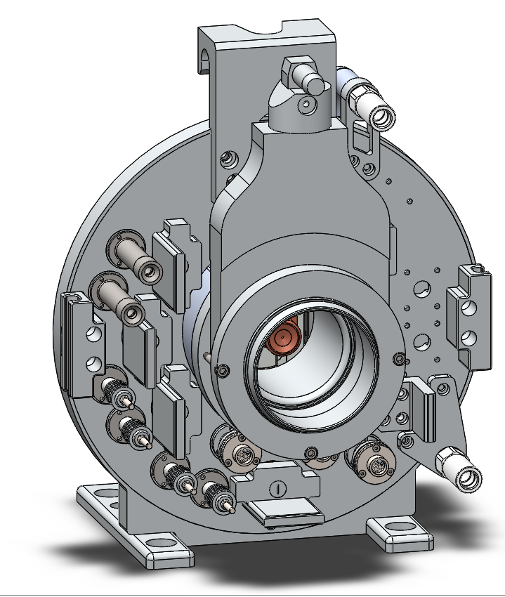
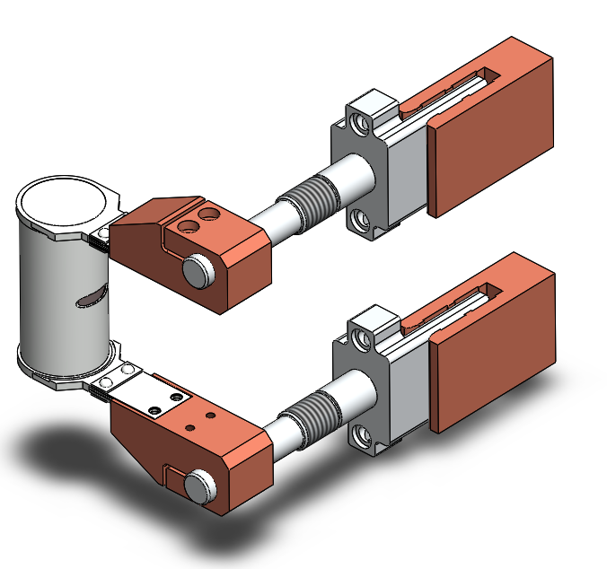
Test Stand: High Power Connector Test Stand
Cooling water in/out
Current flow
Current flow
Cooling water in/out

Slide 26
Test Stand: Converter Tests at E-Linac
HTV Development
Goals (fulfill RS4, 5, 14):
Find best material combination for electron to gamma converter
Quantify maximum possible power deposition on converter before failure
Test high Z/low Z material interface under electron beam
Qualify best material combination through acceptance test
Results Drive:
Converter and target vessel design
Target station design
Status: Testing in progress
High Power Connector Test Stand
Converter Tests at
E-Linac
ARIEL Corrosion Erosion test (ACE)
ARIEL Thermal Test Stand (ATTS)
Tested at E-Linac

Slide 27
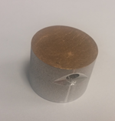
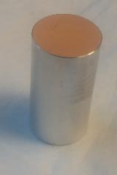
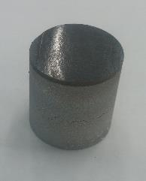
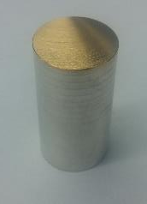
Test Stand: Converter Tests at E-Linac
a) Au-Al Expl. Weld
b) Au-Al E.D. + Ni
Pre-acceptance test
50 beam cycles -> SEM
50 hours CW -> SEM
Acceptance Test
500 h CW on two samples
50 cycles on two samples
Each sample experiences both CW and cycles
Each sample should come from different batches
Failed
Failed
c) Au-Al E.D.
d) Ta-Al Expl. Weld
Failed
Passed

Slide 28
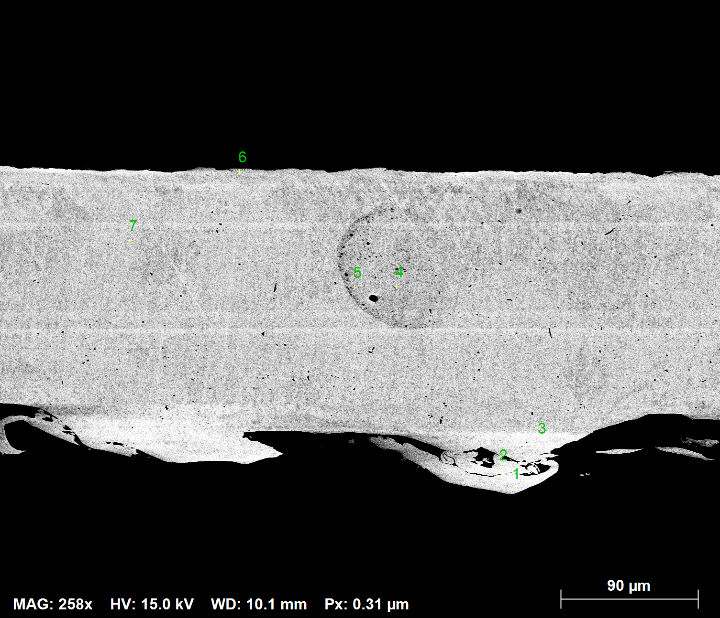
Test Stand: Converter Tests at E-Linac
HTV Development
Results:
Found possible material combination for the converter
Acceptance test results April 2018
Started E-Linac operation with realistic beam conditions
High Power Connector Test Stand
Converter Tests at
E-Linac
ARIEL Corrosion Erosion test (ACE)
Ta_{0.99} Al_{0.01}
Ta_{0.99} Al_{0.01}
Ta_{0.965} Al_{0.005} O_{0.03}
ARIEL Thermal Test Stand (ATTS)
Tested at E-Linac
Ta_{0.99} Al_{0.01}
Notes:
3 yrs delayed, but very important now that we have the results. First time elinac operated with realistic beam conditions, lots of profit from this test stand, within and beyond scope of test

Slide 29
Test Stand: ARIEL Corrosion Erosion test (ACE)
HTV Development
Goals (fulfill RS12, 14):
Quantify effects of DI water cooling on aluminum converter and target vessel body
Test welded samples of target vessel
Quantify pressure drop in cooling circuits
Results Drive:
Target vessel design and manufacturing
Status: Design complete, waiting for materials to arrive
High Power Connector Test Stand
Converter Tests at
E-Linac
ARIEL Corrosion Erosion test (ACE)
ARIEL Thermal Test Stand (ATTS)
Tested at ATTS
Notes:
Show weld tests of the tv backplate, with material tests, on ACE stand

Slide 30
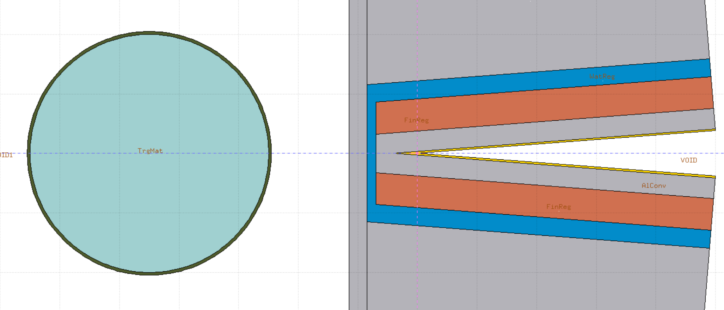
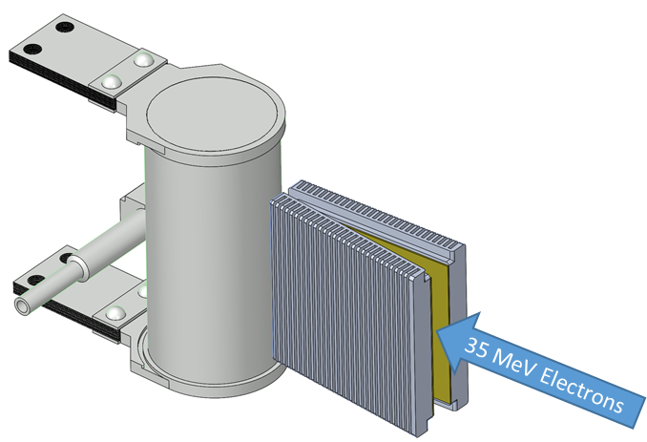
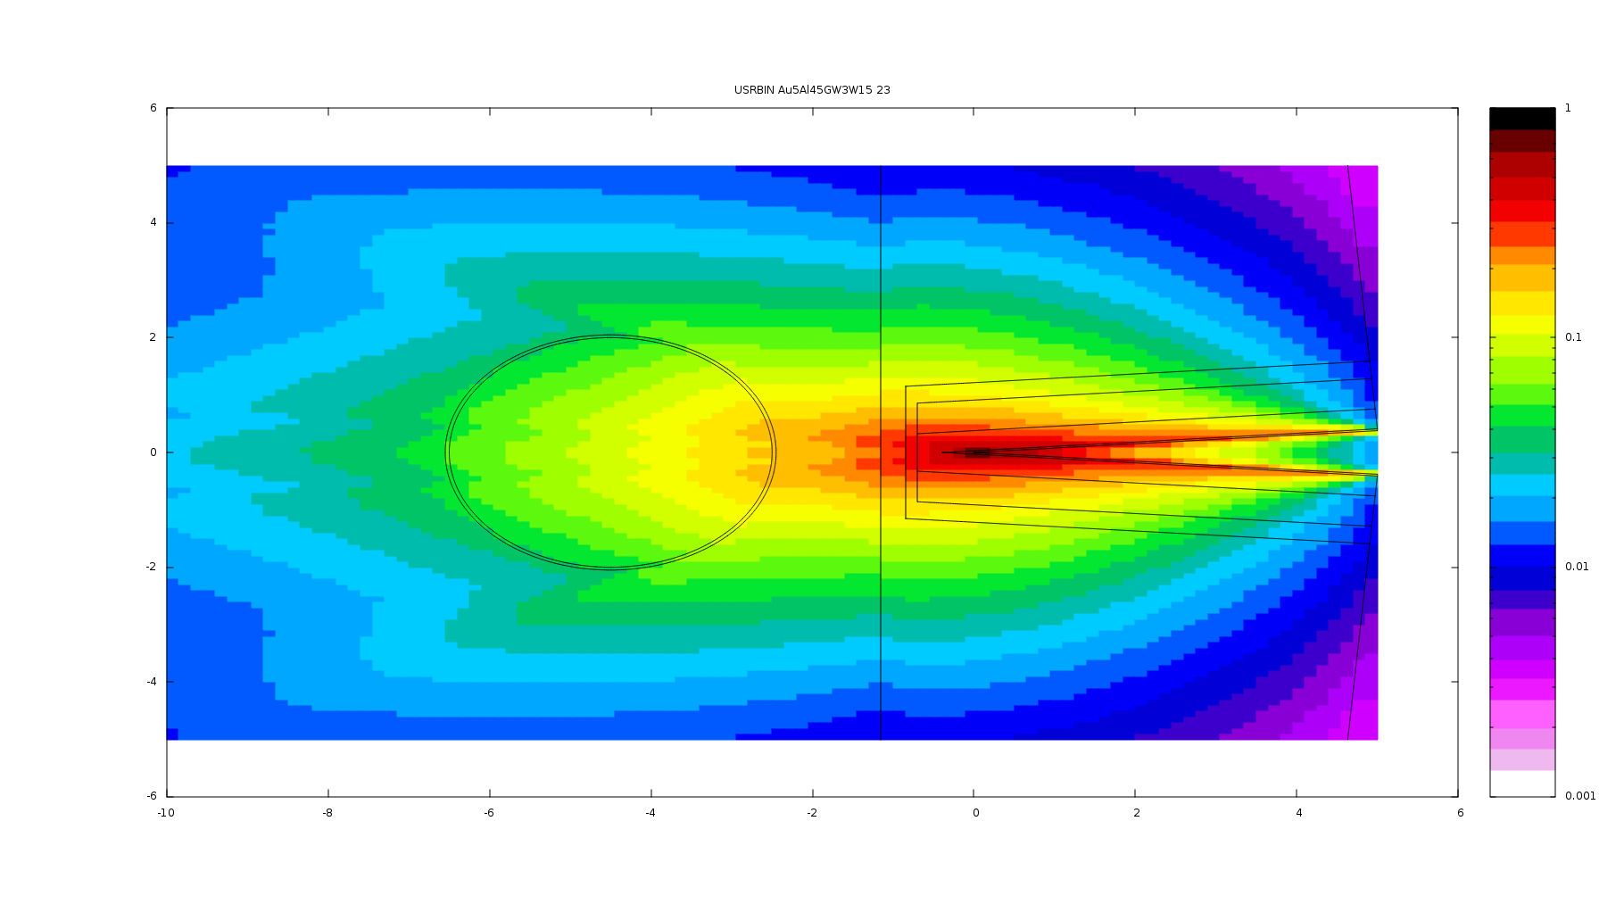
Test Stand: ARIEL Corrosion Erosion test (ACE)
FLUKA model of energy deposition
AETE
Photon Flux
1
1E-1
1E-2
1E-3
Notes:
Show weld tests of the tv backplate, with material tests, on ACE stand

Slide 31
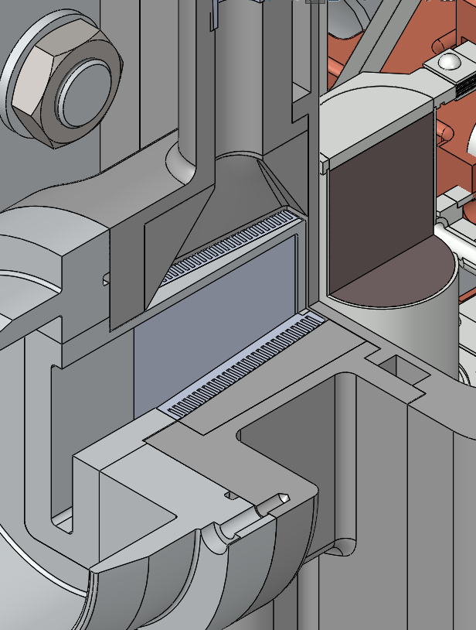
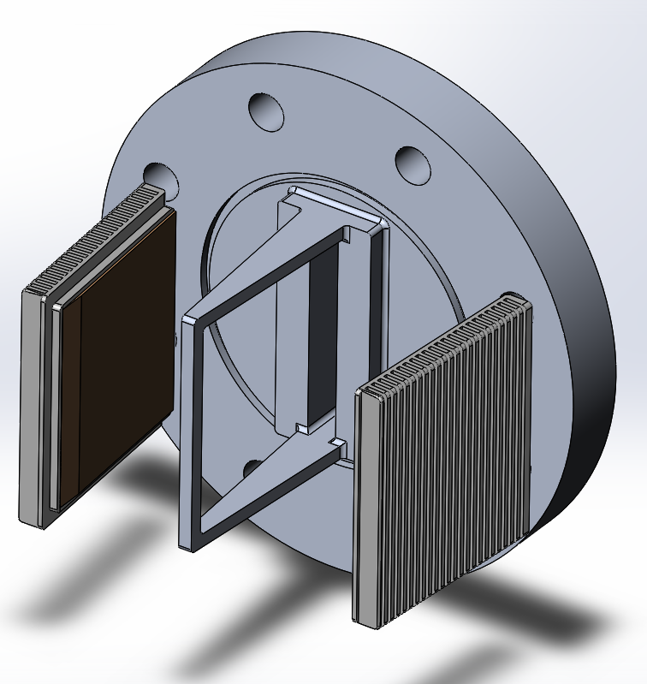
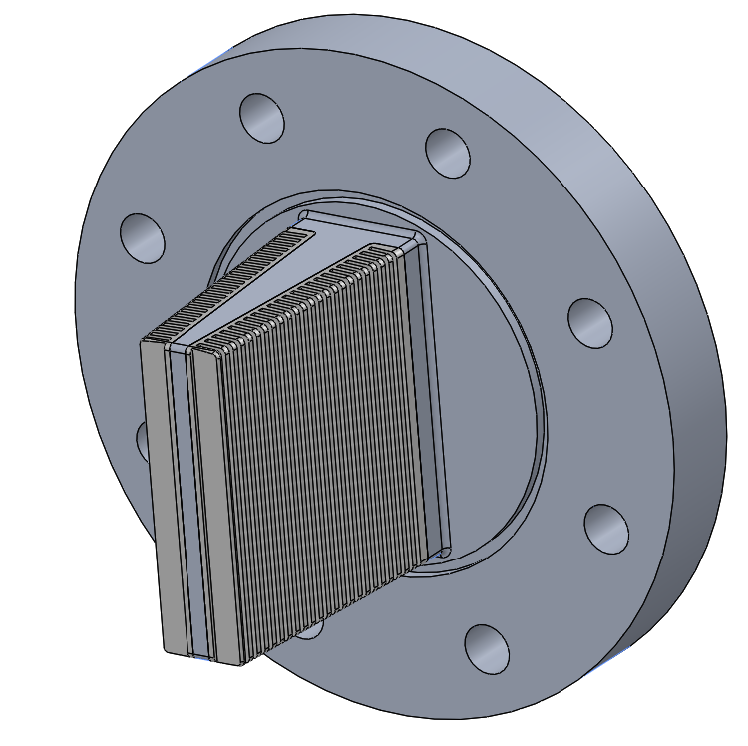
Test Stand: ARIEL Corrosion Erosion test (ACE)
Mechanical design
Cooling water
Notes:
Show weld tests of the tv backplate, with material tests, on ACE stand

Slide 32
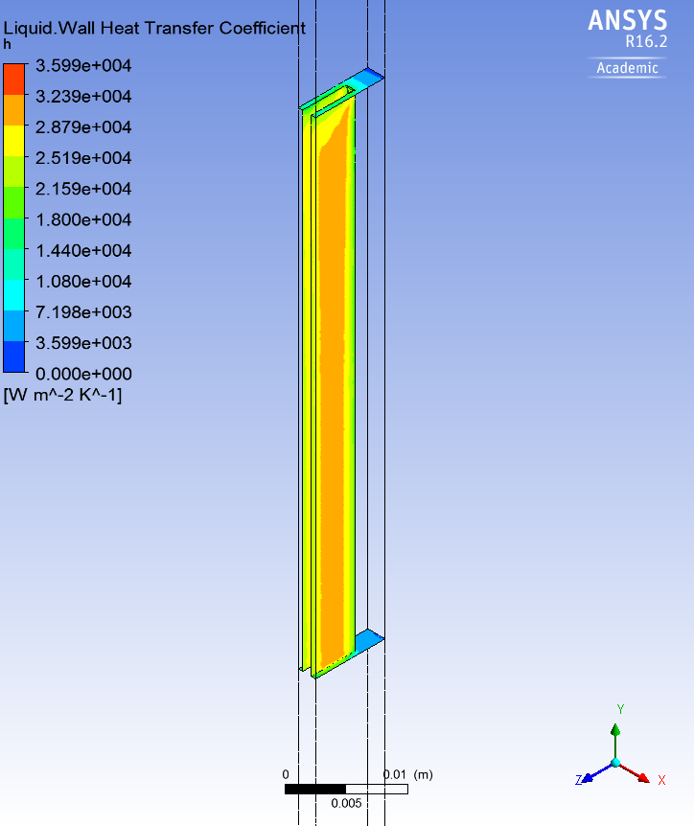
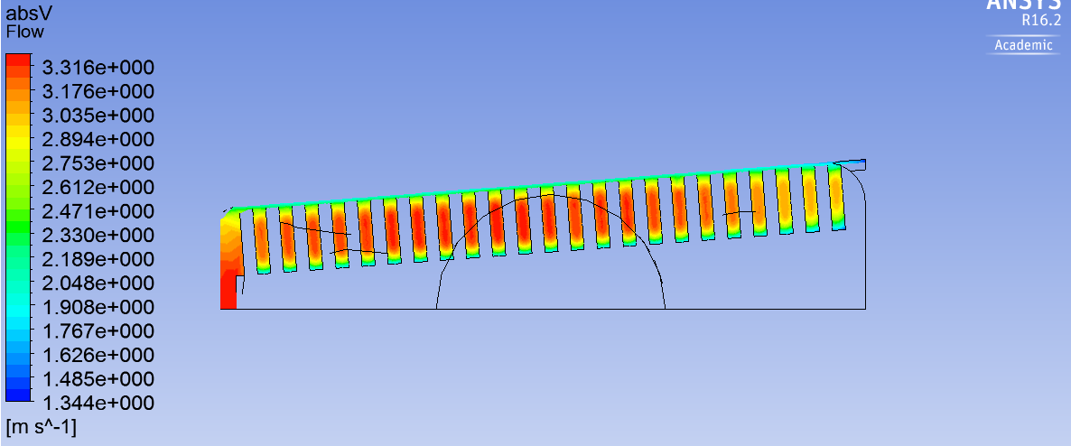
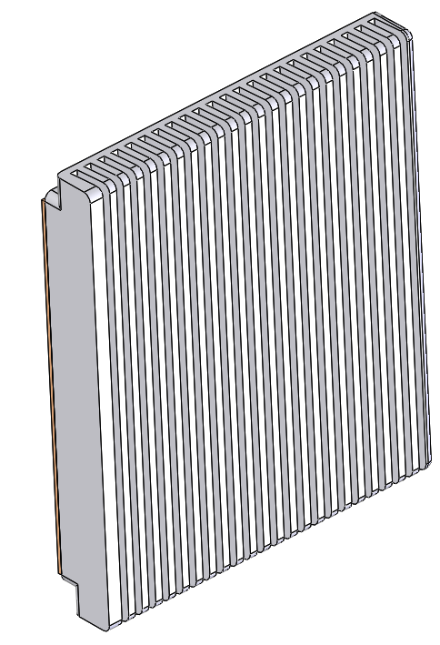
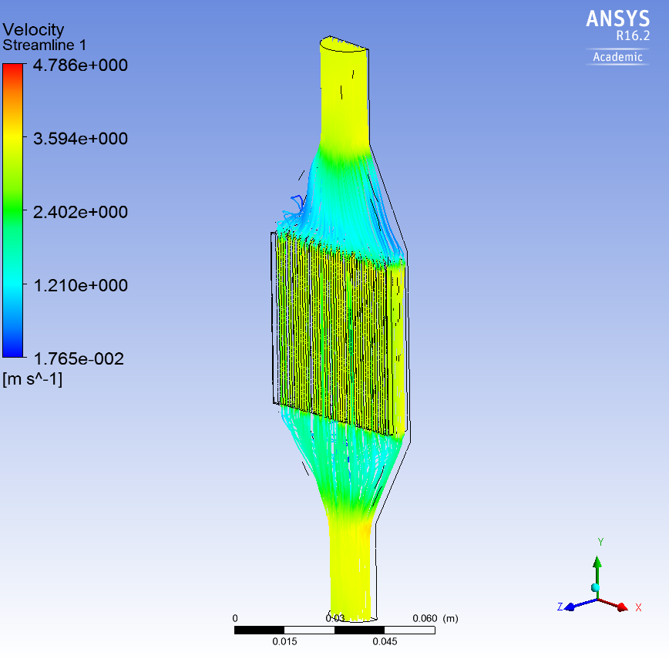
Test Stand: ARIEL Corrosion Erosion test (ACE)
Thermal and fluid design
Heat Transfer Coefficient [W/m² K]
Fluid Velocity [m/s]
5 cm tall
1 mm thick
1 mm space
50 mm long
v
Notes:
Show weld tests of the tv backplate, with material tests, on ACE stand

Slide 33
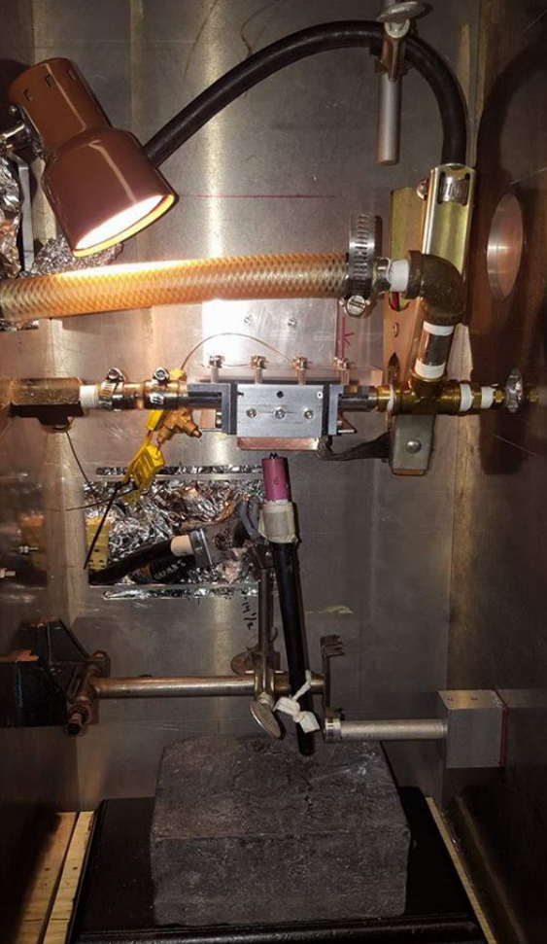
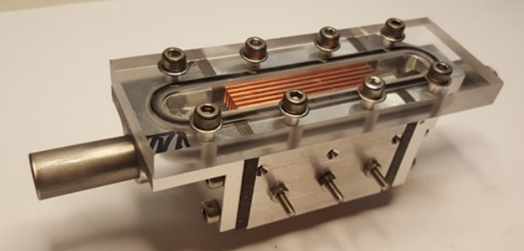
Test Stand: ARIEL Corrosion Erosion test (ACE)
ANSYS thermal model verification
University of Victoria
Converter Fins
Flow
Arc Welder
Notes:
Show weld tests of the tv backplate, with material tests, on ACE stand

Slide 34
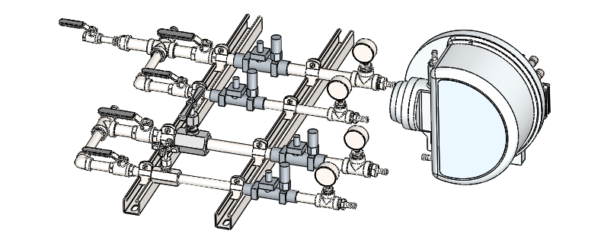
Test Stand: ARIEL Corrosion Erosion test (ACE)
ACE Stand
DI water in
DI water out
Notes:
Add photo of converter fins, pre-test results from UVIC, fluka simulation, thermal simulation results from brendan

Slide 35
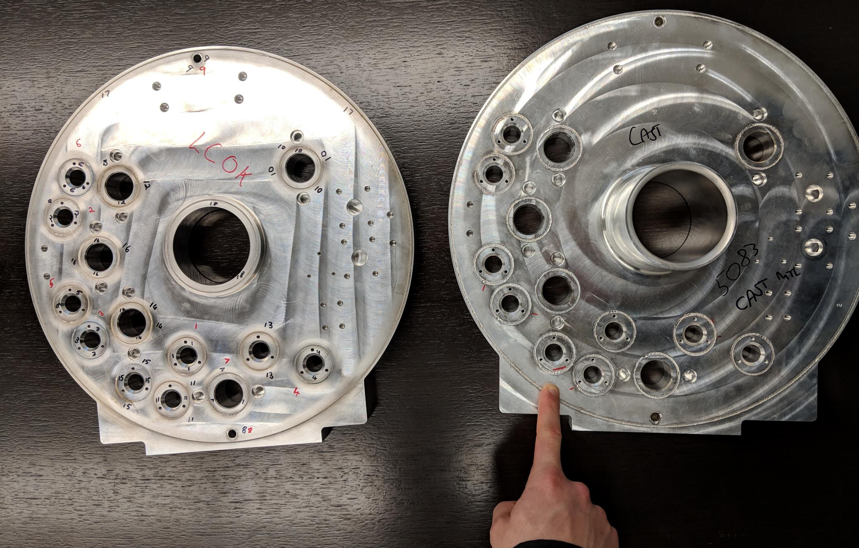
Test Stand: ARIEL Corrosion Erosion test (ACE)
Welded backplate testing
Notes:
Add photo of converter fins, pre-test results from UVIC, fluka simulation, thermal simulation results from brendan

Slide 36
Test Stand: ARIEL Thermal Test Stand
HTV Development
Goals (fulfill RS1, 6, 7):
Heat target to 2200C and prove electrical and thermal performance of components
Verifying requirements and capacities of HTV components, including high current connectors and gamma window
Tailoring current path and emissivity of target container
Testing gamma window, heat shield design, graphite inserts
Target longevity under high thermal loads
Further target thermal development
Results Drive:
Target station thermal and electrical design
Target vessel and component thermal design
High voltage services design
Status: Testing in progress
High Power Connector Test Stand
Converter Tests at
E-Linac
ARIEL Corrosion Erosion test (ACE)
ARIEL Thermal Test Stand (ATTS)

Slide 37
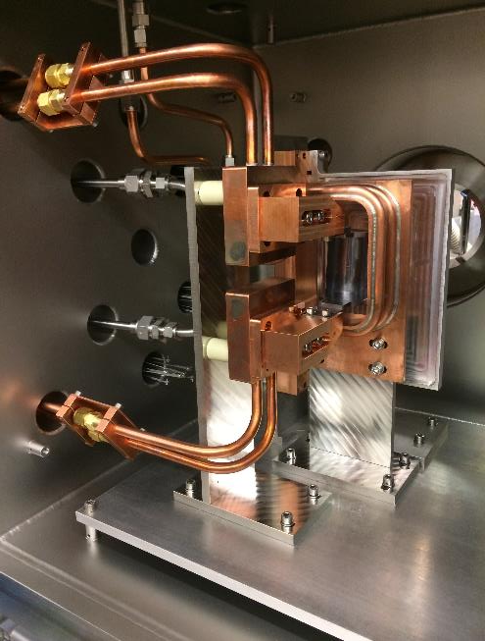
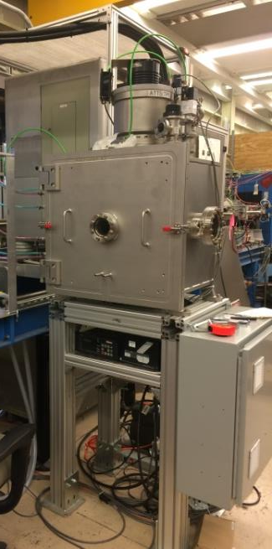
Test Stand: ARIEL Thermal Test Stand

Slide 38
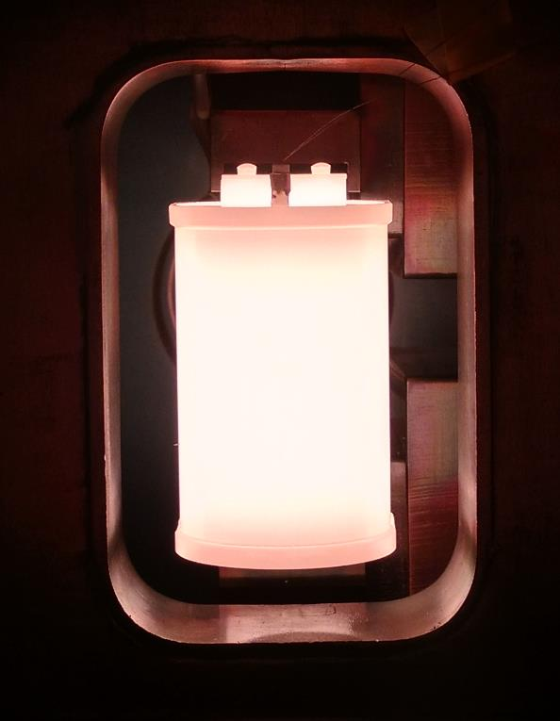
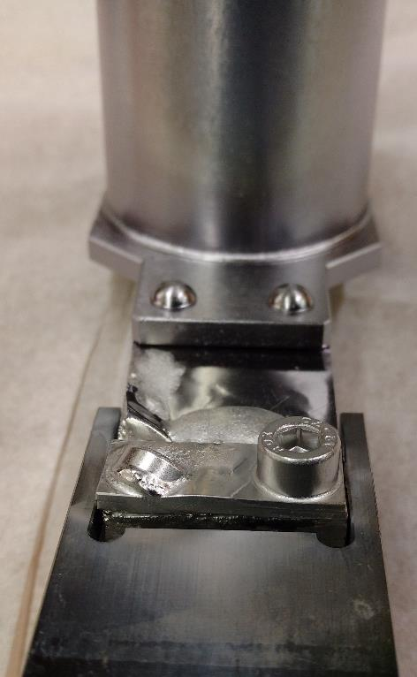
Test Stand: ARIEL Thermal Test Stand
1340 A
1580ºC
Component failure: 1750A

Slide 39
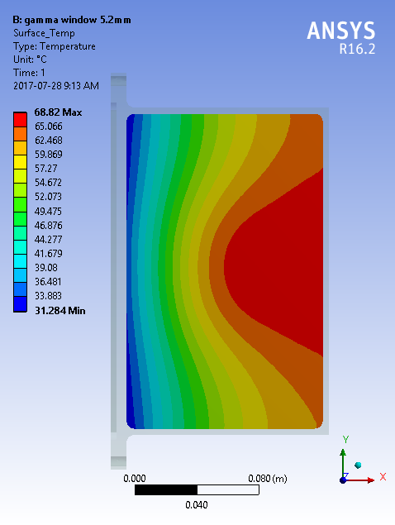
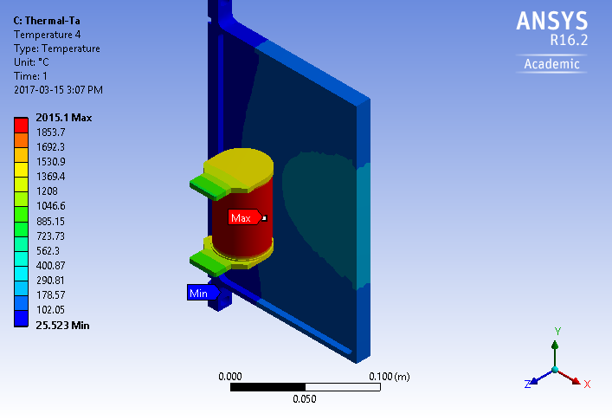
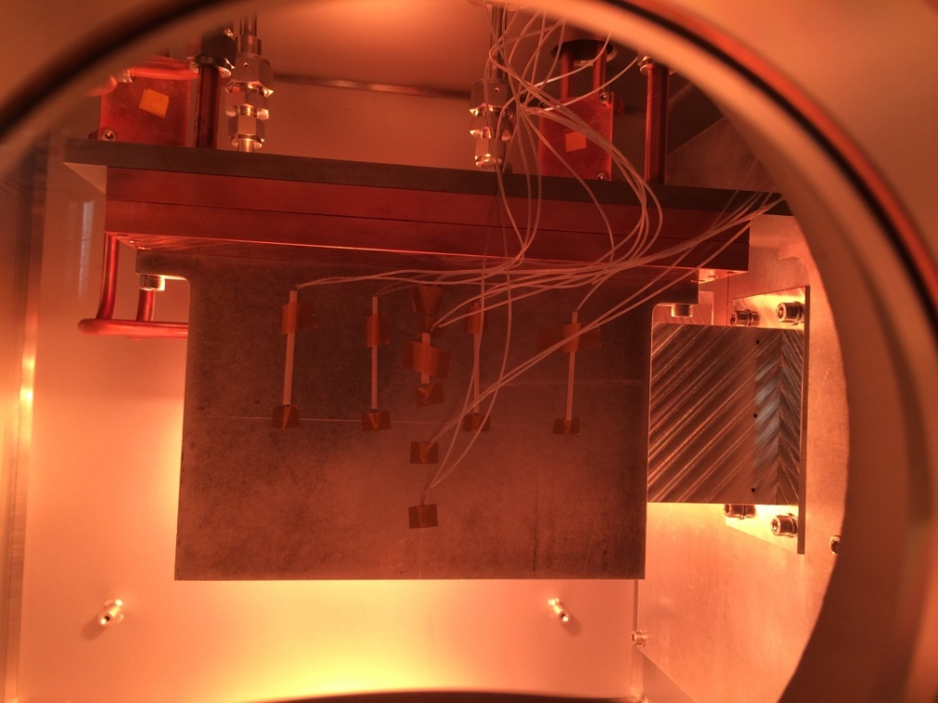
Test Stand: ARIEL Thermal Test Stand
1340 A
1580ºC

Slide 40
Risk Mitigation: Tests and Development
HTV Development
Target Station Development
Operations Development
High Power Connector Test Stand
HVFT Purge Test
Remote Handling Mockup Tests
Converter Tests at
E-Linac
HVFT Material testing
Target Vessel Exchange tool tests
ARIEL Corrosion Erosion test (ACE)
Pillow Seal Testing
ARIEL Ion Source Development
Extraction Electrode Feedthrough Test
ARIEL Target Material Development
Target Vessel Coupling Test Stand
TV Coupling Piston Leak Test
ARIEL Thermal Test Stand (ATTS)
Pumping & Heating Investigation Stand
(PHI)
Target and Ion Source Acceptance Stand (TISA)
Meeting requirements for safety, reliability, and beam production

Slide 41
Test Stand: Pillow Seal Testing
Target Station Development
Goals (fulfill RS35, 79):
Quantify leak rate and force of engagement of intermodule seals
Quantify compliance to angular and axial misalignment
Results drive
Backout strategy in the event of target module failure
Target station structural design
ARIEL vacuum design
Status: Testing complete
HVFT Purge Test
HVFT Material testing
Pillow Seal Testing
Extraction Electrode Feedthrough Test
Target Vessel Coupling Test Stand
TV Coupling Piston Leak Test
Pumping and Heating Investigation Stand
(PHI)

Slide 42
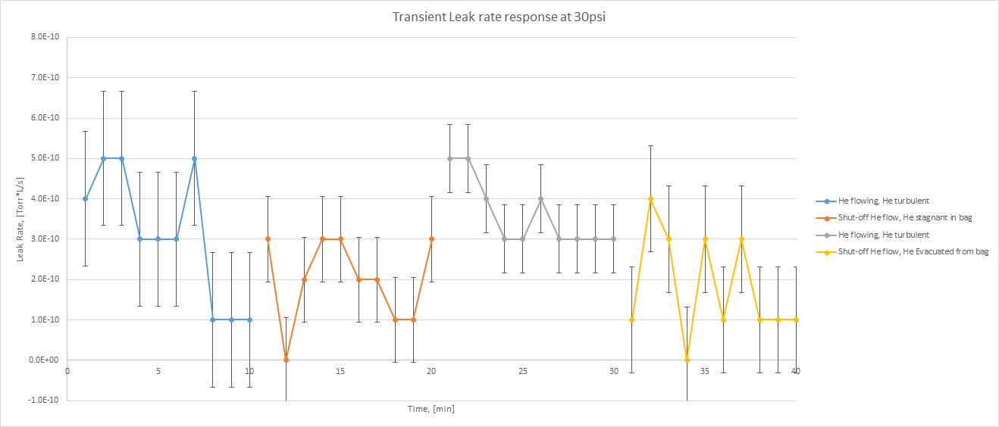
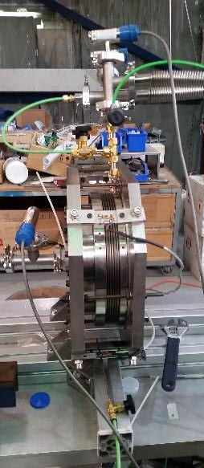
Test Stand: Pillow Seal Testing

Slide 43
Test Stand: Target Vessel Coupling Test Stand
Target Station Development
Goals (fulfill RS24, 25, 29):
Quantify engagement force of HTV to TM
Measure engagement force of individual connectors
Discover issues with alignment/tolerances of connectors
Optimize compliance to misalignment
Test seal vacuum repeatability
Results Drive:
Target station design
Target vessel design
Status: Testing complete
HVFT Purge Test
HVFT Material testing
Pillow Seal Testing
Extraction Electrode Feedthrough Test
Target Vessel Coupling Test Stand
TV Coupling Piston Leak Test
Pumping and Heating Investigation Stand
(PHI)

Slide 44
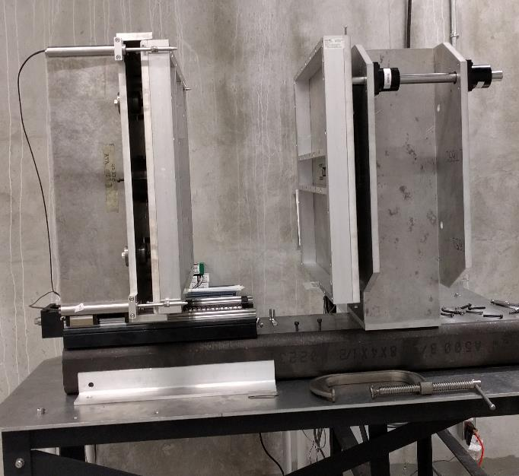
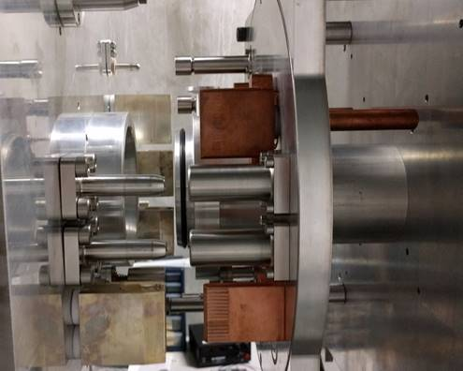
Test Stand: Target Vessel Coupling Test Stand

Slide 45
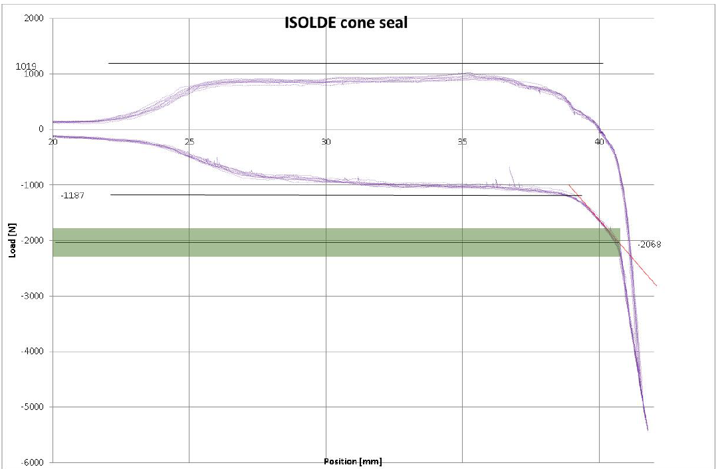
Test Stand: Target Vessel Coupling Test Stand
Sealing Force: 1.1kN
Disconnect
Connect
Change in slope = Fully connected
Slope indicates coupling stand stiffness

Slide 46
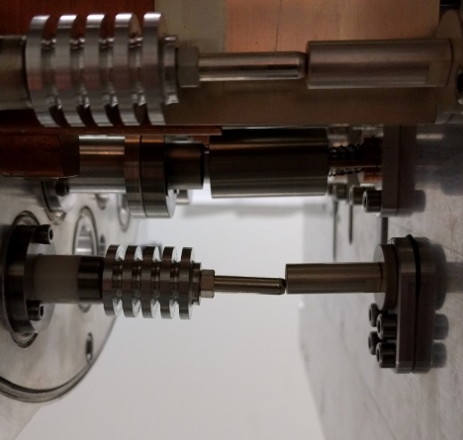
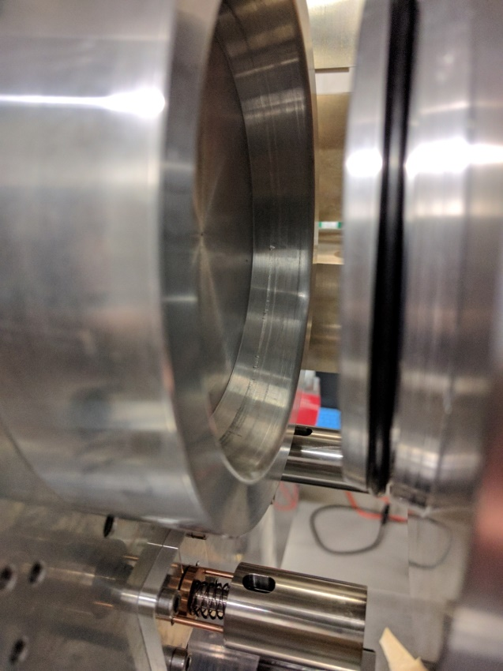
Test Stand: Target Vessel Coupling Test Stand

Slide 47
Test Stand: Target Vessel Coupling Test Stand
Target Station Development
Results:
Change from conical seal to conical alignment/face seal, allowing separation of alignment and sealing
Highlighted issues with target vessel stiffness
Highlighted importance of guiding features for alignment
Alerted design team to connector design issues
Quantified sealing force for coupling drive mechanism design
HVFT Purge Test
HVFT Material testing
Pillow Seal Testing
Extraction Electrode Feedthrough Test
Target Vessel Coupling Test Stand
TV Coupling Piston Leak Test
Pumping and Heating Investigation Stand
(PHI)

Slide 48
Test Stand: TV Coupling Piston Leak Test
Target Station Development
Goals (fulfill RS74):
Measure leak rate of target vessel tray table actuation device into the secondary volume
Measure force generated by piston and compare to required engagement force of target vessel on front end
Quantify degradation in leak rate/piston seals over life of the piston
Results drive:
Design of the TM front end
Design of the secondary gas volume
Design of the nuclear ventilation system
Design of the gas storage system
Status: Design complete, waiting for materials
HVFT Purge Test
HVFT Material testing
Pillow Seal Testing
Extraction Electrode Feedthrough Test
Target Vessel Coupling Test Stand
TV Coupling Piston Leak Test
Pumping and Heating Investigation Stand
(PHI)
Tested at
Coupling Test Stand

Slide 49
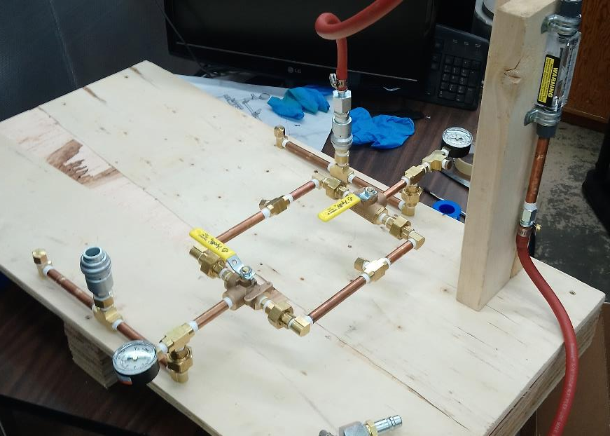
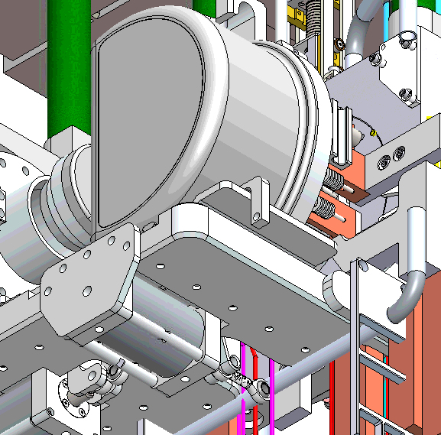
Test Stand: TV Coupling Piston Leak Test
to piston
to piston

Slide 50
Test Stand: Pumping and Heating Investigation Stand (PHI)
Target Station Development
Goals:
Perform integrated system testing of HTV: target heating, ion source, mass marker, water cooling
Realistic gamma window tests
Full service delivery to target with repeatable coupling
Long term development of target containers, emissivity optimization, target deflection, and many more
Results Drive:
Design of the target station
Design of the target vessel
Status: Design complete, waiting for parts to arrive
HVFT Purge Test
HVFT Material testing
Pillow Seal Testing
Extraction Electrode Feedthrough Test
Target Vessel Coupling Test Stand
TV Coupling Piston Leak Test
Pumping and Heating Investigation Stand
(PHI)

Slide 51
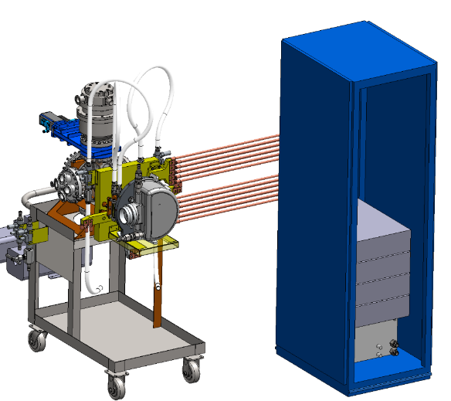
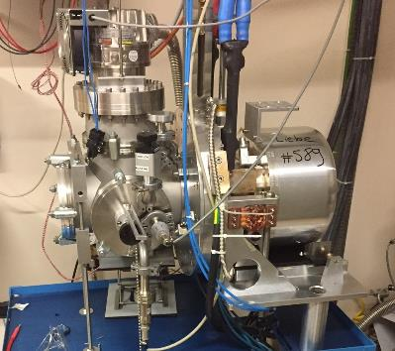
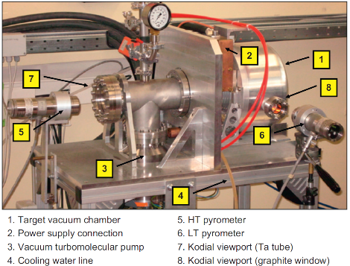
Test Stand: Pumping and Heating Investigation Stand (PHI)
ISOLDE pump-stand
SPES Target Test Stand
PHI Stand
https://doi.org/10.1016/j.finel.2011.01.005

Slide 52
Test Stand: Pumping and Heating Investigation Stand (PHI)
Combine all lessons learned at HTV development tests +
Target Station development tests
Ability to perform repeatability test on HTV coupling
Vacuum components to be reused for ARIEL labs
Power supplies reused at TISA
Future addition of coupling from converter side

Slide 53
Risk Mitigation: Tests and Development
HTV Development
Target Station Development
Operations Development
High Power Connector Test Stand
HVFT Purge Test
Remote Handling Mockup Tests
Converter Tests at
E-Linac
HVFT Material testing
Target Vessel Exchange tool tests
ARIEL Corrosion Erosion test (ACE)
Pillow Seal Testing
ARIEL Ion Source Development
Extraction Electrode Feedthrough Test
ARIEL Target Material Development
Target Vessel Coupling Test Stand
TV Coupling Piston Leak Test
ARIEL Thermal Test Stand (ATTS)
Pumping & Heating Investigation Stand
(PHI)
Target and Ion Source Acceptance Stand (TISA)
Meeting requirements for safety, reliability, and beam production

Slide 54
Test Stand: Remote Handling Mockup Tests
Operations Development
Goals (fulfill RS29):
Verify that all maintenance operations can be done using manipulators
Test designs of remote handling components in a hot cell environment
Develop tools and jigs for disassembly and maintenance
Provide feedback to the design team
Results drive:
All module front end designs
Selection and design of hot cell tools and jigs
Status: Design in progress
Remote Handling Mockup Tests
Target Vessel Exchange tool tests
ARIEL Ion Source Development
ARIEL Target Material Development
Target and Ion Source Acceptance Stand (TISA)

Slide 55
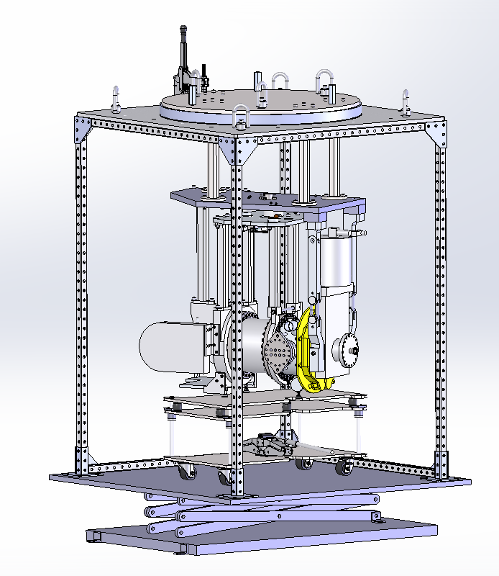
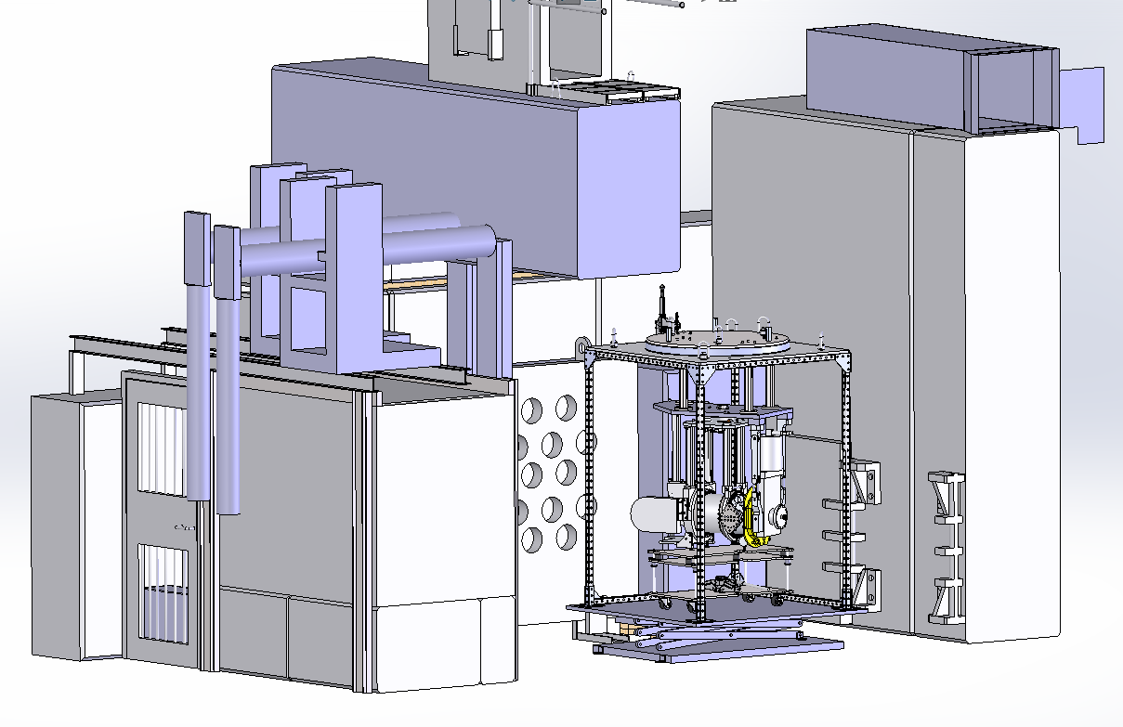
Test Stand: Remote Handling Mockup Tests

Slide 56
Test Stand: Target Vessel exchange tool tests
Operations Development
Goals (fulfill RS21, 24, 26, 33):
Test target vessel exchange tools
Ensure target exchange can be done within the operational schedule
Perform target vessel rescues using target hall cranes
Provide feedback to target vessel extraction tool design from hands on experience
Results drive:
Target vessel design, alignment features
Target vessel extraction tool design
Hot cell and vault interface
Status: Testing in progress
Remote Handling Mockup Tests
Target Vessel Exchange tool tests
ARIEL Ion Source Development
ARIEL Target Material Development
Target and Ion Source Acceptance Stand (TISA)

Slide 57


Test Stand: Target Vessel exchange tool tests
Hook Block
Ballast Weight
Plates (20 kg)
Target Transfer Tool
Prototype Rev1
Tool mounted
cameras
Lifting Bracket
Target Station
Mockup
30 kg Target
Vessel Dummy
Overview
Camera
Target Vessel Table
and Locating Pins

Slide 58


Test Stand: Target Vessel exchange tool tests
Ruler Cameras
HMI
Future Camera
Views
Crane Control Panel
For Remote-Mode

Slide 59
Test Stand: ARIEL Target Material Development
Operations Development
Goals (fulfill RS21):
Optimize current target production to meet operational requirements of ARIEL
  Aim to speed up target production from 12 wks/target to 1wk/target
Synthesize and characterize targets for ARIEL, meeting specific electron driver beam requirements
Qualification of commercially available BeO
Status: Tests ongoing
Remote Handling Mockup Tests
Target Vessel Exchange tool tests
ARIEL Ion Source Development
ARIEL Target Material Development
Target and Ion Source Acceptance Stand (TISA)

Slide 60

Test Stand: ARIEL Target Material Development
Operations Development
Results so far:
Optimized target material casting procedure to decrease number of steps in production
Vacuum limits to evaporator changed to speed up target carbonization (reduced from 3 days to 25 minutes)
Leverages existing ISAC equipment to perform development for ARIEL
Developing full loaded target from currently obtained results
Remote Handling Mockup Tests
Target Vessel Exchange tool tests
2 cm
ARIEL Ion Source Development
ARIEL Target Material Development
Example of UCx cast target disc. A target discs is a graphite foil with UC₂/C (UCx) cast on.
A full target consists on ̴ 200 to 250 UCx cast target discs.
Target and Ion Source Acceptance Stand (TISA)

Slide 61
Test Stand: Target and Ion Source Acceptance Stand (TISA)
Operations Development
Goals (fulfill RS2, 3, and many more):
Enable coupling and operation of target/ion sources in a system identical to that on-line
Prototyping full ARIEL system from converter module up to and including the pre-separator magnet
See integrated effects of coupling modules
Test vacuum seal repeatability
Results Drive:
Target station design and validation testing
Status: Design in progress
Remote Handling Mockup Tests
Target Vessel Exchange tool tests
ARIEL Ion Source Development
ARIEL Target Material Development
Target and Ion Source Acceptance Stand (TISA)

Slide 62

Test Stand: Target and Ion Source Acceptance Stand (TISA)
Validates high voltage system design
Service delivery to target
Validates mechanical design and alignment of system
Position and functionality of optics

Slide 63
Test Stand: Target and Ion Source Acceptance Stand (TISA)
Acceptance tests to prevent premature failure (~35 targets per year).
Commissioning/alignment verification of components prior to on-line installation.
Reproducing on-line issues.
Target and ion source development.

Slide 64
Technically Challenging Areas
 |  | HTV Dev Tests + ATTS Component level testing | TS Dev Tests + PHI HTV + TS integrated testing | TISA ARIEL system integrated testing
e⁻ to γ converter | Material
 | Cooling
 | Lifetime
γ window | Cooling
Target container | Heating
Target vessel | Cooling
 | Manufacturability
 | Coupling
 | Conditioning
Target station | Interfaces
 | HVFT Operations
 | Ion beam extraction
 | Acceptance tests

Slide 65

Technically Challenging Area: Operations
Technical Challenges
Target material production
  Synthesis of ARIEL targets for optimal release of purer neutron rich isotopes (ARIEL Target Material Dev)
Ion source optimization
  Need confirmation that simulations are correct? (ARIEL Ion Source Dev)
Target Vessel Extraction/Installation
  Accurate and repeatable process (Target Extraction Tool Tests)
  Rescue stuck target vessels (Target Extraction Tool Tests)
Design for operability and maintainability
  Manipulator reach and access (Mockup Test stand)
  Maintenance and End of Life disassembly (Mockup Test stand)
Target station interface
  Allow vertical extraction of modules in case of failure (Pillow seal tests)

Slide 67
Test Stand: High Voltage Feedthrough Material Testing
Target Station Development
Goals (fulfill RS89):
Qualify high voltage feedthrough resin material for use
Test for electrical insulation qualities for 60kV operation
Quantify mechanical properties of resin material
Results Drive:
High voltage feedthrough mechanical design
Target station design
Status: specifying material samples for testing
HVFT Purge Test
HVFT Material testing
Pillow Seal Testing
Extraction Electrode Feedthrough Test
Target Vessel Coupling Test Stand
TV Coupling Piston Leak Test
Pumping and Heating Investigation Stand
(PHI)

Slide 68
Test Stand: Extraction Electrode Feedthrough Test
Target Station Development
Goals (fulfill RS17, 18, 19):
Verify mechanical design of extraction electrode assembly
Quantify/remove backlash in the system
Gain hands on experience with components
Results drive:
Target station design
Status: Design in progress
HVFT Purge Test
HVFT Material testing
Pillow Seal Testing
Extraction Electrode Feedthrough Test
Target Vessel Coupling Test Stand
TV Coupling Piston Leak Test
Pumping and Heating Investigation Stand
(PHI)

Slide 69

Test Stand: ARIEL Corrosion Erosion test (ACE)
Welded backplate testing
Notes:
Add photo of converter fins, pre-test results from UVIC, fluka simulation, thermal simulation results from brendan

Slide 70
Test Stand: HVFT Purge test
Target Station Development
Goals:
Quantify amount of active water left in the target module after a gas purge
Provide feedback to high voltage feedthrough design
Results Drive:
High voltage feedthrough design
Target station design
Hot cell design
Status: Testing complete
HVFT Purge Test
HVFT Material testing
Pillow Seal Testing
Extraction Electrode Feedthrough Test
Target Vessel Coupling Test Stand
TV Coupling Piston Leak Test
Pumping and Heating Investigation Stand
(PHI)

Slide 71



Test Stand: HVFT Purge test

Slide 72




Test Stand: HVFT Purge test
After initial purging, with no purging feature

Slide 73
Test Stand: ARIEL Ion Source Development
Operations Development
Goals:
Validating simulations for ion beam properties for RIB transport and CANREB
Perform calibrations of magnetic field, temperature, and emittance at the ion source for comparison to simulations
Use calibrations and simulations to optimize ion source performance
Results drive:
Optimization and design of ARIEL ion sources for yield, beam quality, and purity
Status: Tests ongoing
Remote Handling Mockup Tests
Target Vessel Exchange tool tests
ARIEL Ion Source Development
ARIEL Target Material Development
Target and Ion Source Acceptance Stand (TISA)

Slide 74


Test Stand: ARIEL Target Material Development
Emittance Simulation
Emittance Measurement

Slide 75


Test Stand: ARIEL Target Material Development
Magnetic Field Measurements
Temperature Measurements

