Slide 1
AETE Concept Review
Present Schedule
Critical Path
Key Dependencies
Alexander Gottberg on behalf of the AETE Team
February 22, 2018

Slide 2
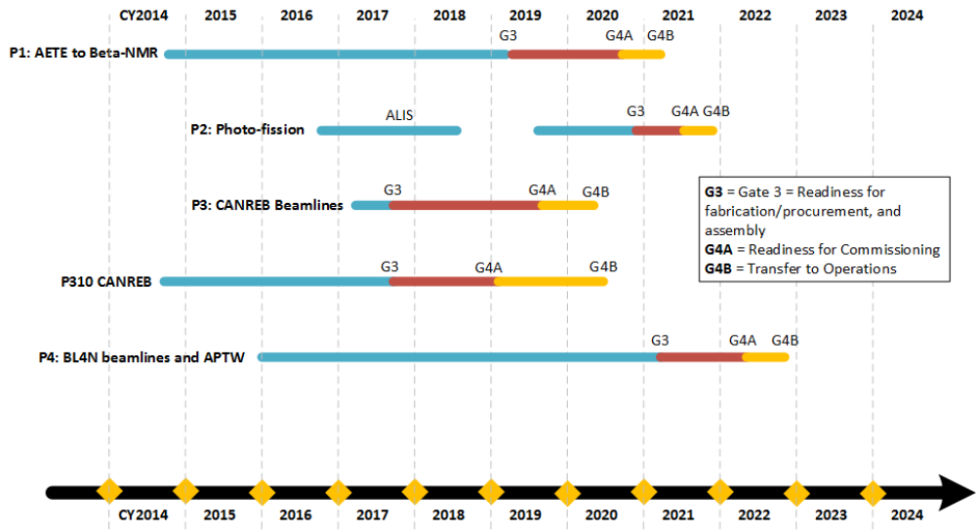
Overall Schedule as Presented at ASSC, October 2017

Slide 3
Schedule Logic
Schedule is driven by:
Critical path
  High-voltage feedthrough (long lead time)
  Converter and target thermal development (design input for target vessel design)
  Early completion of TISA to allow time for design iteration
  AETE critical APTW development (impact on AETE assembly)
  Critical interfaces to allow other projects to progress (e.g. early procurement of hot cell ➔ freezing premature designs)
Retire highest technical risks as early as possible
  Tests and prototypes, especially converter tests, target thermal tests, target vessel prototypes, coupling tests
  Pillow seals as only available technical solution to allow for fail-safe extraction of failed target module
  High-voltage feedthrough (if redesign is required the target module will change considerably)
  Secondary gas concept and cooling concept for secondary gamma deposition
Highest budget risks even if not on critical path or technical risk
  Target/ion source front-end
  High-voltage feedthrough
  Secondary gas concept
Schedule is constrained by:
Limited manpower
  After leveling, schedule calls for 19 FTE (≈85% of tasks covered)
  Currently approx. 9 FTE available
  Resource action plan will make 14 FTE available in next months
Availability of TRIUMF technical services
  Test stands are on critical path and often progress slower than scheduled due to delay in service installations
Budget
  Some streamlined solutions are not possible and additional internal development work is required to meet budget (e.g. secondary gas, shielding, support structure)
  Choosing in-house development over outsourcing, even if service or product is available externally (e.g. ALIS clean room, quick disconnectors)
Schedule is relaxed by:
  Availability of designs, drawings, models, documentation, manpower from collaborating institutes
  (CERN, VECC, SCK)

Slide 4
AETE Near-Critical Path
High-voltage feed thru
TIS/FE developement
TISA development
Service connections

Slide 5
AETE Near-Critical Path
Tests at PHI stand
Target thermal tests
TISA integration
CTS no longer on critical path because solution had to be assumed to progress with design

Slide 6
Critical Milestones
Therapeutic isotopes transfer system concept review (March 2018)
AETE hermetic target vessel concept review (March 2018)
CTS results presented (April 2018)
AETE critical APTW kick-off meeting (April 2018)
ATTS thermal test results presented (April 2018)
High-voltage feed thru concept review (May 2018)
APTW entrance module concept review (May 2018)
Electron beam raster concept review (June 2018)
Phi stand ready for testing (June 2018)
Secondary gas concept review (June 2018)
Phi stand phase 1 tests complete (July 2018)
AETE HV chase concept review (July 2018)
Target ion source frontend concept review (July 2018)
Phi stand phase 2 (coupling system) ready for testing (August 2018)
APTW HTV concept review (August 2018)
Service Space concept review (October 2018)
AETE concept review (October 2018)

Slide 7
Schedule and Project Risks
Manpower ramp-up unsuccessful or insufficient
The ARIEL phase 4 schedule is based on a phase 1 schedule snapshot that was taken approx. 2 years ago before the phase 1 schedule was developed in detail, 2018 will see a ramp-up of phase 4 work for a team that is still heavily involved in phase 1 development
Phase 1 and phase 4 completion are moving closer together and the overlap of same-skill resource needs increases
Possibilities for APTW installation will be limited during AETE commissioning ➔ APTW needs to be developed concurrent with AETE
Electron-to-gamma converter concept cannot be validated at ongoing irradiation tests, or accelerator not available to perform tests
Major design deficiencies identified at TISA
Target and converter thermal management does not allow for 100 kW operation
Insufficient experienced human resources (the team is motivated, engaged, efficient but has very limited technical experience in the field)
Large budget uncertainties on some line items (some wiggle room through module shield plug, converter module, target vessel budgets)

