Slide 1
Particle Physics Faculty Meeting
Agenda
News/Updates
20-year vision summaries
Quantum Technologies
Scientific Computing
Fundamental Physics with AMO
Particle Physics

Slide 2
Sudden News

Slide 3
Science Week
August 16-20
Monday and Tuesday
Recent achievements
+ Keynote speakers
s

Slide 4
Science Week
Monday and Tuesday
Recent achievements (focus on early careers at all levels)
Particle Physics
Max Swiatlowski
Patrick de Perio
ALPHA postdoc (TBD)
Luise Poley
Nirmal Raj
Poster session (15-20 total across the lab)
Particle Physics (experiment) 3-4
SciTech 1
SciComp 1
Theory 2
Please send suggested speakers and titles
s

Slide 5
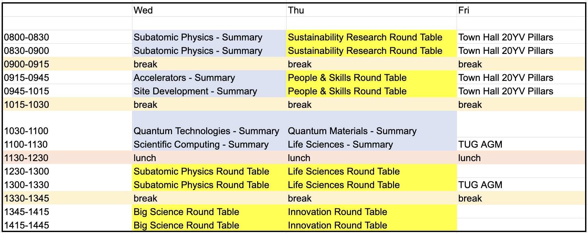
Science Week
Invited keynote speakers for Particle Physics
Veronica Sanz (Valencia/Sussex)
Eckhard Elsen (CERN/DESY)
Marcel Demarteau (ORNL)
Wednesday and Thursday – 20-year vision focus
Summaries of “listening and visioning” phase
+ Town Hall style “Round Tables”
s

Slide 6
Covid
From Adrian during yesterdays townhall

Slide 7
Workday
There is an effort undergoing to document and summarize questions and concerns as to how Workday might affect us in our work
This includes an ongoing dialogue with finance/accounting
If you are interested in contributing, please contact Beatrice Franke who is starting to collect feedback and questions

Slide 8
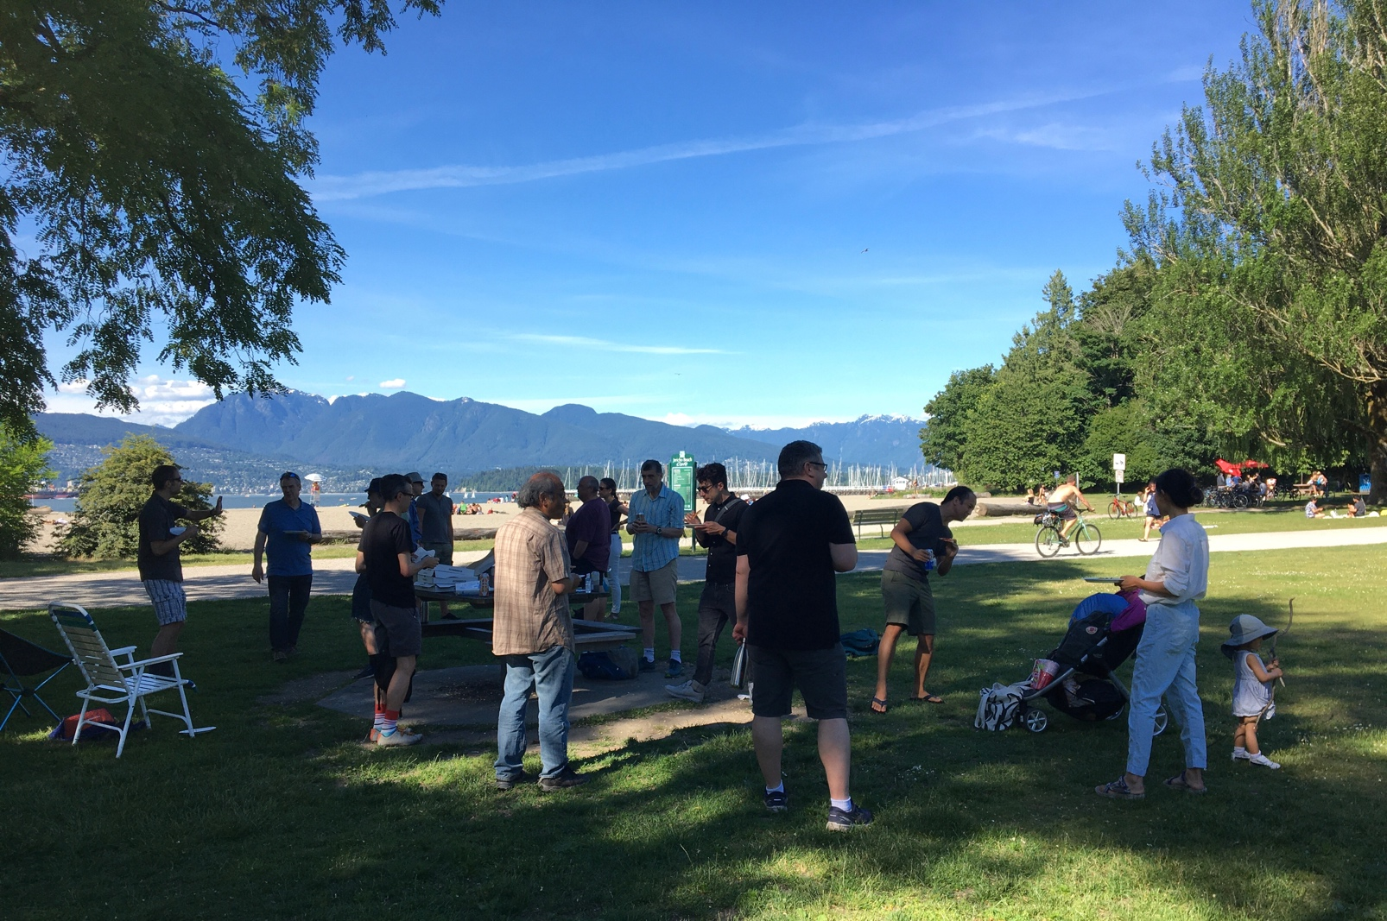
Jericho Meeting
Thanks to everyone who came out
Good discussions
Beautiful day

Slide 9
AOB

Slide 10
Next Meeting
August 12th

