Slide 1
Lessons learned from the US program on Nb₃Sn magnets for HL LHC, applicable to future IR2 quadrupoles at the EIC
P. Ferracin
on behalf of the US LARP/AUP and CERN MQXF collaboration
EIC Accelerator Partnership Workshop 2021
October 26th, 2021
Virtual

Slide 2
Acknowledgements
LARP and US HL-LHC Accelerator Upgrade Project (AUP)
  BNL: K. Amm, M. Anerella, A. Ben Yahia, H. Hocker, P. Joshi, J. Muratore, J. Schmalzle, H. Song, P. Wanderer
  FNAL: G. Ambrosio, G. Apollinari, M. Baldini, J. Blowers, R. Bossert, R. Carcagno, G. Chlachidze, J. DiMarco, S. Feher, S. Krave, V. Lombardo, C. Narug, A. Nobrega, V. Marinozzi, C. Orozco, T. Page M. Parker, S. Stoynev, T. Strauss, M. Turenne, D. Turrioni, A. Vouris, M. Yu
  LBNL: D. Cheng, P. Ferracin, L. Garcia Fajardo, E. Lee, M. Marchevsky, M. Naus, H. Pan, I. Pong, S. Prestemon, K. Ray, G. Sabbi, G. Vallone, X. Wang
  NHMFL: L. Cooley, J. Levitan, J. Lu, R. Walsh
CERN: HL-LHC Project
  A. Ballarino, H. Bajas, M. Bajko, B. Bordini, N. Bourcey, S. Izquierdo Bermudez, H. Felice, S. Ferradas Troitino, L. Fiscarelli, J. Fleiter, M. Guinchard, O. Housiaux, F. Lackner, F. Mangiarotti, A. Milanese, P. Moyret, J.C. Perez, H. Prin, R. Principe, E. Ravaioli, T. Sahner, S. Sequeira Tavares, E. Takala, E. Todesco

Slide 3
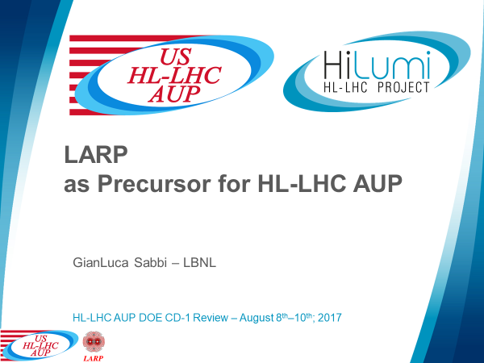
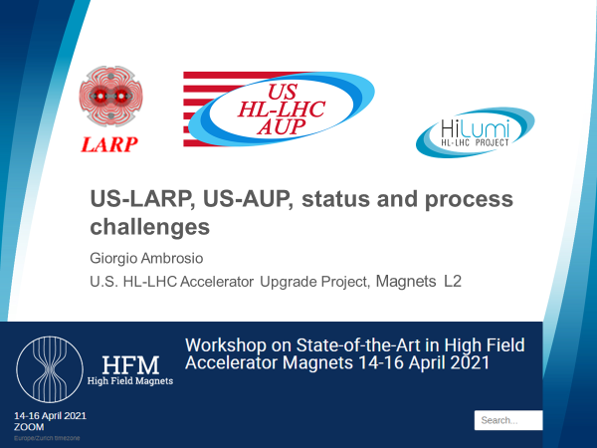


Acknowledgements

Slide 4

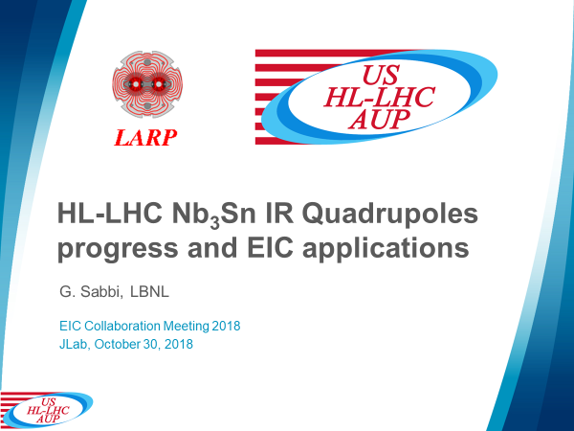
Acknowledgements

Slide 5
Outline
R&D on Nb₃Sn quadrupoles (LARP)
HL-LHC and MQXF (LARP/AUP and CERN)
Nb₃Sn quadrupole magnets for EIC
Conclusions

Slide 6
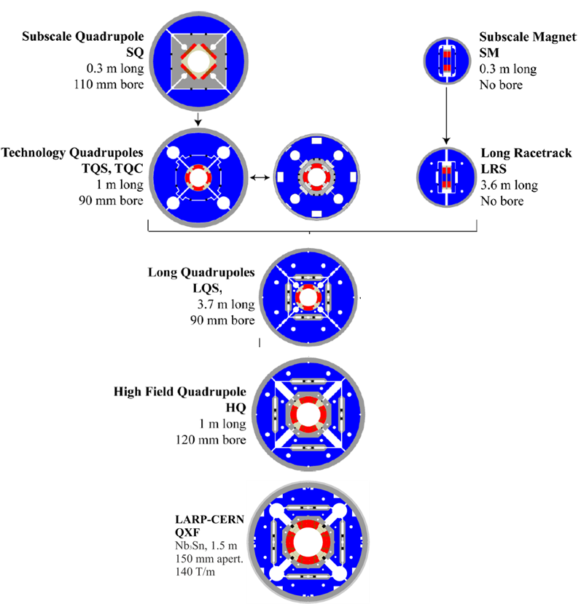
Overview of R&D on Nb₃Sn quadrupole magnets for LHC Luminosity Upgrade
US LHC Accelerator Research Program LARP (2003-2018)
US Accelerator Upgrade Project AUP (2018-present)
CERN HL-LHC (2011-present)
MQXF
1 m, 4.2 m, and 7.15 m long
150 mm aperture

Slide 7
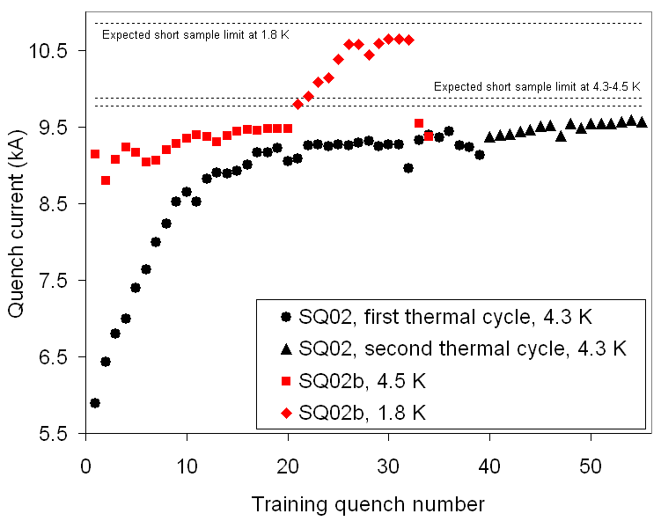
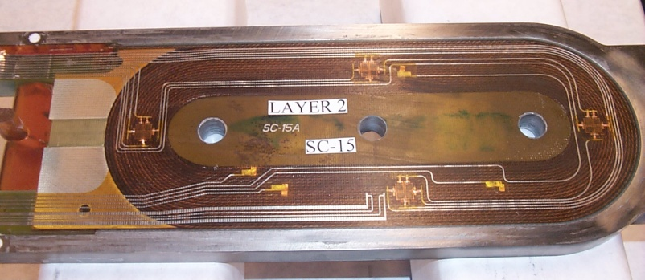
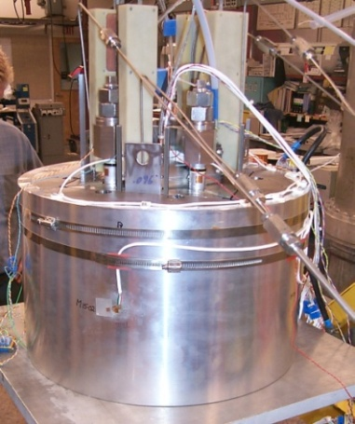
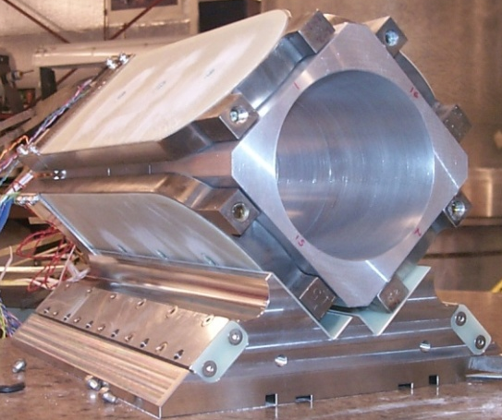
Subscale quadrupole SQ
110 mm aperture
0.3 m length
Racetrack coils
Demonstrated assembly and loading procedure
Conductor characterization
  Measurements of quench propagation velocity
Validation of FE models

Slide 8
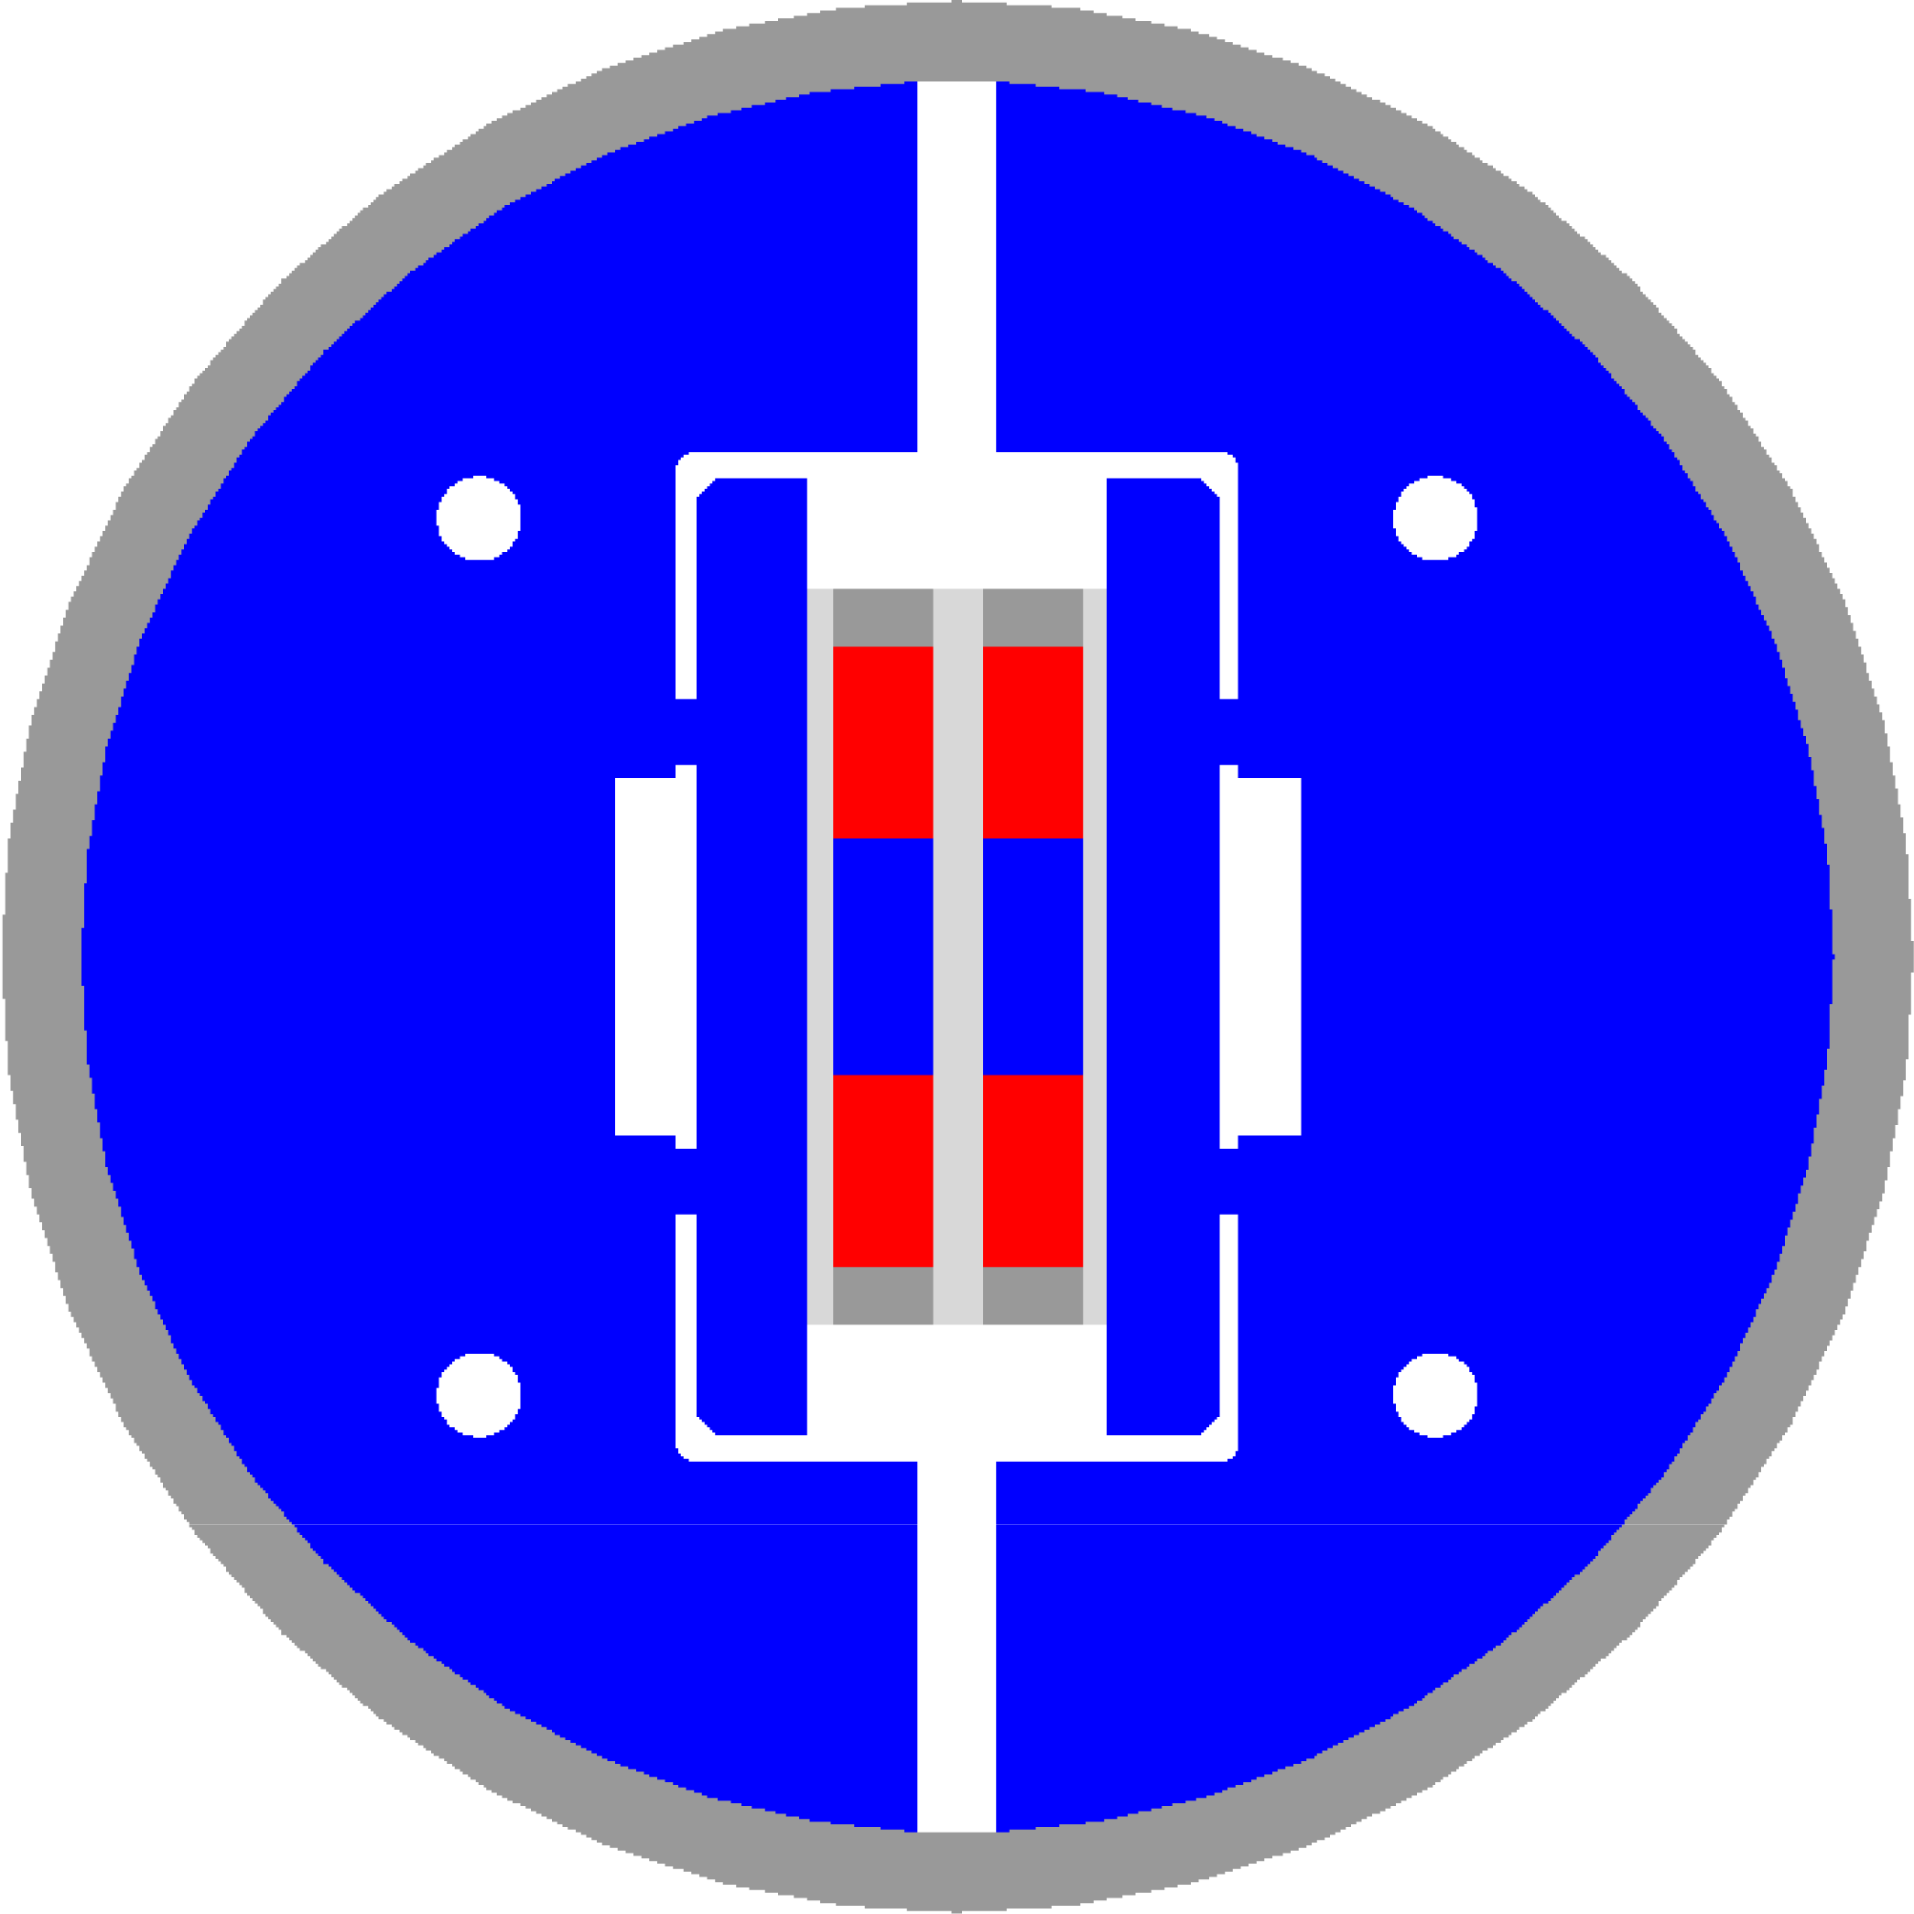
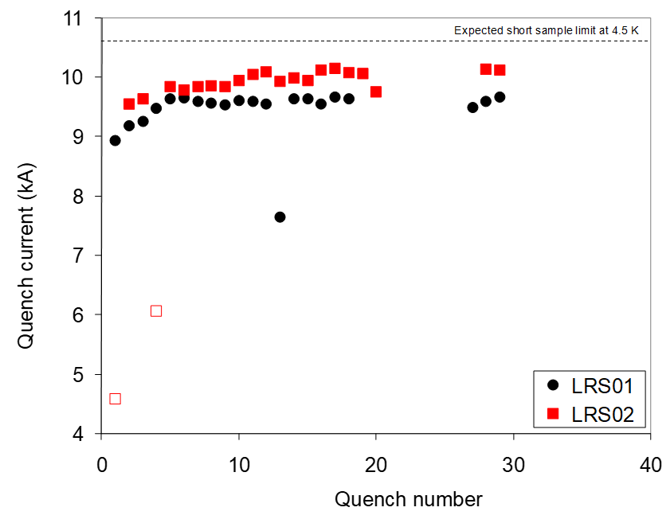
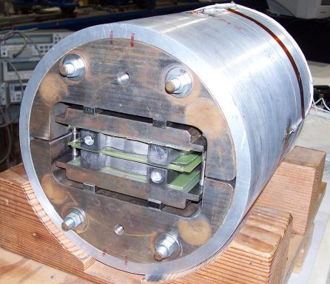
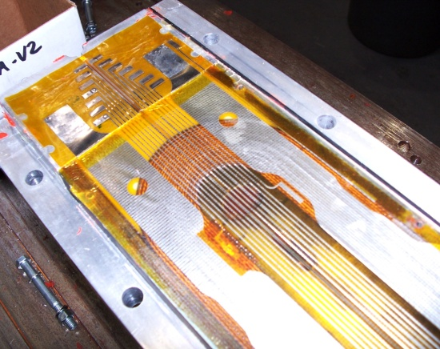
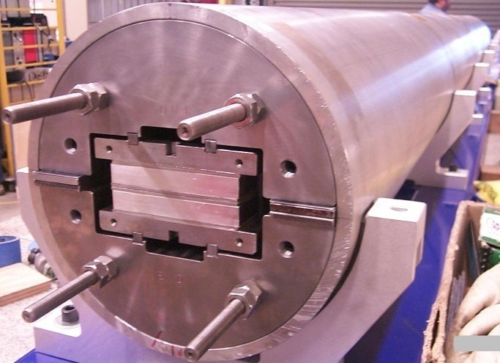
Long Racetrack (LR)
Common-coil (dipole)
3.6 m length
Racetrack coils
First scale up of coil and structure
Coil R&D: handling, reaction & impregnation
Structure R&D: friction effects, assembly

Slide 9
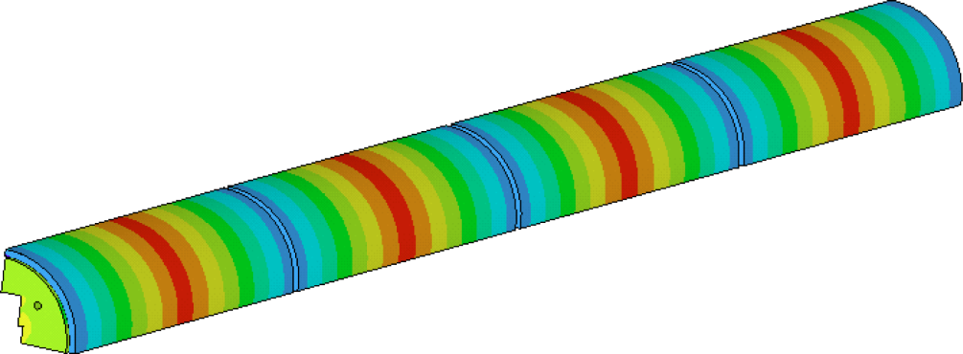
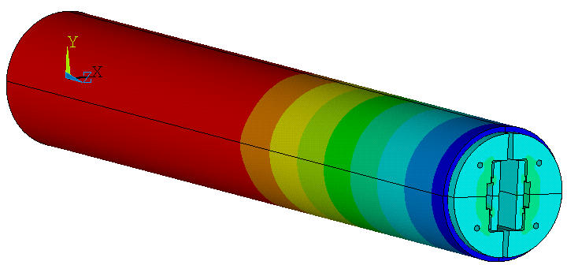
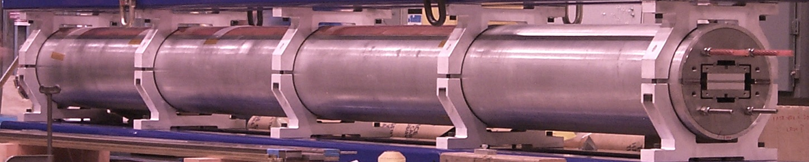
Long Racetrack (LR)
Extensive study of 3D mechanical effect in long structure with aluminum shells
First segmented al shell
  Reduction of axial strain
  More uniform coil stress

Slide 10
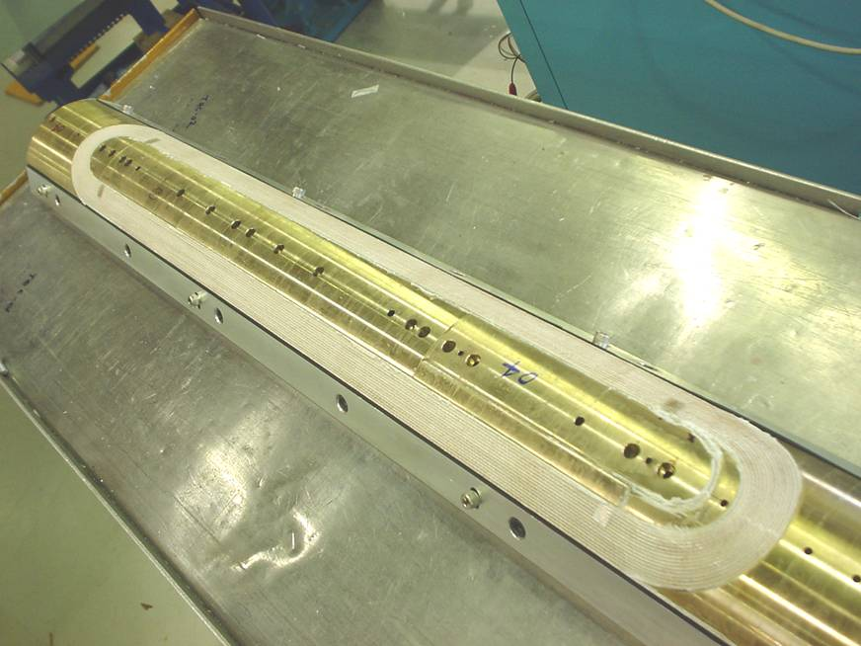
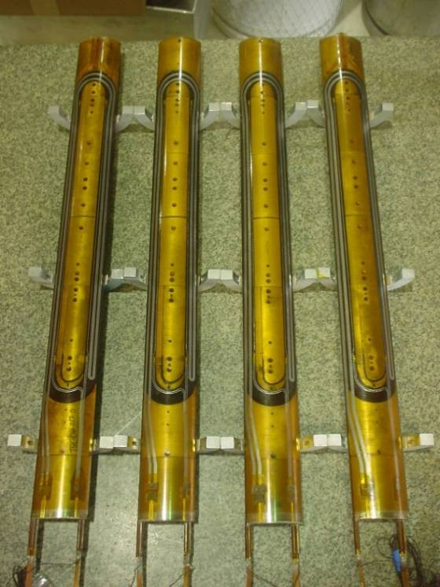
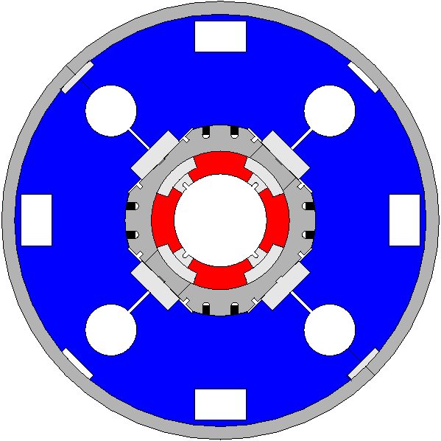
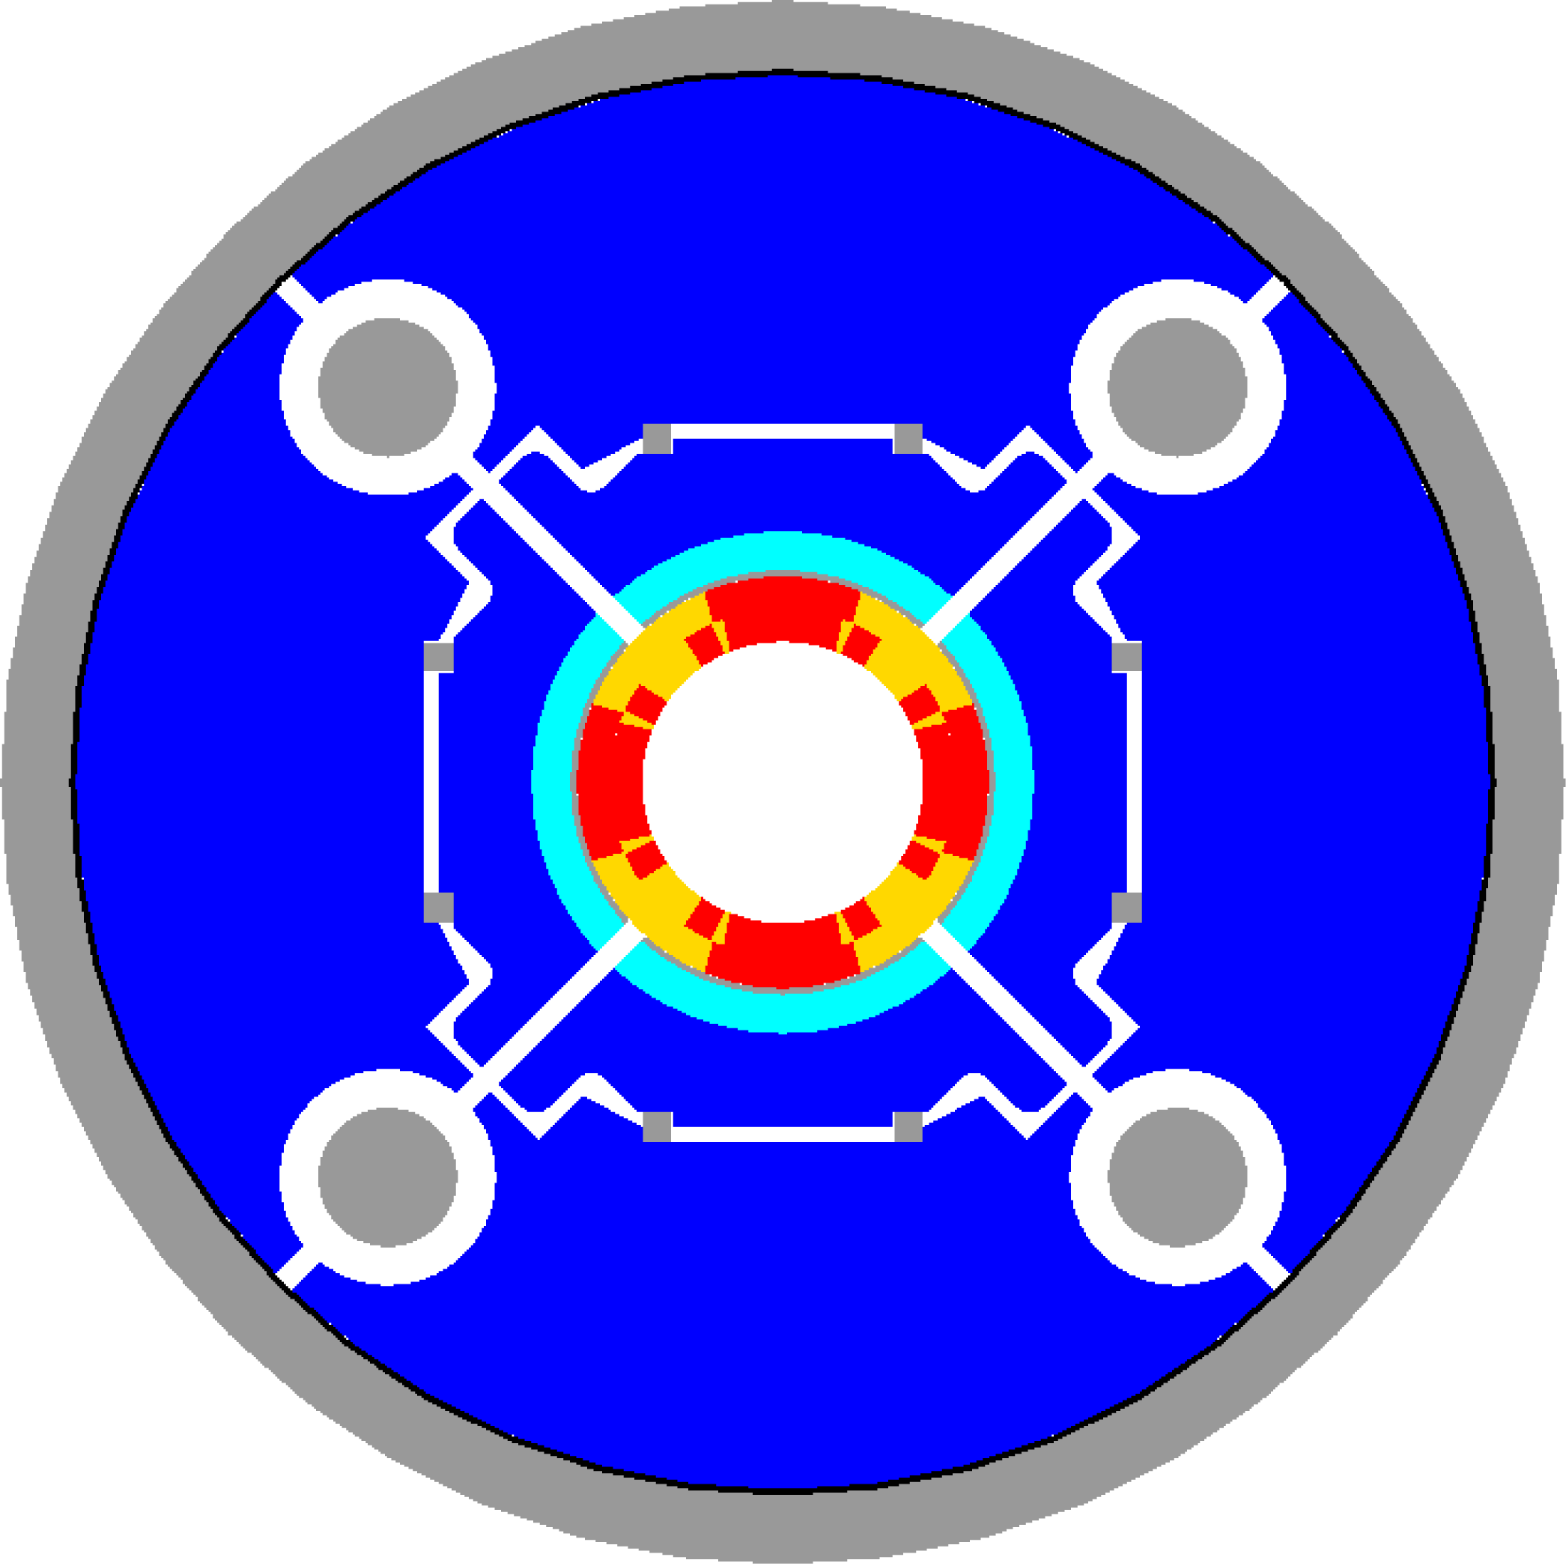
Technological Quadrupoles TQ
90 mm aperture
1 m length
Double-layer, cosθ coils
Cos-theta coil design and fabrication process
Two support structures, same coils
  TQS (al-shell based)
  TQC (ss-collar based)
TQC
TQS

Slide 11
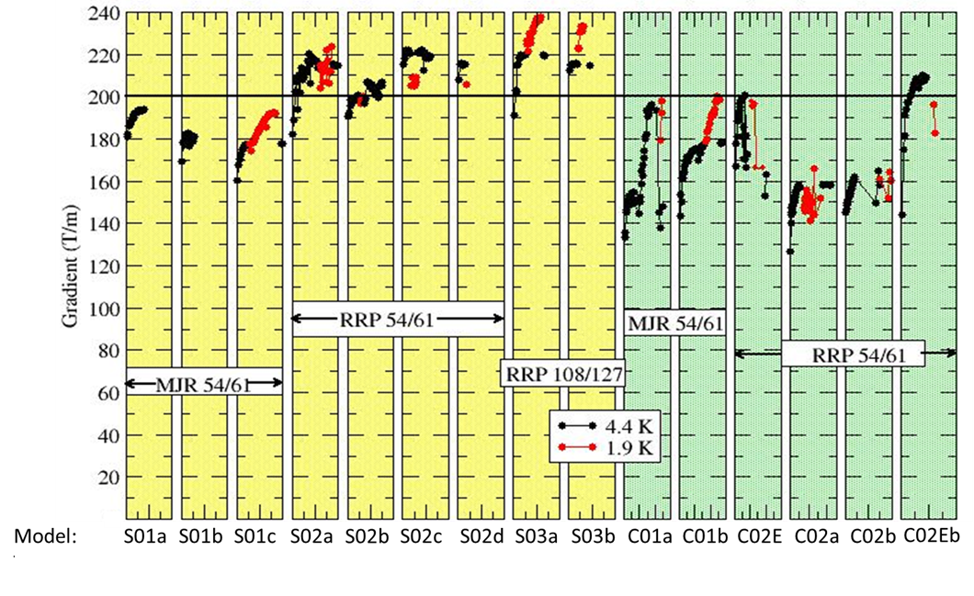
Technological Quadrupoles TQ
Two mechanical structures were developed for the TQ coils and their performance was compared in a series of 15 tests
Both structures surpassed the target gradient of 200 T/m
The shell structure was selected

Slide 12
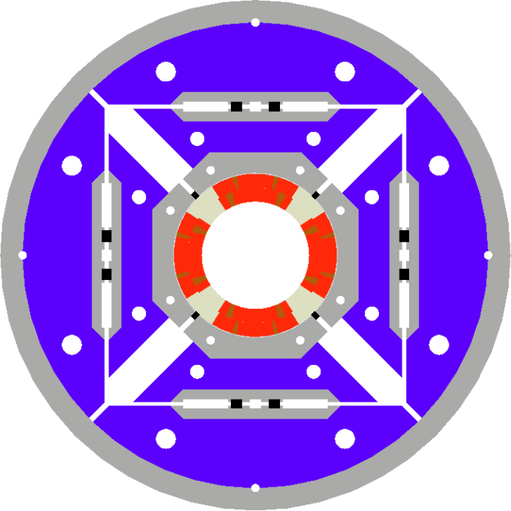
The aluminum shell based concept
Pre-load with
  Water-pressurized Bladders
  Loading keys
  Aluminum shell
    Segmented (from LR)

Slide 13
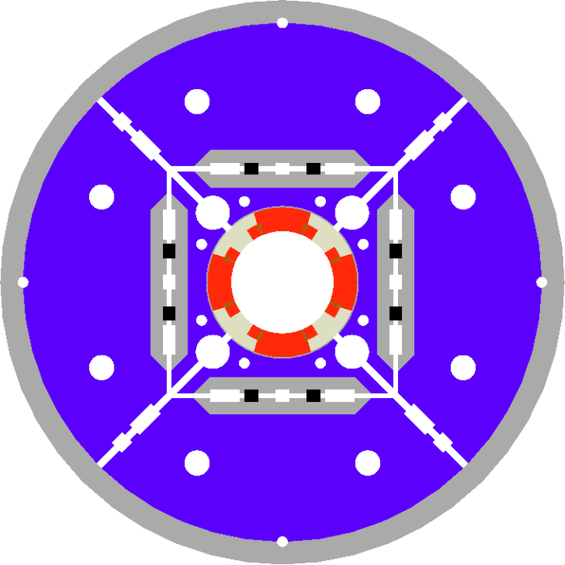
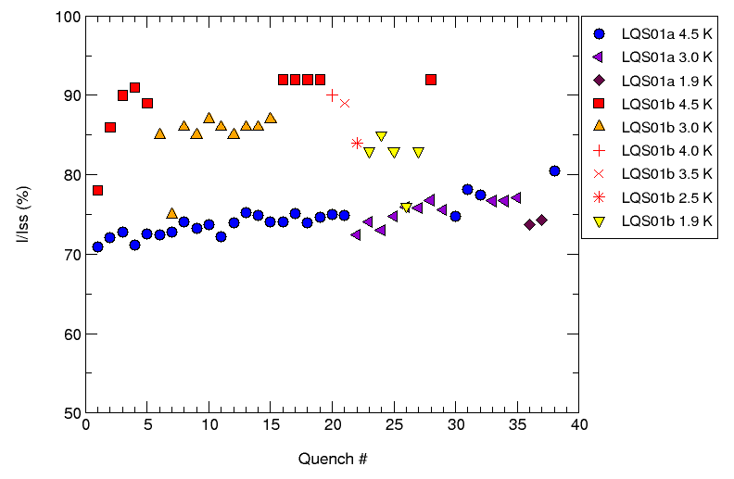
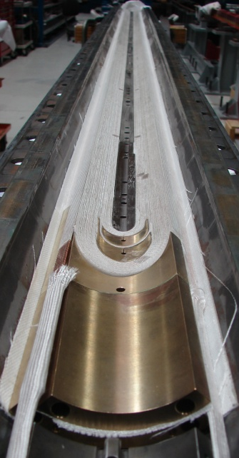
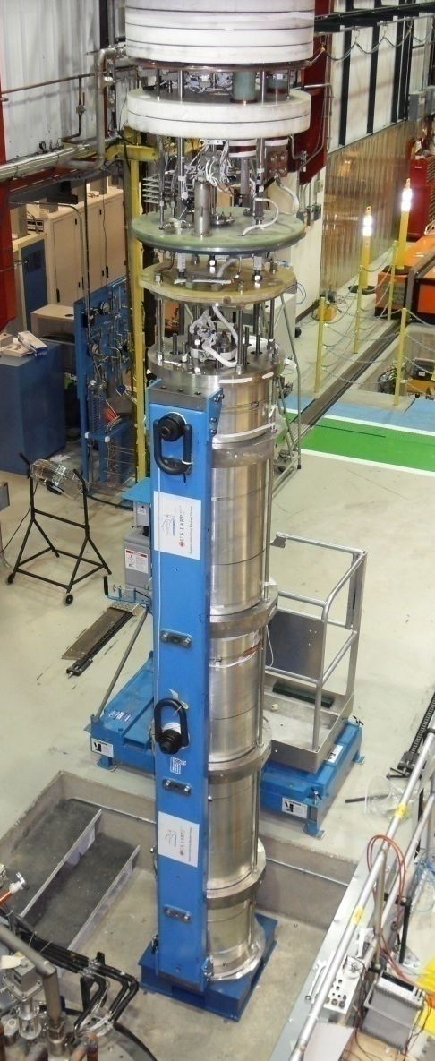
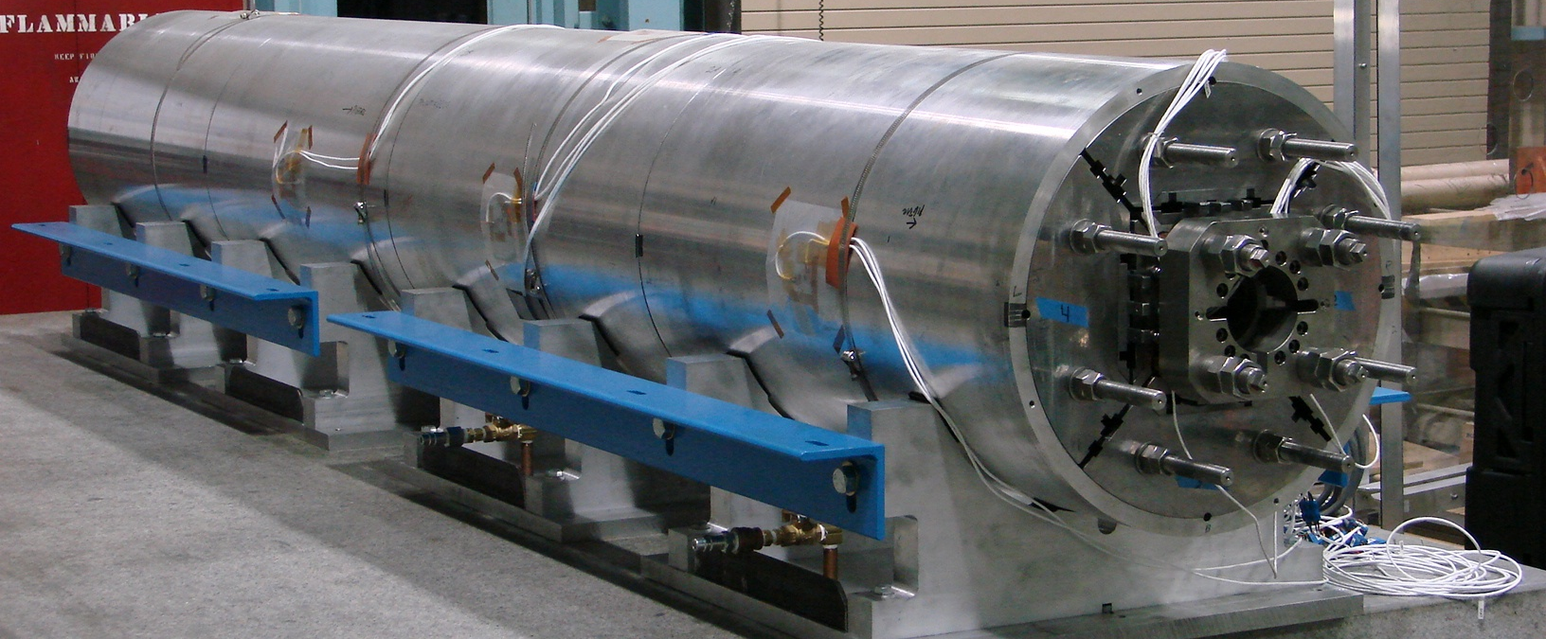
Long quadrupole LQ
90 mm aperture
3.5 m length
Double-layer, cosθ coils
LARP milestone
First scale-up of cosθ coils and quadrupole shell structure

Slide 14
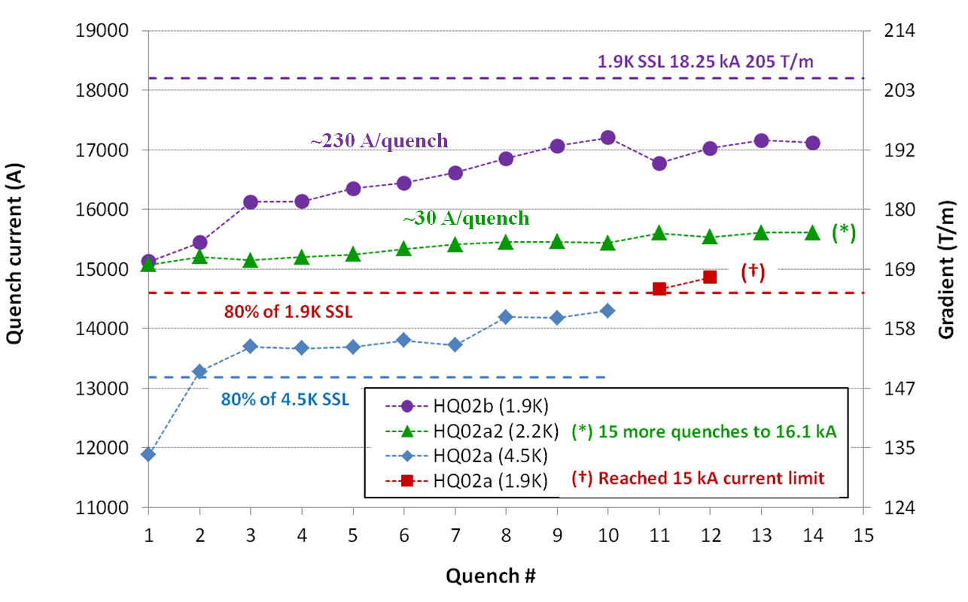
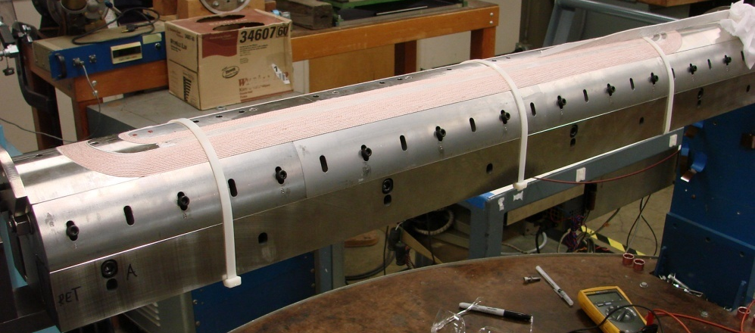
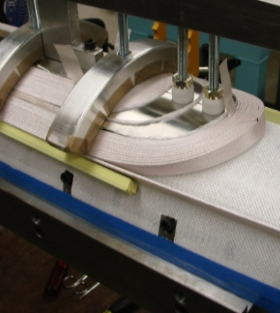
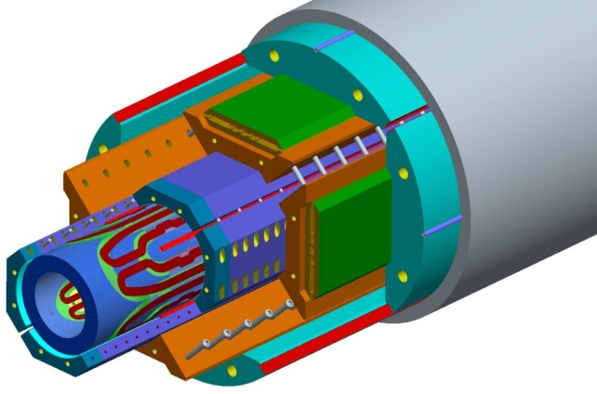
High field quadrupole HQ
120 mm aperture
1 m length
Double-layer, cosθ coils
R&D on larger aperture and “accelerator quality” features
  Full alignment of all components

Slide 15
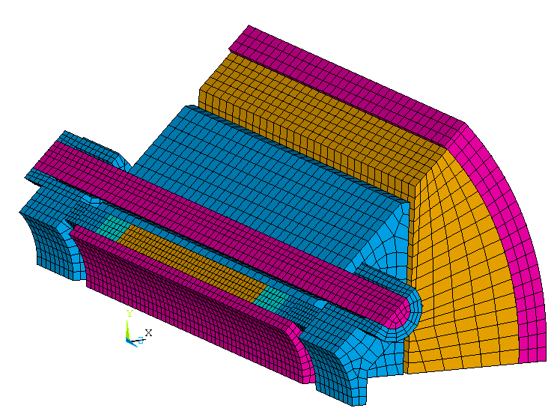
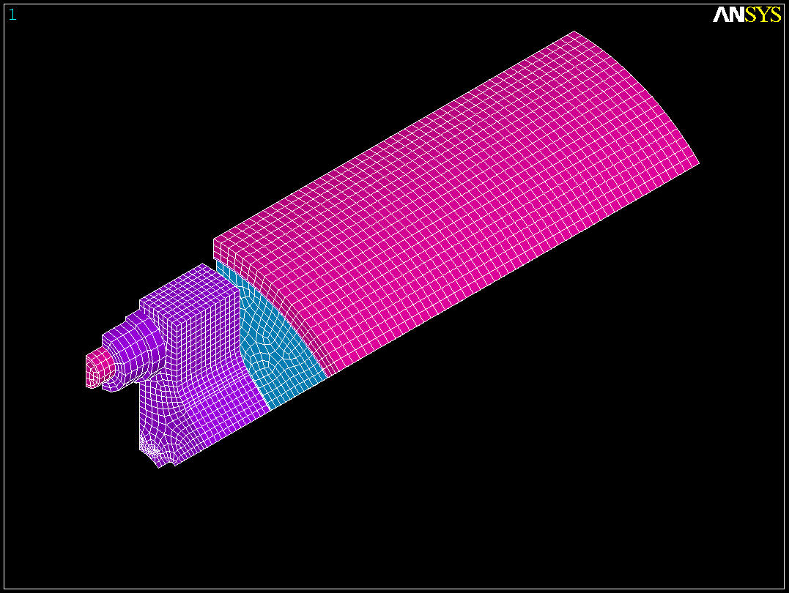
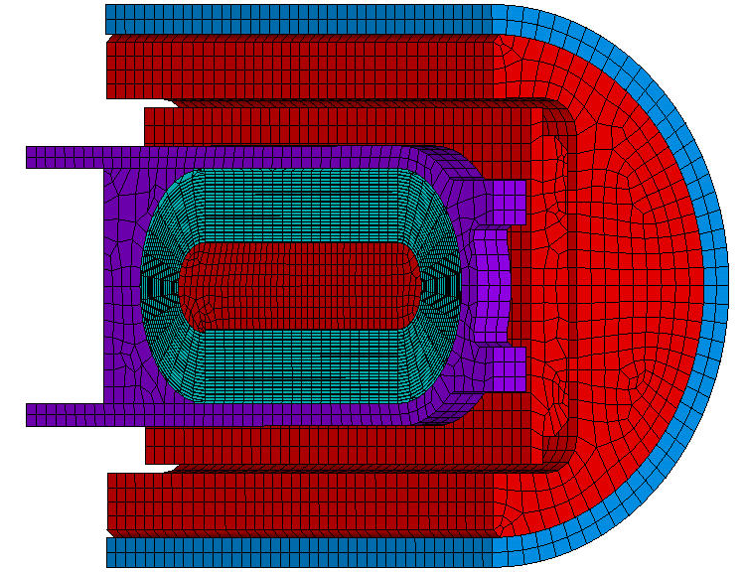
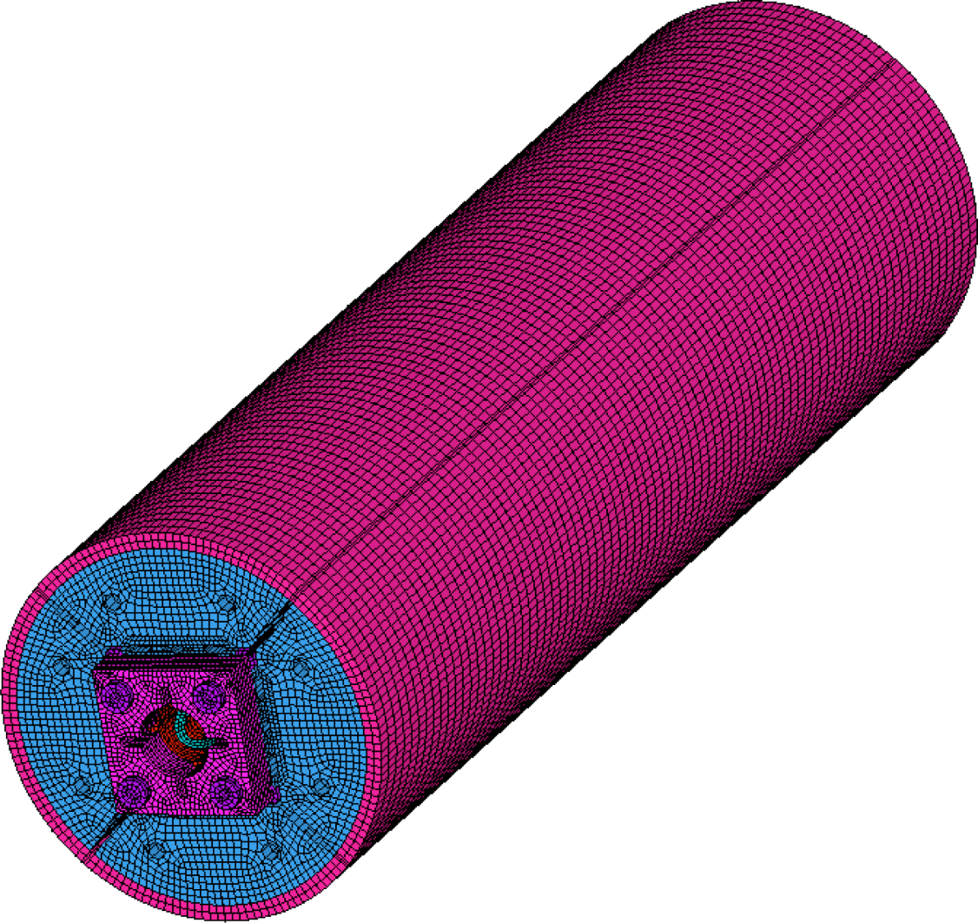
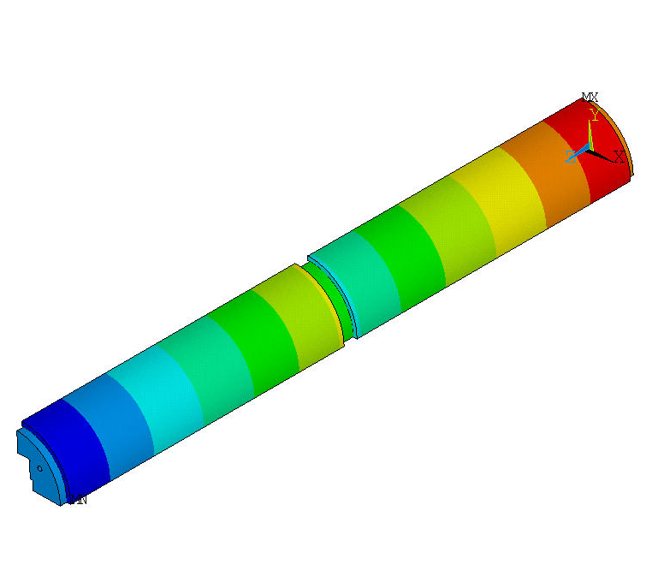
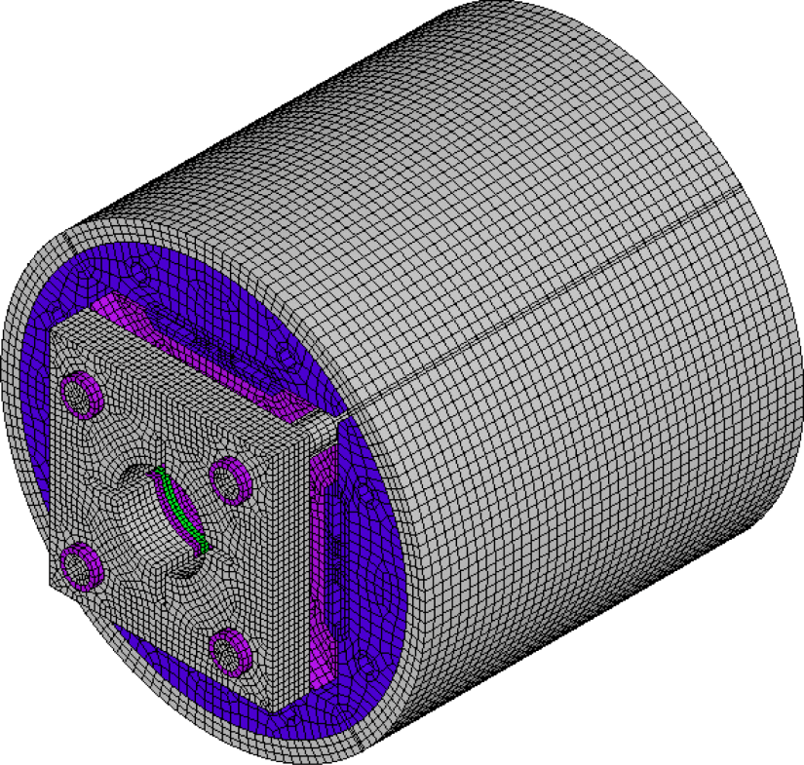
3D modeling for mechanical analysis
SQ
TQS
SM
LQS
LRS
HQ

Slide 16
Outline
R&D on Nb₃Sn quadrupoles (LARP)
HL-LHC and MQXF (LARP/AUP and CERN)
Nb₃Sn quadrupole magnets for EIC
Conclusions

Slide 17
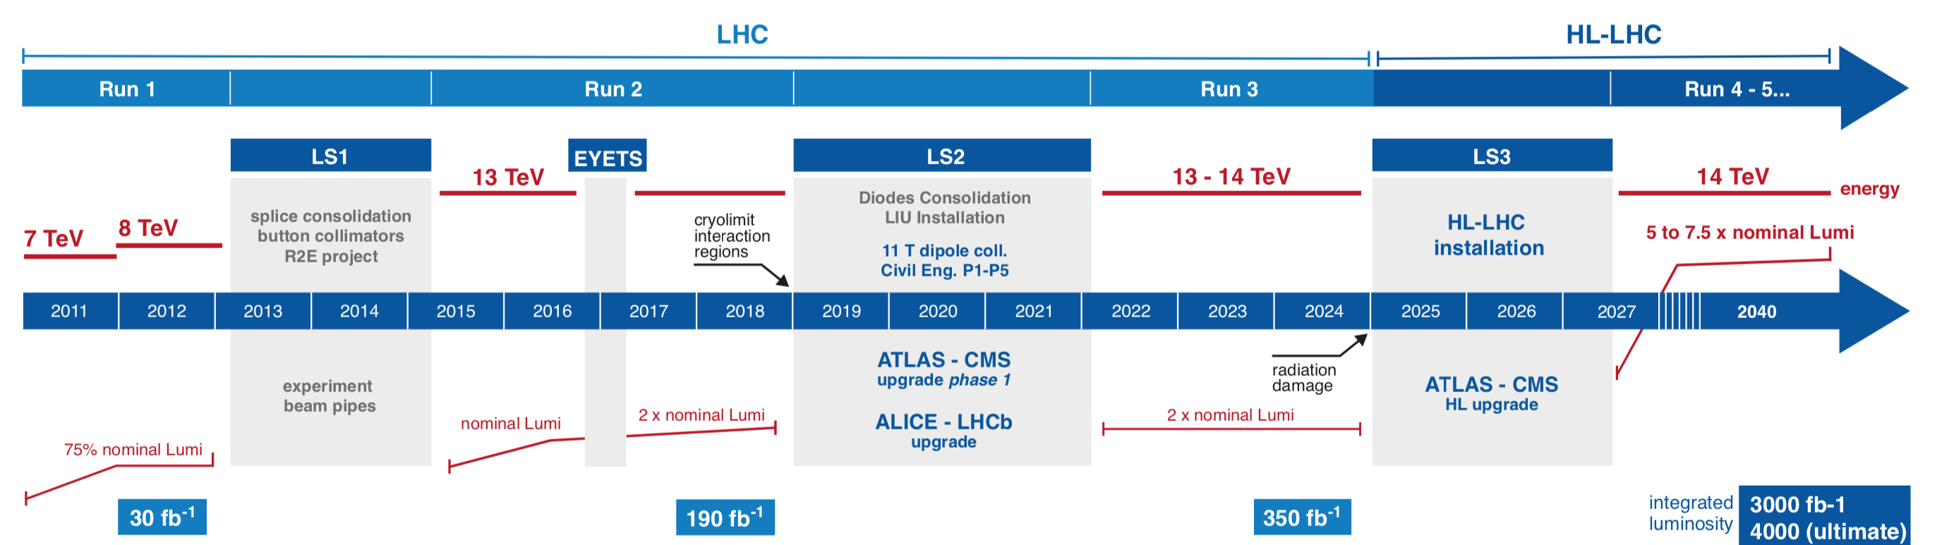
From LHC to HL-LHC
LHC operating at 6.5 TeV
In the period 4
  Peak luminosity of 2⋅10³⁴ cm⁻²s⁻¹
  Integrated luminosity of 350 fb⁻¹
High Luminosity LHC (HL-LHC)
  Upgrade the Interaction Region in 2025-2027
  Peak luminosity of 5 to 7⋅10³⁴ cm⁻²s⁻¹ → 3000 fb⁻¹
  3000 fb⁻¹ integrated luminosity in following ~12 years

Slide 18
HL-LHC Interaction Region
New inner triplet quadrupole
  From 70 mm aperture Nb-Ti to 150 mm aperture Nb₃Sn
    Larger aperture to reduce the beam size
    Nb₃Sn allows keeping a compact triplet notwithstanding the larger aperture
LHC
HiLumi LHC

Slide 19
HL-LHC IR quadrupoles
Q1/Q3 (by US-AUP)
  2 magnets (MQXFA) per cold mass, each 4.2 m long
Q2a/Q2b (by CERN)
  1 magnet (MQXFB) per cold mass, 7.15 m long, with corrector
Different lengths, but identical design

Slide 20
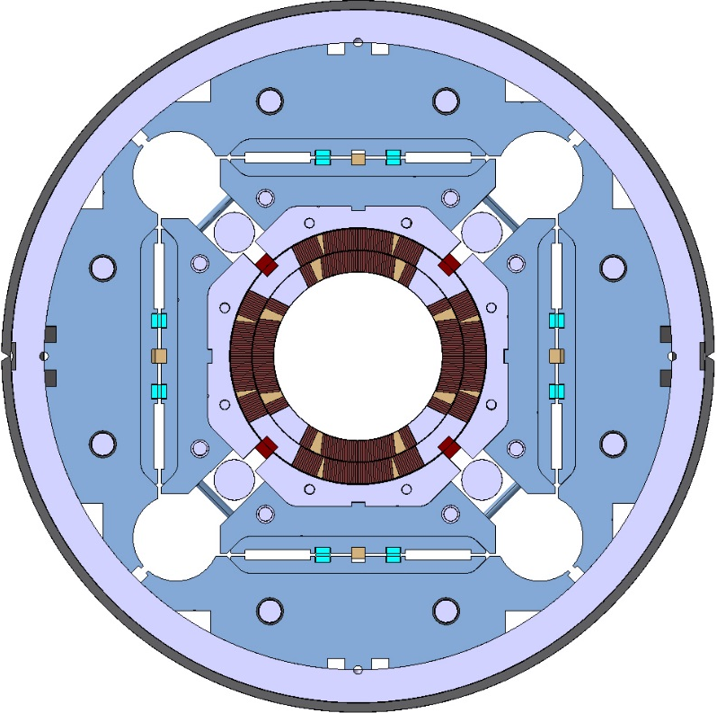
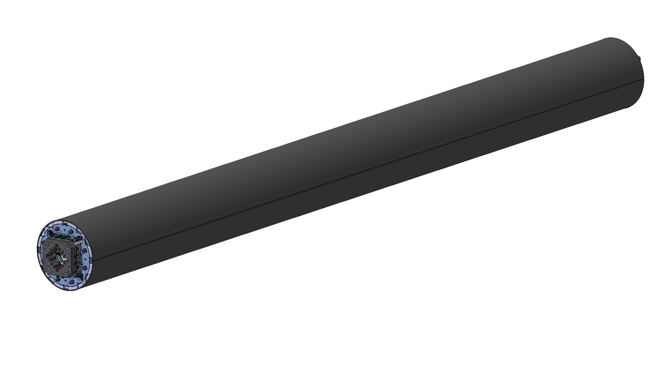
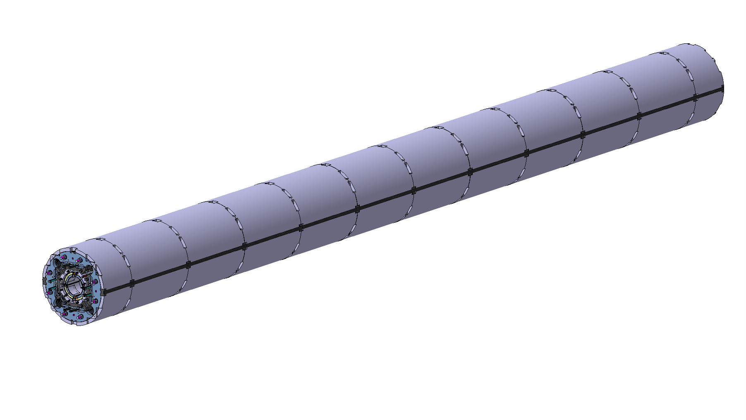
MQXF design and parameters
2-layes cosϑ coils with 150 mm aperture
18 mm width cable
Nominal (ultimate) conditions (7 (7.5) TeV)
  1.9 K
  G = 132.2 (142.1) T/m
  I = 16.23 (17.49) kA
  B = 11.4 (12.3) T
Operational margin: 23% at I_{nom}
Temperature margin at I_{nom} = 5.0-5.5 K
Shell based structure
  Segmented al shell
SS shell as Lhe containment

Slide 21

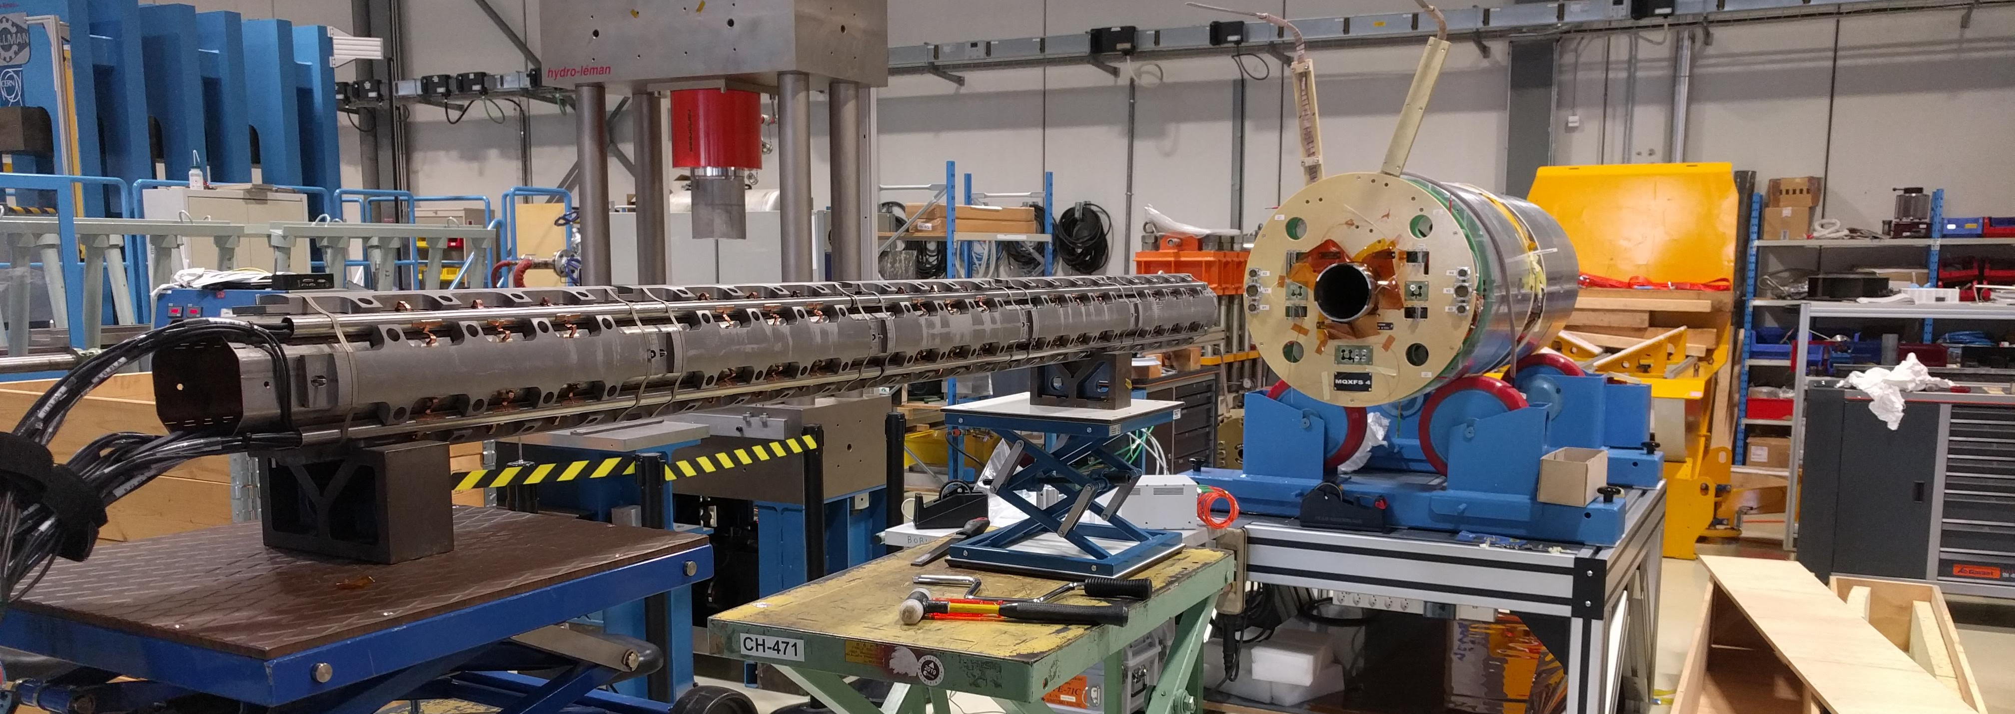
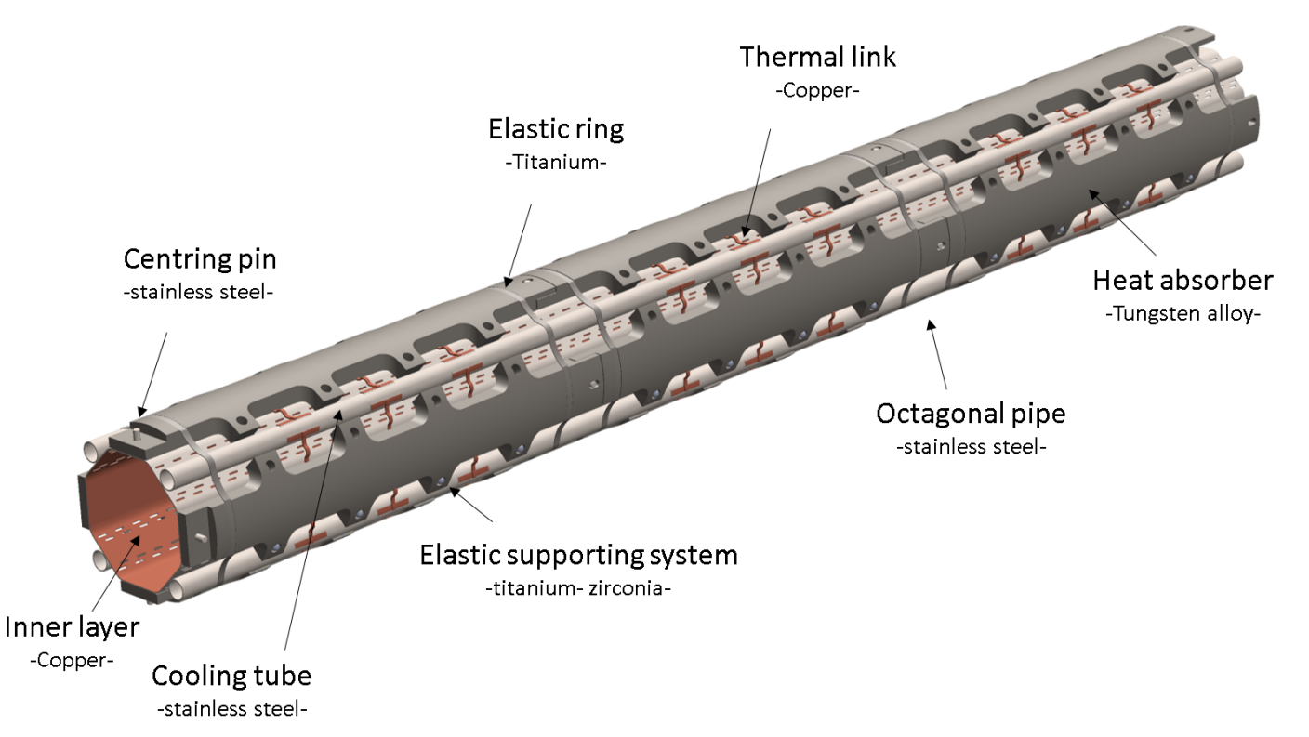
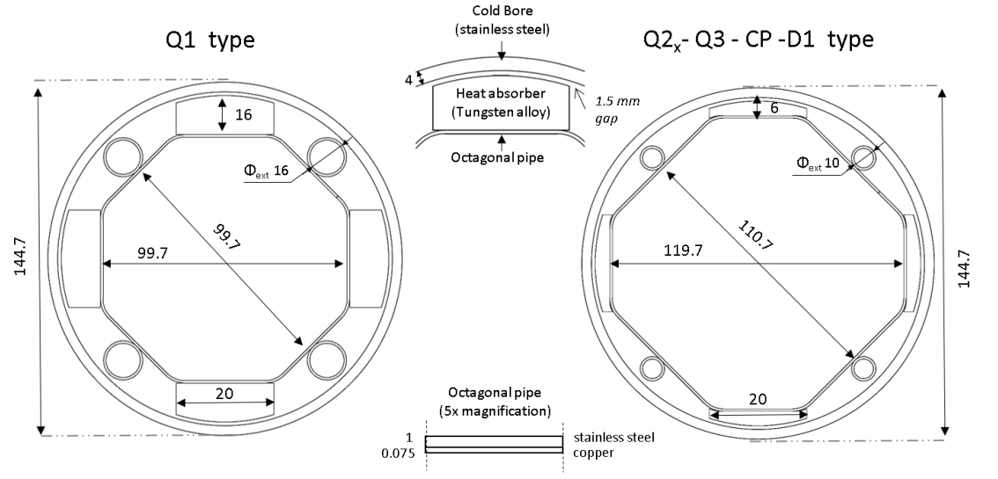
MQXF design and parameters
4 mm cold bore tube
  1.5 mm radial gap to the coil
16 mm thick tungsten absorber

Slide 22
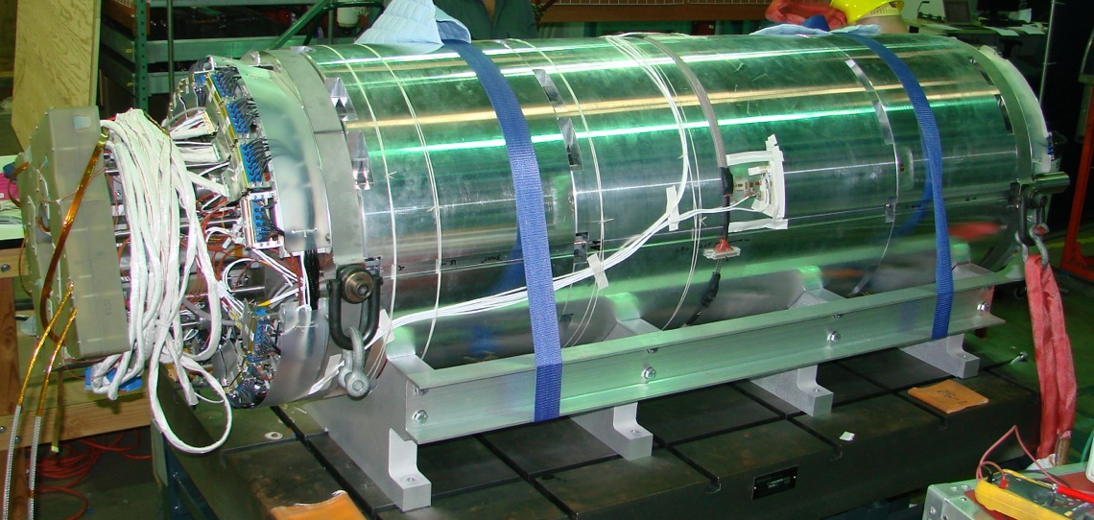
Short model program MQXFS

Slide 23
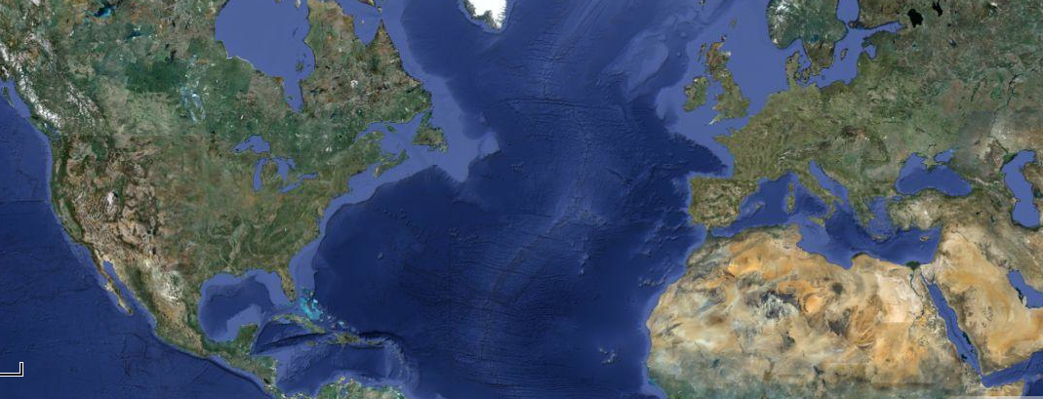
Short model program MQXFS
MQXFS1
MQXFS01
FNAL
Coil 3-5
CERN
LBNL
Coil 3-5
BNL
Coils 103-104
Structure 1
Analysis of test results carried out in parallel by LARP and CERN

Slide 24
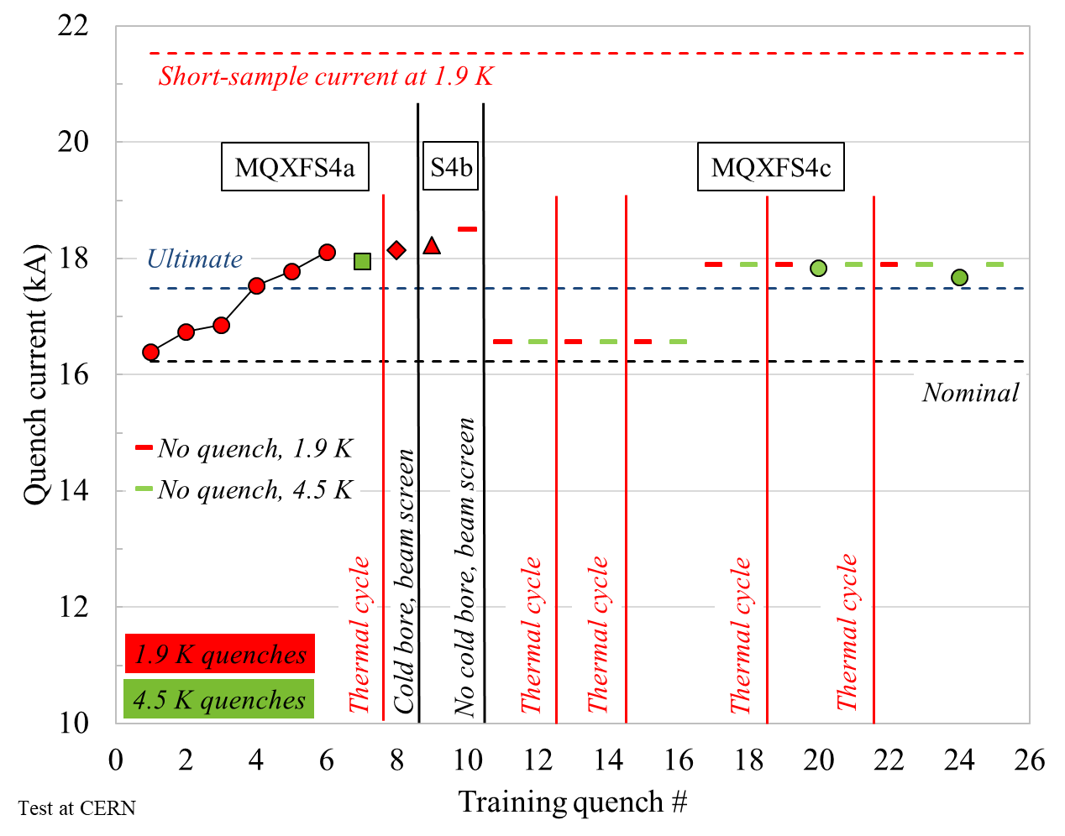
Short model program MQXFS
(LARP/AUP and CERN)
6 short models tested
  All reached nominal
  5 out of 6 reached ultimate
In the last 4 short models
  Perfect memory after thermal cycle
  Able to operate above ultimate both at
    1.9 K (85%-90% of I_{ss} )
    4.5 K (90%-95% of I_{ss} )
No degradation observed after up to 8 thermal cycles and 1000 powering cycles

Slide 25
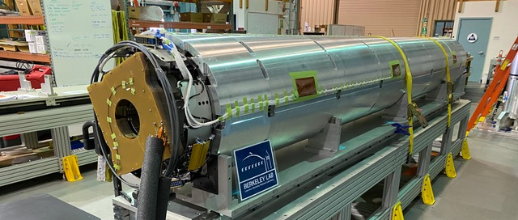
MQXFA
(LARP/AUP)

Slide 26
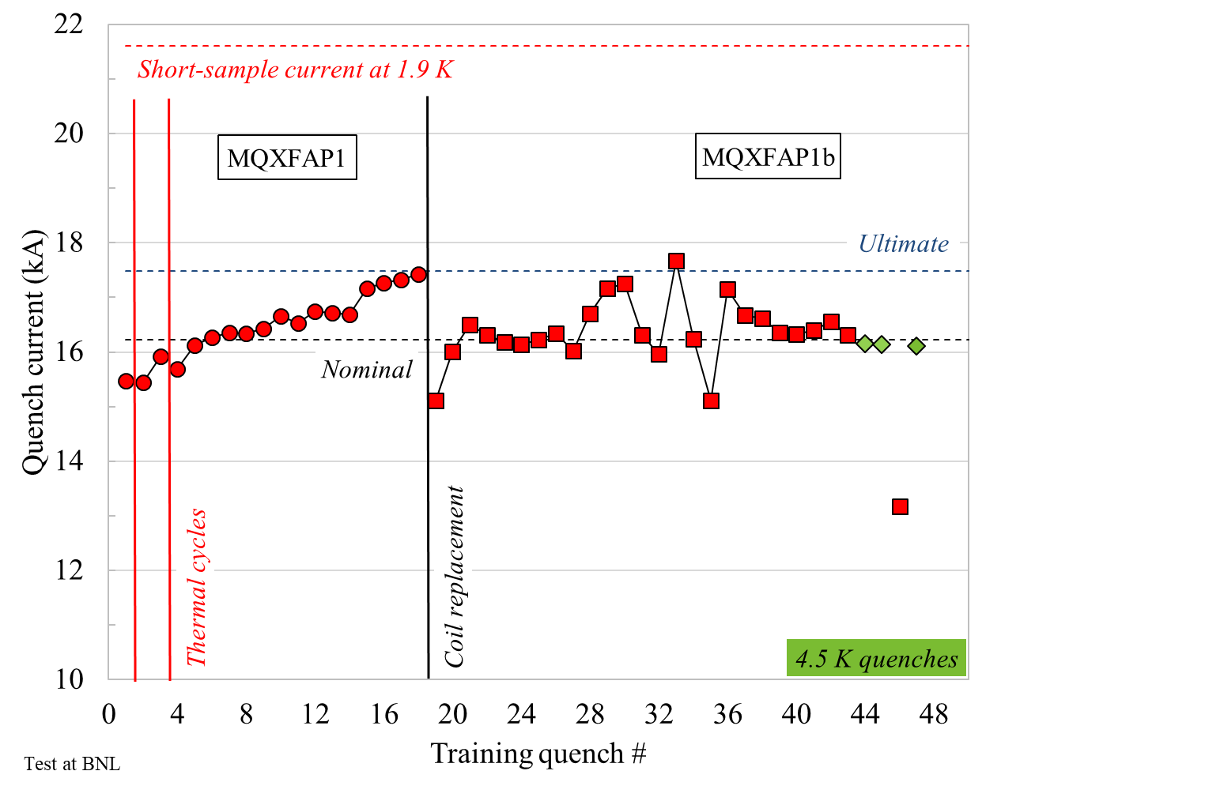
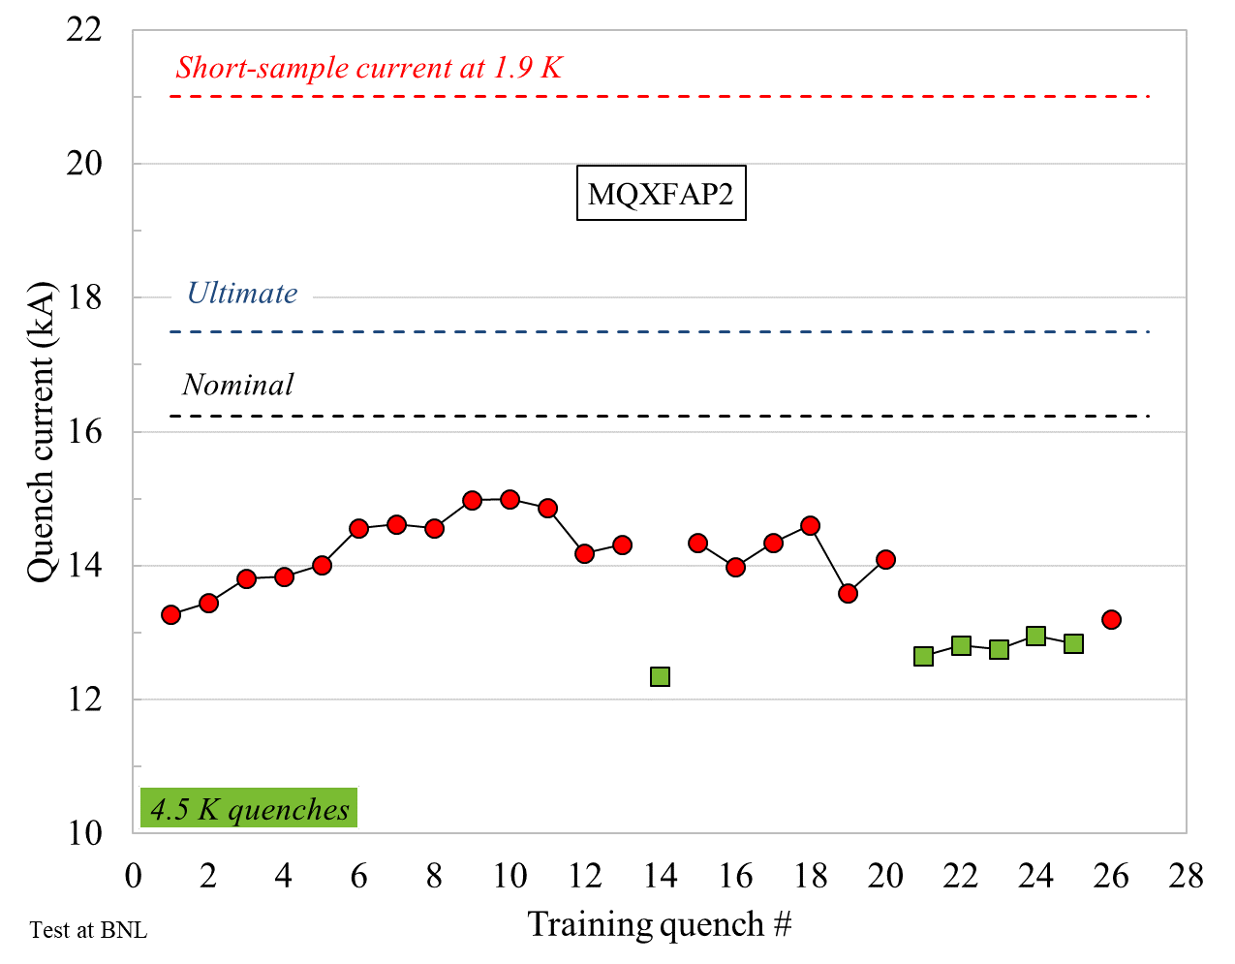
MQXFA
(LARP/AUP)
1st prototype (AP1) training stopped for electrical failure (coil to structure)
  Reassembled, it was then limited by an old coil
2nd prototype (AP2)
  Performance limited by structural failure of aluminum shell

Slide 27


MQXFAP1-2 lessons learned
After AP1
  Clearly defined and strictly followed electrical design criteria
    Test procedures and test levels
After AP2
  Developed structural design criteria based on Failure Assessment Diagram
    Defined assembly/loading process and stress limits

Slide 28

MQXFA
(LARP/AUP)
5 series MQXFA magnets tested (not yet cold-mass)
  4 successful magnets: reached nominal
  5th limited by one coil: to be disassembled for coil replacement
16 more magnets and 10 cold masses to go

Slide 29

MQXFB
(CERN)

Slide 30


MQXFB
(CERN)
Two prototype cold-masses (BP1 and BP2) tested
  Both limited below nominal
  In both cases, quenches in one coil straight section, performance loss at 4.5 K consistent with 1.9 K behavior, reproducible after thermal cycle

Slide 31



MQXFB
Lessons learned / action items
Production on hold to review/improve
  Coil fabrication process and tooling
    To improve coil uniformity and reduce risk of conductor damage
  Review assembly process
    Reduce coil peak stress and improve pre-load uniformity
  Review of ss shell welding
    Minimize impact of shell welding on coil stress
To be implemented in MQXFA

Slide 32


MQXF Field Quality
Overall, field quality under control
Possibility of partially correct low order non allowed harmonics with magnetic shims

Slide 33

Overall MQXF timeline
T0: key parameters selected (aperture, cable geometry…)
To nominal / not to nominal

Slide 34

From TQS to MQXF from R&D to accelerator quality
MQXFS
TQS

Slide 35
Outline
R&D on Nb₃Sn quadrupoles (LARP)
HL-LHC and MQXF (LARP/AUP and CERN)
Nb₃Sn quadrupole magnets for EIC
Conclusions

Slide 36



Compact Nb₃Sn IR quadrupole
Limited available space
  Compact design with active shielding
New magnet design with HQ coils
  No iron yoke
Full 3D mechanical analysis, with novel axial support system
Magnet assembled and ready for test at BNL

Slide 37

Compact Nb₃Sn IR quadrupole
In scale

Slide 38

Nb₃Sn quadrupole magnets for EIC
QFFDS01A
QFFDS01B
2.9 m length
164 mm ap.
70 mm width
96 T/m grad.
3.2 m length
256 mm aperture
92 mm width
71 T/m grad.
Some preliminary considerations
  S01A relatively similar to MQXF
  Length for both demonstrated in LARP/AUP (magnets, not cold mass)
  Coil width may be reduced
  Challenges
    Very large aperture→ high stress on the conductor
    Compactness?

Slide 39
Outline
R&D on Nb₃Sn quadrupoles (LARP)
HL-LHC and MQXF (LARP/AUP and CERN)
Nb₃Sn quadrupole magnets for EIC
Conclusions

Slide 40
Conclusions
The LARP-AUP-CERN programs successfully demonstrated Nb₃Sn quadrupole magnets
  Apertures from 90 to 150 mm
  Lengths from 1 to 4.2 m
Work in progress
  Lengths >4.2 m (7.15 m)
  Full cold masses
Very good field quality achievable
Mechanics and fabrication processes require an extremely tight control
Some possible R&D towards EIC IR
  Very compact support structures
  Very large aperture

Slide 41
Appendix

Slide 42

MQFXA
4.2 m length, 150 mm ap., 36 mm width, 130 T/m grad.

Slide 43

QFFDS01A
2.9 m length, 164 mm ap., 70 mm width, 96 T/m grad.

Slide 44

QFFDS01B
3.2 m length, 256 mm ap., 92 mm width, 71 T/m grad.

