Slide 1
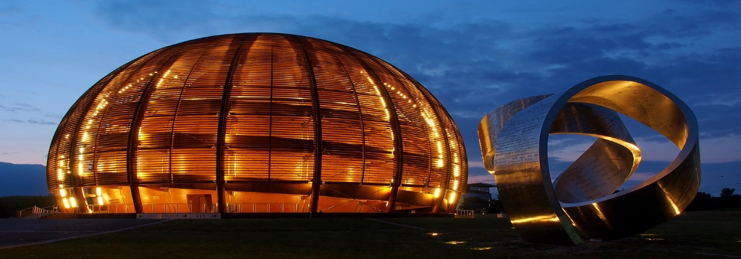
CERN FPC status and perspectives
Overview of the various challenges regarding the construction of very high power Fundamental Power Couplers
TRIUMF 2021 EIC Accelerator Partnership Workshop,
26-29 October 2021, On-line Format
eric.montesinos@cern.ch
On behalf on all colleagues involved in the topic
Thanks to all of them for the tremendous amount of work and for all the invaluable competencies provided!

Slide 2
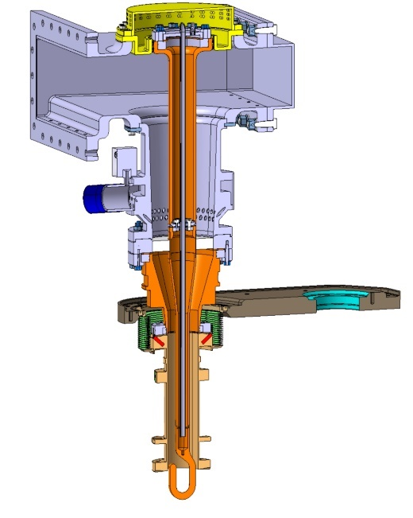
Charge
A talk on the development of power couplers for HL-LHC crabs and general power coupler development at CERN that could benefit the 200 and 400 MHz crab development for EIC
Personal note, a FPC is independent to the kind of cavity, crab or not crab, these are more the key parameters that will define the needs
  Frequency
  Power handling (cw and peak)
  Coupling (fixed or variable)
The HL-LHC Crab DQW FPC
400 MHz
1 MWp
100 kW

Slide 3
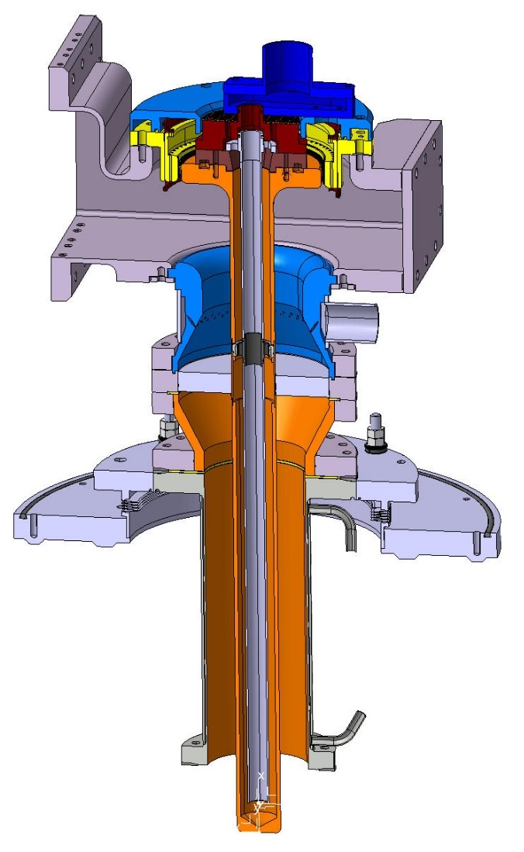
FPC design input parameters
Ceramics
  Ceramic material
  Metallization
  Window families
    Disk
    Cylindrical
    Coaxial disk
  Two windows
  Single window
  Solutions proposed
Antenna
  Adjustable coupler
  Antenna shape
Outer Antenna line
  Copper for RF
  Stainless steel
  Bad coating
  RF & vacuum seal
Protection of the FPC
Cryomodule integration
Orientation of the FPC
Inner antenna cooling
WG to coax
Multipacting
  Ti sputtering
  DC polarisation
Simulation and proposed solution
  Cylindrical Design
  Coaxial disk
  Disk
Construction
Clean room
  Clean process study
  Mock-ups
  Preparation for assembly
  Assembly in ISO 5
  Assembly in ISO 4
FPC test boxes
FPC test benches
  In clean room
  Resonant ring
RF conditioning
  Ceramic cracks
  Conditioning process
  VCA
  Pulses
  Ramping
  Repetition rate
  TW and SW mode
  Automated process
  Processing time
  Summary
First test results
  Arcing
Transmission Lines
FPC
High Power RF
kW to MW amplifier
Accelerating Cavity

Slide 4
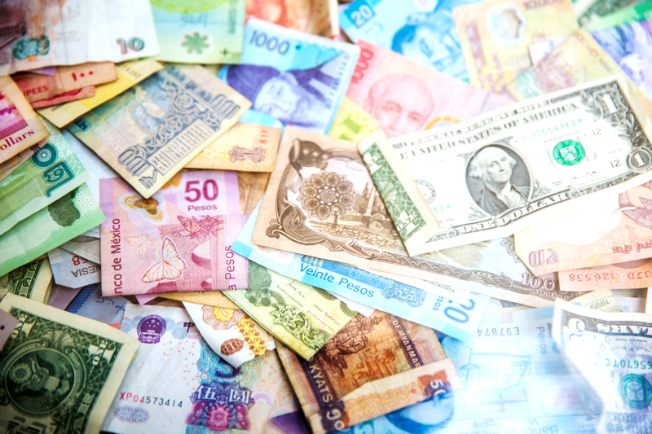
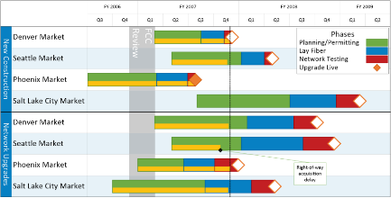
FPC design input parameters
Ceramics
  Ceramic material
  Metallization
  Window families
    Disk
    Cylindrical
    Coaxial disk
  Two windows
  Single window
Antenna
  Adjustable coupler
  Antenna shape
  Inner antenna cooling
RF conditioning
  Test boxes
  Conditioning process
  VCA
  Pulses
  Ramping
  Repetition rate
  TW and SW mode
  Automated process
  Processing time
Simulation and proposed solution
  Cylindrical Design
  Coaxial disk
  Disk
All parameters linked together and often conflicting
Cost
WG to coax
Protection of the FPC
Orientation of the FPC
Schedule
Construction
Multipacting
  Ti sputtering
  DC polarisation
Outer Antenna line
  Copper for RF
  Stainless steel
  Bad coating
  RF & vacuum seal
Cryomodule integration
Clean room
  Clean process study
  Mock-ups
  Preparation for assembly
  Assembly in ISO 5
  Assembly in ISO 4
FPC test benches
  In clean room
  Resonant ring

Slide 5









Overview of the CERN power couplers since the 2000’s
2000
2005
2010
2015
2020
LHC
16
SPS 2
16
SPL 1
4
4
4
SPL 3 HG
LHC
SPL 2
Linac4
26
4
Crab DQW
2
ESRF
2
SPL
APS 1
2
Crab RFD
SOLEIL
4
SPS LIU
24
APS 2
16
Crab series
16
LHC 2
Operation
FCC
Design to spares (3-8 years)

Slide 6
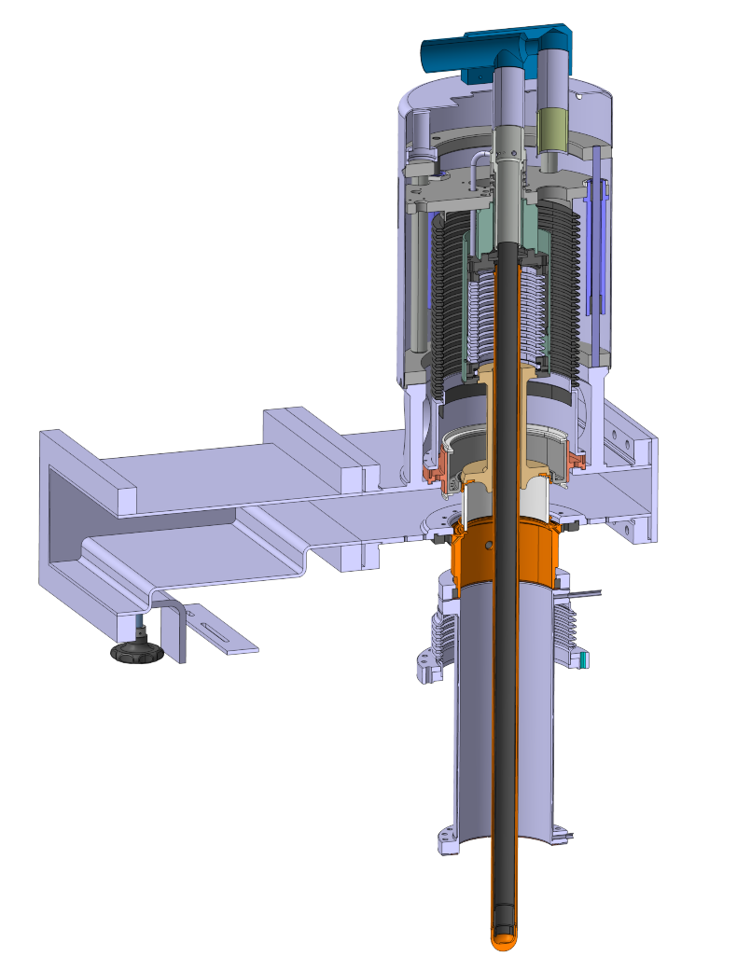
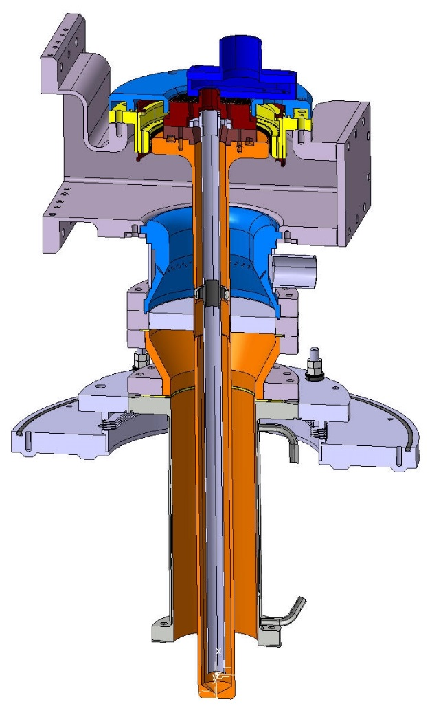
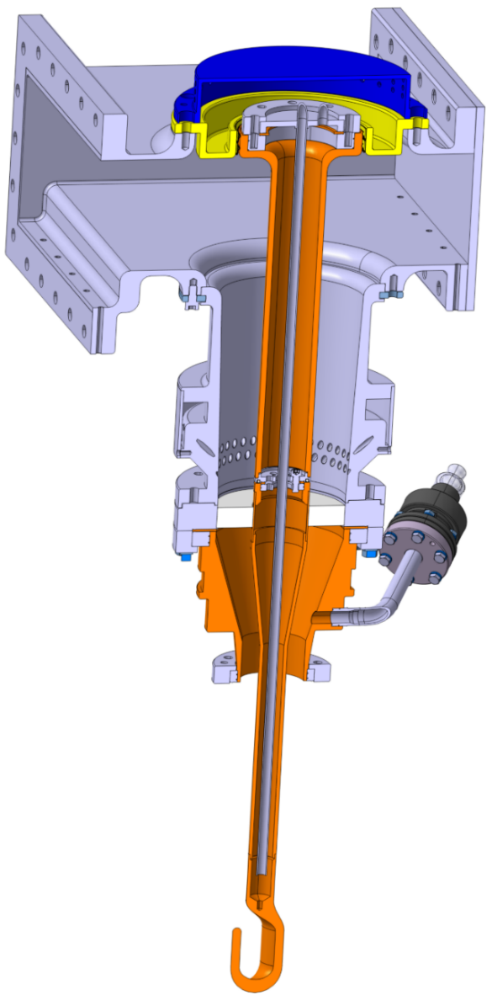
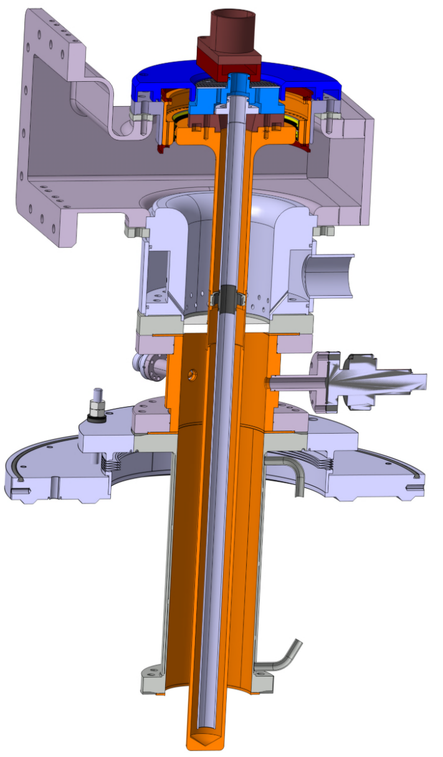
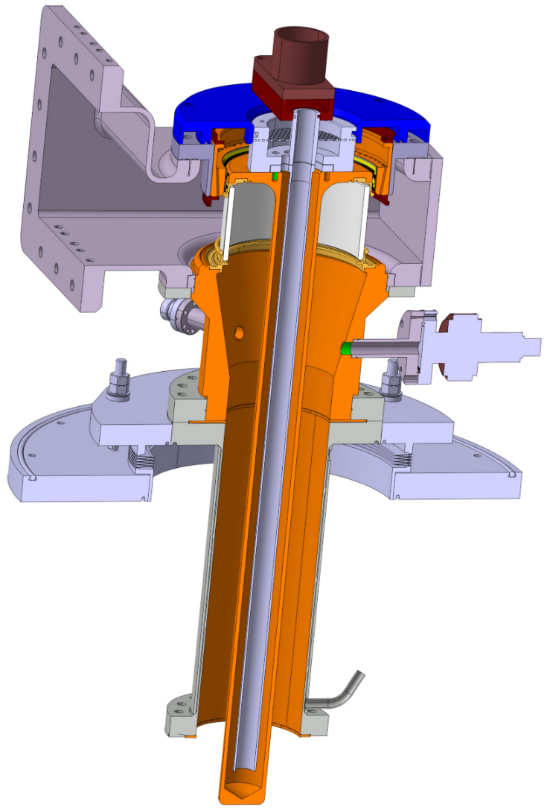
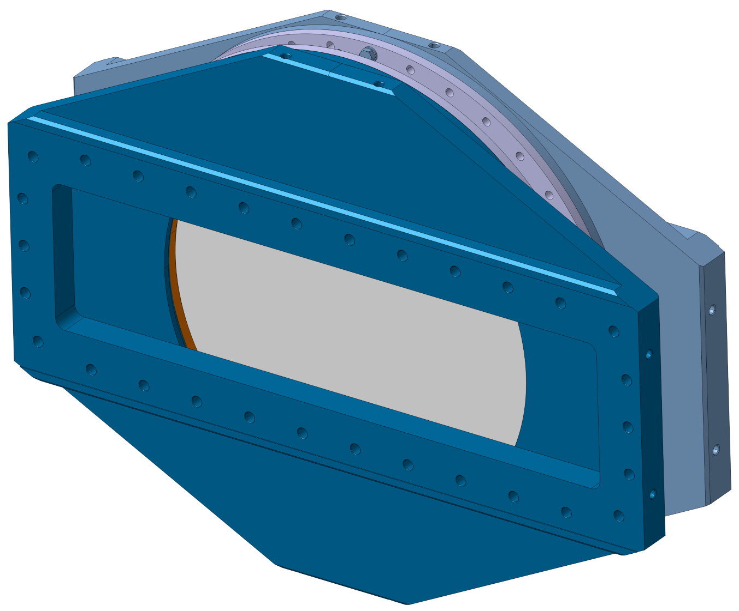


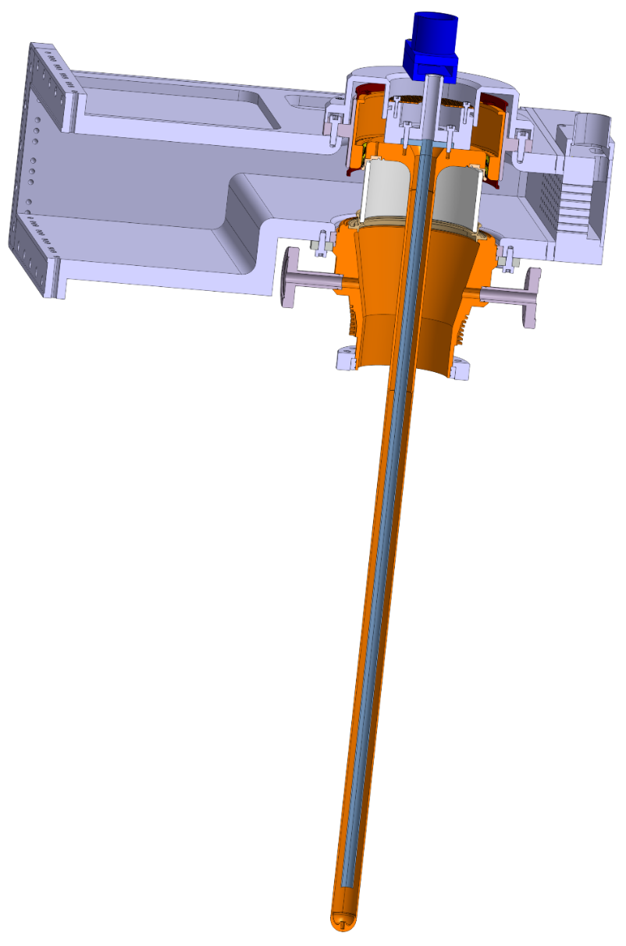
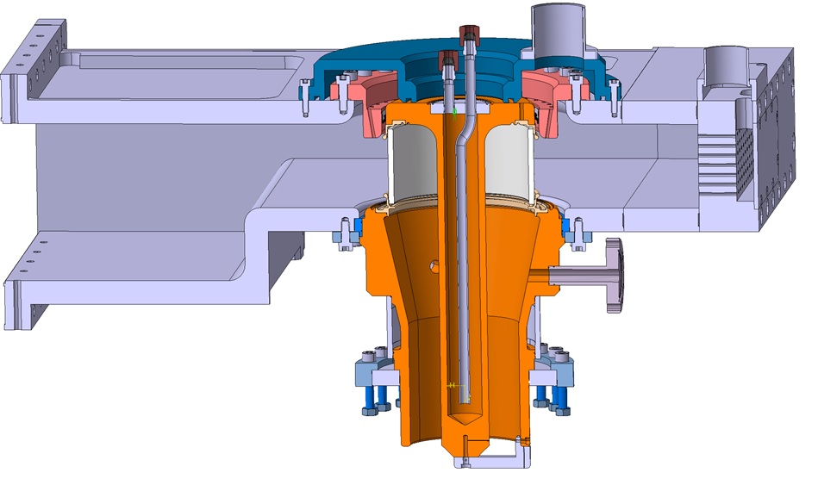




Overview of the CERN power couplers since the 2000’s
LHC 400 MHz 500 kW
SPS 2.0 200 MHz 750 kW
SPL 1.0 704 MHz 900 kWp 10%
SPL 2.0 704 MHZ 1000 kWp 10%
Linac4 352 MHz 1000 kWp 10%
Crab DQW 400 MHz 100 kW
Crab RFD 400 MHz 100 kW
ESRF 352 MHz 200 kW
SOLEIL 352 MHz 200 kW
APS 1.0 352 MHz 200 kW
SPS LIU 200 MHz 800 kW
HG (SPL 3.0) 704 MHz 1500 kWp 10%
LHC 2.0 400 MHz 600 kW
APS 2.0 352 MHz 250 kW
FCC 400 MHz 1000 kW
LHC
SPL

Slide 7
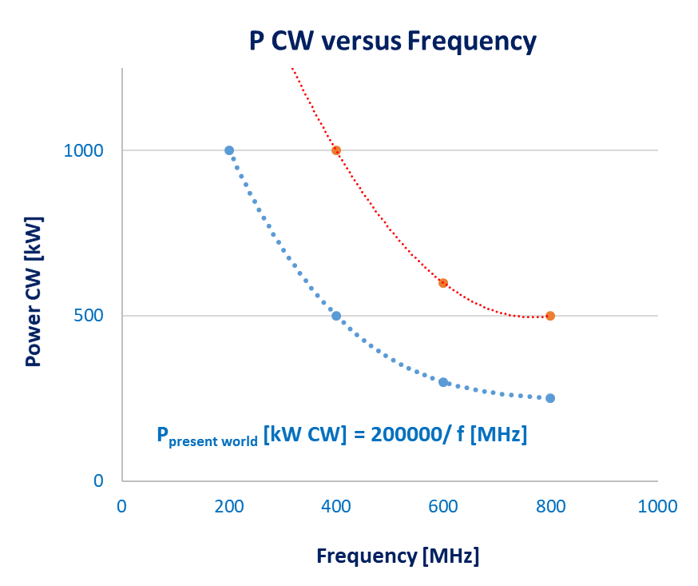
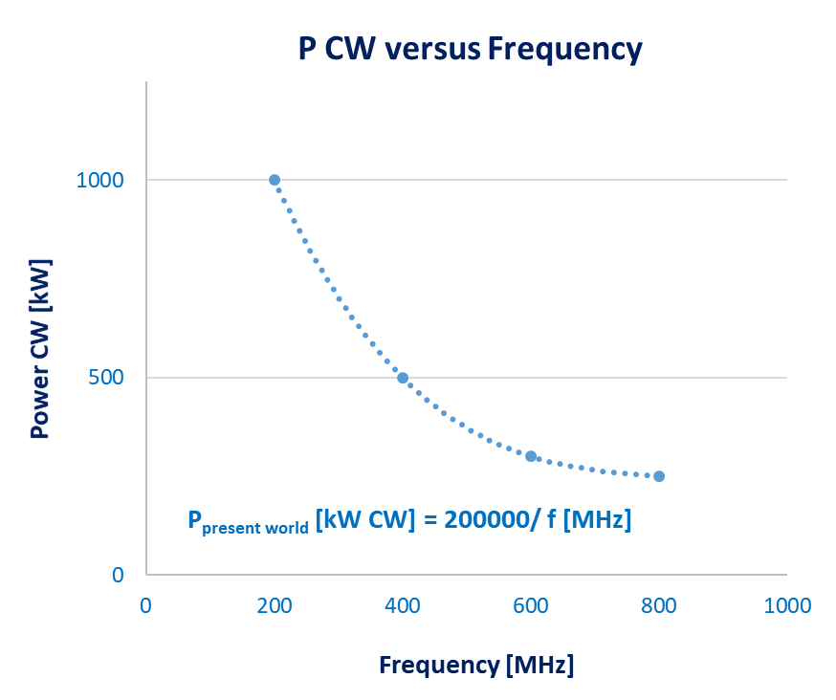
Overview of the CERN power couplers since the 2000’s
LHC 400 MHz 500 kW
SPS 2.0 200 MHz 750 kW
SPL 1.0 704 MHz 900 kWp 10%
SPL 2.0 704 MHZ 1000 kWp 10%
Linac4 352 MHz 1000 kWp 10%
Crab DQW 400 MHz 100 kW
Crab RFD 400 MHz 100 kW
ESRF 352 MHz 200 kW
SOLEIL 352 MHz 200 kW
APS 1.0 352 MHz 200 kW
SPS LIU 200 MHz 800 kW
HG (SPL 3.0) 704 MHz 1500 kWp 10%
LHC 2.0 400 MHz 600 kW
APS 2.0 352 MHz 250 kW
FCC 400 MHz 1000 kW
P_{FCC} = 2 x P_{present world}

Slide 8
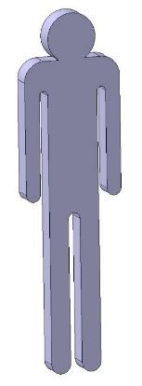
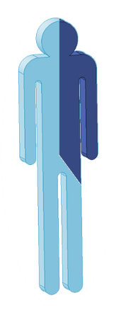
FTE (Full Time Equivalent)
Activities | FTE year
RF Design | 0.2
Mechanical Design | 1.8
Raw material | 0.05
External machining pilot | 0.5
Internal machining | 1.0
Surface treatments | 0.1
Brazing | 0.2
Titanium sputtering | 0.1
BE welding | 0.1
Metrology | 0.05
Assembly | 0.5
Vacuum tests | 0.1
RF Conditioning | 0.5
Clean room assembly | 0.1
Total | 5.3

Slide 9
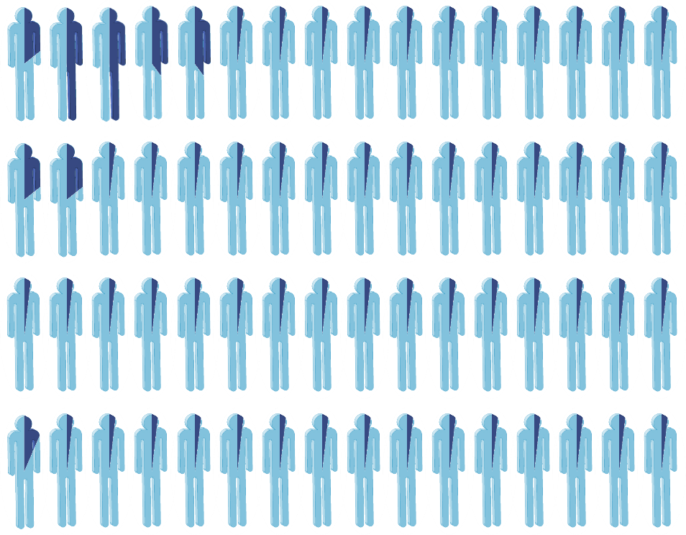
FTE (Full Time Equivalent)
Activities | FTE year
RF Design | 0.2
Mechanical Design | 1.8
Raw material | 0.05
External machining pilot | 0.5
Internal machining | 1.0
Surface treatments | 0.1
Brazing | 0.2
Titanium sputtering | 0.1
BE welding | 0.1
Metrology | 0.05
Assembly | 0.5
Vacuum tests | 0.1
RF Conditioning | 0.5
Clean room assembly | 0.1
Total | 5.3
At CERN, more than 60 experts working (very) part time on the topic

Slide 10
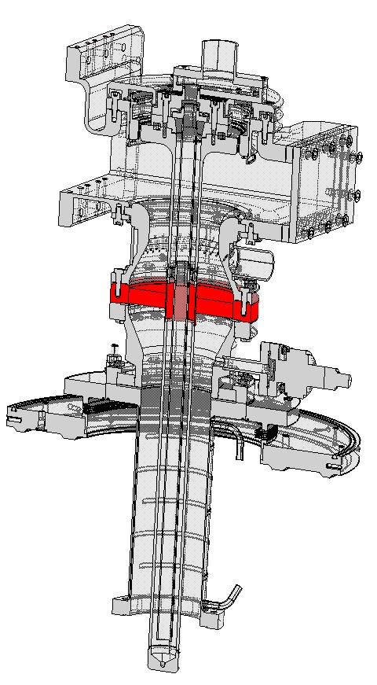
Key item: the ceramic window
This is the most important device of a FPC
It ensures the vacuum leak tightness of the FPC, and of the entire machine!
Any leak on the window immediately leads into degradation of the cavity and of the machine
It is commonly a ceramic brazed with metal

Slide 11
Ceramic material
 | Purity | RF losses | Brazing
Al₂O₃ | 99.9 % | Very Low | Very difficult
Al₂O₃ | 97.6 % | Medium | Medium
Al₂O₃ | 95 % | Higher | Easier
Most of the windows are built with an Al2O3 ceramic
A very important parameter is the purity of the ceramic
A too pure ceramic will be with very few losses, that is perfect for RF power, but will be very difficult to braze as the metallization will not adhere
A ceramic with impurities will be much easier to braze, but will have a lot of losses that will induce a difficult cooling
CERN published a reference document in 1996 (10 pages) explaining all the parameters that a ceramic for RF window shall fulfil
http://cds.cern.ch/record/91419?ln=fr
It is still in use, and all our ceramics are the Al2O3 - 97.6 % purity ones
This is one of our first topic for R&D with respect to FCC high power requirements, we launched a program to master how to braze 99.9 % purity ceramics

Slide 12
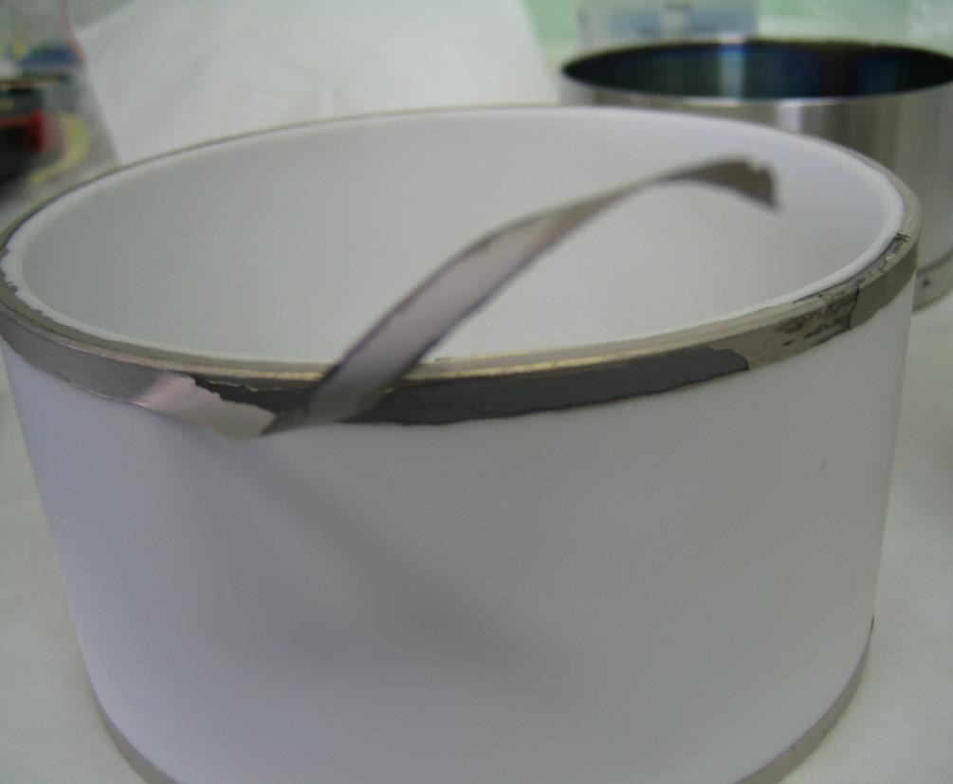
Metallization
Before brazing the metallic line, the window has to be metallized
The most common medium used is a Molly-Manganese deposition on the surfaces to be brazed
It is often painted by hands
This paint is very sensible and must be kept in movement at any time, under a controlled temperature and humidity
The metallic lines will be brazed onto that MoMn support, it is of the highest importance
A default in the metallization of the ceramic, one can easily understand that it will not be possible to braze any metallic part onto it

Slide 13
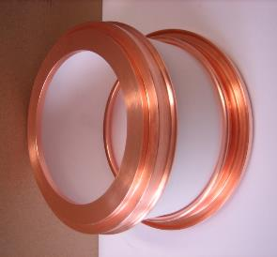
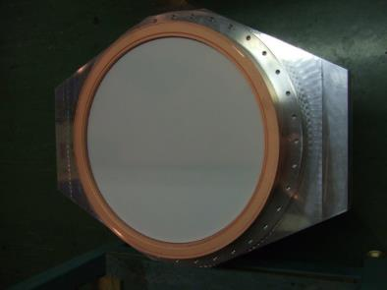
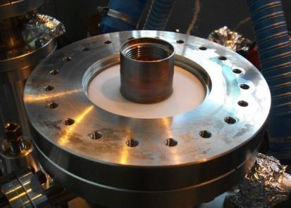
Window families
Disk windows
SPS, 800 MHz
150 KW CW
Linac4, 352 MHz
1 MW 10 % duty
LHC 2, 400 MHz
1 MW (expected) CW
Cylindrical windows
LHC, 400 MHz
500 kW CW
ESRF/SOLEIL/APS, 352 MHz
250 kW CW
SPL, 704 MHz
1 MW 5 % duty
Coaxial disk windows
HL-LHC Crab, 400 MHz
100 KW CW
SPL 2.0, 704 MHz
1 MW 5 % duty
SPL 3.0, 704 MHz
2 MW (expected) 5 % duty

Slide 14
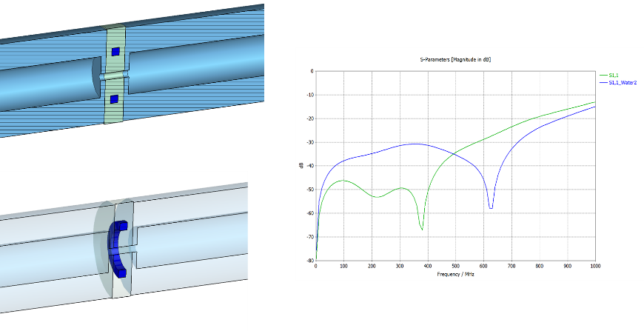
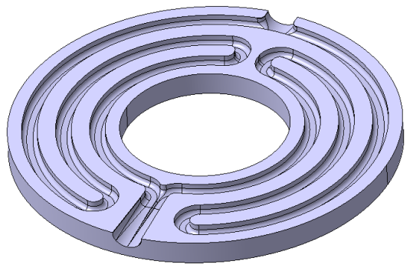
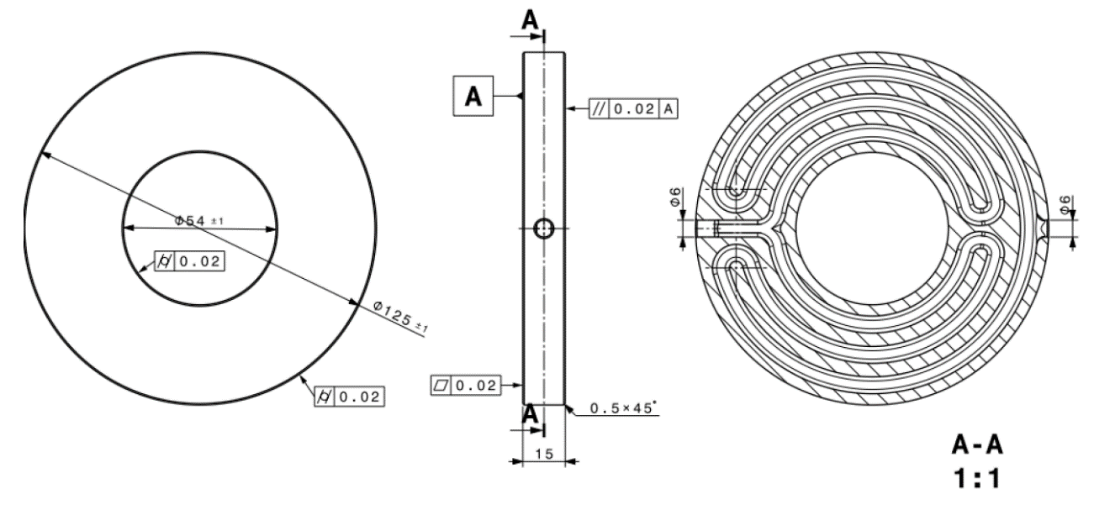
Water cooled from the inside ceramics
With the help of or mechanical experts, we launched a prototyping of a 3D printed ceramic with water channels cooling down the ceramic from the inside
This should help getting to higher power handling

Slide 15
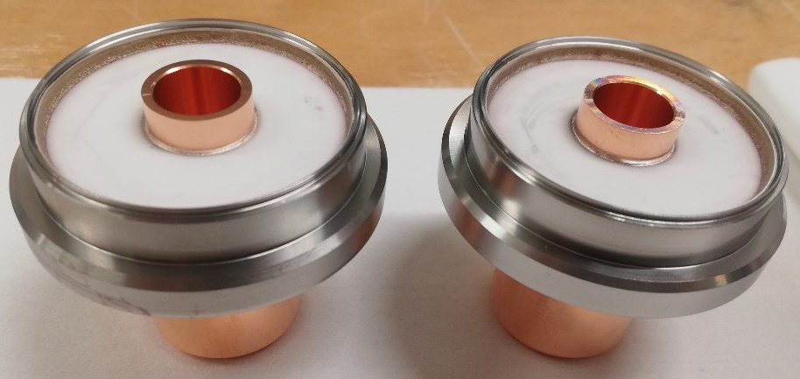
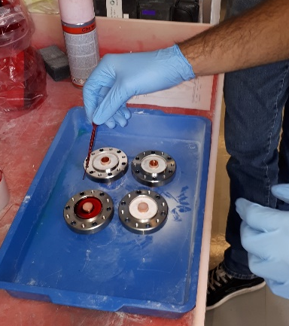
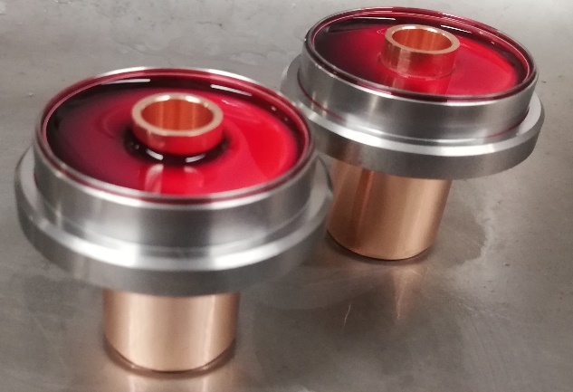
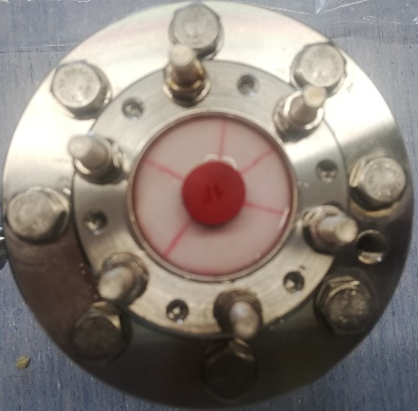
Penetrant liquid qualification
In order to qualify the ceramic, we applied a penetrant liquid to reveal the possible cracks
  Leak test
  Apply penetrant liquid on the air side of the ceramic
  Wait for 15 minutes
  Rinse with water
  Rinse with isopropyl alcohol
  Rinse with acetone
  Visual control
  Leak test
In case of a crack, this method quickly reveals the default, this is very useful to validate the brazing process

Slide 16

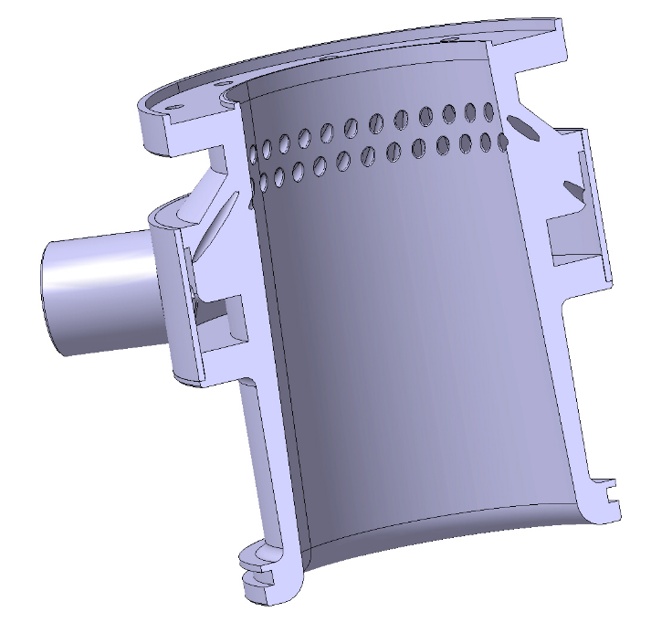
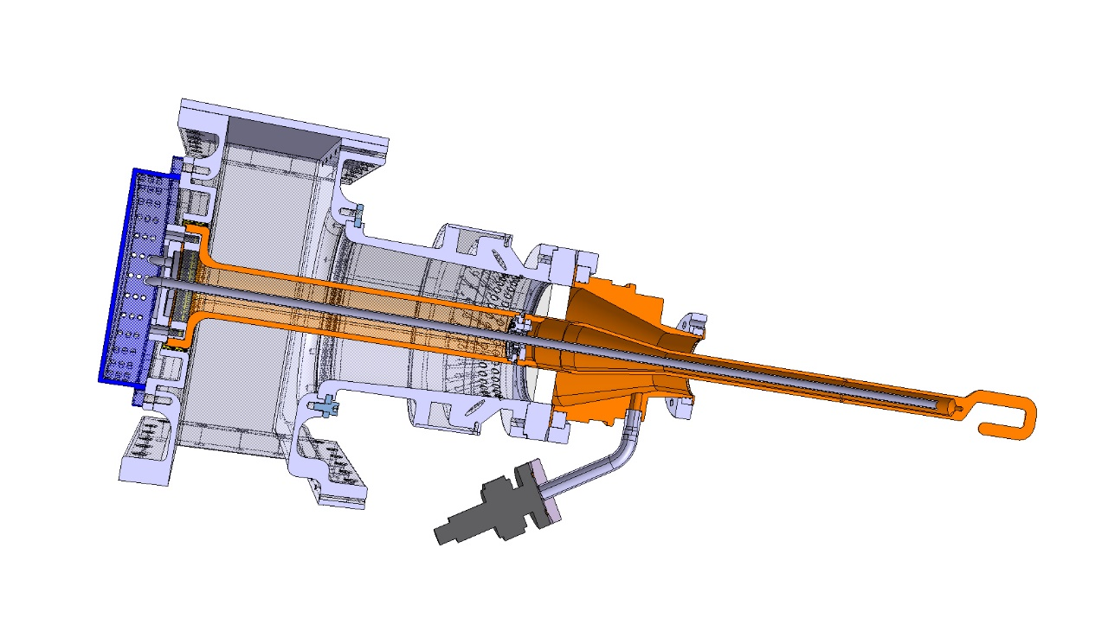
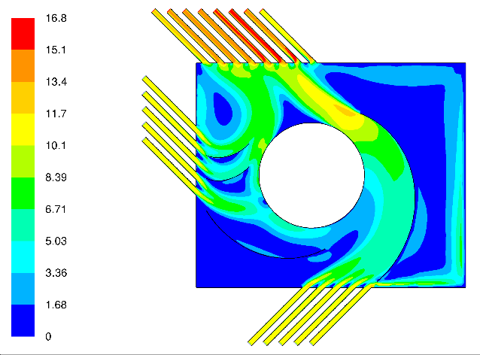
Cyclotronic© air cooling
In order to cool down the ceramic from the air side, we invented the cyclotronic air cooling system
The goal is to avoid any ‘no air flow area’ that would generate a hot spot
To do so, the air is directed down to the ceramic and with a tangential angle
This was proven very efficient with the SPL couplers
Air inlet directed to the ceramic and with a tangential angle to avoid ‘no air flow areas’
Cyclotronic © air cooling

Slide 17
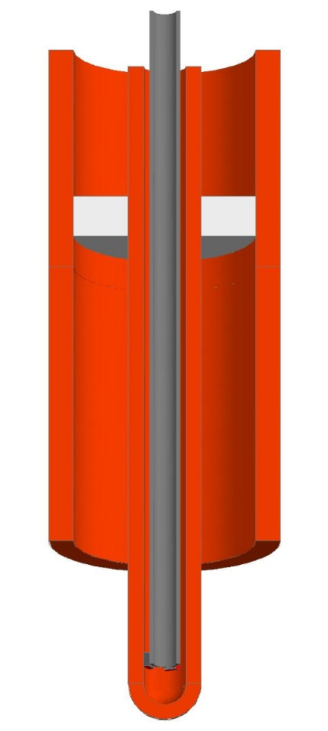
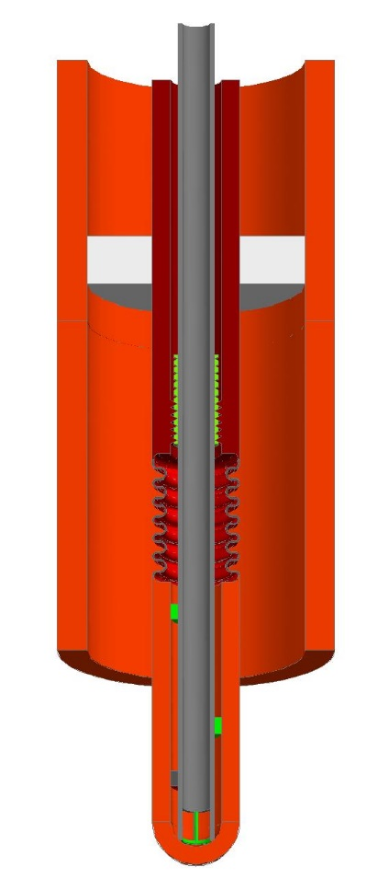
Variable coupling requirement
Advantages of variable coupler
  Better for Q_{ext} matching
  Better for power distribution
Drawbacks of adjustable coupler
  More complex to design
  Need a moving system not stressing the ceramic
  Need bellows somewhere
    More EB welding
    Increases the vacuum leak risk
    Increases mutipacting difficulties
  Increases the number of mechanical operations
  Subsequently increases the total price
Disk window
fixed coupler
Disk window
adjustable coupler

Slide 18
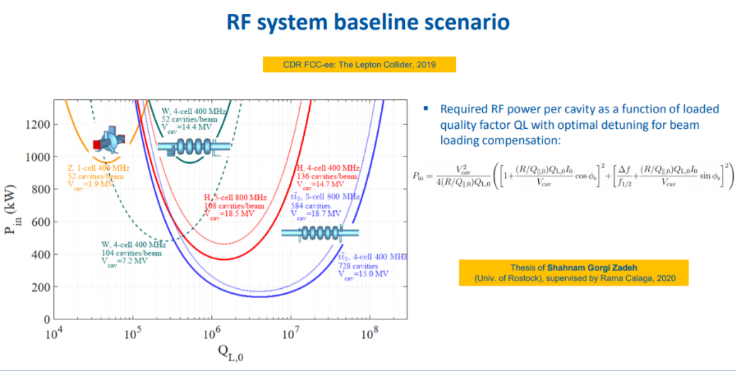
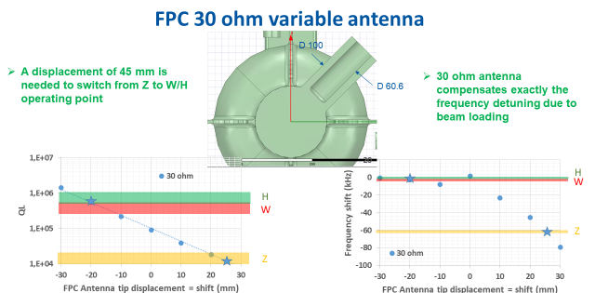
Variable coupling requirement
For FCC machines, as we want to re-use the same cavities and couplers without going back to the clean room, a variable coupler is mandatory
This will be another topic to be looked at into details (external stub [BNL-EIC], movable antenna [CERN-LHC], ‘new deformable material’ [CERN R&D])
The antenna shape is part of the study, such that the best impedance is chosen regarding tuning needs
Courtesy Olivier Brunner & Franck Peauger

Slide 19
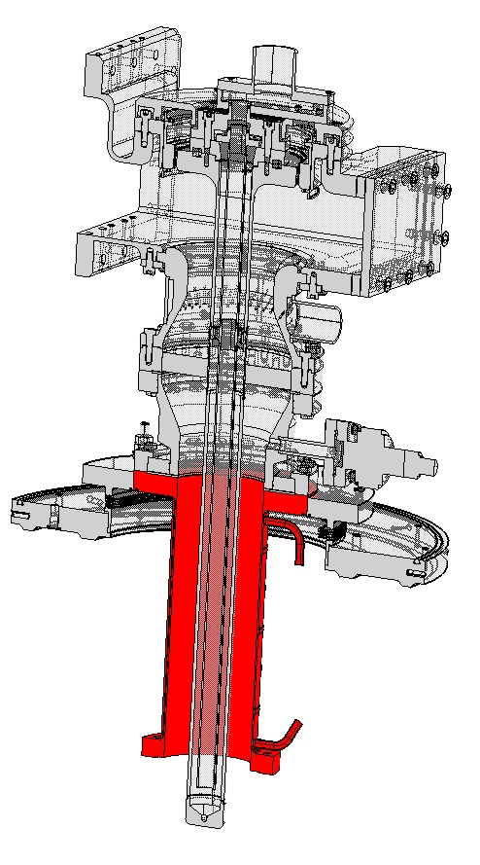
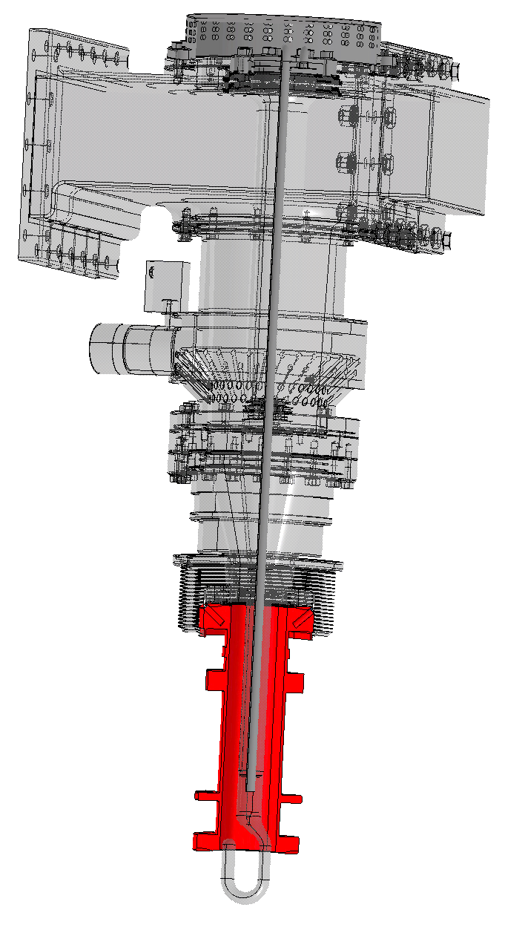
Heat Transfer
In order to ensure thermal shielding between the FPC and the cavity the outer antenna can be with thermal anchors (usually feasible with lower average power handling) or with a Double walled Tube using gas helium as coolant (higher average power levels)
It is a part of the coupler as being the outer line of the FPC antenna coaxial line
From an RF point a view, it is a simple outer conductor tube
Its contraction must be perfectly pre-calculated, because this will give the coupling value (Q_{ext})

Slide 20
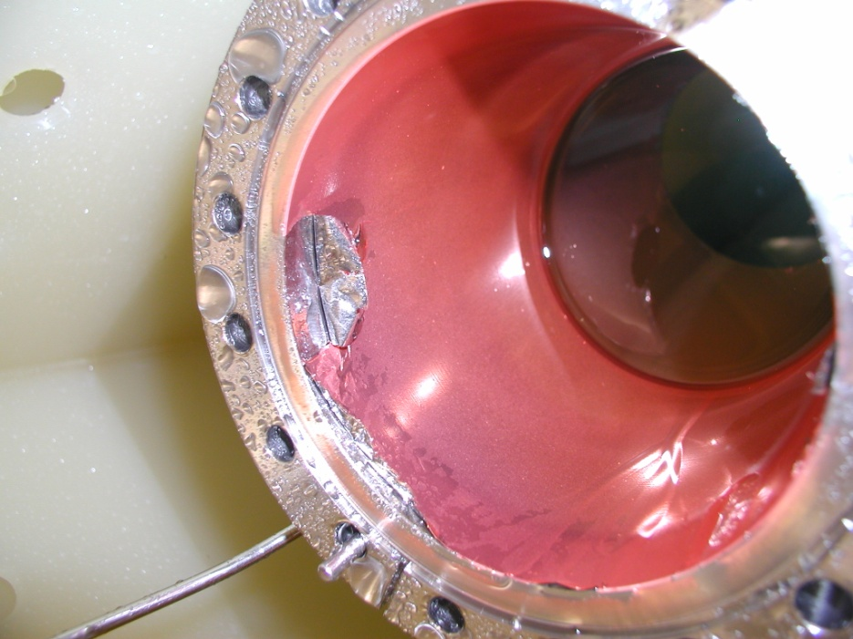
Heat Transfer
With SRF cavities, we usually have
  A thin Stainless Steel support, being the good thermal insulator, onto which we add a thin layer of few µm of copper, being the RF conductor with minimum RF losses and as being very thin, not transmitting so well the thermal losses to the cryogenic system
  At the time of LEP and LHC we did Nickel flash + 7 µm copper sputtering (better uniformity of the layer)
  With the recent HL-Crab we did 1.5 mm Stainless Steel + Gold 2 µm + galvanic Copper layer 10 µm
  We will launch 1.5 mm Stainless Steel + Gold 2 2 µm + galvanic Gold layer 12 µm, main advantage would be no more oxidation and discoloration effect
Every time we launch a new production (SPL, Crab) we experience difficulties
This copper coating is one of the key processes for all the couplers over the world
A SPL outer line with its copper layer peeling from the Stainless Steel support. More than one year of work lost in a few second, more than half a year to repair

Slide 21
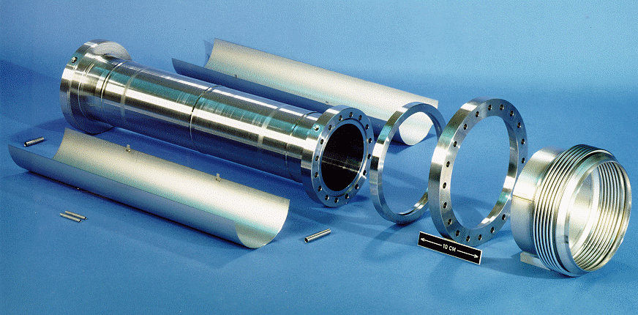
Heat Transfer
Since LEP time, as we experienced a lot of difficulties with the outer tube component, we decided to have the Stainless Steel part built from a single block of massive 316LN
This is to prevent any multipacting troubles due to any change in the RF nor thermal structure
This has to be re-evaluated as for a large series production this would cost a lot
Double walled tube, inner tube and flanges machined from a massive block of 316 LN, second wall being two halves tubes EBW on it

Slide 22
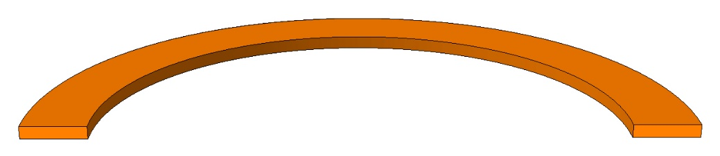
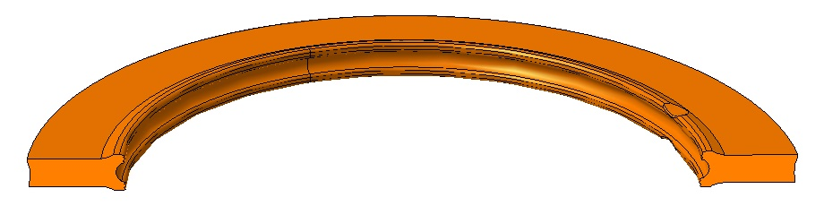
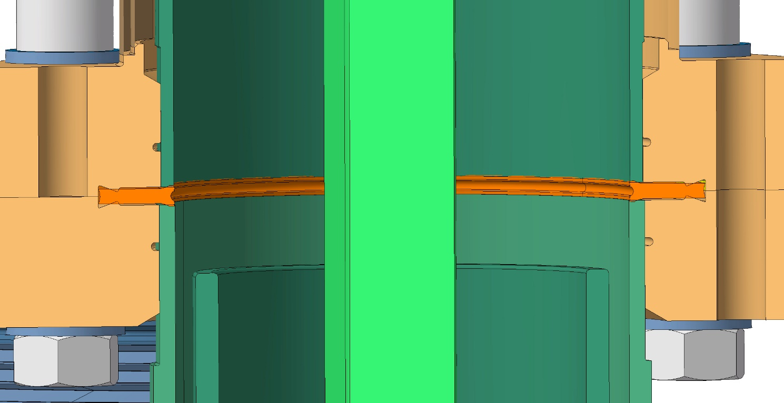
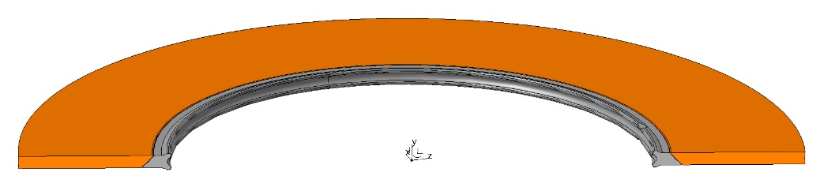
Vacuum seal at cold
When connecting the FPC to the cavity, we have to take care of the losses that could induce losses in cryo system, as well as damaging the ‘RF path’ due to bad contact at high power levels
Copper OFE gasket
Copper OFE gasket with RF contact
Copper OFE gasket with Nb RF contact

Slide 23
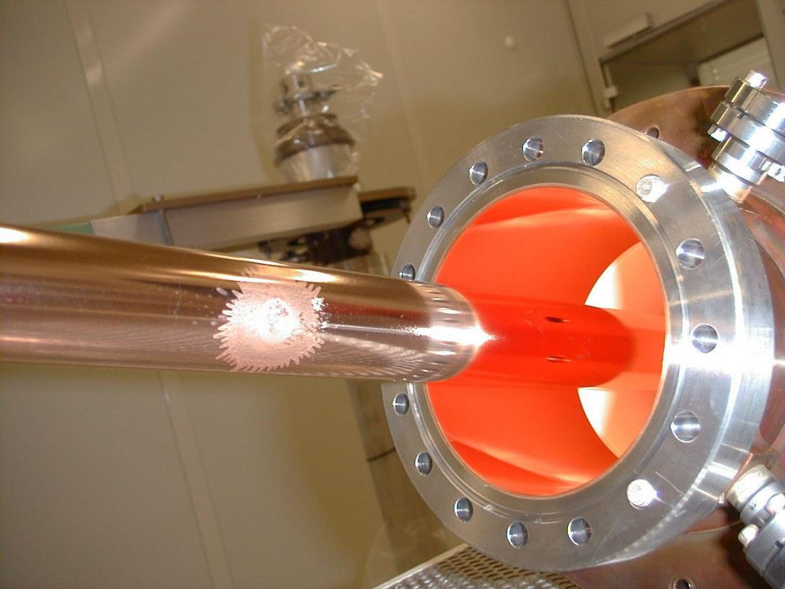
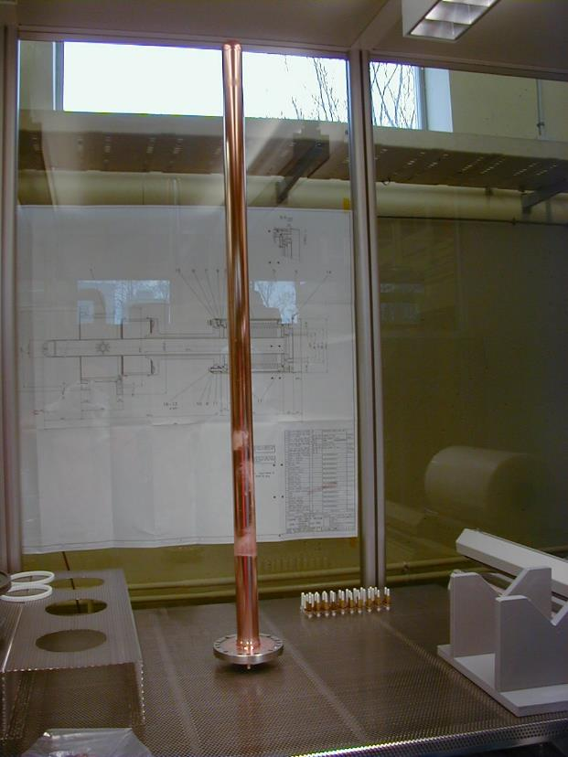
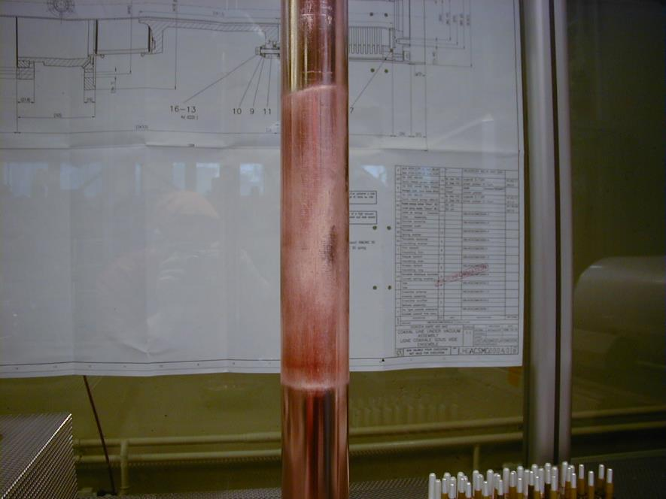
Multipacting
Never neglect the danger of multipacting
Nowadays there are codes that will allow us to take multipacting into account whilst designing the coupler geometry
However, always keep in mind an advice I received from Joachim Tückmantel ‘when your simulation tool tells you there will be multipacting… there will probably be multipacting. When it does not tell you there will be multipacting… there could nevertheless be multipacting! So always implement a multipacting stopper [DC bias]’
We work on an additive manufacturing pseudo random surface that should reduce the multipacting occurences
Multipacting could lead into impressive effects that will irreversibly damage the FPC

Slide 24
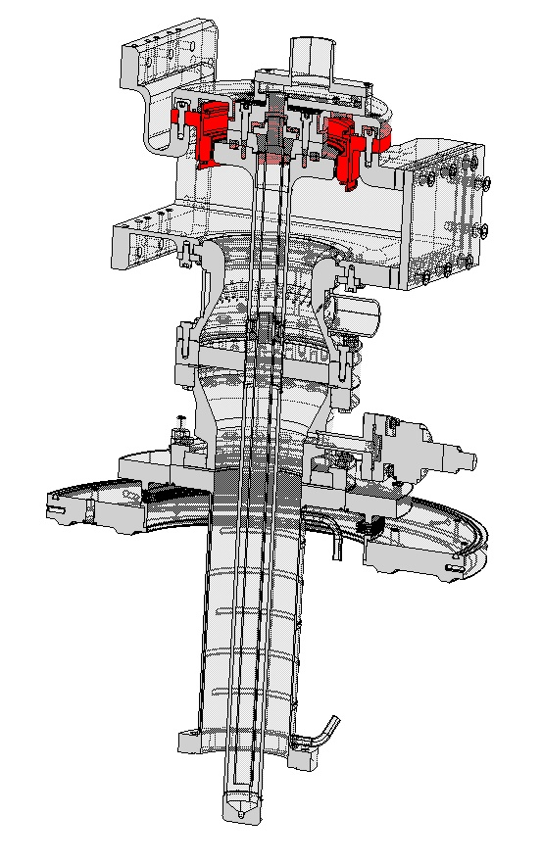
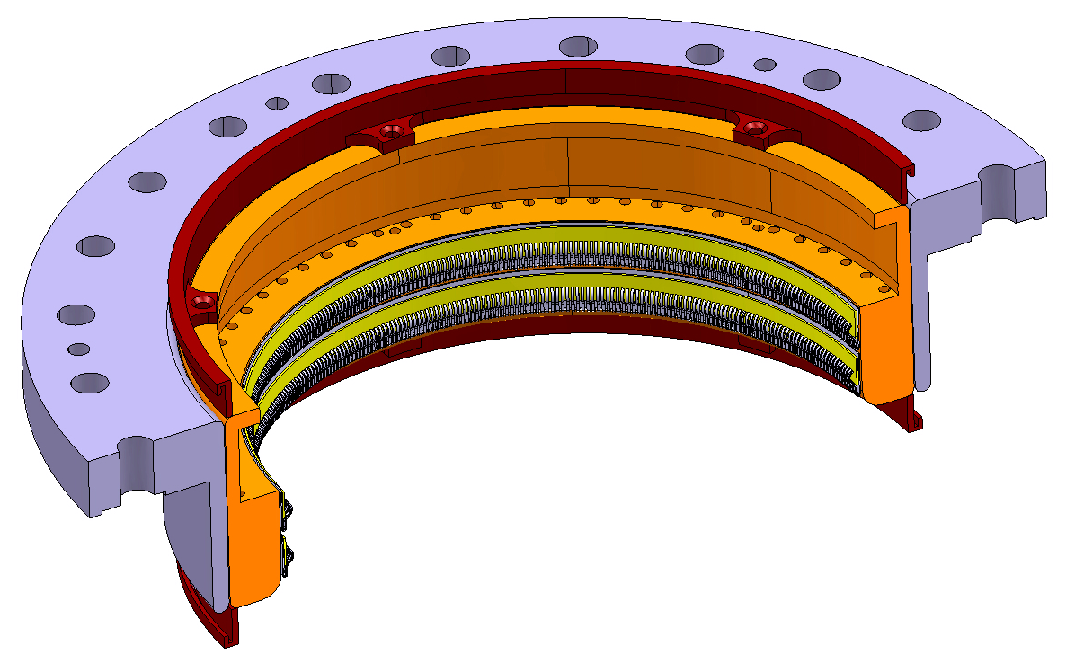
DC polarisation
A good multipacting suppressor is to apply DC polarisation on the antenna, this will modify the electron trajectories and prevent the multipacting to occur
HV in the range of 2 to 5 kV DC range is needed
It should not be used during conditioning of the couplers, but can be applied during operation of the machine if needed or in prevention of the troubles

Slide 25


TiN or TiOx coating
Toshiba window
(SNS, CEA, KEK)
Secondary Electron Emission Yield (SEY) of ceramic is not very good (SEY ~7), so to avoid multipacting, vacuum side of the window is Ti (or TiN) coated (SEY ~1.5)
In addition, it provides a high resistive layer that helps to remove electrostatic discharge
Ti coating of the ceramic is a well mastered process at CERN, however
  We do not really know how to measure Ti coating, we need to launch a program in order to be able to measure it
  Too thin, not multipactor suppressor
  Too thick, adding a layer with RF losses, that can break the ceramic
  In case of special shape, how guaranty Ti coating is really everywhere?
We launched a study for SEY ~ 1 ceramics with industrials (Thales, Kyocera) and with KEK
?
How to ensure the TiN coating behind the chokes ?

Slide 26























Cleanroom requirements
Our Crab cavities are with high gradient, we needed to take care of the FPC in clean room from the first day, including assembly on the test box
We first prepared all actions on a flip book, we trained ourselves on mock-ups outside clean room

Slide 27


Cleanroom requirements
Especially for SRF cavities, none of the peripherals should pollute the cavity
Specific clean room assembly processes must be applied, they have to be carefully studied in order to guaranty the minimum pollution due to FPC or HOM couplers being assembled onto the cavity
We developed specific tooling, recently 3D printed with accura 25 ® (Polypropylene-like) as being qualified particle free for ISO 4 clean room
The use of a robot is also a key for success
As soon as per the design phase, FPC also have to take into consideration clean room assembly, this will ease the entire work
Robot, tooling and protections for clean room
3D plastic printed cavity to train ourselves
with the clean room tooling

Slide 28



Cleanroom requirements
ISO 5 preparation of FPC and test boxes
Cleanliness aspects must also be though from the very beginning such that cavities are not polluted
This covers design of the couplers themselves, and also tooling and processes
Specific cleaning process
ISO 4 FPC on cavities

Slide 29

Cryomodule integration
Integration of the cavities, including the FPC is to be looked at since the very beginning as well
Indeed, the machine will be full of equipment, and given the power requirements, transmission lines will be quite large, and connection to the coupler will be a challenge

Slide 30
Choice of the cryomodule
Minimal
distance
The FPC and the cavity will be connected together
After that, the beam vacuum should remain closed until installation into the machine
Very important decision for the design of the coupler with respect to the choice of the cryomodule as it imposes a short distance from the ceramic to the beam axis

Slide 31


Choice of cryomodule
https://youtu.be/eI5M_LAO-xE
An alternative would be to have a ‘box type’ cryomodule, that enables to close the beam vacuum with ‘other (longer)’ distance from the ceramic to the beam axis

Slide 32



Orientation of the FPC?
LHC cryomodule
couplers above the cavities
XFEL cryomodule
couplers on the side of the cavities
SNS cryomodule
couplers below the cavities
Always a lot of discussions, but from the FPC point of view, there are always pros and cons, and at the end, with many projects, with many angles, there is not ‘one best’ solution

Slide 33






Mass production
Whatever the solutions retained for the cavities, there will be a large number of couplers to be produced (~ 1’500)
The design of the coupler will (probably) be made such that it can be assembled on all cavities with a common vacuum side, and a frequency tuned air side
1364 cavities of 3 types, installation spread over 11 years
‘Plug and Play’ waveguide with matching step and DC capacitor included
  1-2 connect the monobloc waveguide to the body line (defines the frequency of the FPC)
  3 Insert the contacts ring, without stress given to the ceramic
  4 Final assembly of air cooling system

Slide 34
Test bench
The FPC test box is a specific piece of transmission line under vacuum ensuring a perfect transmission between two couplers in order to test their power capability and validate them
High
pressure
(air or gas)
Beam
vacuum
(10⁻⁷ to 10⁻¹⁰ mbar)
Transmission Lines
Test box
FPC
FPC
Load or short-circuit
High Power RF
kW to MW amplifier

Slide 35

HL-LHC crab test box
One test box in Stainless Steel 304 L (usage vacuum), all in one machined
Exact same design in Aluminium EN AW-6082, all in one machined, that perfectly does the job for much less expensive cost

Slide 36



Test bench
The crab test box has been made compatible with the two couplers
HL-LHC Crab test box

Slide 37

Test bench
XFEL test box at LAL test bench

Slide 38


RF processing
Key parameters for a safe process
  Loop with vacuum pressure modulating RF power
  Automated process with short pulses first
Key parameters for a quick process
Assembly in clean room is mandatory, particularly for SRF cavities
Bake out of all systems is mandatory
Several test boxes is mandatory
Multi couplers in series is a good option
AM and FM do not make it quicker

Slide 39
RF processing
In TW mode, with the test bench connected to a matched load, there will be no reflection
If the power source allows it, the couplers should be tested up to 1.5 their nominal operating value
In SW mode, the test bench is connected to a variable short circuit that will be moved over λ/2
At every λ/4 + λ/2 from the short-circuit plane, there will be twice the voltage, equivalent to 4 times the power
This allows to qualify the couplers at any phase
This is required as when an arc or equivalent will occur, it will move towards the signal source, the amplifier, applying the same kind of voltage all along the transmission lines and the couplers

Slide 40
RF processing
We need to define the best RF processing strategy in order to guaranty mass production delivery schedule
Total duration 2 windows + 2 windows = 64 days
Exchange
Windows
2 days
Processing 2 windows
30 days
Exchange
Windows
2 days
Processing 2 windows
30 days
Preparation next 2 windows, 5 days
Bake out
5 days
Preparation next 2 windows, 5 days
Bake out
5 days
Total duration 4 windows = 37 days
With Linac 4 windows, we did some tests with four windows in series, and we were much faster than two plus two windows
Exchange
Windows
2 days
Processing 4 windows
35 days
Preparation next 4 windows,
6 days
Bake out
5 days

Slide 41



Resonant ring(s)
Testing the FPC with the resonant ring solution helps to drastically reduce the cost of the test benches
One resonant ring is demonstrated, we still have to design and test the two rings option (including FRT)
One ring option testing disk windows of the SPS has been constructed, two rings option still to be developed

Slide 42

Conclusion
Regarding FPC, being FCC or EIC, we have a very wide R&D program in front of us
  Power handling, variable coupler, ceramics, heat load, cryomodule integration, machine integration, multipacting, clean room processes and tooling, test boxes, test benches, RF processing, resonant rings,
  cost optimization,
  mass production optimization
The FPC community exists, please, simply join

Slide 43

















World Wide Fundamental Power Coupler (WWFPC) meetings
 | CERN | Eric Montesinos
 | KEK | Eiji Kako
 | DESY | Wolf-Dietrich Möller
 | KEK | Yasuchika Yamamoto
 | RIKEN | Kazutaka Ozeki
 | IHEP | Tong ming Huang
 | LAL | Walid Kaabi
 | IPNO | Emmanuel Rampnoux
 | BNL | Wencan Xu
 | IBS | Ilkyoung Shin
 | CEA | Guillaume Devanz
 | Cornell | Vadim Veshcherevich
 | JLAB | Robert Rimmer
 | ORNL | Mark Champion
 | FNAL | Sergey Kazakov
 | SLAC | Chris Adolphsen

Slide 44
Some previous talks on the topics
Date | Event | Link
Jun 2019 | WWFPC meeting #5 | WWFPC meeting #5 indico link
Jun 2018 | WWFPC meeting #4 | WWFPC meeting #4 indico link
Jul 2017 | WWFPC meeting #3 | WWFPC meeting #3 indico link
Jul 2016 | WWFPC meeting #2 | WWFPC meeting #2 indico link
Jun 2015 | WWFPC meeting #1 | WWFPC meeting #1 indico link
Jun 2021 | SRF 2021 | SRF 2021 FPC tutorial (E. Montesinos)
Sep 2015 | SRF 2015 | SRF 2015 FPC tutorial (G. Devanz)
Sep 2013 | SRF 2013 | SRF 2013 FPC tutorial (E. Kako)
Sep 2011 | SRF 2011 | SRF 2011 FPC tutorial (W.-D. Mueller)
Sep 2009 | SRF 2009 | SRF 2009 FPC tutorial (S. Noguchi)
May 2017 | FCC week #3, Berlin | FPC challenges and perspectives for FCC
May 2016 | 6th SLHiPP, Cockcroft | coupler conditioning at CERN
Mar 2015 | FCC week #1, Washington | Fundamental power couplers
May 2014 | CWRF workshop, Trieste | 20 years of high average Fundamental Power Coupler designs at CERN
Nov 2013 | LCWS13, Tokyo | Choice of one/two RF windows
Dec 2012 | Superconducting technologies workshop, CERN | Challenges in RF Fundamental Power Coupler (FPC) Technology
May 2012 | CWRF workshop, Port Jefferson | RF fundamental power coupler news
Dec 2011 | First SLHiPP collaboration meeting, CERN | Recent fundamental power coupler designs and tests
May 2010 | CWRF workshop, Barcelona | CERN SPL proposed RF power couplers
Oct 2007 | SRF 2007, Beijing | Construction and processing of the variable RF FPC for the LHC Superconducting cavities

Slide 45
Thank you
They did not know it was impossible, so they did it… (Mark Twain)
Simplicity is the ultimate sophistication (Leonardo da Vinci)

Slide 46
Thank you
They did not know it was impossible, so they did it… (Mark Twain)
Simplicity is the ultimate sophistication (Leonardo da Vinci)

