Slide 1
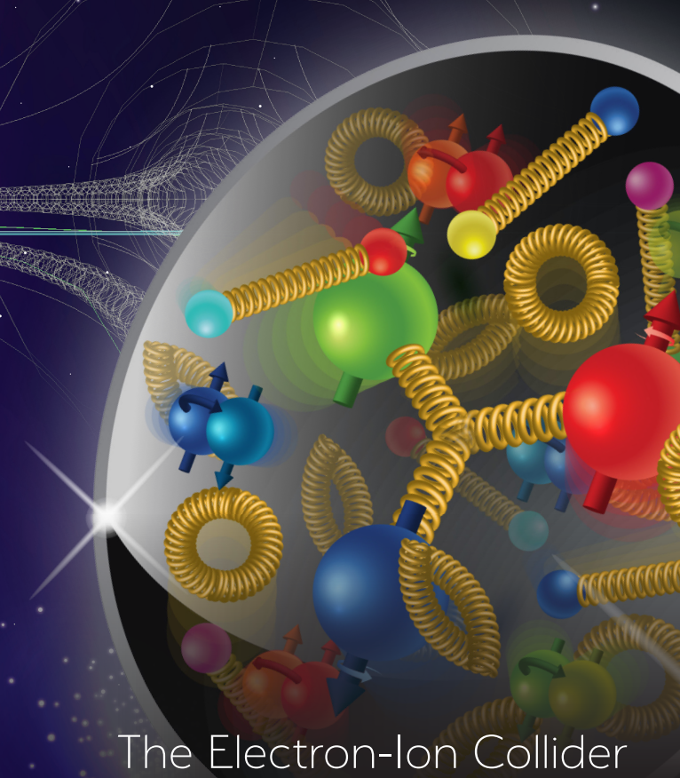


Alternate Crab Cavity Design
Andrei Lunin, Vyacheslav Yakovlev
October 27, 2021
TRIUMF 2021 EIC Accelerator Partnership Workshop

Slide 2
Outline
Concept of the HOM-free deflecting cavity
QMiR (2.815 GHz) deflecting cavity for ANL/SPX project
- EM design
- Production and Testing
QMiR (2.6 GHz) for ILC Crab Cavity
- HOM Analysis
- Mechanical Analysis (LFD and dF/dP)
- Frequency Tuner and Dressed Cavity Design
QMiR (3 GHz and 3.25 GHz) for ELLETRA-II upgrade
Conclusions

Slide 3
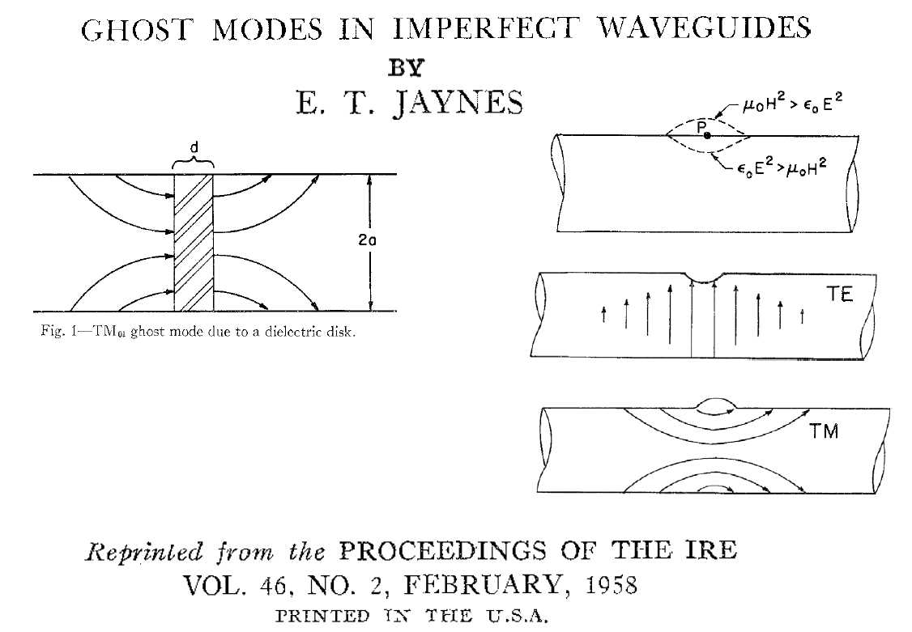
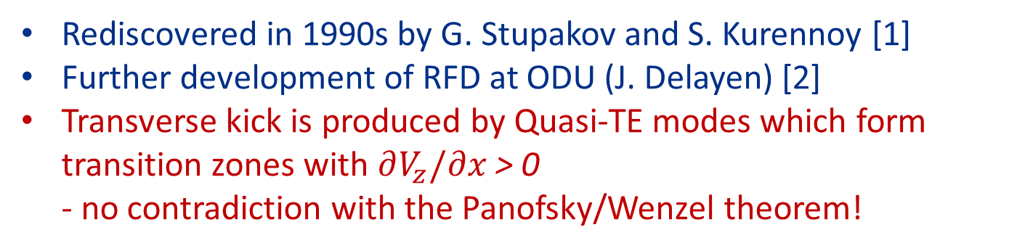
HOM-free Deflecting Cavity Concept
The key idea is based on the formation of TE “ghost” modes
Rediscovered in 1990s by G. Stupakov and S. Kurennoy [1]
Further development of RFD at ODU (J. Delayen) [2]
Transverse kick is produced by Quasi-TE modes which form transition zones with $∂V_{z}/∂x$ > 0
- no contradiction with the Panofsky/Wenzel theorem!
[1] PHYS. REV. VOL. 49-1, 1994
[2] PHYS. REV. SPECIAL TOPICS - ACCELERATORS AND BEAMS 16, 012004 (2013)

Slide 4
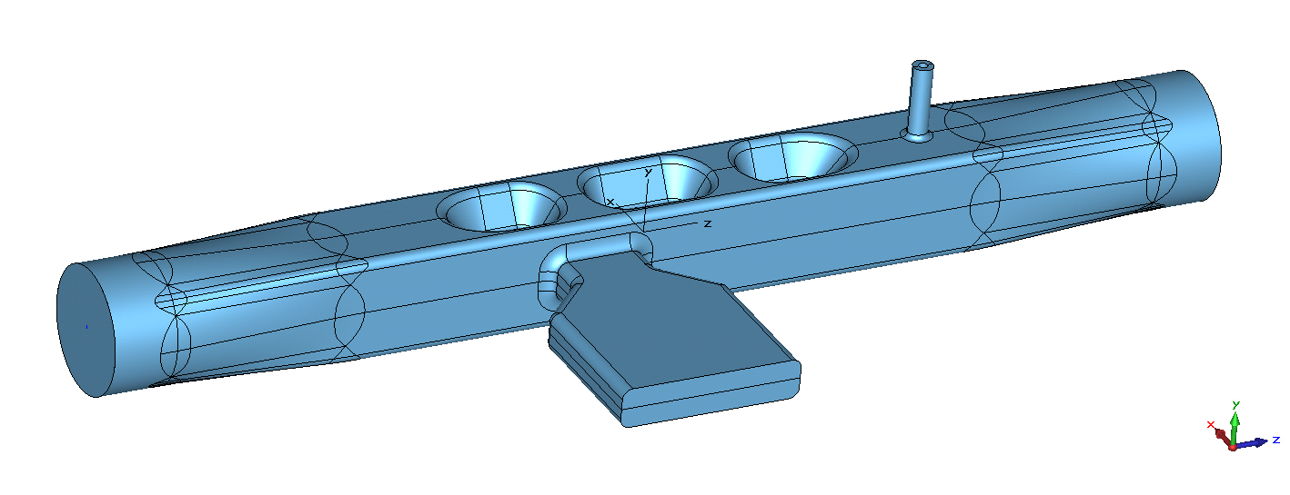
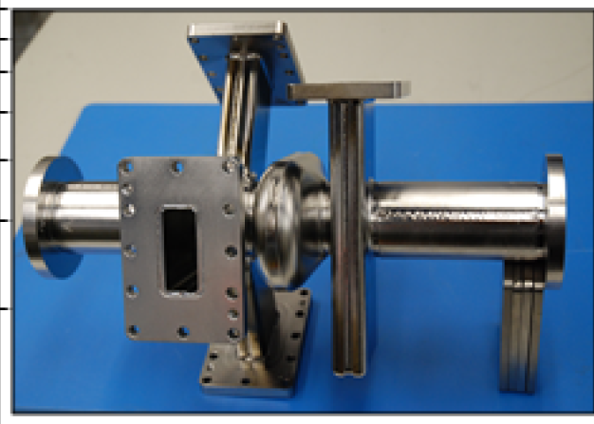
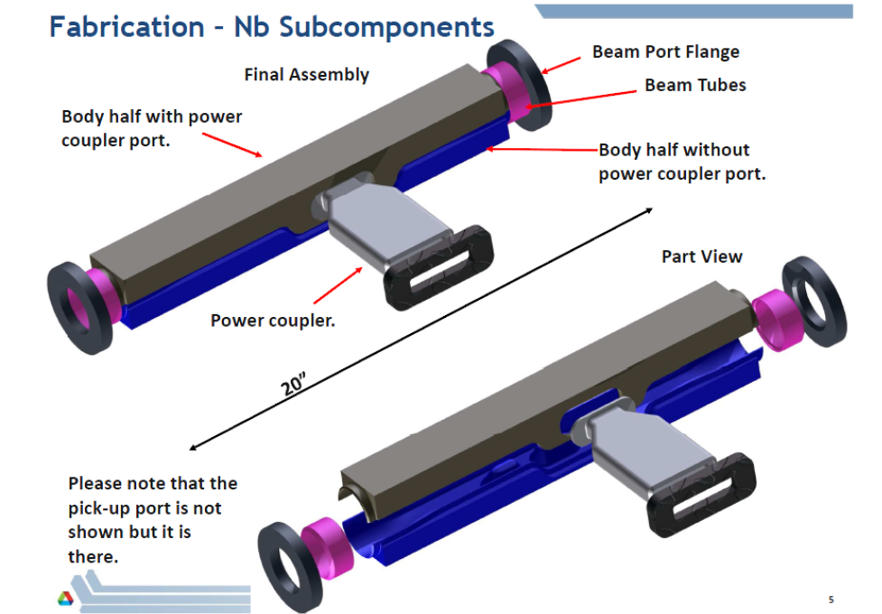
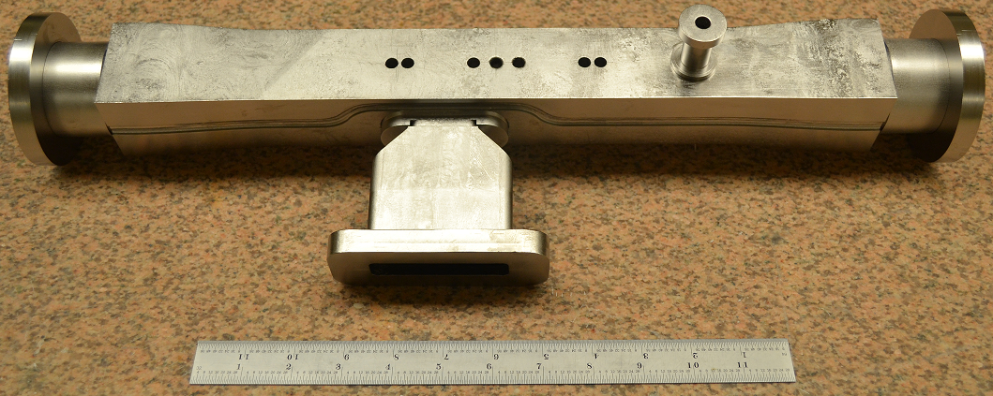
Compact HOM-free Deflecting Cavity QMIR
Quasi-Waveguide Multicell Deflecting Resonator [1]
- Proposed as replacement of Mark-II deflecting cavity for APS/SPX project
4 x
1 x
- Prototype built and tested at ANL in 2013 [2]
[1] A. Lunin, I. Gonin, M. Awida, T. Khabiboulline, V. Yakovlev, A. Zholents, Physics Procedia 79 ( 2015) 54 – 62
[2] Zachary Conway on behalf of ANL PHY LINAC Development Group, 04/23/2013

Slide 5
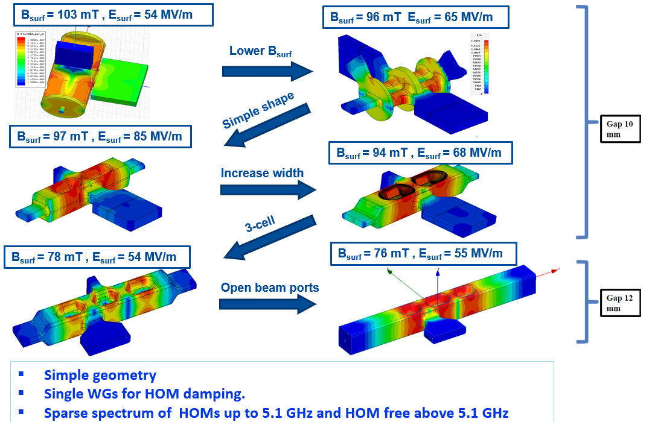
R&D on Deflecting Cavity for ANL/SPX

Slide 6
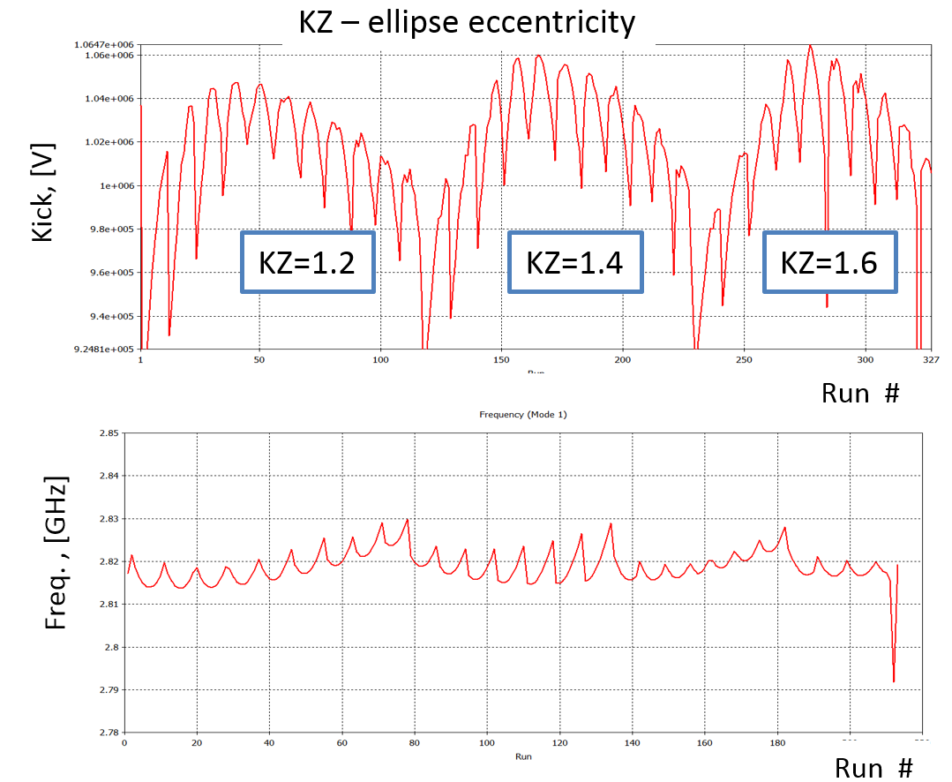
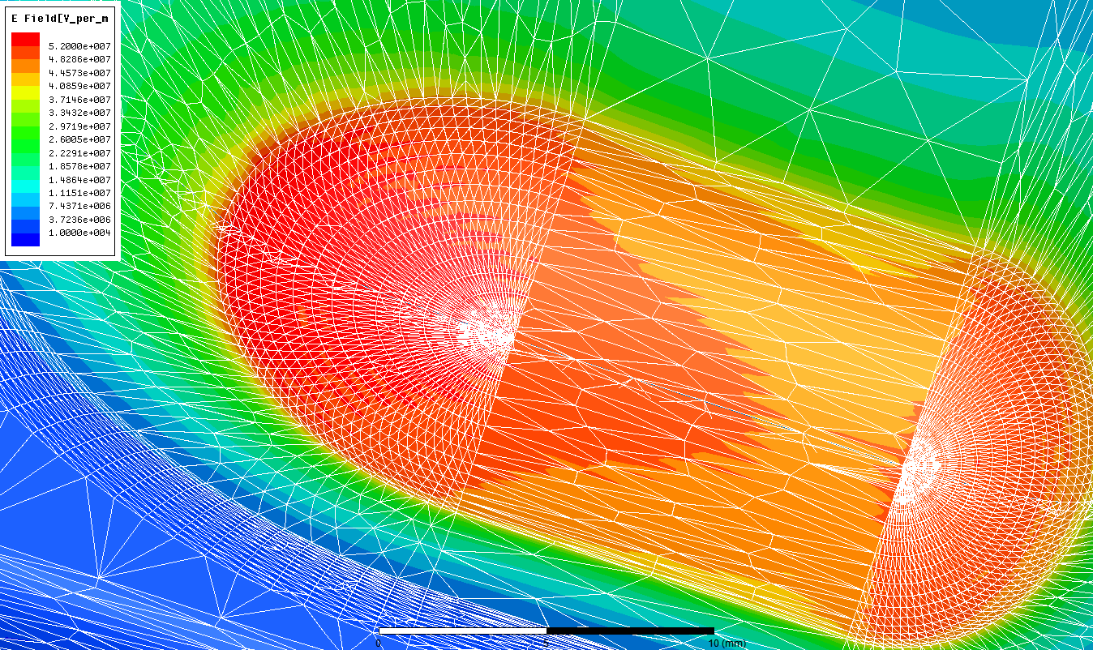
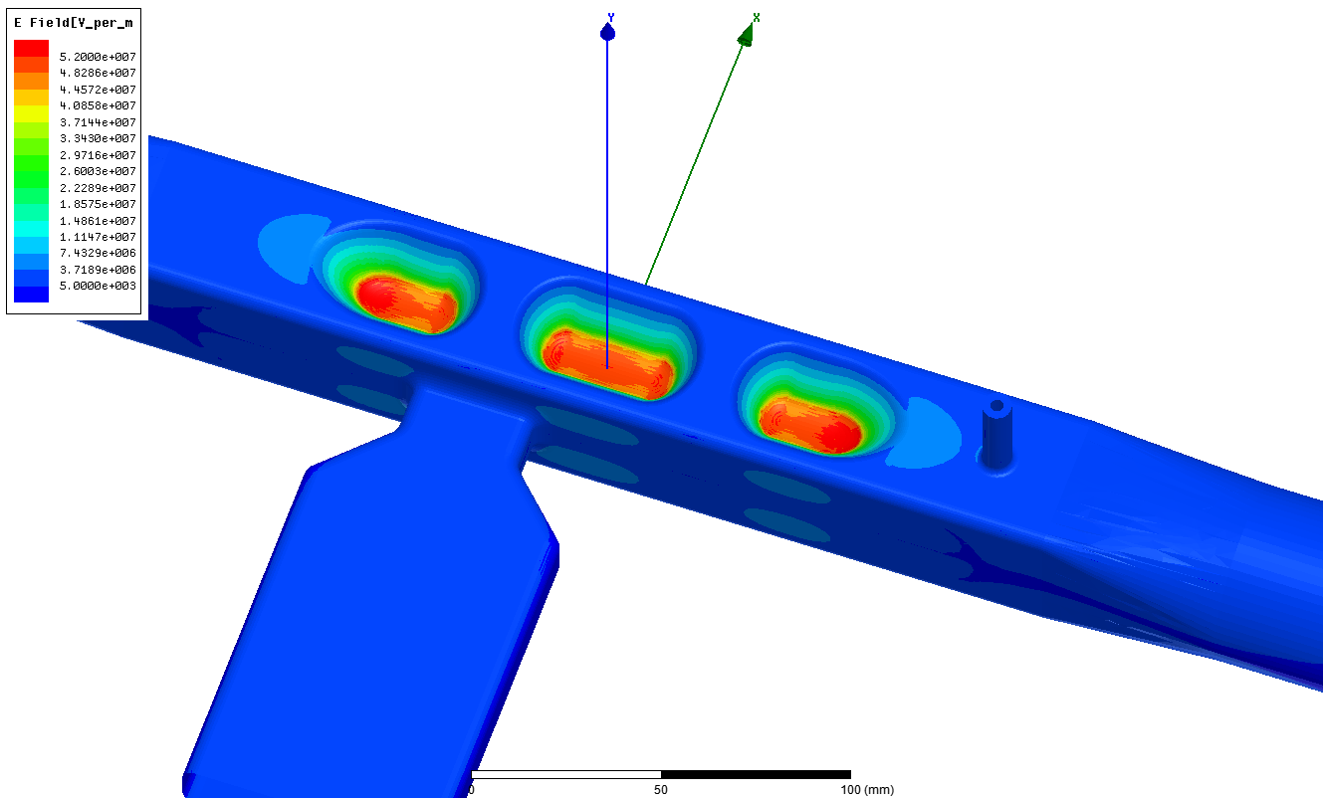
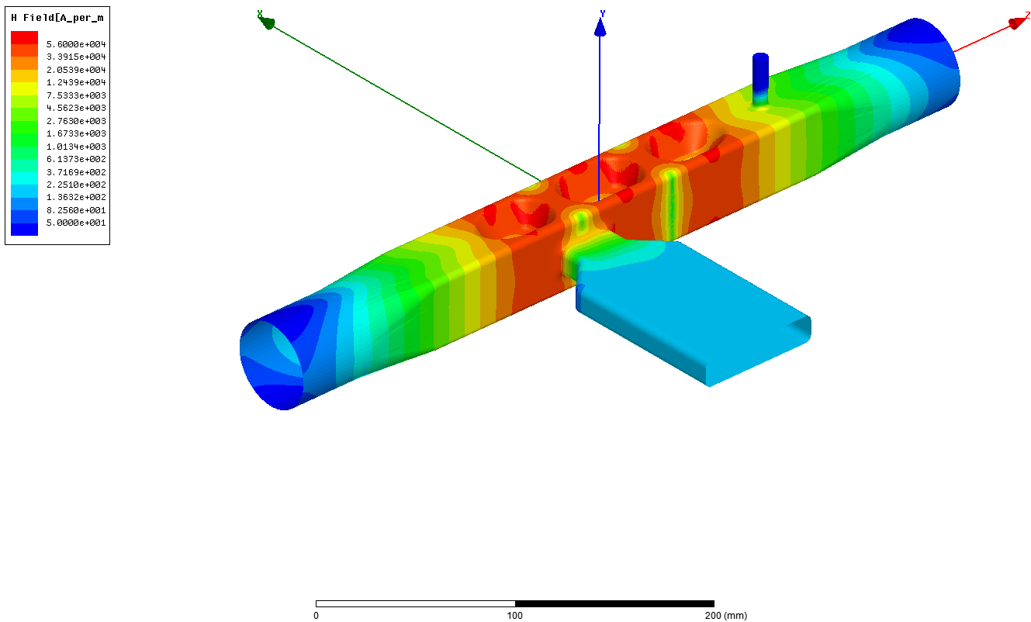
R&D on Deflecting Cavity for ANL/SPX
Operating trapped mode surface electric (up) and magnetic (down) fields
Model is fully parameterized
The frequency derivation was calculated for each parameter in order to preserve the operating mode frequency on the stage of geometry creation.
General ellipsoid is used for hollow surface representation
Global optimum search algorithm

Slide 7
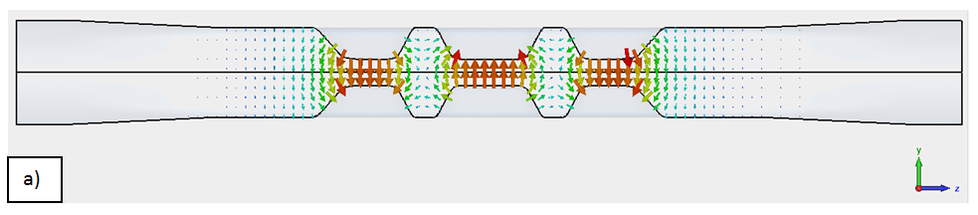
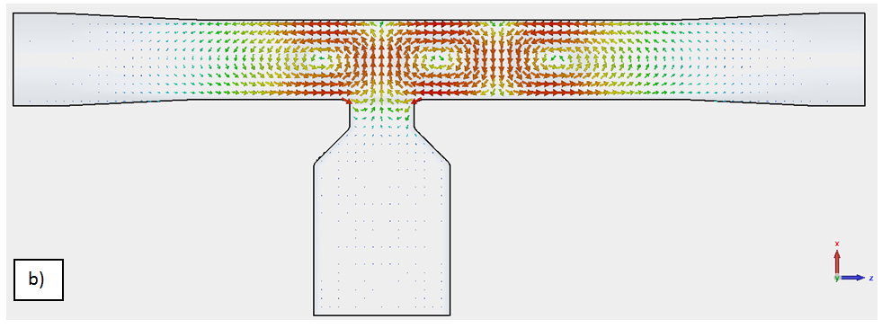
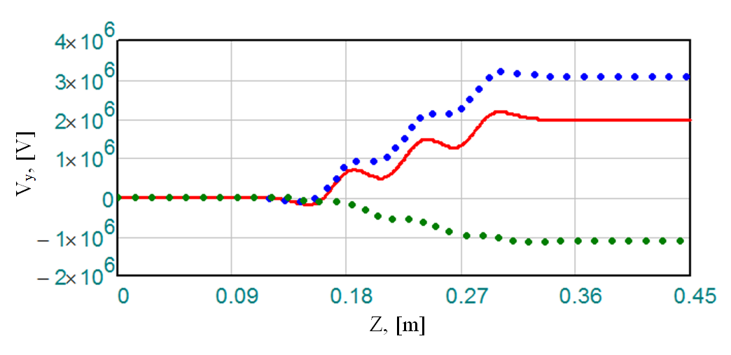
Operating Dipole Mode
Transverse electric (blue) and magnetic (red) field components along the cavity axis.
QMiR has a record high (R/Q)_{t} >1kΩ
Integrated vertical kick along the cavity axis (solid red curve is the overall kick, dotted blue and green curves are electric and magnetic kicks).
Freq | 2815 MHz
V_{kick} | 2 MV
E_{max} | 55 MV/m
B_{max} | 76 mT
(R/Q)_{Y} | 1040 Ω
G | 130
W_{STOR} | 0.23 J

Slide 8
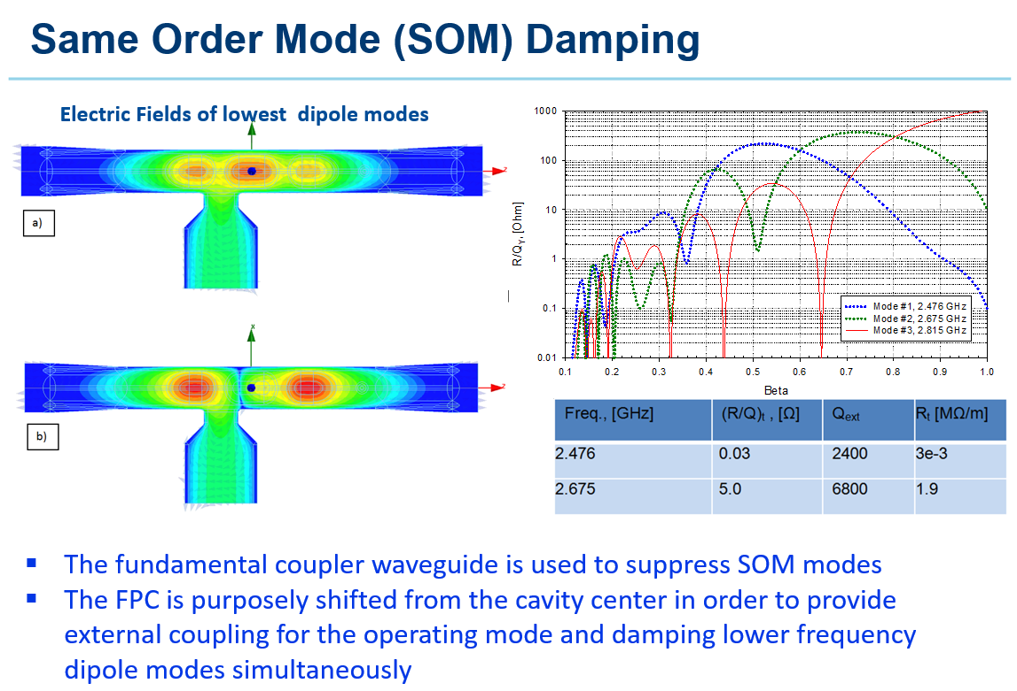
Same Order Mode (SOM) Damping

Slide 9
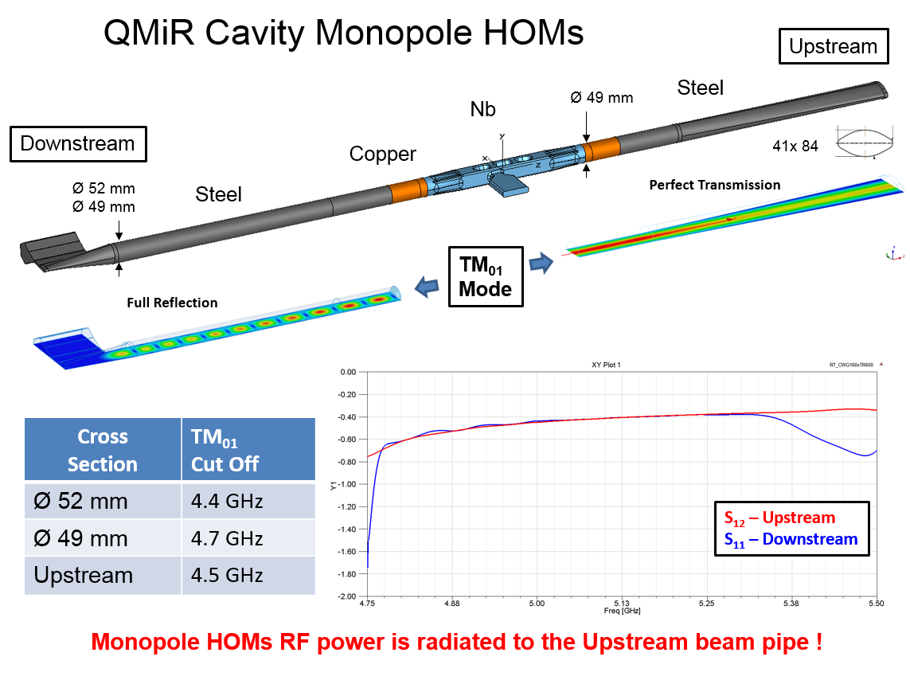
HOM Damping in the APS Ring

Slide 10
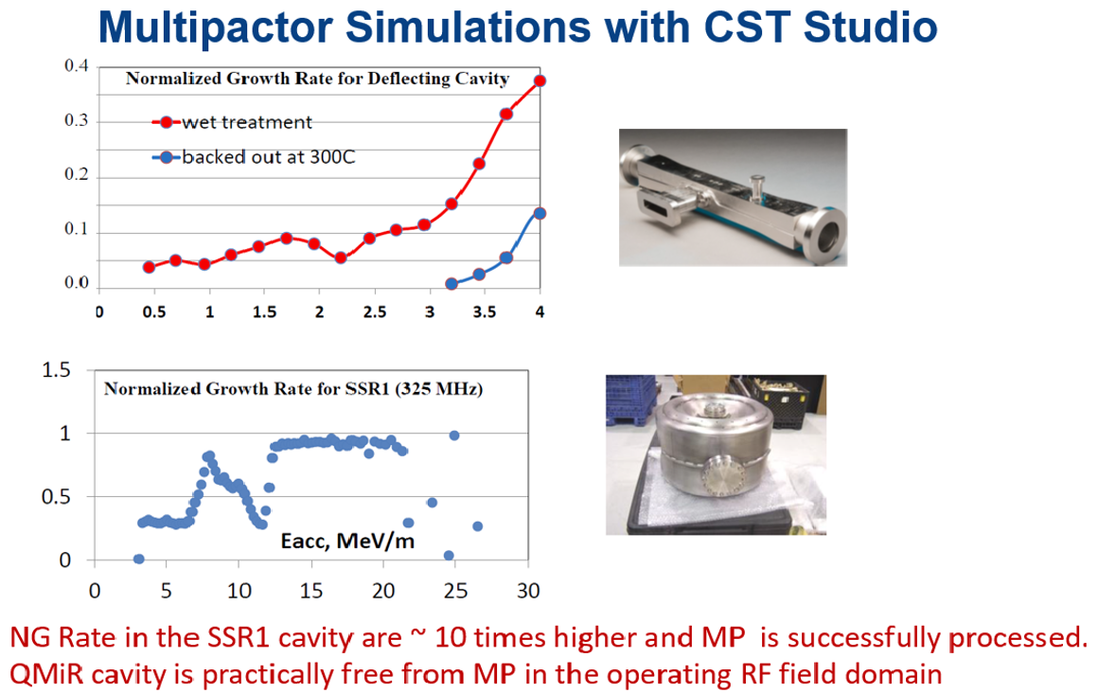
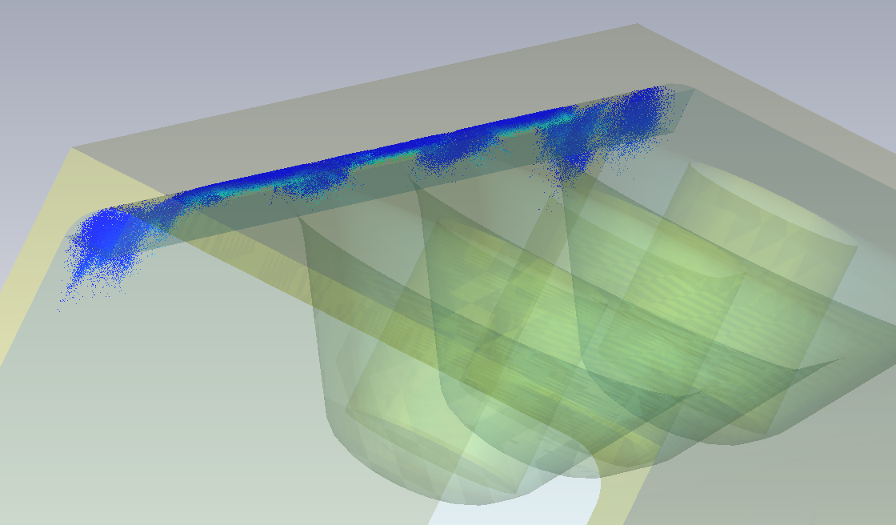
Multipactor Analysis in QMiR

Slide 11
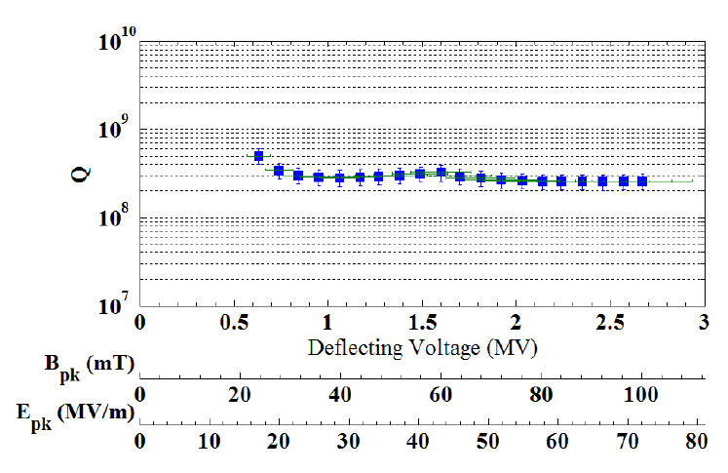
QMIR Prototype Production and Testing
Bare QMiR (21.75' Long) cavity
Cavity received EP-treatment before the test
Measured maximal deflecting voltage of 2.7 MV exceeded the design goal of 2.0 MV @2K vertical test of QMiR prototype [1]
Relatively low Q₀ (3E8) is due to extra RF losses at covering flanges
Further QMiR development was stopped due to the cancelation of ANL/SPX project

Slide 12
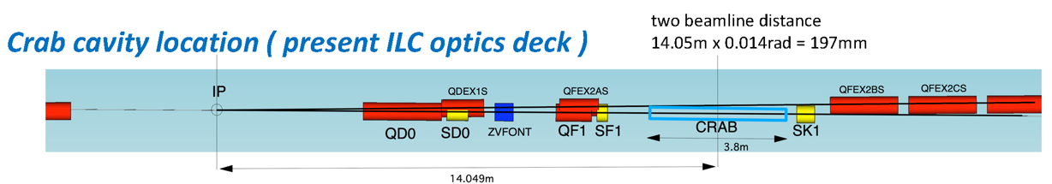
QMIR Application for ILC Crab Cavity
The kick voltage is inverse proportional to frequency (V_{t} ~ f ⁻¹)
The CC space is limited by a close beamlines distance (< 0.2 m)
For the deflecting voltage of about 0.9 MV the cavity has considerably small surface fields, Ep ≈25 MV/m, Bp ≈ 35 mT
QMiR cavity @2.6 GHz looks a good choice!

Slide 13
QMiR Cavity for ILC (scaled to 2.6 GHz)
There are two Same Order Modes (SOM) that have a low (R/Q)*Q
SOM/HOM external couplings Qext < 10⁴
SOM/HOMs longitudinal and transverse impedances (@1mm):
(R/Q)z <= 100 Ω, (R/Q)x <= 1 Ω and (R/Q)y <= 10 Ω
SOM/HOM spectrum is sparse and strongly damped

Slide 14
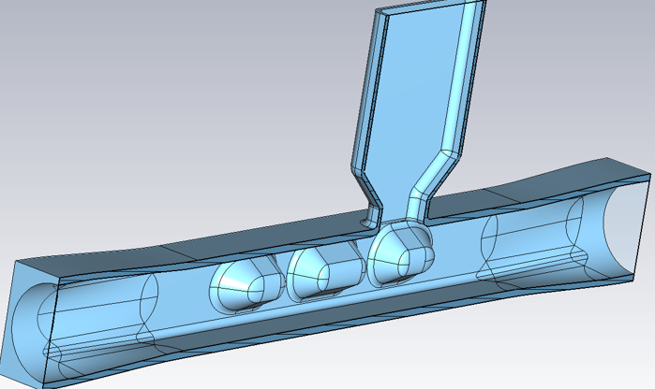
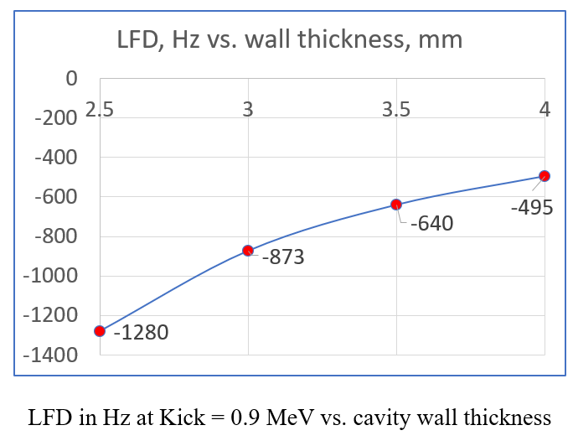
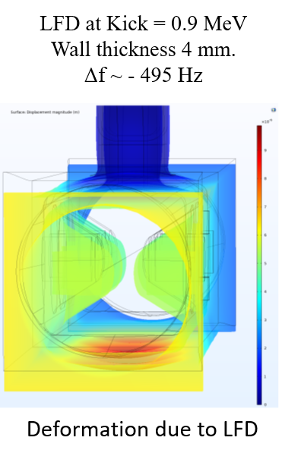
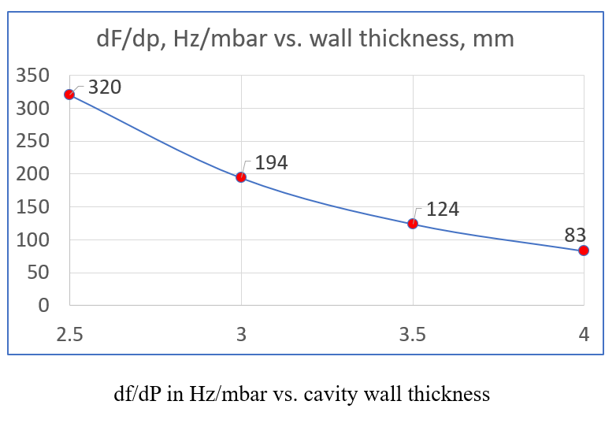
Mechanical Analysis LFD and dF/dP (by I. Gonin)
LFD < 500 Hz
dF/dP < 100 Hz
QMiR LFD and dF/dP are less than the cavity bandwidth (few kHz)

Slide 15
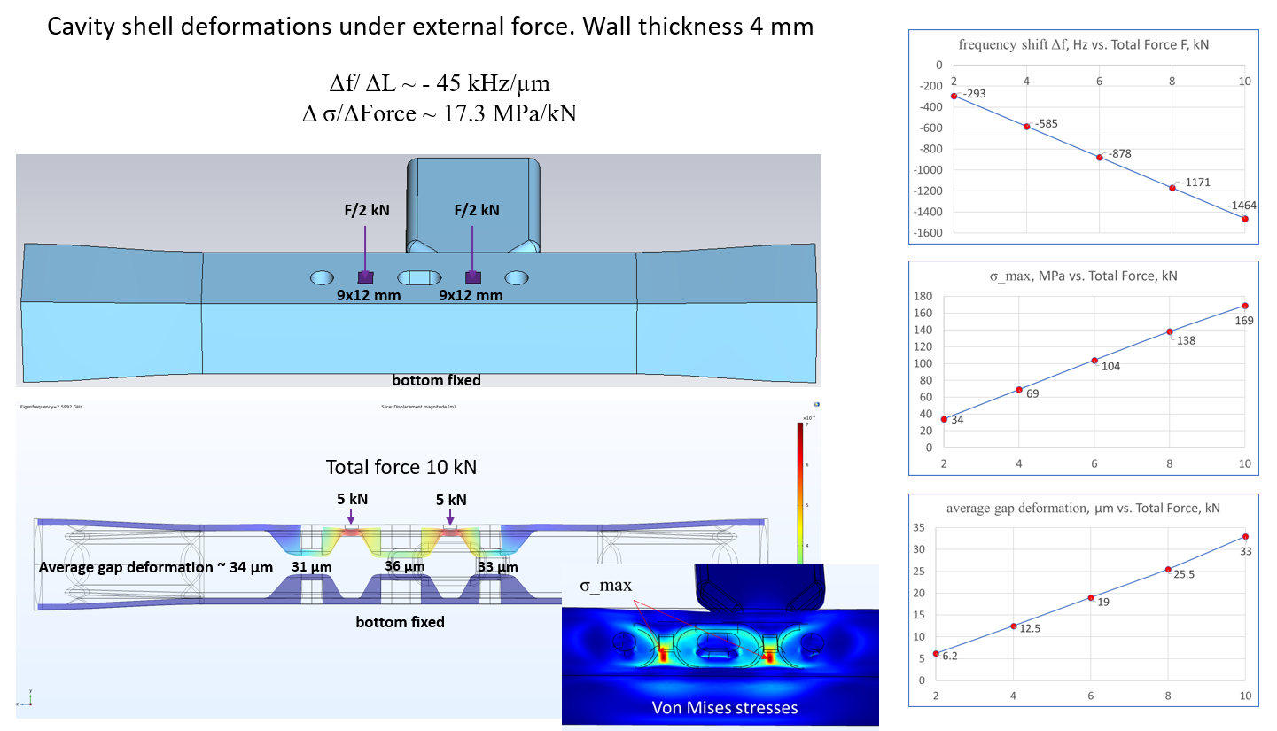
Mechanical Analysis of Frequency Tuning (by I. Gonin)
Maximum frequency tuning range: ~ 1..2 MHz

Slide 16
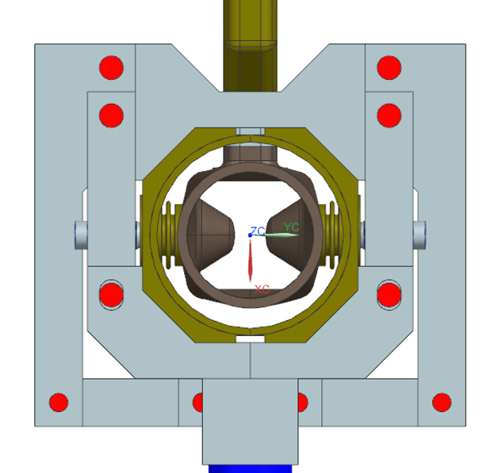
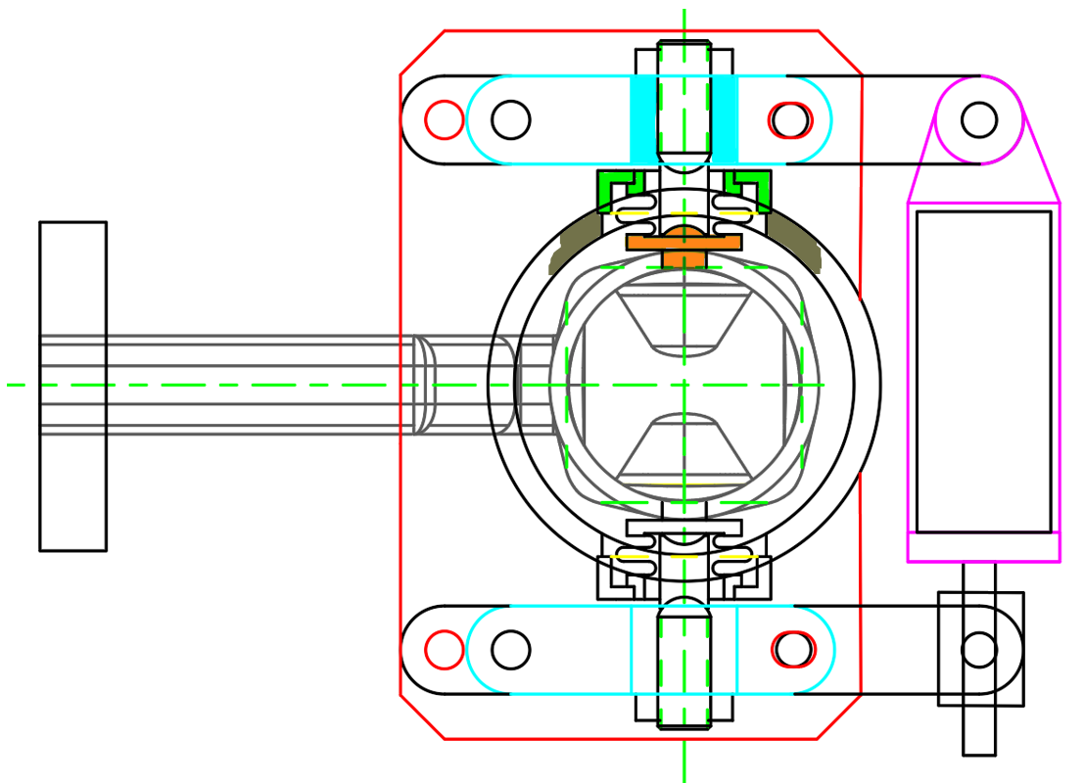
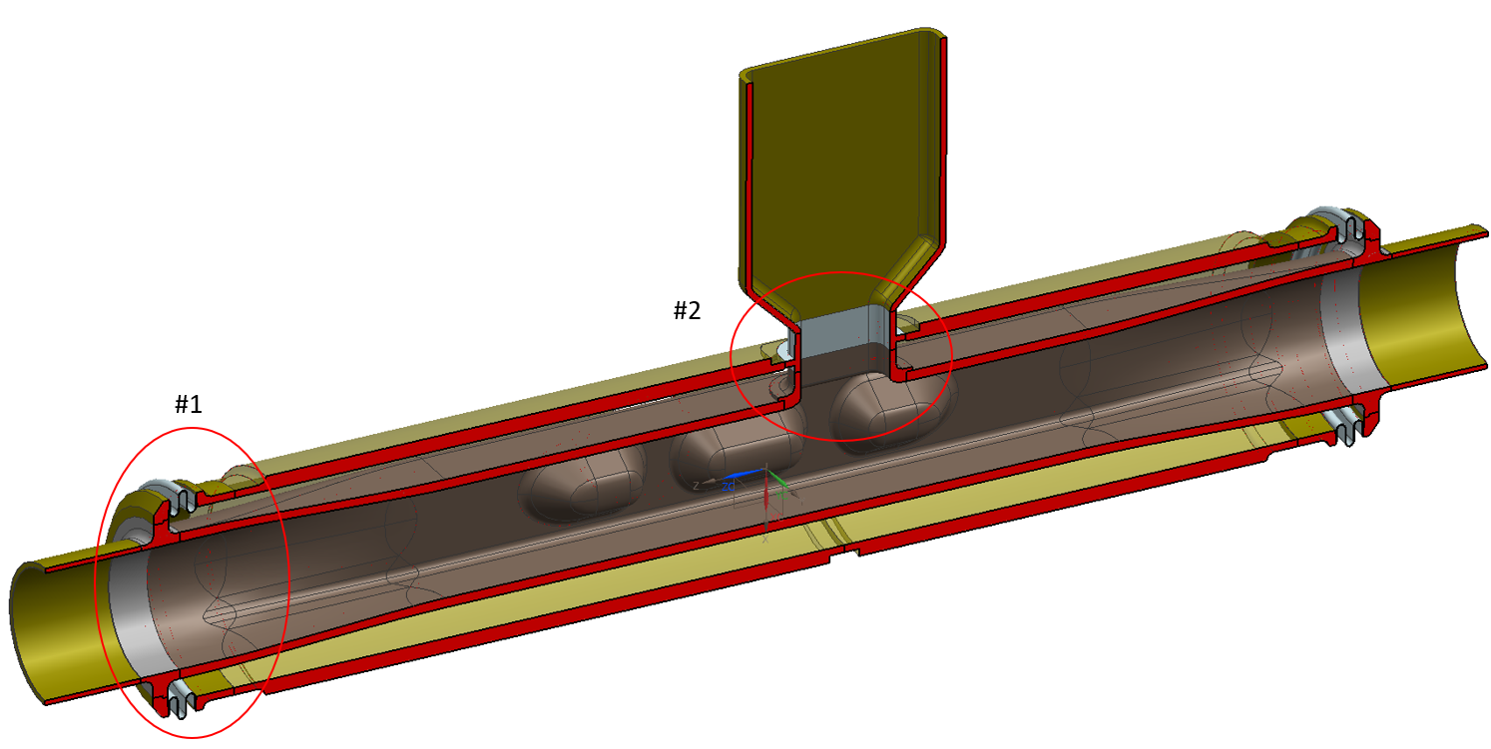
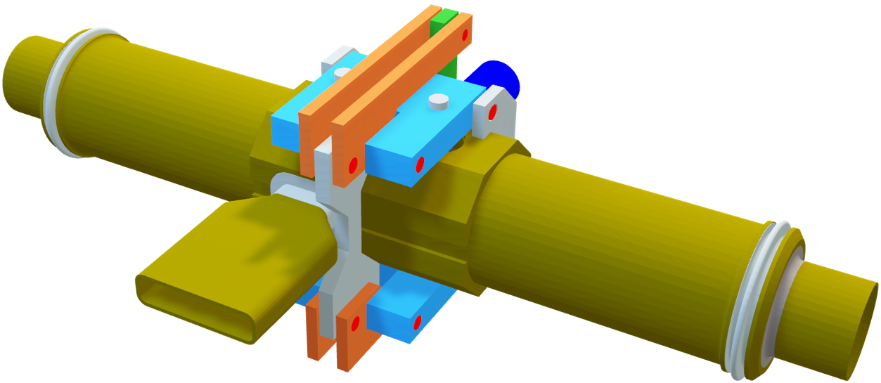
QMiR Cavity Slow Tuner Design (by V. Polubotko)
Compact lever-type frequency tuner
LHe Vessel
Dressed QMiR Cavity
Design of frequency tuner integrated with dressed cavity is ongoing

Slide 17
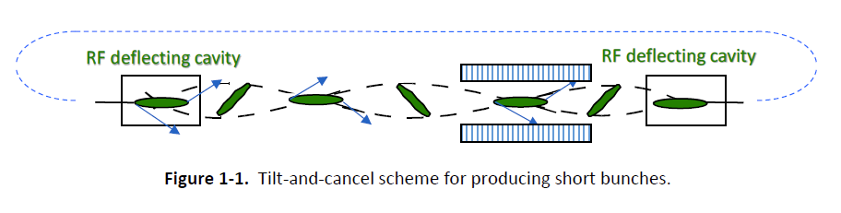
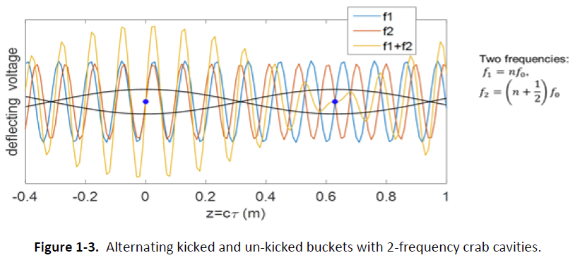
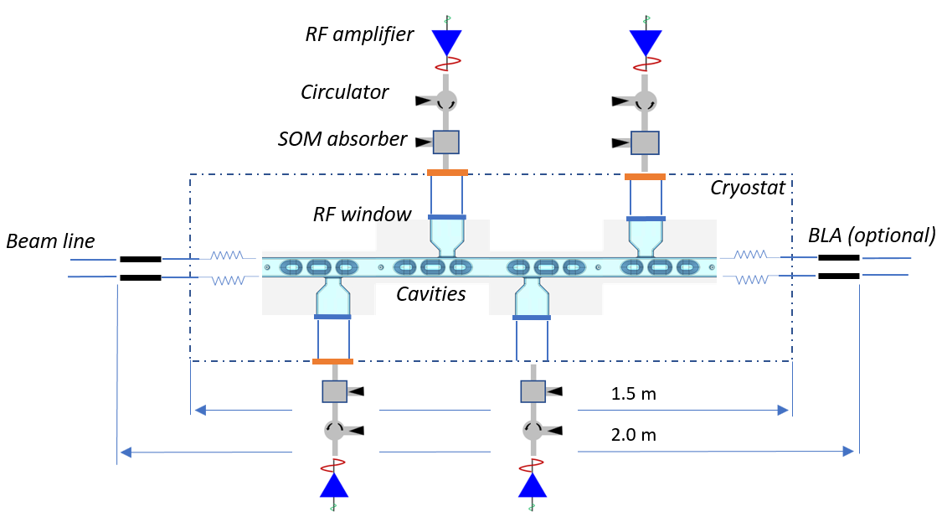
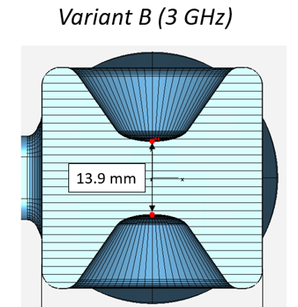
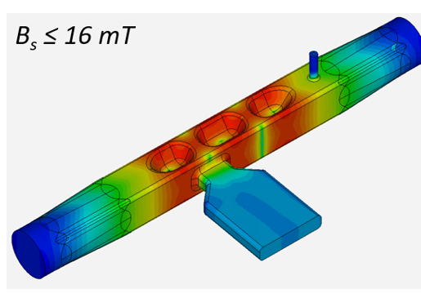
QMiR Cavity for ELLETRA-II Upgrade (ST Trieste)
Original scheme for ANL/SPX[1]
SPX 2-Frequency scheme
Deflecting System for ST Trieste [2]
Large aperture
Low B-field
MAC for ST Trieste recommended to proceed with the QMiR type Crab Cavities, 3 GHz and 3.25 GHz for ELLETRA-II upgrade
[1] A. Zholents, P. Heimann, M. Zolotorev, J. Byrd, NIM in Physics Research Section A 425(1-2), 1999.
[2] A. Lunin, T. Khabiboulline, V. Yakovlev, FERMILAB-TM-2756-TD, Technical Note, Fermilab, 2021.

Slide 18
Conclusions
A Quasi-Waveguide Multicell Deflecting Resonator (QMIR) is a viable option for Crab and Deflecting Cavities applications
QMIR is very compact and simple (no HOM-couplers)
It has sparse HOM spectrum
It has acceptable loss/kick factors
No MP in operation voltage domain.
QMIR cavity is now being considered for the Elletra-2 and ILC projects.
It meets all the project requirements
Fermilab can design, build and test QMIR cavities for a variety of particle accelerator applications

Slide 19
Backup Slides

Slide 20
2.6 GHz QMiR for ILC Crab Cavity
For the ILC bunch length (0.3 mm rms), the loss and kick factors:
k_loss <= 50 V/pC and k_kick <= 0.1 V/pC/mm

Slide 21
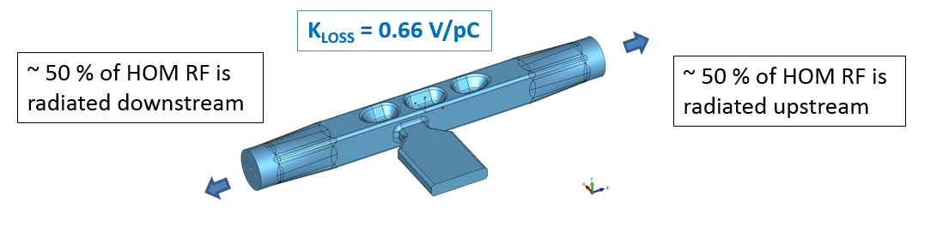
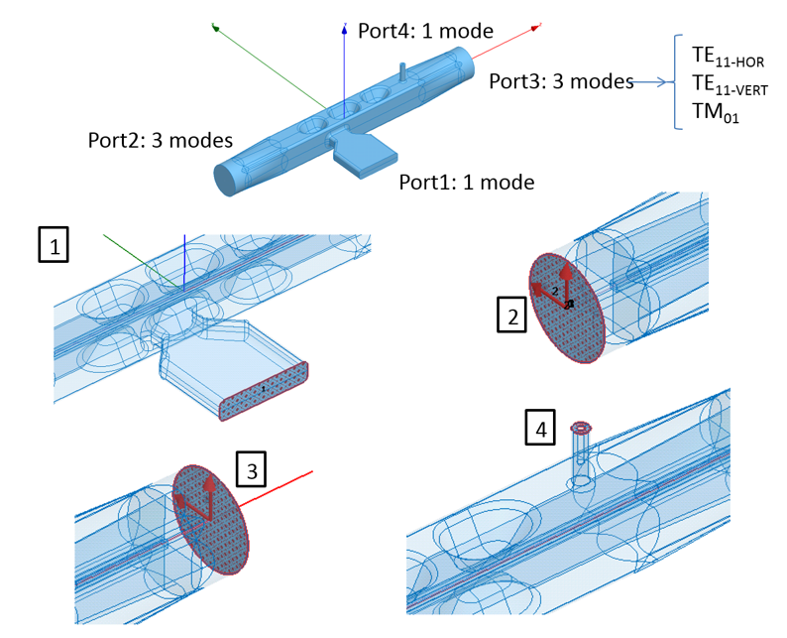
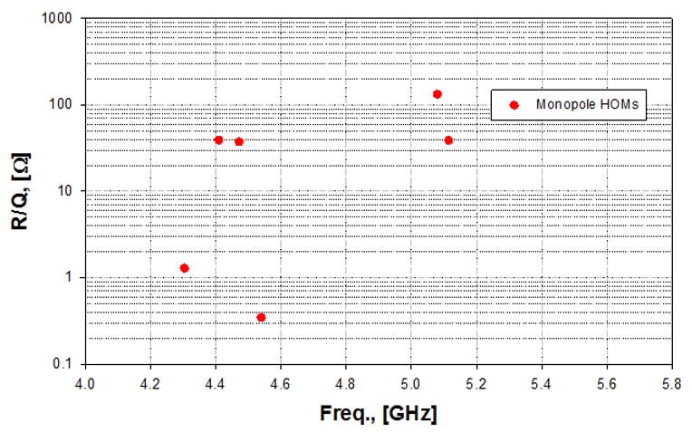
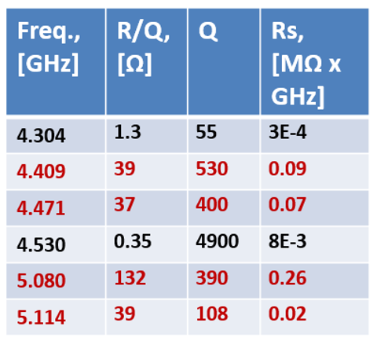
High Order Mode (HOM) Damping
Cavity is HOM-free at f > 5.2 GHz

Slide 22
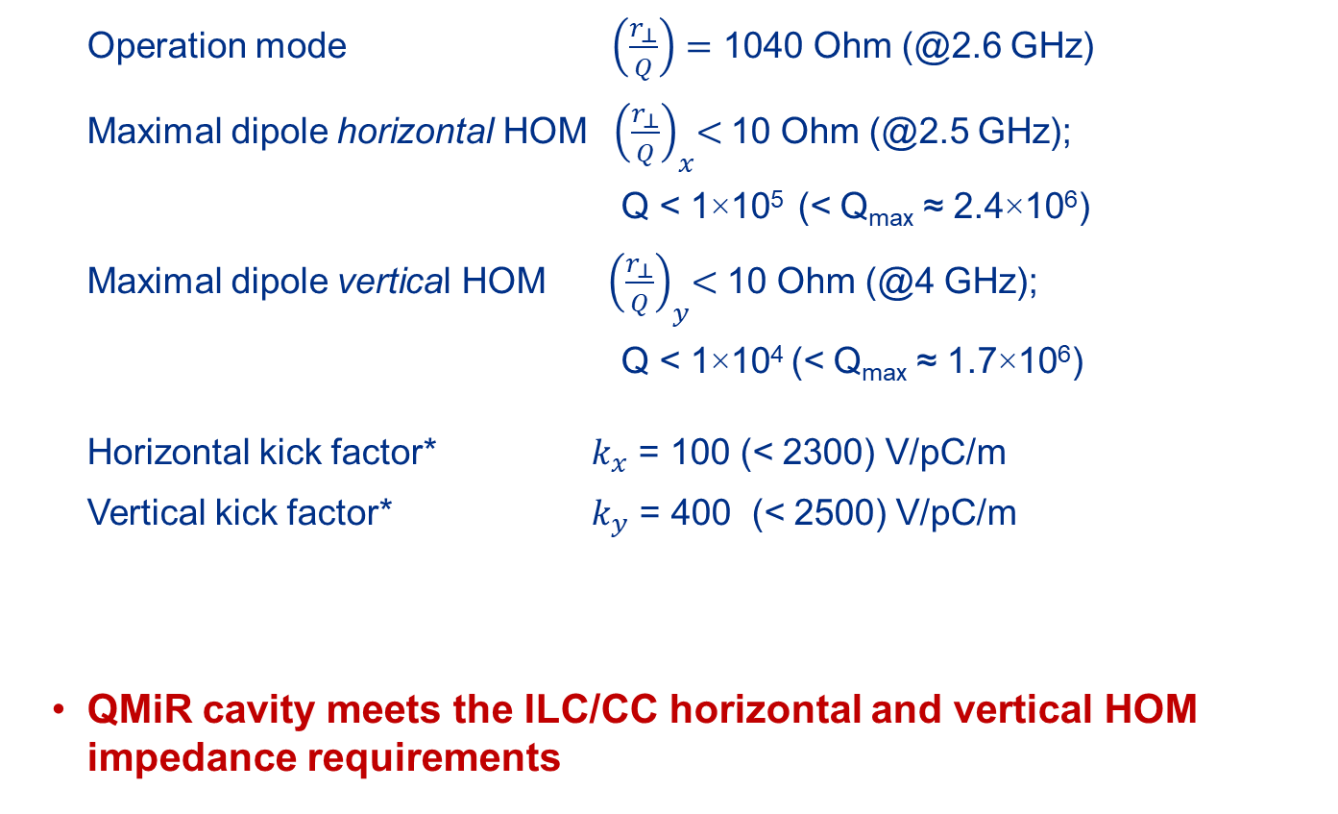
QMiR Cavity for ILC (scaled to 2.6 GHz)
Operation mode $\left(\frac{r_{⊥}}{Q}\right)=$ 1040 Ohm (@2.6 GHz)
Maximal dipole horizontal HOM ${ \left(\frac{r_{⊥}}{Q}\right)}_{x}<$10 Ohm (@2.5 GHz);
Q < 1×10⁵ (< Q_{max} ≈ 2.4×10⁶)
Maximal dipole vertical HOM ${ \left(\frac{r_{⊥}}{Q}\right)}_{y}<$ 10 Ohm (@4 GHz);
Q < 1×10⁴ (< Q_{max} ≈ 1.7×10⁶)
Horizontal kick factor* $k_{x}$ = 100 (< 2300) V/pC/m
Vertical kick factor* $k_{y}$ = 400 (< 2500) V/pC/m
QMiR cavity meets the ILC/CC horizontal and vertical HOM impedance requirements
* GdfidL calculation for 0.3 mm bunch length (cross check with ECHO-3D code is ingoing)

Slide 23
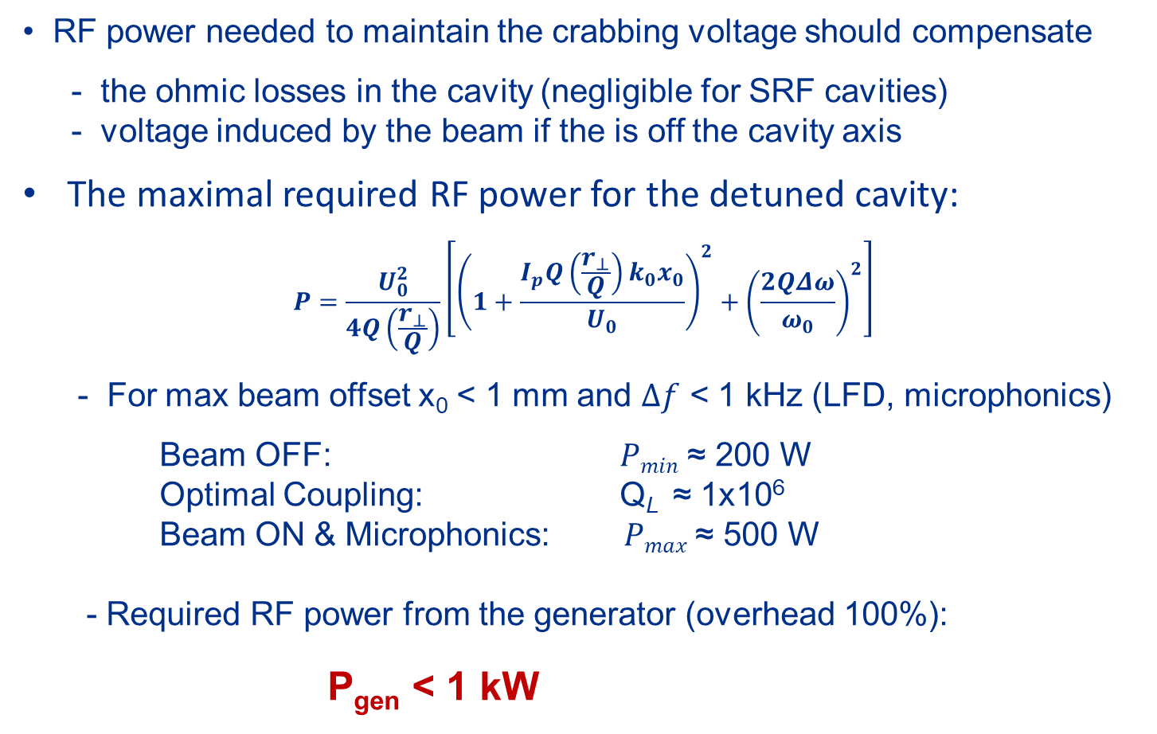
QMiR Cavity for ILC RF Power
RF power needed to maintain the crabbing voltage should compensate
- the ohmic losses in the cavity (negligible for SRF cavities)
- voltage induced by the beam if the is off the cavity axis
The maximal required RF power for the detuned cavity:
$$P=\frac{U_{0}^{2}}{4Q\left(\frac{r_{⊥}}{Q}\right)}\left[{\left(1+\frac{I_{p}Q\left(\frac{r_{⊥}}{Q}\right){k_{0}x}_{0}}{U_{0}}\right)}^{2}+{\left(\frac{2QΔω}{ω_{0}}\right)}^{2}\right]$$
- For max beam offset x₀ < 1 mm and $Δf$ < 1 kHz (LFD, microphonics)
Beam OFF: $Pmin$ ≈ 200 W
Optimal Coupling: Q_{L} ≈ 1x10⁶
Beam ON & Microphonics: $Pmax$≈ 500 W
- Required RF power from the generator (overhead 100%):
P_{gen} < 1 kW

