Slide 1

Carbon coating technology
P. Costa Pinto, V. Baglin, P. Chiggiato, P. Cruikshank, S. Fiotakis, A. Granadeiro Costa, M. Himmerlich, H. Kos, N. Kos, M. Taborelli, J. Tagg
  Introduction to a-C films with low Secondary Electron Emission
    Secondary Electron Yield (SEY, δ) of carbon materials
    Effect of Impurities
    Ageing in air
    Ageing
  Coating technology at CERN
    Coating techniques
    Adapt the coating technique to the constrains
    The SPS case
    The HL-LHC case
  Summary

Slide 2
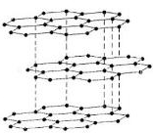
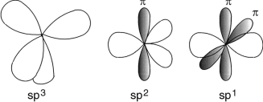

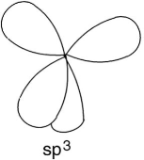

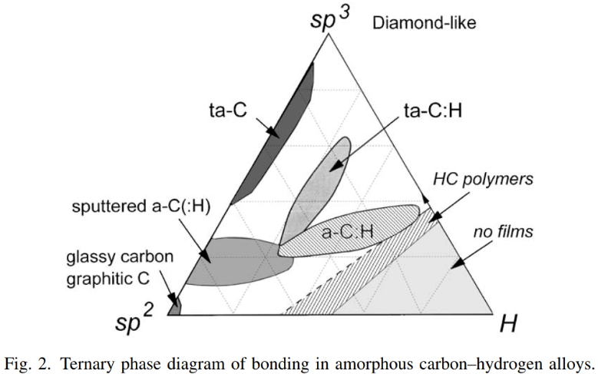
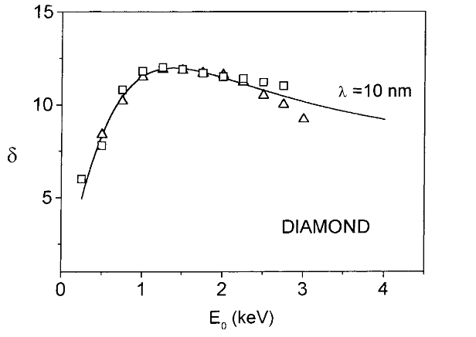
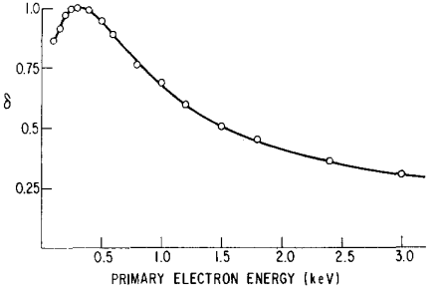
1 – Introduction to low SEE a-C films
The SEY (δ) of carbon materials depend on the molecular bonds between carbon atoms.
Graphite =>low SEY
Carbon thin films
Diamond => high SEY
high SEY
δ_{max} ~ high
δ_{max} ~ 1
low SEY
JACQUES CAZAUX, Mikrochim
. Acta 132, 173±177 (2000)
N. REY WHETTEN JOURNAL OF APPLIED PHYSICS
VOLUME 34. NUMBER 4 (PART 1) APRIL 1963
high SEY

Slide 3
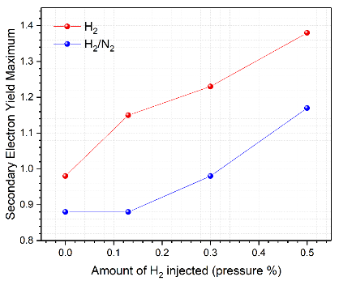
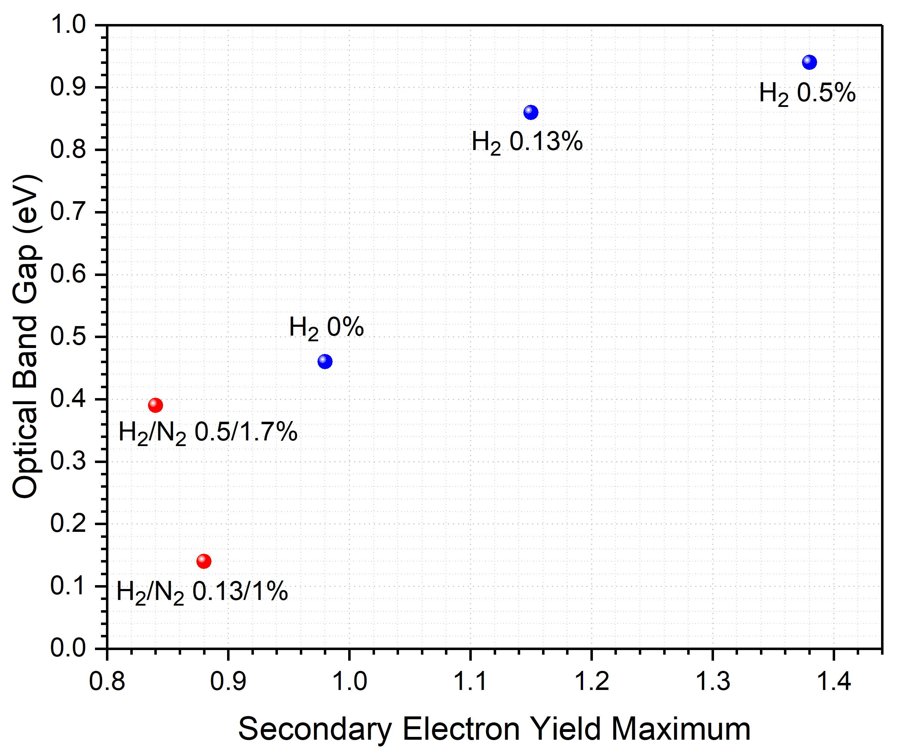
1 – Introduction to low SEE a-C films
The effect of impurities: hydrogen is bad

Slide 4
1 – Introduction to low SEE a-C films
The effect of impurities: hydrogen is bad nitrogen is good
1%

Slide 5
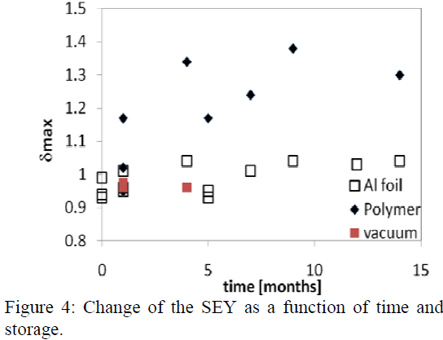
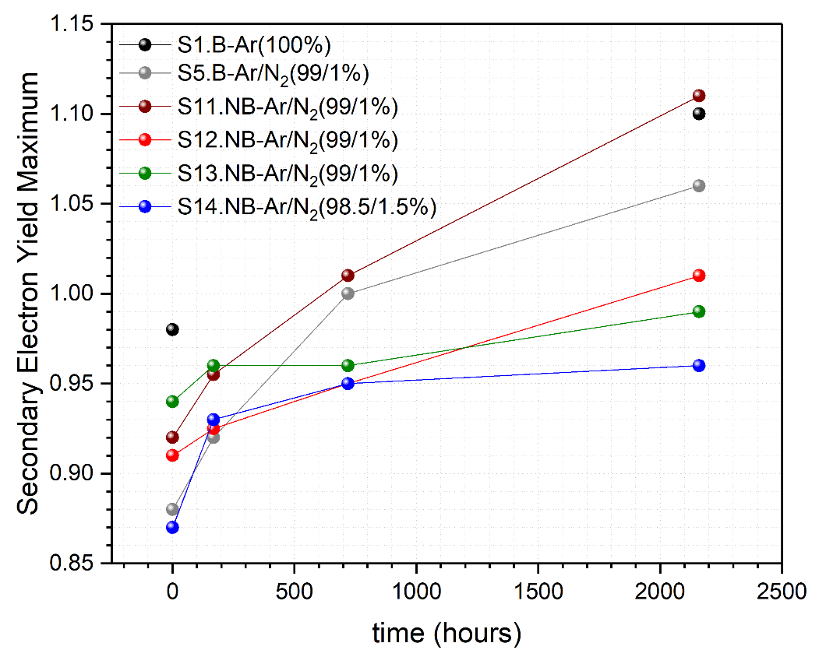
1 – Introduction to low SEE a-C films
Ageing
IPAC 2011 TUPS027
Magnetron sputtering
Al foil Hollow Cathode sputtering
3 months
In air
(wrapped in Al foil)

Slide 6
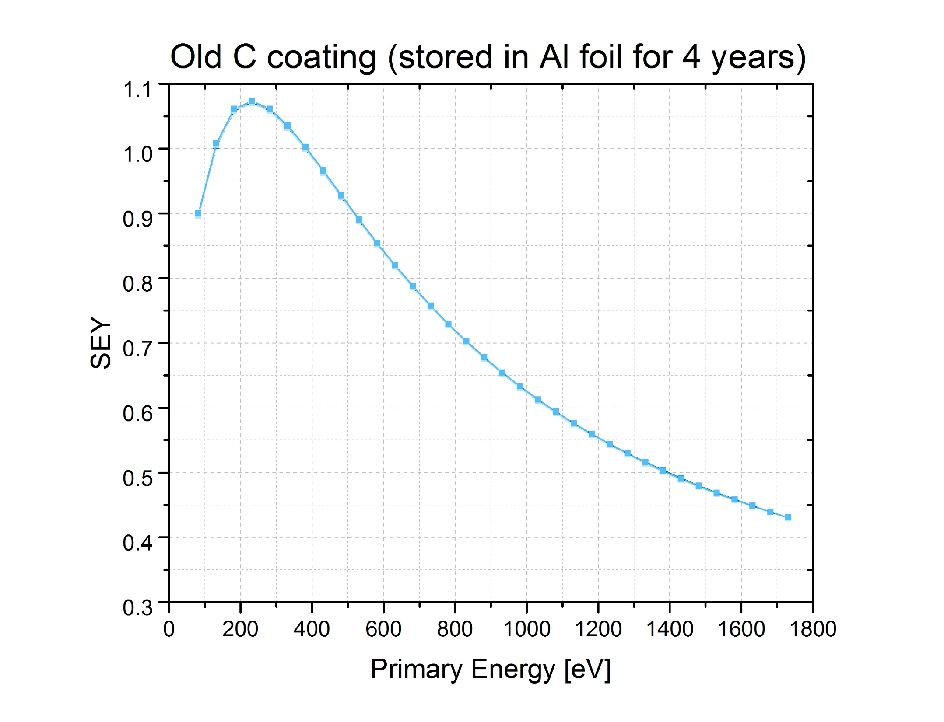
1 – Introduction to low SEE a-C films
Ageing
3 months
In air
(wrapped in Al foil)
1st QF coating done by magnetron sputtering

Slide 7
2 – Coating technology at CERN
Coating techniques
Sputtering
Plasma
Assisted
CVD
PLD
Pulsed Laser Deposition
Cathodic
Arc
Thermal evaporation
Thermal
CVD
Chemical Vapour deposition
Not tested at CERN

Slide 8
2 – Coating technology at CERN
Coating techniques
Sputtering
Plasma
Assisted
CVD
PLD
Pulsed Laser Deposition
High deposition rate and easy to scale up
SEY_{max}~1 if performed at high pressure
(to quench the energy of the C atoms)
SEY_{max}~1
SEY_{max} > 1.4 due to high hydrogen content from precursor gases (CH₄, C₂H₂)
Adaptable to a wide range of geometries
Poor adhesion on Cu
Low deposition rate (sputtering yield)

Slide 9
2 – Coating technology at CERN
Coating techniques
Sputtering
Plasma
Assisted
CVD
PLD
Pulsed Laser Deposition
High deposition rate and easy to scale up
SEY_{max}~1 if performed at high pressure
(to quench the energy of the C atoms)
SEY_{max}~1
SEY_{max} > 1.4 due to high hydrogen content from precursor gases (CH₄, C₂H₂)
Adaptable to a wide range of geometries
Poor adhesion on Cu
Low deposition rate (sputtering yield)

Slide 10
2 – Coating technology at CERN
Adapt the coating technique to the constrains
Geometry of the object to be coated: cylindrical, planar, ellipsoidal, etc.
Accessibility: tube with/without flanges; already inserted in a yoke of a magnet; in the accelerator tunnel;
Adhesion: substrate material, surface treatments, bakeout before coating?
Residual gas during coating: outgassing / pumping (materials; bakeout before coating? thermal treatments)
Schedule & budget
Whenever possible, integrate the coating process from the design phase.

Slide 11
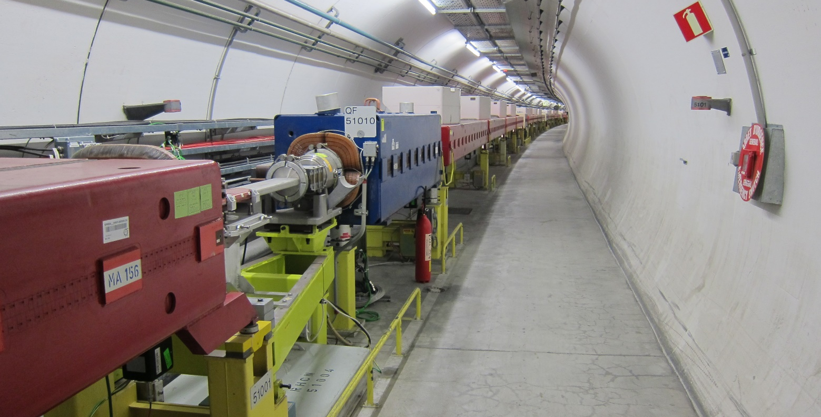
2 – Coating technology at CERN
The SPS case
Drift chambers
ID 159 mm
Quad chambers
Ellipsoid
Quad chambers
ID 80 mm
Dipole chambers
racetrack
Beam pipes with different geometries:
Quad and dipole chambers are embedded in the yoke. (bakeout not possible)
Keep quads and dipoles in the ring => coat in-situ

Slide 12
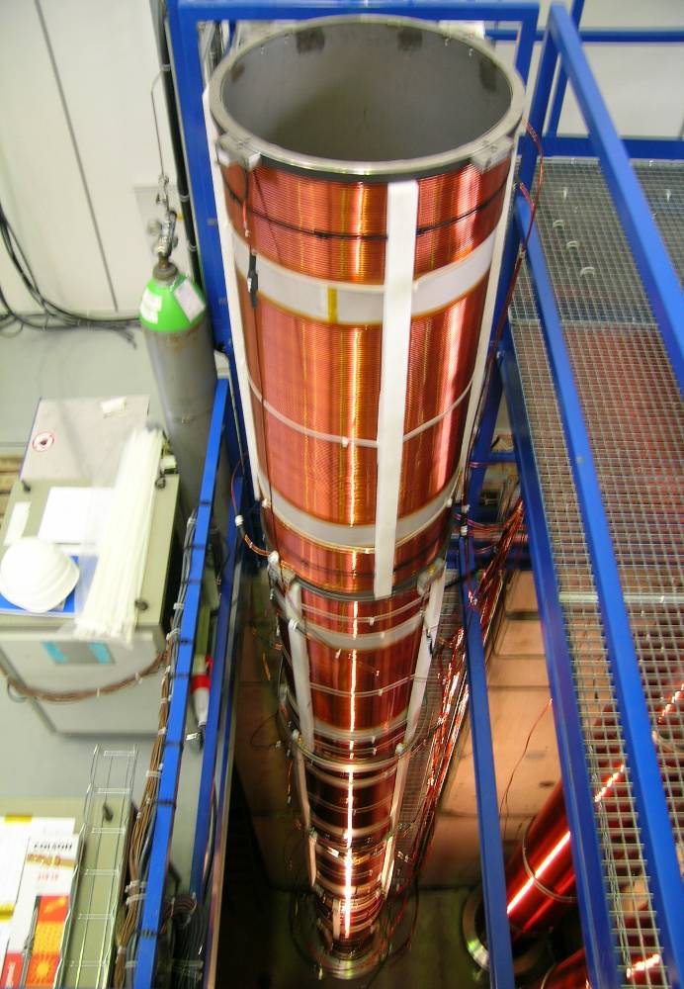
2 – Coating technology at CERN
The SPS case
Drift chambers
ID 159 mm
Beam pipes with different geometries:
Coat ex-situ by DC cylindrical Magnetron sputtering (solenoid)
Bakeout before coating (24@150 oC)
Pressure Ar ~4x10⁻² mbar
Power density ~ 200 W / meter of target
Sputtering rate ~ 12 nm / hour
Graphite rod
(OD 14 mm)
B supplied
by a
solenoid

Slide 13
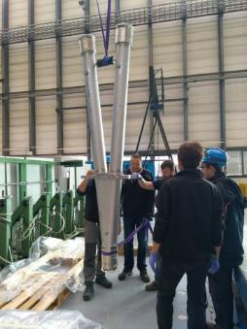
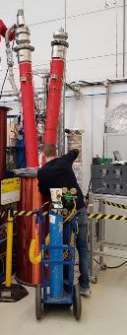
2 – Coating technology at CERN
The SPS case
Drift chambers
ID 159 mm
Beam pipes with different geometries:
Coat ex-situ by DC cylindrical Magnetron sputtering (solenoid)
Graphite rod
(OD 14 mm)
B supplied
by a
solenoid

Slide 14
2 – Coating technology at CERN
The SPS case
Drift chambers
ID 159 mm
Beam pipes with different geometries:
Coat ex-situ by DC cylindrical Magnetron sputtering (solenoid)
Graphite rod
(OD 14 mm)
B supplied
by a
solenoid
Add NEG pumping for H₂
NEG target (flashes)

Slide 15
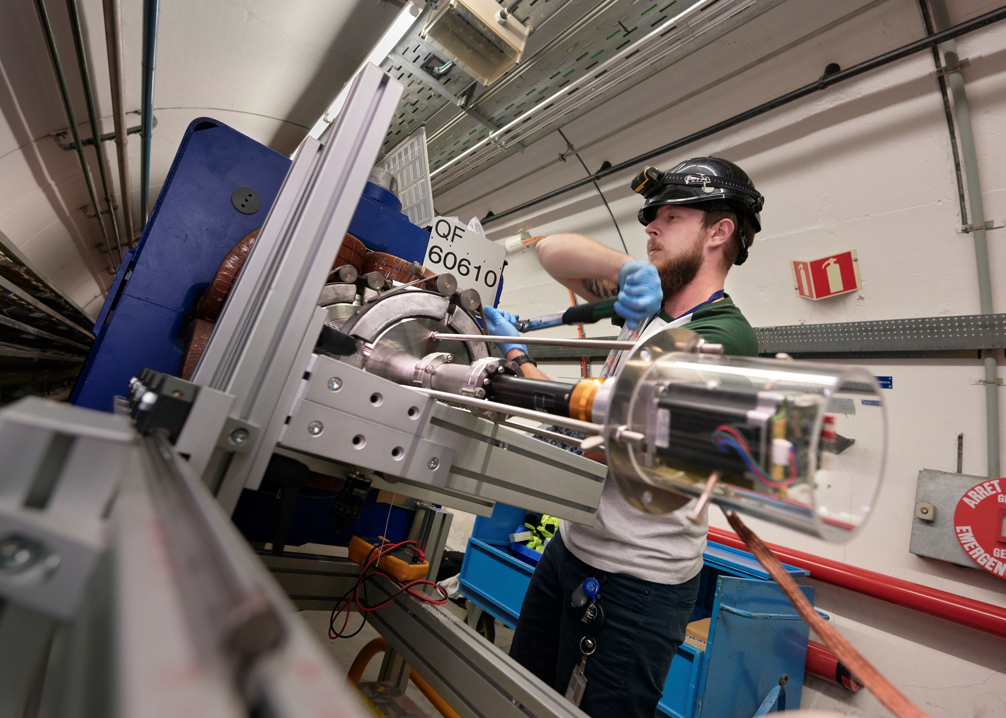
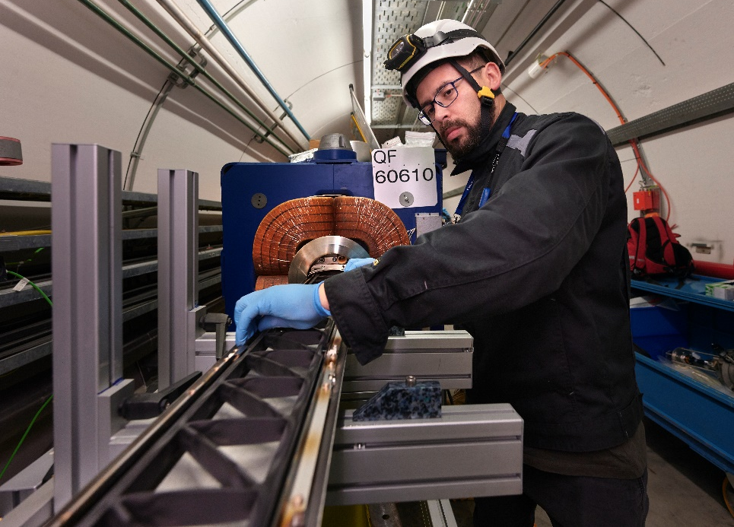
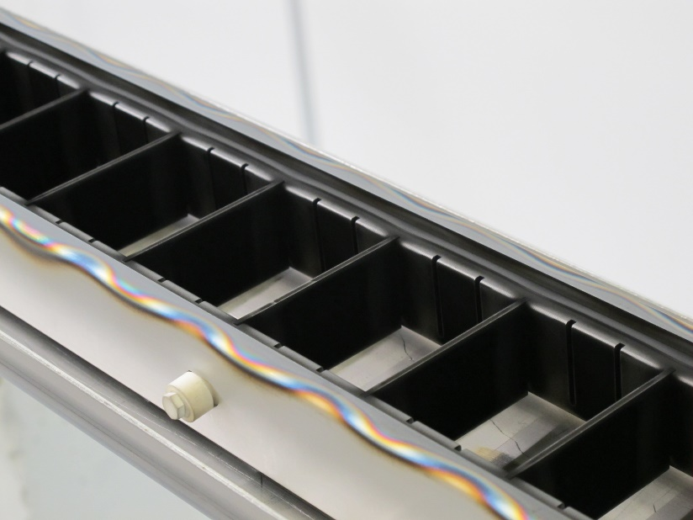
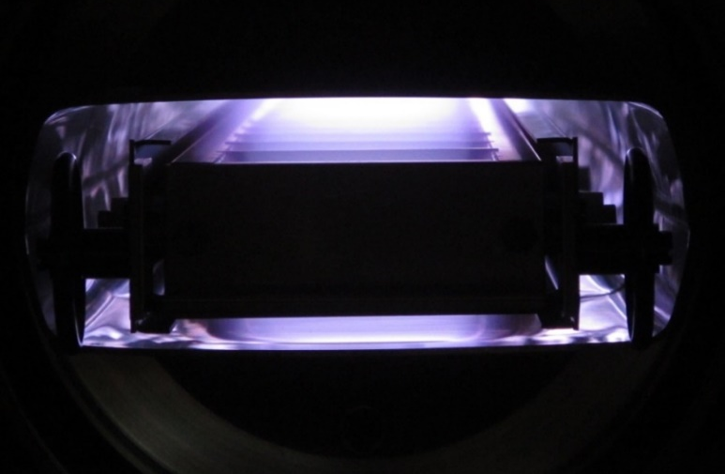
2 – Coating technology at CERN
The SPS case
Quad chambers
Ellipsoid
Dipole chambers
racetrack
Coat in-situ by
DC hollow cathode
sputtering
QF quads
MBB dipoles

Slide 16
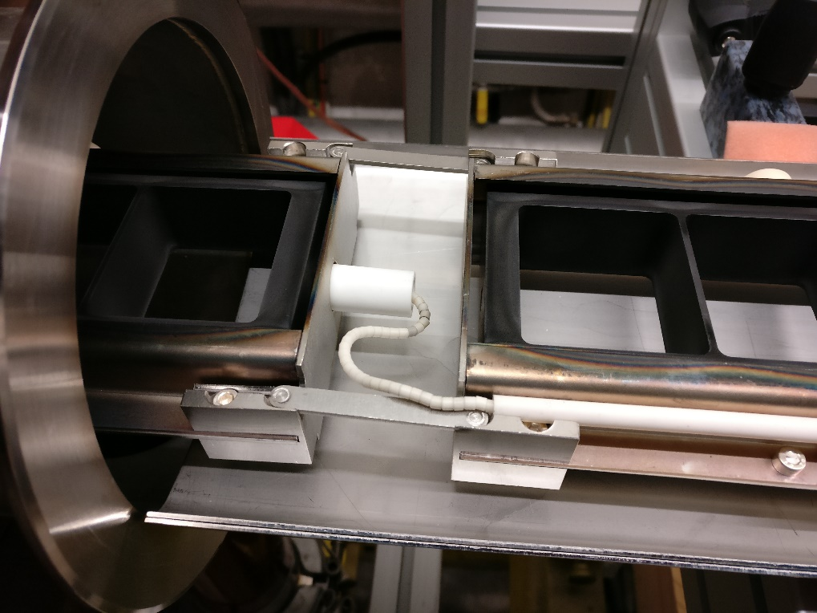
2 – Coating technology at CERN
The SPS case
Quad chambers
Ellipsoid
Dipole chambers
racetrack
Coat in-situ by
DC hollow cathode
sputtering
QF quads
MBB dipoles

Slide 17
2 – Coating technology at CERN
The SPS case
Quad chambers
Ellipsoid
Dipole chambers
racetrack
Coat in-situ by
DC hollow cathode
sputtering
QF quads
MBB dipoles
No bakeout before coating
Pressure Ar ~1.1x10⁻¹ mbar
Power density ~ 120 W / m
Sputtering rate ~ 20 nm / hour
20 hours -> 400 nm films

Slide 18
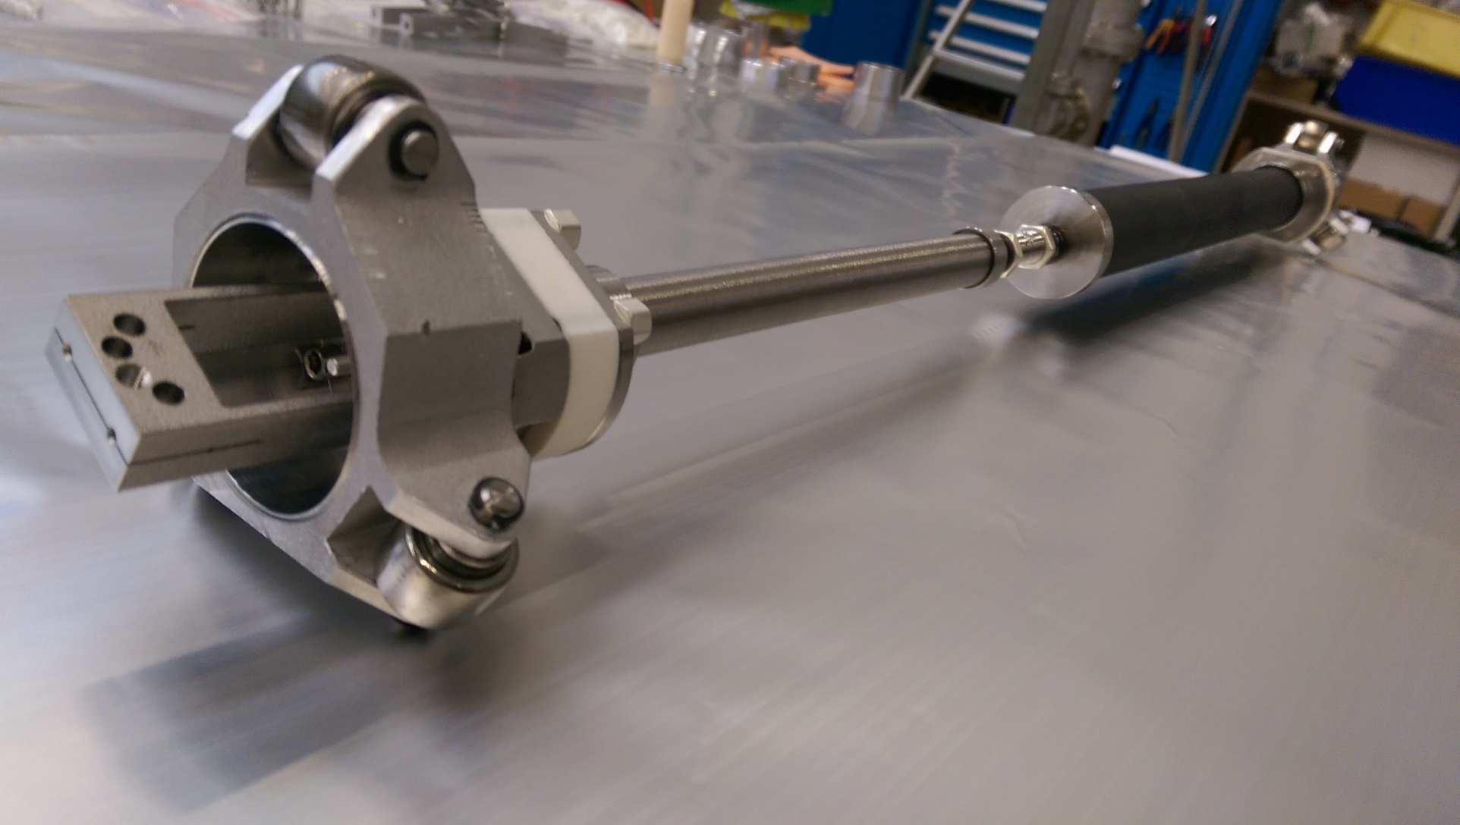
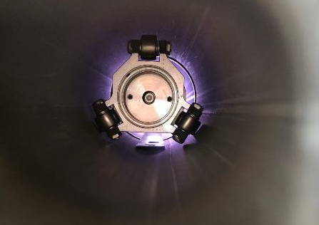
2 – Coating technology at CERN
The SPS case
Quad chambers
ID 80 mm
QD quads
Coat by DC pulsed cylindrical magnetron sputtering (with LHC technology)

Slide 19
2 – Coating technology at CERN
The SPS case
The first large scale production in the SPS during the CERN Long Shutdown (212 coating runs):
88 QF quadrupole magnets (294 m) coated in-situ 2 runs / week with 2 systems
110 Short straight Section elements (104 m) coated ex-situ 2 runs / week with 2 systems
29 Drift vacuum chamber (80 m) coated ex-situ 2 runs / week with 2 systems

Slide 20
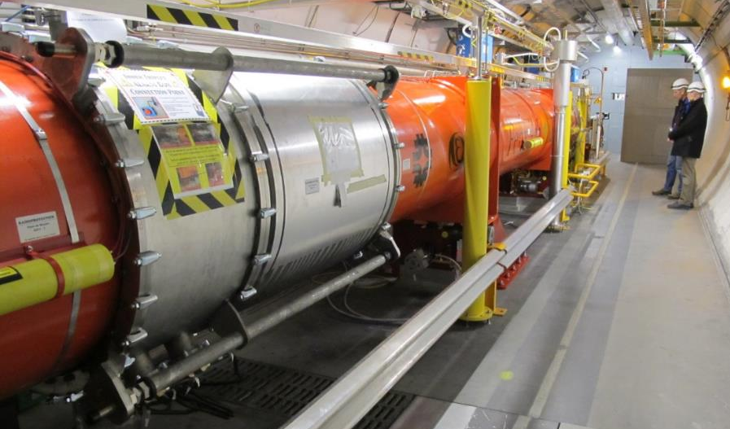
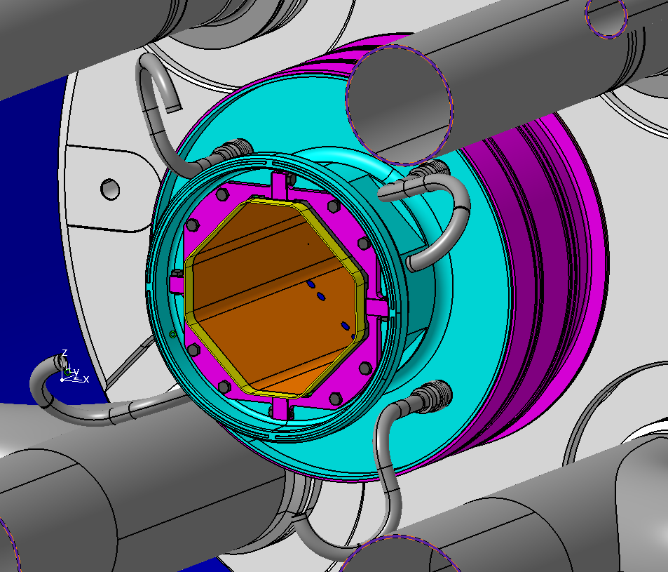
2 – Coating technology at CERN
The HL-LHC case
In-situ coatings
(inner triplets ALICE and LHCb)
Ex-situ coatings
(New inner triplets ATLAS and CMS)

Slide 21
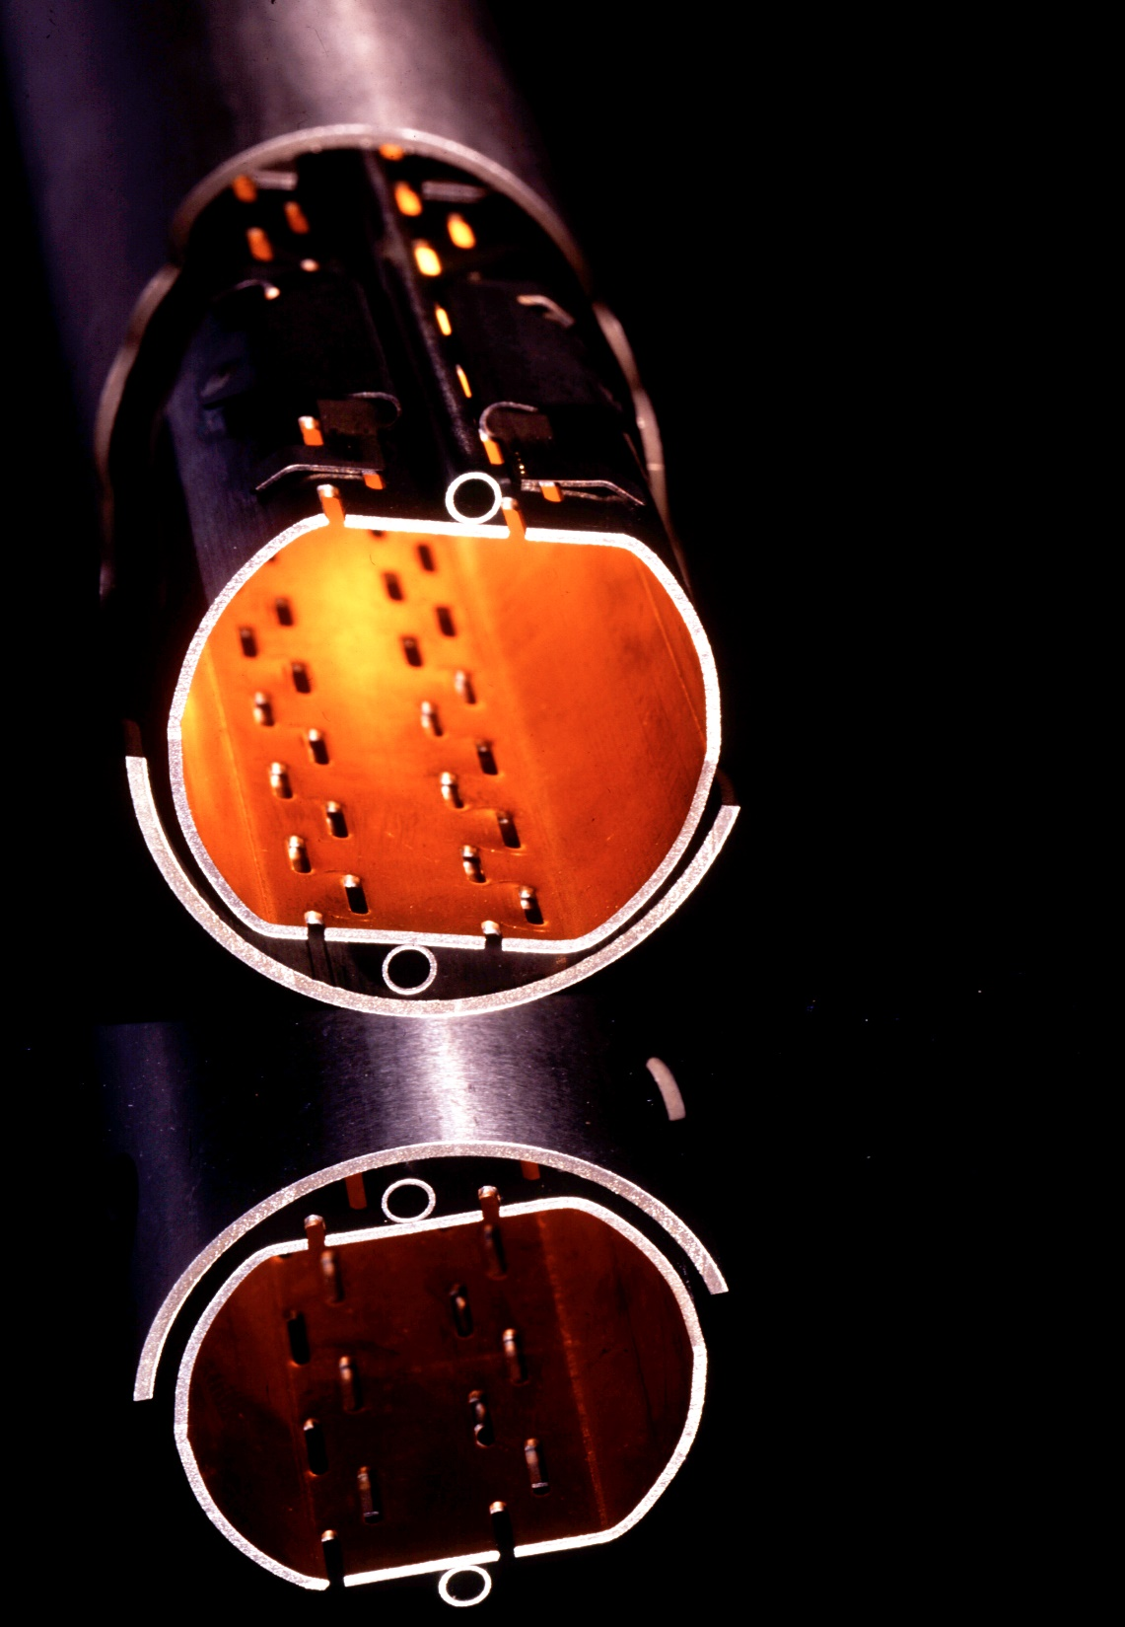
2 – Coating technology at CERN
The HL-LHC case
In-situ coatings
(inner triplets ALICE and LHCb)
Only 150 mm to insert the coating device => modular sputtering source
High outgassing of H₂O and H₂ => Ti gettering

Slide 22
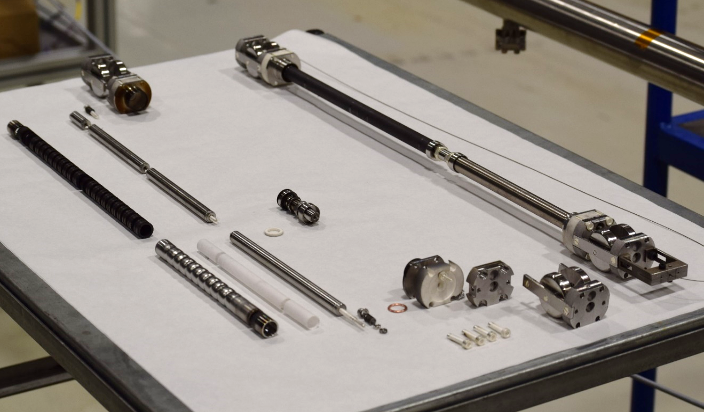
2 – Coating technology at CERN
The HL-LHC case
In-situ coatings
(inner triplets ALICE and LHCb)
Only 150 mm to insert the coating device => modular sputtering source
High outgassing of H₂O and H₂ => Ti gettering

Slide 23
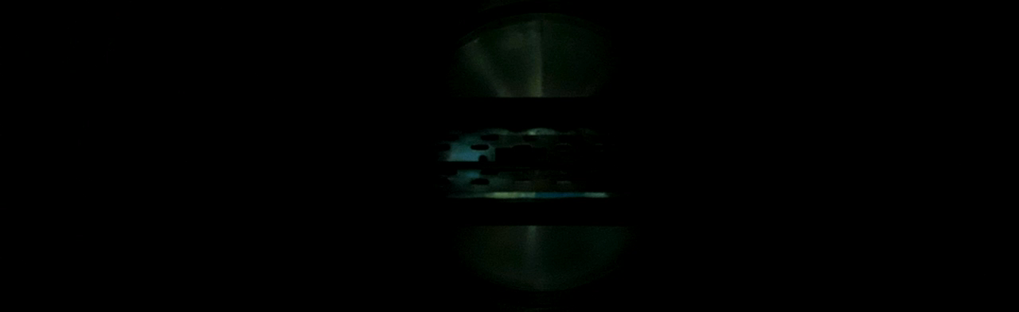
2 – Coating technology at CERN
The HL-LHC case
In-situ coatings
(inner triplets ALICE and LHCb)
Pulled by cables
along the beam screen
Only 150 mm to insert the coating device => modular sputtering source
High outgassing of H₂O and H₂ => Ti gettering
Cu substrate => critical for adhesion => ion etching + Ti underlayer

Slide 24
2 – Coating technology at CERN
The HL-LHC case
In-situ coatings
(inner triplets ALICE and LHCb)
Ar⁺ ~500 eV
Only 150 mm to insert the coating device => modular sputtering source
Pulled by cables
along the beam screen
High outgassing of H₂O and H₂ => Ti gettering
Oxide layer
CuO, Cu₂O, Cu(OH)₂
OFE Cu (~80 μm)
Cu substrate => critical for adhesion => ion etching + Ti underlayer
Beam screen
Stainless steel (~ 1.5 mm)

Slide 25
2 – Coating technology at CERN
The HL-LHC case
In-situ coatings
(inner triplets ALICE and LHCb)
Vent to 80% N₂ + 20% O₂ (“dry air”)
Only 150 mm to insert the coating device => modular sputtering source
High outgassing of H₂O and H₂ => Ti gettering
Oxide layer without
copper hydroxide
Cu₂O
OFE Cu (~80 μm)
Cu substrate => critical for adhesion => ion etching + Ti underlayer
Beam screen
Stainless steel (~ 1.5 mm)

Slide 26
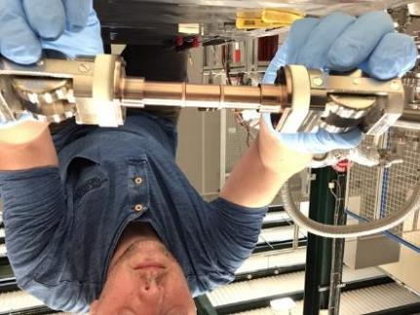
2 – Coating technology at CERN
The HL-LHC case
In-situ coatings
(inner triplets ALICE and LHCb)
Only 150 mm to insert the coating device => modular sputtering source
High outgassing of H₂O and H₂ => Ti gettering
Cu substrate => critical for adhesion => ion etching + Ti underlayer

Slide 27
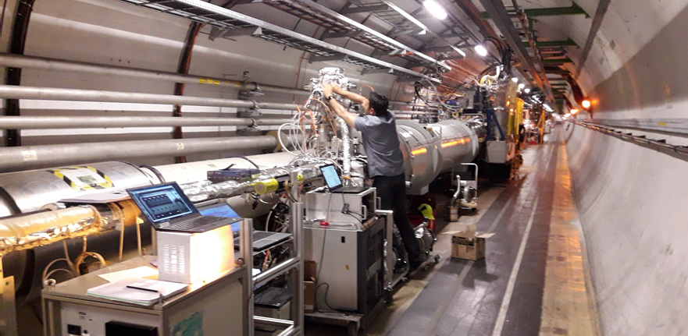
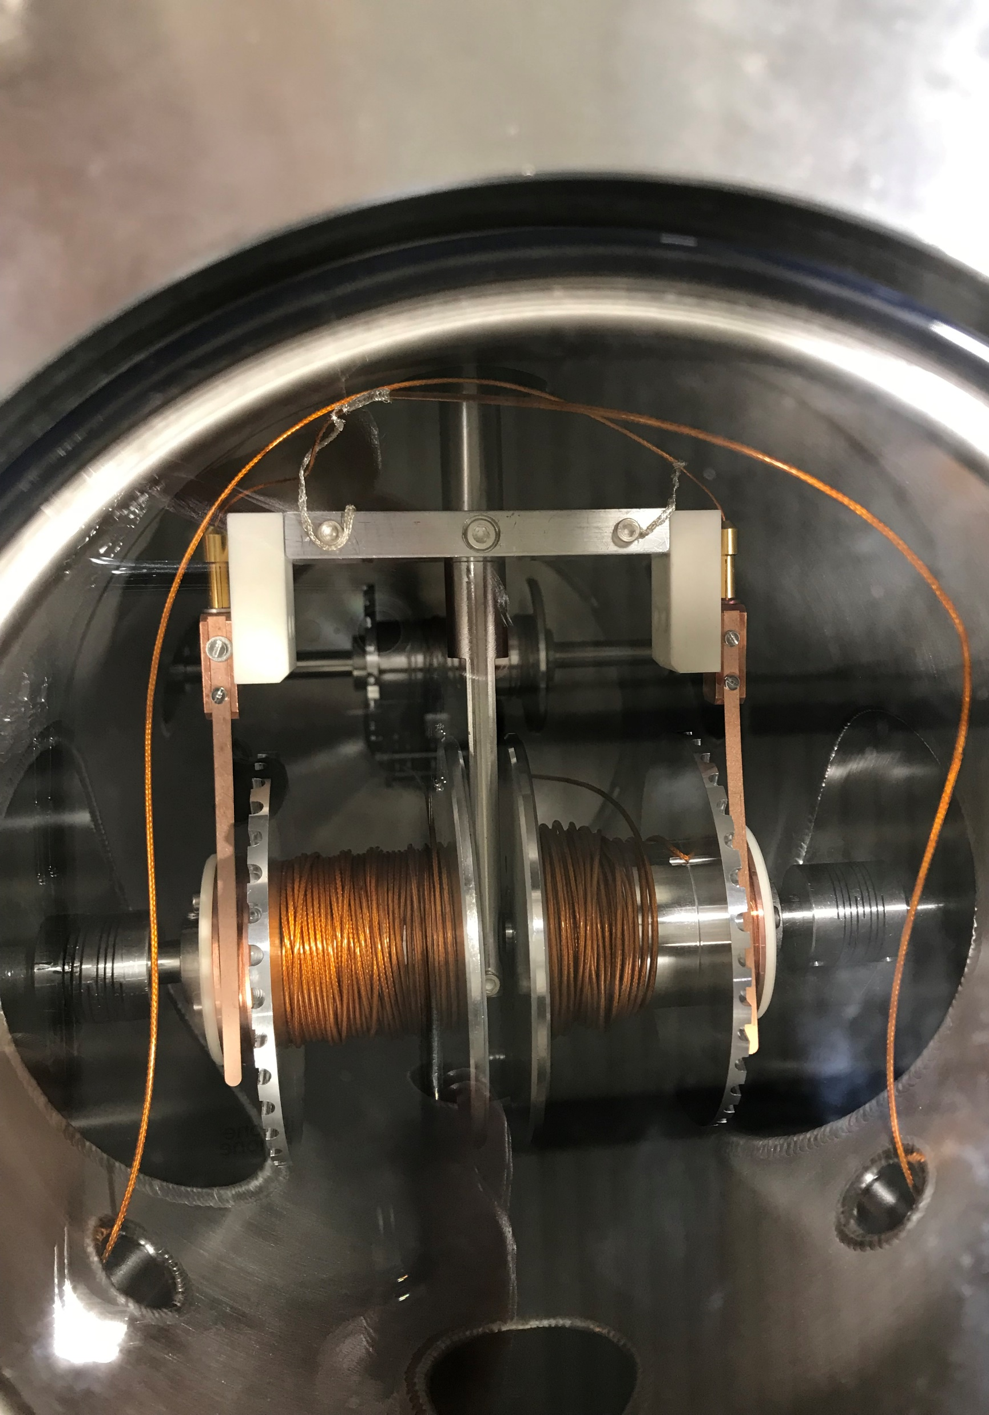
2 – Coating technology at CERN
The HL-LHC case
In-situ coatings
(inner triplets ALICE and LHCb)
Only 150 mm to insert the coating device => modular sputtering source
High outgassing of H₂O and H₂ => Ti gettering
Cu substrate => critical for adhesion => ion etching + Ti underlayer
3 weeks to coat a 14 m long quad => several systems in parallel

Slide 28
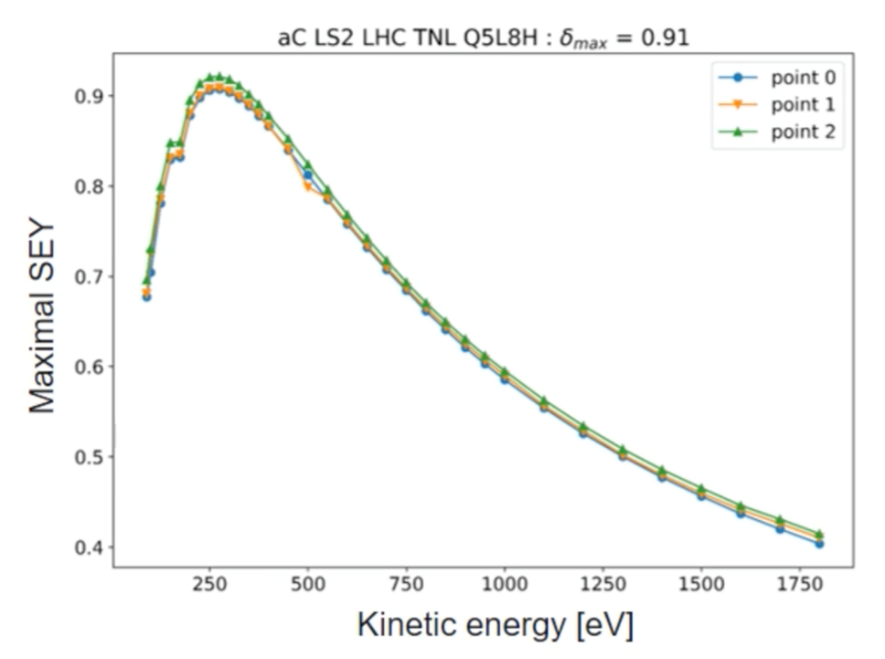
2 – Coating technology at CERN
The HL-LHC case
In-situ coatings
(inner triplets ALICE and LHCb)

Slide 29
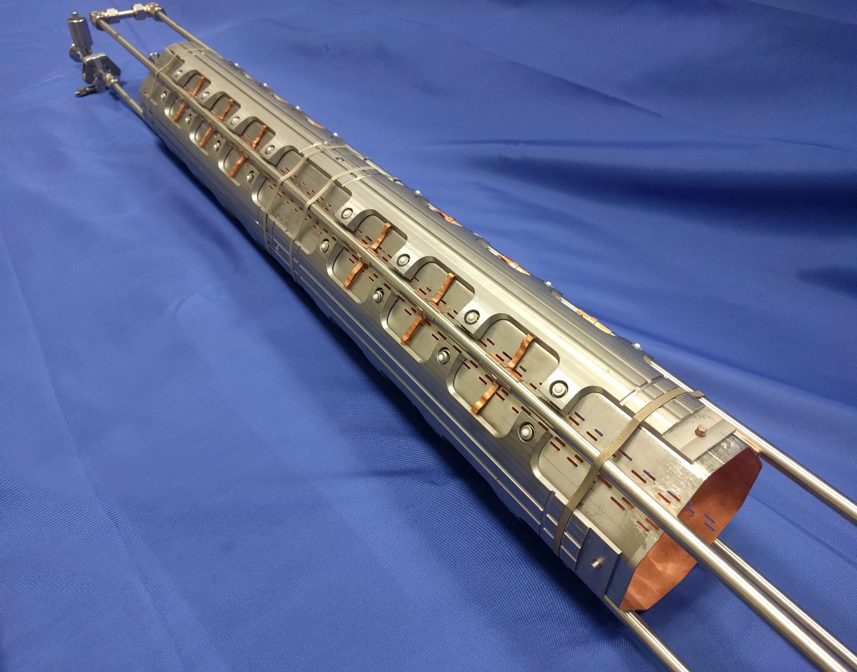
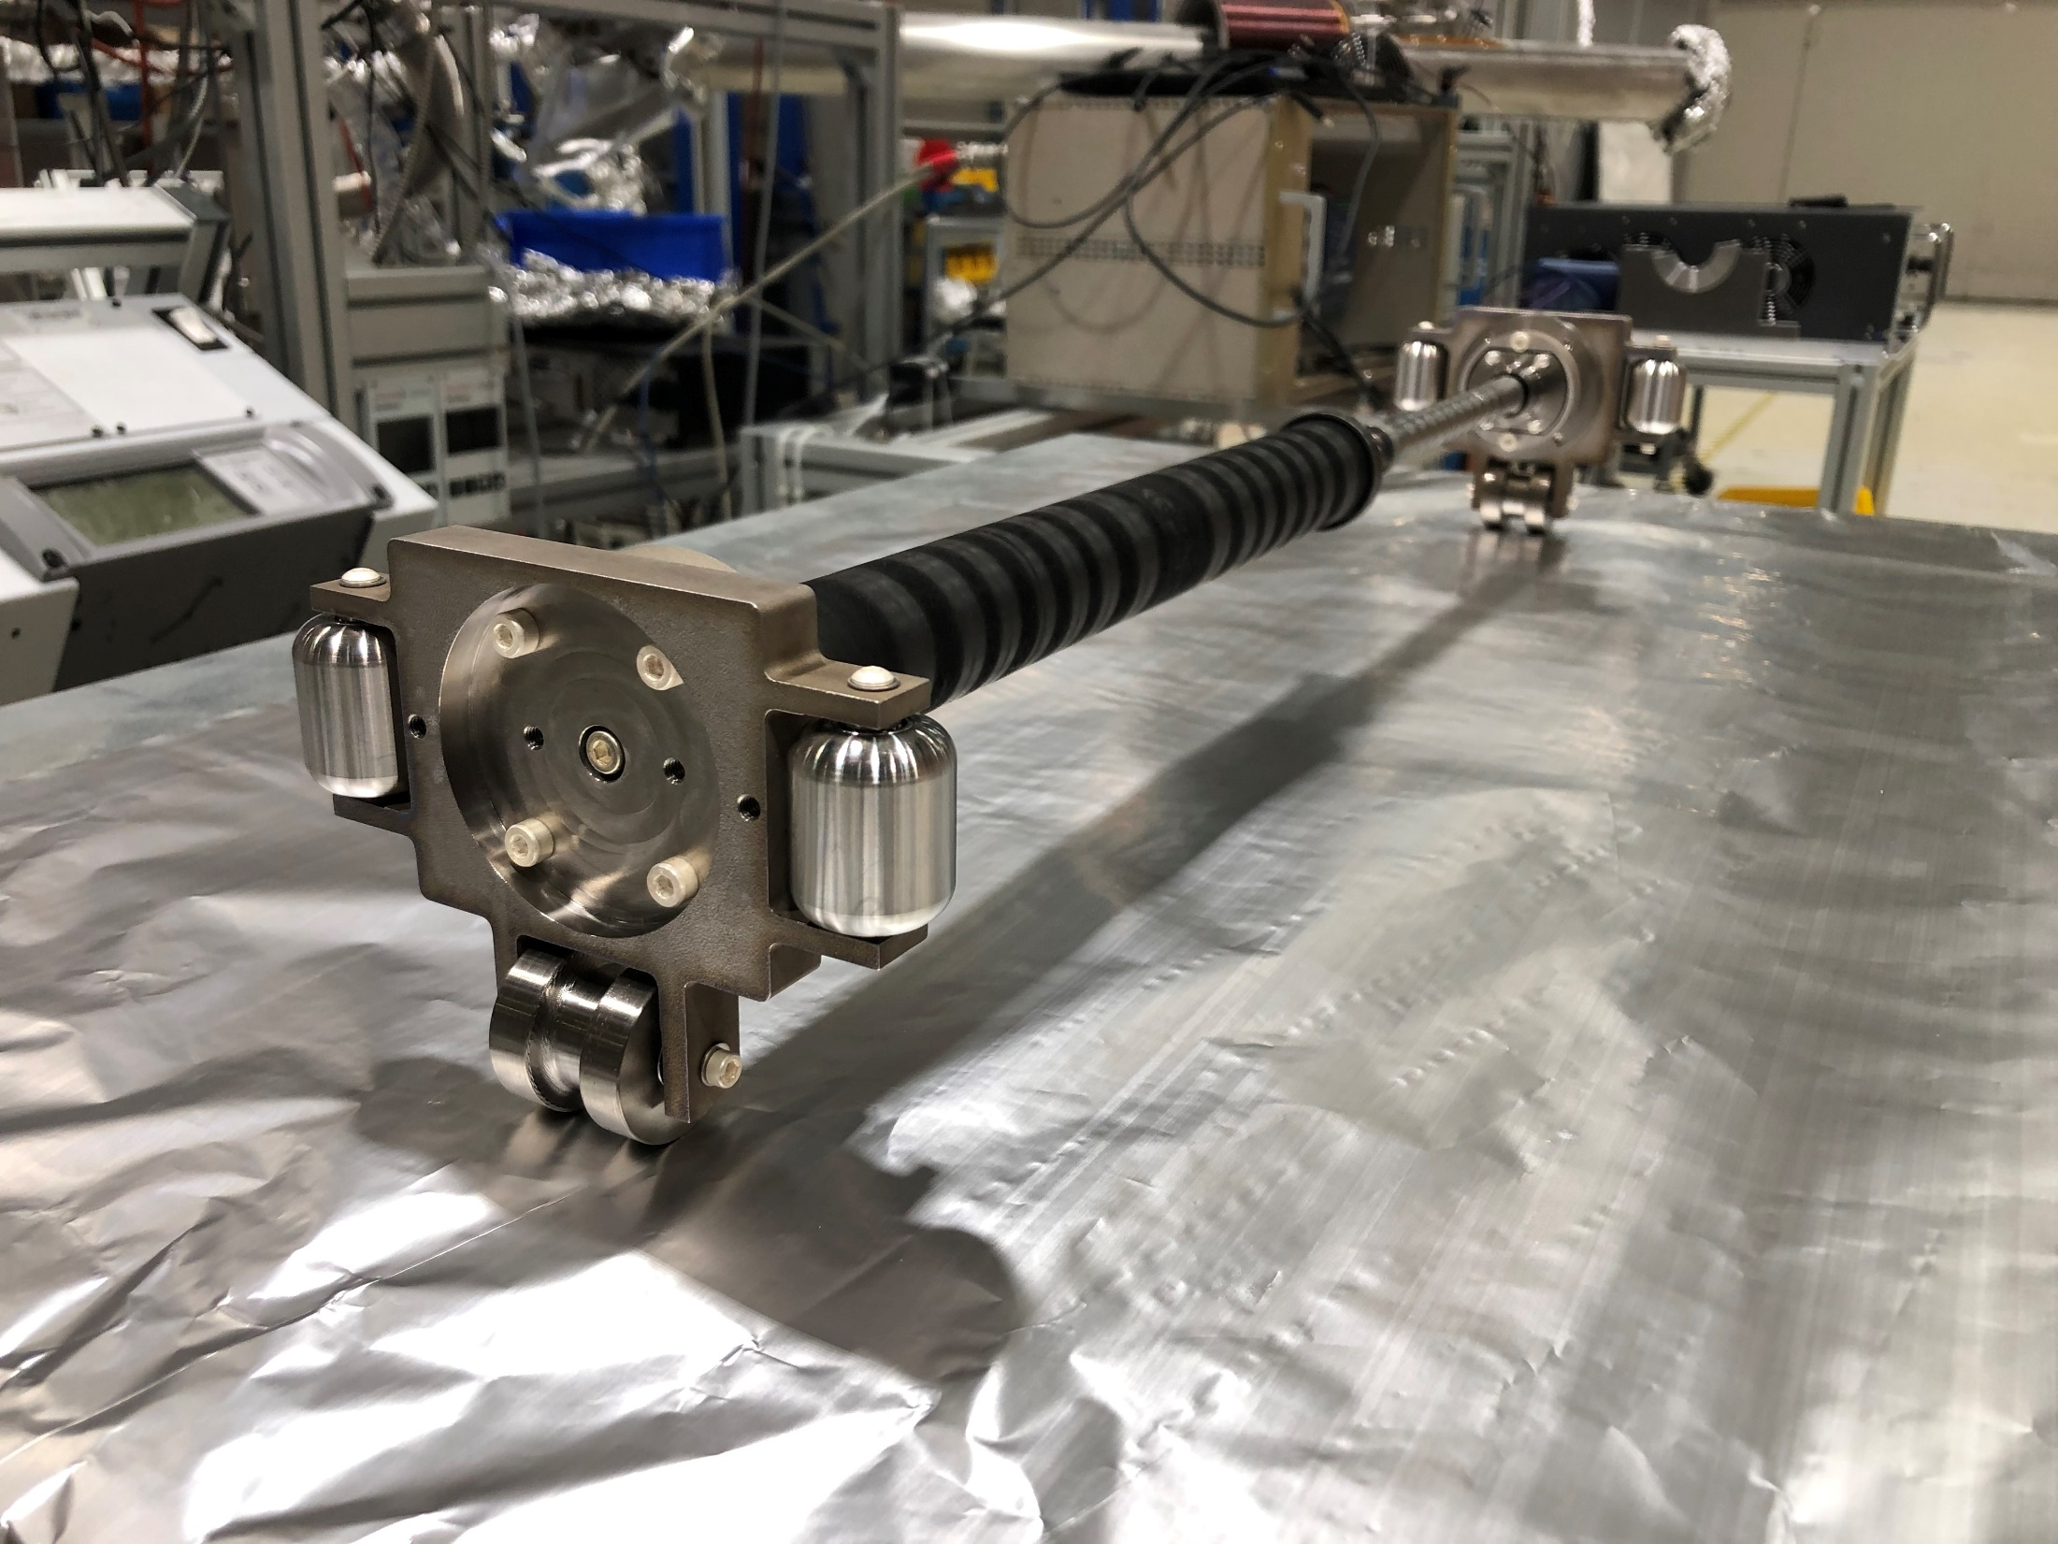
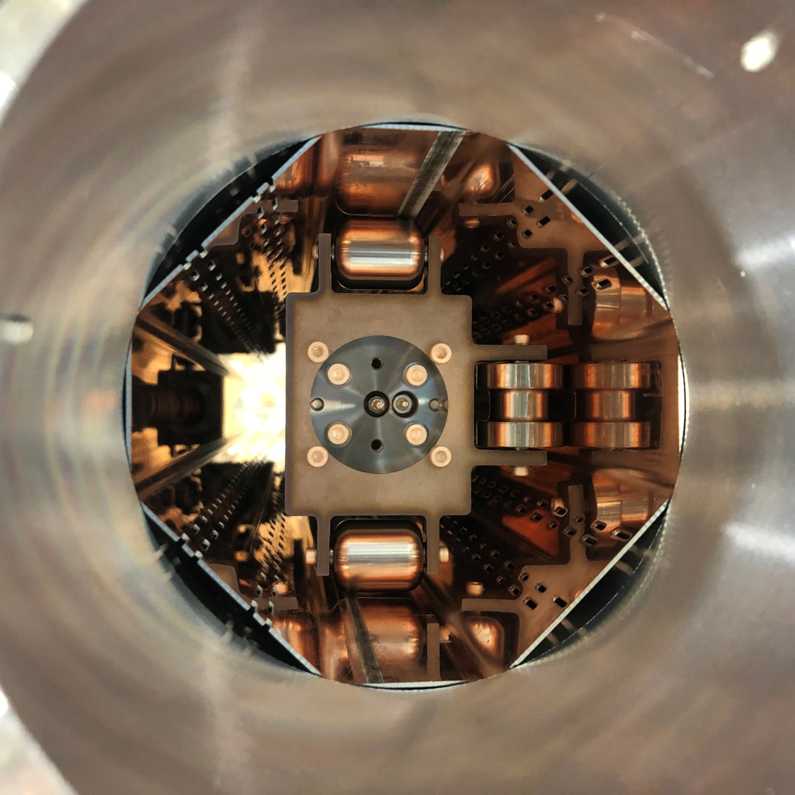
2 – Coating technology at CERN
The HL-LHC case
Ex-situ coatings
(New inner triplets ATLAS and CMS)
=> Adapt the in-situ technology to the new geometry

Slide 30
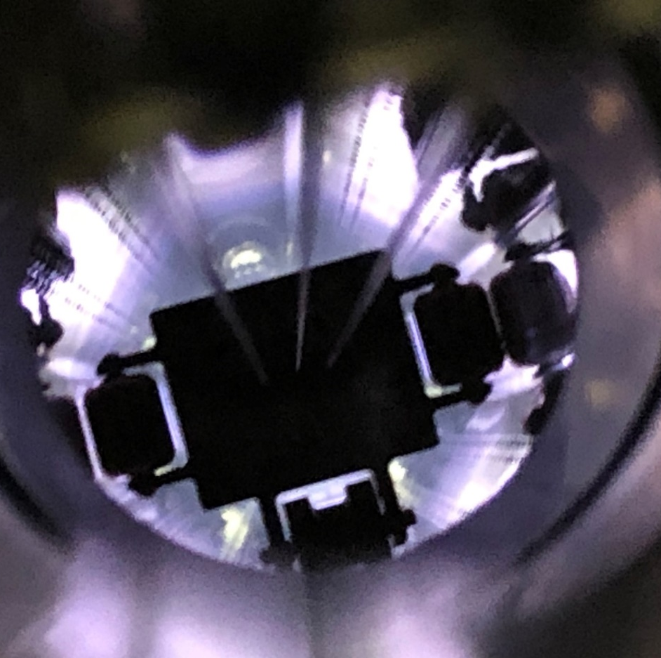
2 – Coating technology at CERN
The HL-LHC case
Ex-situ coatings
(New inner triplets ATLAS and CMS)
=> Adapt the in-situ technology to the new geometry

Slide 31
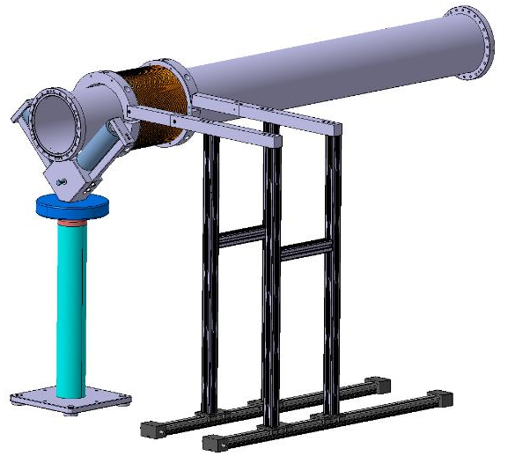
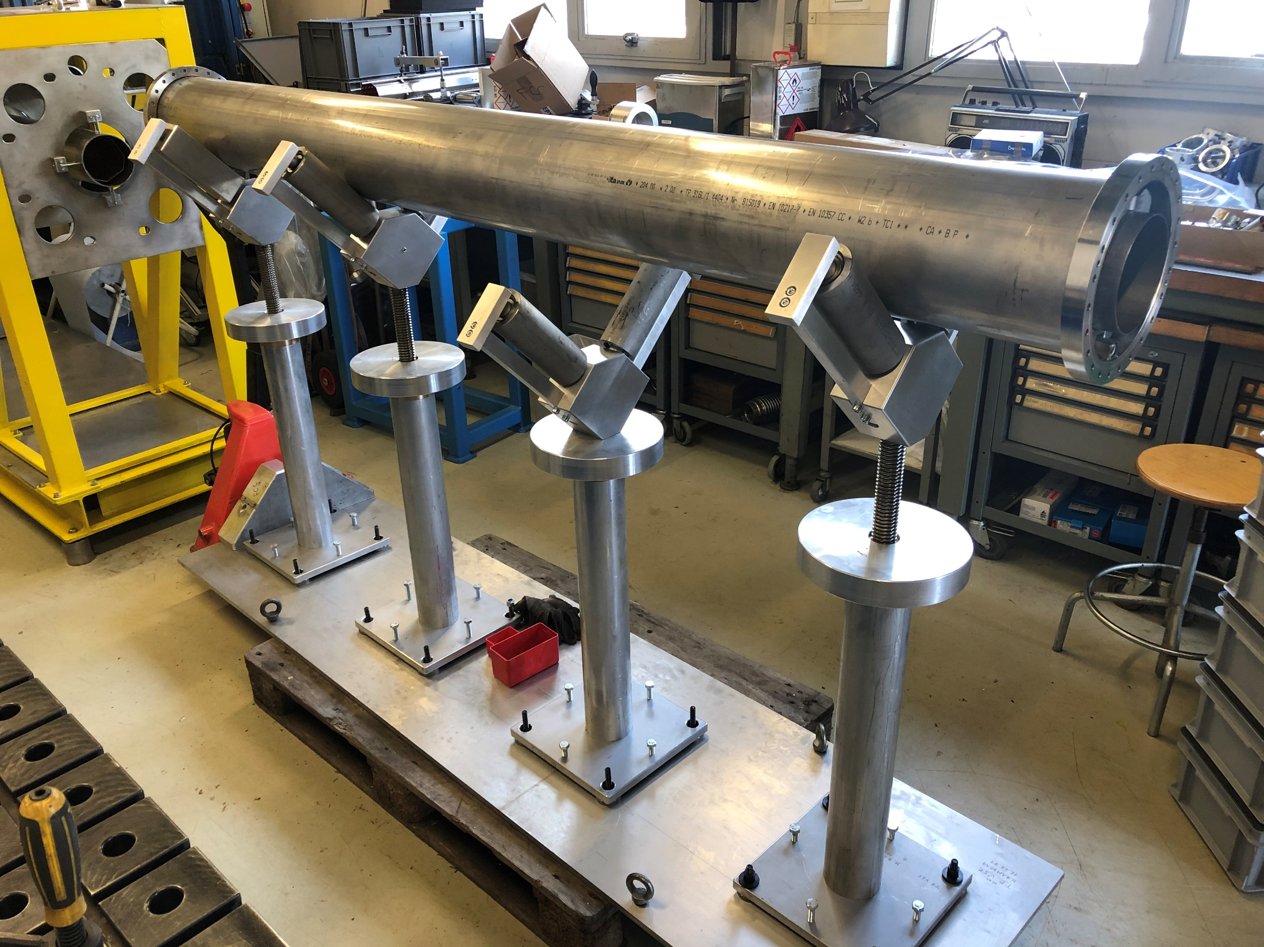
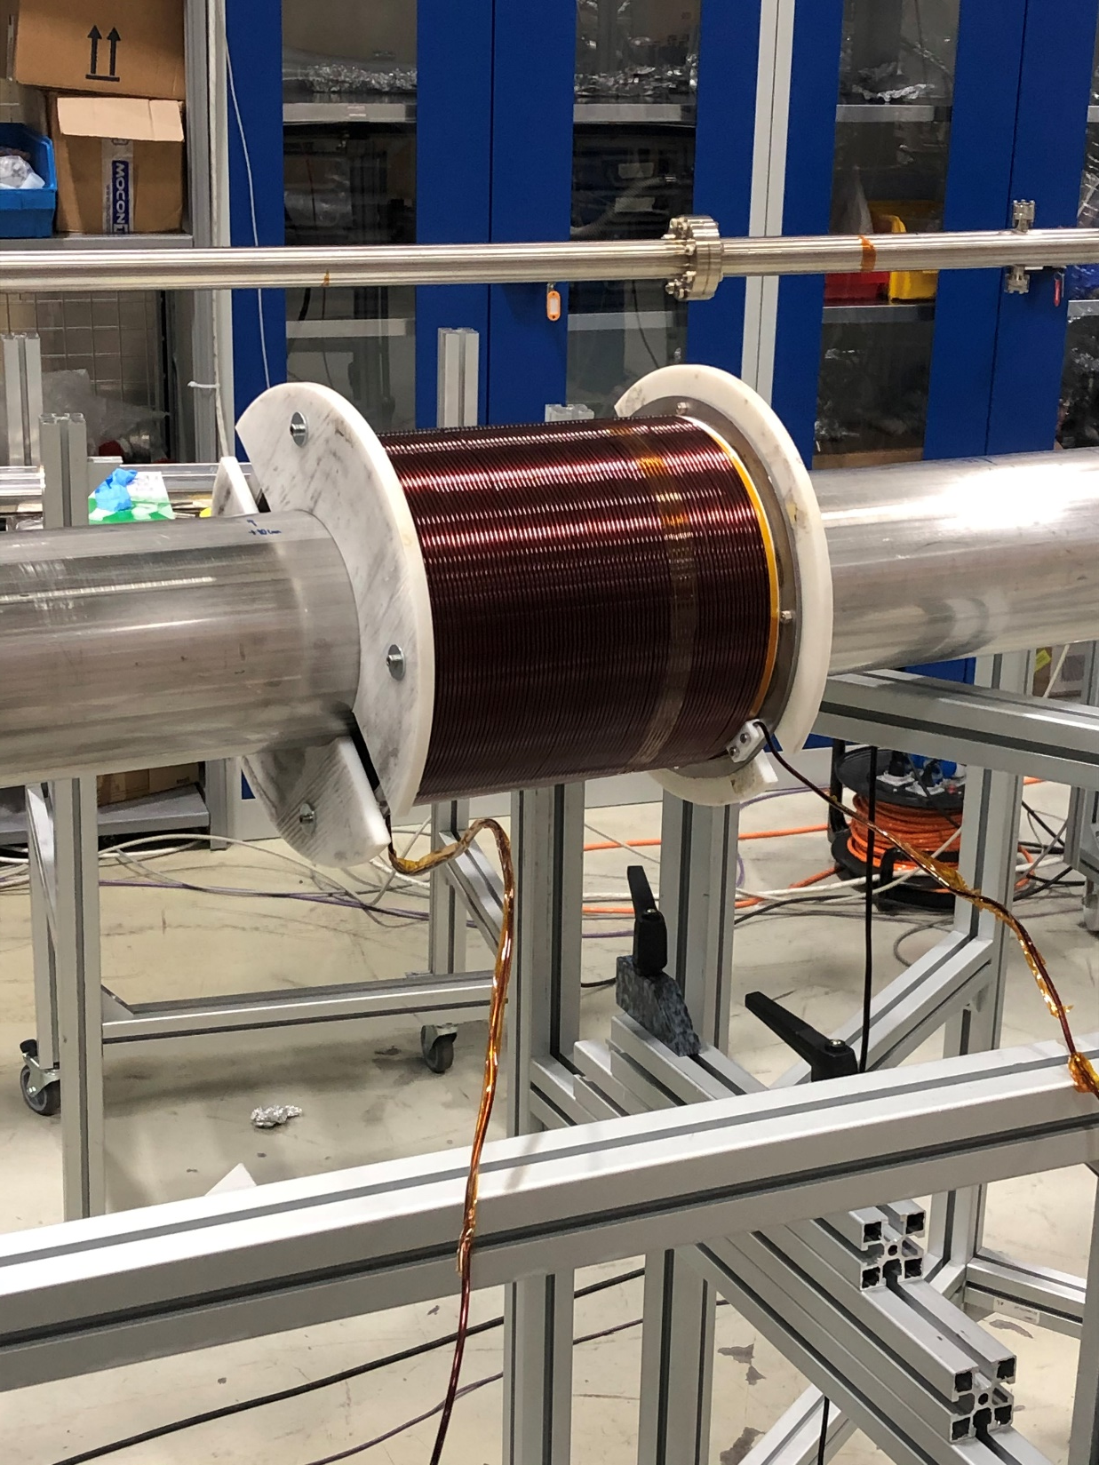
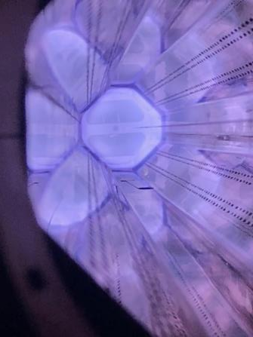
2 – Coating technology at CERN
The HL-LHC case
Ex-situ coatings
(New inner triplets ATLAS and CMS)
=> Adapt the in-situ technology to the new geometry

Slide 32
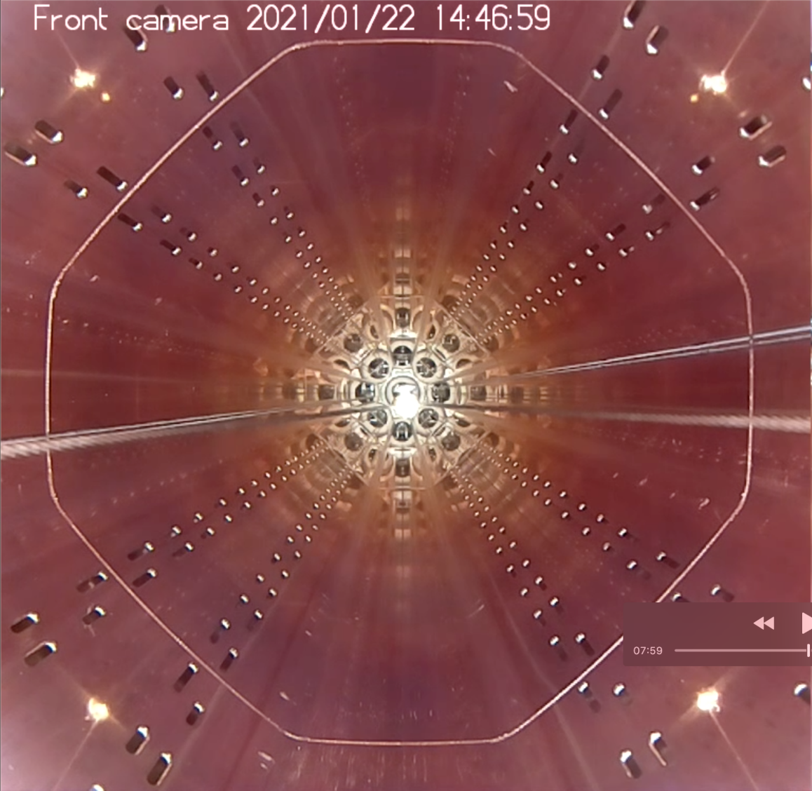
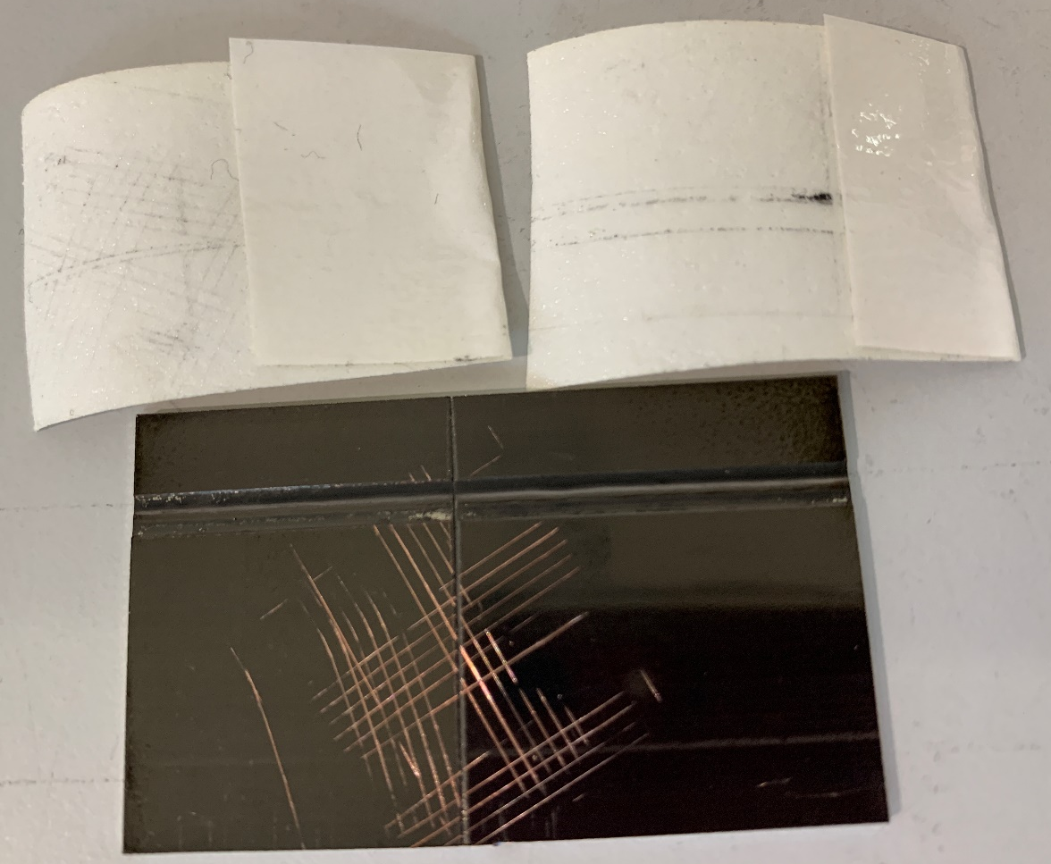
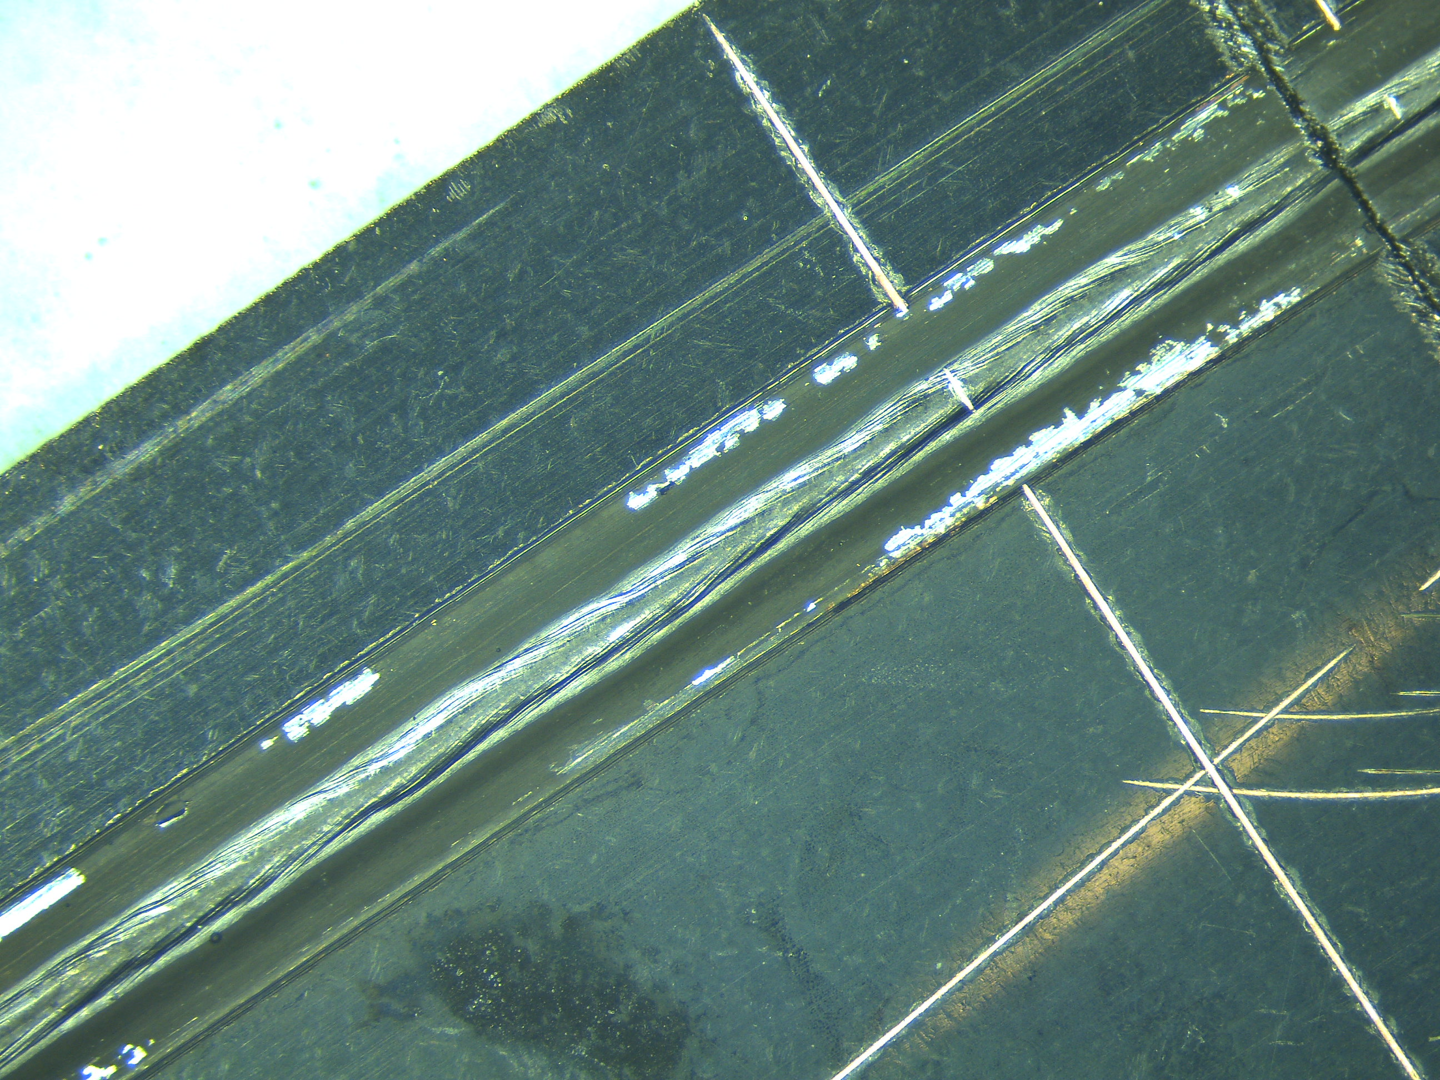
2 – Coating technology at CERN
The HL-LHC case
Ex-situ coatings
(New inner triplets ATLAS and CMS)
=> Adapt the in-situ technology to the new geometry

Slide 33
2 – Coating technology at CERN
The HL-LHC case
Ex-situ coatings
(New inner triplets ATLAS and CMS)
=> Adapt the in-situ technology to the new geometry

Slide 34
2 – Coating technology at CERN
The HL-LHC case
Ex-situ coatings
(New inner triplets ATLAS and CMS)
=> Adapt the in-situ technology to the new geometry

Slide 35
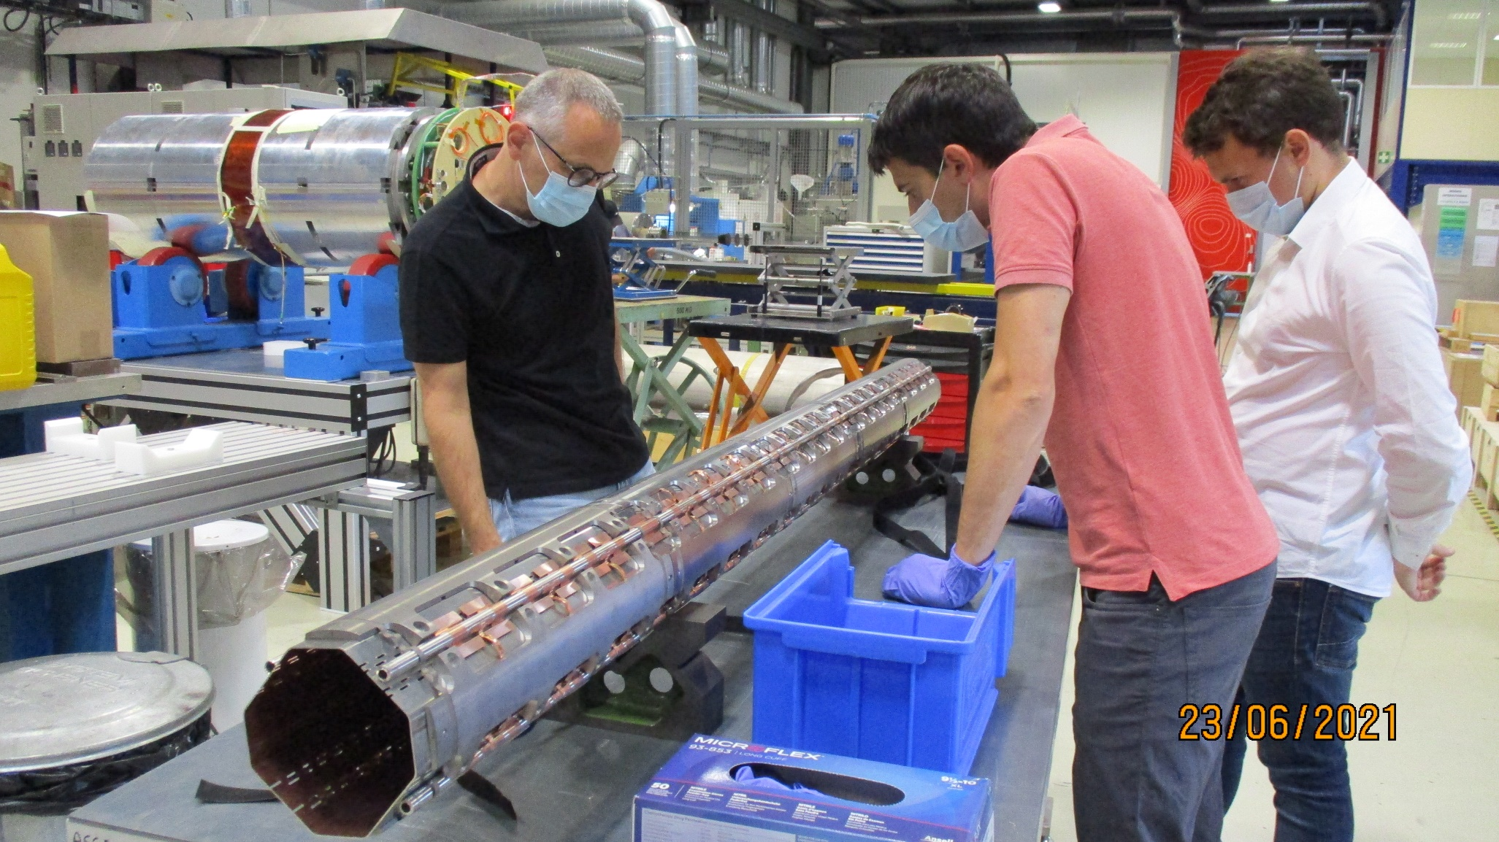
2 – Coating technology at CERN
The HL-LHC case
Ex-situ coatings
(New inner triplets ATLAS and CMS)
=> Adapt the in-situ technology to the new geometry
The a-C film resisted to the deformations induced by quenching at nominal currents.
Tests at 4x nominal current ongoing.

Slide 36
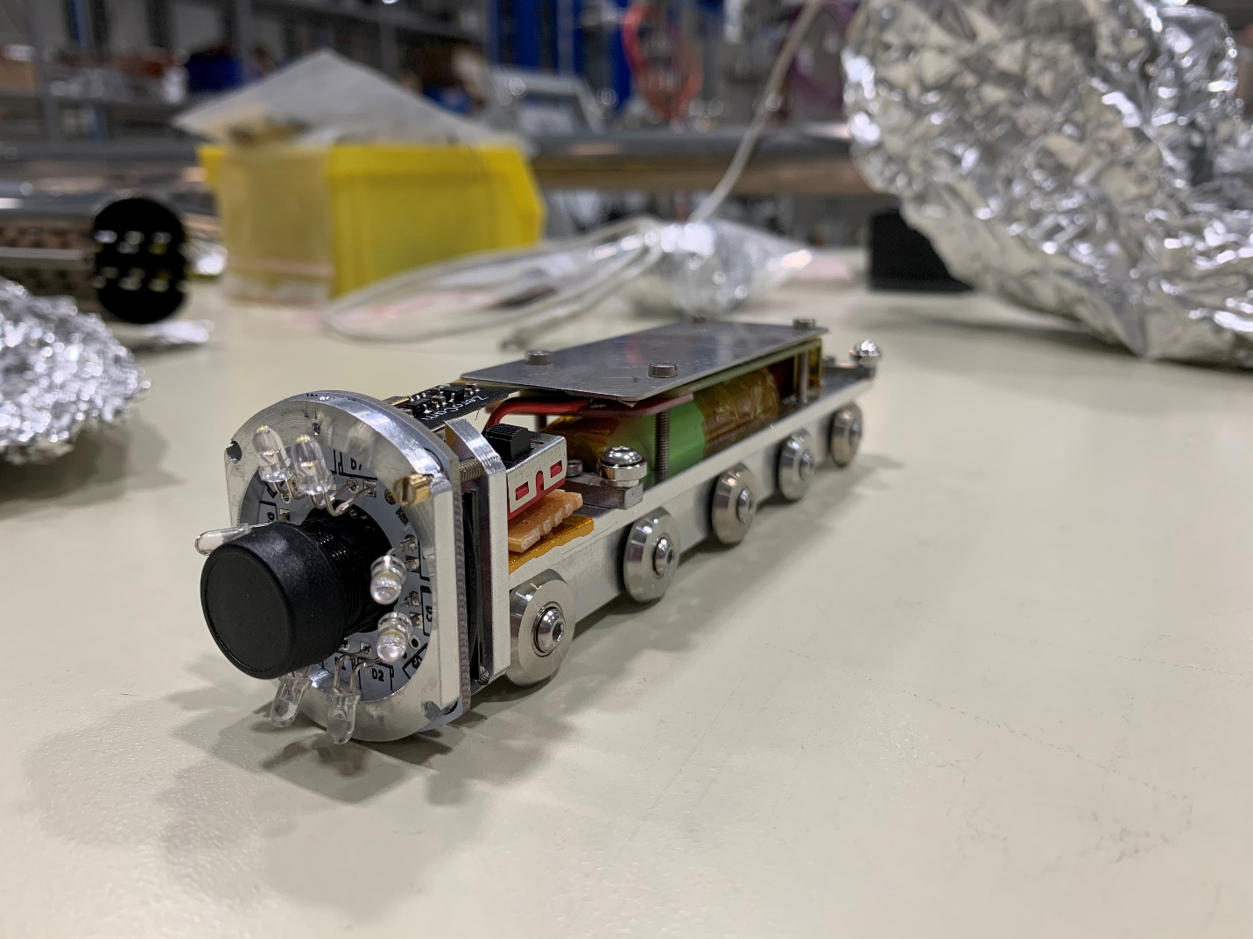
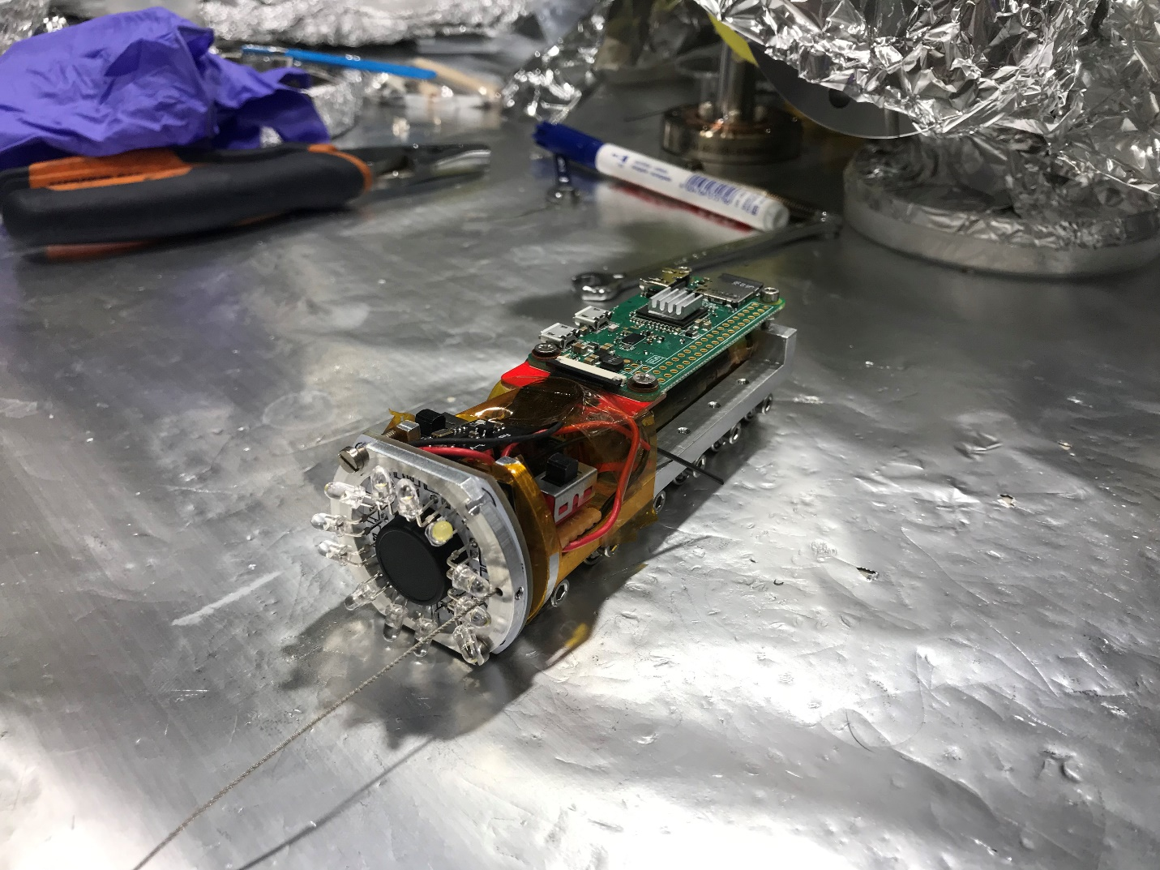
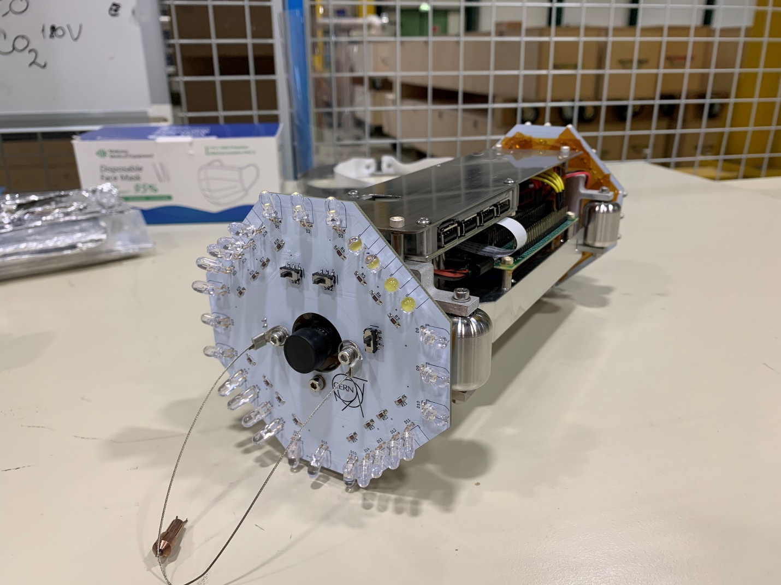
2 – Coating technology at CERN
The HL-LHC case
Optical inspection devices (before / after coating)
Raspbery Pi camera + motherboard + battery + LED based light system

Slide 37
3 – Summary
The coating technique to produce carbon films with low SEY must favor sp2 hybridization (sputtering, PLD). SEY increases with H content and decreases with N content.
A growing technological corpus is available to cope with the constrains of the particle accelerator’s community: in-situ / ex-situ; getter co-deposition; N doping; re-set of copper oxide; optical inspection devices…
Large scale production is feasible: more than 200 coating runs during the LS2 coating campaign in the SPS resulted on a average SEY ~1. (in-situ + ex-situ coatings). More to come during LHC run 3 (ex-situ) and LS3 (in-situ).
No pre-defined recipe: the coating technique & process should be adapted to each specific case. Take into account the coating from the design phase is the bet practice.

Slide 38

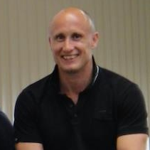
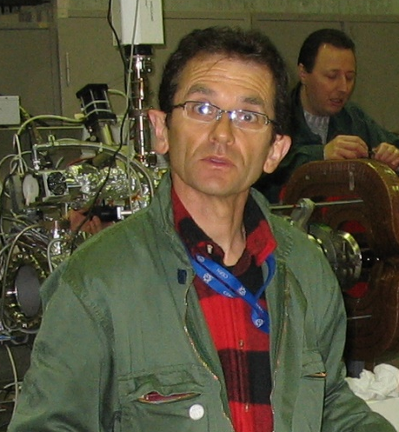
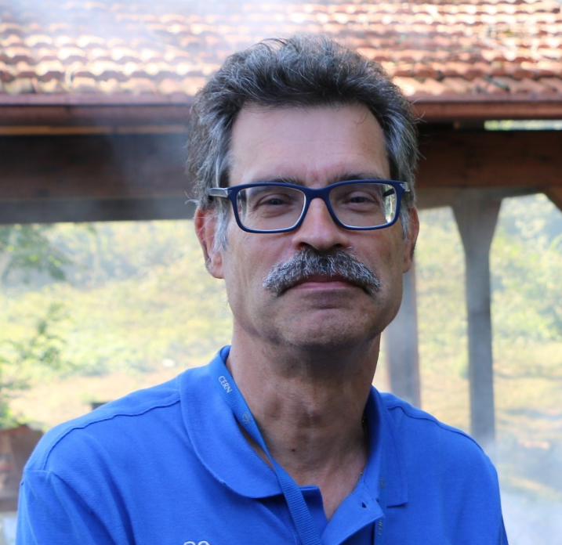

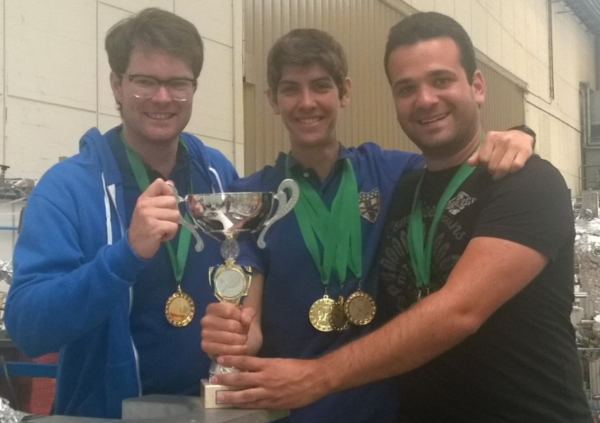







Thank you for your attention

