Slide 1

Electromagnetic characterization of coatings for accelerators
26/10/2021
Maria Rosaria
Masullo
Antonello
Andreone*
Can
Koral
Andrea
Passarelli
Maria
De Stefano*
University of Naples Federico II -Italy
TRIUMF 2021 EIC Accelerator Partnership Workshop

Slide 2
Coatings and resistive wall impedance
Coatings required (as examples) for reducing surface degassing or for secondary electron yield mitigation…but layers of coating materials significantly increase the resistive wall impedance
Low conductivity, thin layer coatings (NEG, a‐C)
Rough surfaces (LESS)
Surface impedance of the beam pipe depends on electromagnetic properties of coatings.
Electromagnetic characterization of “coating materials” is fundamental to evaluate accelerator performance limitations and build up a machine impedance model.

Slide 3
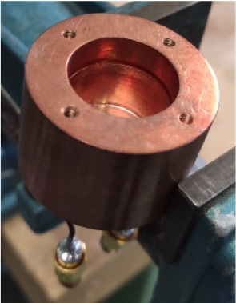
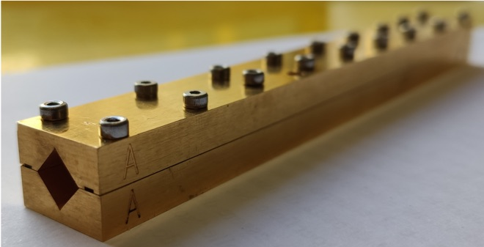
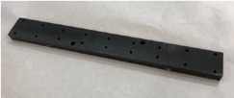

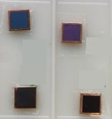
Two different methods
Electromagnetic characterization of Coating materials
Dielectric resonator
Sub-THz waveguide
• high sensitivity
• small skin-depth
LESS(Laser engineered surface structures)
NEG(Non-Evaporable Getter)
a-C (Amorphous carbon)
• conductivity compared with copper
• small samples (10x10mm)
• homogeneous coating
• coating thickness issues

Slide 4
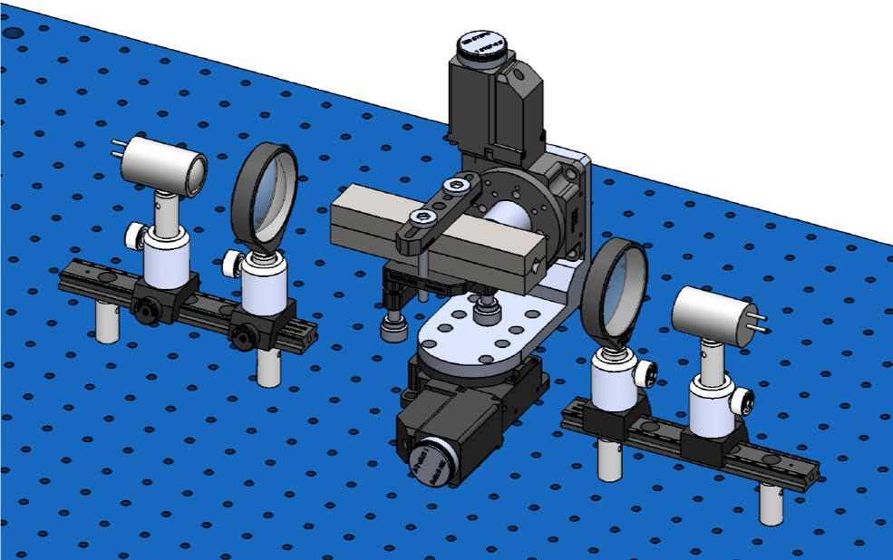
Sub-THz waveguide attenuation: the proposed method
Evaluation of the signal attenuation inside a DUT with coating deposited.
Electromagnetic characterization
of coating materials.
Sub-THz transmission methodology

Slide 5

The DUT
Material | Iron
Waveguide | Circular
Length | 42
Radius | 0.9
Horns | Pyramidal
Length | 39
External side | 6
Total Length | 120
Dimension in mm

Slide 6
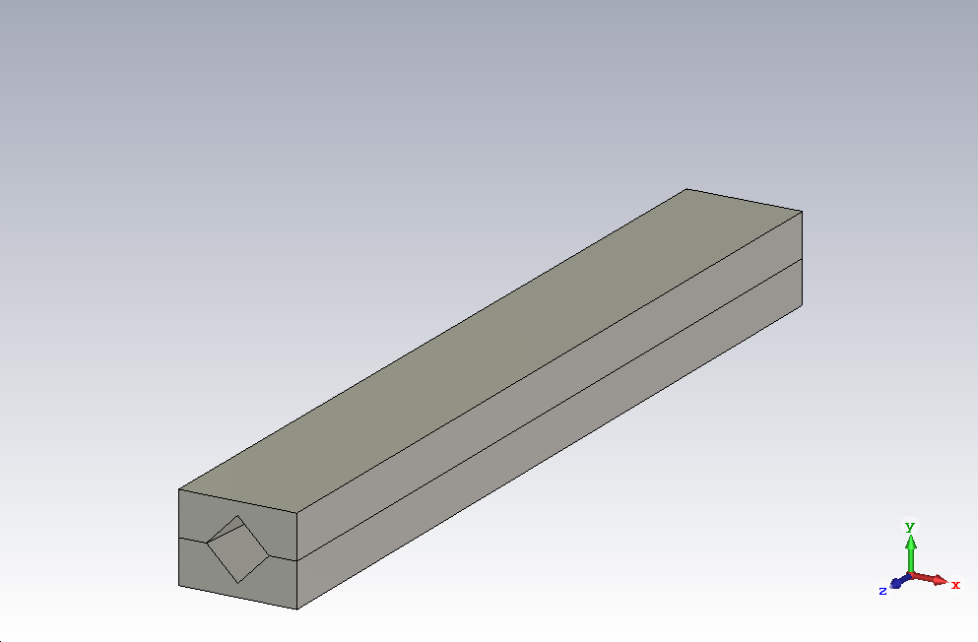
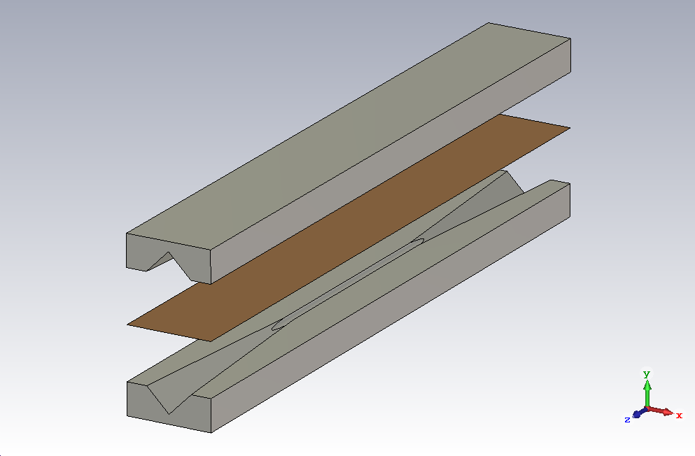
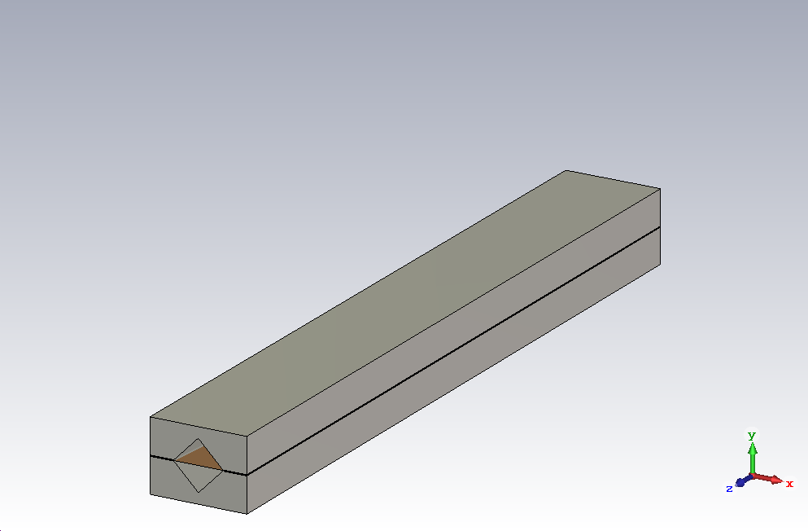
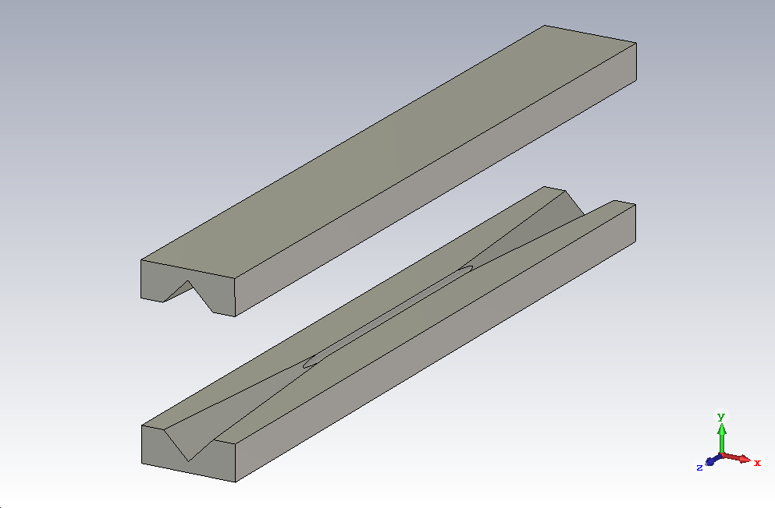
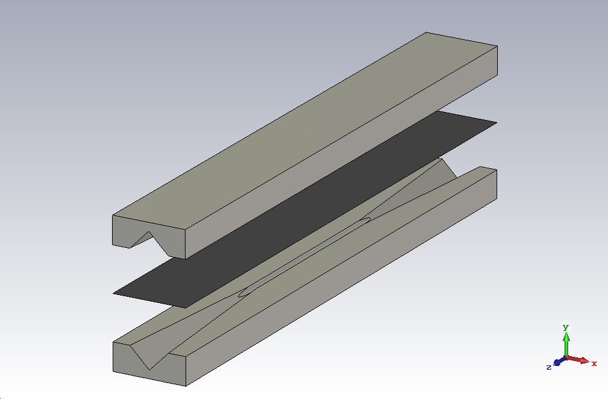

The Device Under Test
1
2
3
Copper foil
as
reference
4
5
6
Coated foil
to measure
Methodology advantages: 1)Homogeneous deposition, 2)System reusability, 3)Large area coating

Slide 7
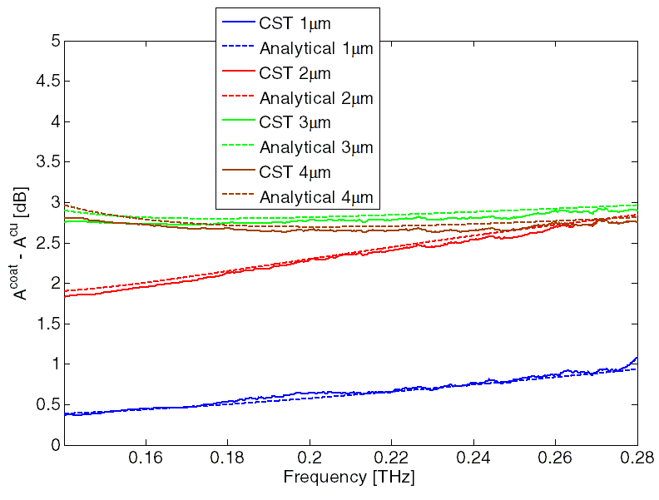
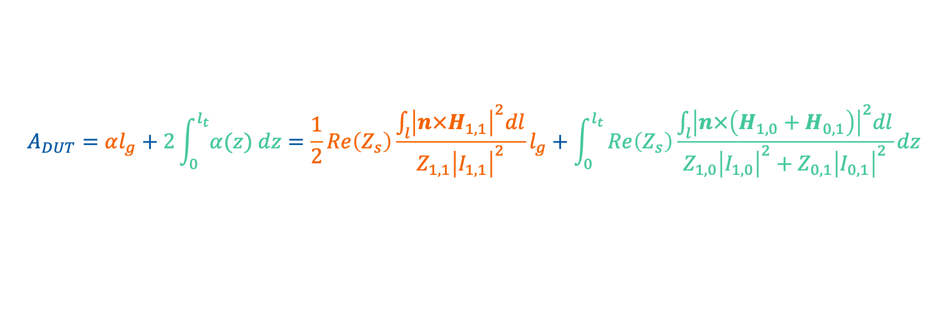
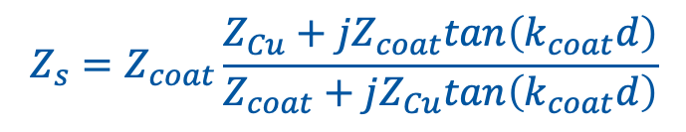
Analytical evaluations
In-house retrieval method
Waveguide of length l_{g} (TE_{1,1} mode) + pyramidal transitions of length l_{t} (TE_{1,0} TE_{0,1} modes)
$$A_{DUT}=αl_{g}+2\int_{0}^{l_{t}}{α(z) dz}=\frac{1}{2}Re\left(Z_{s}\right)\frac{\int_{l}{{\left|n×H_{1,1}\right|}^{2}dl}}{Z_{1,1}{\left|I_{1,1}\right|}^{2}}l_{g}+\int_{0}^{l_{t}}{Re\left(Z_{s}\right)\frac{\int_{l}{{\left|n×\left(H_{1,0}+H_{0,1}\right)\right|}^{2}dl}}{Z_{1,0}{\left|I_{1,0}\right|}^{2}+Z_{0,1}{\left|I_{0,1}\right|}^{2}}}dz$$
Reliable analytical tool
$$Z_{s}=Z_{coat}\frac{Z_{Cu}+jZ_{coat}tan\left(k_{coat}d\right)}{Z_{coat}+jZ_{Cu}tan\left(k_{coat}d\right)}$$
Surface impedance
Z and k are functions of material conductivity
For calculations
Copper conductivity: σ_{cu} = 6∙10⁷ S/m
NEG conductivity: σ_{NEG} = 3.5∙10⁵ S/m

Slide 8
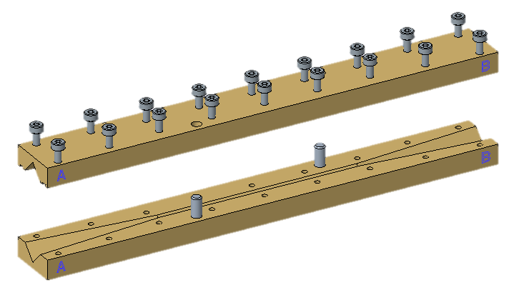
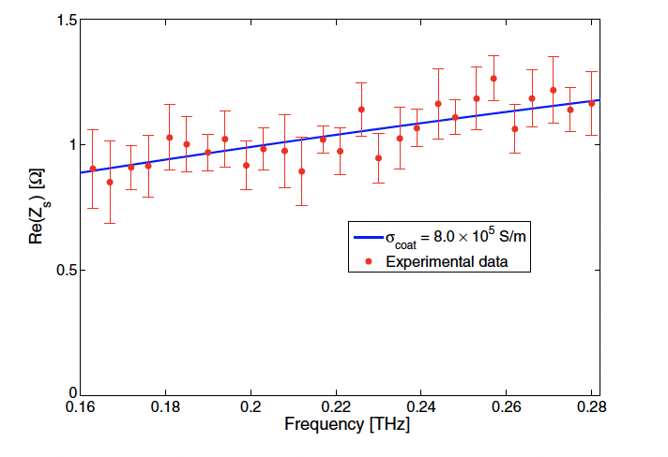


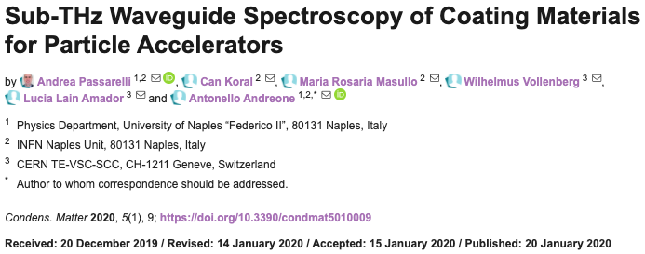
Measurement results on NEG
System specifications:
Spectral Range: > 5 THz
Dynamic Range > 90 dB
Scanning Range ~ 850 ps
Spectral Resolution < 1.5 GHz
Accurate guiding system manufacturing
NEG thickness 3.96 micron
The methodology allows us to directly evaluate the Re(Z_{s} ) that we can use in beam dynamics calculations
From surface impedance Z_{s} to resistive wall impedance Z_{wall}

Slide 9
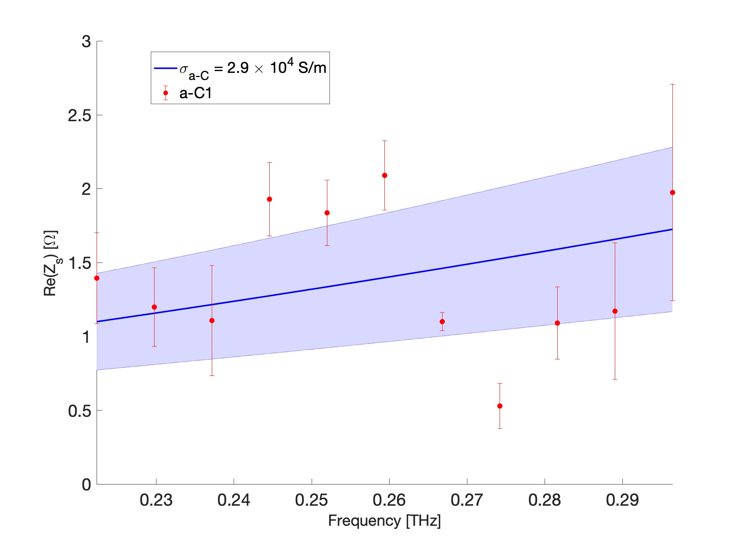
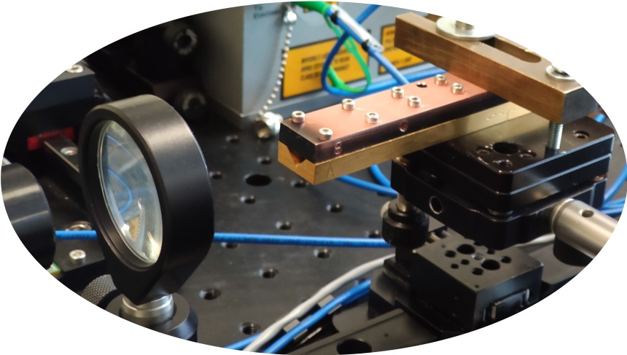
Measurement results on a-C
Mechanical stress a-C coating on Cu slab
3 μm of Amorphous carbon on copper bulk

Slide 10
Dielectric resonant cavity

Slide 11
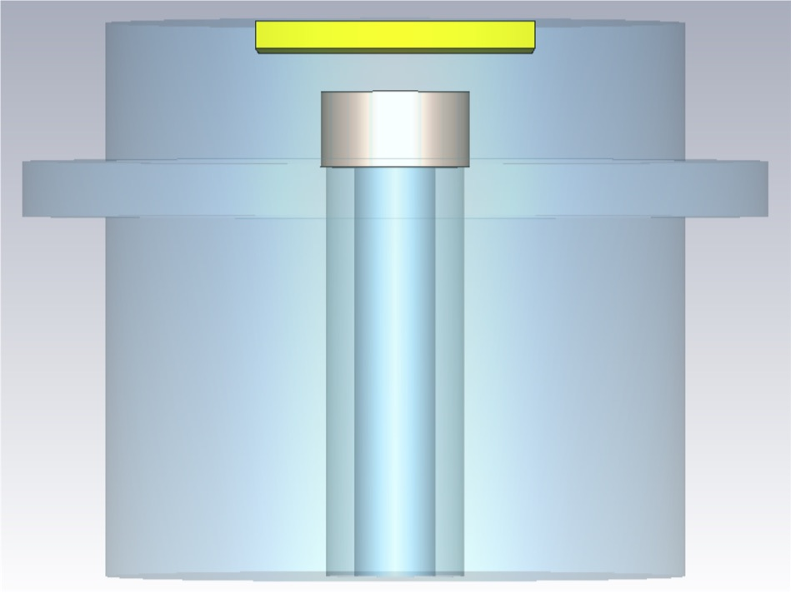
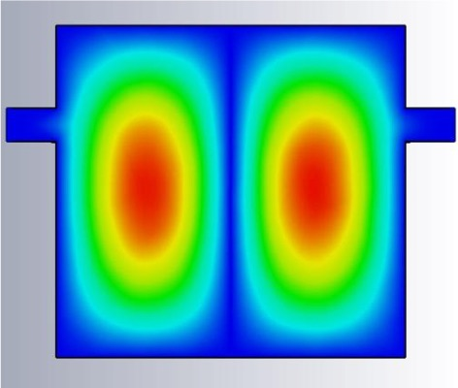
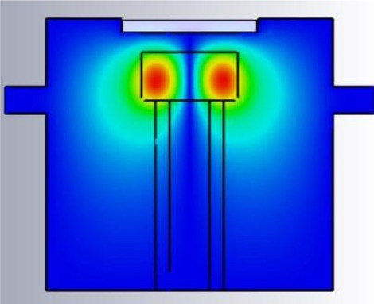
Resonant structure methodology
Dielectric resonator: Resonant structure methodology improves the sensitivity
for the electromagnetic characterization of very thin laser surface treated
structures and conductivity close to copper one
CU coated DUT
Sapphire
Hollow
holder
E field distribution
TE₀₁₁ mode

Slide 12
Resonant structure methodology-simulations
Copper vs. molybdenum coated DUT
Δh
sapphire
radius
The maximum Q-factor percentage difference is obtained
with a minimum distance between the DUT and the sapphire

Slide 13
Resonant structure methodology- simulations
Expected LESS
The sapphire with
larger radius (3.5 mm)
will be used, because
of its higher sensitivity
in EM characterization
of coating materials
(LESS)

Slide 14
Conclusion
Electromagnetic characterization of coating materials
Sub-THz waveguide attenuation
  Reliable analytical model for the conductivity retrieval. Good agreement with CST solver.
  Successful measurement campaign: reliable and handy method to evaluate the electromagnetic properties of samples under test.
  Published results on NEG and novels on a-C coatings.
Resonant structure methodology
  Improves the sensitivity, useful for electromagnetic characterization of very thin laser surface treated structures (i.e. LESS)

