Slide 1
Beam collimators and transverse mode coupling instability
2021 EIC Accelerator Partnership Workshop
2021-10-27
KEKB: Lessons from SuperKEKB
Takuya Ishibashi and Michael Blaskiewicz

Slide 2
Contents
Beam collimators in SuperKEKB main ring
Design
Issue
  Beam induced damage
  Beam size blowup in LER (TMCI derived from localized wake)
Plan
  R&D of durable jaws for beam hits
  Non-linear collimator at LER OHO section (during Long Shutdown-1 in 2022)
Synchro-betatron instabilites in the LER [Michael Blaskiewicz]
Summary

Slide 3
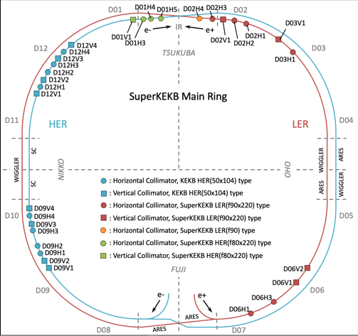
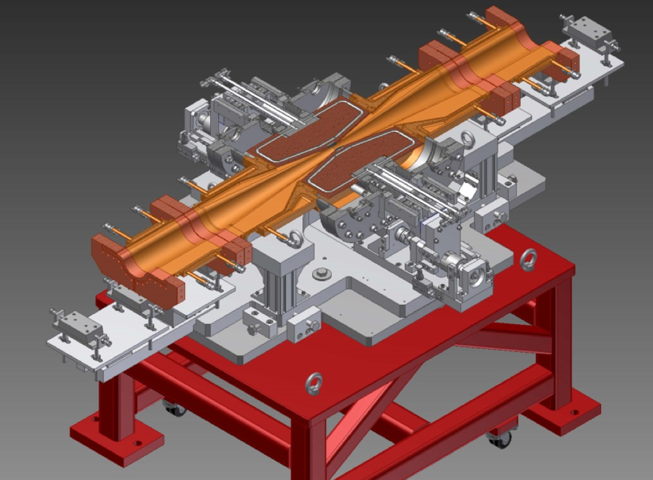
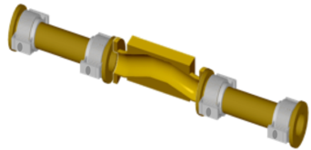
Beam collimators in SuperKEKB
There are two types of collimators in SuperKEKB MR.
  KEKB type: Tapered chamber itself approaches the beam. The tip is made of Cu coated titanium.
  SuperKEKB type: A chamber has two movable jaws, and they approaches the beam.
In HER, 8 horizontal and 8 vertical KEKB type collimators have been reused at the same location as KEKB era. 3 horizontal and 1 vertical SuperKEKB type collimators have been installed in Tsukuba straight section.
In LER, 7 horizontal and 4 vertical SuperKEKB type collimators have been installed.
KEKB type
SuperKEKB type
[Y. Suetsugu et al., NIM A 513, 465 (2003)]
[T. Ishibashi et al., PRAB 23, 053501 (2020)]
Location of collimators in MR

Slide 4
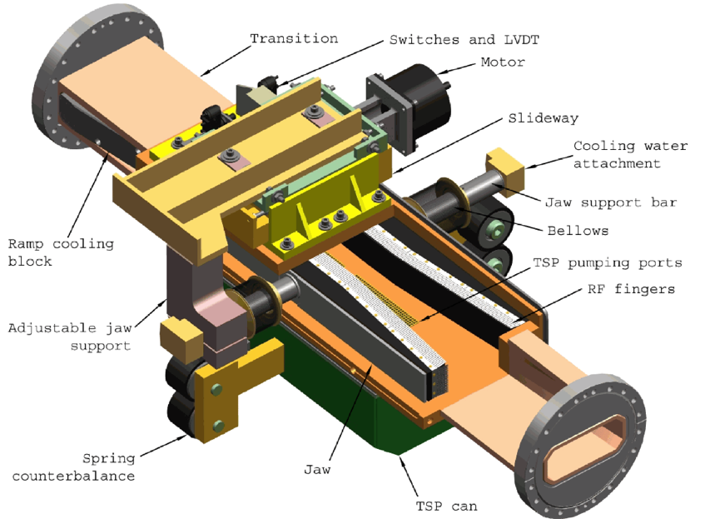
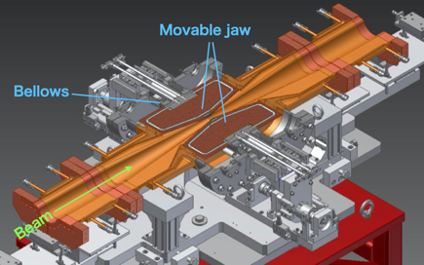
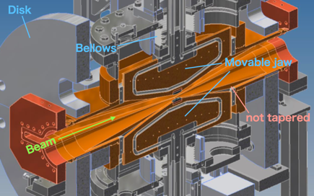
Design
We referenced movable collimators for PEP-II in SLAC for the basic design of the SuperKEKB type.
A collimator chamber has two movable jaws, which are placed the horizontal/vertical direction.
Part of the movable jaws is hidden inside the antechambers to avoid a trapped mode in gaps between the movable jaw and the chamber.
The chamber is tapered to the center of the collimator in order to avoid excitation of trapped-modes.
Materials at the tip of the jaws are tungsten (1st ver.), tantalum (2nd ver.), and carbon (low-Z, special ver.).
Collimator in PEP-II
Horizontal direction
Vertical direction
[S. DeBarger et al., SLAC-PUB-11752]
SuperKEKB type collimator

Slide 5
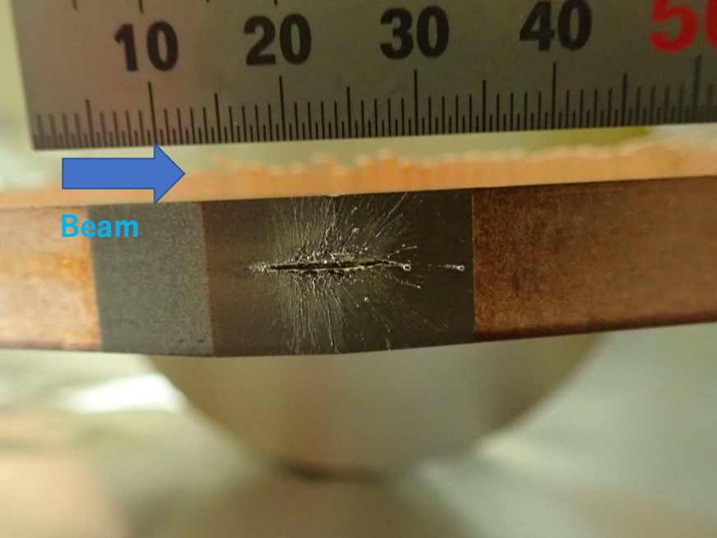
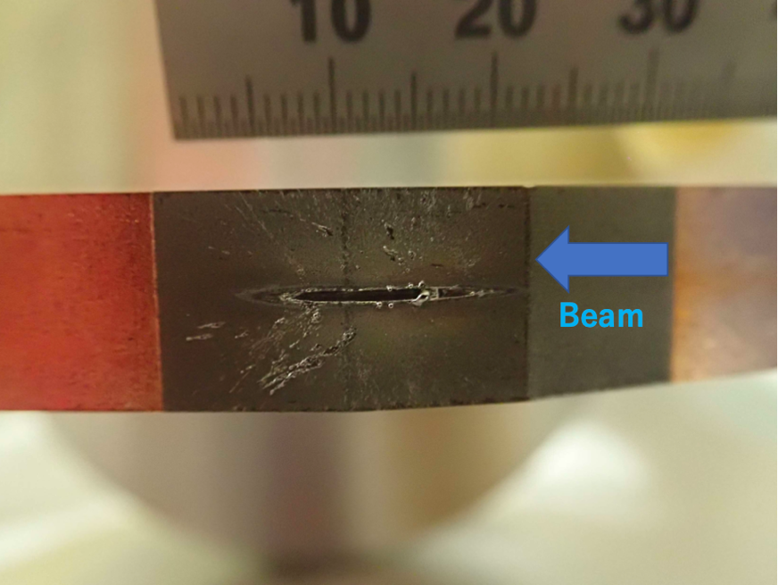
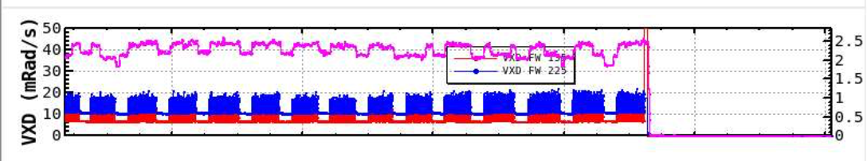
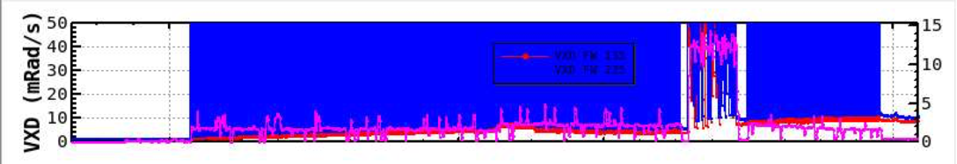
Issue – Damage
* short tantalum tip which has 5 mm.
Jaws of the collimators were damaged by beam hit.
  LER: D02V1 (2021ab), D06V1(2021ab)*, D06V1 (2020ab)*, D06V2 (2019c), D02V1 (2019ab), D02V1 (Phase-2)
  HER: D01V1 (Phase-2)
A huge beam loss and pressure burst has happened near them with a QCS quench .
The damaged tungsten tip has embrittled. For the tantalum tip, it did not embrittle.
The cause is unknown. A candidate is an interaction between the beam and a dust in the beam pipes.
The damaged jaws of D02V1 were replaced once during 2020c and 2021b because of the high BG level.
[S. Terui]
Before damage
After damage
D02V1 bottom side (38 μSv/h)
D02V1 top side (95 μSv/h)
taken on 2021-06-08

Slide 6
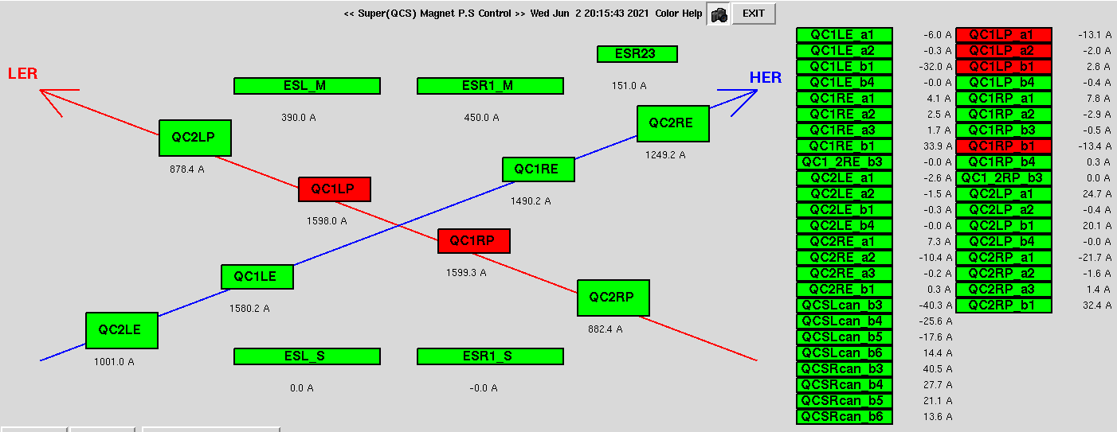
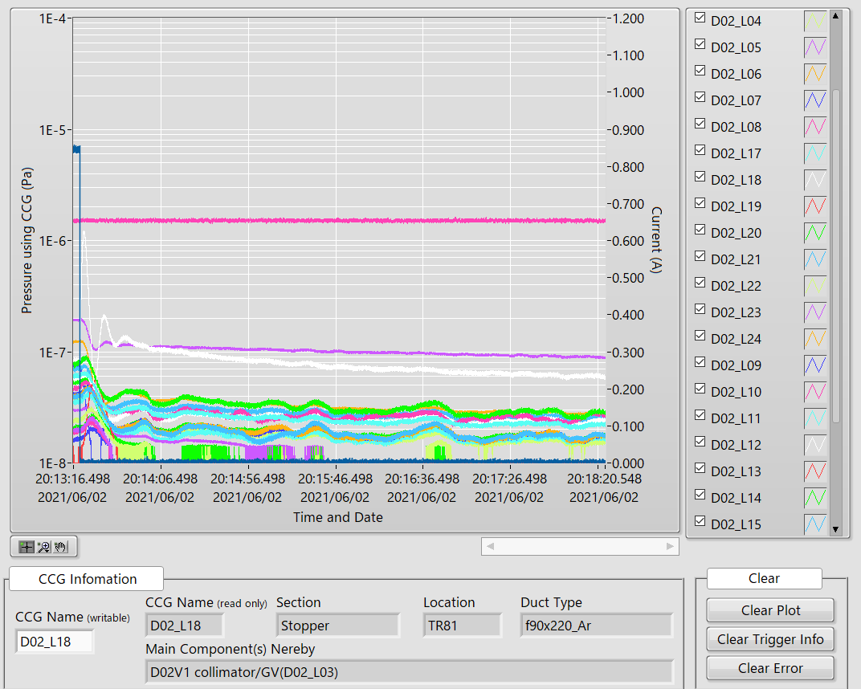
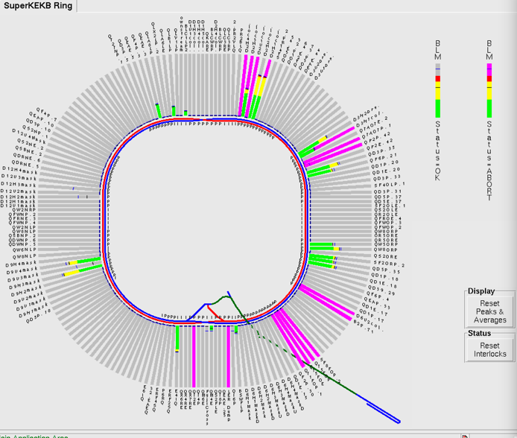
Issue – Damage
In case of a damaged event in 2021-06-02 20:13 (2021b run).
Pressure near CCG D02_L18 and D06_L12, which are placed near D02V1 and D06V1 collimator respectively, was increased instantaneously (beam hit the jaws probably).
QCS quench happened (QC1LP, QC1RP in LER).
Status of QCS
Pressure and beam current
LER Current
CCG D02_L18
Loss monitors in the rings

Slide 7
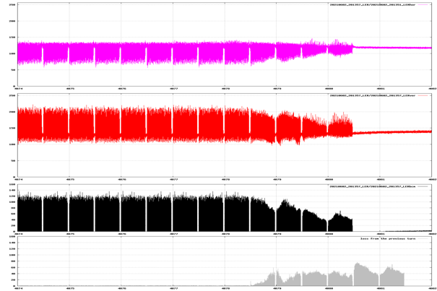
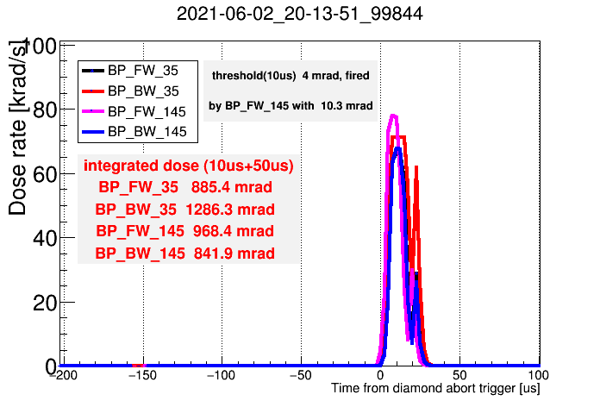
Issue – Damage
Sudden beam loss happened within 2-turn before the beam abort.
Dose on VXD diamond sensors of Belle II were extremely high and the signal saturated (usual beam loss abort: ~50 mRad or less).
The cause of the huge beam loss is unknown so far. One of the candidates is the interaction between the beam and a dust in the beam pipe.
  Results of simulations indicate that the beam loses at not the vertical collimators but the horizontal collimators mainly [Y. Funakoshi].
a turn
BOR(LER H)
1st train
2nd train
BOR(LER V)
BCM
BCM loss
Dose in VXD diamond sensors of Belle II
Bunch oscillation recorder (BOR) and bunch current monitor (BCM), BOR signal is proportional to (bunch displacement)×(bunch intensity).

Slide 8
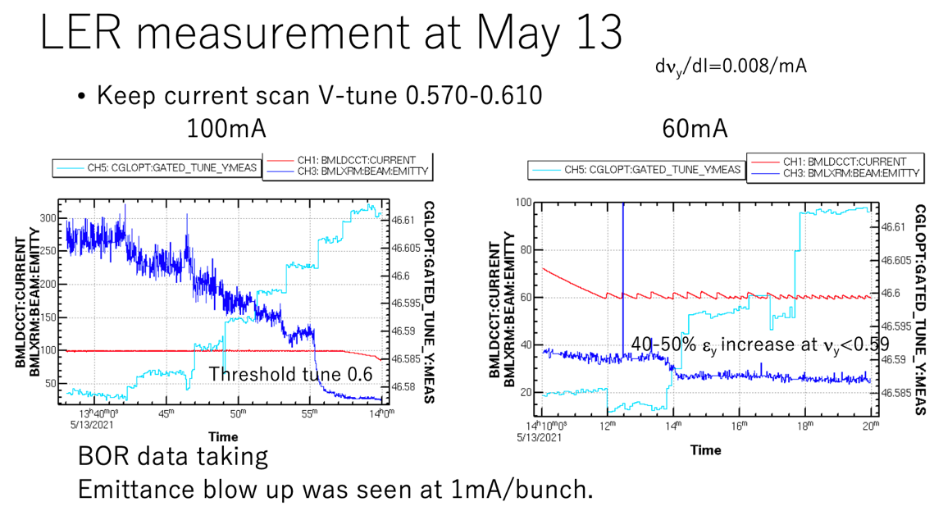
Issue – Beam size blowup in LER (TMCI)
We’ve observed beam size blowup in LER at low bunch current (~1.0 mA/bunch).
[K. Ohmi et al.]
97 bunches

Slide 9
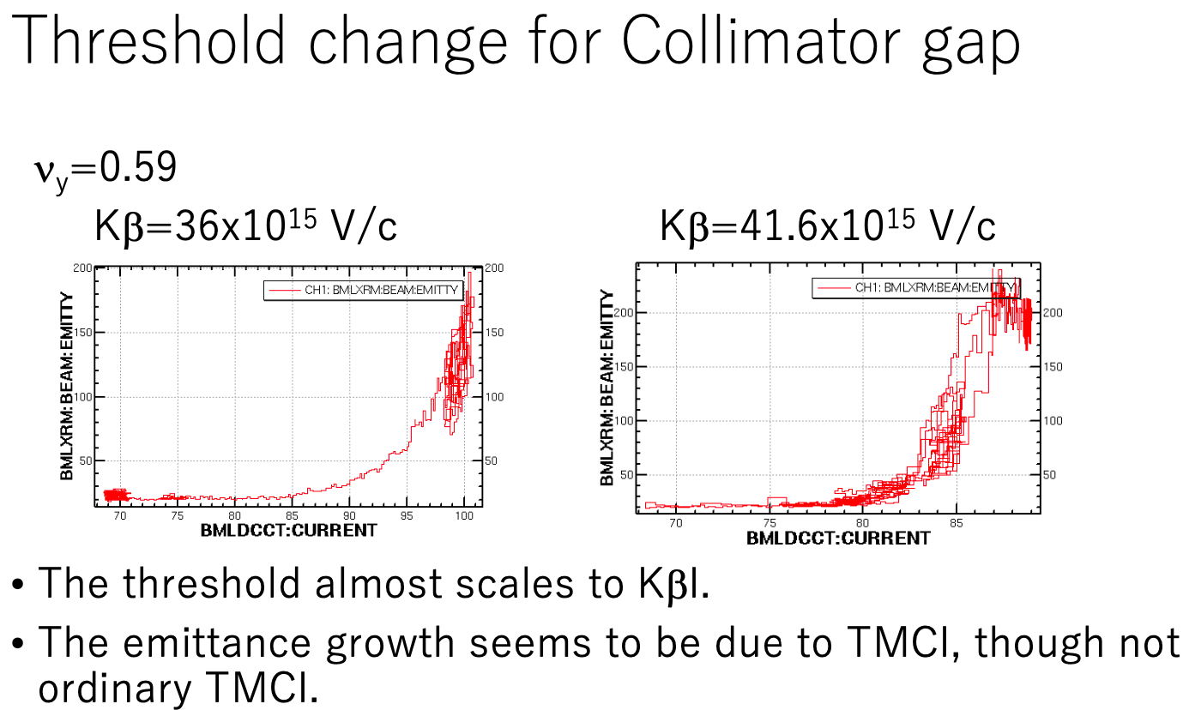
Issue – Beam size blowup in LER (TMCI)
[K. Ohmi et al.]

Slide 10
Issue – Beam size blowup in LER (TMCI)
[S. Terui et al.]
Change chromaticity
Change chromaticity
and collimator’s aperture
Change chromaticity and FB gain
The beam size blowup can be suppressed by increasing the vertical chromaticity.
The threshold of the blowup increases with the negative chromaticity.
The blowup can be suppressed by increasing the feedback gain.

Slide 11
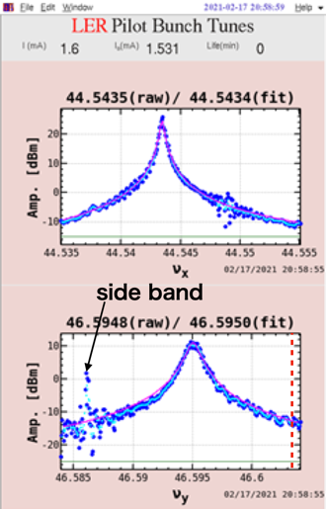
Issue – Beam size blowup in LER (TMCI)
We can accumulate ~1.5 mA/bunch at least.
We‘ve not observed the coupling of the modes 0 and -1 yet.
We‘ve observed the vertical beam size blowup before the coupling.
2021-02-17
βy* = 8 mm, single-bunch operation
Tune shift: ~0.008 mA⁻¹
ν_{y} ~ 0.595 @ 1.6 mA/bunch
We were not able to inject up to ~1.7 mA/bunch (rep. rate 1 Hz).
TMCI threshold (calc.): ~1.77 mA/bunch
D02V1: 2.17 mm, -1.8 mm, D03V1: ±9 mm,
D06V1: ±2 mm, D06V2: ±9 mm
Δ~0.009

Slide 12
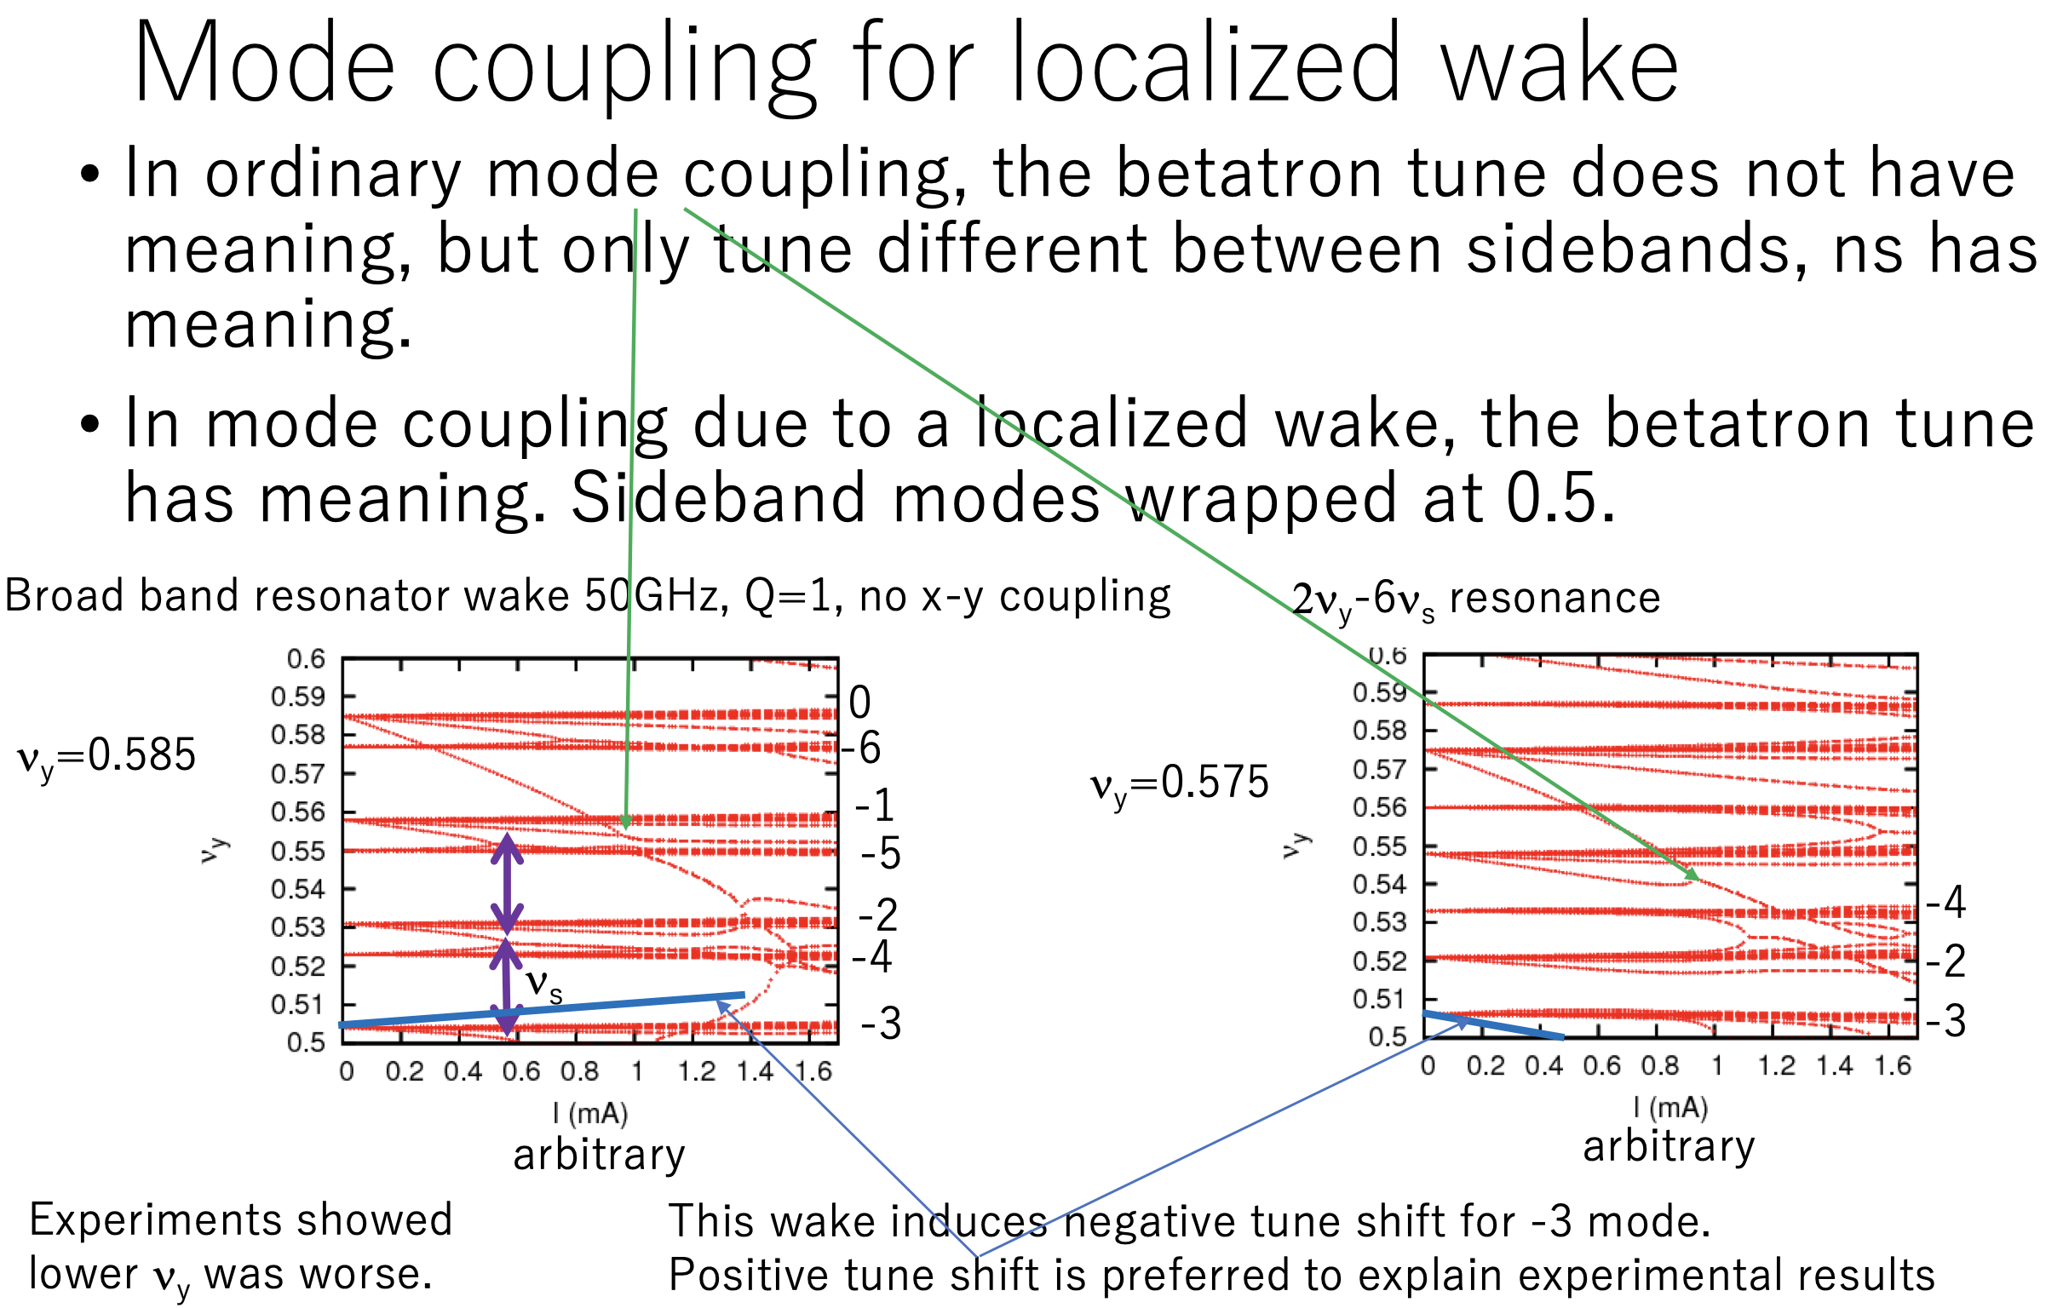
Issue – Beam size blowup in LER (TMCI)
[K. Ohmi]

Slide 13
Issue – Beam size blowup in LER (TMCI)
Summary of TMCI in LER
  We can accumulate the bunch current up to calculated value using a broad impedance model, however we’ve observed the vertical beam size blowup around ~60% of the calculated values.
  The bunch current threshold about the beam size blowup depends on the tune and the chromaticity.
    Proper vertical tune and/or higher chromaticity can increase the threshold.
    Since the threshold in the ordinary TMCI doesn’t depend on the tune, the beam size blowup can be caused by the localized wake in the vertical collimators.
    We’ve not observed the coupling of the modes 0 and -1, so K. Ohmi has suggested that we should observe this, which is the ordinary TMCI, in a higher vertical tune (ν_{y} > 0.6).
  The beam size blowup has been observed for the single-beam operation (no collision). We’ve observed a beam size blowup in LER with the collision, and it has been caused by the beam-beam because the beam size depends on not the collimators’ aperture but the current balance between LER and HER. We've not been able to accumulate the bunch current till the TMCI threshold with the collision so far.
  The threshold of the blowup may increase at least up to ~0.9-1.0 mA with present collimator setting by choosing the vertical tune and/or the vertical chromaticity.
  For higher beam current operation assuming L=1×10³⁵ cm⁻² s⁻¹, a bunch current more than 1.0 mA will be needed for LER, so this beam size blowup by TMCI may be more serious.
  There is a possibility that the tune to avoid the blowup is not good for the luminosity performance.
    D. Zhou‘s strong-strong beam-beam simulation has predicted that the luminosity will increase by 10% by moving from the present tune to the designed tune (ν_{x}, ν_{y})=(.53, .57).

Slide 14

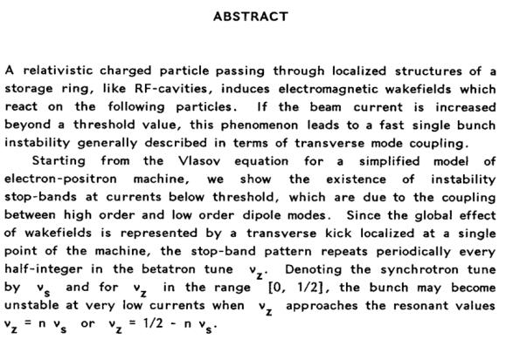



Slide 15
Issue – Beam size blowup in LER (TMCI)
(Example) parameter sets for L=1×10³⁵ cm⁻² s⁻¹.
[Y. Funakoshi]
 | LER | HER | LER | HER
# of bunches | 1564+1 |  | 2345+1
Luminosity | 4.79 x 10³⁴ cm⁻²s⁻¹ |  | 1.0 x 10³⁵ cm⁻²s⁻¹
I_{total} | 1.41 A | 0.986 A | 2.35 A | 1.64 A
I_{bunch} | 0.898 mA | 0.630 mA | 1.0 mA | 0.7 mA
βy* | 1 mm | 1 mm | 0.8 mm | 0.8 mm

Slide 16
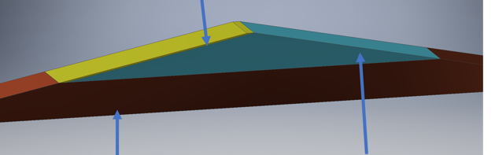
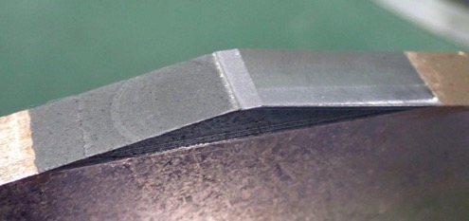
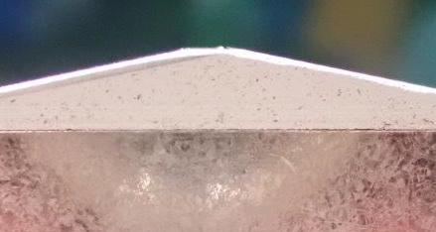
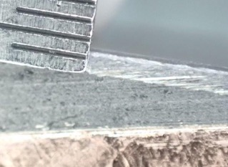
Plan – R&D of durable jaws (hybrid jaw)
We installed hybrid type jaws in D06V2 during this summer shutdown for the test purpose. The tip is made from carbon and tantalum in order to improve the robustness regarding to the beam hit.
It could be difficult to form the protrusions on the tip.
Model
Tantalum
Actual
Copper
CFC (Carbon-fiber-composited Carbon)
Tantalum
Tantalum
CFC
Cu plate
CFC
Cu
Cu

Slide 17
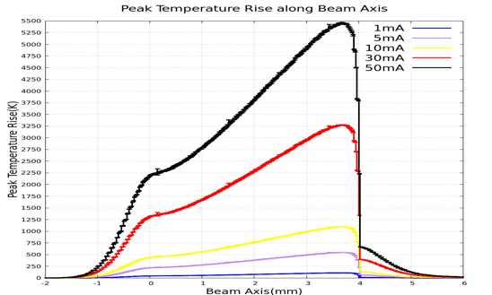
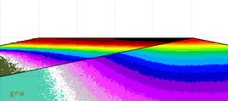
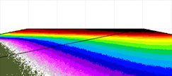
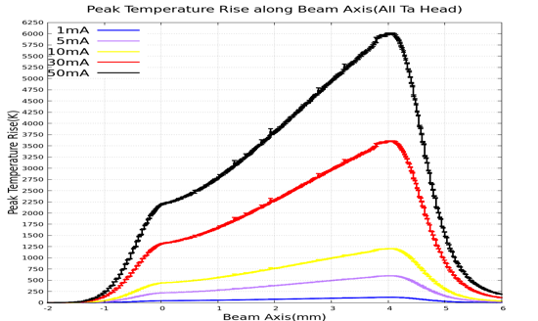
Plan – R&D of durable jaws (hybrid jaw)
[Y. Morikawa, S. Terui]
Temperature Rise(1mA)-Hybrid type
Temperature Rise(1mA)-All Ta
When 30 mA beam hits the jaw, the volume of the melting tantalum is 68 % less compared to the standard jaw. This might relax the bad effect on the background (durable jaw?).

Slide 18
Plan – R&D of durable jaws (titanium jaw)
High-Z (Ta/W)
  The radiation length is short (Ta: 0.41 cm, W: 0.35 cm), and we can decrease the length at the tip of the jaw to a few mm.
  The electric conductivity is acceptable (Ta: 7.61e6 S/m, W: 18.9e6 S/m). [Ref. Cu: 59.6e6 S/m]
  Easy to damage.
  Large effect to raise the IR background when it’s damaged (This is derived from the mass density of the protrusions on the tip surface?)
  Generate radioactive dusts when it’s damaged. Radiation Science Center has commented that the half-life time of the Ta may be longer compared to that of W. However, it’s very easy to generate the dusts for W when it’s damaged…
  In the future, the radioactivity can limit the replacement work. We may have to wait the decay of the radioactivity and be not able to replace during runs.
Low-Z (Carbon)
  The radiation length is long (C: 19.32 cm) . We need longer tip (>60 mm) to shield the halo, and this raise the geometrical impedance.
  The electric conductivity is very low (C: 3e5 S/m), and the resistive wall also raises the impedance. However, we can avoid this by adopting Cu plate on the carbon.
  The melting point is high.
  Very difficult to damage.
Mid-Z (Ti)
  The radiation length is intermediate (Ti: 3.56 cm), and we can adopt a dozen mm for the tip length.
  The electric conductivity is acceptable (Ti: 2.38e6 S/m). If we need Cu plating, we can do it as with the jaws of KEKB type collimators.
  Easy to damage from the experiences of KEKB type collimators in HER.
  Nevertheless, we’ve used damaged Ti jaws in HER without major impact on the IR backgrounds. (This is derived from the mass density?)
  (→ Titanium jaws may have good balance in terms of the durability and the impedance.)
  Difficult to generate the radioactive dusts when it’s damaged from the experiences of KEKB type collimators in HER.

Slide 19
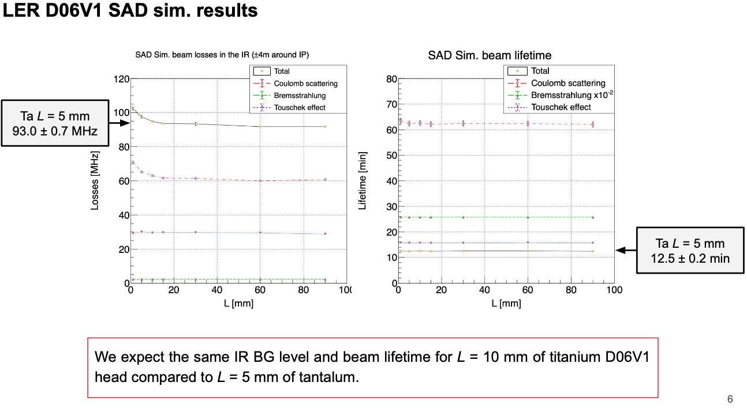
D06V1 titanium head study by A. Natochii
We could also use the Ti-10 mm jaw in the non-linear collimator by A. Natochii’s simulations.

Slide 20
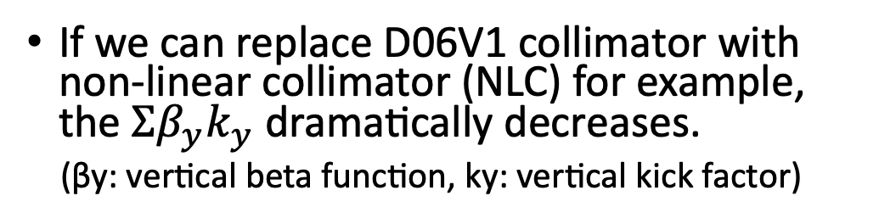
Plan – Non-linear collimator at LER OHO section
Present collimator setting (2021ab)
  D06V1: primary collimator: most tightly closed and suppresses the injection BG.
  D02V1: second collimator: closest vertical collimator to IP and very important to suppress BG
  D06V2, D03V1: backup: not so tightly closed. D03V1 can be used for a backup of D02V1.
If we can replace D06V1 collimator with non-linear collimator (NLC) for example, the $Σβ_{y}k_{y}$ dramatically decreases.
(βy: vertical beta function, ky: vertical kick factor)
NLC

Slide 21
Plan – Non-linear collimator at LER OHO section
Collimator setting (half-aperture) during physics run in 2021b (βy*=1 mm)
 | β_{y} [m] | 2021-06-30 [mm] | 2021-07-02 [mm]
D06V1 top | 67.3 | 3.06 | 3.84
D06V1 bottom |  | -2.65 | -2.65
D06V2 top | 20.6 | 2.27 | 2.25
D06V2 bottom |  | -2.26 | -2.24
D03V1 top | 17.0 | 8.00 | 7.99
D03V1 bottom |  | -8.00 | -7.99
D02V1 top | 13.9 | 1.30 | 1.71
D02V1 bottom |  | -1.14 | -1.35
NLC@OHO | 2.9 | 5.7 | 5.7
The β_{y} at the D06V1 is large, and the aperture is narrow.
The β_{y} at the NLC is small, and the aperture is wide.
→ can dramatically decrease the $Σβ_{y}k_{y}$ if we can replace D06V1 with NLC.

Slide 22
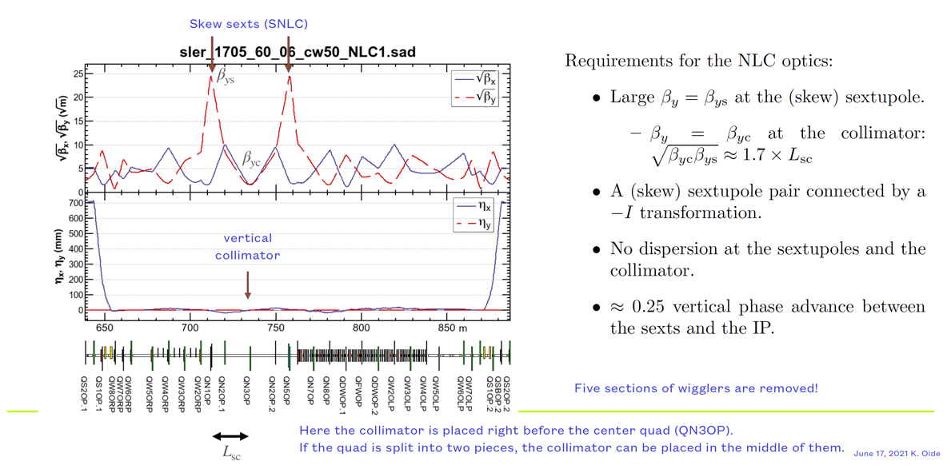


Plan – Non-linear collimator at LER OHO section
Scheme
$$−I$$
[K. Oide]
$${∆μ}_{y}=\frac{π}{2}$$

Slide 23
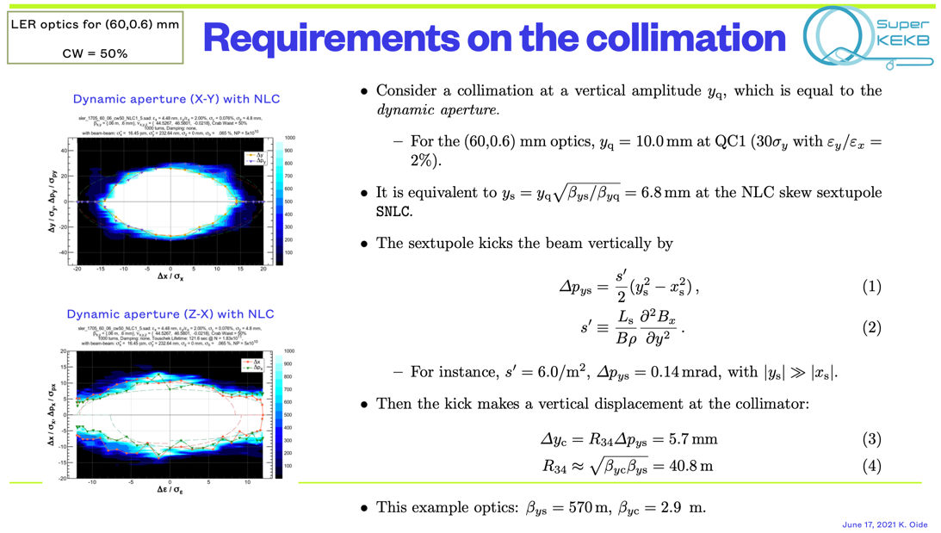
Plan – Non-linear collimator at LER OHO section
[K. Oide]

Slide 24
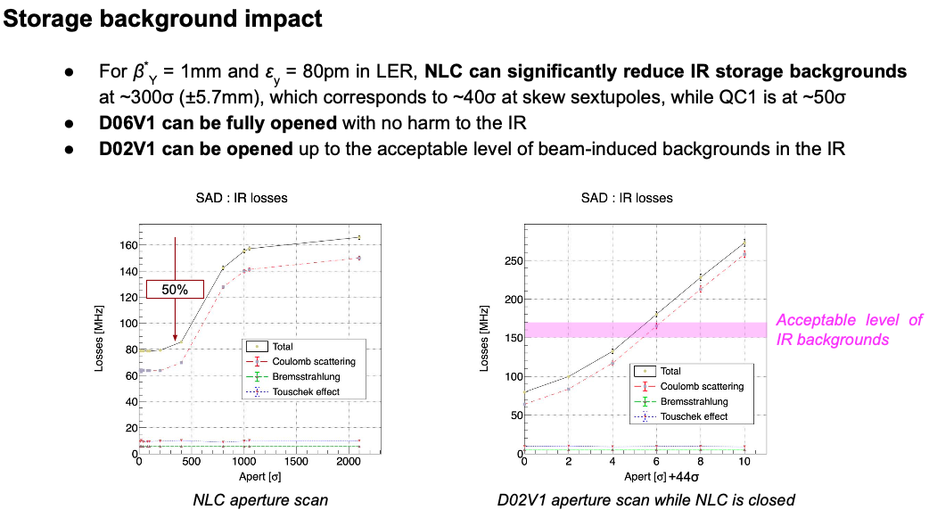
Plan – Non-linear collimator at LER OHO section
[A. Natochii]

Slide 25
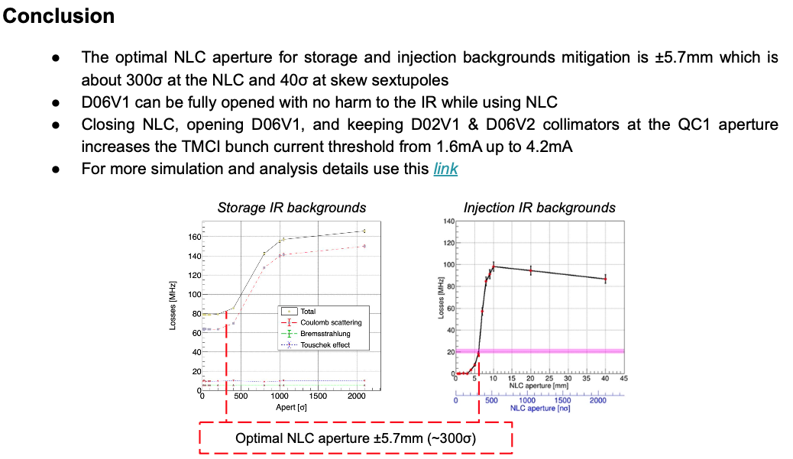
Plan – Non-linear collimator at LER OHO section
[A. Natochii]

Slide 26
Synchrobetatron Instabilites in the LER
[Michael Blaskiewicz]
A preliminary study of transverse stability was made using TRANFT. (M. Blaskiewicz, “The TRANFT User’s Manual” BNL-77074-2006-IR)
Only resistive wall and a smallish step function wake were used.
Took a bunch charge of 50 nC (large) at β_{y}=10.4 m.
The tune shift of the rigid mode is ΔQ_{y0}=-0.01, less than Q_{s}=0.025.
Other parameters are close to the LER

Slide 27
Results
[Michael Blaskiewicz]
Calculated growth rates with all the wake either in one location or split evenly between two locations on opposite sides of the ring.
For one kick per turn the beam was strongly unstable just above the integer and half integer. For two kicks per turn the beam was unstable just above the integer. The green line shows the imaginary part of the tune driven by a single thin lens with a strength k that satisfies βk=4πΔQ_{y}=-0.13, which was the rigid mode kick strength in the simulations.
For a half integer tune, 2 thin lenses at symmetric locations are stable. Hence, the behavior for 2 kicks per turn is reasonable.

Slide 28
Comments
[Michael Blaskiewicz]
The instability simulations were done with a tune step of 0.01, it is possible a finer structure will emerge with smaller step size.
This effect is discussed in
F. Ruggerio “TRANSVERSE MODE COUPLING INSTABILITY DUE TO LOCALIZED
STRUCTURES” Particle Accelerators 20, p45, (1986).
Figure 1 from that paper shows threshold current versus Q_{y0} for Q_{s}=0.10.
I have not looked hard enough to comment on the narrow stable regions.
The details in the plot probably
depend on detailed input, but the
general characteristic of reduced
threshold current just above the
integer agrees with simulations.
Note that short range wakes always
defocus, hence above or below the
integer matters.

Slide 29
Summary
Collimators are an indispensable sub-system in SuperKEKB MR to reduce the detector BG and avoid the QCS quench. However, there are serious issues:
  Beam induced damage
  TMCI in LER caused by localized wake in vertical collimators
Non-linear collimator at LER OHO section could relax the TMCI. We have plans to construct this during Long Shutdown-1 (LS1), 2022.
We’re also working to understand the observed transverse blow-up through machine studies, building a machine impedance model able to reproduce the instability in a TMCI working group of SuperKEKB International Task Force.
  Contact person: Mauro Migliorati (SAPIENZA - Università di Roma)
  Sub-contact person: Takuya Ishibashi (KEK)

Slide 30
Thank you for your attention.

Slide 31
backup

Slide 32
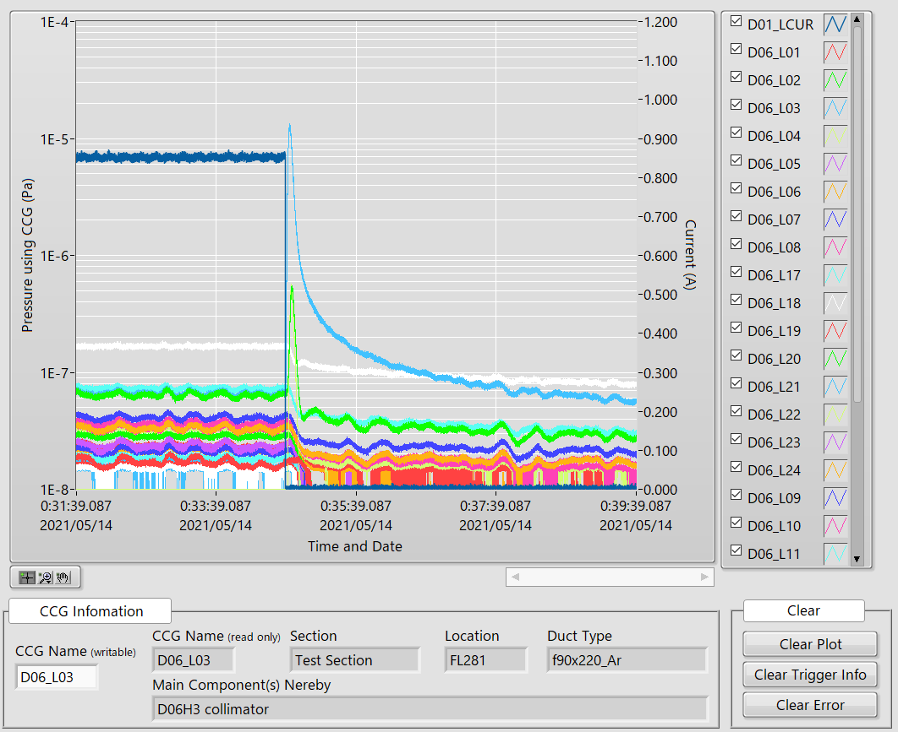
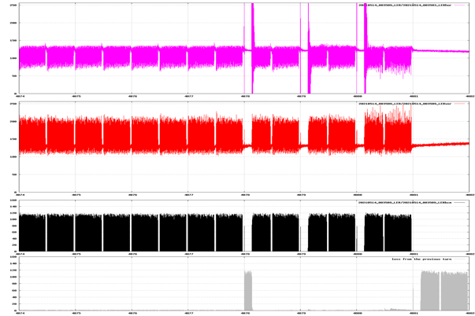
Issue – Accidental firing of injection kickers
Accidental firing of injection kickers in LER has happened.
Example:
  On 2021-05-14 00:35, a both ring abort happened.
  QCS quench (QC1RP a1, a2, b1).
  A pressure burst at D06H3 collimator was observed.
loss
LER current
BOR(LER H)
Pressure burst
(CCG D06_L03)
BOR(LER V)
BCM
BCM loss

Slide 33
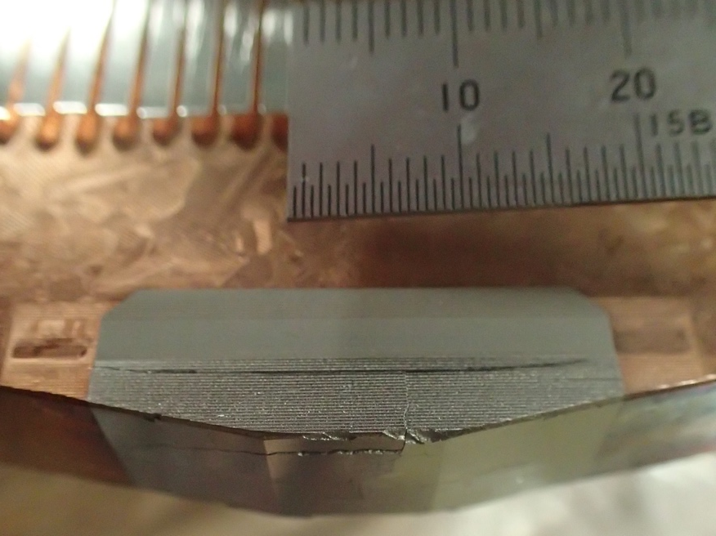
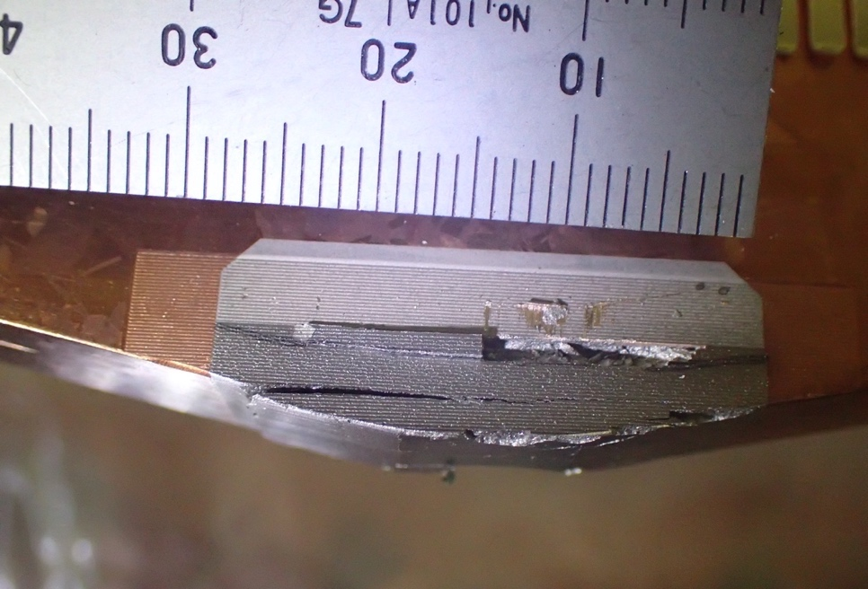
Issue – Accidental firing of injection kickers
D06H3 collimator has used for the protection from the accidental firing, and it was severely damaged.
We replaced them with healthy ones during this summer shutdown.
  We don’t have the spare jaws for D06H3 collimator. Thus, we removed jaws of D06H1 and installed them into D06H3.
  We installed new jaws into D06H1 instead, however the length of the jaws is short for this collimator. The minimum aperture of D06H1 is ±14 mm.
  We’re staring to manufacture the spare jaws made of tantalum, and it’ll be delivered till the beginning of next Jan.
All the thyratrons have been replaced with ones which have a higher breakdown voltage, during this summer shutdown [T. Mimashi]. However, the accidental firings had occurred during 2021c, and this could be caused by noise in the trigger system. An additional system has been installed to guarantee the coincidence of the trigger in a hurry.
beam
beam
D06H3 IN (~700 μSv/h)
D06H3 OUT (~320 μSv/h)

Slide 34
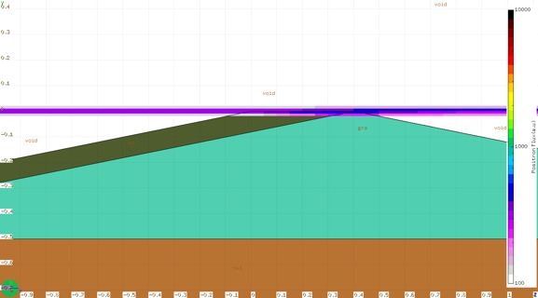
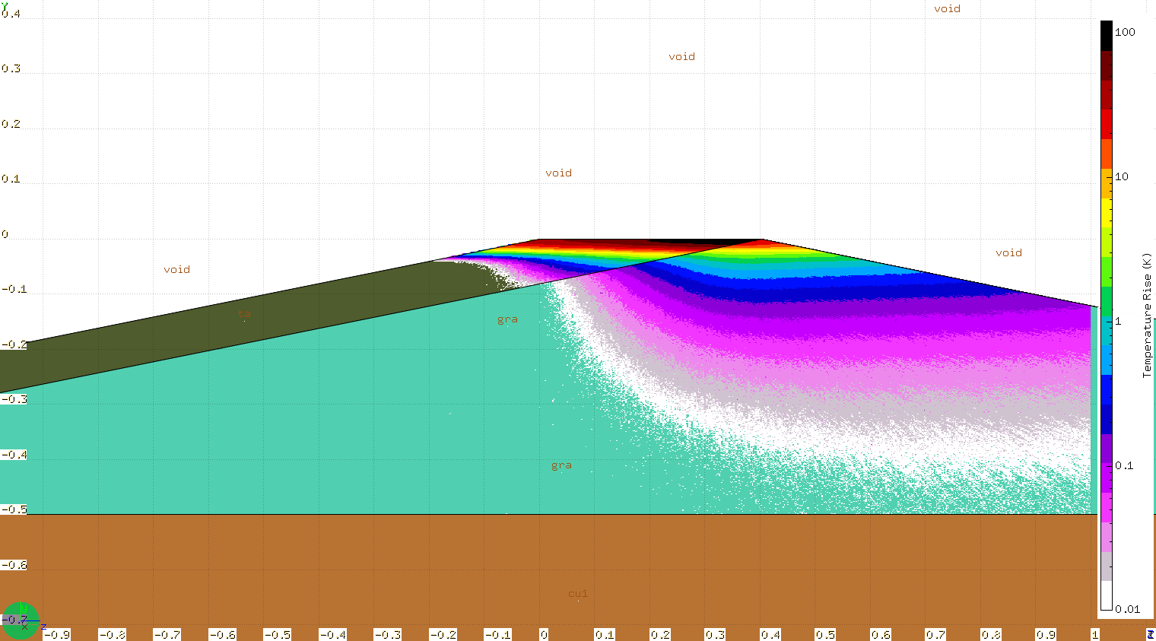
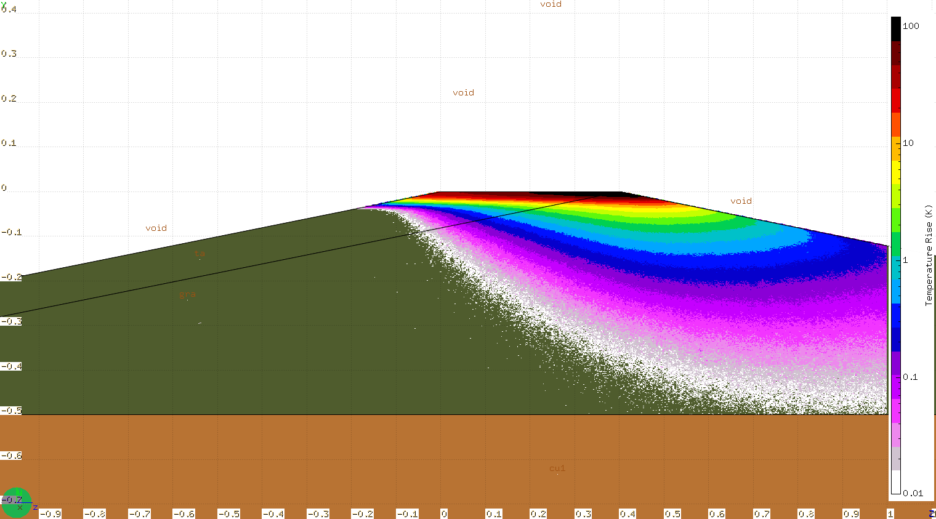
Plan – R&D of durable jaws (hybrid jaw)
Positron Flux
[Positron Beam]
・Beam Size : σy = 100um, σx = 300um
・Beam Energy : ４GeV
・No energy spread
・Lower half of the beam hit the jaw
・Beam current (assuming 99.4kHz)：
1 mA, 5 mA, 10 mA, 30 mA, 50 mA
property
[Y. Morikawa, S. Terui]
Temperature Rise(1mA)-Hybrid type
Temperature Rise(1mA)-All Ta
tantalum
Carbon

Slide 35
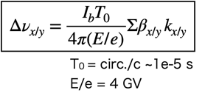
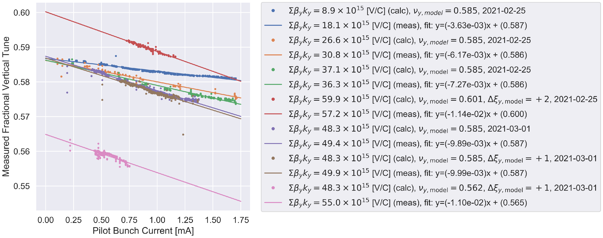
Vertical tune shift

Slide 36
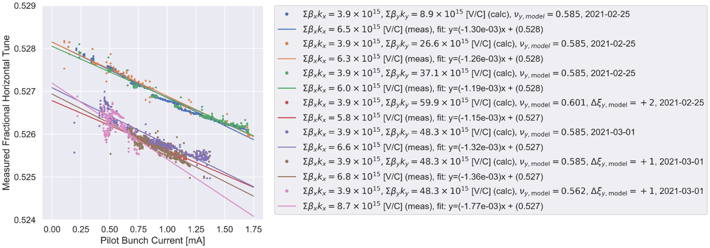
Horizontal tune shift

Slide 37
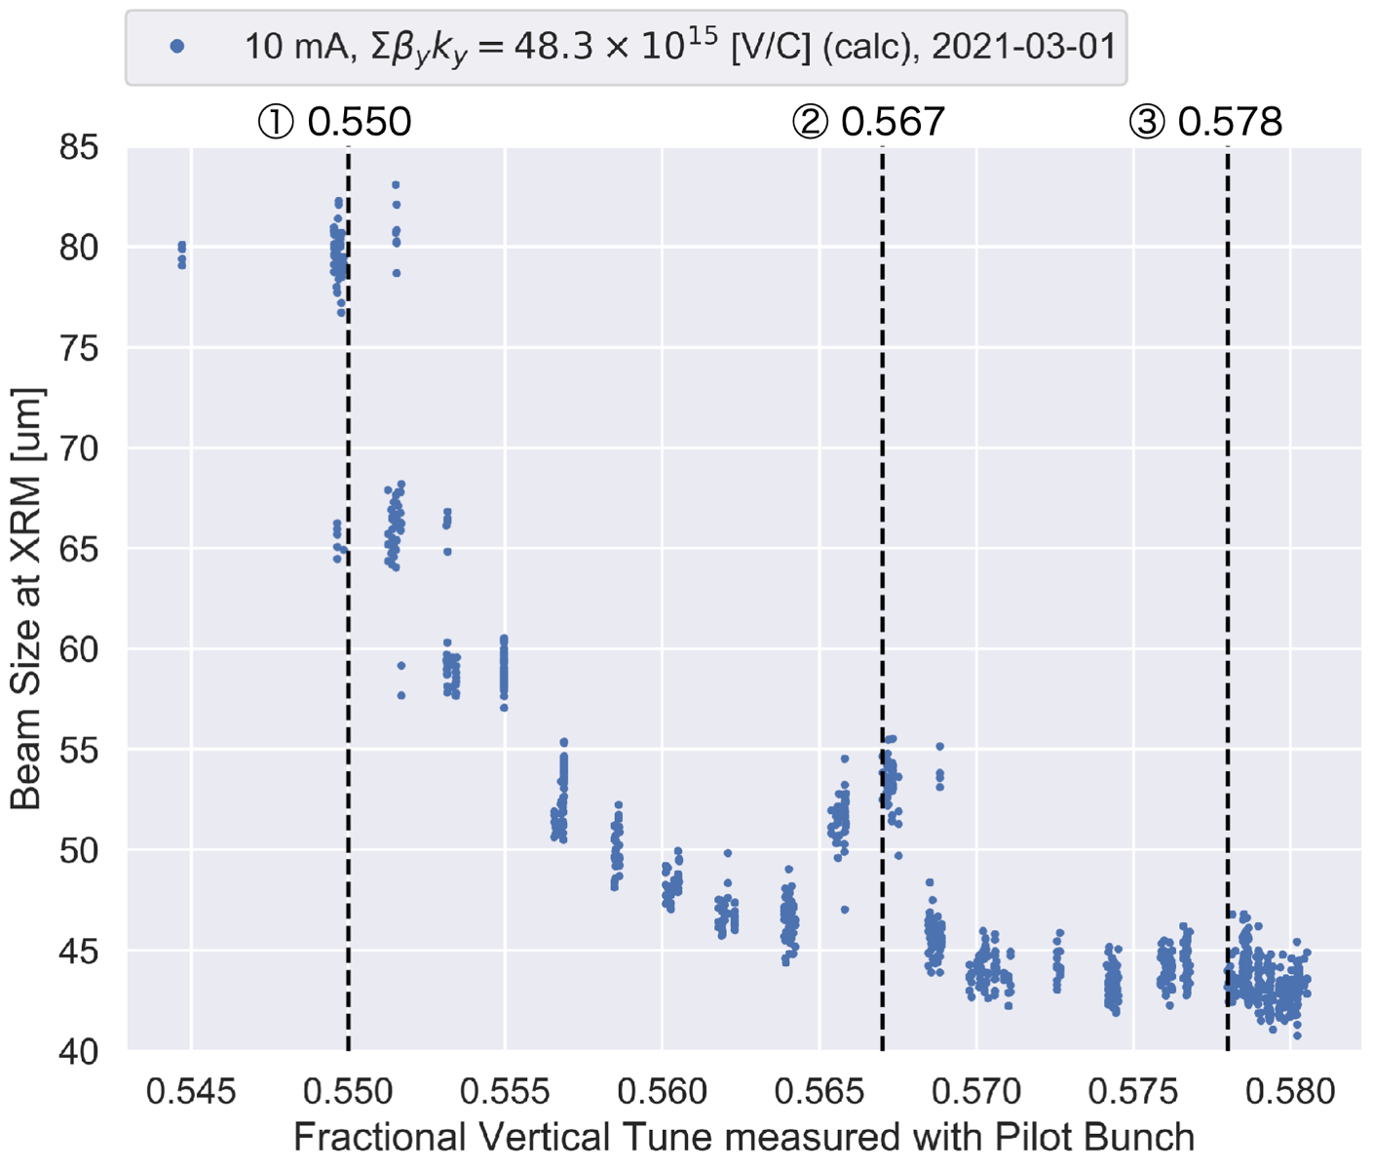
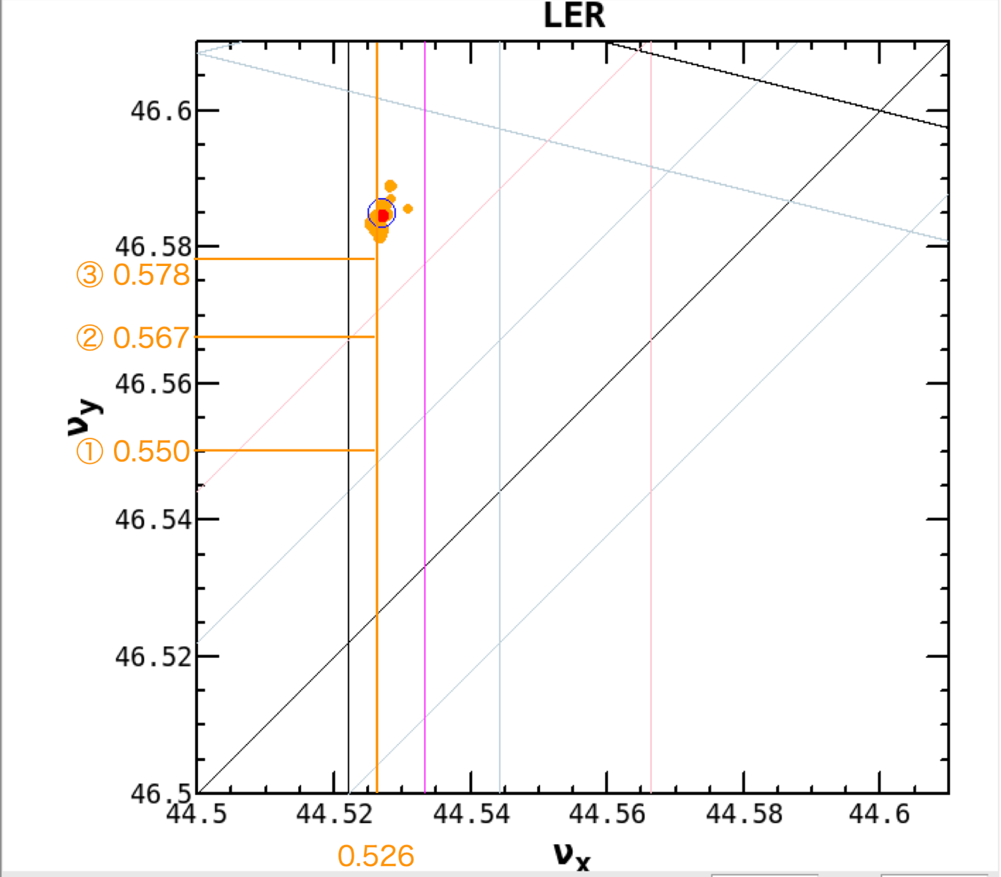
Vertical tune scan

Slide 38
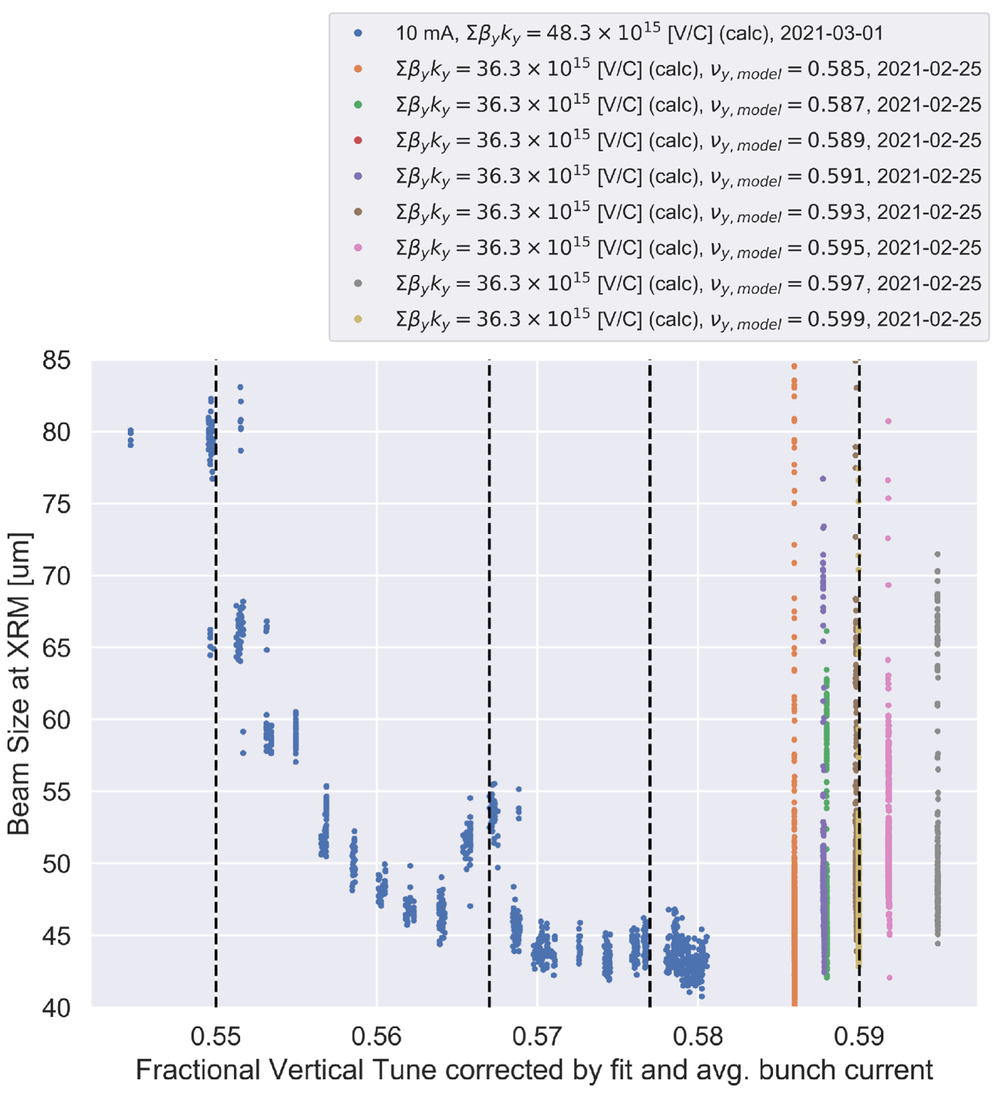
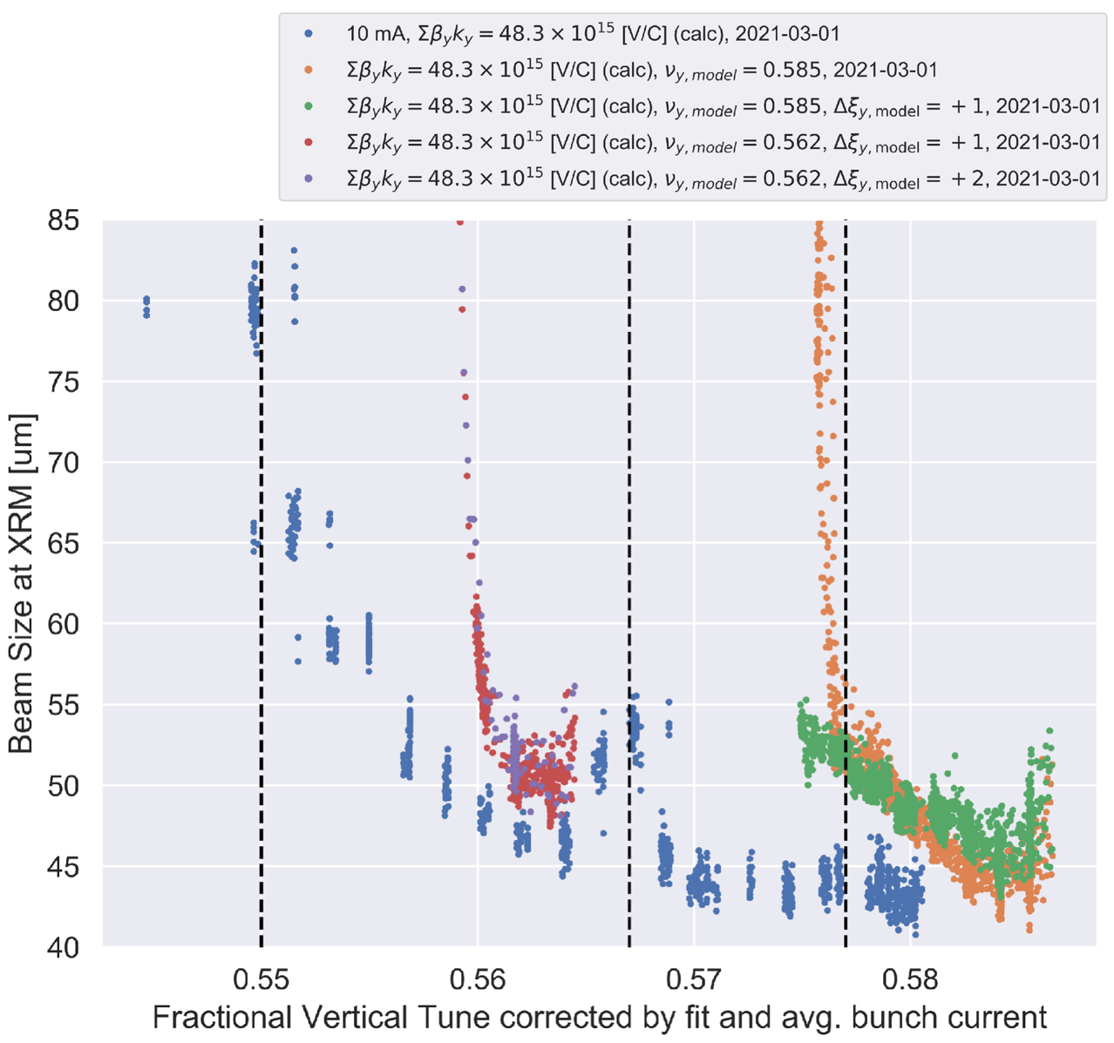
Beam size blowup
Tune scan

Slide 39
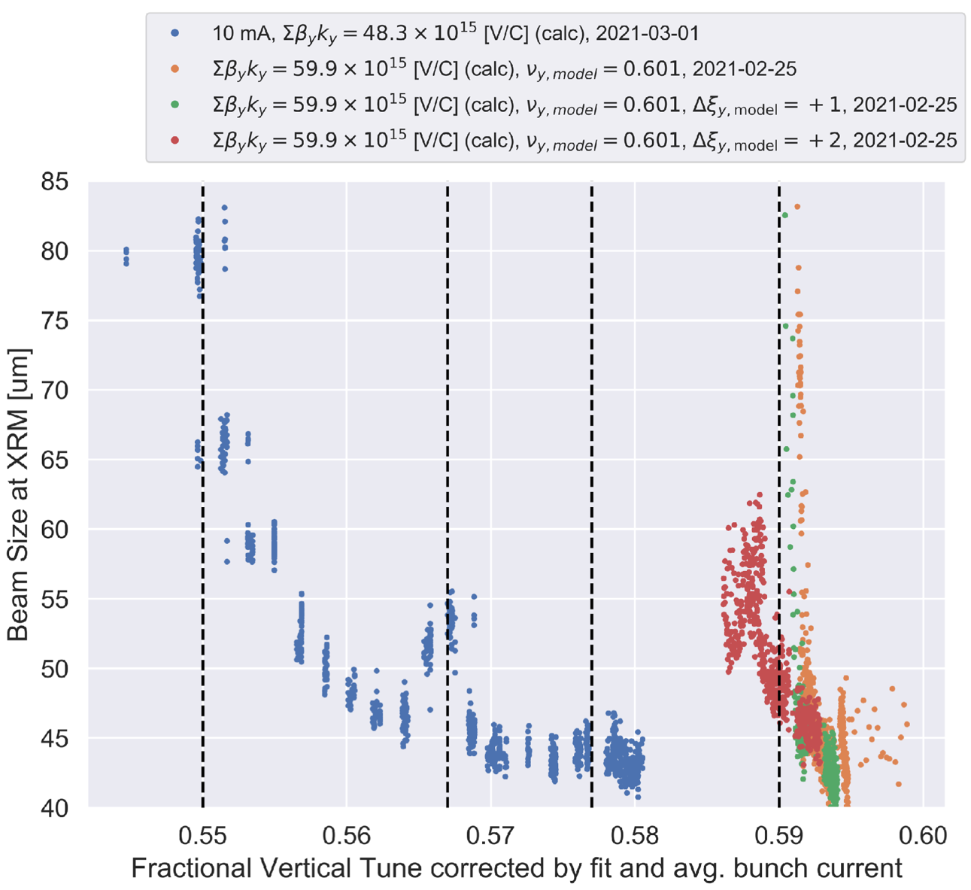
Beam size blowup
Chromaticity scan

Slide 40
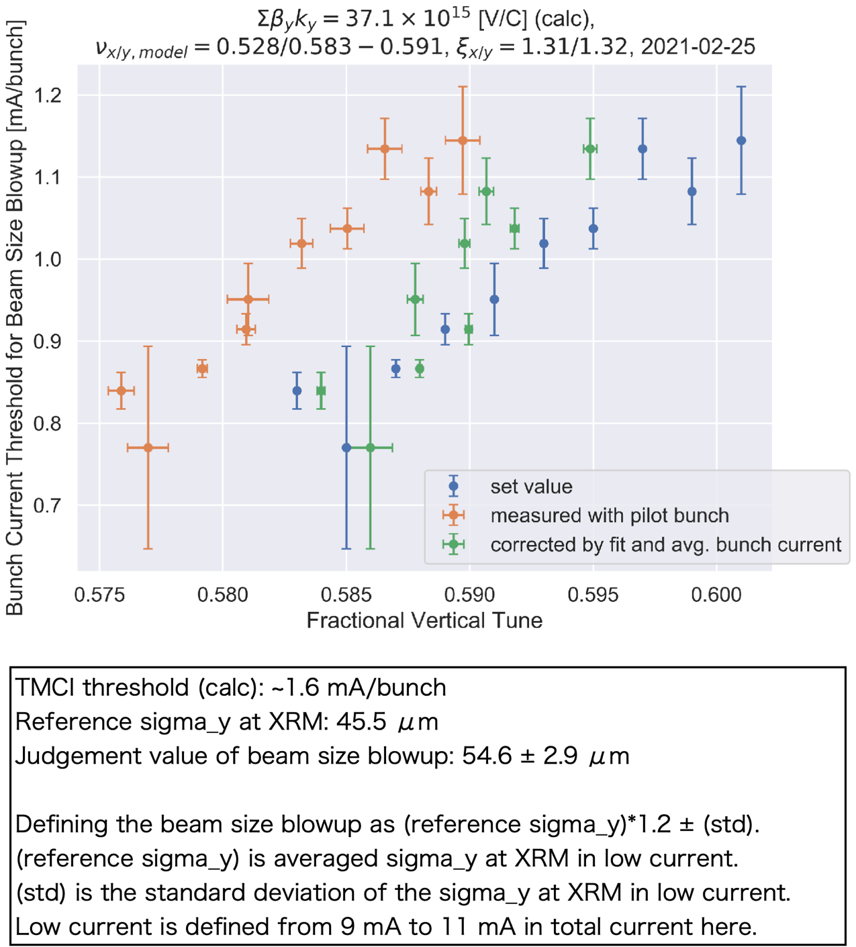

Beam size blowup

Slide 41


Beam length measurements for collimator apertures
[H. Ikeda]
We measured the bunch length in LER in the collimators’ impedance study simultaneously.
No correlation for the collimators’ apertures.
However, it’s longer than expected.

