Slide 1
EIC Impedance Assessment and Collective Effects
Alexei Blednykh
Deputy of the Accelerator Development and R&D Division Director
TRIUMF 2021 EIC Accelerator Partnership Workshop
October 26-29, 2021
A. Blednykh Accel Phys TRIUMF 2021 EIC Accelerator Partnership Workshop October 26-29 2021

Slide 2
Overview
Wakefield/Impedance analysis and collective effects in EIC are a work in progress.
We will discuss the impedance budget and the results presented up to-date.
Three electrodynamics codes CST (M. Sangroula, P. Thieberger), GdfidL, ECHO 3D (G. Wang) are used for the wakefield/impedance and the local power loss simulations.
Particle tracking simulations are performed with TRANFT & ELEGANT.
CSR wakefield is calculated by Demin Zhou’s CSRZ code for uniform rectangular cross-section (using parabolic equation) for two different lattices, 5GeV and 10GeV.
We are using BNL institutional cluster, NSLS-II resources, for parallel computations.
A. Blednykh Accel Phys TRIUMF 2021 EIC Accelerator Partnership Workshop October 26-29 2021

Slide 3
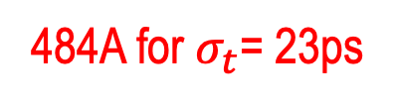
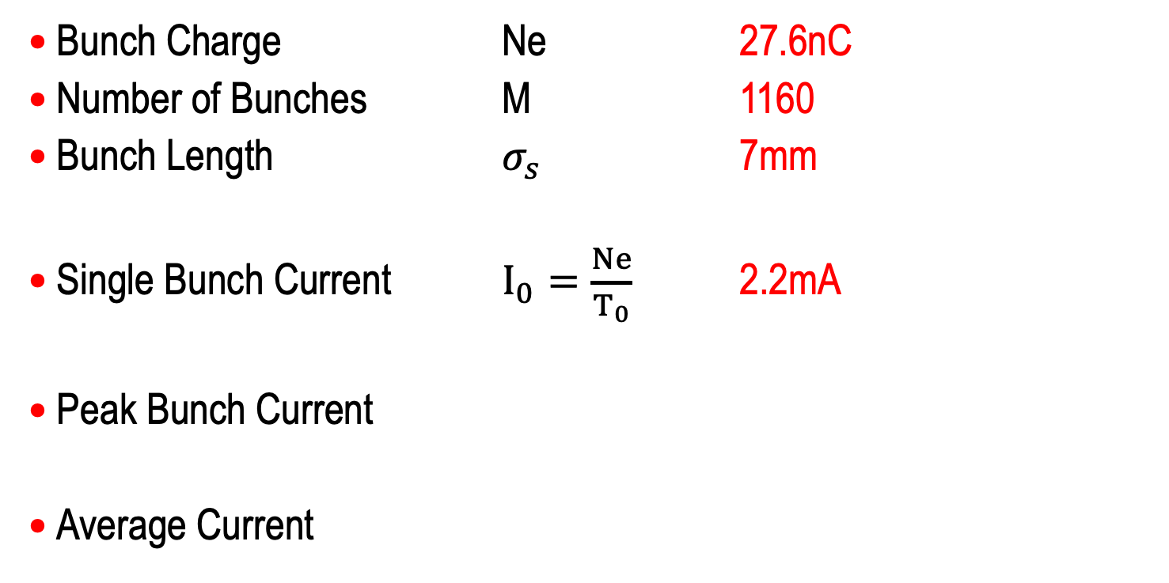
ESR Beam Intensity Parameters
Bunch Charge Ne 27.6nC
Number of Bunches M 1160
Bunch Length $σ_{s}$ 7mm
Single Bunch Current $I_{0}=\frac{Ne}{T_{0}}$ 2.2mA
Peak Bunch Current
Average Current
484A for $σ_{t}$= 23ps
2.5A
A. Blednykh Accel Phys TRIUMF 2021 EIC Accelerator Partnership Workshop October 26-29 2021

Slide 4
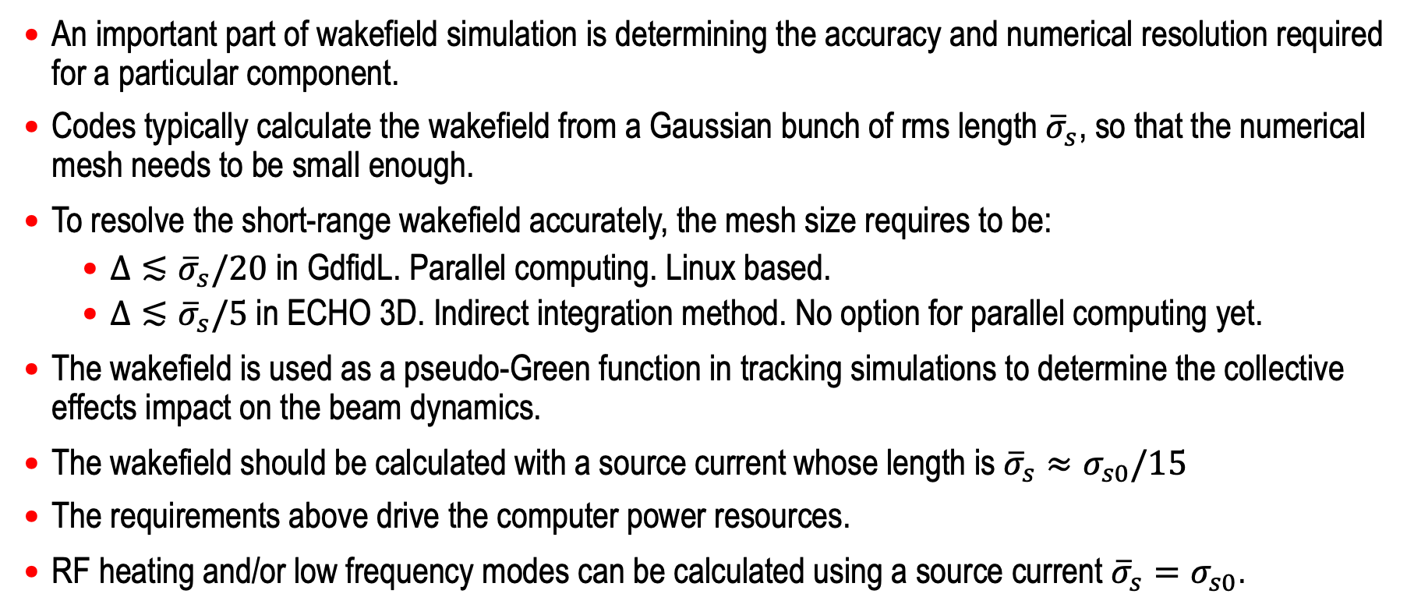
Calculation of the Pseudo-Green Function
An important part of wakefield simulation is determining the accuracy and numerical resolution required for a particular component.
Codes typically calculate the wakefield from a Gaussian bunch of rms length ${\overline{σ}}_{s}$, so that the numerical mesh needs to be small enough.
To resolve the short-range wakefield accurately, the mesh size requires to be:
  $Δ≲{\overline{σ}}_{s}/20$ in GdfidL. Parallel computing. Linux based.
  $Δ≲{\overline{σ}}_{s}/5$in ECHO 3D. Indirect integration method. No option for parallel computing yet.
The wakefield is used as a pseudo-Green function in tracking simulations to determine the collective effects impact on the beam dynamics.
The wakefield should be calculated with a source current whose length is ${\overline{σ}}_{s}≈σ_{s0}/15$
The requirements above drive the computer power resources.
RF heating and/or low frequency modes can be calculated using a source current ${\overline{σ}}_{s}=σ_{s0}$.
Review Article, A. Blednykh, G. Bassi, V. Smaluk, and R. Lindberg, “Impedance modeling and its application to the analysis of the collective effects”, Phys. Rev. Accel. Beams 24, 104801 (2021).
A. Blednykh Accel Phys TRIUMF 2021 EIC Accelerator Partnership Workshop October 26-29 2021

Slide 5
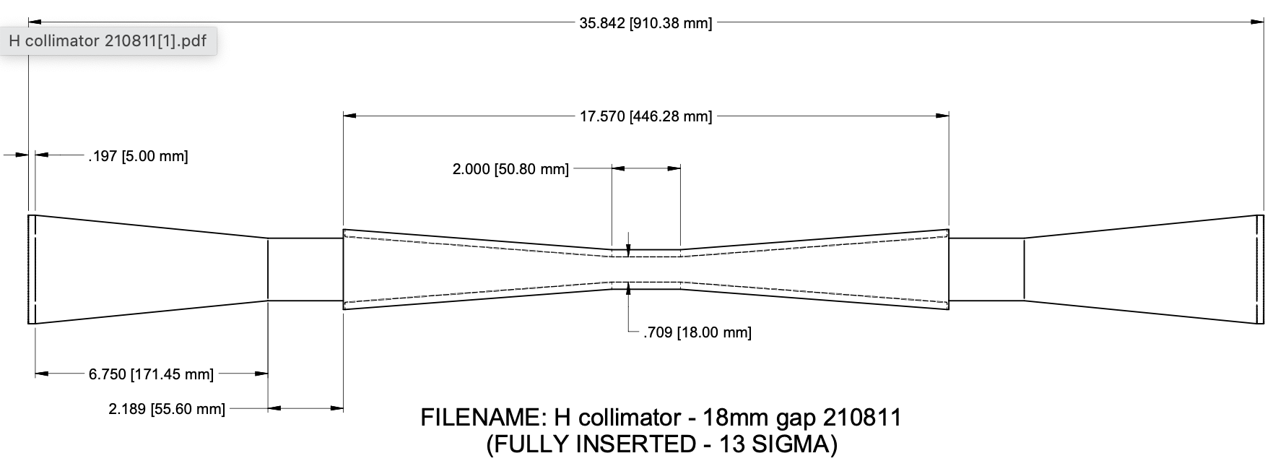
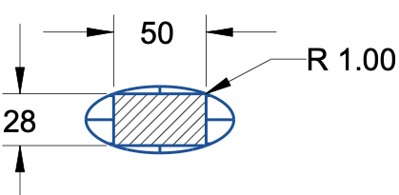
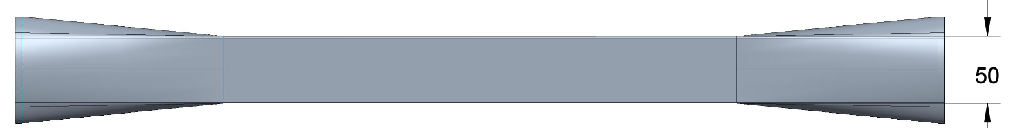

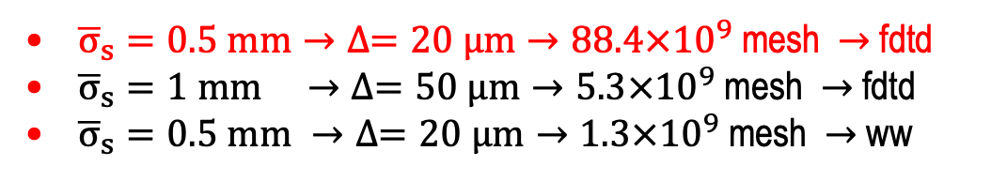
ESR Horizontal In-Vacuum Collimator
The total length is 910mm, with a ~370mm taper length.
The middle section has a rectangular profile
Available NSLS-II Computer Resources
23 x 24 CPU’s & 23 x 750 GB RAM
D. Hidas
Detailed conceptual design in C. Hetzel’s talk
Computer Resources Usage
20 $μm$
Collimator
GdfidL Algorithms
  Finite Difference Time Domain (-fdtd)
  Moving Window (-windowwake)
${\overline{σ}}_{s}=0.5 mm→∆=20 μm→88.4×{10}^{9}$ mesh $→$fdtd
${\overline{σ}}_{s}=1 mm →∆=50 μm→5.3×{10}^{9}$ mesh $→$fdtd
${\overline{σ}}_{s}=0.5 mm →∆=20 μm→1.3×{10}^{9}$ mesh $→$ ww
Transition
Longitudinal short-range wakefield W(s)
G. Wang
Codes benchmarking: G. Wang, M. Blaskiewicz, A. Blednykh and M. Sangroula, IPAC2021 Proceeding, WEPAB032
Top View of the Tapered Transition
A. Blednykh Accel Phys TRIUMF 2021 EIC Accelerator Partnership Workshop October 26-29 2021

Slide 6
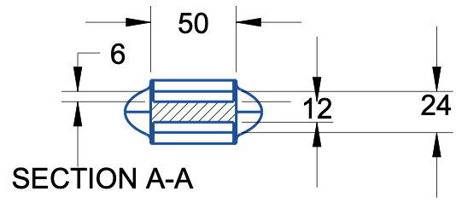
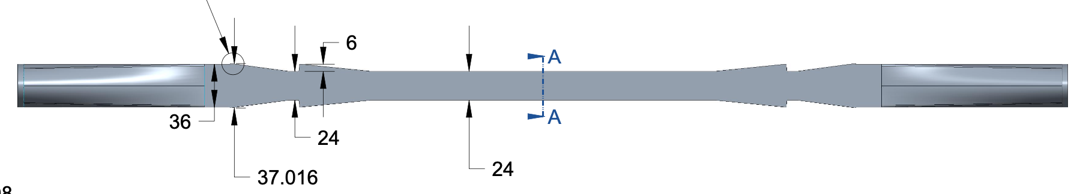
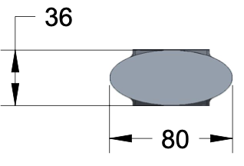
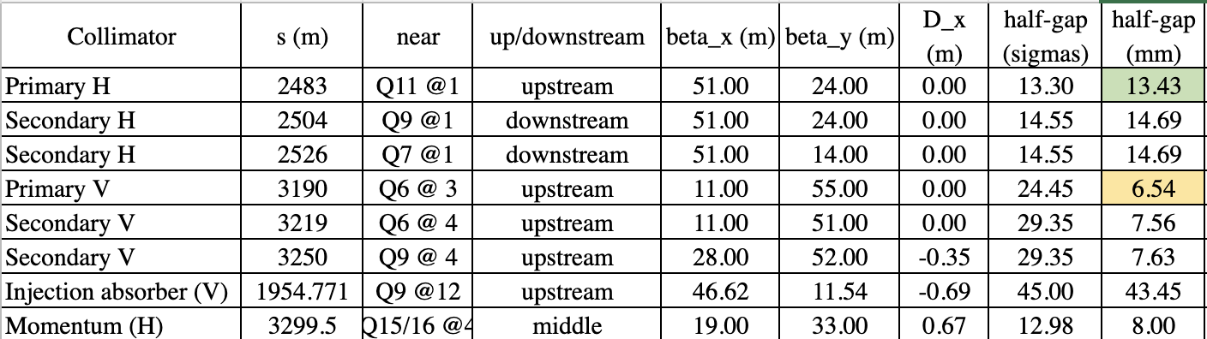
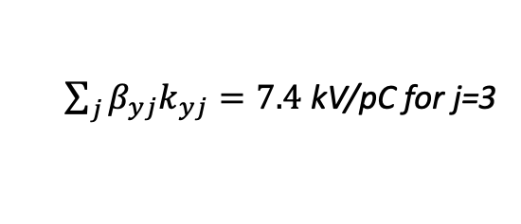
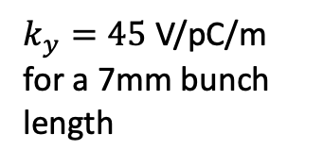
ESR Vertical Collimator (W_{yD})
At open position
M. Valette, A. Drees, C. Hetzel, J. Belong, G. Wang, M. Blaskiewicz
20um STEPSIZE - GdfidL
$k_{y}=45$ V/pC/m for a 7mm bunch length
$\sum_{j}{β_{yj}k_{yj}=7.4}$ kV/pC for j=3
Contribution of three VCLMs is ~30% of the present total vertical impedance budget.
A. Blednykh Accel Phys TRIUMF 2021 EIC Accelerator Partnership Workshop October 26-29 2021

Slide 7
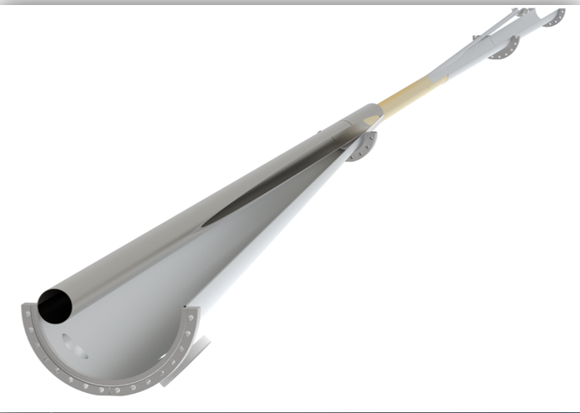
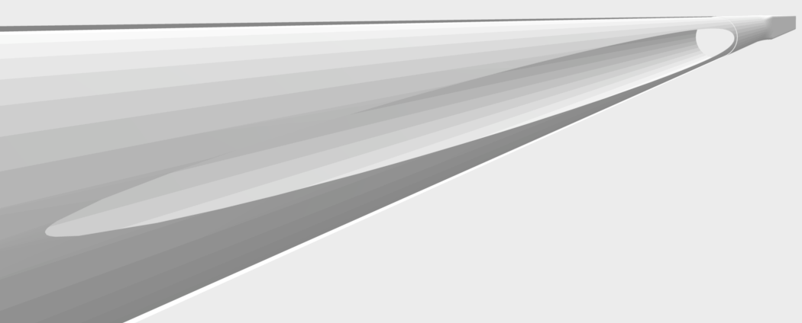
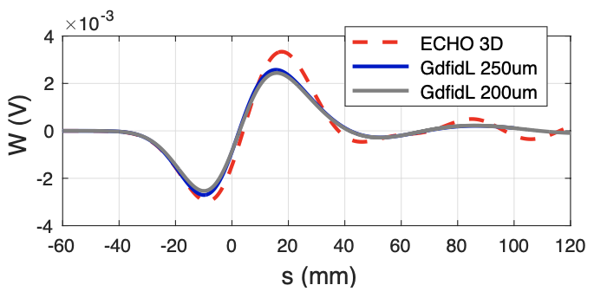
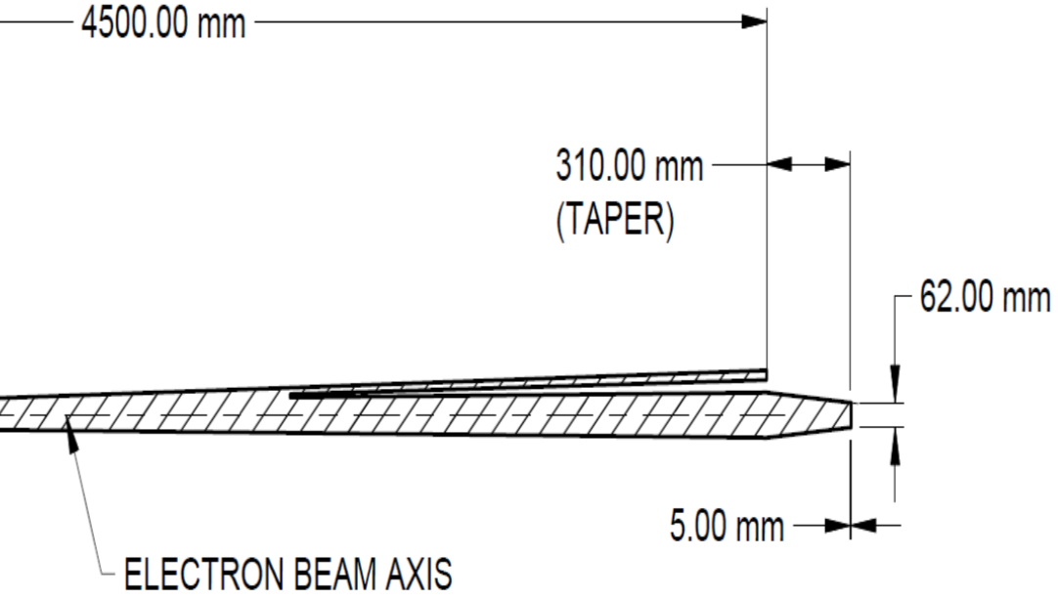
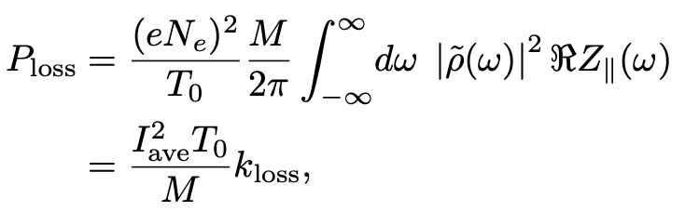




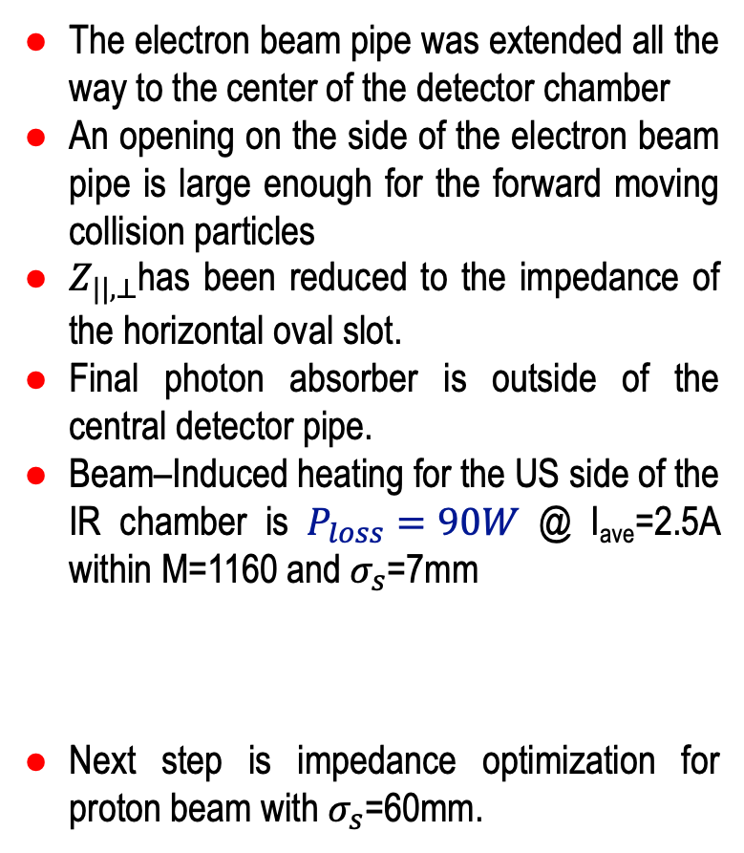
IR Chamber Design
- A. Blednykh, E. C. Aschenauer, M. Blaskiewicz, C. Hetzel, M. Sangroula, G. Wang, H. Witte, IPAC2021 Proceeding, WEPAB032
- H. Witte et al., These PAC2021 Proceedings, WEPAB002
Horizontal Oval Slot (US)
The electron beam pipe was extended all the way to the center of the detector chamber
An opening on the side of the electron beam pipe is large enough for the forward moving collision particles
$Z_{||,⊥}$has been reduced to the impedance of the horizontal oval slot.
Final photon absorber is outside of the central detector pipe.
Beam–Induced heating for the US side of the IR chamber is $P_{loss}=90W$ @ I_{ave}=2.5A within M=1160 and $σ_{s}$=7mm
Next step is impedance optimization for proton beam with $σ_{s}$=60mm.
$$e^{−}$$
40mm
1.4m long Beryllium section
$∅$60mm
$$e^{−}$$
Tapered Transition (DS)
$∅$60mm
C. Hetzel
A. Blednykh Accel Phys TRIUMF 2021 EIC Accelerator Partnership Workshop October 26-29 2021

Slide 8
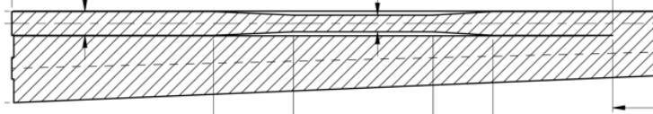
IR Impedance Optimization for e-Beam
Upstream Side
Downstream Side
Real part of the longitudinal impedance
Real part of the longitudinal impedance
The loss factor as a function of bunch length
The loss factor as a function of bunch length
A. Blednykh Accel Phys TRIUMF 2021 EIC Accelerator Partnership Workshop October 26-29 2021

Slide 9
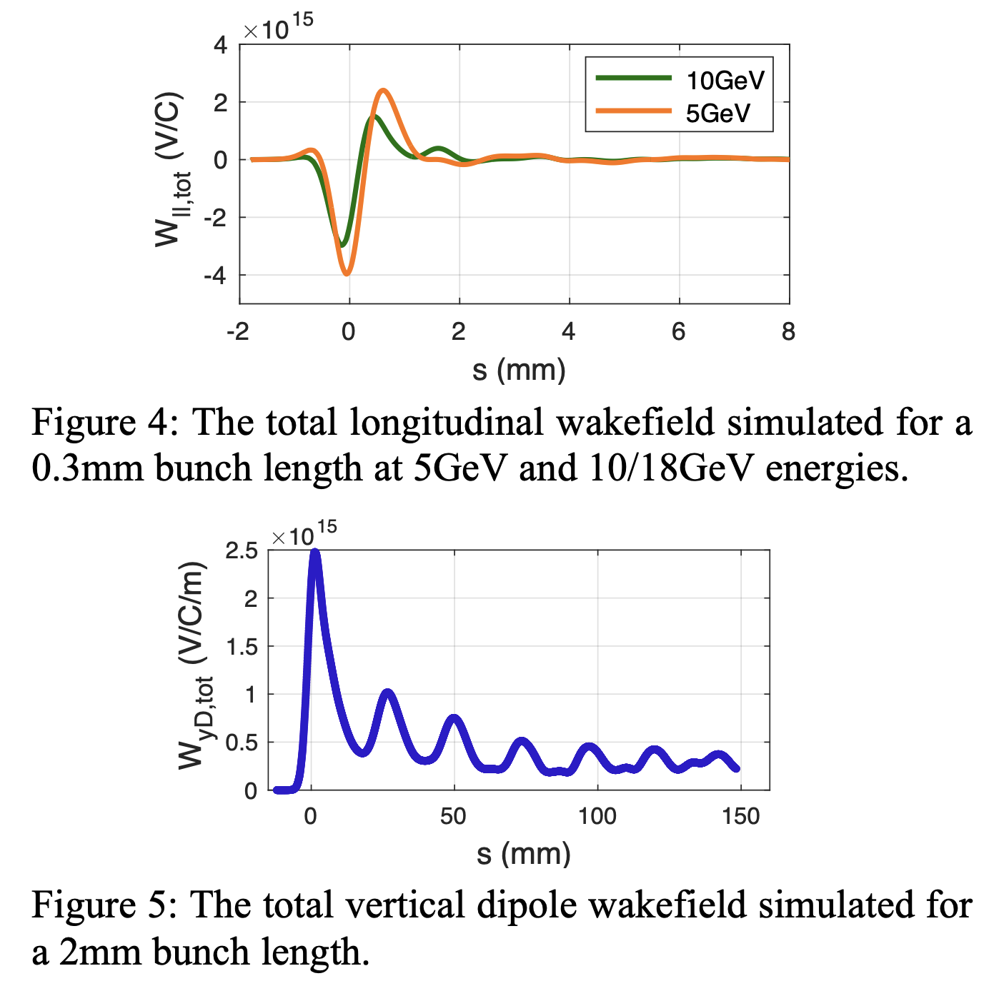
ESR – Impedance Budget
Components | Abbreviation | Number | Status
Bellows | BLW | 350 | ✓ x2 (NEG)
Collimator Ramp¹ | CLM | 16 | ✓
Horizontal In-Vacuum Collimator | HIVC | 3 | TBD
Vertical In-Vacuum Collimator | VIVC | 3 | TBD
Crab Cavity | CRBCVT | 2 | ✓
Beam Position Monitor² | BPM | 494 | ✓
Gate Valve² | GV | 30 | ✓
Stripline Kicker² | SK | 18 | ✓
Main RF Cavity² | CVT | 23 | ✓
Tapered Transition in RF Section | TPRD | 9? | TBD
Multipole Chamber Absorber | MPABS | 292 | ✓
Dipole Chamber Absorber | DPABS | 250 | ✓
Flange Joints | FLNG | 1500 | TBD
Resistive Wall | RW | - | ✓
Coherent Synchrotron Radiation | CSR | - | ✓
We performed several iterations on W(s) optimization of :
  ESR BPM Button (P. Thieberger) - sb & beam-ind. heating
  ESR Flange Joints - sb effect
1 - SKEKB design
2 - NSLS-II design
✓ - Included into the total W(s)
A. Blednykh Accel Phys TRIUMF 2021 EIC Accelerator Partnership Workshop October 26-29 2021

Slide 10
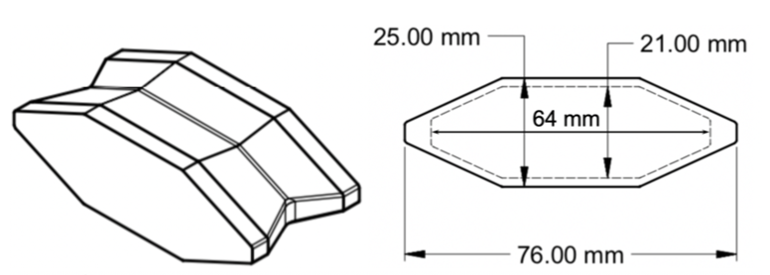
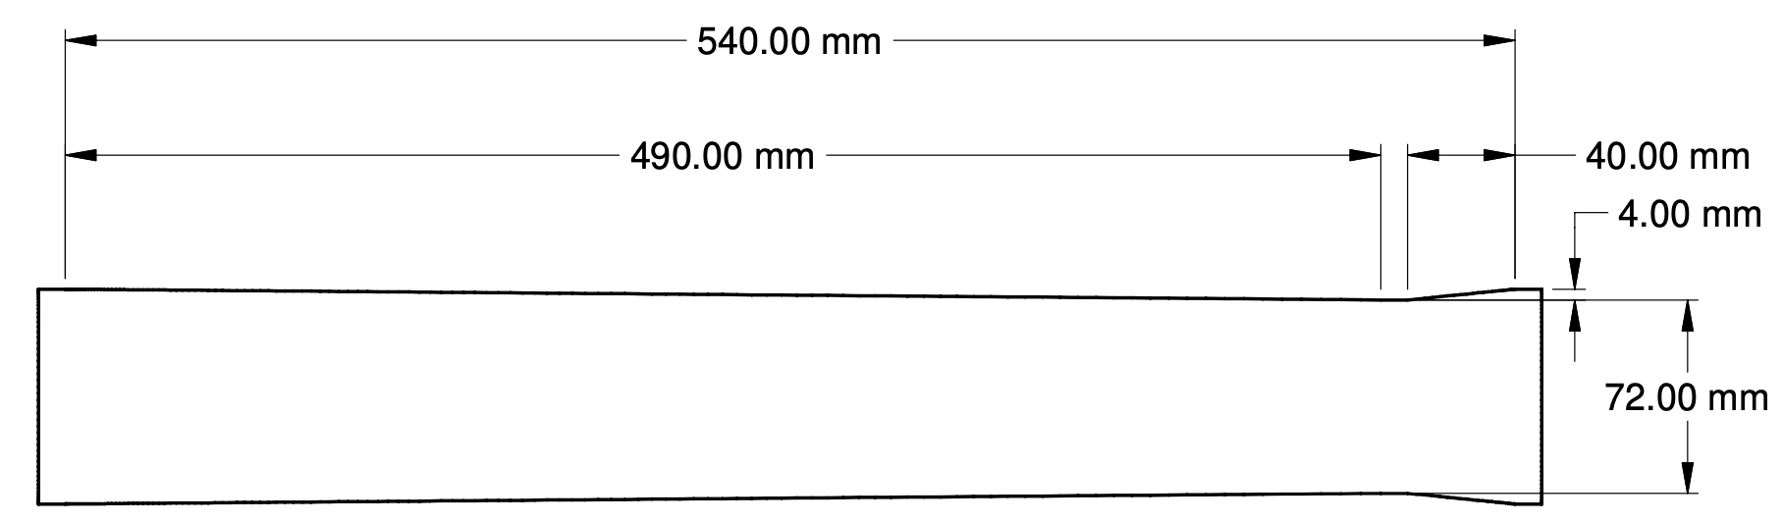
FFT of the Total Longitudinal Wakefield at 5GeV
14GHz
Real part of the longitudinal impedance
Imaginary part of the longitudinal impedance
The strong resonance peak at 14GHz corresponds to 494 BPMs
The microwave instability threshold did not change after replacing the NSLS-II flange absorbers with the EIC absorber design.
NSLS-II Flange Absorber
EIC Absorber
A. Blednykh Accel Phys TRIUMF 2021 EIC Accelerator Partnership Workshop October 26-29 2021

Slide 11


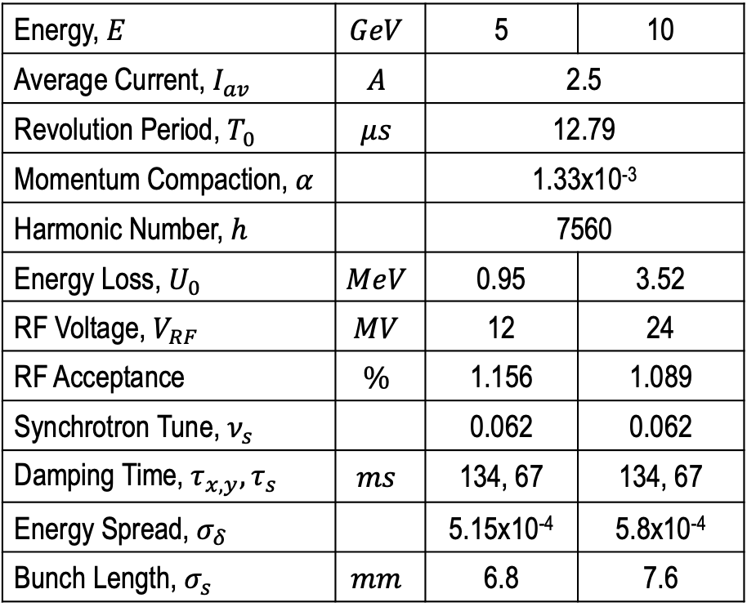
Microwave Instability Threshold at 5GeV
Energy, $E$ | $$GeV$$ | 5 | 10
Average Current, $I_{av}$ | $$A$$ | 2.5
Revolution Period, $T_{0}$ | $$μs$$ | 12.79
Momentum Compaction, $α$ |  | 1.33x10⁻³
Harmonic Number, $h$ |  | 7560
Energy Loss, $U_{0}$ | $$MeV$$ | 0.95 | 3.52
RF Voltage, $V_{RF}$ | $$MV$$ | 12 | 24
RF Acceptance | $$\%$$ | 1.156 | 1.089
Synchrotron Tune, $ν_{s}$ |  | 0.062 | 0.062
Damping Time, $τ_{x,y},τ_{s}$ | $$ms$$ | 134, 67 | 134, 67
Energy Spread, $σ_{δ}$ |  | 5.15x10⁻⁴ | 5.8x10⁻⁴
Bunch Length, $σ_{s}$ | $$mm$$ | 6.8 | 7.6
$$I_{th,μw}$$
Energy spread $σ_{δ}$ and bunch length $σ_{τ}$ as a function of single-bunch current
Microwave instability threshold is $I_{th,μw}=15 mA$
NSLS-II, APS, … need less than 1M macroparticles & 1 kick per turn for numerical simulations.
EIC requires, at least, 8M macroparticles and 8 wakefield elements per turn, C>3times longer, momentum compaction 5 times larger, … .
A. Blednykh Accel Phys TRIUMF 2021 EIC Accelerator Partnership Workshop October 26-29 2021

Slide 12



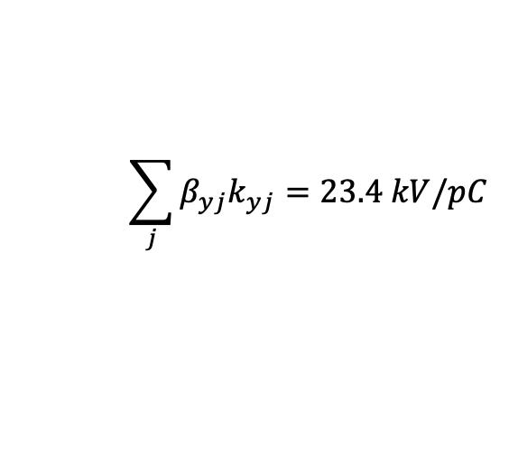

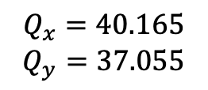
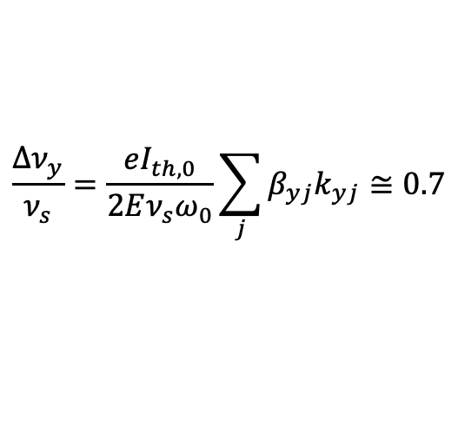





Transverse Mode Coupling Instability at 5GeV Lattice
Total Dipole Vertical Wakefield
Chromaticity 0/0
$$σ_{s}=7mm$$
$$Q_{x}=40.165$$
$$Q_{y}=37.055$$
w/o $W_{||,tot}$ & $W_{Q}$
$k_{yD}=876$ V/pC/m
The TMCI at zero chromaticity
$$E=5GeV$$
$$ν_{s}=0.06157$$
$$\frac{∆ν_{y}}{ν_{s}}=\frac{eI_{th,0}}{2Eν_{s}ω_{0}}\sum_{j}{β_{yj}k_{yj}≅0.7}$$
$$β_{y,av}=26.72$$
$$\sum_{j}{β_{yj}k_{yj}=23.4 kV/pC}$$
$$ω_{0}=2π × 78.195kHz$$
$$I_{th}=9mA$$
ELEGANT: $I_{th}=8.2mA$
A. Blednykh Accel Phys TRIUMF 2021 EIC Accelerator Partnership Workshop October 26-29 2021

Slide 13
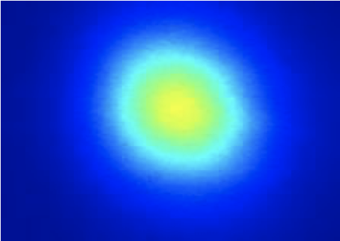
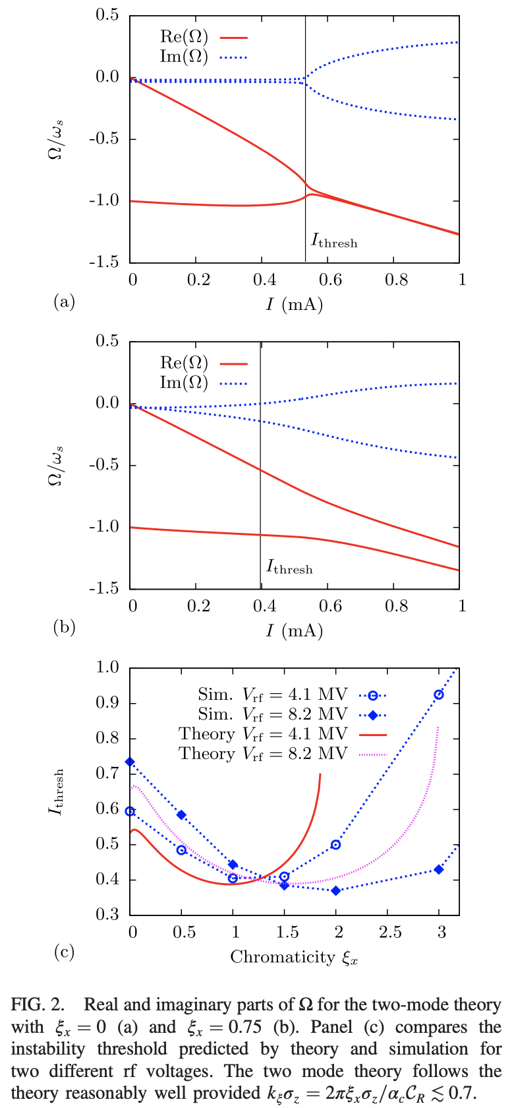
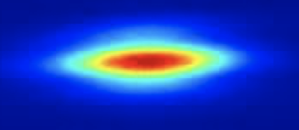
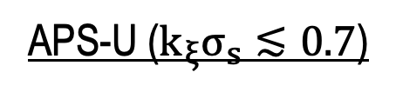

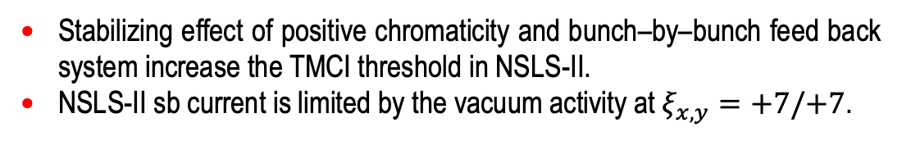
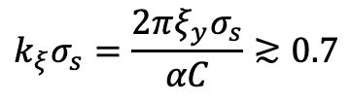
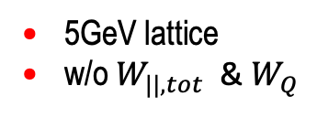

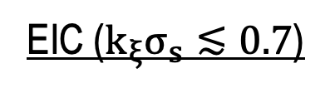

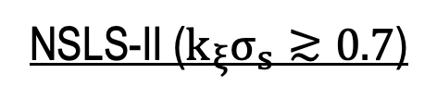
TMCI Threshold vs. Chromaticity
NSLS-II ($k_{ξ}σ_{s}≳0.7$)
APS-U ($k_{ξ}σ_{s}≲0.7$)
EIC ($k_{ξ}σ_{s}≲0.7$)
$$C=792 m \& α=3.7×{10}^{−4}$$
$C=1100 m \&$ $α=5.66×{10}^{−5}$
$C=3833.93 m \&$ $α=1.33×{10}^{−3}$
5GeV lattice
w/o $W_{||,tot}$ & $W_{Q}$
Experimental data
Two-Mode approximation valid when
$$k_{ξ}σ_{s}=\frac{2πξ_{y}σ_{s}}{αC}≳0.7$$
Stabilizing effect of positive chromaticity and bunch–by–bunch feed back system increase the TMCI threshold in NSLS-II.
NSLS-II sb current is limited by the vacuum activity at $ξ_{x,y}=+7/+7$.
R. Lindberg, Phys. Rev. Accel. Beams 19, 124402
A. Blednykh Accel Phys TRIUMF 2021 EIC Accelerator Partnership Workshop October 26-29 2021

Slide 14
Concluding Remarks
Calculations and optimization of the EIC vacuum components is continuing.
As the first step we use the geometric impedances of the vacuum chamber components simulated for NSLS-II and Super KEKB.
The impedance budget is updated based on the current impedance data for 5 GeV and 10/18 GeV lattices.
The estimated instability thresholds are above the required sb current of 2.2mA.
The IR vacuum chamber design is in progress. The DS side will be optimized with more details available.
Design of the vacuum components is selected upon water cooling possibilities
A. Blednykh Accel Phys TRIUMF 2021 EIC Accelerator Partnership Workshop October 26-29 2021

Slide 15
Acknowledgments
EIC
J. Bellon, A. Drees, H. Witter, C. Hetzel, M. Blaskiewicz, K. Smith, P. Thieberger, G. Wang, M. Sangroula, S. Verdu Andres, Q. Wu, R. Rimmer, D. Gassner, E. Aschenauer, C. Montag, V. Ptitsyn, …
NSLS-II
D. Hidas
APS-U
R. Lindberg
SKEKB
D. Zhou, K. Shibata
Sirius
H. O. Duarte
A. Blednykh Accel Phys TRIUMF 2021 EIC Accelerator Partnership Workshop October 26-29 2021

Slide 16
Back Up
A. Blednykh Accel Phys TRIUMF 2021 EIC Accelerator Partnership Workshop October 26-29 2021

Slide 17
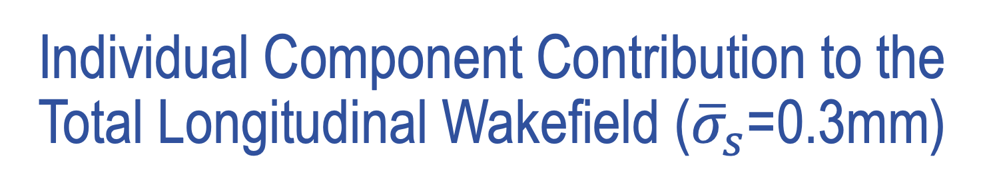
Individual Component Contribution to the Total Longitudinal Wakefield (${\overline{σ}}_{s}$=0.3mm)
Bellows, Ramp Collimators and Gate Valves are the first few largest sources
A. Blednykh Accel Phys TRIUMF 2021 EIC Accelerator Partnership Workshop October 26-29 2021

Slide 18
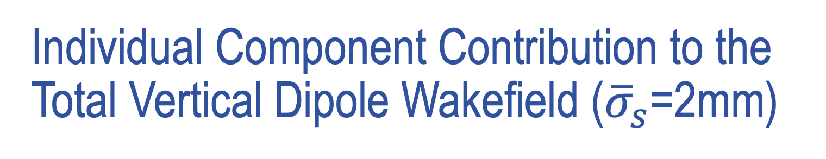
Individual Component Contribution to the Total Vertical Dipole Wakefield (${\overline{σ}}_{s}$=2mm)
Bellows, BPM and Gate Valves are the first few largest sources.
A. Blednykh Accel Phys TRIUMF 2021 EIC Accelerator Partnership Workshop October 26-29 2021

