Slide 1
Machine Detector Interface & Collimation System
M. Valette, A. Drees, G. Robert-Demolaize
With contributions from:
J. Bellon, A. Blednyk, C. Hetzel, S. Seletskiy
27th Oct. 2021
EIC Accelerator Partnership Workshop

Slide 2
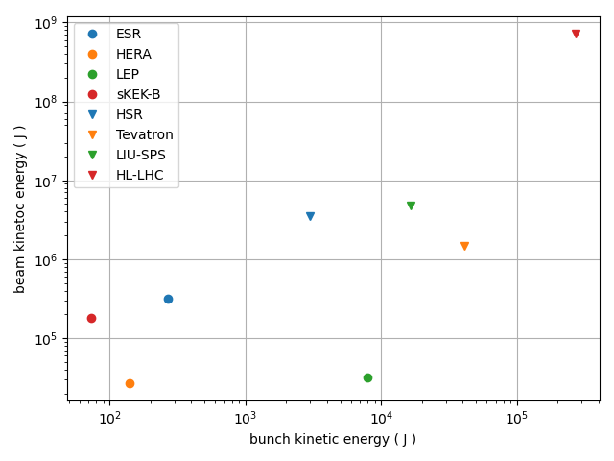
Introduction - Machine Detector Interface
The EIC will feature powerful beams
-10x the stored energy of RHIC
-2x SuperKEK-B target stored energy with 1/2 the bunches
Collimators accomplish 2 main missions
-Beam cleaning to reduce radiation &
backgrounds form lost particles
-Machine protection from
accidental beam loses
(CCs, kickers, instabilities, …)
Constraints
-Impedance budget
-Beam lifetime
-$ budget

Slide 3
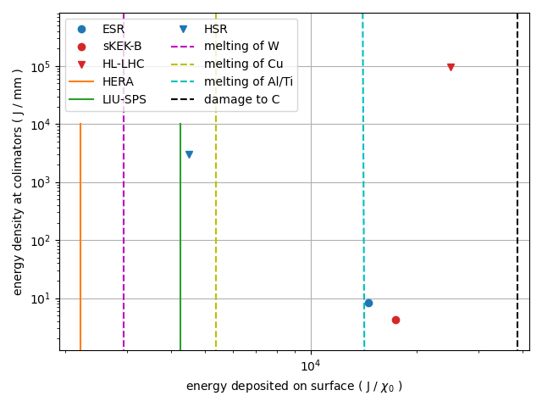
Context
-The e⁻ bunches will be very dense (0.5 mm²) and melt metals in case of normal impact.
-The p⁺ beam will have similar parameters as the post-LIU SPS.
Other complexes have reported issues limiting performance:
-SuperKEK-B experienced instabilities causing collimator damage and limiting beam currents.
-HL-LHC will switch to coated collimators (MoGr) to reduce impedance.
Assuming SKEKB-like tails

Slide 4
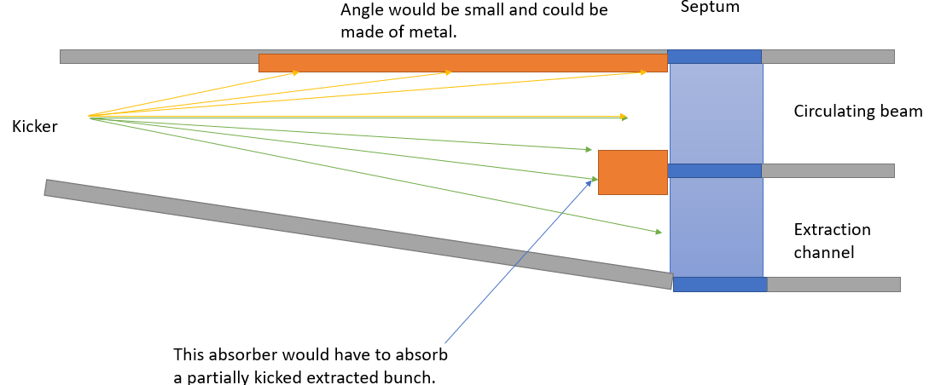
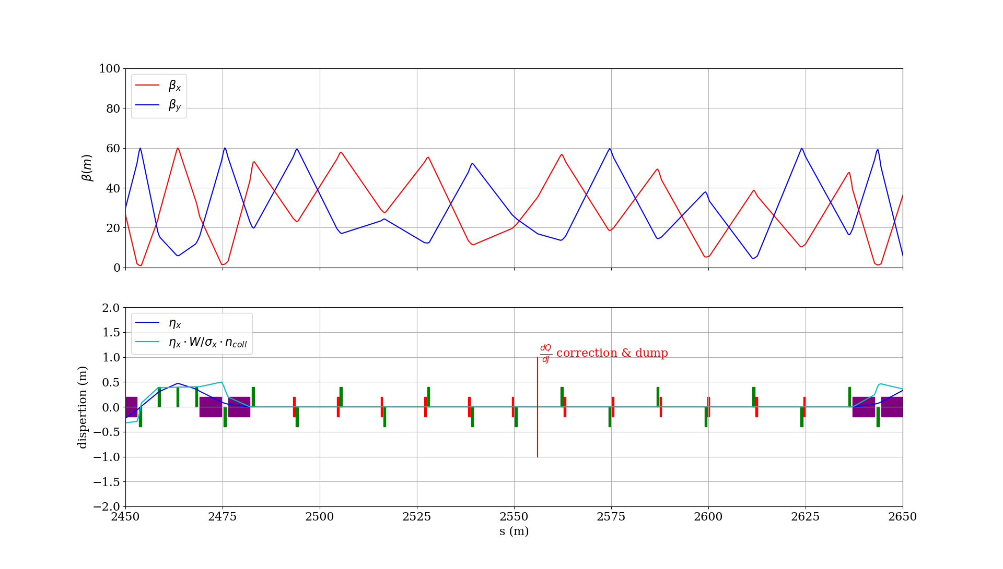
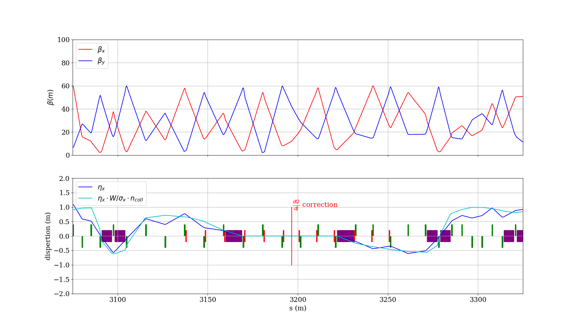
Electron ring
IR12 - Injection protection
Focus on the 10 GeV case with the most stored energy.
Planned in IR2 & 4 :
-2-sided prim. + 2 sec. for cleaning and flexibility with phase advances and optics
+injection shielding in IR2
(+masks in IR6 & 8)
IR2 - Horizontal
IR4 – Vertical & Momentum

Slide 5
Electron ring (2)
IR2
primary
secondary
secondary
Arc
Exp. magnets
Exp. detector
Collimation hierarchy :
-Imposed by squeezed optics in the IRs
-Retraction from prim. -> sec. -> app. based on orbit stability
-Arc is tighter than experiment in the horizontal plane
-Masks upstream of IRs will avoid losses into the focusing quads showering to the detectors
48σ
45σ
Horizontal
14σ
14σ
13σ
e⁻ beam
Masks
23σ
primary
28σ
28σ
secondary
secondary
70σ
Exp. magnets
63σ
Vertical
Exp. detector
Arc
IR4

Slide 6
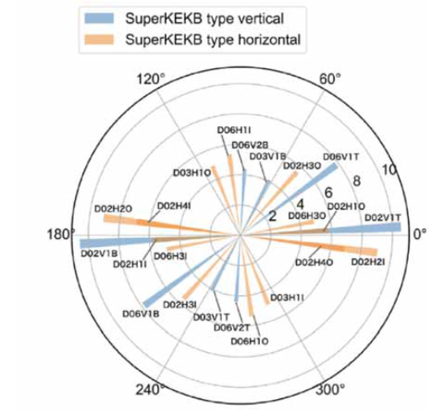
Optics considerations
Phase advances :
-key to protect against kicker failures
-important to ensure cleaning efficiency from the secondaries
-optics will have to be monitored to ensure protection/cleaning
Orbit stability, beta beating, errors, …, will affect collimations hierarchy by increasing retraction margins.
We are following developments at KEK-B closely to learn from their experience.
Kickers
Sec.
Sec.
0°
Q1eR
Prim.
Inj. Abs.
Prim.
Q1eF
270°
90°
180°
Sec.
Sec.
Experiment

Slide 7
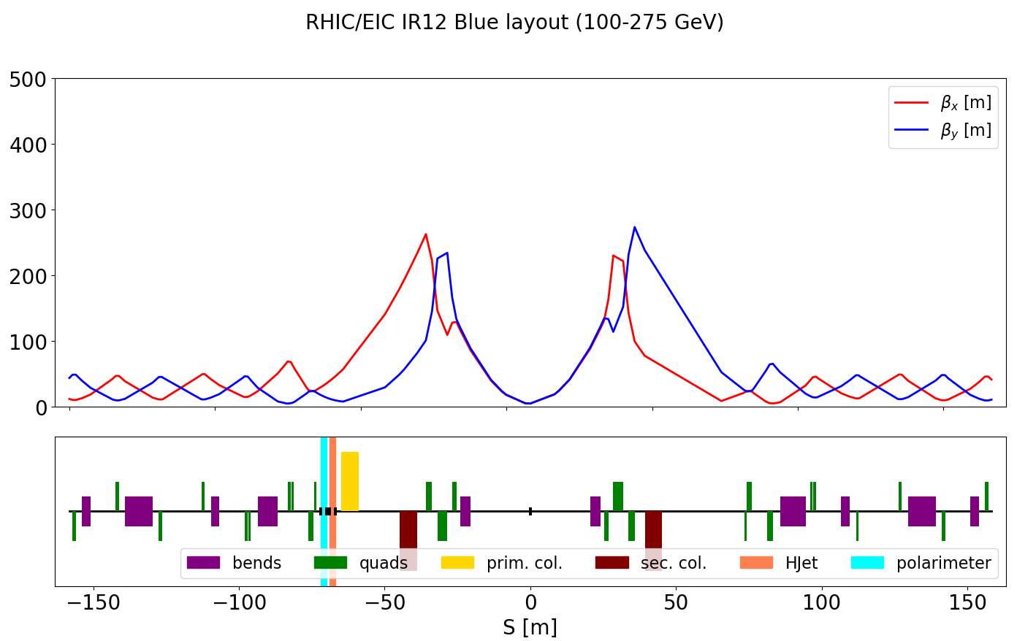
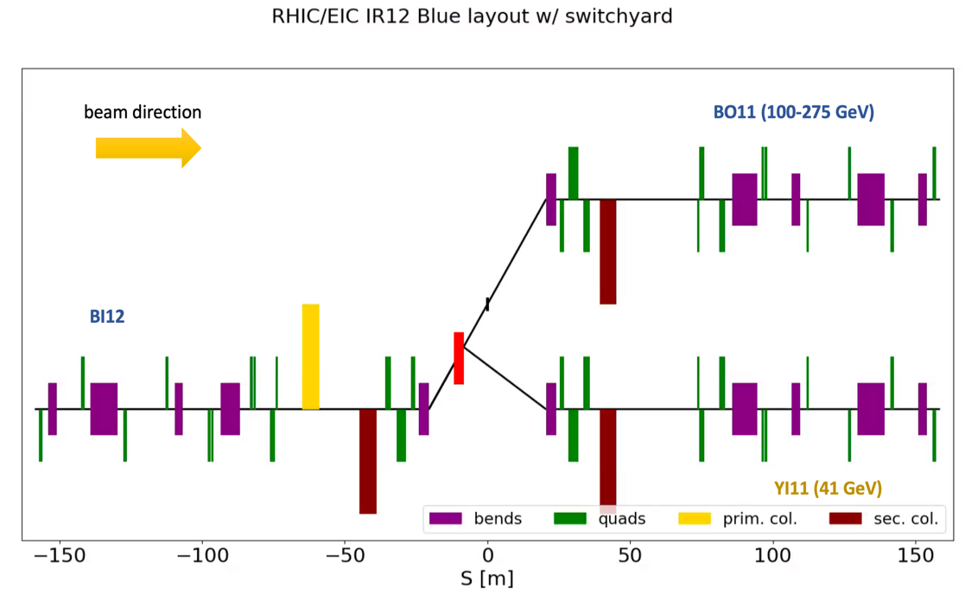
Hadron ring
Different constraints:
-Different loss behavior for protons/ions
-Cold ring requires good cleaning efficiency in the arcs
-More flexibility on the optics
We can benefit from RHIC and LHC experience.
Planned in IR12 :
-issues with other users due to radiation
-switchyard doubles the second secondary
Momentum collimators are planned for the sector 11 dummy.
Courtesy G. Robert-Demolaize

Slide 8
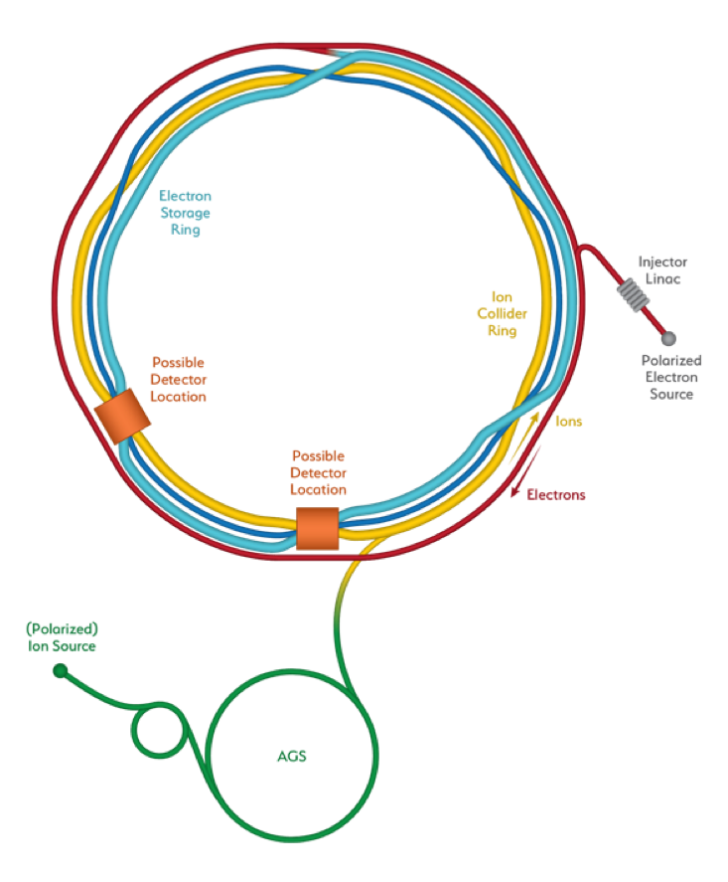
Summary
Sector 12 p primaries
and secondaries
Electron : 5-7 collimators
Hadrons : 5-7 collimators
+absorbers and masks
Sector 11 p momentum collimation (‘dummy’)
IR2 e Horizontal collimation
(and potential abort)
IR12 e Injection absorbers
IR4 e Vertical Collimation
IR4 e momentum collimation
p Injection protection
(note: not actual inj. location)
Comparison table
 | LER | HER | RHIC (Yellow) | ESR | HSR
1 sided | 0 | 16 | 3 | 1 | 1
2 sided | 11 | 4 | 0 | 7 | 7
Total | 22 | 24 | 3 | 15 | 15

Slide 9
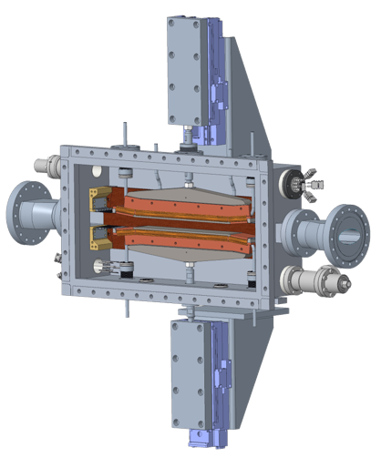
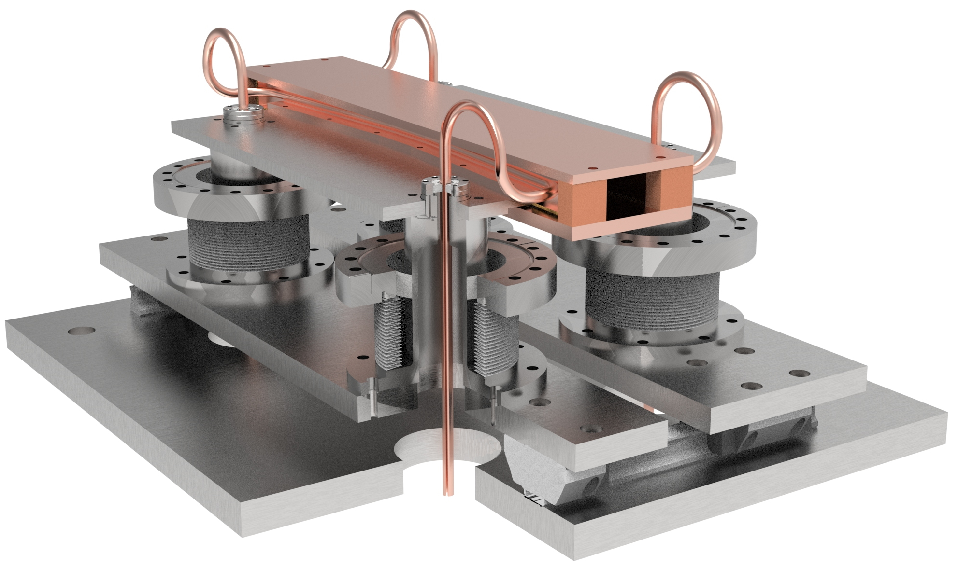
Mechanical Design
Electrons :
The tips would be made of coated Carbon and 30-90 cm long.
With 1:10 tapering to standard apertures (impedance), the collimators would be 90-120 cm long without RF fingers and bellows.
Hadrons :
The collimators would have similar lengths with longer jaw and less tapering
Designs courtesy of Vacuum taskforce, see C. Hetzel’s talk from this morning.

Slide 10
Conclusion & Outlook
Upcoming simulation studies :
-ANSYS : to study heat extraction from SR and short lifetimes.
-FLUKA : to investigate particle deflection, energy deposition and potential damage/activation. Will allow confirming jaw length and materials/coatings.
-SixTrack : Tracking and cleaning efficiency simulations will confirm the number and location of collimators.
Integration of collimators into their respective IRs must be consolidated to ensure fitting geometry and cohabitation with other instruments. Work has already started for IR12.
Opportunities for collaboration :
-Collimator / Kicker / Dump design
-Tracking / Background simulations
-Coatings, surface processing, …..

Slide 11
Thank you for your attention !
Questions ?

Slide 12
Locations of interest : momentum
Goal : large η_{x}
figure of merit η_{x}.W/σ_{x}.n_{coll} > 1.
IR4
FOM = 1 !
Upstream of IR6
A bit crowded
Masks between the two experiments

Slide 13
Summary table
https://brookhavenlab-my.sharepoint.com/:x:/g/personal/mvalette_bnl_gov/EXwLNtgLRe1GhWV1DpmBLVEBynh3Z3woU0xyS-i1dE6cBg?e=BDWudO
Link to live version
5/10 GeV
18 GeV
Collimator | s (m) | near | up/downstream | beta_x (m) | beta_y (m) | D_x (m) | half-gap (sigmas) | half-gap (mm) | target punch through | tip length (m) | material | phase advance | Full open (sigmas) | half-gap (mm) | Stroke
Primary H | 2483.0993 | Q11 @1 | downstream | 23.87 | 16.80 | 0.00 | 13.06 | 9.02 | 0.01 | 0.27 | C (coated) | 0 | 20 | 13.82 | 4.80
Secondary H | 2504.3607 | Q9 @1 | downstream | 49.49 | 22.41 | 0.00 | 14.31 | 14.24 | 0.00001 | 0.81 | C (coated) | 60.84309 | 20 | 19.90 | 5.66
Secondary H | 2526.9222 | Q7 @1 | upstream | 52.30 | 24.86 | 0.00 | 14.31 | 14.63 | 0.00001 | 0.81 | C (coated) | 95.42692 | 20 | 20.45 | 5.82
Primary V | 1842.4243 | Q10 @11 | downstream | 25.22 | 52.20 | -0.35 | 23.31 | 5.83 | 0.01 | 0.27 | C (coated) | 0 | 40 | 10.01 | 4.18
Secondary V | 1864.5826 | Q8 @11 | upstream | 15.50 | 57.35 | -0.03 | 28.41 | 7.45 | 0.00001 | 0.81 | C (coated) | 36.29843 | 40 | 10.49 | 3.04
Secondary V | 1909.7409 | Q4 @11 | upstream | 20.25 | 56.97 | 0.08 | 28.41 | 7.43 | 0.00001 | 0.81 | C (coated) | 114.8636 | 40 | 10.46 | 3.03
Injection absorber (V) | 1954.771 | Q9 @12 | upstream | 46.62 | 11.54 | -0.69 | 38.00 | 36.69 | 0.0005 | 0.54 | C | NA
Momentum (H) | 3299.5 | Q15/16 @4 | middle | 21.36 | 35.70 | 0.70 | 12.87 | 8.41 | 0.000001 | 0.45 | Al (coated ?) | NA
Collimator | s (m) | near | up/downstream | beta_x (m) | beta_y (m) | D_x (m) | half-gap (sigmas) | half-gap (mm) | target punch through | tip length (m) | material | phase advance | Full open (sigmas) | half-gap (mm) | Stroke
Primary H | 2483.1 | Q11 @1 | downstream | 23.87 | 16.80 | 0.00 | 11.94 | 9.04 | 0.01 | 0.27 | C (coated) | 0 | 20 | 15.14 | 6.10
Secondary H | 2504.4 | Q9 @1 | downstream | 49.49 | 22.41 | 0.00 | 13.06 | 14.24 | 0.00001 | 0.81 | C (coated) | 60.84309 | 20 | 21.80 | 7.56
Secondary H | 2526.9 | Q7 @1 | upstream | 52.30 | 24.86 | 0.00 | 13.06 | 14.63 | 0.00001 | 0.81 | C (coated) | 95.42692 | 20 | 22.41 | 7.77
Primary V | 1842.4 | Q10 @11 | downstream | 25.22 | 52.20 | -0.35 | 18.12 | 5.85 | 0.01 | 0.27 | C (coated) | 0 | 40 | 12.92 | 7.07
Secondary V | 1864.6 | Q8 @11 | upstream | 15.50 | 57.35 | -0.03 | 22.01 | 7.45 | 0.00001 | 0.81 | C (coated) | 36.29843 | 40 | 13.55 | 6.09
Secondary V | 1909.8 | Q4 @11 | upstream | 22.28 | 58.77 | -0.04 | 22.01 | 7.55 | 0.00001 | 0.81 | C (coated) | 138.1612 | 40 | 13.71 | 6.17
Injection absorber (V) | 1954.8 | Q9 @12 | upstream | 46.62 | 11.54 | -0.69 | 35.00 | 37.02 | 0.0005 | 0.54 | C | NA
Momentum (H) | 3299.5 | Q15/16 @4 | middle | 18.75 | 55.06 | 0.52 | 9.28 | 6.22 | 0.000001 | 0.45 | Al (coated ?) | NA

Slide 14
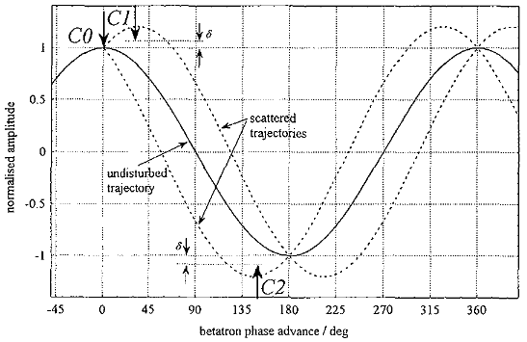

Slide 15
